Slide 1
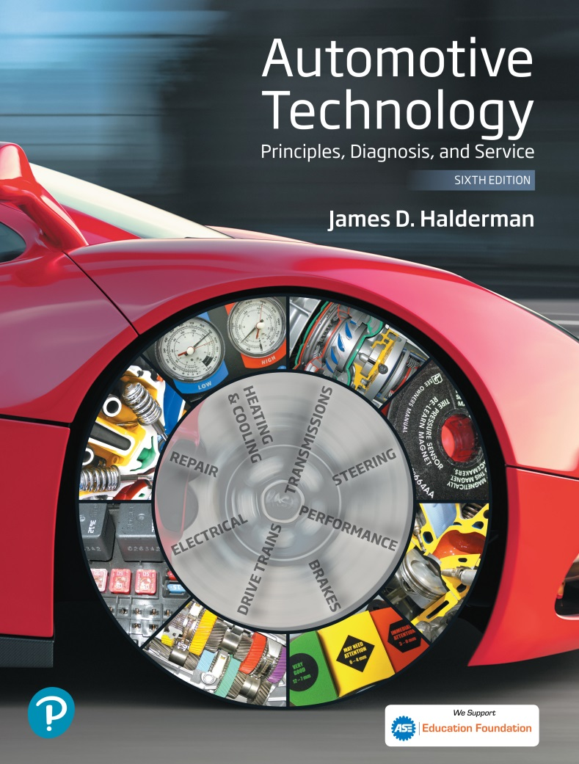
Automotive Technology Principles, Diagnosis, and Service
Sixth Edition
Chapter 131
Four-Wheel Drive and All-Wheel Drive
Copyright © 2018, 2015, 2011 Pearson Education, Inc. All Rights Reserved

Slide 2
LEARNING OBJECTIVES (1 of 2)
131.1 Explain the operation of four-wheel-drive and all-wheel-drive systems.
131.2 Describe the components of a transfer case.
131.3 Discuss the purpose and function of an interaxle differential.

Slide 3
LEARNING OBJECTIVES (2 of 2)
131.4 Describe the different types of four-wheel-drive axles.
131.5 Describe the procedure to diagnose and service transfer cases and locking hubs.

Slide 4
FOUR WHEEL DRIVE SYSTEMS (1 OF 2)
Purpose and Function
  A four-wheeled vehicle has engine torque applied to all four wheels (four-wheel drive).
Transfer Case
  The transfer case permits the driver to select 2WD or 4WD and low-speed or high-power gear ratio while in four-wheel drive.
Locking Hubs
  The driver must manually lock the front hubs in order for power to be delivered to the wheels.

Slide 5
FOUR WHEEL DRIVE SYSTEMS (2 OF 2)
Auto-Locking Hubs
  When the speed difference between the wheels and the front drive axle is great, the hubs will automatically lock and allow engine torque to be applied to the front wheels.
Full-Time Four-Wheel Drive Systems
  This method uses a center differential to allow front and rear wheels to travel at different speeds under all operating conditions.
  The center differential can be locked using a viscous coupling or an electronically controlled clutch.

Slide 6
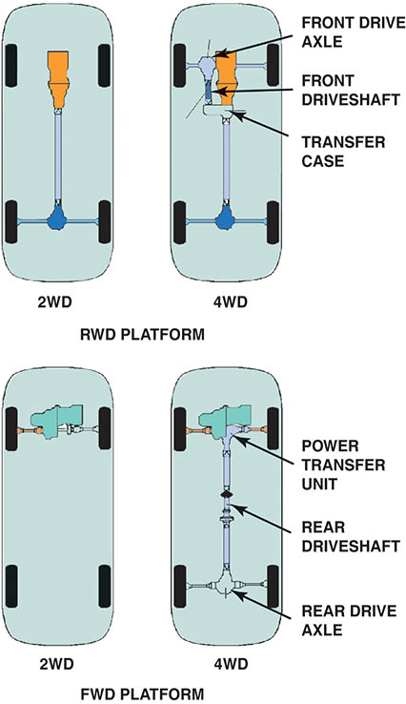
Figure 131.1 Four-wheel-drive vehicles can be achieved by using an existing rear-wheel-drive arrangement and adding a transfer case, or a front-wheel-drive arrangement with the addition of rear axle output shaft and center differential assembly

Slide 7
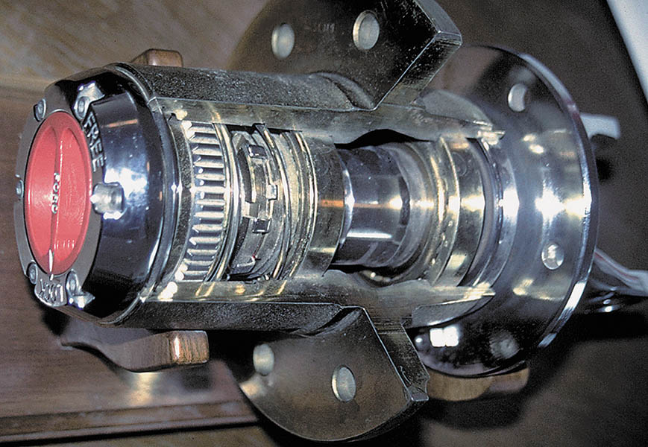
Figure 131.2 Cutaway of a manually-operated locking hub

Slide 8
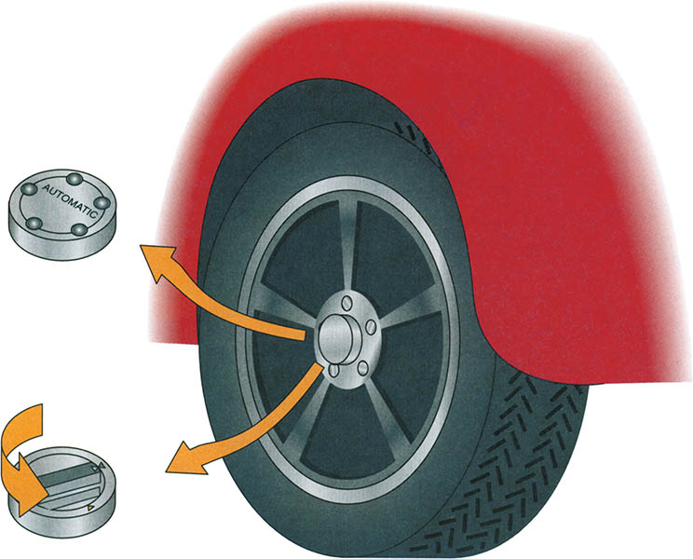
Figure 131.3 Manual locking hubs require that the hubs be rotated to the locked position by hand to allow torque to be applied to the front wheels. Automatic locking hubs enable the driver to shift into four-wheel drive from inside the vehicle

Slide 9
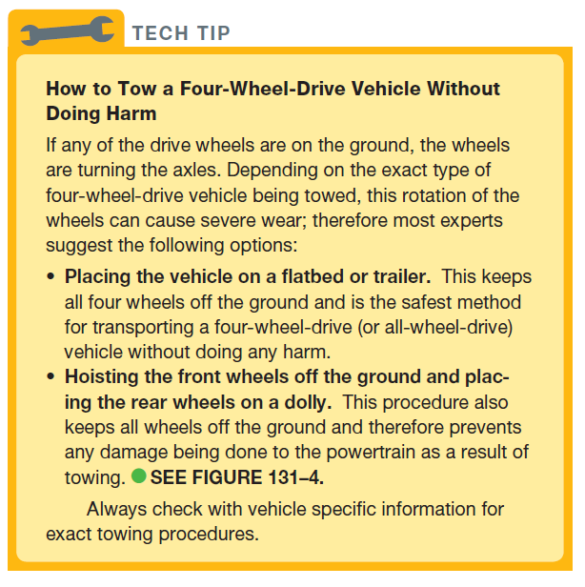
Tech Tip

Slide 10
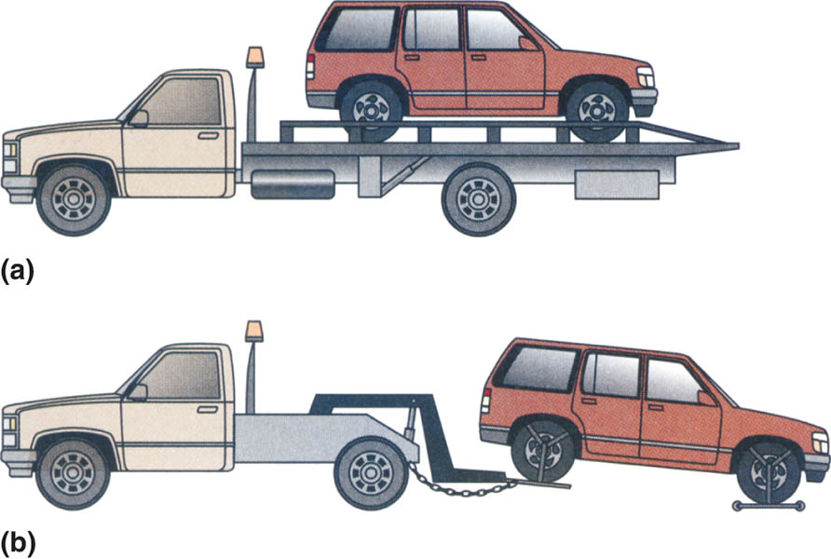
Figure 131.4 If a four-wheel-drive vehicle must be towed, it should be either on (a) a flatbed truck

Slide 11
Figure 131.4 If a four-wheel-drive vehicle must be towed, it should be either on (b) a dolly

Slide 12
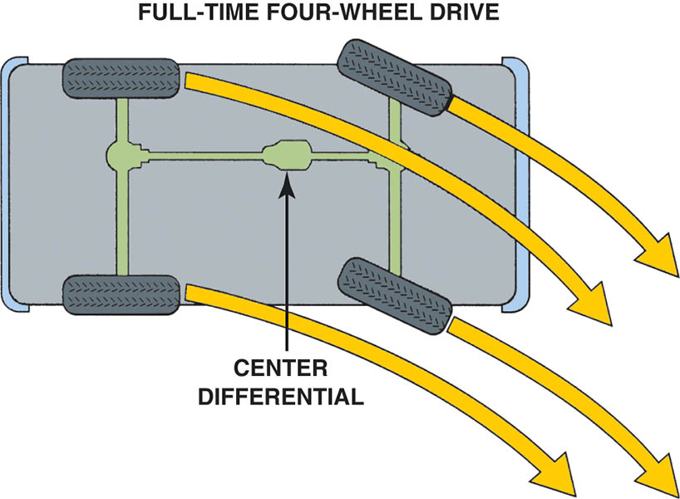
Figure 131.5 When turning a corner, each wheel takes a slightly different path and rotates at a slightly different speed. A full-time system uses a center differential that allows for any speed differences between the front and rear axles. It can therefore be activated on any surface—slippery or dry

Slide 13
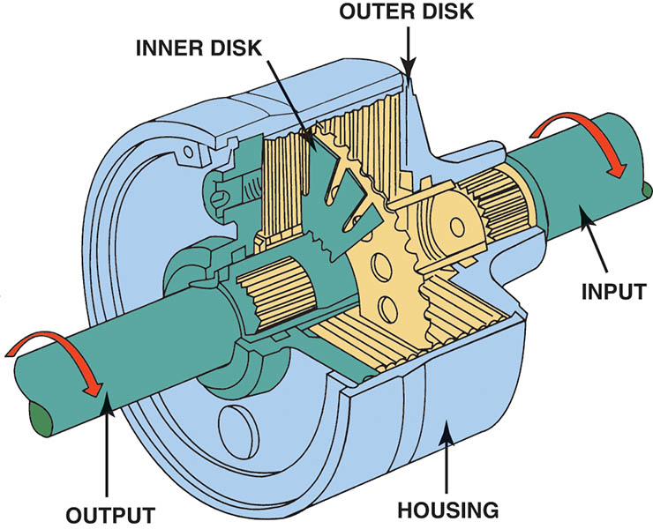
Figure 131.6 A viscous coupling is a sealed unit containing many steel discs. One-half of them are splined to the input shaft, with every other disc splined to the output shaft. Surrounding these discs is a thick (viscous) silicone fluid that expands when hot and effectively locks the discs together

Slide 14
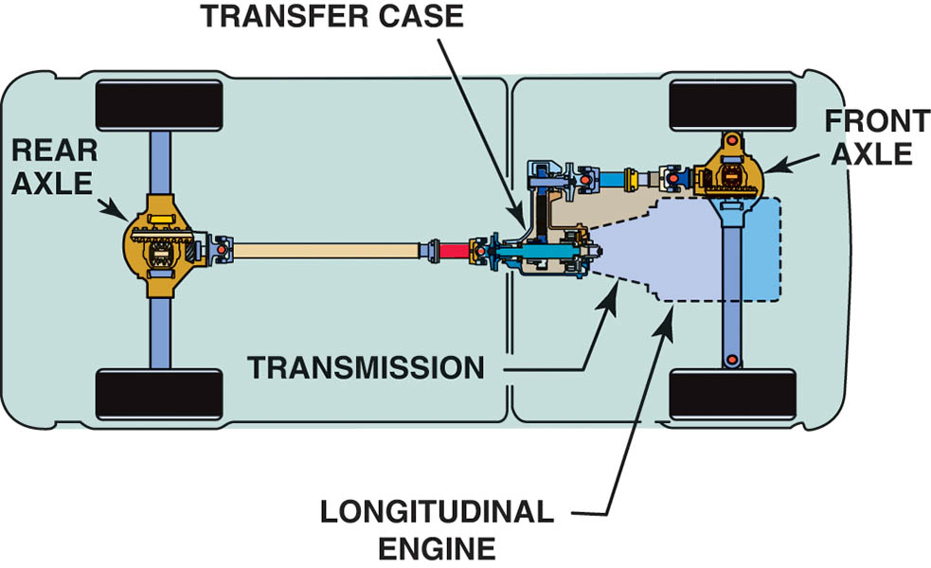
Figure 131.7 A typical four-wheel-drive vehicle that uses a longitudinal engine and a transfer case to send engine torque to both the front and rear wheel

Slide 15
ALL-WHEEL DRIVE
Some cars and light trucks are equipped with an all-wheel-drive system that uses a transfer case with a center differential and only one speed (high).
Combined with a limited-slip differential in the rear, and sometimes also in the front, an all-wheel-drive system can provide ideal road traction under all driving conditions without any action by the driver.

Slide 16
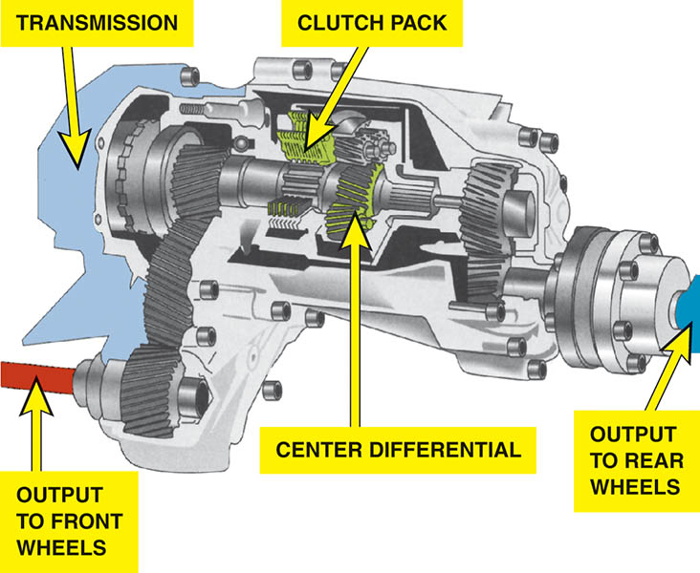
Figure 131.8 The center differential is the heart of a typical all-wheel-drive system. All-wheel-drive systems do not use a low range, and therefore the vehicle may not be able to go off-road like a vehicle equipped with a four-wheel drive with a low range

Slide 17
FRONT AND REAR DIFFERENTIAL AXLE RATIOS
In most four-wheel-drive vehicles, the overall gear ratio of the front differential is slightly higher than the overall ratio of the rear differential.
Although the difference between the ratios is small, the purpose is to prevent the drive train from binding.
The different ratios also help reduce resonant vibration and noise created in the driveline.

Slide 18
TRANSFER CASE (1 OF 2)
The purpose and function of the transfer case is to direct engine torque to the front and rear axle assemblies.
Most transfer cases also provide for two types of shifts:
  Mode Shift (2WD-4WD)
  Range Shift (High-Low)

Slide 19
TRANSFER CASE (2 OF 2)
Gear-To-Gear Transfer Cases
  One gear shaft is attached to the transmission output shaft. The second shaft acts as an idler, and the third shaft is the output to the front axle.
Planetary Gear Set Transfer Cases
  Many transfer cases use a planetary gear set for gear reduction in low range.
  To achieve direct 1:1 output from the transfer case, any two of the three elements can be locked together and the entire assembly will rotate as a unit.

Slide 20
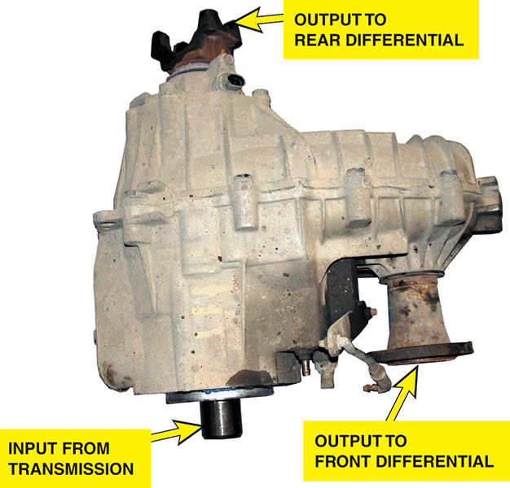
Figure 131.9 A typical transfer case is attached to the output of the transmission and directs engine torque to the rear or to the front and rear differentials

Slide 21
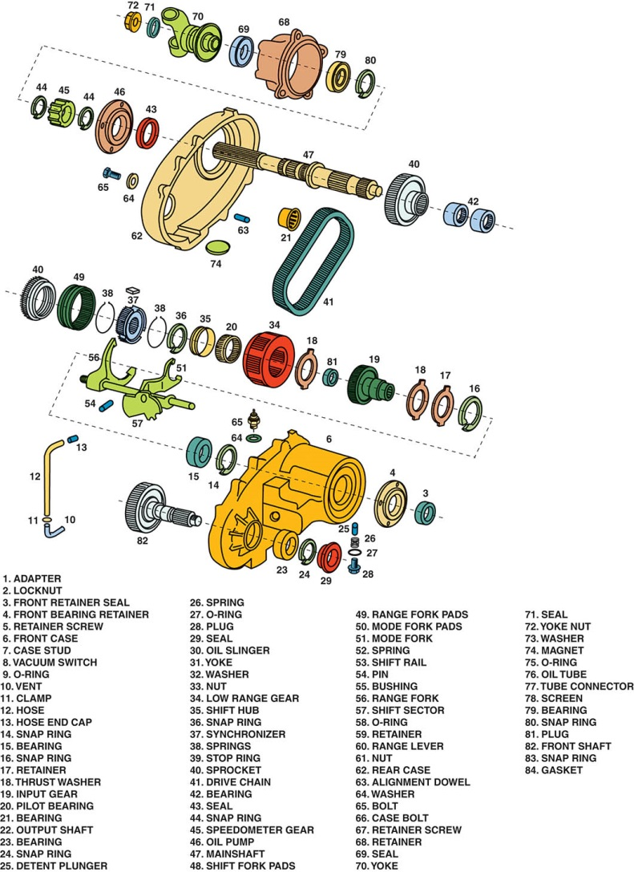
Figure 131.10 An exploded view of a New Venture 241 transfer case

Slide 22
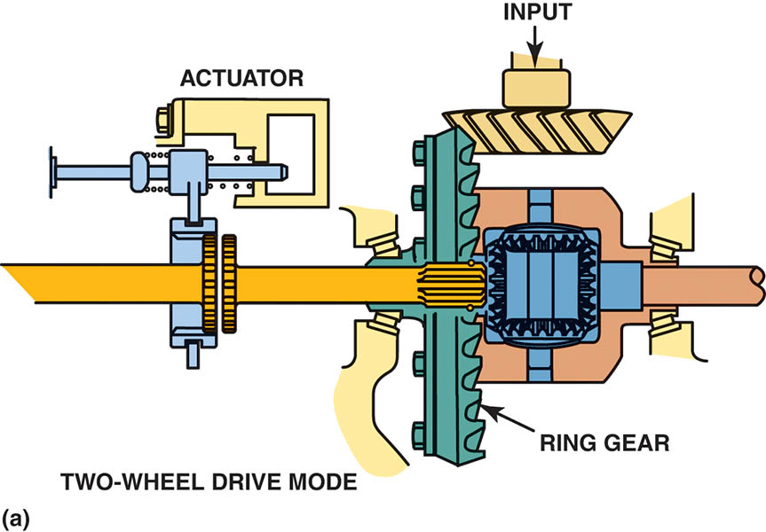
Figure 131.11 (a) When one axle shaft is disconnected, both front wheels can rotate independently, reducing excessive tire wear

Slide 23
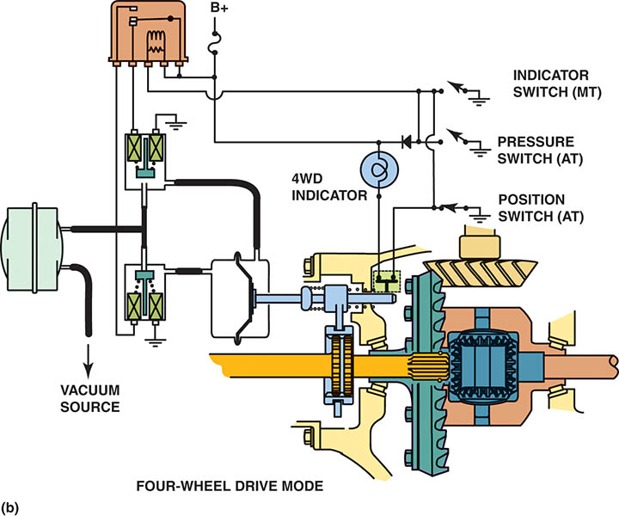
Figure 131.11 (b) In four-wheel-drive mode, vacuum is applied to the front part and the opposite side is vented to atmospheric pressure retracting the shift motor stem. When the transfer case is placed in two-wheel drive, the vacuum is applied to the other side of the diaphragm and the shift collar moves, unlocking the front axles

Slide 24
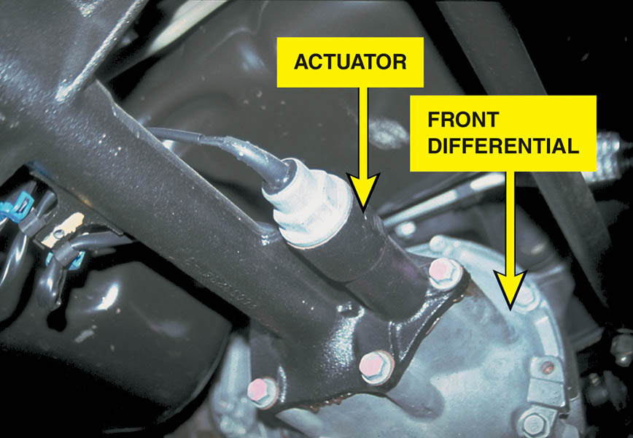
Figure 131.12 A General Motors sport utility vehicle front axle showing the electric axle disconnect actuator

Slide 25
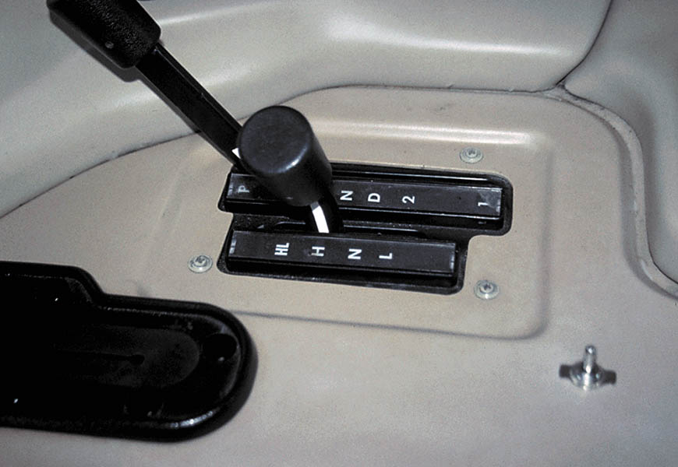
Figure 131.13 The range shift selector on a Hummer H1 sport utility vehicle. This vehicle is always in four-wheel drive, but the driver can select neutral (N) or low range

Slide 26
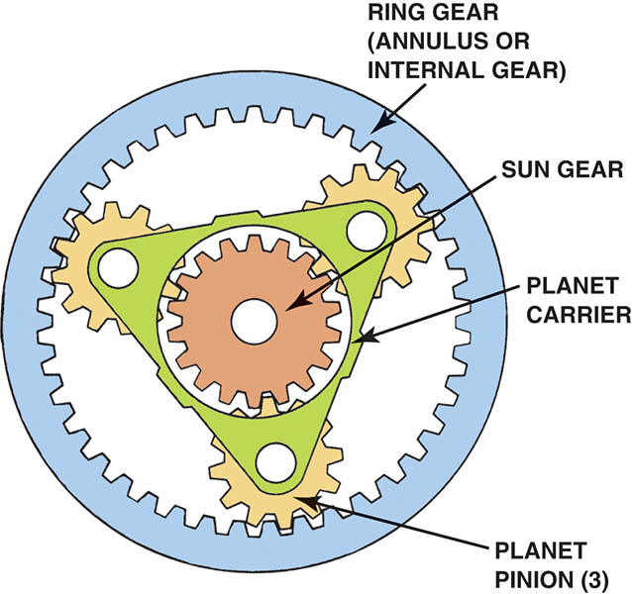
Figure 131.14 A typical planetary gear set used in a transfer case

Slide 27
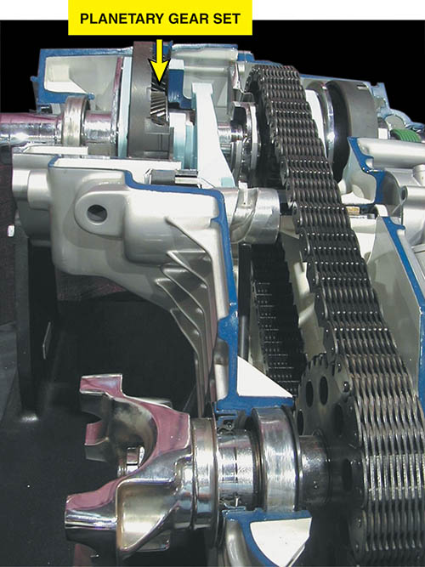
Figure 131.15 Cutaway of a planetary gear set transfer case

Slide 28
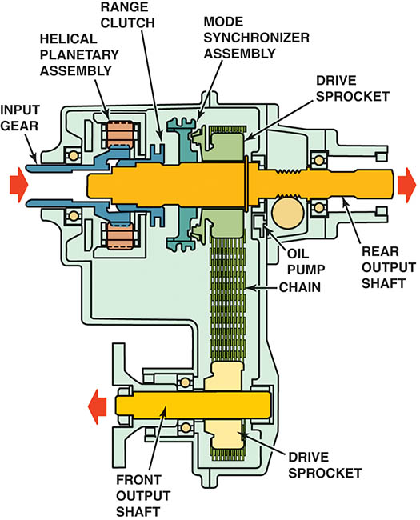
Figure 131.16 Two-wheel-drive/high-range torque flow in a NV231 transfer case. The sliding range clutch is shifted to the forward position by the range lever and fork, which connects the input gear to the output shaft and rear axle. The mode synchronizer sleeve is moved out of engagement from the drive sprocket to remove torque from the front axle

Slide 29

Figure 131.17 Four-wheel-drive/high-range torque flow in a NV231 transfer case. The range clutch position remains the same as in two-wheel drive/high-range, but the synchronizer sleeve is moved rearward and engages the drive sprocket clutch teeth. This action connects the drive sprocket to the rear output shaft, thereby applying equal torque to both front and rear output shafts

Slide 30
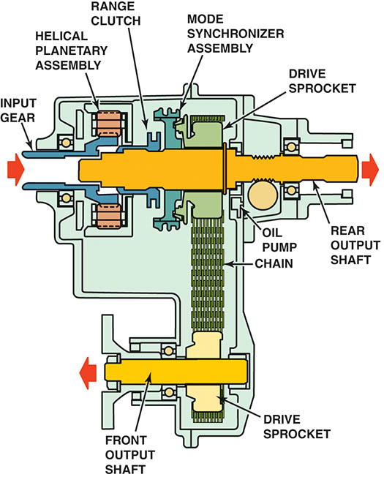
Figure 131.18 Four-wheel-drive/low-range torque flow in a NV231 transfer case. The mode synchronizer assembly remains engaged and the range clutch is moved to the rearward position. The annulus (ring) gear is fixed to the case and the input (sun) gear drives the pinion gears, which walk around the stationary annulus gear and drive the planetary carrier and output shaft at a speed lower than the input gear

Slide 31
QUESTION 1: ?
What is the purpose of the transfer case?

Slide 32
ANSWER 1:
To allow the driver to switch between 2WD or 4WD and low and high range.

Slide 33
INTERAXLE DIFFERENTIAL
An interaxle differential (center differential) is used to prevent driveline harshness and vibration, commonly referred to as driveline windup.
An interaxle differential can be found in various configurations including:
  Standard bevel gear differential
  Planetary gear differential
  Viscous coupling

Slide 34
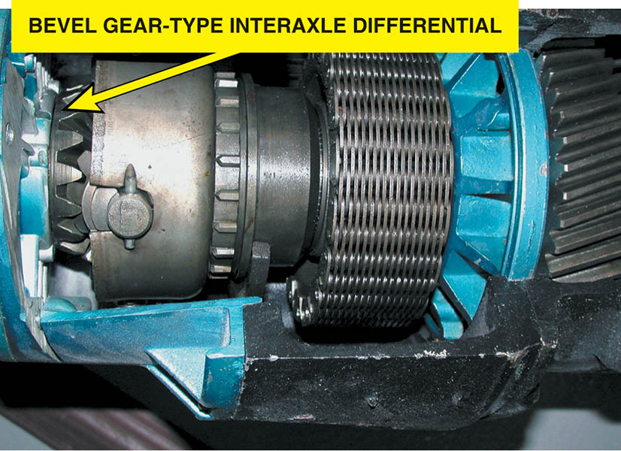
Figure 131.19 A bevel gear-type interaxle differential

Slide 35
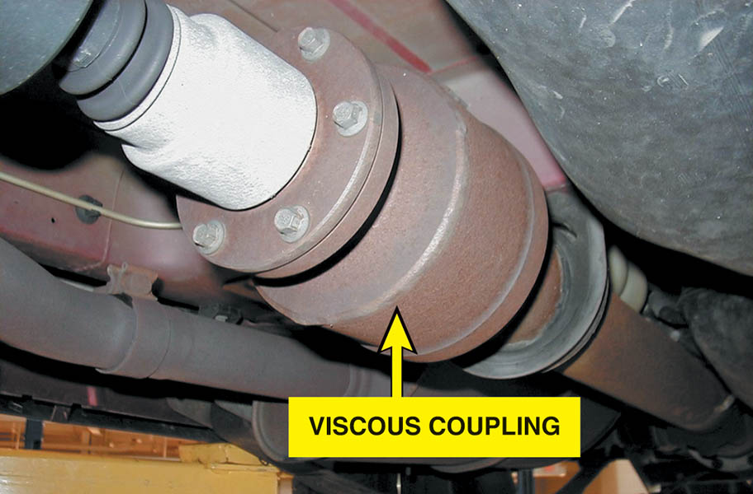
Figure 131.20 A viscous coupling. Note that the unit is attached to the output shaft between the transfer case (or transaxle) and the rear differential. A typical viscous coupling in a sealed unit is serviced as a complete assembly

Slide 36
FOUR WHEEL DRIVE AXLES
Four-wheel-drive vehicles use a variety of drive shafts and U-joint designs:
  Standard Cardan-type U-joints
  Constant velocity (CV) joints

Slide 37
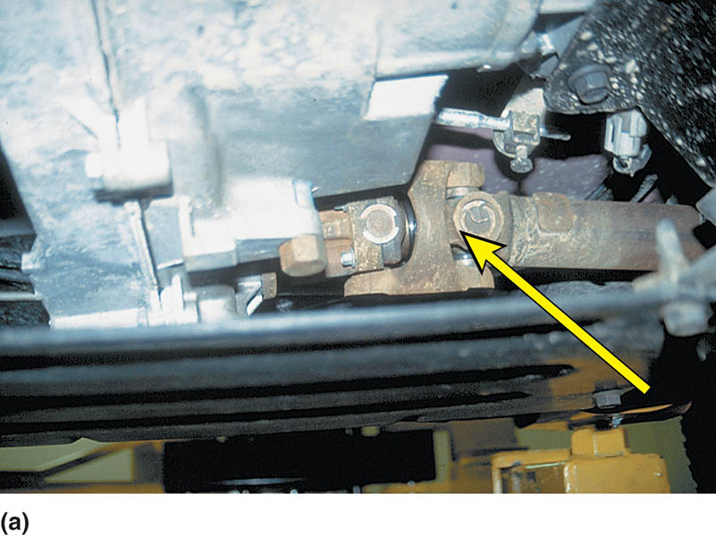
Figure 131.21 (a) A standard Cardan U-joint used on the output driveshaft from the transfer case to the front differential assembly

Slide 38
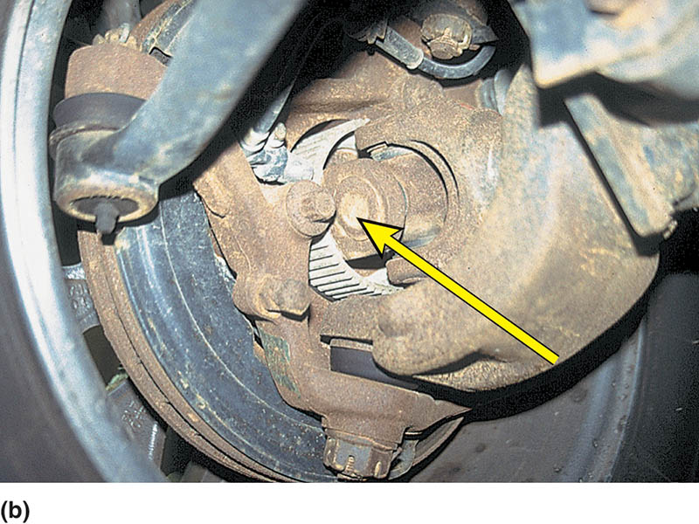
Figure 131.21 (b) A Cardan-type U-joint at the front drive wheels on a Jeep Wrangler

Slide 39
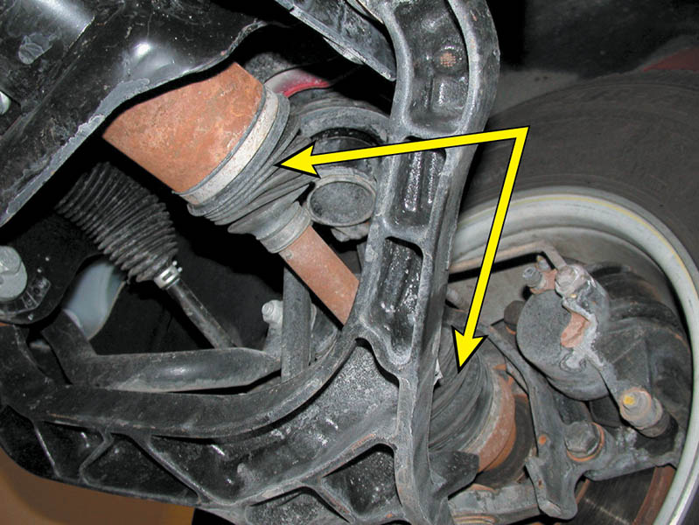
Figure 131.22 Constant velocity (CV) joints are used on the front axles of many four-wheel-drive vehicles like this Chevrolet Blazer

Slide 40
TRANSFER CASE SERVICE AND PROBLEM SOLVING
Transfer case preventative maintenance that may need to be done:
  Draining and refilling the transfer case.
  Drive chain replacement.
  Bearings.
  Shift mechanisms.

Slide 41
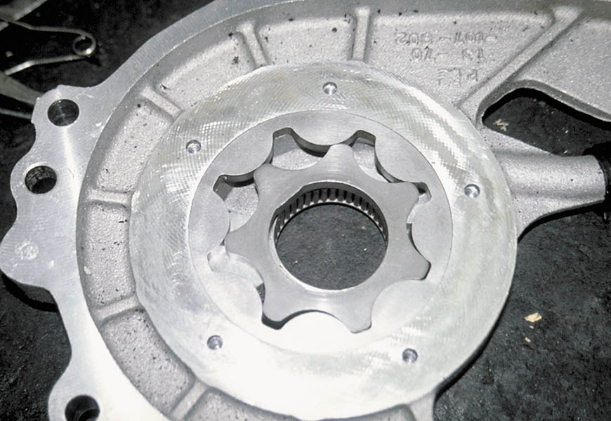
Figure 131.23 Most transfer cases use an internal oil pump to force the lubricant throughout the unit. Using the correct lubricant is critical to the proper operation of the transfer case

Slide 42
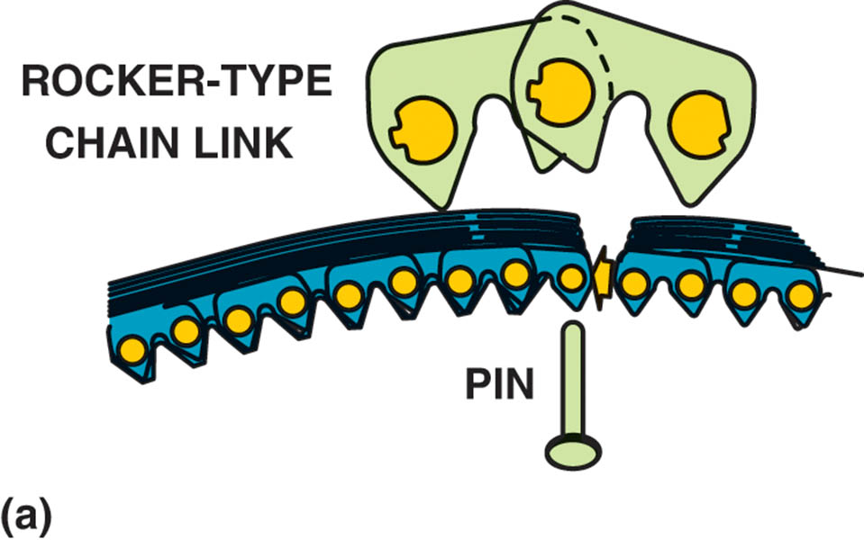
Figure 131.24 (a) A pin and rocker-type chain, which is also called a rocker joint-type chain, is used in transfer cases because of low noise and high efficiency, which improves fuel economy

Slide 43
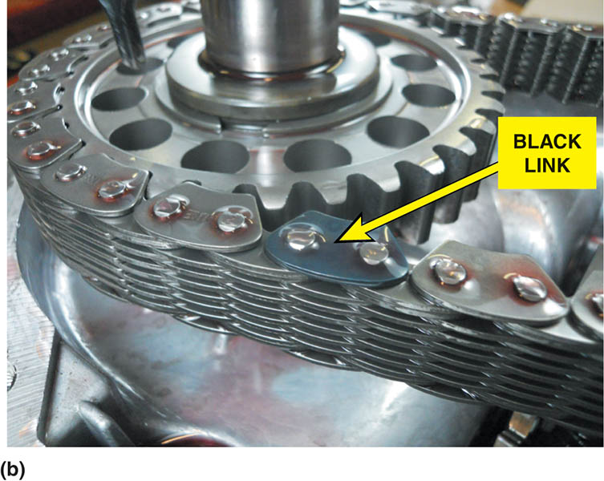
Figure 131.24 (b) A rocker pin-type chain used in a transfer case. The black link faces upward and is used as an indicator to the service technician to help insure that the chain is replaced in the same side up when it is reassembled

Slide 44
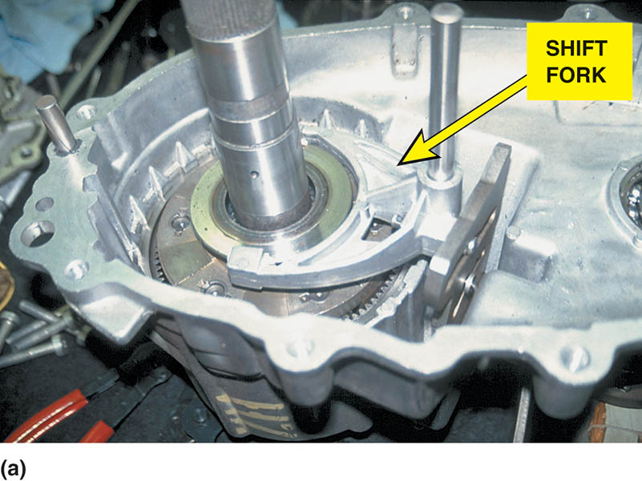
Figure 131.25 (a) The transfer case shift forks attach to the synchronizer sleeve

Slide 45
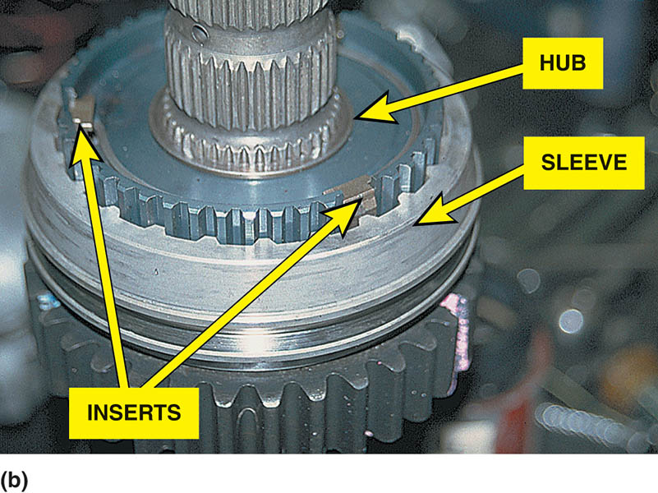
Figure 131.25 (b) The sleeve, hub, and inserts are similar in design except larger than those used in a manual transmission/transaxle

Slide 46
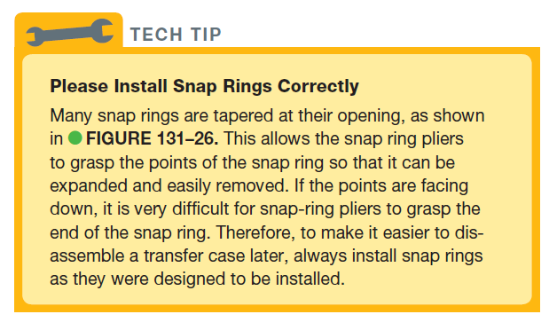
TECH TIP

Slide 47
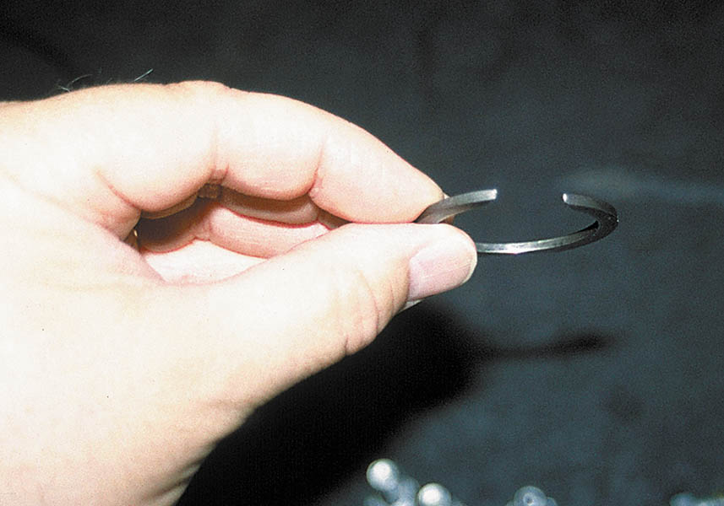
Figure 131.26 When reassembling a transfer case (or another automotive component) that includes a snap ring, always be sure that the upper opening is tapered from the top to allow snap-ring pliers room to get a grip on the open end

Slide 48
QUESTION 2: ?
What types of preventative maintenance may be performed on a transfer case?

Slide 49
ANSWER 2:
  Draining and refilling the transfer case, drive chain replacement, bearings, and shift mechanisms.

Slide 50
DIAGNOSING AND SERVING LOCKING HUBS
Locking front hubs should be cleaned periodically, especially if the vehicle has been driven under water or in dusty conditions.
Check the service information for the exact procedure for the vehicle being serviced.
Service kits are often available for the hubs.

Slide 51
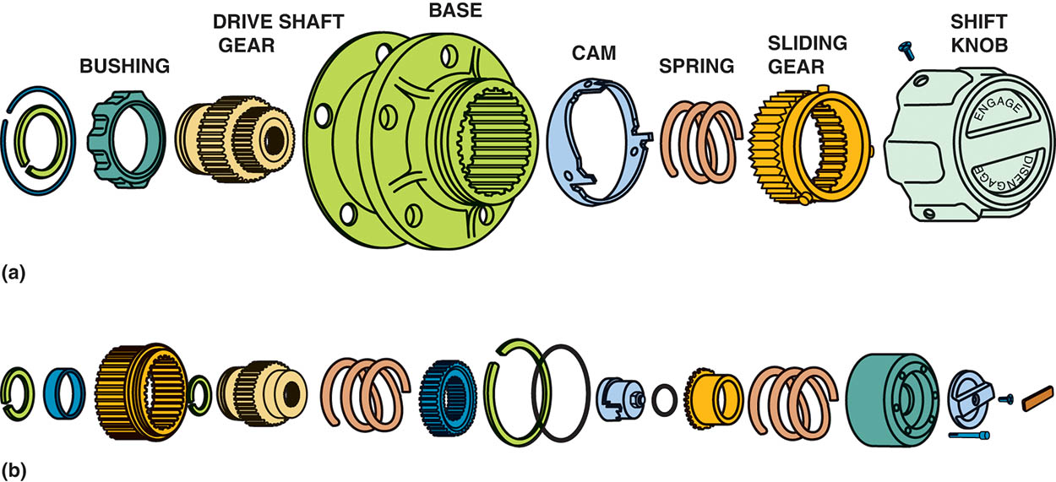
Figure 131.27 (a) An exploded view of a Dualmatic® manual locking hub

Slide 52
Figure 131.27 (b) A Warn® manual locking hub

Slide 53
NV-242 TRANSFER CASE SERVICE

Slide 54
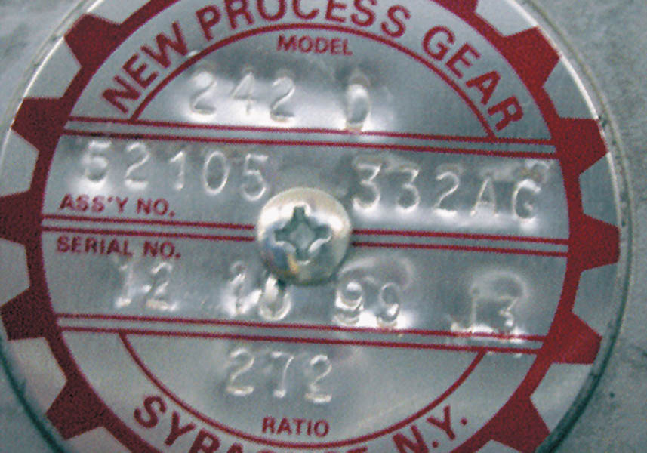
1 The identification plate on the housing indicates the transfer case is a New Venture (New Process) model #242 and has a low-range gear ratio of 2.72.1.

Slide 55
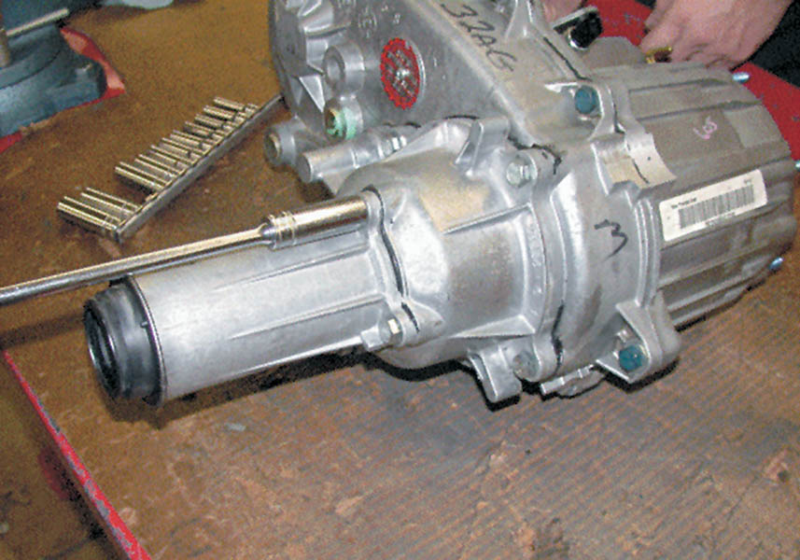
2 Rear output shaft housing being removed.

Slide 56
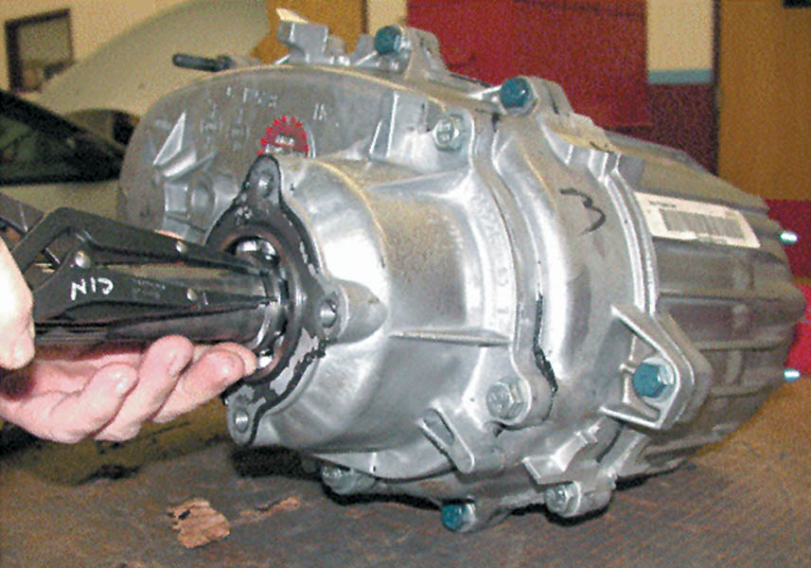
3 Before the case can be separated, the bearing retaining snap ring must be removed using snap-ring pliers.

Slide 57
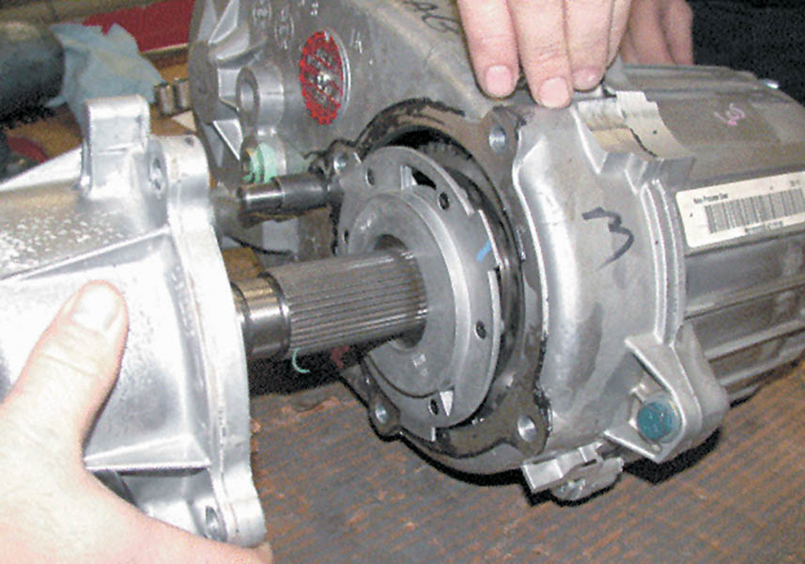
4 The lubricating oil pump is visible after the cover and bearing assembly have been removed.

Slide 58
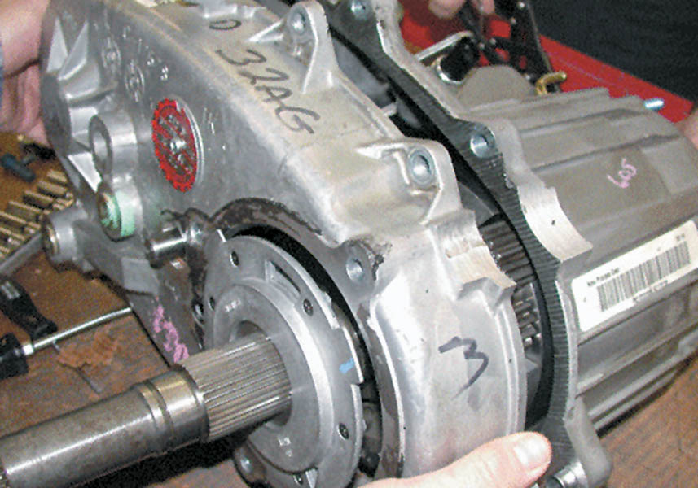
5 The two case halves are being separated.

Slide 59
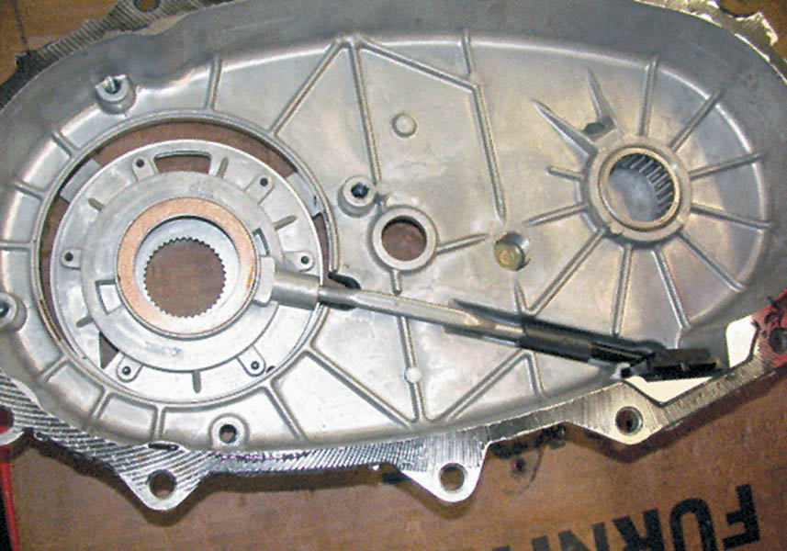
6 The oil pump assembly, pickup screen, and tube are visible on the backside of the case cover.

Slide 60
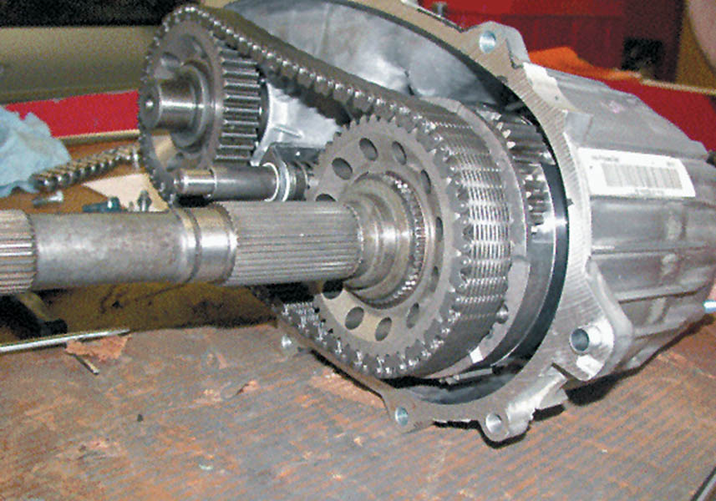
7 The rear output shaft and sprocket are visible on the right. The front output shaft and sprocket are visible on the left connected by the drive chain.

Slide 61
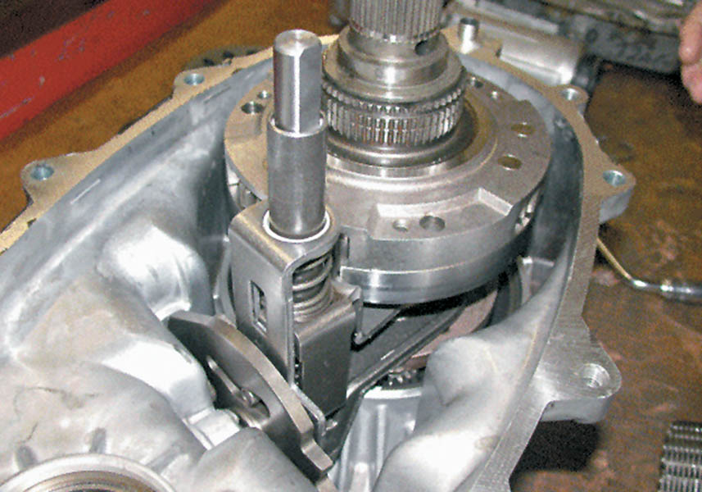
8 View of the shift levers and the center differential after the chain has been removed.

Slide 62
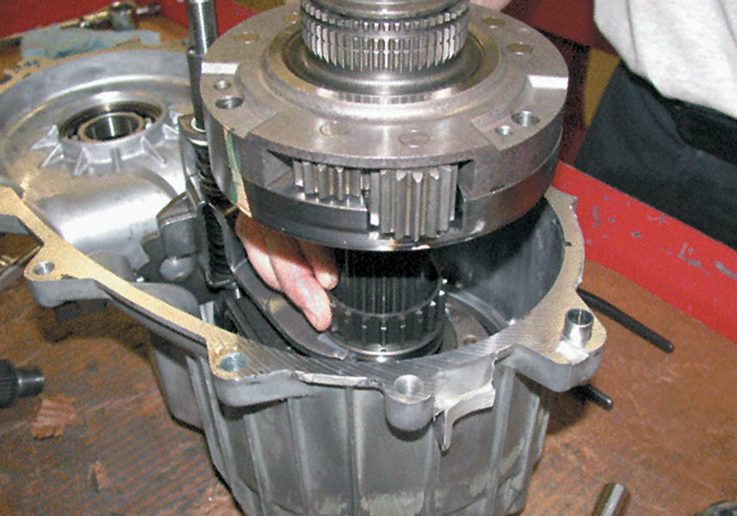
9 Differential being removed.

Slide 63
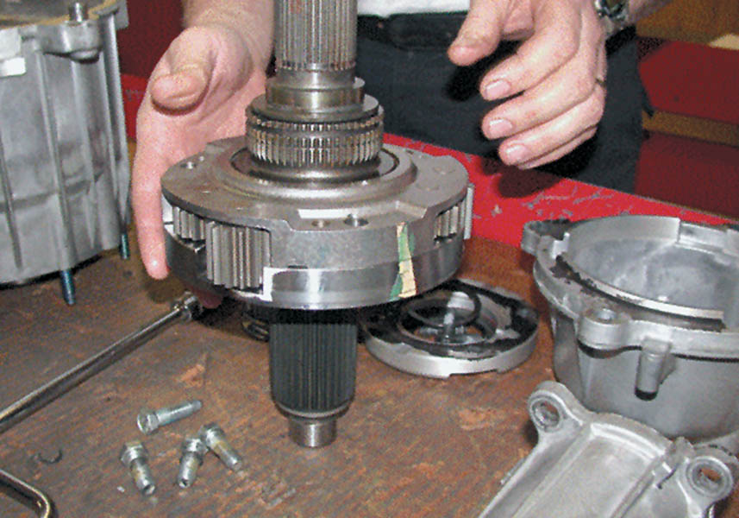
10 Center differential assembly after removal from the transfer case.

Slide 64
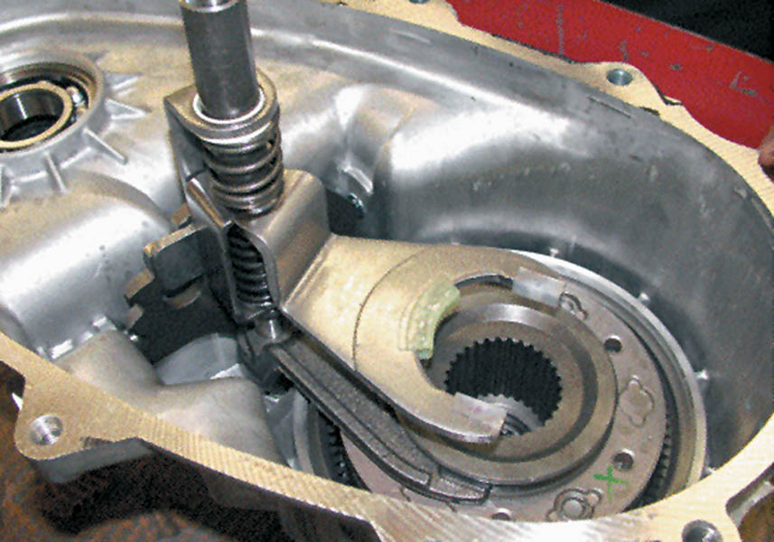
11 Mode shift fork (upper fork) is used to change two-wheel drive and four-wheel drive. The fork is attached to the range hub, which changes four-wheel drive high to four-wheel drive low.

Slide 65
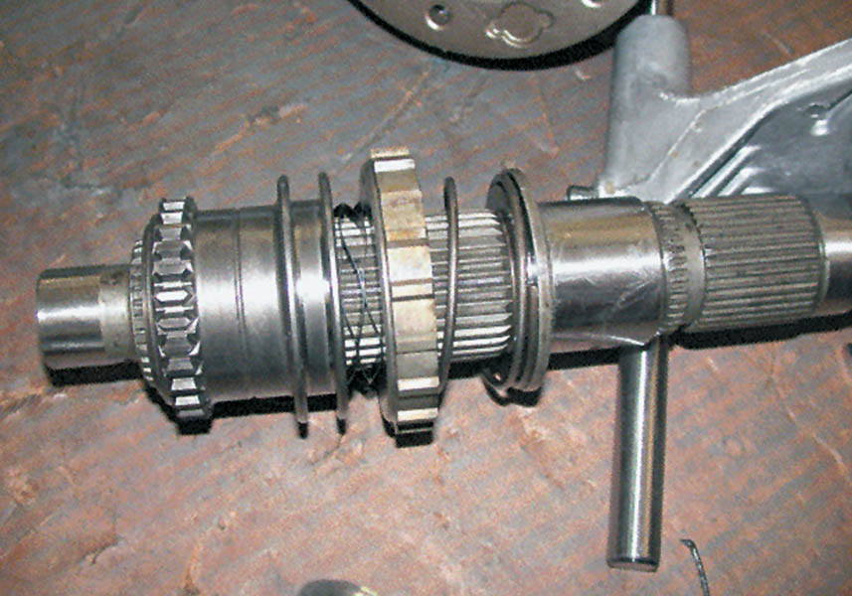
12 Main shaft showing the range hub (left), which changes the transfer case between four-wheel high and four-wheel low.

Slide 66
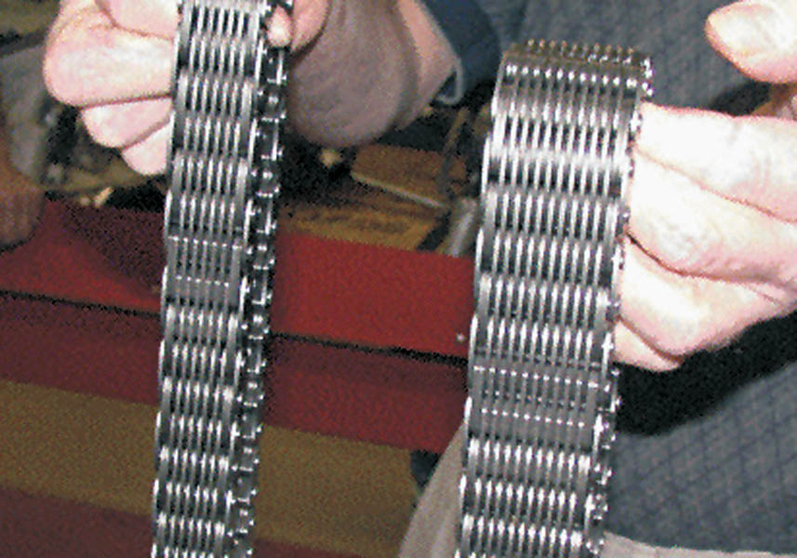
13 The chain used on the NV-242 (right) is larger than the chain used in the smaller version NV-231 (left).

Slide 67
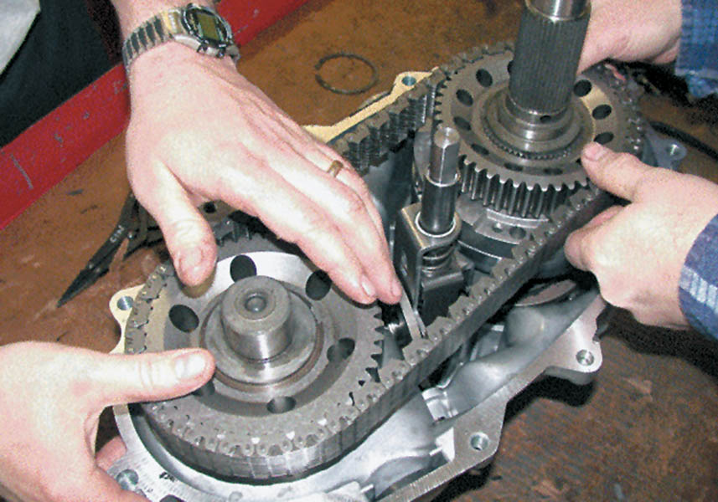
14 Reinstalling the components and the drive chain.

Slide 68
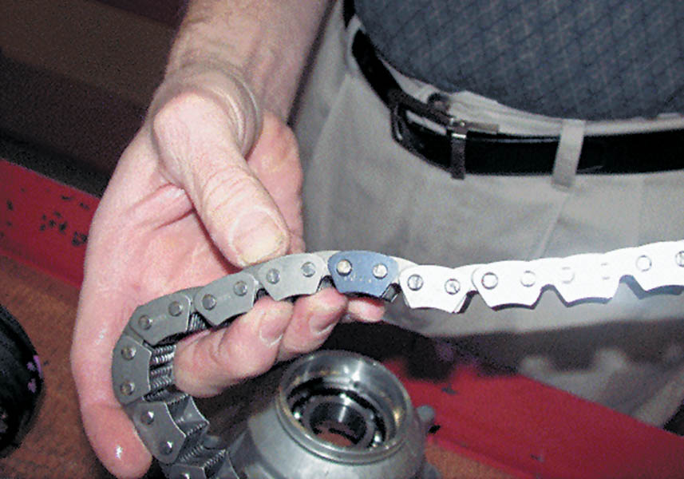
15 The drive chain should be installed with the black (dark) link(s) up.

Slide 69
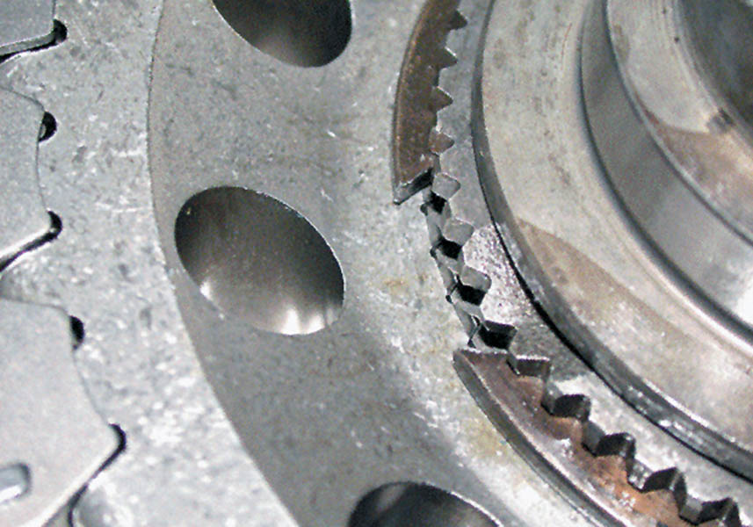
16 Install all snap rings so that the sharpest tips face up so snap-ring pliers can grab onto the tips for easier removal.

Slide 70
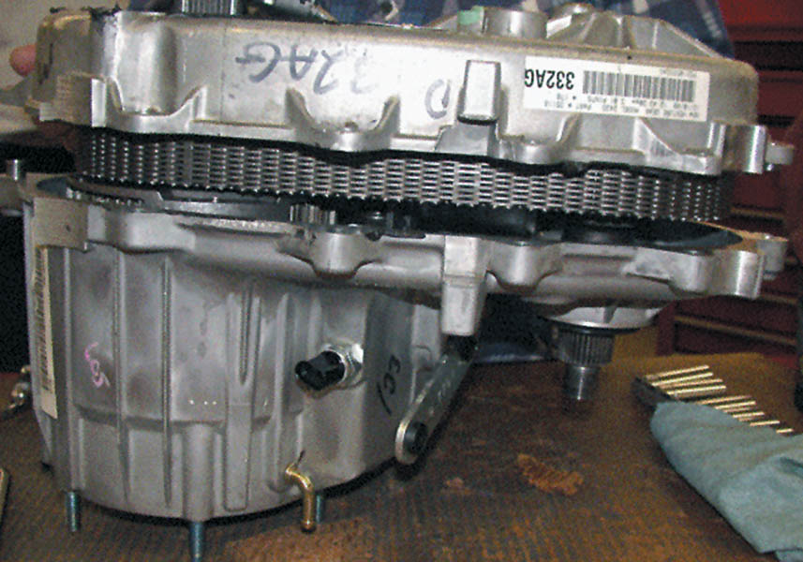
17 Assembling the case halves.

Slide 71

18 The parting surface should be sealed with RTV silicone. Do not use too much or the oil pump screen can become clogged.

Slide 72

19 After attaching the oil pump and tube, the output shaft housing is installed.

Slide 73

20 The output shaft speed sensor drive gear is correctly installed in this photo. The slip yoke of the drive shaft slips onto the splines and inside the nylon gear.

Slide 74

21 The electronically-shifted version of the case is identical except that the shifting is achieve an electric motor, shown here installed in a vehicle.

Slide 75

Copyright

