Slide 1
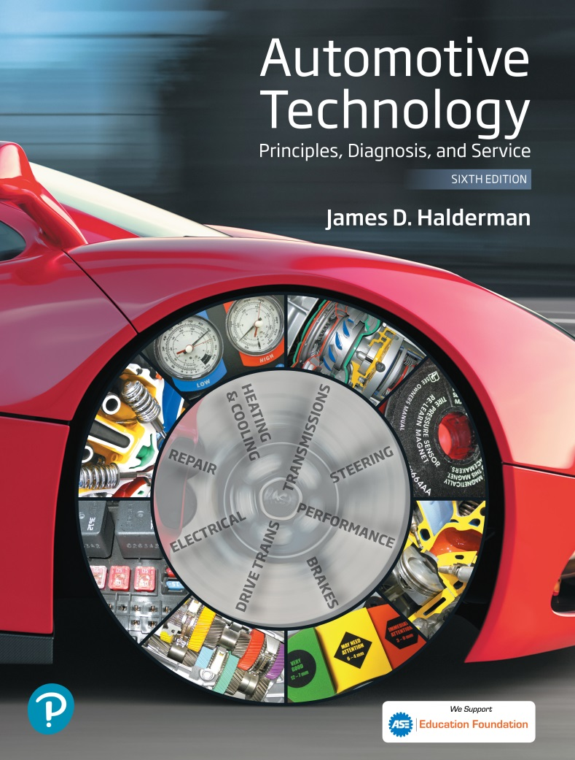
Automotive Technology Principles, Diagnosis, and Service
Sixth Edition
Chapter 130
Drive Axles and Differentials
Copyright © 2018, 2015, 2011 Pearson Education, Inc. All Rights Reserved

Slide 2
LEARNING OBJECTIVES (1 of 2)
130.1 Describe the operation of a differential and the gear ratios set types.
130.2 Compare the operation of a standard open differential and a limited slip differential.
130.3 Describe the components of a differential and the types of bearings used in drive axles.
130.4 Explain how to identify, determine the axle ratio, diagnose, inspect, and disassemble a differential.

Slide 3
LEARNING OBJECTIVES (2 of 2)
130.5 Explain how to set the drive pinion depth and replace the pinion shaft bearing.
130.6 Describe the procedure to check backlash and set the preload for pinion gears and side bearings.
130.7 Discuss differential lubricants.

Slide 4
DRIVE AXLES
Terminology
  The major parts of a drive axle include:
  The ring and pinion gears
  Differential
  Axle shafts
Purpose and Function
  To change the direction of engine torque.
  To allow the drive wheels to rotate at different speeds.

Slide 5
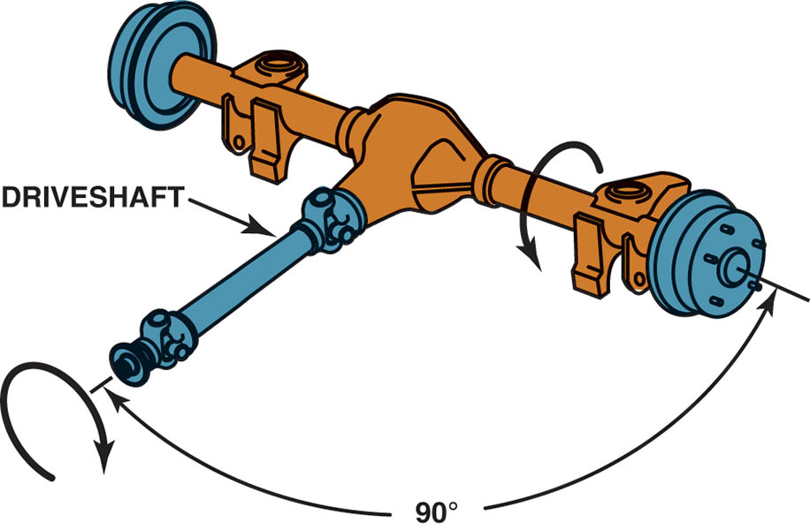
Figure 130.1 The differential assembly changes the direction of engine torque and increases the torque to the drive wheels

Slide 6
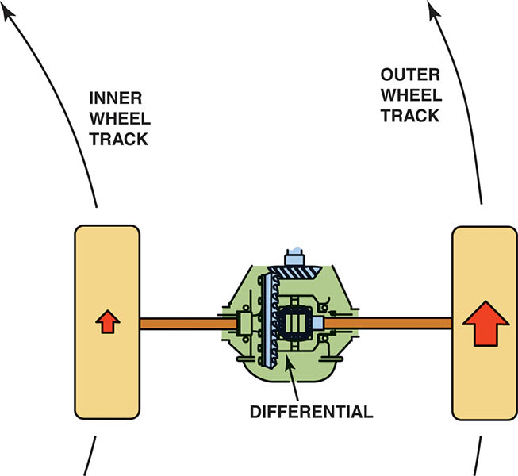
Figure 130.2 The difference between the travel distance of the drive wheels is controlled by the differential

Slide 7
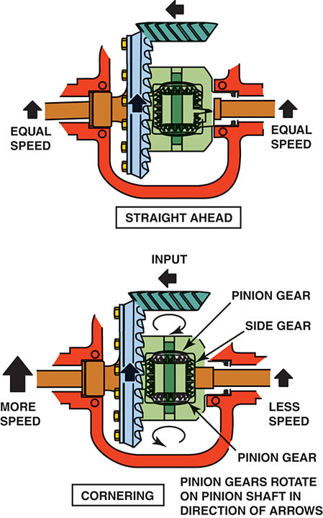
Figure 130.3 When the vehicle turns a corner, the inner wheel slows and the outer wheel increases in speed to compensate. This difference in rotational speed causes the pinion gears to “walk” around the slower side gear

Slide 8
PARTS OF A DIFFERENTIAL (1 OF 2)
The driveshaft applies torque to the drive pinion gear.
The ring gear is attached to a differential case that also contains small beveled spider gears or pinion gears.
A pinion shaft passes through the two pinion gears in the case.
In mesh with the pinion gears are two side gears that are splined to the inner ends of the axles.

Slide 9
PARTS OF A DIFFERENTIAL (2 OF 2)
The Pinion and Ring Gears During Operation
  Each slanted ring gear tooth has two ends. Its toe is closest to the ring gear center; its heel, closest to the outside circumference.
  The tooth root is the depression lying between two teeth, and the crown is the very top of each tooth.
  While a vehicle accelerates, the drive pinion contacts the ring teeth on its drive, or convex side.
  While decelerating, the drive pinion contacts the ring teeth on its coast, or concave side.

Slide 10
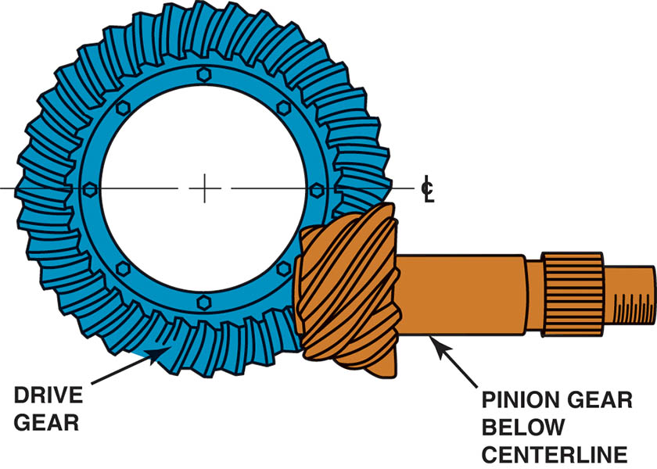
Figure 130.4 A hypoid gear set uses a drive pinion that meshes with the ring gear below the center line of the ring gear

Slide 11
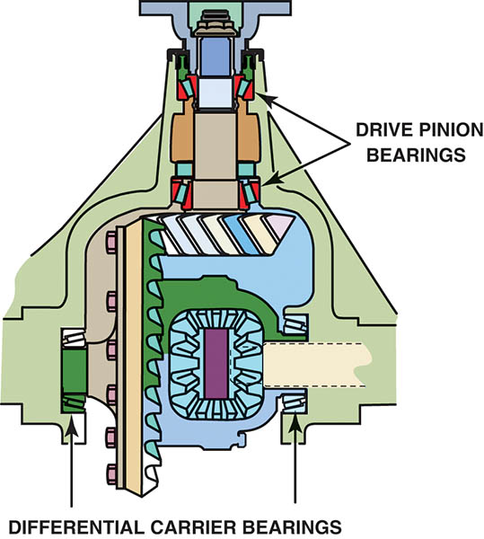
Figure 130.5 A pair of tapered roller bearings called carrier bearings is used to locate the drive pinion gear and the differential case and ring gear. Another pair of bearings locates the drive pinion gear

Slide 12
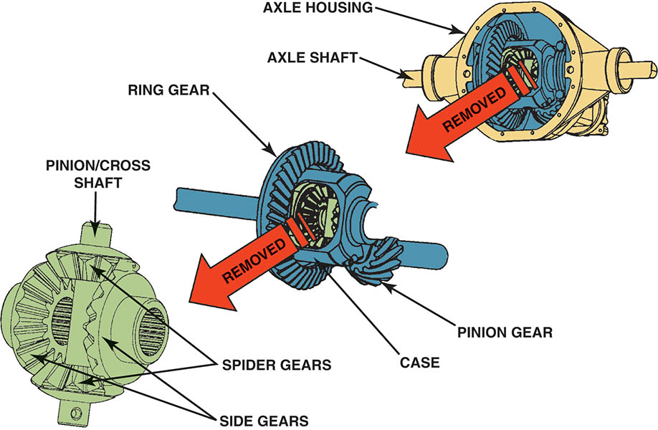
Figure 130.6 The relationship among the ring gear and drive pinion as well as the side and spider gears

Slide 13
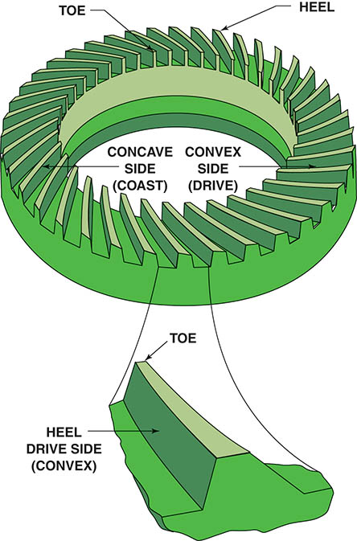
Figure 130.7 The drive side is the convex side of the ring gear except for some front axles used in four-wheel vehicles, and they often use the concave side on the drive side

Slide 14
QUESTION 1: ?
What is a hypoid gear set?

Slide 15
ANSWER 1:
A gear set where the pinion meshes with the ring gear below the centerline of the ring gear.

Slide 16
DIFFERENTIAL GEAR RATIOS
The gear ratio of the final drive (differential) is called the axle ratio.
To determine the axle ratio, divide the number of teeth of the ring gear (driven gear) by the number of teeth of the drive pinion gear (driving gear).

Slide 17
RING AND PINION GEAR SET TYPES
Hunting gear sets are gear sets with final drive ratios expressible in a fraction that cannot be reduced to any lower terms.
Non-hunting gear sets are gear sets with final drive ratios expressible as a whole number.
Partially non-hunting gear sets are gear sets with final drive ratios expressible as a reducible fraction not equaling a whole number.

Slide 18
OPEN DIFFERENTIALS
Purpose and Function
  While cornering, allows the wheels to turn at much greater differences in speed.
Torque Flow Through a Standard Open Differential
  Open differentials deliver equal torque to both wheels at all times.
  When traveling straight on smooth road surfaces the ring gear, carrier, and the drive axles are traveling at the same speed.
  The ability of the differential pinion gears to spin on their shafts allows each axle to rotate at a different speed.

Slide 19
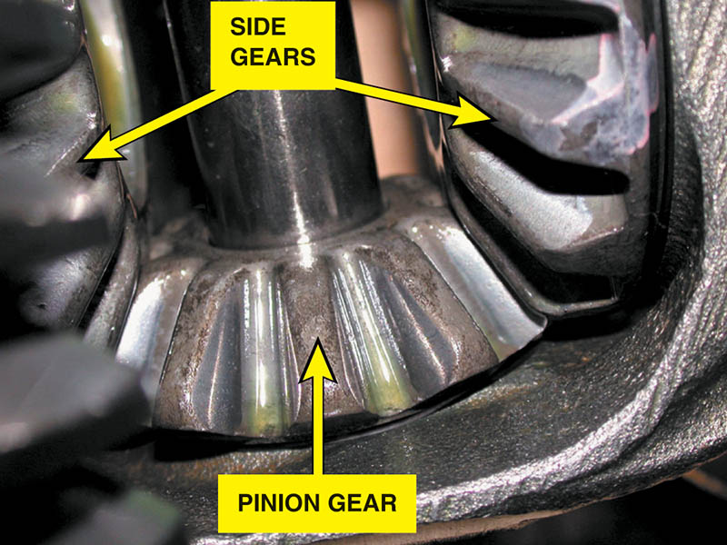
Figure 130.8 A close-up view of the side gears and spider (pinion) gear. Note the ridges on the gear teeth. These ridges are manufactured into the gear teeth to help retain lubricant so that no metal-to-metal contact occurs

Slide 20
LIMITED SLIP DIFFERENTIALS (1 OF 4)
Purpose and Function
  A limited-slip differential distributes torque to both wheels equally or unequally, allowing the wheels to turn at the same or at different speeds depending on traction.
Parts and Operation
  Preloaded clutches use two mechanisms to accomplish this action.
  A coil, Belleville, or leaf spring applies a force against the two side gears.
  A multidisc clutch pack or cones lie behind one or both of the side gears

Slide 21
LIMITED SLIP DIFFERENTIALS (2 OF 4)
Cone-Type
  Uses two tapered cones instead of multidisc clutch packs.
  The cone’s tapered end fits inside a dished receptacle machined into the case.
  When the cones are forced into their dished receptacles, they come to a stop smoothly, locking the side gears to the case.

Slide 22
LIMITED SLIP DIFFERENTIALS (3 OF 4)
Viscous Coupled Limited-Slip Units
  Half of the plates are splined to the case, and the other half are alternately splined to each side gear.
  The plates are housed in a sealed chamber, which is filled with a thick and viscous silicone-based fluid.
  The silicone allows normal speed differences between two shafts, resisting high-speed differences associated with wheel spin on one shaft.

Slide 23
LIMITED SLIP DIFFERENTIALS (4 OF 4)
The Eaton “Locker” Differential
  When a vehicle spins a rear wheel, both the preloaded multidisc differential and the Eaton “locker” compress their clutch packs lying between the side gears and the case.
  This allows the case to directly drive the axles, bypassing the effect of the rotating differential pinions.
Torsen Differentials
  Uses a set of worm side gears in mesh with individual worm wheel pinions that are supported by the differential case.

Slide 24
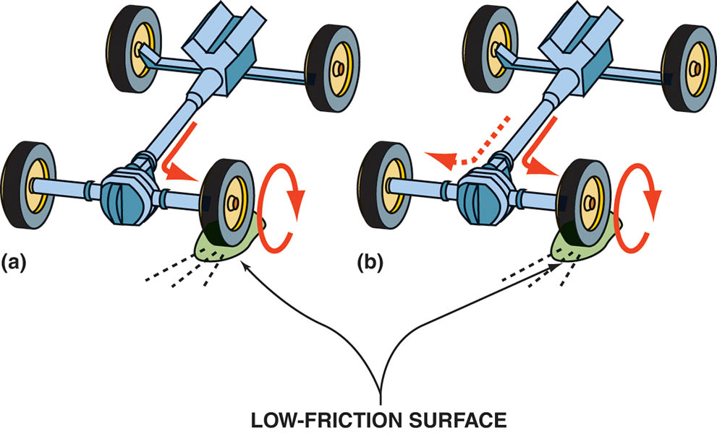
Figure 130.9 (a) A two-wheel-drive vehicle equipped with an open differential. (b) A two-wheel-drive vehicle equipped with a limited-slip differential

Slide 25
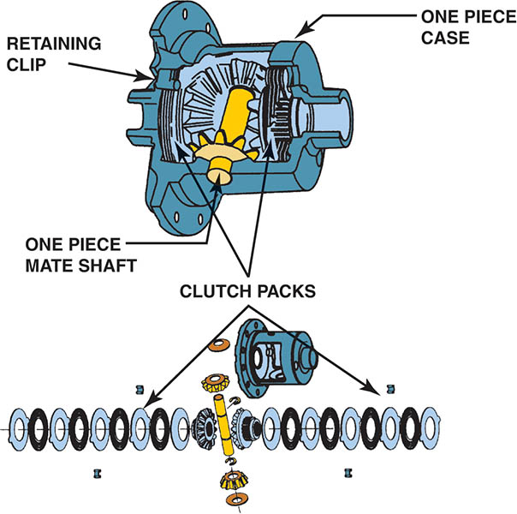
Figure 130.10 Trac-loc limited-slip differential. This type of limited-slip differential uses the preload force from a spring and the torque generated by the side gears as the two axles rotate at different rates to apply the clutches and limit the amount of difference in the speed of two axles

Slide 26
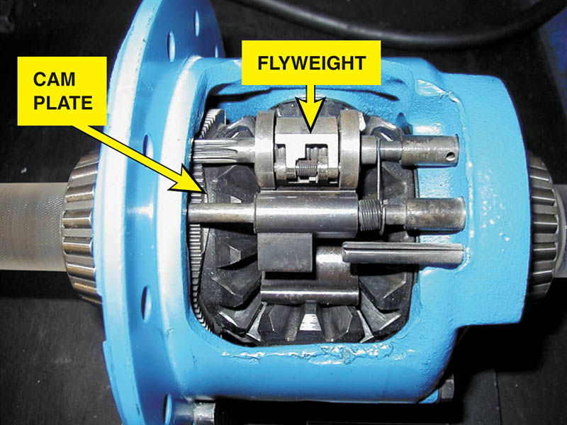
Figure 130.11 An Eaton locker differential

Slide 27
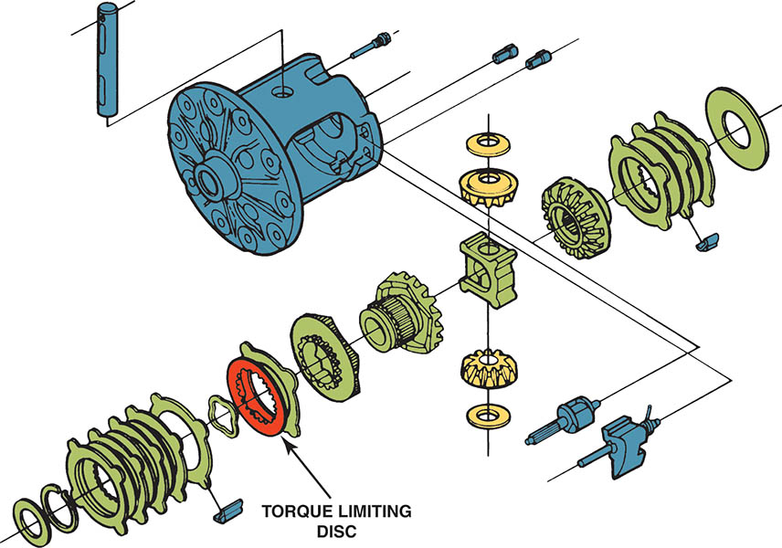
Figure 130.12 This Eaton design differential uses a torque-limiting disc to prevent the possibility of breaking an axle in the event of a high torque demand. When the disc tangs shear, the differential will continue to function but as an open rather than as a limited-slip differential

Slide 28
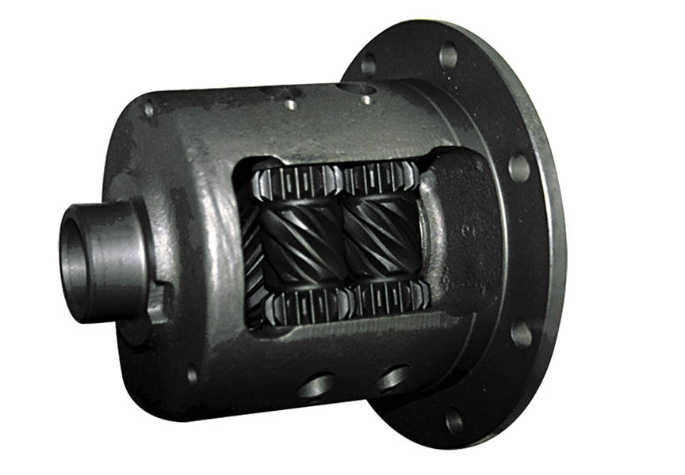
Figure 130.13 A Torsen differential. This type of differential provides torque to both drive wheels even if one tire is on ice. The complex system of gears allows this smooth transfer of torque without the use of clutches

Slide 29
QUESTION 2: ?
How does a Torsen differential provide limited slip capabilities?

Slide 30
ANSWER 2:
It uses a set of worm gears in mesh with individual worm wheel pinions.

Slide 31
DIFFERENTIAL COMPONENTS (1 OF 2)
Drive Pinions
  The drive pinion gear of the differential is driven by a flange often called a companion flange.
  The final drive pinion shaft may be supported by bearings using one of two methods:
  Two opposed taper roller bearings, with a collapsible (compressible) spacer.
  a straddle-mounted pinion that uses two opposed taper roller bearings and a third smaller bearing on the machined pilot.

Slide 32
DIFFERENTIAL COMPONENTS (2 OF 2)
Drive Pinion Gear Depth
  The pinion shaft mounting method also determines how deeply the pinion gear meshes into the ring gear.
  The pinion depth adjustment is made by changing the thickness of a shim (spacer).
Side Bearings
  The differential case is supported by two side bearings pressed onto its sides.
  These are usually tapered roller bearings and are preloaded to ensure case rotation without axial or radial movement.

Slide 33
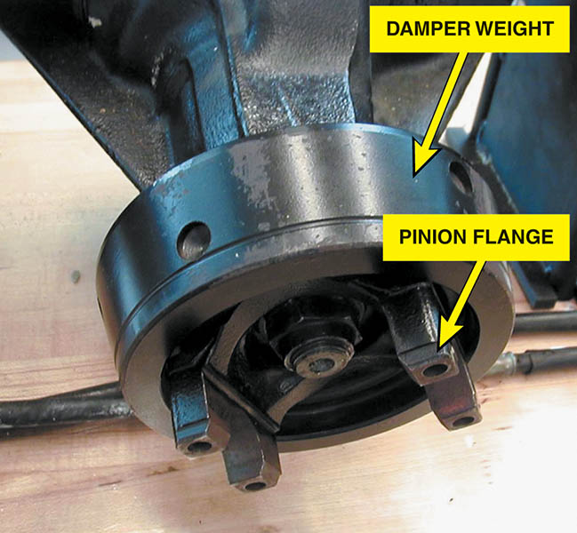
Figure 130.14 This pinion flange is equipped with a damper weight to help dampen driveline vibrations

Slide 34
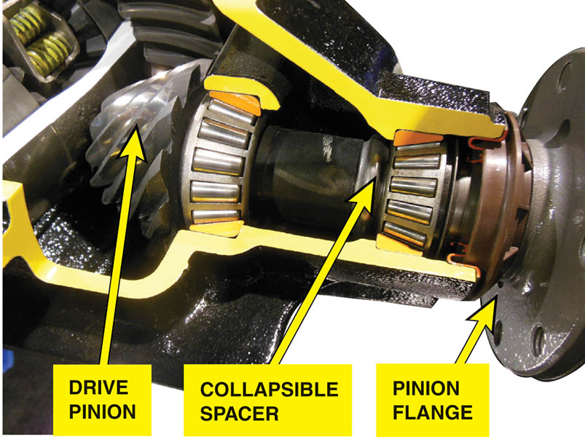
Figure 130.15 A collapsible spacer-type drive pinion shaft

Slide 35
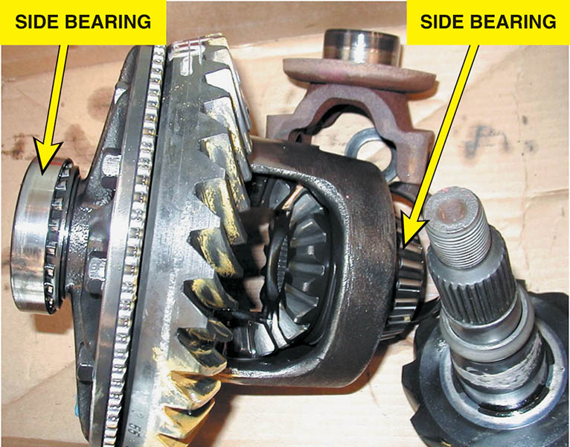
Figure 130.16 Side bearings are press fit on the differential case

Slide 36
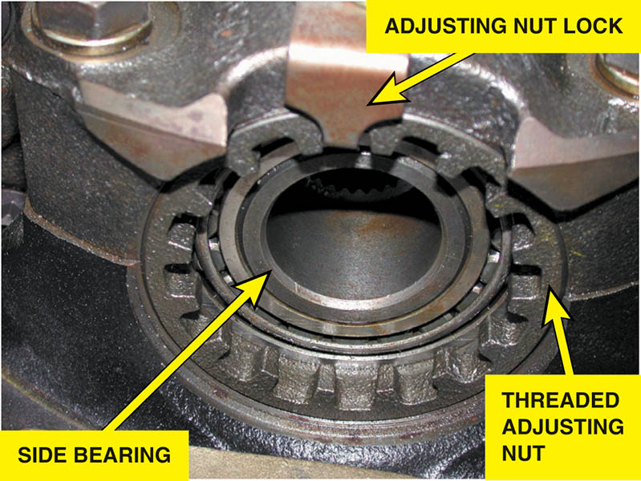
Figure 130.17 Some side bearings use threaded adjusters to adjust preload

Slide 37
DIFFERENTIAL AXLE BEARINGS (1 OF 2)
Ball Bearings/ Rear Axles
  If ball bearings are used, the bearing itself absorbs the radial forces.
  There is no axle shaft end play (thrust) adjustment.
Straight Roller Bearings/ Rear Axle
  The axle surface serves as the inner race.
  The bearing is lubricated by the hypoid lubricant.
  There is no axle shaft end play adjustment with this design.

Slide 38
DIFFERENTIAL AXLE BEARINGS (2 OF 2)
Tapered Roller Bearings/ Rear Axles
  The bearing is pre-lubricated before it is installed and is held by a press fit on the axle shaft.
  The axle shaft end play is adjustable using either an adjusting nut or shims.

Slide 39
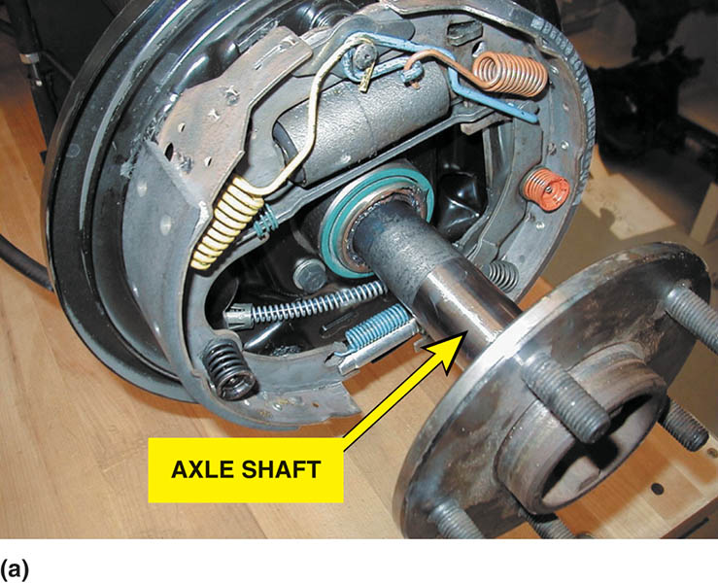
Figure 130.18 (a) The axle shaft itself is the inner race if a straight roller bearing is used

Slide 40
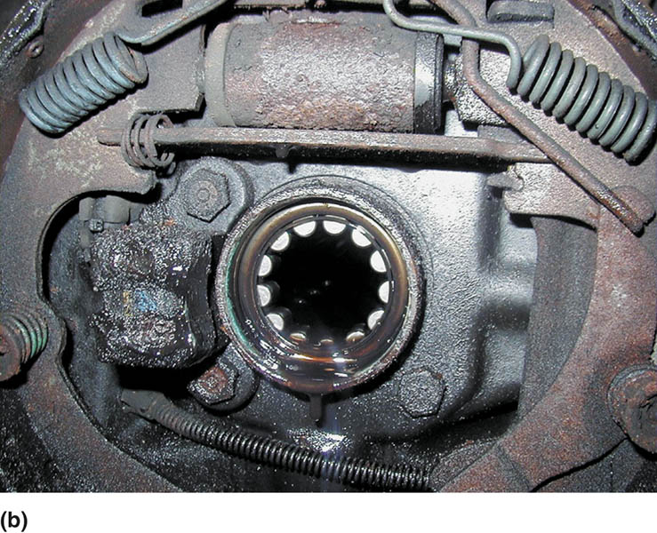
Figure 130.18 (b) The straight roller bearings are lubricated by the rear axle fluid, and a leak at the rear axle seal can cause this fluid to get onto brake components

Slide 41
DIFFERENTIAL IDENTIFICATION
Before any service work is performed on a differential assembly, the exact axle specification must be determined.
Differential assembly identification includes:
  Visual identification
  Axle assembly number
  Limited-slip identification tag
  Differential cover shape

Slide 42
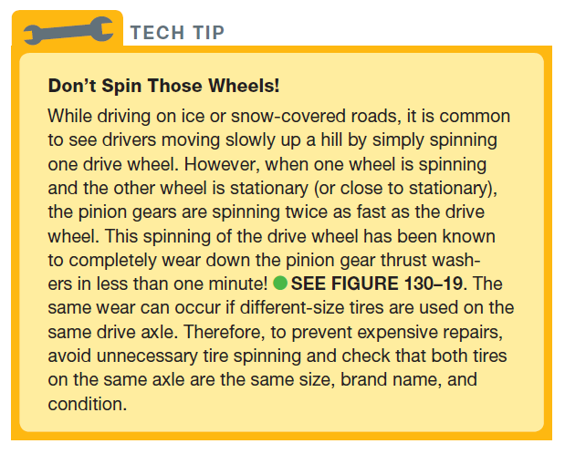
Tech Tip

Slide 43
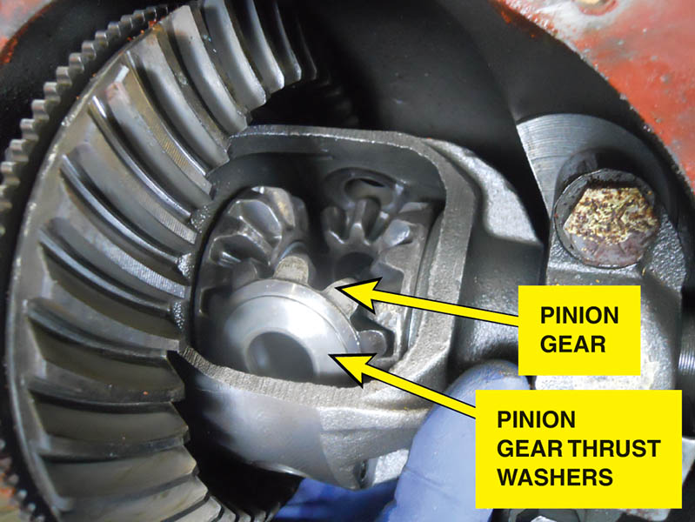
Figure 130.19 The pinion gear thrust washers can be destroyed by spinning one wheel for an extended period of time

Slide 44
DETERMINING THE AXLE RATIO OF A DIFFERENTIAL
Hoist the vehicle safely.
Mark the rear tires with masking tape at 12 o’clock position.
Mark the driveshaft with masking tape.
Have an assistant hold one drive tire to keep it from moving and slowly rotate the other drive tire exactly 10 times while the assistant counts the driveshaft revolutions.
Multiply the driveshaft revolutions by 2 (except for a limited- slip differential), and then move the decimal point one place to the left.

Slide 45
REAR END NOISE DIAGNOSIS
Typical noise and its sources include:
  Grinding or growling noise while turning —usual cause is a defective axle bearing.
  Whine noise during cruise —drive pinion bearings are the likely causes of this type of noise.

Slide 46
DIFFERENTIAL INSPECTION
Carefully inspect the differential for obvious damage or wear.
Check the backlash.
Also use a dial indicator to check ring gear runout.

Slide 47
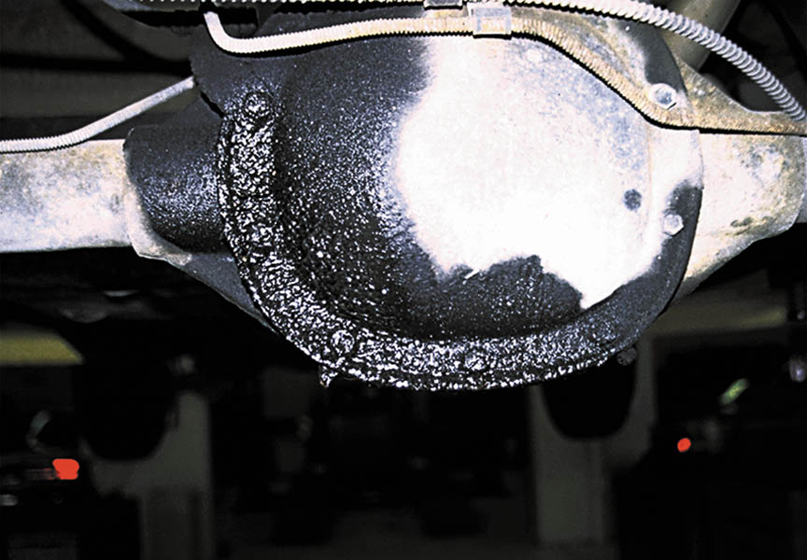
Figure 130.20 This differential has obviously been leaking. If the differential lubricant is low, wear may have occurred that would require further inspection

Slide 48
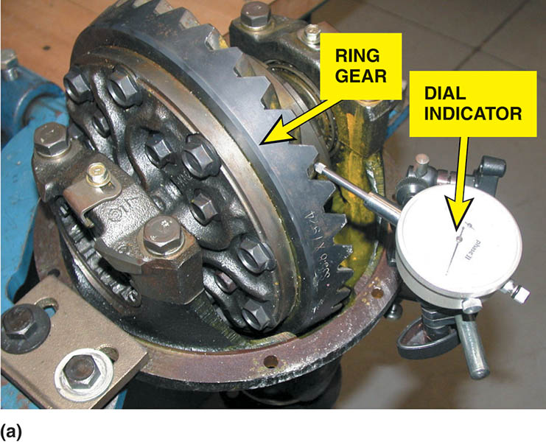
Figure 130.21 (a) Backlash is determined by mounting a dial indicator to the differential housing and placing the button of the gauge against a tooth of the ring gear. Moving the ring gear back and forth will indicate on the dial indicator the amount of backlash

Slide 49
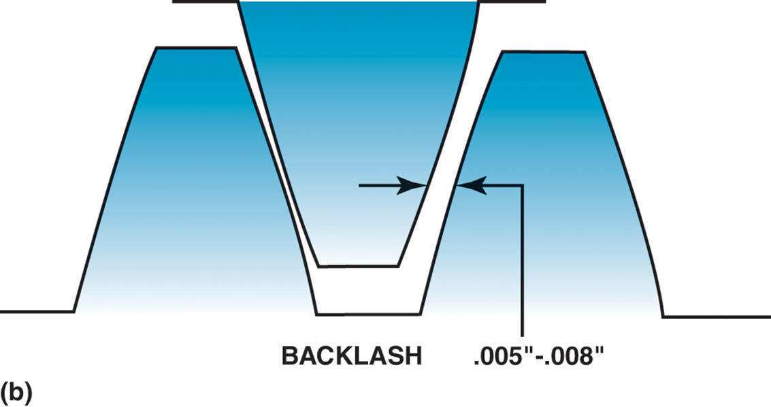
Figure 130.21 (b) Backlash is the clearance between the drive pinion and the ring gear teeth

Slide 50
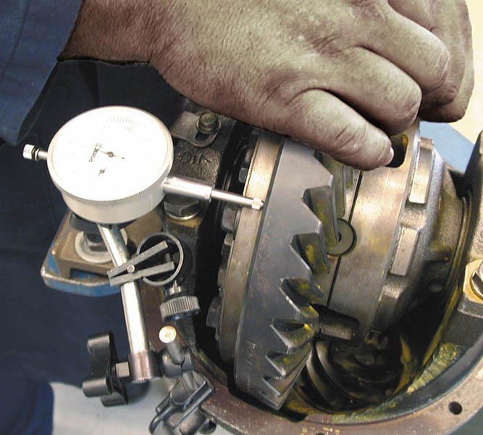
Figure 130.22 Ring gear runout should be less than 0.002 inch (0.05 mm) as measured by a dial indicator

Slide 51
TOOTH CONTACT PATTERN TEST
A tooth contact pattern test is an excellent method for checking proper drive pinion depth as well as proper backlash between the drive pinion and the ring gear.
Any faults in these areas will be reflected in the pattern.

Slide 52
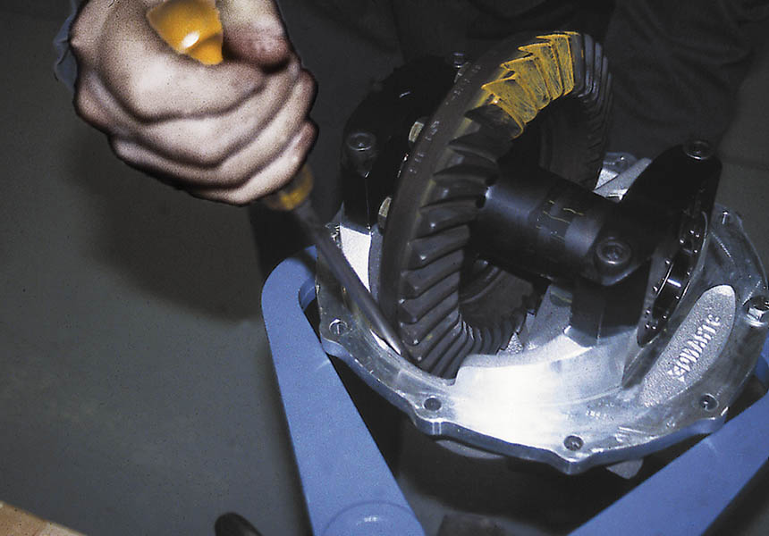
Figure 130.23 Force has to be applied to the ring gear to achieve a proper contact pattern

Slide 53
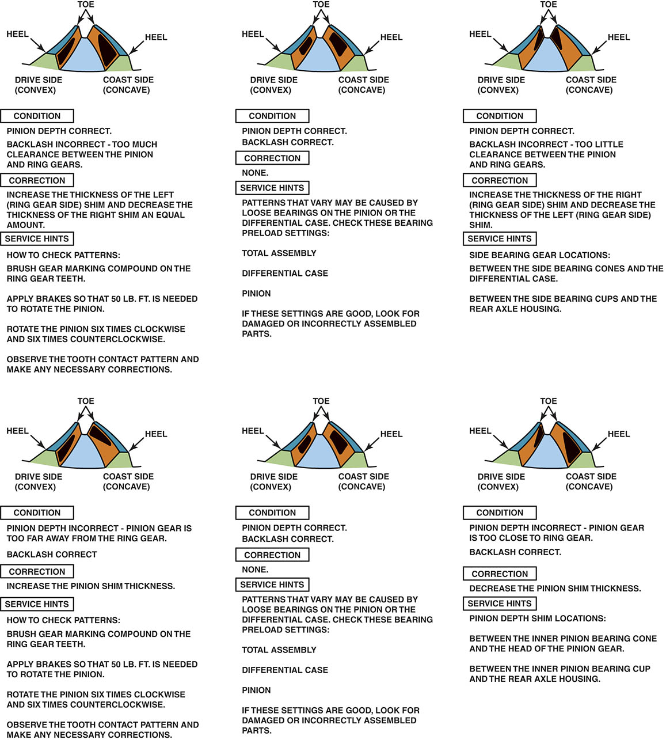
Figure 130.24 Tooth contact pattern

Slide 54
DIFFERENTIAL DISASSEMBLY
Remove the housing cover and drain fluid.
Remove pinon shaft
Push in axles and remove c-clips
Remove axles
Mark and remove side bearing caps
Install spreader and remove carrier case.
Remove pinion shaft nut and washer
Remove pinion flange, seal and front bearing.
Remove pinion gear.

Slide 55
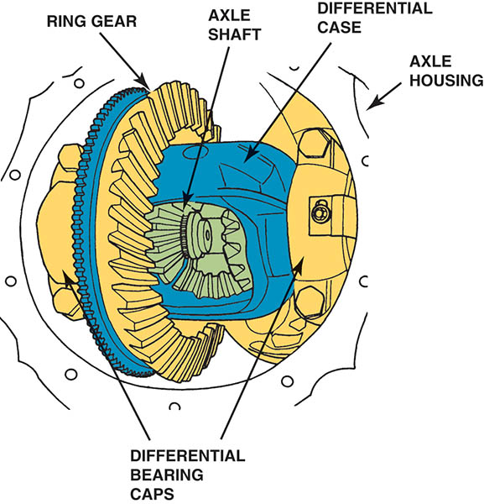
Figure 130.25 Mark the differential bearing caps before removing them to make sure that they are replaced in the same location

Slide 56
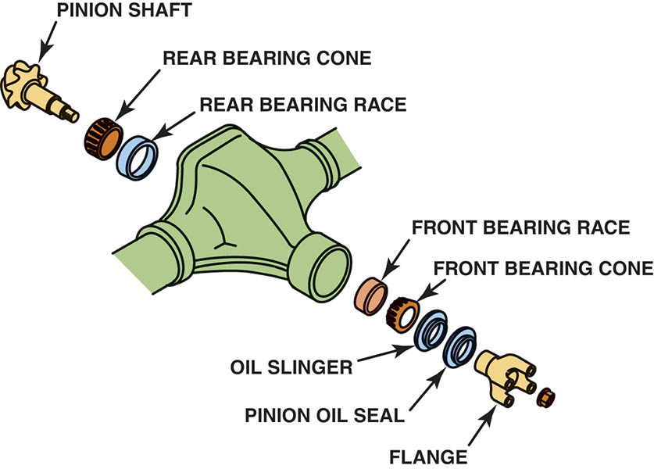
Figure 130.26 Pinion gear and associated parts. The pinion end yoke is also called the pinion flange

Slide 57
PINION SHAFT BEARING REPLACEMENT
The rear pinion shaft bearing (closest to the drive pinion gear) is usually pressed out the drive pinion.
A shim is usually located between the drive pinion gear and the rear drive pinion bearing to properly position the drive pinion in relation to the ring gear.
Two methods are used to ensure proper drive pinion gear preload
  Shims
  Collapsible spacer

Slide 58
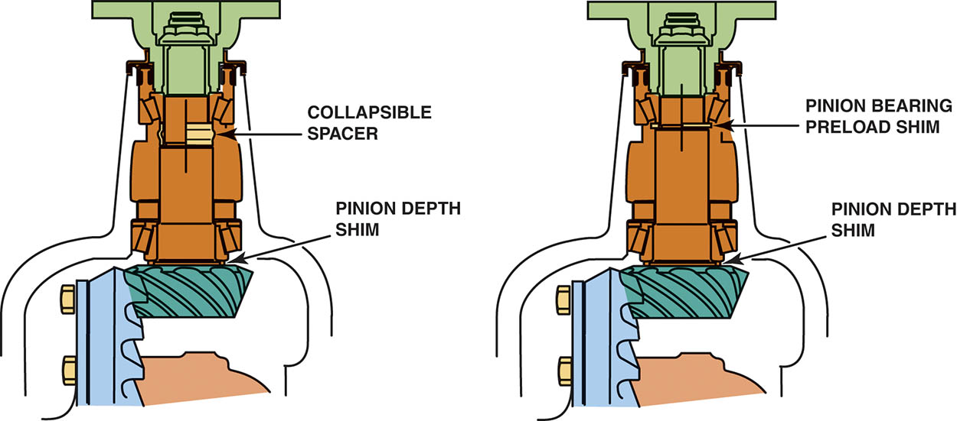
Figure 130.27 The pinion on the left uses a collapsible spacer, and the pinion on the right uses shims to provide the necessary preload to the pinion shaft bearings

Slide 59
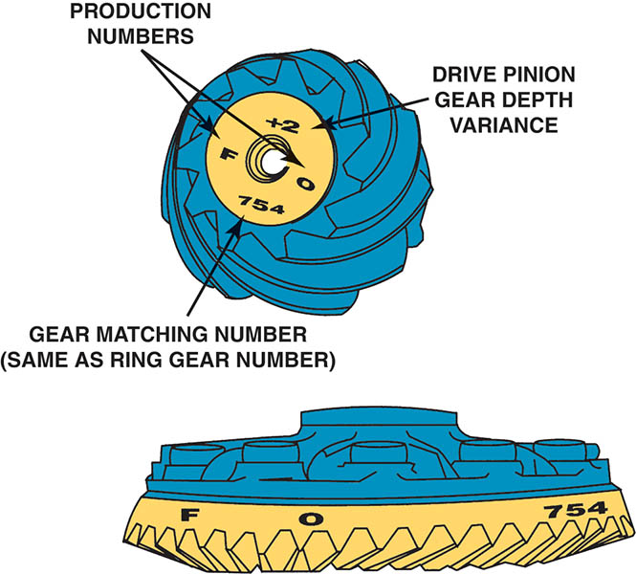
Figure 130.28 The ring and pinion gears are a matched set and are marked for correct pinion depth variance

Slide 60
DRIVE PINION DEPTH
Correct drive pinion depth measurement can be determined in several different ways:
  Wear pattern analysis.
  Plus (+) and minus (−) markings on the drive pinion.
  A gauging set and depth micrometer.

Slide 61
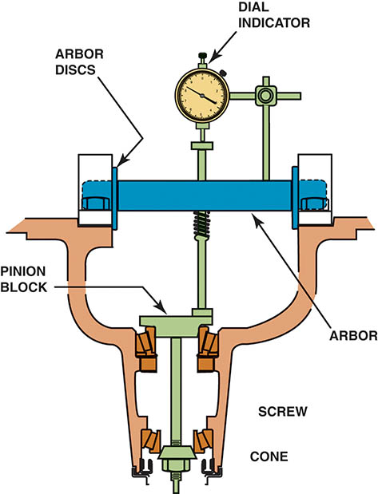
Figure 130.29 Special tool kit used for determining the correct pinion shaft shim thickness

Slide 62
PINION GEAR PRELOAD
A new drive pinion nut should be used and tightened to specifications.
After the nut has been tightened, torque needed to rotate the drive pinion should be measured using a beam-type torque wrench.
The drive pinion nut is then tightened farther until the turning torque is within specifications.

Slide 63
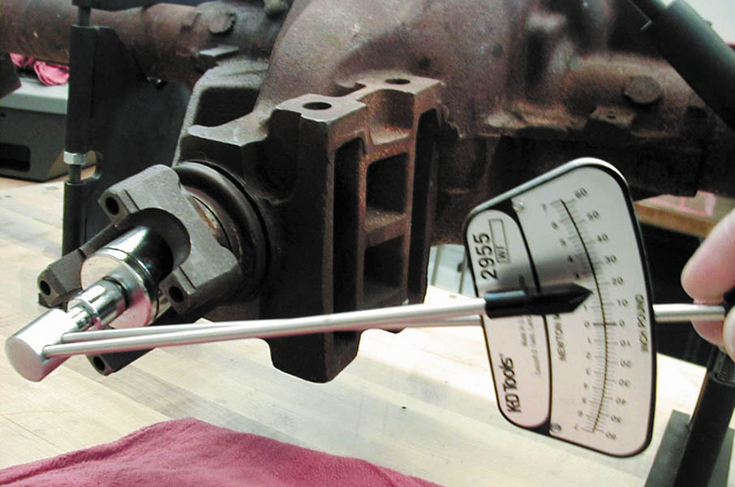
Figure 130.30 Using an inch-pound torque wrench to check the rotating torque of the drive pinion. This procedure is very important if the axle uses a collapsible spacer.

Slide 64
CHECKING AND CORRECTING BACKLASH
A dial indicator is used to measure backlash.
The backlash should be checked at three or four points around the ring gear.
Backlash normally is between 0.005 and 0.008 inch (0.10 and 0.20 mm) for most axle assemblies.
Backlash is corrected by moving the ring gear either closer or farther away from the drive pinion gear.
  Transferring shims from one side of the axle housing to the other.
  Turning threaded adjusters located in the differential housing bores.

Slide 65
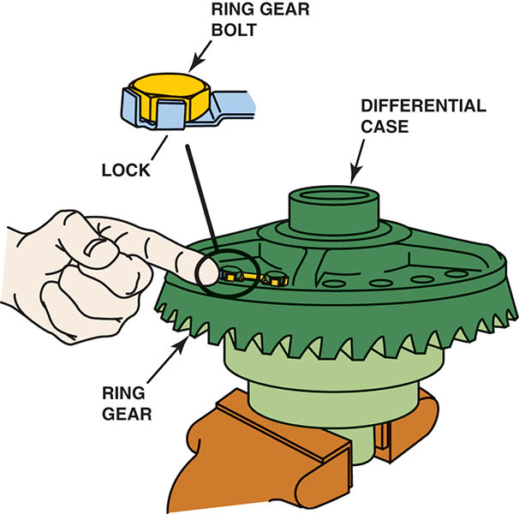
Figure 130.31 If the ring gear has been removed from the differential case or if a new ring gear is being installed, always replace the ring gear bolts

Slide 66
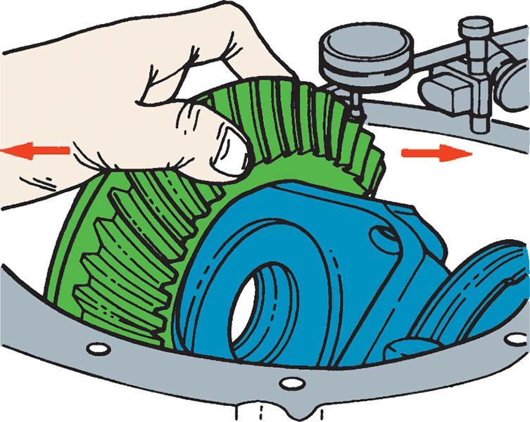
Figure 130.32 Backlash should be between 0.005 and 0.008 inch on most differentials. If the backlash is too great, add shim thickness to the ring gear side and subtract shim thickness from the opposite side

Slide 67
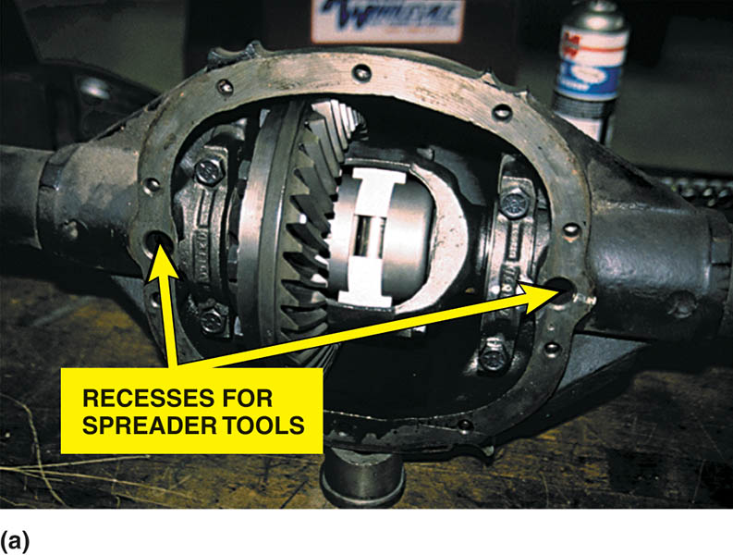
Figure 130.33 (a) Some vehicle manufacturers recommend using a housing spreader tool that fits into the round openings on both sides

Slide 68
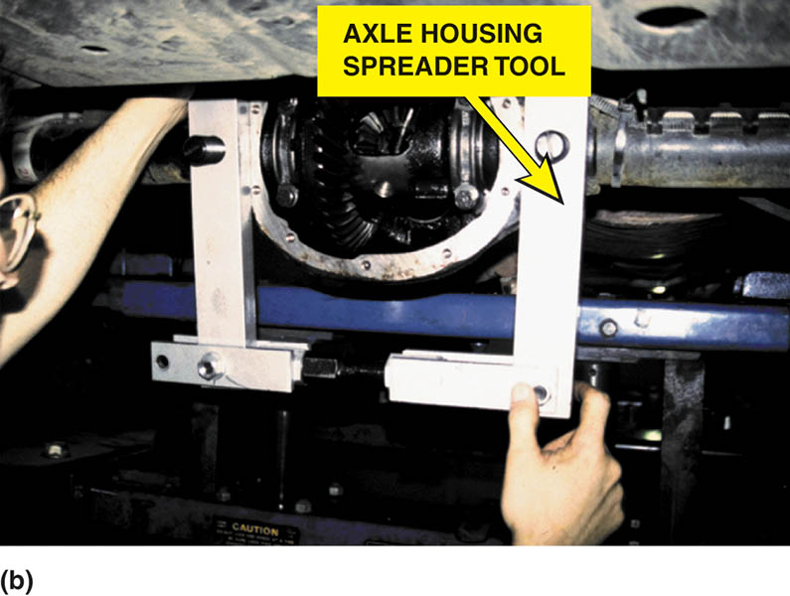
Figure 130.33 (b) The spreader tool being installed. The housing is spread a specified amount and the differential is then installed into the housing

Slide 69
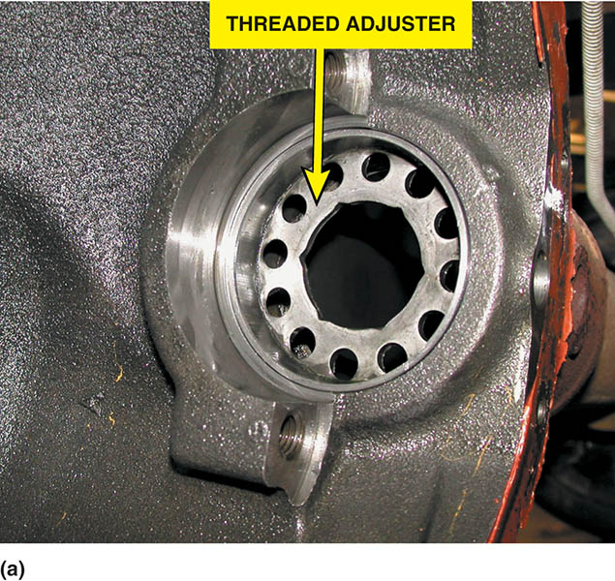
Figure 130.34 (a) Note the hex shape of the threaded adjuster used to adjust side bearing preload and ring gear backlash on a Dodge Dakota truck

Slide 70
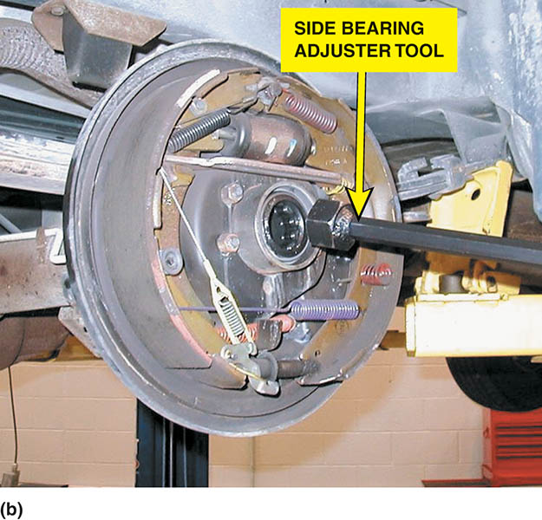
Figure 130.34 (b) A long handled adjuster tool is needed to turn the side bearing adjuster on this truck

Slide 71
SETTING SIDE BEARING PRELOAD
To accomplish the proper preload, thicker shims than were used to set proper backlash are placed between the housing and the differential to provide for the proper preload on the side bearings.
After setting the preload, double-check that the backlash is within specification.

Slide 72
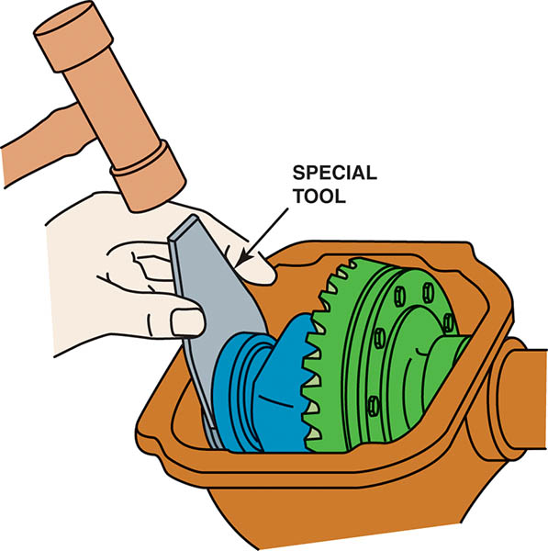
Figure 130.35 On many axles, it is necessary to use a special tool to install steel spacers (shims) to achieve the specified backlash and side bearing preload

Slide 73
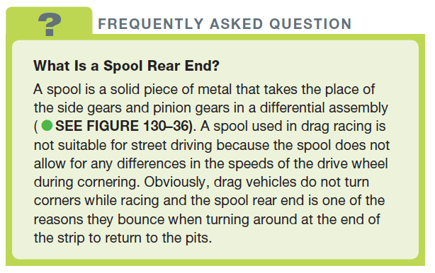
FREQUENTLY ASKED QUESTION

Slide 74
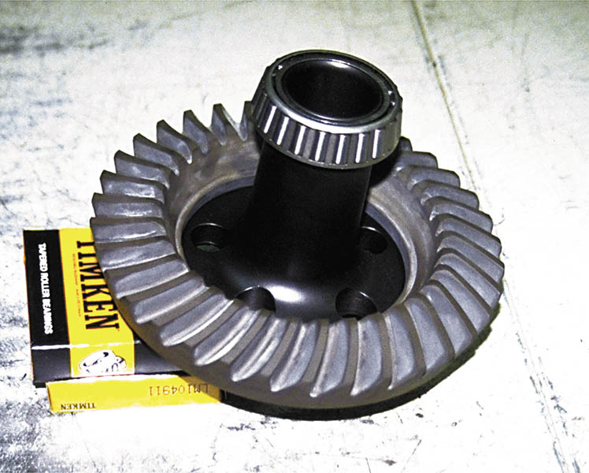
Figure 130.36 A spool used in a rear end for drag racing only

Slide 75
REASSEMBLY OF THE DIFFERENTIAL ASSEMBLY
After the backlash has been checked to be within factory specifications, the axle shafts can be installed.
Install the axle c-clips.
Install the differential cover.
Fill with the correct lubricant.

Slide 76
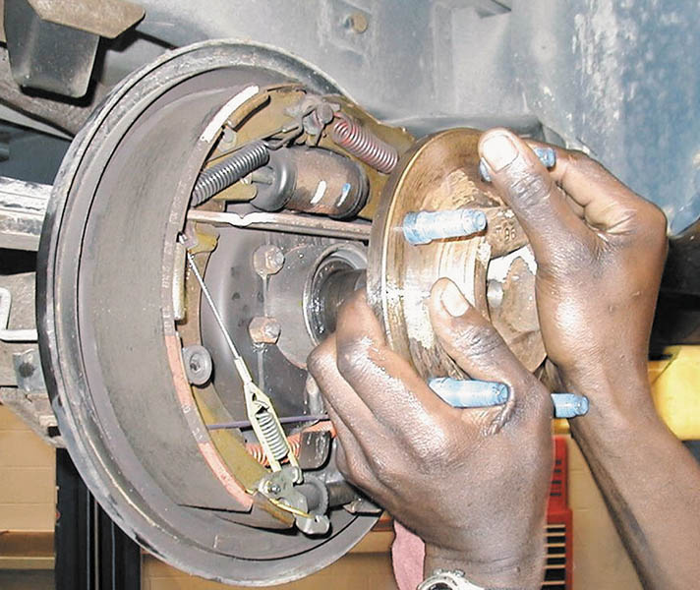
Figure 130.37 Install the axle shaft, being careful to not damage the seal

Slide 77
DIFFERENTIAL LUBRICANT
Because all differentials use hypoid gear sets, a special lubricant is necessary because the gears both roll and slide between their meshed teeth.
Most differentials require:
  SAE 80W-90 GL-5
  SAE 75W-90 GL-5
  SAE 80W GL-5
Limited-slip differentials (often abbreviated LSD) usually use a friction modifier additive.

Slide 78
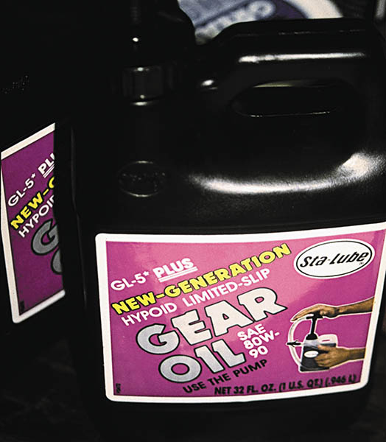
Figure 130.38 A container of GL-5 SAE 80W-90 gear lubricant

Slide 79
QUESTION 3: ?
What is the purpose of the limited slip additive?

Slide 80
ANSWER 3:
To modify the characteristics of the lubricant to prevent chattering on turns.

Slide 81
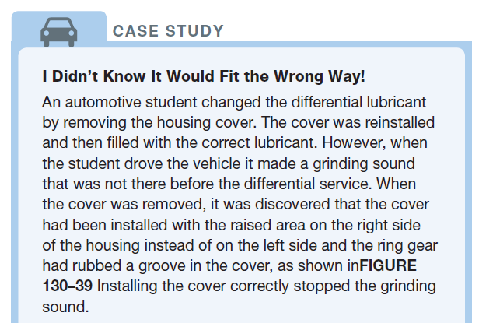
CASE STUDY

Slide 82
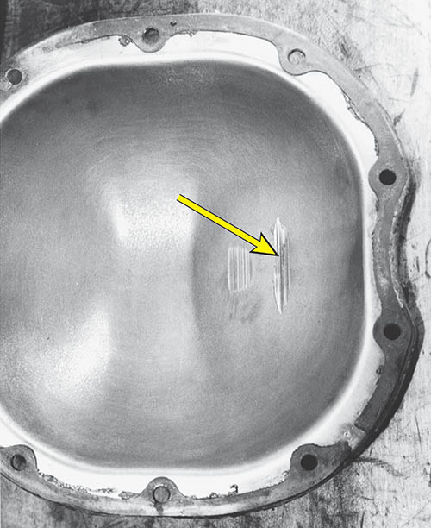
Figure 130.39 The beginning automotive student did not realize that the axle housing cover could fit the wrong way. The only problem was that the ring gear scraped against the cover

Slide 83
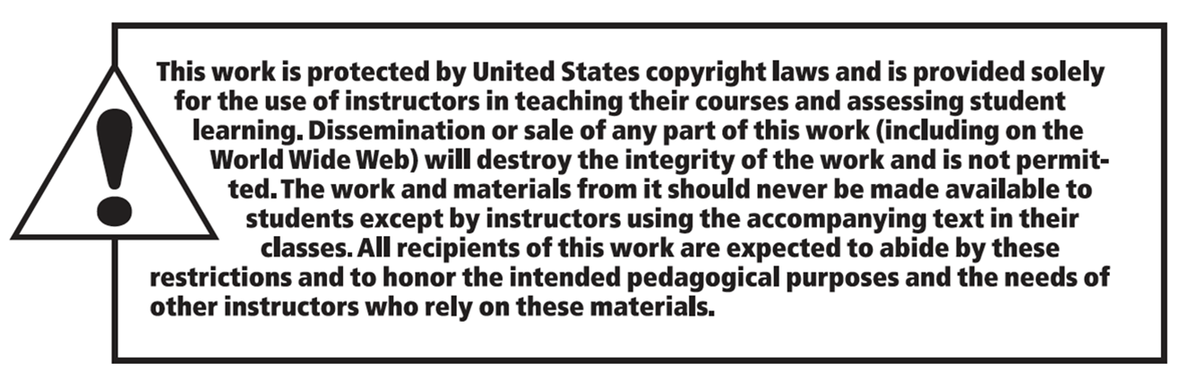
Copyright

