Slide 1

Automotive Technology Principles, Diagnosis, and Service
Sixth Edition
Chapter 129
Drive Shaft and CV Joint Service
Copyright © 2018, 2015, 2011 Pearson Education, Inc. All Rights Reserved

Slide 2
LEARNING OBJECTIVES (1 of 2)
129.1 Explain how to diagnose and inspect a U-joint.
129.2 List the steps necessary to replace a U-joint.
129.3 Explain how to perform a measurement of the working angles of a U-joint.

Slide 3
LEARNING OBJECTIVES (2 of 2)
129.4 Diagnose problems with CV joints and describe the service procedures for replacing CV joints.
129.5 This chapter will help prepare for Suspension and Steering (A4) ASE certification test content area “C” (Related Suspension and Steering Service).

Slide 4
U-JOINT DIAGNOSIS
Symptoms of a Defective U-Joint
Vibration or harshness at highway speed
A clicking sound whenever the vehicle is moving either forward or in reverse
A clunking sound whenever changing gears, such as moving from drive to reverse

Slide 5
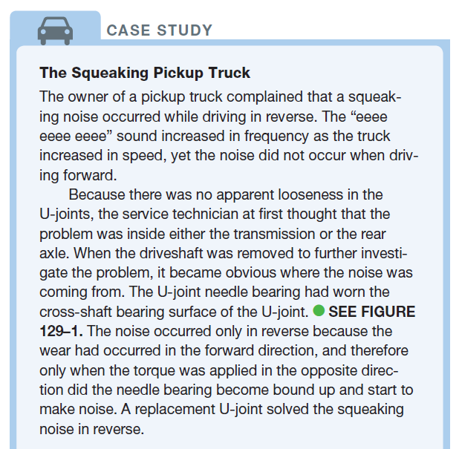
CASE STUDY

Slide 6
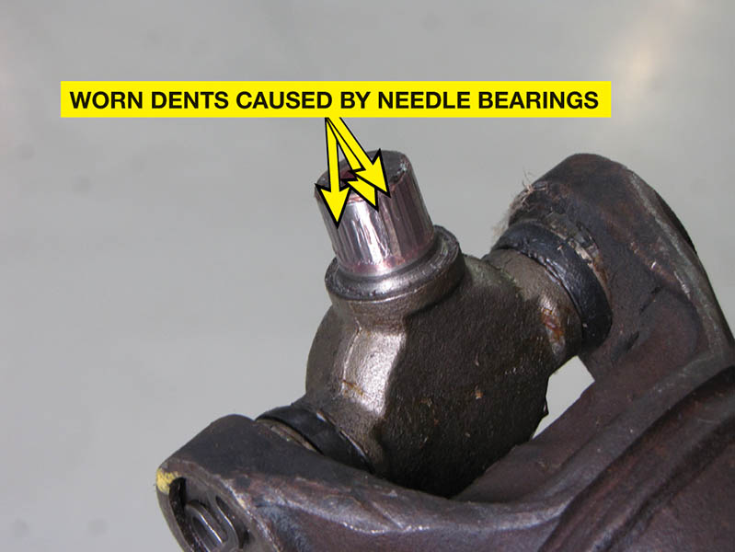
Figure 129.1 Notice how the needle bearings have worn grooves, called Brinelling, into the bearing surface of the U-joint

Slide 7
QUESTION 1: ?
What are the symptoms of a defective u-joint?

Slide 8
ANSWER 1:
A vibration, a clicking noise or a clunking noise.

Slide 9
DRIVE SHAFT AND U-JOINT INSPECTION
The driveshaft should be inspected for the following:
Any dents or creases caused by impact
Undercoating, grease, or dirt buildup on the driveshaft
Any movement of the U-joints
To inspect U-joints, move each joint through its full travel

Slide 10
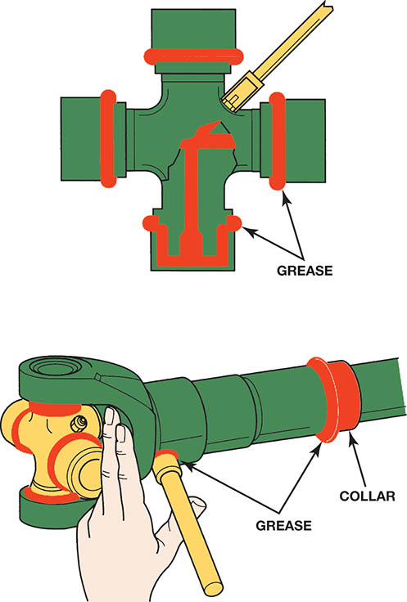
Figure 129.2 All U-joints and spline collars equipped with a grease fitting should be greased four times a year as part of a regular lubrication service

Slide 11
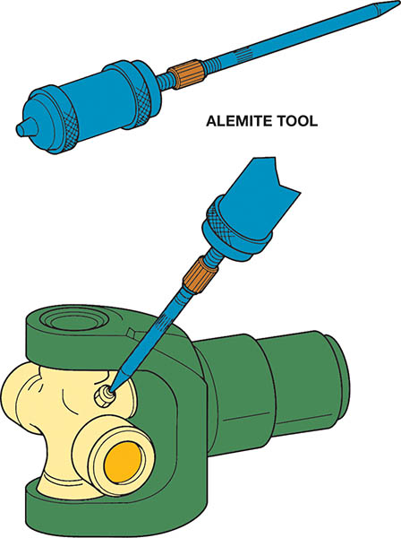
Figure 129.3 Many U-joints require a special grease gun tool to reach the grease fittings

Slide 12
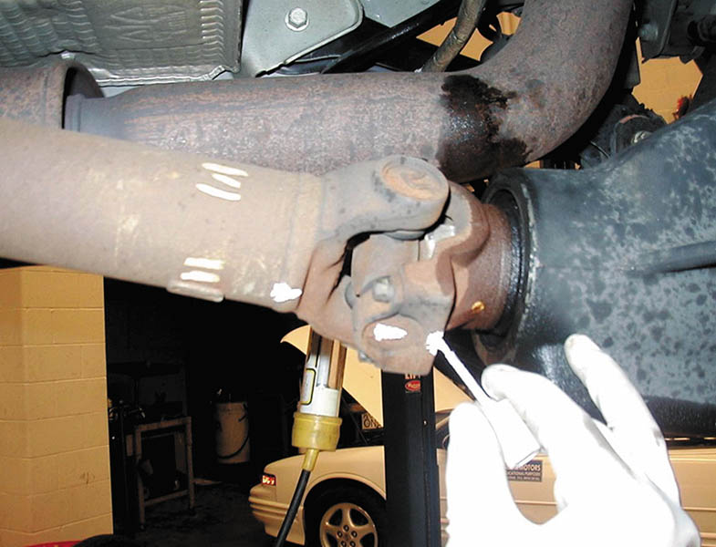
Figure 129.4 Always mark the original location of U-joints before disassembly

Slide 13
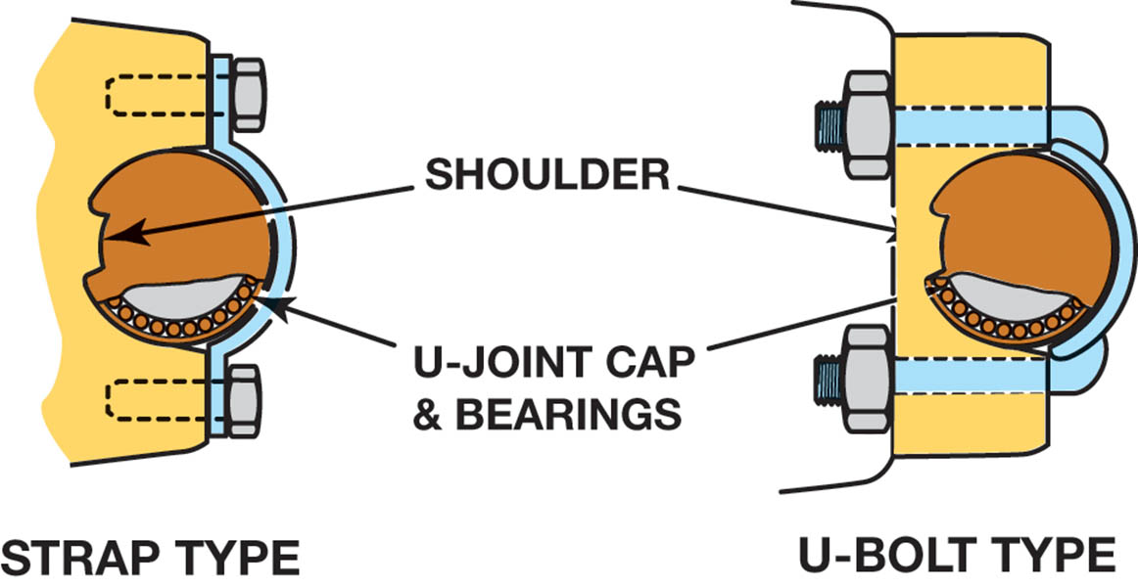
Figure 129.5 Two types of retaining methods that are commonly used at the rear U-joint at the differential

Slide 14
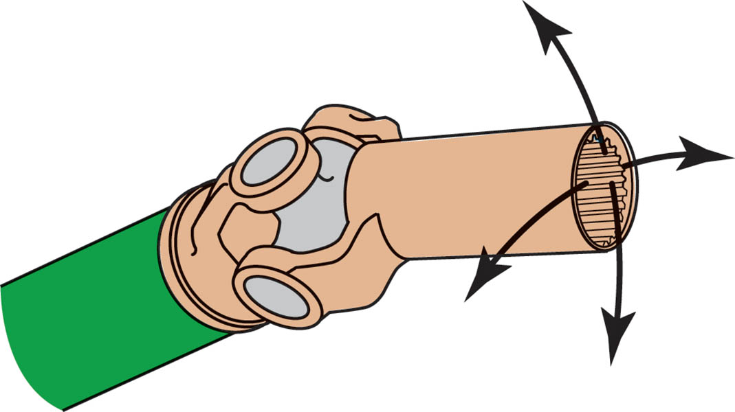
Figure 129.6 The best way to check any U joint is to remove the driveshaft from the vehicle and move each joint in all directions. A good U-joint should be free to move without binding

Slide 15
U-JOINT REPLACEMENT
Three types of retainers are used to keep the bearing caps on the U-joints: the outside snap ring, the inside retaining ring, and injected synthetic (usually nylon).
After removing the retainers, use a press or a vise to separate the U-joint from the yoke.
After removing any dirt or burrs from the yoke, press in a new U-joint.
Rotate the new joint after installation to make sure it moves freely, without binding or stiffness.

Slide 16
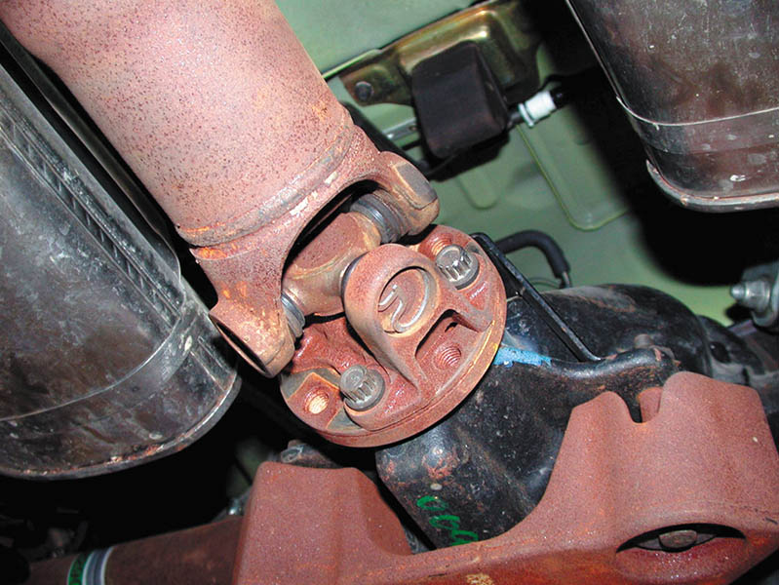
Figure 129.7 Typical U-joint that uses an outside snap ring. This style of joint bolts directly to the companion flange that is attached to the pinion gear in the differential

Slide 17
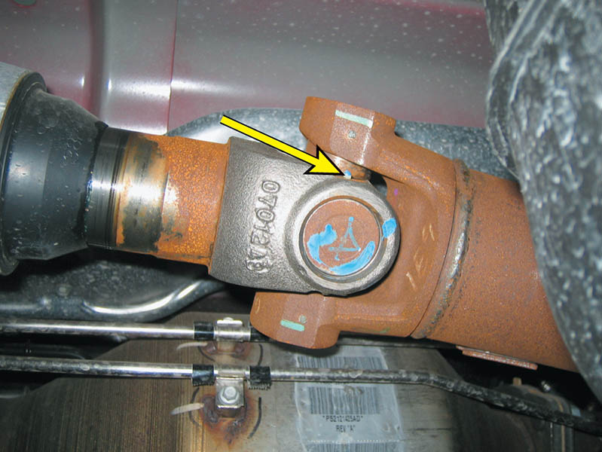
Figure 129.8 A U-joint that is held together by nylon and usually requires that heat be applied to remove from the yoke

Slide 18
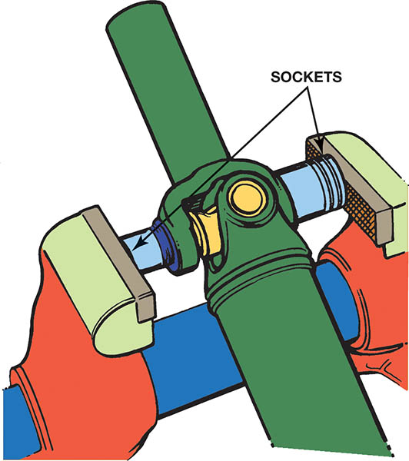
Figure 129.9 Use a vise and two sockets to remove a U-joint. One socket fits over the bearing cup and the other fits on the bearing to press-fit the cups from the crosspiece

Slide 19
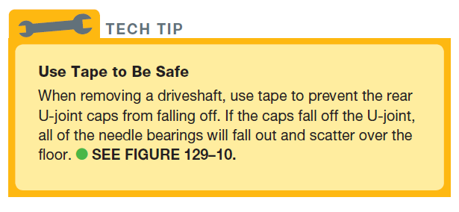
Tech Tip

Slide 20
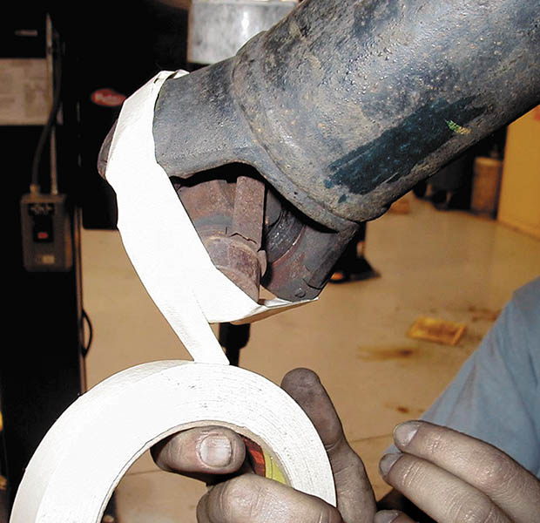
Figure 129.10 Taping the U-joint to prevent the caps from coming off

Slide 21
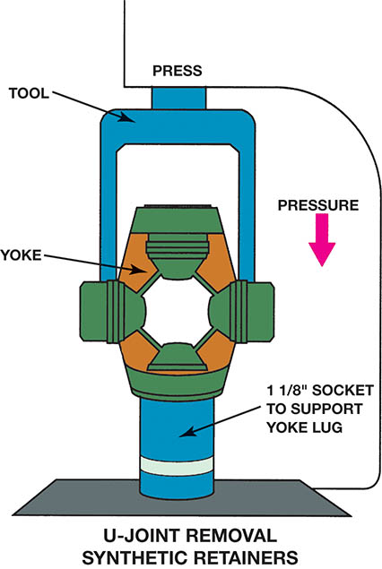
Figure 129.11 A special tool being used to press apart a U-joint that is retained by injected plastic. Heat from a propane torch may be necessary to soften the plastic to avoid exerting too much force on the U-joint

Slide 22
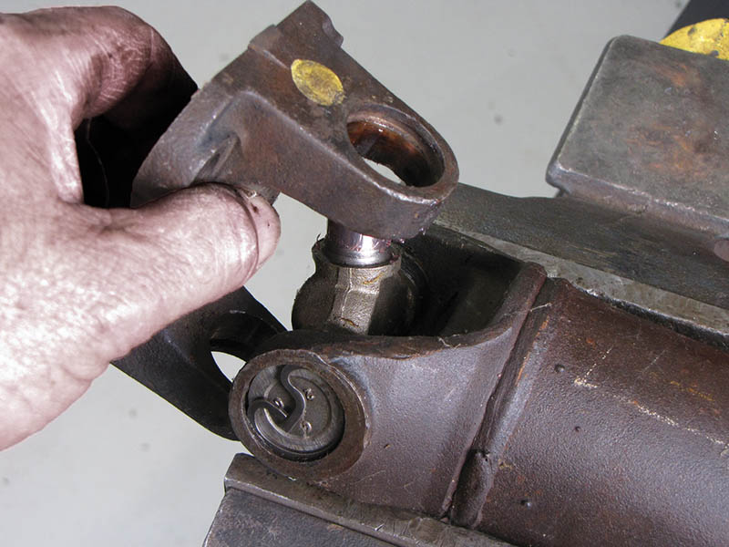
Figure 129.12 Removing the worn cross from the yoke

Slide 23
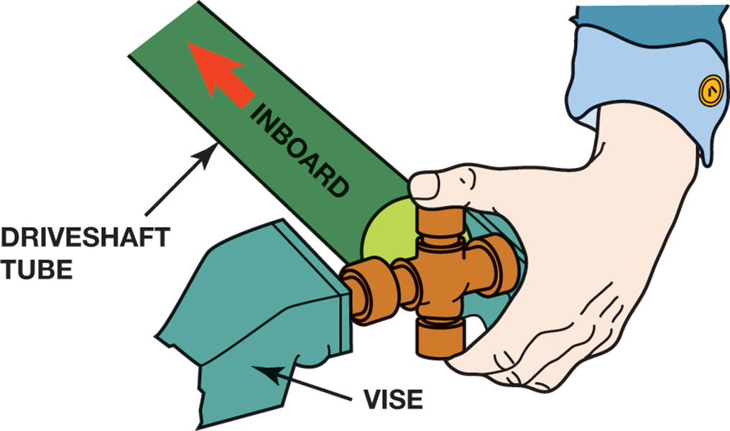
Figure 129.13 When installing a new U-joint, position the grease fitting on the inboard side (toward the driveshaft tube) and in alignment with the grease fitting of the U-joint at the other end

Slide 24
U-JOINT WORKING ANGLES
Unequal or incorrect U-joint working angles can cause severe vibrations. Driveshaft and U-joint angles may change from the original factory setting due to one or more of the following:
Defective or collapsed engine or transmission mounts
Defective or sagging springs, especially the rear springs due to overloading or other causes
Accident damage or other changes to the chassis of the vehicle
Vehicle modification that raises or lowers the ride height

Slide 25
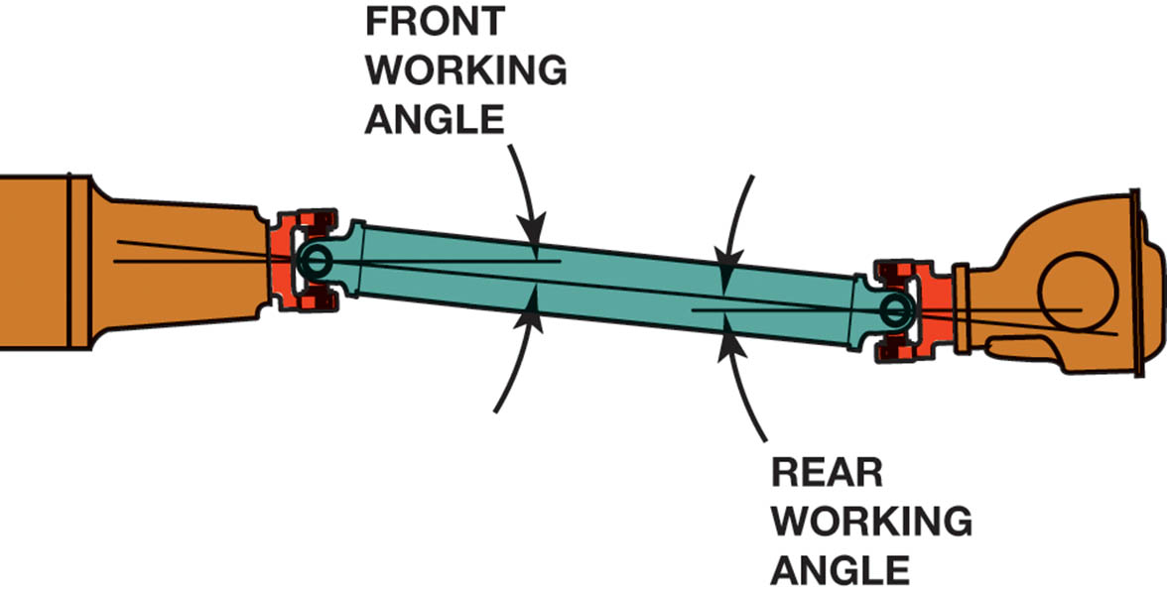
Figure 129.14 The working angle of most U-joints should be at least 1/2 degree (to permit the needle bearing to rotate in the U-joints) and should not exceed 3 degrees or a vibration can occur in the driveshaft, especially at higher speeds. The difference between the front and rear working angles should be within 1/2 degree of each other

Slide 26
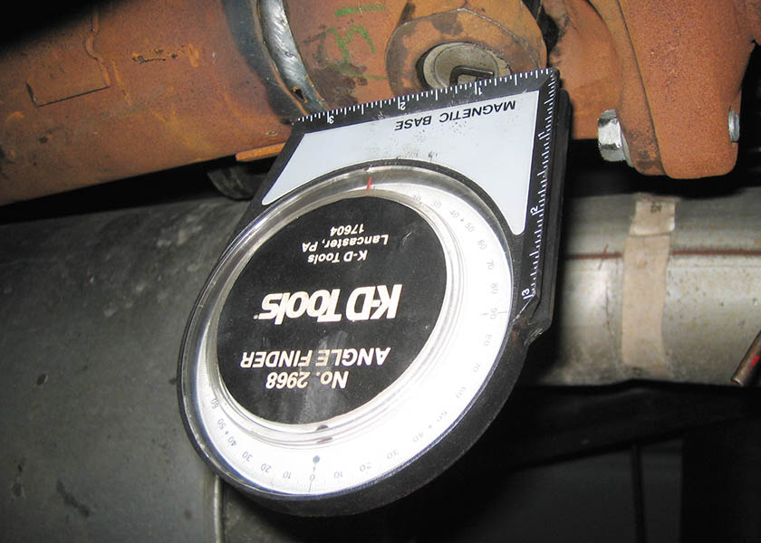
Figure 129.15 An inclinometer with a magnetic base is being used to measure the angle of the driveshaft at the rear U joint

Slide 27
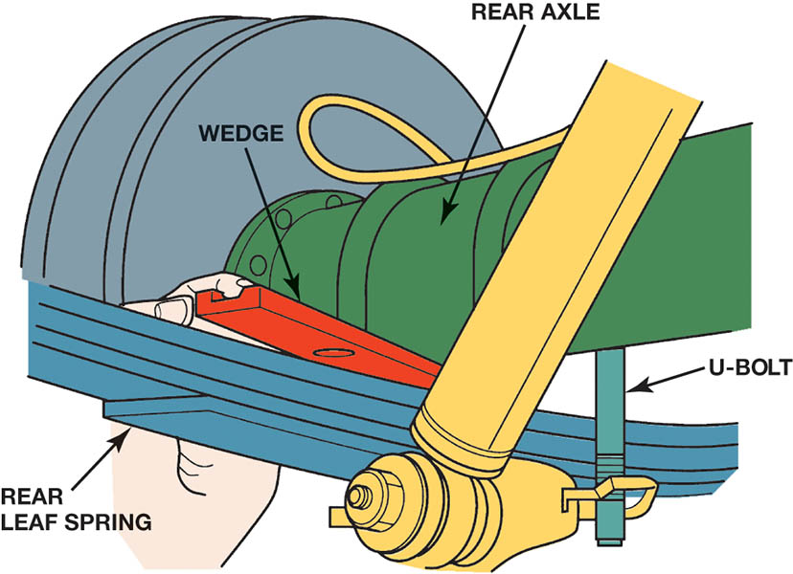
Figure 129.16 Placing a tapered metal wedge between the rear leaf spring and the rear axle pedestal to correct rear U-joint working angles

Slide 28
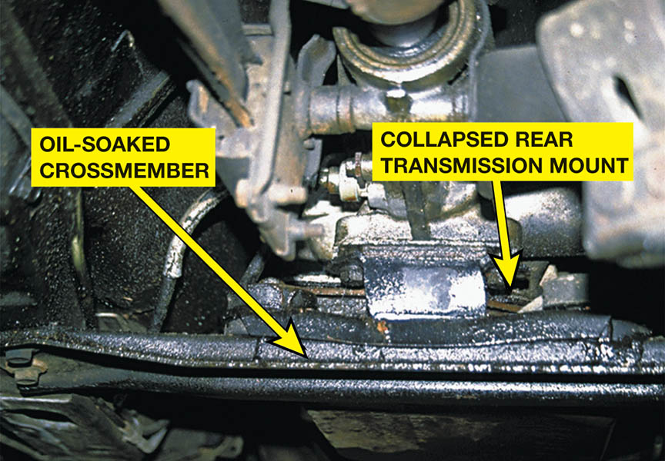
Figure 129.17 A transmission oil pan gasket leak allowed automatic transmission fluid (ATF) to saturate the rear transmission mount rubber, causing it to collapse. After replacing the defective mount, proper driveshaft angles were restored and the driveline vibration was corrected

Slide 29
QUESTION 2: ?
What is the allowable difference in working angles between the front and rear u-joint?

Slide 30
ANSWER 2:
½ degree.

Slide 31
CV JOINT DIAGNOSIS
When a CV joint wears or fails, the most common symptom is noise while driving.
An outer fixed CV joint will most likely be heard when turning sharply and accelerating at the same time.
This noise is usually a clicking sound.

Slide 32
REPLACEMENT SHAFT ASSEMBLIES
In many places the standard repair procedure is the replacement of the entire drive assembly if there is a CV joint failure.
It is felt that even a slight amount of dirt or water inside a CV joint is unacceptable.

Slide 33
CV JOINT SERVICE
Remove the front wheel and hub nut.
Disconnect the knuckle to allow enough room to move outward enough to remove the drive axle shaft.
Remove the axle from the hub bearing.
Remove the inner joint from the transaxle.
Disassemble, clean and inspect all components.
Replace the entire joint if there are any worn parts.
Reinstall the drive axle shaft in the reverse order of removal.

Slide 34
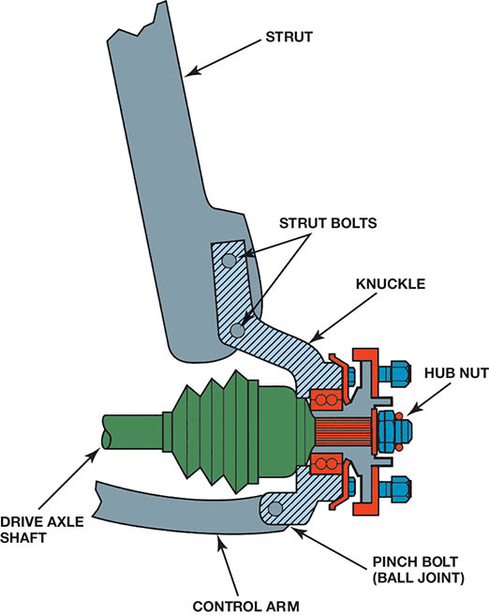
Figure 129.18 The hub nut must be removed before the hub bearing assembly or drive axle shaft can be removed from the vehicle

Slide 35
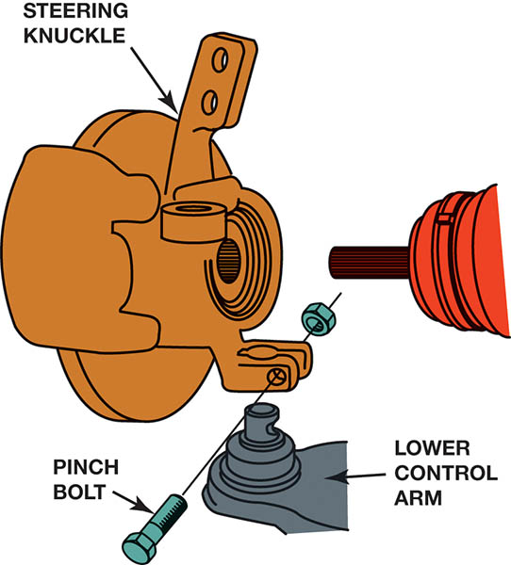
Figure 129.19 Many knuckles are attached to the ball joint on the lower control arm by a pinch bolt

Slide 36
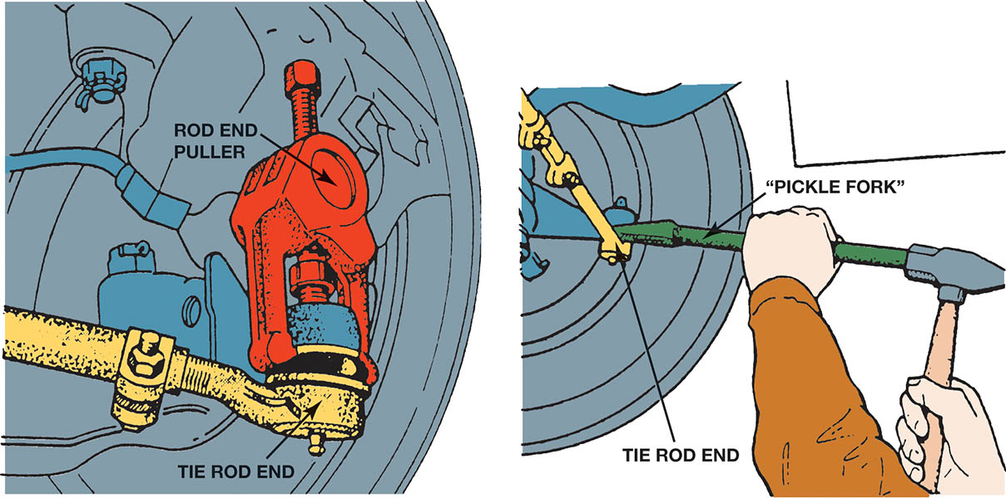
Figure 129.20 The preferred method for separating the tie rod end from the steering knuckle is to use a puller such as the one shown. A “pickle-fork”-type tool should be used only if the tie rod is going to be replaced.

Slide 37
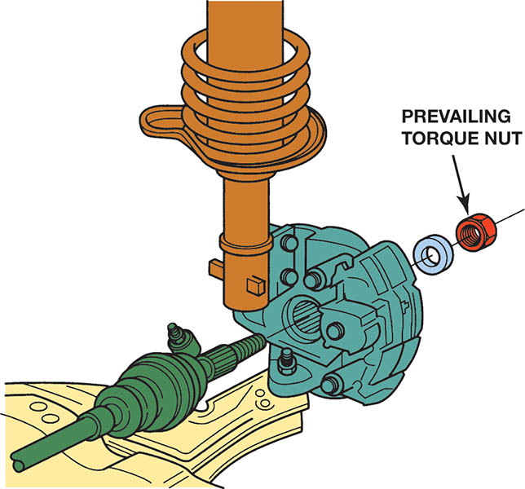
Figure 129.21 Many drive axles are retained by prevailing torque nut that must not be reused. Prevailing torque nuts are slightly deformed or contain a plastic insert that holds the nut tight (retains the torque) to the shaft without loosening

Slide 38
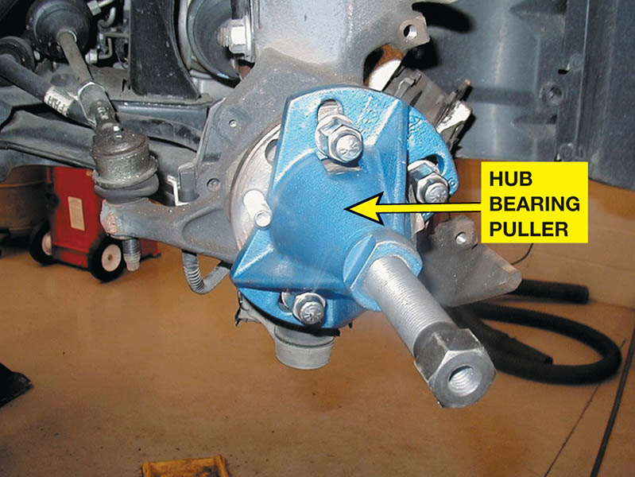
Figure 129.22 A special General Motors tool is being used to separate the drive axle shaft from the wheel hub bearing

Slide 39
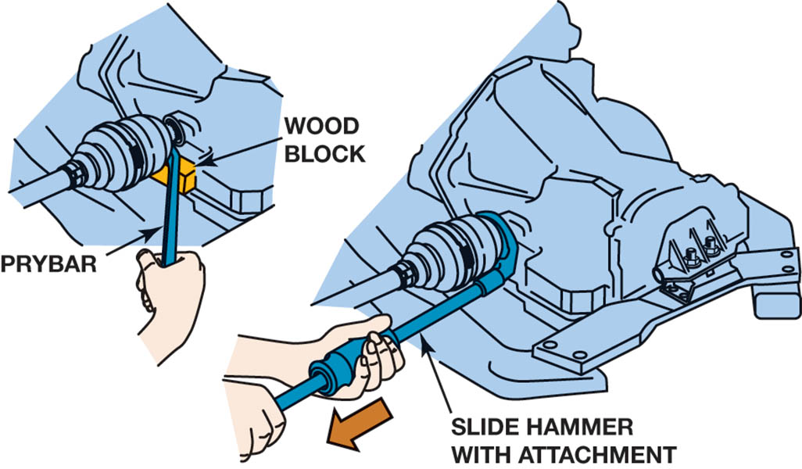
Figure 129.23 Most inner CV joints can be separated from the transaxle with a prybar

Slide 40
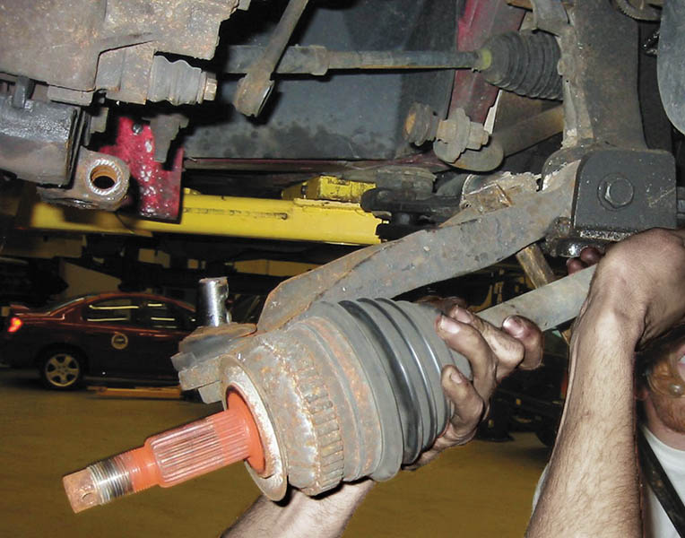
Figure 129.24 When removing a drive axle shaft assembly, use care to avoid pulling the plunge joint apart

Slide 41
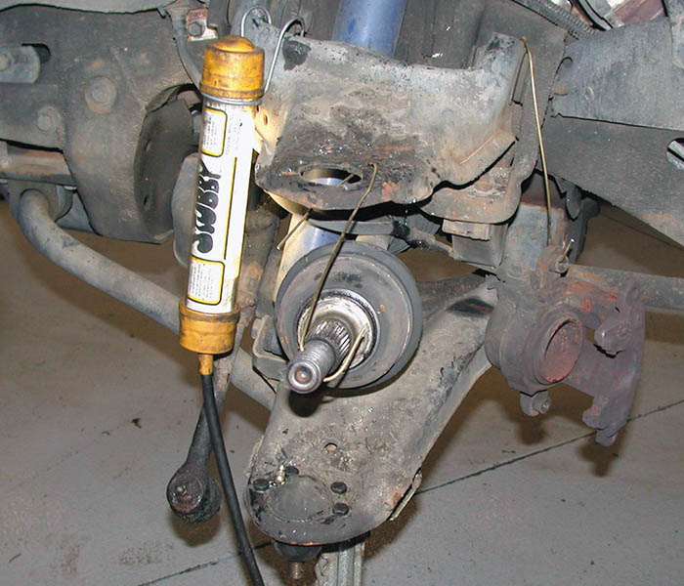
Figure 129.25 If other service work requires that just one end of the drive axle shaft be disconnected from the vehicle, be sure that the free end is supported to prevent damage to the protective boots or allowing the joint to separate

Slide 42
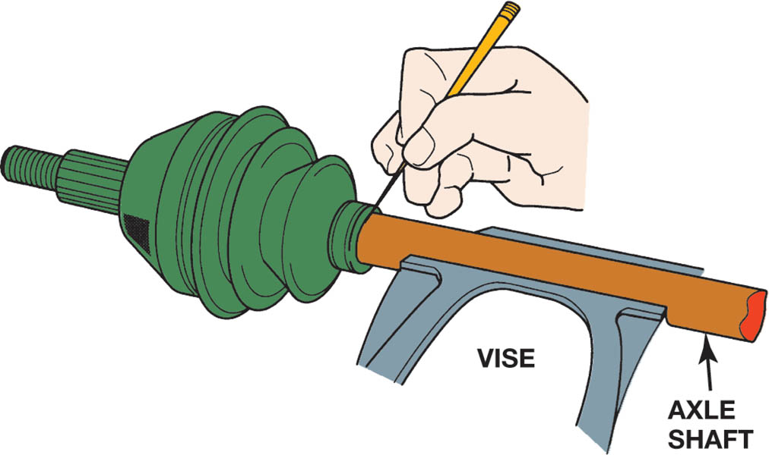
Figure 129.26 With a scribe, mark the location of the boots before removal. The replacement boots must be in the same location

Slide 43
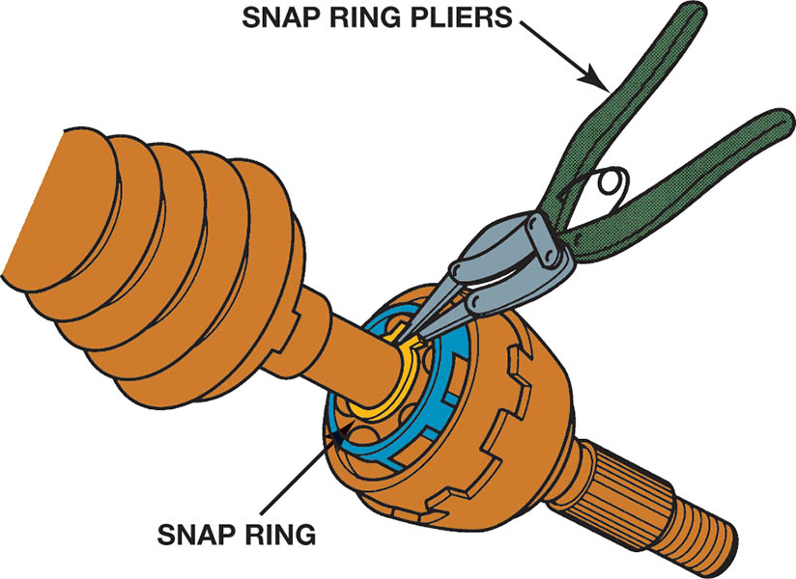
Figure 129.27 Most CV joints use a snap ring to retain the joint on the drive axle shaft

Slide 44
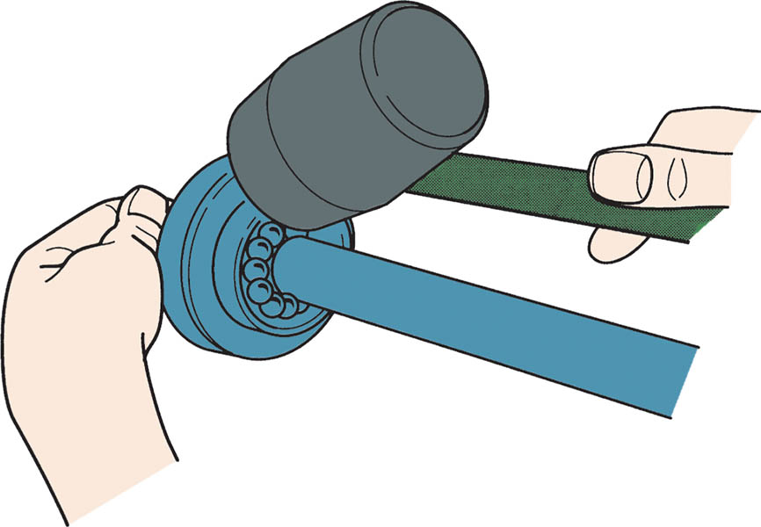
Figure 129.28 After releasing the snap ring, most CV joints can be tapped off the shaft using a brass or shot-filled plastic (dead blow) hammer

Slide 45
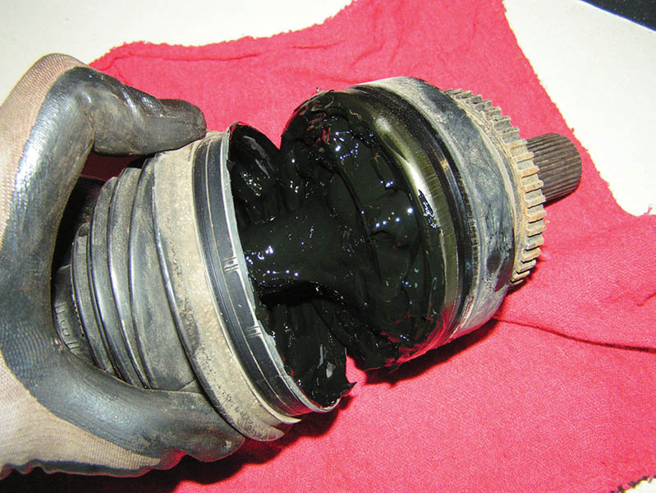
Figure 129.29 Typical outer CV joint after removing the boot and the joint from the drive axle shaft. This joint was removed from the vehicle because a torn boot was found. After disassembly and cleaning, this joint was found to be OK and was put back into service.

Slide 46
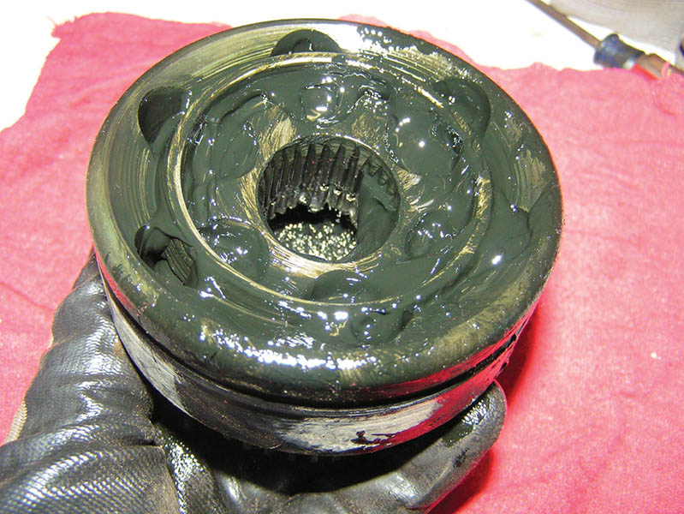
Figure 129.31 Be sure to use all of the grease supplied with the replacement joint or boot kit. Use only the grease supplied and do not use substitute grease

Slide 47
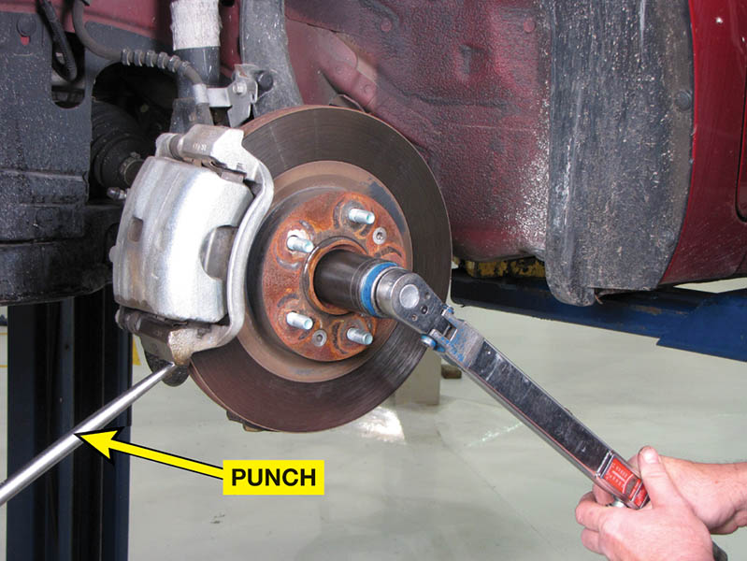
Figure 129.32 A punch being used to keep the rotor from rotating while torqueing the axle shaft spindle nut

Slide 48
QUESTION 3: ?
What is a symptom of a defective outer CV joint?

Slide 49
ANSWER 3:
A clicking noise on turns.

Slide 50
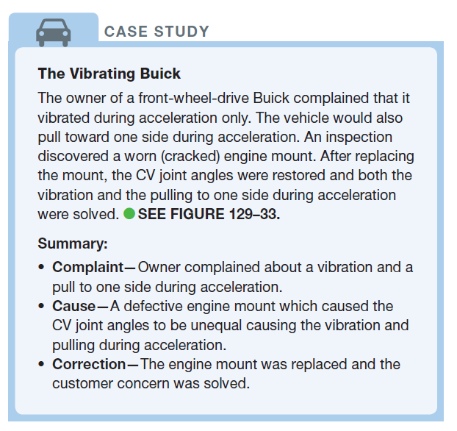
CASE STUDY

Slide 51
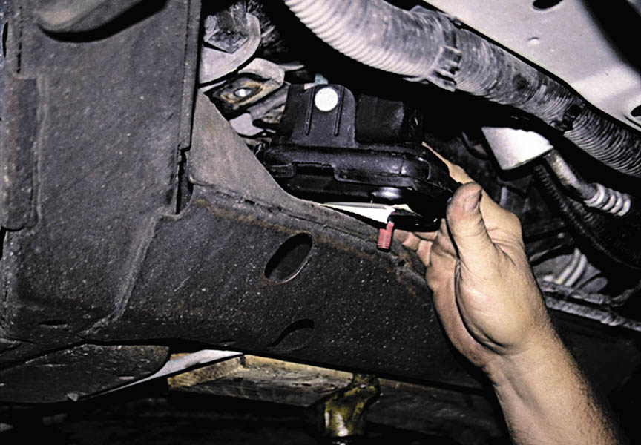
Figure 129.33 The engine had to be raised higher to get the new (non-collapsed) engine mount installed

Slide 52
Drive Axle Shaft Replacement

Slide 53
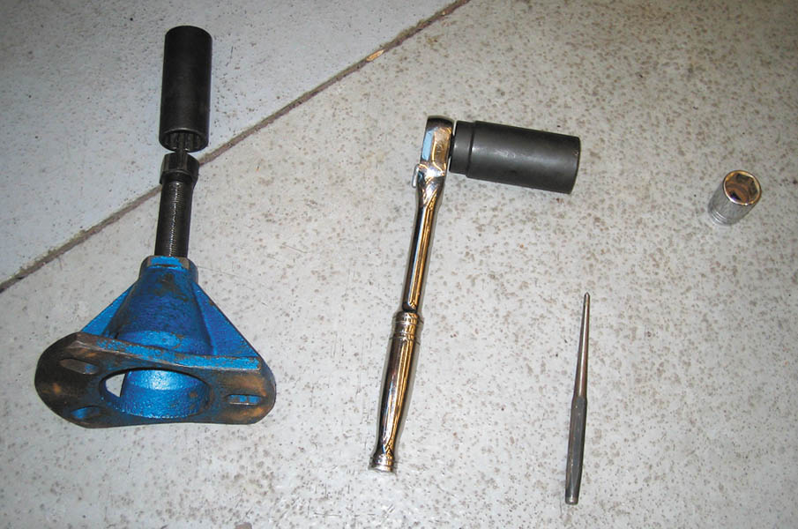
1 Tools needed to replace a drive axle shaft on a General Motors vehicle include a drift, sockets, plus a prybar bearing/axle shaft special tool.

Slide 54
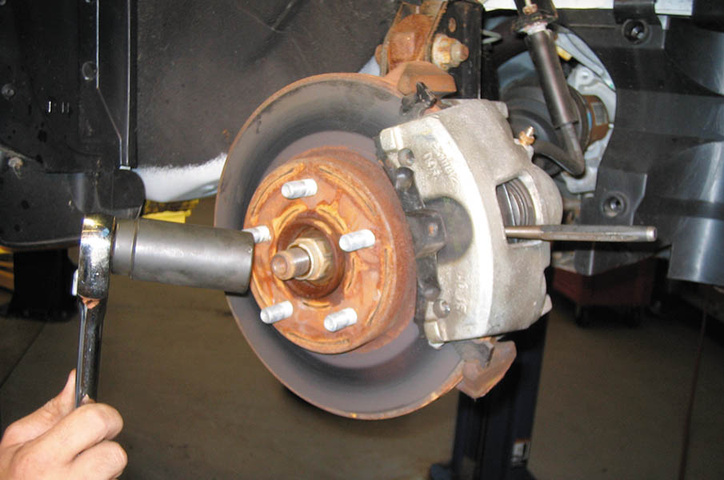
2 The drive axle shaft retaining nut can be loosened with the tire on the ground, or use a drift inserted into the rotor cooling fins before removing the nut.

Slide 55
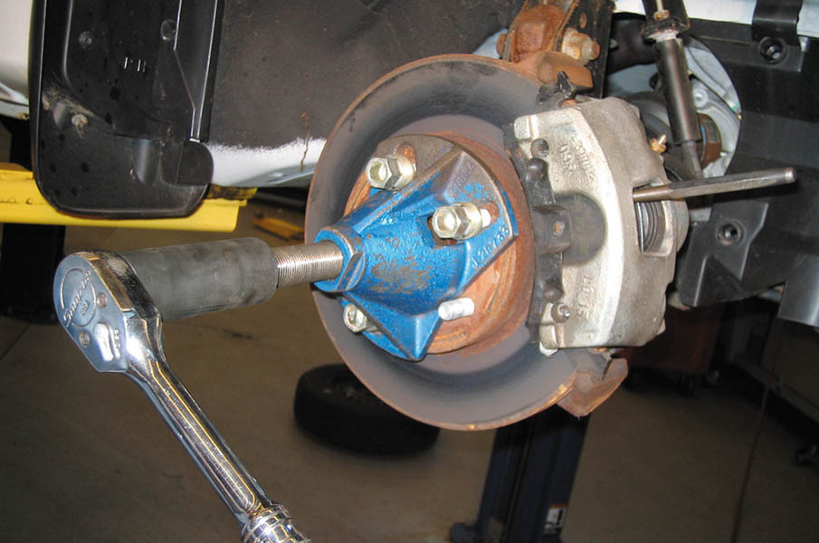
3 Using a special tool to push the drive axle splines from the bearing assembly.

Slide 56
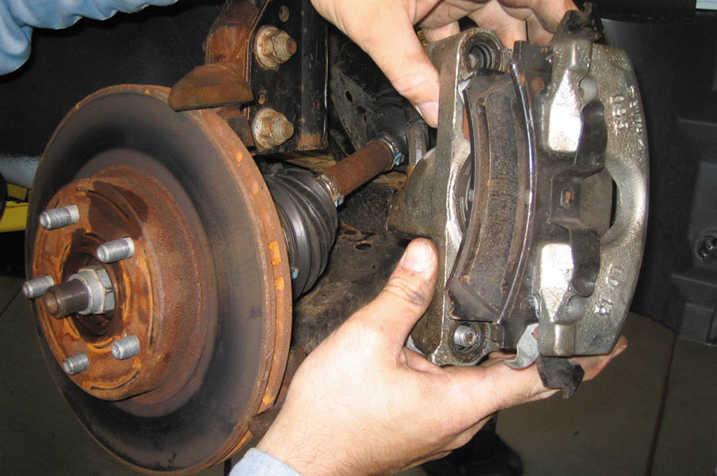
4 Remove the disc brake caliper and support it out of the way. Then, remove the disc brake rotor.

Slide 57
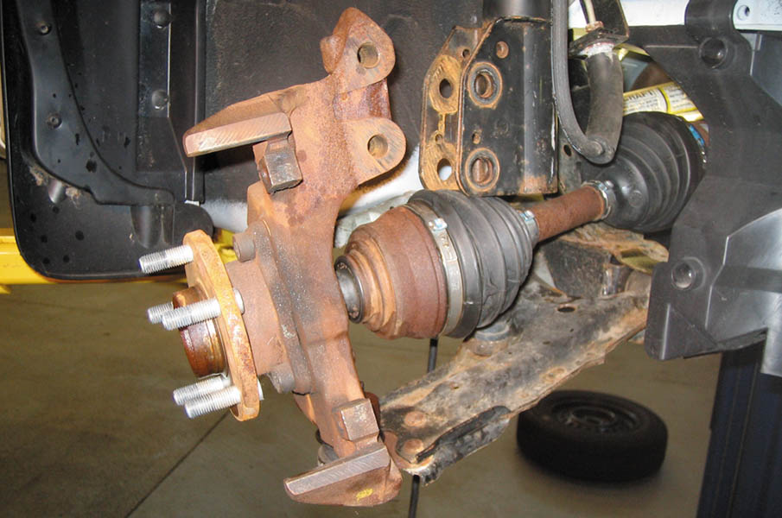
5 The lower ball joint could have been removed instead of disconnecting the strut from the knuckle so that the alignment could be retained.

Slide 58
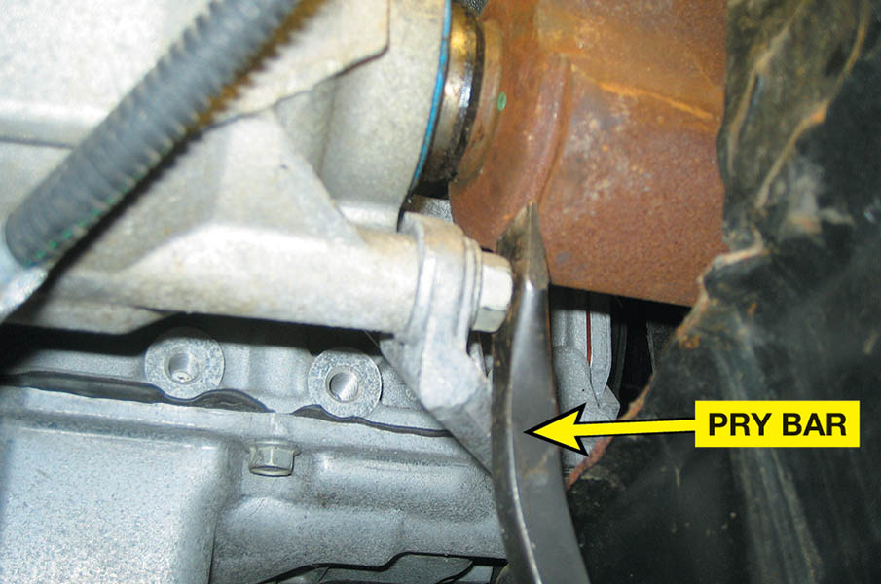
6 A prybar is used to separate the inner drive axle shaft joint from the transaxle.

Slide 59
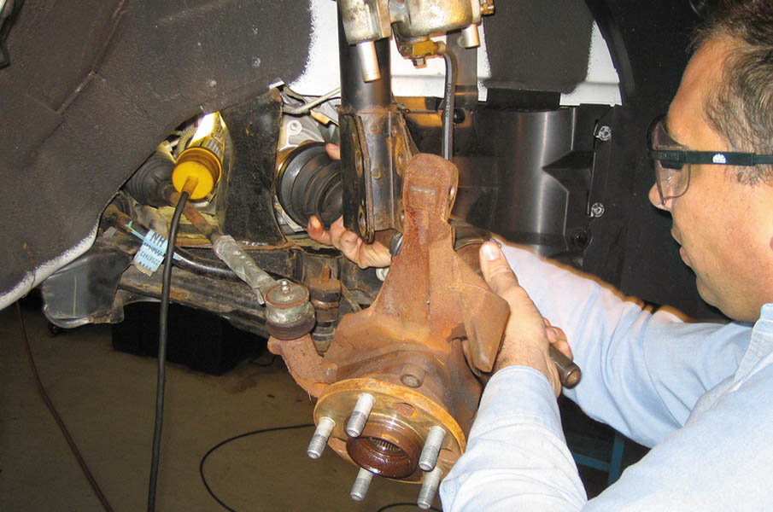
7 After the inner joint splines have been released from the transaxle, carefully remove the drive axle shaft assembly from the vehicle.

Slide 60
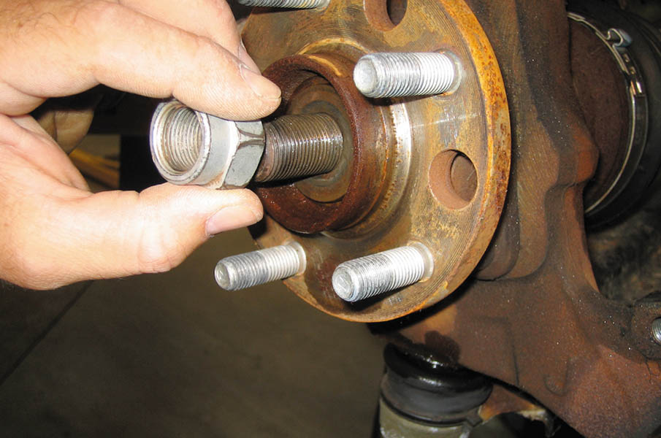
8 To install, reverse the disassembly procedure and be sure to install the washer under the retainer-nut, and always use a new prevailing torque nut.

Slide 61
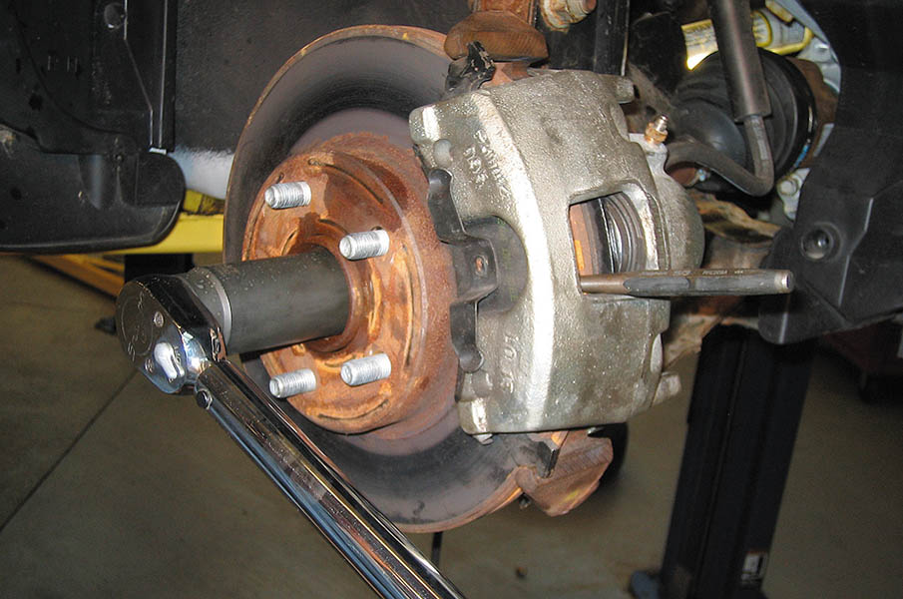
9 Reinstall the disc brake rotor and caliper and then torque the drive axle shaft retaining nut to factory specifications.

Slide 62
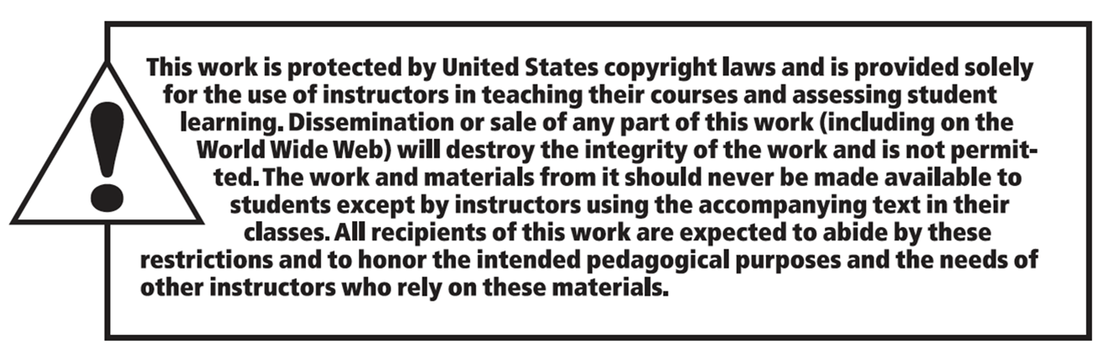
Copyright

