Slide 1

Automotive Technology Principles, Diagnosis, and Service
Sixth Edition
Chapter 128
Drive Shafts and CV Joints
Copyright © 2018, 2015, 2011 Pearson Education, Inc. All Rights Reserved

Slide 2
LEARNING OBJECTIVES
128.1 Describe driveshaft design and balance.
128.2 Describe the function and operation of U-joints.
128.3 Discuss the two types of CV joints and how they work.

Slide 3
DRIVESHAFTS
Purpose and Function
  A drive shaft transmits engine torque from the transmission or transaxle (if front-wheel drive) to the rear axle assembly or drive wheels.
Driveshaft Design
  Most drive shafts are constructed of hollow steel tubing.
  Some vehicle manufacturers use aluminum drive shafts.
  Composite-material drive shafts are also used in some vehicles.

Slide 4
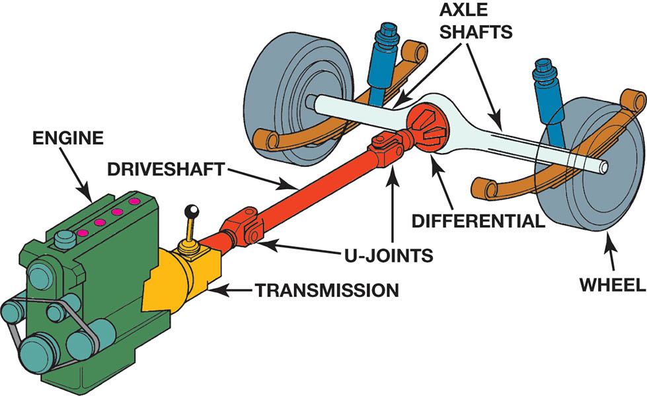
Figure 128.1 Typical rear-wheel-drive powertrain arrangement. The engine is mounted longitudinal (lengthwise)

Slide 5
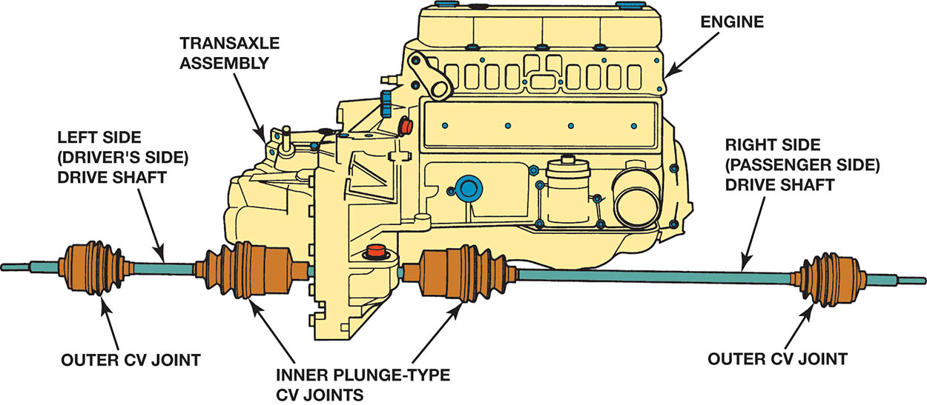
Figure 128.2 On a rear wheel drive vehicle, the drive shaft transmits engine torque from the transmission to the rear axle assembly and drive wheels. On a front-wheel-drive vehicle drive shafts (also called axle shafts) transmit torque from the transaxle to each of the front drive wheels

Slide 6
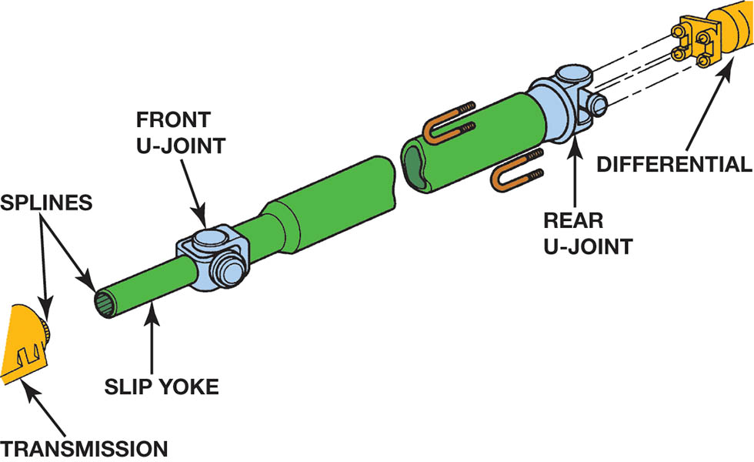
Figure 128.3 Typical driveshaft (also called a propeller shaft). The driveshaft transfers engine power from the transmission to the differential

Slide 7
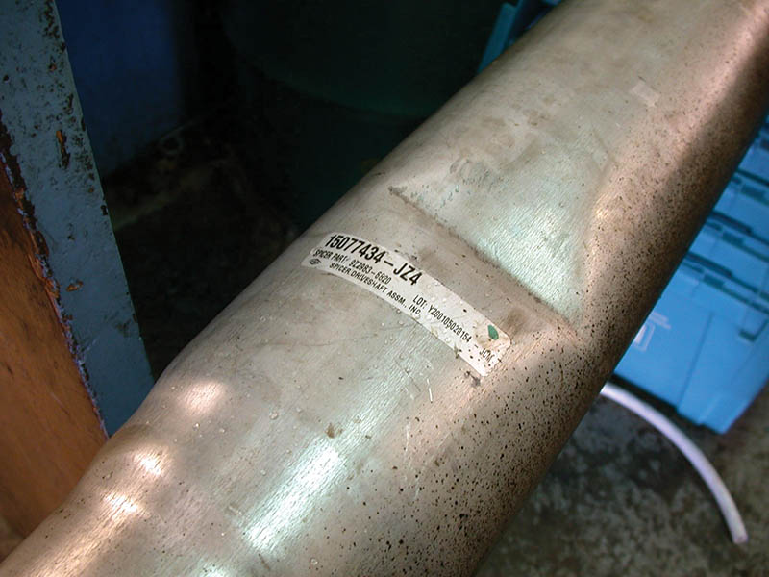
Figure 128.4 This driveshaft was found to be dented during a visual inspection and has to be replaced

Slide 8
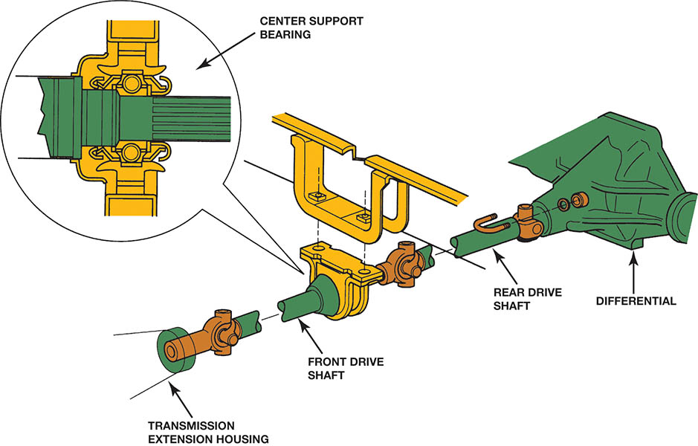
Figure 128.5 A center support bearing is used on many vehicles with long two-part drive shafts

Slide 9
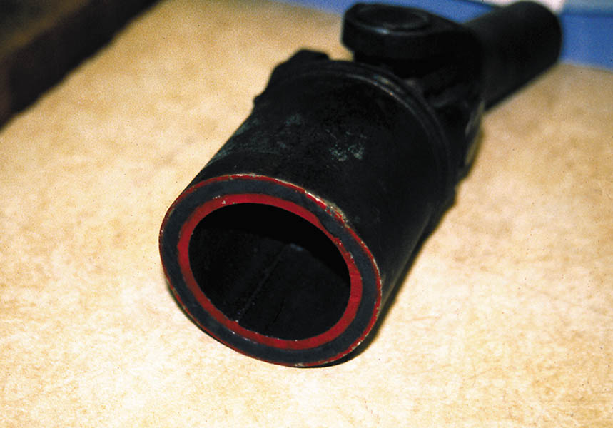
Figure 128.6 Some drive shafts use rubber between an inner and outer housing to absorb vibrations and shocks to the driveline

Slide 10
QUESTION 1: ?
What is the purpose of the drive shaft?

Slide 11
ANSWER 1:
Transmit engine torque to the drive wheels.

Slide 12
DRIVESHAFT BALANCE
Driveshaft balance should be within 0.5% of the driveshaft weight.
To get a replacement driveshaft, it is usually necessary to know the series of U-joints (type or style of U-joint) and the center-to-center distance between the U-joints.

Slide 13
U-JOINT DESIGN AND OPERATION
A simple universal joint can be made from two Y-shaped yokes connected by a cross-member called a cross or spider.
The four arms of the cross are called trunnions.
U-joints allow the wheels and the rear axle to move up and down, remain flexible, and still transfer torque to the drive wheels.
Universal joints used in a typical driveshaft should have a working angle of 1/2 to 3 degrees.

Slide 14
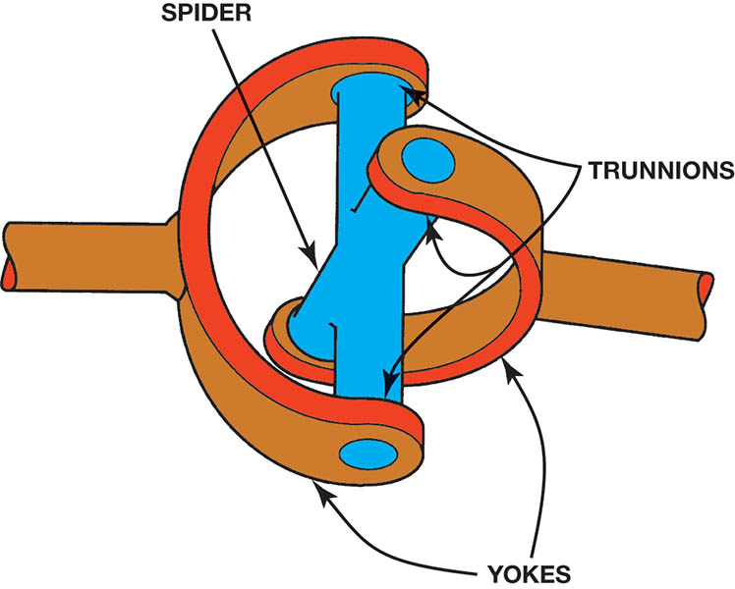
Figure 128.7 A simple universal joint (U-joint)

Slide 15
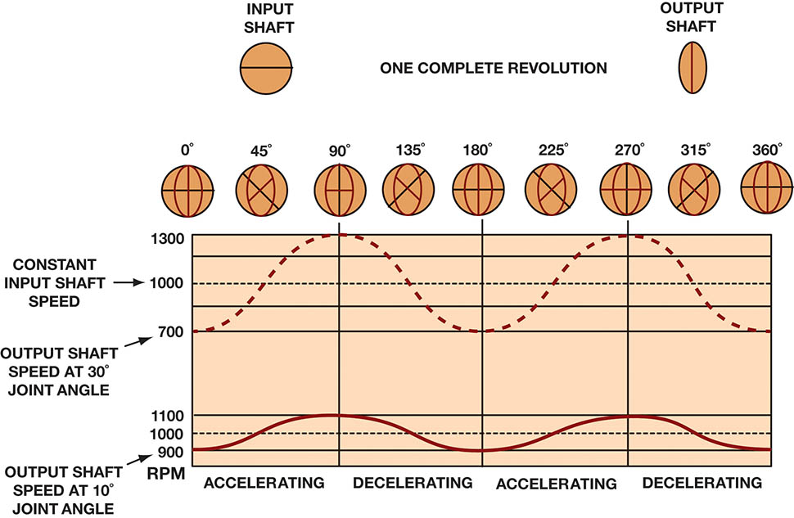
Figure 128.8 How the speed difference on the output of a typical U-joint varies with the speed and the angle of the U-joint.

Slide 16
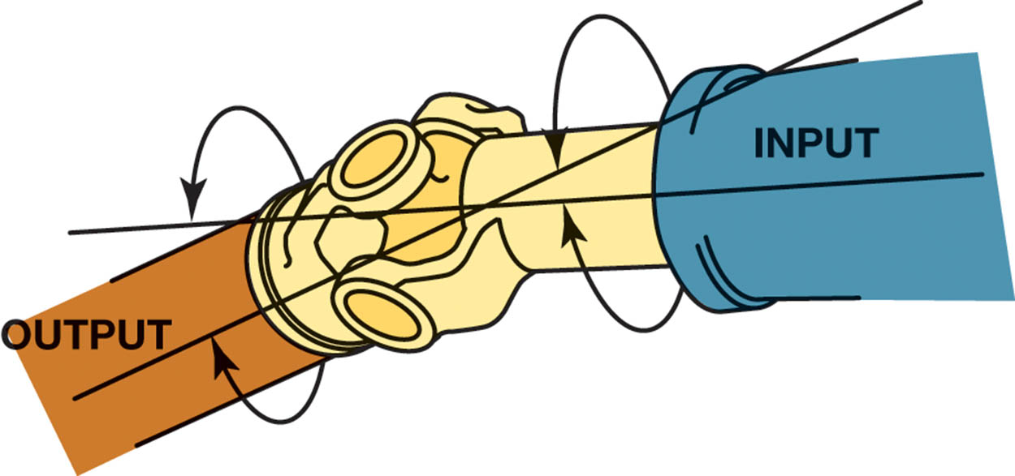
Figure 128.9 The joint angle is the difference between the angles of the joint

Slide 17
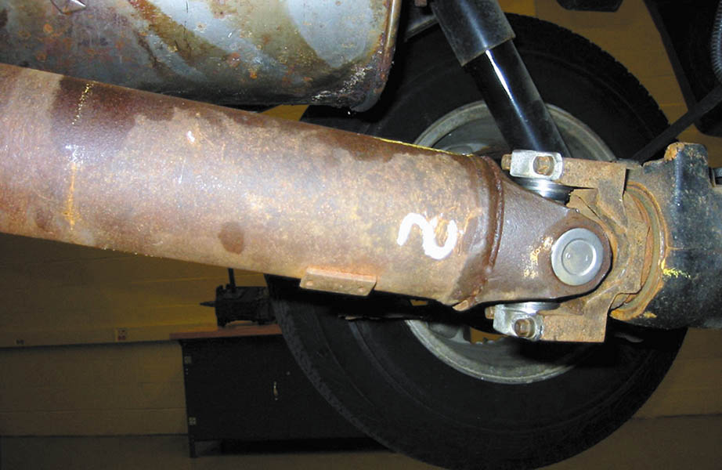
Figure 128.10 The angle of this rear Cardan U-joint is noticeable

Slide 18
QUESTION 2: ?
The four arms of the u-joint cross are referred to as what?

Slide 19
ANSWER 2:
Trunnions.

Slide 20
DOUBLE-CARDAN JOINTS
Regular U-joints are usually designed to work up to 12 degrees of angularity.
If two Cardan-style U-joints are joined together, the angle at which this double-Cardan joint can function is about 18 to 20 degrees.

Slide 21
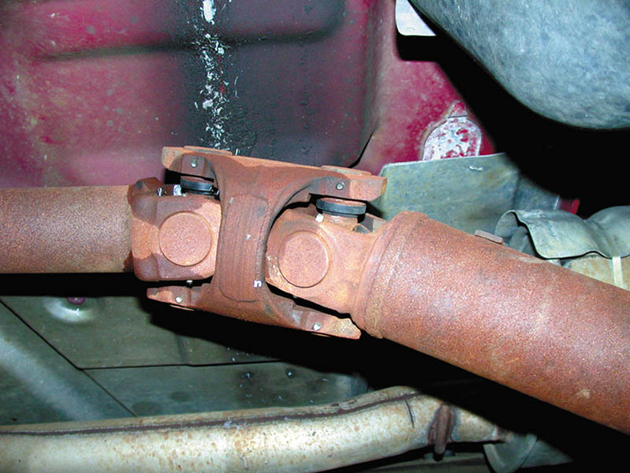
Figure 128.11 A double-Cardan U-joint

Slide 22
CONSTANT VELOCITY JOINTS (1 OF 3)
Purpose and Function
  Constant velocity joints, commonly called CV joints, are designed to rotate without changing speed.
Rzeppa Joints
  The Rzeppa joint transfers torque through six round balls that are held in position midway between the two shafts.
Outer CV Joints
  The Rzeppa-type CV joint is most commonly used as an outer joint on most front-wheel-drive vehicles.

Slide 23
CONSTANT VELOCITY JOINTS (2 OF 3)
Inner CV Joints
  Inner CV joints have to be able to allow the drive axle shaft to move up and down and allow the drive axle shaft to change length as required during vehicle suspension travel movements.
Drive Axle Shafts
  Unequal-length drive axle shafts (also called half shafts) result in unequal drive axle shaft angles to the front drive wheels.
  Some vehicles are manufactured with an intermediate shaft that results in equal drive axle shaft angles.

Slide 24
CONSTANT VELOCITY JOINTS (3 OF 3)
CV Boot Materials
  CV boots are made from either natural rubber, silicone rubber, hard thermoplastic, or urethane.
CV Joint Grease
  Most CV joint grease is molybdenum-disulfide-type grease, commonly referred to as moly grease.

Slide 25
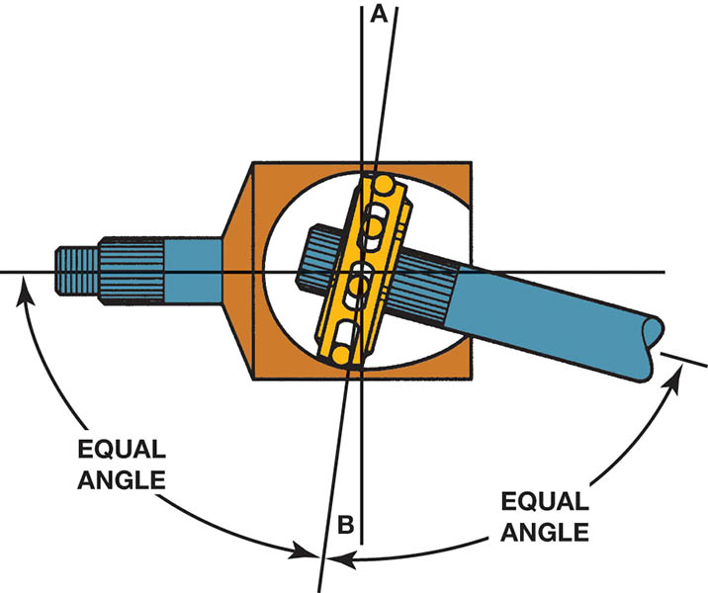
Figure 128.12 A constant velocity (CV) joint can operate at high angles without a change in velocity (speed) because the joint design results in equal angles between input and output

Slide 26
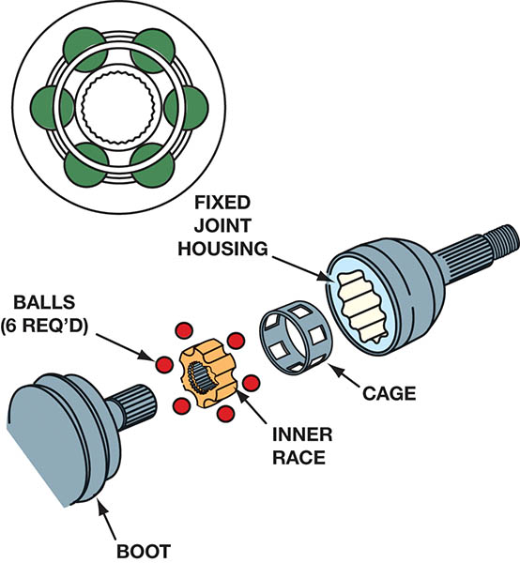
Figure 128.13 A Rzeppa fixed joint. This type of CV joint is commonly used at the wheel side of the drive axle shaft. This joint can operate at high angles to compensate for suspension travel and steering angle changes

Slide 27
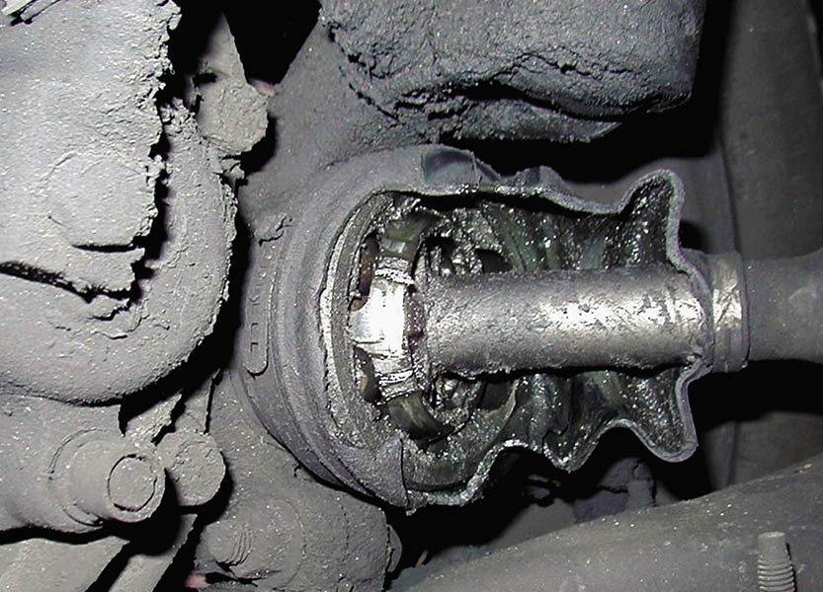
Figure 128.14 The protective CV joint boot has been torn away on this vehicle and all of the grease has been thrown outward onto the brake and suspension parts. The driver of this vehicle noticed a “clicking” noise, especially when turning

Slide 28
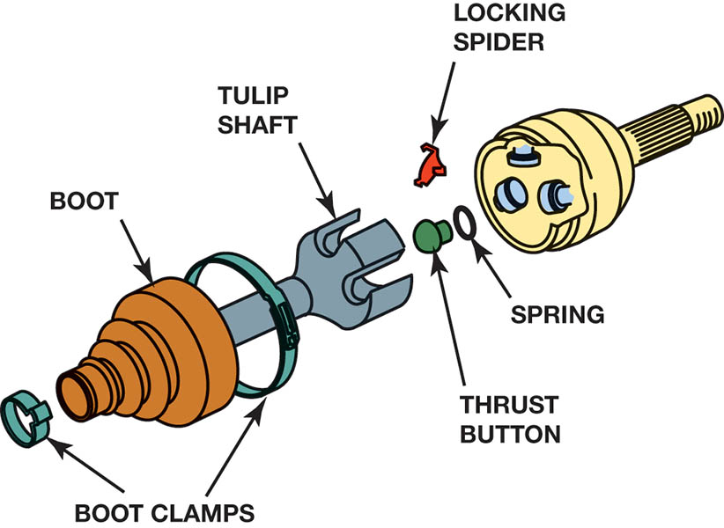
Figure 128.15 A tripod fixed joint. This type of joint is found on some Japanese vehicles. If the joint wears out, it is to be replaced with an entire drive axle shaft assembly

Slide 29
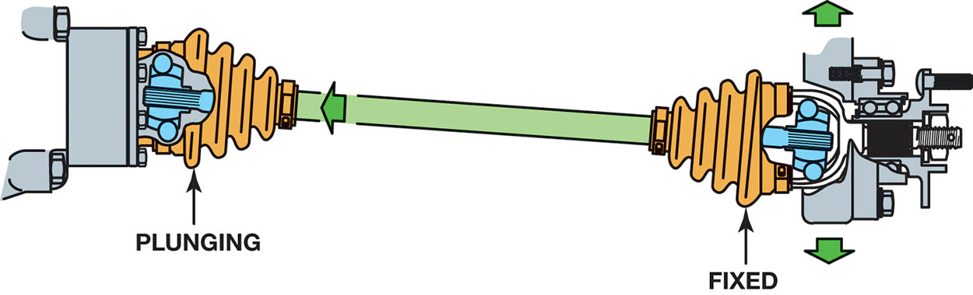
Figure 128.16 The fixed outer joint is required to move in all directions because the wheels must turn for steering as well as move up and down during suspension movement. The inner joint has to be able to not only move up and down but also plunge in and out as the suspension moves up and down

Slide 30
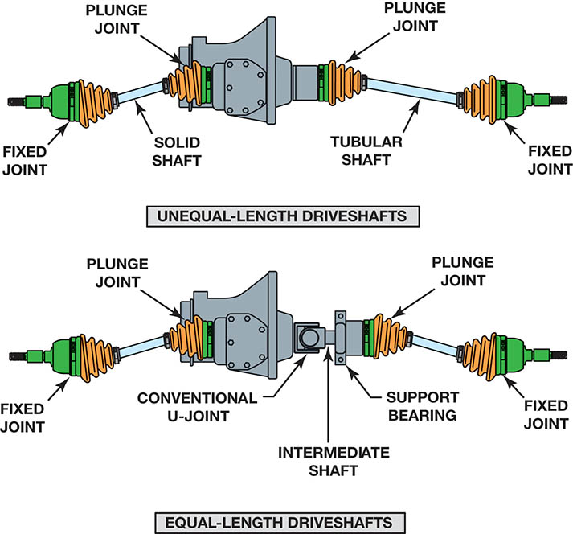
Figure 128.17 Unequal-length drive shafts result in unequal drive axle shaft angles to the front drive wheels. This unequal angle side to side often results in a steering of the vehicle during acceleration called torque steer. By using an intermediate shaft, both drive axles are the same angle and the torque steer effect is reduced

Slide 31
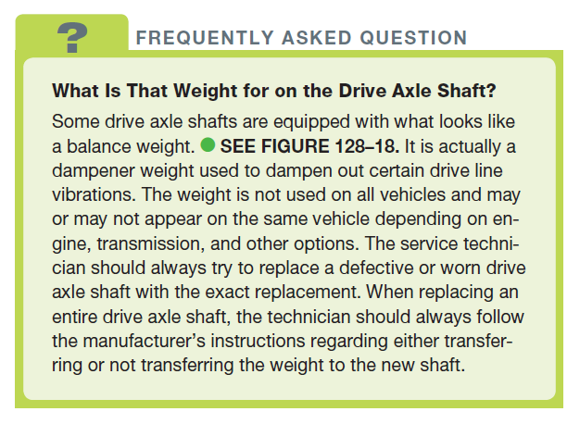
FREQUENTLY ASKED QUESTION

Slide 32
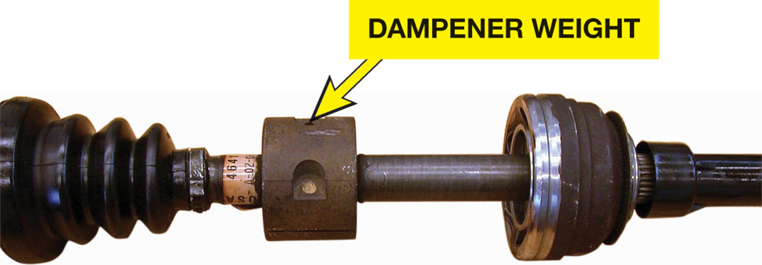
Figure 128.18 A typical drive axle shaft with dampener weight

Slide 33
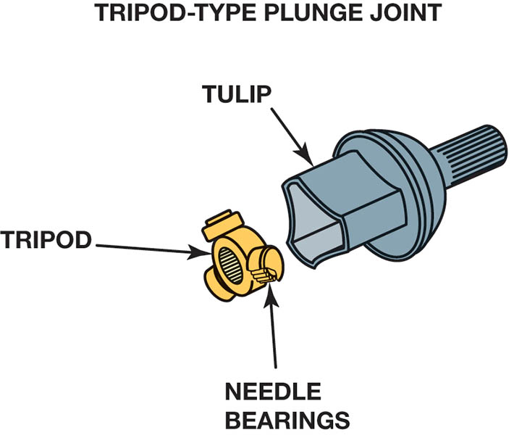
Figure 128.19 A tripod joint is also called a tripot, tripode, or tulip design

Slide 34
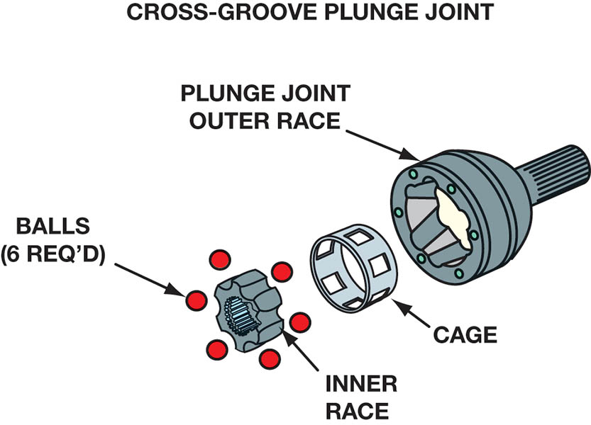
Figure 128.20 A cross-groove plunge joint is used on many German front-wheel-drive vehicles and as both inner and outer joints on the rear of vehicles that use an independent-type rear suspension

Slide 35
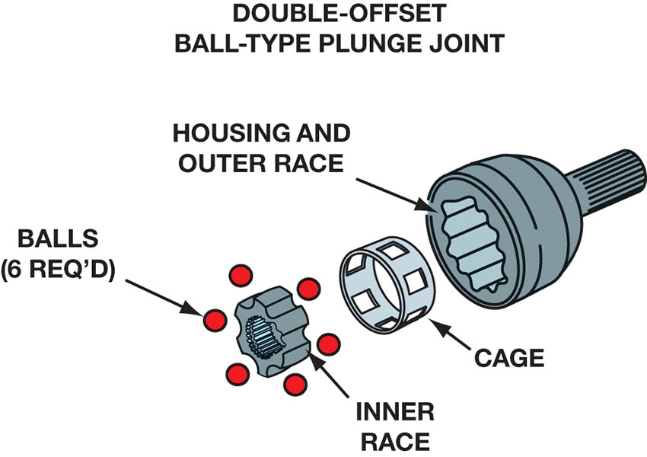
Figure 128.21 Double-offset ball-type plunge joint

Slide 36
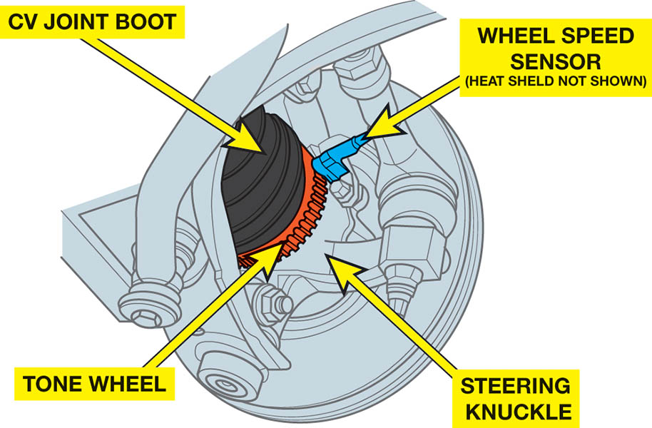
Figure 128.22 Many outer CV joints include the tone wheel for the wheel speed sensor used by the anti-lock and stability control systems

Slide 37
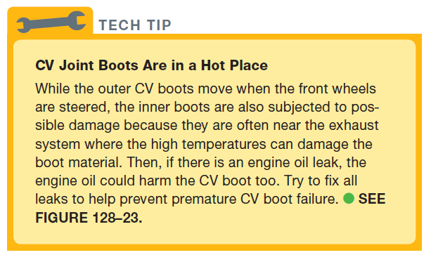
Tech Tip

Slide 38
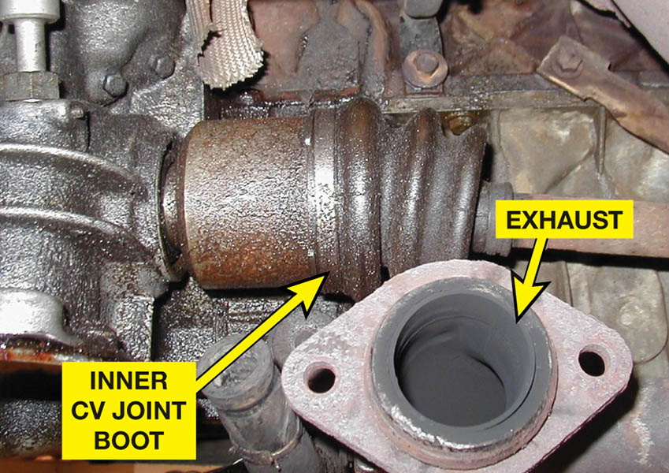
Figure 128.23 Many CV joints are close to the exhaust system where they are exposed to higher than normal temperatures

Slide 39
QUESTION 3: ?
What are the four materials typically used to make a CV boot?

Slide 40
ANSWER 3:
  Natural rubber, silicone rubber, hard thermoplastic, or urethane.

Slide 41

Copyright

