Slide 1
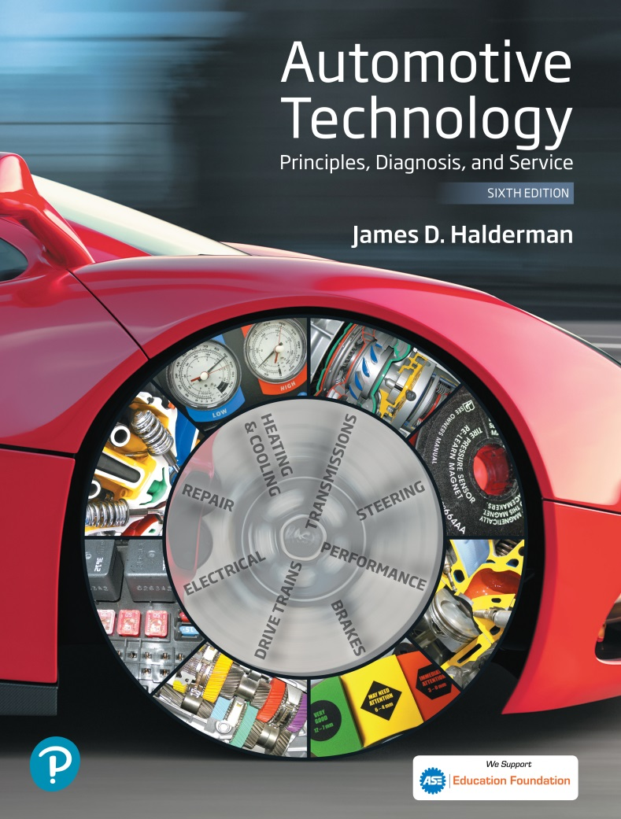
Automotive Technology Principles, Diagnosis, and Service
Sixth Edition
Chapter 127
Manual Transmissions/ Transaxles
Copyright © 2018, 2015, 2011 Pearson Education, Inc. All Rights Reserved

Slide 2
LEARNING OBJECTIVES (1 of 2)
127.1 Discuss the need for a transmission.
127.2 Explain the different types of gears and gear ratios.
127.3 Describe the relationship between torque, speed, and power.
127.4 Describe the construction of a transmission.
127.5 Describe the torque flow through a manual transmission.

Slide 3
LEARNING OBJECTIVES (2 of 2)
127.6 Describe speed gears.
127.7 Explain the construction and operation of a synchronizer.
127.8 Describe the torque flow through a five-speed manual transmission.
127.9 Describe the procedure to diagnose, remove, disassemble, and install manual transmission/transaxle.

Slide 4
THE NEED FOR A TRANSMISSION
A vehicle requires a lot of torque to start off and to climb hills, yet it does not require as much torque to move on level ground.
Using gears allows the engine speed to increase at low vehicle speeds yet still permits the engine speed to drop at higher speeds to save fuel and reduce exhaust emissions.

Slide 5
GEAR TYPES (1 OF 2)
Spur Gear
A spur gear consists of a gear blank with straight-cut teeth around its entire circumference.
Helical Gear
A helical gear, although similar to a spur gear, has its teeth cut at an angle to the axis of the gear.
External Gears
Gear teeth on their outside circumference

Slide 6
GEAR TYPES (2 OF 2)
Internal Ring Gears
Gears having teeth along the inside circumference.
Bevel Gears
The teeth of a bevel gear are cut at an angle to the outside gear surface.
Hypoid Gears
Hypoid gear sets have gear teeth that are curved much like the teeth of a spiral bevel gear.

Slide 7
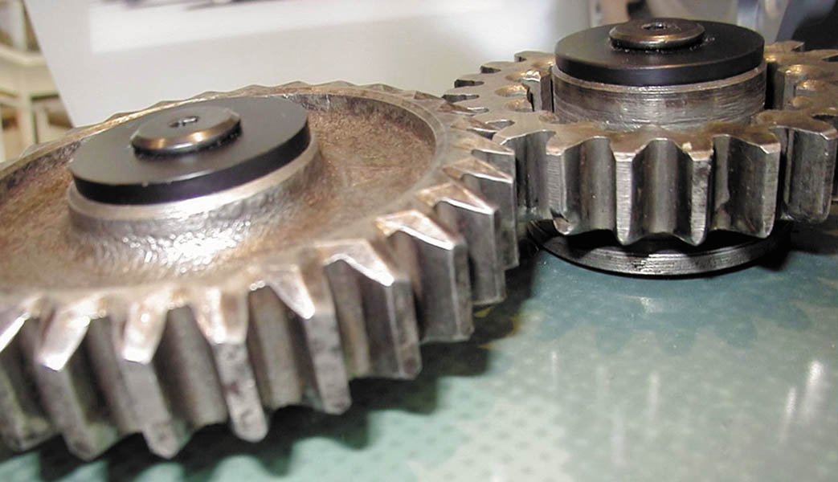
Figure 127.1 Spur gears have straight-cut teeth

Slide 8
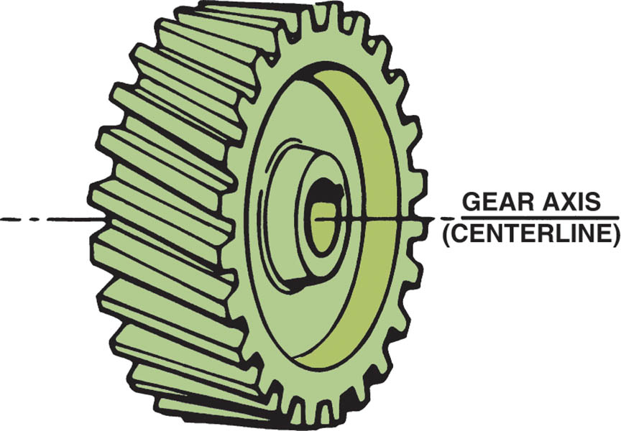
Figure 127.2 The teeth of a helical gear are cut at an angle to the gear axis

Slide 9
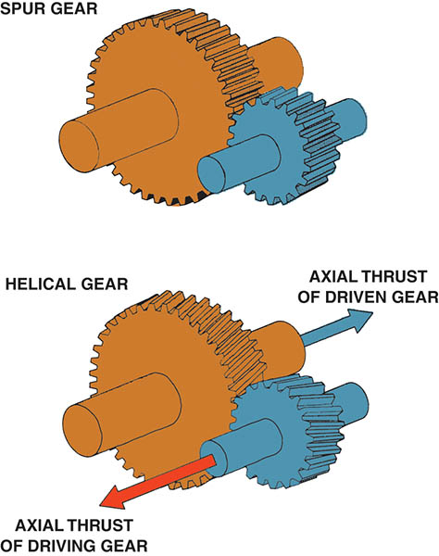
Figure 127.3 A spur gear has straight-cut teeth. This design is very strong and is used where strength is important. Spur gears are noisy during operation. Helical-cut gears, on the other hand, operate quietly but create a force in line with the axis of the gears due to the angle of the gear teeth

Slide 10
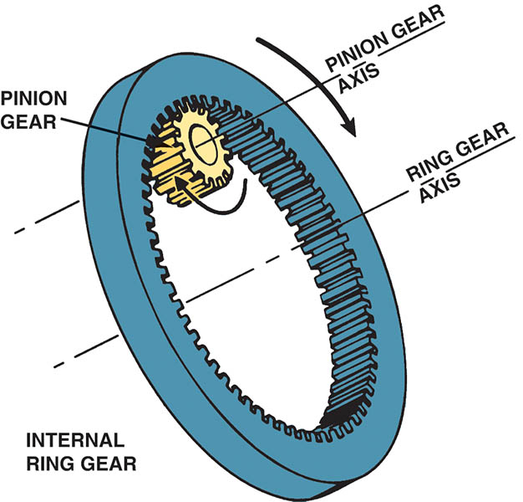
Figure 127.4 A pinion gear meshed with an internal ring gear rotates in the same direction around a parallel axis of rotation

Slide 11
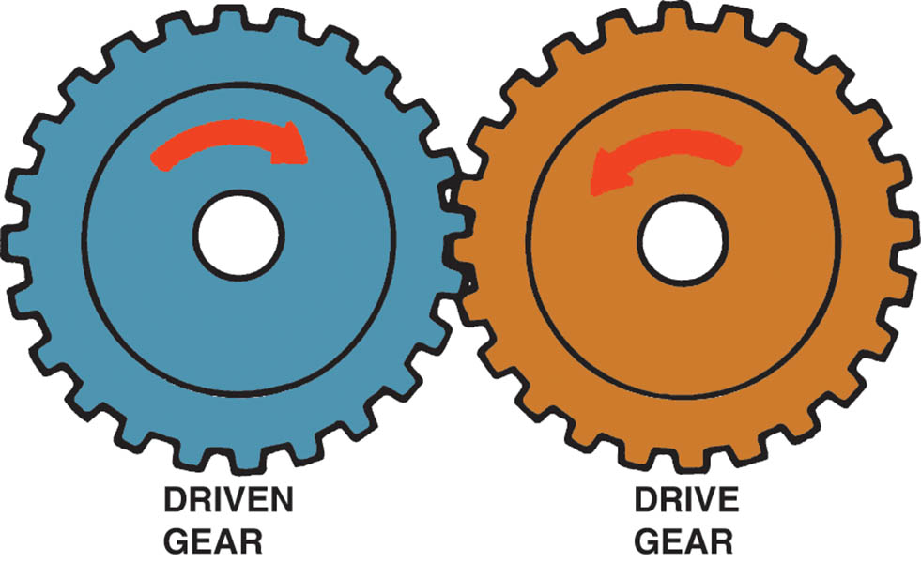
Figure 127.5 When two external gears mesh, they rotate in opposite directions

Slide 12
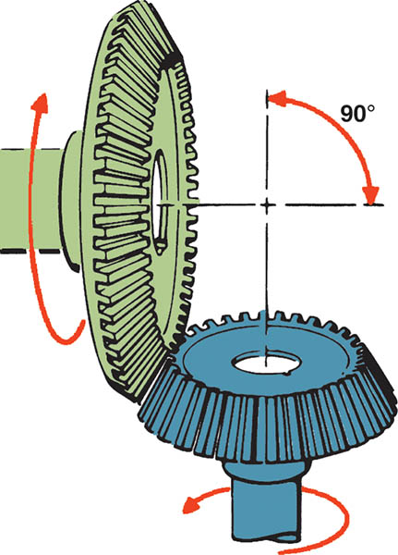
Figure 127.6 Bevel gears are often used to change the direction of rotation and are typically used in differentials

Slide 13
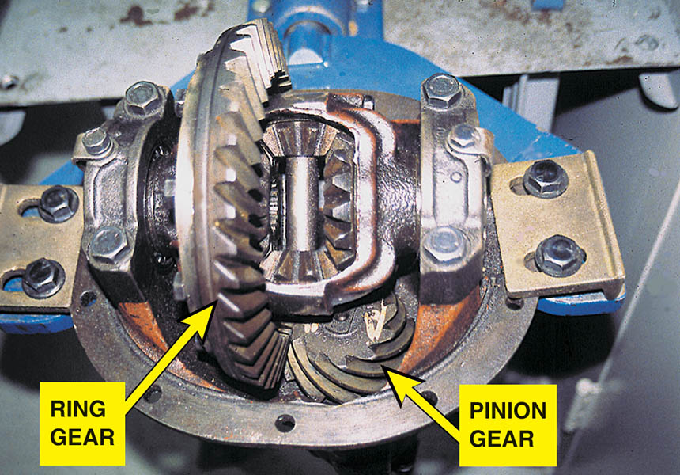
Figure 127.7 A differential uses a hypoid gear set to provide a change in the direction of torque and for gear reduction (torque increases) to the drive wheels

Slide 14
GEAR RATIOS (1 OF 3)
Gear ratio is expressed as the number of rotations the drive gear must make in order to rotate the driven gear through one revolution.
Gear ratios, which are expressed relative to the number one, fall into three categories:
Direct drive
Gear reduction
Overdrive

Slide 15
GEAR RATIOS (2 OF 3)
Direct Drive
If two meshed gears are the same size and have the same number of teeth, they will turn at the same speed.
Gear Reduction
If one gear drives a second gear that has three times the number of teeth, the smaller drive gear must travel three complete revolutions in order to drive the larger gear through one rotation.

Slide 16
GEAR RATIOS (3 OF 3)
Overdrive
Overdrive is the opposite of a gear reduction condition and occurs when a driven gear turns faster than its drive gear.
Idler Gears
A gear that operates between the drive and driven gears is called a floating gear, or idler gear.
Idler gears affect direction of rotation not the speed of the gear.

Slide 17
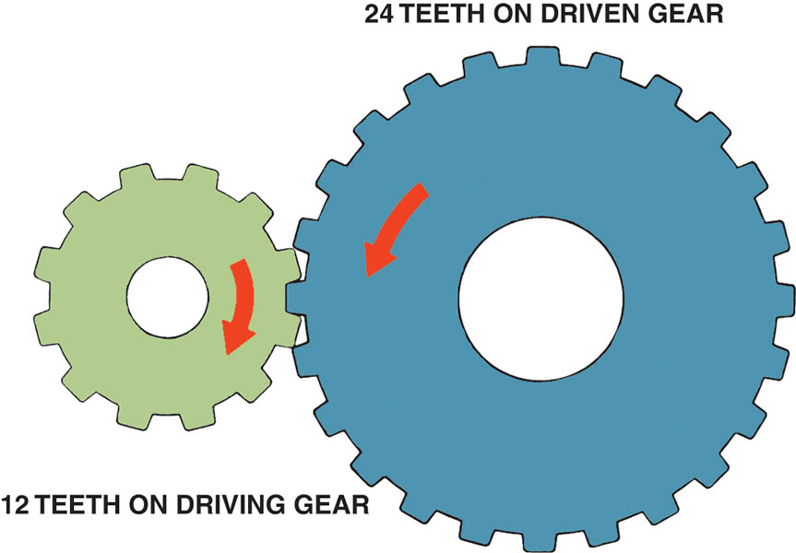
Figure 127.8 Gear ratio is determined by dividing the number of teeth of the driven (output) gear (24 teeth) by the number of teeth on the driving (input) gear (12 teeth). The ratio illustrated is 2:1

Slide 18
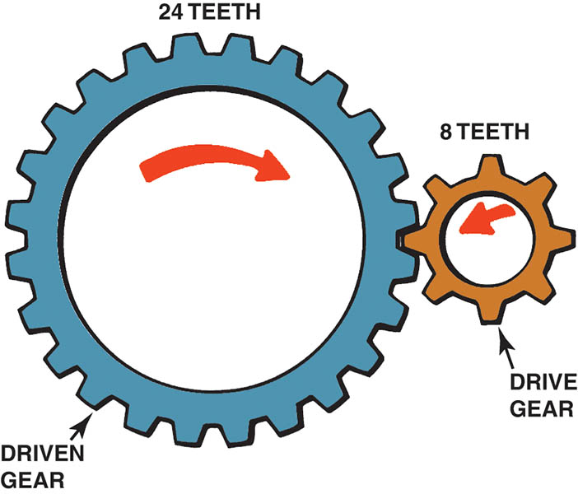
Figure 127.9 This gear combination provides a gear reduction of 3:1

Slide 19
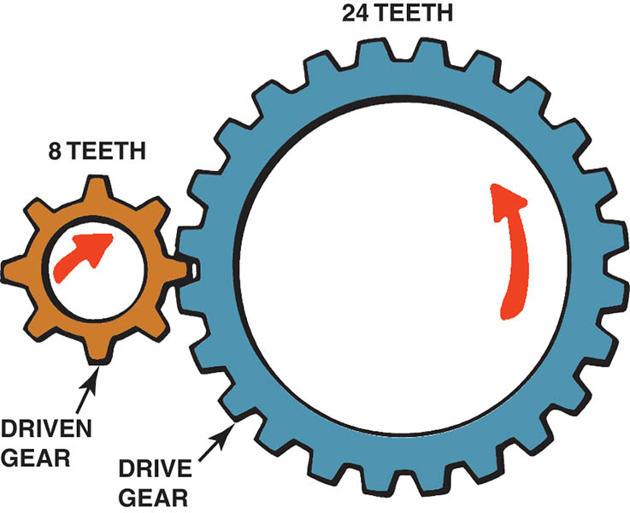
Figure 127.10 This gear combination provides an overdrive ratio of 0.33:1

Slide 20
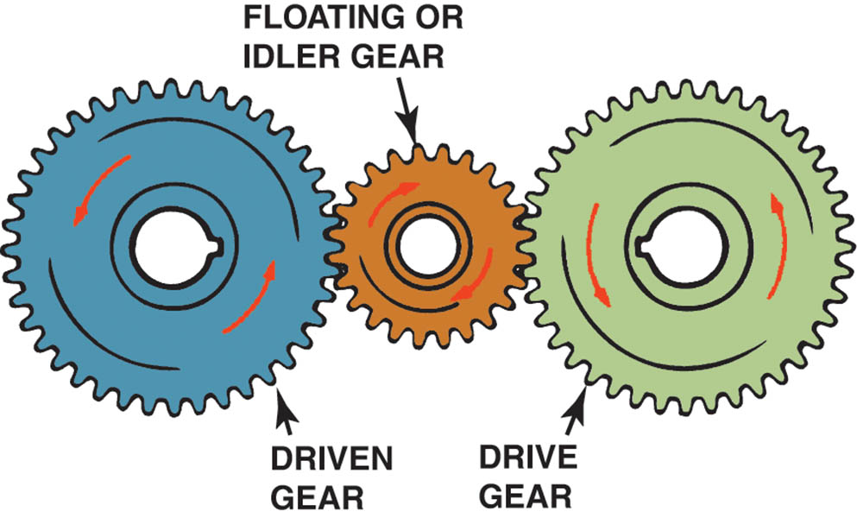
Figure 127.11 Idler gears affect the direction of rotation in a gear train, but not the final drive ratio

Slide 21
QUESTION 1: ?
In an overdrive gear ratio what is the relationship between the drive and driven gear?

Slide 22
ANSWER 1:
The driven gear turns faster than its drive gear.

Slide 23
TOEQUE, SPEED, AND POWER
Gears apply torque much like a wrench does; each tooth of a gear is actually a lever.
Torque and Speed Relationship
Torque and speed have an inverse relationship: as one goes up, the other goes down.
Torque Multiplication
Levers can be used to increase or multiply torque.
Either distance or speed must always be given up in order to increase, or multiply, torque.

Slide 24
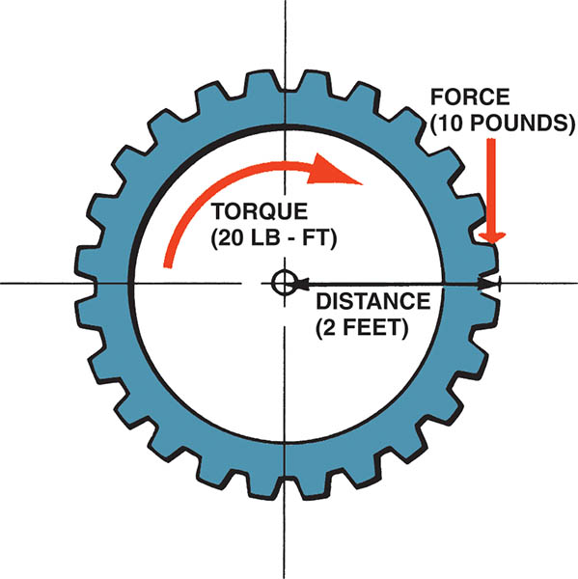
Figure 127.12 Gears apply torque in the same way a wrench applies torque—the force applied multiplied by the distance from the center of the gear equals the torque

Slide 25
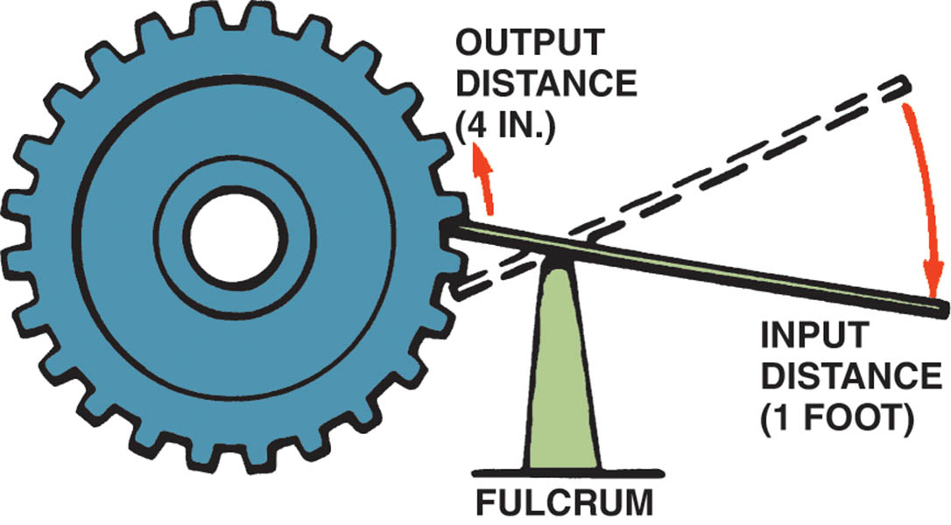
Figure 127.13 A lever can be used to multiply torque, but it does so at the expense of distance or speed

Slide 26
TRANSMISSION CONSTRUCTION (1 OF 2)
A transmission is usually constructed of cast aluminum.
The front of the transmission attaches to a separate bell housing.
At the front of the transmission (toward the engine) is the front bearing retainer.
The rear of the transmission usually includes a separate casting called the extension housing.

Slide 27
TRANSMISSION CONSTRUCTION (2 OF 2)
The center housing is usually referred to as the transmission case.
The input shaft is splined to the clutch disc and is also referred to as the main gear, clutch gear, or main drive pinion assembly.
The main shaft, also called the output shaft.
All manual transmissions/transaxles use a countershaft.

Slide 28
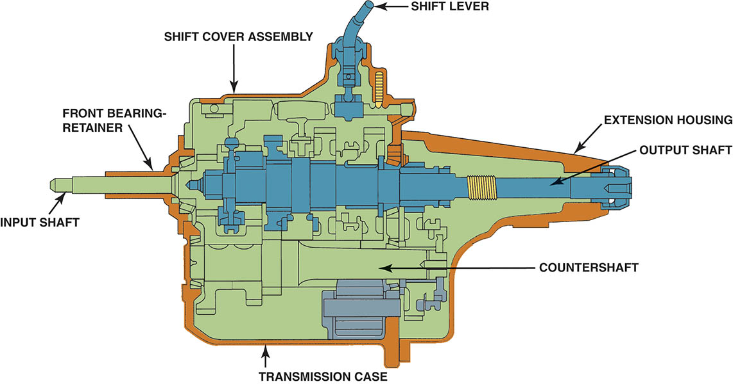
Figure 127.14 Cross section of a five-speed manual transmission showing the main parts

Slide 29
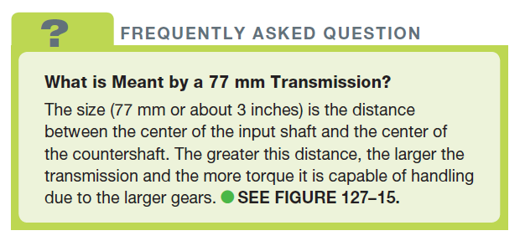
FREQUENTLY ASKED QUESTION

Slide 30
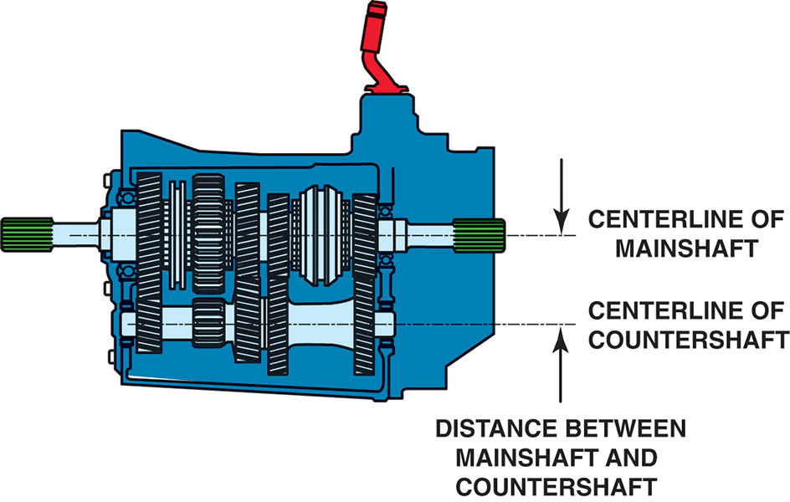
Figure 127.15 The torque capacity of a transmission is determined by the size of the gear and bearings used. The greater the distance, usually measured in millimeters such as 77 mm, between the main shaft and the countershaft, the greater the torque capacity

Slide 31
TORQUE FLOW THROUGH A MANUAL TRANSMISSION
The engine torque is applied to the input shaft when the clutch is engaged (clutch pedal up).
This torque is applied to the main gear.
The engine torque is multiplied by the ratio difference between the main gear and the cluster gear.
The engine torque then is applied to the drive wheels through the driveshaft, differential, and drive axles.

Slide 32
SPEED GEARS
The gears on the main shaft are free to move on the shaft and are connected to the main shaft through the synchronizer hub when a shift is made.
The gears that rotate on the main shaft are called speed gears and are free to rotate on a film of oil or on bearings.

Slide 33
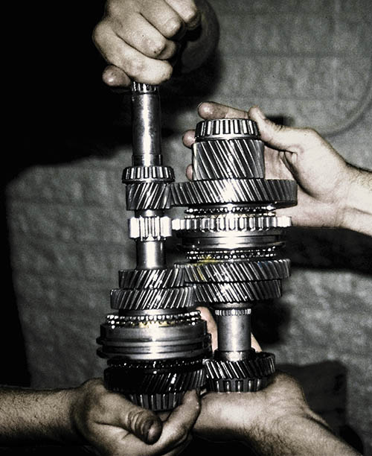
Figure 127.16 Notice that the countershaft and the main shaft both use gears of increasing size that mesh together

Slide 34
SYNCHRONIZER PARTS AND OPERATION (1 OF 2)
Interlocks either in the shifter linkage itself or inside the transmission/transaxle prevent selecting two gears at the same time.
Synchronizers are used in manual transmissions/transaxles to make shifting easier.
To synchronize means to make two or more events occur at the same time.
The synchronizer ensures the two gears to be meshed must be rotating at the same speed.

Slide 35
SYNCHRONIZER PARTS AND OPERATION (2 OF 2)
Synchronizer Construction
Although there are a number of design variations, all are similar and include a hub, a sliding sleeve, a blocker ring, (or stop ring or synchronizer ring), keys, and springs.
Synchronizer Operation
When a force on the sleeve that moves it toward the speed gear. The sleeve and the inserts contact the stop ring (blocking ring). The synchronizer ring (stop ring) engages the cone on the speed gear, causing both assemblies to reach the same speed.

Slide 36
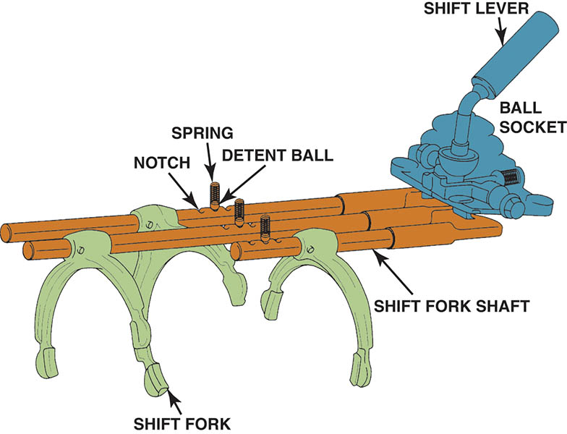
Figure 127.17 A typical shift mechanism is designed to not only give the driver a solid feel when shifting, but also prevents shifting into reverse except from the neutral position

Slide 37
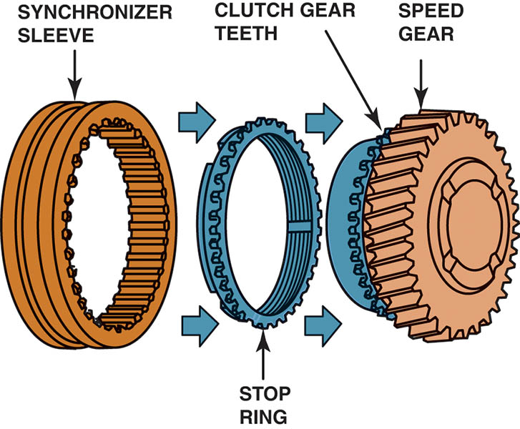
Figure 127.18 When a shift is made, the sleeve is moved toward the speed gear. The sleeve presses the stop ring against the cone area of the speed gear. The friction between the stop ring and the speed gear causes the speed of the two to become equal, permitting the sleeve to engage the gear clutch teeth of the speed gear.

Slide 38
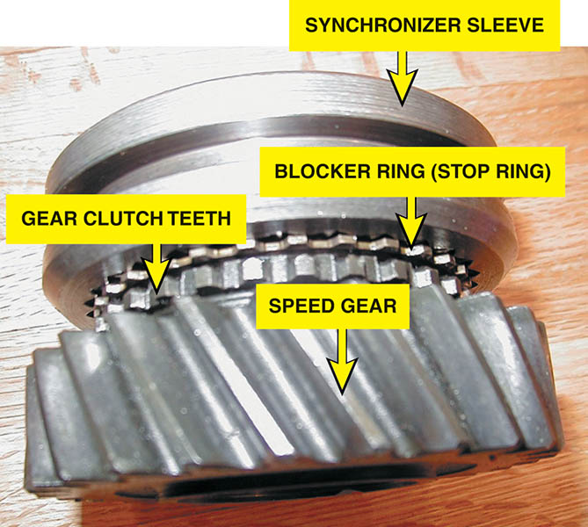
Figure 127.19 Typical synchronizer assembly

Slide 39
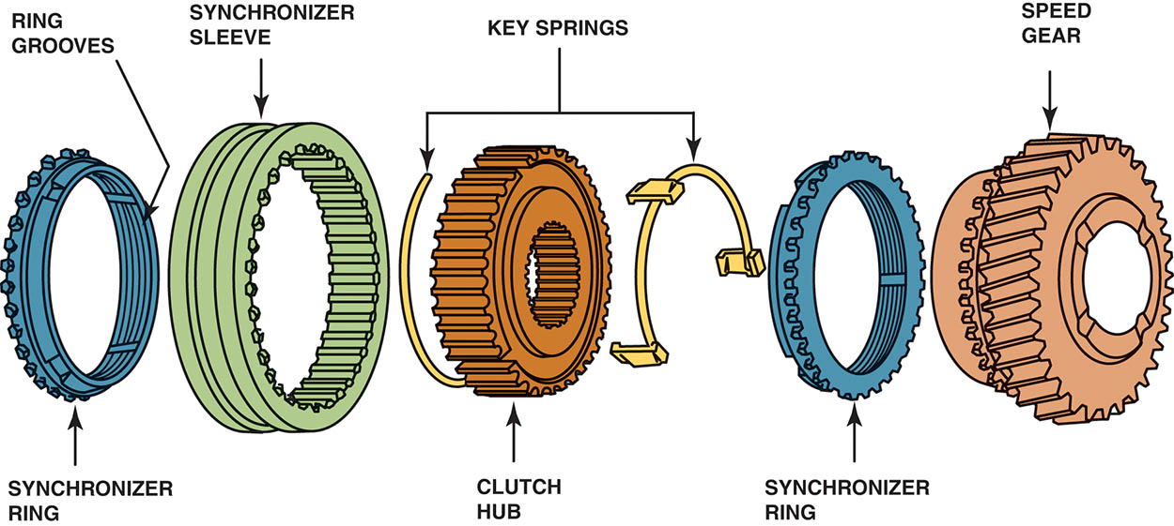
Figure 127.20 Synchronizer keys are attached to the clutch hub and push against the synchronizer ring when the sleeve is being moved during a shift. Notice the grooves on the synchronizer ring. These grooves prevent lubricating oil from becoming trapped between the ring and the cone surface of the speed gear.

Slide 40
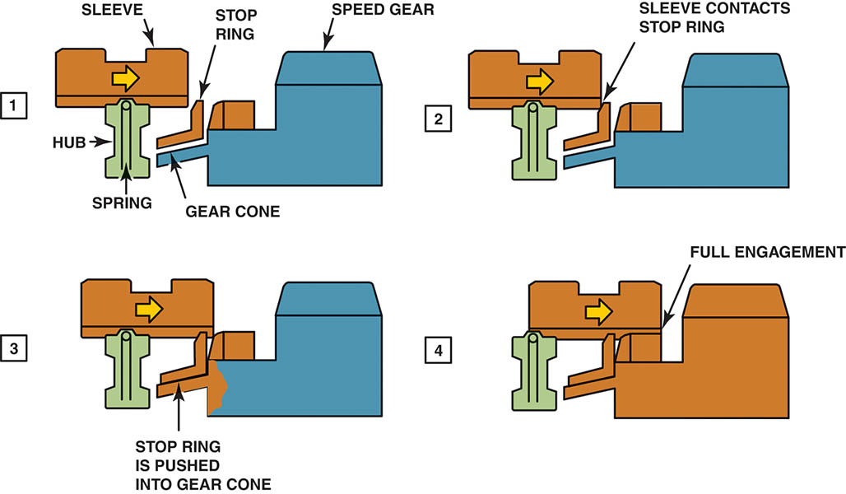
Figure 127.21 A shift sequence starts when the shift fork applies a force on the sleeve that moves it toward the speed gear. (2) The sleeve and the inserts contact the stop ring. (3) The synchronizer ring engages the cone on the speed gear, causing both assemblies to reach the same speed. (4)

Slide 41
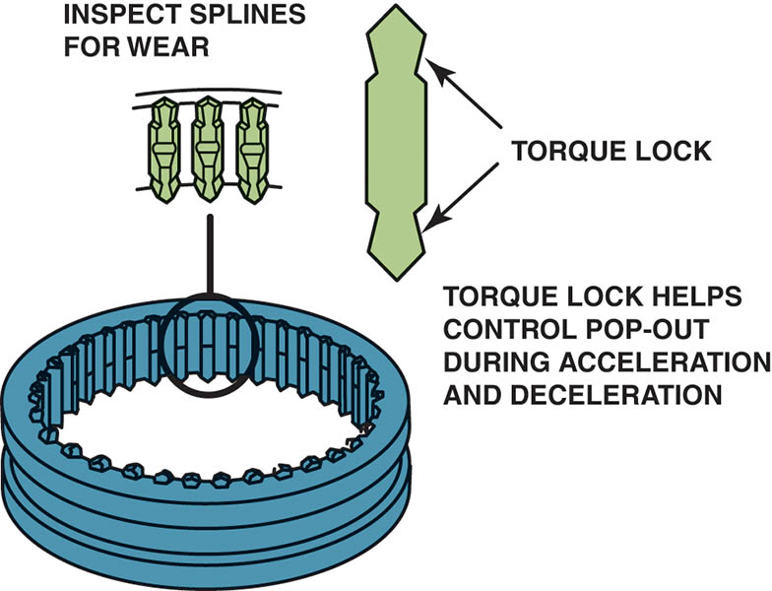
Figure 127.22 Before reassembling the transmission/transaxle, carefully inspect the splines on the synchronizer sleeves for wear. The shape of the splines helps prevent the transmission/transaxle from jumping out of gear during acceleration and deceleration

Slide 42
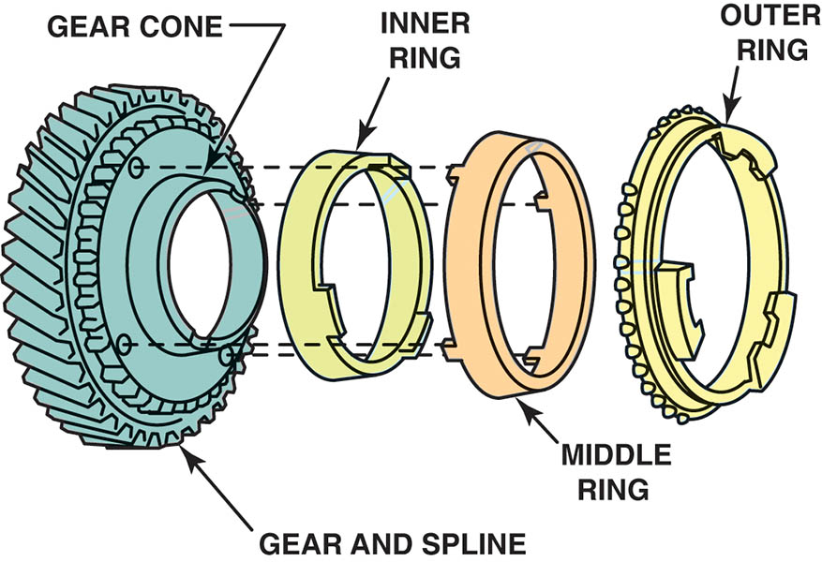
Figure 127.23 Exploded view of a triple-cone synchronizer. The inner and outer rings rotate with the synchronizer sleeve while the middle ring rotates with the speed gear

Slide 43
QUESTION 2: ?
What is the purpose of the synchronizer?

Slide 44
ANSWER 2:
The synchronizer ensures the two gears to be meshed must be rotating at the same speed.

Slide 45
FIVE SPEED TRANSMISSION TORQUE FLOW (1 OF 3)
Neutral
All of the synchronizer sleeves are centered on their hubs.
First Gear
In first gear, the shift linkage slides the 1–2 synchronizer sleeve rearward toward the first speed gear.
Second Gear
In second gear, the shift linkage slides the 1–2 synchronizer sleeve forward, away from the first speed gear and toward the second speed gear.

Slide 46
FIVE SPEED TRANSMISSION TORQUE FLOW (2 OF 3)
Third Gear
In third gear, the shift linkage centers the 1–2 synchronizer sleeve and moves the 3–4 synchronizer sleeve back toward the third speed gear.
Fourth Gear
In fourth gear, the shift linkage moves the 3–4 synchronizer sleeve forward, away from the third speed gear and toward the input shaft drive gear.

Slide 47
FIVE SPEED TRANSMISSION TORQUE FLOW (3 OF 3)
Fifth Gear
In fifth gear, the shift linkage centers the 3–4 synchronizer sleeve and moves the fifth synchronizer sleeve toward the fifth speed gear.
Reverse
There are two common reverse gear designs used on transmissions:
Sliding gear
Constant-mesh gear

Slide 48
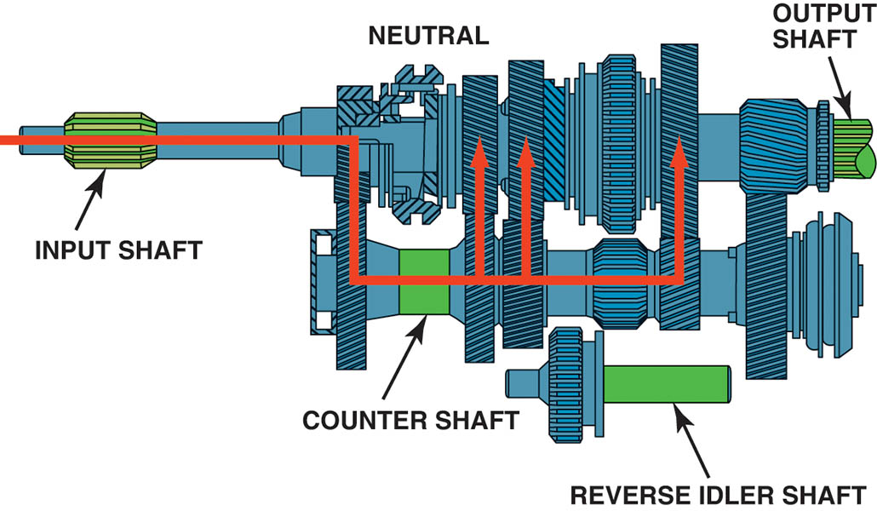
Figure 127.24 In neutral, the input shaft and the countershaft are rotating if the clutch is engaged (clutch pedal up), but no torque is being transmitted through the transmission

Slide 49
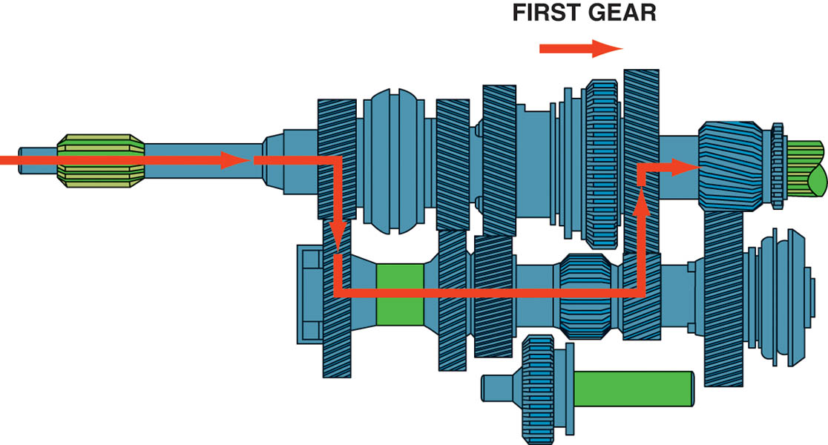
Figure 127.25 In first gear, the 1–2 synchronizer sleeve is moved rearward, locking the first speed gear to the output shaft. Torque is transmitted from the input shaft to the countershaft and then to the output shaft

Slide 50
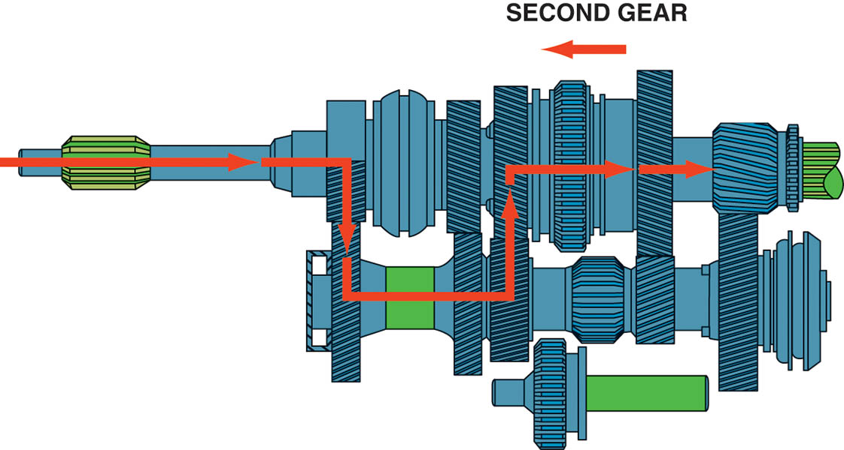
Figure 127.26 In second gear, the 1–2 synchronizer sleeve is moved forward, which locks the second speed gear to the output shaft

Slide 51
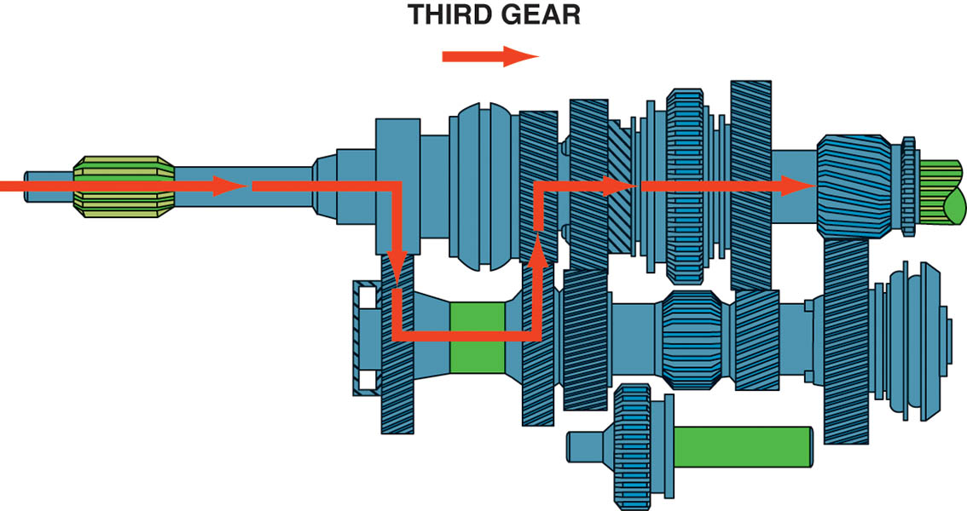
Figure 127.27 To achieve third gear, the shaft linkage first centers the 1–2 synchronizer sleeve and then moves the 3–4 synchronizer sleeve rearward, locking third speed gear to the output shaft

Slide 52
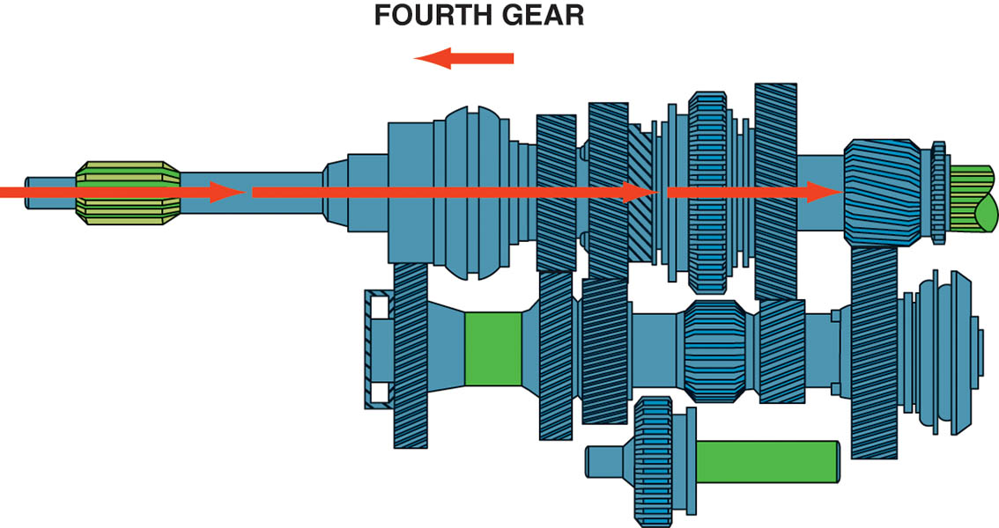
Figure 127.28 In fourth gear, the 3–4 synchronizer sleeve is moved forward, which locks the fourth speed gear to the output shaft

Slide 53
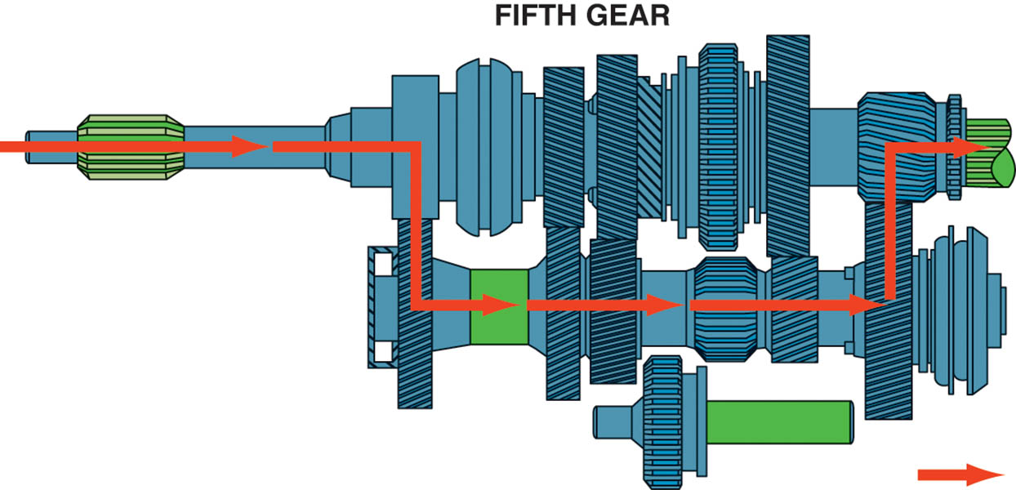
Figure 127.29 To achieve fifth gear, the shift linkage first centers the 3–4 synchronizer sleeve and then moves the fifth synchronizer sleeve toward the fifth speed gear, locking it to the output shaft

Slide 54
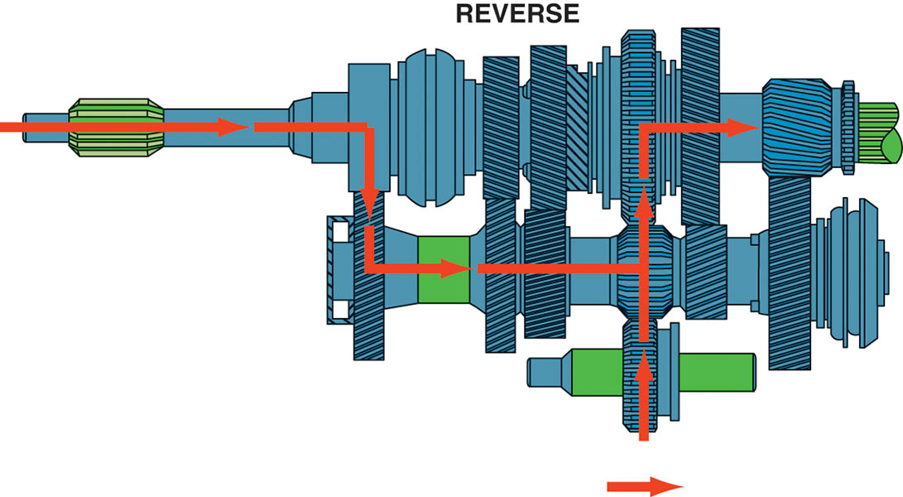
Figure 127.30 Torque flows through the transmission in reverse gear. Note that the idler gear drives the 1–2 synchronizer sleeve gear, which is splined to the output shaft

Slide 55
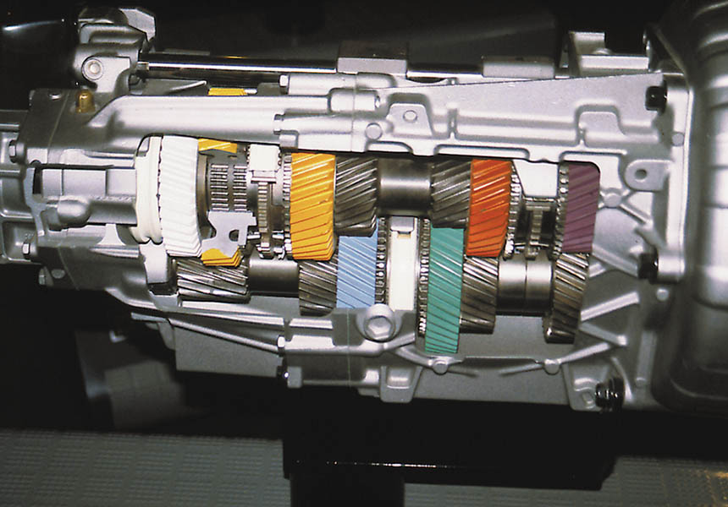
Figure 127.31 Cutaway of a T56 six-speed transmission showing all of its internal parts

Slide 56
MANUAL TRANSAXLE CONSTRUCTION
Most transaxles use speed gears and synchronizers on both the input and output shafts.
The differential assembly, also called a final drive assembly, attaches to the output shaft and splits the torque to both front drive axles.

Slide 57
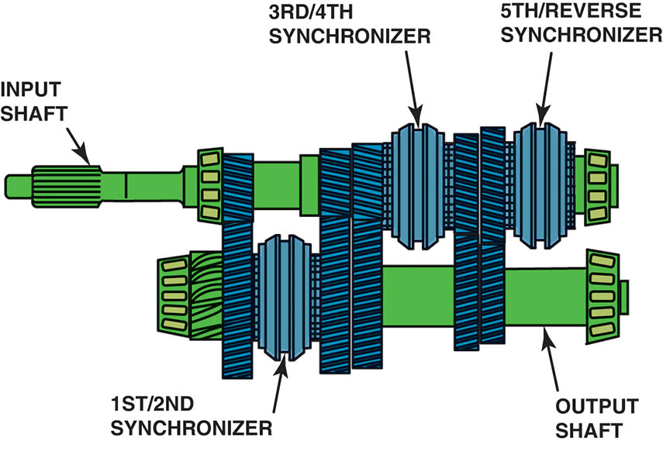
Figure 127.32 Notice that this five-speed transaxle from a Dodge/Plymouth Neon uses synchronizers on both the input and output shafts

Slide 58
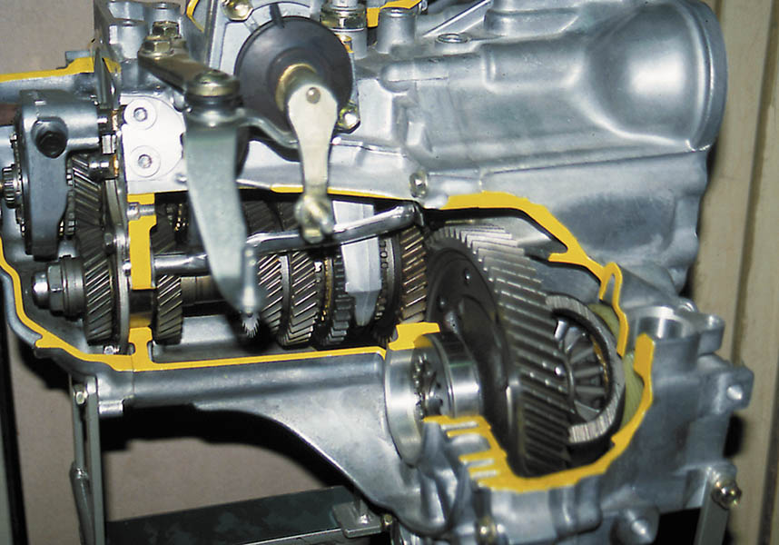
Figure 127.33 Cutaway of a typical manual transaxle showing all of its internal parts including the final drive assembly

Slide 59
TRANSMISSION/ TRANSAXLE REMOVAL
Disconnecting the negative battery cable.
Safely hoisting and supporting the vehicle.
Supporting the engine with a holding fixture or other support (front-wheel-drive).
Remove the drive axle shafts or drive shaft (rear-wheel-drive).
Remove the clutch linkage and shift linkage.
Disconnect the vehicle speed sensor and reverse (backup) light connectors.
Remove the attaching bolts/nuts from the engine and transmission/transaxle mounts and then removing the unit from the vehicle.

Slide 60
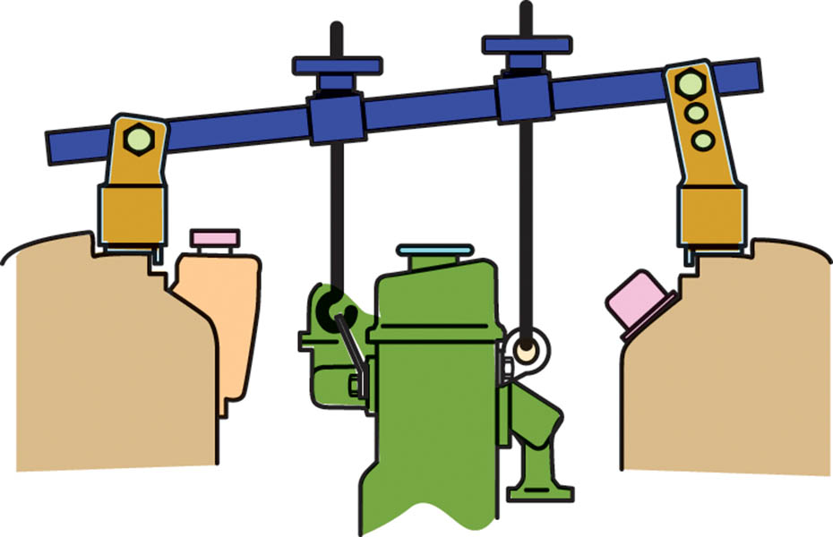
Figure 127.34 Most front-wheel-drive (FWD) vehicles require the use of a fixture to support the engine before removing the transaxle

Slide 61
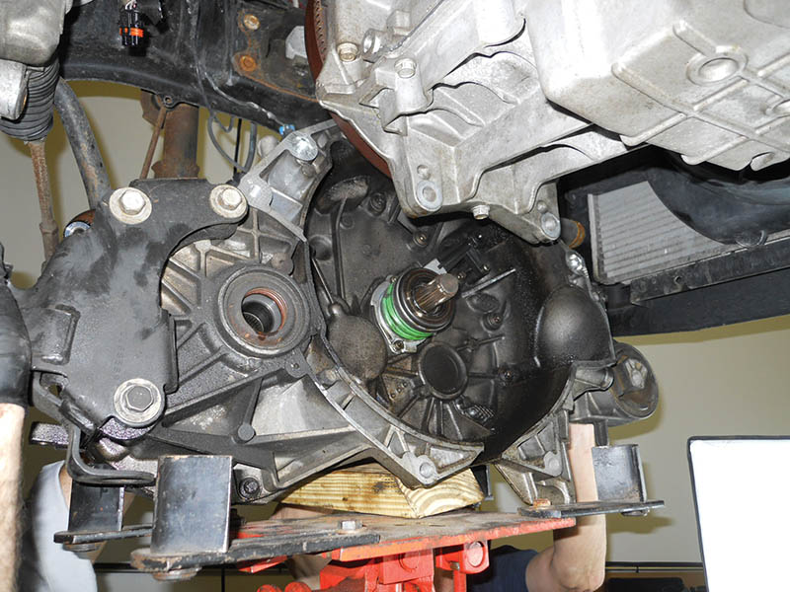
Figure 127.35 A transaxle being removed from underneath a vehicle and being supported by a transmission jack

Slide 62
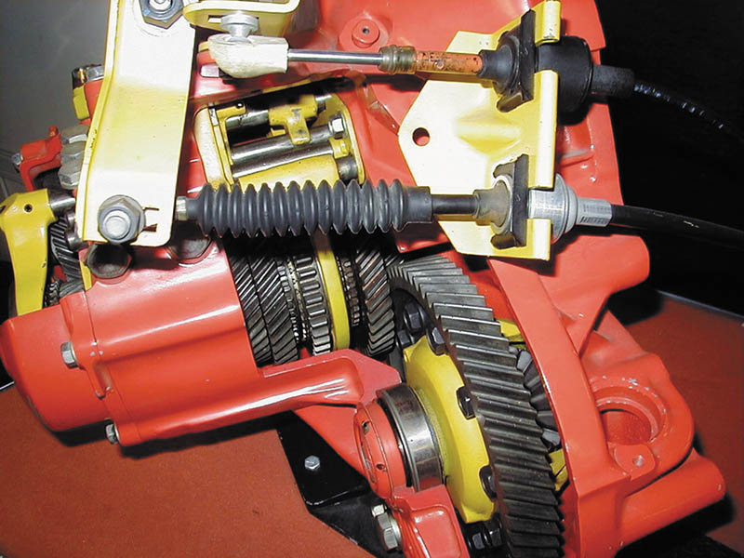
Figure 127.36 Typical cable-operated shift linkage used on a front-wheel-drive transaxle

Slide 63
TRANSMISSION/ TRANSAXLE DISASSEMBLY
Before disassembling the transmission/transaxle, drain any remaining gear lubricant from the unit and dispose of it properly.
Mount the transmission/transaxle on a holding fixture or place it on a large, clean work surface.
Check the service manual for the exact disassembly procedures to follow for the unit being serviced.

Slide 64
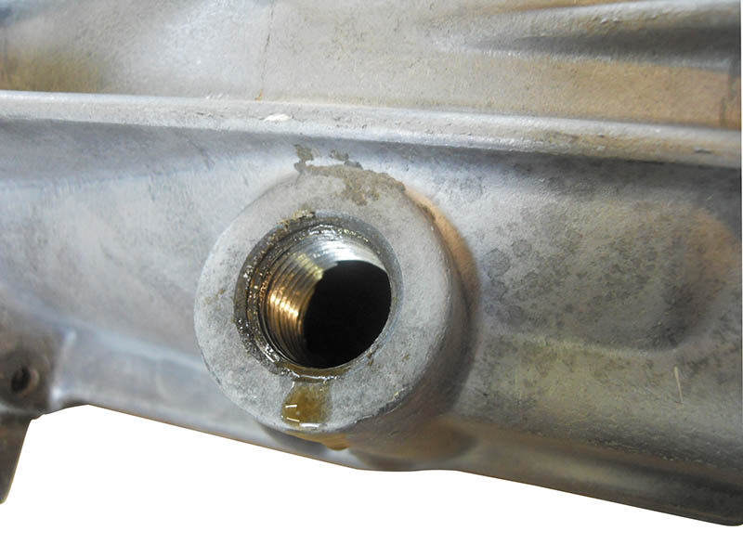
Figure 127.37 Drain the fluid into a suitable container and dispose of the old fluid according to local, state, and federal regulations

Slide 65
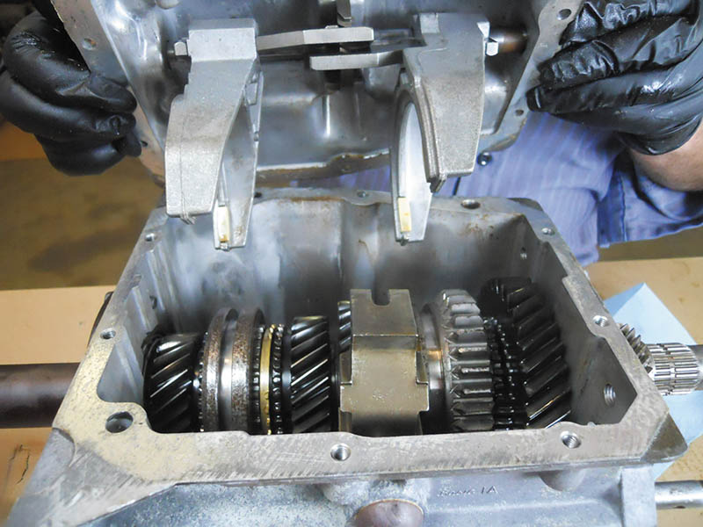
Figure 127.38 A Borg-Warner T5 five-speed transmission shown with the shifter cover removed

Slide 66
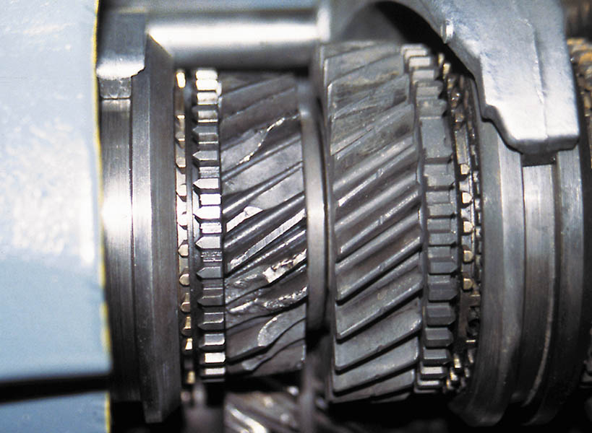
Figure 127.39 The cost to replace these gears may exceed the cost of a replacement transmission

Slide 67
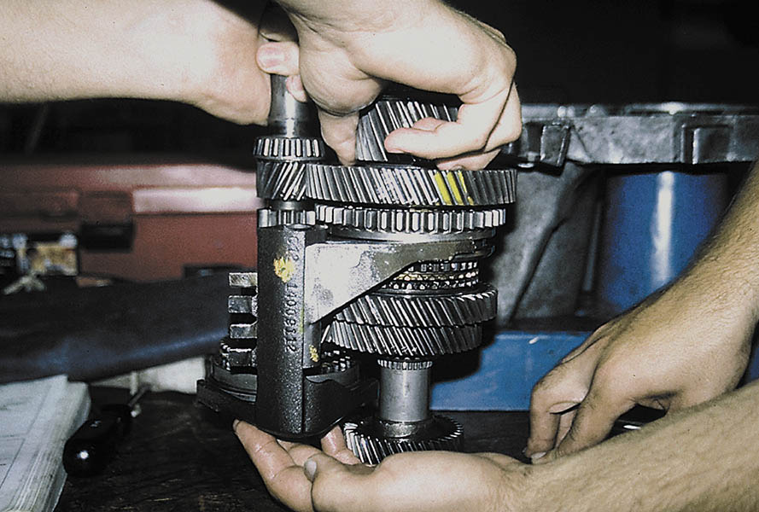
Figure 127.40 It often requires two people to assemble a transaxle because the shaft with the shifter forks needs to be placed into the case as an assembly, as on this unit

Slide 68
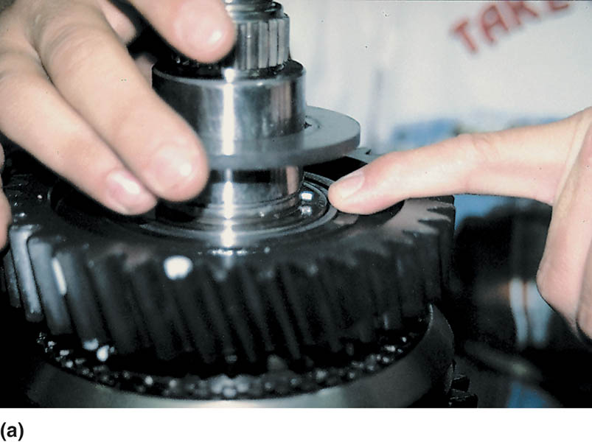
Figure 127.41 (a) During the disassembly of any manual transmission/transaxle, carefully check for the location of the snap rings. Often they are hidden. Consult the factory service manual or unit repair manual for information and procedures for the unit being serviced

Slide 69
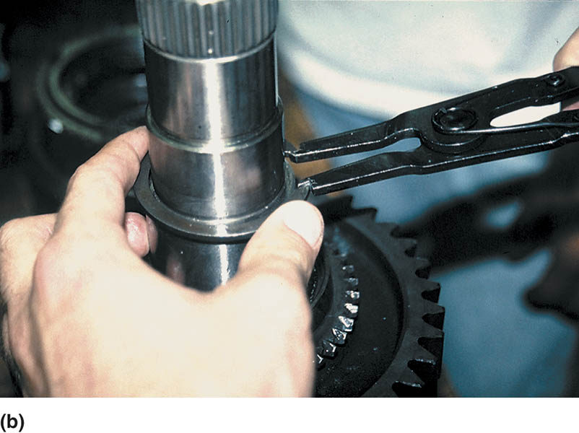
Figure 127.41 (b) Using snap-ring pliers to remove a snap ring. Many snap rings have an “up” side. Be sure to reinstall any snap rings in the correct direction

Slide 70
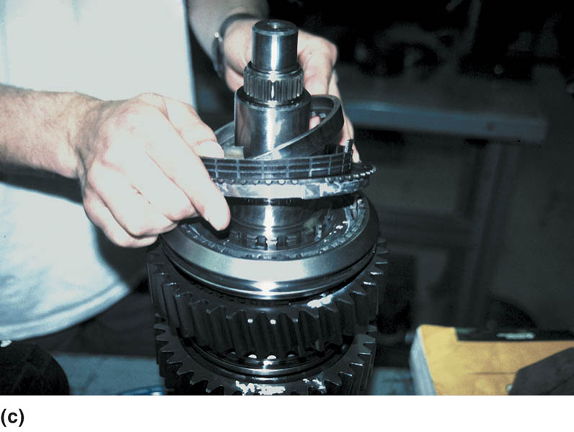
Figure 127.41 (c) After the snap ring is removed, some components can be simply lifted off the main shaft, while other gears may require the use of a press

Slide 71
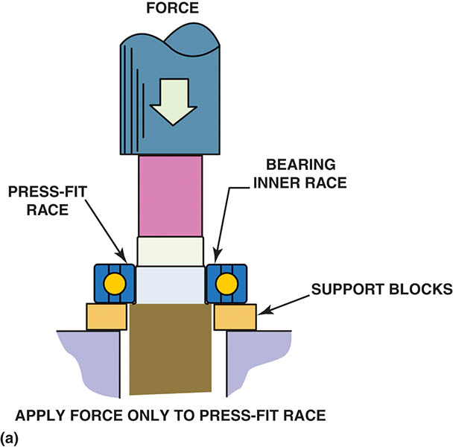
Figure 127.42 (a) When a ball bearing is pressed off a shaft, the bearing should be supported by the inner race (if possible) so the force is not exerted on the outer race by the balls

Slide 72
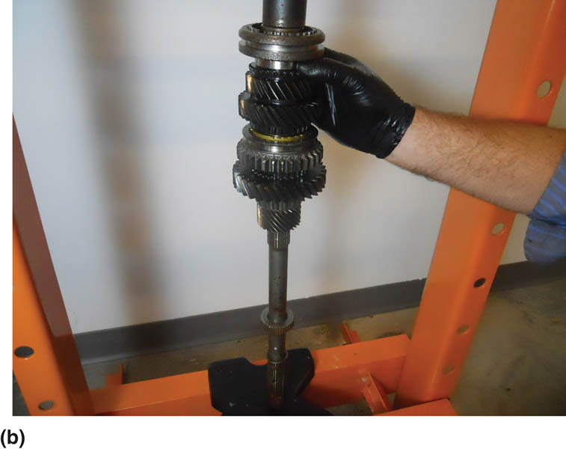
Figure 127.42 (b) Use caution when pressing parts onto the main shaft. Always follow the specified assembly procedures as found in service information

Slide 73
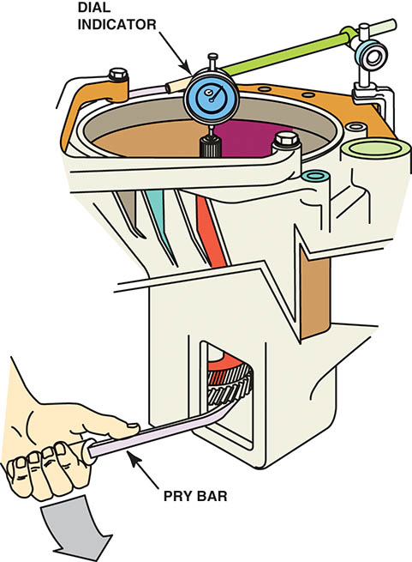
Figure 127.43 The dial indicator is set up to measure input shaft endplay as it is lifted and dropped using the pry bar

Slide 74
HARD-TO-SHIFT PROBLEM DIAGNOSIS
Several items that could be worn or defective can cause a manual transmission/transaxle to be difficult to shift, including:
Clutch not fully disengaging.
Worn synchronizer.
Worn, cracked, or loose shift forks.
Excessive input- or main-shaft end play.
Improper lubrication.

Slide 75
GEAR LUBRICATION
After the installation of the transmission/transaxle, the unit should be filled with the correct lubricant.
SAE 80W-90 (GL-4) gear lube
STF (synchromesh transmission fluid), but with friction characteristics designed for manual transmissions.
ATF (automatic transmission fluid)
Engine oil (usually SAE 5W-30)

Slide 76
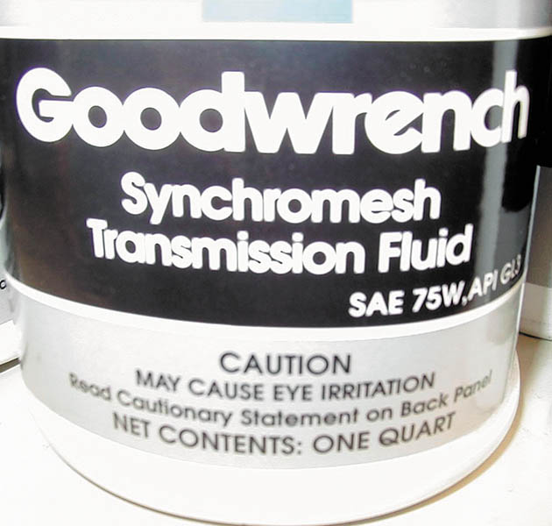
Figure 127.44 Some manual transmissions/transaxles require synchromesh transmission fluid

Slide 77
NV 1500 MANUAL TRANSMISSION SERVICE

Slide 78
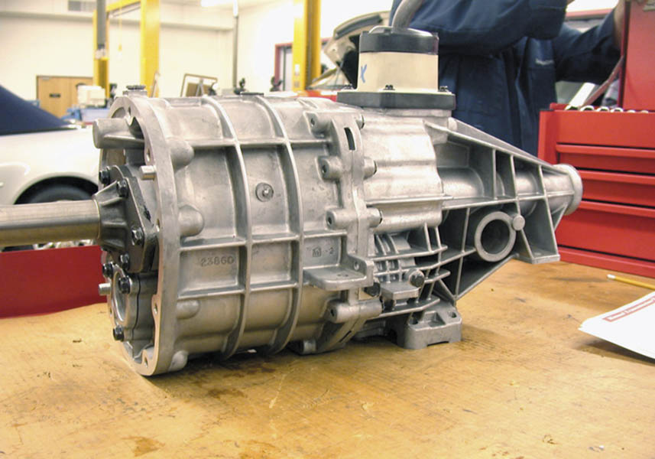
1 A NV-1500 five-speed manual transmission is used in two-wheel drive applications only.

Slide 79

2 The shifter assembly has been removed. Note the roll pin in the center of the shift lever socket.

Slide 80

3 Snap-ring pliers are being used to remove the snap ring retaining the input shaft bearing.

Slide 81

4 The upside down case is being separated showing the countershaft (top) and shift forks.

Slide 82

5 Before further disassembly can be accomplished, the shift lever socket roll pin must be driven out using a punch and a hammer.

Slide 83

6 The shift shaft and forks can now be removed.

Slide 84

7 The reverse idle gear is unbolted from the case and removed.

Slide 85

8 The output shaft assembly fifth gear (far left) and the synchronizer assemblies.

Slide 86

9 The bearing is being removed using a bearing splitter and a hydraulic press.

Slide 87

10 A speed gear (bottom) along with the double row needle bearing used between the shaft and the speed gear. The hub (center) is splined and rotates with the output shaft.

Slide 88

11 A synchronizer assembly being reassembled. It often takes several hands to hold the hub (center) and the sleeve (outer ring).

Slide 89

12 A hydraulic press is used to reassemble output shaft and bearing.

Slide 90

13 The assembled output shaft is held against the counter shaft to double check that all of the gears have been correctly assembled.

Slide 91

14 The assembled output shaft and counter shaft are being reinstalled in the transmission case.

Slide 92

15 The case halves are bolted together.

Slide 93

16 The last step is to assembly the shift lever and check for proper operation in all gear positions.

Slide 94
NV-350 TRANSAXLE SERVICE

Slide 95

1 After the transaxle has been removed from the vehicle and the fluid drained, place the transaxle on a work surface.

Slide 96

2 The bell housing case half containing the large output shaft front bearing (center) and the input shaft front bearing (smaller bearing on the left).

Slide 97

3 The differential assembly is simply lifted out of half of the case.

Slide 98

4 The input and output shafts are a press fit into the bearings and are also retained with a snap ring, which must be removed.

Slide 99

5 Using a special tool, the input and output shafts are pressed out of the housing using a hydraulic press.

Slide 100

6 The input shaft can be disassembled using a bearing splitter and a press, or two screwdrivers to pry the gears off the shaft.

Slide 101

7 This transaxle uses both brass and powdered metal synchronizer rings with a fiber (paper) inner cone surface.

Slide 102

8 Synchronizer ring gaps are being measured using a feeler (thickness) gauge. The factory specifications are usually 0.040 to 0.069 inches.

Slide 103

9 The gear clutch teeth should be inspected for wear.

Slide 104

10 An assembled synchronizer assembly containing a sleeve, keys, springs, and detent.

Slide 105

11 The input shaft (left) and the output shaft (right) are checked for proper assembly before being installed into the case.

Slide 106

12 The differential bearing preload is determined by measuring for zero end play; then adding the thickness shim under the bearing cup.

Slide 107

13 The bearing cup is being installed using an installation tool and a hammer.

Slide 108

14 All of the shift forks and shift arms must be aligned properly before installing the components into the case.

Slide 109

15 All of the components, including the differential (right), the output shaft (center), and the input shaft (left), plus the shift linkage are installed and checked for proper positioning.

Slide 110

16 The case halves being reinstalled. The bearings (top) must be pressed back onto the input and output shafts using a press.

Slide 111

17 The bell housing case being reattached.

Slide 112

18 The completed assembly. Notice the bearing cover (top) has already been installed.

Slide 113

Copyright

