Slide 1

Automotive Technology Principles, Diagnosis, and Service
Sixth Edition
Chapter 125
Alignment Diagnosis and Service
Copyright © 2018, 2015, 2011 Pearson Education, Inc. All Rights Reserved

Slide 2
LEARNING OBJECTIVES (1 of 3)
125.1 List the various checks that should be performed before aligning a vehicle.
125.2 Explain the diagnosis of lead, memory steer, and torque steer.
125.3 Describe alignment specifications and setup procedures.
125.4 Discuss how to measure camber, caster, SAI, toe, and TOOT.
125.5 Describe how to perform a pre-alignment inspection.

Slide 3
LEARNING OBJECTIVES (2 of 3)
125.7 List the types of alignments.
125.8 Explain how to adjust the rear camber, front camber, SAI, and included angle.
125.9 Describe how to set the toe, center the steering wheel, and adjust tolerance.
125.10 Explain the method of aligning electronic-suspension vehicles and modified vehicles.
125.11 Describe how to diagnose hidden structural damage.

Slide 4
LEARNING OBJECTIVES (3 of 3)
125.12 Describe how to reset the steering angle sensor.
125.13 This chapter will help prepare for ASE Suspension and Steering (A4) certification test content area “D” (Wheel Alignment Diagnosis, Adjustment, and Repair).

Slide 5
PURPOSE OF AN ALIGNMENT
Proper wheel alignment of all four wheels is important for the safe handling of any vehicle.
Tire life and fuel economy are maximized and vehicle handling is sure and predictable.

Slide 6
PRE-ALIGNMENT CORRECTION TECHNIQUES
There are four basic steps in the correction of any problem:
  Verify
  Isolate
  Repair the problem
  Recheck

Slide 7
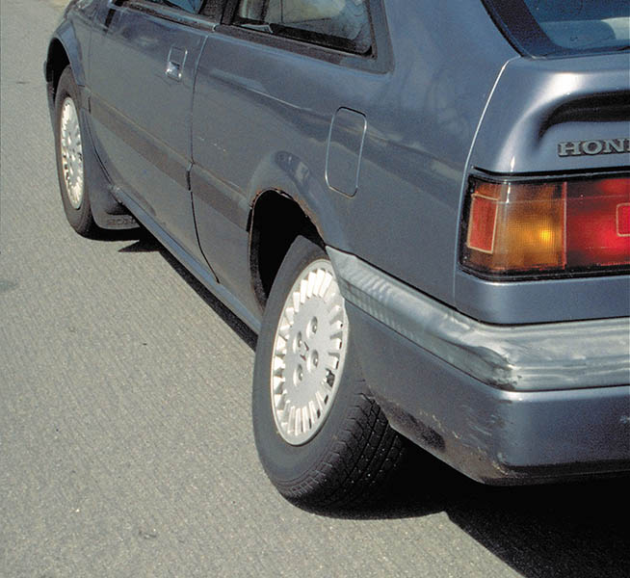
Figure 125.1 The owner of this Honda thought that all it needed was an alignment. Obviously, something more serious than an alignment caused this left rear wheel to angle inward at the top

Slide 8
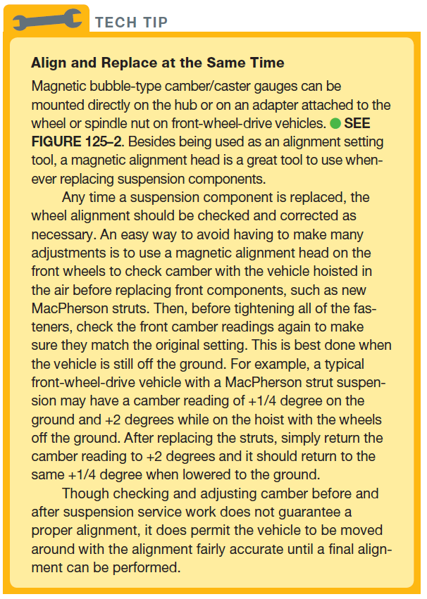
Tech Tip

Slide 9
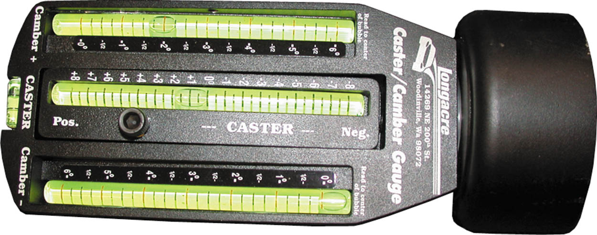
Figure 125.2 Magnetic bubble-type camber/caster gauge. To help it keep its strong magnetism, it is best to keep it stored stuck to a metal plate or metal tool box

Slide 10
PRE-ALIGNMENT CHECKS
Before checking or adjusting the front-end alignment, the following items should be checked and corrected, if necessary, as part of the pre-alignment checks:
  Tire inflation, size and tread depth
  Wear bearing adjustment
  Looseness or damage in front end components
  Vehicle ride height
  Looseness or damage in steering components
  Brake drag

Slide 11
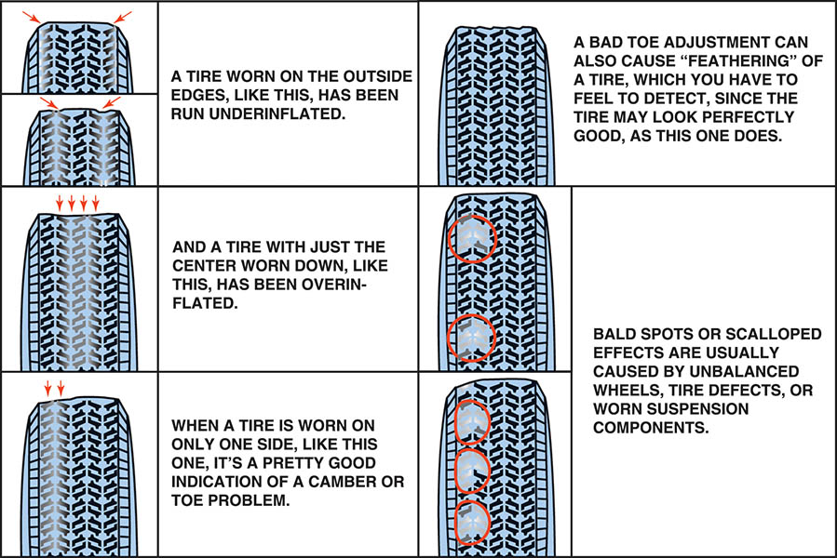
Figure 125.3 Typical tire wear chart as found in a service manual. Abnormal tire wear usually indicates a fault in a steering or suspension component that should be corrected or replaced before an alignment is performed

Slide 12
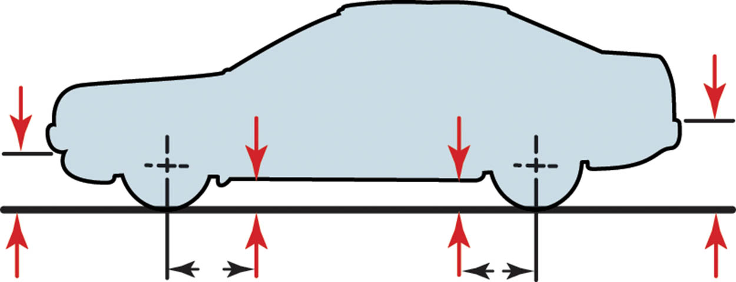
Figure 125.4 Measuring points for ride (trim) height vary by manufacturer

Slide 13
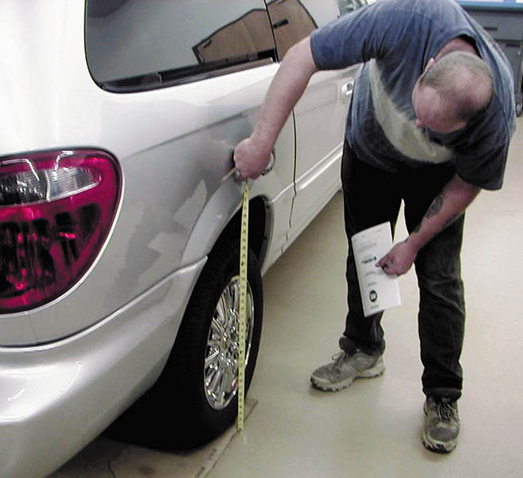
Figure 125.5 Measuring to be sure the left and right sides of the vehicle are of equal height. If this measurement is not equal side to side by as little as 1/8 inch (3 mm), it can affect the handling of the vehicle

Slide 14
QUESTION 1: ?
What is the purpose of a pre-alignment check?

Slide 15
ANSWER 1:
To find and correct any problems prior to the alignment.

Slide 16
LEAD/PULL
Diagnosis
Before aligning the vehicle, verify the customer complaint first, then perform a careful inspection.
  Inspect all tires for proper inflation.
  Road test the vehicle on a straight, level road.
  If the lead/pull problem is sometimes toward the left and other times toward the right, check for a memory steer condition.
  If the lead/pull problem occurs during acceleration and deceleration, check for a torque steer condition.

Slide 17
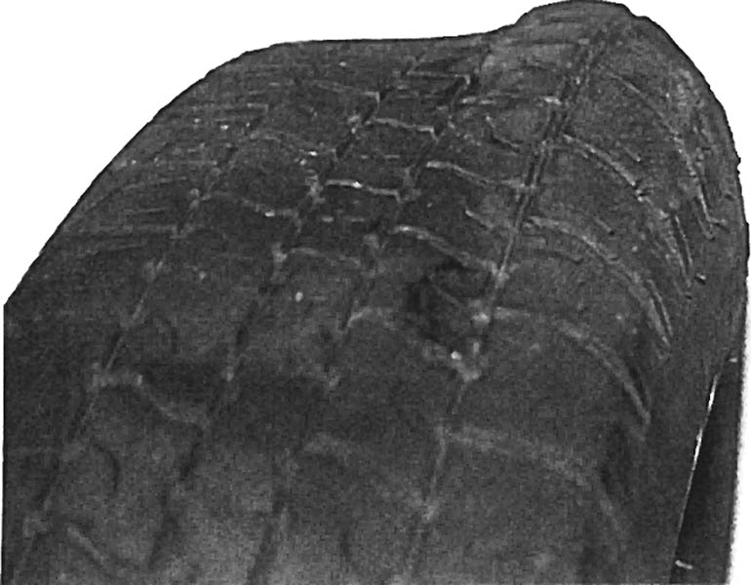
Figure 125.6 The bulge in this tire was not noticed until it was removed from the vehicle as part of a routine brake inspection. After replacing this tire, the vehicle stopped pulling and vibrating

Slide 18
MEMORY STEER
Diagnosis
  Memory steer is a term used to describe the lead or pull of a vehicle caused by faults in the steering or suspension system.
Correction
  A binding suspension or steering component is the most likely cause of memory steer.

Slide 19
TORQUE STEER
Diagnosis
  Torque steer occurs in front-wheel-drive vehicles when engine torque causes a front wheel to change its angle from straight ahead.
Correction
  Confirm it is not a normal condition.
  A defective motor mount may cause the powertrain to not be level.
  Confirm alignment angles.

Slide 20
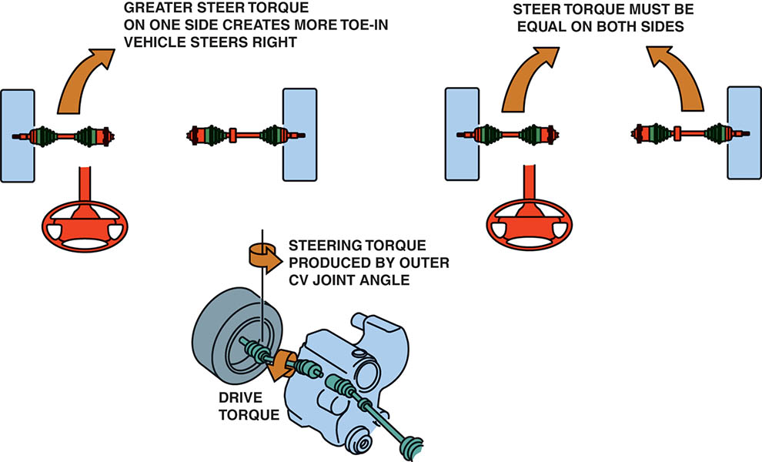
Figure 125.7 Equal outer CV joint angles produce equal steer torque (toe-in). If one side receives more engine torque, that side creates more toe-in and the result is a pull toward one side, especially during acceleration

Slide 21
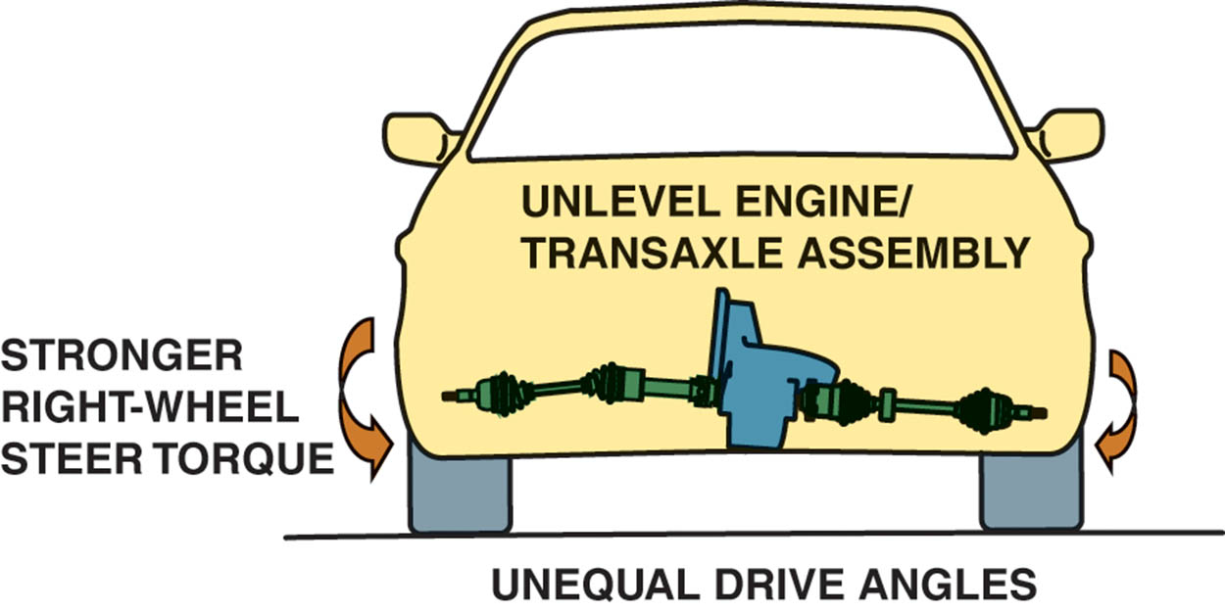
Figure 125.8 Broken or defective engine or transaxle mounts can cause the powertrain to sag, causing unequal drive axle shaft CV joint angles

Slide 22
ALIGNMENT SPECIFICATIONS (1 OF 2)
Before attempting any alignment, consider the following:
  Determine the correct specifications for the exact vehicle being checked.
  Ensure the vehicle is properly loaded.
Reading Alignment Specifications
  Maximum/Minimum/Preferred Method
  Plus or Minus Method

Slide 23
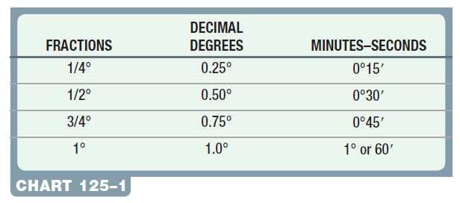
ALIGNMENT SPECIFICATIONS (2 OF 2)
Degrees, Minutes, and Fractions

Slide 24
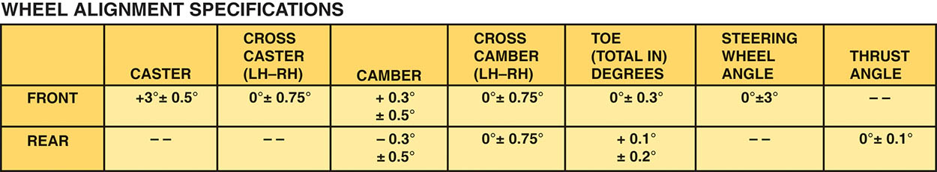
Figure 125.9 This alignment chart indicates the preferred setting with a plus or minus tolerance

Slide 25
ALIGNMENT SETUP PROCEDURES
Typical alignment procedures include the following:
  Drive onto the alignment rack straight and center ramps under vehicle.
  Chock the wheels.
  Attach and calibrate the wheel sensors to each wheel.
  Unlock all rack or turn plates.
  Lower the vehicle and jounce the suspension.
  Follow the procedures for the alignment equipment.

Slide 26
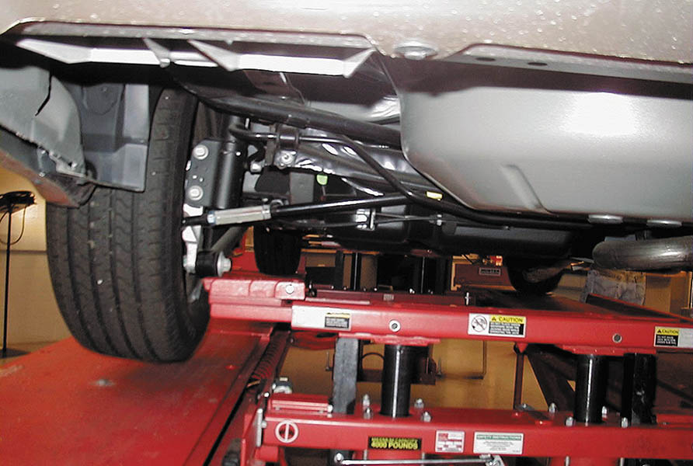
Figure 125.10 Using the alignment rack hydraulic jacks, raise the tires off the rack so that they can be rotated as part of the compensating process

Slide 27
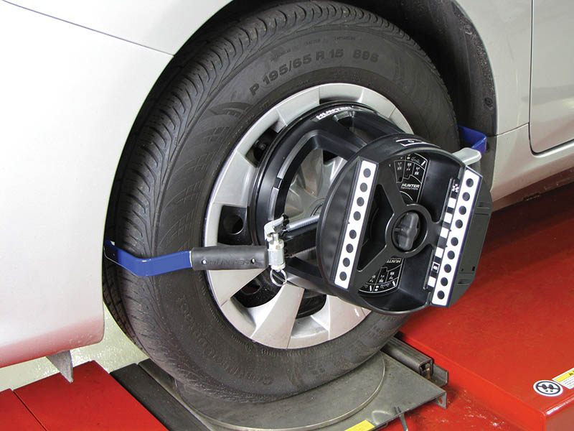
Figure 125.11 An optical-type wheel sensor. Compensation is achieved by simply rolling the vehicle backward and forward

Slide 28
MEASURING CAMBER, CASTER, SAI, TOE, AND TOOT (1 OF 2)
Camber
  Camber is measured with the wheels in the straight ahead position on a level platform.
Caster
  Caster is measured by moving the front wheels through an arc inward, then outward, from straight ahead.
SAI
  Steering axis inclination (SAI) is also measured by performing a caster sweep of the front wheels.

Slide 29
MEASURING CAMBER, CASTER, SAI, TOE, AND TOOT (2 OF 2)
TOE
  Toe is determined by measuring the angle of both front and both rear wheels from the straight-ahead (0 degree) position.
TOOT
  Toe-out on turns (TOOT) is a diagnostic angle and is normally not measured as part of a regular alignment, but it is recommended to be performed as part of a total alignment check.

Slide 30
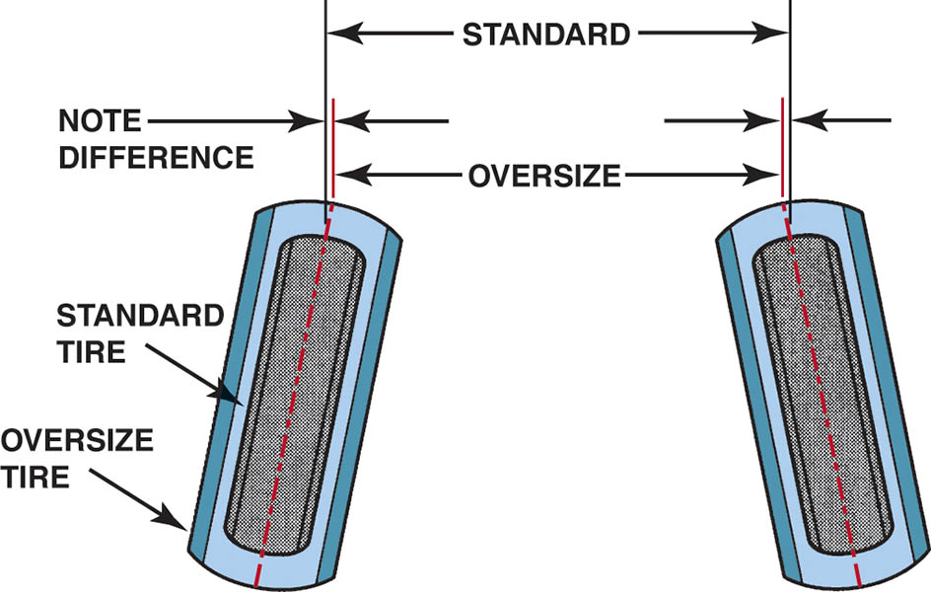
Figure 125.12 If toe for an oversize tire is set by distance, the toe angle will be too small. Toe angle is the same regardless of tire size

Slide 31
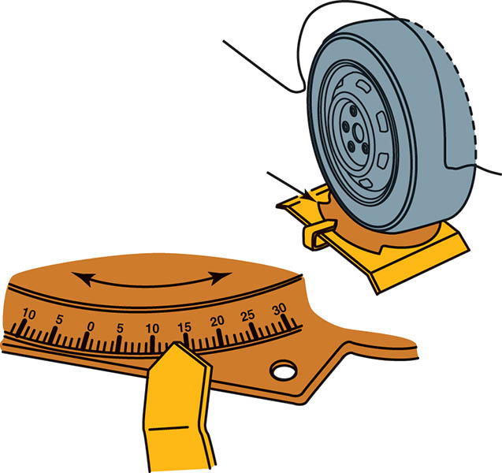
Figure 125.13 The protractor scale on the front turn plates allows the technician to test the turning radius by turning one wheel to an angle specified by the manufacturer and observing the angle of the other front wheel.

Slide 32
SPECIFICATIONS VERSUS ALIGNMENT READINGS
Secure both the alignment specifications from the manufacturer and the alignment readings and compare the two.
Before starting an alignment, check the SAI, included angle, setback, and toe-out on turns to make sure that there is no hidden damage such as a bent spindle or strut that was not found during the pre-alignment inspection.

Slide 33
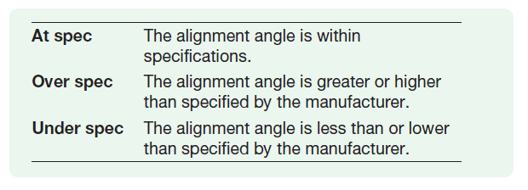
CHECKING FOR BENT STRUTS, SPINDLES, OR CONTROL ARMS
Before attempting to correct an alignment, check all the angles and use the appropriate diagnostic chart to check for hidden damage that a visual inspection may miss.
Understand the terms used in the charts:

Slide 34
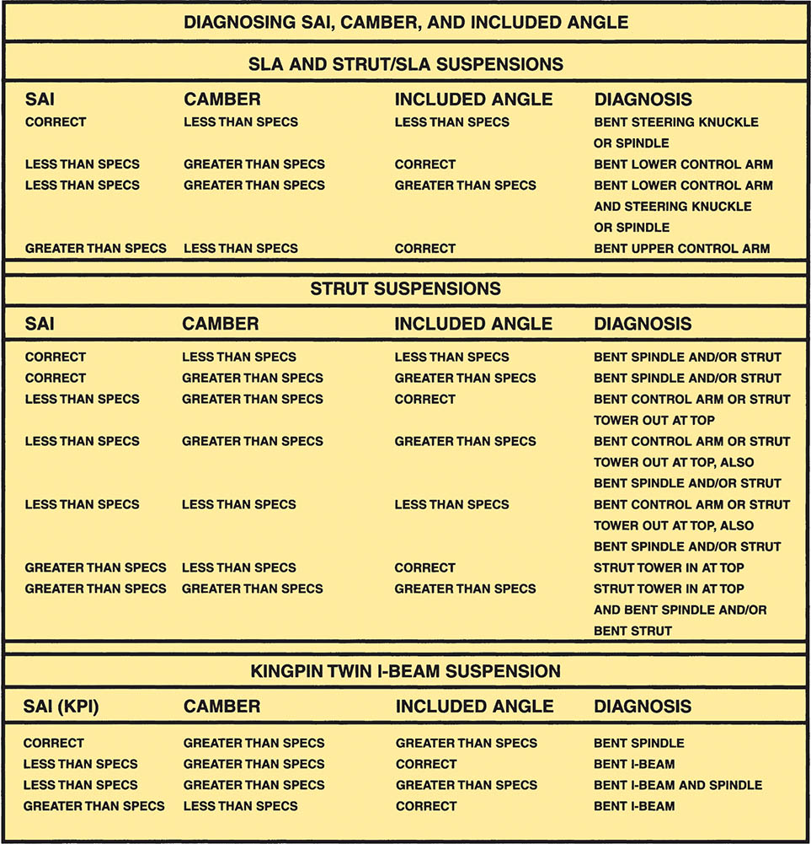
Figure 125.14 By checking the SAI, camber, and included angle, a damaged suspension component can be determined by using this chart

Slide 35
CHECKING FRAME ALIGNMENT OF FRONT-WHEEL-DRIVE VEHICLES
Many front-wheel-drive vehicles mount the drive train (engine and transaxle) and lower suspension arms to a subframe or cradle.
If the frame is shifted either left or right, this can cause differences in SAI, included angle, setback, and camber.

Slide 36
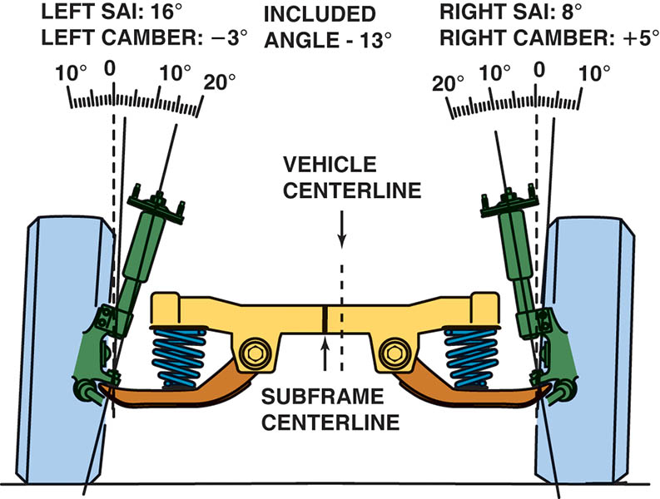
Figure 125.15 In this example, both SAI and camber are far from being equal side to side. However, both sides have the same included angle, indicating that the frame may be out of alignment.

Slide 37
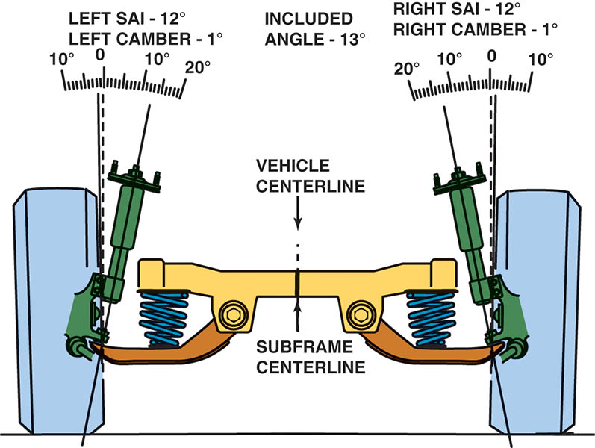
Figure 125.16 This is the same vehicle as shown in Figure 125–15, except now the frame (cradle) has been shifted over and correctly positioned. Notice how both the SAI and camber become equal without any other adjustments necessary

Slide 38
TYPES OF ALIGNMENTS (1 OF 3)
Geometric Centerline
  Used until the 1980s. Now considered obsolete.
Thrust Line
  A thrust line alignment uses the thrust angle of the rear wheels and sets the front wheels parallel to the thrust line.
Four-Wheel Alignment
  A four-wheel alignment is the most accurate alignment method and is necessary to ensure maximum tire wear and vehicle handling.

Slide 39
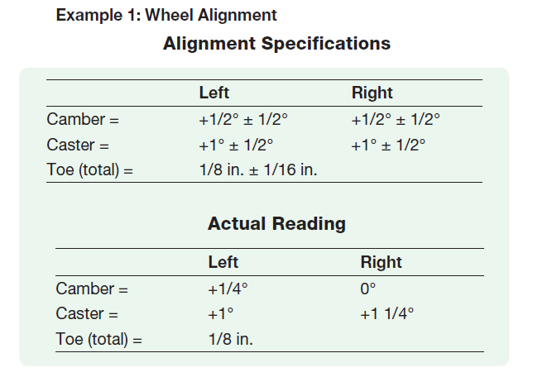
TYPES OF ALIGNMENTS (2 OF 3)
Sample Alignment Specifications and Readings

Slide 40
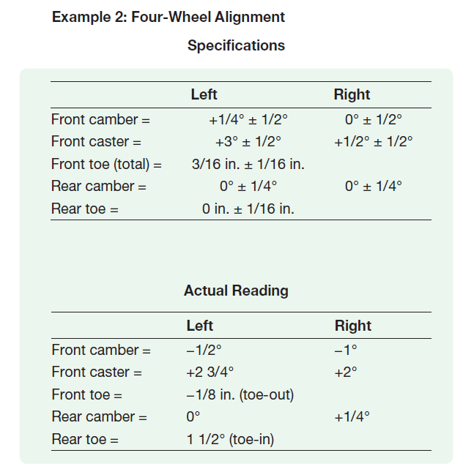
TYPES OF ALIGNMENTS (3 OF 3)

Slide 41
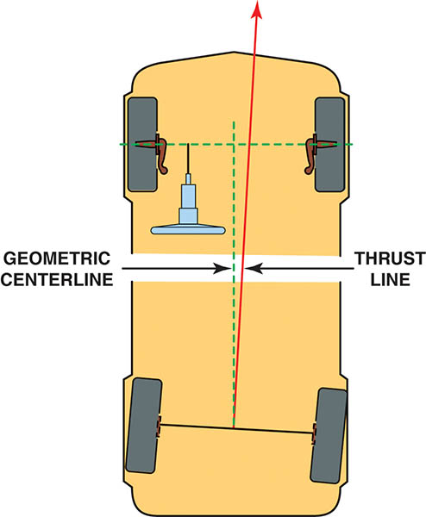
Figure 125.17 Geometric-centerline-type alignment sets the front toe readings based on the geometric centerline of the vehicle and does not consider the thrust line of the rear wheel toe angles

Slide 42

Figure 125.18 Thrust line alignment sets the front toe parallel with the rear-wheel toe

Slide 43
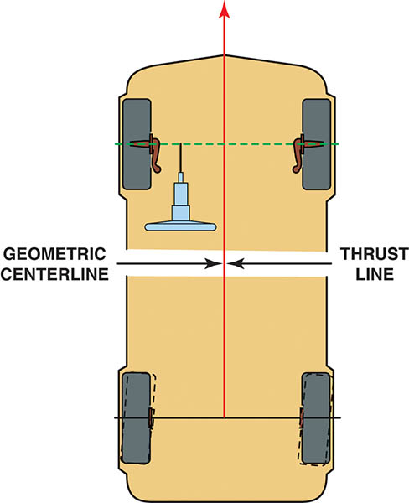
Figure 125.19 Four-wheel alignment corrects for any rear wheel toe to make the thrust line and the geometric centerline of the vehicle both the same

Slide 44
QUESTION 2: ?
What are the three types of alignment?

Slide 45
ANSWER 2:
Geometric centerline, Thrust line, and four-wheel alignment.

Slide 46
ADJUSTING REAR CAMBER
Adjusting rear camber is the first step in the four-wheel alignment process.
Rear camber is rarely made adjustable, but can be corrected by using aftermarket alignment kits or shims.
When using aftermarket plastic or metal alignment shims to correct angles, follow the manufacturers procedures.

Slide 47
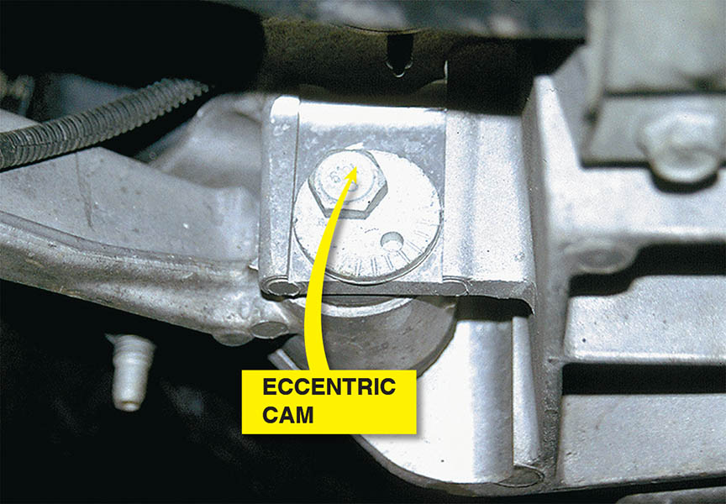
Figure 125.20 The rear camber is adjustable on this vehicle by rotating the eccentric cam and watching the alignment machine display

Slide 48
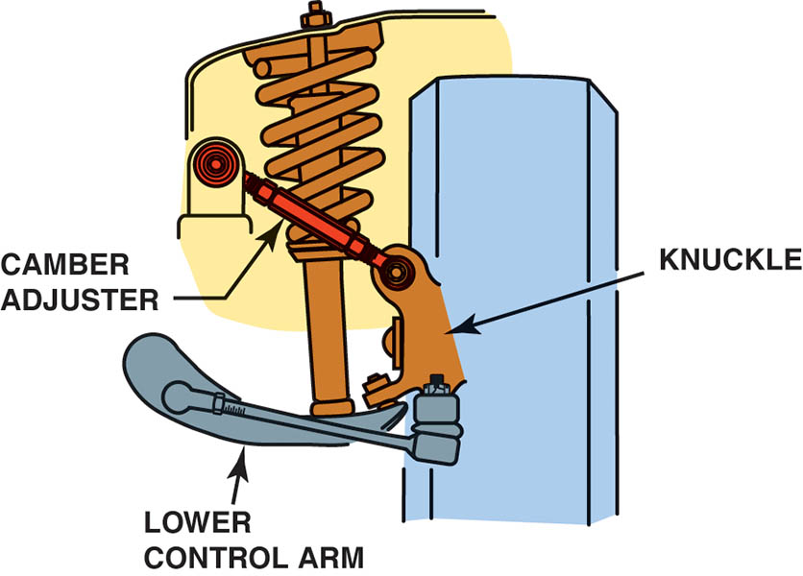
Figure 125.21 Some vehicles use a threaded fastener similar to a tie rod to adjust camber on the rear suspension

Slide 49
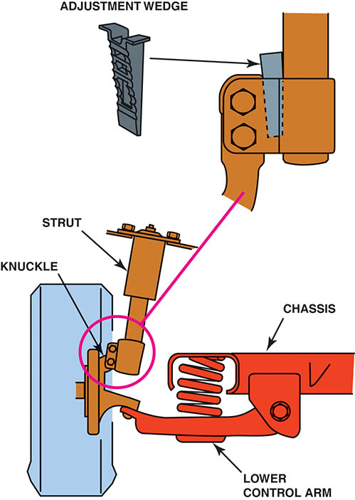
Figure 125.22 Aftermarket alignment parts or kits are available to change the rear camber

Slide 50
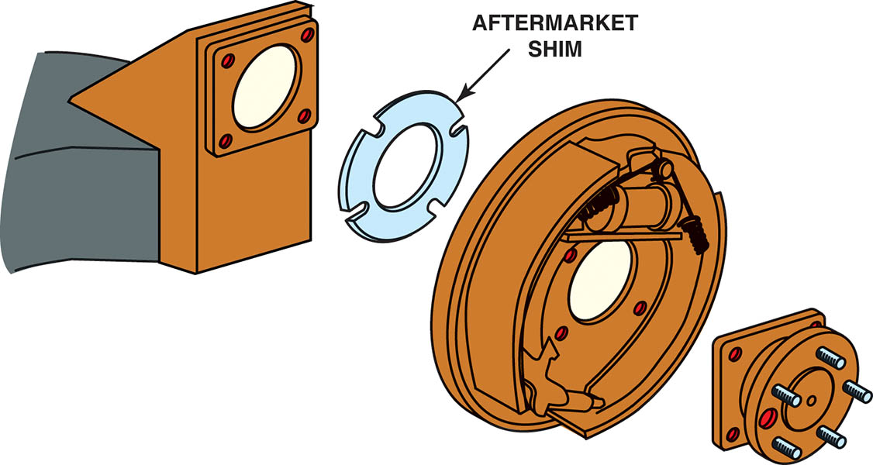
Figure 125.23 Full-contact plastic or metal shims can be placed between the axle housing and the brake backing plate to change rear camber, toe, or both

Slide 51
ADJUSTING REAR TOE
Many vehicle manufacturers provide adjustment for rear toe on vehicles that use an independent rear suspension.
Rear toe is often adjusted using an adjustable tie rod end or an eccentric cam on the lower control arm.
Most solid rear axles do not have a method to adjust rear toe except for aftermarket shims or kits.

Slide 52
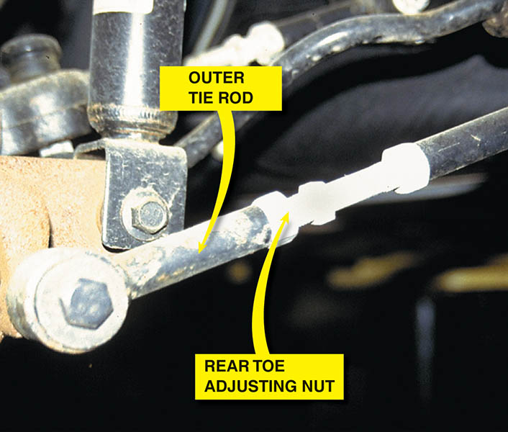
Figure 125.24 The rear toe was easily set on this vehicle. The adjusting nuts were easy to get to and turn. Adjusting rear toe is not this easy on every vehicle

Slide 53
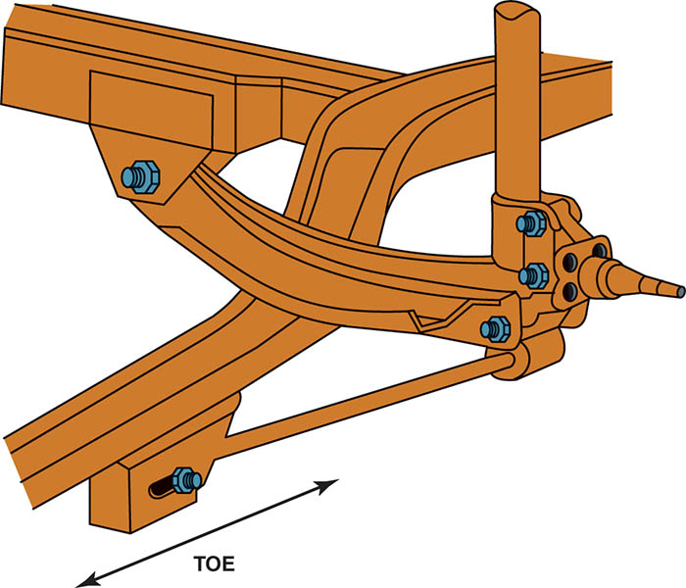
Figure 125.25 By moving various rear suspension members, the rear toe can be changed

Slide 54
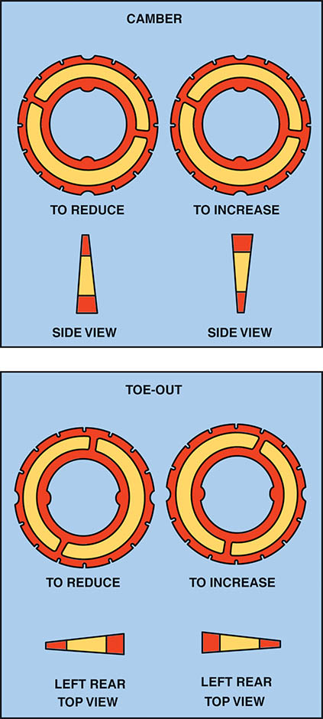
Figure 125.26 The use of these plastic or metal shims requires that the rear wheel as well as the hub assembly and/or backing plate be removed. Proper torque during reassembly is critical to avoid damage to the shims

Slide 55
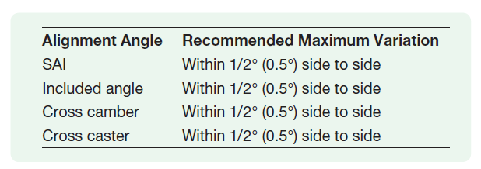
GUIDELINES FOR ADJUSTING FRONT CAMBER/SAI AND INCLUDED ANGLE
If the camber is adjusted at the base of the MacPherson strut, camber and included angle are changed and SAI remains the same.
If camber is adjusted by moving the upper strut mounting location, included angle remains the same, but SAI and camber change.

Slide 56
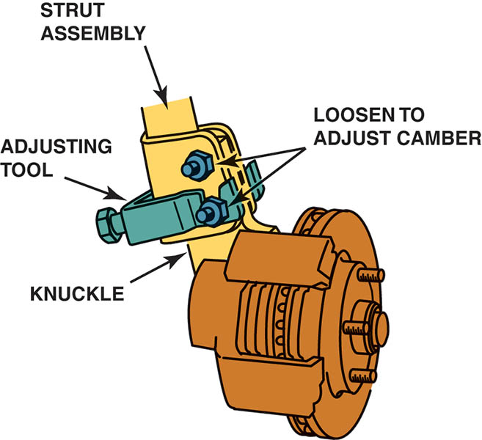
Figure 125.27 Many struts allow camber adjustment at the strut-to-knuckle fasteners. Here a special tool is being used to hold and move the strut into alignment with the fasteners loosened. Once the desired camber angle is achieved, the strut nuts are tightened and the tool is removed

Slide 57
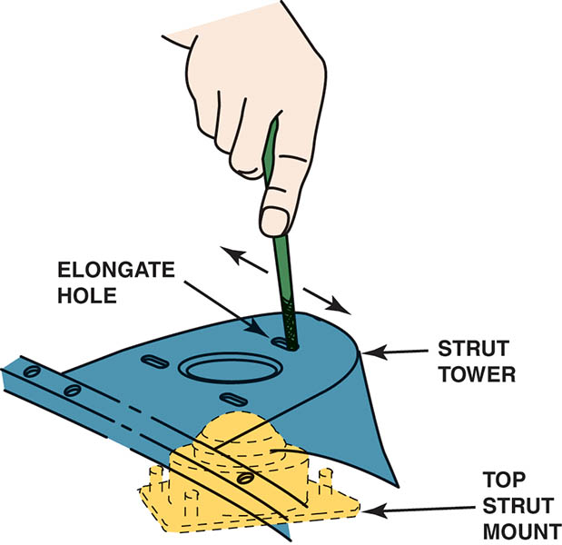
Figure 125.28 Some struts require modification of the upper mount for caster adjustment, as shown, or side-to-side to change camber

Slide 58
FRONT CAMBER/CASTER ADJUSTMENT METHODS
Many vehicles are constructed with only limited camber/caster factory adjustment.
Adjustment methods include:
  Shims
  Slots
  Cams
  Nuts

Slide 59
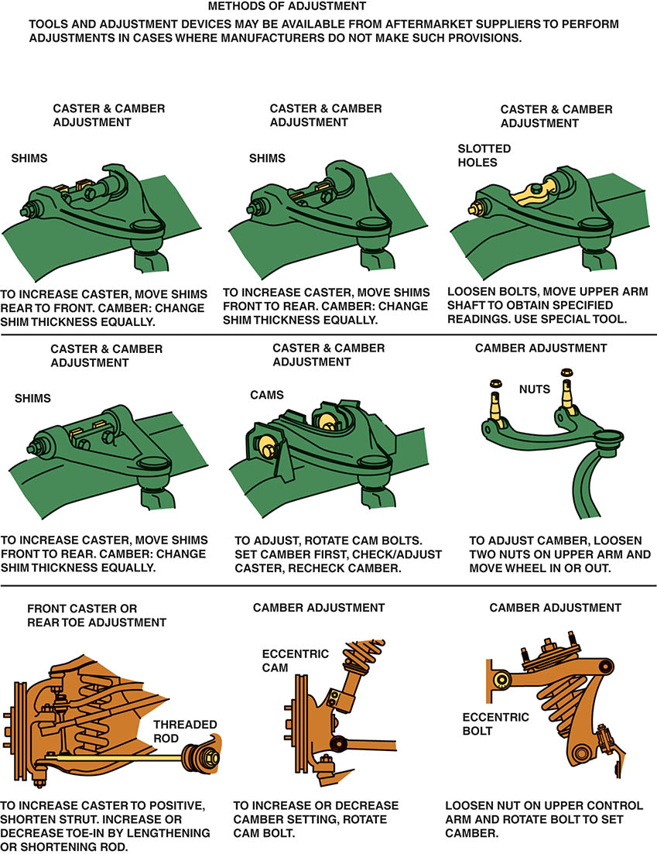
Figure 125.29 An example of the many methods that are commonly used to adjust front caster and camber

Slide 60
ADJUSTING FRONT CAMBER/CASTER
Most manufacturers recommend adjusting caster, then camber, before adjusting the toe.
As the caster is changed, the camber and toe also change.
If the camber is then adjusted, the caster is unaffected.

Slide 61
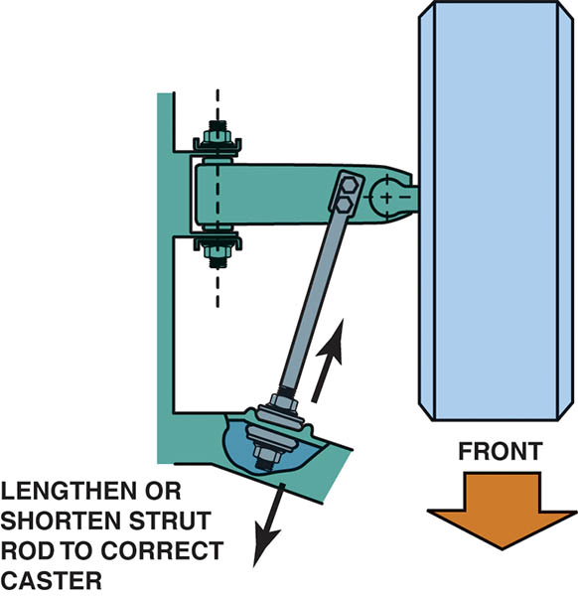
Figure 125.30 If there is a nut on both sides of the strut rod bushing, then the length of the rod can be adjusted to change caster

Slide 62
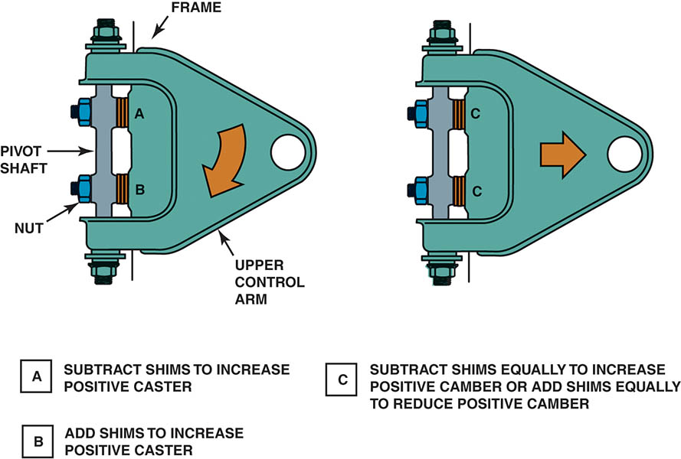
Figure 125.31 Placing shims between the frame and the upper control arm pivot shaft is a popular method of alignment for many SLA suspensions. Both camber and caster can be easily changed by adding or removing shims

Slide 63
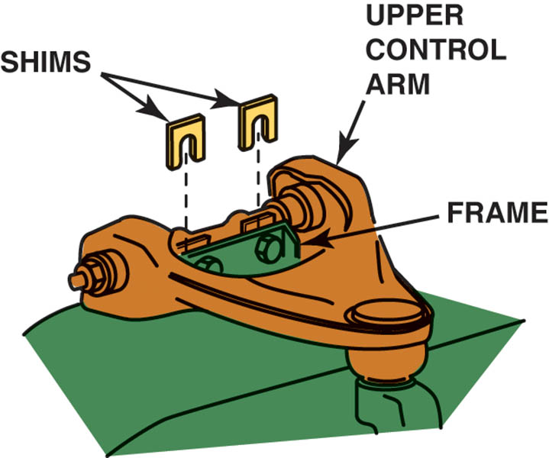
Figure 125.32 The general rule of thumb is that a 1/8 inch shim added or removed from both shim locations changes the camber angle about 1/2 degree. Adding or removing a 1/8 inch shim from one shim location changes the caster by about 1/4 degree

Slide 64
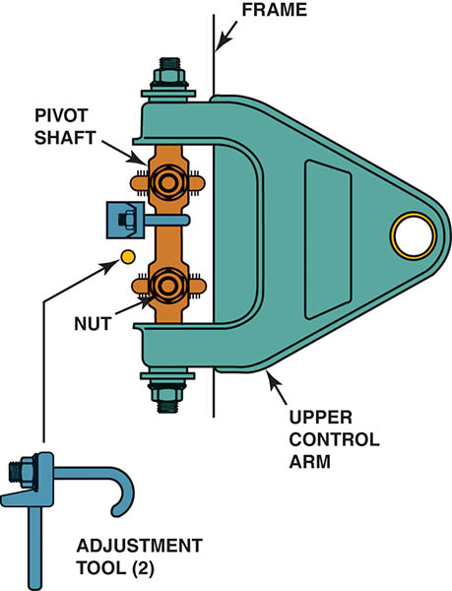
Figure 125.33 Some SLA-type suspensions use slotted holes for alignment angle adjustments. When the pivot shaft bolts are loosened, the pivot shaft is free to move unless held by special clamps as shown. By turning the threaded portion of the clamps, the camber and caster can be set and checked before tightening the pivot shaft bolts

Slide 65
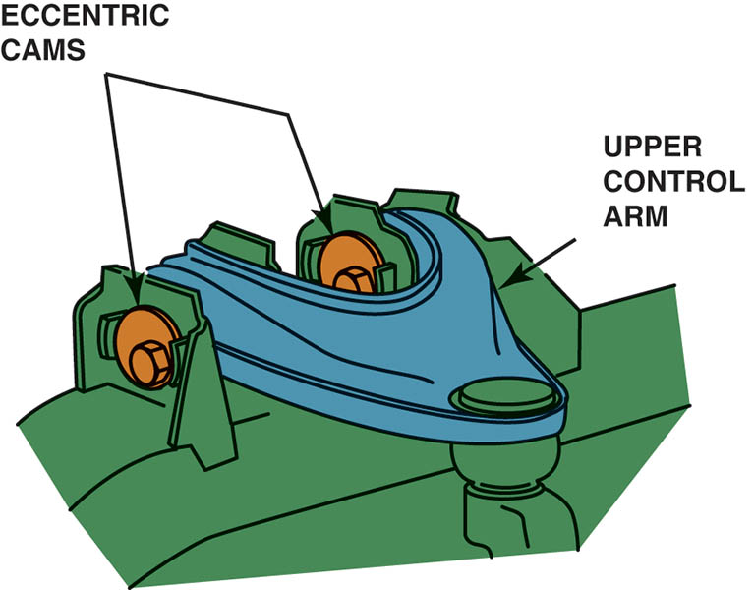
Figure 125.34 When the nut is loosened and the bolt on the eccentric cam is rotated, the upper control arm moves in and out. By adjusting both eccentric cams, both camber and caster can be adjusted

Slide 66
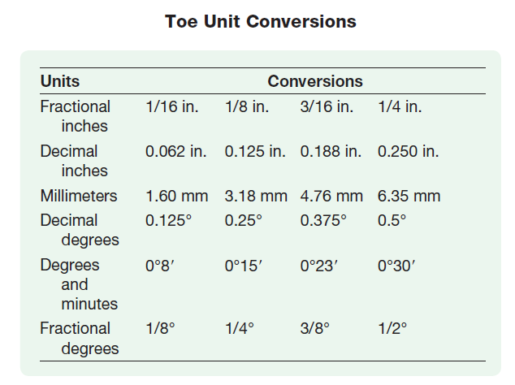
SETTING TOE (1 OF 2)

Slide 67
SETTING TOE (2 OF 2)
To make sure the steering wheel is straight after setting toe, it must be locked in the straight-ahead position while the toe is being adjusted.
To lock the steering wheel, always use a steering wheel lock that presses against the seat and the outer rim of the steering wheel.
Centerline steering is a centered steering wheel with the vehicle traveling a straight course.

Slide 68
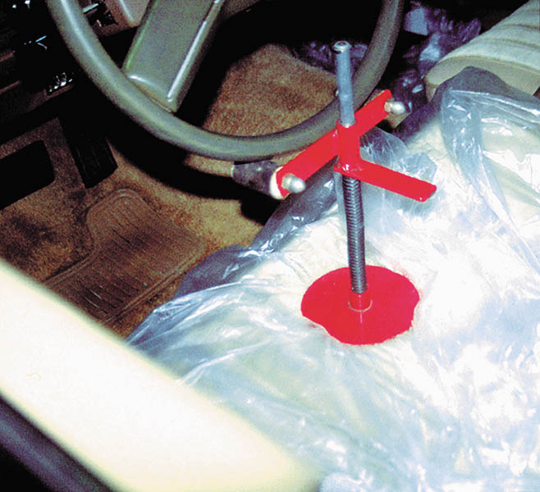
Figure 125.35 Many procedures for setting toe specify that the steering wheel be held in the straight-ahead position using a steering wheel lock, as shown. One method recommended by Hunter Engineering sets toe without using a steering wheel lock

Slide 69
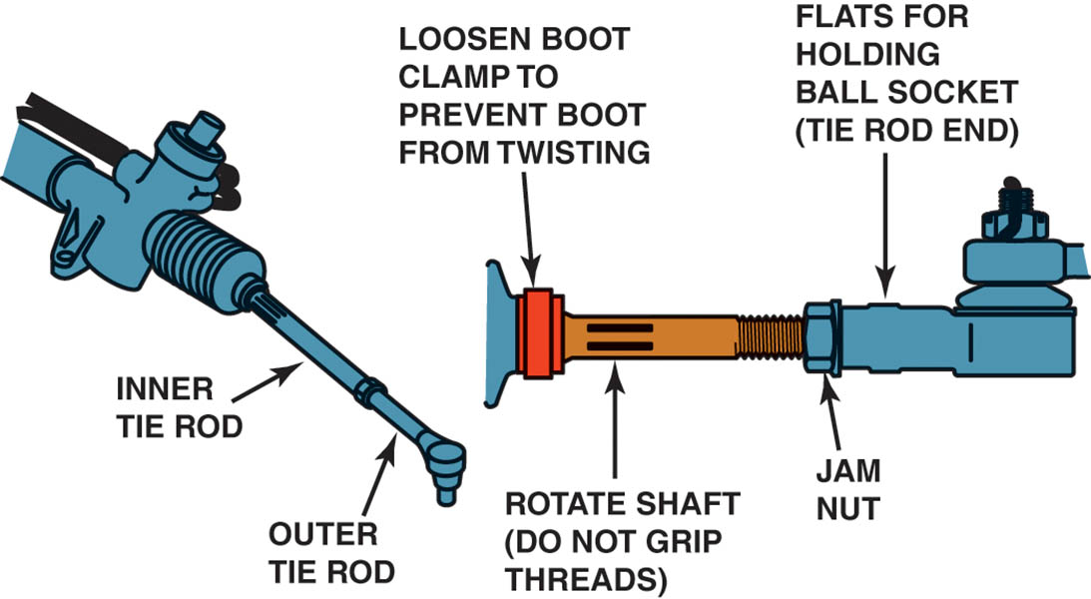
Figure 125.36 Adjusting toe by rotating the tie rod on a vehicle equipped with rack-and-pinion steering

Slide 70
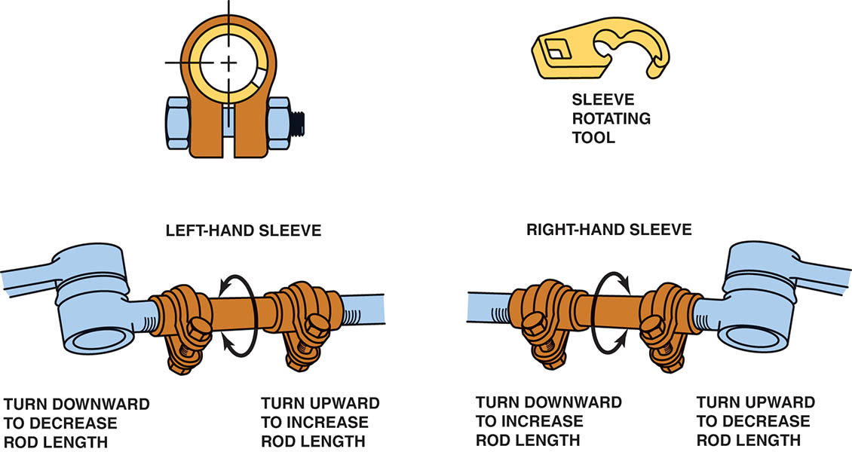
Figure 125.37 Toe is adjusted on a parallelogram type steering linkage by turning adjustable tie rod sleeves. Special tie rod sleeve adjusting tools should be used that grip the slot in the sleeve and will not crush the sleeve while it is being rotated

Slide 71
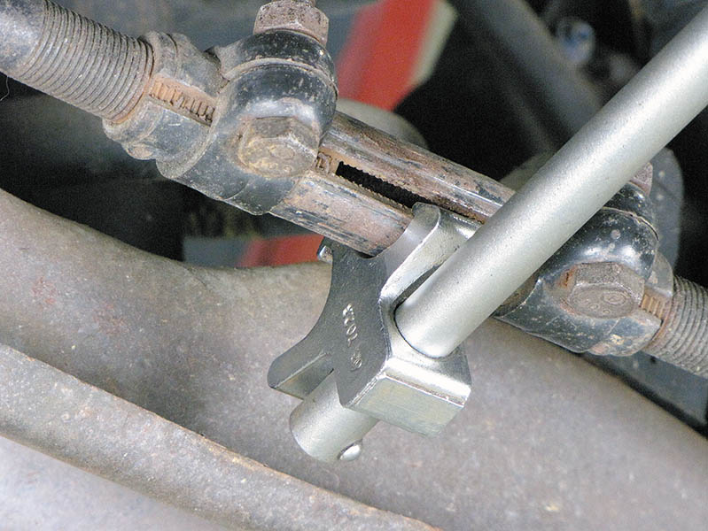
Figure 125.38 Special tie rod adjusting tools should be used to rotate the tie rod adjusting sleeves. The tool grips the slot in the sleeve and allows the service technician to rotate the sleeve without squeezing or damaging the sleeve

Slide 72
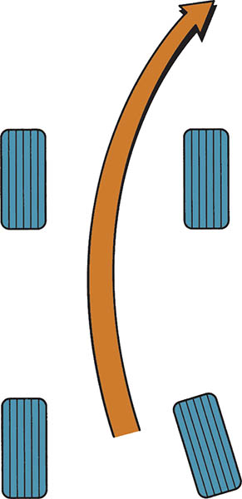
Figure 125.39 The toe-in on the right wheel creates a turning force toward the right

Slide 73
CENTERING THE STEERING WHEEL
Centerline steering should be accomplished by adjusting the tie rod length on both sides of the vehicle while the toe is set.

Slide 74
TOLERANCE ADJUSTMENT PROCEDURE
Many vehicles are designed and built without a method to change caster or camber, or both. (All vehicles have an adjustment for toe.)
Before trying an aftermarket alignment correction kit, many technicians first attempt to correct the problem by moving the suspension attachment points within the build tolerance.

Slide 75
AFTERMARKET ALIGNMENT METHODS
Aftermarket alignment kits are available for most vehicles.
Kit may include:
  Shims
  Cam bolts
  Parts with greater adjustment ranges

Slide 76
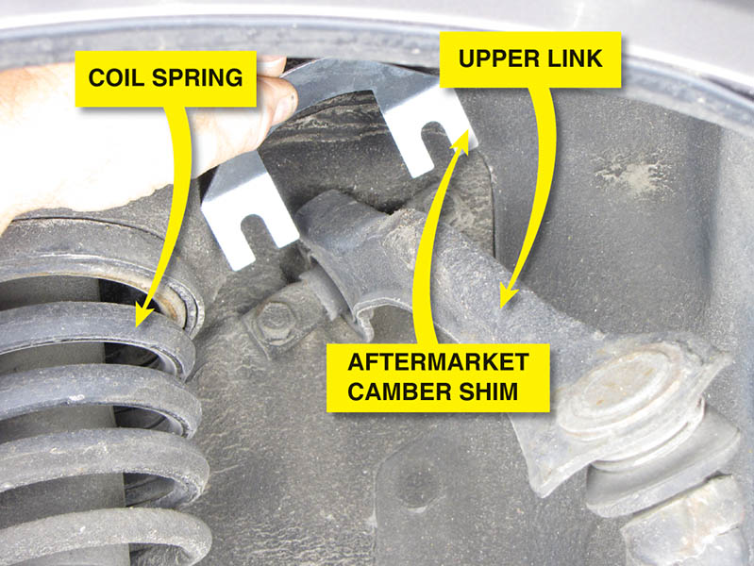
Figure 125.40 An aftermarket camber shim can be added to change the front camber on this Honda

Slide 77
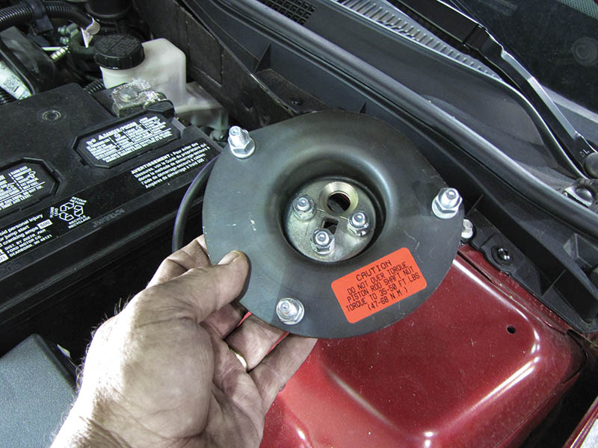
Figure 125.41 An aftermarket kit for this Ford is installed at the top of the strut tower and allows more camber and caster adjustment than is possible with the factory adjustment

Slide 78
ALIGNING ELECTRONIC SUSPENSION VEHICLES
Always check service information and read carefully all on-screen instructions on the alignment machine. Some examples of the steps that may be needed include:
  Verify the exact type of electronic suspension.
  Check that the ride height (suspension height) is within factory specifications.
The steering wheel angle, as well as the radar cruise control sensor, will often need to be recalibrated using a scan tool.

Slide 79
ALIGNING MODIFIED VEHICLES
Alignment Concerns
Because the ride height is changed from stock factory setting, the following can occur:
  The steering axis inclination (SAI) is now incorrect.
  Because the steering linkage and the control arms are no longer parallel, bump steer can occur.
  Because the ride height changed, camber and toe also changed.
Aftermarket kits are available to help correct some concerns.

Slide 80
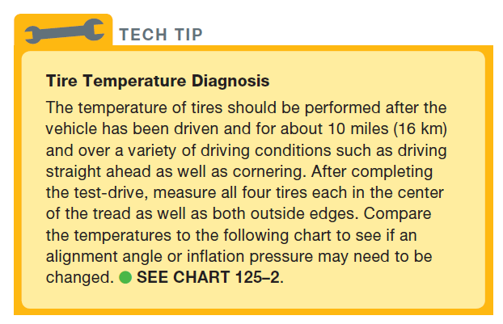
TECH TIP

Slide 81
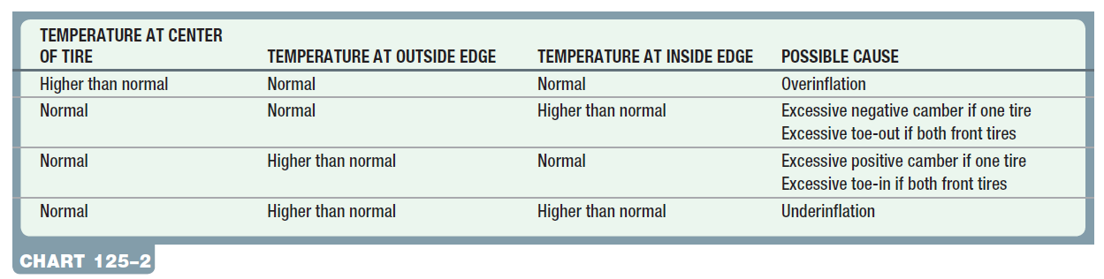
TIRE TEMPERATURE AND CAUSES

Slide 82
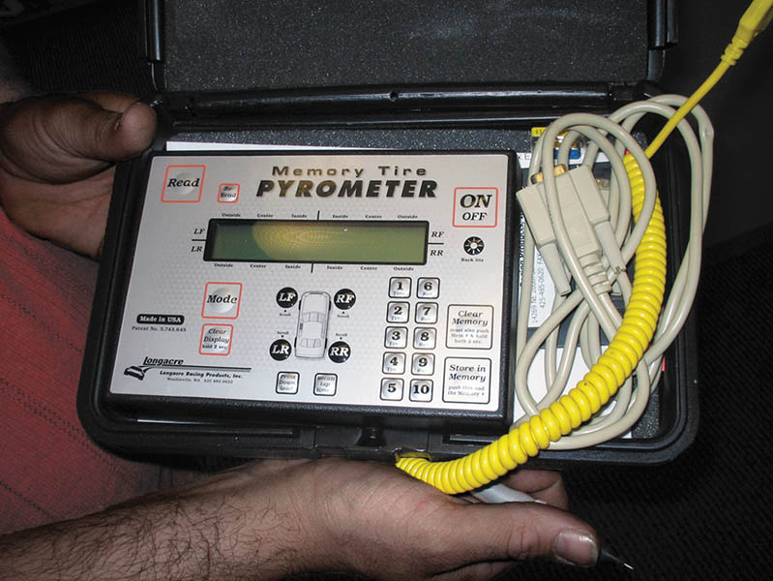
Figure 125.42 A typical tire temperature pyrometer. The probe used is a needle that penetrates about 1/4 inch (7 mm) into the tread of the tire for most accurate readings

Slide 83
HIDDEN STRUCTURAL DAMAGE
Many accidents result in hidden structural damage that can cause alignment angles to be out of specification.
Frame/Body Diagonals
  If the frame or body is perfectly square, then the diagonal measurements should be within 1/8 inch (3 mm) of each other.

Slide 84

Figure 125.43 Jig holes used at the assembly plant to locate suspension and drivetrain components. Check service information for the exact place to measure and the specified dimensions when checking for body or frame damage

Slide 85
RESET STEERING ANGLE SENSOR (SAS) (1 OF 2)
Purpose
  The steering angle sensor (SAS) is usually located at the base of the steering column inside the vehicle and monitors the driver’s steering input from straight ahead.
Analog Steering Angle Sensor
  An analog steering angle sensor is similar to a throttle position sensor with a three-wire connector.

Slide 86
RESET STEERING ANGLE SENSOR (SAS) (2 OF 2)
Digital Steering Angle Sensor
  These sensors produce a digital square wave signal with the frequency or pattern depending on the speed and direction the wheel is turning.
Resetting Steering Angle Sensors
  There are two basic types of reset procedures including:
  Self calibration
  Scan tool calibration

Slide 87

Figure 125.44 A typical analog-type steering angle sensor that uses a variable voltage as the steering wheel is rotated

Slide 88

Figure 125.45 The output of a typical digital steering angle sensor

Slide 89
QUESTION 3: ?
What is the purpose of the steering angle sensor?

Slide 90
ANSWER 3:
The sensor monitors the drivers input from straight ahead.

Slide 91
ALIGNMENT

Slide 92

1 Begin the alignment procedure by first driving the vehicle onto the alignment rack as straight as possible.

Slide 93

2 Stop just short of the turn plate and position the plate to center it on the tire tread.

Slide 94

3 Check and adjust tire pressures and perform the pre-alignment checks necessary to be assured of proper alignment.

Slide 95

4 Securely mount the targets or alignment heads.

Slide 96

5 Select the exact vehicle on the aligner. The aligner may have a bar code reader to enter the vehicle VIN.

Slide 97

6 On this vehicle, a message is displayed concerning the electric power steering.

Slide 98

7 This aligner uses a roll-forward compensation method.

Slide 99

8 An alignment reading is displayed even though caster has not yet been measured. The readings marked in red indicate that they are not within specifications.

Slide 100

9 Before performing a caster sweep, install a brake pedal depressor to keep the front wheels from rotating when the steering wheel is turned.

Slide 101

10 Perform the caster sweep by turning the front wheels inward, and then outward following the instructions on the screen.

Slide 102

11 Most alignment machines will display where to make the alignment correction and will often include drawings and live action videos that show the procedure.

Slide 103

12 The rear toe is being adjusted by rotating the eccentric cam on the lower control arm while watching the display.

Slide 104

13 The alignment machine display indicates that front caster is not a factory-adjustable angle.

Slide 105

14 Adjusting the front toe on this vehicle involves loosening the jam nut (left wrench) and rotating the tie rod using the right wrench.

Slide 106

15 An adjustment of the right front toe is needed to achieve a perfect alignment.

Slide 107

16 A final step is needed for vehicles equipped with a steering angle sensor and/or electric power steering. The wireless reset tool is attached to the data connector.

Slide 108

17 With the wheel straight ahead the sensor shows an incorrect reading.

Slide 109

18 Follow the instructions on the screen to reset the electric power steering (EPS) sensors. The final alignment readings can be printed and attached to the work order.

Slide 110

Copyright

