Slide 1
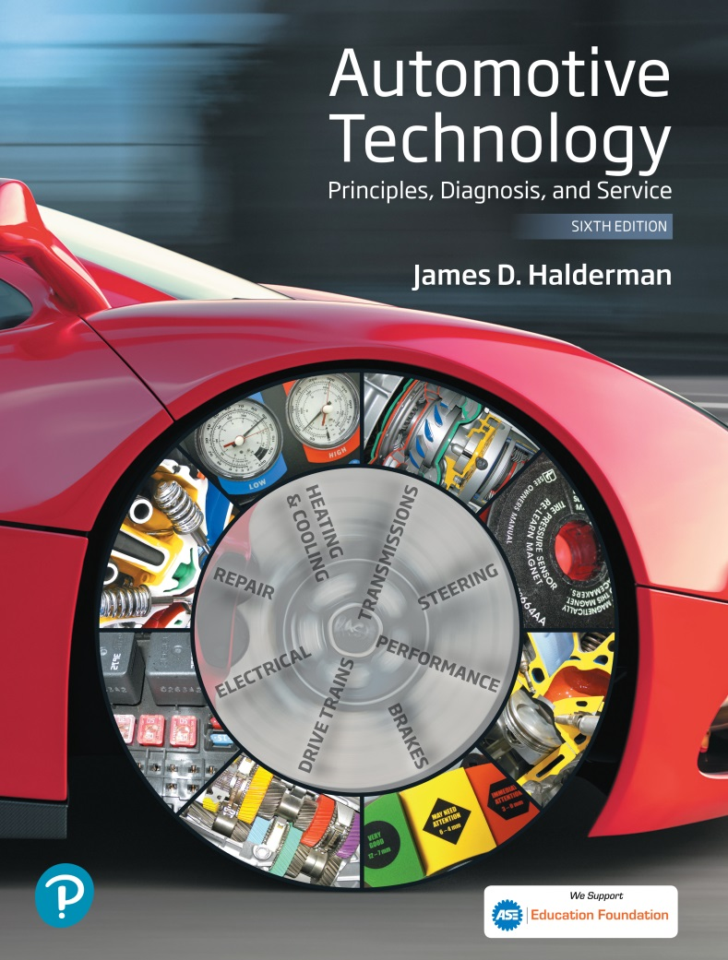
Automotive Technology Principles, Diagnosis, and Service
Sixth Edition
Chapter 124
Wheel Alignment Principles
Copyright © 2018, 2015, 2011 Pearson Education, Inc. All Rights Reserved

Slide 2
LEARNING OBJECTIVES (1 of 2)
124.1 Define wheel alignment and discuss alignment-related problems.
124.2 Define camber, caster, toe, and SAI.
124.3 Discuss included angle, scrub radius, turning radius, setback, thrust angle, and tracking.

Slide 3
LEARNING OBJECTIVES (2 of 2)
124.4 Explain the importance of four-wheel alignment.
124.5 This chapter will help prepare for ASE Suspension and Steering (A4) certification test content area “D” (Wheel Alignment Diagnosis, Adjustment, and Repair).

Slide 4
DEFINITION OF WHEEL ALIGNMENT
A wheel alignment is the adjustment of the suspension and steering to ensure proper vehicle handling with minimum tire wear.
The change in alignment angles may result from one or more of the following conditions:
  Wear of the steering and the suspension components
  Bent or damaged steering and suspension parts
  Sagging springs, which can change the ride height of the vehicle and therefore the alignment angles

Slide 5
ALIGNMENT RELATED PROBLEMS (1 OF 2)
Pull
  A pull is generally defined as a definite tug on the steering wheel toward the left or the right while driving straight on a level road.
Lead or Drift
  A lead or drift is a mild pull that does not cause a force on the steering wheel that the driver must counteract.
Road Crown Effects
  On a two-lane road, the center of the road is often higher than the berms, resulting in a road crown.

Slide 6
ALIGNMENT RELATED PROBLEMS (2 OF 2)
Wander
  A wander is a condition where constant steering wheel corrections are necessary to maintain a straight-ahead direction on a straight, level road.
Stiff Steering or Slow Return to Center
  Hard to steer problems caused by tires, low fluid, or mechanical binding.
Tramp or Shimmy Vibrations
  Up and down or side-to-side vibrations caused by out of balance or defective tires and wheels.

Slide 7
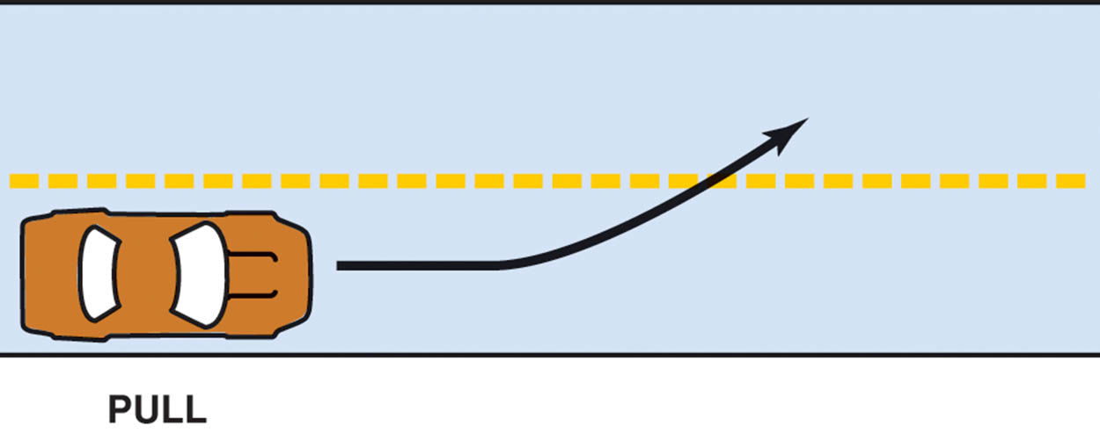
Figure 124.1 A pull is usually defined as a tug on the steering wheel toward one side or the other

Slide 8
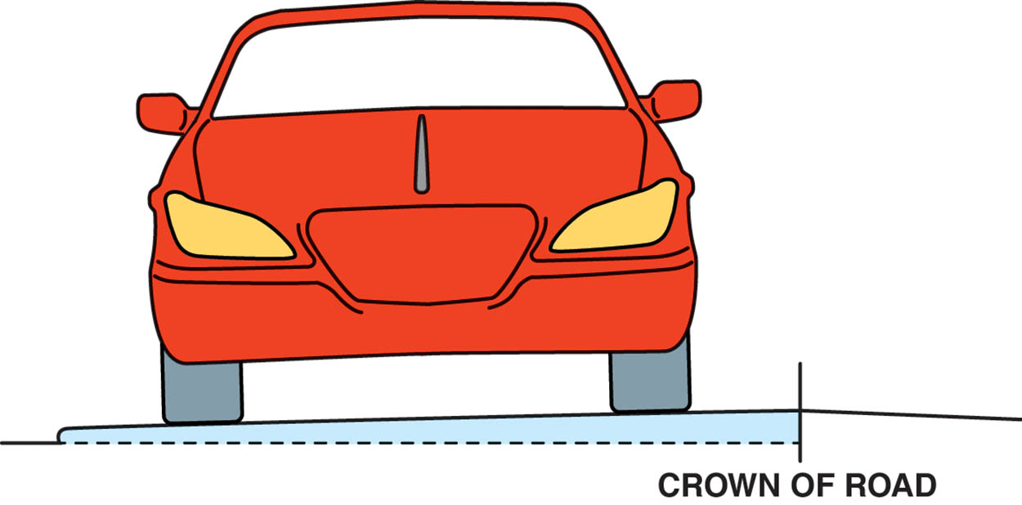
Figure 124.2 The crown of the road refers to the angle or slope of the roadway needed to drain water off the pavement

Slide 9
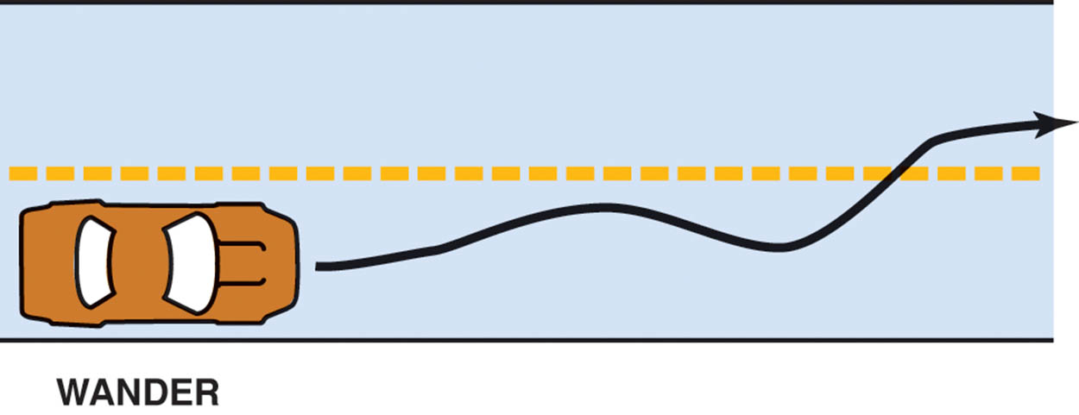
Figure 124.3 Wander is an unstable condition requiring constant driver corrections

Slide 10
CAMBER
Definition
  Camber is the inward or outward tilt of the wheels from true vertical as viewed from the front or rear of the vehicle.
  Camber can cause tire wear if not correct.
  Camber can cause pull if it is unequal side to side.
  Incorrect camber can cause excessive wear on wheel bearings.
  Camber is not adjustable on many vehicles.

Slide 11
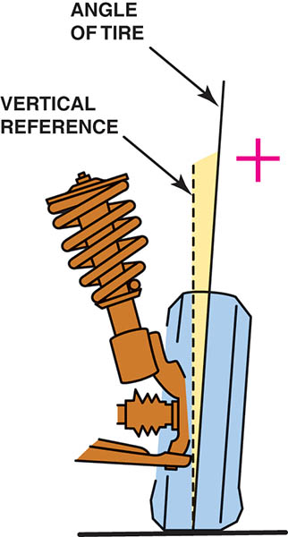
Figure 124.4 Positive camber. The dotted line represents true vertical, and the solid line represents the angle of the wheel

Slide 12
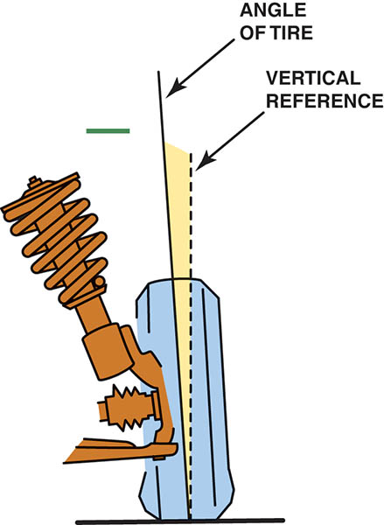
Figure 124.5 Negative camber. The dotted line represents true vertical and the solid line represents the angle of the wheel

Slide 13
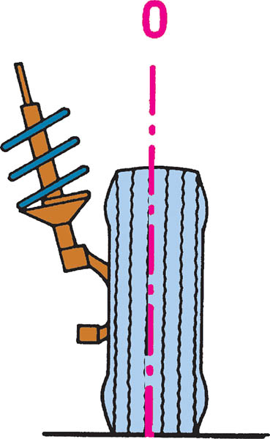
Figure 124.6 Zero camber. Note that the angle of the tire is true vertical

Slide 14
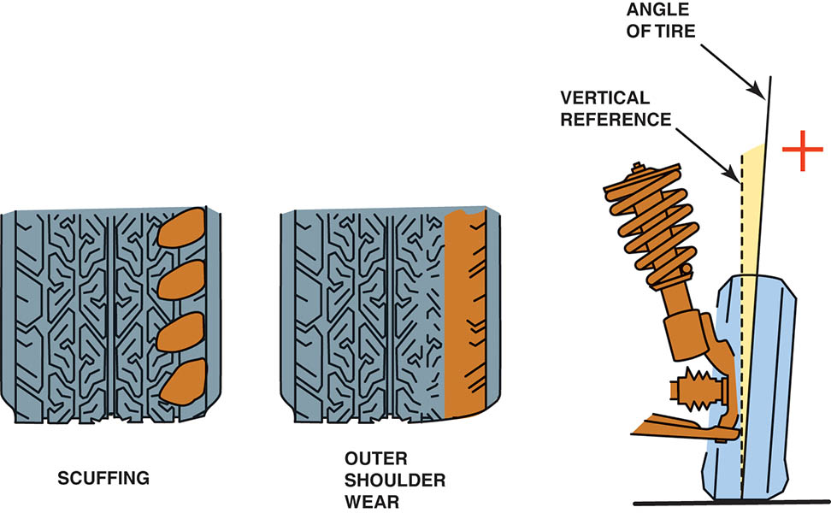
Figure 124.7 Excessive positive camber and how the front tires would wear due to the excessive camber

Slide 15
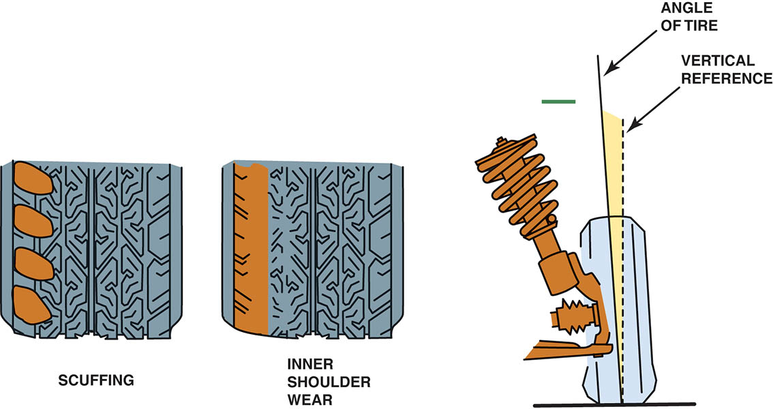
Figure 124.8 Excessive negative camber and how the front tires would wear due to the excessive camber

Slide 16
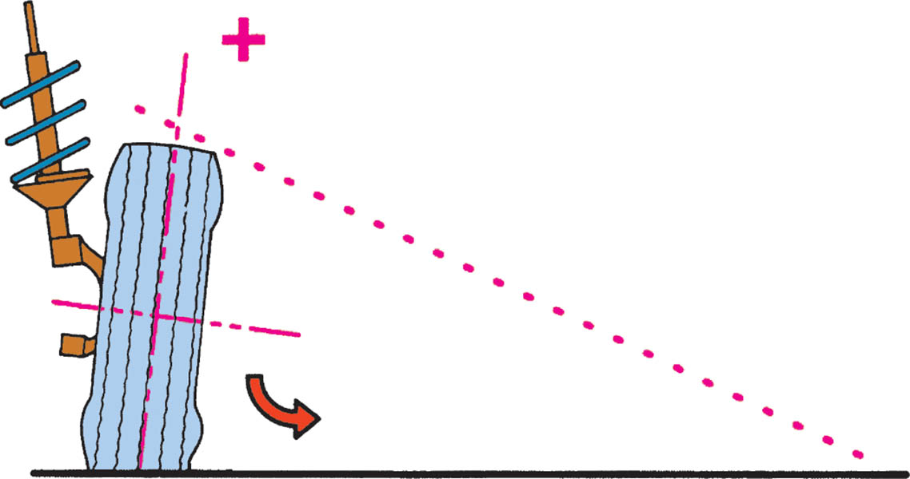
Figure 124.9 Positive camber tilts the tire and forms a cone shape that causes the wheel to roll away or pull outward toward the point of the cone

Slide 17
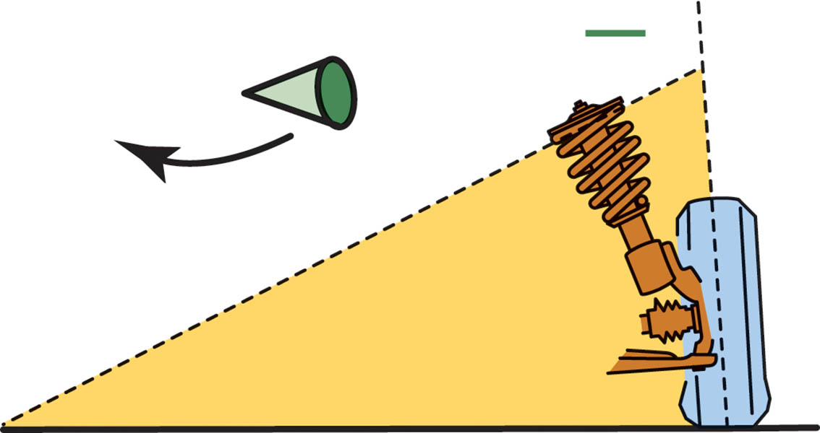
Figure 124.10 Negative camber creates a pulling force toward the center of the vehicle

Slide 18
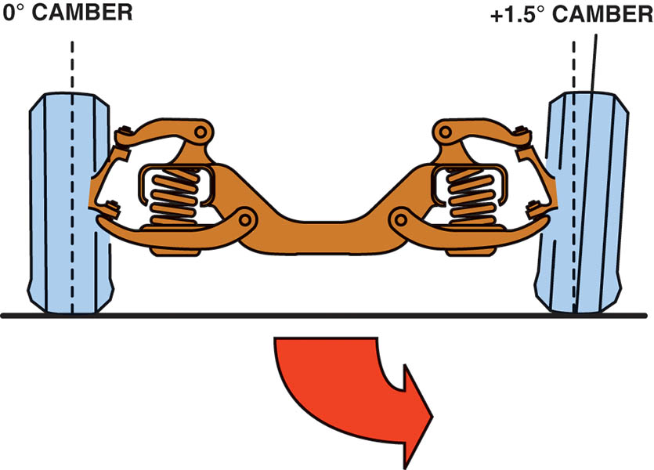
Figure 124.11 If camber angles are different from one side to the other, the vehicle will pull toward the side with the most camber

Slide 19
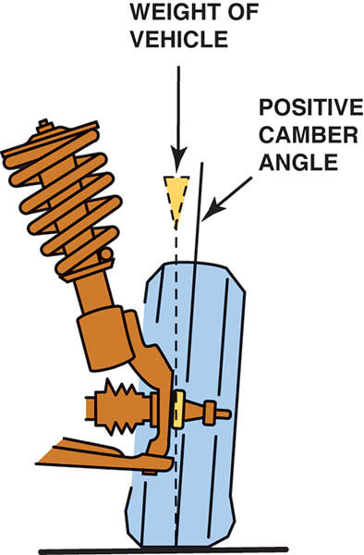
Figure 124.12 Positive camber applies the vehicle weight toward the larger inner wheel bearing. This is desirable because the larger inner bearing is designed to carry more vehicle weight than the smaller outer bearing

Slide 20
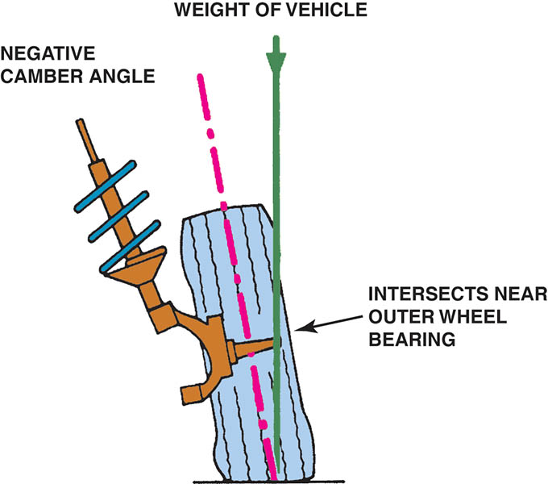
Figure 124.13 Negative camber applies the vehicle weight to the smaller outer wheel bearing. Excessive negative camber, therefore, may contribute to outer wheel bearing failure

Slide 21
QUESTION 1: ?
What is the effect of unequal camber?

Slide 22
ANSWER 1:
  Camber can cause pull if it is unequal side to side.

Slide 23
CASTER
Definition
  Caster is the forward or rearward tilt of the steering axis in reference to a vertical line as viewed from the side of the vehicle.
  Caster is not a tire-wearing angle, but positive caster does cause changes in camber during a turn.
  Caster is a stability angle.
  Caster can cause pull if unequal.
  Caster is not adjustable on many vehicles.
  Caster should be equal on both sides.

Slide 24
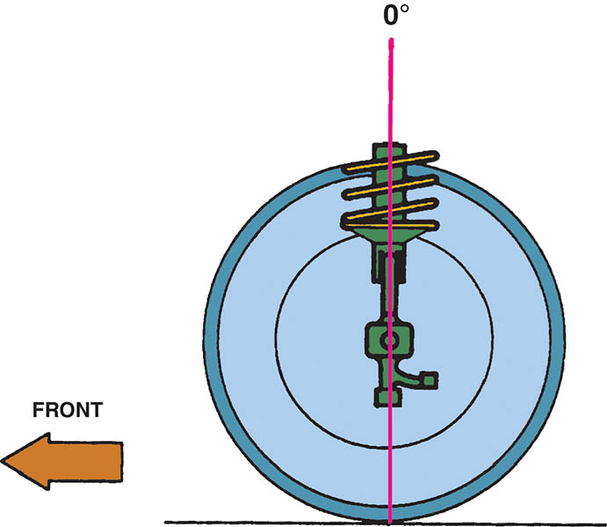
Figure 124.14 Zero caster

Slide 25
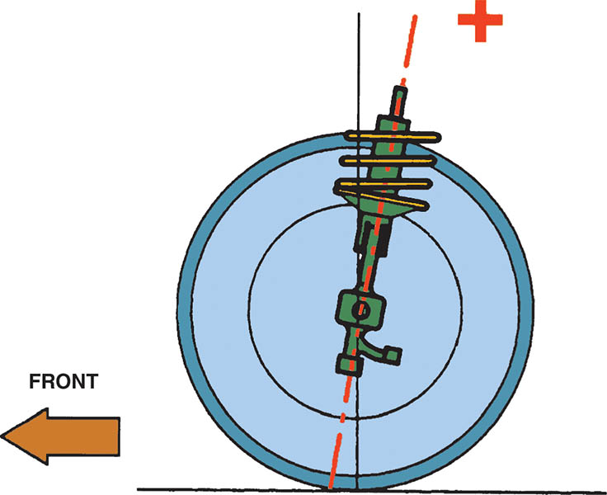
Figure 124.15 Positive (+) caster

Slide 26
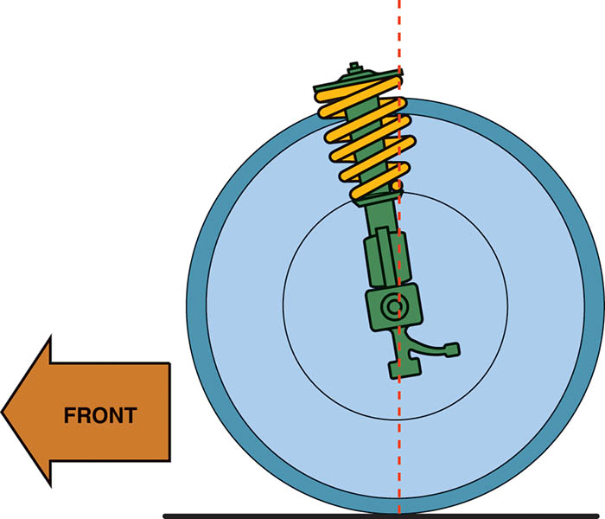
Figure 124.16 Negative (−) caster is seldom specified on today’s vehicles because it tends to make the vehicle unstable at highway speeds. Negative caster was specified on some older vehicles not equipped with power steering to help reduce the steering effort

Slide 27
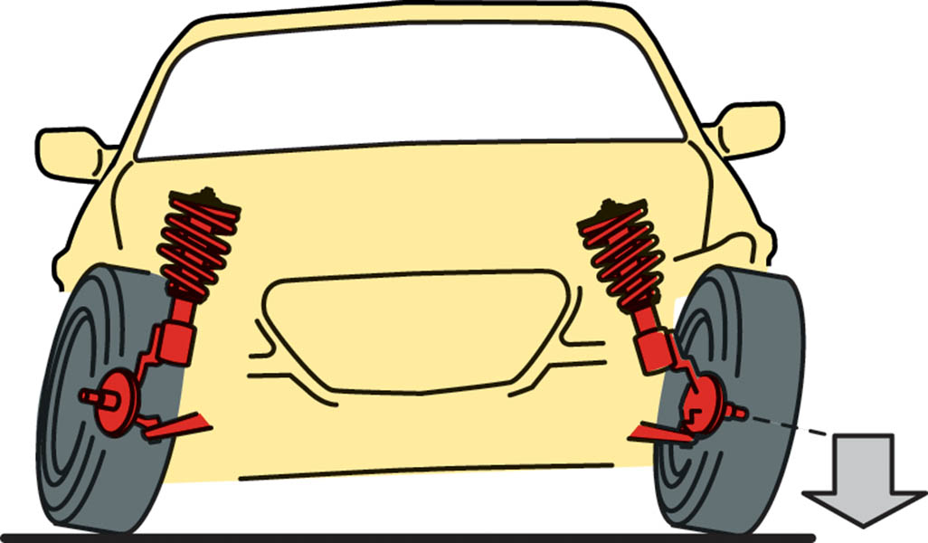
Figure 124.17 As the spindle rotates, it lifts the weight of the vehicle due to the angle of the steering axis

Slide 28
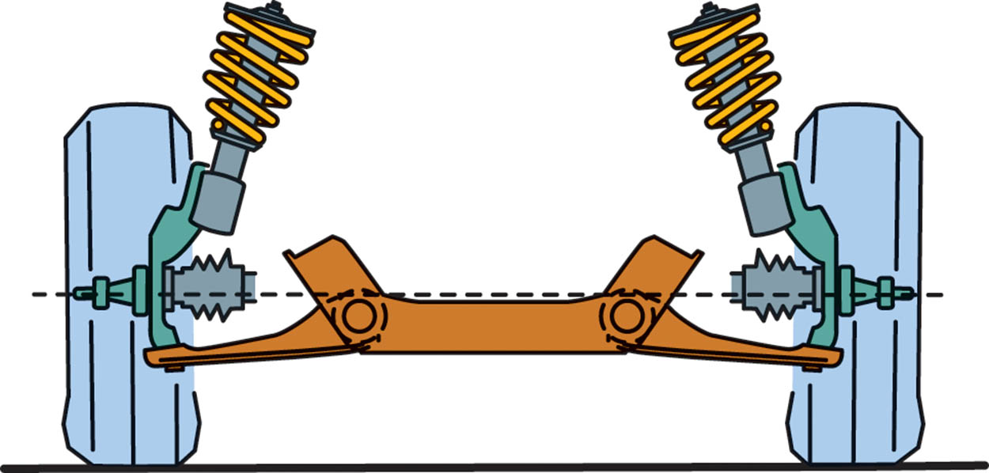
Figure 124.18 Vehicle weight tends to lower the spindle, which returns the steering to the straight-ahead position

Slide 29
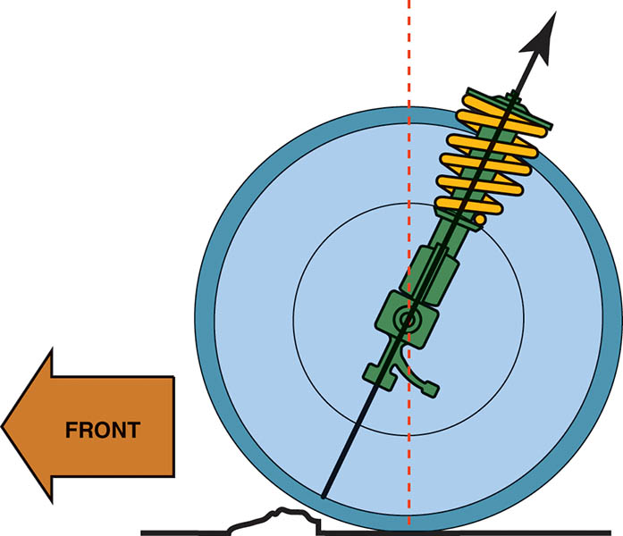
Figure 124.19 High caster provides a road shock path to the vehicle

Slide 30
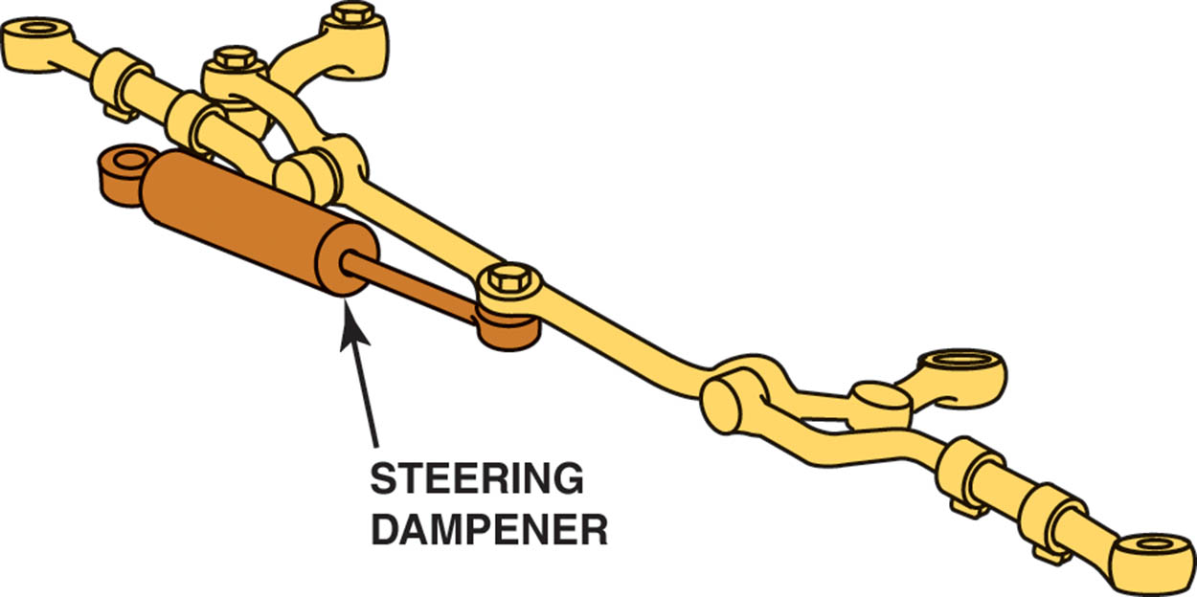
Figure 124.20 A steering dampener is used on many pickup trucks, sport-utility vehicles (SUVs), and many luxury vehicles designed with a high-positive-caster setting. The dampener helps prevent steering wheel kickback when the front tires hit a bump or hole in the road.

Slide 31
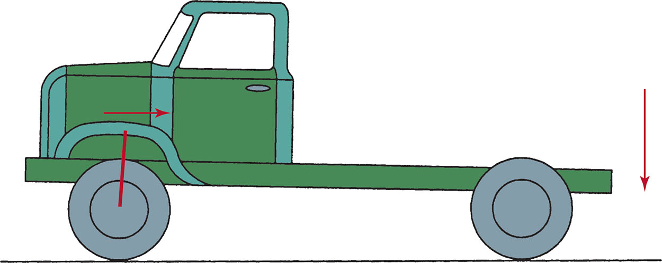
Figure 124.21 As the load increases in the rear of a vehicle, the top steering axis pivot point moves rearward, increasing positive (+) caster

Slide 32
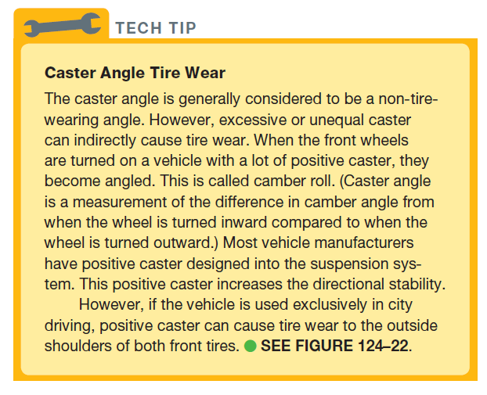
Tech Tip

Slide 33
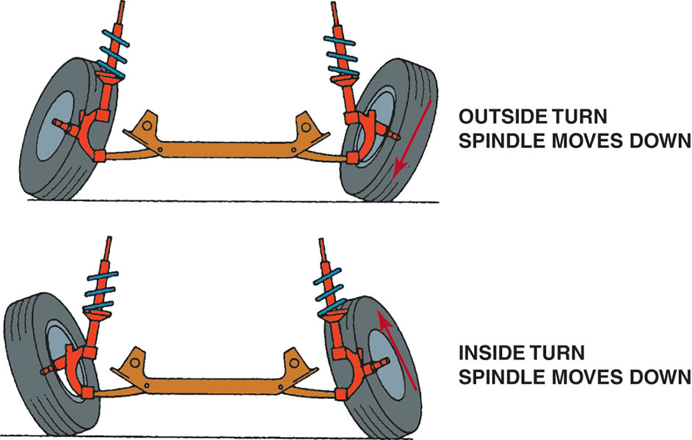
Figure 124.22 Note how the front tire becomes tilted as the vehicle turns a corner with positive caster. The higher the caster angle, the more the front tires tilt, causing camber-type tire wear

Slide 34
QUESTION 2: ?
How does incorrect caster effect front tire wear?

Slide 35
ANSWER 2:
  Caster is not a tire-wearing angle, but positive caster does cause changes in camber during a turn.

Slide 36
TOE
Definition
  Toe is the difference in distance between the front and rear of the tires.
  Incorrect toe is the major cause of excessive tire wear!
  Incorrect front toe does not cause a pull condition.
  All vehicles can be adjusted for front toe.
  Many vehicle manufacturers specify a slight amount of toe-in to compensate for the natural tendency of the front wheels to spread apart (become toed-out).

Slide 37
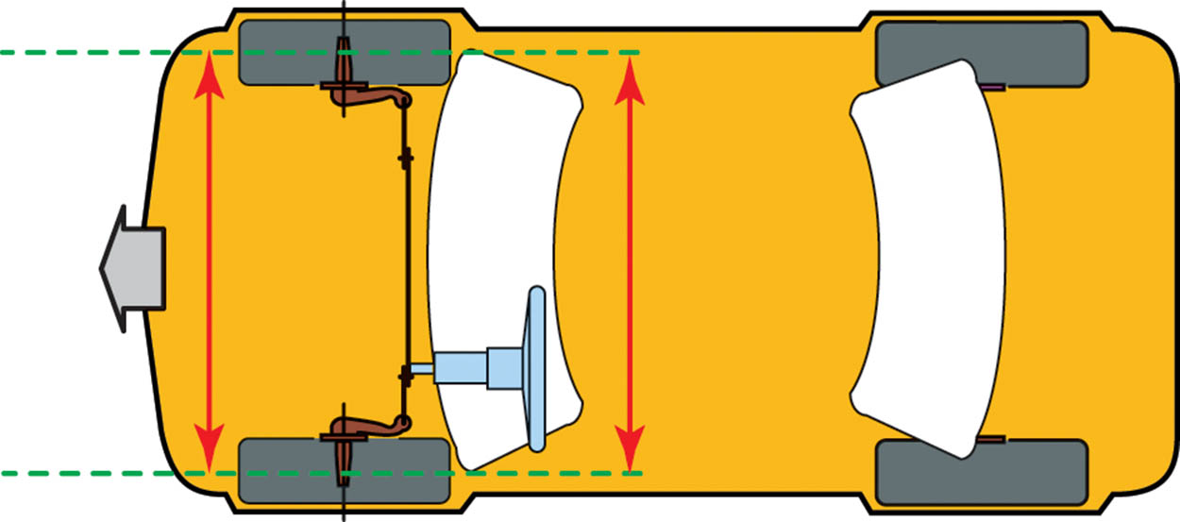
Figure 124.23 Zero toe. Note how both tires are parallel to each other as viewed from above the vehicle

Slide 38
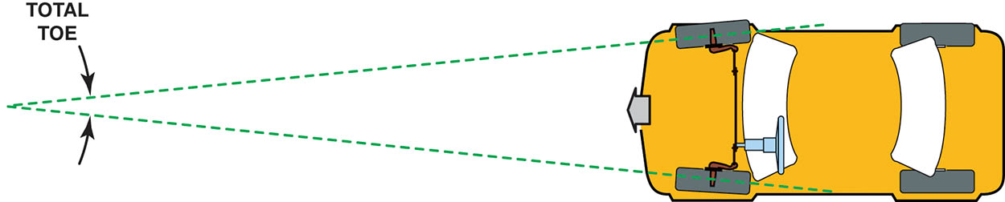
Figure 124.24 Total toe is often expressed as an angle. Because both front wheels are tied together through the tie rods and center link, the toe angle is always equally split between the two front wheels when the vehicle moves forward

Slide 39
Figure 124.25 Toe-in, also called positive (+) toe

Slide 40
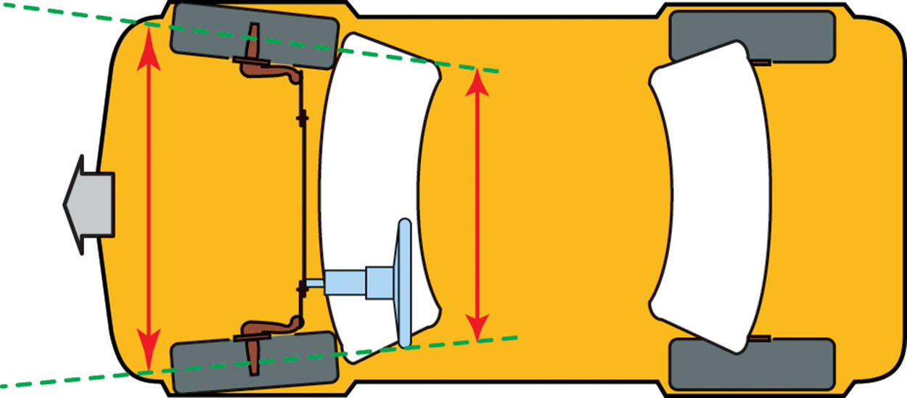
Figure 124.26 Toe-out, also called negative (−) toe

Slide 41
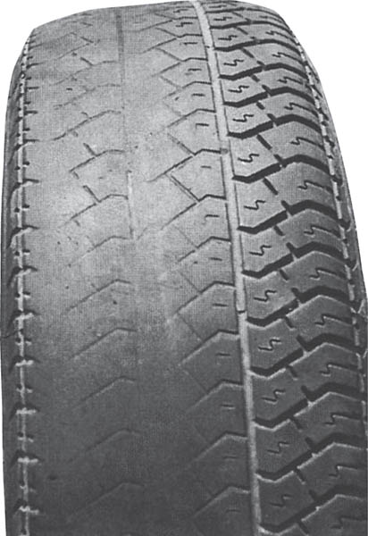
Figure 124.27 This tire is just one month old! It was new and installed on the front of a vehicle that had about 1/4 inch (6 mm) of toe-out. By the time the customer returned to the tire store for an alignment, the tire was completely bald on the inside.

Slide 42
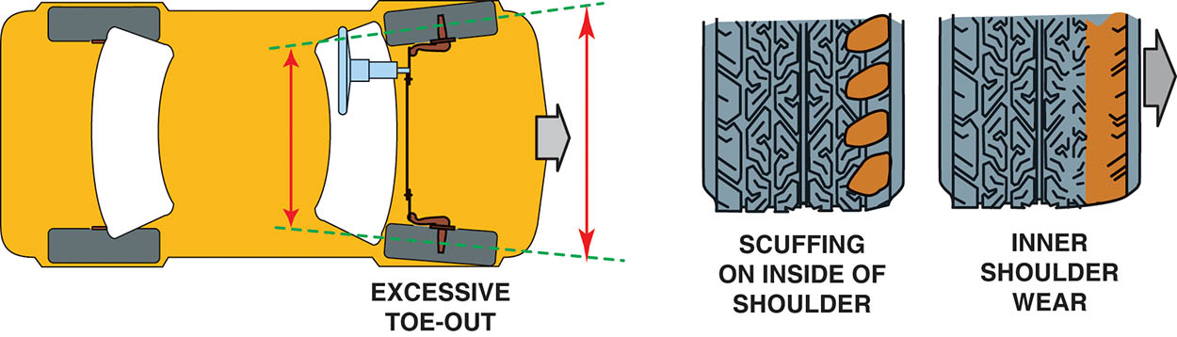
Figure 124.28 Excessive toe-out and the type of wear that can occur to the side of both front tires

Slide 43
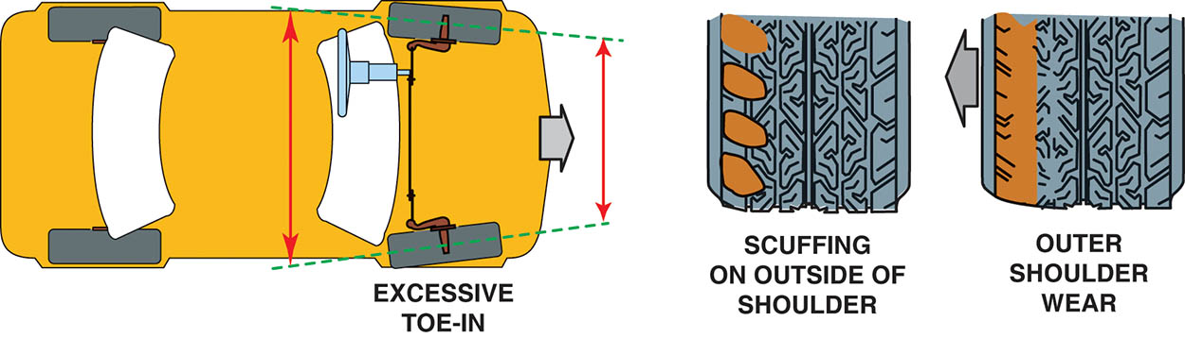
Figure 124.29 Excessive toe-in and the type of wear that can occur to the outside of both front tires

Slide 44
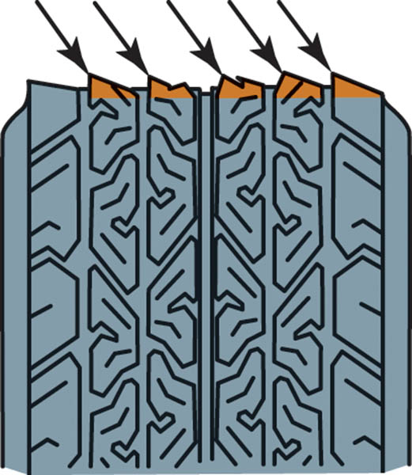
Figure 124.30 Feather-edge wear pattern caused by excessive toe-in or toe-out

Slide 45
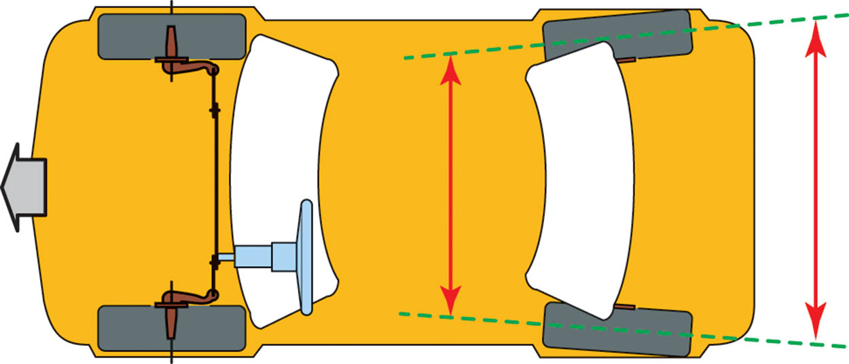
Figure 124.31 Rear toe-in (+). The rear toe (unlike the front toe) can be different for each wheel while the vehicle is moving forward because the rear wheels are not tied together as they are in the front

Slide 46
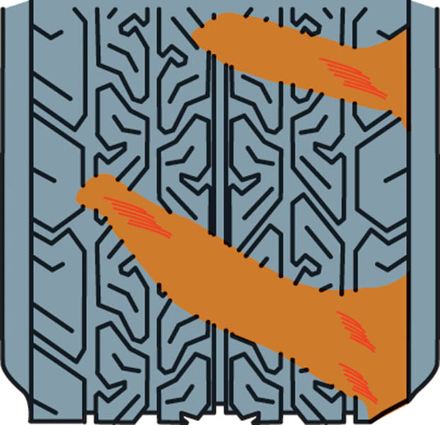
Figure 124.32 Incorrect toe can cause the tire to run sideways as it rolls, resulting in a diagonal wipe

Slide 47
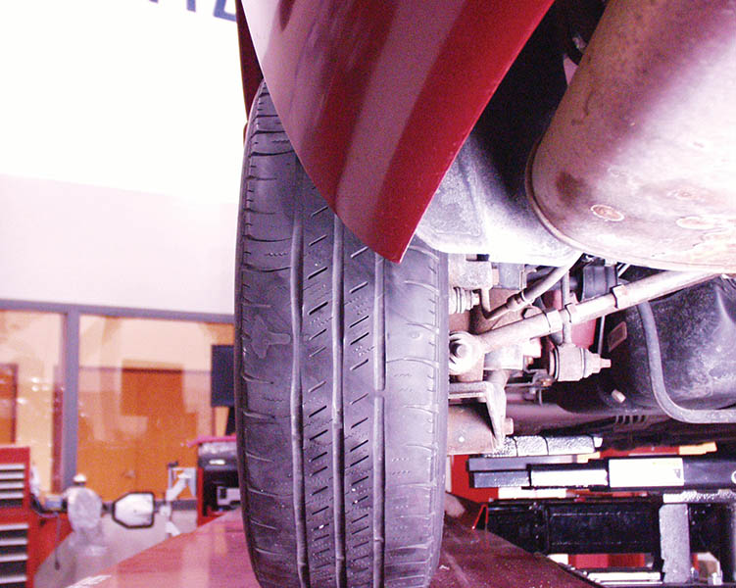
Figure 124.33 Diagonal wear such as shown here is usually caused by incorrect toe on the rear of a front-wheel-drive vehicle

Slide 48
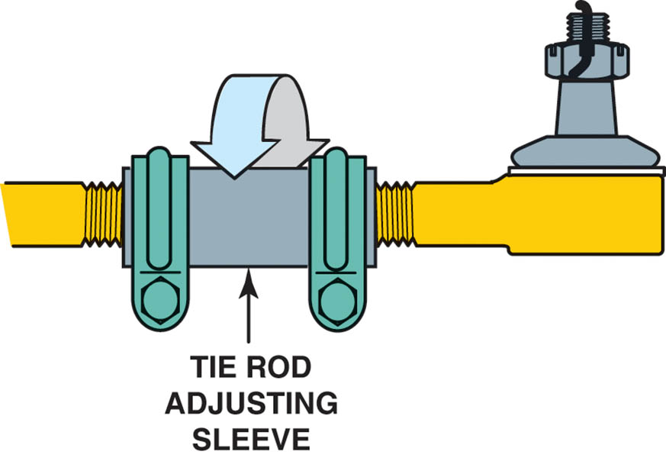
Figure 124.34 Toe on the front of most vehicles is adjusted by turning the tie rod sleeve, as shown

Slide 49
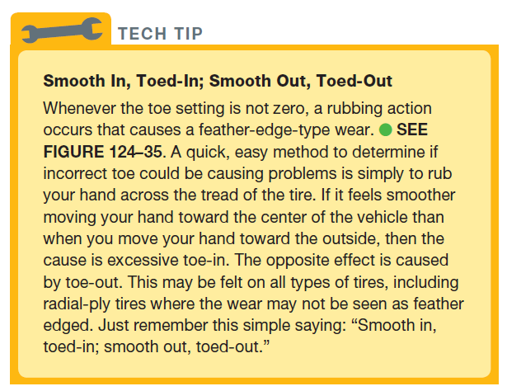
TECH TIP

Slide 50
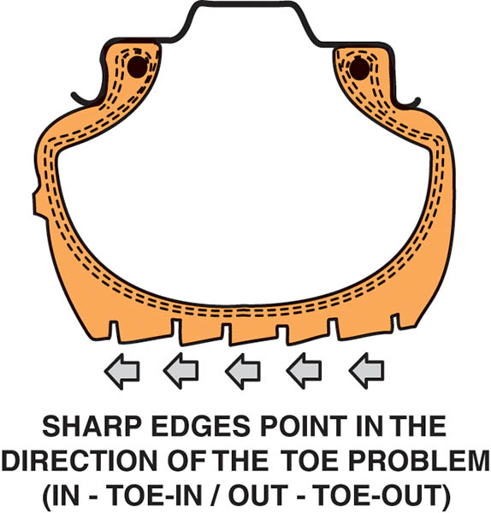
Figure 124.35 While the feathered or sawtooth tire tread wear pattern may not be noticeable to the eye, this wear can usually be felt by rubbing your hand across the tread of the tire

Slide 51
QUESTION 3: ?
What is the most significant effect of incorrect toe adjustment?

Slide 52
ANSWER 3:
  Incorrect toe is the major cause of excessive tire wear!

Slide 53
STEERING AXIS INCLINATION
The steering axis is the angle formed between true vertical and an imaginary line drawn between the upper and lower pivot points of the spindle.
The purpose of SAI is to provide an upper suspension pivot location that causes the spindle to travel in an arc when turning, which tends to raise the vehicle.

Slide 54
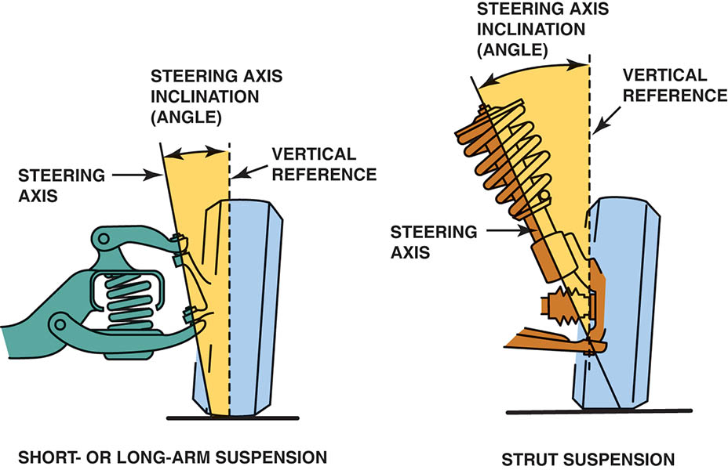
Figure 124.36 The left illustration shows that the steering axis inclination angle is determined by drawing a line through the center of the upper and lower ball joints The right illustration shows that the steering axis inclination angle is determined by drawing a line through the axis of the upper strut bearing mount assembly and the lower ball joint

Slide 55
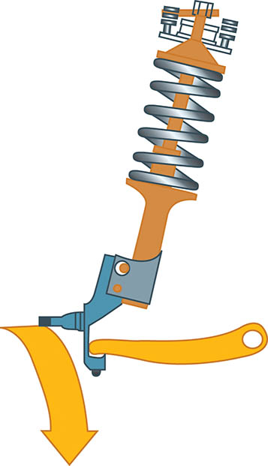
Figure 124.37 The SAI causes the spindle to travel in an arc when the wheels are turned. The weight of the vehicle is therefore used to help straighten the front tires after a turn and to help give directional stability

Slide 56
INCLUDED ANGLE
The included angle is the SAI added to the camber reading of the front wheels only.
Included angle is an important angle to measure for diagnosis of vehicle handling or tire wear problems.
For best handling both the included angle and SAI should be within 1/2 degree of the other side of the vehicle.

Slide 57
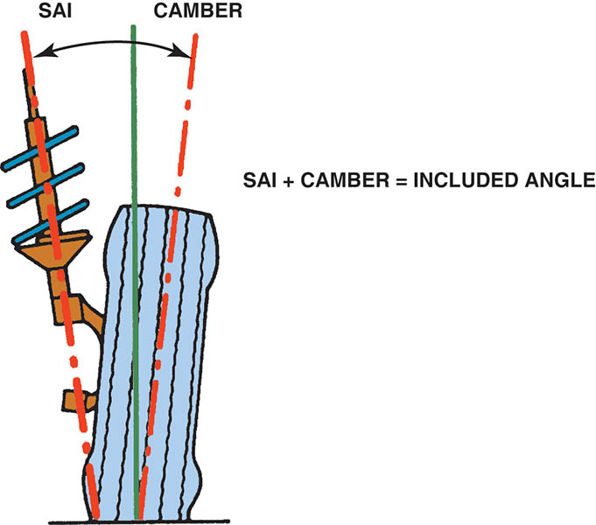
Figure 124.38 Included angle on a MacPherson-strut-type suspension

Slide 58
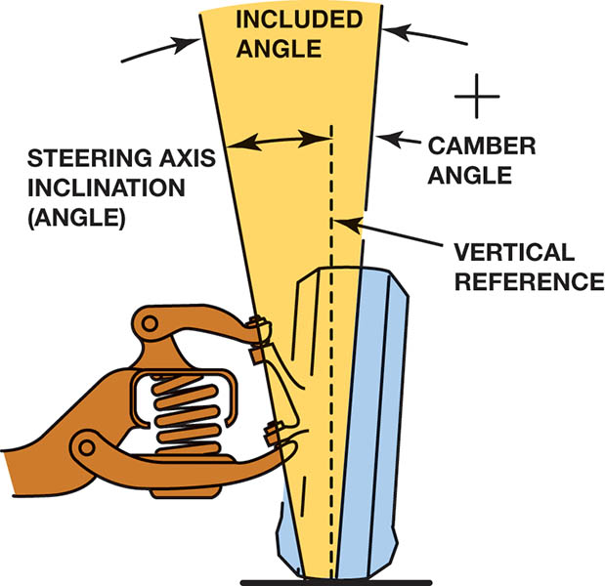
Figure 124.39 Included angle on an SLA-type suspension. The included angle is the SAI angle and the camber angle added together

Slide 59
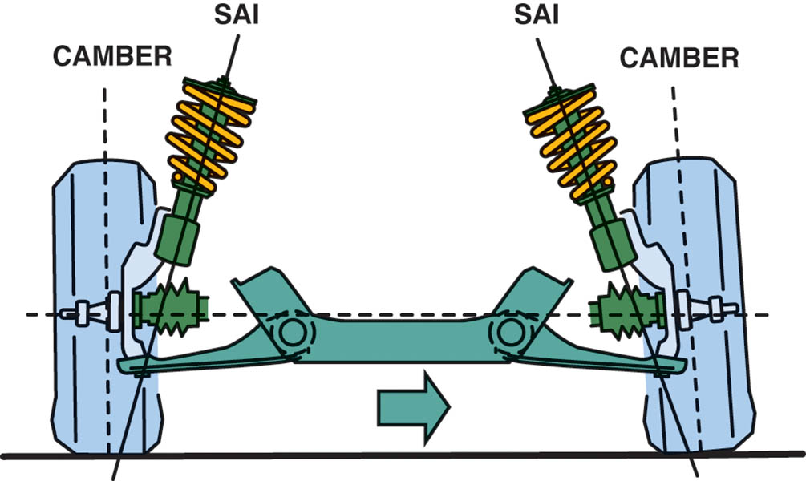
Figure 124.40 Cradle placement. If the cradle is not replaced in the exact position after removal for a transmission or clutch replacement, the SAI, camber, and included angle will not be equal side to side

Slide 60
SCRUB RADIUS
Scrub radius refers to the distance between the line through the steering axis and the centerline of the wheel at the contact point with the road surface.
Scrub radius is not adjustable and cannot be measured.
  A bent spindle can cause a change in the scrub radius.
  Changing tire or wheel sizes can affect scrub radius.

Slide 61
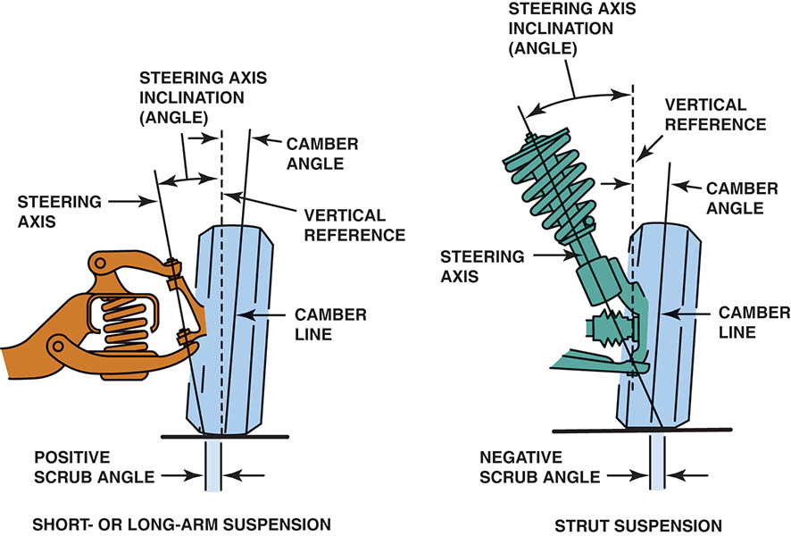
Figure 124.41 A positive scrub radius (angle) is usually built into most SLA front suspensions, and a negative scrub radius is usually built into most MacPherson-struttype front suspensions

Slide 62
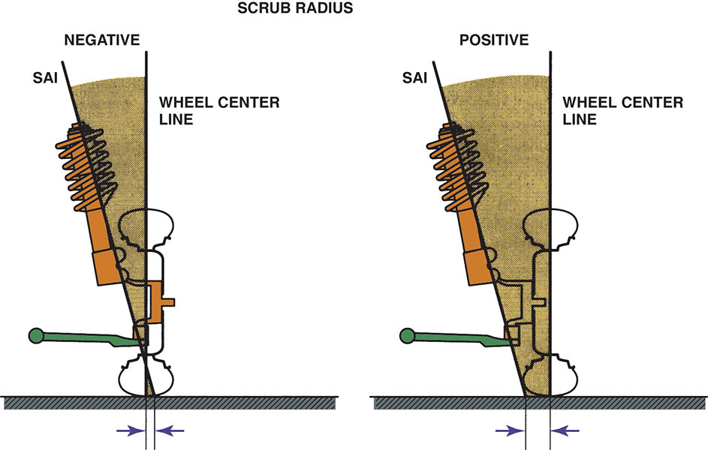
Figure 124.42 With negative scrub radius, the imaginary line through the steering axis inclination (SAI) intersects the road outside of the centerline of the tire. With positive scrub radius, the SAI line intersects the road inside the centerline of the tires

Slide 63
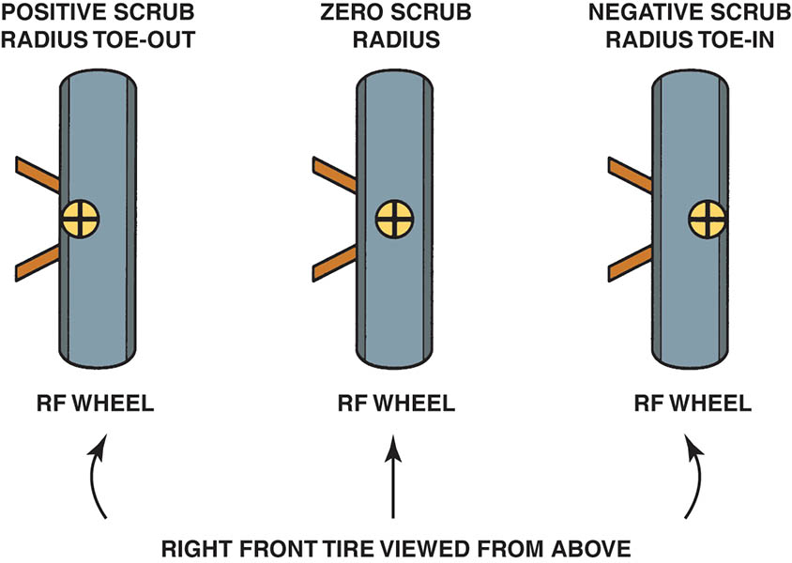
Figure 124.43 With a positive scrub radius, the pivot point, marked with a + mark, is inside the centerline of the tire and will cause the wheel to turn toward the outside, especially during braking. Negative scrub radius, as is used with most front-wheel-drive vehicles, generates an inward force on the tires

Slide 64
TURNING RADIUS (TOE-OUT ON TURNS)
Whenever a vehicle turns a corner, the inside wheel has to turn at a sharper angle than the outside wheel because the inside wheel has a shorter distance to travel.
Turning radius is a nonadjustable angle.
Symptoms of out-of-specification turning angle include the following:
  Tire squeal noise during normal cornering.
  Scuffed tire wear

Slide 65
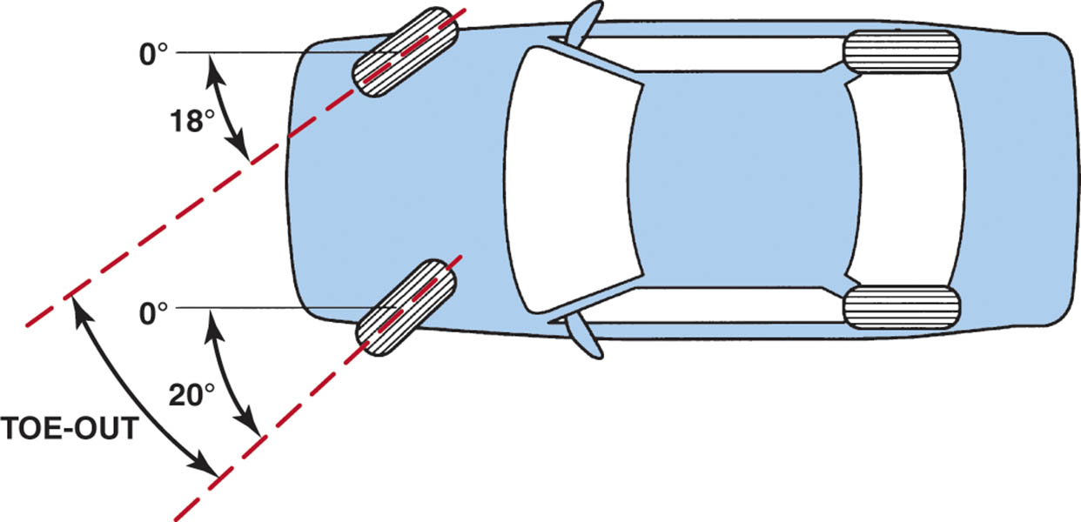
Figure 124.44 To provide handling, the inside wheel has to turn at a greater turning radius than the outside wheel

Slide 66
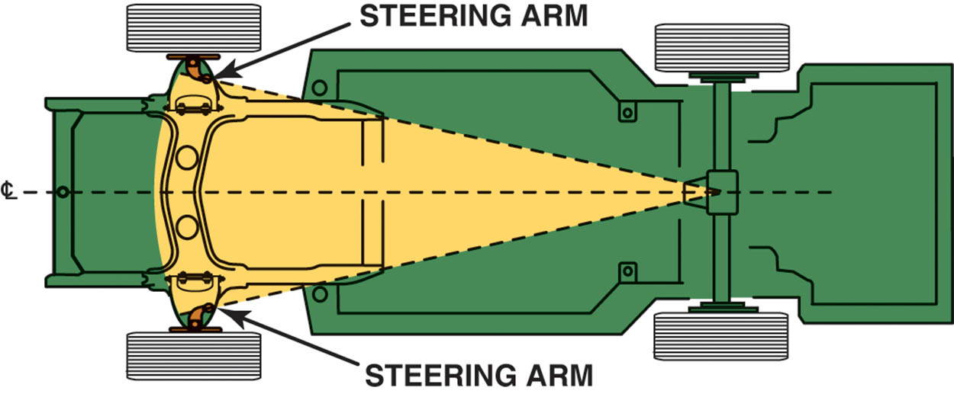
Figure 124.45 The proper toe-out on turns is achieved by angling the steering arms

Slide 67
SETBACK
Setback is the angle formed by a line drawn perpendicular (at 90 degrees) to the front axles.
Setback is a nonadjustable measurement, even though it may be corrected.
Setback can be measured with a four-wheel alignment machine.

Slide 68
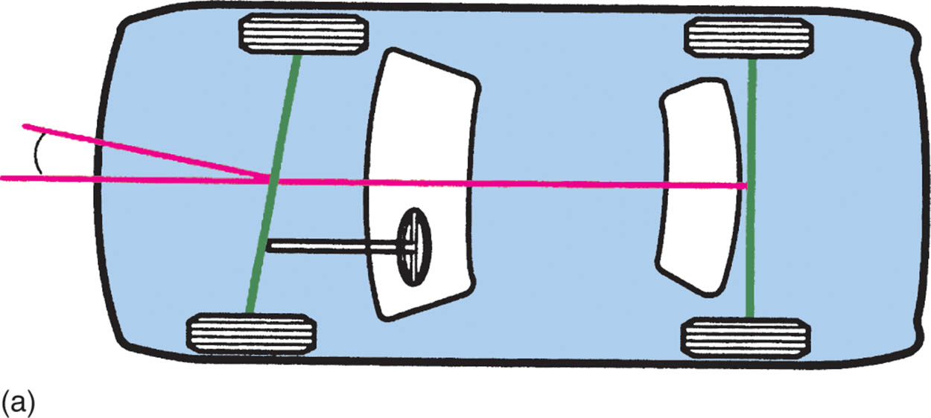
Figure 124.46 (a) Positive setback

Slide 69
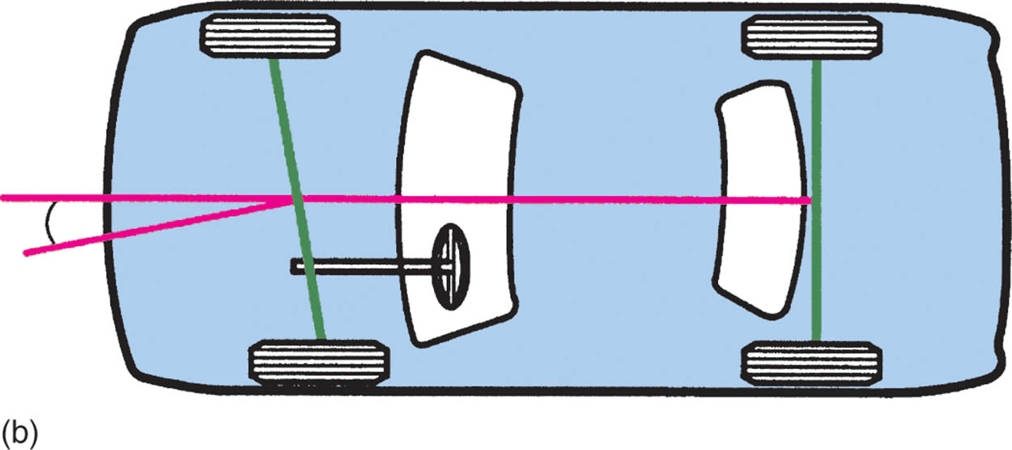
Figure 124.46 (b) Negative setback

Slide 70
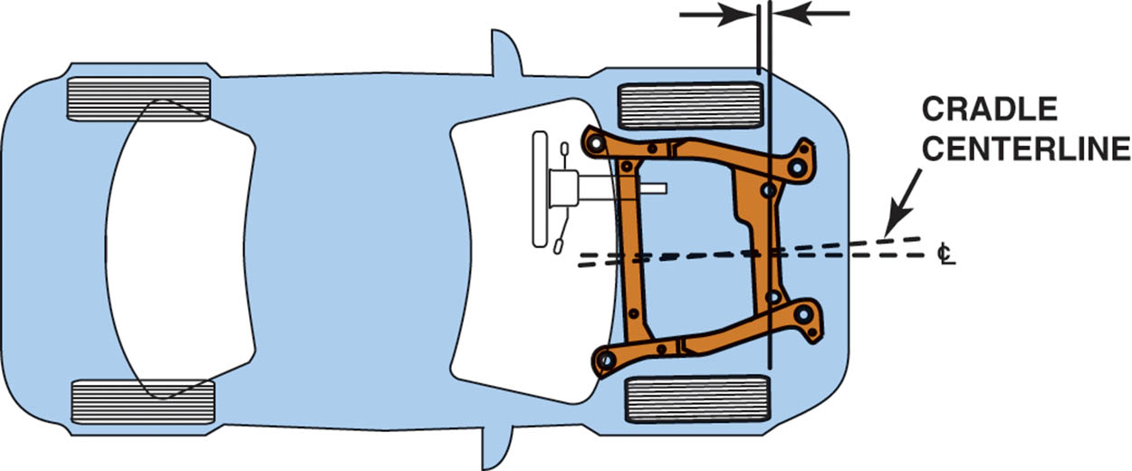
Figure 124.47 Cradle placement affects setback

Slide 71
THRUST ANGLE
Thrust angle is the angle of the rear wheels as determined by the total rear toe.
The total of the rear toe setting determines the thrust line, or the direction the rear wheels are pointed.

Slide 72

Figure 124.48 (a) Zero thrust angle

Slide 73

Figure 124.48 (b) Thrust line to the right

Slide 74

Figure 124.48 (c) Thrust line to the left

Slide 75
TRACKING
The rear wheels should track directly behind the front wheels.
If the vehicle has been involved in an accident, it is possible that the frame or rear axle mounting could cause dog tracking.
Dog tracking is an alignment condition that is caused by having the rear wheel toe angles out of line with the front wheels causing the vehicle to travel slightly sideways.

Slide 76

Figure 124.49 (a) Proper tracking

Slide 77

Figure 124.49 (b) Front wheels steering toward thrust line

Slide 78
FOUR-WHEEL ALIGNMENT
Four-wheel alignment refers to the checking and/or adjustment of all four wheels.
Four-wheel alignment is important for proper handling and tire wear.

Slide 79

Copyright

