Slide 1
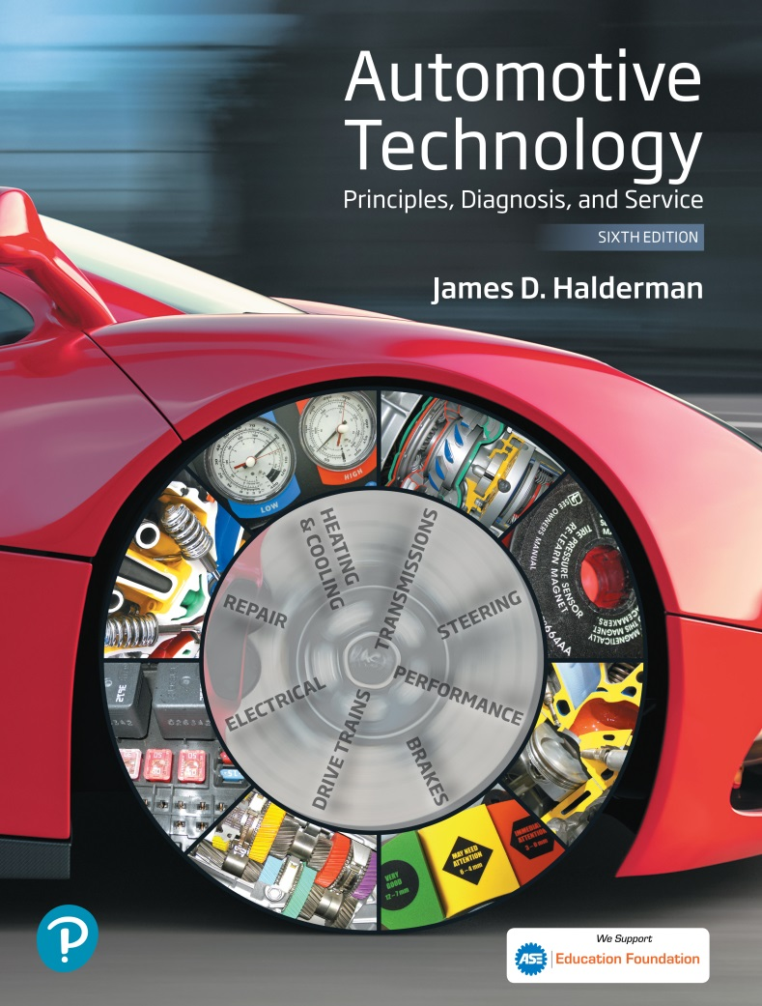
Automotive Technology Principles, Diagnosis, and Service
Sixth Edition
Chapter 123
Electric Power Steering Systems
Copyright © 2018, 2015, 2011 Pearson Education, Inc. All Rights Reserved

Slide 2
LEARNING OBJECTIVES (1 of 2)
123.1 Describe the purpose, and function, and types of electric power steering systems.
123.2 Explain how electric power steering systems operate.
123.3 Discuss how to diagnose electric power steering system faults.
123.4 Describe the self-parking feature and its relationship to power steering.

Slide 3
LEARNING OBJECTIVES (2 of 2)
123.5 Describe electro-hydraulic power steering.
123.6 This chapter will help prepare for the Steering and Suspension (A4) ASE certification test content area “A” (Steering Systems Diagnosis and Repair).

Slide 4
ELECTRIC POWER STEERING OVERVIEW (1 OF 2)
Purpose and Function
Electric power steering takes the place of hydraulic components that were previously used by using an electric motor to provide power assist effort.
Advantages
Improved fuel economy.
Increase in usable power.
Improved cold weather starting.
Reduced engine compartment complexity.

Slide 5
ELECTRIC POWER STEERING OVERVIEW (2 OF 2)
Types of EPS Systems
Rack mounted.
The assist motor attached to the rack and is often called a rack-and pinion electric power steering (R-EPS) system.
Column mounted.
Sensors and the assist motor located inside the vehicle.

Slide 6
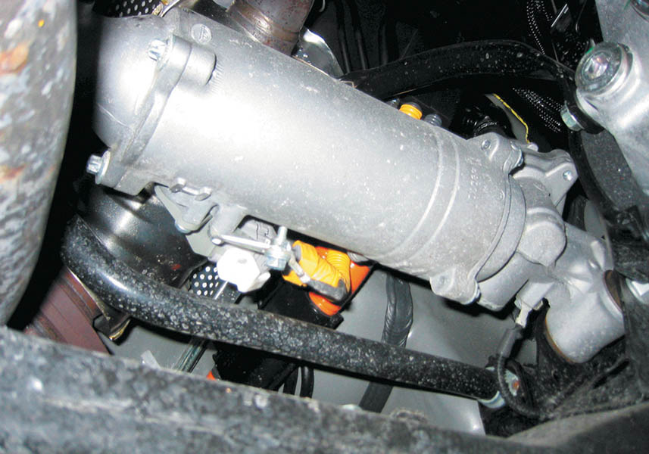
Figure 123.1 A rack mounted electric power steering gear on a Lexus RX 400 h taken from underneath the vehicle.

Slide 7
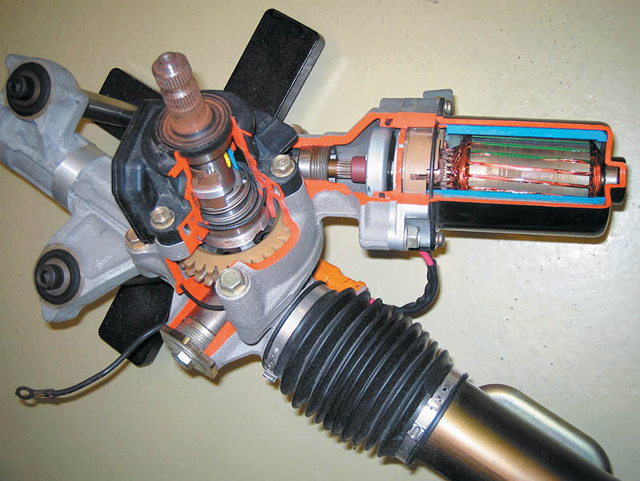
Figure 123.2 Honda electric power steering unit cutaway, which is an example of pinion-mounted electric power steering system

Slide 8
QUESTION 1: ?
What is the purpose of electronic power steering?

Slide 9
ANSWER 1:
Electric power steering takes the place of hydraulic components that were previously used by using an electric motor to provide power assist effort.

Slide 10
EPS SYSTEM PARTS AND OPERATION
Types of Motors Used
Most electric power steering units use a DC electric motor.
Some operate from 42 volts while others operate from 12 volts.
EPS Control Unit
The EPS electronic control unit (ECU) calculates the amount of needed assist based on the input from the steering torque sensor.

Slide 11
EPS SYSTEM PARTS AND OPERATION
EPS Inputs and Outputs
Powertrain control module (PCM)
Body control module (BCM)
Power steering control module (PSCM)
Battery voltage
Steering shaft torque sensor
Steering wheel position sensor
Power steering motor
Driver information center (DIC)
Serial data communications circuits

Slide 12
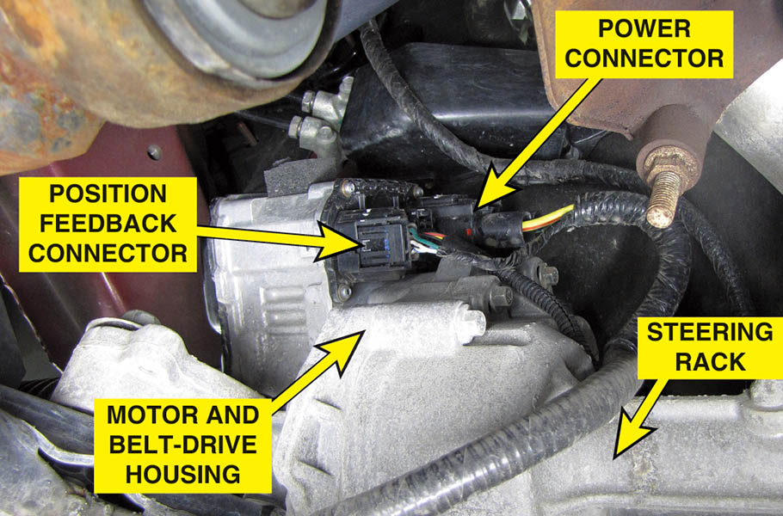
Figure 123.3 A Ford electric power steering rack-mounted motor tat drives the rack through a toothed belt. This assembly is located on the passenger side of the vehicle opposite to where the steering column shaft is attached to the rack

Slide 13
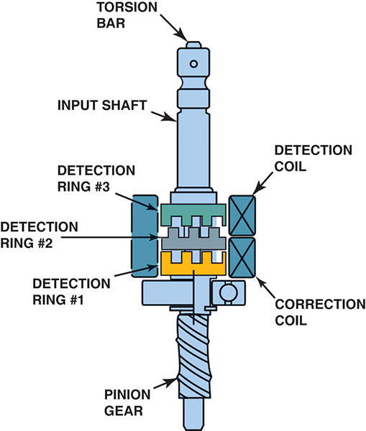
Figure 123.4 The torque sensor converts the torque the driver is applying to the steering wheel into a voltage signal

Slide 14
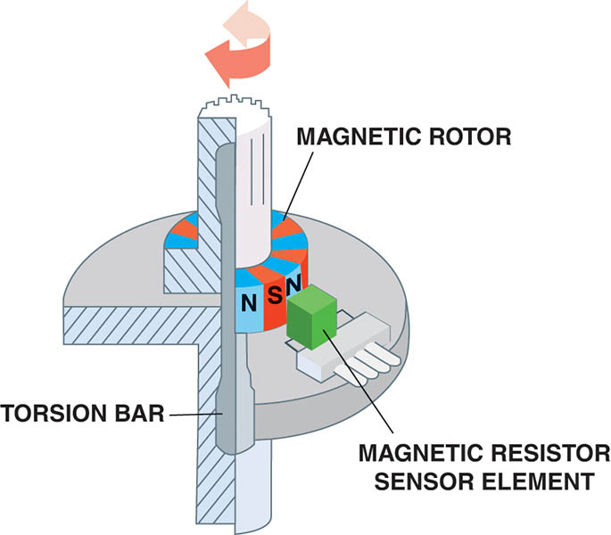
Figure 123.5 A cutaway view showing the operation of the torque sensor used in electric power steering systems

Slide 15
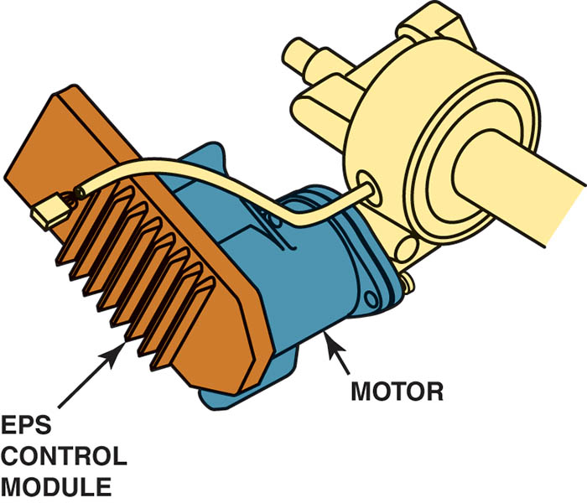
Figure 123.6 The power steering control module (PSCM) is attached to the motor of the electric power steering assembly

Slide 16
STEERING SHAFT TORQUE SENSOR
The PSCM uses the steering shaft torque sensor as a main input for determining steering direction and the amount of assist needed.
When torque is applied to the steering column shaft during a right turn, the sensor signal 1 voltage increases, while the signal 2 voltage decreases.
When torque is applied to the steering column shaft during a left turn, the sensor signal 1 voltage decreases, while the signal 2 voltage increases.
The PSCM recognizes this change in signal voltage as steering direction and steering column shaft torque.

Slide 17
STEERING WHEEL POSITION SENSOR
The PSCM uses the steering position sensor (SPS) to determine the steering system on-center position.
The sensor is a 5-volt dual-analog signal device with a signal voltage range of 0 to 5 volts.
The sensor’s signal 1 and signal 2 voltage values will increase and decrease within 2.5 to 2.8 volts of each other as the steering wheel is turned.

Slide 18
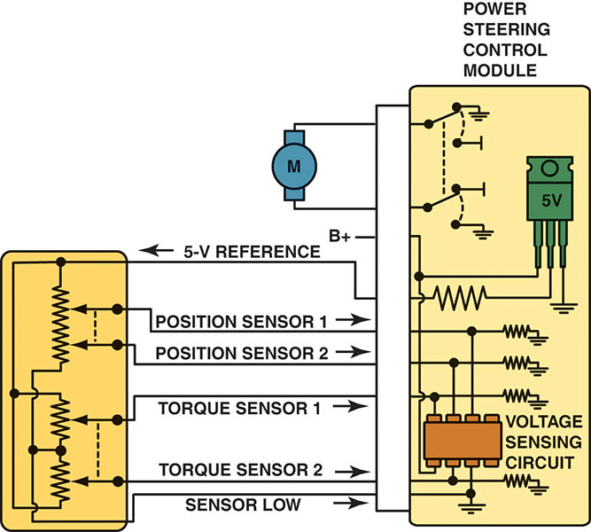
Figure 123.7 Schematic showing the electric power steering and the torque/position sensor

Slide 19
QUESTION 2: ?
What is the purpose of the steering wheel position sensor?

Slide 20
ANSWER 2:
To determine the steering system on-center position.

Slide 21
POWER STEERING MOTOR
The power steering motor is a 12-volt brushless DC reversible motor with a 65-amp rating.
The motor assists steering through a worm gear and reduction gear located in the steering column housing.
The motor draws about 750 to 1,000 watts or about 1 horsepower at full assist.

Slide 22
POWER STEERING CONTROL MODULE (PSCM)
Purpose and Function
The PSCM uses a combination of steering shaft torque sensor input, vehicle speed, calculated system temperature, and steering tuning to determine the amount of steering assist.
Fault Detection
If the power steering system is exposed to excessive amounts of static steering conditions, the PSCM will go into a protection mode to avoid thermal damage due to overheating of the power steering components.

Slide 23
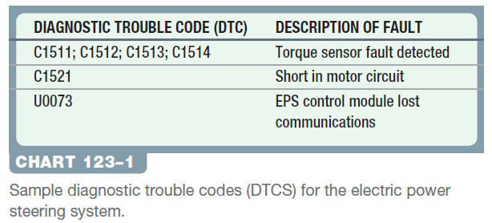
EPS DIAGNOSIS
The PSCM has the ability to detect malfunctions within the power steering system.

Slide 24
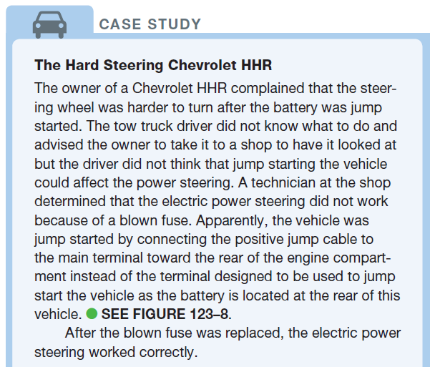
CASE STUDY

Slide 25
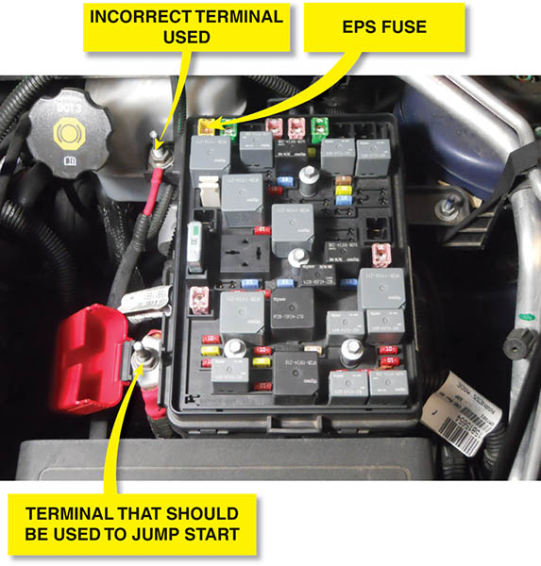
Figure 123.8 The blown fuse is the yellow 60-amp fuse next to the terminal at the top

Slide 26
SELF-PARKING SYSTEM (1 OF 2)
Purpose and Function
The self-parking feature uses the electric power steering to steer the vehicle.
Sensors Involved
Wheel speed sensor (WSS)
Steering-angle sensor
Ultrasonic sensors

Slide 27
SELF-PARKING SYSTEM (2 OF 2)
Self-Park Operation
The systems vary by manufacturer and have different levels of driver intervention.
Diagnosis and Testing
A fault in any one sensor will disable self-parking.
Always follow the factory recommended diagnostic and testing procedures.

Slide 28
ELECTRO-HYDRAULIC POWER STEERING (1 OF 2)
Purpose and Function
Electro-hydraulic power steering is used on the Chevrolet Silverado mild hybrid truck.
The system uses an electric motor to drive a hydraulic pump.
The electro-hydraulic power steering (EHPS) module controls the power steering motor, which has the function of providing hydraulic power to the brake booster and the steering gear.
Components of the system include:
Electric motor, Hydraulic pump
Fluid level sensor, Electronic controller
Fluid reservoir and cap

Slide 29
ELECTRO-HYDRAULIC POWER STEERING (2 OF 2)
EHPS Module
The electro-hydraulic power steering (EHPS) module is operated from the 36-volt (nominal) power supply.
The EHPS module receives the following messages from the CAN bus:
Vehicle speed
Service disconnect status
PRNDL (shift lever) position
Torque converter clutch (TCC)/cruise dump signal (gives zero adjust brake switch position)

Slide 30
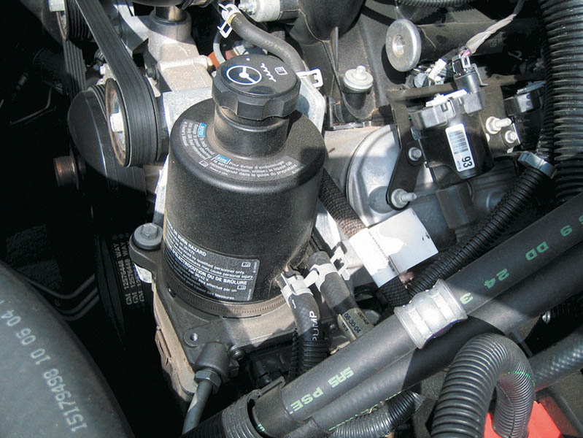
Figure 123.9 An electro-hydraulic power steering assembly on a Chevrolet hybrid pickup truck

Slide 31
QUESTION 3: ?
What is the purpose of the electro-hydraulic power steering system?

Slide 32
ANSWER 3:
To provide steering assist during engine-off operating periods.

Slide 33

Copyright

