Slide 1
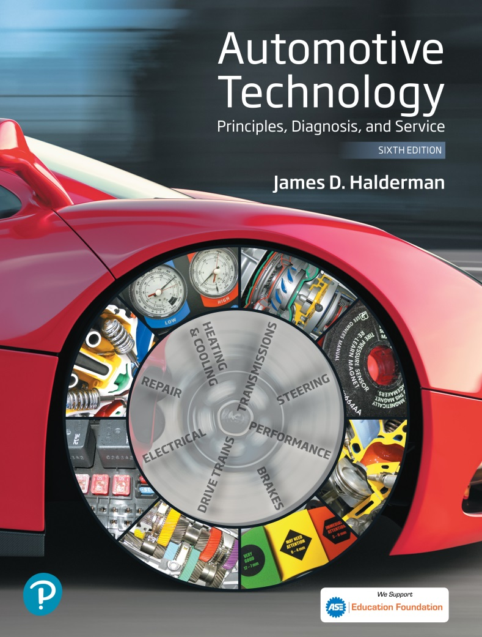
Automotive Technology Principles, Diagnosis, and Service
Sixth Edition
Chapter 121
Steering Linkage and Service
Copyright © 2018, 2015, 2011 Pearson Education, Inc. All Rights Reserved

Slide 2
LEARNING OBJECTIVES (1 of 2)
121.1 Identify steering linkage components.
121.2 Describe rack-and-pinion inner tie rod ends.
121.3 Describe four-wheel steering systems.
121.4 Discuss steering linkage lubrication.
121.5 Describe the purpose and procedure for performing a dry park test.

Slide 3
LEARNING OBJECTIVES (2 of 2)
121.6 List common wear items in steering systems.
121.7 Describe the steps for under-vehicle inspection of steering systems.
121.8 Explain how to replace steering linkage parts.
121.9 This chapter will help prepare for Suspension and Steering (A4) ASE certification test content area “A” (Steering System Diagnosis and Repair).

Slide 4
STEERING LINKAGE (1 OF 2)
Purpose and Function
  The steering linkage relays steering forces from the steering gear to the front wheels.
Parallelogram-type design
  Four tie rods, two inner and two outer (left and right)
  A center link (between the tie rods)
  An idler arm on the passenger side
  A pitman arm attached to the steering gear output shaft (pitman shaft)

Slide 5
STEERING LINKAGE (2 OF 2)
Tie Rod Ends
  Tie rod ends connect the steering linkage to the steering knuckles and to other steering linkage components.
  Conventional tie rod ends use a hardened steel ball stud assembled into a hardened steel and thermoplastic bearing.
  An internal preload spring limits the ball stud endplay and helps compensate for ball-and-socket wear.

Slide 6
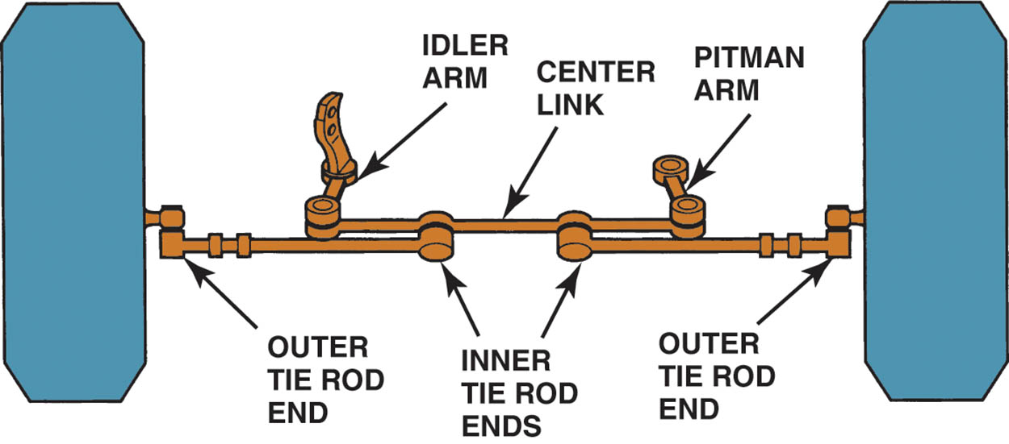
Figure 21.1 Steering movement is transferred from the pitman arm that is splined to the sector shaft (pitman shaft), through the center link and tie rods, to the steering knuckle at each front wheel. The idler arm supports the passenger side of the center link and keeps the steering linkage level with the road. This type of linkage is called a parallelogram-type design

Slide 7
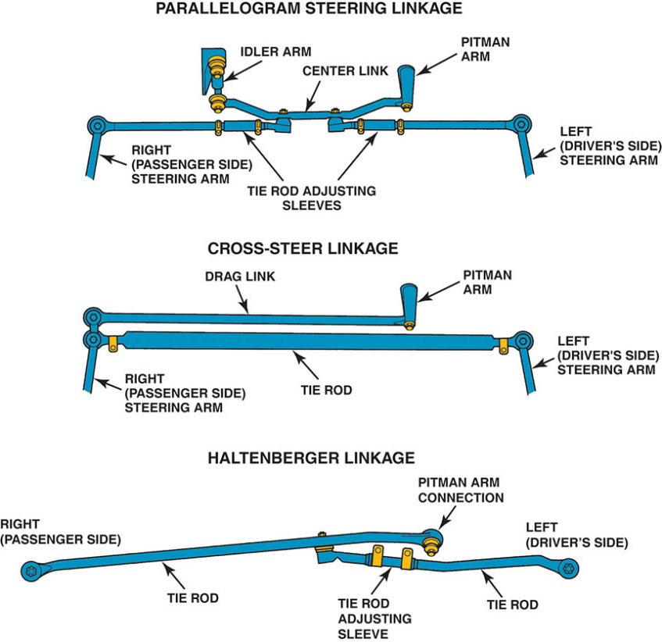
Figure 121.2 The most common type of steering is the parallelogram. The cross-steer and Haltenberger linkage designs are used on some trucks and vans

Slide 8
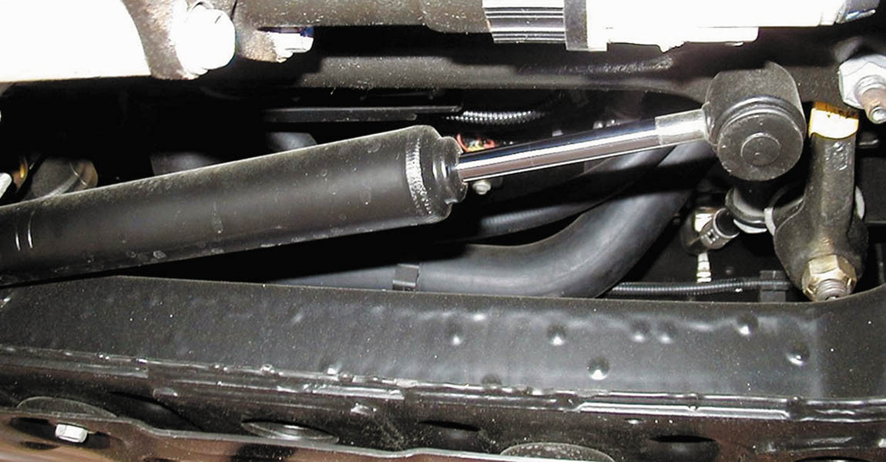
Figure 121.3 Typical steering dampener used on a Hummer H2

Slide 9
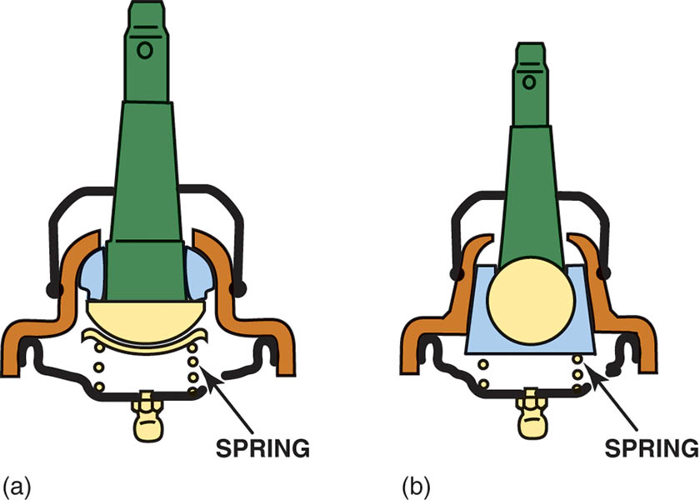
Figure 121.4 (a) A dual bearing design with a preload spring. The use of two bearing surfaces allows one surface for rotation (for steering) and another surface for pivoting (to allow for suspension up-and-down movement). (b) The nylon wedge bearing type allows for extended lube intervals. Wear is automatically compensated for by the tapered design and spring-loaded bearing

Slide 10
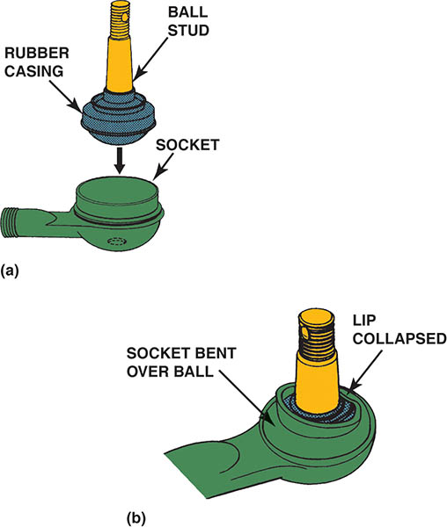
Figure 121.5 (a) A rubber-bonded socket is constructed of a rubber casing surrounding the ball stud, which is then inserted into the socket of the tie rod end. The hole in the socket allows air to escape as the ball stud is installed and there is not a place for a grease fitting. (b) The socket is crimped over the ball so that part of the socket lip retains the stud

Slide 11
RACK AND PINION INNER TIE ROD ENDS
Terminology
  The inner tie rod end is also called a ball socket assembly.
  The inner tie rod assemblies are attached to the end of the steering rack by one of several methods.
    Staked
    Riveted or Pinned
    Bolts (Center Take Off Racks)

Slide 12
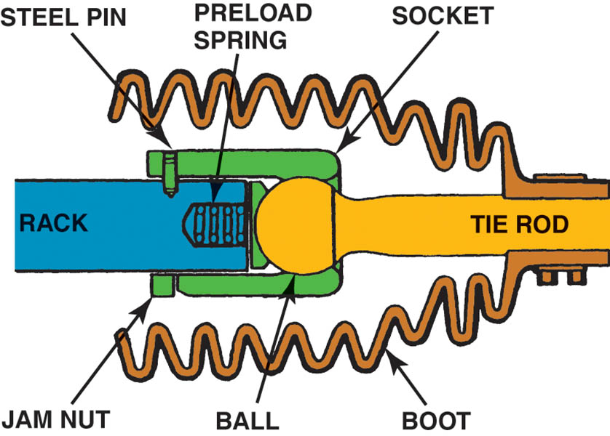
Figure 121.6 Rack-and-pinion steering systems use a ball and- socket-type inner tie rod end

Slide 13
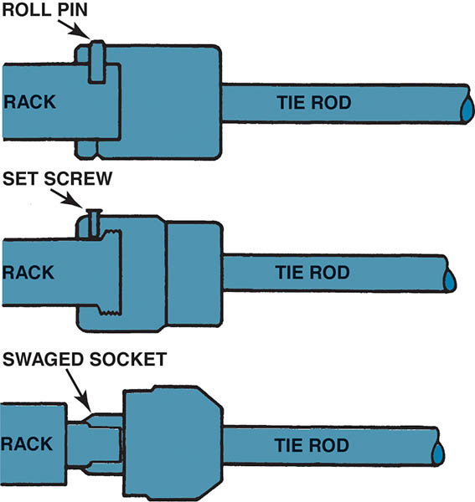
Figure 121.7 A variety of methods are used to secure the inner tie rod end socket assembly to the end of the rack

Slide 14
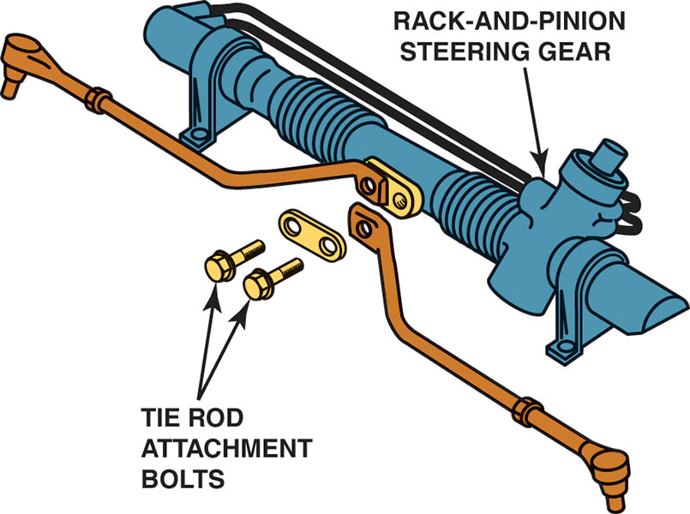
Figure 121.8 Exploded view of a center-take-off-style rack-and-pinion steering gear assembly

Slide 15
FRONT STEER VERSUS REAR STEER
Terminology
  Front steer, also called forward steer, is the term used to describe a vehicle that has the steering gear in front of the front wheel centerline.
  If the steering gear linkage is located behind the wheels, it is called rear steer and the cornering forces are imposed on the steering in the direction of the turn.

Slide 16
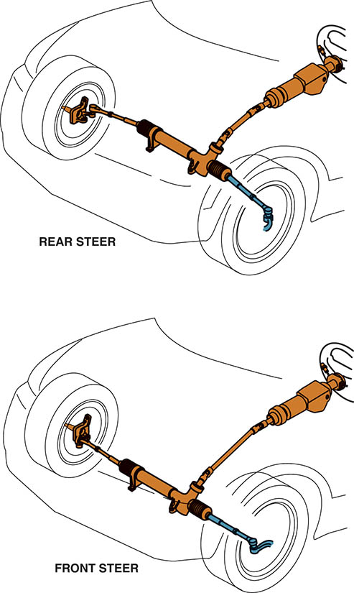
Figure 121.9 In a rear-steer vehicle, the steering linkage is behind the centerline of the front wheels, whereas the linkage is in front on a front-steer vehicle

Slide 17
QUESTION 1: ?
What is the difference between front steer and rear steer?

Slide 18
ANSWER 1:
The steering rack is either forward or in back of the wheel centerline.

Slide 19
FOUR-WHEEL STEERING SYSTEMS
Terminology
  Same-phase steering. Same-phase steering means that the front and rear wheels are steered in the same direction.
  Opposite-phase steering. Also called negative-phase mode, opposite-phase steering is when the front wheels and rear wheels are steered in the opposite direction.
Quadrasteer
  Quadrasteer™ is a General Motors four-wheel steering system that dramatically enhances low-speed maneuverability, high-speed stability, and towing capability.

Slide 20
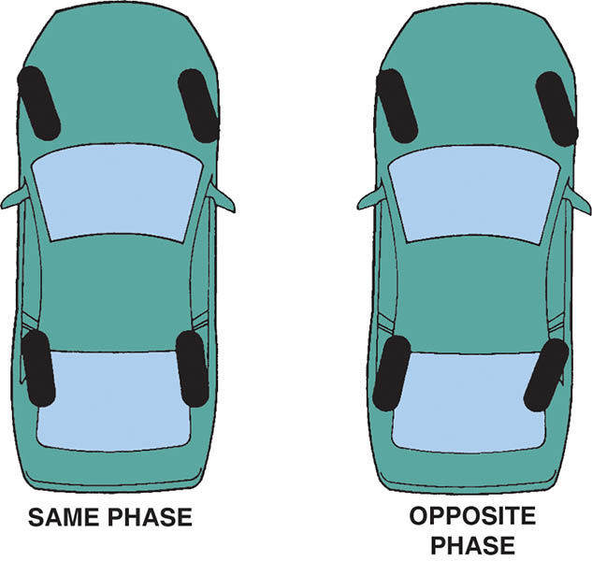
Figure 121.10 Opposite-phase four-wheel steer is usually used only at low vehicle speed to help in parking maneuvers. Same-phase steering helps at higher speeds and may not be noticeable by the average driver

Slide 21
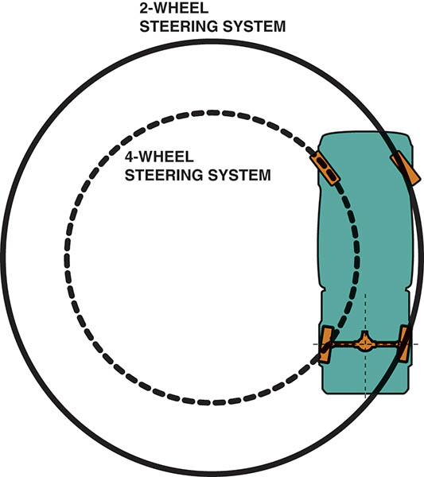
Figure 121.11 Being equipped with four-wheel steer allows a truck to make shorter turns than would otherwise be possible

Slide 22
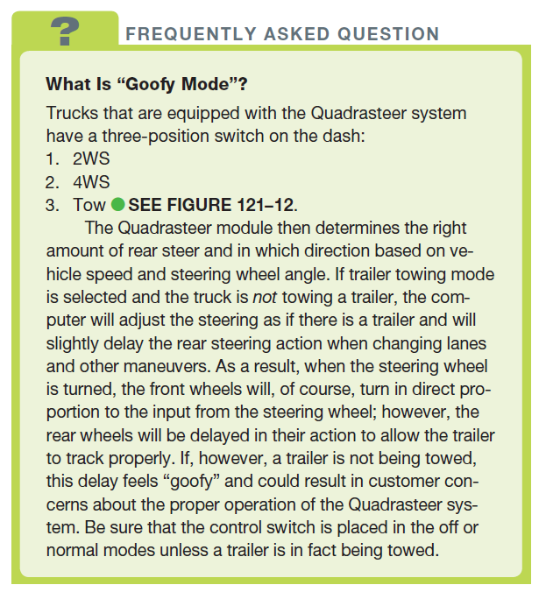
FREQUENTLY ASKED QUESTION

Slide 23
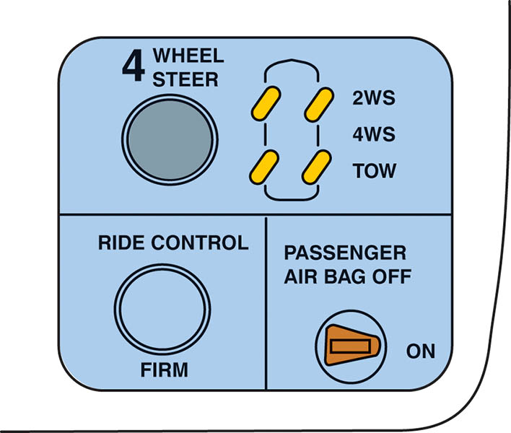
Figure 121.12 The dash-mounted select switch showing the three positions for the four-wheel steer system

Slide 24
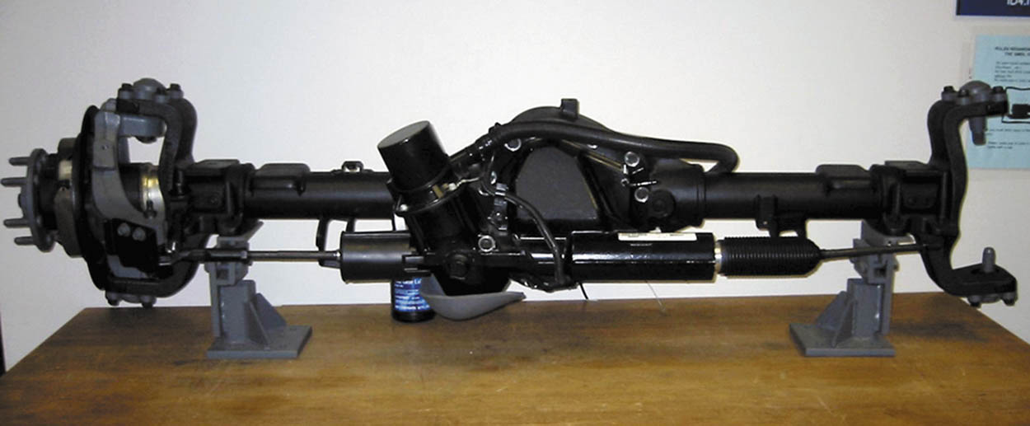
Figure 121.13 A Quadrasteer system showing all of the components. The motor used to power the rear steering rack can draw close to 60 amperes during a hard turn and can be monitored using a Tech 2

Slide 25
STEERING LINKAGE LUBRICATION
Keeping all joints equipped with a grease fitting properly greased is necessary for long life and ease of steering.
During a chassis lubrication, do not forget to put grease on the steering stop, if so equipped.

Slide 26
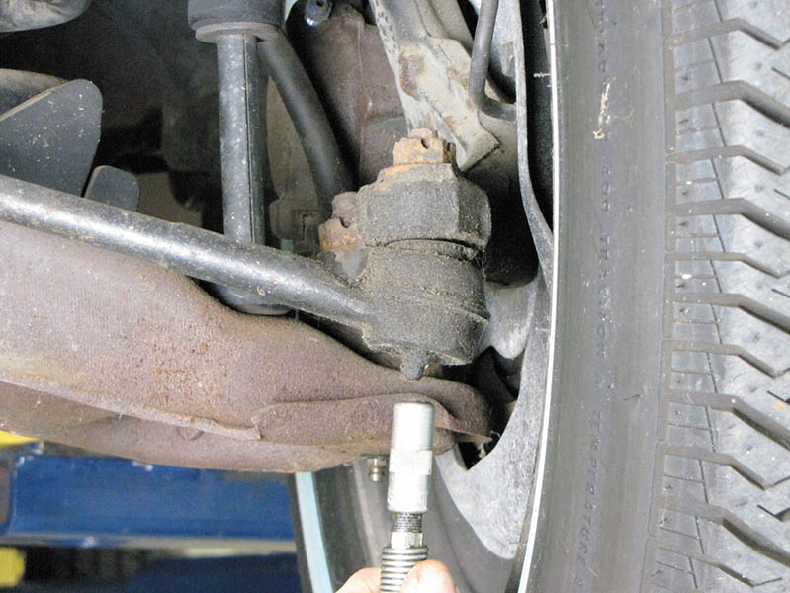
Figure 121.14 Greasing a tie rod end. Some joints do not have a hole for excessive grease to escape, and excessive grease can destroy the seal

Slide 27
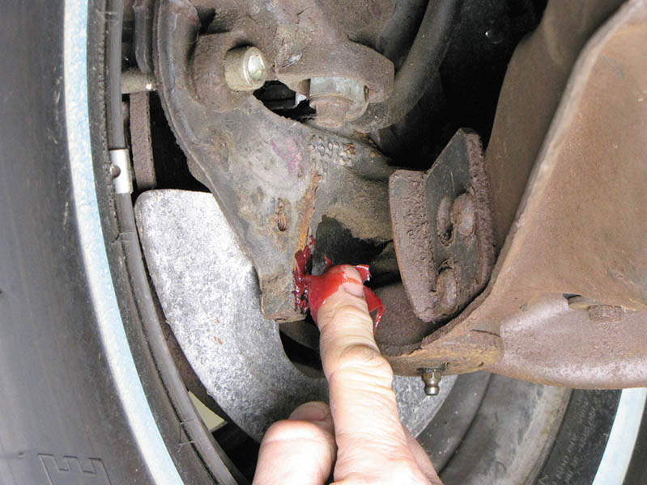
Figure 121.15 Part of steering linkage lubrication is applying grease to the steering stops. If these stops are not lubricated, a grinding sound may be heard when the vehicle hits a bump when the wheels are turned all the way one direction or the other. This often occurs when driving into or out of a driveway that has a curb

Slide 28
DRY PARK TEST
Purpose
  One of the most effective, yet easy to perform, steering component inspection methods is called the dry park test.
  Excessive play in the steering wheel can be caused by worn or damaged steering components.
This simple test is performed with the vehicle on the ground or on a drive-on ramp-type hoist, moving the steering wheel back and forth slightly while an assistant feels for movement at each section of the steering system.

Slide 29
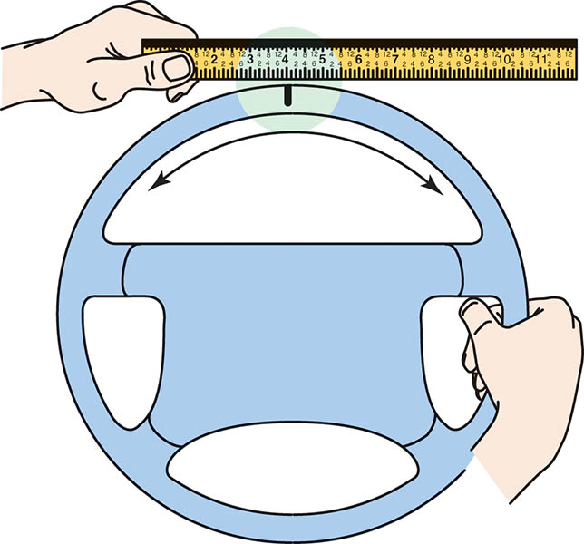
Figure 121.16 Checking for freeplay in the steering

Slide 30
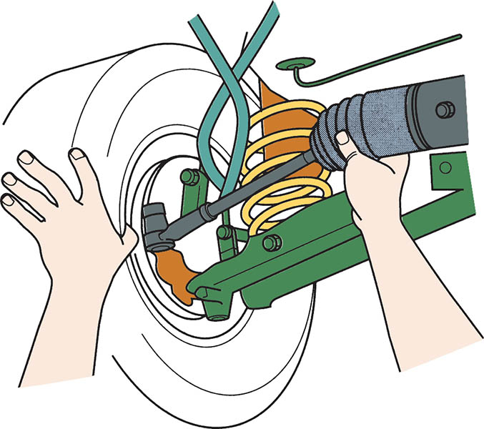
Figure 121.17 All joints should be felt during a dry park test. Even inner tie rod ends (ball socket assemblies) can be felt through the rubber bellows on many rack-and-pinion steering units

Slide 31
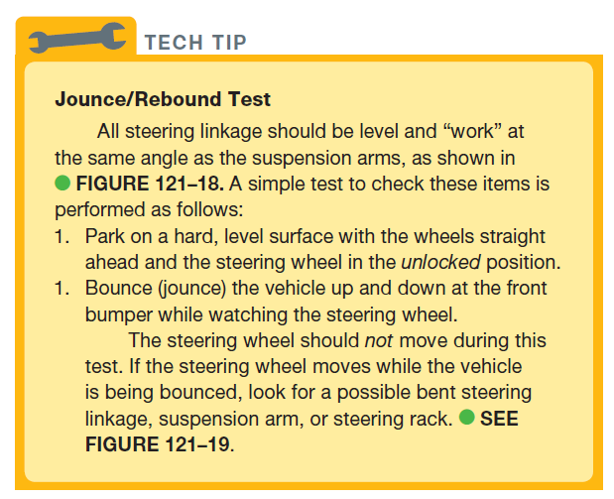
TECH TIP

Slide 32
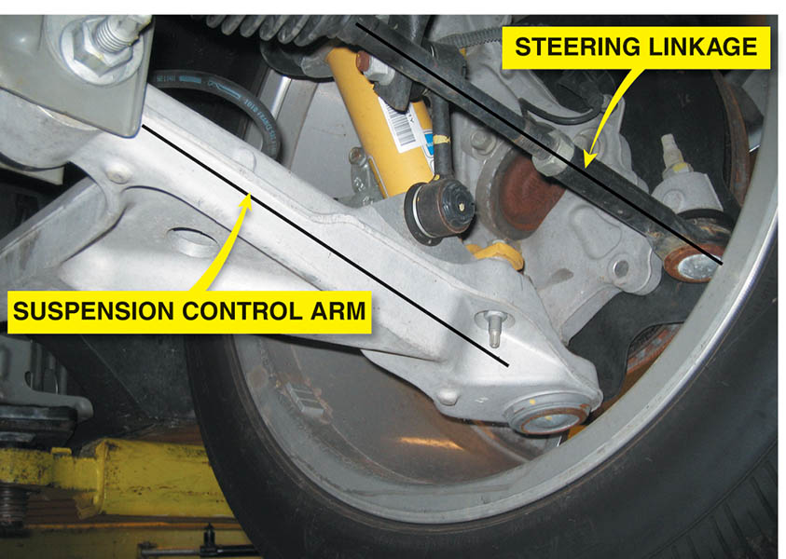
Figure 121.18 The steering and suspension arms must remain parallel to prevent the up-and-down motion of the suspension from causing the front wheels to turn inward or outward

Slide 33
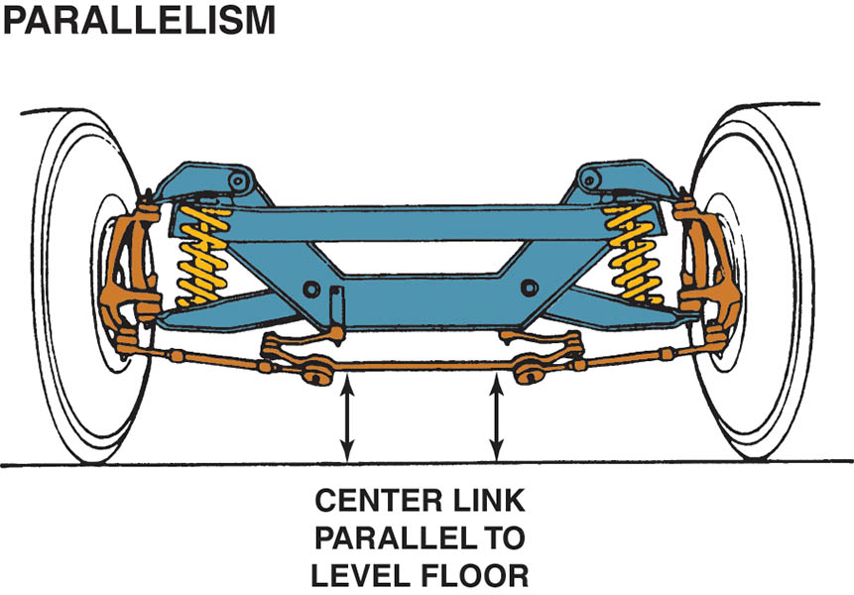
Figure 121.19 The center link should be parallel to the ground

Slide 34
QUESTION 2: ?
What is the purpose of the dry park test?

Slide 35
ANSWER 2:
A test that is designed to help identify freeplay in steering components.

Slide 36
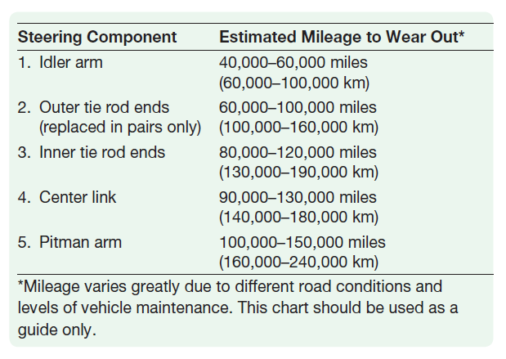
COMMON WEAR ITEMS

Slide 37
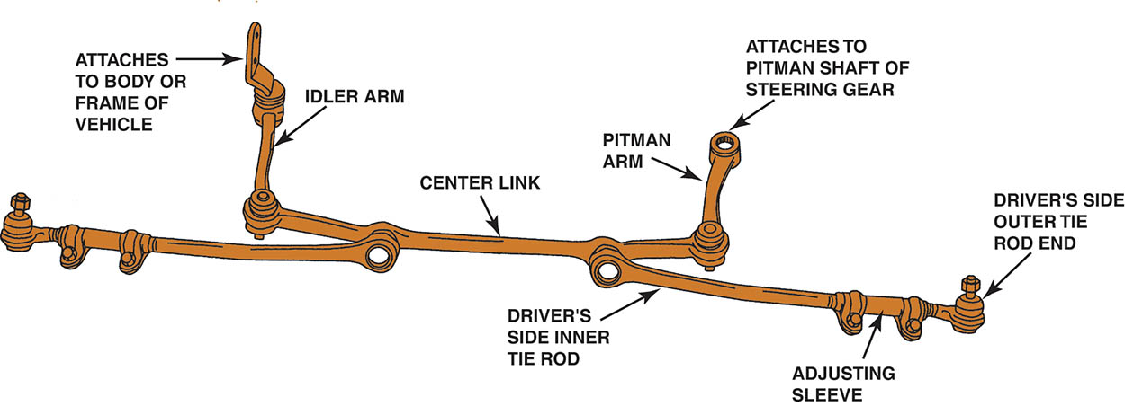
Figure 121.20 Typical parallelogram steering linkage. The center link can also be named the relay rod, drag link, or connecting link

Slide 38
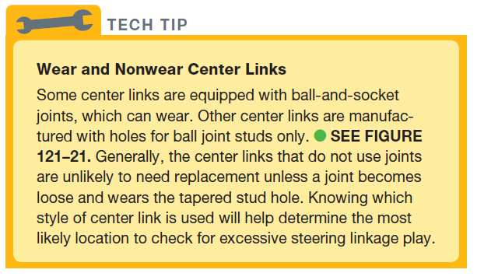
TECH TIP

Slide 39
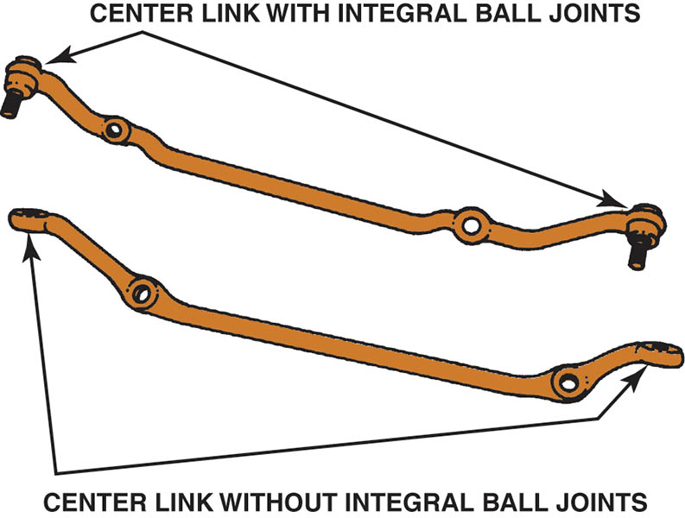
Figure 121.21 Some center links have ball joints while others have tapered socket holes to accept ball joints on the pitman arm, idler arm, and inner tie rod ends

Slide 40
UNDER-VEHICLE INSPECTION
Inspect each part for damage due to an accident or bent parts due to the vehicle hitting an object in the roadway.
Idler arm inspection is performed by using hand force of 25 lb (110 N-m) up and down on the arm.
All other steering linkage should be tested by hand for any vertical or side-to-side looseness.
All steering components should be tested with the wheels in the straight-ahead position.

Slide 41
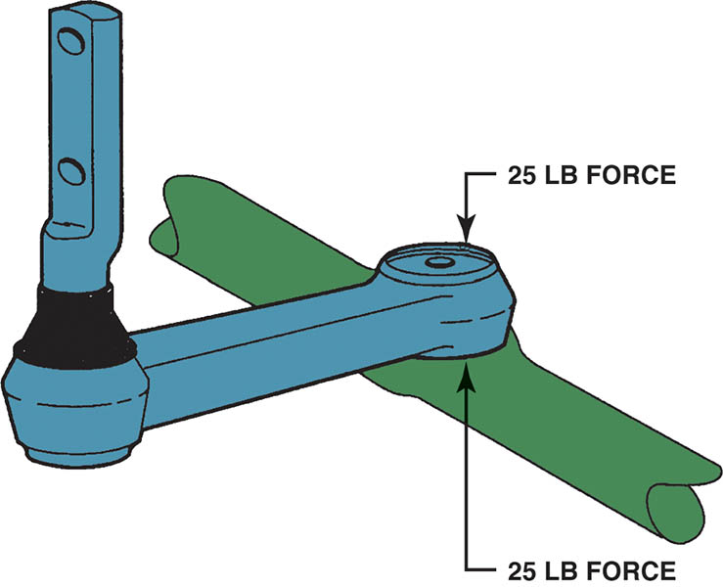
Figure 121.22 To check an idler arm, most vehicle manufacturers specify that 25 pounds of force be applied by hand up and down to the idler arm. The idler arm should be replaced if the total movement (up and down) exceeds 1/4 inch (6 mm)

Slide 42
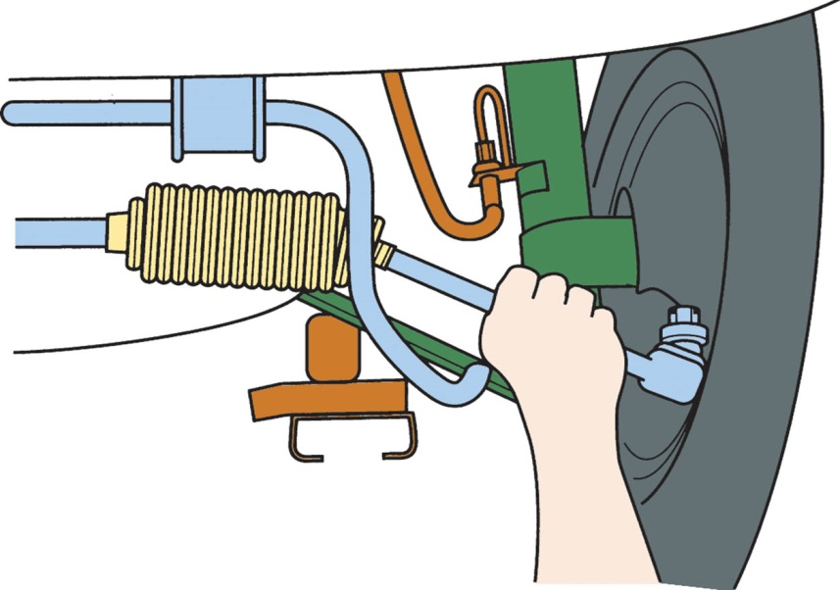
Figure 121.23 Steering system component(s) should be replaced if any noticeable looseness is detected when moved by hand

Slide 43
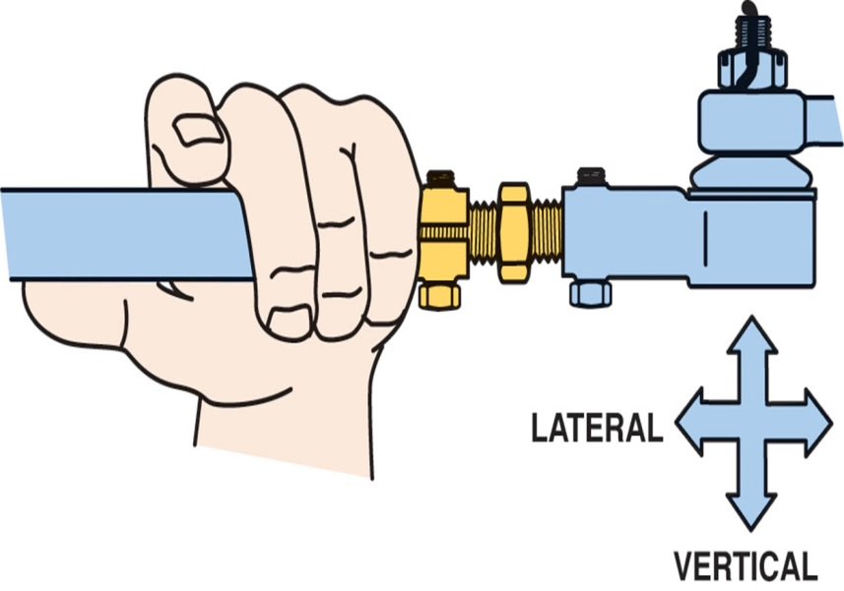
Figure 121.24 All joints should be checked by hand for any lateral or vertical play

Slide 44
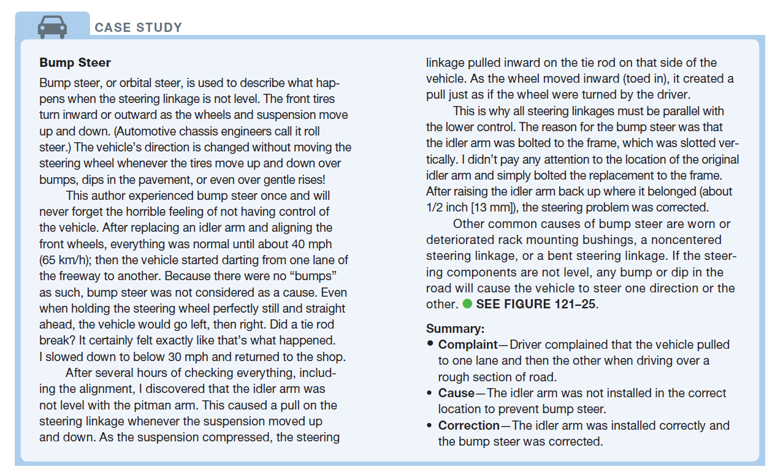
CASE STUDY

Slide 45
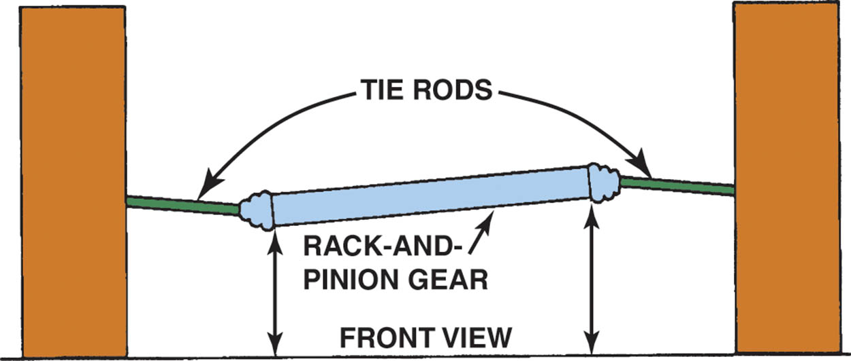
Figure 121.25 If a rack-and-pinion or any other steering linkage system is not level, the front tires will be moved inward and/or outward whenever the wheels of the vehicle move up or down

Slide 46
STEERING LINKAGE REPLACEMENT
Parallelogram Type
  When replacing any steering system component, it is best to replace all defective and marginally good components at the same time.
  When replacing tie rod ends, use the adjusting sleeve to adjust the total length of the tie rod to the same position and length as the original.
Service of Ball-Socket Assemblies
  Inner tie rod end assemblies used on rack-and-pinion steering units often require special tools.

Slide 47
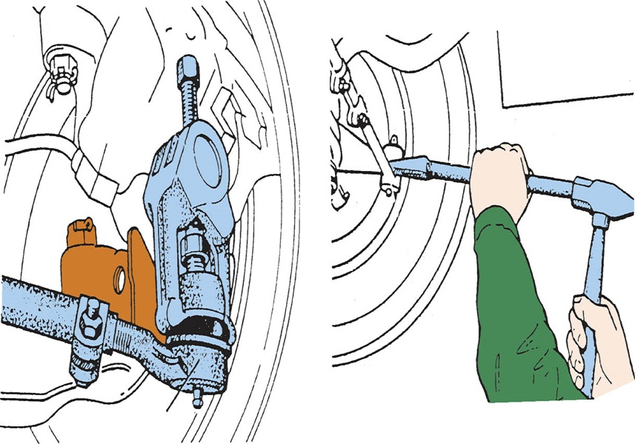
Figure 121.26 The preferred method for separating the tie rod end from the steering knuckle is to use a puller such as the one shown. A pickle-fork-type tool should only be used if the tie rod end is going to be replaced. A pickle-fork-type tool can damage or tear the rubber grease boot

Slide 48
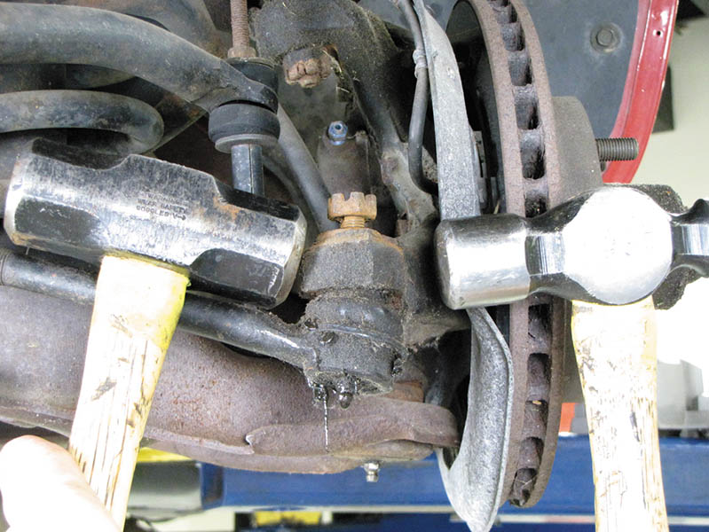
Figure 121.27 Two hammers being used to disconnect a tie rod end from the steering knuckle. One hammer is used as a backing for the second hammer. Notice that the attaching nut has been loosened, but not removed. This prevents the tie rod end from falling when the tapered connection is knocked loose

Slide 49
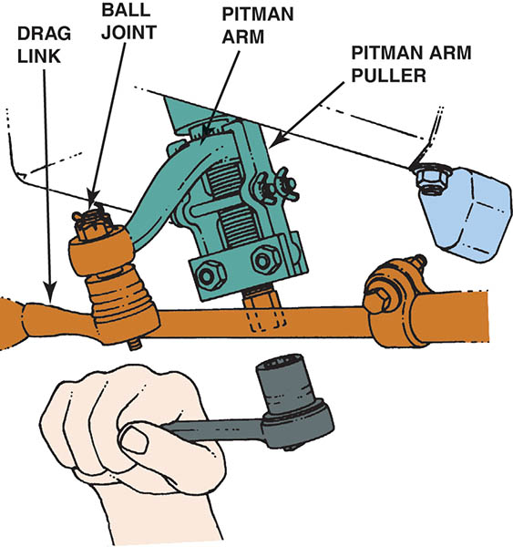
Figure 121.28 A pitman arm puller is used to remove the pitman arm from the pitman shaft

Slide 50
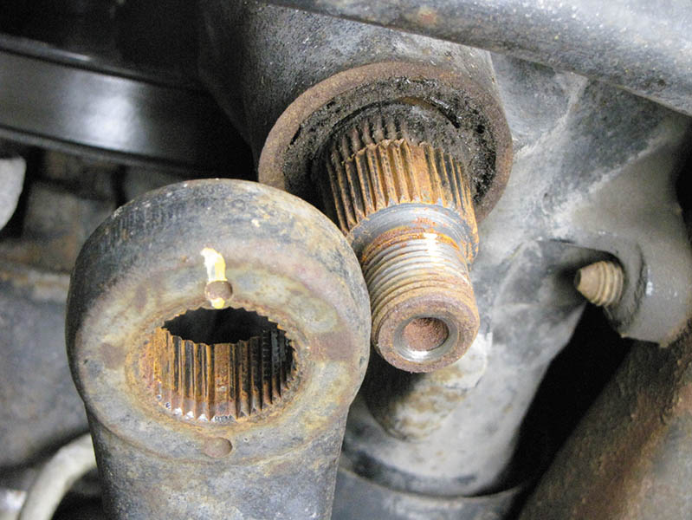
Figure 121.29 Pitman arm and pitman shaft indexing splines

Slide 51
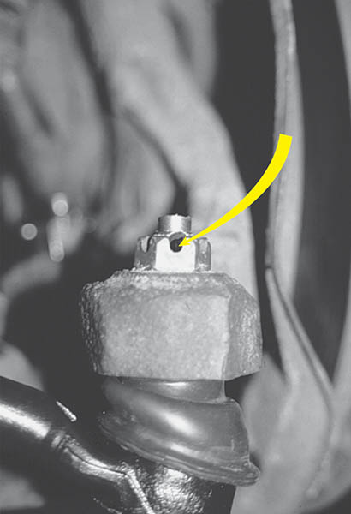
Figure 121.30 Align the hole in the tie rod end with the slot in the retaining nut. If the holes do not line up, always tighten the nut farther (never loosen) until the hole lines up

Slide 52
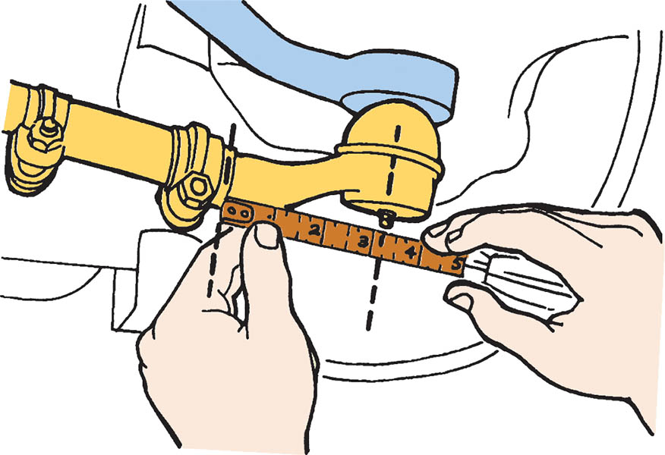
Figure 121.31 Replacement tie rods should be of the same overall length as the originals. Measure from the edge of the tie rod sleeve to the center of the grease fitting. When the new tie rod is threaded to this dimension, the toe setting will be close to the original

Slide 53
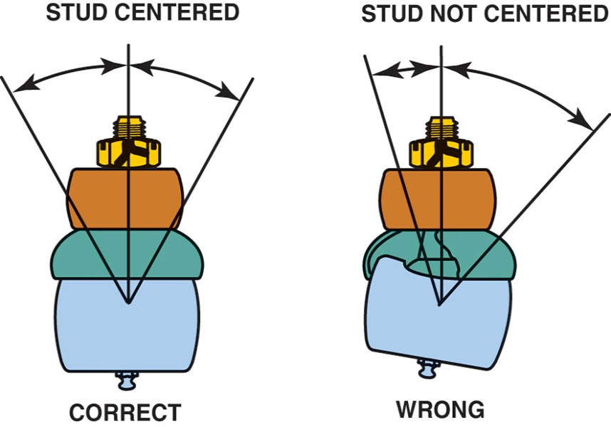
Figure 121.32 All tie rod ends should be installed so that the stud is in the center of its operating range, as shown

Slide 54
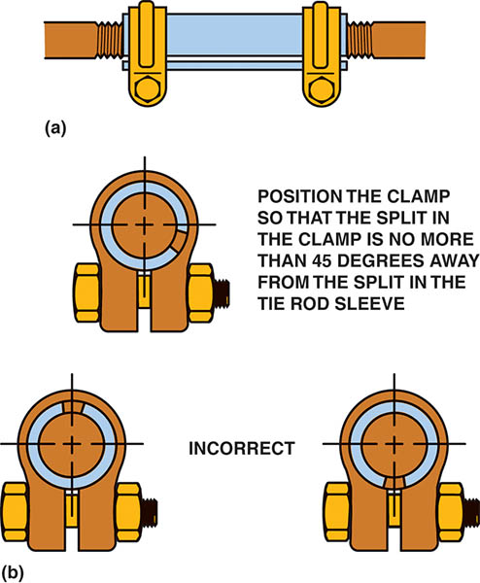
Figure 121.33 (a) Tie rod adjusting sleeve. (b) Be sure to position the clamp correctly on the sleeve

Slide 55
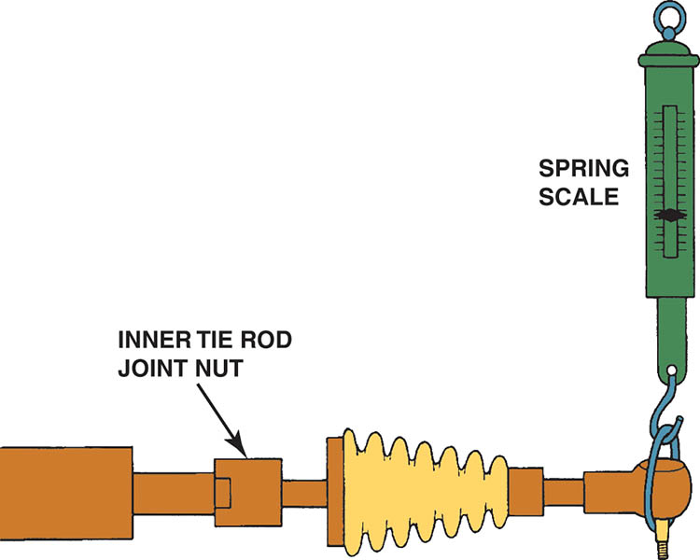
Figure 121.34 An articulation test uses a spring scale to measure the amount of force needed to move the tie rod in the ball socket assembly. Most manufacturers specify a minimum of 1 pound (4.4 N) of force and a maximum of 6 pound (26 N)

Slide 56
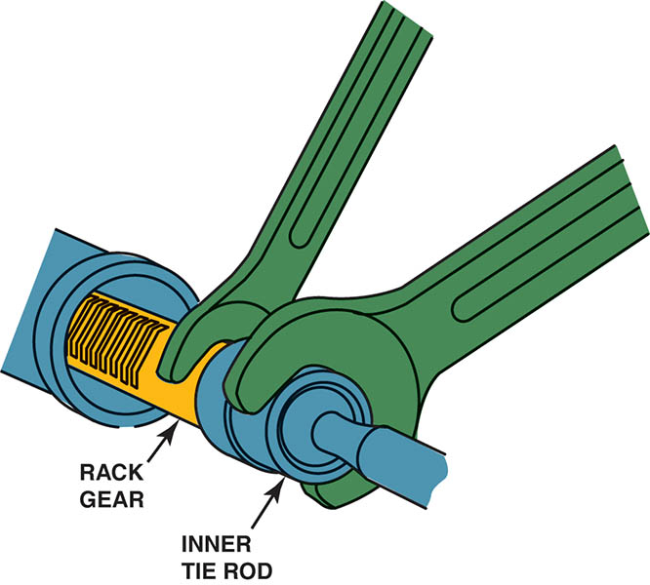
Figure 121.35 Removing a staked inner tie rod assembly requires two wrenches—one to hold the rack and the other to unscrew the joint from the end of the steering rack

Slide 57
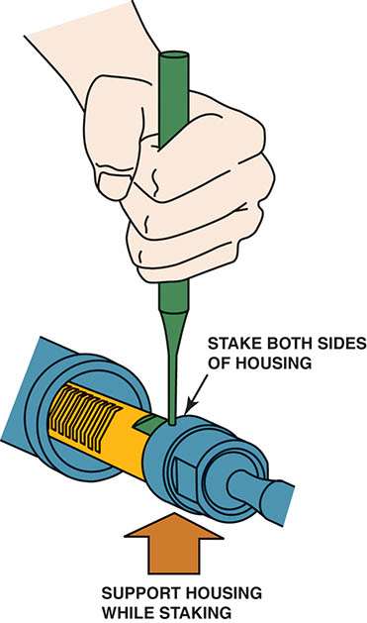
Figure 121.36 When the inner tie rod end is reassembled, both sides of the housing must be staked down onto the flat shoulder of the rack

Slide 58
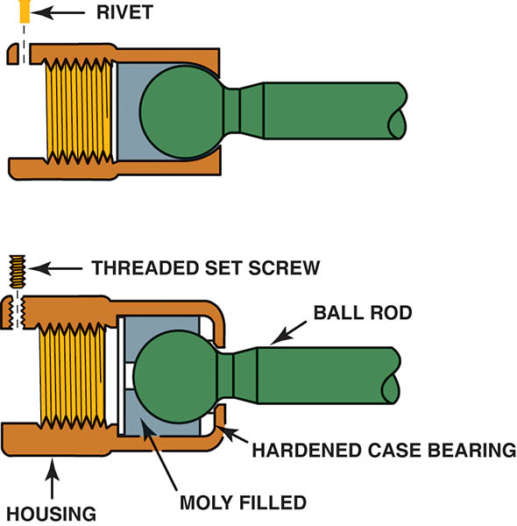
Figure 121.37 After replacing an inner tie rod end, the socket assembly should be secured with a rivet or set screw depending on the style of the replacement part

Slide 59
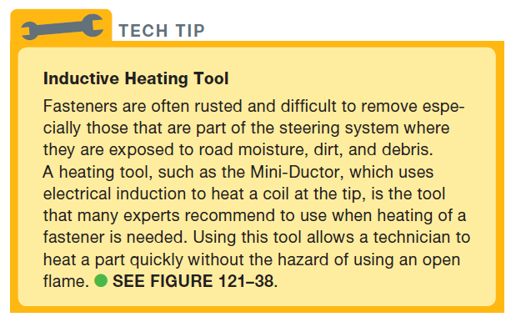
Tech Tip

Slide 60
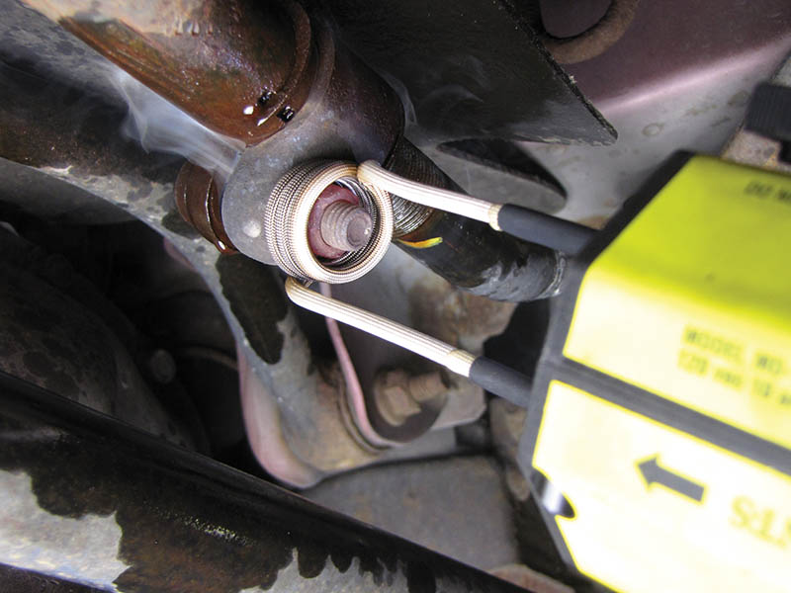
Figure 121.38 Using an inductive heater caused this retaining nut to be cherry red in a just a few seconds

Slide 61
QUESTION 3: ?
What is the most common cause of bump steer?

Slide 62
ANSWER 3:
The rack and pinion gear is not parallel to the road surface.

Slide 63
DRY PARK TEST

Slide 64
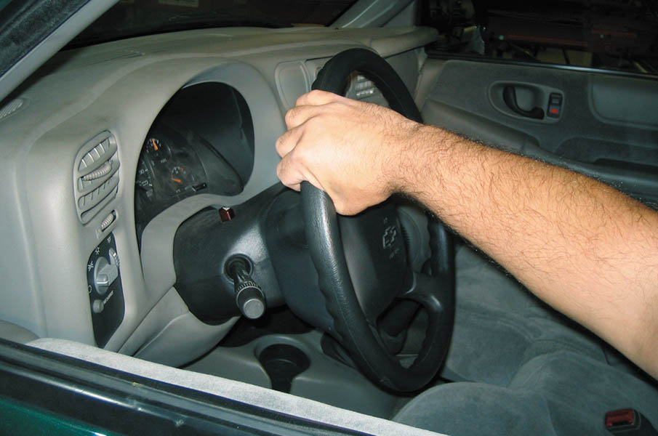
1. Drive the vehicle onto a drive-on-type hoist and have an assistant gently rotate the steering wheel back and forth about 2 inches (50 mm).

Slide 65
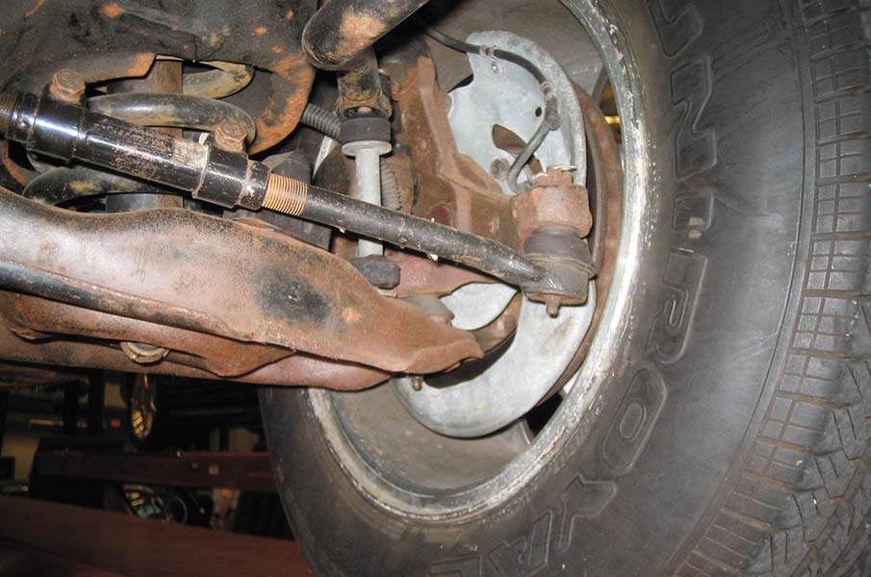
2. Perform a visual inspection of the steering and suspension system, looking for damage from road debris or other faults.

Slide 66
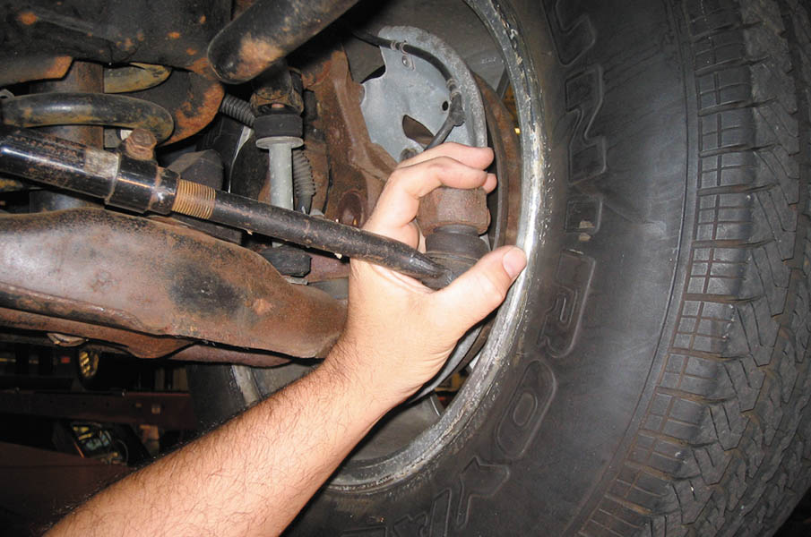
3. As the assistant wiggles the steering wheel, grasp the joint at the outer tie rod end on the driver’s side to check for any movement.

Slide 67
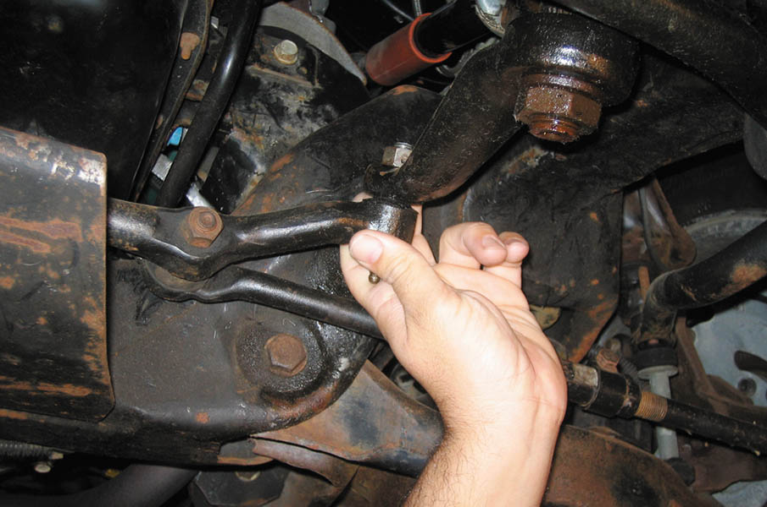
4. Next, check for any freeplay at the pitman arm.

Slide 68
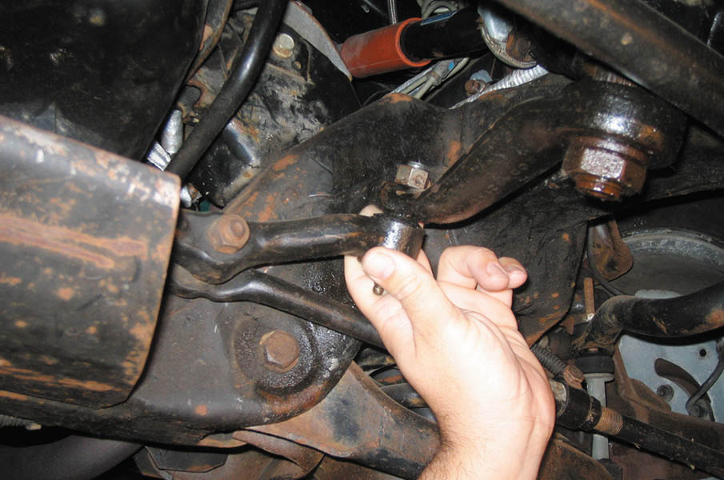
5. Check the joint between the left inner tie rod end and the center link for play.

Slide 69

6. Move to the passenger side and check for any looseness at the joint between the center link and the right side inner tie rod end.

Slide 70

7. Check for looseness at the idler arm connector to the center link and the idler arm at the frame mount.

Slide 71

8. Check for looseness at the passenger-side outer tie rod end. After the inspection, record the results on the work order.

Slide 72

Copyright

