Slide 1
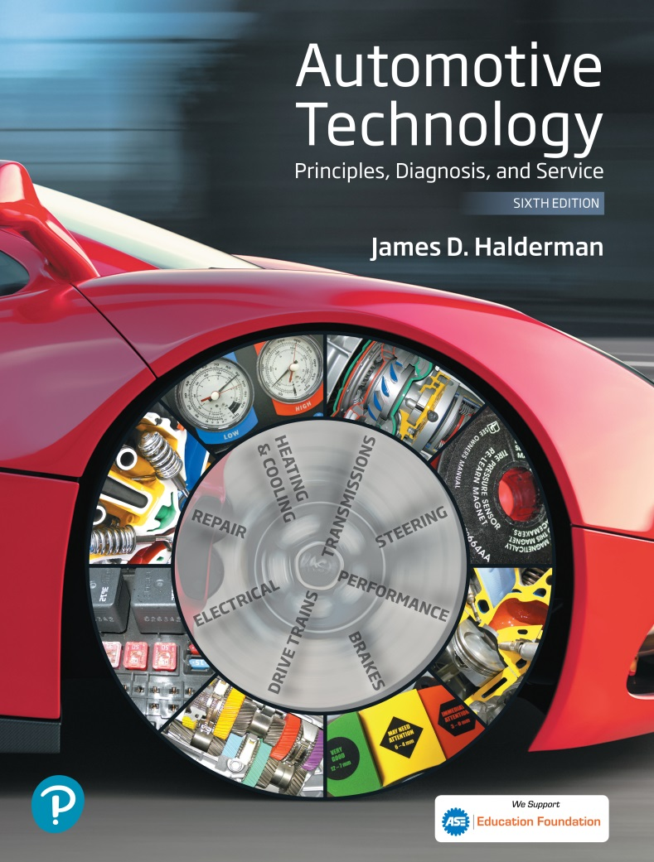
Automotive Technology Principles, Diagnosis, and Service
Sixth Edition
Chapter 120
Steering Columns and Gears
Copyright © 2018, 2015, 2011 Pearson Education, Inc. All Rights Reserved

Slide 2
LEARNING OBJECTIVES (1 of 2)
120.1 Describe the purpose and function of a steering wheel.
120.2 Explain how to remove a steering wheel.
120.3 Discuss steering columns and intermediate shafts.
120.4 Explain the purpose and function of conventional steering gears.

Slide 3
LEARNING OBJECTIVES (2 of 2)
120.5 Explain how a recirculating ball steering gear works.
120.6 Describe how a rack-and-pinion steering gear works.
120.7 This chapter will help prepare for Suspension and Steering (A4) ASE certification test content area “A” (Steering System Diagnosis and Repair).

Slide 4
STEERING WHEELS
Purpose and Function
  The steering wheel, which consists of a rigid rim and a number of spokes connecting the rim to a center hub, attaches to the top of the steering shaft at its center.
Air Bags
  The module fits in front of the nut that secures the steering wheel to the steering shaft.
  Bolts at the back of the steering wheel fasten the airbag module to the steering wheel.

Slide 5
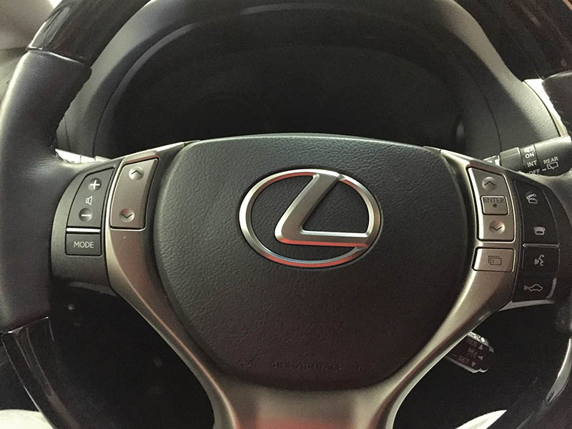
Figure 120.1 A steering wheel assembly includes a driver’s side air bag module plus many also include steering wheel controls

Slide 6
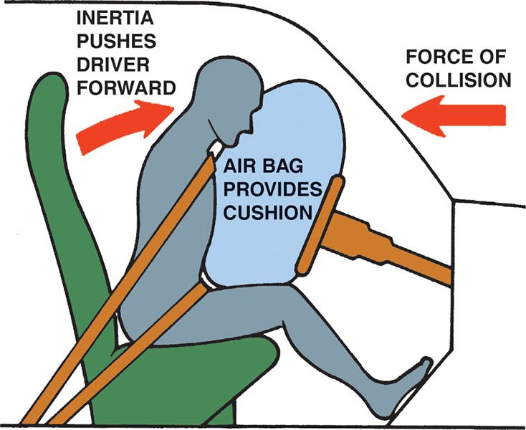
Figure 120.2 The airbag inflates at the same time the driver moves toward the steering wheel during a front-end collision and supplements the protection of the safety belt

Slide 7
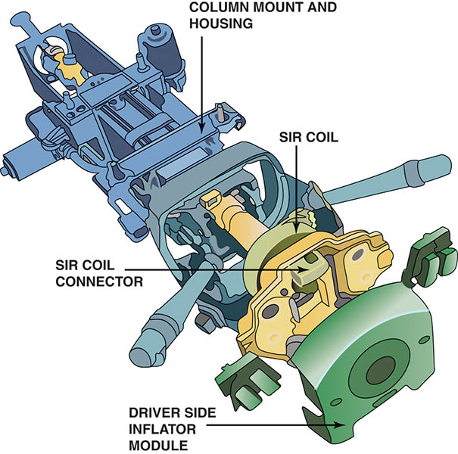
Figure 120.3 The airbag module attaches to the steering wheel and is removed as an assembly to service the steering wheel and column

Slide 8
STEERING WHEEL REMOVAL
If the steering wheel must be removed, first disconnect the airbag wire connector at the base of the steering column.
After removal of the airbag inflator module, remove the steering wheel retaining nut.
Note the locating marks on the steering wheel and steering shaft.
Use a steering wheel puller to remove the steering wheel from the steering shaft.

Slide 9
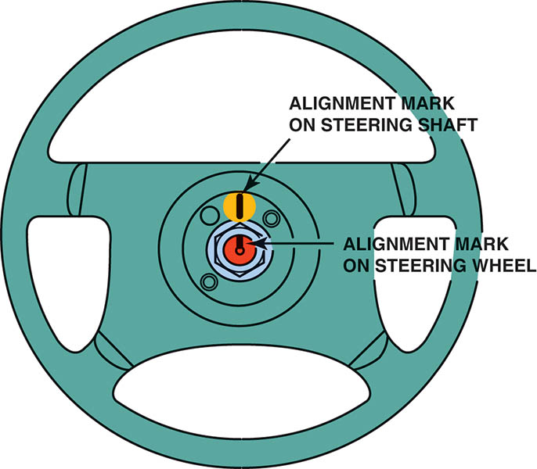
Figure 120.4 Most vehicles have alignment marks made at the factory on the steering shaft and steering wheel to help the service technician keep the steering wheel in the center position

Slide 10
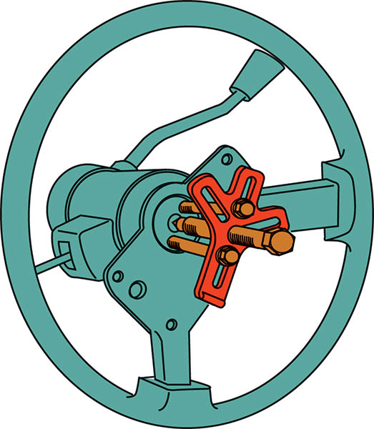
Figure 120.5 A puller being used to remove a steering wheel after the steering wheel retaining nut has been removed

Slide 11
QUESTION 1: ?
How is the steering wheel typically retained on the steering shaft?

Slide 12
ANSWER 1:
A nut holds the steering wheel on a splined and tapered shaft.

Slide 13
STEERING COLUMNS (1 OF 4)
Purpose and Function
  The steering shaft transmits rotary motion from the steering wheel to the steering gear.
Steering Shaft
  The steering shaft extends from the steering wheel to the steering gear.
Universal Joint
  Universal joints allow changes in the angle between two rotating shafts.

Slide 14
STEERING COLUMNS (2 OF 4)
Flexible Couplings
  A flexible coupling is a simple device made of rubber, or rubber reinforced with fabric, that is placed between two shafts to allow for a change in angle between them.
Column Cover
  To keep the wiring from the jacket-mounted switches out of sight, the part of the steering column that extends into the passenger compartment is shrouded by the column cover.

Slide 15
STEERING COLUMNS (3 OF 4)
Collapsible Column
  Federal law requires that steering columns and shafts collapse to absorb some of the energy of the crash and lessen the danger of injury to the driver.
Tilt Mechanisms
  Allow the driver to adjust the angle of the steering wheel relative to the steering column.

Slide 16
STEERING COLUMNS (4 OF 4)
Telescoping Steering Columns
  The top of the steering shaft and jacket can be pulled out toward the driver or pushed in toward the dashboard, and then locked into the new position.
Steering Column Construction
  The construction on the steering column varies with the design of the dash and the type of steering system used on the vehicle.
  Follow the manufacturers instructions when disassembling and reassembling the steering column.

Slide 17
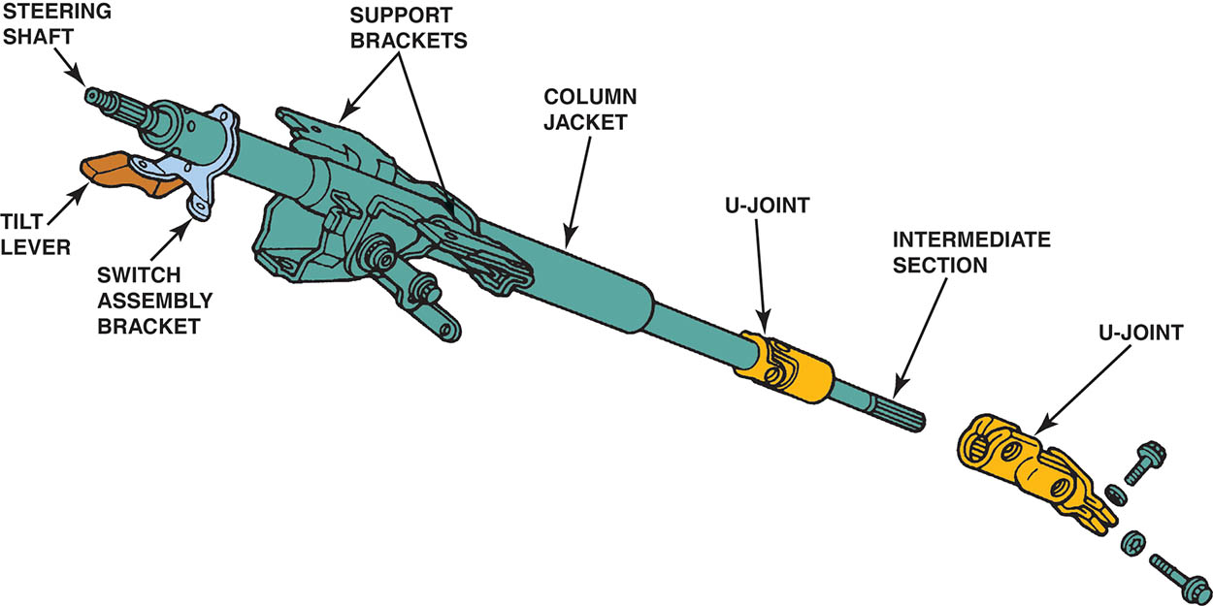
Figure 120.6 The steering shaft links the steering wheel to the steering gear while the column jacket, which surrounds part of the shaft, holds support brackets and switches. This steering shaft has a small intermediate section between the main section and the steering gear

Slide 18
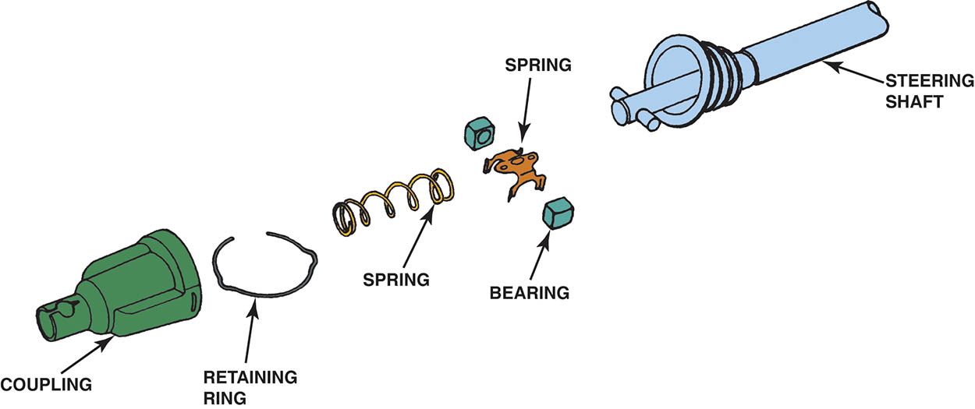
Figure 120.7 A pot joint is a flexible coupling used to join two shafts that allow plunging motion

Slide 19
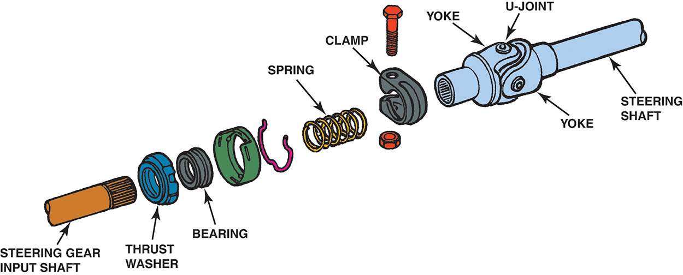
Figure 120.8 A typical intermediate steering shaft assembly showing a U-joint and related components

Slide 20
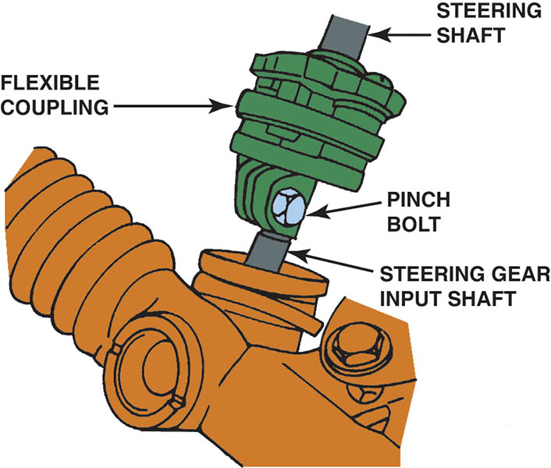
Figure 120.9 A flexible coupling is used to isolate road noise and vibration from the steering shaft

Slide 21
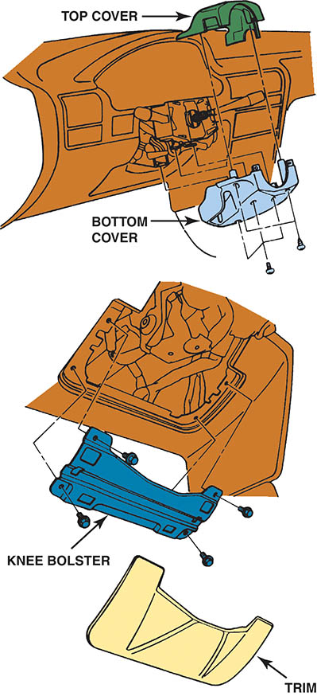
Figure 120.10 Steering column covers are often part of the interior trim

Slide 22
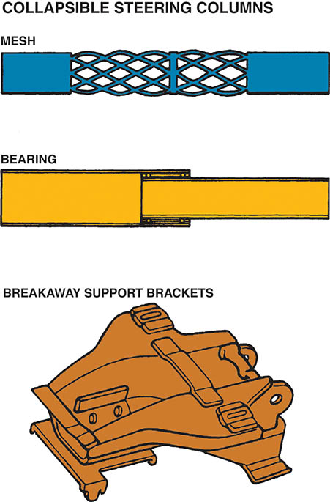
Figure 120.11 Collapsible steering columns include a mesh design that crushes easily, a bearing design that allows one section of the column to slide into the other, and a breakaway device that separates the steering column from the body of the vehicle in the event of a front-end collision

Slide 23
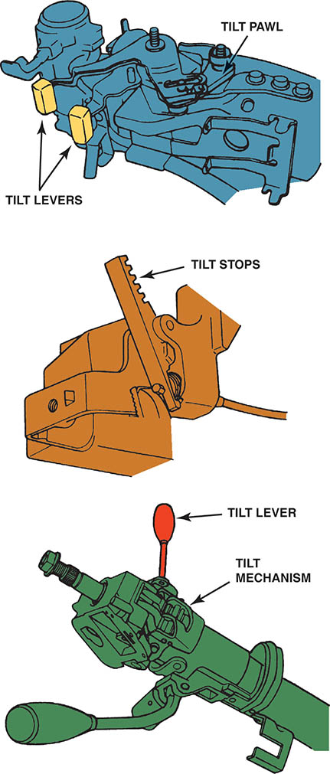
Figure 120.12 Tilt mechanisms vary by design and vehicle manufacturer, although most use a ratchet to position the top portion of the steering column

Slide 24
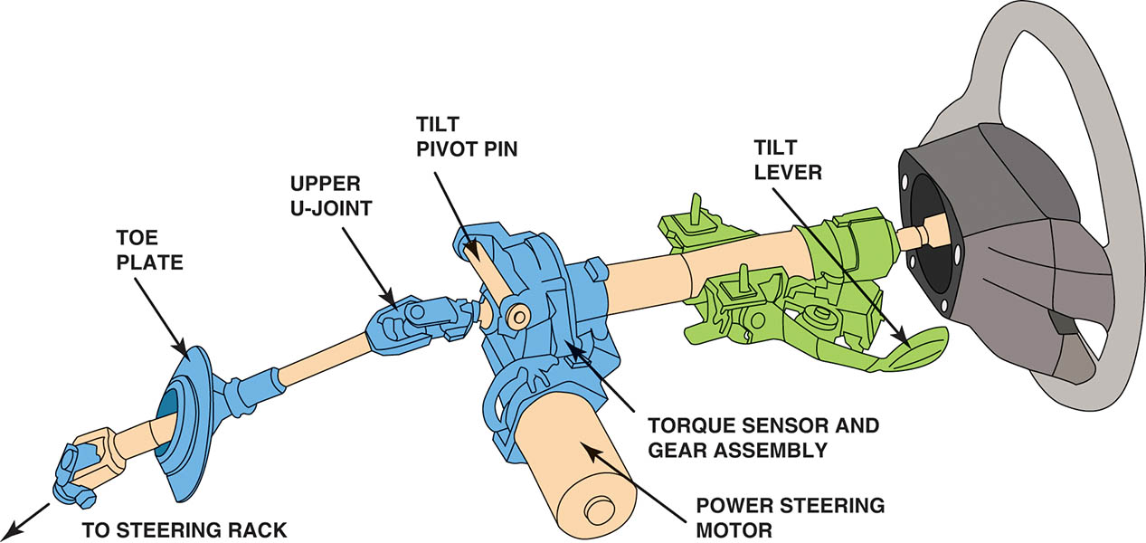
Figure 120.13 Typical steering column showing all of the components from the steering wheel to the steering gear. Note that this column uses a column-type electric power steering system (EPS) and a tilt wheel

Slide 25
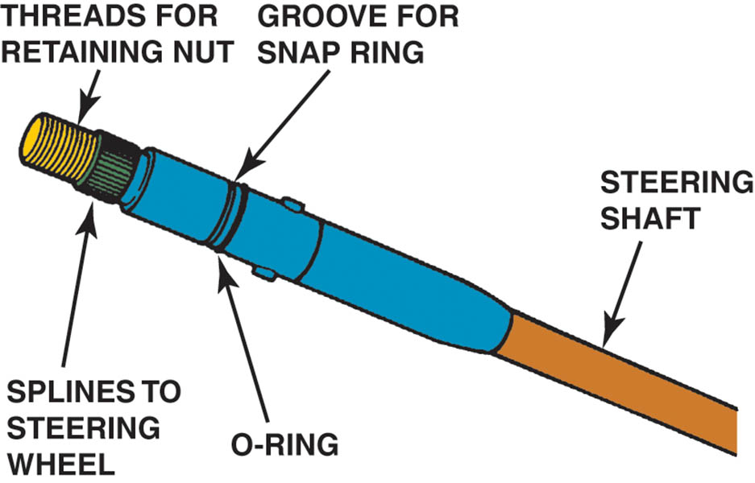
Figure 120.14 The steering shaft splines onto the steering wheel

Slide 26
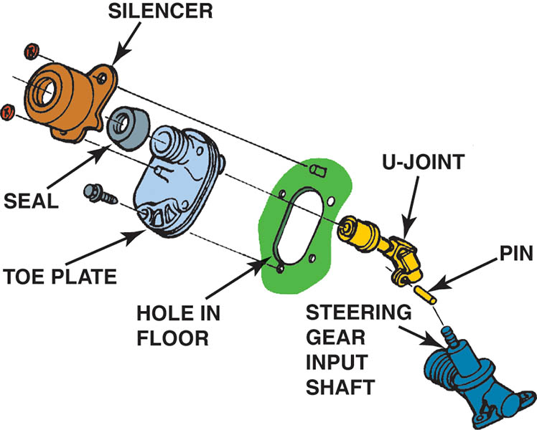
Figure 120.15 The toe plate seals the hole from the steering shaft and helps seal out noise and moisture

Slide 27
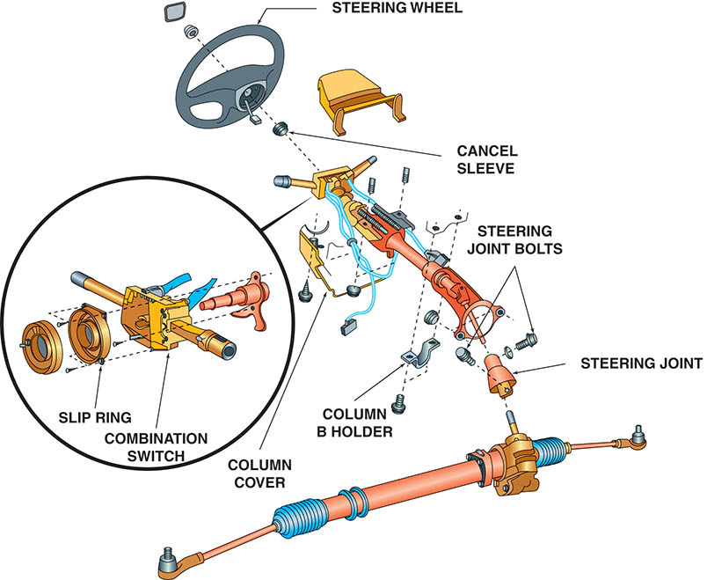
Figure 120.16 The upper portion of the steering column contains the combination switch, often called the multi-function switch used to control many functions

Slide 28
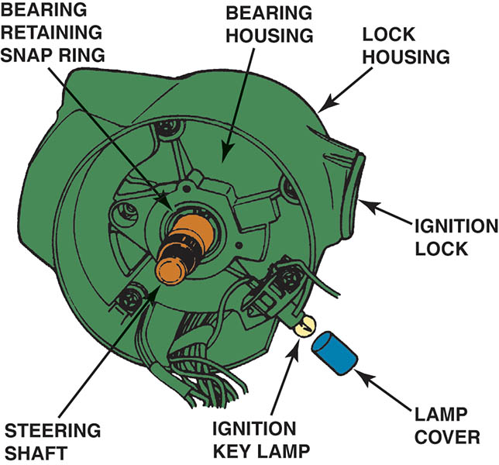
Figure 120.17 The upper section of the steering column contains the steering shaft bearing

Slide 29
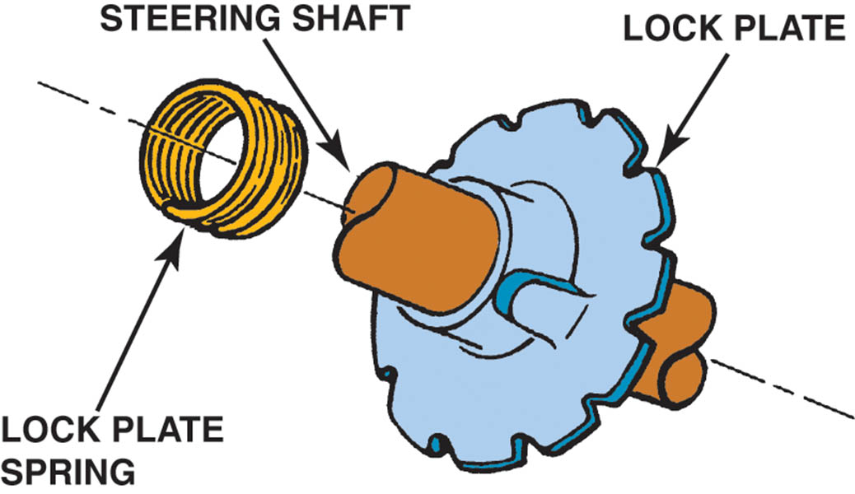
Figure 120.18 The lock plate engages an ignition lock pawl to keep the steering wheel in one position when the ignition is off

Slide 30
QUESTION 2: ?
Why does federal law require a steering column and shaft to be collapsible?

Slide 31
ANSWER 2:
To absorb energy in a crash and reduce the risk of injury.

Slide 32
CONVENTIONAL STEERING GEAR
Purpose and Function
  All steering gears have an input gear, which transmits rotary movement from the steering wheel into the steering gear, and an output gear, which causes the steering linkage to move laterally.
Steering Gear Ratio
  If the steering wheel is rotated 20 degrees and results in the front wheels rotating 1 degree, then the steering gear ratio is 20:1 (read as “20 to 1”).
  Most steering gears and some rack-and-pinion steering gears feature a variable ratio.

Slide 33
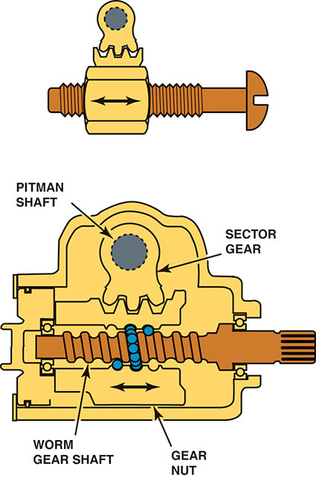
Figure 120.19 As the steering wheel is turned, the nut moves up or down on the threads, shown using a bolt to represent the worm gear and the nut representing the gear nut that meshes with the teeth of the sector gear

Slide 34
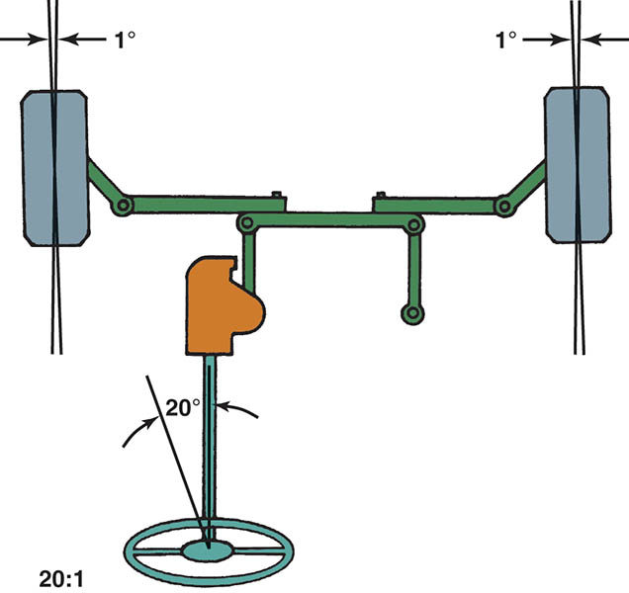
Figure 120.20 Steering gear ratio is the ratio between the number of degrees the steering wheel is rotated to the number of degrees the front wheel turns

Slide 35
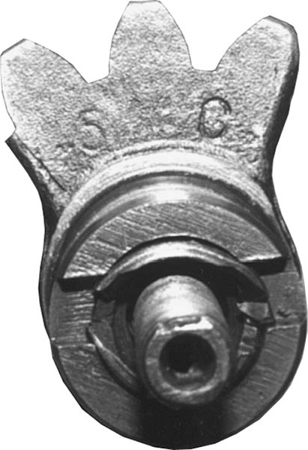
Figure 120.21 Constant-ratio steering gear sector shaft. Notice that all three gear teeth are the same size

Slide 36
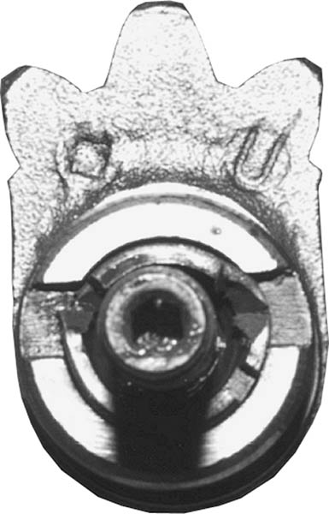
Figure 120.22 Variable-ratio steering gear sector shaft. Notice the larger center gear tooth

Slide 37
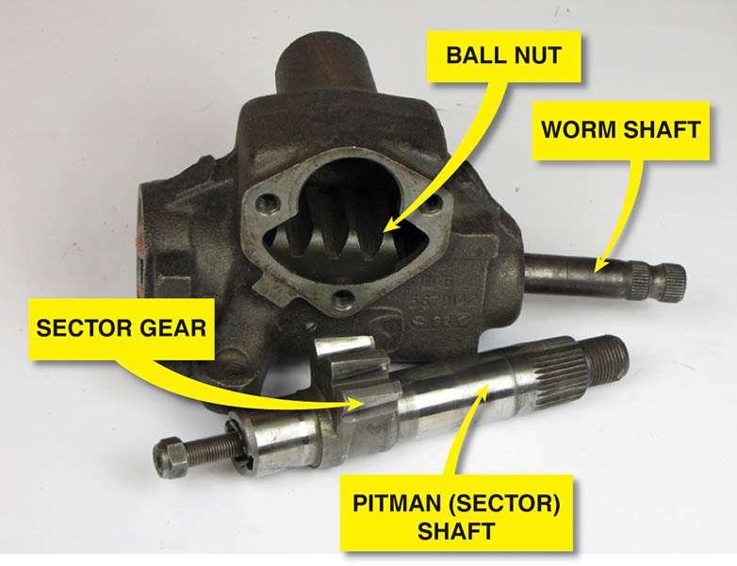
Figure 120.23 The sector gear meshes with the gear teeth on the ball nut

Slide 38
RECIRCULATING BALL STEERING GEAR
Parts and Operation
  The end of the steering gear input shaft, or worm shaft, splines to the steering shaft U-joint and provides rotary input to the steering gear.
  The adjuster plug at the lower end of the worm gear holds the worm gear, shaft, and bearings inside the steering gear housing.
  Steel balls roll through the tunnels formed by the ball nut grooves and the worm gear thread.

Slide 39
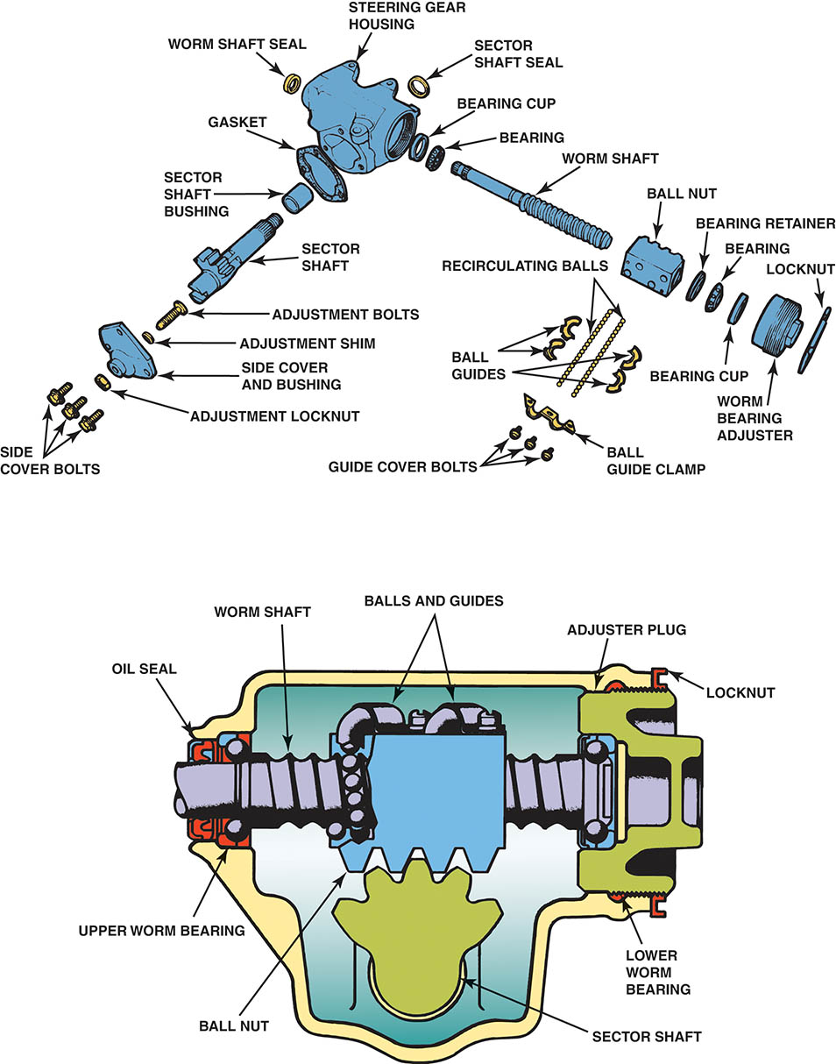
Figure 120.24 A typical manual recirculating ball steering gear

Slide 40
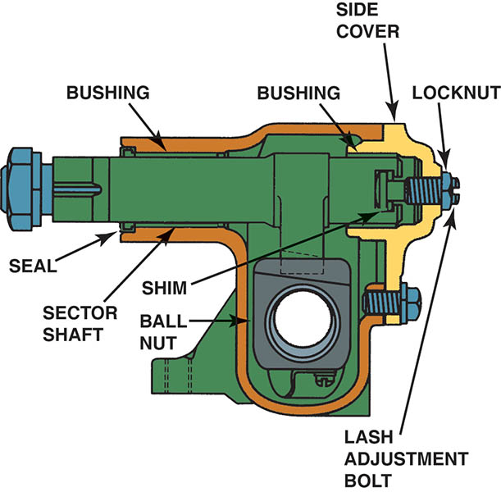
Figure 120.25 The sector shaft is supported by bushings, one in the housing and one in the side cover

Slide 41
STEERING GEAR ADJUSTMENTS
Worm bearing preload is adjusted by one of two methods: turning an adjustment nut or screw or installing selectively sized shims.
Gear mesh preload (over-center adjustment) determines how sensitive the steering gear is to small steering wheel movements during straight-ahead driving.
Sector shaft endplay is a measurement of how much room the sector shaft has to slide axially.

Slide 42
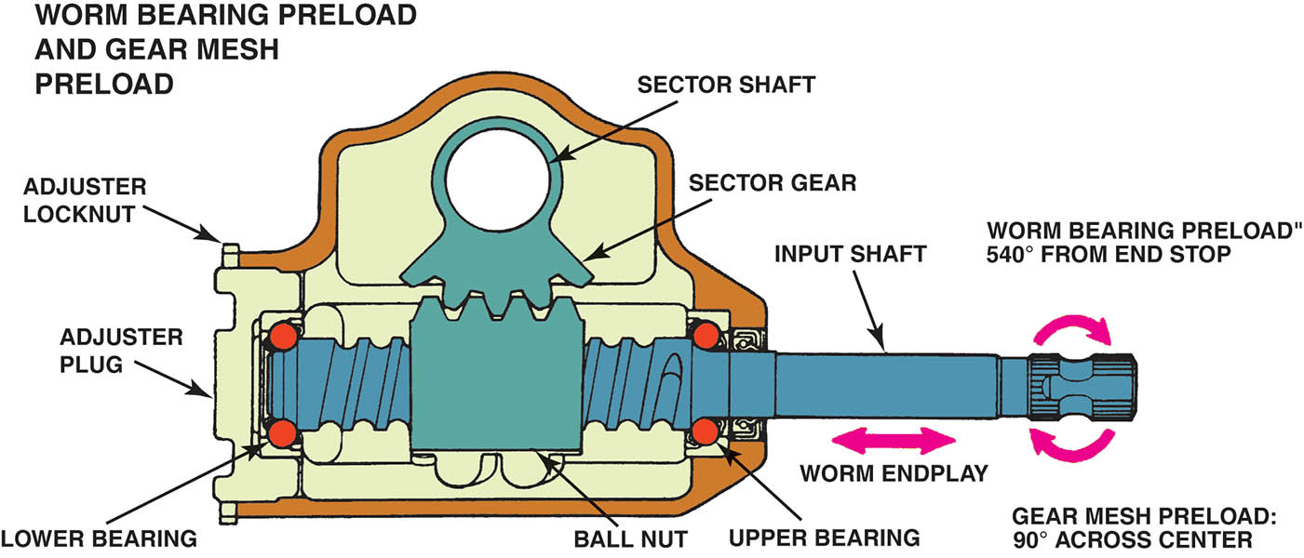
Figure 120.26 Worm bearing preload is a turning force measured in inch-pounds or Newton-meters and worm endplay is axial movement measured in fractions of an inch or millimeters

Slide 43
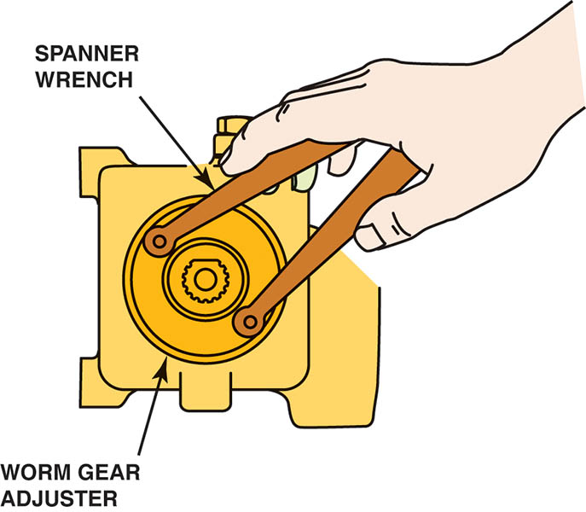
Figure 120.27 The first step to adjust worm gear freeplay is to bottom the worm gear nut, using a spanner wrench designed to fit into the two holes in the nut

Slide 44
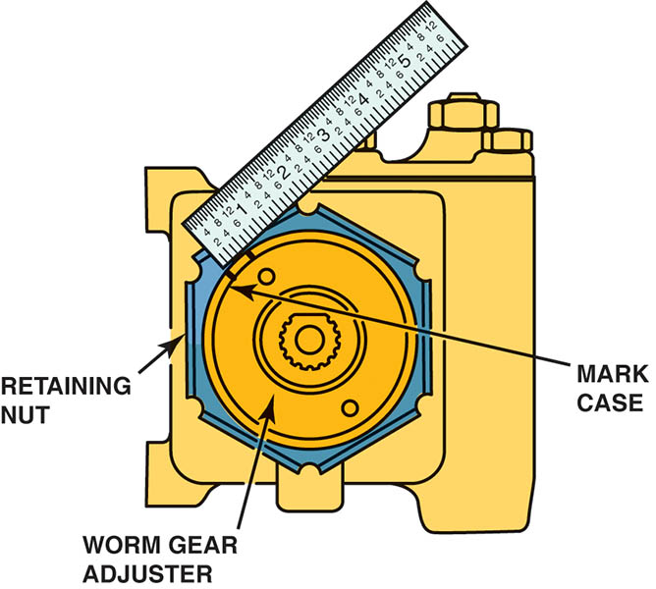
Figure 120.28 After the worm gear nut has been tightened, measure 1/2 inch (13 mm) and mark the case. Using the spanner wrench, rotate the worm gear nut counterclockwise 1/2 inch, align the marks, and then tighten the retaining nut. This procedure gives the proper worm gear endplay

Slide 45
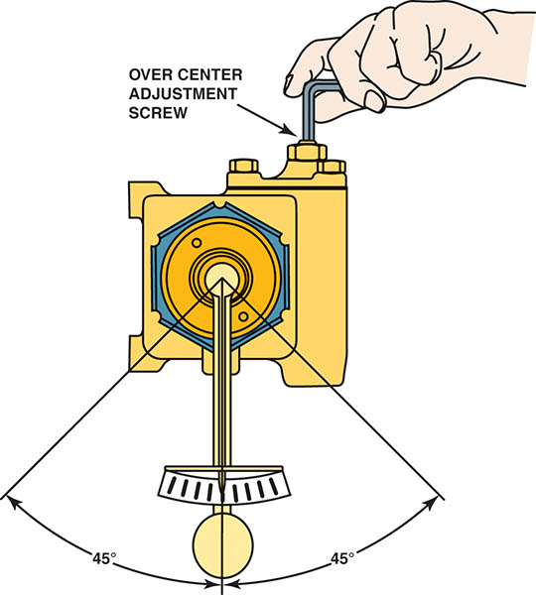
Figure 120.29 After the worm bearing preload procedure has been completed, use the torque wrench to measure the rotating torque, which should be 6- to 15 inch-pounds. If the rotating torque is within the specified range, adjust the overcenter adjustment screw until you achieve 6- to 10 inch-pounds more rotating torque and then tighten the retaining nut

Slide 46
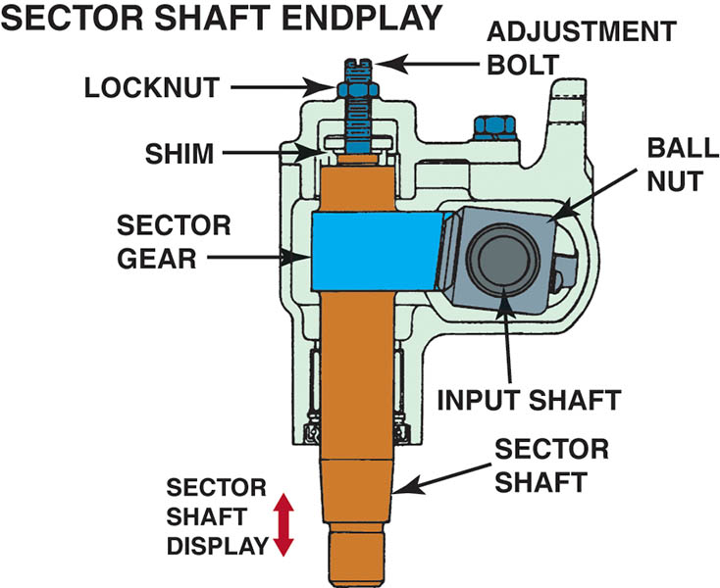
Figure 120.30 Sector shaft endplay is the measurement of how far the sector shaft can move axially and is measured in fractions of an inch or millimeters

Slide 47
RACK AND PINION STEERING GEAR
Parts and Operation
  The pinion gear teeth mesh with the teeth on the rack so that when the pinion gear turns, it pushes the rack from side to side.
  The rack connects directly to the tie rod in the steering linkage to move the linkage back and forth in a straight line.
  Most rack-and-pinion units use a small metal tube running along the outside of the housing to connect the two boots and transfer air from one to the other.

Slide 48
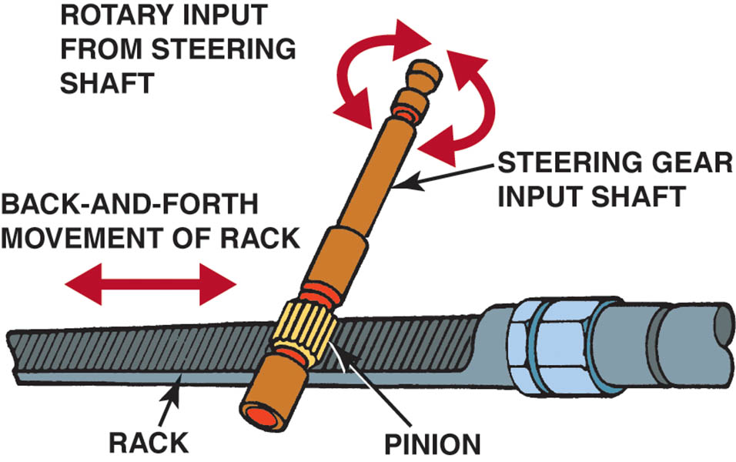
Figure 120.31 Rack-and-pinion steering gear operation is simple, direct, and the rack is in a straight line to the front wheels

Slide 49
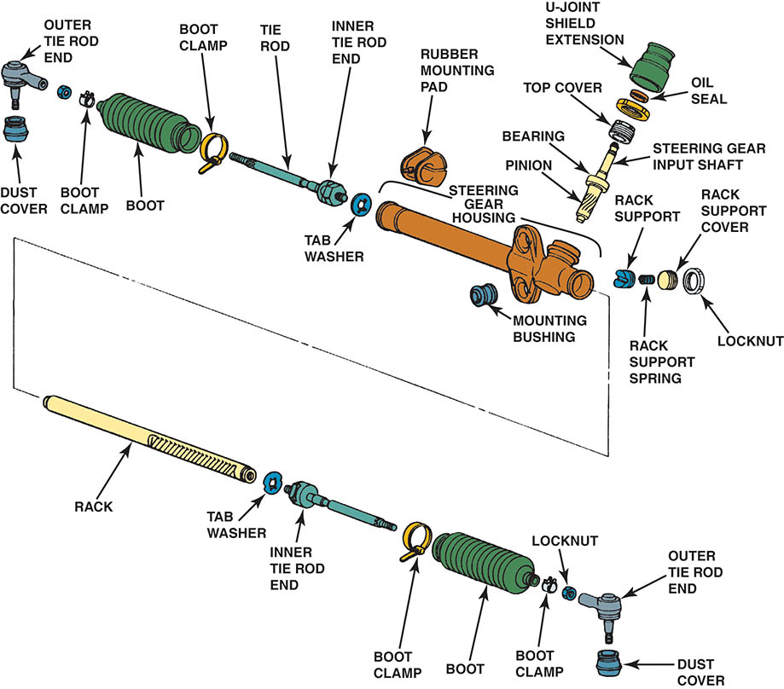
Figure 120.32 A typical manual rack-and-pinion steering gear used in a small front-wheel-drive vehicle

Slide 50
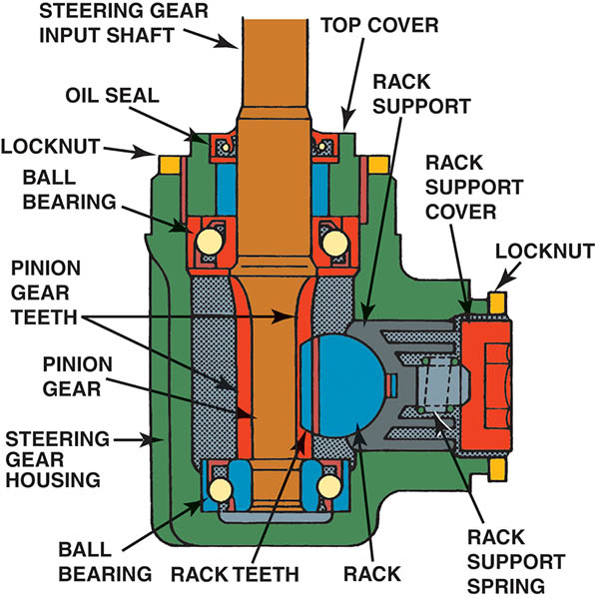
Figure 120.33 The spring-loaded rack support positions the rack to keep it from rubbing against the housing and establishes the pinion torque

Slide 51
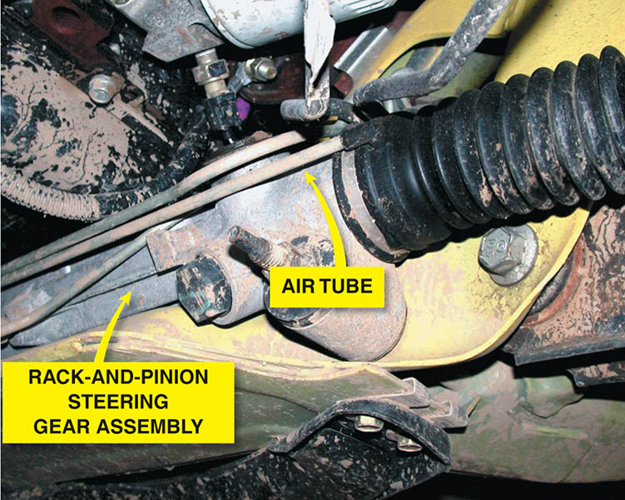
Figure 120.34 A small air tube is used to transfer air between the boots as they extend and compress during turns

Slide 52
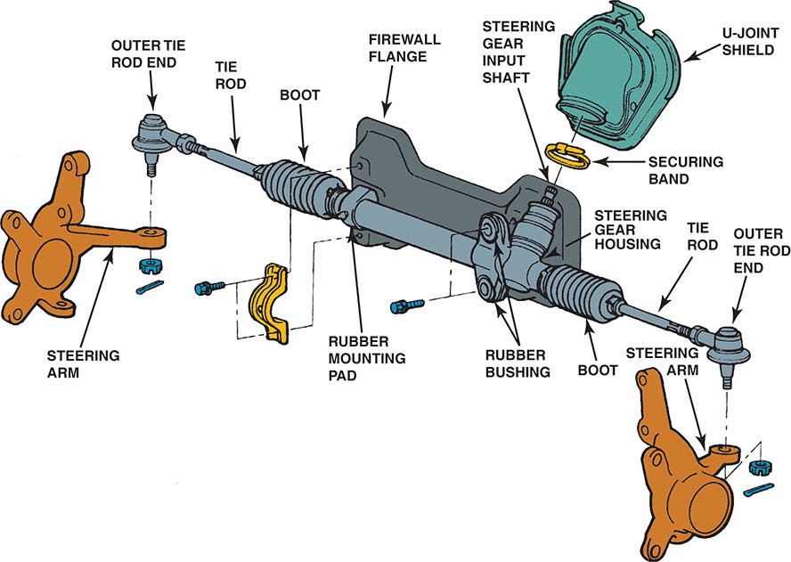
Figure 120.35 This manual rack-and pinion steering gear mounts to the bulkhead (firewall), whereas others mount to the engine cradle or frame of the vehicle

Slide 53
RACK AND PINION ADJUSTMENTS
Pinion torque is a measurement of how much turning force is needed at the input shaft for the pinion to overcome the resistance of the rack and move it.
To provide adjustable pinion bearing preload, there may be a threaded adjustment mechanism or selectively sized shims that install behind a shim cover.

Slide 54
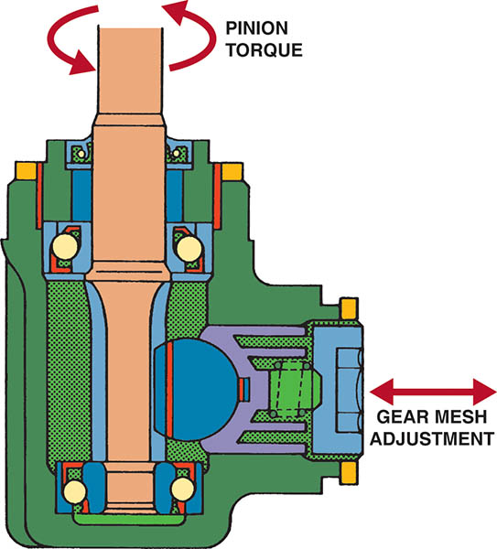
Figure 120.36 Pinion torque is a turning torque force measured in inch-pounds or Newton-meters. Tightening the rack support against the rack increases the pinion torque

Slide 55
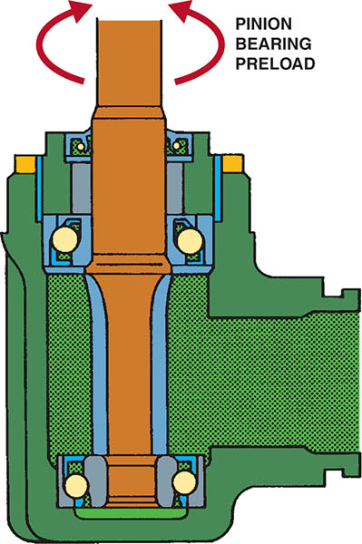
Figure 120.37 Pinion bearing preload is a measurement of the turning force required to overcome the resistance of the pinion shaft bearings

Slide 56
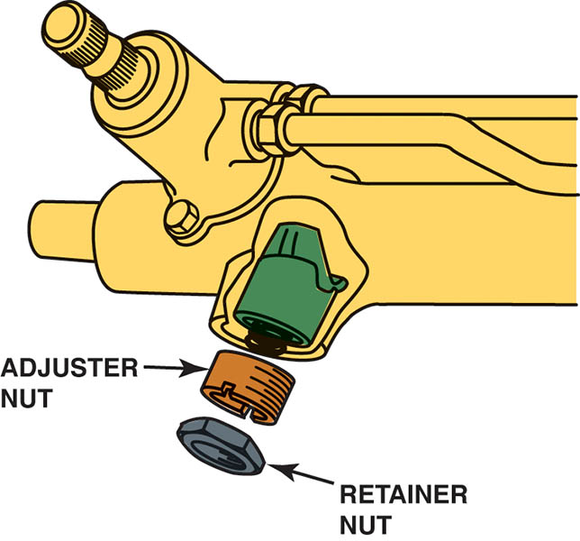
Figure 120.38 To adjust the rack-and-pinion gear preload, loosen the retaining nut and tighten the adjuster nut until it bottoms. Then loosen 60 degrees (one “flat” of the six-sided retainer). Tighten retaining nut

Slide 57
QUESTION 3: ?
What steering gear adjustments are possible on a typical rackand-
pinion steering gear?

Slide 58
ANSWER 3:
Pinion bearing preload.

Slide 59

Copyright

