Slide 1

Automotive Technology Principles, Diagnosis, and Service
Sixth Edition
Chapter 12
Measuring Systems and Tools
Copyright © 2018, 2015, 2011 Pearson Education, Inc. All Rights Reserved

Slide 2
LEARNING OBJECTIVES
12.1 Compare the English customary measuring system and the metric system.
12.2 Discuss the purpose of tape measures, micrometers, and depth micrometers.
12.3 Discuss the purpose of telescopic gauges, small-hole gauges, and dial calipers.
12.4 Discuss the purpose of the straightedges, dial indicators, feeler gauges, and dial bore gauges.

Slide 3
ENGLISH CUSTOMARY MEASURING SYSTEM
Established AD 1100.
One Foot: (12 inches) equal to “typical” foot of the day.
One yard (36 inches) The distance from King Henry’s nose to the end of outstretched hand.
One mile: equal to 1000 paces or steps of a Roman soldier.
The pound and gallon evolved from Roman measurements.

Slide 4
METRIC SYSTEM OF MEASURE
Created in late 1700s in France
1 meter equals 1/40,000,000 of the circumference of the earth.
Common Prefixes:
m = milli = 1/1,000
k = kilo = 1,000
M = mega = 1,000,000

Slide 5
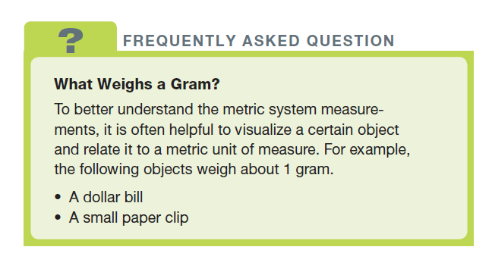
FREQUENTLY ASKED QUESTION

Slide 6
LINEAR MEASUREMENTS (TAPE MEASURE/RULE)
Measure or rule divided into smaller units.
Many be fraction, metric, or both.
Typically largest units of measure are:
Inches
Centimeters

Slide 7
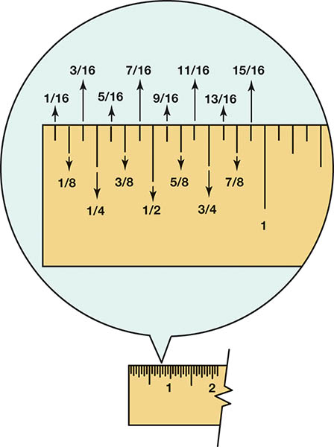
Figure 12.1 A rule showing that the larger the division, the longer the line

Slide 8
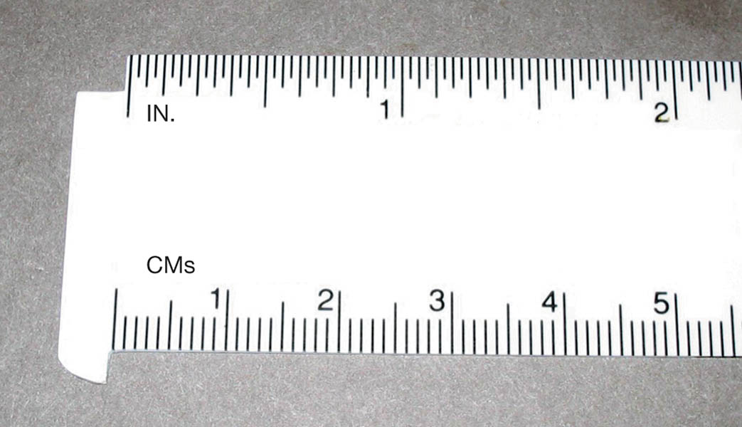
Figure 12.2 A plastic rule that has both inches and centimeters. Each line between the numbers on the centimeters represents 1 millimeter because there are 10 millimeters in 1 centimeter

Slide 9
MICROMETER
The most used measuring tool in engine service and repair.
Accurate to 1/10,000 of an inch or .001mm.
Multiple sizes depending on measurement.
Most automotive micrometers contain a ratchet stop.
Newer models have a digital display.

Slide 10
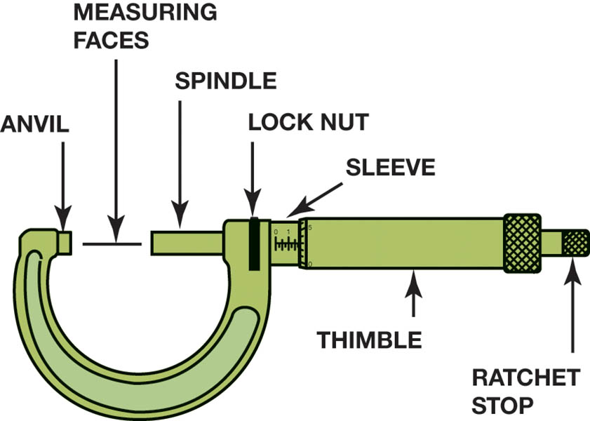
Figure 12.3 A typical micrometer showing the names of the parts. The sleeve may also be called the barrel or stock

Slide 11
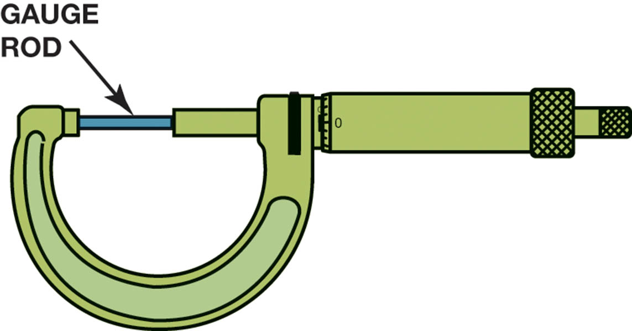
Figure 12.4 All micrometers should be checked and calibrated as needed using a gauge rod

Slide 12
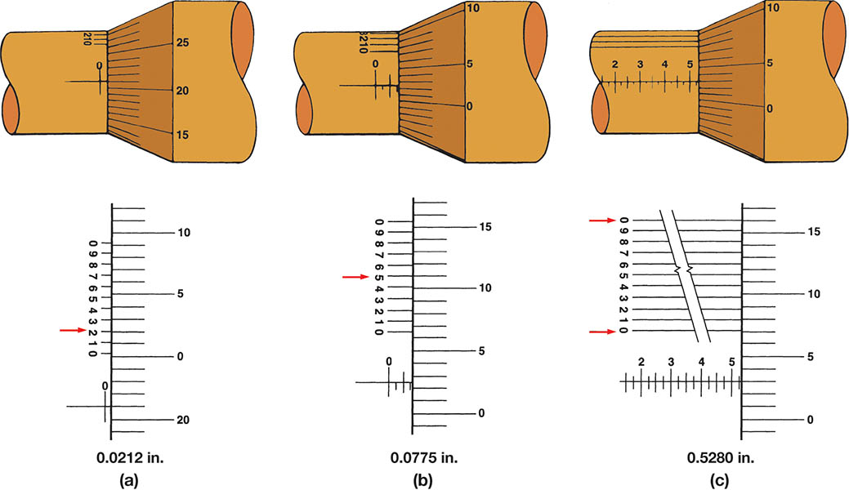
Figure 12.5 The three micrometer readings are (a) 0.0212 inch; (b) 0.0775 inch; (c) 0.5280 inch. These measurements used the vernier scale on the sleeve to arrive at the ten-thousandth measurement. The number that is aligned represents the digit in the ten-thousandth place

Slide 13
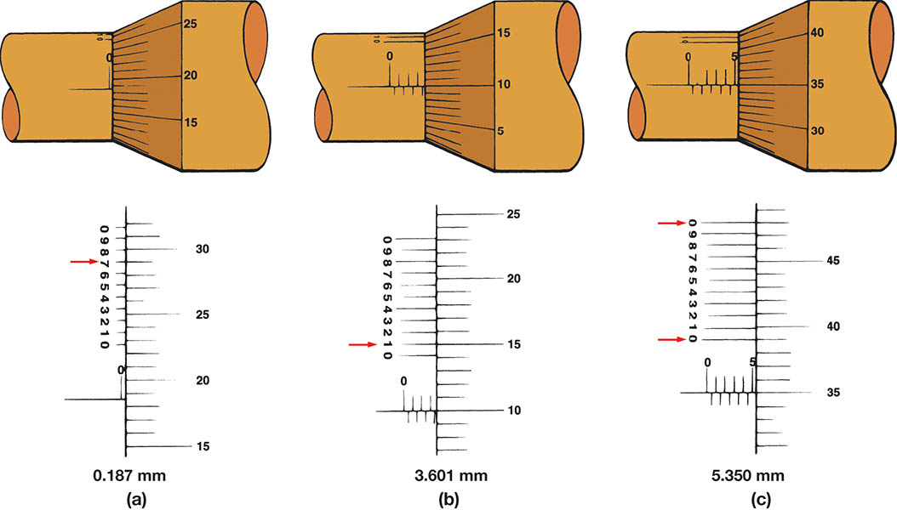
Figure 12.6 Metric micrometer readings that use the vernier scale on the sleeve to read to the nearest 0.001 millimeter. The arrows point to the final reading for each of the three examples

Slide 14
QUESTION 1: ?
How is the measurement on a micrometer read?

Slide 15
ANSWER 1:
The measurement is the total of the values on the sleeve and the thimble.

Slide 16
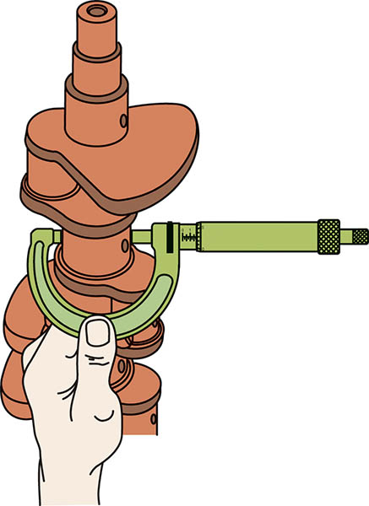
Figure 12.7 Using a micrometer to measure the main bearing journal for out-of-round and taper

Slide 17
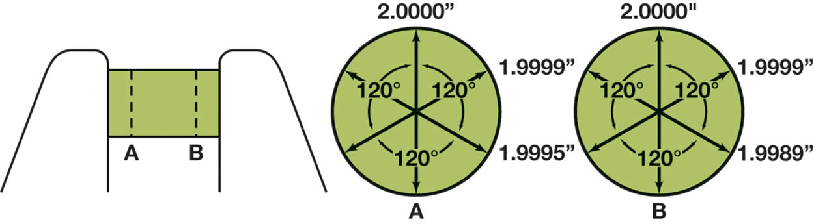
Figure 12.8 Crankshaft journal measurements. Each journal should be measured in at least six locations, but also in position A and position B and at 120-degree intervals around the journal

Slide 18
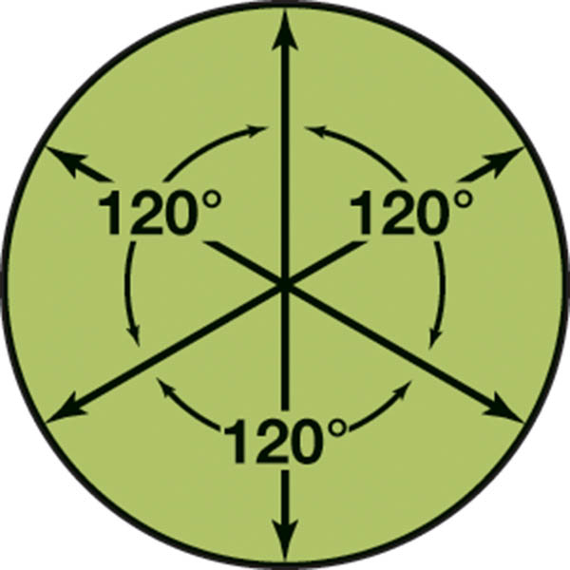
Figure 12.9 Camshaft journals should be measured in three locations, 120 degrees apart, to check for out-of-round

Slide 19
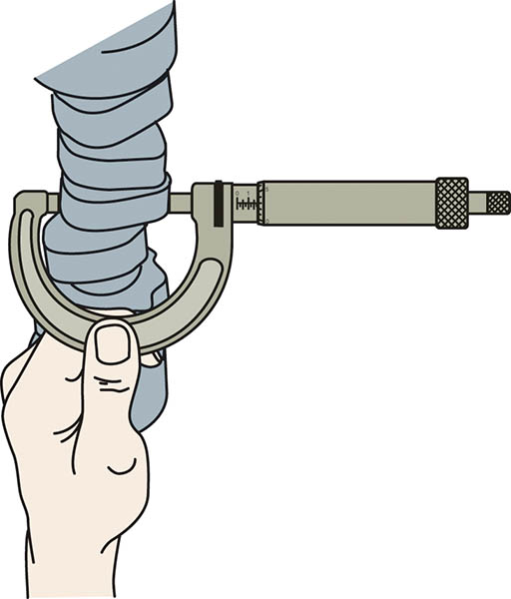
Figure 12.10 Checking a camshaft for wear by measuring the lobe height with a micrometer

Slide 20
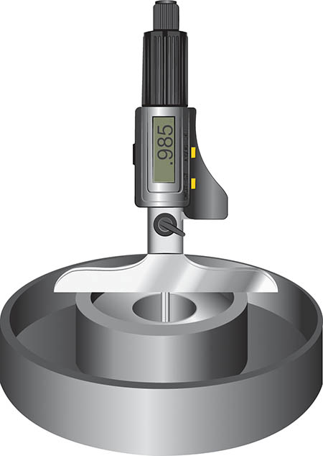
Figure 12.11 A digital readout depth micrometer

Slide 21
Telescopic Gauge
Used to measure the inside diameter or bore of a hole or cylinder.
Rotating the handle locks the arms in contact with the bore.
Can be used to measure:
Camshaft bearing bore
Main bearing bore
Connecting rod bore

Slide 22
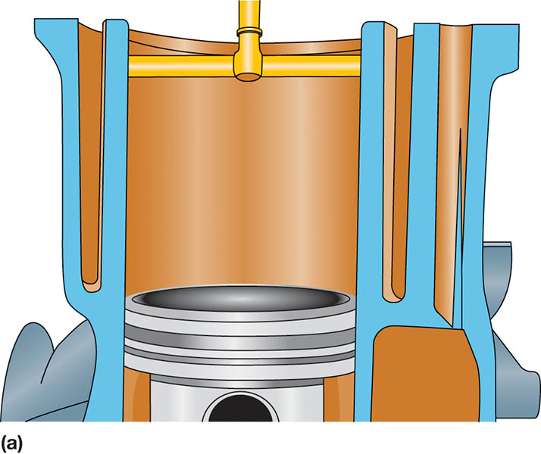
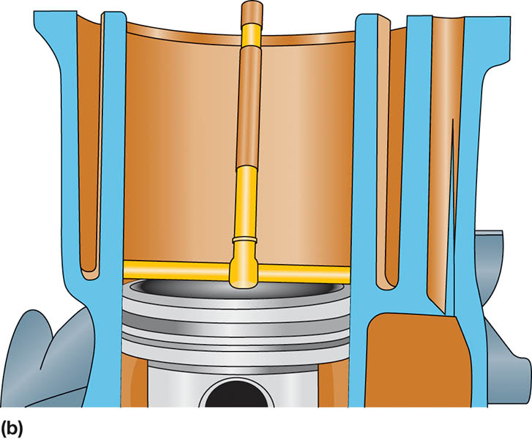
Figure 12.12 When the head is first removed, the cylinder taper and out-of-round should be checked below the ridge (a) and above the piston when it is at the bottom of the stroke (b)

Slide 23
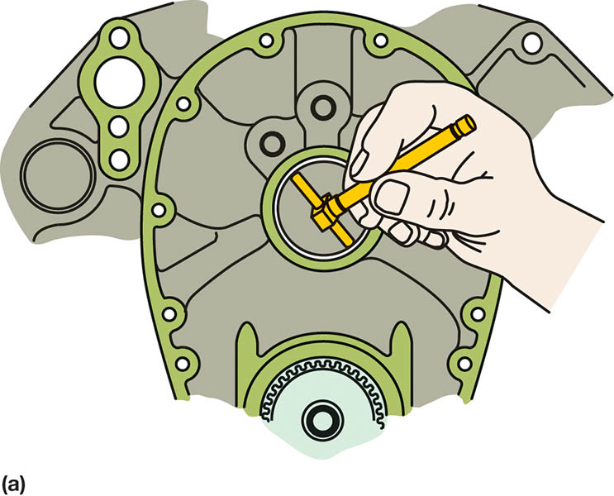
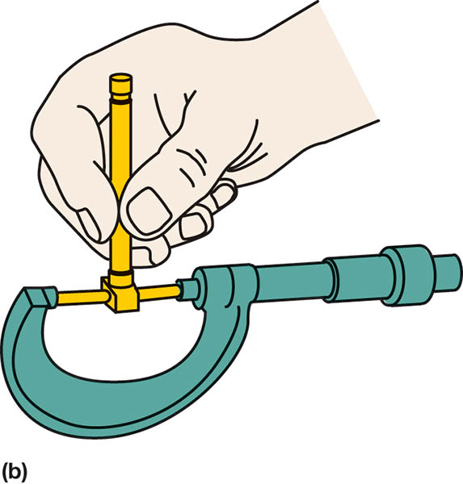
Figure 12.13 (a) A telescopic gauge being used to measure the inside diameter (ID) of a camshaft bearing. (b) An outside micrometer used to measure the telescopic gauge

Slide 24
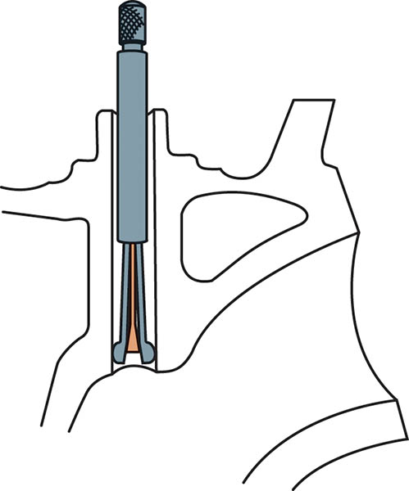
Figure 12.14 Cutaway of a valve guide with a small hole gauge adjusted to the hole diameter

Slide 25
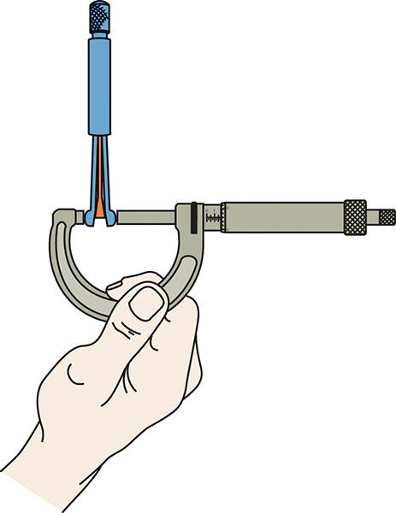
Figure 12.15 The outside of a small hole gauge being measured with a micrometer

Slide 26
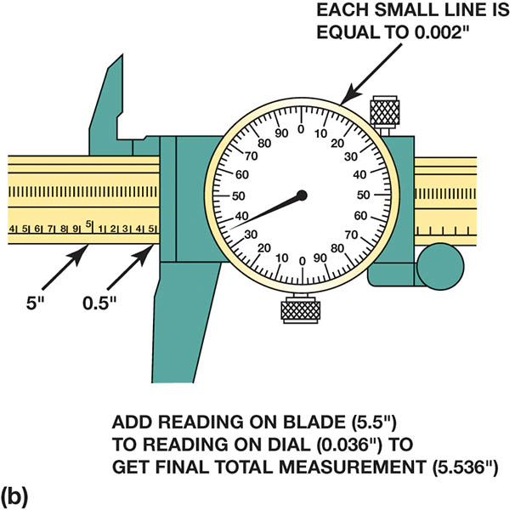
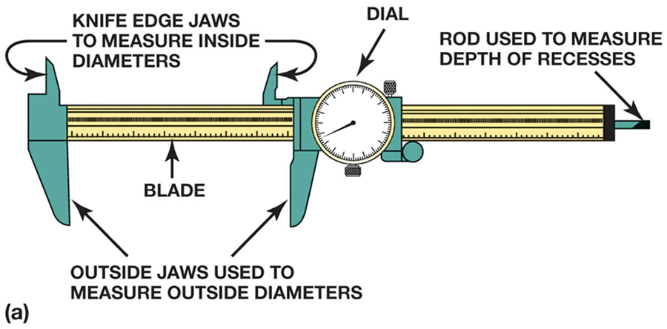
Figure 12.16 (a) A typical dial caliper. This is a very useful measuring tool for automotive engine work because it is capable of measuring inside, outside, and depth measurements. (b) To read a dial caliper, simply add the reading on the blade to the reading on the dial

Slide 27
FEELER GAUGE
Also know as thickness gauge.
Accurately manufactured strip of metal to measure clearance between components.
Examples:
Piston ring gap
Piston ring side clearance
Connecting rod side clearance
Piston-to-wall clearance
Valve clearance

Slide 28
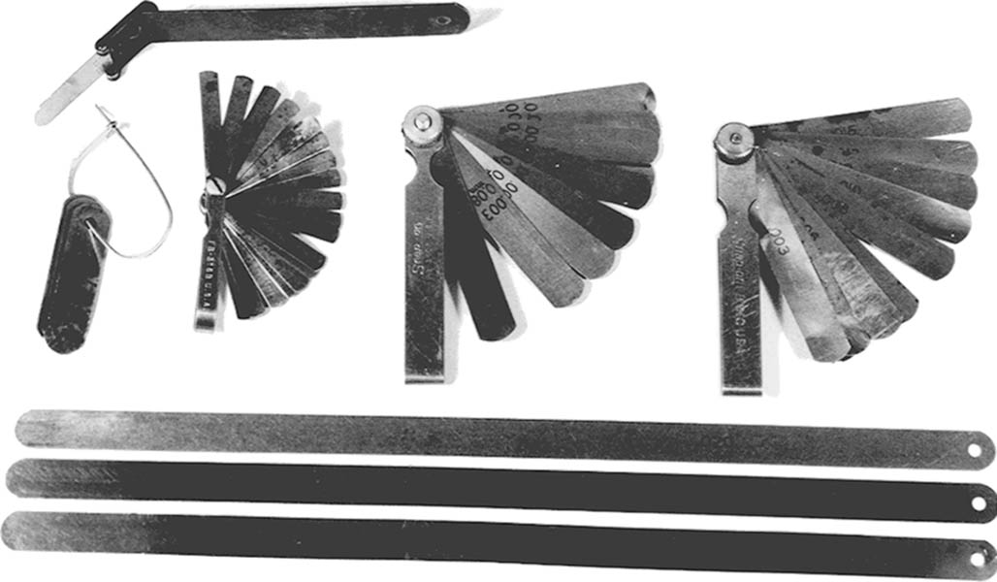
Figure 12.17 A group of feeler gauges (also known as thickness gauges) used to measure between two parts. The long gauges on the bottom are used to measure the piston-to-cylinder wall clearance

Slide 29
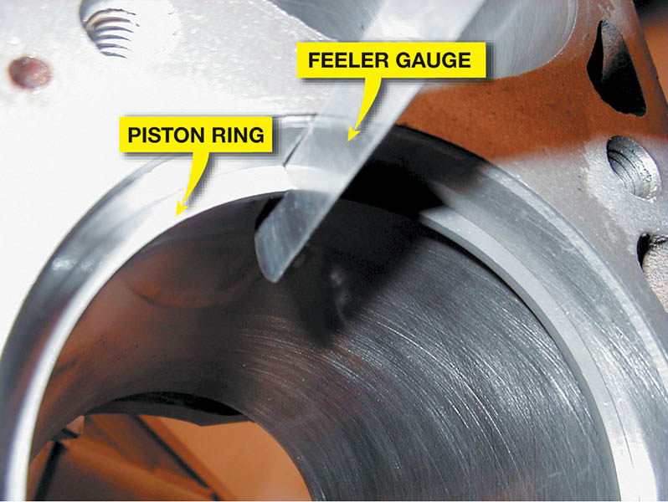
Figure 12.18 A feeler gauge, also called a thickness gauge, is used to measure the small clearances, such as the end gap of a piston ring

Slide 30
STRAIGHTEDGE
Precision ground metal measuring gauge.
Used to check flatness of engine components.
Examples:
Cylinder heads
Cylinder block deck
Straightness of main bearing bores (saddles)
.

Slide 31
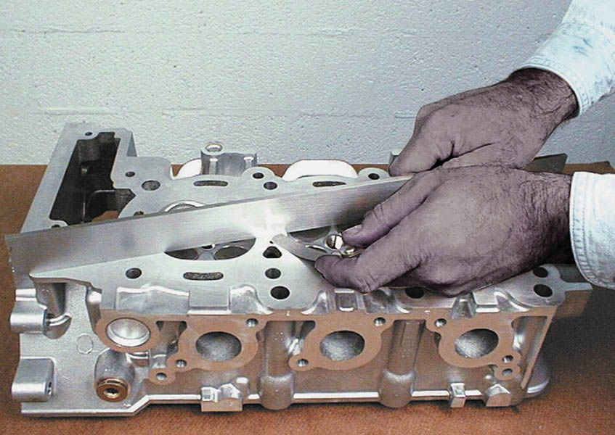
Figure 12.19 A straightedge is used with a feeler gauge to determine if a cylinder head is warped or twisted

Slide 32
QUESTION 2: ?
How is a straightedge used to determine if a surface is warped?

Slide 33
ANSWER 2:
The straightedge is used with a feeler gauge to determine if a surface is warped.

Slide 34
DIAL INDICATOR
Precision measuring device.
Used to measure end play, runout, and wear.
Can be mounted three ways:
Magnetic mount
Clamp mount
Threaded rod

Slide 35
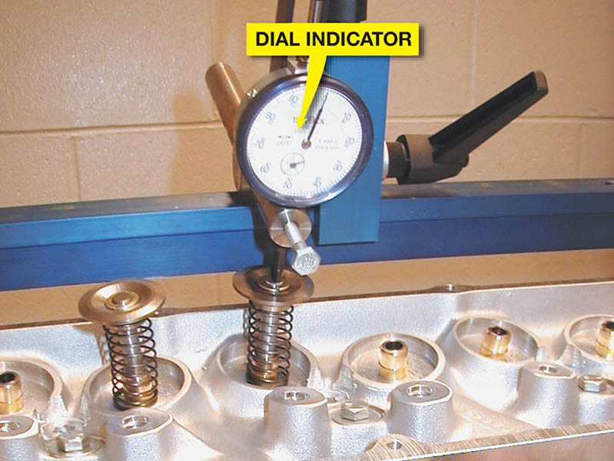
Figure 12.20 A dial indicator is used to measure valve lift during flow testing of a high-performance cylinder head

Slide 36
DIAL BORE GAUGE
Use to measure cylinder taper, and out-of-round.
The tool has to be adjusted to a specific dimension.
It measures differences or variations rather than actual measurements.

Slide 37
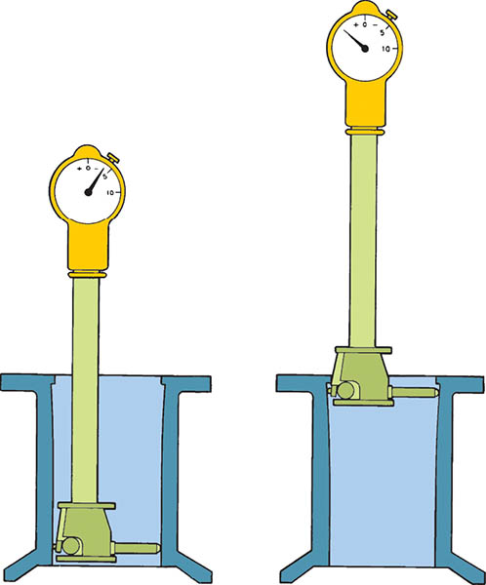
Figure 12.21 A dial bore gauge is used to measure cylinders and other engine parts for out-of-round and taper conditions

Slide 38
QUESTION 3: ?
Why does a dial bore gauge has to be set to a dimension before using?

Slide 39
ANSWER 3:
Because it shows the difference in
cylinder or bore, rather than an actual measurement.

Slide 40

Copyright

