Slide 1
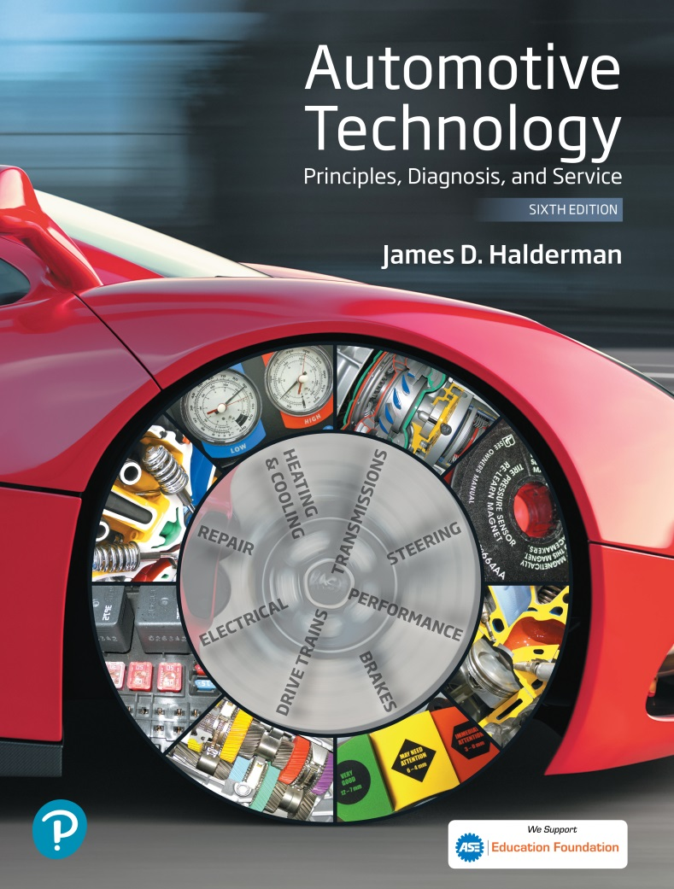
Automotive Technology Principles, Diagnosis, and Service
Sixth Edition
Chapter 119
Electronic Suspension Systems
Copyright © 2018, 2015, 2011 Pearson Education, Inc. All Rights Reserved

Slide 2
LEARNING OBJECTIVES (1 of 2)
119.1 Discuss the need for electronic suspension systems.
119.2 Explain the characteristics of the various sensors used for electronic suspension control..
119.3 Describe electronic suspension system actuators.
119.4 List the types of electronic suspension systems.

Slide 3
LEARNING OBJECTIVES (2 of 2)
119.5 Describe the parts and operation of the automatic level control system.
119.6 Explain the procedure to troubleshoot rear electric leveling systems.
119.7 Explain how magneto-rheological shocks work.
119.8 This chapter will help prepare for ASE Suspension and Steering (A4) certification content area “C” (Related Suspension and Steering Service).

Slide 4
THE NEED FOR ELECTRONIC SUSPENSIONS
Electronic suspension controls provide a variable shock stiffness or spring rate.
The main advantage of electronic controls is that the suspension can react to different conditions.
The system provides a firm suspension feel for fast cornering and quick acceleration and braking, with a soft ride for cruising.

Slide 5
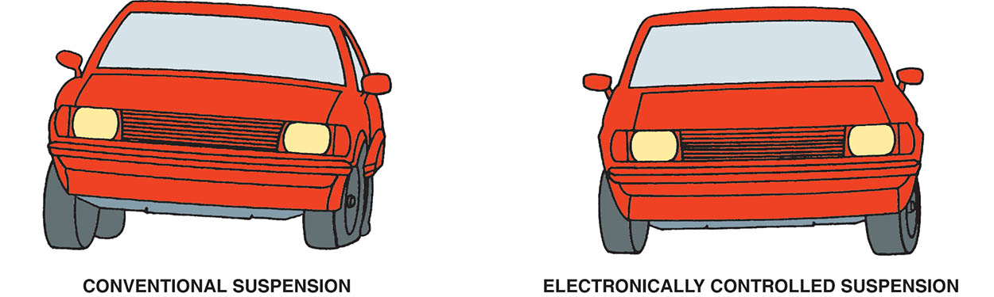
Figure 119.1 An electronically controlled suspension system can help reduce body roll and other reactions better than most conventional suspension systems

Slide 6
ELECTRONIC SUSPENSION CONTROLS AND SENSORS (1 OF 4)
Inputs and Outputs
Sensors and switches provide input to the electronic control module (ECM), or system computer.
The computer causes an actuator (output) to perform some type of mechanical action.
Height Sensors
A height sensor senses the vertical relationship between the suspension component and the body.
Four height sensors, one at each wheel, deliver an input signal to the ECM.

Slide 7
ELECTRONIC SUSPENSION CONTROLS AND SENSORS (2 OF 4)
Steering Wheel Position Sensor
The function of this sensor is to provide the control module with signals relating to steering wheel position, speed, and direction.
Vehicle Speed Sensor
The vehicle speed sensor is a magnetic sensor and generates an analog signal whose frequency increases as the speed increases.
The ride is made firmer at high speeds and during braking and acceleration and less firm at cruise speeds.

Slide 8
ELECTRONIC SUSPENSION CONTROLS AND SENSORS (3 OF 4)
Pressure Sensor
This sensor is typically found on systems such as air suspension, real-time damping, and road-sensing suspension that use a compressor assembly.
Lateral Acceleration Sensor
Provides the suspension control module with feedback regarding vehicle cornering forces.
This sensor can be either a stand-alone unit or combined with the yaw rate sensor.

Slide 9
ELECTRONIC SUSPENSION CONTROLS AND SENSORS (4 OF 4)
Yaw Rate Sensor
This information is used to determine how far the vehicle has deviated from the driver’s intended direction.
Driver Selector Switch
The driver selector switch, which is typically dash mounted, allows the driver to select the firmness of the suspension system.

Slide 10
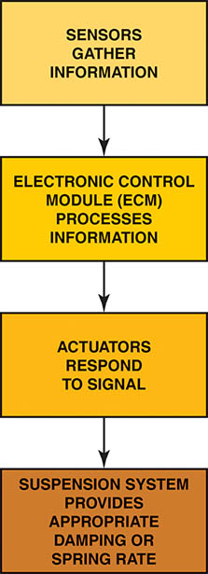
Figure 119.2 Input devices monitor conditions and provide information to the electronic control module, which processes the information and operates the actuators to control the movement of the suspension

Slide 11
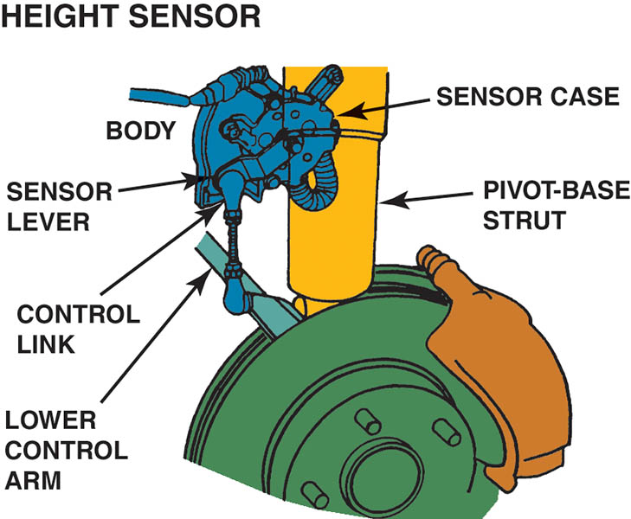
Figure 119.3 A typical electronic suspension height sensor, which bolts to the body and connects to the lower control arm through a control link and lever

Slide 12
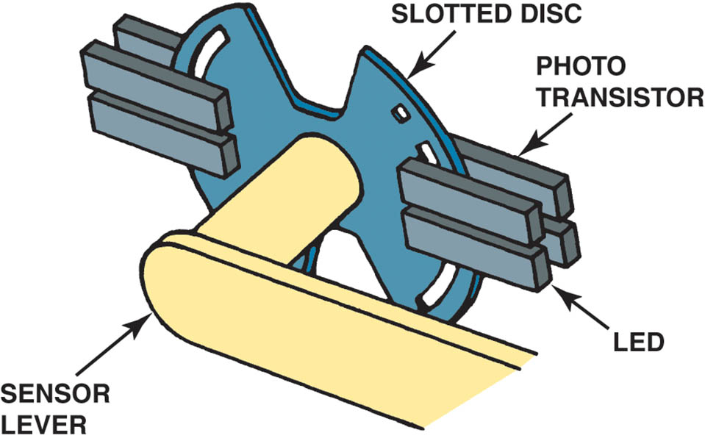
Figure 119.4 When suspension action moves the lever, it rotates the slotted disc and varies how much of the photo transistor is exposed to the LEDs, which vary the input signal

Slide 13
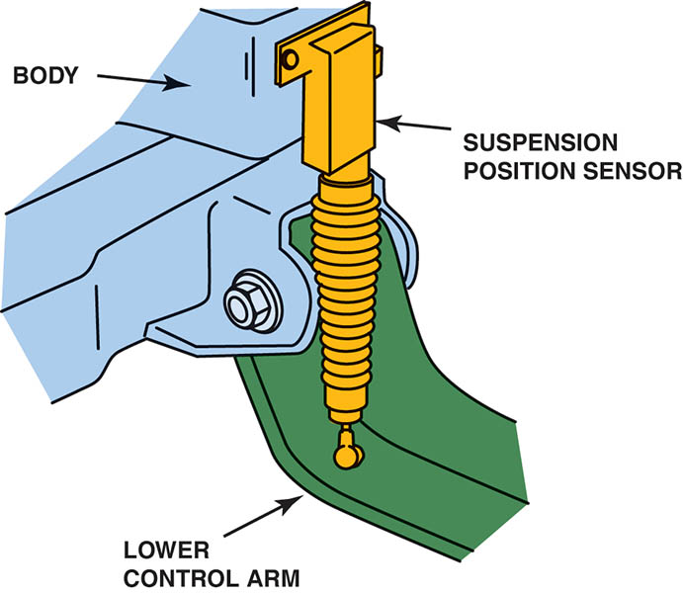
Figure 119.5 Typical suspension position sensor

Slide 14
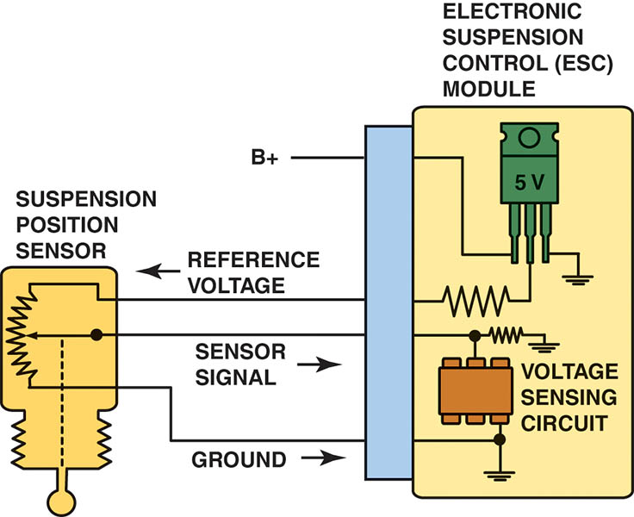
Figure 119.6 A three-wire suspension position sensor schematic

Slide 15
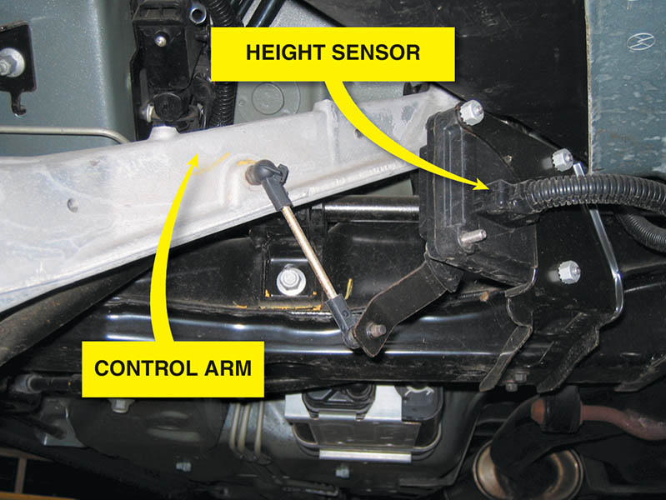
Figure 119.7 A suspension height sensor

Slide 16
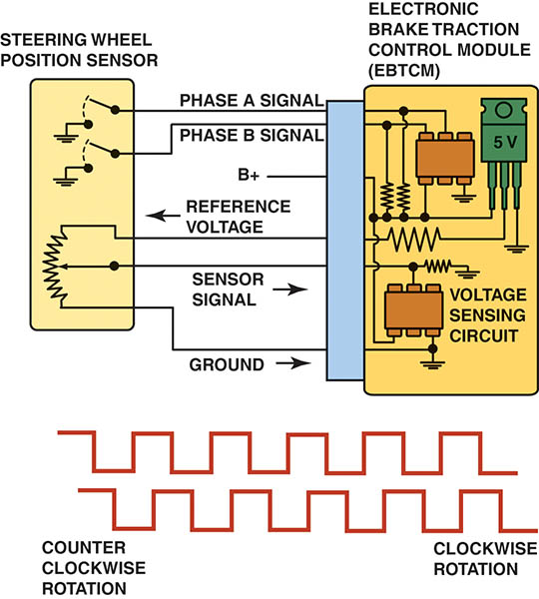
Figure 119.8 The steering wheel position (hand wheel position) sensor wiring schematic and how the signal varies with the direction that the steering wheel is turned

Slide 17
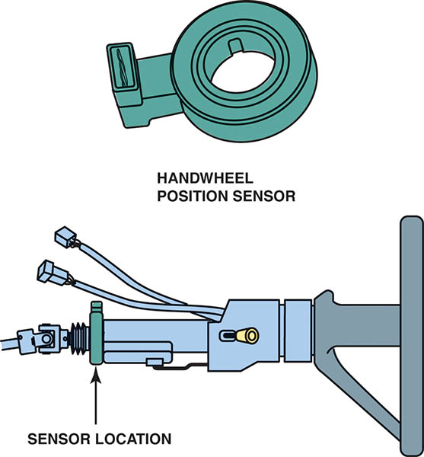
Figure 119.9 The handwheel position sensor is located at the base of the steering column

Slide 18
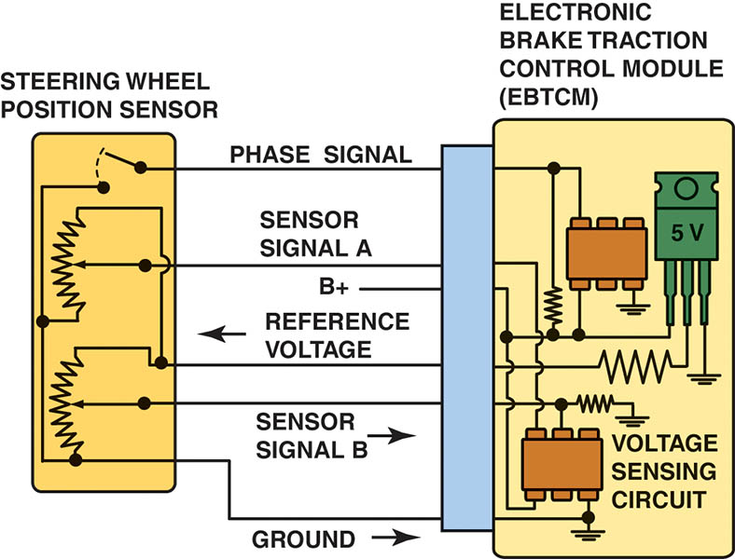
Figure 119.10 Steering wheel (hand wheel) position sensor schematic

Slide 19
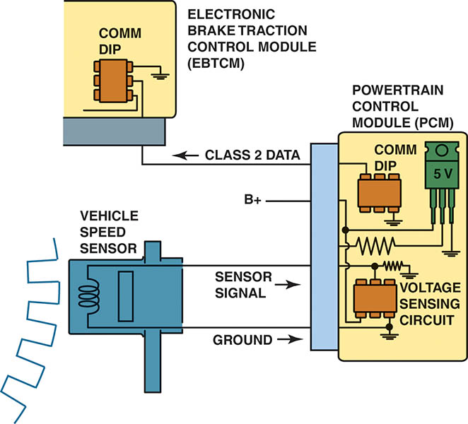
Figure 119.11 The VS sensor information is transmitted to the EBCM by Class 2 serial data

Slide 20
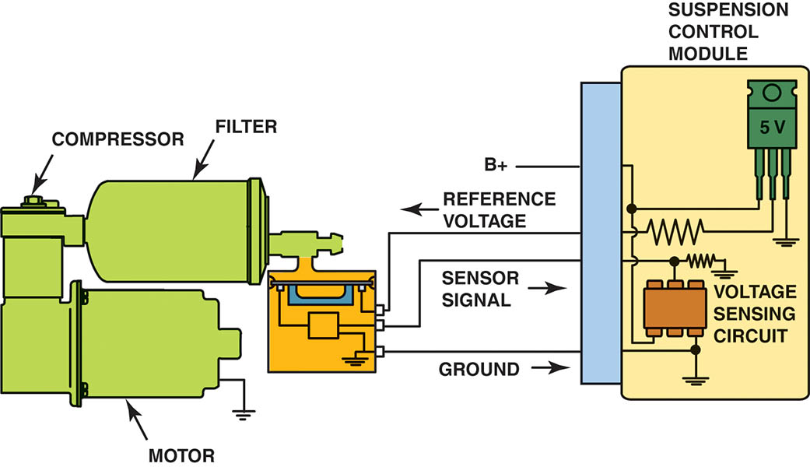
Figure 119.12 An air pressure sensor

Slide 21
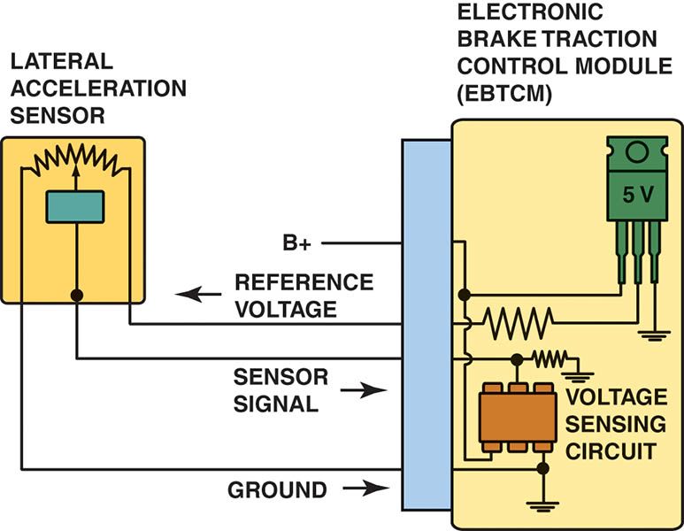
Figure 119.13 A schematic showing the lateral acceleration sensor and the EBCM

Slide 22
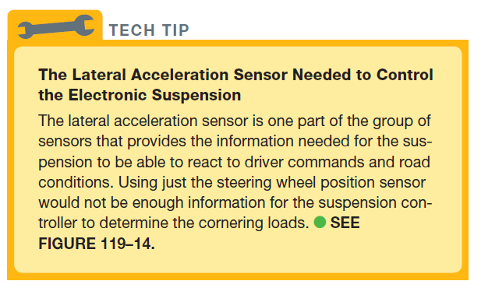
Tech Tip

Slide 23
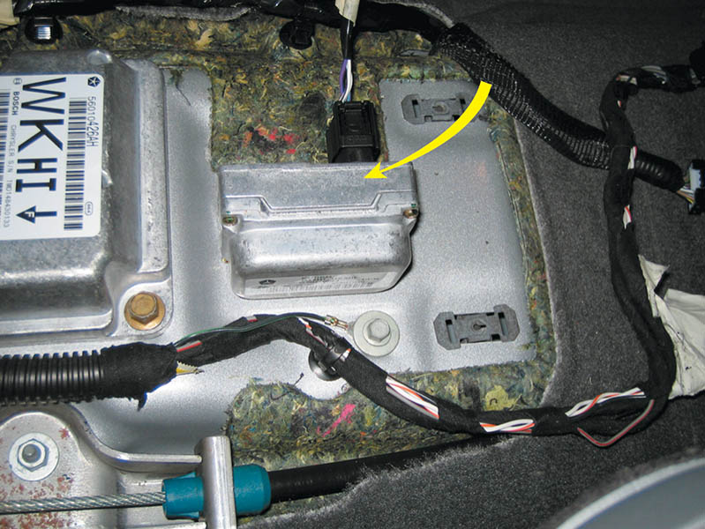
Figure 119.14 The lateral accelerometer sensor (G-sensor) is usually located under the center console. This sensor can be tested by unbolting the sensor, turning it on its side with the key on, engine off (KOEO), and looking at the scan tool data to verify that it reads 1 G

Slide 24
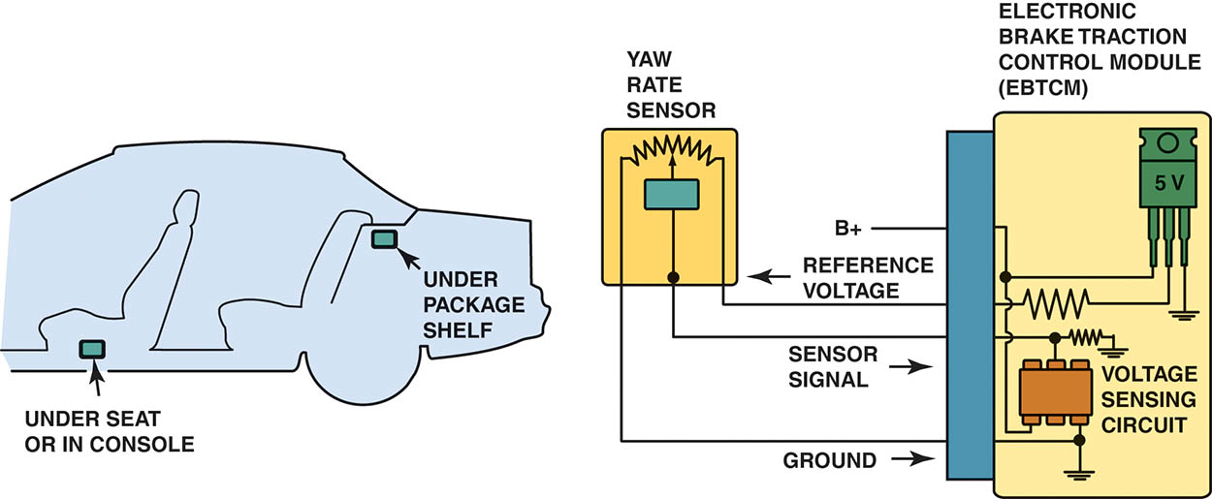
Figure 119.15 Yaw rate sensor showing the typical location and schematic

Slide 25
QUESTION 1: ?
What is the purpose of the Yaw Rate sensor?

Slide 26
ANSWER 1:
To determine how far the vehicle has deviated from the driver’s intended direction.

Slide 27
ELECTRONIC SUSPENSION SYSTEM ACTUATORS (1 OF 2)
Terminology
Actuators are usually inductive devices that operate using an electromagnetic field.
Solenoids
In a solenoid, the core of the electromagnet also acts as a plunger to open and close a passage or to move a linkage.
When the solenoid is energized, current passes through the coil and magnetizes the core.
When de-energized, the spring returns the plunger to the default position.

Slide 28
ELECTRONIC SUSPENSION SYSTEM ACTUATORS (2 OF 2)
An airflow control valve is an example of a solenoid used in an electronically controlled suspension.
As the solenoid plunger extends and retracts, it opens and closes air passages between the system air-pressure tank and the air springs.
Actuator Motors
A motor uses this principle to convert electrical energy into mechanical movement.
An actuator motor uses a permanent magnet and four stator coils to drive the air spring control rod.

Slide 29
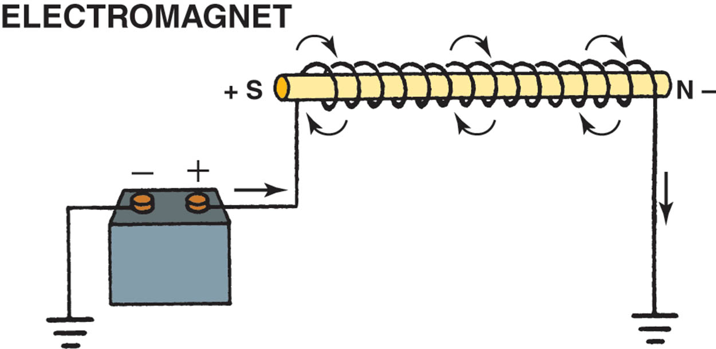
Figure 119.16 A magnetic field is created whenever an electrical current flows through a coil of wire wrapped around an iron core

Slide 30
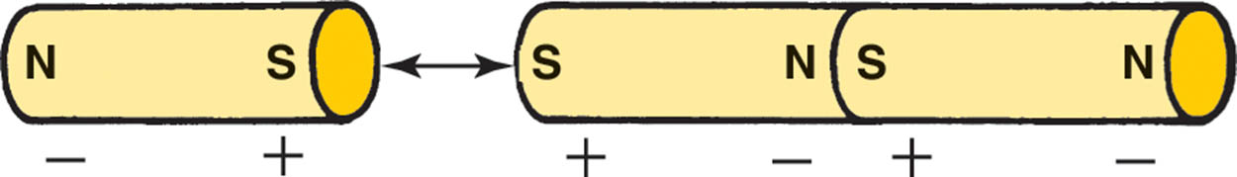
Figure 119.17 When magnets are near each other, like poles repel and opposite poles attract

Slide 31
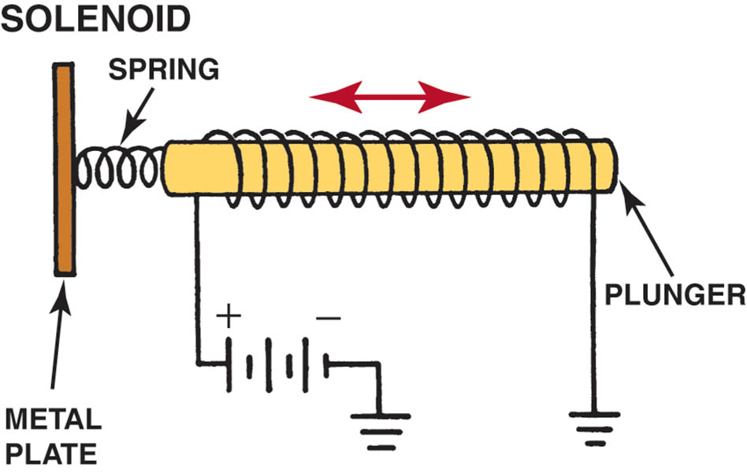
Figure 119.18 When electrical current magnetizes the plunger in a solenoid, the magnetic field moves the plunger against spring force. With no current, the spring pushes the plunger back to its original position

Slide 32
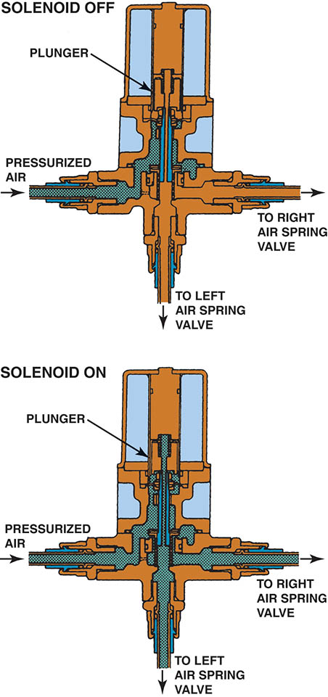
Figure 119.19 This air supply solenoid blocks pressurized air from the air spring valves when off. The plunger pulls upward to allow airflow to the air spring valves when the solenoid is energized

Slide 33
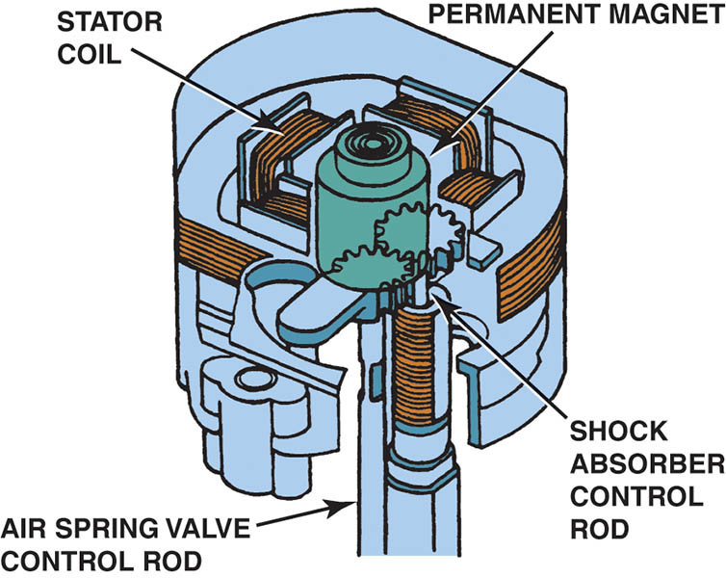
Figure 119.20 An actuator motor uses a permanent magnet and four stator coils to drive the air spring control rod

Slide 34
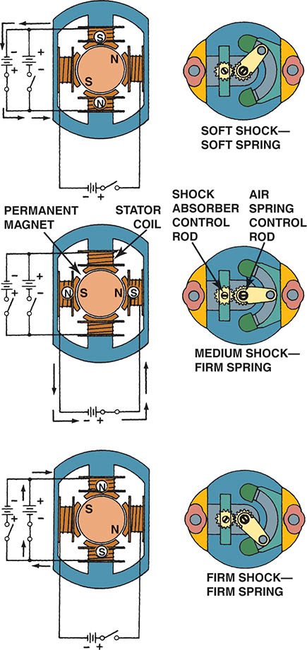
Figure 119.21 The stator coils of the actuator are energized in three ways to provide soft, medium, or firm ride from the air springs and shock absorbers

Slide 35
TYPES OF ELECTRONIC SUSPENSION (1 OF 5)
The types of electronic suspension systems used on General Motors vehicles, as examples, include:
Selectable Ride
Automatic Level Control
Air Suspension
Computer Command Ride
Real-Time Dampening/Road-Sensing Suspension
Vehicle Stability Enhancement System
Magneto-Rheological Suspension (F55)

Slide 36
TYPES OF ELECTRONIC SUSPENSION (2 OF 5)
Selectable Ride
The most basic of the electronic systems offered by General Motors.
Allows the driver to choose between two distinct damping levels:
Firm
Normal
Automatic Level Control
Automatically adjusts the rear height of the vehicle in response to changes in vehicle loading and unloading.

Slide 37
TYPES OF ELECTRONIC SUSPENSION (3 OF 5)
Air Suspension
The system is designed to maintain rear trim height within 3/16 inch (4 mm) in all loading conditions, and the leveling function will deactivate if the vehicle is overloaded.
Variable Rate Air-Springs
In an air spring system with ordinary shock absorbers, the ECM uses the air springs to control trim height and is used on many Ford, Mercury, and Lincoln vehicles.

Slide 38
TYPES OF ELECTRONIC SUSPENSION (4 OF 5)
General Motors Computer Command Ride
The General Motors computer command ride (CCR) system controls ride firmness by automatically controlling an actuator in each of the four struts to increase ride firmness as speed increases.
Real-Time Dampening and Road Sensing Suspension
Real-time dampening (RTD) independently controls a solenoid in each of the four shock absorbers in order to control the vehicle ride characteristics and is capable of making changes within milliseconds (0.001 second).

Slide 39
TYPES OF ELECTRONIC SUSPENSION (5 OF 5)
Bi-State and Tri-State Dampers
The bi-state damper provides various amounts of damping by directing hydraulic damping fluid in the suspension shock absorber or strut.
A tri-state damper has an integral electrical strut actuator that rotates a selector valve to change the flow of hydraulic damping fluid.

Slide 40
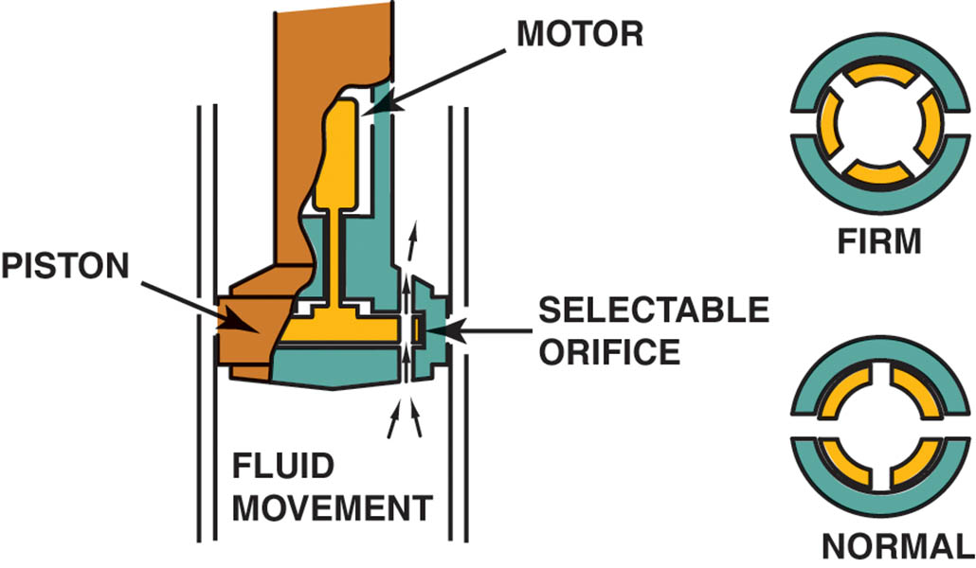
Figure 119.22 Selectable ride as used on Chevrolet and GMC pickup trucks

Slide 41
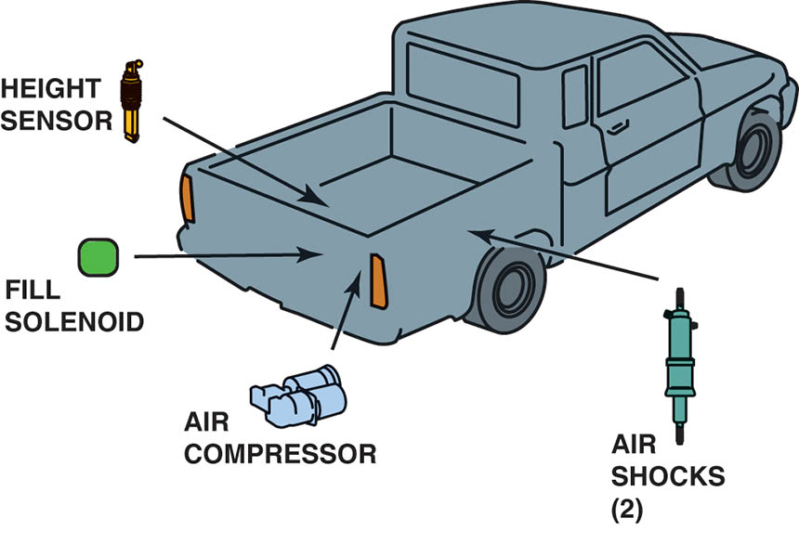
Figure 119.23 ALC maintains the same ride height either loaded or unloaded by increasing or decreasing the air pressure in the rear air shocks

Slide 42
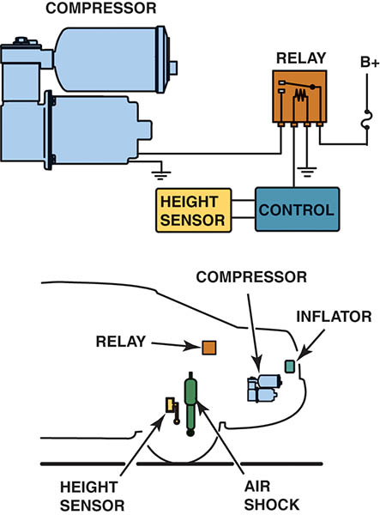
Figure 119.24 A typical schematic showing the air suspension compressor assembly and sensor

Slide 43
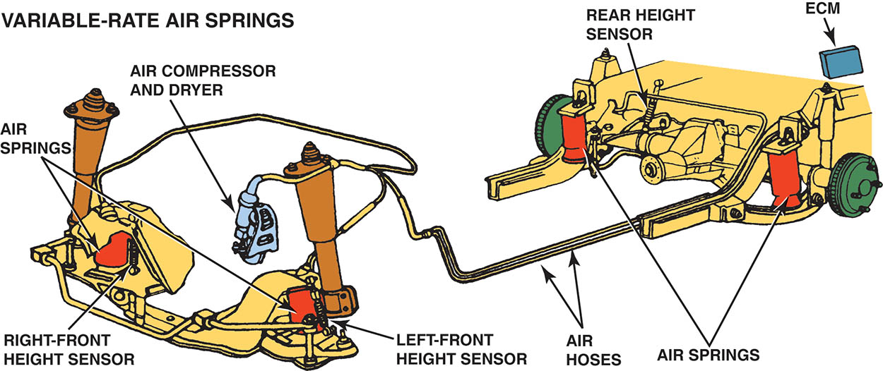
Figure 119.25 The typical variable-rate air spring system uses three height sensors, two in the front and one in the rear, to monitor trim height and to provide input signals to the ECM

Slide 44
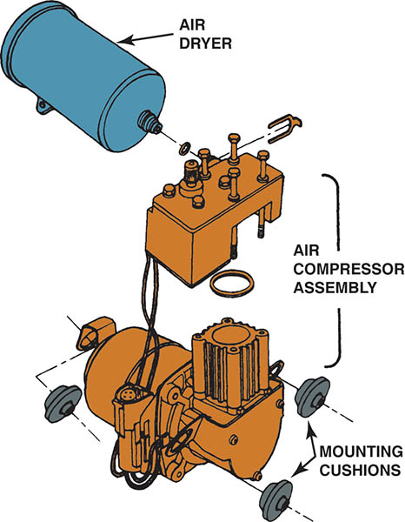
Figure 119.26 The air spring compressor assembly is usually mounted on rubber cushions to help isolate it from the body of the vehicle. All of the air entering or leaving the air springs flows through the regenerative air dryer

Slide 45
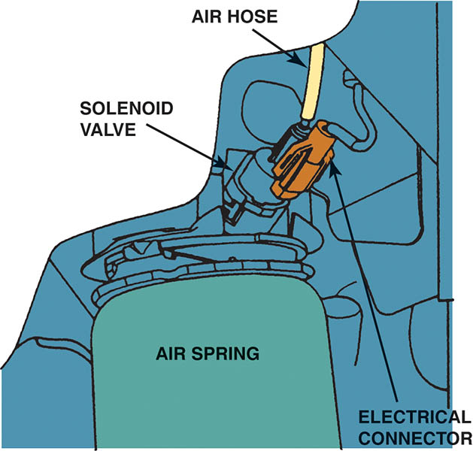
Figure 119.27 A solenoid valve at the top of each spring regulates airflow into and out of the air spring

Slide 46
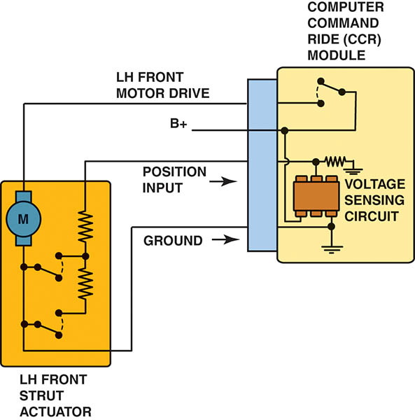
Figure 119.28 Schematic showing computer command ride system

Slide 47
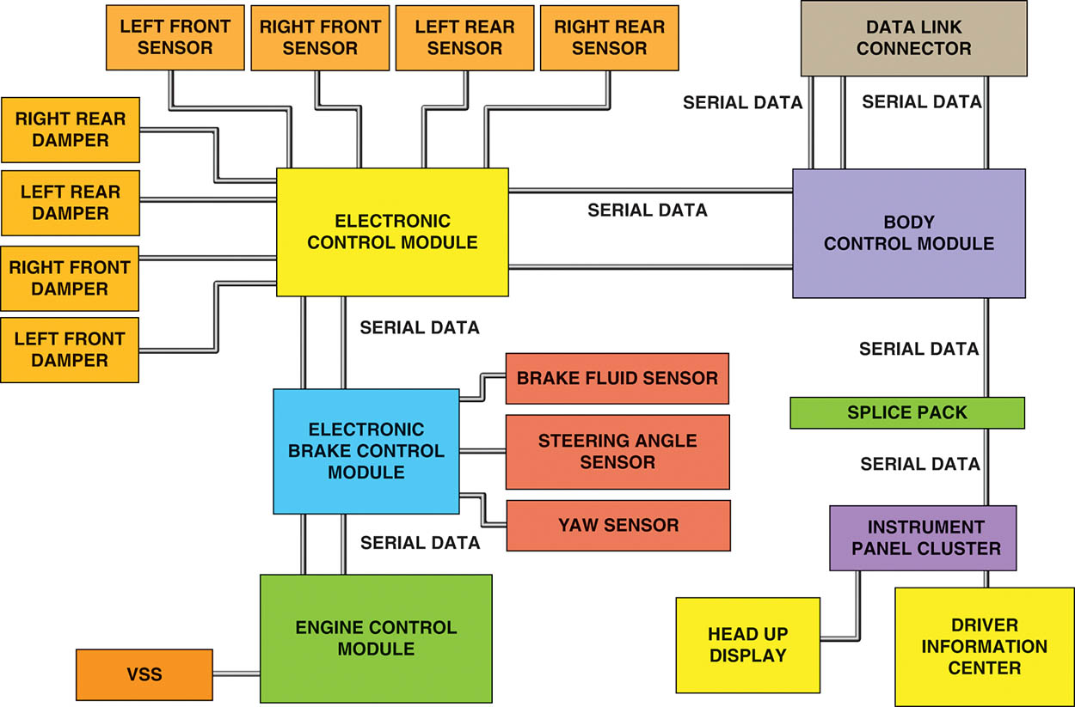
Figure 119.29 Diagram of the components and connections of the real-time damping and road-sensing suspension system

Slide 48
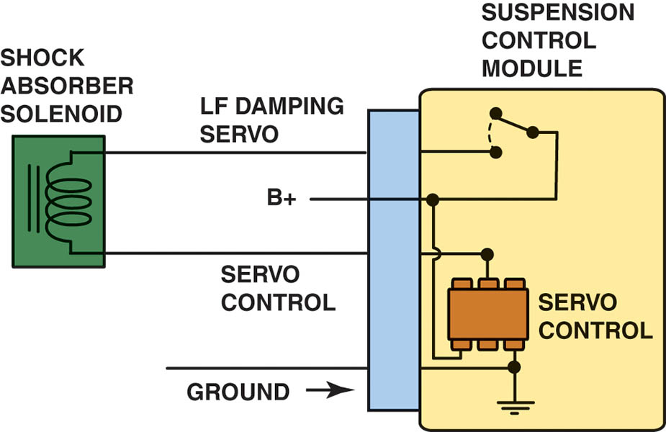
Figure 119.30 Schematic showing the shock control used in the RSS system

Slide 49
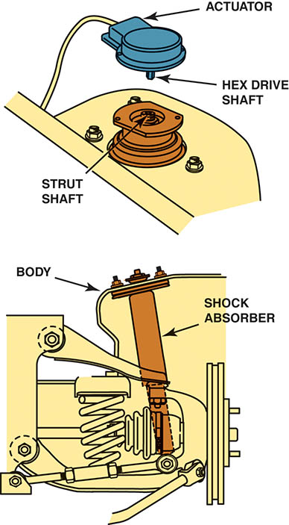
Figure 119.31 Bi-state dampers (shocks) use a solenoid to control fluid flow in the unit to control compression and rebound actions

Slide 50
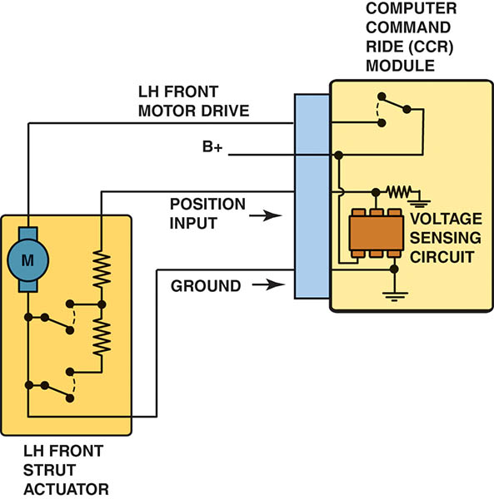
Figure 119.32 A typical CCR module schematic

Slide 51
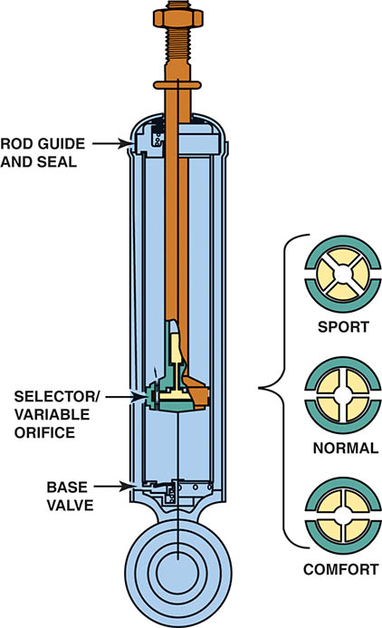
Figure 119.33 The three dampening modes of a CCR shock absorber

Slide 52
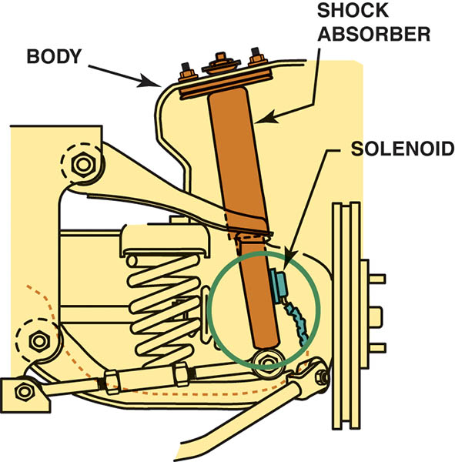
Figure 119.34 Integral shock solenoid

Slide 53
AUTOMATIC LEVEL CONTROL (1 OF 2)
Inflator or Compressor Relay
The suspension control module energizes the relay to activate the compressor motor.
Compressor
The compressor is a positive-displacement air pump and can generate up to 150 pounds of pressure per square inch (PSI).

Slide 54
AUTOMATIC LEVEL CONTROL (2 OF 2)
Air Dryer
The air dryer is responsible for removing moisture from the compressor system.
Exhaust Solenoid
The exhaust solenoid, which is located on the compressor, relieves pressure in the system.

Slide 55
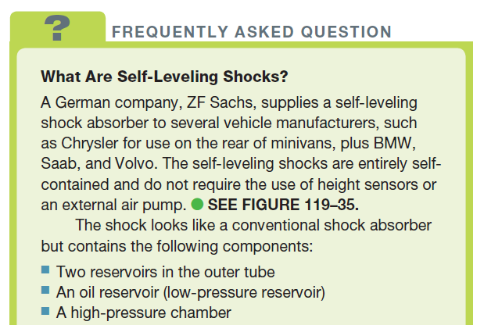
FREQUENTLY ASKED Question

Slide 56
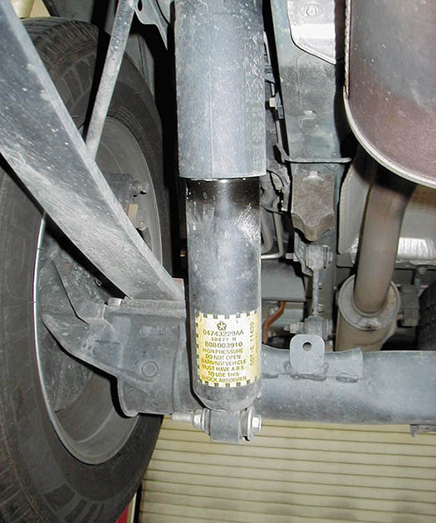
Figure 119.35 A typical ZF Sachs self-leveling shock, as used on the rear of a Chrysler minivan

Slide 57
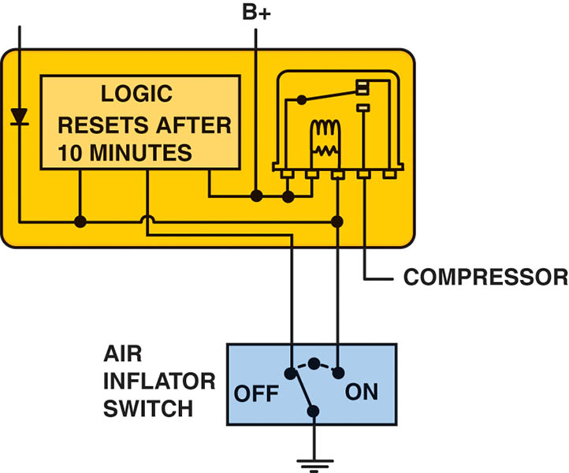
Figure 119.36 Schematic of the ALC system

Slide 58
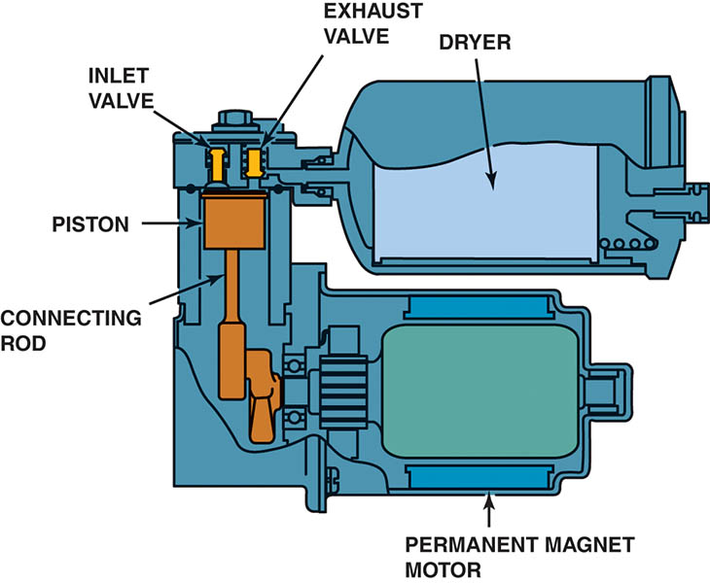
Figure 119.37 Air compressor assembly can be located at various locations depending on the vehicle

Slide 59
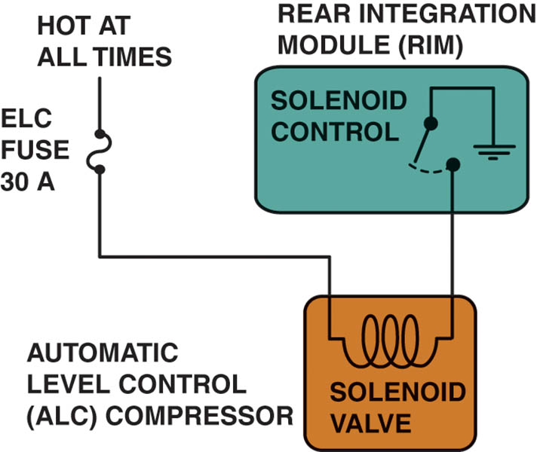
Figure 119.38 The exhaust solenoid is controlled by the rear integration module

Slide 60
QUESTION 2: ?
What is the purpose of an air dryer in an automatic level control system?

Slide 61
ANSWER 2:
To remove the moisture from the system.

Slide 62
TROUBLESHOOTING REAR ELECTRONIC LEVELING SYSTEMS
The first step with any troubleshooting procedure is to check for normal operation.
If the compressor is inoperative check the power and ground.
If the ride height compressor runs excessively, check the air compressor, the air lines, and the air shocks (or struts) with soapy water for air leaks.
Most electronic leveling systems provide some adjustments of the rear ride height by adjusting the linkage between the height sensor and the rear suspension.

Slide 63
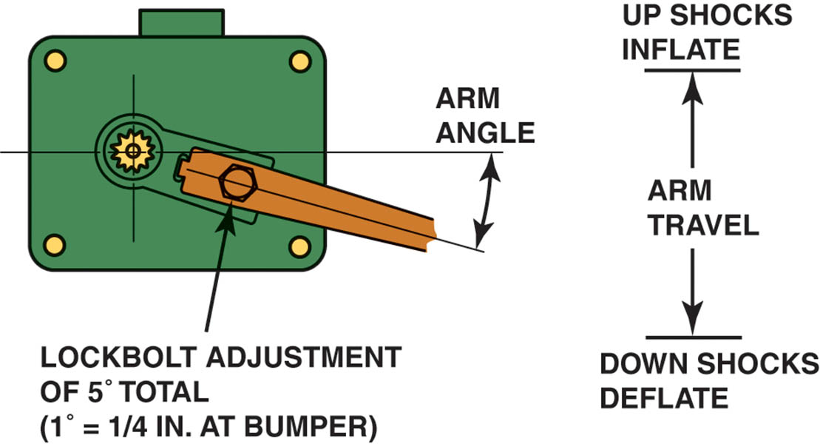
Figure 119.39 Most electronic level-control sensors can be adjusted, such as this General Motors unit

Slide 64
MAGNETO-RHEOLOGICAL (MR) SUSPENSION
Terminology
MR fluid shocks use a working fluid inside the shock that can change viscosity rapidly depending on electric current sent to an electromagnetic coil in each device.
Under normal operating conditions, the fluid flows easily through orifices in the shock and provides little dampening.
When a large or high-frequency bump is detected, a small electrical current is sent from the chassis controller to an electromagnetic coil in each shock and the iron particles in the fluid respond within 3 milliseconds (ms), aligning themselves in fiber like strands.

Slide 65
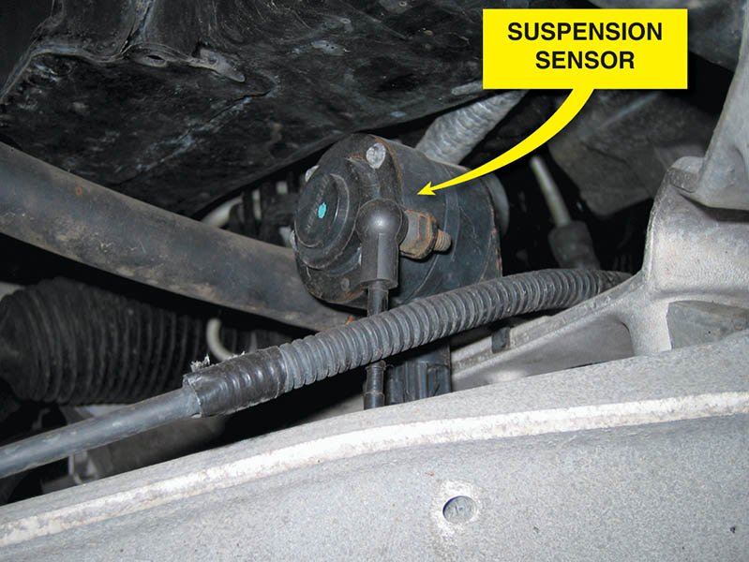
Figure 119.40 Vehicles that use magneto-rheological shock absorbers have a sensor located near each wheel, as shown on this C6 Corvette

Slide 66
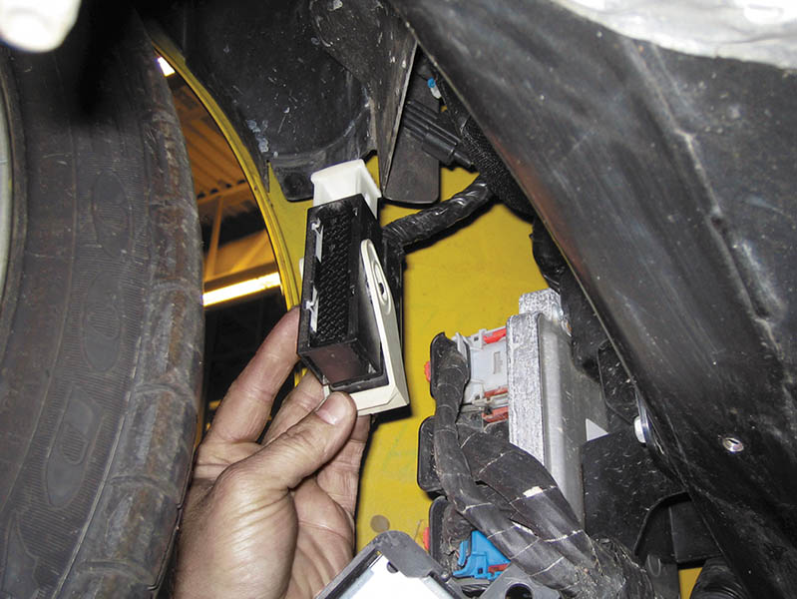
Figure 119.41 The controller for the magneto-rheological suspension system on a C6 Corvette is located behind the right front wheel

Slide 67
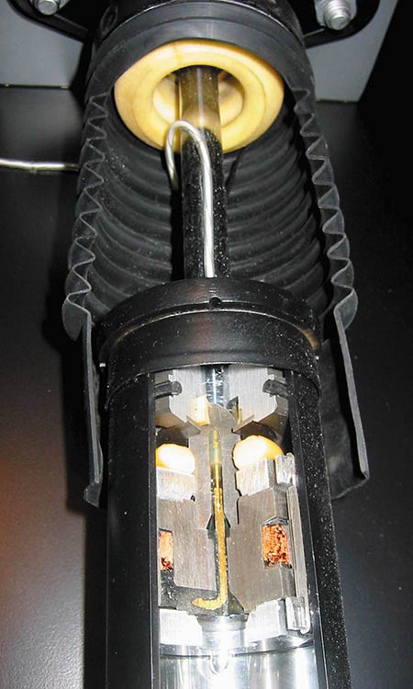
Figure 119.42 A cutaway of a magneto-rheological shock absorber as displayed at the Corvette Museum in Bowling Green, Kentucky

Slide 68
QUESTION 3: ?
How does a Magneto-Rheological shock automatically change dampening rates?

Slide 69
ANSWER 3:
By changing the current flow through the liquid in the shock.

Slide 70

Copyright

