Slide 1
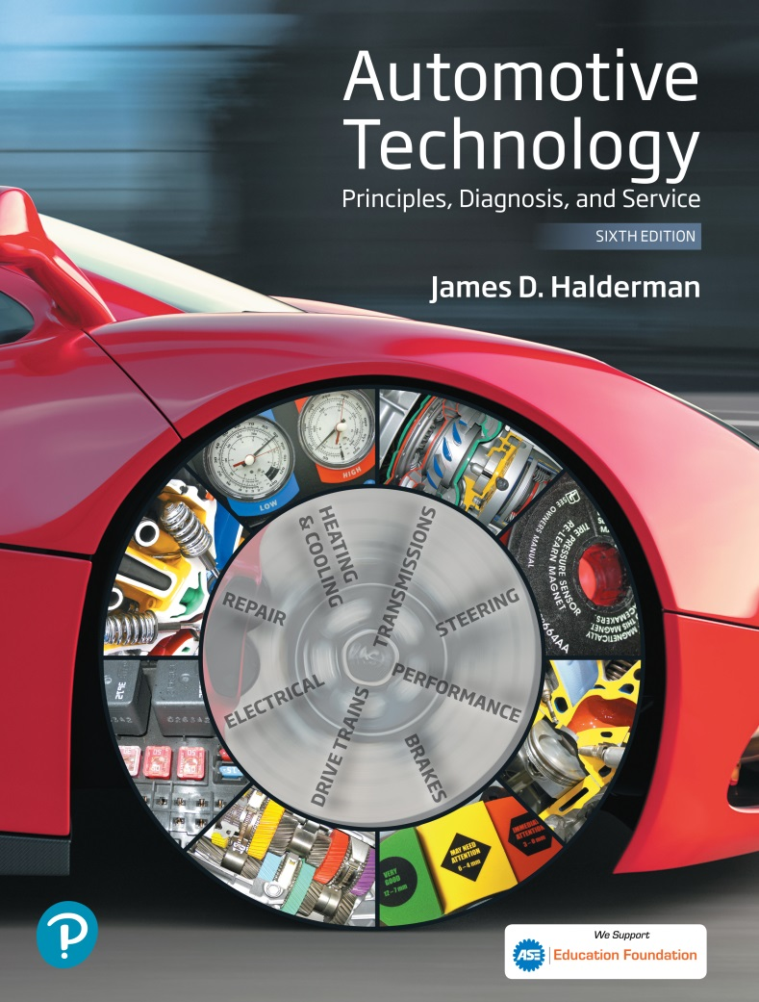
Automotive Technology Principles, Diagnosis, and Service
Sixth Edition
Chapter 118
Rear Suspension and Service
Copyright © 2018, 2015, 2011 Pearson Education, Inc. All Rights Reserved

Slide 2
LEARNING OBJECTIVES (1 of 2)
118.1 Describe solid rear axles and leaf spring suspensions.
118.2 Distinguish between trailing arm and semi-trailing arm rear suspensions..
118.3 Distinguish between independent and semi-independent rear suspensions.

Slide 3
LEARNING OBJECTIVES (2 of 2)
118.4 Explain rear suspension service, including replacement of rear shocks and rear springs.
118.5 This chapter will help prepare for ASE Suspension and Steering (A4) certification content area “B” (Suspension System Diagnosis and Repair).

Slide 4
SOLID REAR AXLES
A solid axle can be used at the rear of either a rear-wheel-drive or front-wheel-drive vehicle.
Advantages
Solid axles can handle large loads.
Disadvantages
Increased proportion of unsprung weight
Side-to-side road shock transference
Poorer tire adhesion

Slide 5
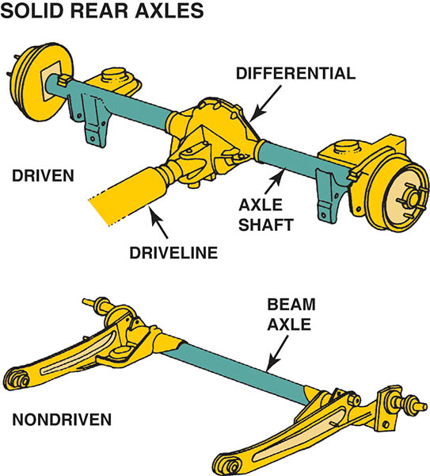
Figure 118.1 Solid axles are used on rear-wheel-drive vehicles as well as on front-wheel-drive vehicles

Slide 6
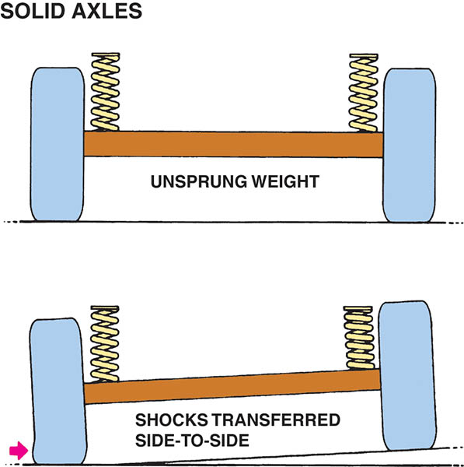
Figure 118.2 A solid axle supports the springs, so the axle and suspension components are unsprung weight. When one wheel rides over a bump, the force of impact transfers through the solid axle to the opposite side, leading to unstable handling

Slide 7
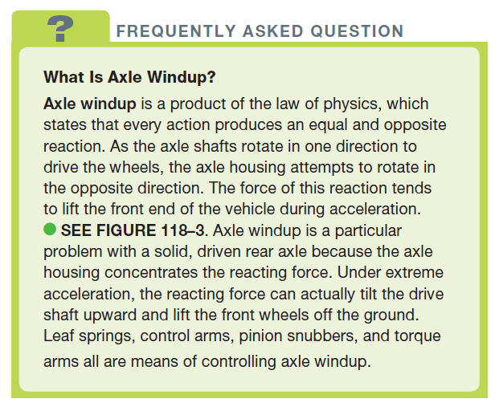
FREQUENTLY ASKED QUESTION

Slide 8
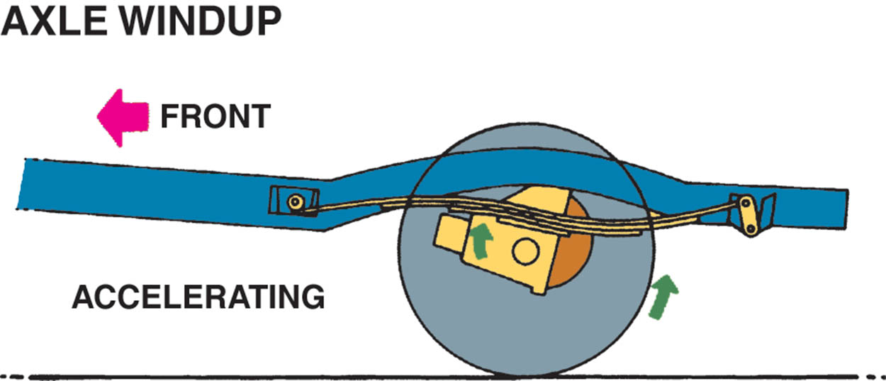
Figure 118.3 When the axle housing reacts against the force of axle shaft rotation, the front of the differential tilts upward, creating axle windup

Slide 9
QUESTION 1: ?
What are the disadvantages of a solid rear axle?

Slide 10
ANSWER 1:
Increased proportion of unsprung weight, side-to-side road shock transference, poorer tire adhesion.

Slide 11
LEAF SPRING REAR SUSPENSIONS
The leaf springs link the axle to the frame and effectively serve two purposes:
Absorbing road shock
Locating the axle under the vehicle
Most rear-wheel-drive trucks use a solid rear axle with leaf springs in an arrangement called a Hotchkiss drive.

Slide 12
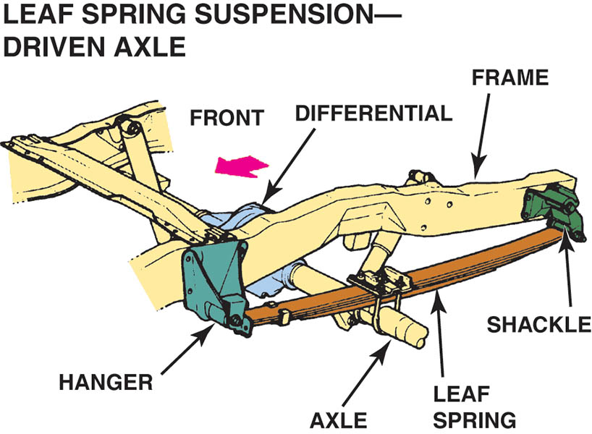
Figure 118.4 A typical rear-wheel-drive pickup truck rear suspension equipped with leaf springs. This type of arrangement is called a Hotchkiss drive and the drivetrain forces are controlled by the rear suspension components

Slide 13
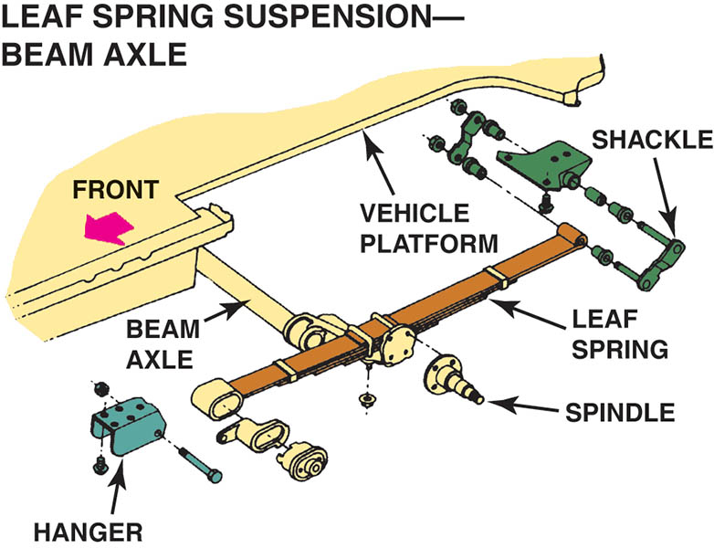
Figure 118.5 An exploded view of a beam axle with multileaf springs

Slide 14
TRAILING ARM REAR SUSPENSIONS
A trailing arm extends from a frame crossmember located ahead of the rear axle back to the axle housing or a wheel knuckle.
Trailing arms may be used to brace either a driven or non-driven solid rear axle against front-to-rear forces.
A trailing arm rear suspension on a non-driven solid axle virtually always includes a track rod, also called a Panhard rod.

Slide 15
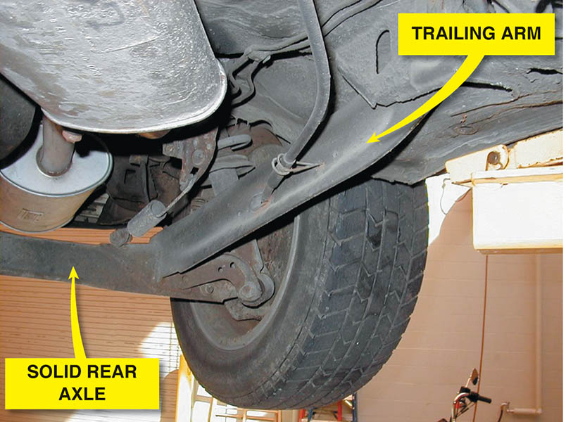
Figure 118.6 A trailing arm rear suspension with a solid axle used on a front-wheel-drive vehicle

Slide 16
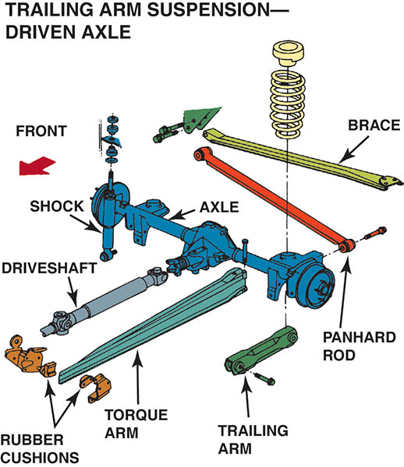
Figure 118.7 This rear suspension systems use a torque arm to control axle windup. If the rubber torque arm bushings (cushions) are worn, a loud “bang” could be heard and felt when accelerating suddenly

Slide 17
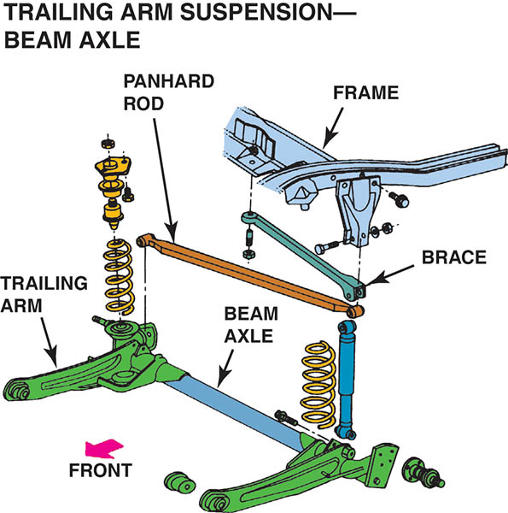
Figure 118.8 A typical beam axle rear suspension, which uses trailing arms and coil springs along with a track rod, also called a Panhard rod, to control side-to-side axle movement

Slide 18
SEMI-TRAILING ARM REAR SUSPENSIONS
A semi-trailing arm is similar to a trailing arm in that it extends back from a frame member to the axle.
Semi-trailing arms have an advantage over trailing arms because they control both side-to-side and front-to-rear motion.
The axle centering pivot bracket and linkage is called a watts linkage

Slide 19
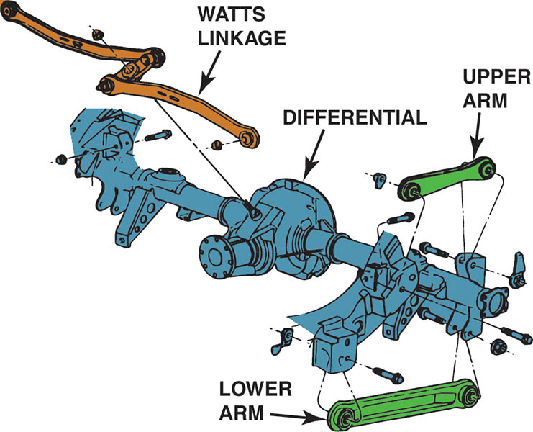
Figure 118.9 This Ford rear suspension uses upper and lower semi-trailing arms to mount the rear axle and a watts linkage to control side-to-side movement

Slide 20
INDEPENDENT REAR SUSPENSIONS
The use of independent rear suspension (IRS) has significantly increased for a variety of reasons.
The reduction in unsprung weight is particularly noticeable for driven axles, which are constructed to transfer the weight of the differential and axles to the frame.
A vehicle with an independent rear suspension rides and handles better than a similar vehicle equipped with a solid rear axle.
IRS reduces tire scrub and improves traction.

Slide 21
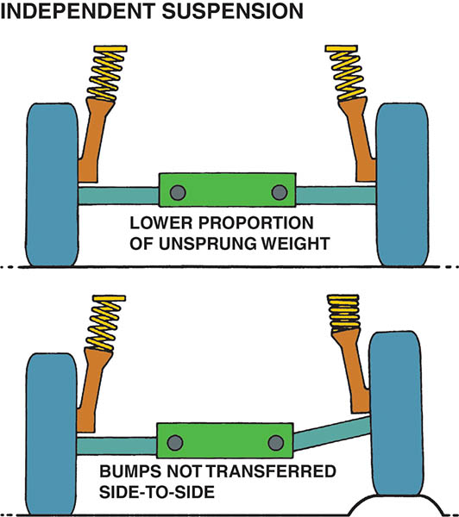
Figure 118.10 An independent rear suspension provides a better ride because less weight is unsprung and the suspension is able to react quickly to bumps in the road without affecting the opposite side

Slide 22
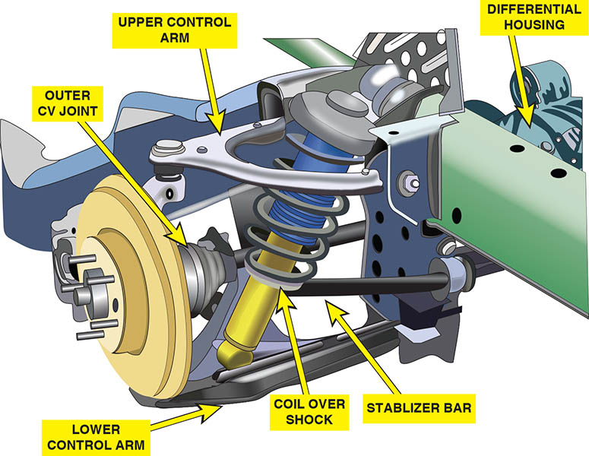
Figure 118.11 A typical short/ long-arm independent rear suspension

Slide 23
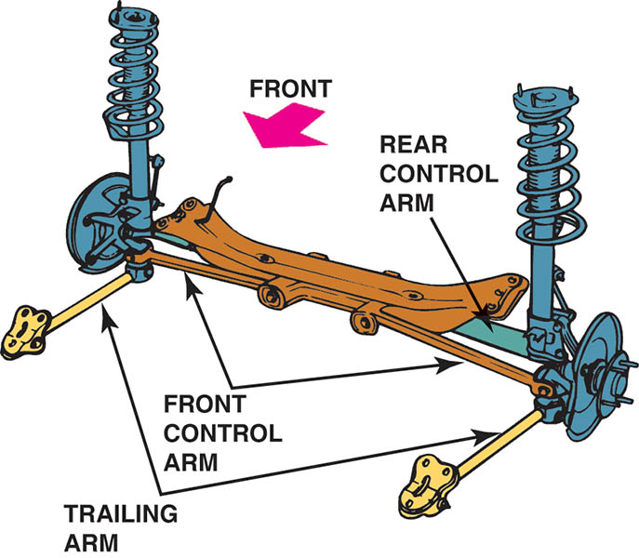
Figure 118.12 This independent rear suspension uses a MacPherson strut, two parallel lower transverse control arms, and a trailing arm

Slide 24
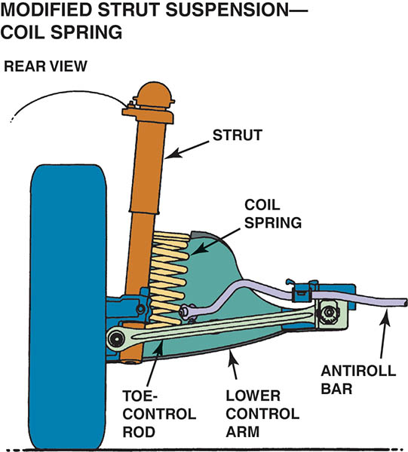
Figure 118.13 The toe-control rod provides an extra brace to keep the rear wheels straight ahead during braking and acceleration on this modified-strut-type independent rear suspension

Slide 25
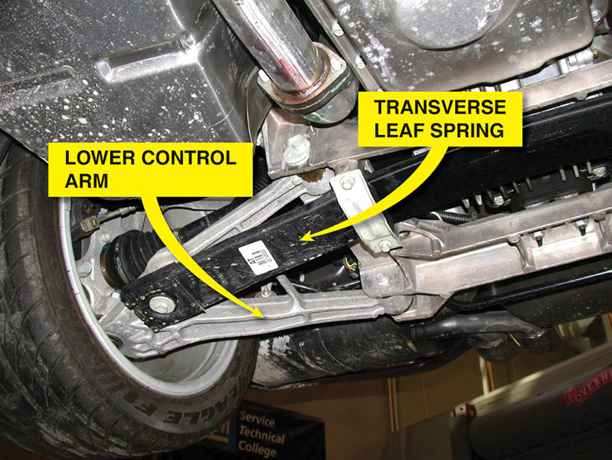
Figure 118.14 A transverse mono-type leaf spring used on the rear suspension of a Chevrolet Corvette

Slide 26
SEMI-INDEPENDENT REAR SUSPENSIONS
A semi-independent suspension is used only at a non-driven rear axle.
A semi-independent design, the crossbeam is placed ahead, rather than at the centerline, of the wheels.
Some semi-independent rear suspensions use struts.

Slide 27
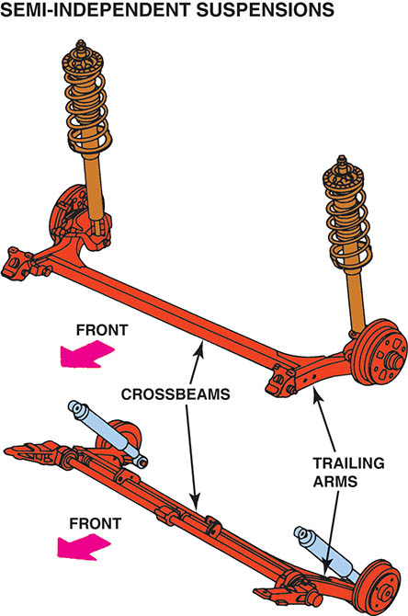
Figure 118.15 The crossbeam is placed toward the front of the vehicle rather than the centerline of the rear wheels on a semi-independent-type rear suspension

Slide 28
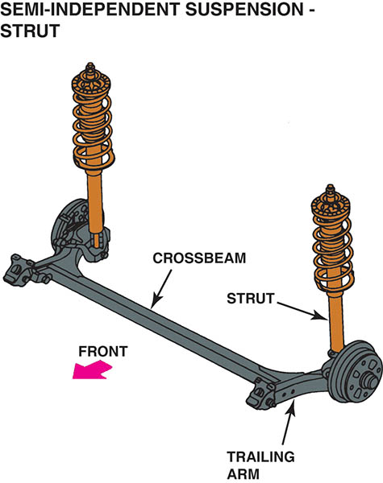
Figure 118.16 A semi-independent rear suspension with MacPherson struts

Slide 29
QUESTION 2: ?
When is a semi-rear independent suspension design used?

Slide 30
ANSWER 2:
When the rear axle is a non-driving axle.

Slide 31
REAR SUSPENSION SERVICE
Rear suspension service starts with a thorough test-drive, to observe any unusual noises or vibrations that may be caused by a fault with a rear suspension component.
After a test-drive, safely hoist the vehicle and perform a thorough visual inspection.
Use an appropriate prybar and move all of the bushings and joints, checking for deterioration or freeplay.

Slide 32
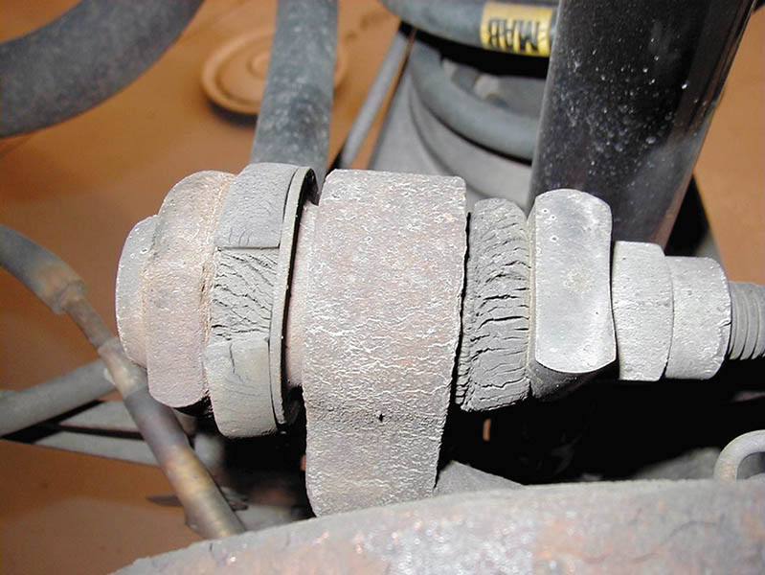
Figure 118.17 Check all rubber bushings for excessive cracking

Slide 33
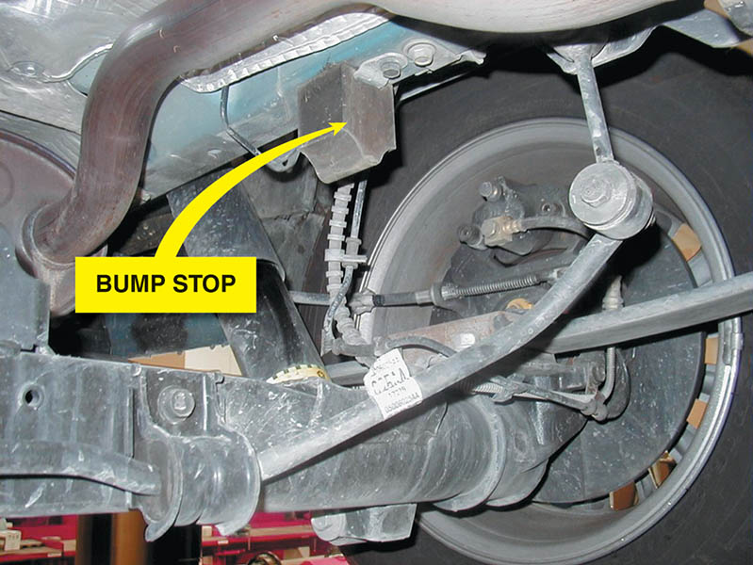
Figure 118.18 Carefully inspect the bump stops for damage during a thorough visual inspection

Slide 34
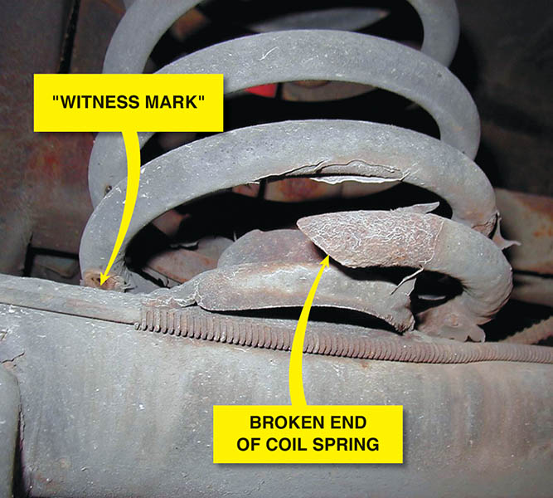
Figure 118.19 A broken spring was discovered during a routine under-vehicle visual inspection. Notice the witness marks that show that the spring coils have been hitting each other

Slide 35
REAR SHOCK REPLACEMENT
Precautions
The rear axle must be supported prior to removing the shocks.
Air Shock Installation
Most replacement air shocks are directional and are labeled left and right.
Use care when installing the air lines to prevent unwanted leaks.

Slide 36
REAR SPRING REPLACEMENT (1 OF 2)
Rear Coil Springs
Support the rear axle assembly with tall safety stands.
Remove the lower shock absorber mounting bolts/nuts and disconnect the shock absorber from the rear axle assembly.
Lower the rear axle just enough to remove the coil springs.

Slide 37
REAR SPRING REPLACEMENT (2 OF 2)
Rear Leaf Springs
Rear leaf springs often need replacement due to one of the following common causes:
Individual leaves of a leaf spring often crack, then break.
The center bolt breaks
Replacement
Install the new spring, being careful to position the center bolt correctly into the hole on the axle pedestal.

Slide 38
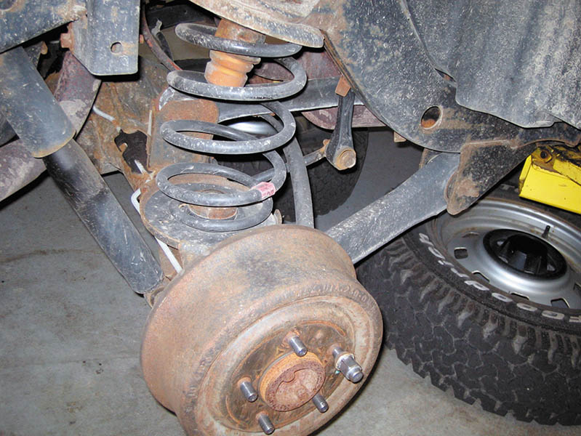
Figure 118.20 The shock absorber needs to be disconnected before removing the coil spring. Installation is the reverse of removal procedure

Slide 39
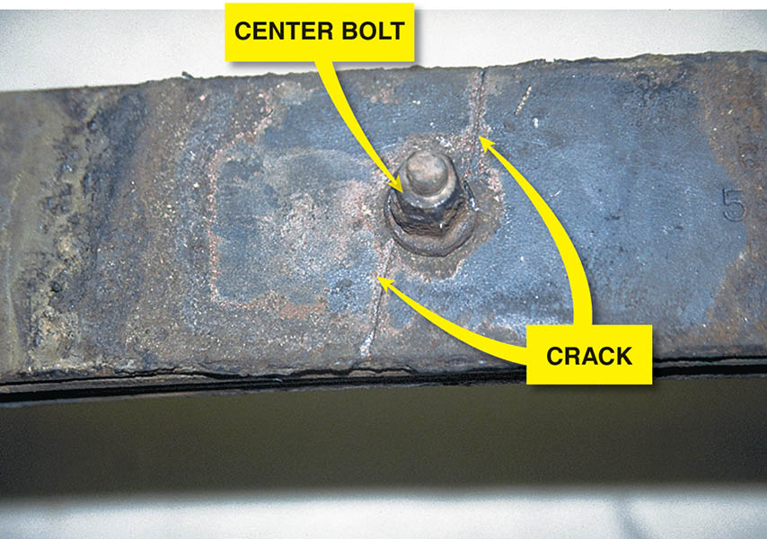
Figure 118.21 The center bolt is used to hold the leaves of the leaf spring together. However, the hole for the center bolt also weakens the leaf spring. The crack shown is what a technician discovered when the leaf spring was removed during the diagnosis of a sagging rear suspension

Slide 40
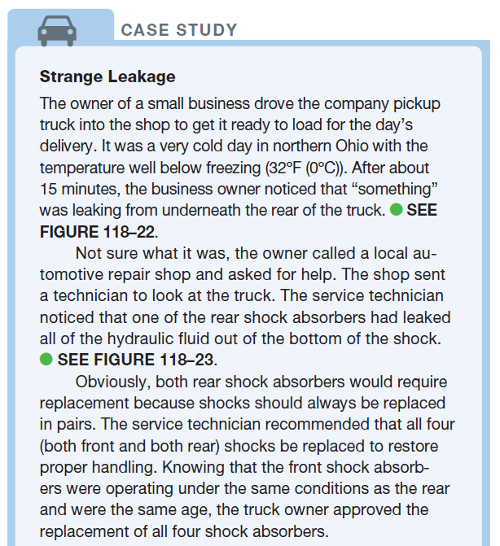
CASE STUDY

Slide 41
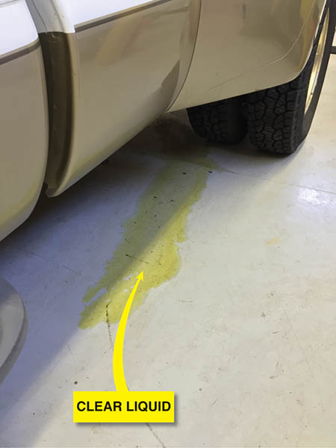
Figure 118.22 Whatever was leaking appeared to be a clear liquid but it did not smell like gasoline. What could it be from the rear of the truck?

Slide 42
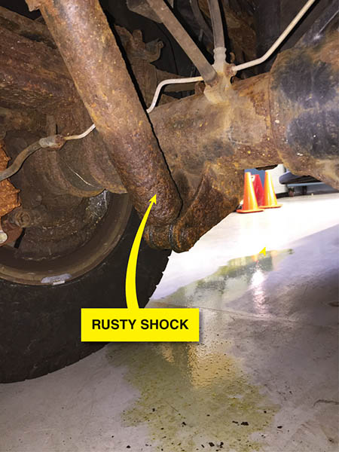
Figure 118.23 The source of the leak was discovered to be hydraulic shock fluid that had leaked from the bottom of the shock and not from around the shaft seal, which is the most likely location for shocks to leak. Apparently, rust had eaten through the housing of the shock

Slide 43
QUESTION 3: ?
What must be done when a rear shock absorber is replaced?

Slide 44
ANSWER 3:
The rear axle must be supported.

Slide 45
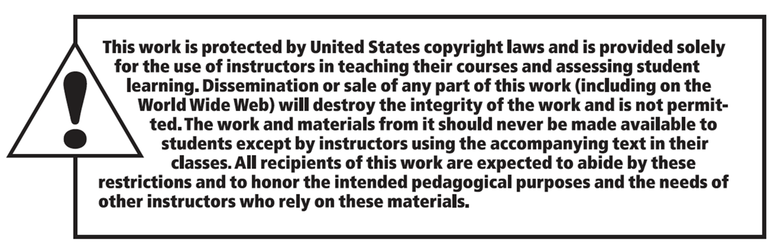
Copyright

