Slide 1
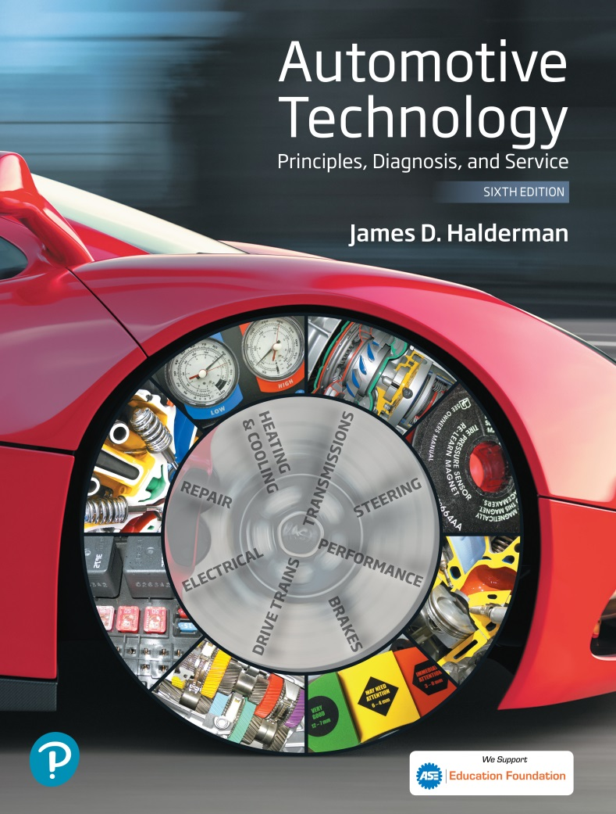
Automotive Technology Principles, Diagnosis, and Service
Sixth Edition
Chapter 117
Front Suspension and Service
Copyright © 2018, 2015, 2011 Pearson Education, Inc. All Rights Reserved

Slide 2
LEARNING OBJECTIVES (1 of 2)
117.1 Describe different front suspension types.
117.2 Diagnose short/long-arm (SLA) suspension systems and discuss strut suspension.
117.3 Explain how to perform a road test, a dry park test, and a visual inspection.
117.4 Discuss the diagnosis of ball joints and kingpins.
117.5 Discuss the diagnosis of shock absorbers and struts.

Slide 3
LEARNING OBJECTIVES (2 of 2)
117.6 Describe how to replace MacPherson struts.
117.7 Explain the diagnosis of stabilizer bar links and bushings.
117.8 Discuss the diagnosis of strut rod bushings, front coil springs, steering knuckles, torsion bars, and control arm bushings.
117.9 This chapter will help prepare for ASE Suspension and Steering (A4) certification content area “B” (Suspension System Diagnosis and Repair).

Slide 4
FRONT SUSPENSION TYPES
Solid Axles
Early cars and trucks used a solid (or straight) front axle to support the front wheels.
Kingpins
At the end of solid axle, they allow the front wheels to rotate for steering.
Twin-I Beam
Strong steel twin beams that cross provide independent front suspension operation with the strength of a solid front axle.

Slide 5
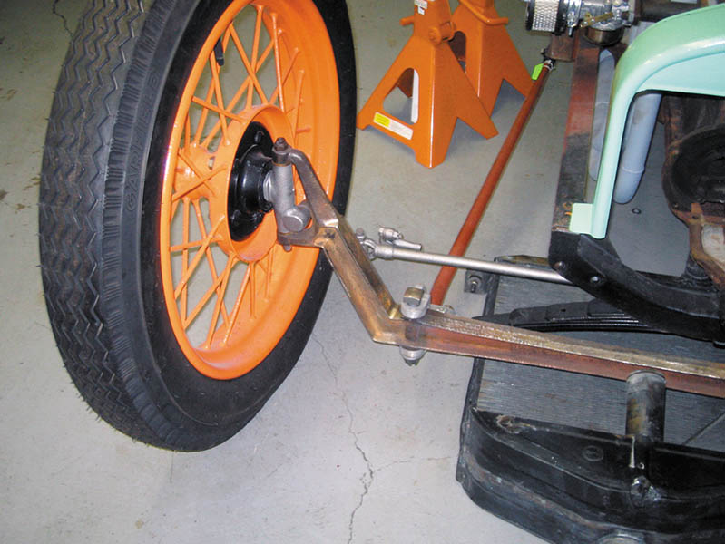
Figure 117.1 Most early vehicles used single straight axles

Slide 6
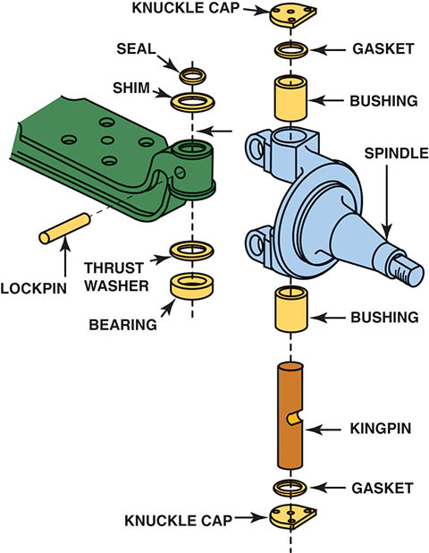
Figure 117.2 Typical kingpin used with a solid axle

Slide 7
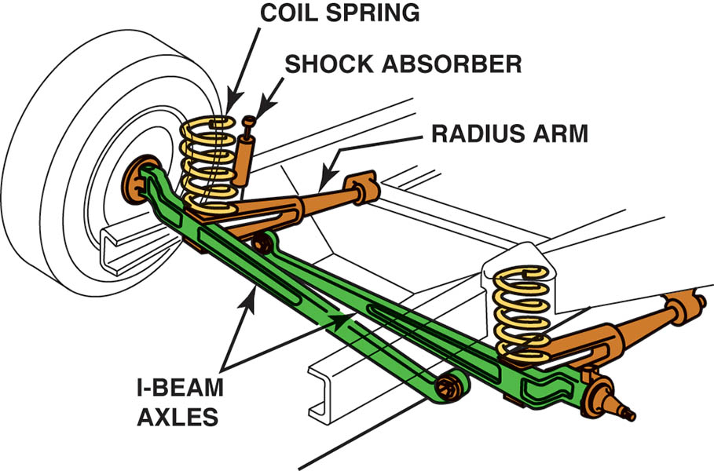
Figure 117.3 Twin I-beam front suspension. Rubber bushings are used to support the I-beams to the frame and help isolate road noise

Slide 8
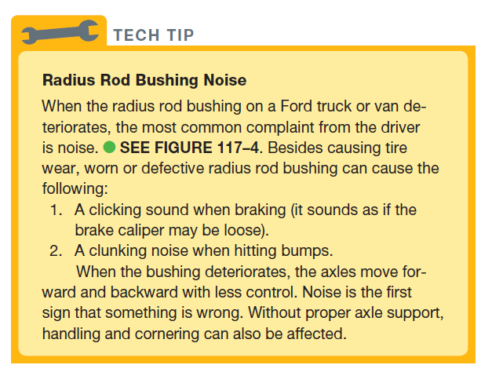
Tech Tip

Slide 9
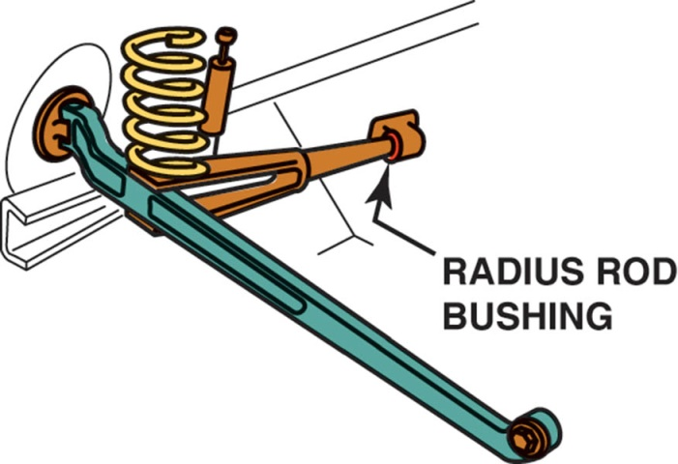
Figure 117.4 The rubber radius rod bushing absorbs road shocks and helps isolate road noise

Slide 10
SHORT/LONG-ARM SUSPENSIONS (1 OF 2)
Terminology
The short/long-arm suspension uses a short upper control arm and a longer lower control arm and is usually referred to as the SLA-type suspension.
Strut Rods
A strut rod, also called a reaction rod, provides support to the axle during braking and acceleration forces.

Slide 11
SHORT/LONG-ARM SUSPENSIONS (2 OF 2)
Coil Spring Front Suspensions
Locating the coil spring on the lower control arm is the most common SLA-type suspension configuration.
Torsion Bar Front Suspensions
Short/long-arm suspensions use longitudinal torsion bars, especially in trucks.

Slide 12
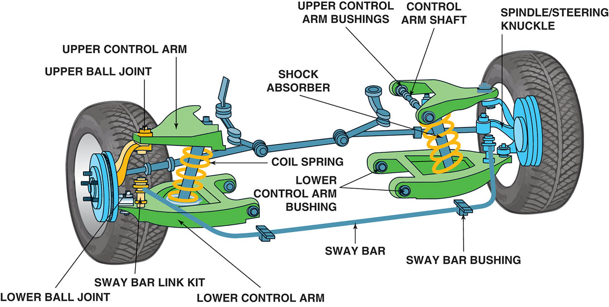
Figure 117.5 The upper control arm is shorter than the lower control arm on a short/long-arm (SLA) suspension

Slide 13
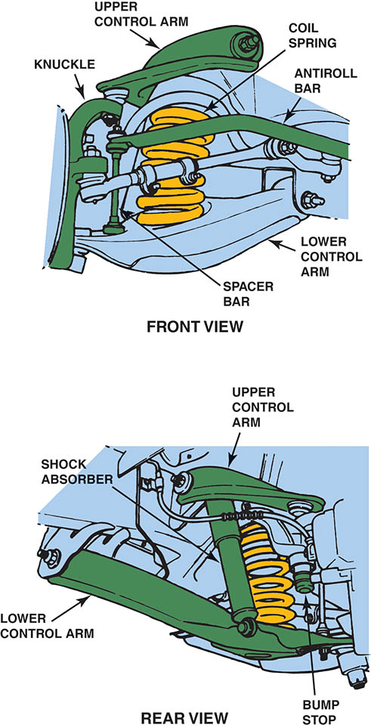
Figure 117.6 A typical SLA-front suspension using coil springs

Slide 14
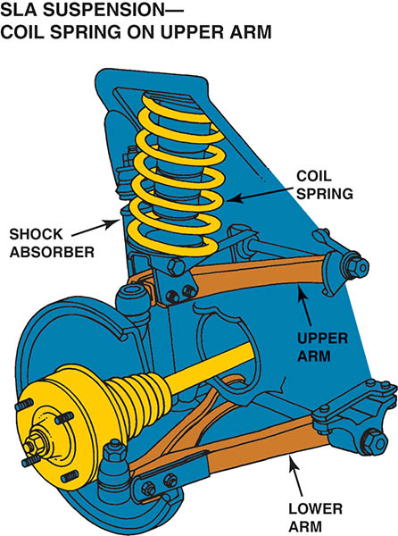
Figure 117.7 An SLA-type suspension with the coil spring placed on top of the upper control arm

Slide 15
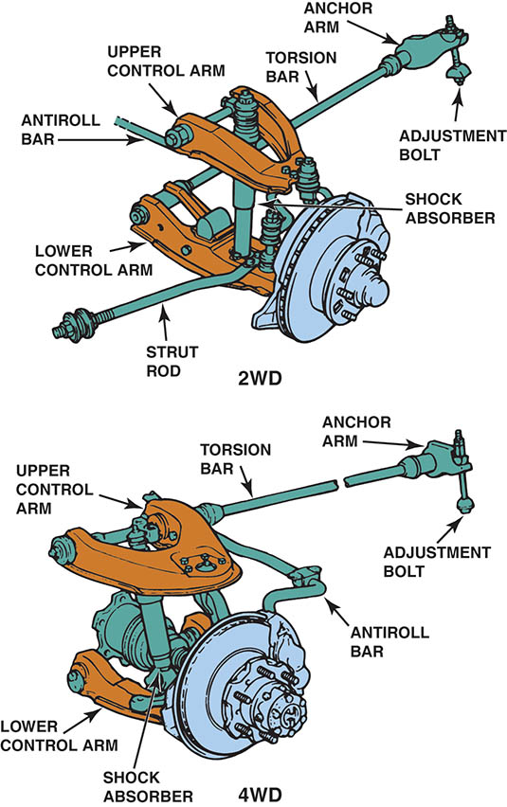
Figure 117.8 A torsion bar SLA suspension can use either the lower or the upper control arm

Slide 16
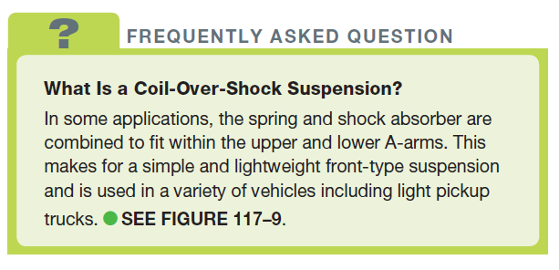
FREQUENTLY ASKED QUESTION

Slide 17
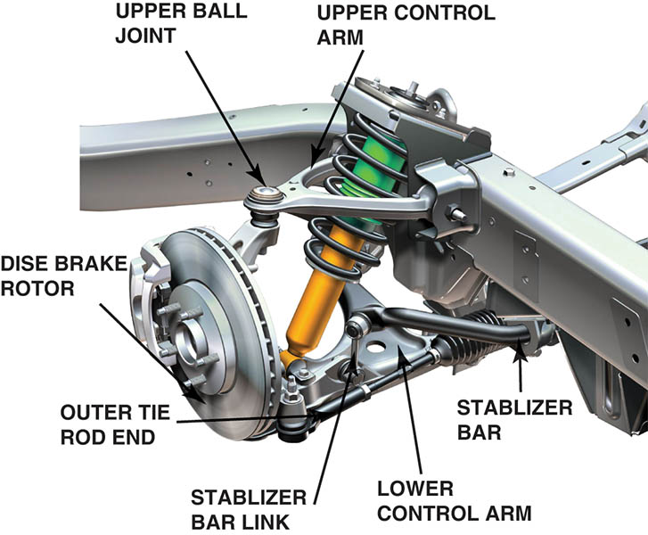
Figure 117.9 An SLA-type suspension that uses a coil-over shock assembly

Slide 18
STRUT SUSPENSION
Parts and Operation
A MacPherson strut includes the suspension spring that transfers the weight of the body to the wheel.
A modified strut does not include a spring as part of the assembly.
A multilink front suspension uses two control arms as well as a structural strut assembly.

Slide 19
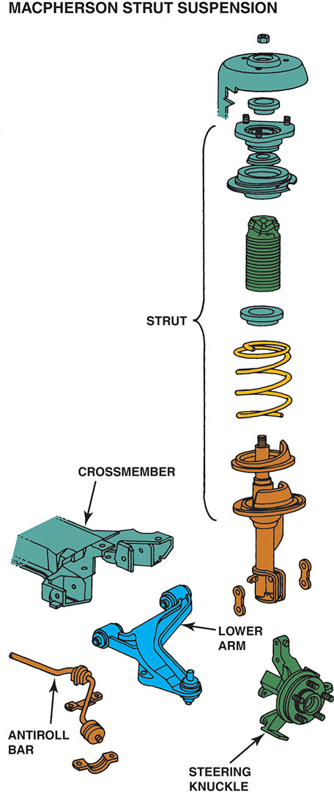
Figure 117.10 A typical MacPherson strut showing all of the components of the assembly. A strut includes the shock and the spring in one structural assembly

Slide 20
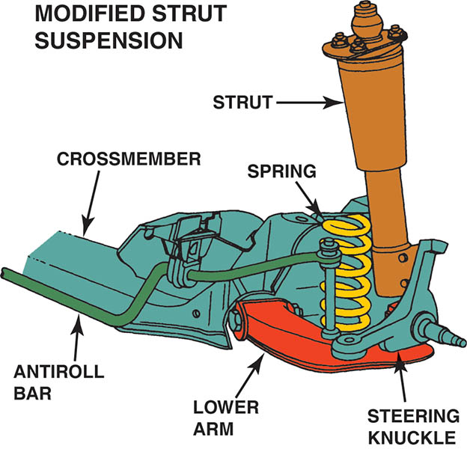
Figure 117.11The modified strut front suspension is similar to a MacPherson strut suspension except that the coil spring is seated on the lower control arm and is not part of the strut assembly

Slide 21
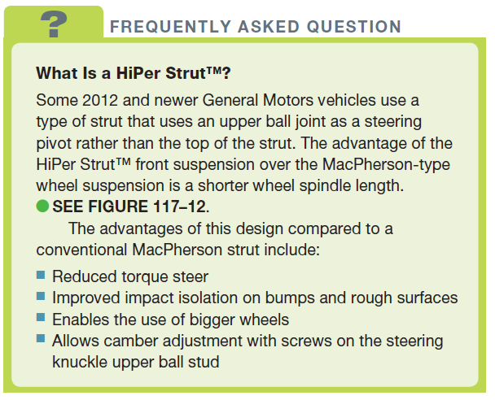
FREQUENTLY ASKED QUESTION

Slide 22
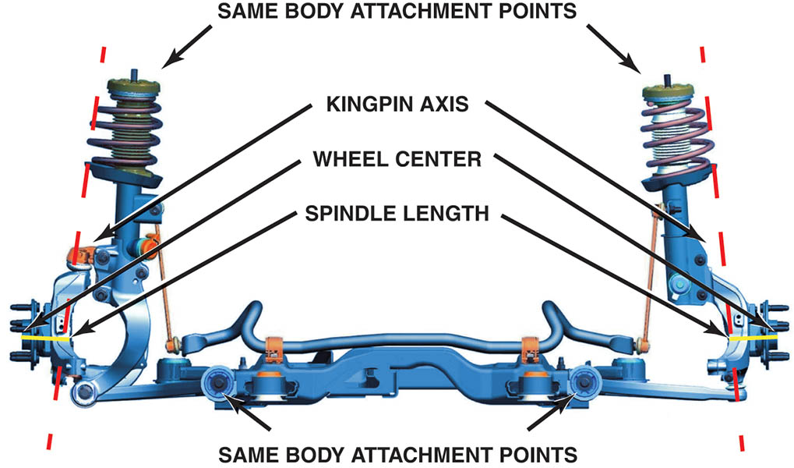
Figure 117.12 The HiPer Strut (left) compared to the traditional MacPherson strut (right)

Slide 23
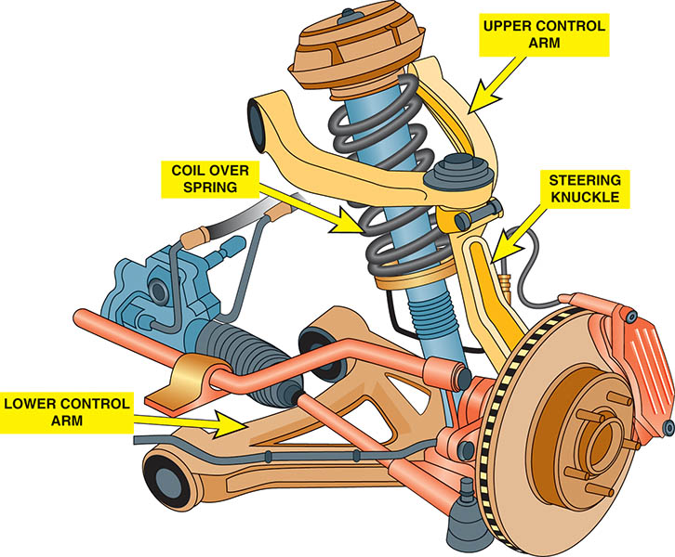
Figure 117.13 A typical multilink front suspension system

Slide 24
SERVICING THE SUSPENSION SYSTEM
When the driver notices that the vehicle is not riding or handling as it did, he or she brings it to a technician to repair or align the vehicle.
The smart technician should always road test any vehicle before and after servicing.

Slide 25
ROAD TEST DIAGNOSIS (1 OF 2)
While driving, try to determine when and where the noise or problem occurs, such as the following:
In cold or warm weather
With cold or warm engine/vehicle
While turning, left only, right only

Slide 26
ROAD TEST DIAGNOSIS (2 OF 2)
A proper road test for any suspension system problem should include the following:
Drive beside parked vehicles.
Drive into driveways.
Drive in reverse while turning.
Drive over a bumpy road.

Slide 27
DRY PARK TEST (SUSPENSION)
The dry park test is performed by having an assistant move the steering wheel side to side while feeling and observing for any free-play in the steering or suspension.
In this suspension analysis using the dry park test, the technician should observe the following for any noticeable play or unusual noise:
Front wheel bearings.
Control arm bushing wear or movement.
Ball joint movement.

Slide 28
VISUAL INSPECTION
A thorough visual inspection should include checking all of the following:
Shock absorbers and struts.
Springs
Stabilizer bar links and bushings
Upper and lower shock absorber mounting points
Bump stops
Body-to-chassis mounts
Engine and transmission (transaxle) mounts
Suspension arm bushings.

Slide 29
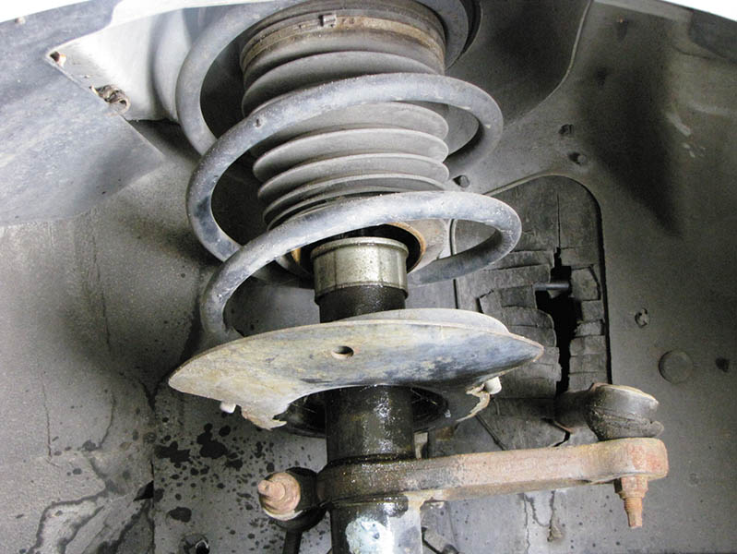
Figure 117.14 A leaking strut. Either a cartridge insert or the entire strut will require replacement. If a light film of oil is seen, this is to be considered normal. If oil is dripping, then this means that the rod seal has failed

Slide 30
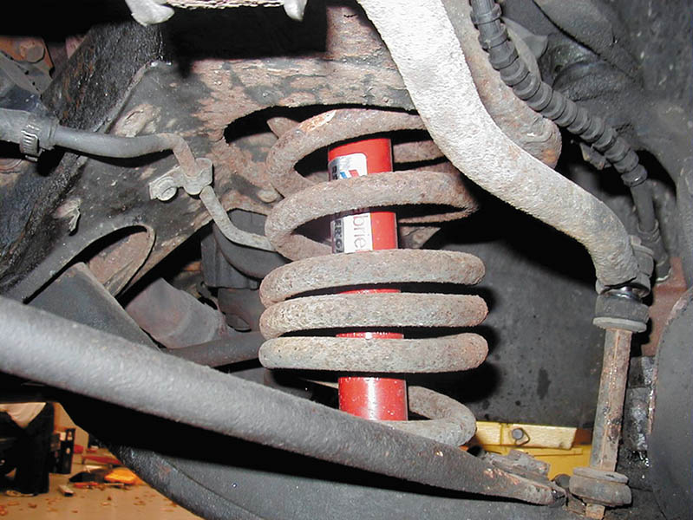
Figure 117.15 This front coil spring looks as if it has been heated with a torch in an attempt to lower the ride height of the vehicle. Both front springs will require replacement

Slide 31
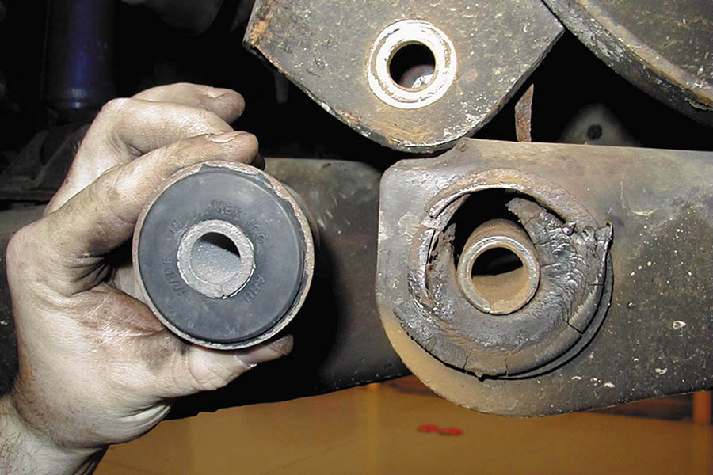
Figure 117.16 It is easy to see that this worn control arm bushing needs to be replaced. The new bushing is shown next to the original

Slide 32
QUESTION 1: ?
What is the purpose of the dry park test?

Slide 33
ANSWER 1:
To look for play in components as the steering wheel is turned side-to-side.

Slide 34
BALL JOINTS (1 OF 3)
Diagnosis and Inspection
Defective or worn ball joints can cause looseness in the suspension and the following common driver complaints:
Loud popping or squeaking whenever driving over curbs, such as into a driveway
Shimmy-type vibration felt in the steering wheel
Vehicle wander or a tendency not to track straight
Excessive freeplay in the steering wheel

Slide 35
BALL JOINTS (2 OF 3)
A ball joint inspection should also be done when an alignment is performed or as part of any other comprehensive vehicle inspection.
Always check wear-indicator-type ball joints with the wheels of the vehicle on the ground.
To perform a proper non-indicator-type ball joint inspection, the force of the vehicle’s springs must be unloaded from the ball joint.
Follower ball joints (friction ball joints) should also be inspected while testing load-carrying ball joints.

Slide 36
BALL JOINTS (3 OF 3)
Ball Joint Removal
The removal procedures vary with the style of ball joint and the design of the suspension system.
The preferred method to separate ball joints in a puller.
Use caution so as to not damage any attaching components.
Follow the manufacturers recommended procedures.
Many vehicles are equipped with non-replaceable ball joints, and the entire control arm must be replaced if the ball joint is worn or defective.

Slide 37
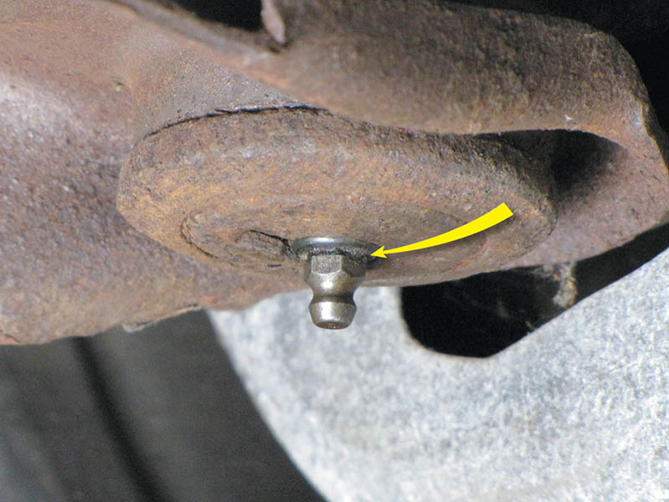
Figure 117.17 Grease fitting projecting down from the surrounding area of a ball joint. The ball joint should be replaced when the area around the grease fitting is flush or recessed

Slide 38
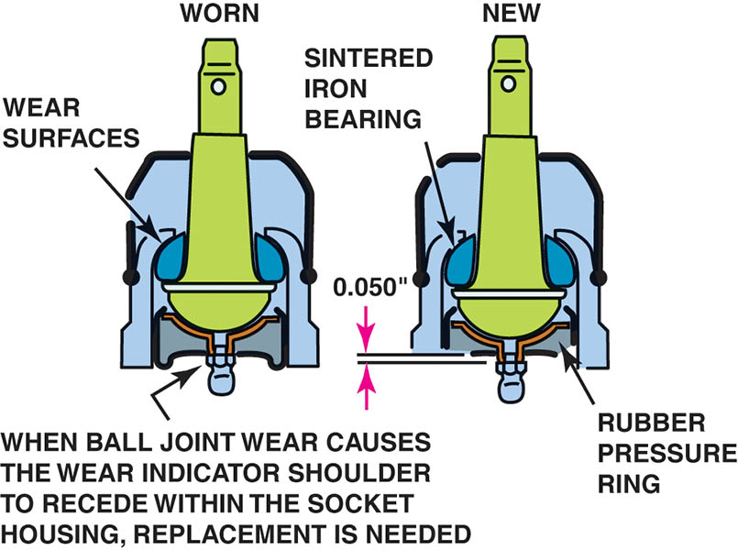
Figure 117.18 Indicator ball joints should be checked with the weight of the vehicle on the ground

Slide 39
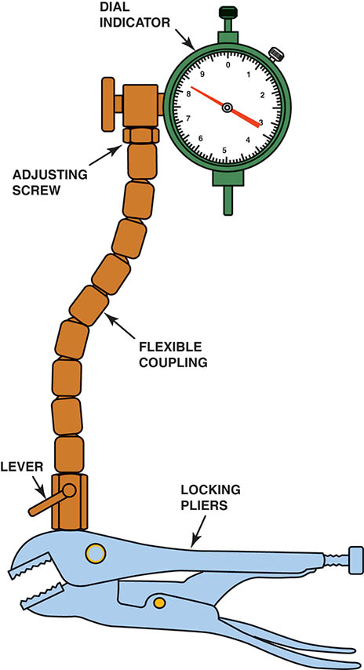
Figure 117.19 Typical dial indicator used to measure the suspension component movement. The locking pliers attach the gauge to a stationary part of the vehicle and the flexible coupling allows the dial indicator to be positioned at any angle

Slide 40
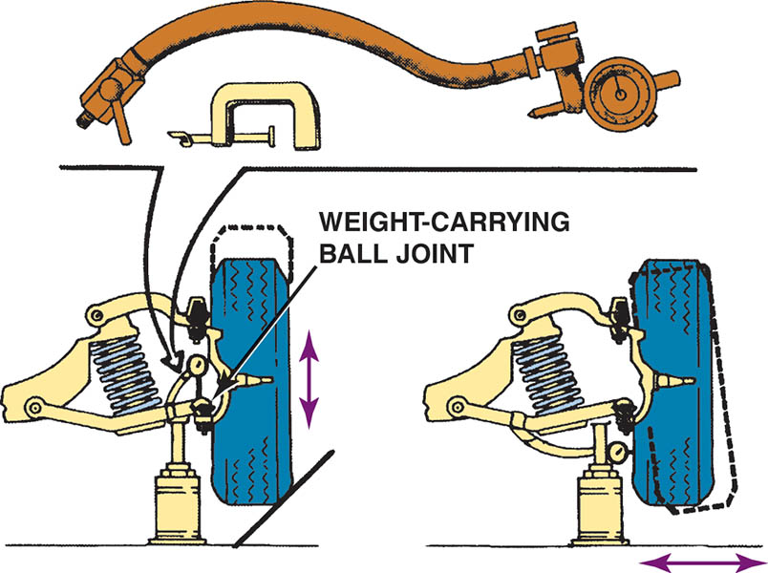
Figure 117.20 If the spring is attached to the lower control arm as in this SLA suspension, the jack should be placed under the lower control arm as shown. A dial indicator should be used to measure the amount of freeplay in the ball joints.

Slide 41
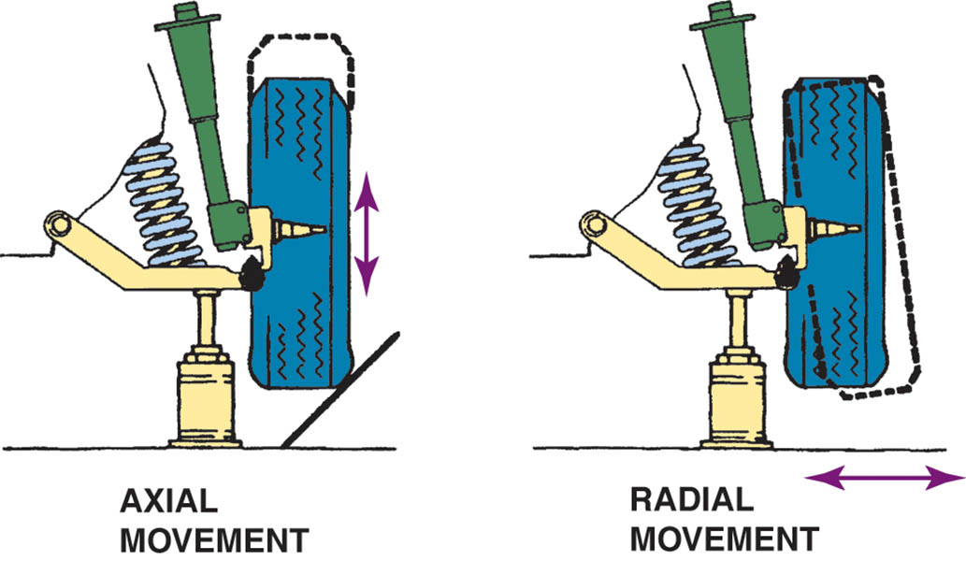
Figure 117.21 The jack should be placed under the lower control arm of this modified MacPherson-type suspension

Slide 42
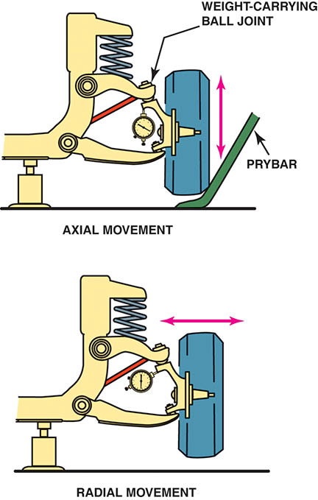
Figure 117.22 If the spring is attached to the upper control arm, the jack should be placed under the frame to check for ball joint wear

Slide 43
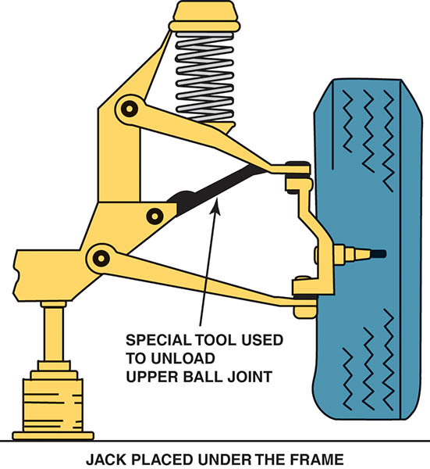
Figure 117.23 A special tool or a block of wood should be inserted between the frame and the upper control arm before lifting the vehicle off the ground. This tool stops the force of the spring against the upper ball joint so that a true test can be performed on the condition of the ball joint

Slide 44
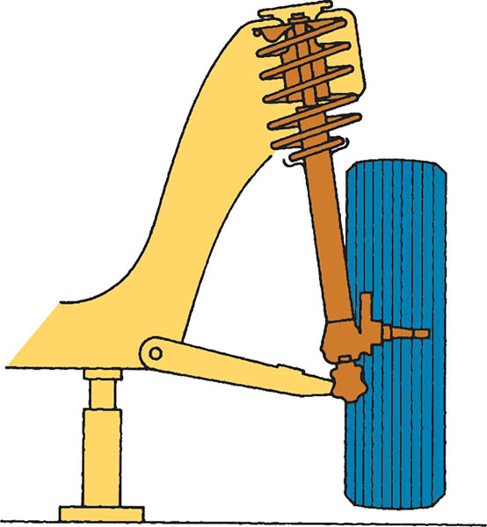
Figure 117.24 The jacking point is under the frame for checking the play of a lower ball joint used with a MacPherson strut

Slide 45
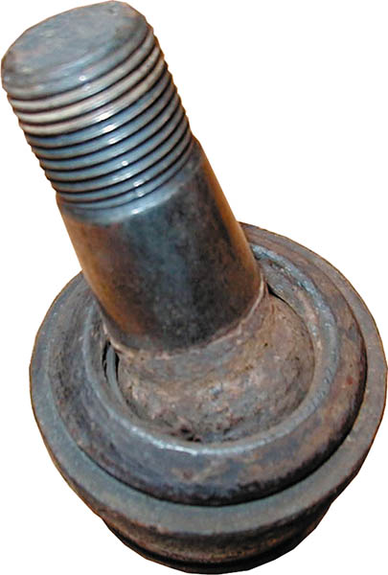
Figure 117.25 This worn and rusty ball joint was found by moving the wheel and looking for movement in the joint

Slide 46
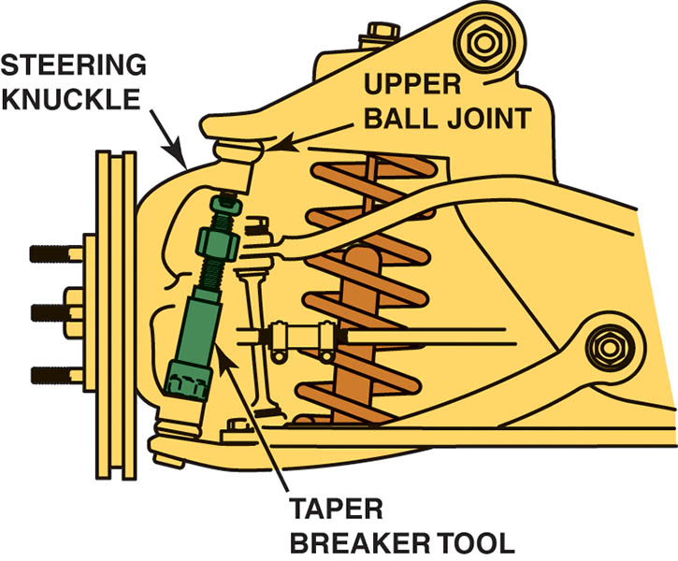
Figure 117.26 Taper breaker tool being used to separate the upper ball joint from the steering knuckle. This is especially important for vehicles equipped with aluminum alloy control arms

Slide 47
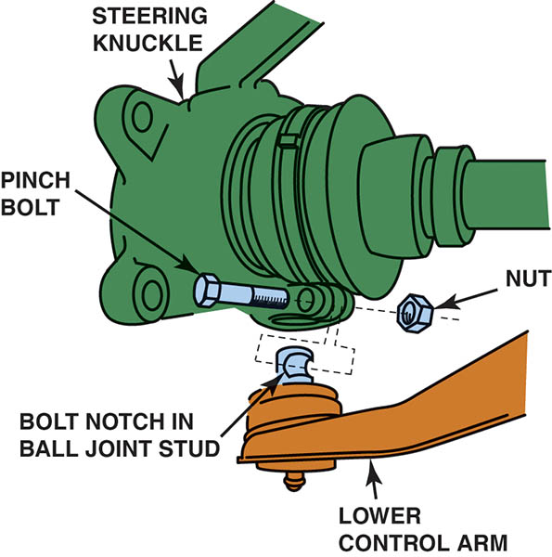
Figure 117.27 A pinch bolt attaches the steering knuckle to the ball joint. Remove the pinch bolt by turning the nut, not the bolt

Slide 48
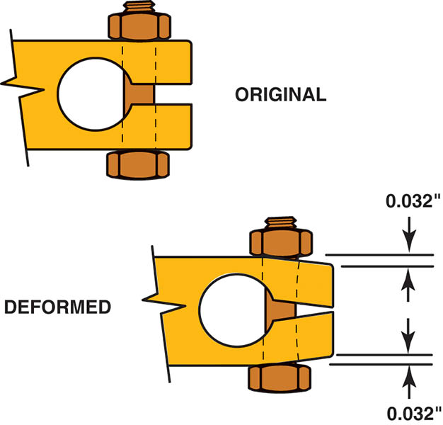
Figure 117.28 If the pinch bolt is overtightened, the steering knuckle can be deformed. A deformed knuckle can cause the pinch bolt to break and the ball joint could become separated from the steering knuckle

Slide 49
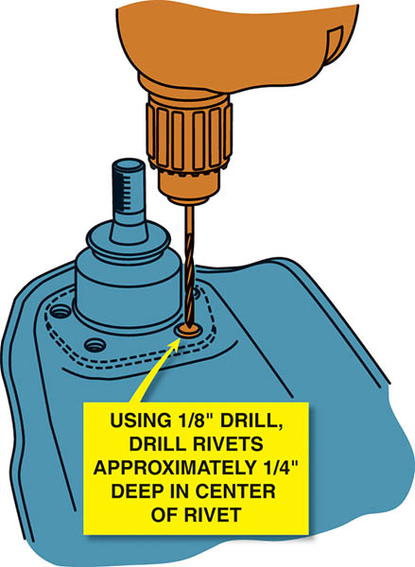
Figure 117.29 By drilling into the rivet, the holding force is released

Slide 50
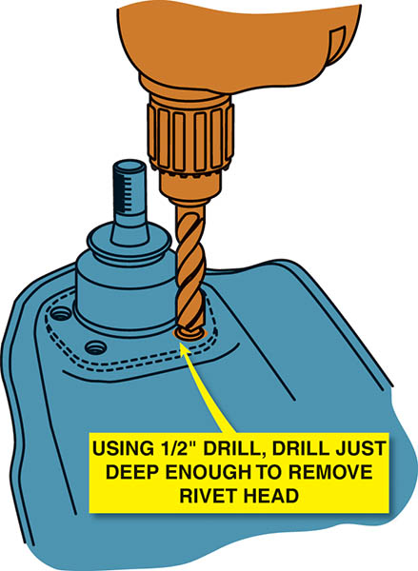
Figure 117.30 The head of the rivet can be removed by using a large-diameter drill bit as shown

Slide 51
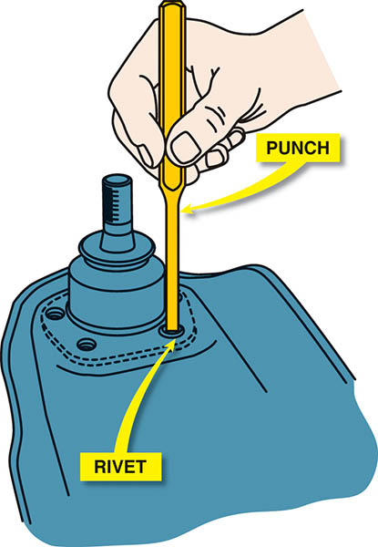
Figure 117.31 A punch and a hammer being used to remove a rivet after the head has been removed

Slide 52
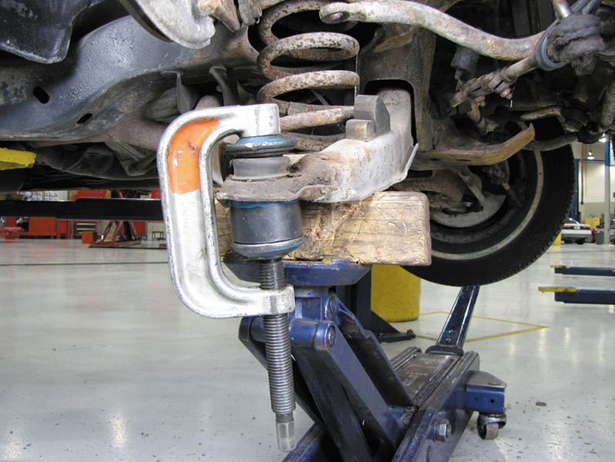
Figure 117.32 Press-in ball joints are best removed using a large C-clamp press, as shown

Slide 53
QUESTION 2: ?
What are the symptoms of a defective ball joint?

Slide 54
ANSWER 2:
Noise, shimmy, wander, and excessive freeplay in the steering.

Slide 55
KINGPIN DIAGNOSIS AND SERVICE (1 OF 2)
Kingpins are designed to rotate inside kingpin bushings with a clearance between them of approximately 0.001 to 0.003 inch (0.025 to 0.075 mm).
Looseness in the kingpin causes looseness in the wheels and steering.
Kingpins can also gall or seize due to lack of lubrication, resulting in very hard steering.

Slide 56
KINGPIN DIAGNOSIS AND SERVICE (2 OF 2)
To remove a typical kingpin, follow these basic steps:
Remove the tire, brake drum, and backing plate or caliper.
Remove the lockpin. The lockpin is usually tapered with a threaded end for the nut. Drive the lockpin out with a drift (punch).
Remove the grease caps and drive the kingpin from the steering knuckle and axle with a hammer and a brass punch or a hydraulic press, if necessary

Slide 57
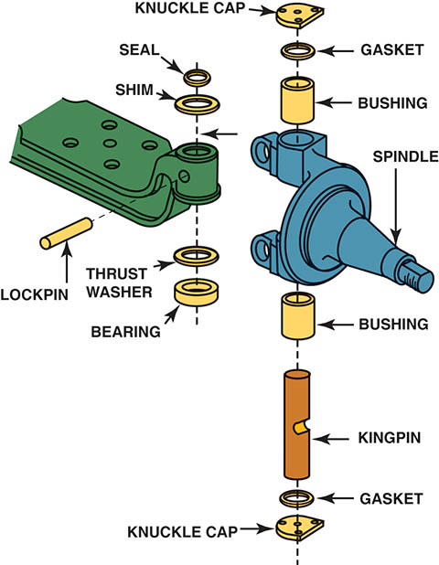
Figure 117.33 Typical kingpin assembly

Slide 58
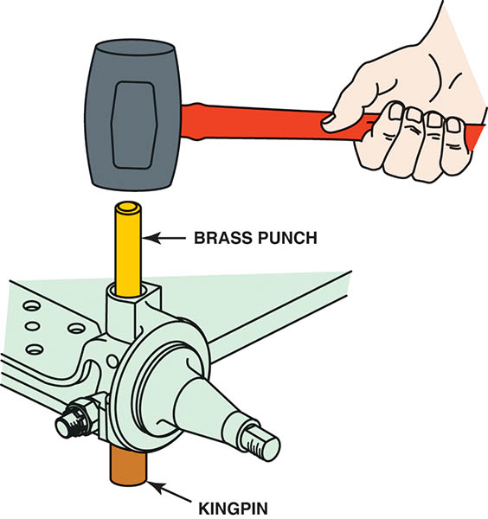
Figure 117.34 Driving a kingpin out with a hammer

Slide 59
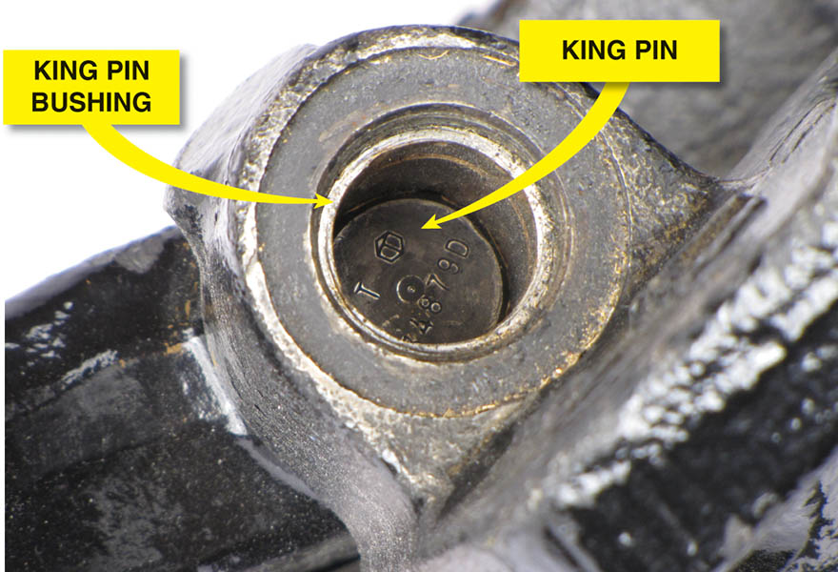
Figure 117.35 A kingpin being removed showing the worn bushing

Slide 60
SHOCK ABSORBERS AND STRUTS (1 OF 2)
Diagnosis
Replacement of shock absorbers may be required when any or all of the following symptoms appear:
Ride harshness.
Frequent bottoming out on rough roads.
Extended vehicle movement after driving on dips or a rise in the road.
Cuppy-type tire wear.
Leaking hydraulic oil.

Slide 61
SHOCK ABSORBERS AND STRUTS (2 OF 2)
Front Shock Replacement
Most front shock absorbers can be replaced either with the vehicle still on the ground or while on a hoist.
Special sockets and other tools are available to remove the nut from the shocks that use a single mounting stem.
The removal of the lower mounting of most front shock absorbers usually involves the removal of two bolts.
Reverse the removal procedure to install replacement shock absorbers.

Slide 62
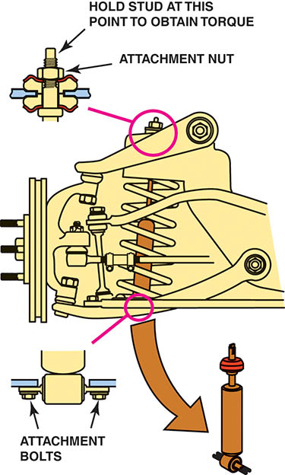
Figure 117.36 Most shock absorbers used on the front suspension can be removed from underneath the vehicle after removing the attaching bolts or nuts

Slide 63
MACPHERSON STRUT REPLACEMENT (1 OF 2)
On most vehicles equipped with MacPherson strut suspensions, strut replacement involves the following steps.
Hoist the vehicle, remove the wheels, and mark the attaching bolts/nuts.
Remove the upper strut mounting bolts except for one to hold the strut until ready to remove the strut assembly.
Remove the brake caliper or brake hose from the strut housing.

Slide 64
MACPHERSON STRUT REPLACEMENT (2 OF 2)
Replacement Step Continued…
After removing all lower attaching bolts, remove the final upper strut bolt and remove the strut assembly from the vehicle.
Place the strut assembly into a strut spring compressor fixture.
Compress the coil spring enough to relieve the tension on the strut rod nut.
After removing the strut rod nut, remove the upper strut bearing assembly and the spring.

Slide 65
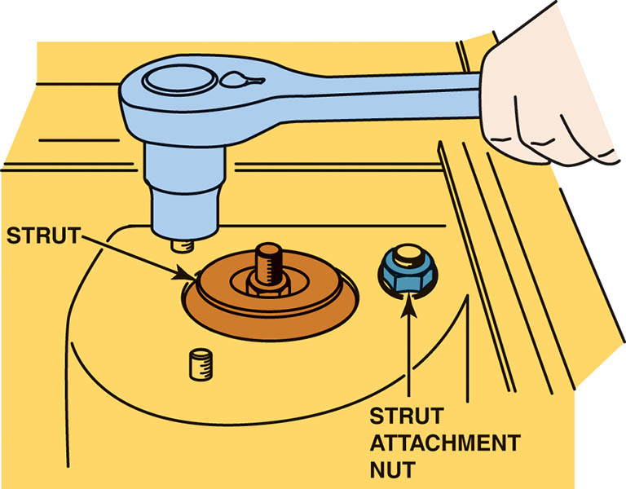
Figure 117.37 Removing the upper strut mounting bolts. Some experts recommend leaving one of the upper strut mount nuts loosely attached to prevent the strut from falling when the lower attaching bolts are removed

Slide 66
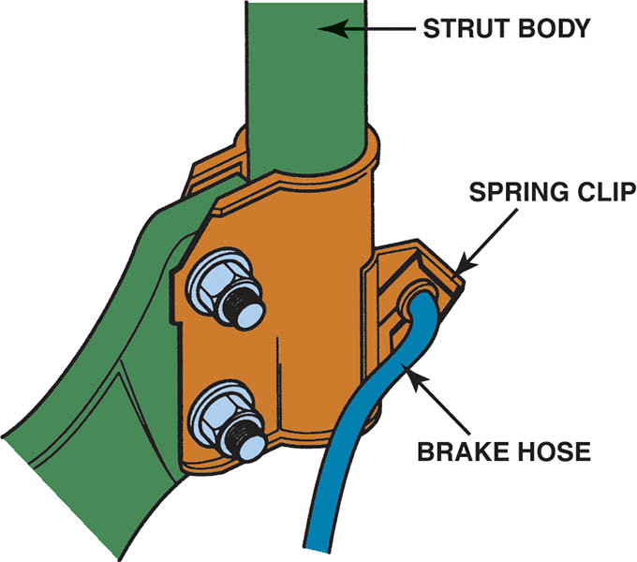
Figure 117.38 A brake hydraulic hose is often attached to the strut housing. Sometimes all that is required to separate the line from the strut is to remove a spring clip

Slide 67
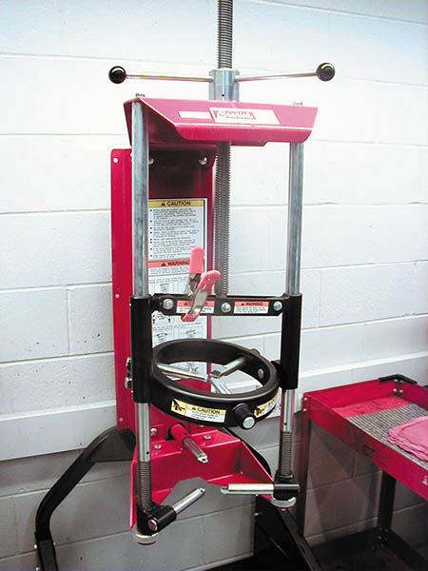
Figure 117.39 Use a strut spring compressor fixture to compress the spring on a MacPherson strut before removing the strut retaining nut

Slide 68
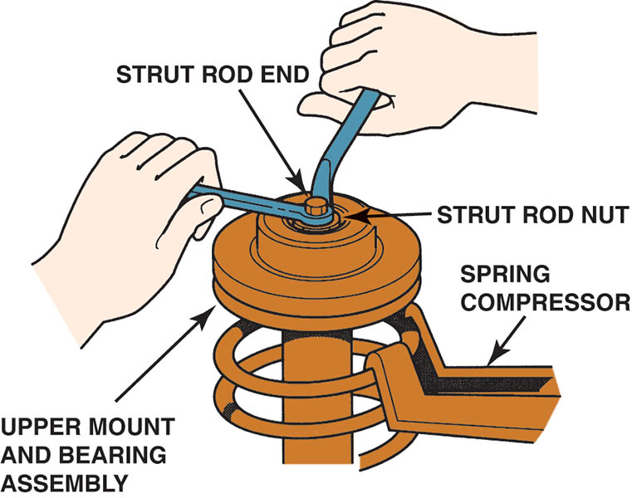
Figure 117.40 Removing the strut rod nut. The strut shaft is being helped with one wrench while the nut is being removed with the other wrench. Notice that the spring is compressed before the nut is removed

Slide 69
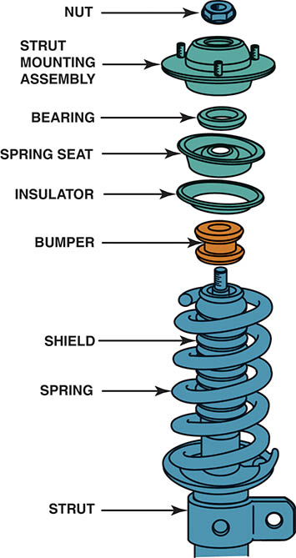
Figure 117.41 Typical MacPherson strut showing the various components

Slide 70
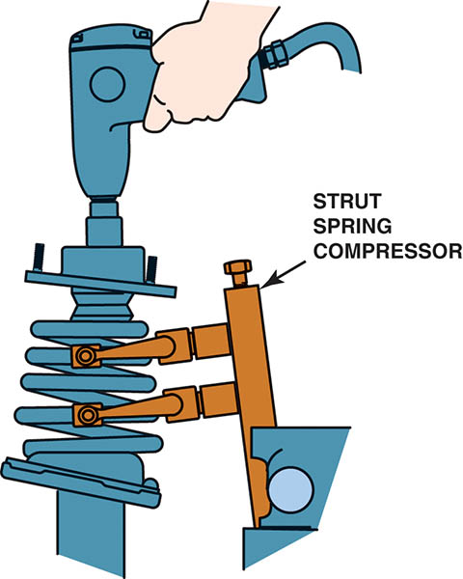
Figure 117.42 After installing the replacement strut cartridge, reinstall the spring and upper bearing assembly after compressing the spring. Notice that the strut is being held in a strut spring compressor fixture

Slide 71
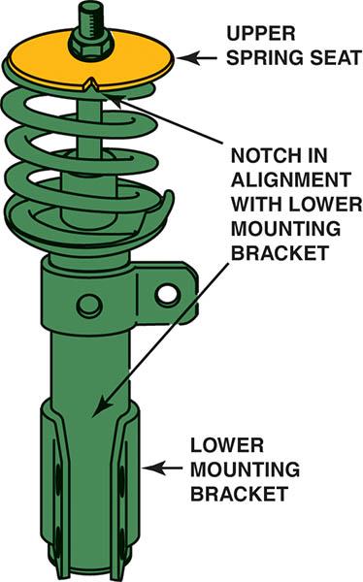
Figure 117.43 Before final assembly, make sure the marks you made are aligned. Some struts are manufactured with marks to ensure proper reassembly

Slide 72
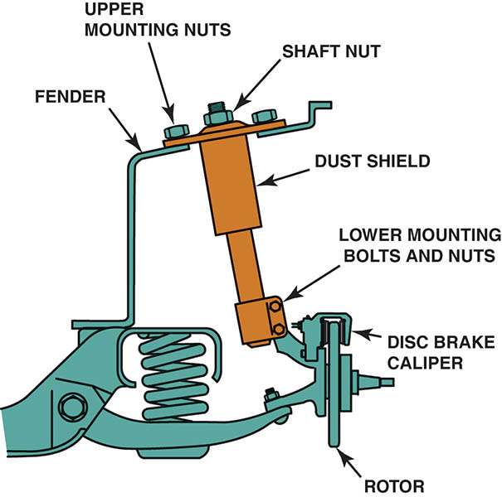
Figure 117.44 The strut on a modified MacPherson strut assembly can be replaced by removing the upper mounting nuts

Slide 73
STABILIZER BAR LINKS AND BUSHINGS
Diagnosis
The most common symptom of defective stabilizer bar links or bushings is noise while turning, especially over bumps.
Replacement
Stabilizer links are usually purchased as a kit consisting of replacement rubber bushings, retainers, a long bolt, and spacer with a nut and lock nut.
Stabilizer bar bushing replacement involves the removal (unbolting) of the bushing retainers that surround the bushing.

Slide 74
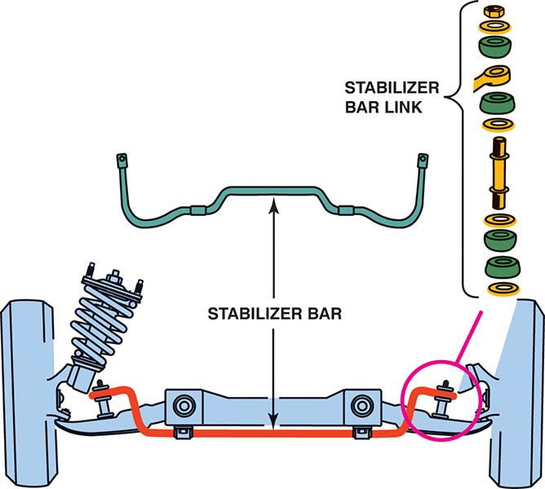
Figure 117.45 Stabilizer bar links should be replaced as a pair

Slide 75
STRUT ROD BUSHINGS
Diagnosis
When strut rod bushings fail, the lower control arm can move forward and backward during braking or when hitting bumps in the road.
Replacement
The strut rod must be removed from the vehicle and then the replacement rubber bushings can be installed.

Slide 76
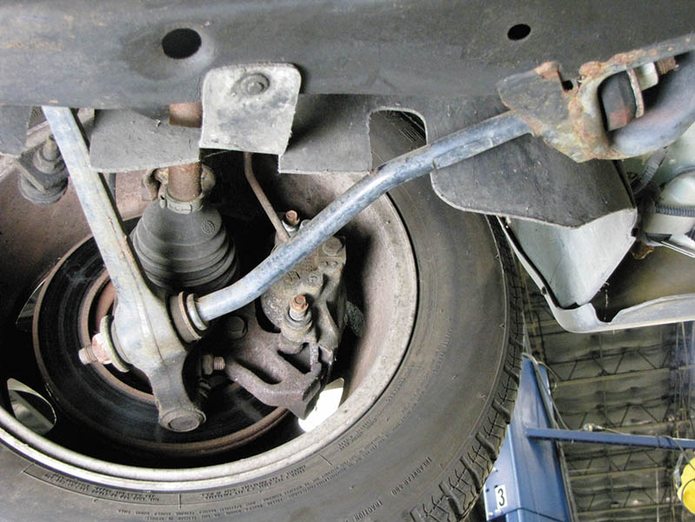
Figure 117.46 A strut rod as viewed from the front of the vehicle

Slide 77

Figure 117.47 Typical strut rod bushing with rubber on both sides of the frame to help isolate noise, vibration, and harshness from being transferred to the passengers

Slide 78
FRONT COIL SPRINGS
Diagnosis
Sagging springs can cause the vehicle to bottom out against the suspension bumpers, and cause the tires to slide laterally (side to side) across the pavement.
Replacement
Springs should be replaced in pairs.
Several aftermarket alternatives are available.
Care should be exercised when compressing a spring.
Follow manufacturers procedures when replacing springs.

Slide 79

Figure 117.48 Notice that if the front coil springs are sagging, the resulting angle of the lower control arm causes the wheels to move from side to side as the suspension moves up and down. Note the difference between the distance at “A” with good springs and the distance at “B” with sagging springs

Slide 80

Figure 117.49 A spring compressor is required by most vehicle manufacturers to be used whenever disassembling a coil spring suspension system

Slide 81

Figure 117.50 The steering knuckle has been disconnected from the lower ball joint. The lower control arm and the coil spring are being held up by a floor jack

Slide 82

Figure 117.51 A rubber mallet is being used to support the upper control arm as the lower control is being lowered using a floor jack. After all of the tension has been removed from the coil spring, it can be removed and the replacement installed

Slide 83

Figure 117.52 Spring insulators are installed between the spring seat and the coil spring to reduce noise

Slide 84

Figure 117.53 The holes in the lower arm are not only used to allow water to drain from the spring seat, but also used as a gauge to show the service technician that the coil spring is correctly seated

Slide 85
QUESTION 3: ?
What are the symptoms of a failed coil spring?

Slide 86
ANSWER 3:
Vehicle sags, suspension bottoms out and tire slide on the pavement.

Slide 87
STEERING KNUCKLES
Diagnosis
Unless a thorough inspection is performed during a wheel alignment, a bent steering knuckle is often overlooked.
Replacement
If the steering knuckle is bent or damaged, it must be replaced.

Slide 88
TORSION BARS
Adjustment
Most torsion bar suspensions are designed with an adjustable bolt to permit the tension on the torsion bar to be increased or decreased to change the ride height.
Adjustments are typically made during an aligment.

Slide 89

Figure 117.54 By rotating the adjusting bolt, the vehicle can be raised or lowered

Slide 90
CONTROL ARM BUSHINGS
Diagnosis
Defective control arm bushings are a common source of vehicle handling and suspension noise problems.
Replacement
To remove an old bushing from a control arm, the control arm must first be separated from the suspension and/ or frame of the vehicle.
Bushings are typically pressed in and out of the control arm.
Some bushings are not serviceable.

Slide 91

Figure 117.55 An adapter and a press or large clamp are used to remove the old bushing from the control arm and to install a new bushing

Slide 92
STRUT REPLACEMENT

Slide 93

1. The tools needed to replace a front strut assembly include several sockets and a ball-peen hammer, plus a strut compressor.

Slide 94

2. After safely hoisting the vehicle to elbow height and removing the wheel covers, remove the front tire/wheel assembly.

Slide 95

3. Remove the two strut retaining nuts.

Slide 96

4. Before using a hammer to drive the retaining bolts from the steering knuckle, thread the nut into the bolt backwards to prevent causing damage to the threads.

Slide 97

5. Remove the retaining bolts and separate the strut from the steering knuckle.

Slide 98

6. Lower the vehicle and remove the upper strut retaining fasteners.

Slide 99

7. Hold the strut while removing the last upper retaining nut and then remove the strut assembly.

Slide 100

8. After the strut has been removed from the vehicle, install the assembly into a strut compressor.

Slide 101

9. Position the jaws of the compressor under the bearing assembly as per the vehicle manufacturer’s instructions.

Slide 102

10. Turn the compressor wheel until all tension of the spring has been relieved from the upper bearing assembly.

Slide 103

11. Remove the strut retaining nut.

Slide 104

12. Remove the strut assembly.

Slide 105

13. Before installing the replacement strut, check the upper bearing by exerting a downward force on the bearing while rotating and check for roughness. Replace if necessary.

Slide 106

14. Install the strut from underneath the spring compressor fixture.

Slide 107

15. Install the strut retaining nut. Most vehicle manufacturers specify that the strut retaining nut be replaced and the old one discarded.

Slide 108

16. Before loosening the tension, check that the coil spring is correctly located at both the top and the bottom, then release the tension on the spring.

Slide 109

17. Remove the strut assembly from the compressor and back of the vehicle and install the upper fasteners. Do not torque to specifications until the lower fasteners have been installed.

Slide 110

18. Attach the lower strut to the steering knuckle using the original hardened bolts and nuts.

Slide 111

19. Using a torque wrench, torque all fasteners to factory specifications.

Slide 112

20. Install the tire/wheel assembly, lower the vehicle, and torque the lug nuts to factory specifications. Align the vehicle before returning it to the customer.

Slide 113

Copyright

