Slide 1
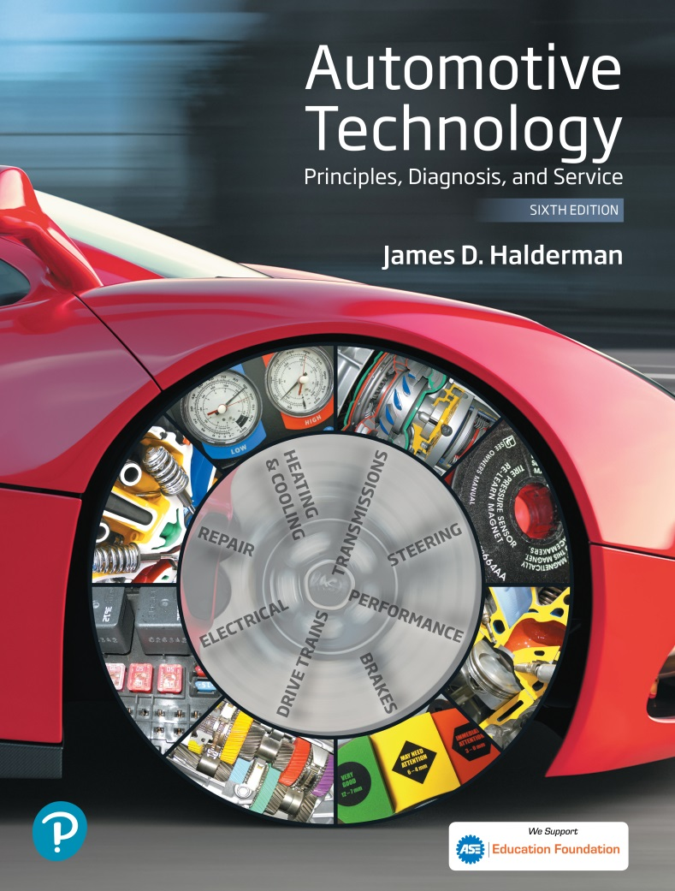
Automotive Technology Principles, Diagnosis, and Service
Sixth Edition
Chapter 116
Suspension System Components and Operation
Copyright © 2018, 2015, 2011 Pearson Education, Inc. All Rights Reserved

Slide 2
LEARNING OBJECTIVES (1 of 2)
116.1 Describe the purpose of a suspension system.
116.2 List the various types of suspensions and their component parts.
116.3 Define Hooke’s law and explain how coil, leaf, and torsion bar springs work.
116.4 Describe how suspension components allow wheel movement up and down and provide for turning.

Slide 3
LEARNING OBJECTIVES (2 of 2)
116.5 Describe how shock absorbers control spring forces.
116.6 Describe the function of bump stops.
116.7 This chapter will help prepare for ASE Suspension and Steering (A4) certification content area “B” (Suspension System Diagnosis and Repair).

Slide 4
INTRODUCTION
The purpose of the suspension is to provide the vehicle with the following:
  A smooth ride
  Accurate steering
  Responsive handling
  Support for the weight of the vehicle
  Maintenance of acceptable tire wear

Slide 5
FRAME CONSTRUCTION (1 OF 2)
Terminology
  The frame of a vehicle supports all the “running gear” of the vehicle, including the engine, transmission, rear axle assembly (if rear-wheel drive), and all suspension components.
Ladder Frame
  A common name for a type of perimeter frame where the transverse (lateral) connecting members are straight across.

Slide 6
FRAME CONSTRUCTION (2 OF 2)
Perimeter Frame
  Consists of welded or riveted frame members around the entire perimeter of the body.
Sub-Type Frames
  A partial frame often used on unit-body vehicles to support the power train and suspension components.
Unit Body Construction
  Unit-body construction (sometimes called unibody) is a design that combines the body with the structure of the frame.

Slide 7
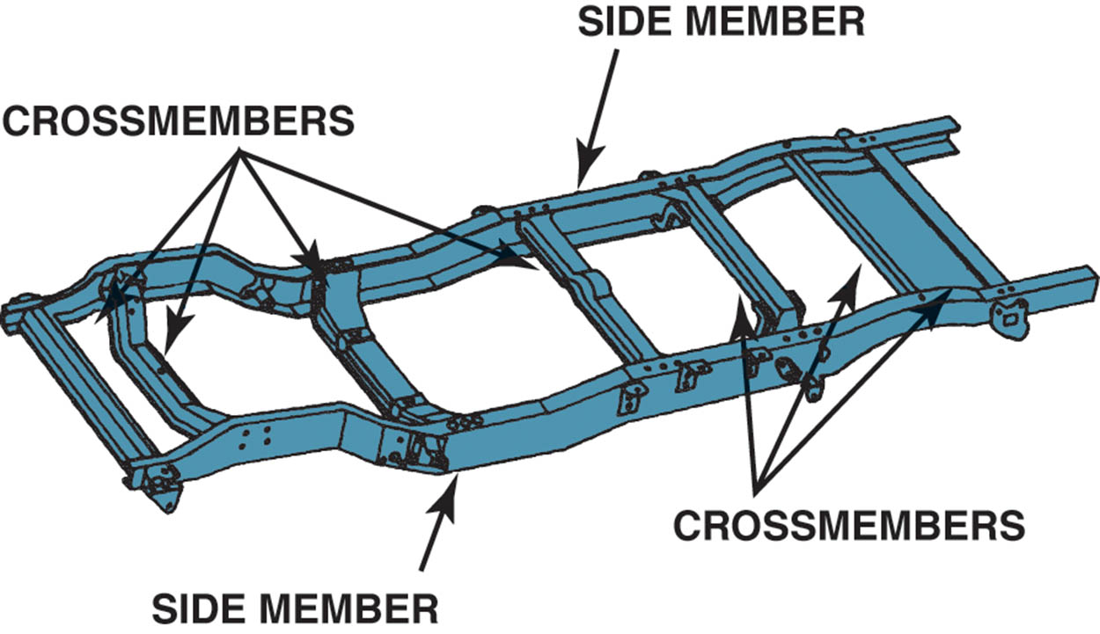
Figure 116.1 A typical truck frame is an excellent example of a ladder-type frame. The two side members are connected by a crossmember.

Slide 8
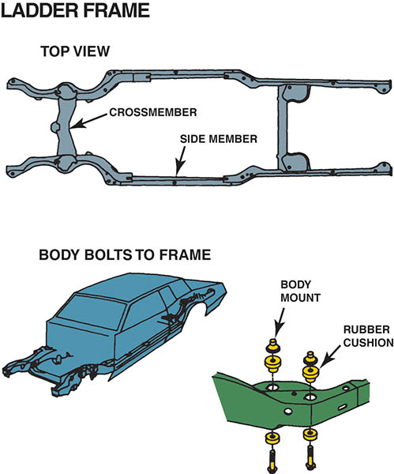
Figure 116.2 Rubber cushions used in body or frame construction isolate noise and vibration from traveling to the passenger compartment.

Slide 9
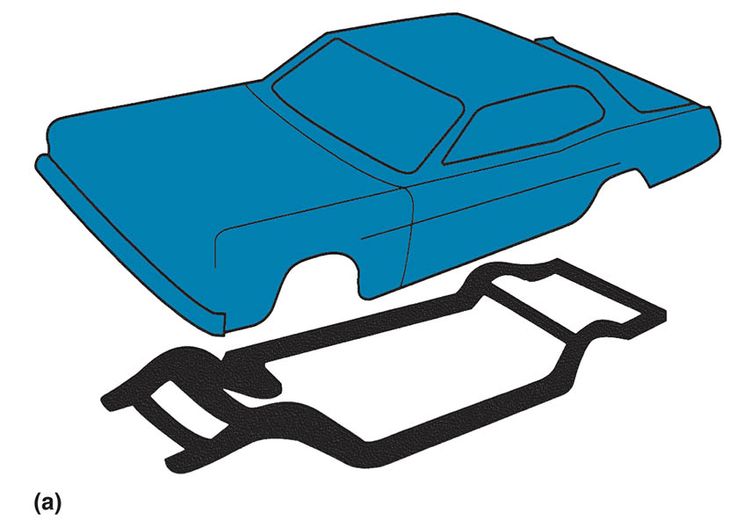
Figure 116.3 (a) Separate body and frame construction

Slide 10
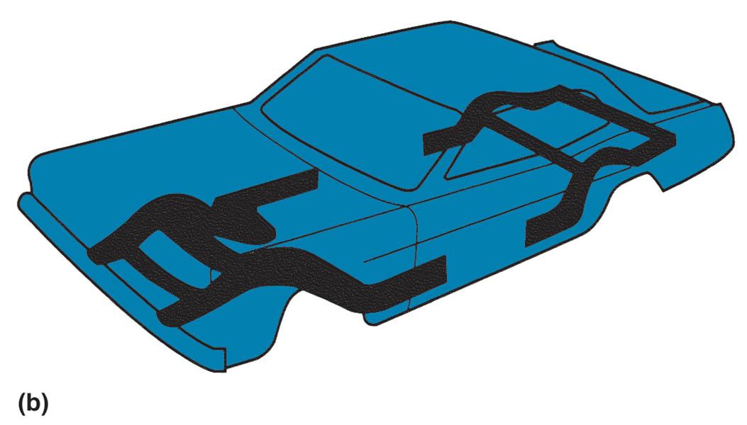
Figure 116.3 (b) unitized construction: the small frame members are for support of the engine and suspension components. Many vehicles attach the suspension components directly to the reinforced sections of the body and do not require the rear frame section.

Slide 11
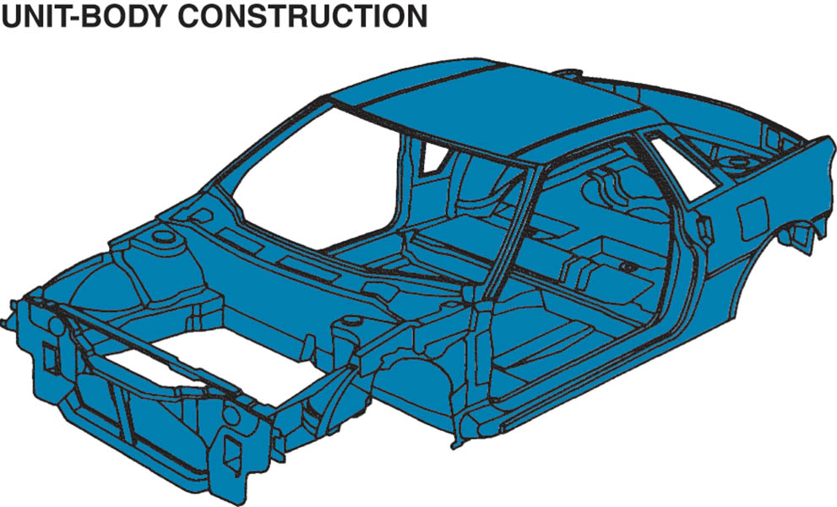
Figure 116.4 Welded metal sections create a platform that combines the body with the frame using unit-body construction.

Slide 12
PLATFORMS
Terminology
  The platform of any vehicle is its basic size and shape.
  Various vehicles of different makes can share the same platform.
Examples of common platforms include the following:
  Chevrolet Impala and Pontiac Grand Prix
  Toyota Camry and Lexus ES 350
  Buick Lucerne and Cadillac DTS

Slide 13
UNSPRUNG WEIGHT
Unsprung weight is anything that allows the wheel to move up and down.
For best handling and ride, the unsprung weight should be kept as low as possible.

Slide 14
TYPES OF SUSPENSIONS
Early suspension systems used a solid axle for front and rear wheels.
Most vehicles today use an independent suspension.
A suspension spring serves two purpose:
  Acts as a buffer between the suspension and frame.
  Each spring transfers part of the vehicle weight to the suspension component it rests on

Slide 15
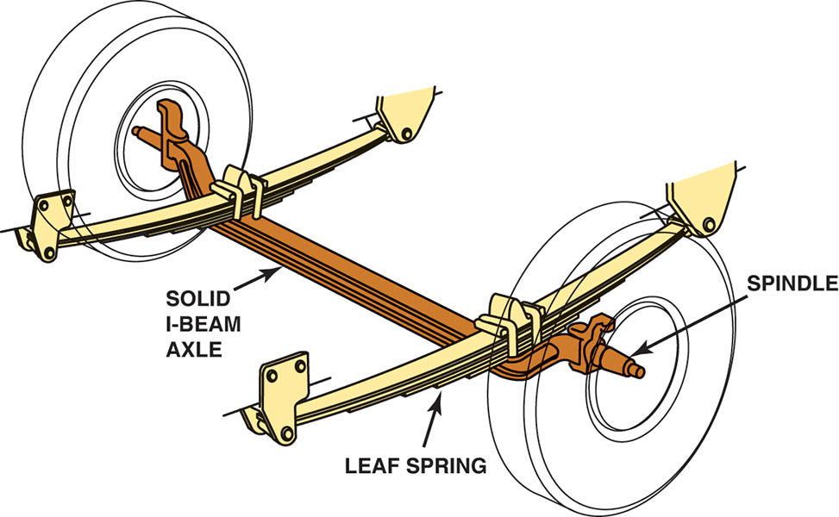
Figure 116.5 Solid I-beam axle with leaf springs

Slide 16
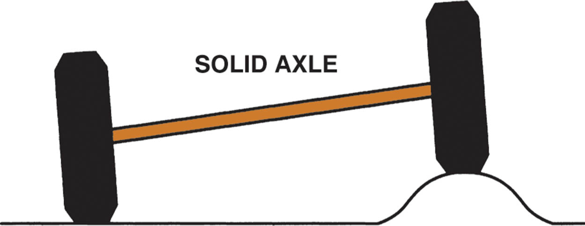
Figure 116.6 When one wheel hits a bump or drops into a hole, both left and right wheels are moved. Because both wheels are affected, the ride is often harsh and feels stiff

Slide 17
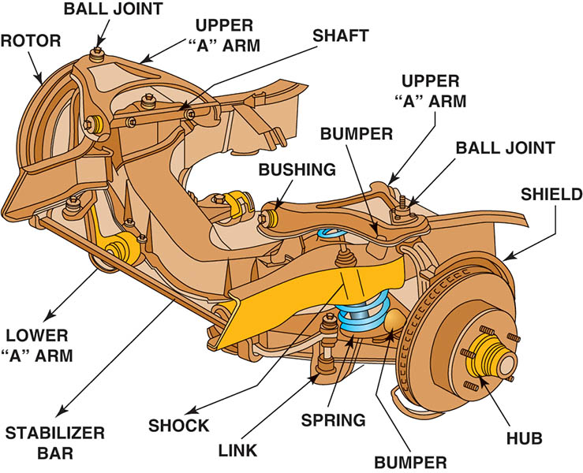
Figure 116.7 A typical independent front suspension used on a rear-wheel-drive vehicle. Each wheel can hit a bump or hole in the road independently without affecting the opposite wheel

Slide 18
HOOKE’S LAW
Definition
  The deflection (movement or deformation) of a spring is directly proportional to the applied force.
  What this means is that when a coil spring, for example, is depressed 1 inch by a weight of 400 pounds, it has a spring rate (K) of 400 Lbs. per inch.
  The higher the spring rate (K), the stiffer the spring.

Slide 19
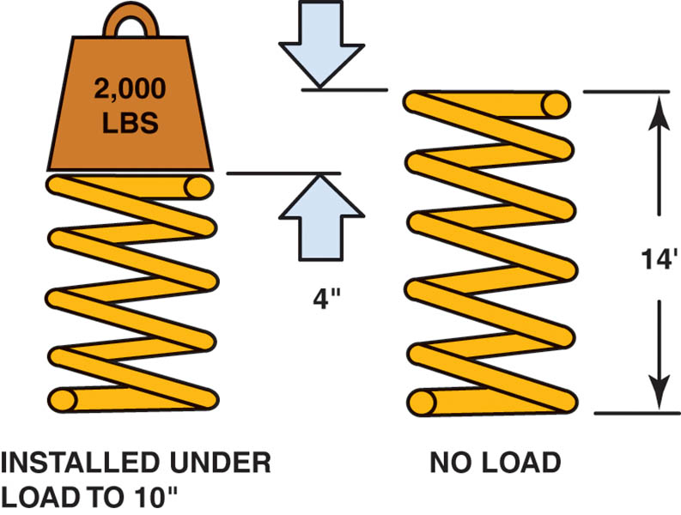
Figure 116.8 This spring was depressed 4 inch due to a weight of 2,000 lb. This means that this spring has a spring rate (K) of 500 lb per inch (2,000 ÷ 4 in. = 500 lb./in.)

Slide 20
QUESTION 1: ?
What does Hooke’s Law state?

Slide 21
ANSWER 1:
  The deflection (movement or deformation) of a spring is directly proportional to the applied force.

Slide 22
COIL SPRINGS (1 OF 4)
Terminology
  Coil springs are made of special round spring steel wrapped in a helix shape.
The strength and handling characteristics of a coil spring depend on the following:
  Coil diameter
  Number of coils
  Height of spring
  Diameter of the steel coil that forms the spring.

Slide 23
COIL SPRINGS (2 OF 4)
Spring Rate
  Spring rate, also called deflection rate, is a value that reflects how much weight it takes to compress a spring a certain amount.
Spring Frequency
  Spring frequency is a value that reflects the speed at which a spring oscillates, or bounces, after it is released from compression or extension.
  Frequency is typically measured in cycles per second (CPS) or hertz (Hz).

Slide 24
COIL SPRINGS (3 OF 4)
Wheel Rate
  Depending on the suspension design, springs are installed a certain distance away from the wheel, which determines the ratio of wheel travel to spring travel, or wheel rate.
Coil Spring Mounting
  Coil springs are usually installed in a spring pocket or spring seat.
  Hard rubber or plastic cushions or insulators are usually mounted between the coil spring and the spring seat

Slide 25
COIL SPRINGS (4 OF 4)
Spring Coatings
  All springs are painted or coated with epoxy to help prevent breakage.
  A scratch, nick, or pit caused by corrosion can cause a stress riser that can lead to spring failure.

Slide 26
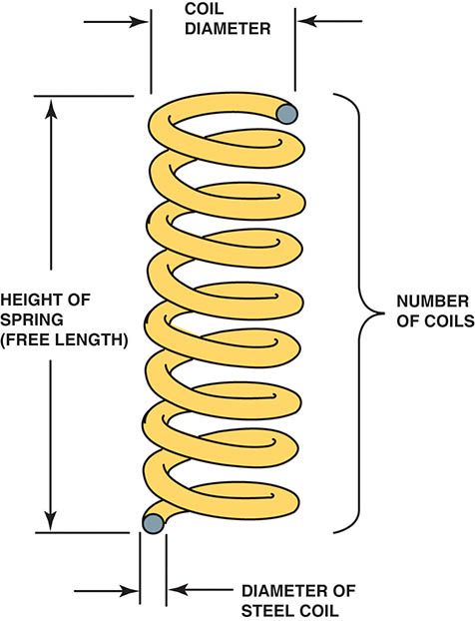
Figure 116.9 The spring rate of a coil spring is determined by the diameter of the spring and the diameter of the steel used in its construction, plus the number of coils and the free length (height)

Slide 27
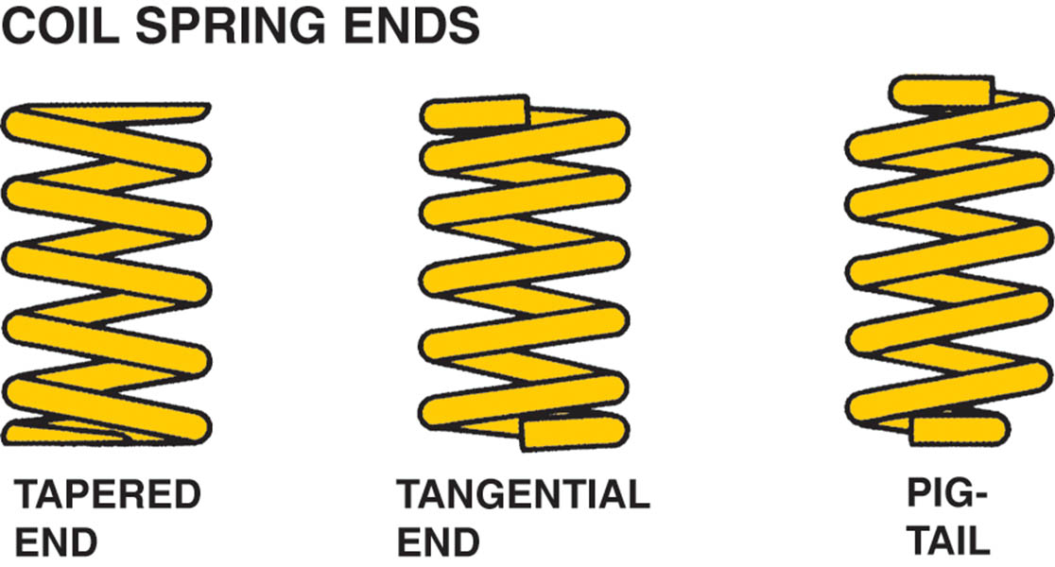
Figure 116.10 Coil spring ends are shaped to fit the needs of a variety of suspension designs

Slide 28
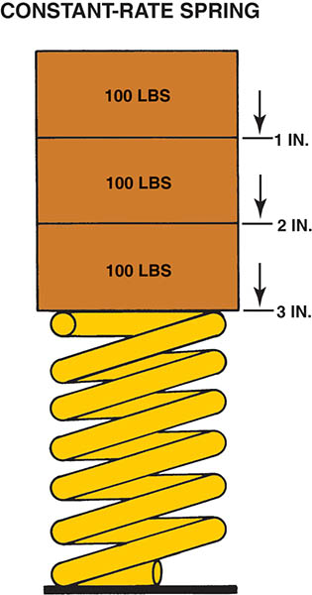
Figure 116.11 A constant-rate spring compresses at the same rate regardless of the amount of weight that is applied

Slide 29
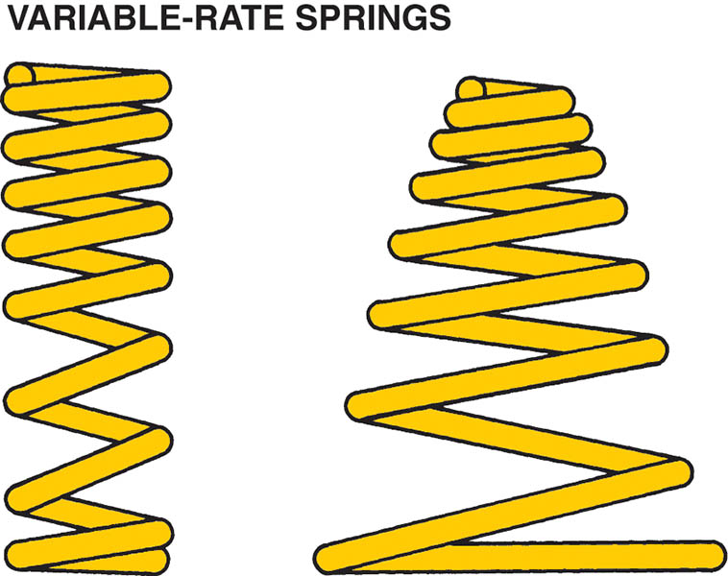
Figure 116.12 Variable-rate springs come in a variety of shapes and compress more slowly as weight is applied

Slide 30
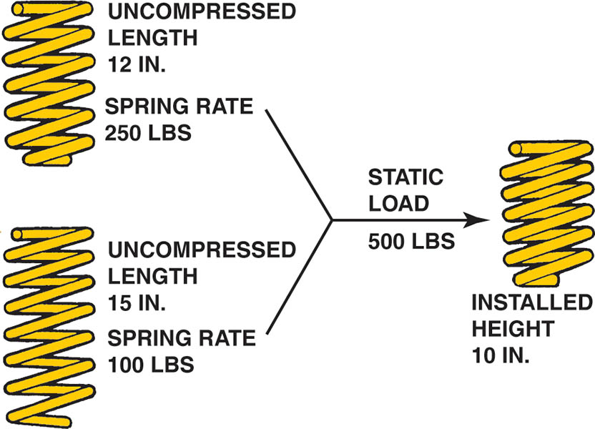
Figure 116.13 Two springs, each with a different spring rate and length, can provide the same ride height even though the higher rate spring will give a stiffer ride

Slide 31
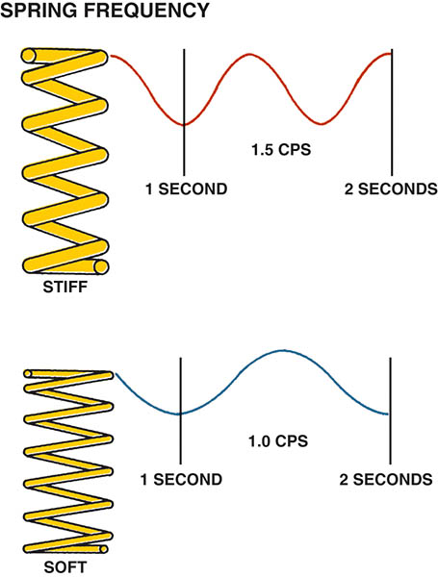
Figure 116.14 Stiffer springs bounce at a higher frequency than softer springs

Slide 32
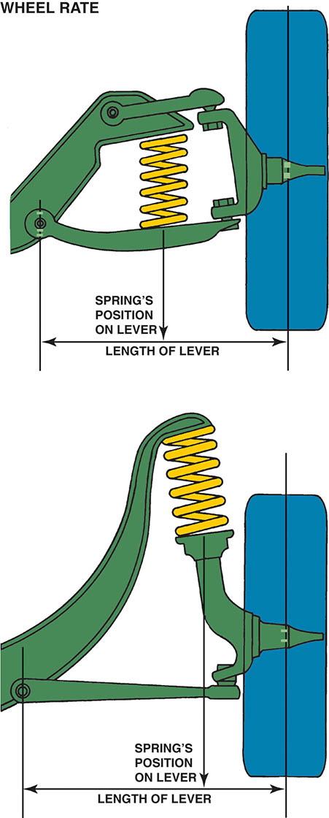
Figure 116.15 The wheel and arm act as a lever to compress the spring. The spring used on the top picture must be stiffer than the spring used on the strut-type suspension shown on the bottom because the length of the lever arm is shorter

Slide 33
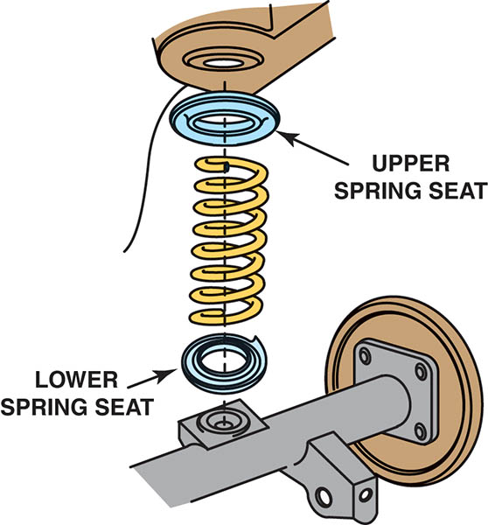
Figure 116.16 The spring cushion helps isolate noise and vibration from being transferred to the passenger compartment

Slide 34
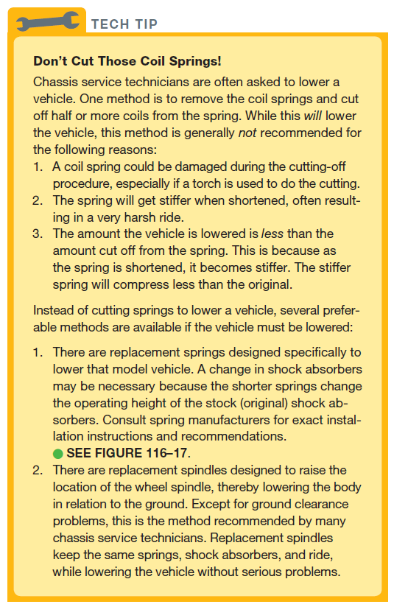
Tech Tip

Slide 35
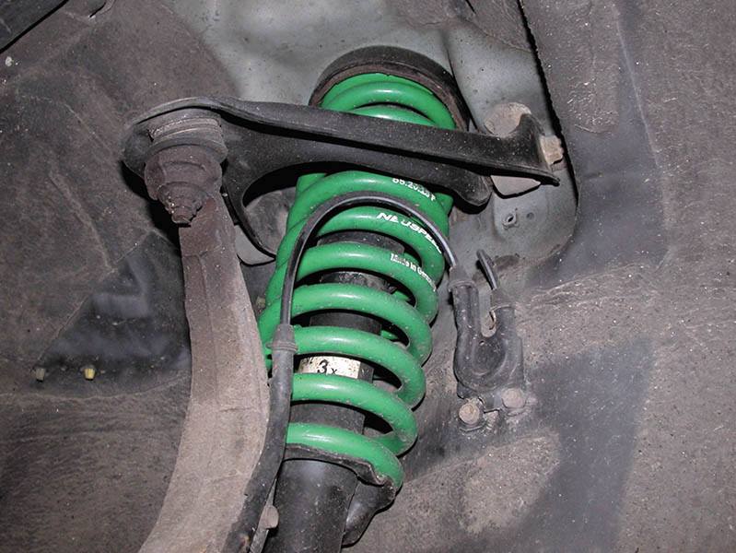
Figure 116.17 This replacement coil spring is coated to prevent rust and corrosion and colored to help identify the spring and/or spring manufacturer

Slide 36
LEAF SPRINGS (1 OF 2)
Terminology
  Leaf springs are constructed of one or more strips of long, narrow spring steel.
  The ends of the spring are rolled or looped to form eyes.
  The leaves are held together by a center bolt, also called a centering pin.
  One end of a leaf spring is mounted to a hanger with a bolt and rubber bushings directly attached to the frame.
  The other end of the leaf spring is attached to the frame with movable mounting hangers called shackles.

Slide 37
LEAF SPRINGS (2 OF 2)
Composite Leaf Springs
  A composite leaf spring is a fiberglass–reinforced epoxy plastic composite leaf spring that has been used on production vehicles since the early 1980s.
Leaf spring rate increases when the thickness increases and decreases as the length increases.

Slide 38
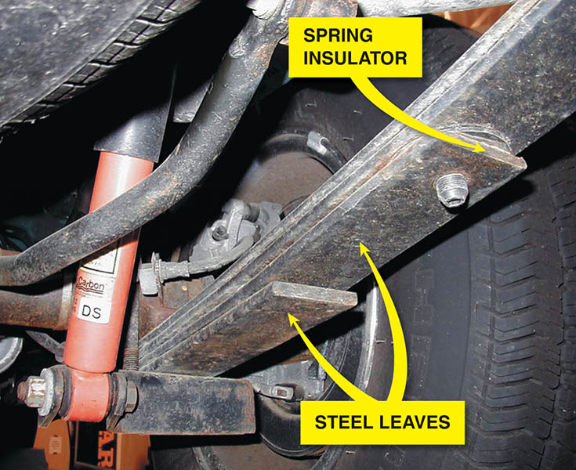
Figure 116.18 A typical leaf spring used on the rear of a pickup truck showing the plastic insulator between the leaves, which allows the spring to move without creating wear or noise

Slide 39
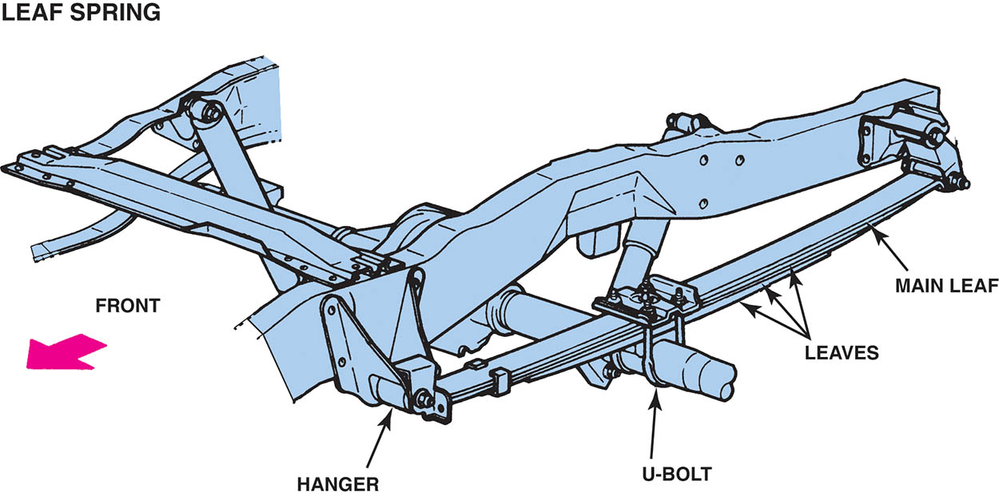
Figure 116.19 A typical leaf spring installation. The longest leaf, called the main leaf, attaches to the frame through a shackle and a hanger

Slide 40
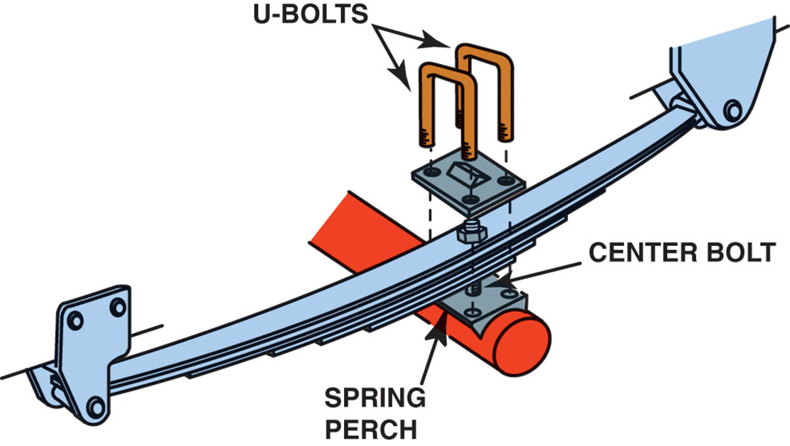
Figure 116.20 All multileaf springs use a center bolt to not only hold the leaves together but also help retain the leaf spring in the center of the spring perch

Slide 41
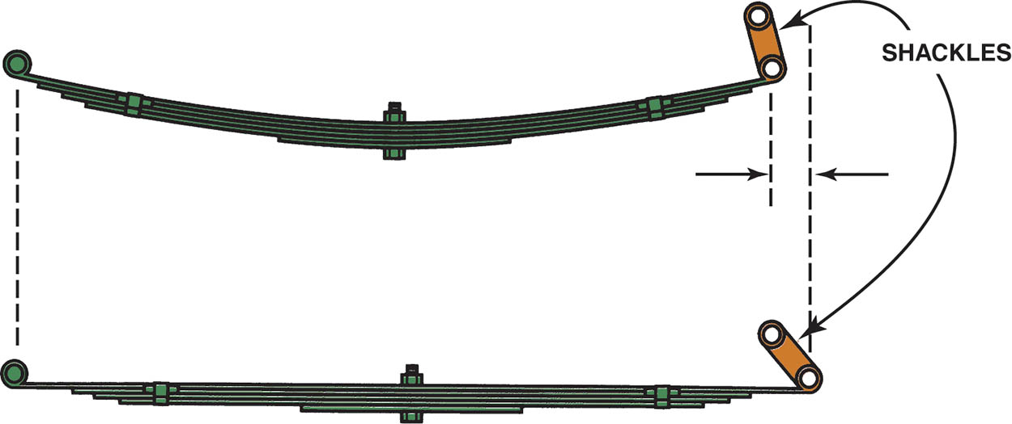
Figure 116.21 When a leaf spring is compressed, the spring flattens and becomes longer. The shackles allow for this lengthening. Rubber bushings are used in the ends of the spring and shackles to help isolate road noise from traveling into the passenger compartment

Slide 42
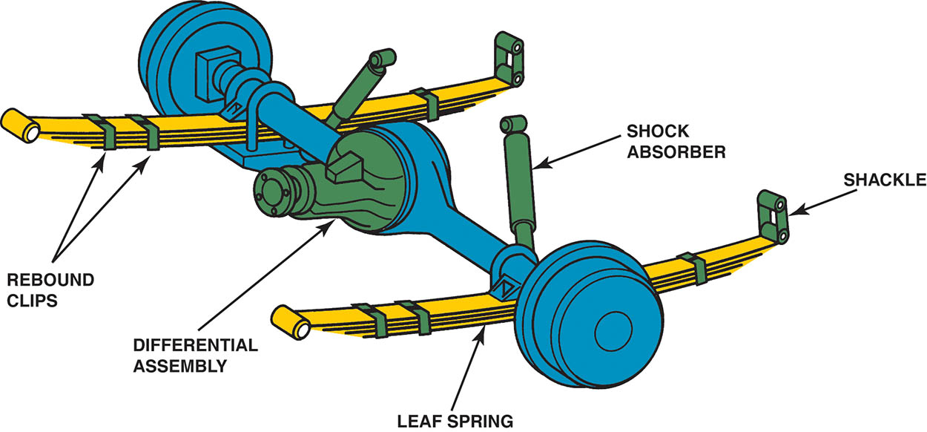
Figure 116.22 Typical rear leaf–spring suspension of a rear-wheel-drive vehicle

Slide 43
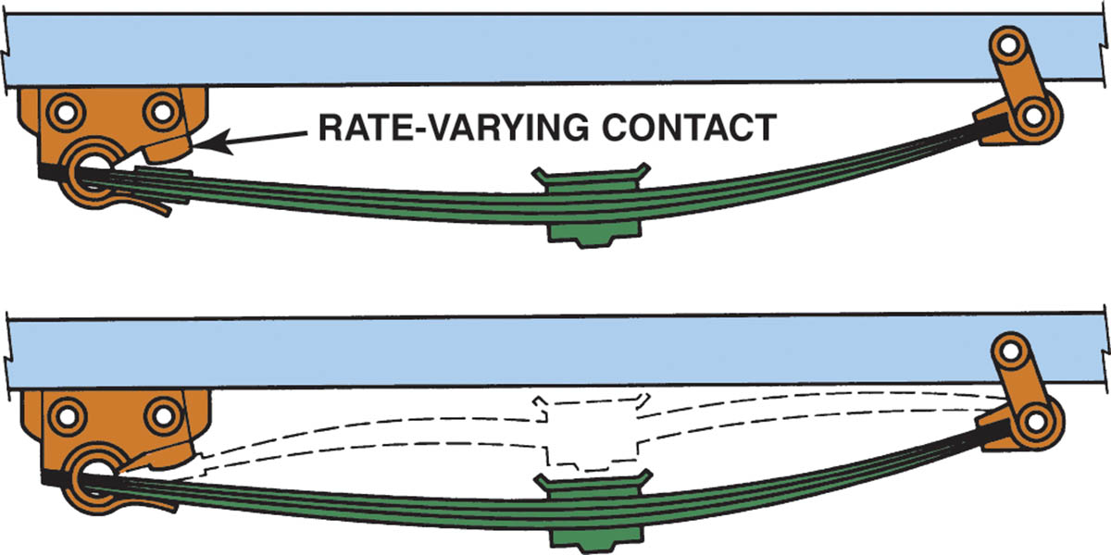
Figure 116.23 As the vehicle is loaded, the leaf spring contacts a section of the frame. This shortens the effective length of the spring, which makes it stiffer

Slide 44
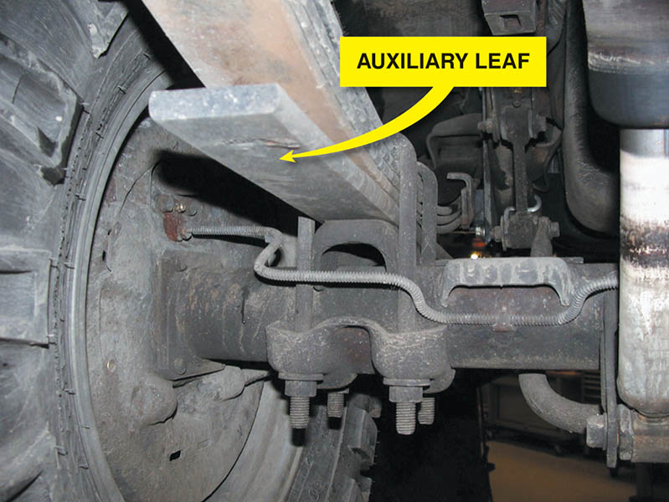
Figure 116.24 Many pickup trucks, vans, and sport-utility vehicles (SUVs) use auxiliary leaf springs that contact the other leaves when the load is increased

Slide 45
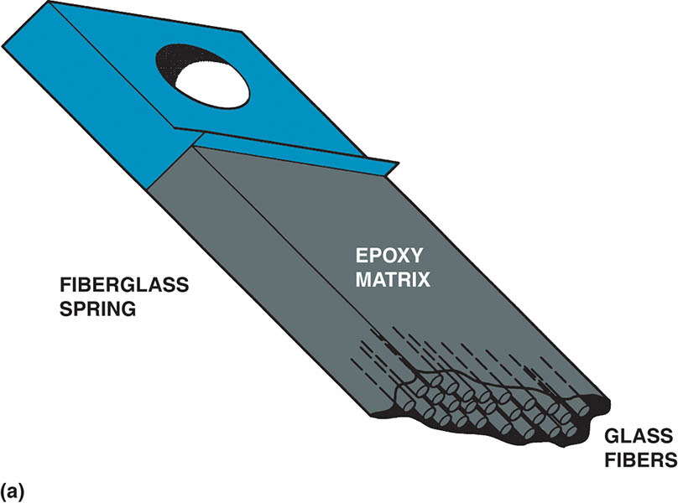
Figure 116.25 (a) A fiberglass spring is composed of long fibers locked together in an epoxy (resin) matrix

Slide 46
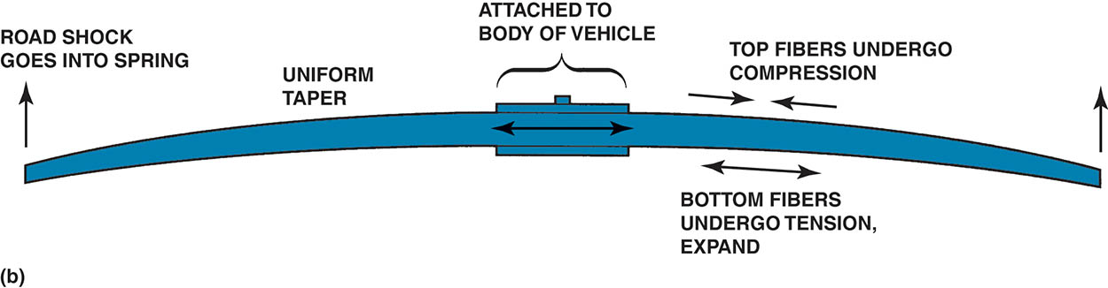
Figure 116.25 (b) When the spring compresses, the bottom of the spring expands and the top compresses. Composite leaf springs are used and mounted transversely (side to side) on Chevrolet Corvettes and at the rear on some other General Motors vehicles

Slide 47
TORSION BARS
Terminology
  A torsion bar is a spring that is a long, round, hardened steel bar similar to a coil spring except that it is a straight bar.
  One end is attached to the lower control arm of a front suspension and the other end to the frame.
  Unlike other types of springs, torsion bars may be adjustable for correct ride height.

Slide 48
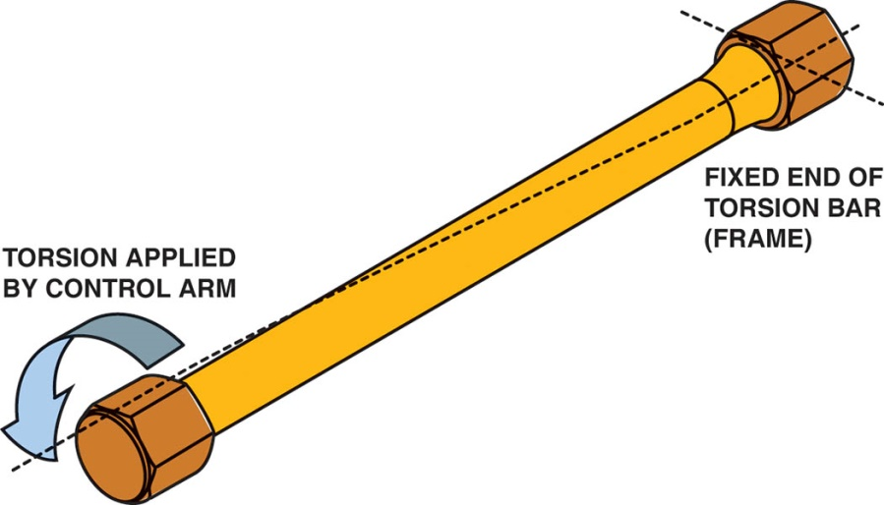
Figure 116.26 A torsion bar resists twisting and is used as a spring on some cars and many four-wheel-drive pickup trucks and sport-utility vehicles. The larger the diameter, or the shorter the torsion bar, the stiffer the bar.

Slide 49
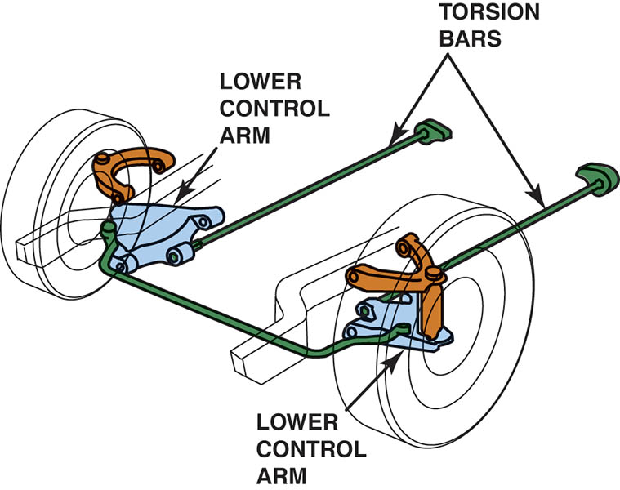
Figure 116.27 Longitudinal torsion bars attach at the lower control arm at the front and at the frame at the rear of the bar

Slide 50
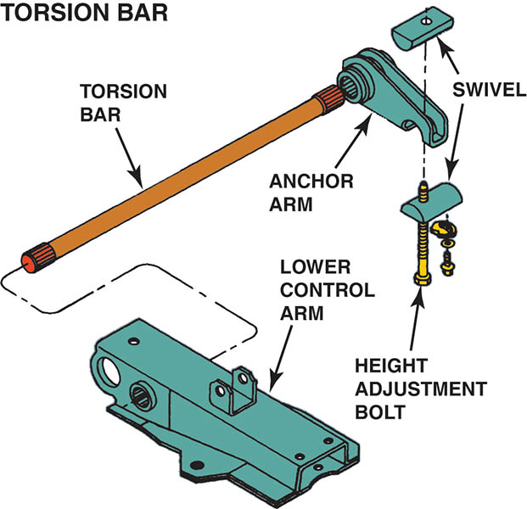
Figure 116.28 One end of the torsion bar attaches to the lower control arm and the other to an anchor arm that is adjustable

Slide 51
SUSPENSION PRINCIPLES
All suspensions must provide for the following supports:
  Transverse (or side-to-side) wheel support.
  Longitudinal (front-to-back) wheel support.
Two very important design factors are called anti-squat and anti-dive.
  Anti-squat refers to the reaction of the body of a vehicle during acceleration.
  Anti-dive refers to the force that causes the front of the vehicle to drop down while braking.

Slide 52
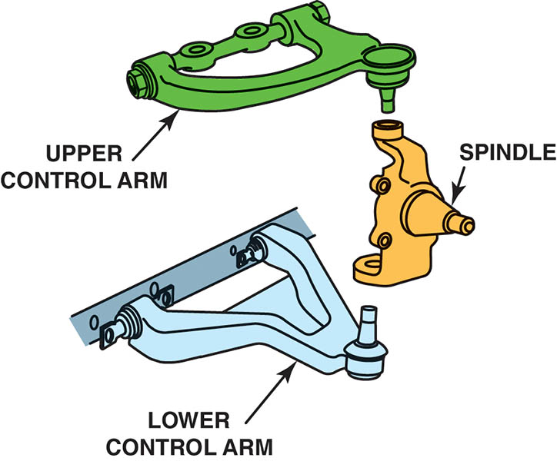
Figure 116.29 The spindle supports the wheels and attaches to the control arm with ball-and-socket joints called ball joints. The control arm attaches to the frame of the vehicle through rubber bushings to help isolate noise and vibration between the road and the body

Slide 53
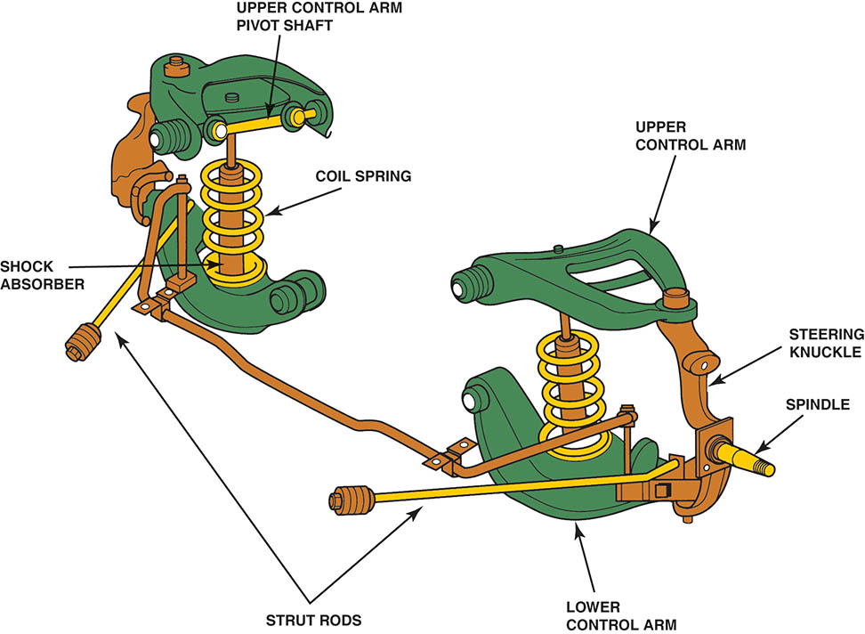
Figure 116.30 The strut rods provide longitudinal support to the suspension to prevent forward or rearward movement of the control arms

Slide 54
STEERING KNUCKLES
Purpose and Function
  A knuckle serves two purposes:
    To join the suspension to the wheel
    Usually includes the spindle where the front wheel bearings are attached
    To provide pivot points between the suspension and wheel
  Knuckles are used with independent suspensions and at the wheels that steer the vehicle.
  The only knuckle that uses a kingpin is a steering knuckle on an I-beam or twin I-beam front suspension.

Slide 55
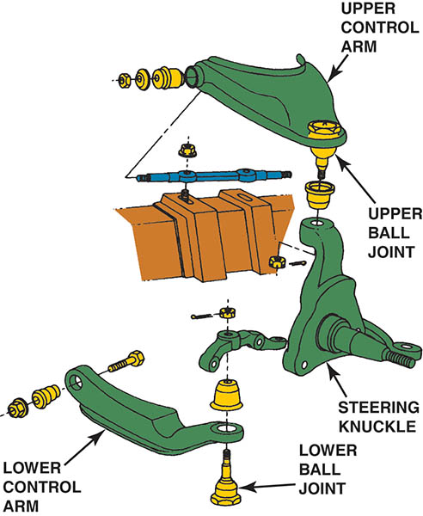
Figure 116.31 The steering knuckle used on a short/long-arm front suspension

Slide 56
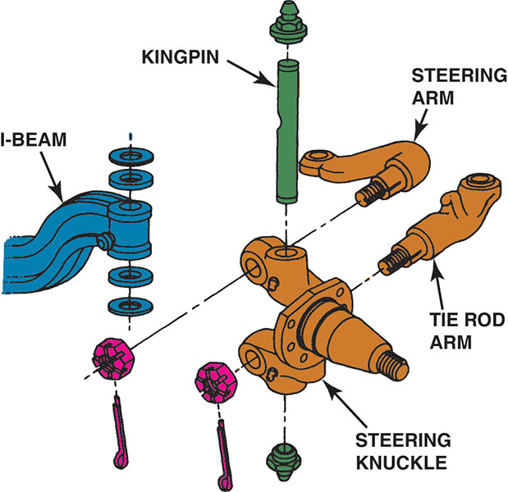
Figure 116.32 A kingpin is a steel shaft or pin that joins the steering knuckle to the suspension and allows the steering knuckle to pivot

Slide 57
CONTROL ARMS
Purpose and Function
  A control arm is a suspension link that connects a knuckle or wheel flange to the frame.
  One end of a control arm attaches to the knuckle or wheel flange, generally with either a ball joint or bushing.
  The opposite end of the arm, which attaches to a frame member, usually pivots on a bushing.

Slide 58
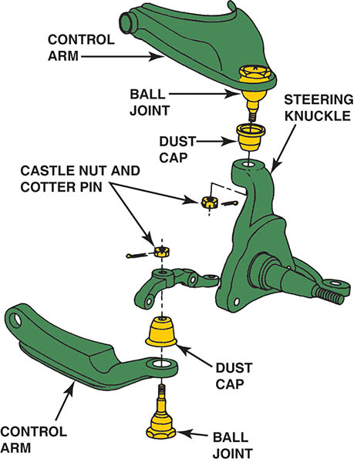
Figure 116.33 Control arms are used to connect the steering knuckle to the frame or body of the vehicle and provide the structural support for the suspension system

Slide 59
BALL JOINTS
Purpose and Function
  Ball joints are actually ball-and-socket joints.
  Ball joints allow the front wheels to move up and down, as well as side to side (for steering)
Ball Joint Design
  Compression loaded; The ball joint is compressed into the control arm by the weight of the vehicle.
  Tension loaded; The weight of the vehicle tends to pull the ball joint back into the control arm by tension.

Slide 60
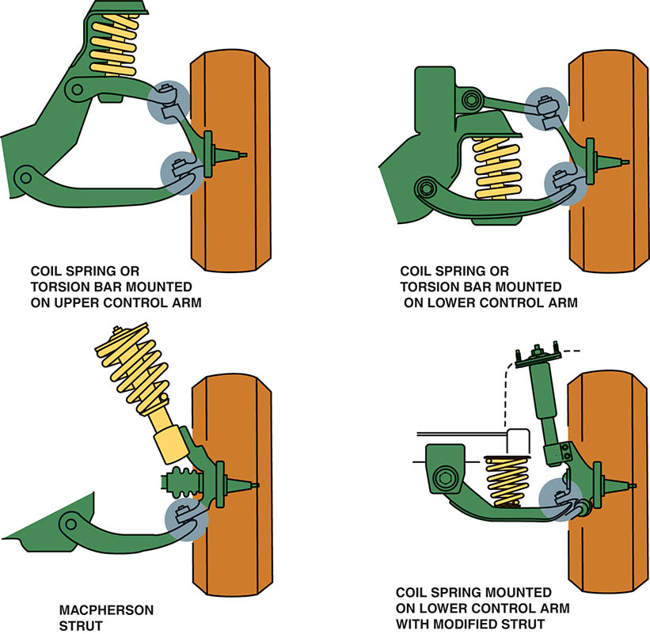
Figure 116.34 Ball joints provide the freedom of movement necessary for steering and suspension movements

Slide 61
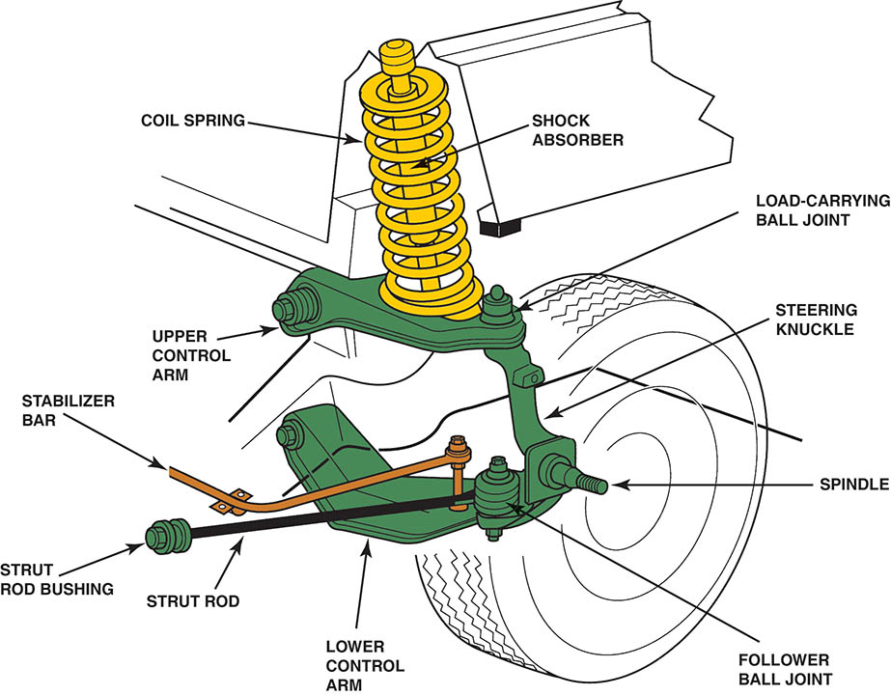
Figure 116.35 The upper ball joint is load carrying in this type of suspension because the weight of the vehicle is applied through the spring, upper control arm, and ball joint to the wheel. The lower control arm is a lateral link, and the lower ball joint is called a follower ball joint

Slide 62
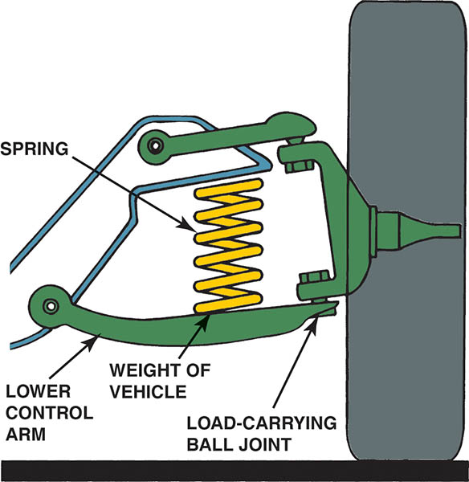
Figure 116.36 The lower ball joint is load carrying in this type of suspension because the weight of the vehicle is applied through the spring, lower control arm, and ball joint to the wheel

Slide 63
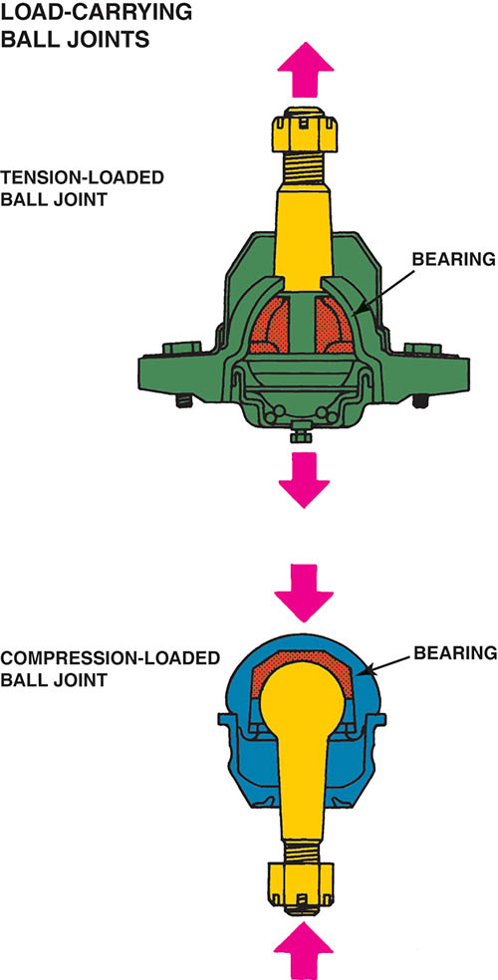
Figure 116.37 All ball joints, whether tension or compression loaded, have a bearing surface between the ball stud and socket

Slide 64
QUESTION 2: ?
What are the designs of ball joint?

Slide 65
ANSWER 2:
Tension loaded and compression loaded.

Slide 66
STRUT RODS
Purpose and Function
  The purpose of the strut rods is to provide forward/backward support to the control arms.
Strut rods are also called tension or compression rods or simply TC rods.
  Tension rods attach in front of the wheels to the body or frame.
  Compression rods attach to the body or frame behind the wheels.

Slide 67
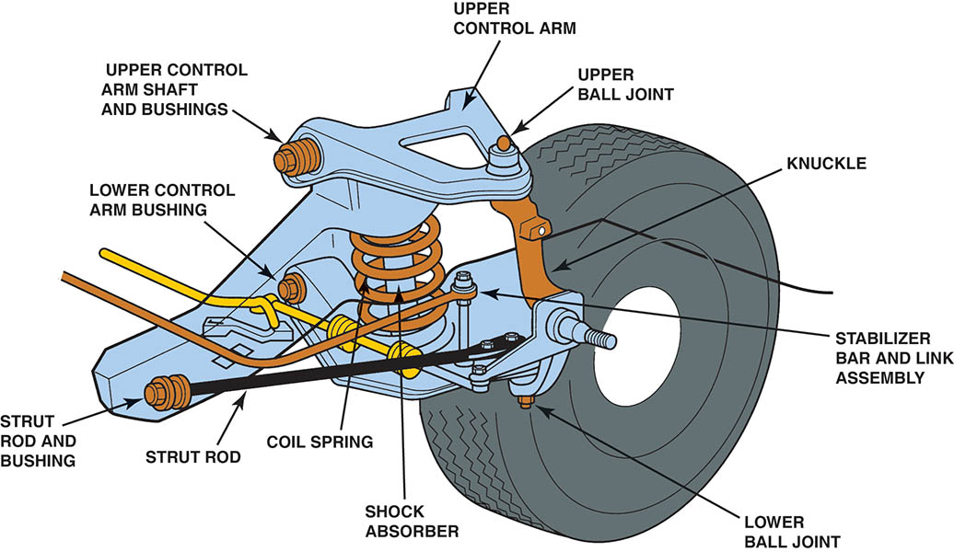
Figure 116.38 A strut rod is the longitudinal support to prevent front-to-back wheel movement. Struts rods are used when there is only one lower control arm bushing and not used where there are two lower control arm bushings

Slide 68
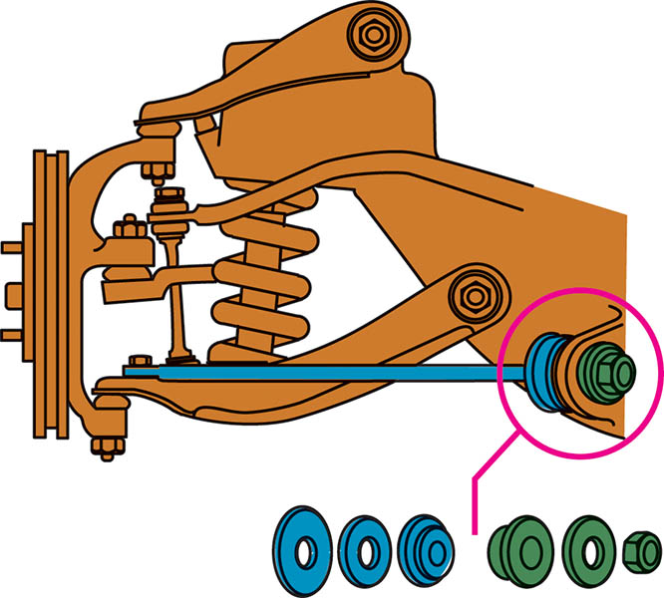
Figure 116.39 Strut rod bushings insulate the steel bar from the vehicle frame or body

Slide 69
STABILIZER BARS
Purpose and Function
  A stabilizer bar is also called an anti-sway bar (sway bar) or anti-roll bar (roll bar).
  A stabilizer bar operates by twisting the bar if one side of the vehicle moves up or down in relation to the other side, such as during cornering, hitting bumps, or driving over uneven road surfaces.
  The purpose of the stabilizer bar is to prevent excessive body roll while cornering and to add stability while driving over rough road surfaces.

Slide 70
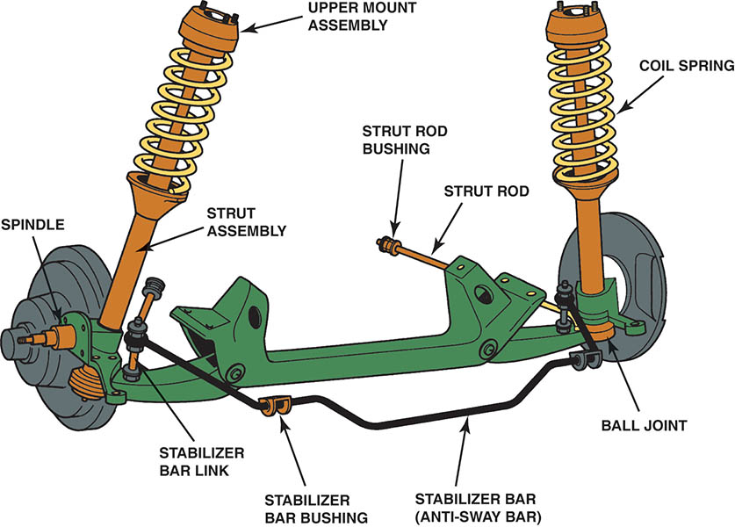
Figure 116.40 Typical stabilizer bar installation

Slide 71
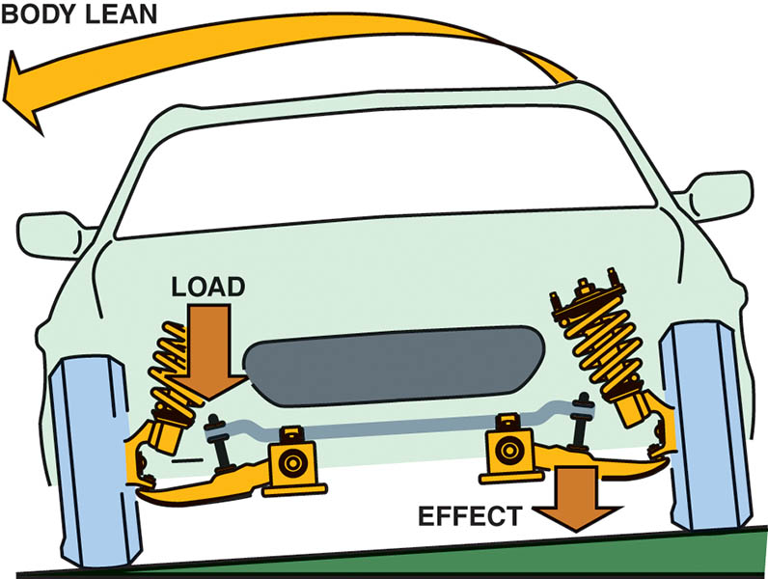
Figure 116.41 As the body of the vehicle leans, the stabilizer bar is twisted. The force exerted by the stabilizer bar counteracts the body lean

Slide 72
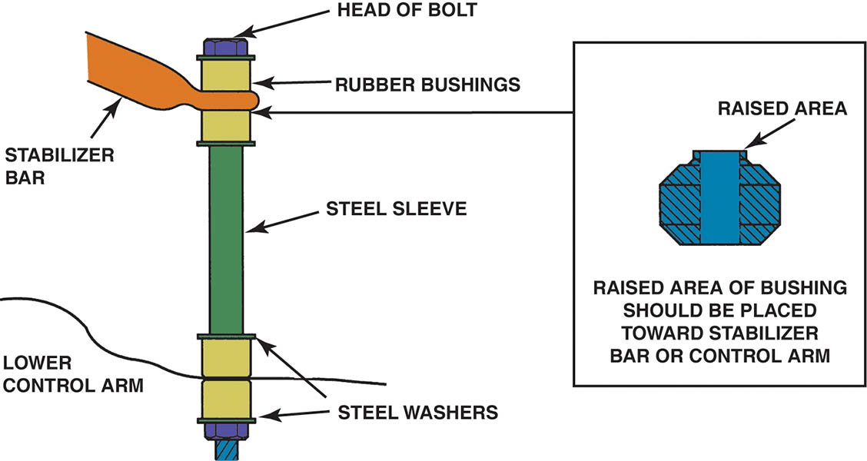
Figure 116.42 Stabilizer bar links are sold as a kit consisting of the long bolt with steel sleeve and rubber bushings. Steel washers are used on both sides of the rubber bushings as shown

Slide 73
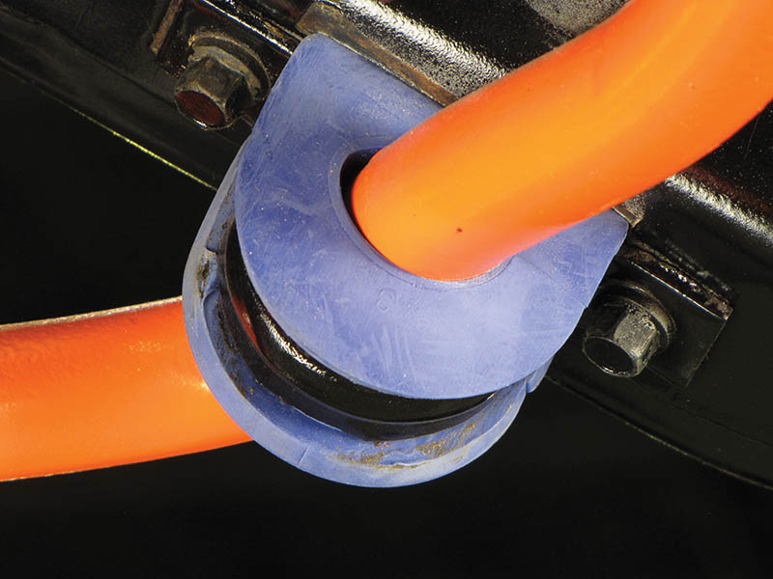
Figure 116.43 A high-performance stabilizer bar that uses a urethane bushing instead of a rubber bushing used in most vehicles. However, the urethane bushing tends to transmit road noise and may be objectionable to some vehicle owners

Slide 74
QUESTION 3: ?
What is the purpose of a stabilizer bar?

Slide 75
ANSWER 3:
To prevent body roll when cornering and to add stability when driving over rough terrain.

Slide 76
SHOCK ABSORBERS (1 OF 3)
Purpose and Function
  Shock absorbers are used on all conventional suspension systems to dampen and control the motion of the vehicle’s springs.
  Most shock absorbers are direct acting because they are connected directly between the vehicle frame or body and the axles.
Shock Absorber Operation
  The hydraulic shock absorber operates on the principle of fluid being forced through a small opening (orifice).

Slide 77
SHOCK ABSORBERS (2 OF 3)
Gas Charged Shocks
  Most shock absorbers on new vehicles are gas charged.
  This pressure helps prevent air pockets from forming in the shock absorber oil as it passes through the small passages in the shock.
Air Shocks/Struts
  Air-inflatable shock absorbers or struts are used in the rear of vehicles to provide proper vehicle ride height while carrying heavy loads.

Slide 78
SHOCK ABSORBERS (3 OF 3)
Air Springs
  A basic air spring consists of a rubber air chamber, generally closed at the bottom by a piston fitted into a control arm, or by a strut shock absorber.
Coil-Over-Shocks
  Coil-over shock absorber uses the force of an external coil spring to boost the performance of the basic shock absorber.

Slide 79
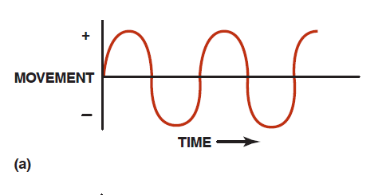
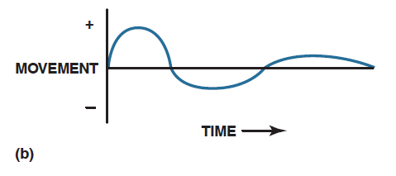
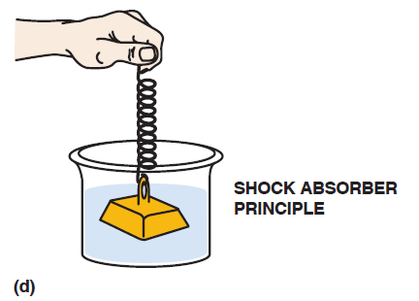

Figure 116.44 (a) Movement of the vehicle is supported by springs without a dampening device. (b) Spring action is dampened with a shock absorber. (c) The function of any shock absorber is to dampen the movement or action of a spring, similar to using a liquid to control the movement of a weight on a spring (d).

Slide 80

Figure 116.45 Shock absorbers work best when mounted as close to the spring as possible. Shock absorbers that are mounted straight up and down offer the most dampening

Slide 81

Figure 116.46 When a vehicle hits a bump in the road, the suspension moves upward. This is called compression or jounce. Rebound is when the spring (coil, torsion bar, or leaf) returns to its original position

Slide 82

Figure 116.47 (a) A cutaway drawing of a typical double-tube shock absorber

Slide 83

Figure 116.47 (b) Notice the position of the intake and compression valve during rebound (extension) and jounce (compression)

Slide 84

Figure 116.48 Oil flow through a deflected disc-type piston valve. The deflecting disc can react rapidly to suspension movement. For example, if a large bump is hit at high speed, the disc can deflect completely and allow the suspension to reach its maximum jounce distance while maintaining a controlled rate of movement

Slide 85

Figure 116.49 Gas-charged shock absorbers are manufactured with a double-tube design similar to conventional shock absorbers and with a single or monotube design

Slide 86

Figure 116.50 A rubber tube forms an inflatable air chamber at the top of an air shock. The higher the air pressure in the chamber, the stiffer the shock

Slide 87

Figure 116.51 (a) The front suspension of a Lincoln with an air-spring suspension

Slide 88

Figure 116.51 (b) Always check in the trunk for the cutoff switch for a vehicle equipped with an air suspension before hoisting or towing the vehicle

Slide 89

Figure 116.52 Some air springs are auxiliary units to the coil spring and are used to control ride height while the coil spring is the weight-bearing unit

Slide 90

Figure 116.53 A coil-over shock is a standard hydraulic shock absorber with a coil spring wrapped around it to increase stiffness and/or take some of the carrying weight off of the springs

Slide 91

FREQUENTLY ASKED QUESTION

Slide 92

Figure 116.54 The shock absorber is on the right and the fluid reservoir for the shock is on the left

Slide 93
STRUTS (1 OF 2)
Purpose and Function
  A strut is a sturdy shock absorber that is also a structural component of the suspension.
Macpherson Struts
  A MacPherson strut includes the suspension spring. A coil spring that surrounds the strut casing so that it transfers the weight of the body to the wheel.
  A bearing on a front-wheel strut allows it to rotate on the vertical steering axis.

Slide 94
STRUTS (2 OF 2)
Modified Struts
  Unlike a MacPherson unit, a modified strut does not include a spring as part of the assembly and is used in the front on some vehicles and on the rear of others.
  Most modified strut rear suspensions use coil springs mounted on the lower control arm.

Slide 95

Figure 116.55 A strut is a structural part of the suspension and includes the spring and shock absorber in one assembly

Slide 96

Figure 116.56 A modified strut used on the rear suspension; it is the structural part of the assembly

Slide 97

Figure 116.57 Suspension bumpers are used on all suspension systems to prevent metal-to-metal contact between the suspension and the frame or body of the vehicle when the suspension “bottoms out” over large bumps or dips in the road

Slide 98
BUMP STOPS
Purpose and Function
  A bump stop is a rubber or foam bumper is used to absorb and isolate the suspension from the frame or body.

Slide 99

Figure 116.58 A bad suspension bumper (strike-out bumper) that was likely caused by a defective shock absorber. Both will require replacement

Slide 100

Copyright

