Slide 1
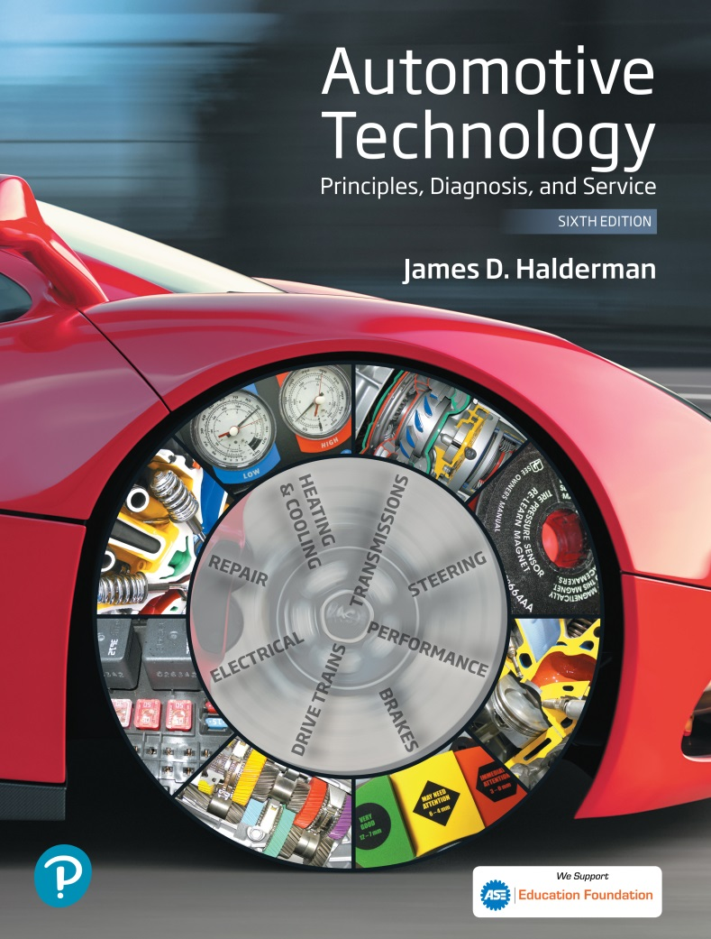
Automotive Technology Principles, Diagnosis, and Service
Sixth Edition
Chapter 115
Tire and Wheel Service
Copyright © 2018, 2015, 2011 Pearson Education, Inc. All Rights Reserved

Slide 2
LEARNING OBJECTIVES (1 of 2)
115.1 State the importance of proper tire inflation.
115.2 Describe tire inspection.
115.3 Describe the correct lug nut removal, tightening procedure, and torque for wheel installation.
115.4 State the purpose of tire rotation.
115.5 Discuss radial runout and lateral runout.

Slide 3
LEARNING OBJECTIVES (2 of 2)
115.6 List the steps for replacing a tire.
115.7 Discuss how to balance wheel and tire assembly (static and dynamic).
115.8 Discuss how to repair tires using internal patch.
115.9 This chapter will help prepare for ASE Suspension and Steering (A4) certification content area “E” (Wheel and Tire Diagnosis and Repair).

Slide 4
TIRE SERVICE AND PROPER INFLATION
Need for Service
Premature wear can often be avoided by checking and performing routine service, such as frequent rotation and monthly inflation checks.
Tire Inflation Pressure
Tires should always be inflated to the pressure indicated on the driver’s door or pillar sticker.
Tires should be checked when cold, before the vehicle has been driven.

Slide 5
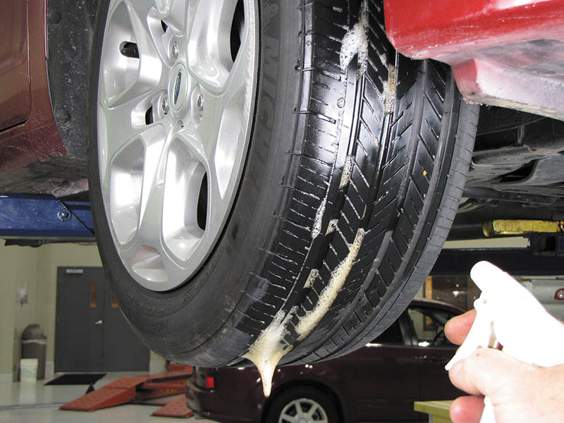
Figure 115.1 Using soapy water from a spray bottle is an easy method to find the location of an air leak from a tire

Slide 6
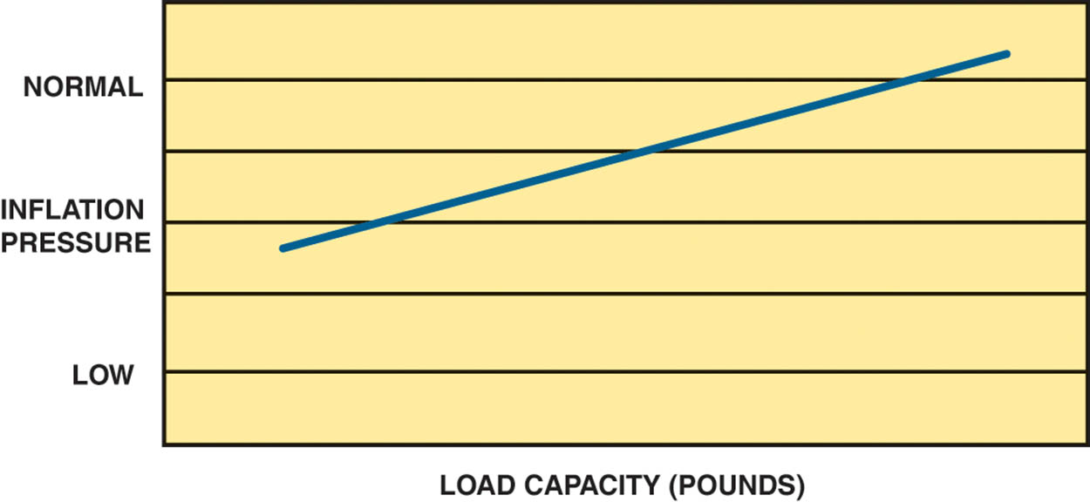
Figure 115.2 Chart showing the relationship between tire inflation pressure and load capacity of the tire

Slide 7
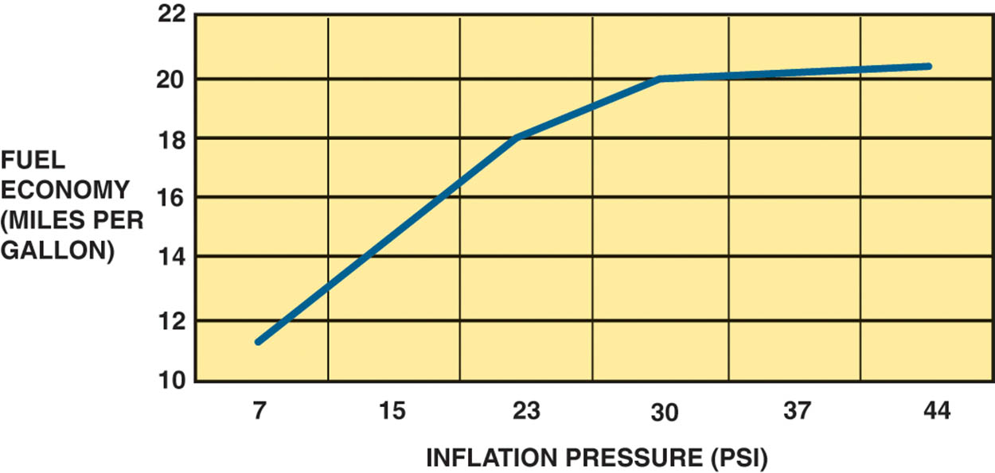
Figure 115.3 Note that a drop in inflation pressure has a major effect on fuel economy

Slide 8
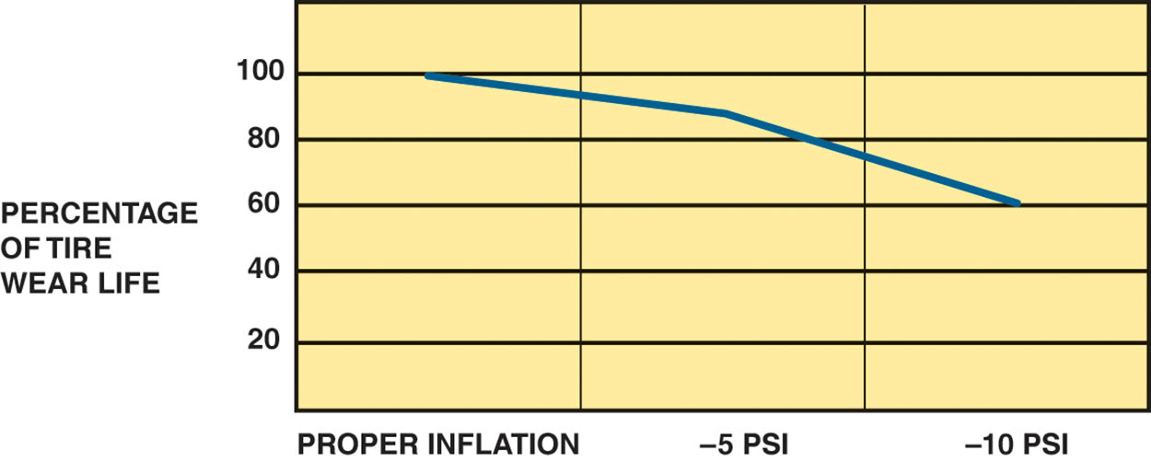
Figure 115.4 Note that if a tire is underinflated by 5 PSI, the life expectancy is reduced by 20% and by about 40% if the inflation pressure is less than specified by 10 PSI.

Slide 9
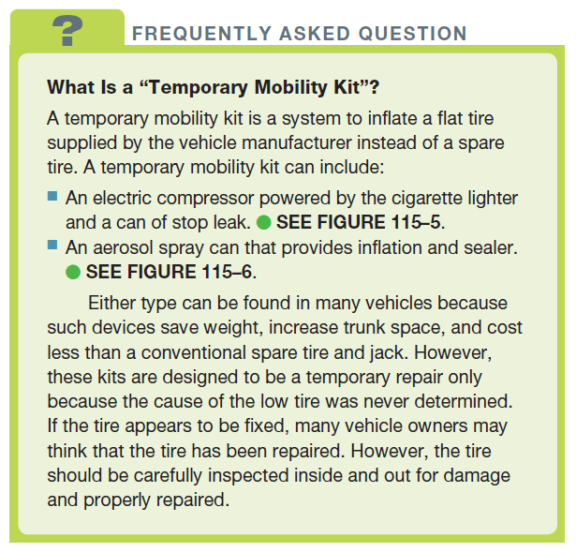
FREQUENTLY ASKED QUESTION

Slide 10
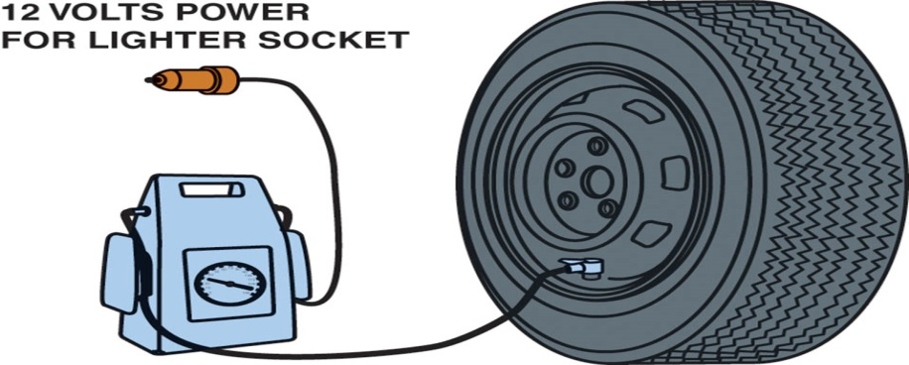
Figure 115.5 A temporary inflation pump that uses 12 volts from the cigarette lighter to inflate the tire

Slide 11
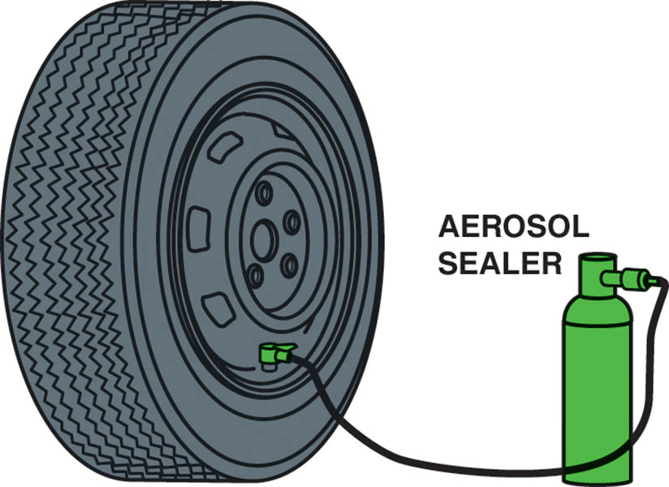
Figure 115.6 Many vehicle manufacturers include an aerosol can of sealer on vehicles that are not equipped with a conventional spare tire

Slide 12
NITROGEN INFLATION
Definition
Air contains about 78% nitrogen, 21% oxygen, and 1% other gases.
Some shops recommend and inflate tires using nitrogen instead of using compressed air.
Reasons to Use Nitrogen
The nitrogen molecule is slightly larger than the oxygen molecule so the tire will not loose pressure as quickly.
Compressed nitrogen contains less moisture than compressed air.
Less oxidation of the inner liner of the tire and the corrosion of the wheel.

Slide 13
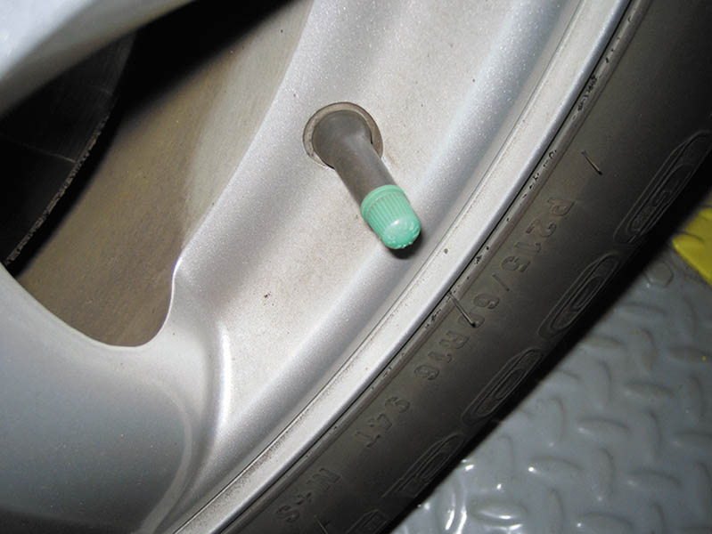
Figure 115.7 Most shops that use nitrogen inflation install a green tire valve cap to let others know that nitrogen, rather than air, has been used to inflate the tire

Slide 14
QUESTION 1: ?
What is the advantage of nitrogen inflation?

Slide 15
ANSWER 1:
Less moisture and corrosion, slower pressure loss, and less oxidation of the inner liner.

Slide 16
TIRE INSPECTION
Visual Inspection
Excessive wear
Sidewall faults
Under inflation (edge wear)
Over inflation (center wear)
Wear as indicated by an alignment issue
Tread Depth
New tires = 11/32 inch
3/32 inch or less—Replace (2/32 inch is the legal limit)

Slide 17
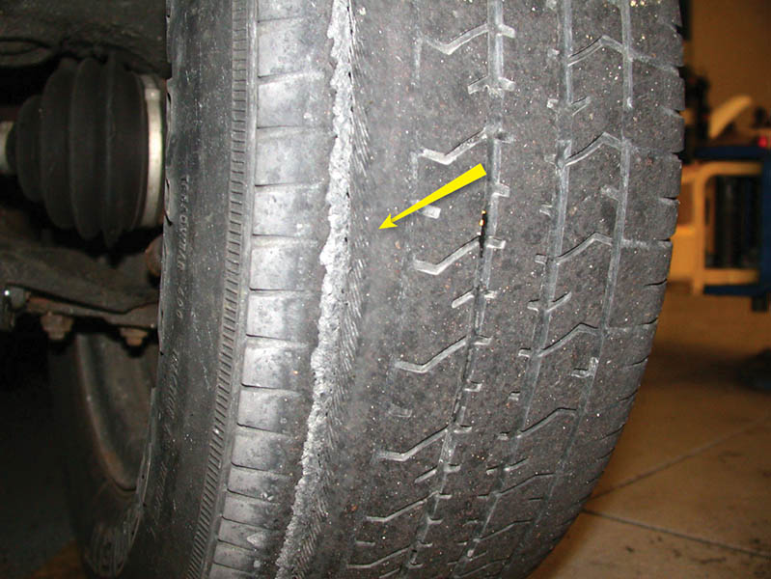
Figure 115.8 Excessively worn tire showing the belt material on the inside edge. This tire requires replacement

Slide 18
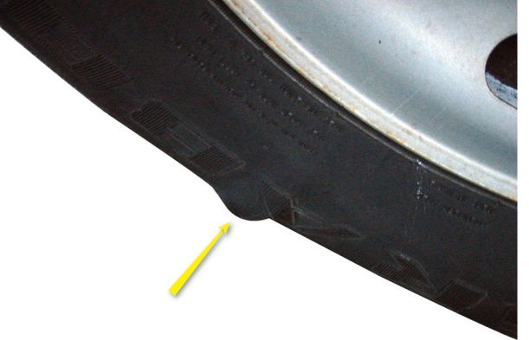
Figure 115.9 A bulge in a tire as a result of either an injury to the sidewall, such as contact with a curb, or an internal fault in the tire. This tire requires replacement

Slide 19
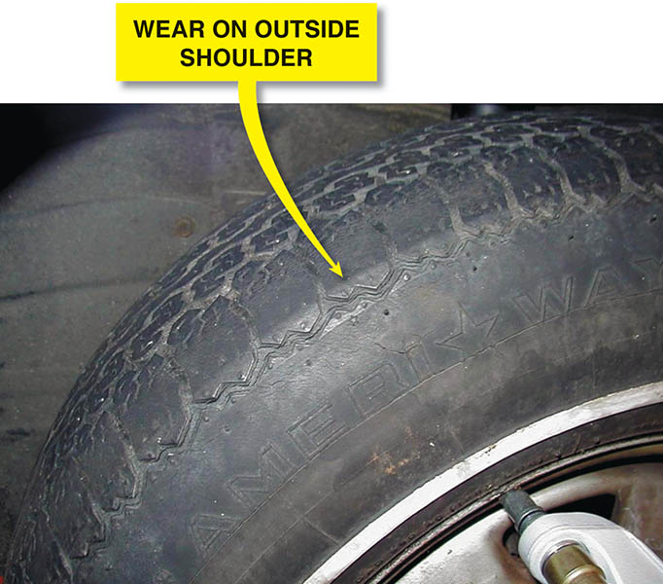
Figure 115.10 Wear on the outside shoulder only is an indication of an alignment problem

Slide 20
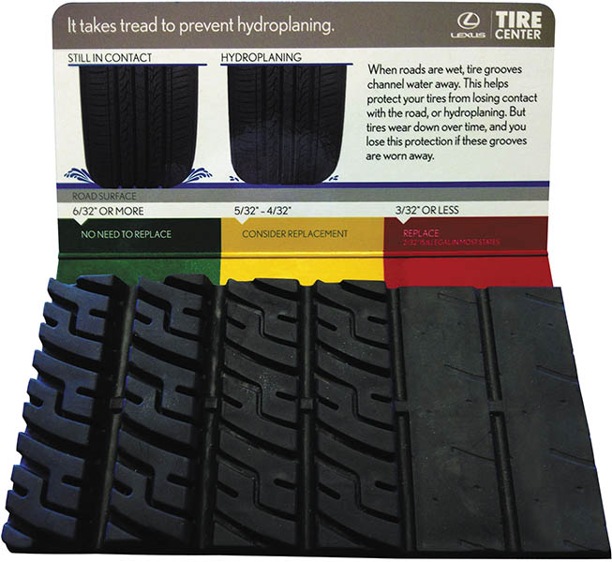
Figure 115.11 A display at a Lexus dealer used to show customers a visual representation of what a tire looks like at various tread depth amounts. This display helps vehicle owners understand tire tread depth measurements

Slide 21
WHEEL REMOVAL/ INSTALLATION (1 OF 3)
Lug Nuts
When removing lug nuts, notice the amount of force needed to remove the nuts.
Always start wheel lug nuts by hand.
Lug Nut Torque
Make certain that the wheel studs are clean and dry.
Torque to the manufacturer’s specifications.

Slide 22
WHEEL REMOVAL/ INSTALLATION (2 OF 3)
Tightening Sequence
Always tighten lug nuts gradually in the proper sequence—star pattern (tighten one nut, skip one, and tighten the next nut).
When removing or installing a locked lug nut, be sure the key is held square to the lug nut to prevent damaging either the nut or the key.

Slide 23
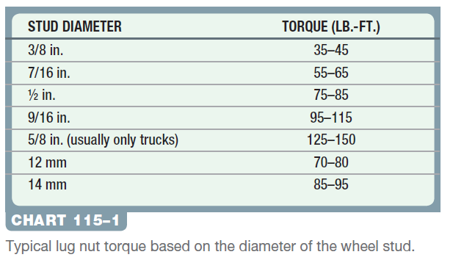
WHEEL REMOVAL/ INSTALLATION (3 OF 3)
Tightening Torque
All vehicle manufacturers recommend that the lug nuts be tightened to factory specifications using a torque wrench.

Slide 24

Figure 115.12 Always tighten wheel lug nuts (or studs) in a star pattern to ensure even pressure on the axle flange, brake rotors or drums, and the wheel itself

Slide 25
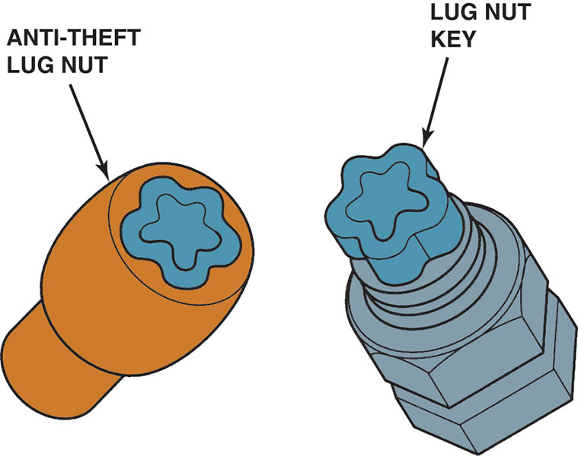
Figure 115.13 Most manufacturers recommend using hand tools rather than an air impact wrench to remove and install locktype lug nuts to prevent damage. If either the key or the nut is damaged, the nut may be very difficult to remove

Slide 26
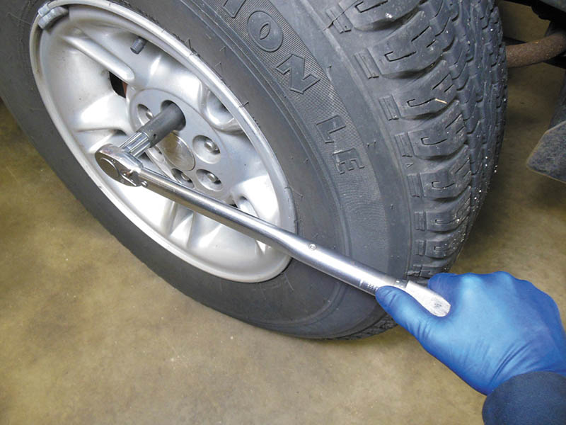
Figure 115.14 A torque wrench being used to tighten lug nuts on a pickup truck

Slide 27
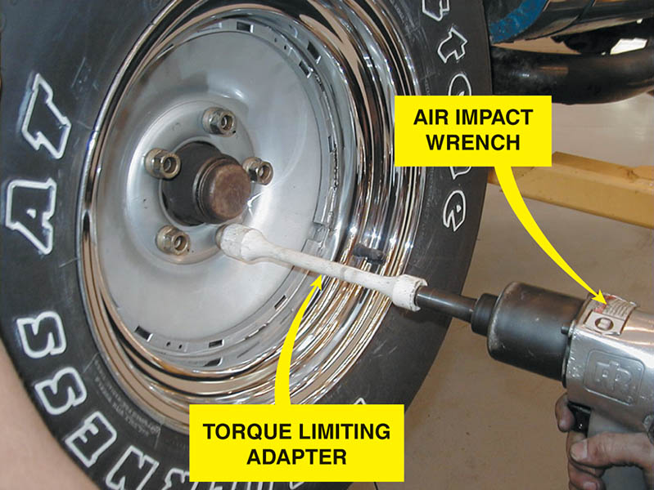
Figure 115.15 A torque-limiting adapter (torque stick) used with an air impact wrench still requires care to prevent overtightening.

Slide 28
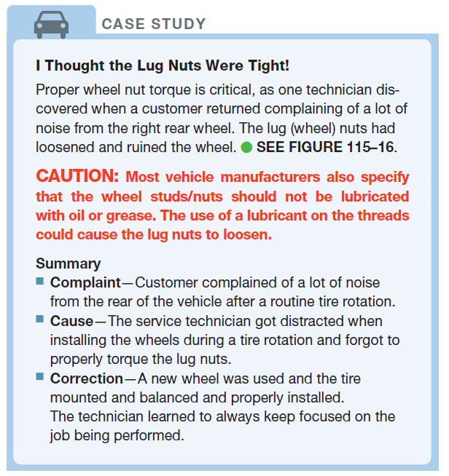
CASE STUDY

Slide 29
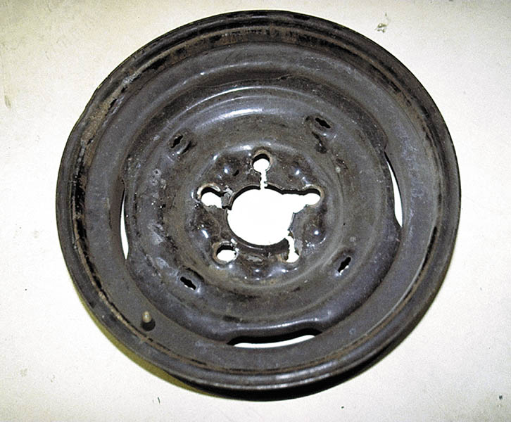
Figure 115.16 This wheel was damaged because the lug nuts were not properly torqued

Slide 30
TIRE ROTATION
Purpose
Tire rotation is essential to ensure long life and even tire wear.
Methods
For best results, tires should be rotated every 6,000 miles or every six months.
Rotate tire position per manufacturers specifications.

Slide 31
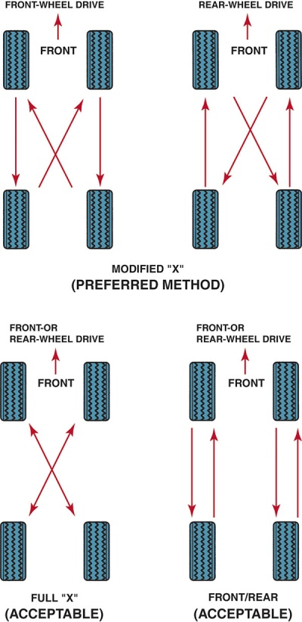
Figure 115.17 The method most often recommended is the modified X method. In this method, each tire eventually is used at each of the four wheel locations.

Slide 32
QUESTION 2: ?
What is the purpose of tire rotation?

Slide 33
ANSWER 2:
To ensure long even tire life.

Slide 34
RADIAL RUNOUT
Why Check
If vibration is felt above 45 mph, regardless of the engine load, the cause is usually due to an out-of-balance or a defective out-of-round tire.
Checking Radial Runout
Place the runout gauge against the tread of the tire in the center of the tread and, while rotating the tire, observe the gauge reading.
Correcting Radial Runout
Match mount or force balance the tire and wheel.

Slide 35
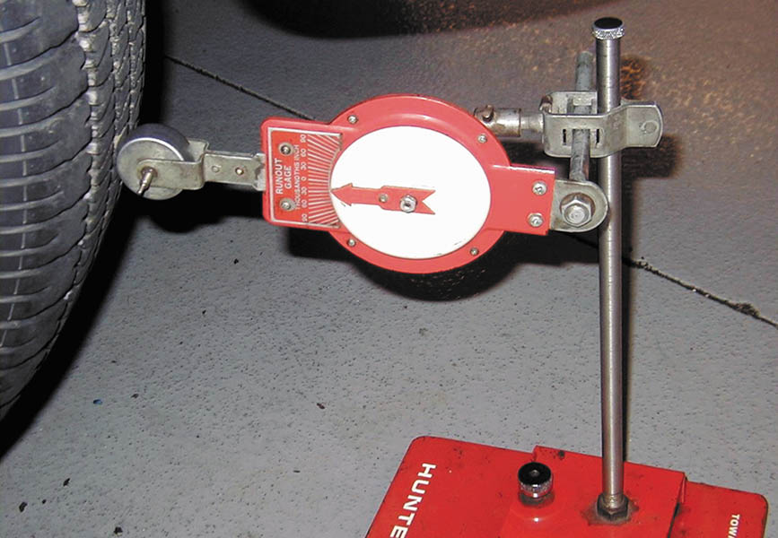
Figure 115.18 A tire runout gauge being used to measure the radial runout of a tire

Slide 36
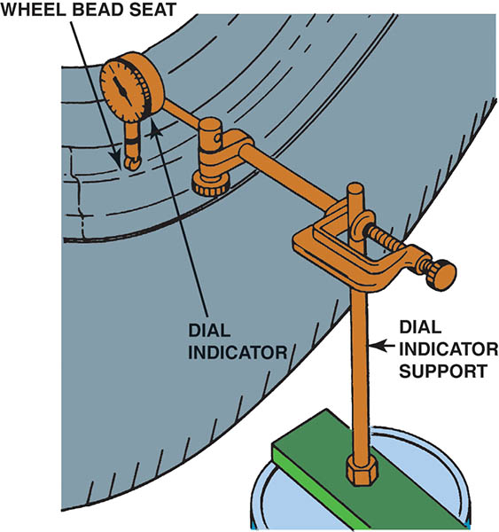
Figure 115.19 To check wheel radial runout, the dial indicator plunger tip rides on a horizontal surface of the wheel, such as the bead seat.

Slide 37
LATERAL RUNOUT
Why Check
A possible problem that tires can cause is a type of vibration called shimmy.
Checking Lateral Runout
This can be checked by using a runout gauge on the side of the tire or wheel.
Correcting Lateral Runout
Damage to tire or wheel
Looseness in the bearing assembly
Mounting surface not clean or wheel not properly torqued.

Slide 38
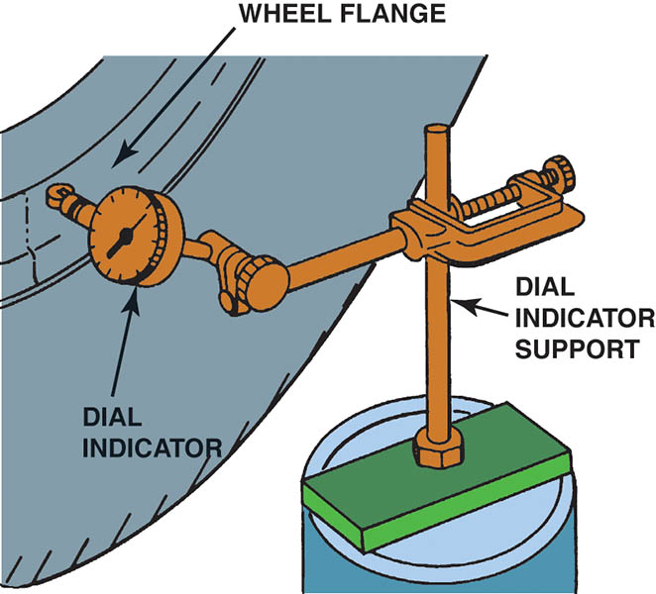
Figure 115.20 To check lateral runout, the dial indicator plunger tip rides on a vertical surface of the wheel, such as the wheel flange

Slide 39
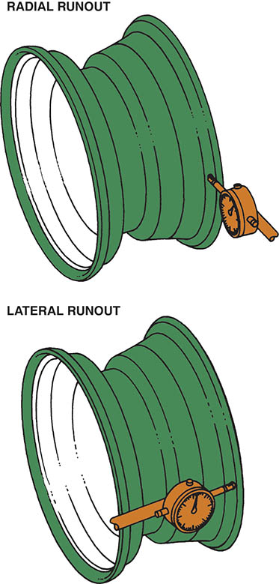
Figure 115.21 The most accurate method of measuring wheel runout is to dismantle the tire and take dial indicator readings on the inside of the wheel rim

Slide 40
TIRE REPLACEMENT
Removing Wheel/Tire Assembly
Check the operation of the tire-pressure monitoring system (TPMS) sensor using a handheld tester before removing the wheel.
Tire Removal from the Wheel
Remove the tire from the rim following the tire machine instructions for proper use.
Installing New Tires
On a clean wheel, ensure the tire is properly lubricated and positioned correctly, and inflated to specifications.

Slide 41
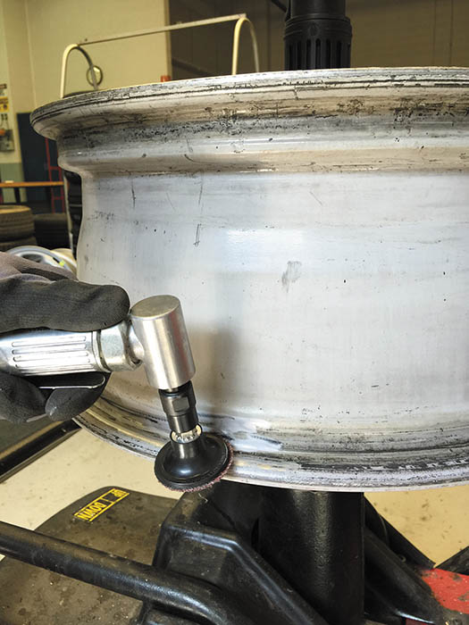
Figure 115.22 Cleaning the bead seat of an alloy wheel using an abrasive pad

Slide 42
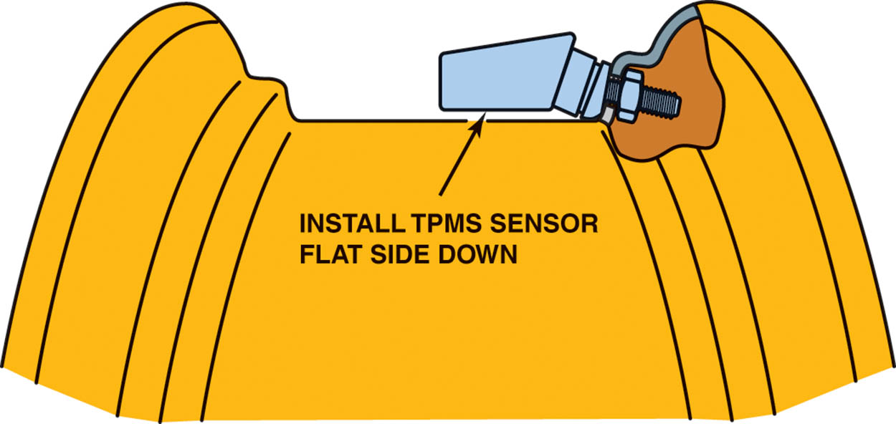
Figure 115.23 When installing a tire-pressure monitoring system sensor, be sure that the flat part of the sensor is parallel to the center section of the rim

Slide 43
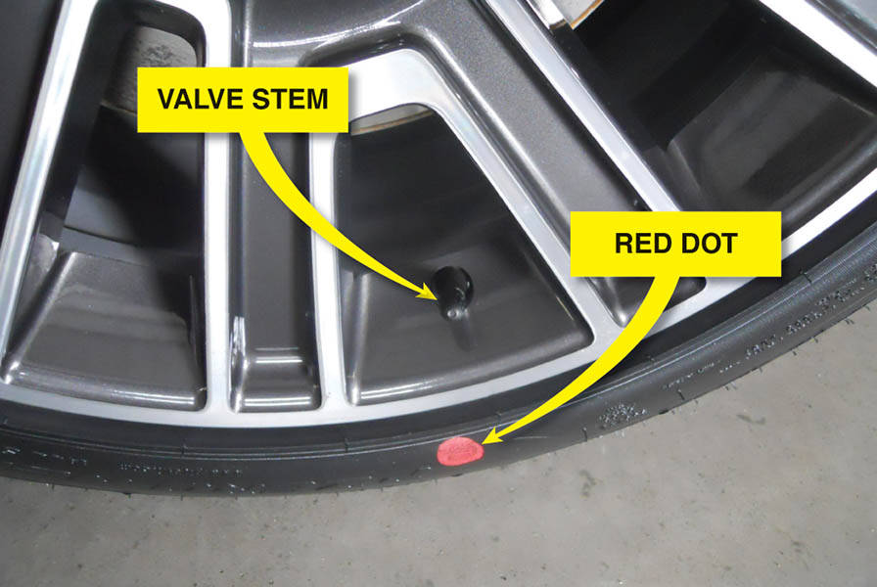
Figure 115.24 Many new tires have painted dots placed there at the tire manufacturer. Yellow Dot- Indicates the light (static) balance point of the tire Red Dot- Indicates the “radial force variation first harmonic maximum”.

Slide 44
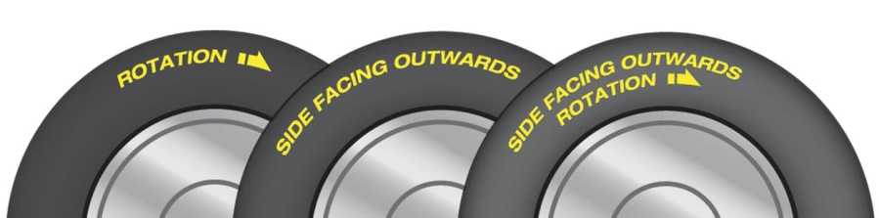
Figure 115.25 Always check the wording on tires and install them correctly to insure that the tire performs as designed.

Slide 45
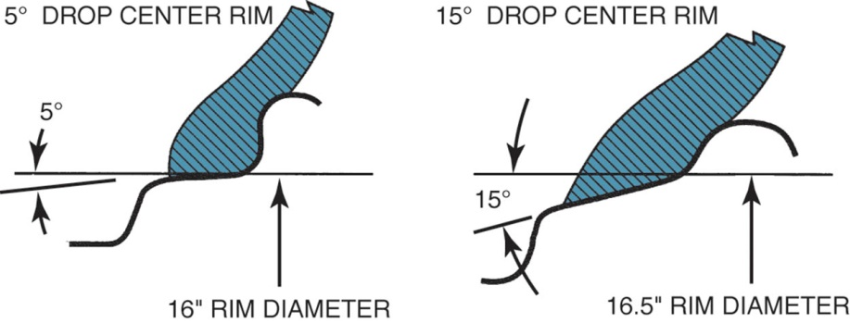
Figure 115.26 Note the difference in the shape of the rim contour of the 16 inch and 16 1/2 inch diameter wheels. While it is possible to mount a 16 inch tire on a 16 1/2 inch rim, it cannot be inflated enough to seat against the rim flange.

Slide 46
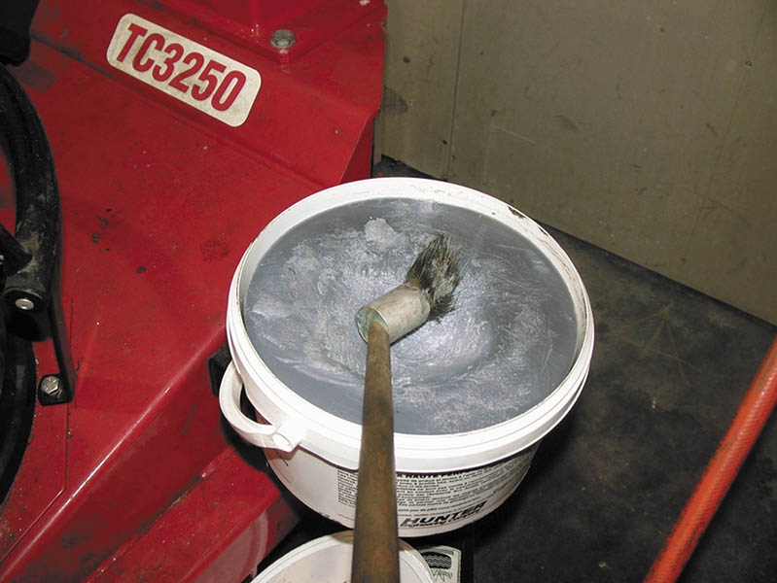
Figure 115.27 Rendered (odorless) animal fat is recommended by some manufacturers of tire changing equipment for use as a rubber lubricant.

Slide 47
TIRE BALANCING
Purpose
Proper tire balance is important for tire life, ride comfort, and safety.
Static Balance
The term static balance means that the weight mass is evenly distributed around the axis of rotation.
Dynamic Balance
The term dynamic balance means that the centerline of weight mass is in the same plane as the centerline of the wheel.

Slide 48
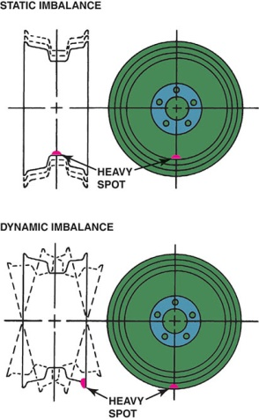
Figure 115.28 A wheel balancer detects heavy spots on the wheel and tire, and indicates where to place weight to offset both static and dynamic imbalance

Slide 49
WHEEL WEIGHTS
Purpose and Function
To correct any imbalance that can normally occur in a tire/wheel assembly.
Wheel Weight Materials
Lead (chemical symbol PB) —being phased out (stick-on and clip-on designs)
Zinc (chemical symbol ZN)—(stick-on and clip-on designs)
Steel (chemical symbol FE)—(stick-on and clip-on designs)
Thermoplastic Polypropylene—high specific gravity plastic (stick-on only)
Clip-on weights attach to the flange, stick-on weights are used on the inside of the rim.

Slide 50
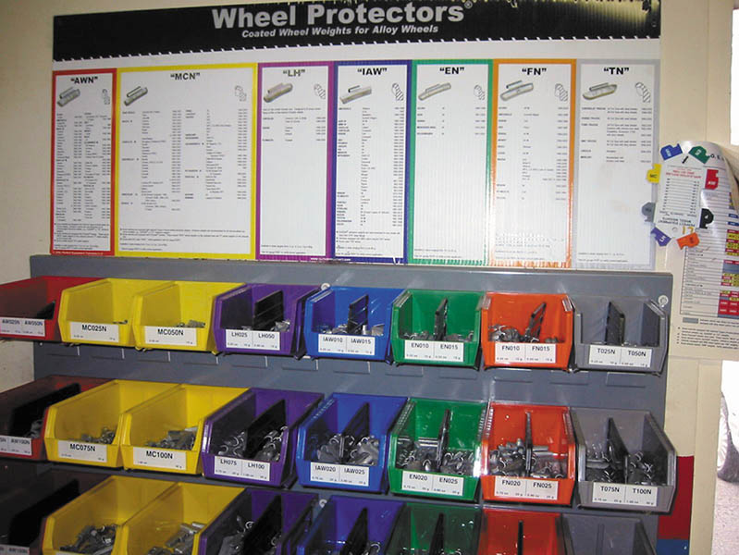
Figure 115.29 An assortment of wheel weights designed to fit different shaped rims

Slide 51
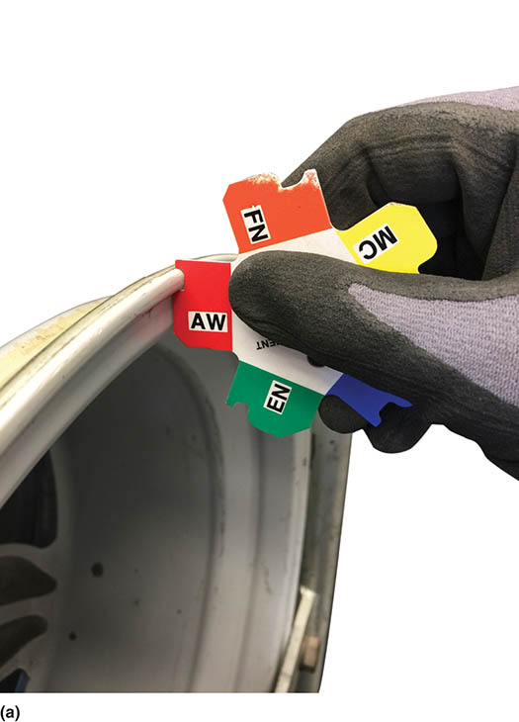
Figure 115.30 (a) Using a rim gauge can be a little tricky as the shape may appear to match several patterns on the rim gauge. This “AW” shape is not a good match

Slide 52
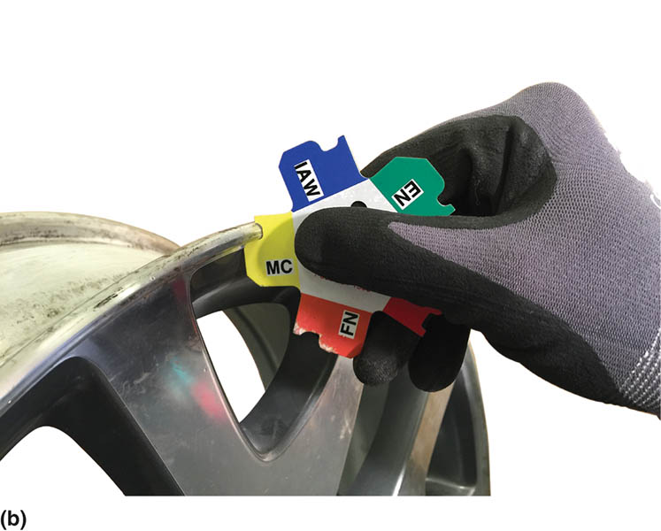
Figure 115.30 (b) Using the gauge shape for “MC” appears to be a perfect match to their rim flange

Slide 53
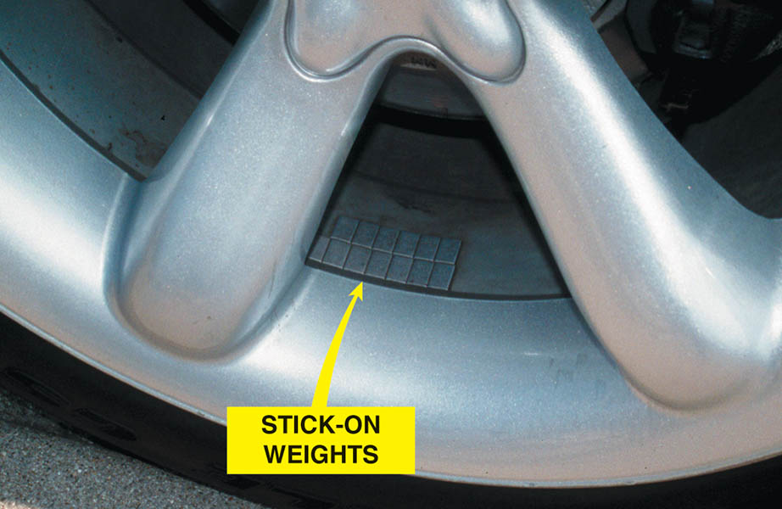
Figure 115.31 Stick-on weights are used from the factory to balance the alloy wheels of this vehicle

Slide 54
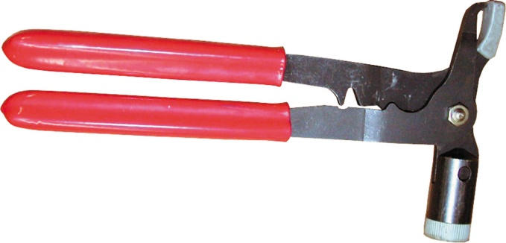
Figure 115.32 Wheel weight pliers are specially designed to remove and install wheel weights

Slide 55
WHEEL/TIRE BALANCERS
Bubble Balancer
Portable and easily stored
Not as accurate as computer balancer
Largely obsolete
Computer Balancer
Dynamic balancer
Accurate within ¼ oz.
Loaded radial and lateral force balancing

Slide 56
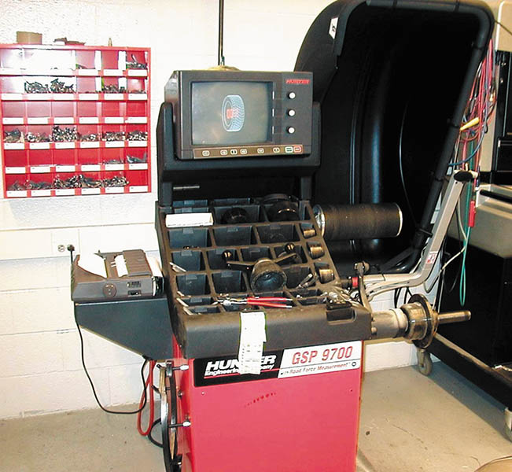
Figure 115.33 A tire balancer that can also detect radial and lateral force variation and instruct the operator where to rotate the tire to achieve the best ride, or indicate a bent wheel

Slide 57
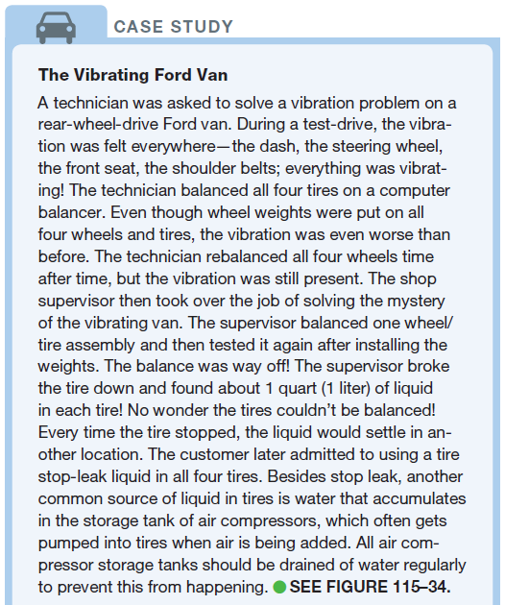
CASE STUDY

Slide 58
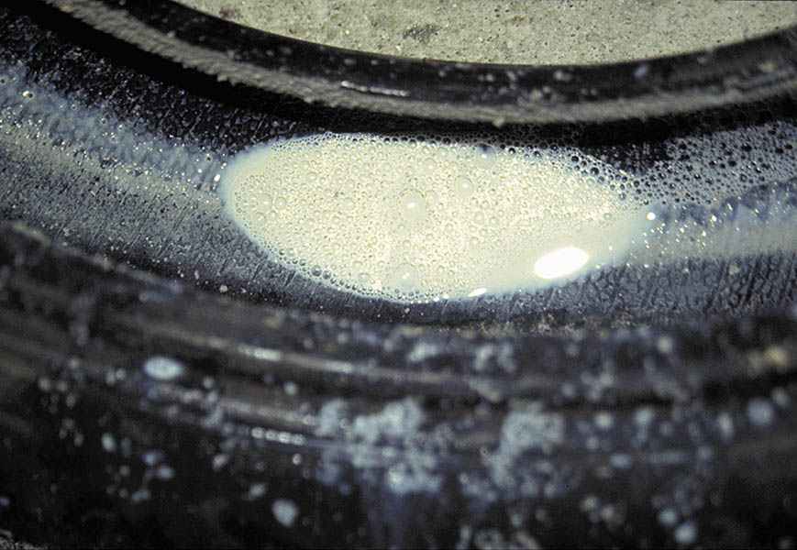
Figure 115.34 Liquid tire stop leak was found in all four tires. This liquid caused the tires to be out of balance

Slide 59
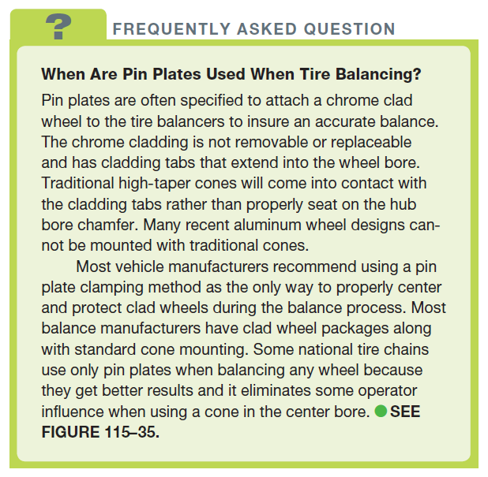
FREQUENTLY ASKED QUESTION

Slide 60
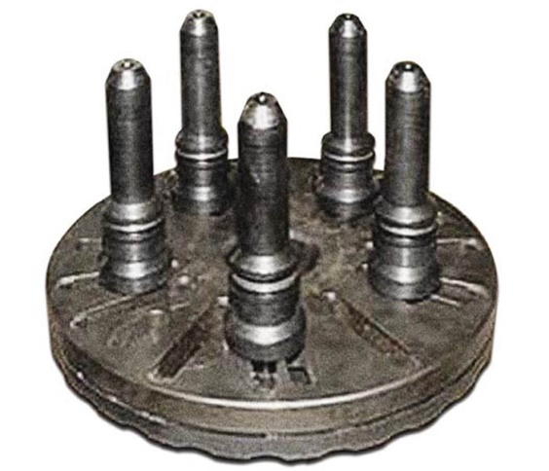
Figure 115.35 A pin plate adapter that is designed to support the wheel/tire assembly on a tire balancer instead of using a centering cone

Slide 61
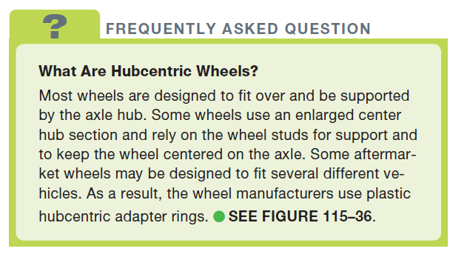
FREQUENTLY ASKED QUESTION

Slide 62
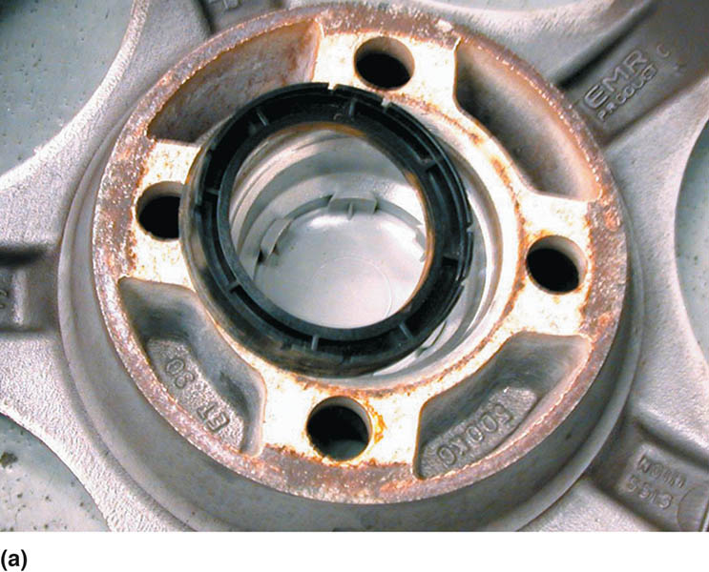
Figure 115.36 (a) A hubcentric plastic ring partially removed from an aftermarket wheel

Slide 63
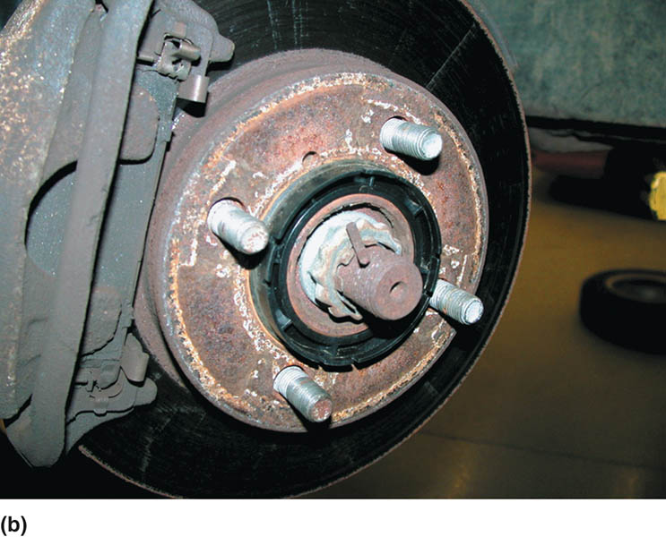
Figure 115.36 (b) A hubcentric plastic ring left on the hub when removing a wheel

Slide 64
TIRE REPAIR
Acceptable Location
Tread punctures, nail holes, or cuts up to 1/4 inch (2.6 mm) can be repaired only within the tire repair (tread) area.
Repairs should be done from the inside of the tire using plugs-patches.
Tire Repair Procedure
Follow the installation and repair procedures of the manufacturer.

Slide 65
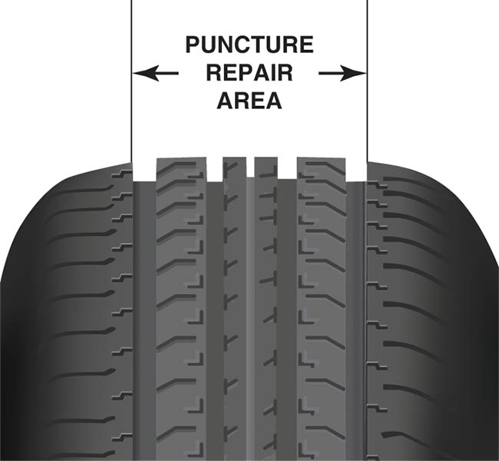
Figure 115.37 A tire should only be repaired if the hole is within the tire puncture repair area. Do not make a repair that is located in the shoulder or belt edge part of the tire.

Slide 66
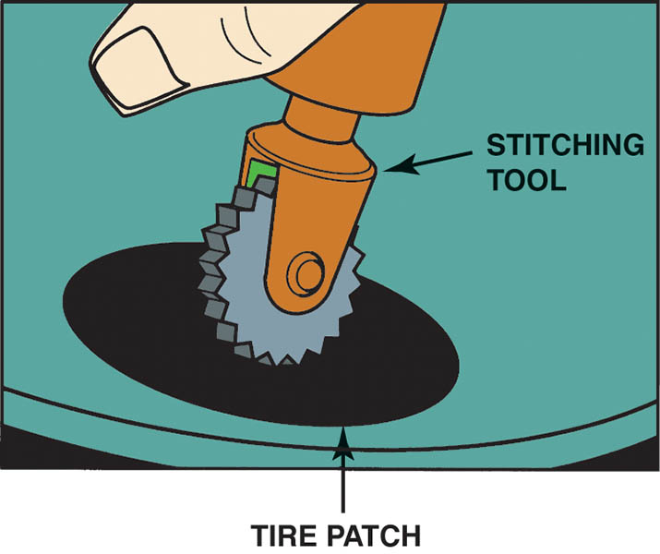
Figure 115.38 A stitching tool being used to force any trapped air out from under the patch

Slide 67
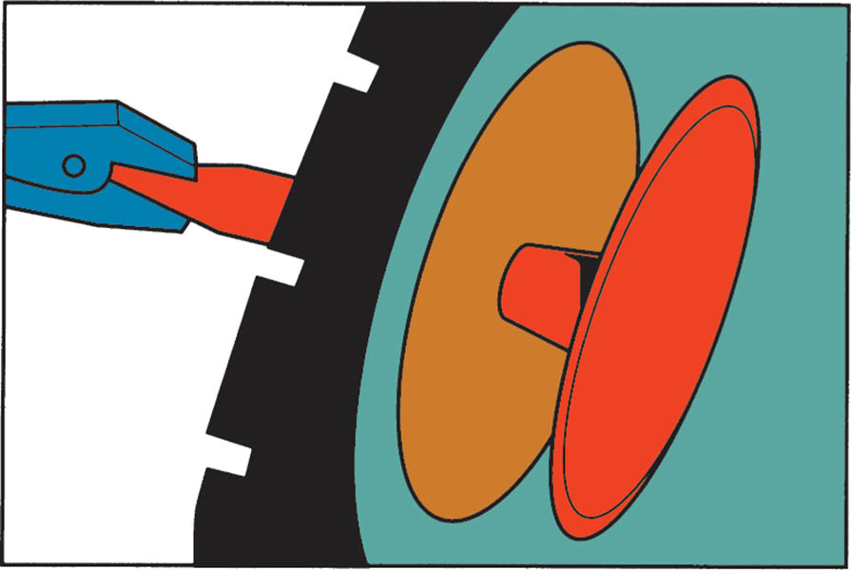
Figure 115.39 A rubber plug being pulled through a hole in the tire. The stem is then cut off flush with the surface of the tire tread

Slide 68
QUESTION 3: ?
What area of the tire is it acceptable to repair?

Slide 69
ANSWER 3:
In the tread area.

Slide 70
TIRE MOUNTING

Slide 71
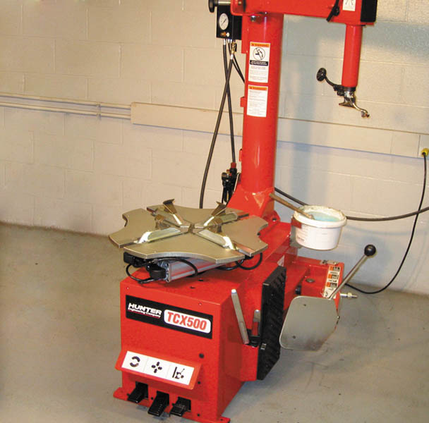
1. A typical tire-changing machine showing the revolving table and movable arm used to remove a tire from the wheel.

Slide 72
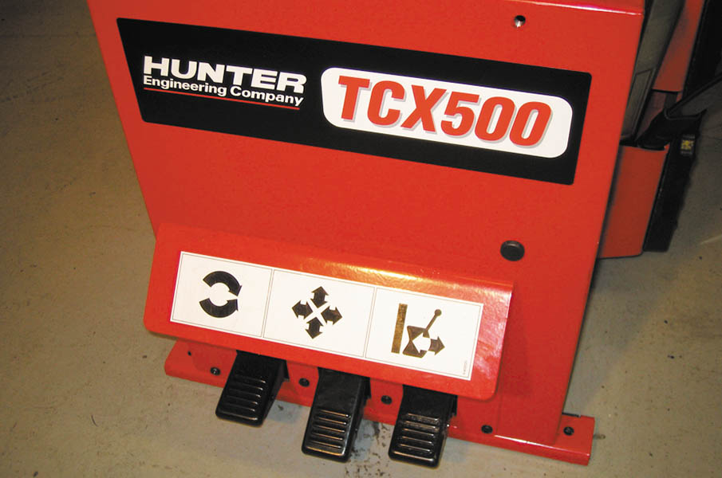
2. The foot-pedal controls allow the service technician to break the tire bead, damp the wheel (rim) to the machine, rotate the tire/wheel assembly, and still have both hands free.

Slide 73
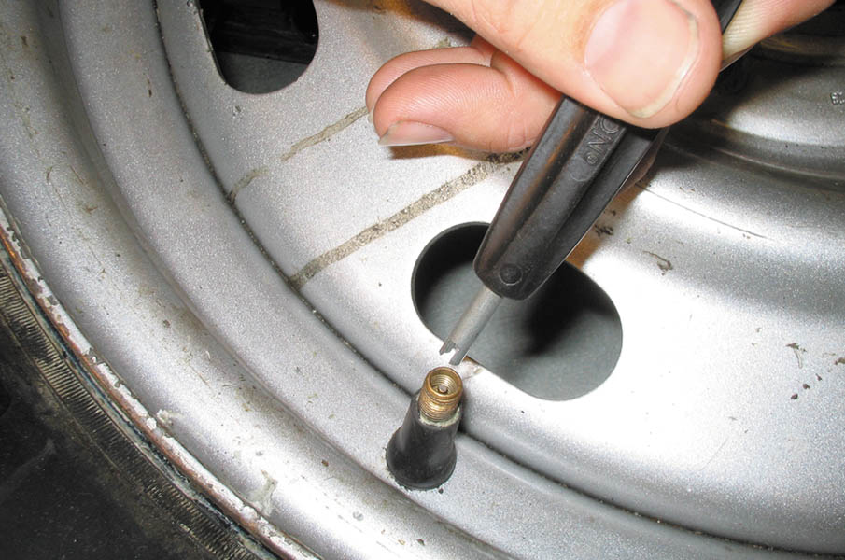
3. Using a tire valve removal tool, unscrew the valve core using extreme caution because the valve is under pressure and can be forced outward and cause personal injury.

Slide 74

4. The valve core removed from the tire valve. Allow all of the air in the tire to escape.

Slide 75

5. A bead breaker is being used to separate the tire from the bead seat of the wheel. Repeat as needed to break the bead on both sides of the wheel.

Slide 76

6. After breaking the beads from both sides of the tire, install the wheel/tire assembly flat onto the machine and, using the foot-pedal control, lock the wheel to the changer.

Slide 77

7. To remove the tire from the wheel, position the arm of the changer against the rim of the wheel and lock in position.

Slide 78

8. The tire tool (flat bar) is placed between the bead of the tire and the wheel. Using tire lubricant can help prevent damage to the tire.

Slide 79

9. The foot-pedal that causes the table to rotate is depressed and the tire is removed from the wheel.

Slide 80

10. Reposition the tire tool to remove the lower bead of the tire from the wheel.

Slide 81

11. As the table of the tire changer is rotated, the tire is released from the wheel and can be lifted off the wheel.

Slide 82

12. Before installing a tire, inspect and clean the bead seat.

Slide 83

13. Before installing a new tire, most experts recommend replacing the tire valve, being installed here, using a tool that pulls the valve through the hole in the wheel.

Slide 84

14. Apply tire soap or rubber lubricant to both beads of the tire.

Slide 85

15. Rotate the tire on the wheel and position the arm so that the tire will be guided onto the rim as the wheel is rotated.

Slide 86

16. Repeat for the upper bead.

Slide 87

17. Inflate the tire, being careful to not exceed 40 PSI. Experts suggest that a tire be in a cage during the initial bead seating inflation to help prevent personal injury if the wheel or tire fails.

Slide 88

18. Install the tire valve core and inflate the tire to specifications.

Slide 89
TIRE REPAIR

Slide 90

1. The source of the leak was detected by spraying soapy water on the inflated tire. Needle-nose pliers are being used to remove the object that caused the flat tire.

Slide 91

2. A part of a razor blade was found to be the cause of the flat tire.

Slide 92

3. A reamer is being used to clean the puncture hole.

Slide 93

4. This technician is using two open-end wrenches to hold the tire beads apart if a tire bead spreader is not available.

Slide 94

5. The surrounding area is being buffed using an air-powered die grinder equipped with a special buffing tool specifically designed for this process.

Slide 95

6. After using a vacuum on all debris and rubber after buffing, apply rubber cement to the area.

Slide 96

7. The brush included with the rubber cement makes the job easy. Be sure to cover the entire area around the puncture.

Slide 97

8. Peel off the paper from the adhesive on the patch. Insert the tip of the patch through the puncture from the inside of the tire.

Slide 98

9. Use a pair of pliers to pull the plug of the patch through the puncture.

Slide 99

10. This view of the patch is from the inside of the tire.

Slide 100

11. To be assured of an airtight patch, the adhesive of the patch should be “stitched” to the inside of the tire using a serrated roller called a stitching tool.

Slide 101

12. A view of the plug from the outside of the tire after metal covering used to pierce the puncture is removed from the patch plug. The plug can be trimmed to the level of the tread using side cutters or a knife.

Slide 102

Copyright

