Slide 1

Automotive Technology Principles, Diagnosis, and Service
Sixth Edition
Chapter 114
Tire Pressure Monitoring Systems
Copyright © 2018, 2015, 2011 Pearson Education, Inc. All Rights Reserved

Slide 2
LEARNING OBJECTIVES (1 of 2)
114.1 Explain why a tire-pressure monitoring system (TPMS) is used.
114.2 Discuss the TREAD Act.
114.3 Explain indirect and direct TPMS.
114.4 List the two types of TPMS pressure sensors.
114.5 Discuss TPMS sensor operation and the TPMS receiver.

Slide 3
LEARNING OBJECTIVES (2 of 2)
114.6 Explain direct TPMS diagnosis and TPMS diagnostic tools.
114.7 List replacement options for TPMS sensors.
114.8 Describe how to relearn TPMS sensors and the tools needed to service a TPMS.
114.9 This chapter will help prepare for ASE Suspension and Steering (A4) certification content area “E” (Wheel and Tire Diagnosis and Repair).

Slide 4
NEED FOR TIRE PRESSURE MONITORING (1 OF 2)
Background
A tire-pressure monitoring system (TPMS) is a system that detects a tire that has low inflation pressure and warns the driver.
There are two systems used:
Indirect
Direct
Low Tire Pressure Effects
Reduced fuel economy, and tire life. Reduces handling and braking efficiency.

Slide 5
NEED FOR TIRE PRESSURE MONITORING (2 OF 2)
Placard Cold Inflation Pressure
The term placard cold inflation pressure is used in service information to indicate the specified tire inflation pressure.
The “placard” is the driver’s side door jamb sticker that shows the tire size and the specified tire inflation pressure.
Temperature and Inflation Pressure
The tires become warmer while the vehicle is being driven, so tires should be checked before the vehicle has been driven or allowed to cool after being driven.

Slide 6
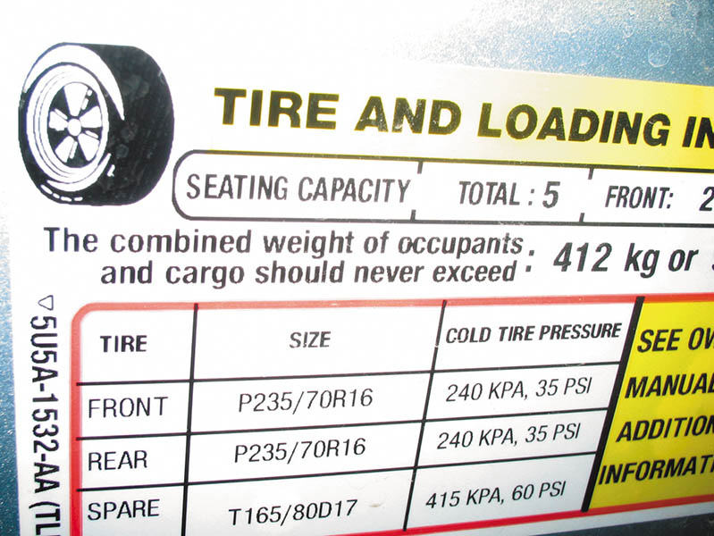
Figure 114.1 The tire-pressure placard (sticker) on the driver’s side door or door jamb indicates the specified tire pressure

Slide 7
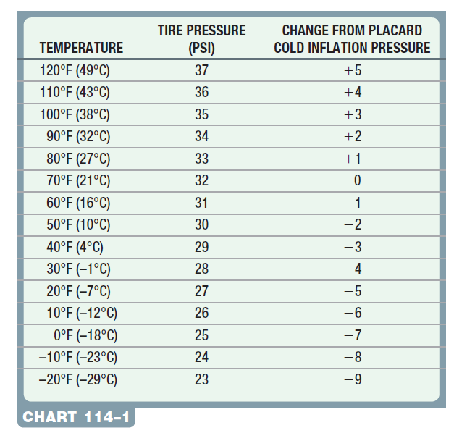
Chart 114-1 The effects of outside temperature on tire inflation, assuming a placard inflation pressure of 32 PSI. The tire inflation pressure changes 1 PSI for each 10 degrees change in temperature.

Slide 8
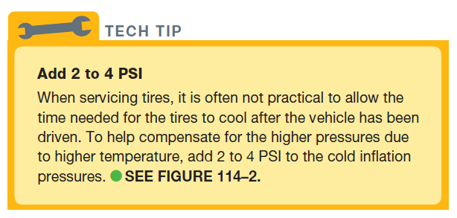
Tech Tip

Slide 9
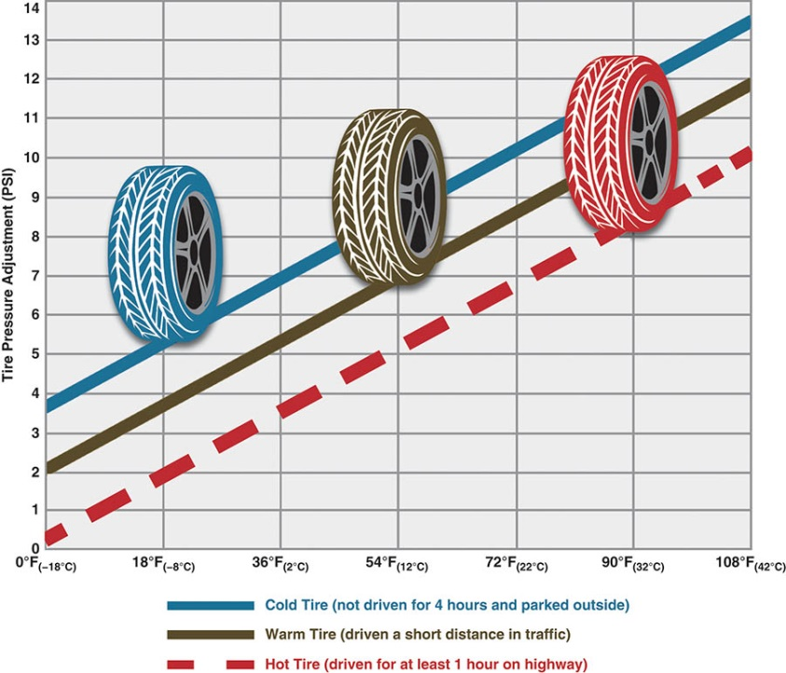
Figure 114.2 Inflation pressure increases as the temperature increases. When checking or correcting inflation pressure when the tires are hot, add 2 to 4 PSI to the placard cold inflation pressure.

Slide 10
QUESTION 1: ?
What are the two types of monitoring systems?

Slide 11
ANSWER 1:
Direct and Indirect.

Slide 12
TREAD ACT (1 OF 2)
The Transportation Recall Enhancement, Accountability, and Documentation (TREAD) Act requires that all vehicles be equipped with a tire-pressure monitoring system that will warn the driver in the event of an underinflated tire.
The National Highway Traffic Safety Administration (NHTSA) requires the installation of tire-pressure monitoring systems in passenger vehicles and light trucks manufactured after September 1, 2007 (2008 model year).

Slide 13
TREAD ACT (2 OF 2)
Warning Lamp
The FMVSS 138 specifies that the driver must be warned of a low tire inflation pressure by turning on an amber warning lamp.
Twenty-Five Percent Rule
The TREAD Act specifies that the driver be warned if any tire inflation pressure drops by 25% or more from the placard cold inflation pressure.

Slide 14
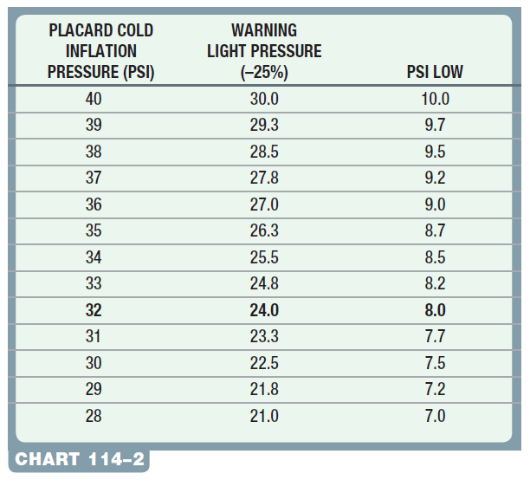
Chart 114-2 Placard inflation pressure compared with the pressure when the TPMS triggers a warning light.

Slide 15
INDIRECT TPMS (1 OF 2)
Function
The system uses speed sensors to detect differences in the speed of the wheels.
An underinflated tire will rotate faster than a properly inflated tire.
Compensation for Cornering
To compensate for this normal change in wheel rotation speed, the indirect tire-pressure monitoring system checks the diagonally opposed wheels.

Slide 16
INDIRECT TPMS (2 OF 2)
Diagnosis of Indirect TPMS
Verify the fault.
Light on- low pressure
Light flashing – system problem
Check tire pressure
Repair fault
Indirect TPMS Relearn Procedures
Check service information for the exact steps to follow.
Typically a reset and a test drive is involved.

Slide 17
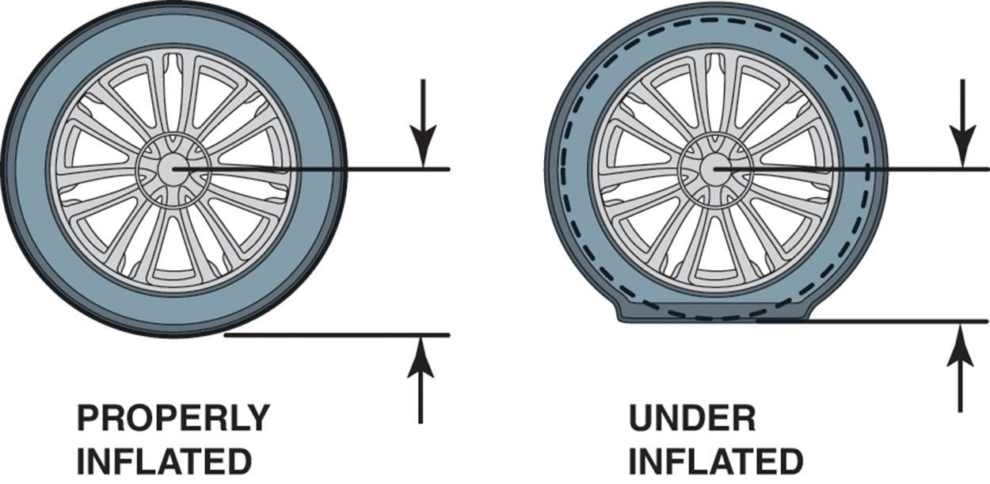
Figure 114.3 A tire with low inflation will have a shorter distance (radius) between the center of the wheel and the road and will therefore rotate faster than a tire that is properly inflated

Slide 18
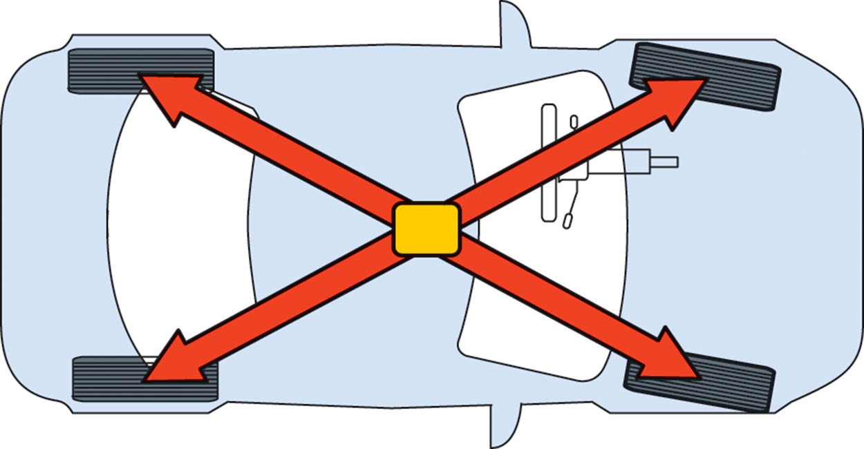
Figure 114.4 The speeds of the diagonally opposed wheels are added together and then compared to the other two wheels to check if one tire is rotating faster

Slide 19
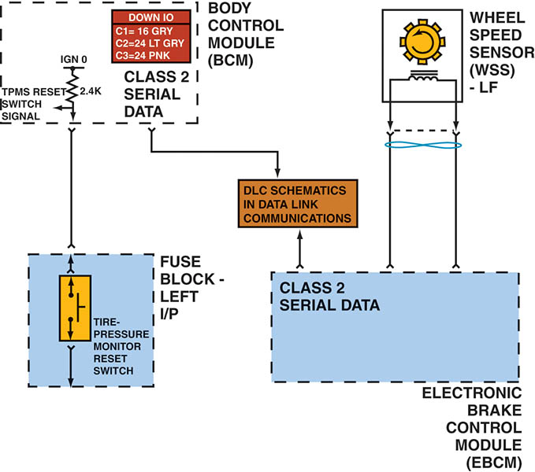
Figure 114.5 The indirect tire-pressure monitoring system has a reset switch that should be depressed after rotating or replacing tires

Slide 20
DIRECT TPMS
Function
Direct tire-pressure monitoring systems use individual pressure sensors located in each wheel to measure the inflation pressure.
Identifying the System
Because of the variety of systems used, service information is needed to determine what type of system is on the vehicle before service work is started.

Slide 21
TPMS PRESSURE SENSORS (1 OF 2)
Manufacturers
The sensors are manufactured by a variety of manufacturers, including:
Beru
Lear
Pacific
Schrader
Siemens
TRW
Each sensor uses a 3-volt lithium ion battery that has a service life of 7 to 10 years.

Slide 22
TPMS PRESSURE SENSORS (2 OF 2)
Types
There are two basic types of pressure sensors used in direct pressure-sensing systems.
Valve-stem-mounted sensor
Banded sensors
Modes of Operation
Active Mode
Sleep Mode
Alert Mode

Slide 23
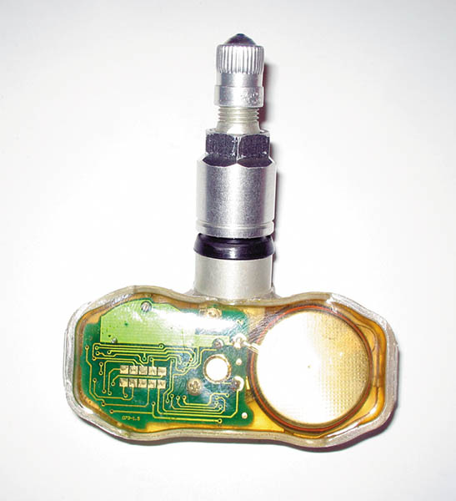
Figure 114.6 A clear plastic valve-stem tire-pressure monitoring sensor, showing the round battery on the right and the electronic sensor and transistor circuits on the left

Slide 24
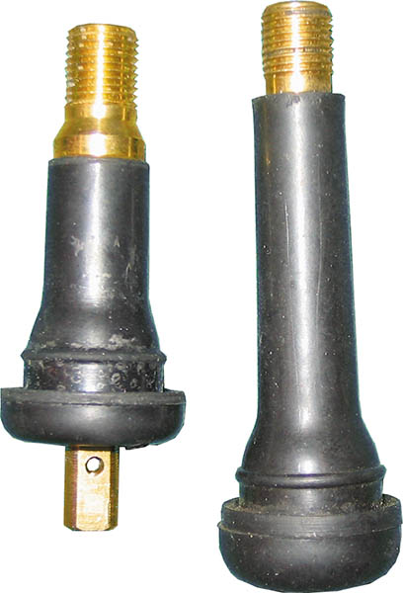
Figure 114.7 A conventional valve stem is on the right compared with a rubber TPMS sensor stem on the left. Notice the tapered and larger brass stem. The rubber TPMS sensor also uses a longer cap that makes it easy for a technician to spot that this is not a conventional rubber valve stem

Slide 25
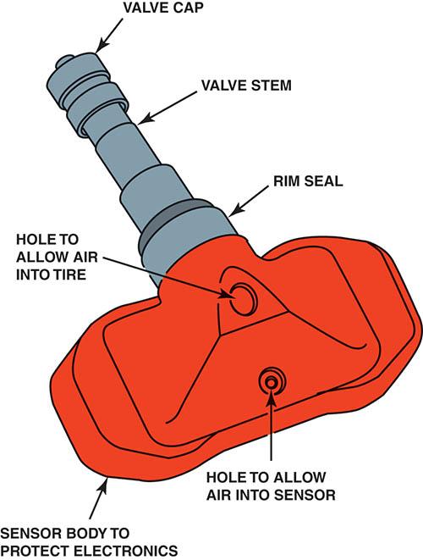
Figure 114.8 The parts of a typical clamp-in TPMS sensor. Notice the small hole used to monitor the inflation pressure. The use of stop leak can easily clog this small hole

Slide 26
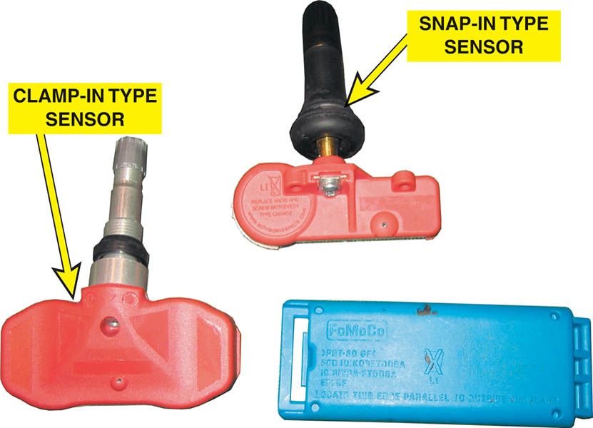
Figure 114.9 The three types of TPMS sensors most commonly found include the two stem-mounted rubber (snap-in) and aluminum (clamp-in), left and top, and the banded sensors (right)

Slide 27
QUESTION 2: ?
What are the two types of direct sensors?

Slide 28
ANSWER 2:
Stem mounted and band mounted.

Slide 29
TPMS SENSOR OPERATION
Designs: The types of sensors include:
Continuous-wave-type sensor
Magnetically triggered-type sensor
Pulse-width-modulated-type sensor
The two most commonly used frequencies are:
315 MHz
433.92 MHz (commonly listed as 434 MHz)

Slide 30
TPMS RECEIVER
Locations
The wireless TPMS receiver is housed in one of the following locations, depending on the vehicle:
Remote keyless entry (RKE) receiver
Body control module (BCM)
Door module
Individual antennas near each wheel well.

Slide 31
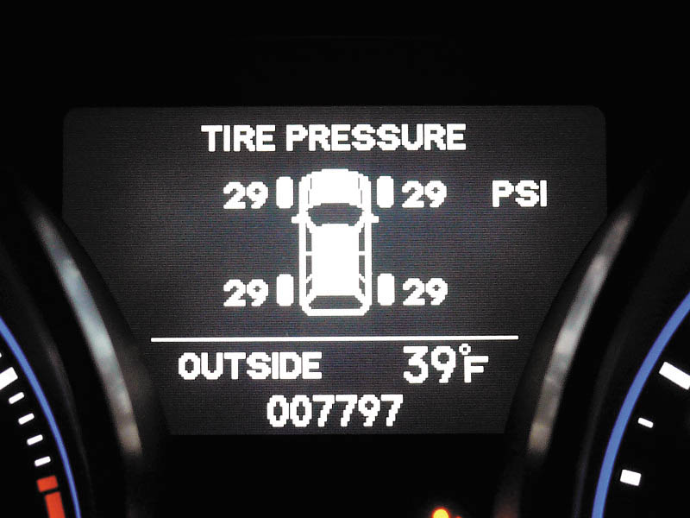
Figure 114.10 Some vehicles display the actual measured tire pressure for each tire on a driver information display

Slide 32
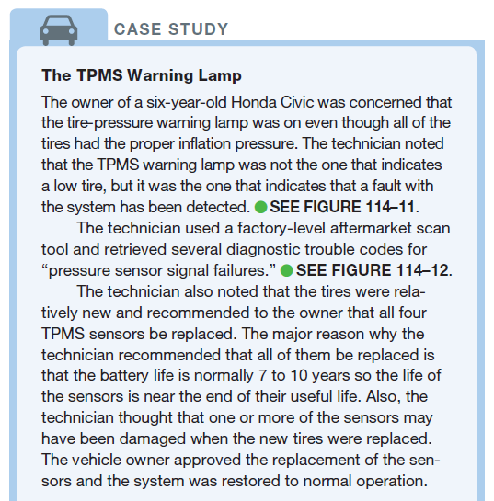
CASE STUDY

Slide 33
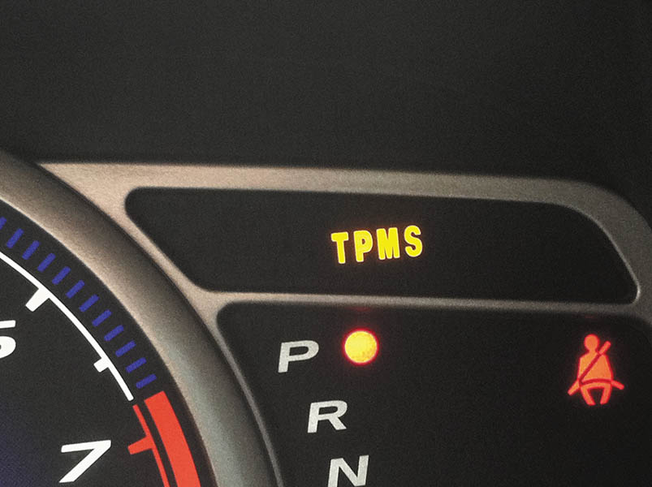
Figure 114.11 The TPMS warning lamp on this vehicle is a separate light from the tire icon light that warns of low tire pressure. In this case, both warning lights were on all of the time

Slide 34
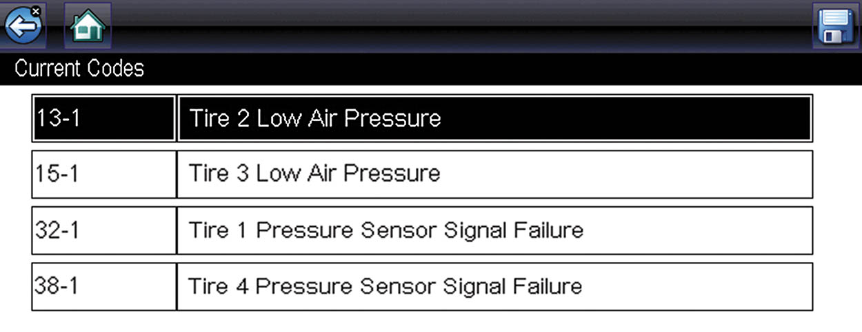
Figure 114.12 The codes set were for low pressure and sensor signal failure

Slide 35
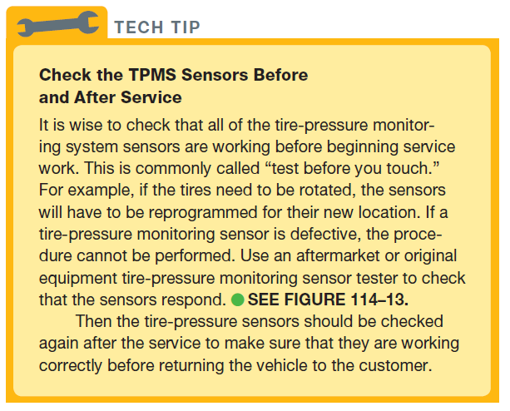
TECH TIP

Slide 36
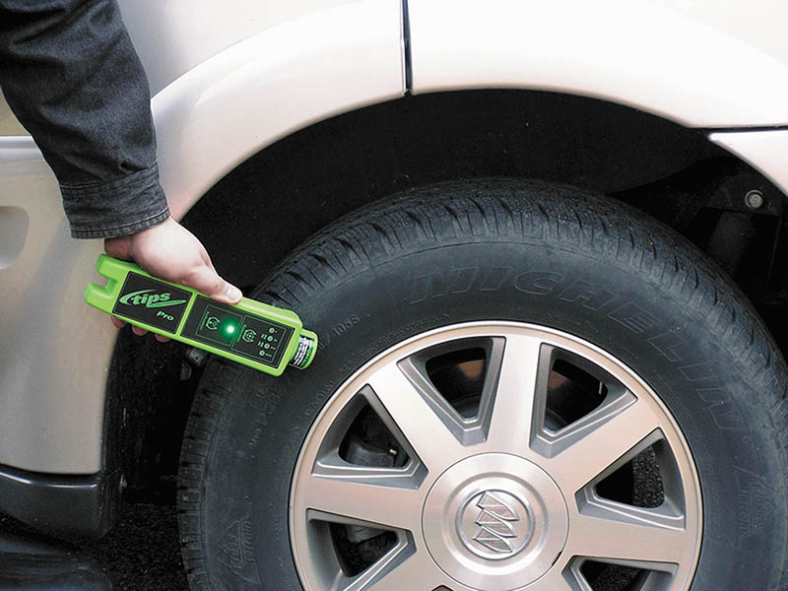
Figure 114.13 A typical tire-pressure monitoring system tester. The unit should be held near the tire and opposite the valve stem if equipped with a wheel-mounted sensor, and near the valve stem if equipped with a valve-stem-type sensor

Slide 37
TPMS DIAGNOSIS
Warning Lamp On (Not Flashing)
Check the door placard for the specified tire inflation pressure.
Check all tires using a known-accurate tire-pressure gauge.
Inflate all tires to the specified pressure.
Warning Lamp Flashing
TPMS sensor not properly registered with the system.
Defective wheel sensors, such as a sensor with a dead battery.
A fault in the receiver or module.

Slide 38
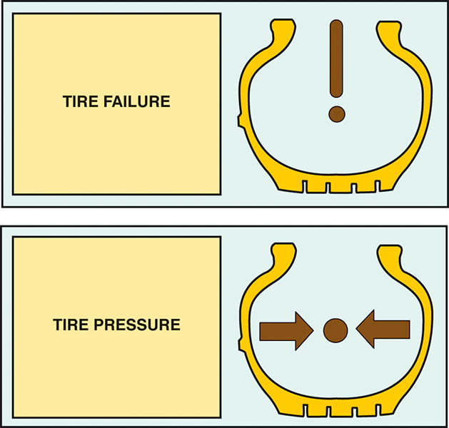
Figure 114.14 A tire-pressure warning light can vary depending on the vehicle, but includes a tire symbol

Slide 39
TPMS SENSOR ACTIVATIONS
Activation methods include:
Using a magnet.
Changing inflation pressure.
Triggered by a handheld TPMS tester.

Slide 40
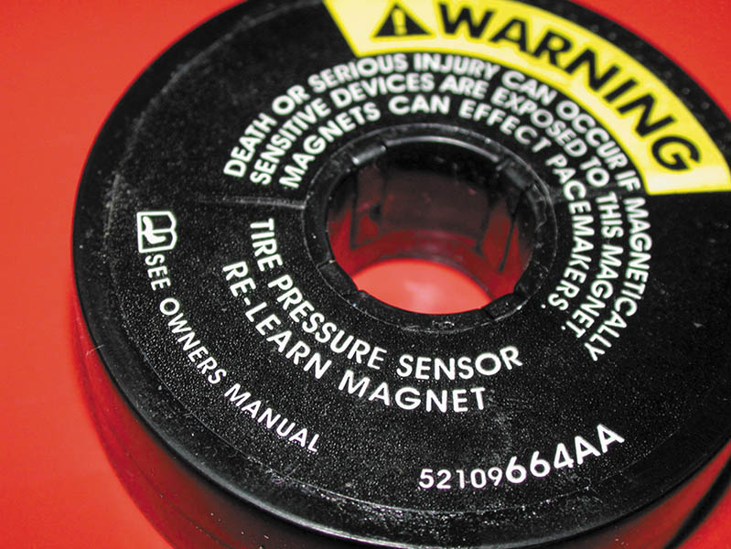
Figure 114.15 A magnet is placed around the valve stem to reprogram some stem-mounted tire-pressure sensors

Slide 41
QUESTION 3: ?
What are the three listed ways to actuate a TPMS sensor?

Slide 42
ANSWER 3:
A magnet, changing tire pressure, and a handheld TPMS tester.

Slide 43
TPMS DIAGNOSTIC TOOLS
TPMS diagnostic tools include a variety of scan tools and handheld testers.
Scan Tools
Register sensors
Perform initialization
Monitor sensor values
Handheld Testers
Sensor activation
Sensor relearn
Programming a new sensor

Slide 44
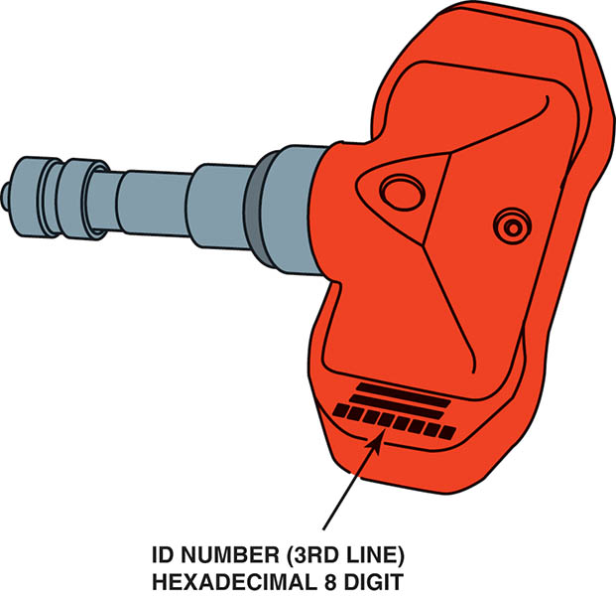
Figure 114.16 When replacing a TPMS sensor, be sure to record the sensor ID because this needs to be entered into the system through the use of a tester or scan tool

Slide 45
SENSOR REPLACEMENT OPTIONS
Original Equipment-Based Sensors
These sensors are made by the original equipment (OE) manufacturer and usually are direct replacement for the factory unit.
Aftermarket Sensors
Original equipment (OE)-based replacement.
Multiple protocol sensors that can be programmed to match whatever the vehicle needs.
Fully programmable sensor—also called clones. This type needs a separate programming device.

Slide 46
TPMS SENSOR RELEARN
Most relearn procedures fall into one of four categories including:
Auto relearn
European Relearn
Manual Relearn
OBD Relearn

Slide 47
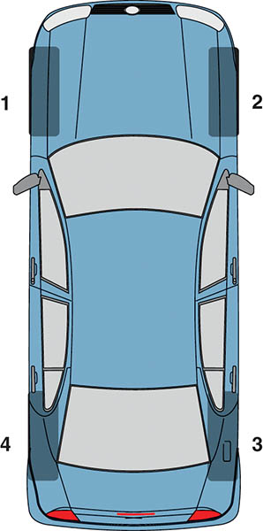
Figure 114.17 The sensor relearn procedure is performed in the following order after the system has been placed in learn mode: LF, RF, RR, and then LR

Slide 48
TPMS SENSOR SERVICE TOOLS
Whenever servicing a tire/wheel assembly that has a direct TPMS system, certain items are needed:
Service Information
Digital tire pressure gauge
Tire valve core torque wrench
Tire valve nut torque wrench
Sensor service kit

Slide 49
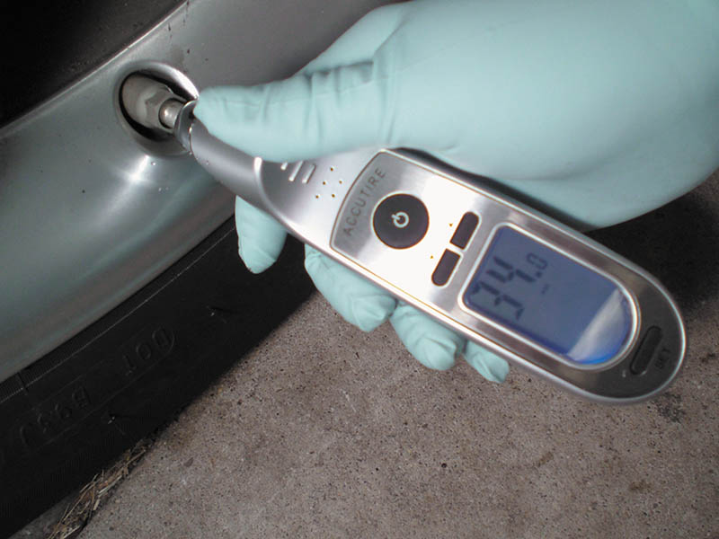
Figure 114.18 Always use an accurate, known-good tire-pressure gauge. Digital gauges are usually more accurate than mechanical gauges

Slide 50
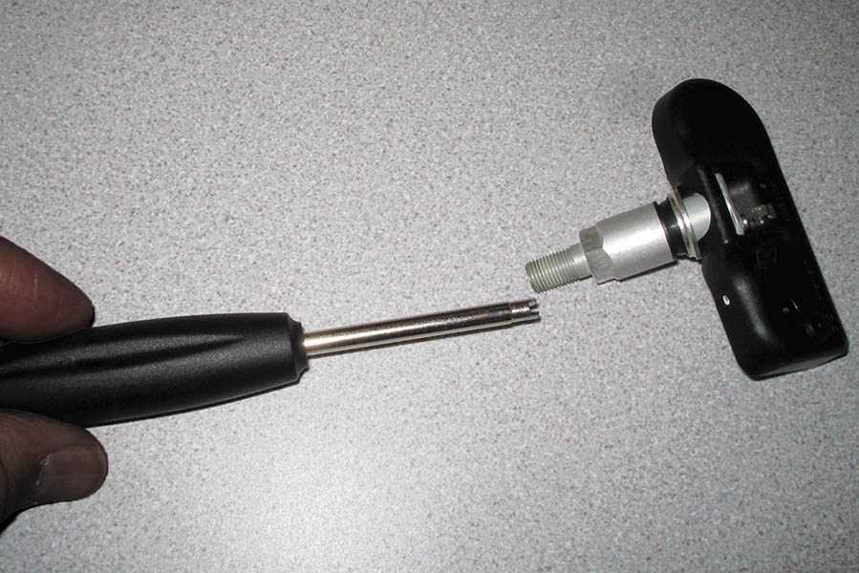
Figure 114.19 A clicker-type valve core tool ensures that the valve core is tightened to factory specifications

Slide 51
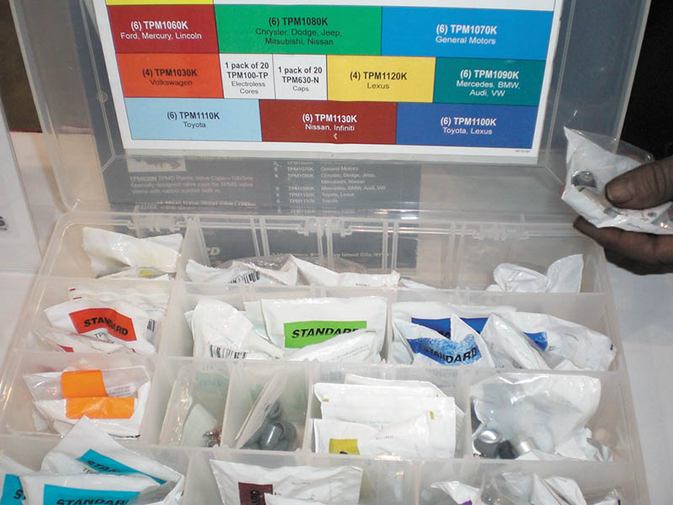
Figure 114.20 An assortment of service parts that include all of the parts needed to service a stem-mounted TPMS sensor being installed after removal for a tire replacement or repair

Slide 52

Copyright

