Slide 1
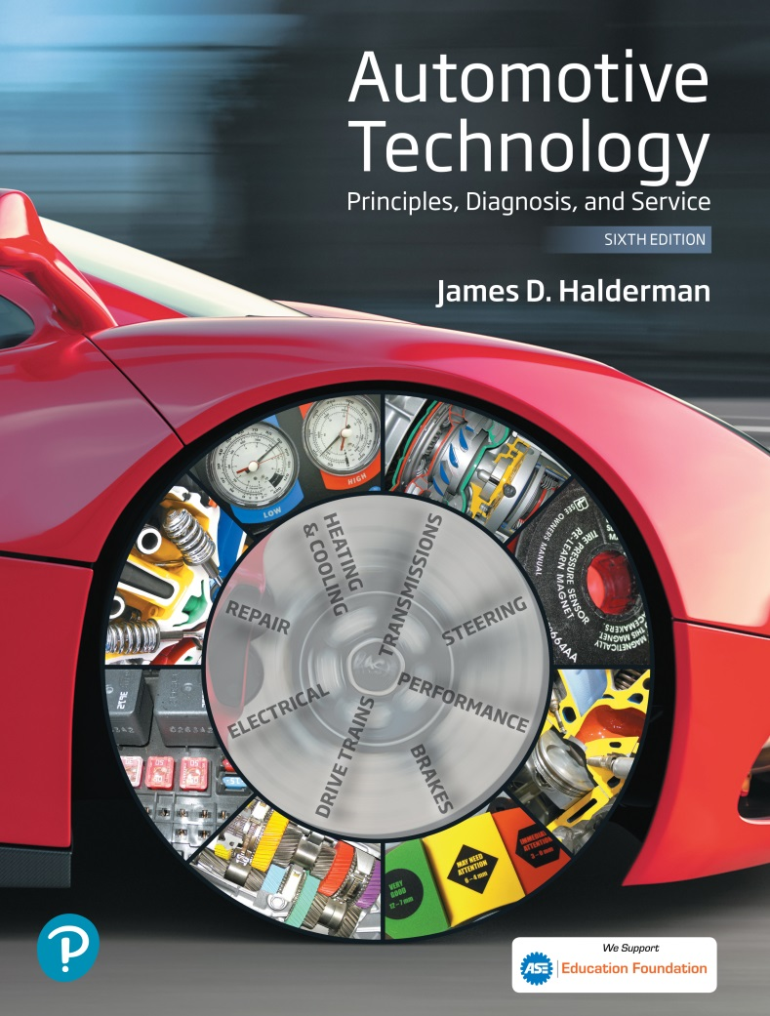
Automotive Technology Principles, Diagnosis, and Service
Sixth Edition
Chapter 113
Tires and Wheels
Copyright © 2018, 2015, 2011 Pearson Education, Inc. All Rights Reserved

Slide 2
LEARNING OBJECTIVES (1 of 2)
113.1 Explain the purpose and functions of tires.
113.2 Identify the parts of a tire and describe how it is constructed.
113.3 Discuss tire sizes, load index, ratings, specifications, and grading.
113.4 Discuss tire conicity and vehicle handling.
113.5 Describe spare tires and run-flat tires.

Slide 3
LEARNING OBJECTIVES (2 of 2)
113.6 Describe tire selection considerations.
113.7 Explain the construction and sizing of steel and alloy wheels and attaching hardware.
113.8 This chapter will help prepare for ASE Suspension and Steering (A4) certification content area “E” (Wheel and Tire Diagnosis and Repair).

Slide 4
INTRODUCTION TO TIRES
Purpose
The friction (traction) between the tire and the road determines the handling characteristics of any vehicle.
Function
Tires provide the following:
Shock absorber action when driving over rough surfaces
Friction (traction) between the wheels and the road

Slide 5
PARTS OF A TIRE (1 OF 3)
Tread
Tread refers to the part of the tire that contacts the ground.
Sidewall
The sidewall is that part of the tire between the tread and the wheel.
Bead
The bead is the foundation of the tire and is located where the tire grips the inside of the wheel rim.

Slide 6
PARTS OF A TIRE (2 OF 3)
Body Ply
The layers of material wrapped around both beads under the tread and sidewall rubber. This creates the main framework, or “carcass,” of the tire.
Belt
A tire belt is two or more layers of material applied over the body plies and under the tread area only to stabilize the tread and increase tread life and handling.

Slide 7
PARTS OF A TIRE (3 OF 3)
Inner Liner
The inner liner is the soft rubber lining (usually a butyl rubber compound) on the inside of the tire that protects the body plies and helps provide for self-sealing of small punctures.
Major Splice
When the tire is assembled by a craftsperson on a tire-building machine, the body plies, belts, and tread rubber are spliced together.

Slide 8
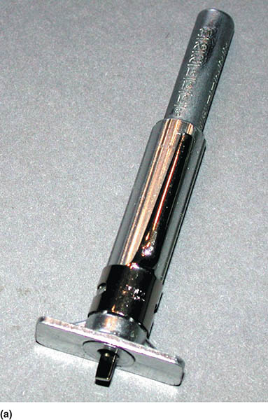
Figure 113.1 (a) A typical tire tread depth gauge. The center movable plunger is pushed down into the groove of the tire

Slide 9
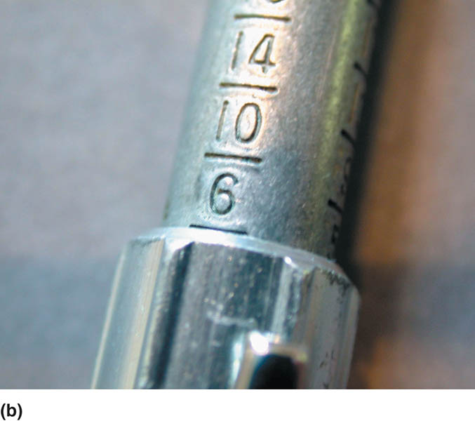
Figure 113.1 (b) The tread depth is read at the top edge of the sleeve. In this example, the tread depth is 6/32 inch

Slide 10
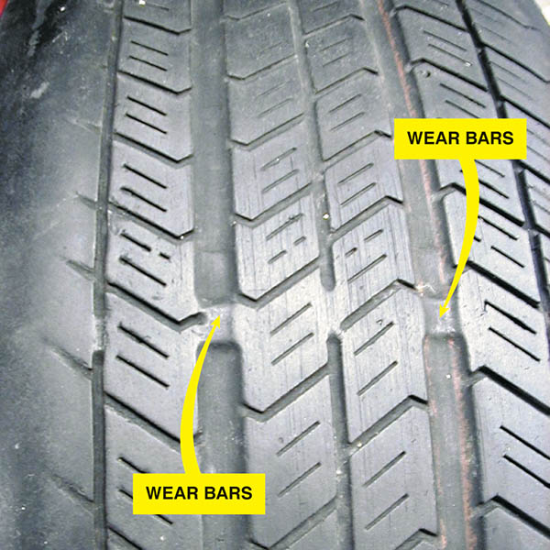
Figure 113.2 Wear indicators (wear bars) are strips of bald tread that show when the tread depth is down to 2/32 inch, which is the legal limit in many states

Slide 11
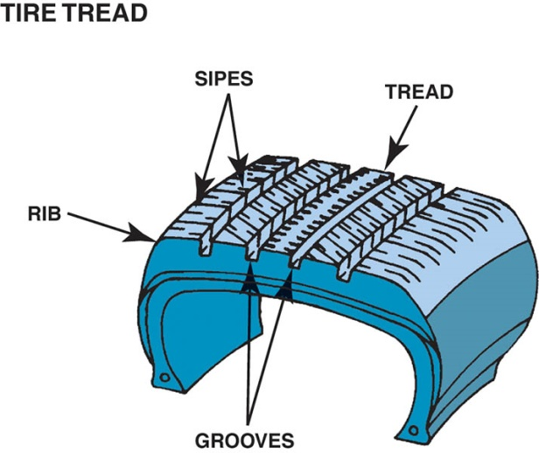
Figure 113.3 The tire tread runs around the circumference of the tire, and its pattern helps maintain traction. The ribs provide grip, while the grooves direct any water on the road away from the surface. The sipes help the tire grip the road

Slide 12
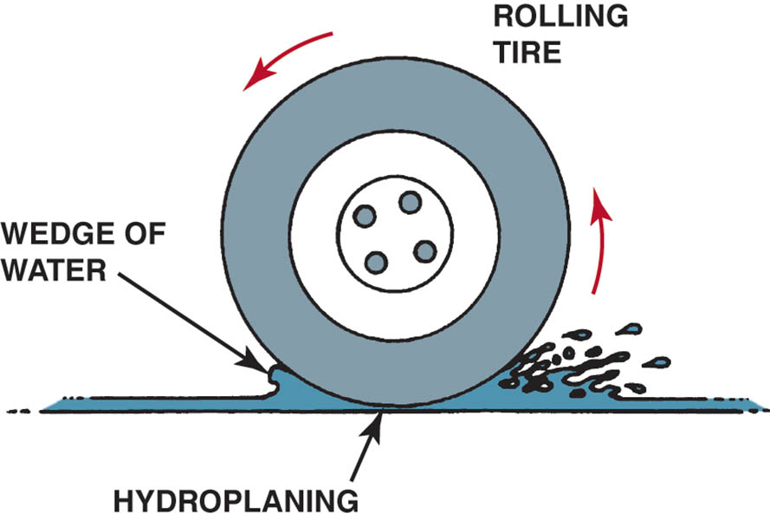
Figure 113.4 Hydroplaning can occur at speeds as low as 30 mph (48 km/h). If the water is deep enough and the tire tread cannot evacuate water through its grooves fast enough, the tire can be lifted off the road surface by a layer of water.

Slide 13
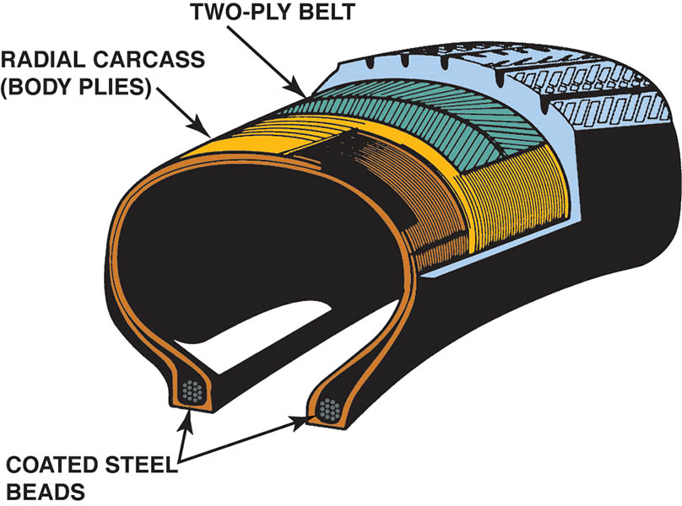
Figure 113.5 Typical construction of a radial tire. Some tires have only one body ply, and some tires use more than two belt plies

Slide 14
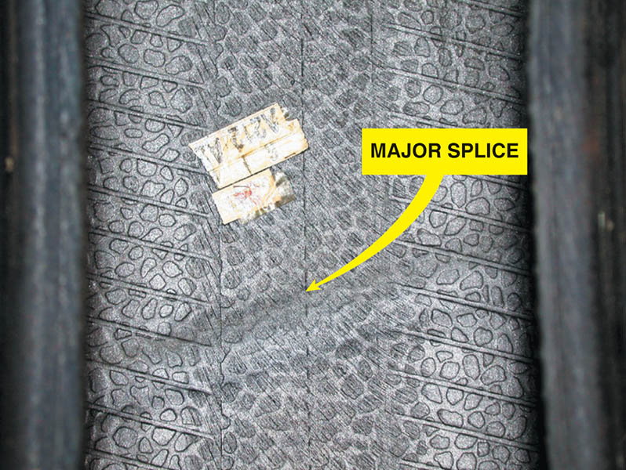
Figure 113.6 The major splice of a tire can often be seen and felt on the inside of the tire. The person who assembles (builds) the tire usually places a sticker near the major splice as a means of identification for quality control

Slide 15
QUESTION 1: ?
What are the seven major parts of the tire?

Slide 16
ANSWER 1:
The tread, sidewalls, bead, body ply, belt, inner liner, and major splice.

Slide 17
TIRE MOLDING
After the tire has been assembled by the tire building machine, it is called a green tire.
The completed green tire is then placed in a mold where its shape, tread design, and all sidewall markings are formed
While in the mold, a steam bladder fills the inside of the tire and forces the tire against the outside of the mold.
The tire is no longer called a green tire but a cured tire

Slide 18
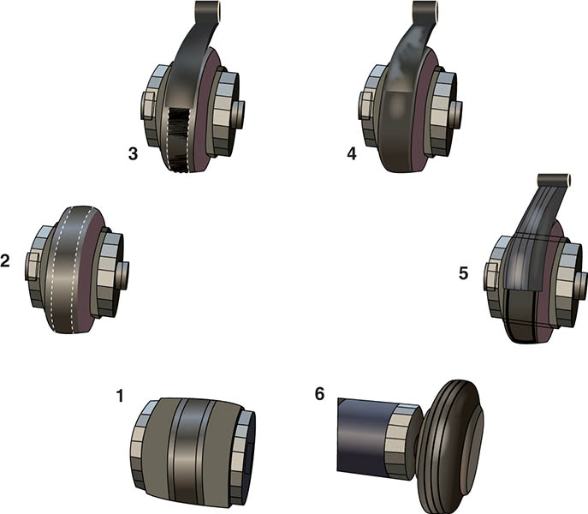
Figure 113.7 Complete stage 1 (body plies, sidewall components, and beads) 2. Building drum expands in preparation to receive the belts and tread 3. Application of belt #1. 4. Application of belt #2. 5. Application of the tread 6. Drum retracts to release the completed green (uncured) tire

Slide 19
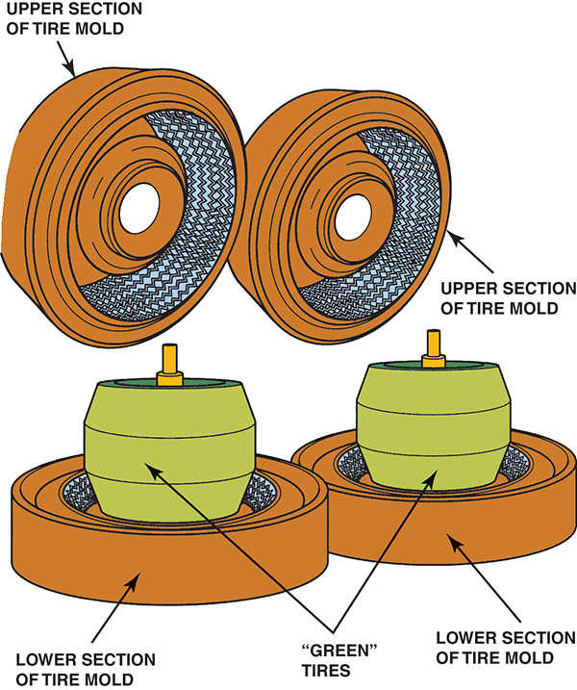
Figure 113.8 After the entire tire has been assembled into a completed “green” tire, it is placed into a tire-molding machine where the tire is molded into shape and the rubber is changed chemically by the heat. This nonreversible chemical reaction is called vulcanization

Slide 20
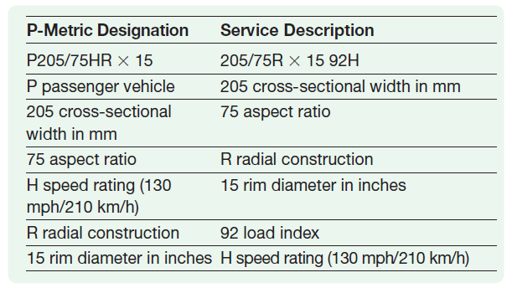
SERVICE DESCRIPTION
Tires built after 1990 use a “service description” method of sidewall information in accordance with ISO 4000 (International Standards Organization) that includes size, load, and speed rating together in one easy-to-read format.

Slide 21
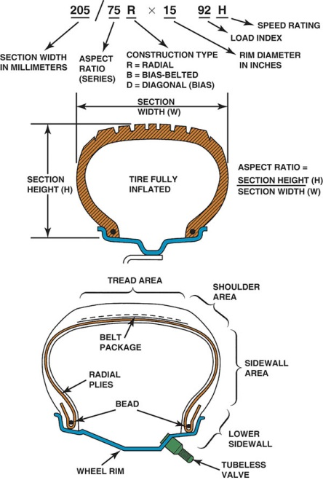
Figure 113.9 (a) Tire size designation includes cross-sectional width and aspect ratio. The aspect ratio is the proportional relationship between the width and the height of the tire expressed as a percentage. (b) Cross-sectional view of a typical tire showing the terminology

Slide 22
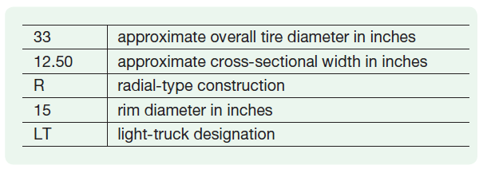
HIGH-FLOTATION TIRES
High-flotation tires for light trucks are designed to give improved off-road performance on sand, mud, and soft soil and still provide acceptable hard-road surface performance. High-flotation tires have a size designation such as 33 × 12.50R × 15LT:

Slide 23
HOW MUCH BIGGER CAN I GO?
When changing tire size, there are many factors to consider:
The tire should be the same outside diameter as the original to maintain the proper suspension, steering, and ride height specifications.
Tire size affects vehicle speed sensor values, ABS brake wheel sensor values that can change automatic transmission operation, and ABS operation.
Generally, a tire that is 10 mm wider is acceptable.

Slide 24
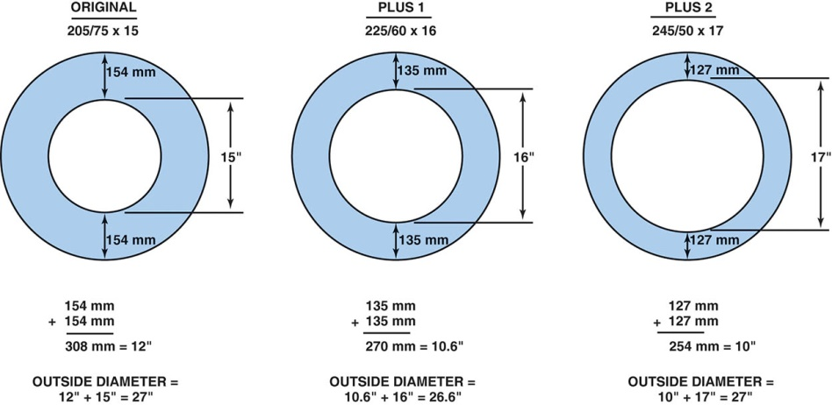
Figure 113.10 Notice that the overall outside diameter of the tire remains almost the same and at the same time the aspect ratio is decreased and the rim diameter is increased

Slide 25
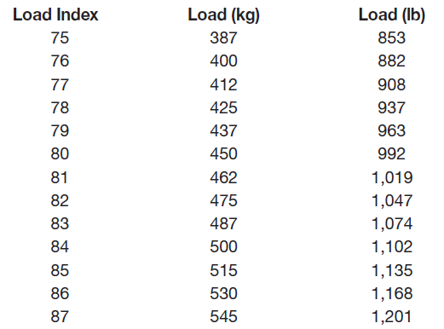
LOAD INDEX AND EQUIVALENT LOADS
The load index is an abbreviated method to indicate the load-carrying capabilities of a tire.
Examples:

Slide 26
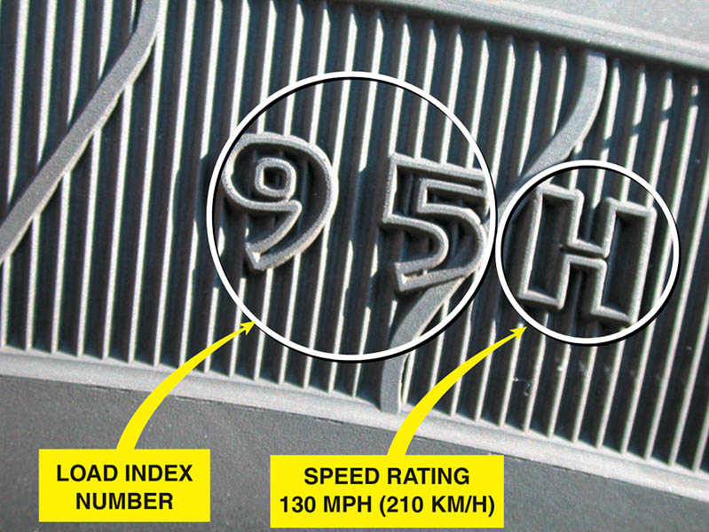
Figure 113.11 Typical sidewall markings for load index and speed rating following the tire size

Slide 27
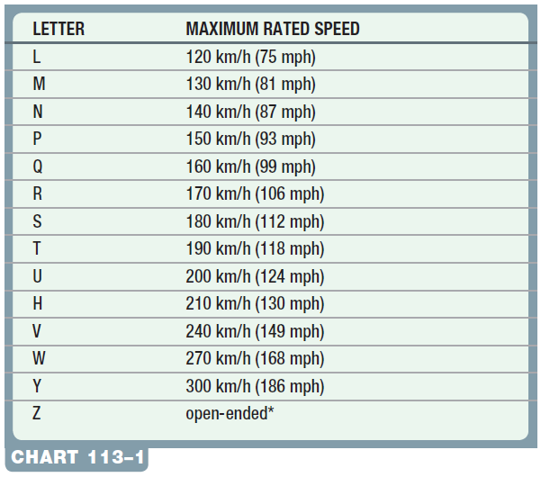
SPEED RATINGS
Tires are rated according to the maximum sustained speed.

Slide 28
TIRE PRESSURE AND TRACTION
All tires should be inflated to the specifications given by the vehicle manufacturer.
Most vehicles have recommended tire inflation figures written in the owner’s manual or on a placard or sticker on the door post or glove compartment.

Slide 29
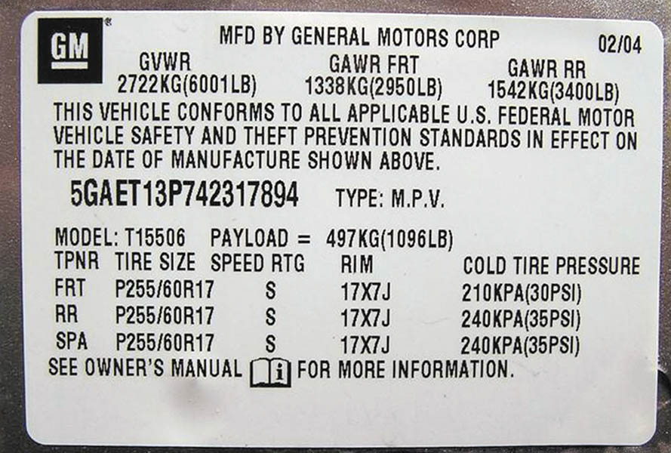
Figure 113.12 A typical door placard used on a General Motors vehicle indicating the recommended tire inflation. Note that the information also includes the size and speed rating of the tire as well as the recommended wheel size

Slide 30
RIM WIDTH AND TIRE SIZE
The rim width is the distance between the tire flanges sometimes called the “flange-to-flange” width.
As a general rule, for a given rim width it is best not to change tire width more than 10 mm (either wider or narrower).
Installing a tire that is too wide or too narrow will cause undesired tire wear.

Slide 31
UNIFORM TIRE QUALITY GRADING SYSTEM (1 OF 3)
The U.S. Department of Transportation and the National Highway Traffic Safety Administration developed a system of tire grading, the Uniform Tire Quality Grading System (UTQGS), to help customers better judge the relative performance of tires.
The three areas of tire performance are tread wear, traction, and temperature resistance.

Slide 32
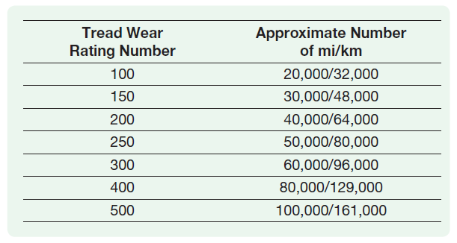
UNIFORM TIRE QUALITY GRADING SYSTEM (2 OF 3)
Tread Wear
The tread wear grade is a comparison rating based on the wear rate of a standardized tire, tested under carefully controlled conditions, which is assigned a value of 100.

Slide 33
UNIFORM TIRE QUALITY GRADING SYSTEM (3 OF 3)
Traction
Traction performance is rated by the letters AA, A, B, and C, with AA being the highest.
Temperature Resistance
Temperature resistance is rated by the letters A, B, and C, with A being the highest rating.

Slide 34
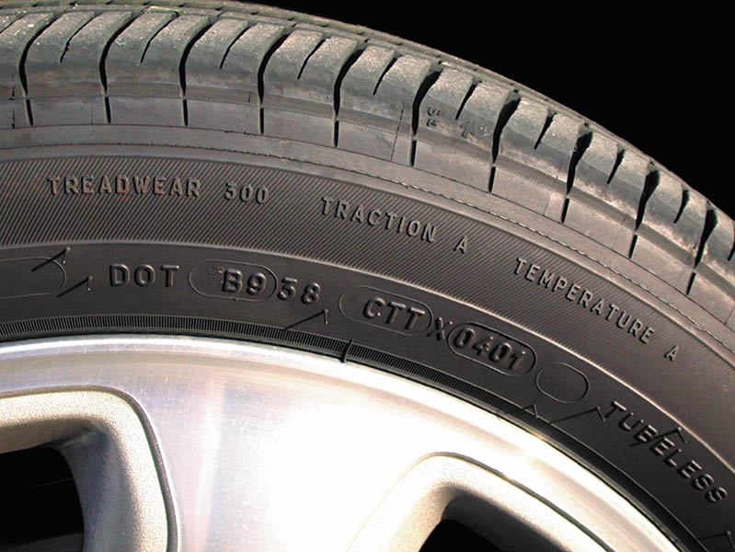
Figure 113.13 Typical “Uniform Tire Quality Grading System” (UTQGS) ratings imprinted on the tire sidewall

Slide 35
QUESTION 2: ?
What are the three criteria used in the Uniform Tire Grading Quality system?

Slide 36
ANSWER 2:
Wear, traction, and temperature resistance.

Slide 37
ALL-SEASON TIRE DESIGNATION
Most all-season tires are rated and labeled as M & S, MS, or M + S, and therefore must adhere to general design features as specified by the Rubber Manufacturers Association (RMA).
Tires labeled M & S are constructed with an aggressive tread design, as well as tread compounds and internal construction that are designed for mud and snow.
One design feature is that the tire has at least 25% void area.
The tread rubber used to make all-season tires is also more flexible at low temperatures.

Slide 38
DOT TIRE CODE
Each tire that is DOT-approved has a DOT number molded into the sidewall of the tire.
The DOT tire code requirements include resistance to tire damage that could be caused by curbs, chuckholes, and other common occurrences for a tire used on public roads.
Starting with tires manufactured after January 1, 2000, the tire build date includes four digits rather than three digits.
A new code such as “3406” means the 34th week of 2006.

Slide 39
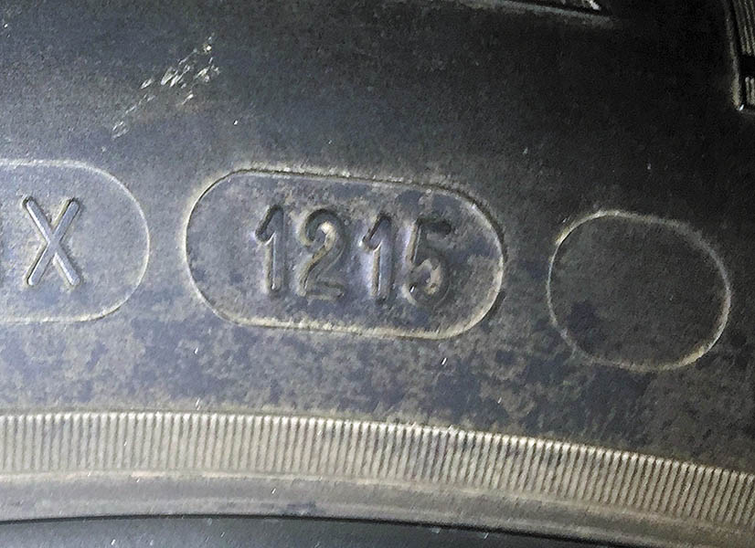
Figure 113.14 Typical DOT date code. This tire was built the 12th week of 2015

Slide 40
TIRE CONICITY AND PLY STEER
Tire conicity can occur during the construction of any radial or belted tire when the parts of the tire are badly positioned, causing the tire to be smaller in diameter on one side.
It can cause the vehicle to pull to one side of the road due to the cone shape of the tire.
Ply steer is another term that describes a slight pulling force on a vehicle due to tire construction.
Ply steer is due to the angle of the cords in the belt layers.

Slide 41
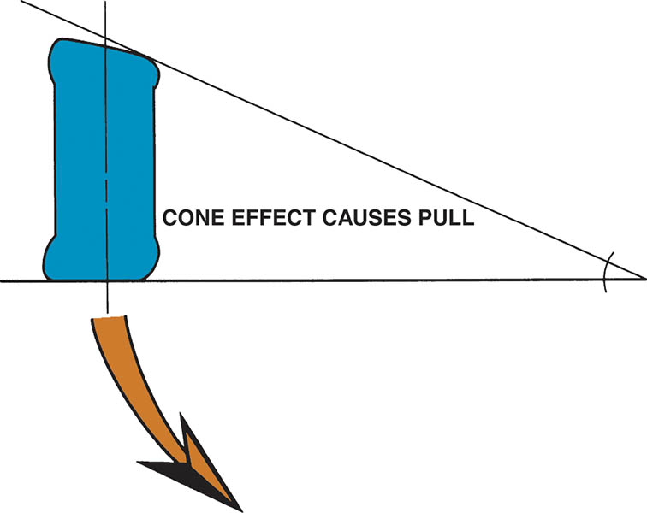
Figure 113.15 Conicity is a fault in the tire that can cause the vehicle to pull to one side due to the cone effect (shape) of the tire

Slide 42
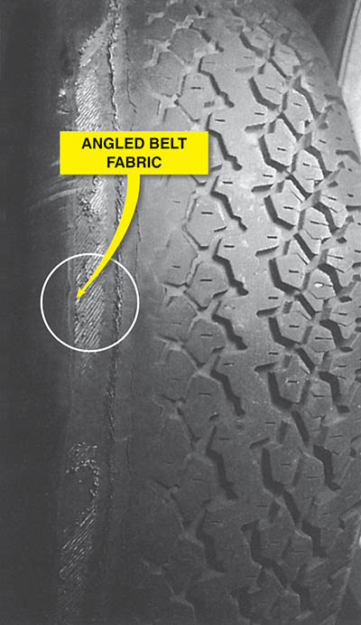
Figure 113.16 Notice the angle of the belt material in this worn tire. The angle of the belt fabric can cause a “ply steer” or slight pulling force toward one side of the vehicle

Slide 43
VEHICLE HANDLING AND TIRE SLIP ANGLE
As a vehicle is turned, the wheels are moved while the tires remain in contact with the road.
These actions “twist” the carcass of the tire and create a slip angle between the direction the wheel is pointing and the direction the tread is pointing.
This movement causes a slight delay in the turning of the vehicle and causes tire wear.

Slide 44
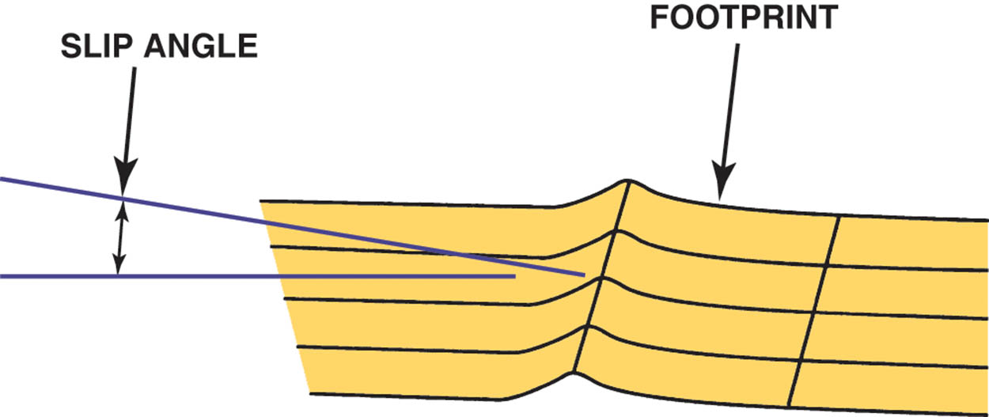
Figure 113.17 Slip angle is the angle between the direction the tire tread is heading and the direction it is pointed

Slide 45
SPARE TIRES
Most vehicles today come equipped with space-saver spare tires.
Many small, space-saving spare tires use a higher-than-normal air inflation pressure, usually 60 PSI (414 kPa).
Space saver spares are designed to provide normal handling but not the same durability as full-size tires.
Space saver tires removed as soon as possible.

Slide 46
RUN-FLAT TIRES (1 OF 2)
Run-flat tires (abbreviated RFT) are designed to operate without any air for a limited distance (usually 50 miles at 55 mph).
A typical run-flat tire (also called extended mobility tire [EMT] or zero pressure [ZP] tire) requires the use of an air pressure sensor/ transmitter and a dash-mounted receiver to warn the driver that a tire has lost pressure.

Slide 47
RUN-FLAT TIRES (2 OF 2)
PAX Run-Flat Tires
Michelin developed a run-flat tire that has three unique components:
A special wheel that has two bead seats that are of different diameters.
A urethane support ring that is designed to support the weight of the vehicle in the event of a flat tire.
A special tire that is designed to operate without air.
Servicing a PAX Wheel/Tire assembly
Follow the manufacturers guidelines for service.

Slide 48
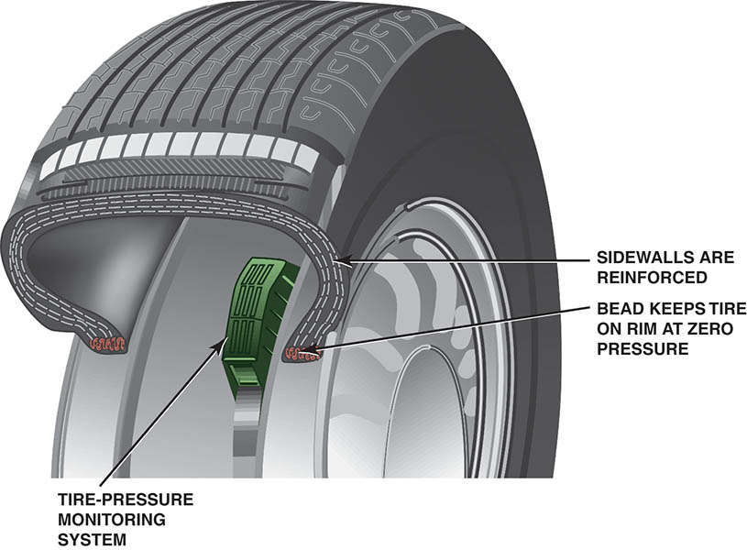
Figure 113.18 Cutaway of a run-flat tire showing the reinforced sidewalls and the required pressure sensor

Slide 49
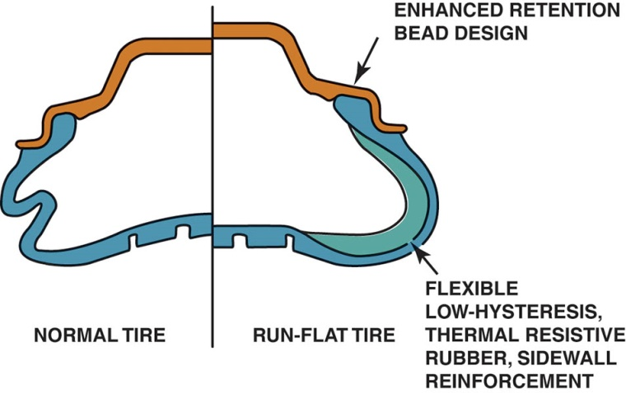
Figure 113.19 A conventional tire on the left and a run-flat tire on the right, showing what happens when there is no air in the tire

Slide 50
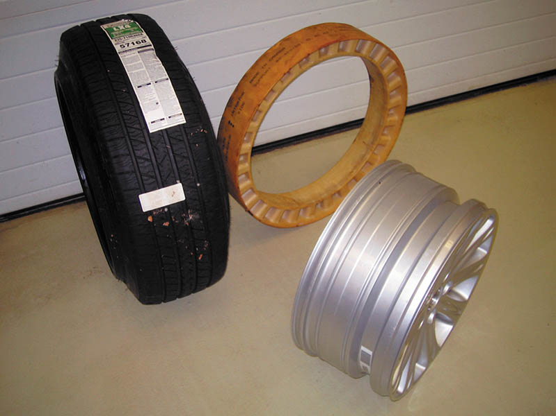
Figure 113.20 The PAX run-flat tire system is composed of three unique components—a special asymmetrical wheel, a urethane support ring, and a special tire

Slide 51
GENERAL MOTORS TPC RATINGS
All General Motors original equipment (OE) tires have a rating that identifies the size as well as the tread design, wear, traction, and heat resistance factors.
All of these factors are combined in a set of numbers and letters that is imprinted in the tire mold.

Slide 52
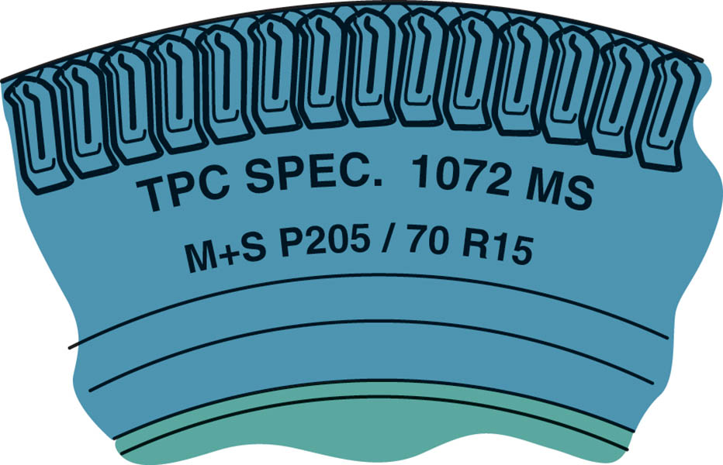
Figure 113.21 The Tire Performance Criteria (TPC) specification number is imprinted on the sidewall of all tires used on General Motors vehicles from the factory

Slide 53
WHEELS (1 OF 3)
Wheel Offset
The wheel has a positive offset if the center section is outward from the wheel centerline.
The wheel has a negative offset if the center section is inboard (or “dished”) from the wheel centerline.
Back Spacing
Back spacing, also called rear spacing or backside setting, is the distance between the back rim edge and the wheel center section mounting pad.

Slide 54
WHEELS (2 OF 3)
Determining Bolt Circle
On four-lug axles and wheels, the bolt circle measurement is simply taken from center to center on opposite studs or holes
On five-lug axles and wheels, one method is to measure from the far edge of one bolt hole to the center of the hole two over from the first.

Slide 55
WHEELS (3 OF 3)
Steel Wheels
A steel wheel is very strong due to its designed shape and the fact that it is work hardened during manufacturing.
Steel wheels are formed from welded hoops that are flared and joined to stamped spiders.
Aluminum Wheels
Forged and cast aluminum wheels are commonly used on cars and trucks.
Forged means that the aluminum is hammered or forged under pressure into shape.

Slide 56
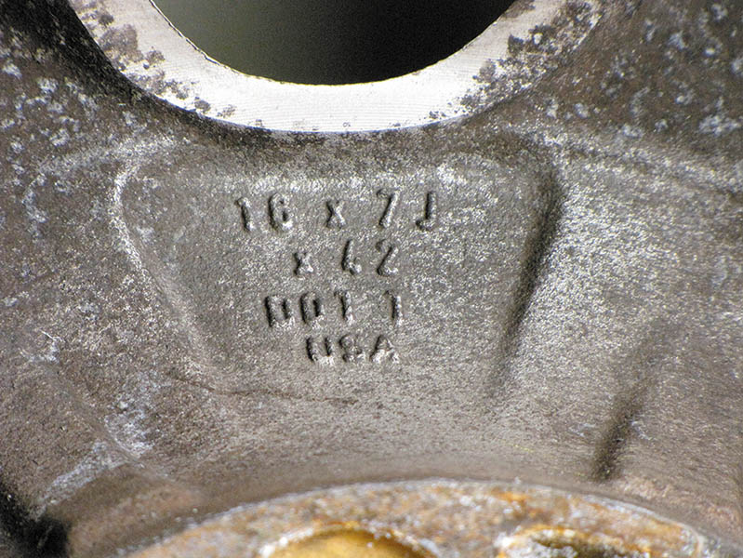
Figure 113.22 The size of the wheel is usually cast or stamped into the wheel. This wheel is 7 inch wide. The letter “J” refers to the contour of the bead seat area of the wheel

Slide 57
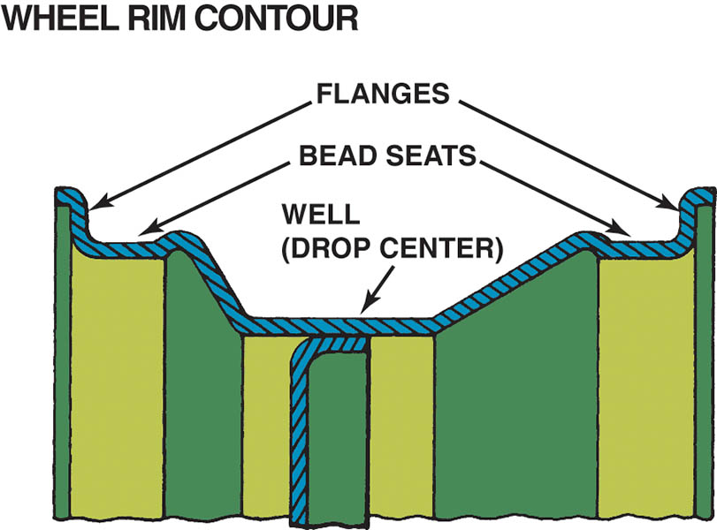
Figure 113.23 The wheel rim well provides a space for the tire to fit during mounting; the bead seat provides a tire-to-wheel sealing surface; the flange holds the beads in place

Slide 58
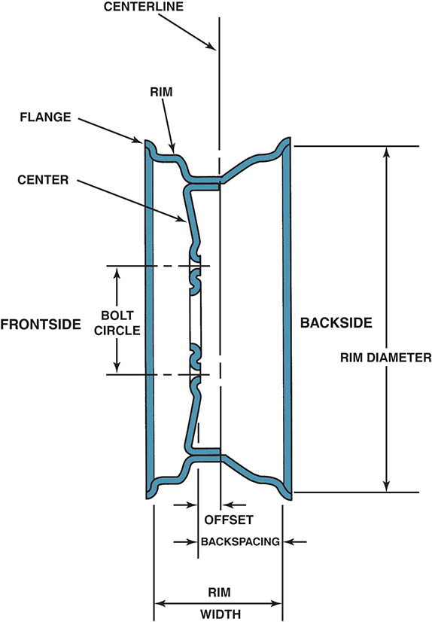
Figure 113.24 A cross section of a wheel showing part designations

Slide 59
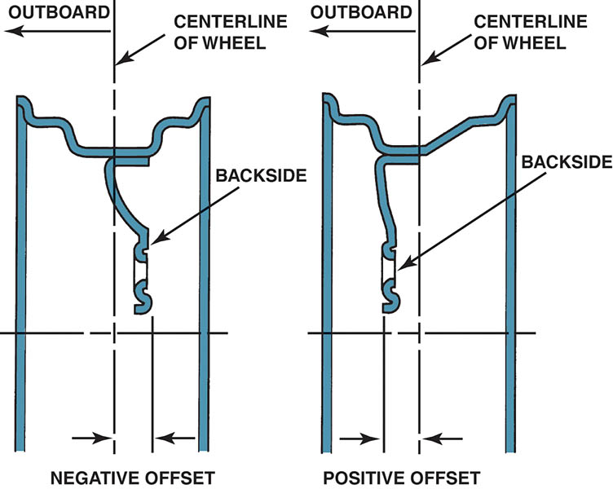
Figure 113.25 Offset is the distance between the centerline of the wheel and the wheel mounting surface

Slide 60
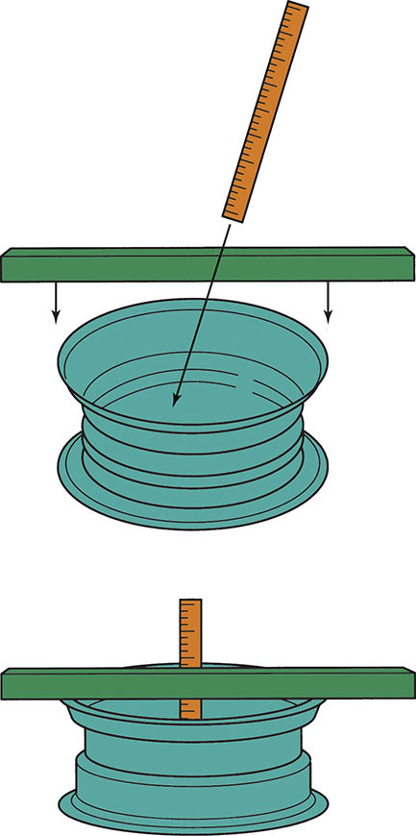
Figure 113.26 Back spacing (rear spacing) is the distance from the mounting pad to the edge of the rim. Most custom wheels use this measurement method to indicate the location of the mounting pad in relation to the rim

Slide 61
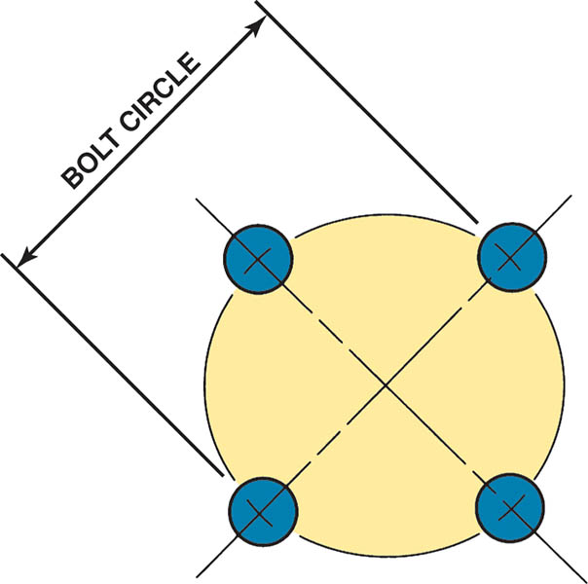
Figure 113.27 Bolt circle is the diameter of a circle that can be drawn through the center of each lug hole or stud. The bolt circle is sometimes referred to as PCD for pitch circle diameter

Slide 62
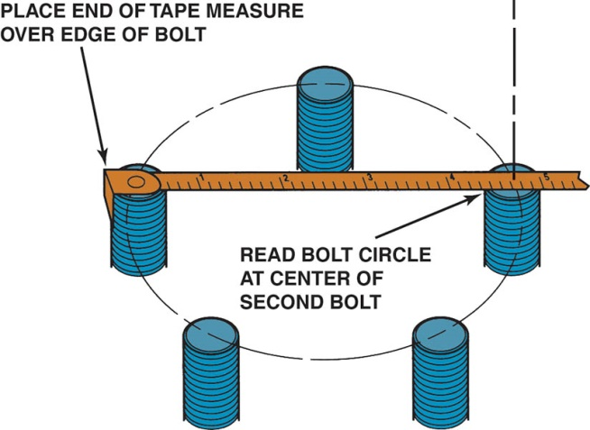
Figure 113.28 Measuring the bolt circle on a five-lug wheel is difficult, but a quick and easy way includes measuring as shown to determine the approximate bolt circle of a five-lug wheel

Slide 63
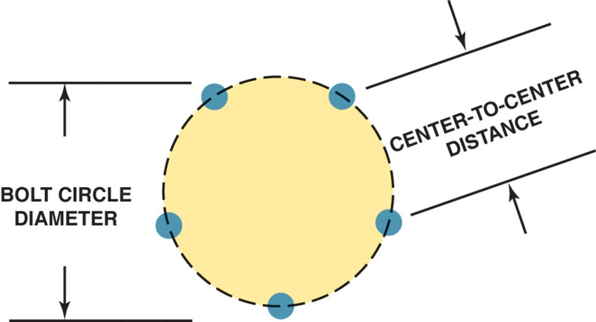
Figure 113.29 Measure center-to-center distance and compare the distance to the figures in the chart in the text to determine the diameter for a five-lug bolt circle

Slide 64
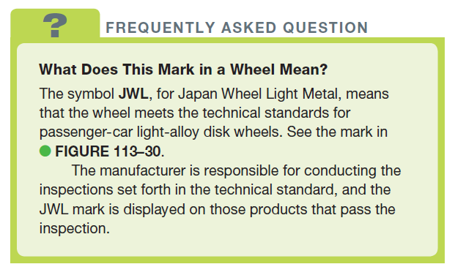
FREQUENTLY ASKED QUESTION

Slide 65
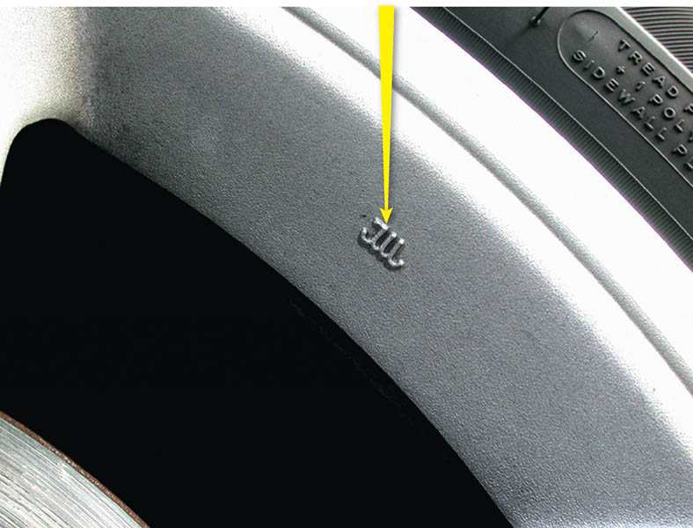
Figure 113.30 A typical JWL symbol for the Japan Wheel Light Metal standard mark

Slide 66
QUESTION 3: ?
What is wheel offset?

Slide 67
ANSWER 3:
The location of the wheel center section relative to the centerline.

Slide 68
TIRE VALVES
All tires use a tire valve, called a Schrader valve, to hold air in the tire.
Most tire experts agree that the valve stem (which includes the Schrader valve) should be replaced whenever tires are replaced.
Aluminum (alloy) wheels often require special metal valve stems that use a rubber washer and are actually bolted to the wheel.

Slide 69
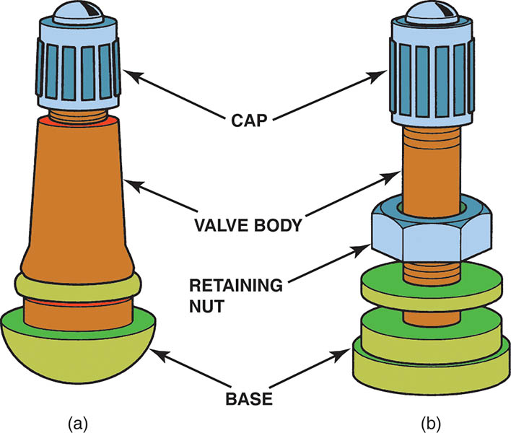
Figure 113.31 a) A rubber snap-in style tire valve assembly. (b) A metal clamp-type tire valve assembly used on most highpressure (over 60 PSI) tire applications such as is found on many trucks, RVs, and trailers.

Slide 70
LUG NUTS
Lug nuts are used to hold a wheel to the brake disc, brake drum, or wheel bearing assembly.
Some vehicles use a lug bolt that is threaded into a hole in the brake drum or bearing assembly.
Typical lug nuts are tapered so that the wheel stud will center the wheel onto the vehicle
Many alloy wheels use a shank-nut-type lug nut that has straight sides without a taper
Lug Studs are pressed into the hub or axle.

Slide 71
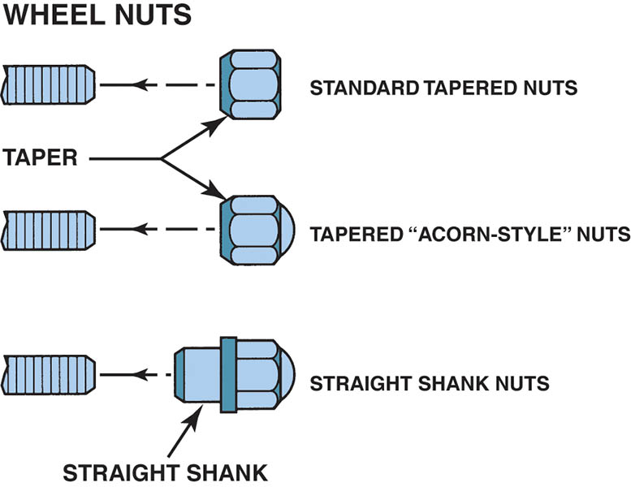
Figure 113.32 Various styles of lug nuts

Slide 72
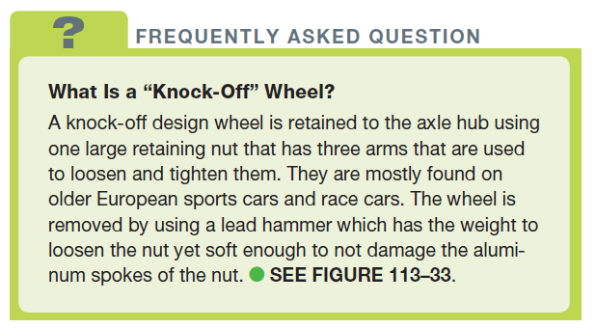
FREQUENTLY ASKED QUESTION

Slide 73
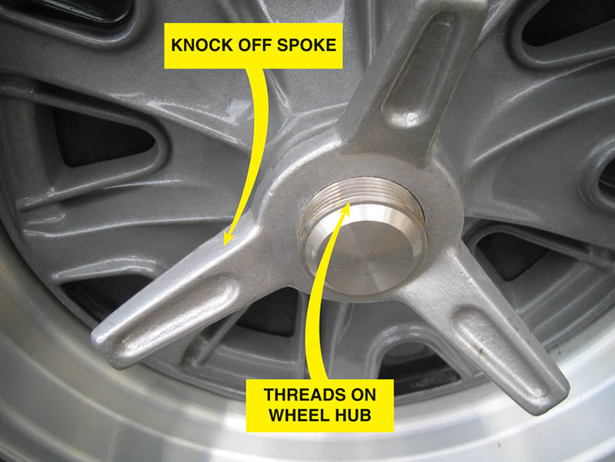
Figure 113.33 (a) A typical knock-off-type wheel showing the large three prong wing nuts and the threads on the wheel hub

Slide 74
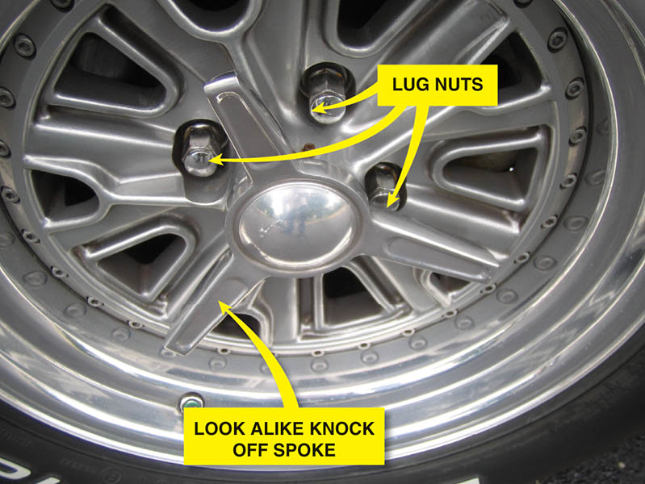
Figure 113.33 (b) A lookalike knock-off wheel that looks like a knock-off but uses lug nuts

Slide 75
TIRE INSPECTION

Slide 76
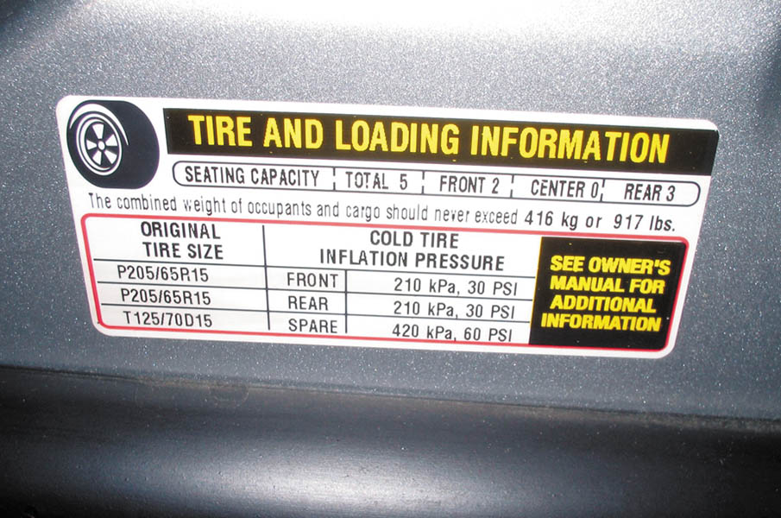
1. Check the tire information placard, usually located on the driver’s door or door jamb, for the specified tire size and inflation pressure.

Slide 77
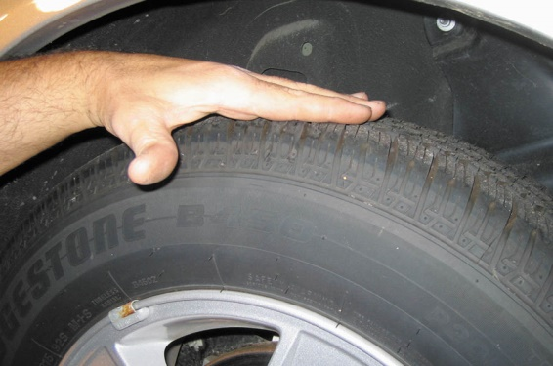
2. Visually check the tires for abnormal wear or damage.

Slide 78
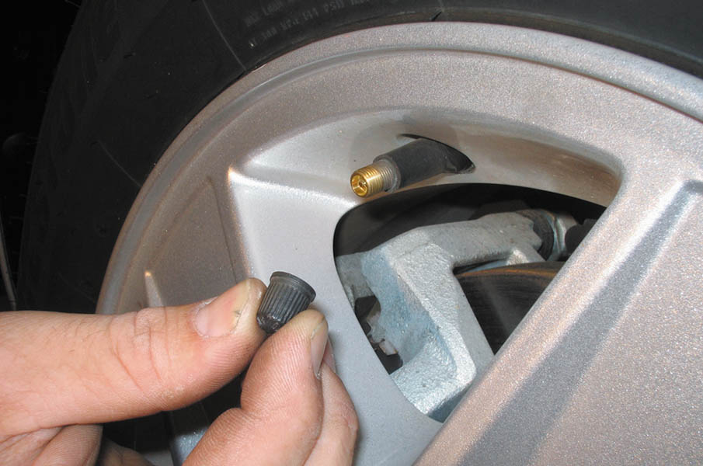
3. Remove the tire valve cap and visually check the condition of the valve stem.

Slide 79
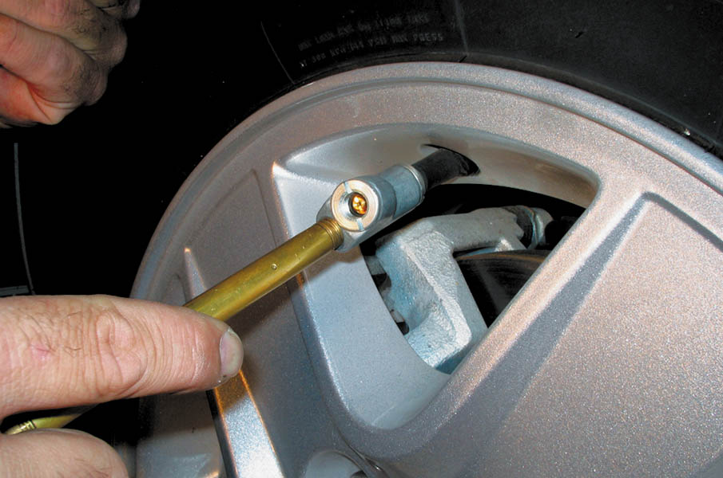
4. Check inflation pressure by pushing the tire-pressure gauge straight onto the end of the tire valve. If a “hissing” sound is heard, then the reading will not be accurate.

Slide 80
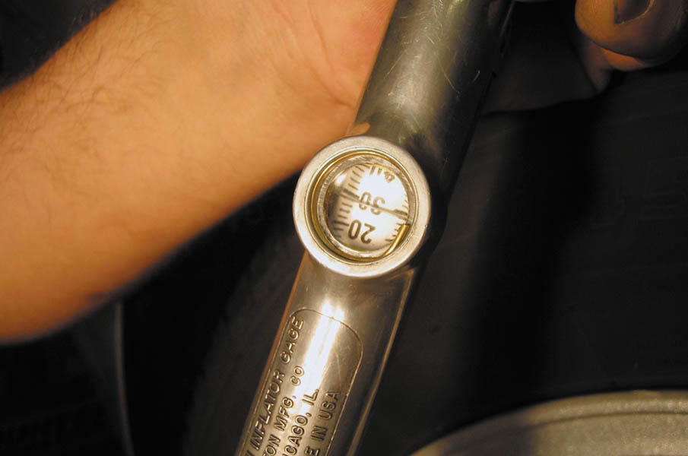
5. Read the pressure and compare to specifications. Use an analog or digital gauge if possible which have been proven to be more accurate than a mechanical pencil type gauge.

Slide 81
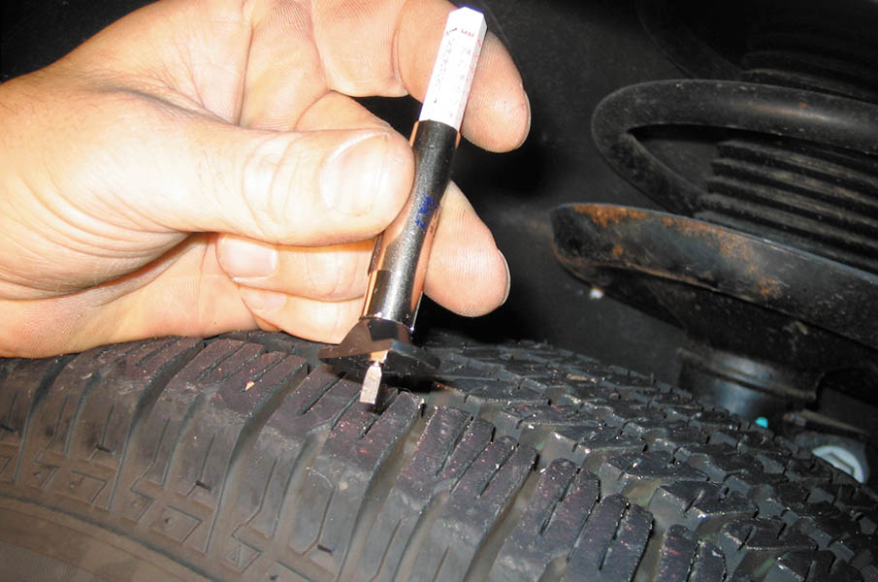
6. A typical tire tread depth gauge.

Slide 82
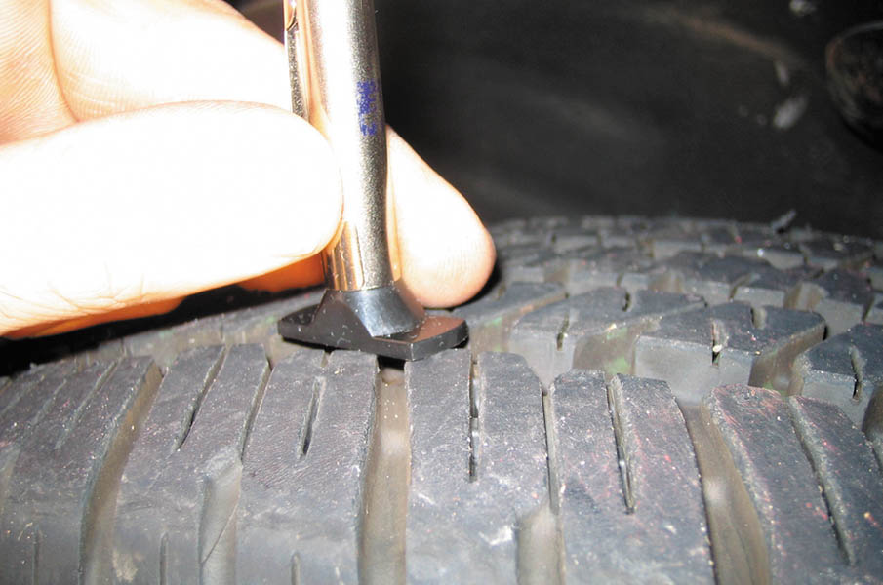
7. The blade of the tire tread depth gauge is pushed down into the groove of the tire at the lowest part.

Slide 83

8. Remove the gauge from the tire and read the tread depth at the metal housing. Tread depth is usually measured in 1/32’s of an inch.

Slide 84

9. If the top of Lincoln’s head is visible, then the tread depth is lower than 2/32 inch, which is the legal limit in many states.

Slide 85

Copyright

