Slide 1
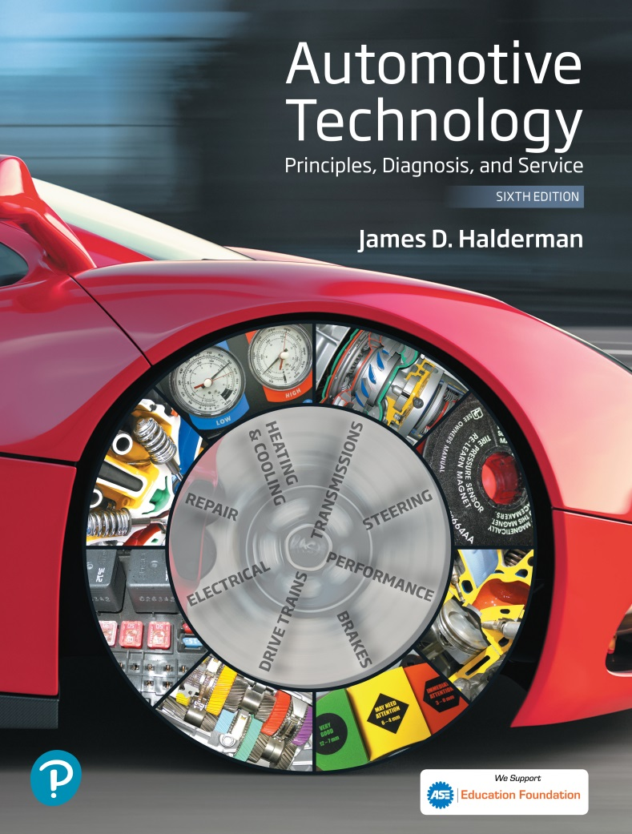
Automotive Technology Principles, Diagnosis, and Service
Sixth Edition
Chapter 112
Electronic Stability Control Systems
Copyright © 2018, 2015, 2011 Pearson Education, Inc. All Rights Reserved

Slide 2
LEARNING OBJECTIVES (1 of 2)
112.1 Discuss the need for electronic stability control (ESC).
112.2 List the requirements for ESC systems.
112.3 Describe how to test the functioning of an ESC system.
112.4 List the sensors needed for the ESC system.

Slide 3
LEARNING OBJECTIVES (2 of 2)
112.5 Describe how a traction control (TC) system works.
112.6 List the steps in the diagnostic process for ESC and TC system faults.
112.7 This chapter will help prepare for Brakes (A5) ASE certification test content area "D" (Electronic Brake Control Systems: Antilock Brake System (ABS), Traction Control System (TCS), and Electronic Stability Control System (ESC) Diagnosis and Repair).

Slide 4
THE NEED FOR ELECTRONIC STABILITY CONTROL
Purpose and Function
  The electronic stability control system applies individual wheel brakes to bring the vehicle under control if either understeering or oversteering conditions occur.
Telltale Lamp
  The ESC lamp, called a telltale light, is required to remain on for as long as the malfunction exists, whenever the ignition is in “On” (“Run”) position.
  Some manufacturers install a switch to limit or disable the system for the key cycle.

Slide 5
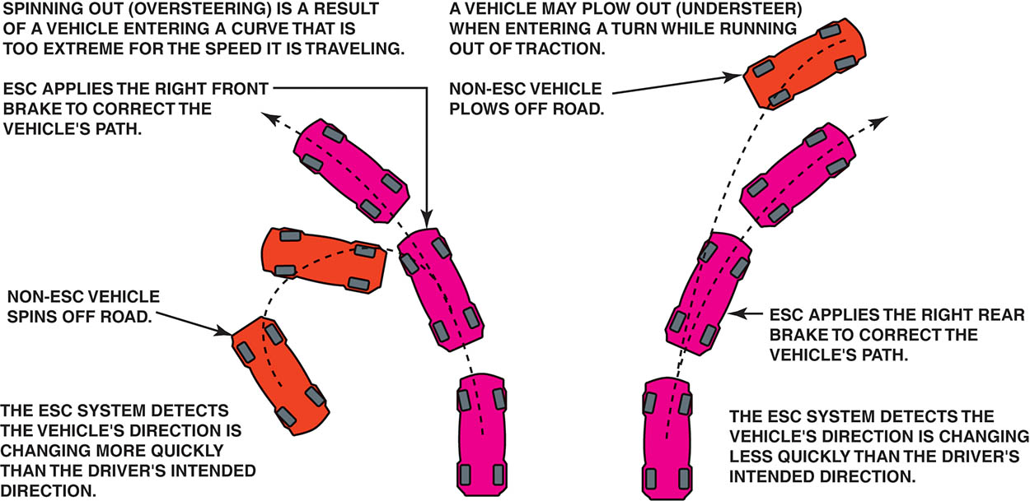
Figure 112.1 The electronic stability control (ESC) system applies individual wheel brakes to keep the vehicle under control of the driver

Slide 6
FEDERAL MOTOR VEHICLE SAFETY STANDARD (FMVSS) NO. 26
Federal Motor Vehicle Safety Standard (FMVSS) No. 126 (June 26, 2008), Electronic Stability Control Systems, requires that all passenger cars, multipurpose passenger vehicles, trucks, and buses that have a gross vehicle weight rating (GVWR) of 10,000 pounds (4,536 kg) or less to be equipped with an electronic stability control system by September 1, 2011 (2012 model-year vehicles).

Slide 7
SINE WITH DWELL TEST
The standardized test used to determine if an electronic stability control system functions okay is called the sine with dwell (SWD) test.
A vehicle is driven at 50 mph (80 km/h) and driven on a curved course that looks like a sine wave or the letter “S” on its side.

Slide 8
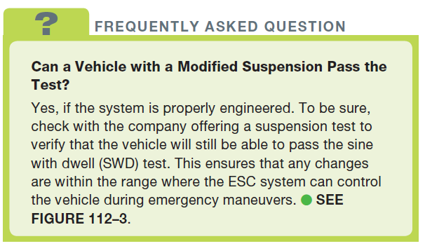
FREQUENTLY ASKED QUESTION

Slide 9
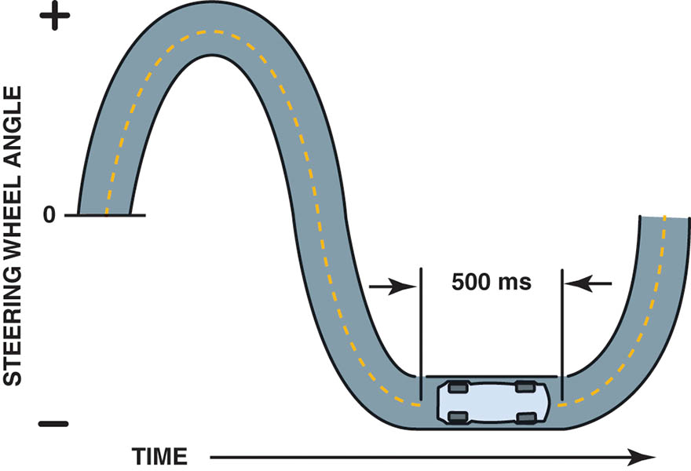
Figure 112.2 The sine with dwell test is designed to test the electronic stability control (ESC) system to determine if the system can keep the vehicle under control

Slide 10
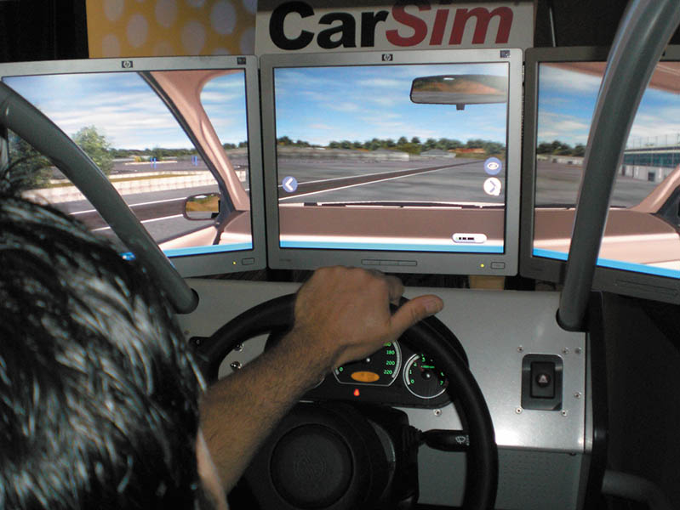
Figure 112.3 Using a simulator is the most cost-effective way for vehicle and aftermarket suspension manufacturers to check that the vehicle is able to perform within the FMVSS No. 126 standard for vehicle stability

Slide 11
ESC SENSORS (1 OF 2)
Steering Wheel Position Sensor
  The function of this sensor is to provide the driver’s intended direction with signals relating to steering wheel position, speed, and direction.
Vehicle Speed Sensor
  ABS wheel speed sensors provide an analog or digital signal based on sensor design.

Slide 12
ESC SENSORS (2 OF 2)
Lateral Acceleration Sensor
  The function of the lateral acceleration sensor is to provide the suspension control module with feedback regarding vehicle cornering forces.
Yaw Rate Sensor
  This information is used to determine how far the vehicle has deviated from the driver’s intended direction.

Slide 13
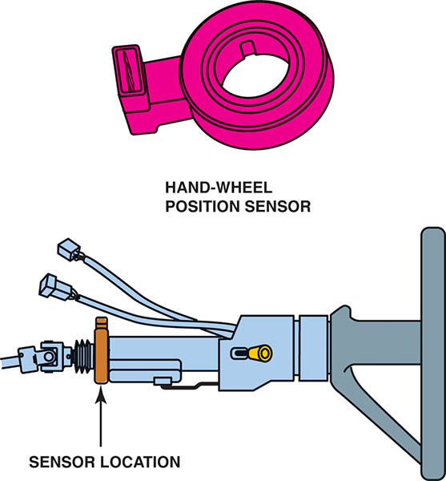
Figure 112.4 The hand-wheel position sensor is usually located at the base of the steering column

Slide 14
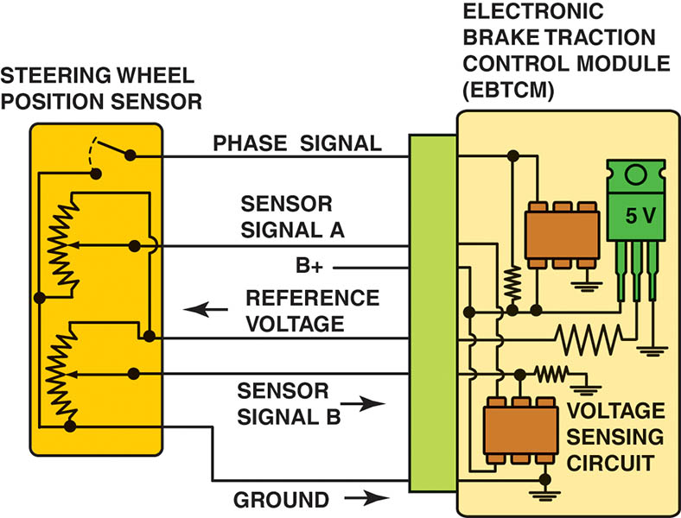
Figure 112.5 Hand-wheel (steering wheel) position sensor schematic

Slide 15
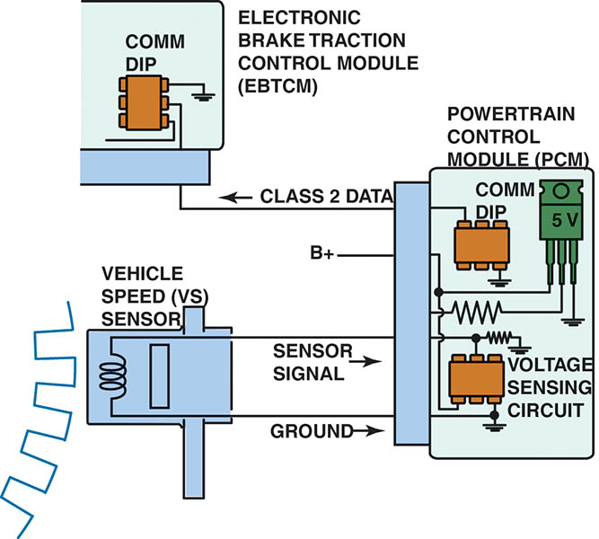
Figure 112.6 The VS sensor information is transmitted to the EBCM by Class 2 serial data

Slide 16
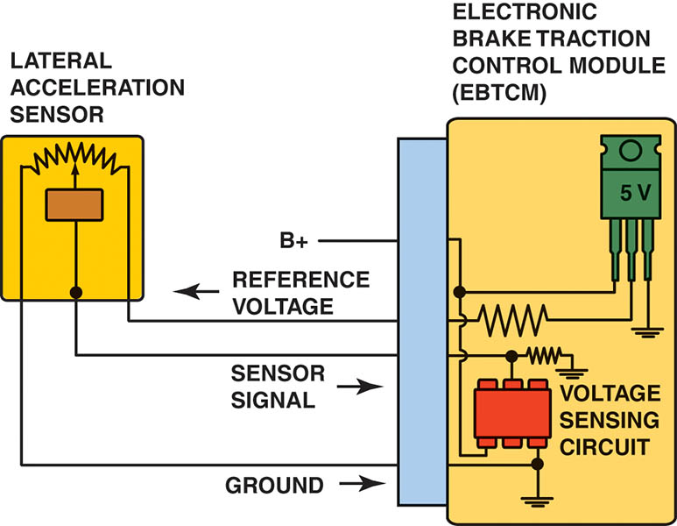
Figure 112.7 A schematic showing the lateral acceleration sensor and EBCM

Slide 17
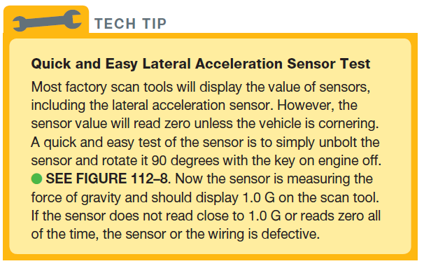
Tech Tip

Slide 18
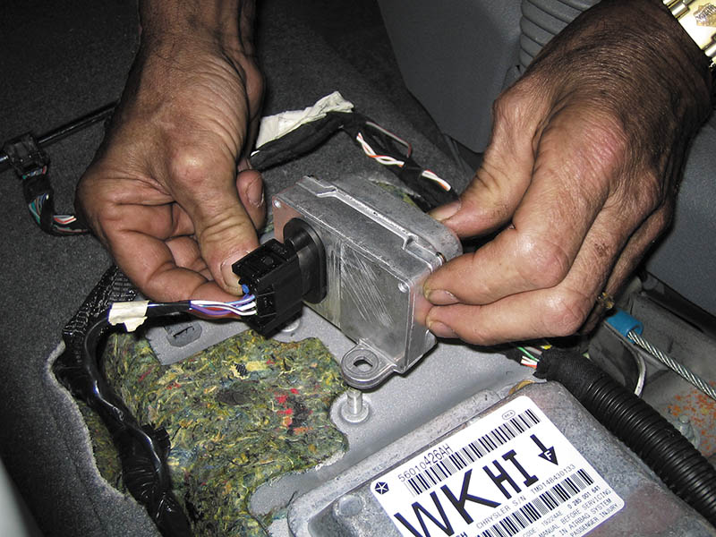
Figure 112.8 A lateral acceleration sensor is usually located under the center console and can be easily checked by unbolting it and turning it on its side while monitoring the sensor value using a scan tool. When it is on its side, the sensor value should read 1.0 G

Slide 19
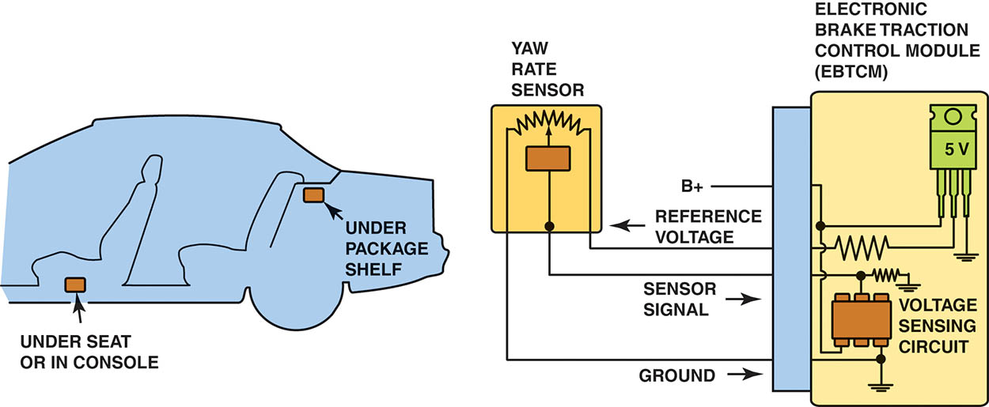
Figure112.9 Yaw rate sensor showing the typical location and schematic

Slide 20
QUESTION 1: ?
What sensors are used in an electronic stability control system?

Slide 21
ANSWER 1:
Vehicle speed sensor, steering wheel position sensor, lateral sensor, yaw rate sensor.

Slide 22
TRACTION CONTROL (1 OF 3)
Purpose and Function
  Traction control allows an ABS to control wheel spin during acceleration.
System Components
  BCM, PCM or ABS Controller
  Throttle position sensor
  Wheel speed sensor
  Engine speed
  Transmission range switch

Slide 23
TRACTION CONTROL (2 OF 3)
Traction Control Operation
  Retard ignition timing to reduce engine torque.
  Decrease the fuel injector pulse-width to reduce fuel delivery to the cylinder to reduce engine torque.
  Reduce the amount of intake air if the engine is equipped with an electronic throttle control (ETC).
  Upshift the automatic transmission/transaxle.
  Apply individual wheel brakes to slow or stop the wheel from spinning.

Slide 24
TRACTION CONTROL (3 OF 3)
Traction Active Light
  This helps alert the driver that the wheels are losing traction.
Traction Deactivation Switch
  A dash-mounted switch that allows the driver to deactivate the system when desired.

Slide 25
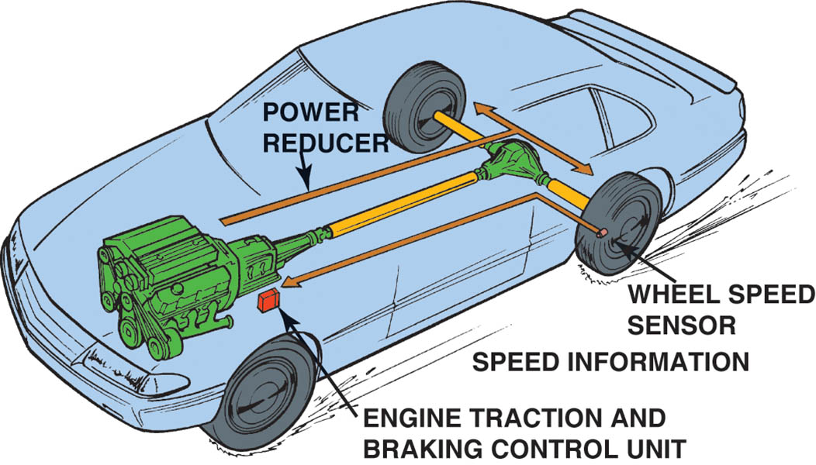
Figure 112.10 Typical traction control system that uses wheel speed sensor information and the engine controller (PCM) to apply the brakes at lower speeds and also reduce engine power applied to the drive wheels

Slide 26
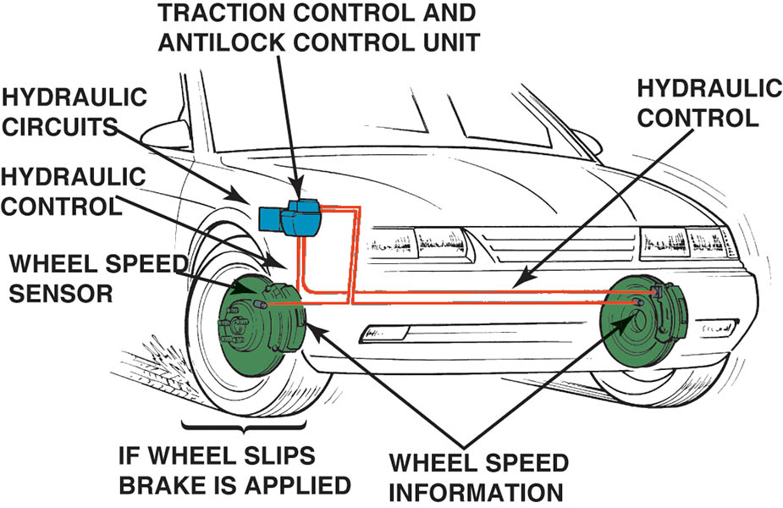
Figure 112.11 Wheel speed sensor information is used to monitor if a drive wheel is starting to spin

Slide 27
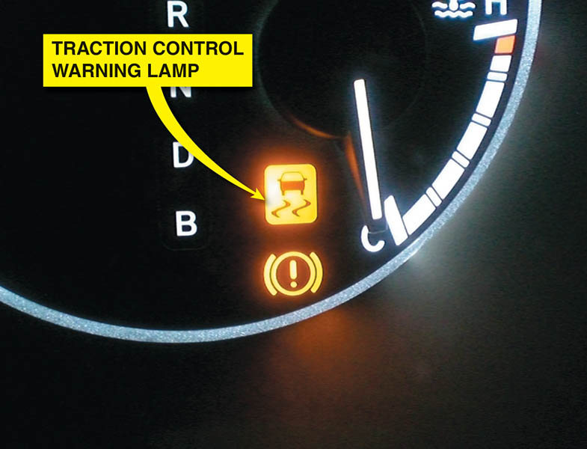
Figure 112.12 A traction control or low traction light on the dash is confusing to many drivers. When the lamp is on or flashing, it indicates that a low traction condition has been determined and the traction control system is working to restore traction.

Slide 28
ESC/TC DIAGNOSIS
Verify the customer concern (complaint).
Perform a thorough visual inspection.
Check service information.
Follow the troubleshooting procedure.
Repair the fault.
Road test the vehicle and verify the repair.

Slide 29
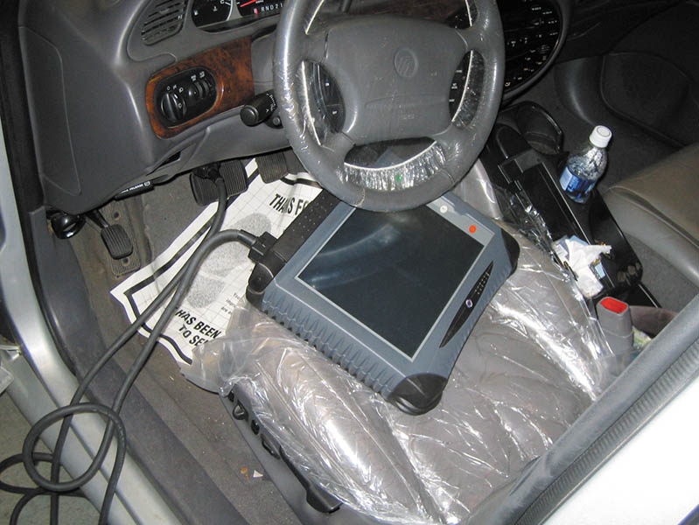
Figure 112.13 The use of a factory scan tool is often needed to diagnose the ESC system

Slide 30
QUESTION 2: ?
What is the purpose of a traction control system?

Slide 31
ANSWER 2:
Control wheel spin on acceleration.

Slide 32

Copyright

