Slide 1

Automotive Technology Principles, Diagnosis, and Service
Sixth Edition
Chapter 111
ABS Diagnosis and Service
Copyright © 2018, 2015, 2011 Pearson Education, Inc. All Rights Reserved

Slide 2
LEARNING OBJECTIVES (1 of 2)
111.1 Explain the ABS diagnostic procedure and retrieval of diagnostic codes.
111.2 Explain how to diagnose the OBD-II ABS system.
111.3 Explain how to diagnose wheel speed sensors.
111.4 List the steps in the hydraulic ABS service procedure.

Slide 3
LEARNING OBJECTIVES (2 of 2)
111.5 Discuss ABS safety precautions.
111.6 This chapter will help prepare for Brakes (A5) ASE certification test content area “D” (Electronic Brake Control Systems: Antilock Brake System (ABS), Traction Control System (TCS), and Electronic Stability Control System (ESC) Diagnosis and Repair).

Slide 4
ABS FAULT DIAGNOSIS (1 OF 2)
ABS Diagnostic Steps
  Verify the customer concern.
  Perform a visual inspection.
  Check for stored diagnostic trouble codes (DTCs).
  Check for technical service bulletins (TSBs).
  Determine the root cause.
  Complete the repair.
  Verify the repair.

Slide 5
ABS FAULT DIAGNOSIS (2 OF 2)
Brake Warning Lamp Operation
  Red brake warning lamp
    Low brake fluid level
    Low pressure in half of the hydraulic system
    The parking brake is applied
    May illuminate due to an ABS failure
  Amber ABS warning lamp
    If the amber warning lamp stays on after the vehicle is started, this means that a fault in the ABS system has been detected.

Slide 6
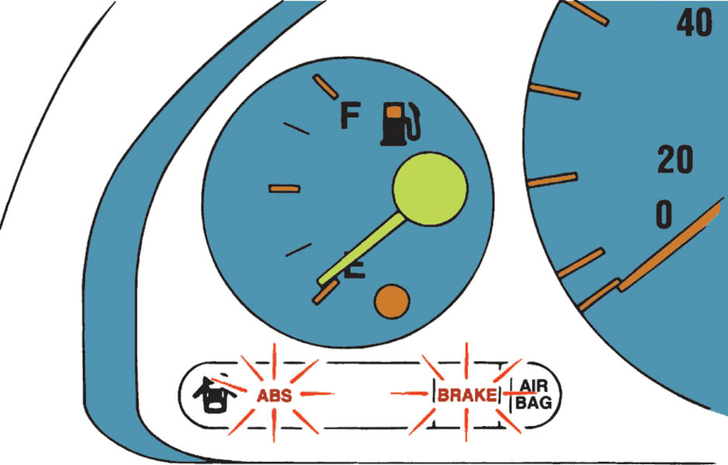
Figure 111.1 On most vehicles equipped with ABS, the ABS and the BRAKE warning lamp should come on as a bulb check when the ignition is first switched on

Slide 7
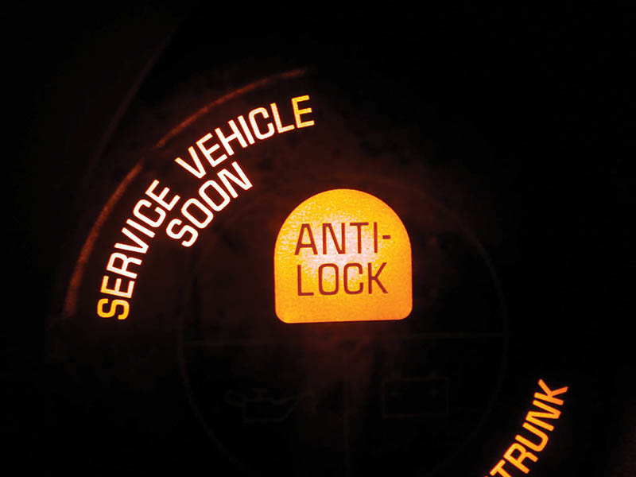
Figure 111.2 An amber ABS

Slide 8
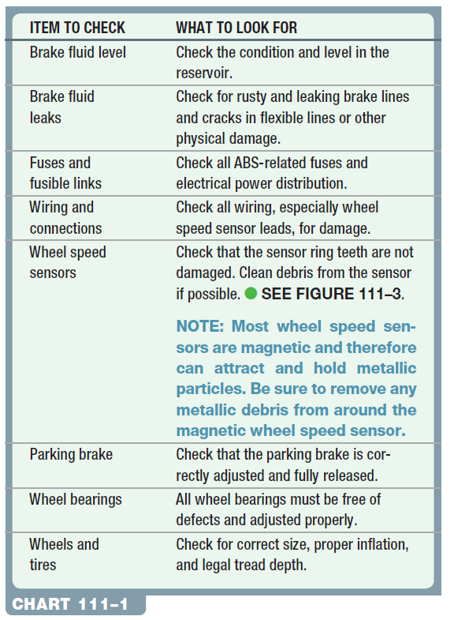
Chart 111-1 Items that should be checked when diagnosing a concern about the antilock brake system (ABS).

Slide 9
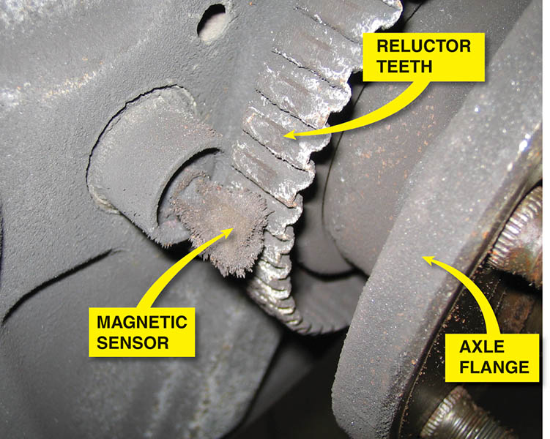
Figure 111.3 A visual inspection of the wheel speed sensor on this older vehicle showed metal “fuzz” had been attracted to the magnetic sensor

Slide 10
QUESTION 1: ?
What does an illuminated red brake warning lamp indicate?

Slide 11
ANSWER 1:
Possible low brake fluid, loss of brake pressure, the parking brake applied, or an ABS failure.

Slide 12
RETREIVING ABS CODES PRIOR TO 1996
Retrieval Methods
  Depending on the exact make, model, and year of manufacture, the procedure can include the use of one or more of the following:
  Scan Tool
  Special Tester
  Fused Jumper Wire
  Test Light
Flash Codes
  The ABS light would blink the code when specific pins were jumped together.
  Some vehicles would not store codes, a breakout box was the method of diagnosis.

Slide 13
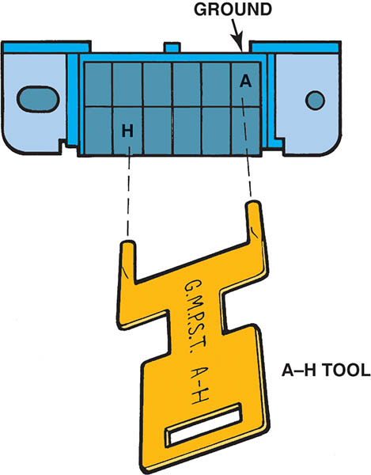
Figure 111.4 General Motors diagnostic connector. Flash codes are available by using a jumper wire to ground (terminal A) to terminal H. This connector is located under the dash near the steering column on older (pre-1996). General Motors vehicles

Slide 14
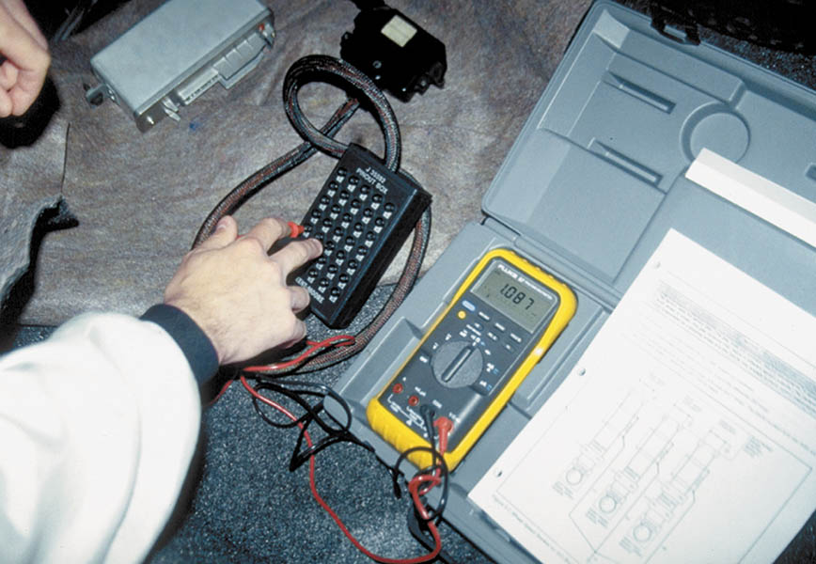
Figure 111.5 A breakout box is being used to diagnose an ABS problem. A digital multimeter is being used to measure resistance and voltage at various points in the system, following the service manual procedure

Slide 15
ABS DIAGNOSIS, OBD-II EQUIPPED VEHICLES (1 OF 2)
Scan Tool Diagnosis
  Most vehicles built since 1996 use the OBD-II diagnostic connector to transmit ABS diagnostic trouble code information to a scan tool.
  Three basic scan tool groups:
    Factory scan tools
    Aftermarket scan tools
    Code readers
ODB-II Connector
  The location is under the dash on the driver’s side usually located within 12 inches (30cm) of the center of the vehicle.

Slide 16
ABS DIAGNOSIS, OBD-II EQUIPPED VEHICLES (2 OF 2)
Control Module Internal Performance Fault
  Typically, if an EBCM reports an internal performance fault, the EBCM must be replaced.
Communications Fault
  This type of fault likely does not indicate that there is a problem within the ABS, but rather sets as a result of another module failing to communicate with the EBCM.
Component-Related Fault
  Identifies an ABS component that is not functioning properly.

Slide 17
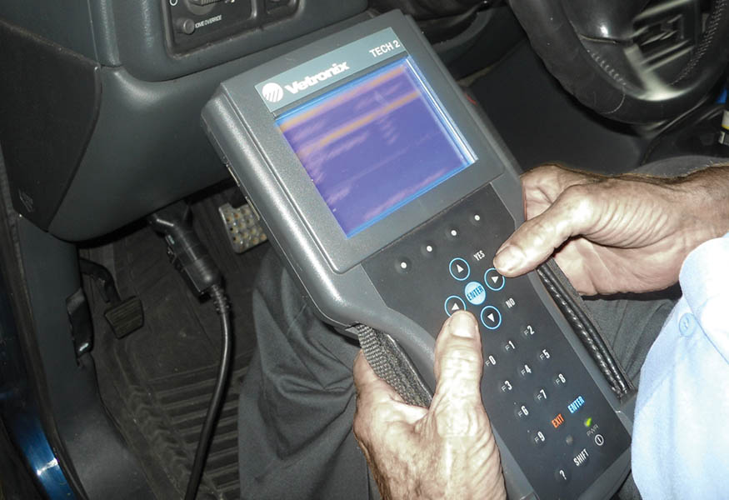
Figure 111.6 A Tech 2 scan tool being used to diagnose an ABS problem on a General Motors’ vehicle

Slide 18
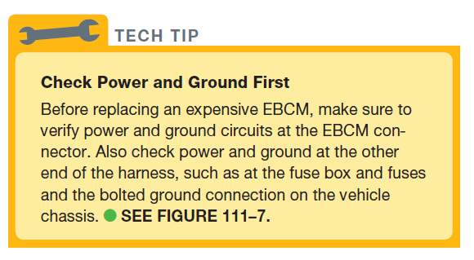
Tech Tip

Slide 19
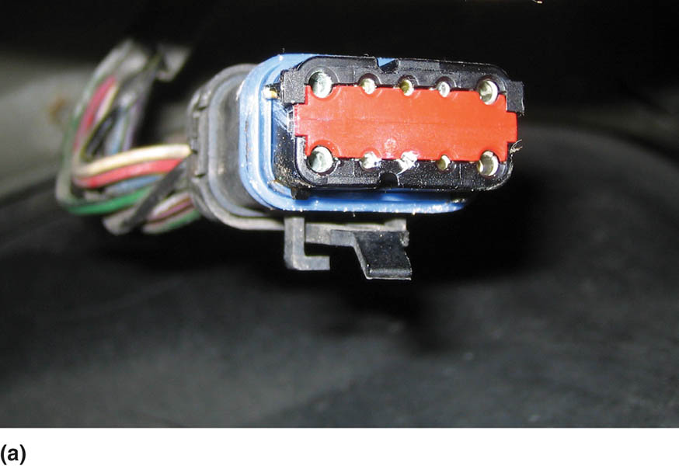
Figure 111.7(a) This corroded electrical connector to the ABS hydraulic control module helped explain why there were many stored diagnostic trouble codes (DTCs)

Slide 20
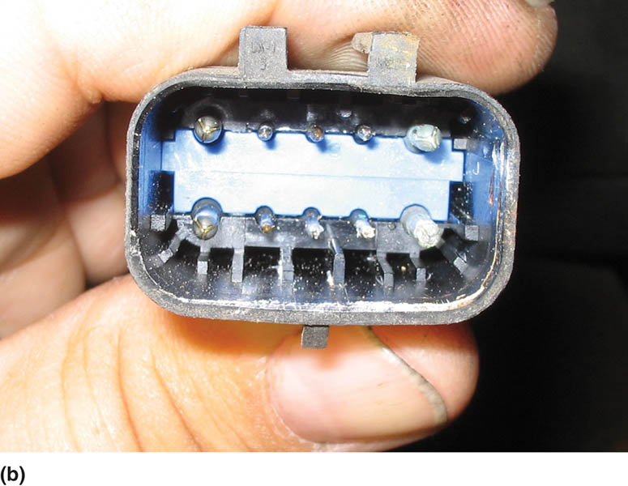
Figure 111.7(b) The male terminals also showed signs of corrosion inside this connector

Slide 21
WHEEL SPEED SENSOR DIAGNOSIS (1 OF 2)
Common Causes of Faults
  These components may suffer from physical damage, buildup of metallic debris on the sensor tip, corrosion, poor electrical connections, and damaged wiring.
Passive Wheel Speed Sensor Diagnosis
  Resistance measurement
  Checking for shorts-to-ground
  AC voltage check
  Scope Testing
  Scan tool testing

Slide 22
WHEEL SPEED SENSOR DIAGNOSIS (2 OF 2)
Active Wheel Speed Sensor Diagnosis
  These sensors are most easily checked using a scan tool.
  Check that battery voltage is available at the sensor with the key on, engine off (KOEO).
  Check the low reference (signal ground) circuit.
  Measure the signal voltage provided by the EBCM along the wheel speed sensor signal circuit KOEO.

Slide 23
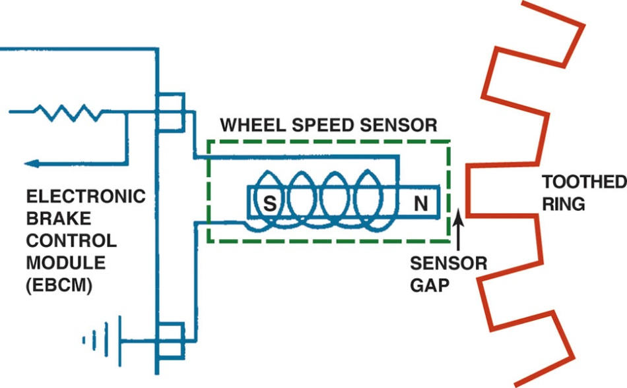
Figure 111.8 Typical wheel speed sensor. When a tooth on the sensor ring is close to the sensor, the strength of the magnetic field is stronger because the metal of the tooth conducts magnetic lines of force better than air.

Slide 24
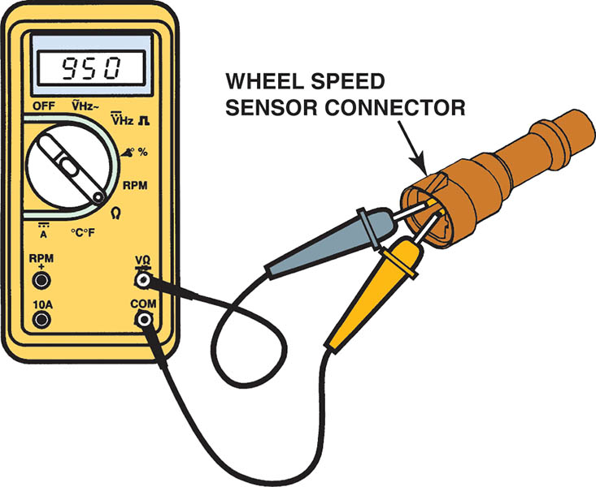
Figure 111.9 Measuring the resistance of a wheel speed sensor

Slide 25
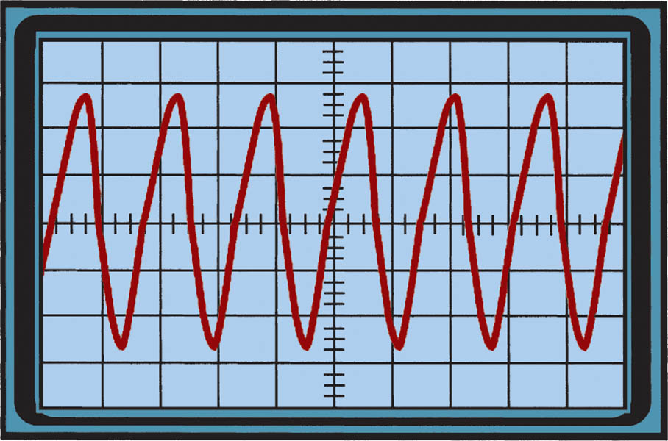
Figure 111.10 A scope can be used to check for proper operation of a wheel speed sensor

Slide 26
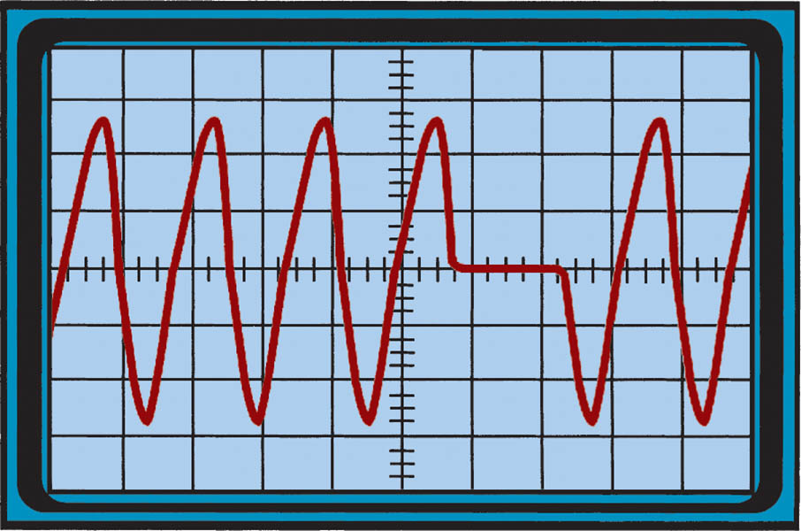
Figure 111.11 A broken tooth on a wheel speed sensor tone ring shows on the scope trace as a missing wave

Slide 27
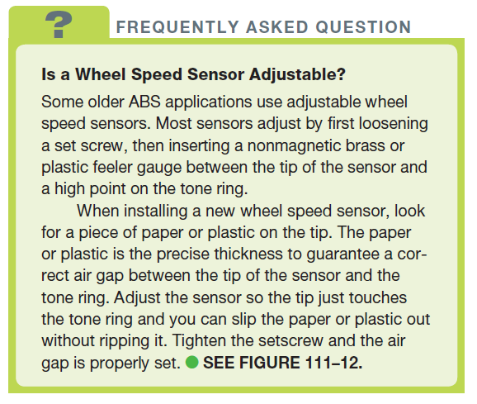
FREQUENTLY ASKED QUESTION

Slide 28
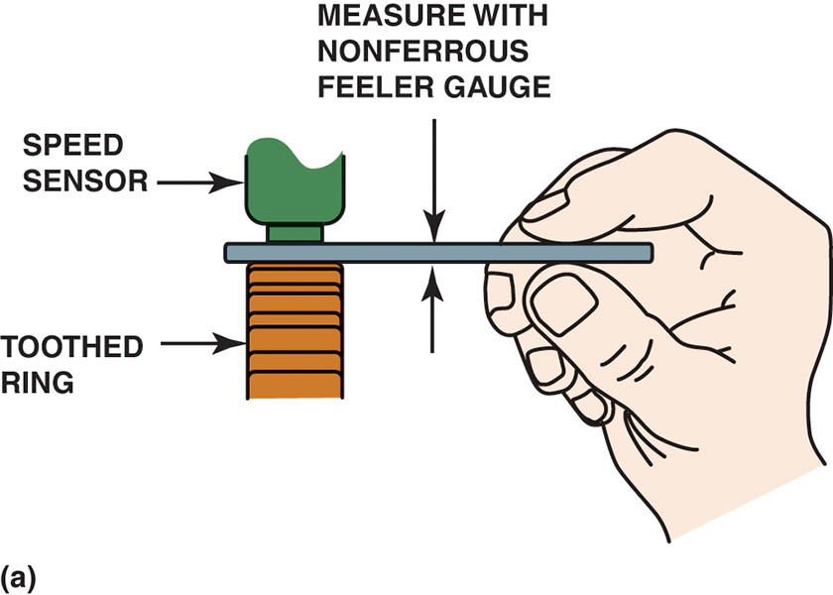
Figure 111.12 (a) Always use a nonferrous (brass or plastic) feeler (thickness) gauge when measuring the gap between the toothed ring and the wheel speed sensor

Slide 29
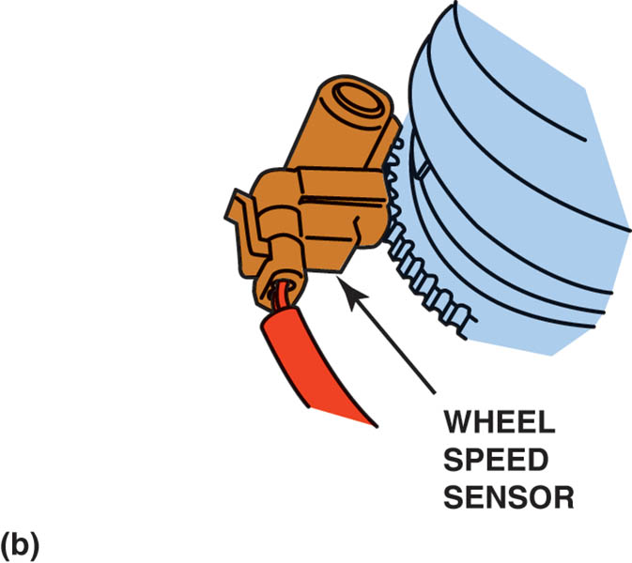
Figure 111.12 (b) Sometimes a sensor is equipped with a paper spacer that is the exact thickness of the spacing required between the toothed ring and the sensor.

Slide 30
QUESTION 2: ?
What are the methods for testing a passive wheel speed sensor?

Slide 31
ANSWER 2:
  Resistance measurement
  Checking for shorts-to-ground
  AC voltage check
  Scope Testing
  Scan tool testing

Slide 32
HYDRAULIC ABS SERVICE
Check Service Information
  Check the service information for the exact vehicle being serviced.
Bleeding the Electronic-Hydraulic Assembly
  Some E-H units can be bled through the use of a scan tool where the valves are pulsed in sequence by the electronic brake controller (computer).
  Some units are equipped with bleeder valves while others must be bled by loosening the brake lines.

Slide 33

Figure 111.13 Special bleed valve tools are often required when bleeding some ABS units such as the Kelsey-Hayes 4WAL system

Slide 34
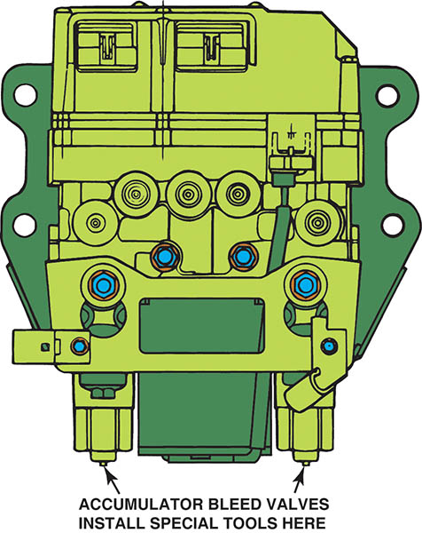
Figure 111.14 Two bleed valve tools are needed to bleed the Kelsey-Hayes 4WAL system, which attaches to the bleeder valves on the accumulator

Slide 35
ABS SAFETY PRECAUTIONS
Avoid mounting the antenna for any transmitting device near the ABS control unit.
Avoid mounting tires of different diameter than that of the original tires.
Never open a bleeder valve or loosen a hydraulic line while the ABS is pressurized.
If arc welding on a vehicle, disconnect all computers (electronic control modules).
Do not pry against or hit the wheel speed sensor ring.

Slide 36

Copyright

