Slide 1
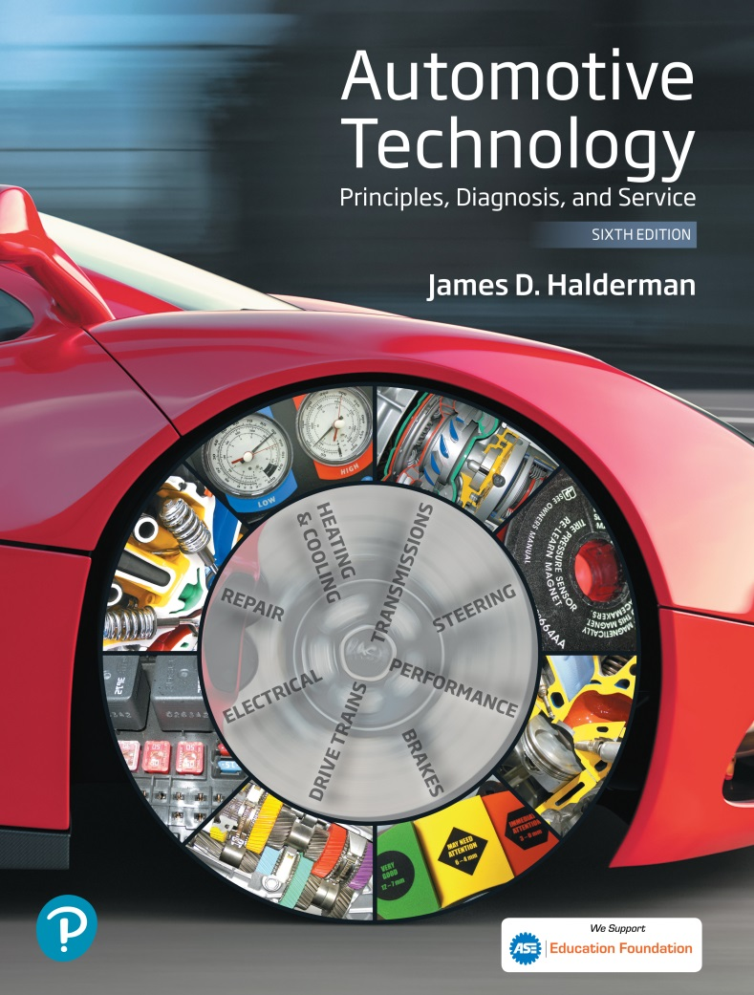
Automotive Technology Principles, Diagnosis, and Service
Sixth Edition
Chapter 110
ABS Components and Operation
Copyright © 2018, 2015, 2011 Pearson Education, Inc. All Rights Reserved

Slide 2
LEARNING OBJECTIVES (1 of 2)
110.1 Explain the need for Antilock brake system (ABS).
110.2 Describe the operation, components, and system configurations of ABS.
110.3 Explain the operation of passive and active wheel speed sensors.

Slide 3
LEARNING OBJECTIVES (2 of 2)
110.4 This chapter will help prepare for the Brakes (A5) ASE certification test content area “D” (Electronic Brake Control Systems: Antilock Brake System (ABS), Traction Control System (TCS), and Electronic Stability Control System (ESC) Diagnosis and Repair).

Slide 4
ANTILOCK BRAKE SYSTEM (1 OF 3)
Purpose and Function
  Antilock brake systems (ABS) help prevent the wheels from locking during sudden braking, especially on slippery surfaces.
ABS and Tire Traction
  The brakes slow the rotation of the wheels, but it is friction between the tire and road that stops the vehicle and allows it to be steered.

Slide 5
ANTILOCK BRAKE SYSTEM (2 OF 3)
Tire Slip and Braking Distance
  On dry or wet pavement, maximum braking traction occurs when tire slip is held between approximately 15% and 25%.
Tire Slip and Vehicle Stability
  In a straight line, nearly all of the available traction can be used to provide braking force.
  If a vehicle has to stop and turn at the same time, the available traction must be divided to provide both cornering (lateral) and braking force.

Slide 6
ANTILOCK BRAKE SYSTEM (3 OF 3)
ABS Limitations
  There are two situations in which an antilock brake system will not provide the shortest stopping distances.
  Straight stops made on smooth, dry pavement by an expert driver.
  When braking on loose gravel or dirt, or in deep, fluffy snow.
ABS and the Law of Physics
  No ABS can overcome the laws of physics.

Slide 7
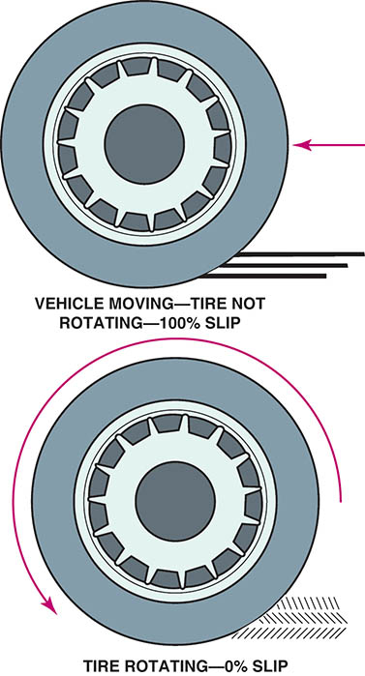
Figure 110.1 Maximum braking traction occurs when tire slip is between 10% and 20%. A rotating tire has 0% slip and a locked-up wheel has 100% slip

Slide 8
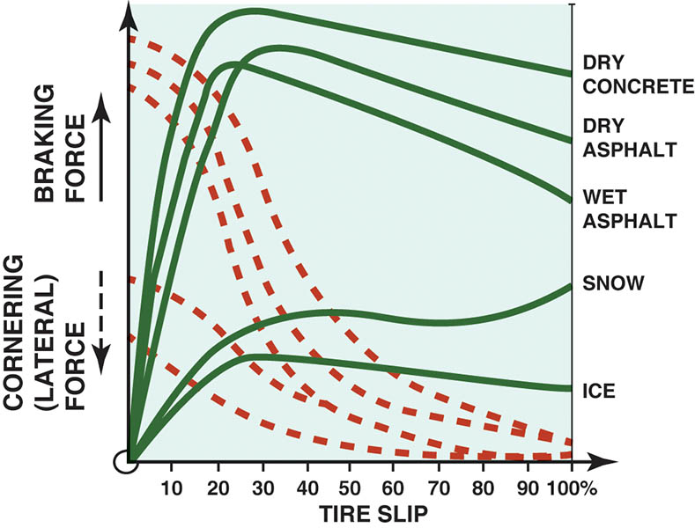
Figure 110.2 Traction is determined by pavement conditions and tire slip

Slide 9
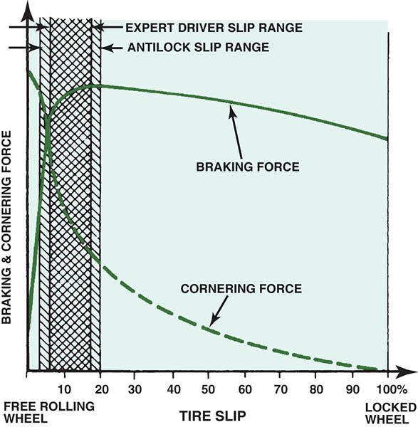
Figure 110.3 A good driver can control tire slip more accurately than an ABS if the vehicle is traveling on a smooth, dry road surface

Slide 10
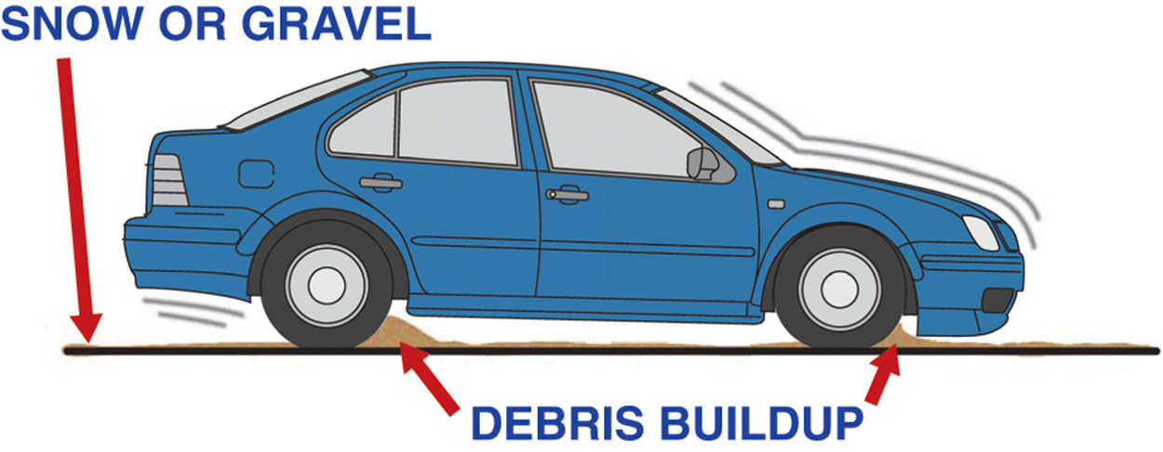
Figure 110.4 A wedge of gravel or snow in the front of a locked wheel can help stop a vehicle faster than would occur if the wheel brakes were pulsed on and off by an antilock brake system

Slide 11
QUESTION 1: ?
What is the purpose of antilock brakes?

Slide 12
ANSWER 1:
To help prevent the wheels from locking during sudden braking, especially on slippery surfaces.

Slide 13
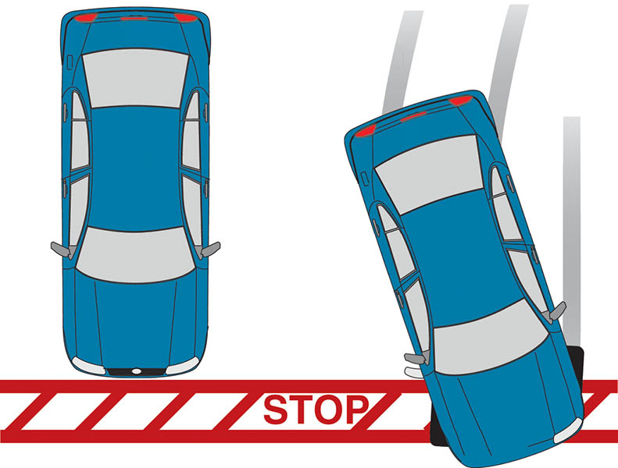
Figure 110.5 Being able to steer and control the vehicle during rapid braking is one major advantage of an antilock brake system

Slide 14
ABS PARTS INVOLVED
Wheel Speed Sensor
  Monitors the speed of each wheel.
Control Module
  Receives inputs and controls outputs.
Valves
  Used to hold, release, and reapply hydraulic pressure to the brakes.
Pump
  Used to restore brake pressure.

Slide 15
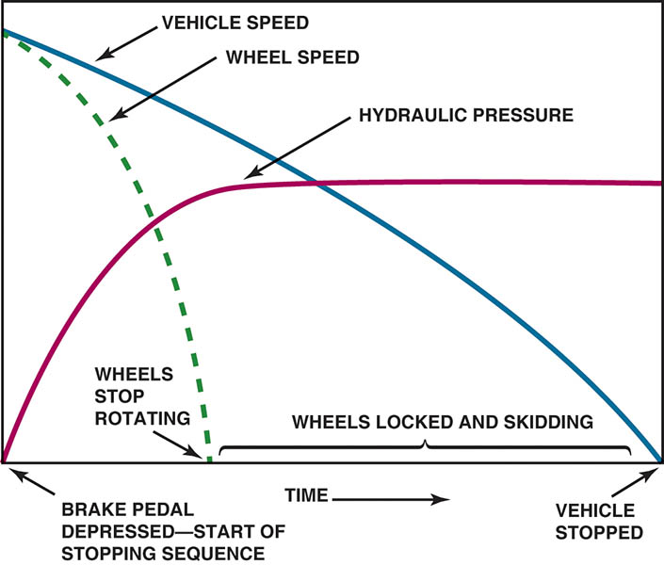
Figure 110.6 A typical stop on a slippery road surface without antilock brakes. Notice that the wheels stopped rotating and skidded until the vehicle finally came to a stop

Slide 16
ABS CHANNELS
Single-Channel Systems
  The single-channel rear-wheel only ABS is used on many rear-wheel-drive pickups and vans.
Three-Channel ABS Systems
  The system uses a separate channel for each front wheel and a common channel for the rear wheels.
Four Channel ABS
  In this system each wheel speed sensor provides input for a separate hydraulic control circuit or channel.

Slide 17
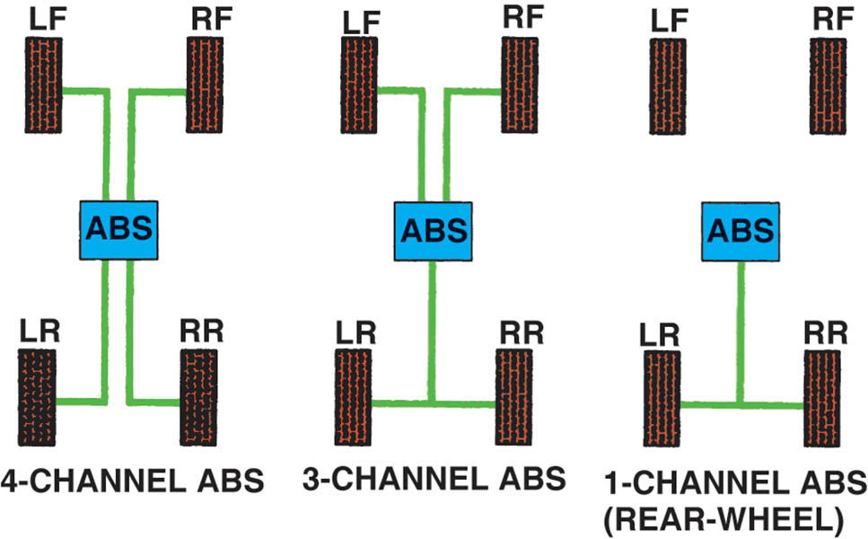
Figure 110.7 ABS configuration includes four channel, three channel, and single channel

Slide 18
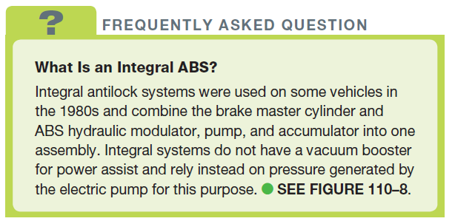
FREQUENTLY ASKED QUESTION

Slide 19
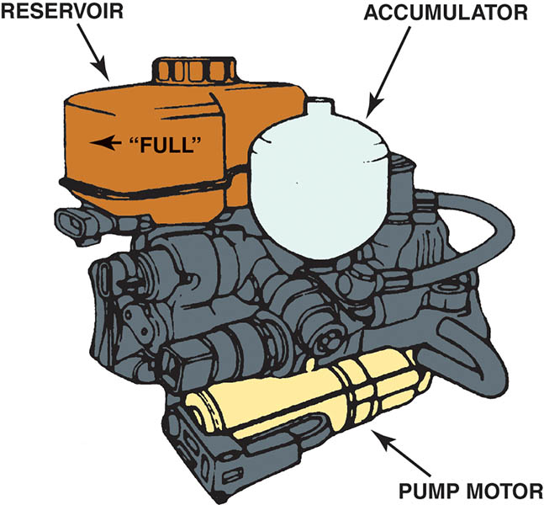
Figure 110.8 A typical integral ABS unit that combines the function of the master cylinder, brake booster, and antilock brake system in one assembly

Slide 20
NONINTEGRAL ABS
Non-integral ABS have a conventional brake master cylinder and vacuum power booster with a separate hydraulic modulator unit.
The pump is for ABS braking (to reapply pressure during the ABS hold–release–reapply cycle), but do not for normal power assist.
Non-integral ABS are the most common type of ABS because of their lower cost and simplicity.

Slide 21
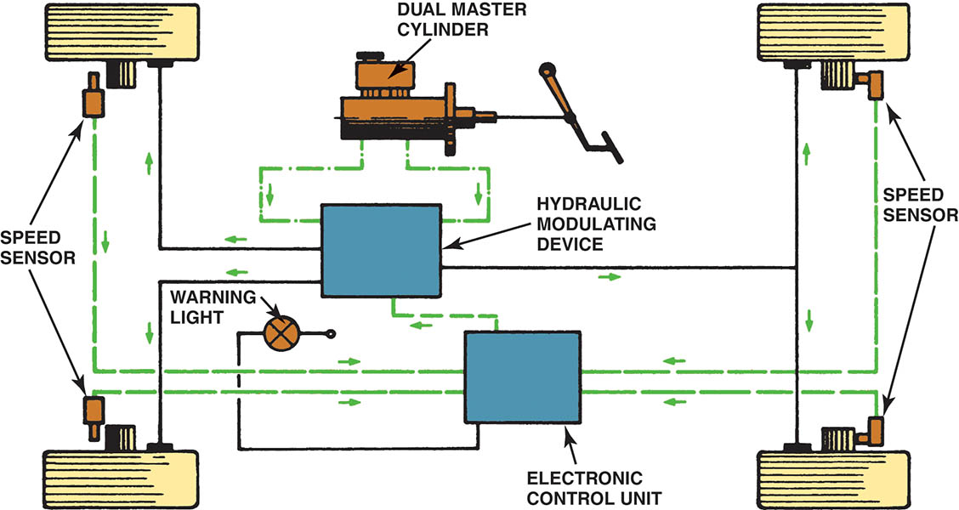
Figure 110.9 A schematic drawing of a typical antilock brake system

Slide 22
ABS CONTROLLER INPUTS AND OUTPUTS (1 OF 2)
Inputs
  Wheel speed—from wheel speed sensors.
  Brake on/off—from the brake pedal switch.
  Steering wheel position—used for electronic stability control.
  Yaw and accelerometer sensors—used for electronic stability control system.
Outputs
  System relay
  Inlet and outlet valves
  Pump motor
  ABS warning lamps

Slide 23
ABS CONTROLLER INPUTS AND OUTPUTS (2 OF 2)
Module Operation
  The control module cycles the solenoid valves in the modulator assembly to pulsate hydraulic pressure in the affected brake circuit (or circuits) based on inputs from the wheel speed sensors.
ABS Warning Lamp
  Comes on/goes out for a bulb check at start.
  Illuminates when a fault is set in the system.
  Illuminates if the system becomes disabled.

Slide 24
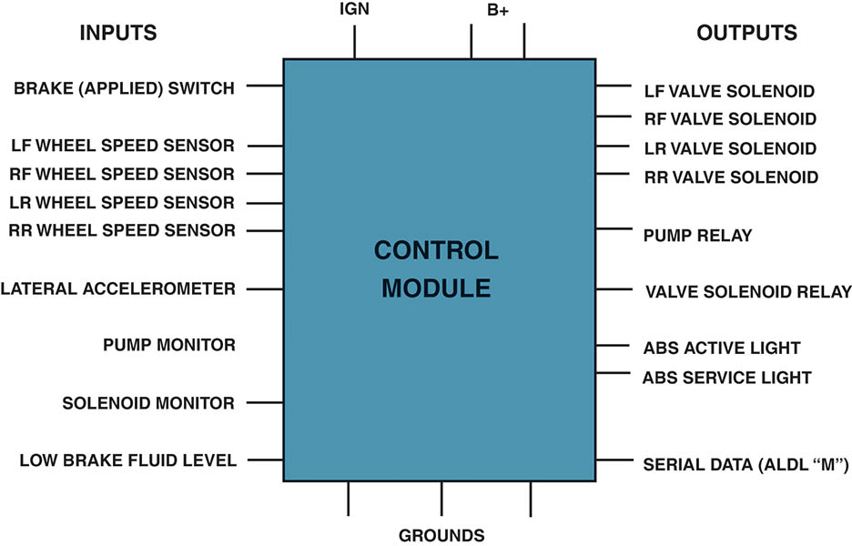
Figure 110.10 Typical inputs and outputs for brake control modules

Slide 25
WHEEL SPEED SENSORS (1 OF 2)
Purpose and Function
  The purpose and function of wheel speed sensors, (WSS), is to monitor the speed of the wheels.
Wheel Speed Sensor Locations
  Steering knuckle, wheel hub, brake backing plate, transmission tail shaft housing, and transfer case.
  The sensor (reluctor) ring will be mounted near the sensor location.

Slide 26
WHEEL SPEED SENSORS (2 OF 2)
Passive Wheel Speed Sensors
  A passive wheel speed sensor generates its own output signal and can operate without an outside voltage being applied.
  The sensor generates an alternating current (AC) voltage.
Active Wheel Speed Sensors
  Hall-effect
  Magneto resistive (MR)
  Require a voltage source and generate a digital square wave signal.

Slide 27
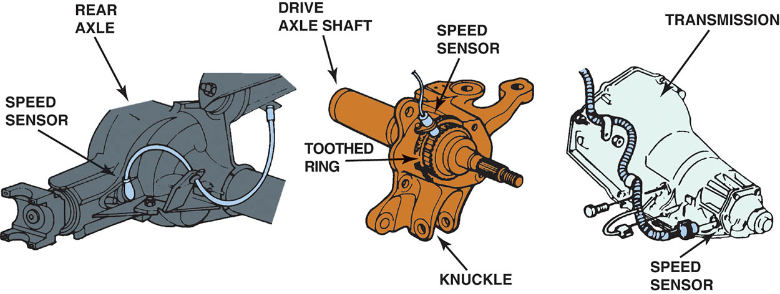
Figure 110.11 Wheel speed sensors for the rear wheels may be located on the rear axle, on the transmission, or on the individual wheel knuckle

Slide 28
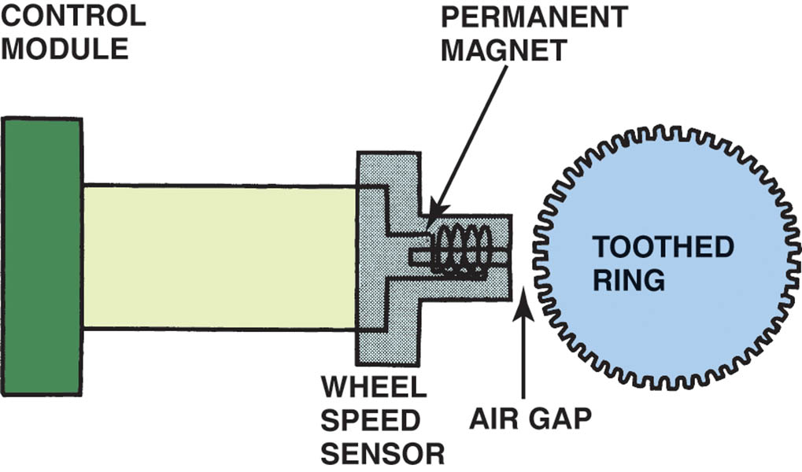
Figure 110.12 A schematic of a typical wheel speed sensor

Slide 29
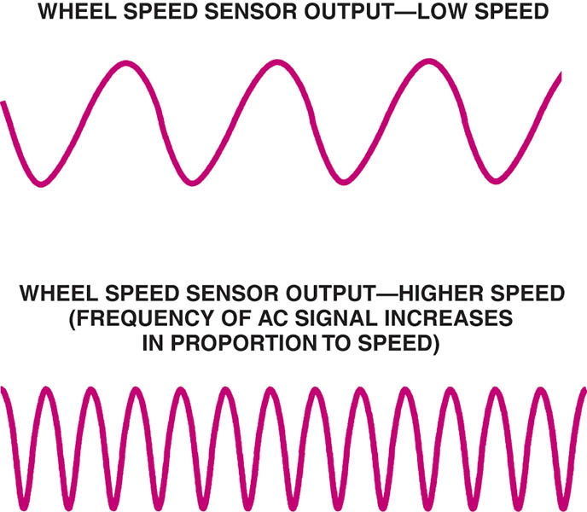
Figure 110.13 Wheel speed sensors produce an alternating current (AC) signal with a frequency that varies in proportion to wheel speed

Slide 30
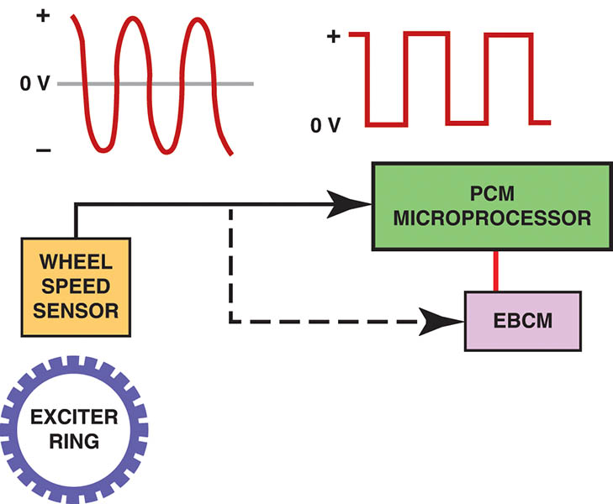
Figure 110.14 A typical passive variable-reluctance sensor produces a sine wave (continuously variable) output signal which is then converted to a square wave inside the PCM and/or the electronic brake control module (EBCM)

Slide 31
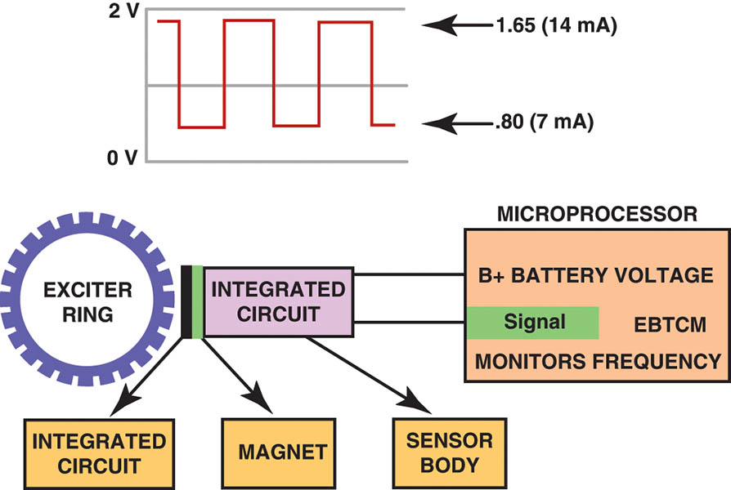
Figure 110.15 A digital wheel speed sensor produces a square wave output signal

Slide 32
QUESTION 2: ?
What are the two types of active wheel speed sensors?

Slide 33
ANSWER 2:
Hall-effect and magneto resistive.

Slide 34
HYDRAULIC MODULATOR ASSEMBLY (1 OF 3)
Purpose and Function
  The modulator valve body houses the valves and pump motor needed to control hydraulic pressure at each wheel.
ABS Solenoid
  The solenoid (when energized) is used to open or close a valve between the master cylinder and an individual brake.

Slide 35
HYDRAULIC MODULATOR ASSEMBLY (2 OF 3)
ABS Control Pressure Stages
  Isolation (pressure hold); prevents any further pressure from the master cylinder reaching the brake.
  Pressure Reduction (decay); Releasing pressure in the brake circuit allows the brake to loosen its grip so the wheel can speed up and regain traction.
  Pressure Increase (build); The circuit is hydraulically opened and the pump motor is energized.
  The cycle repeats as many times as needed until the vehicle either comes to a halt or the driver releases the brake pedal.

Slide 36
HYDRAULIC MODULATOR ASSEMBLY (3 OF 3)
Pump Motor and Accumulator
  A high-pressure electric pump is used in some ABS to generate power assist for normal braking, as well as the reapplication of brake pressure during ABS braking.
  The fluid pressure generated by the pump is stored in the accumulator.

Slide 37
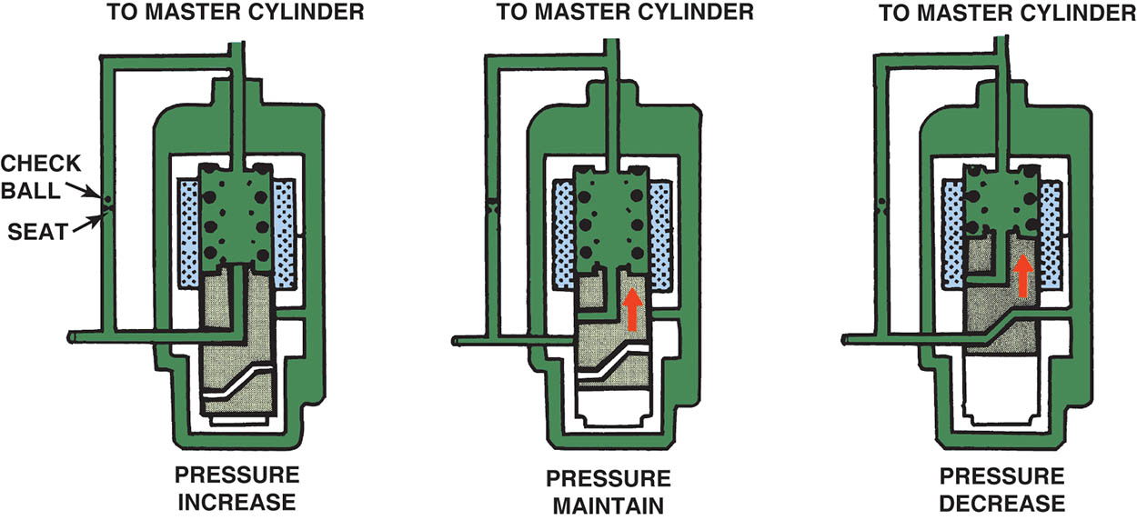
Figure 110.16 An ABS three-way solenoid can increase, maintain, or decrease brake pressure to a given brake circuit

Slide 38
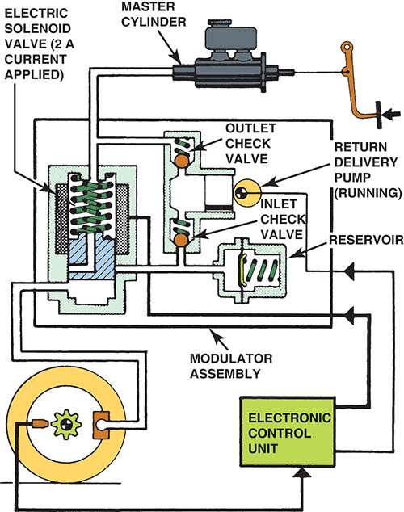
Figure 110.17 The isolation or hold phase of an ABS on a Bosch 2 system

Slide 39
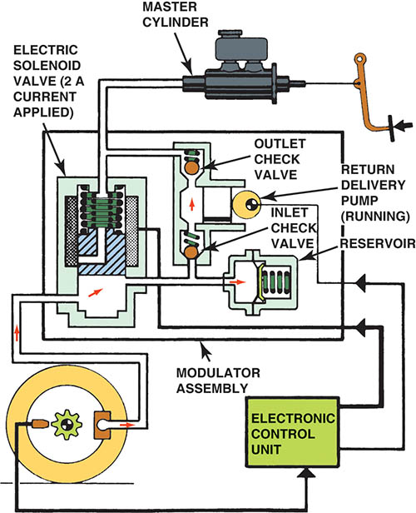
Figure 110.18 During the pressure reduction stage, pressure is vented from the brake circuit so the tire can speed up and regain traction

Slide 40
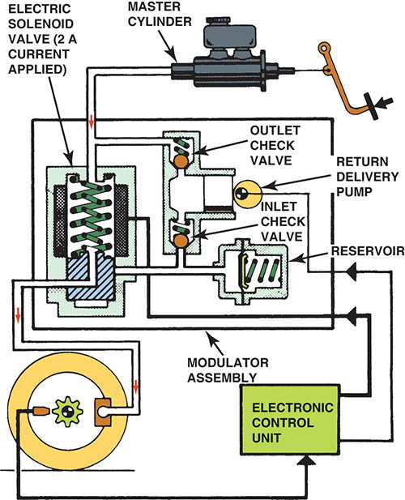
Figure 110.19 The control module reapplies pressure to the affected brake circuit once the tire achieves traction so that normal braking can continue

Slide 41
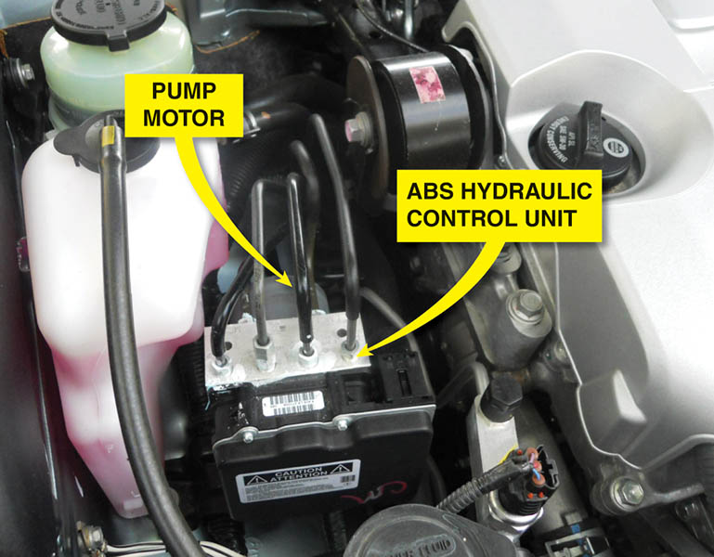
Figure 110.20 A typical ABS hydraulic control assembly

Slide 42
QUESTION 3: ?
What are the three ABS pressure control stages?

Slide 43
ANSWER 3:
Isolation, pressure reduction, pressure increase.

Slide 44
ADVANCED ABS FUNCTIONS (1 OF 2)
Traction Control
  Much of the same equipment that allows an ABS system to control wheel lockup during deceleration can be adopted to control wheel spin during acceleration.
Stability Control
  The software balances brake forces at wheels (side-to-side) to counteract a yaw movement and improve the vehicle stability while braking in cornering maneuvers.

Slide 45
ADVANCED ABS FUNCTIONS (2 OF 2)
Electronic Proportioning
  By using EBCM control software and the hydraulic modulator assembly, the best front-to-rear brake balance can be maintained at all times.
TPMS
  The type is an indirect system that used the wheel speed sensors.

Slide 46
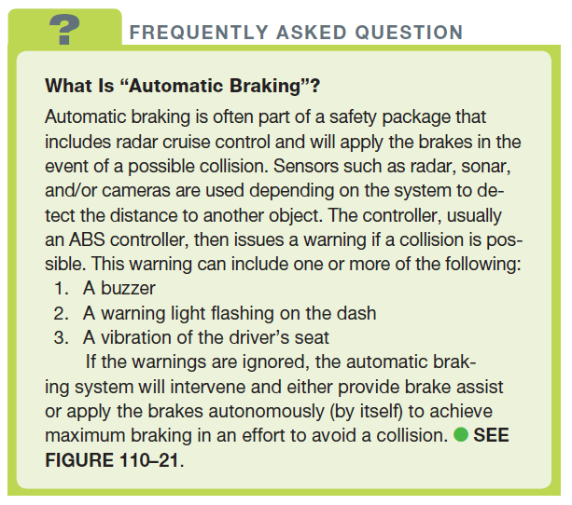
FREQUENTLY ASKED QUESTION

Slide 47
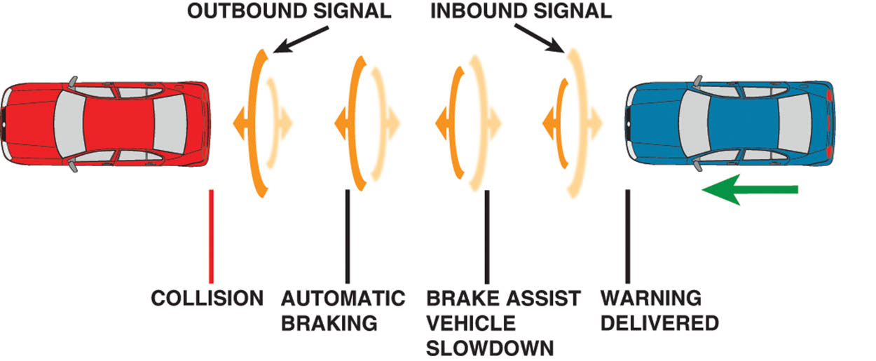
Figure 110.21 Sensors are used to detect when the distance is closing fast enough that a collision may be possible and the system intervenes and automatically applies the brakes if needed

Slide 48
WHEEL SPEED SENSOR

Slide 49
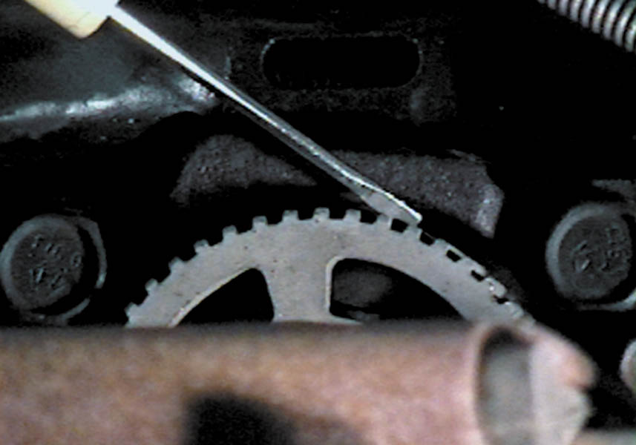
1. A tone ring and a wheel speed sensor on the rear of a Dodge Caravan.

Slide 50
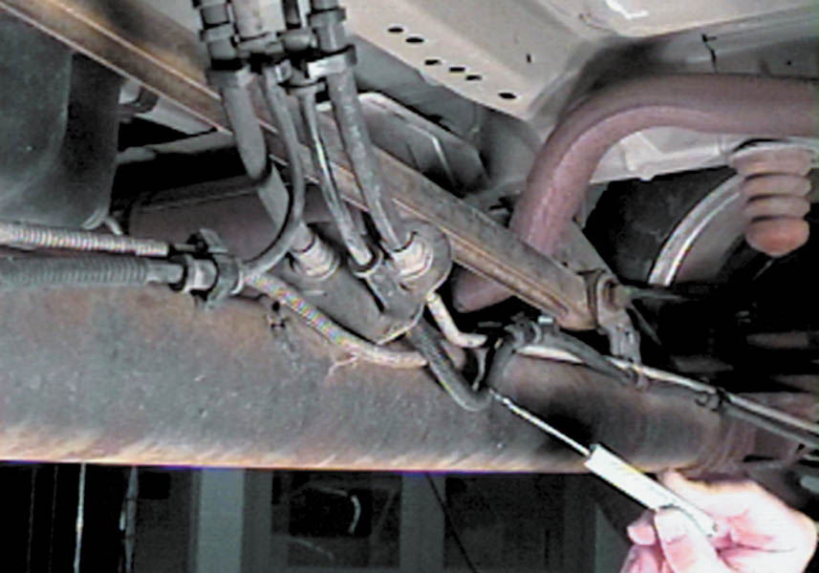
2. The wiring from the wheel speed sensor should be inspected for damage.

Slide 51
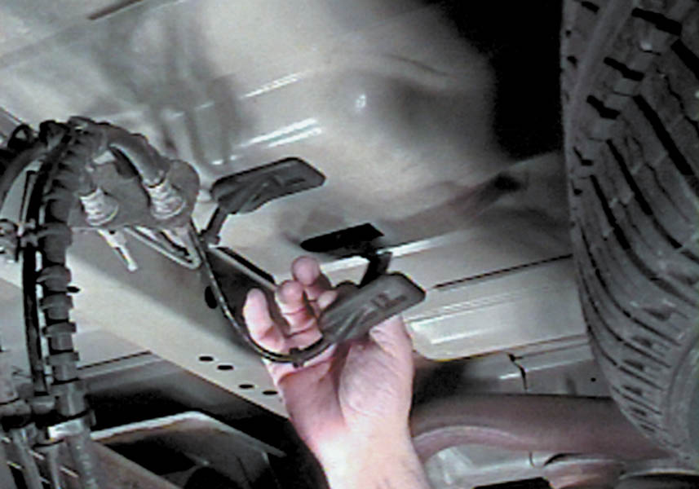
3. To test a wheel speed sensor, disconnect the sensor connector to gain access to the terminals.

Slide 52
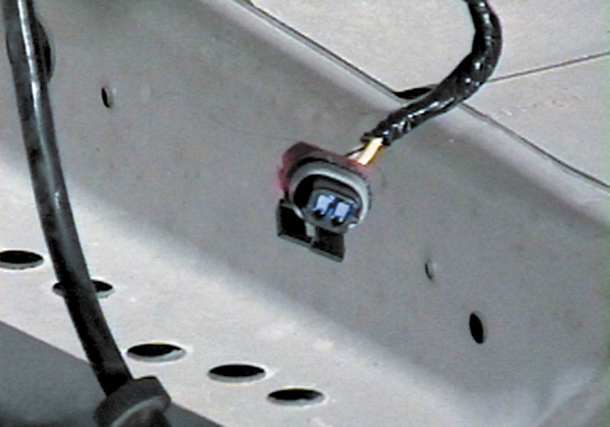
4. Pulling down the rubber seal reveals the connector.

Slide 53
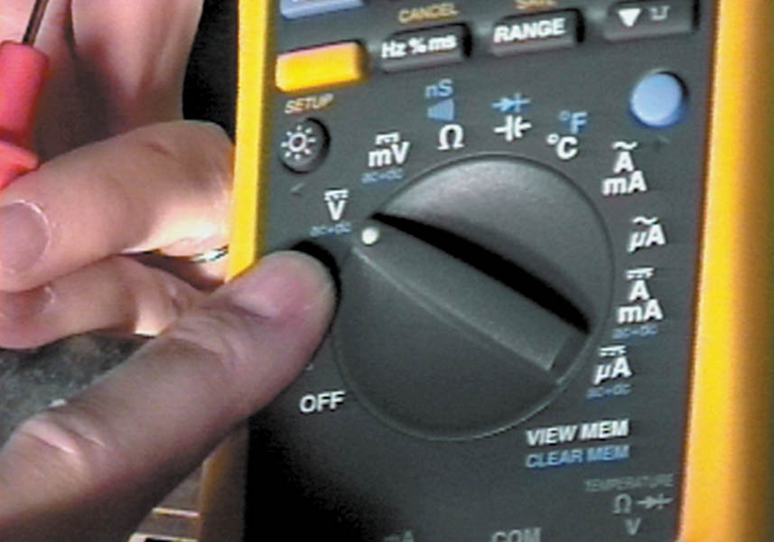
5. The ABS controller (computer) on this vehicle supplies a 2.5-volt reference signal to the wheel speed sensors.

Slide 54
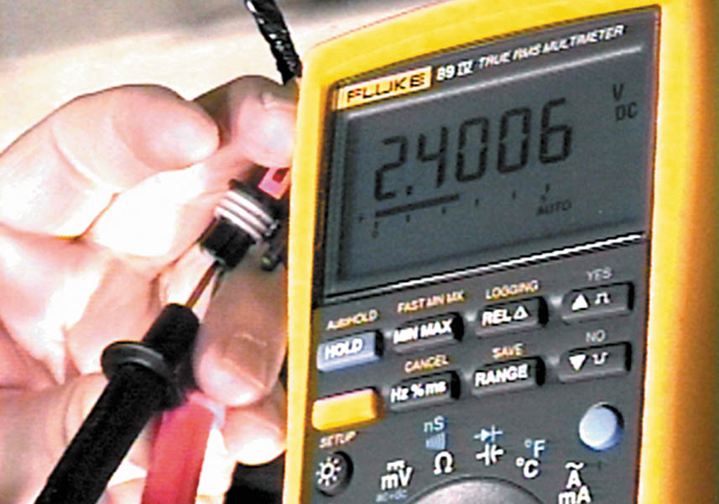
6. The meter reads about 2.4 volts, indicating that the ABS controller is supplying the voltage to the wheel speed sensor.

Slide 55
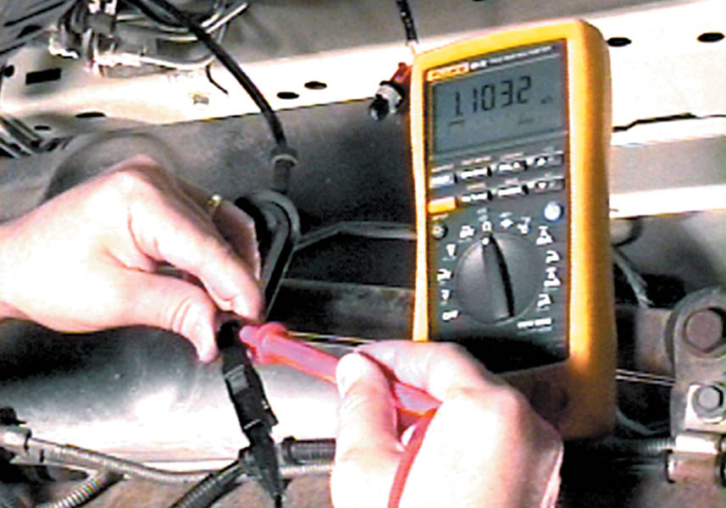
7. The test probes are touched to the terminals leading to the wheel speed sensor and the resistance is 1.1032 k ohms or 1,103.2 ohms.

Slide 56
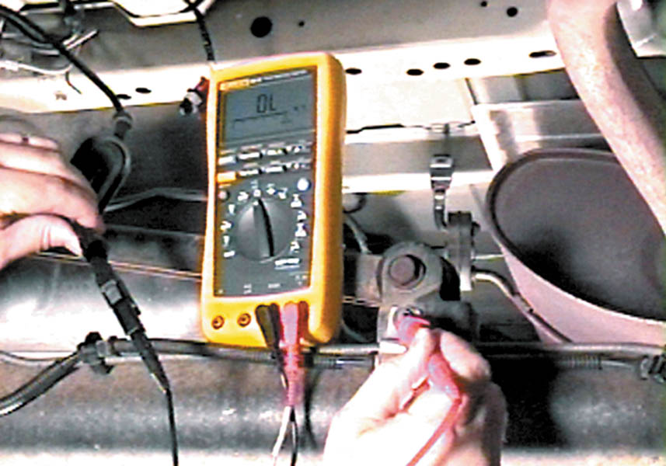
8. The meter should (and does) read “OL,” indicating that the wheel speed sensor and pigtail wiring is not shorted to ground.

Slide 57
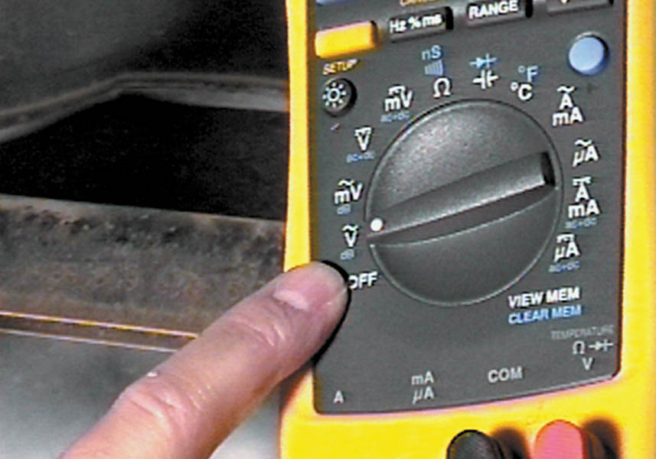
9. To measure the output of the wheel speed sensor, select AC volts on the digital multimeter.

Slide 58
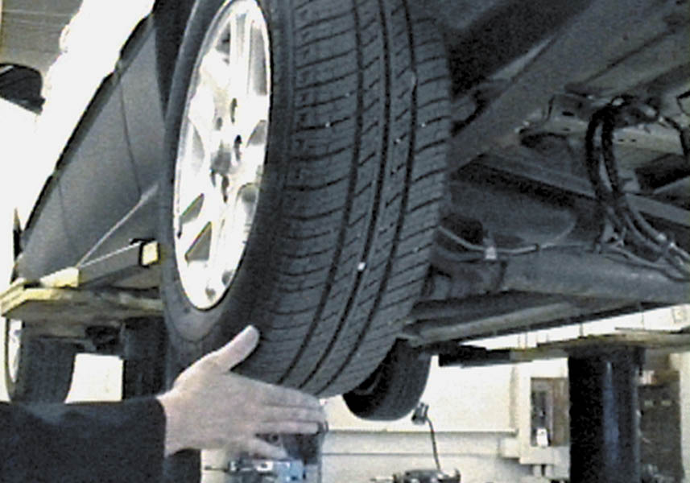
10. Rotate the wheel and tire assembly by hand while observing the AC voltage output on the digital multimeter.

Slide 59
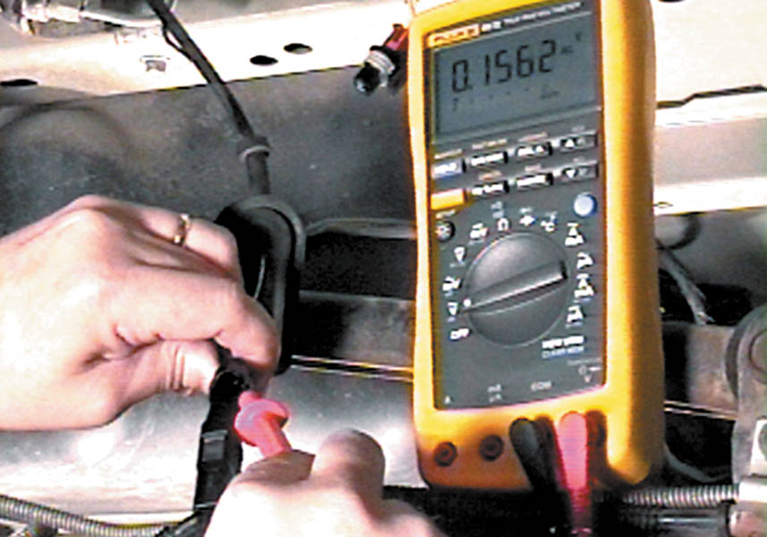
11. A good wheel speed sensor should be able to produce at least 100 mV (0.1 V) when the wheel is spun by hand.

Slide 60
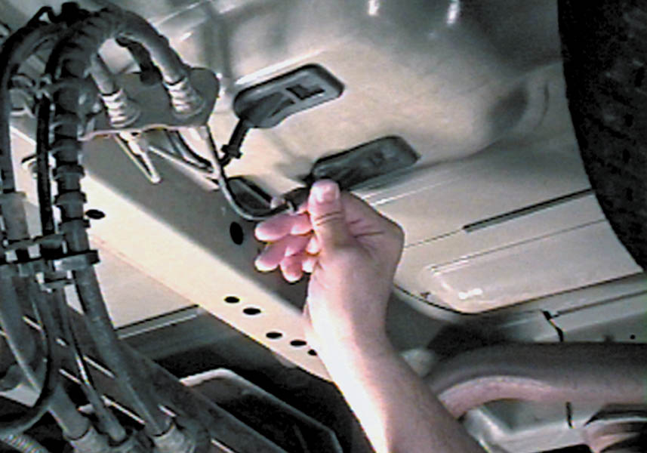
12. After testing, carefully reinstall the wiring connector into the body and under the rubber grommet.

Slide 61
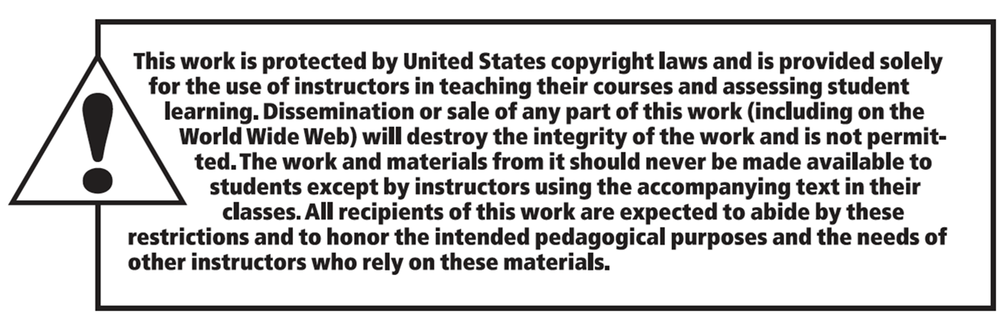
Copyright

