Slide 1
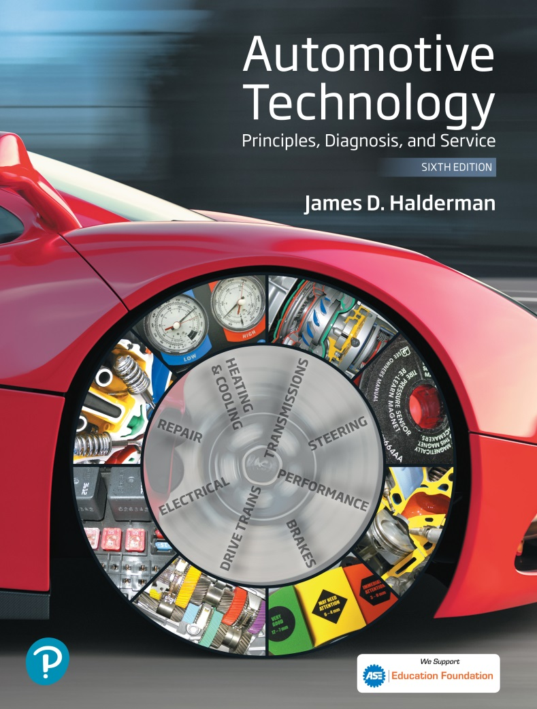
Automotive Technology Principles, Diagnosis, and Service
Sixth Edition
Chapter 11
Vehicle Lifting and Hoisting
Copyright © 2018, 2015, 2011 Pearson Education, Inc. All Rights Reserved

Slide 2
LEARNING OBJECTIVES
11.1 Discuss the purpose of floor jacks and creepers.
11.2. Describe vehicle hoists and drive-on ramps, and discuss the proper methods for safely hoisting a vehicle.

Slide 3
Floor Jack
A hand operated hydraulic device used for lifting vehicles or components.
Uses four casters to move easily
Not designed to hold a load
Requires the use of jack stands

Slide 4
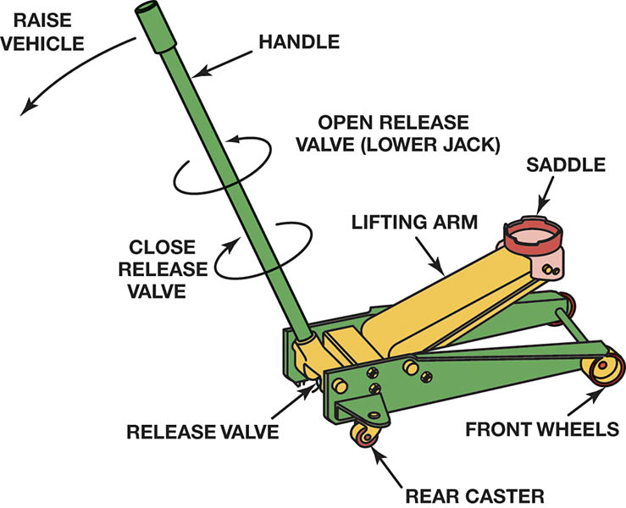
Figure 11.1 A hydraulic hand-operated floor jack

Slide 5
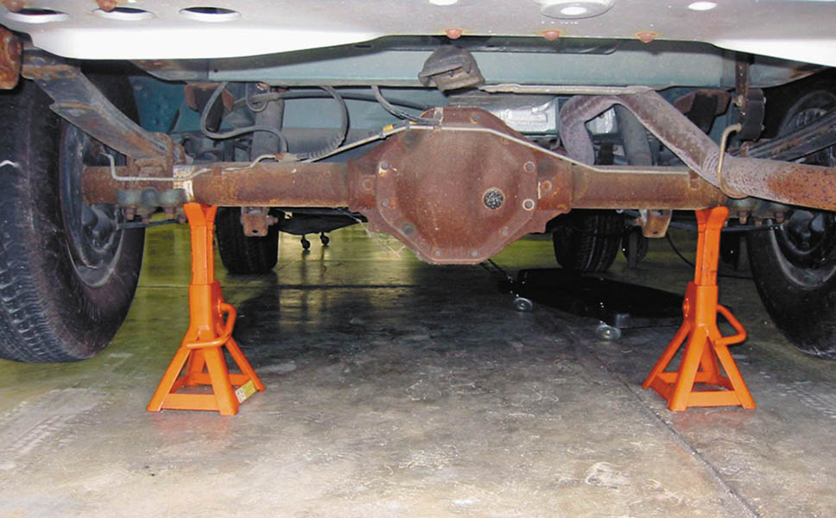
Figure 11.2 Safety stands are being used to support the rear of this vehicle

Slide 6
QUESTION 1: ?
What must be used after lifting a vehicle with a floor jack?

Slide 7
ANSWER 1:
Jack Stands.

Slide 8
CREEPERS
Use by technician to maneuver under vehicle.
Flat or concaved surface equipped with low profile casters.
Should be stored vertically against wall or toolbox to avoid trip hazards.

Slide 9
VEHICLE HOISTS
In-ground: pneumatic/hydraulic.
Above-ground: electric/hydraulic.
Symmetrical: Equal length lift arms.
Asymmetrical: Unequal length lift arms.
Use recommended vehicle lift points.
Lower onto mechanical locks before working.
Before lowering ensure proper clearances.

Slide 10
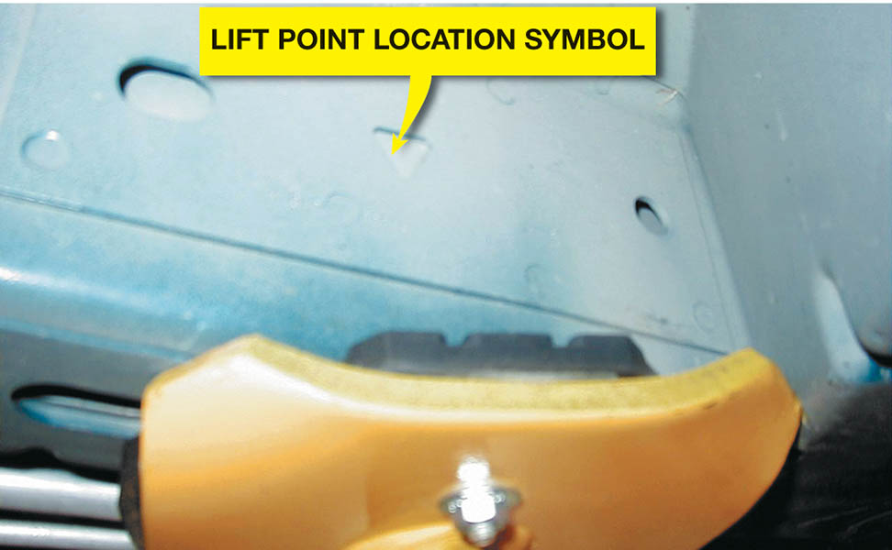
Figure 11.3 Most newer vehicles have a triangular symbol indicating the recommended hoisting lift points

Slide 11
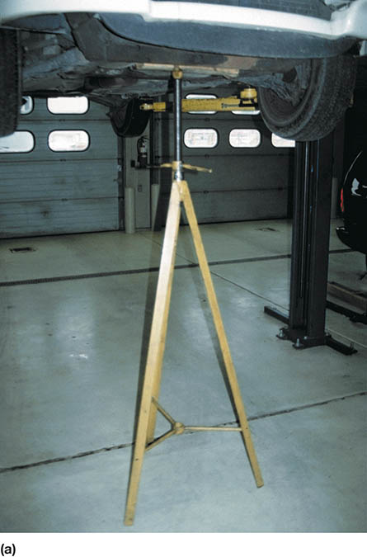
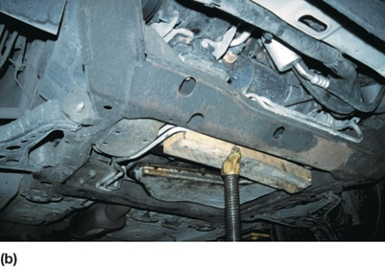
Figure 11.4 (a) Tall safety stands can be used to provide additional support for a vehicle while on a hoist. (b) A block of wood should be used to avoid the possibility of doing damage to components supported by the stand

Slide 12
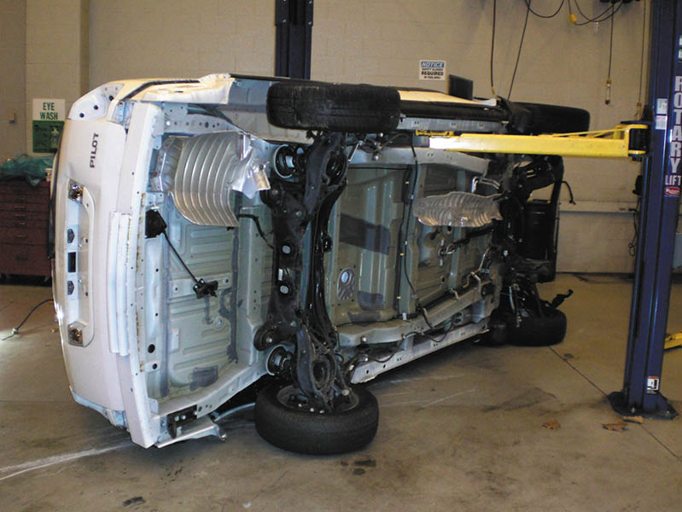
Figure 11.5 This training vehicle fell from the hoist when the pads were not set correctly. No one was hurt, but the vehicle was damaged

Slide 13
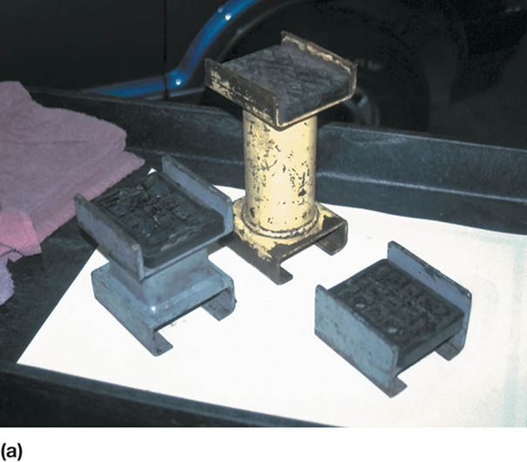
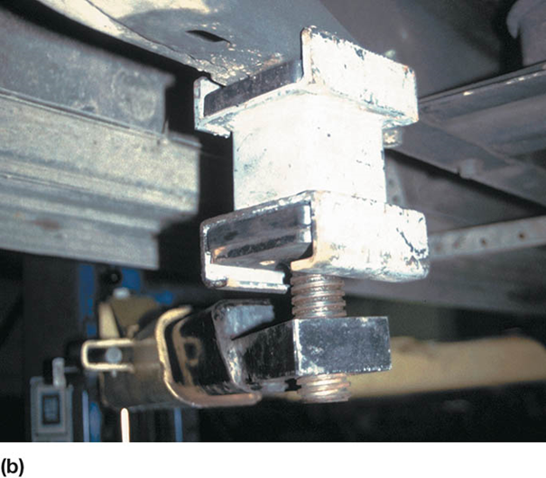
Figure 11.6 (a) An assortment of hoist pad adapters that are often necessary to safely hoist many pickup trucks, vans, and sport utility vehicles. (b) A view from underneath a Chevrolet pickup truck showing how the pad extensions are used to attach the hoist lifting pad to contact the frame

Slide 14
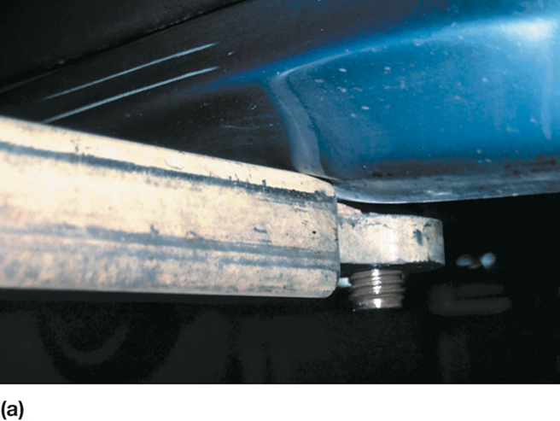
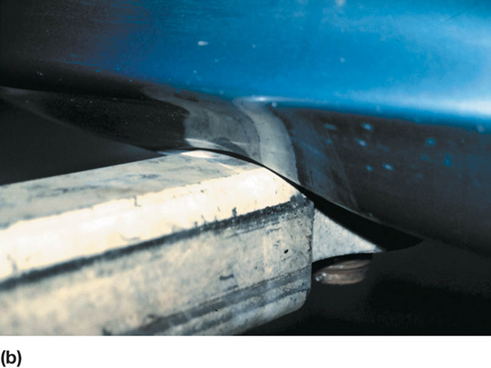
Figure 11.7 (a) In this photo, the pad arm is just contacting the rocker panel of the vehicle. (b) This photo shows what can occur if the technician places the pad too far inward underneath the vehicle. The arm of the hoist has dented in the rocker panel

Slide 15
QUESTION 2: ?
Before working on a vehicle that is on a hoist, what must be done?

Slide 16
ANSWER 2:
Lower the vehicle onto the mechanical locks.

Slide 17
DRIVE-ON RAMPS
Inexpensive way to raise the front or rear of the vehicle.
Ramps store easily.
Caution must be used when placing the vehicle on the ramps.
Wheels on the ground need to be blocked to prevent movement.

Slide 18
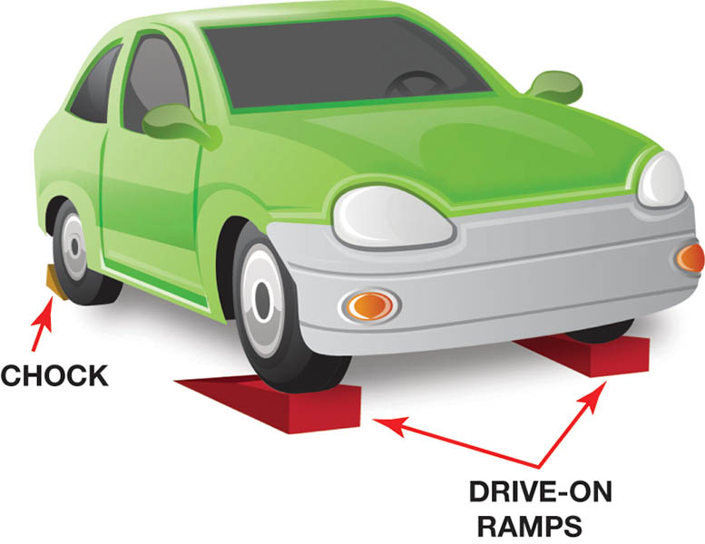
Figure 11.8 Drive-on-type ramps. The wheels on the ground level must be chocked (blocked) to prevent accidental movement down the ramp

Slide 19
HOISTING THE VEHICLE

Slide 20
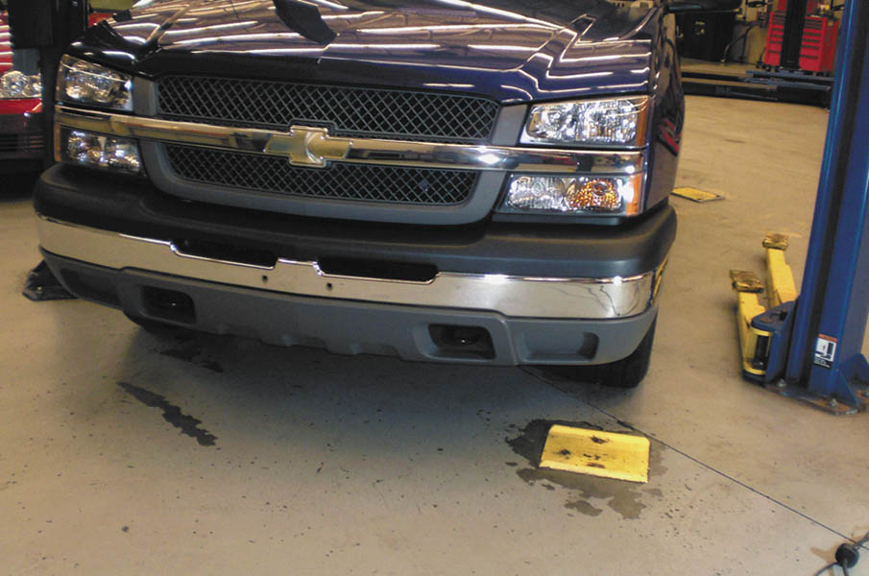
The first step in hoisting a vehicle is to properly align the vehicle in the center of the stall.

Slide 21
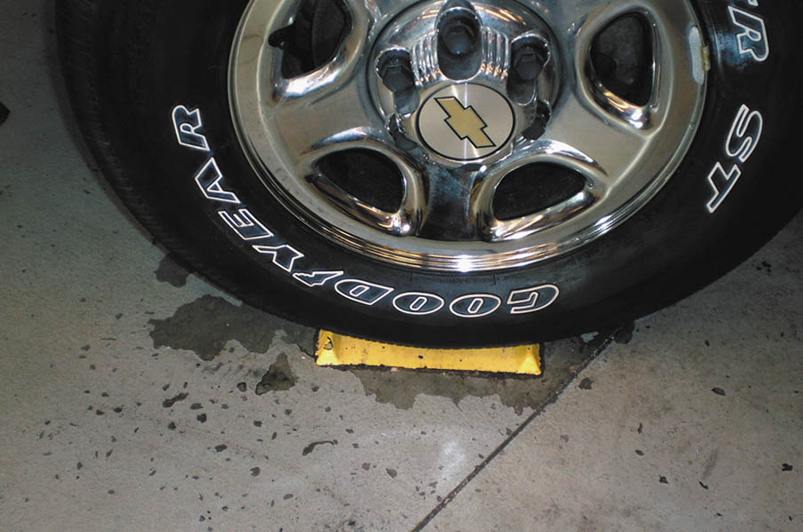
Most vehicles will be correctly positioned when the left front tire is centered on the tire pad.

Slide 22
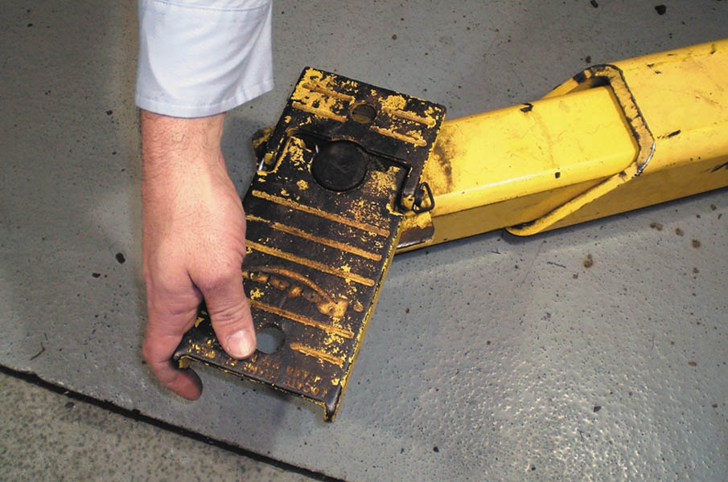
The arms can be moved in and out and most pads can be rotated to allow for many different types of vehicle construction.

Slide 23
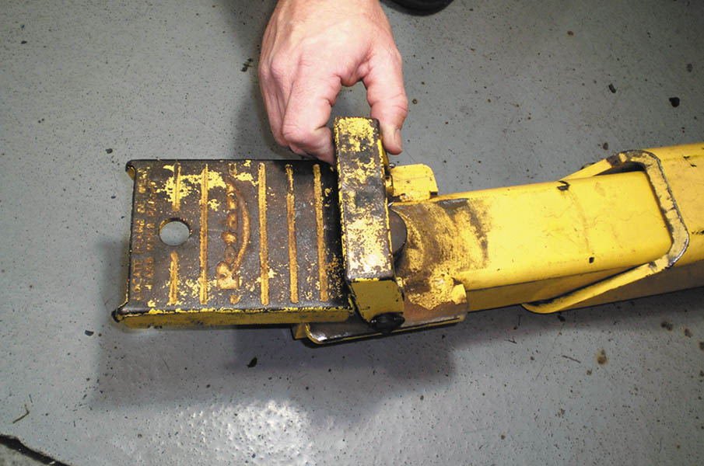
Most lifts are equipped with short pad extensions that are often necessary to use to allow the pad to contact the frame of a vehicle without causing the arm of the lift to hit and damage parts of the body.

Slide 24
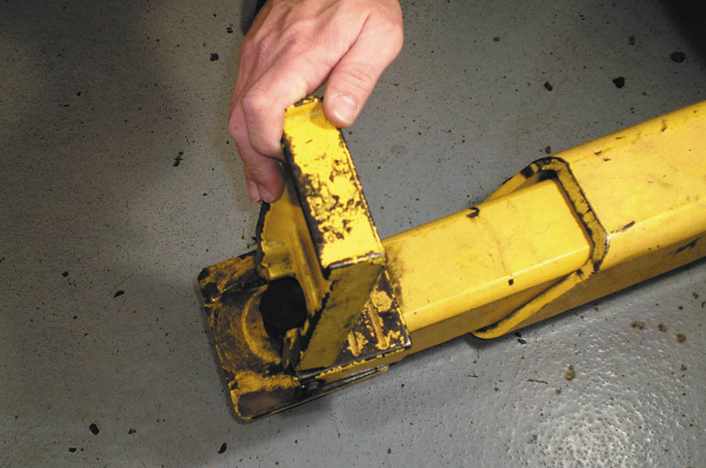
Tall pad extensions can also be used to gain access to the frame of a vehicle. This position is needed to safely hoist many pickup trucks, vans, and sport utility vehicles.

Slide 25
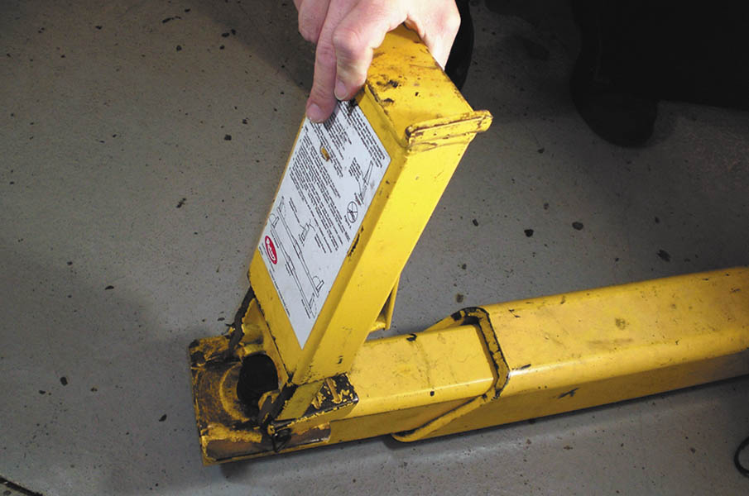
An additional extension may be necessary to hoist a truck or van equipped with running boards to give the necessary clearance.

Slide 26
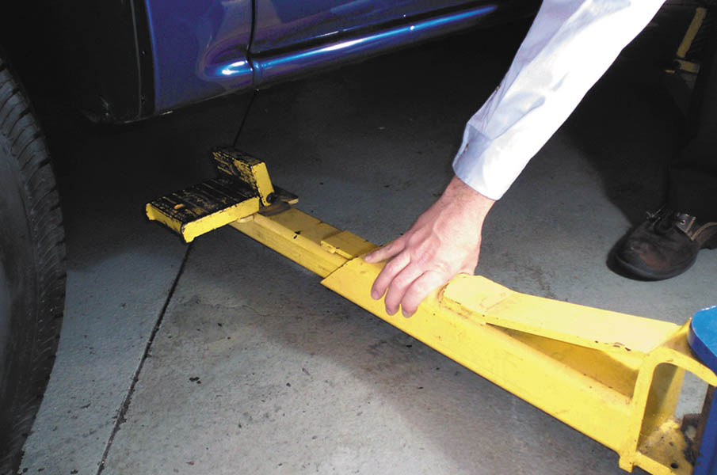
Position the pads under the vehicle in the recommended locations.

Slide 27
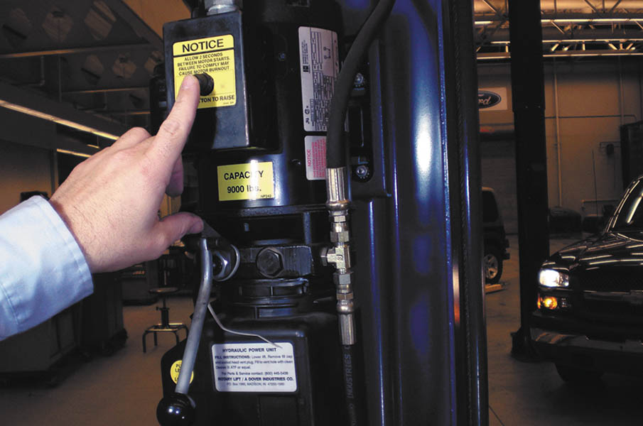
After being sure all pads are correctly positioned, use the electromechanical controls to raise the vehicle.

Slide 28
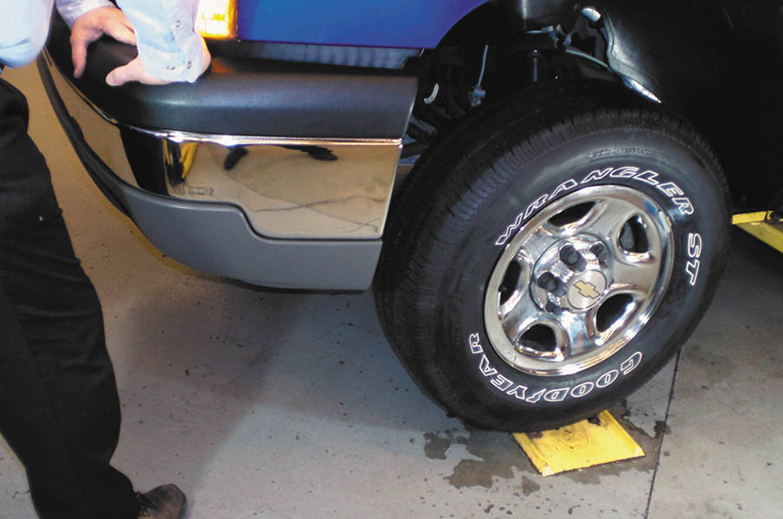
With the vehicle raised one foot (30 cm) off the ground, push down on the vehicle to check to see if it is stable on the pads. If the vehicle rocks, lower the vehicle and reset the pads. The vehicle can be raised to any desired working level. Be sure the safety mechanism is engaged before working on or under the vehicle.

Slide 29
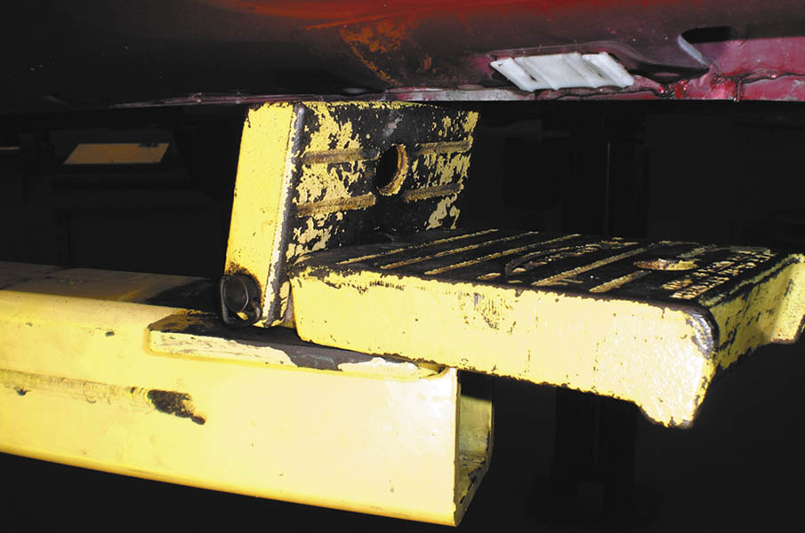
If raising a vehicle without a frame, place the flat pads under the pinch weld seam to spread the load. If additional clearance is necessary, the pads can be raised as shown.

Slide 30
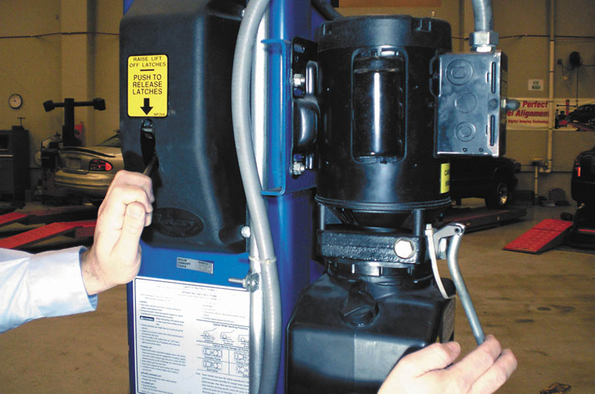
When the service work is completed, the hoist should be raised slightly and the safety mechanism released before using the hydraulics to lower the vehicle.

Slide 31
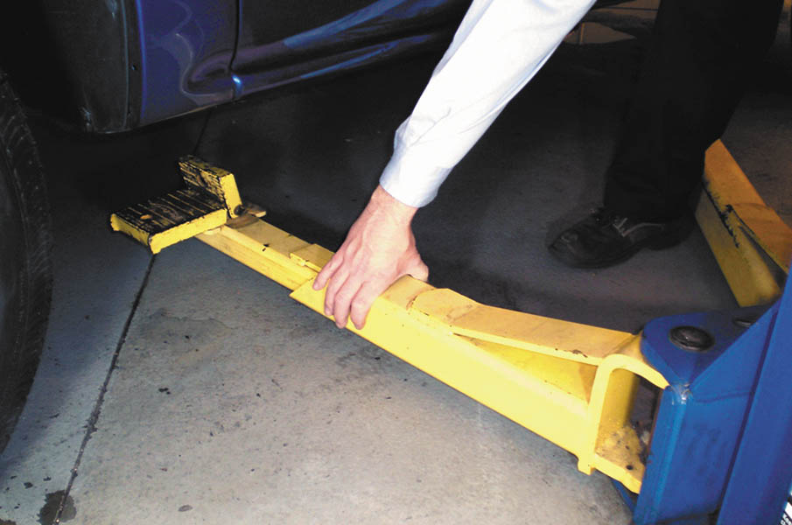
After lowering the vehicle, be sure all arms of the lift are moved out of the way before driving the vehicle out of the work stall.

Slide 32

Copyright

