Slide 1

Automotive Technology Principles, Diagnosis, and Service
Sixth Edition
Chapter 109
Power Brake Unit Operation, Diagnosis, and Service
Copyright © 2018, 2015, 2011 Pearson Education, Inc. All Rights Reserved

Slide 2
LEARNING OBJECTIVES (1 of 2)
109.1 Discuss the need for power brake assist.
109.2 State the principles of vacuum and the vacuum booster theory.
109.3 Discuss the operation of a vacuum check valve, vacuum brake booster, dual-diaphragm vacuum boosters, and brake assist system.
109.4 Discuss the vacuum booster operation test, vacuum booster leak test and hydraulic system leak test.

Slide 3
LEARNING OBJECTIVES (2 of 2)
109.5 Describe how to adjust the pushrod length and disassemble the vacuum brake booster for service.
109.6 Explain the operation and diagnosis of Hydro-boost hydraulic brake booster.
109.7 This chapter will help prepare for the Brakes (A5) ASE certification test content area "A" (Hydraulic, Power Assist, and Parking Brake Systems Diagnosis and Repair).

Slide 4
THE NEED FOR POWER BRAKE ASSIST
To double the stopping power of a disc brake, the driver must double the force on the brake pedal.
When a power booster is fitted, the brake pedal ratio is decreased and the master cylinder bore size is increased.
The combined effect of these changes is to reduce pedal effort, while greatly increasing pedal reserve.

Slide 5
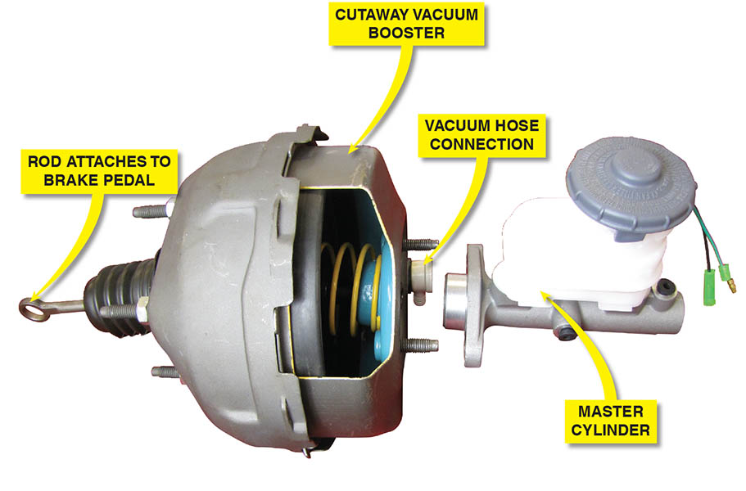
Figure 109.1 Typical vacuum brake booster assembly. The vacuum hose attaches to the intake manifold of the engine

Slide 6
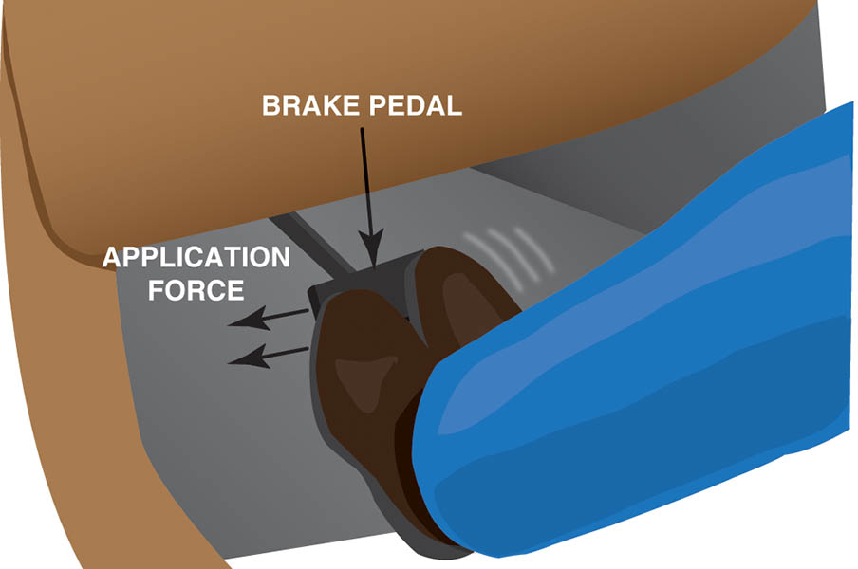
Figure 109.2 A wide brake pedal allows two-foot braking if power assist is lost

Slide 7
PRINCIPLES OF VACUUM
The term vacuum is used to refer to any pressure lower than atmospheric pressure.
Measuring Vacuum
  Vacuum is measured in inches of mercury (in. Hg) or in millimeters of mercury (mm Hg), a figure that indicates how far a column of mercury in a tube will rise when a vacuum is applied at one end and atmospheric pressure at the other.
Booster Vacuum Supply
  Vacuum boosters get their vacuum supply from the engine or a small electric or belt-driven pump.

Slide 8
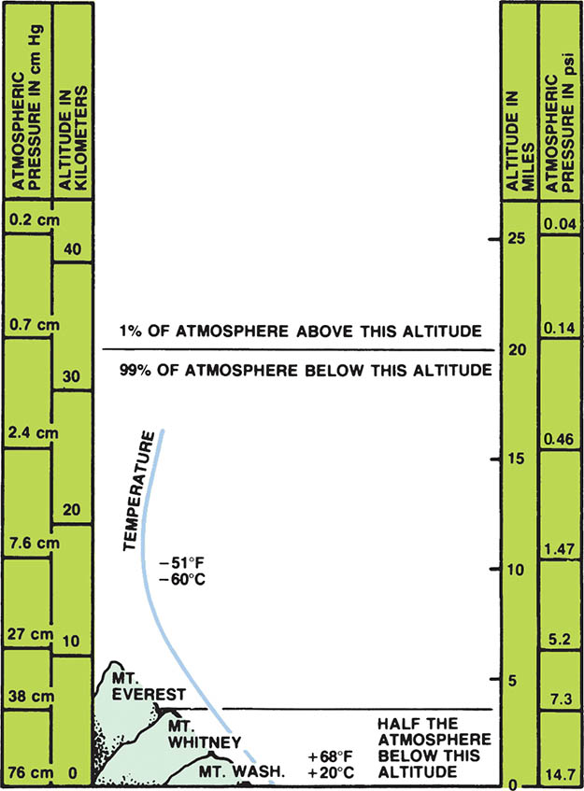
Figure 109.3 Atmospheric pressure varies with altitude

Slide 9
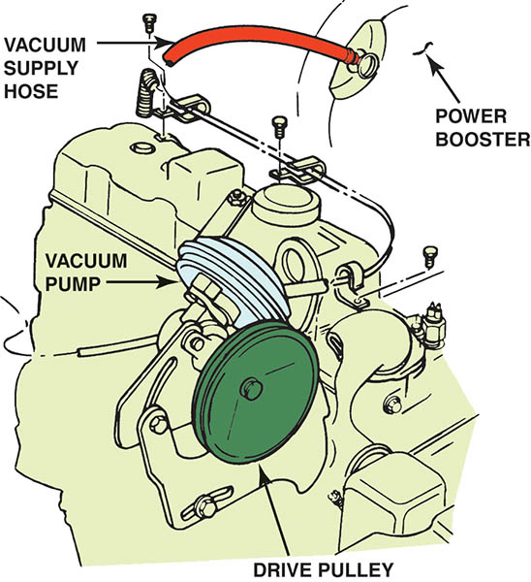
Figure 109.4 A belt-driven auxiliary vacuum pump

Slide 10
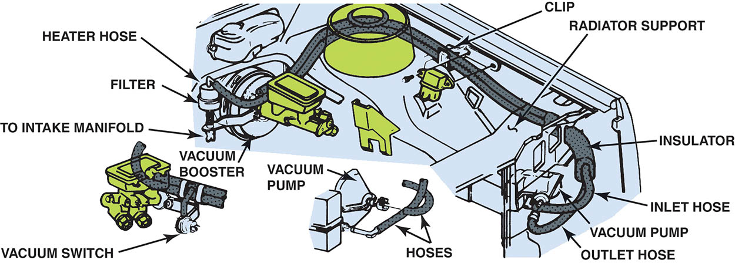
Figure 109.5 An electrically powered vacuum pump

Slide 11
VACUUM BOOSTER THEORY
Vacuum boosters use the principle of pressure differential to increase brake application force.
The typical vacuum booster has a power chamber separated into two smaller chambers by a flexible diaphragm.
When air pressure is greater on one side of the diaphragm than the other, a pressure differential is created.
The amount of force created in this manner is proportional to the difference in pressure between the two sides.

Slide 12
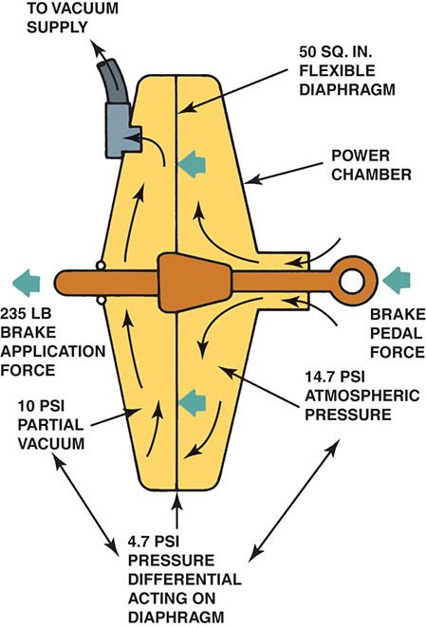
Figure 109.6 Vacuum brake boosters operate on the principle of pressure differential

Slide 13
QUESTION 1: ?
What is the purpose of the brake booster?

Slide 14
ANSWER 1:
To increase the stopping force without increasing the pedal force.

Slide 15
VACUUM CHECK VALVE
All vacuum boosters use a one-way vacuum check valve.
This valve prevents loss of vacuum when the engine stops.

Slide 16
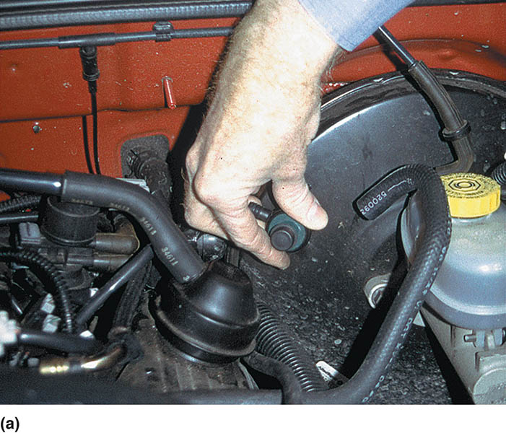
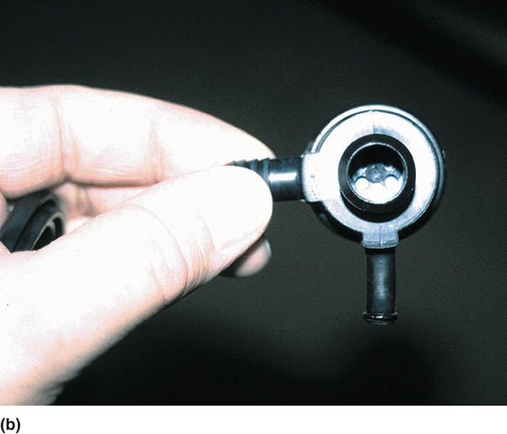
Figure 109.7 (a) Many vacuum brake booster check valves are located where the vacuum hose from the engine (vacuum source) attaches to the vacuum booster. (b) This one-way valve prevents the loss of vacuum when the engine is off. The diaphragm inside allows air to flow in one direction only

Slide 17
VACUUM BRAKE BOOSTER OPERATION (1 OF 2)
Released-Position Operation
  The air valve is seated on the floating control valve, which shuts off the air.
  Vacuum from the engine is present in the space on both sides of the power piston.
Applied-Position Operation
  As the brake pedal is depressed, the floating control valve is moved toward its seat in the power piston, away from the rear of the booster.
  Atmospheric air is allowed to enter between the air valve and the floating control valve pressurizing the rear section of the housing.

Slide 18
VACUUM BRAKE BOOSTER OPERATION (2 OF 2)
Hold-Position Operation
  When the desired pedal position is reached the air valve is once again sealed against the floating control valve and is no longer blocking the vacuum passage in the power piston.
Vacuum-Failure Mode
  For safety in the event of a stalled engine and a loss of vacuum, a power brake booster should have adequate storage of vacuum for several power-assisted stops.

Slide 19
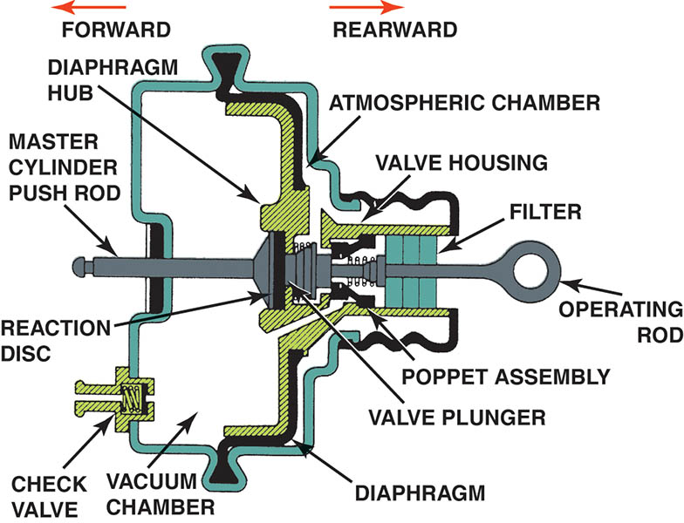
Figure 109.8 Cross-sectional view of a typical vacuum brake booster assembly

Slide 20
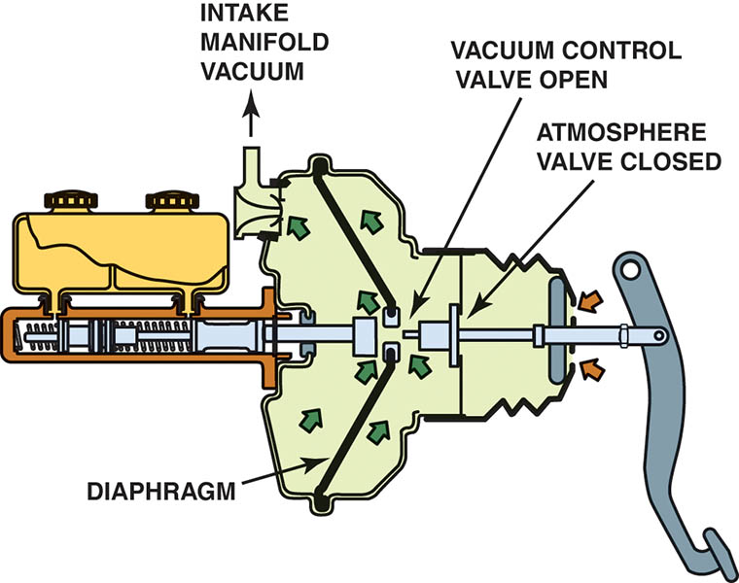
Figure 109.9 In the release position (brake pedal up), the vacuum is directed to both sides of the diaphragm

Slide 21
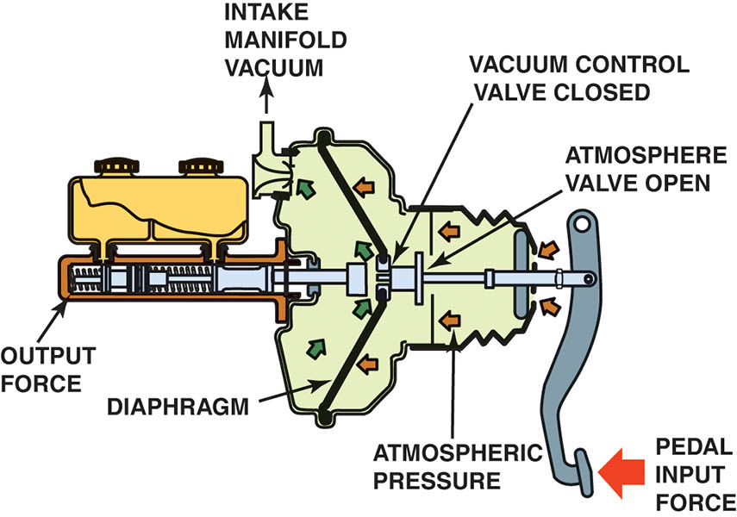
Figure 109.10 Simplified diagram of a vacuum brake booster in the apply position. Notice that the atmospheric valve is open and air pressure is being applied to the diaphragm

Slide 22
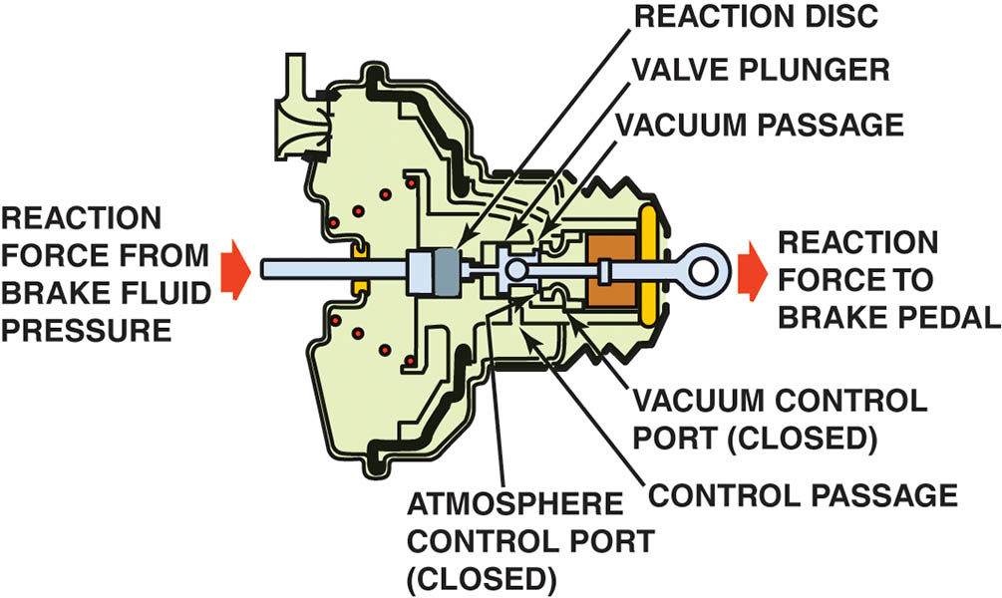
Figure 109.11 Cross section of a vacuum brake booster in the hold position with both vacuum and atmospheric valves closed. Note that the reaction force from the brake fluid pressure is transferred back to the driver as a reaction force to the brake pedal

Slide 23
DUAL - (TANDEM) - DIAPHRAGM VACUUM BOOSTERS
To provide power assist, air pressure must work against a rubber diaphragm.
Instead of increasing the diameter, vacuum booster manufacturers used two smaller-diameter diaphragms and placed one in front of the other.
These designs increased the total area without increasing the physical diameter of the booster.

Slide 24
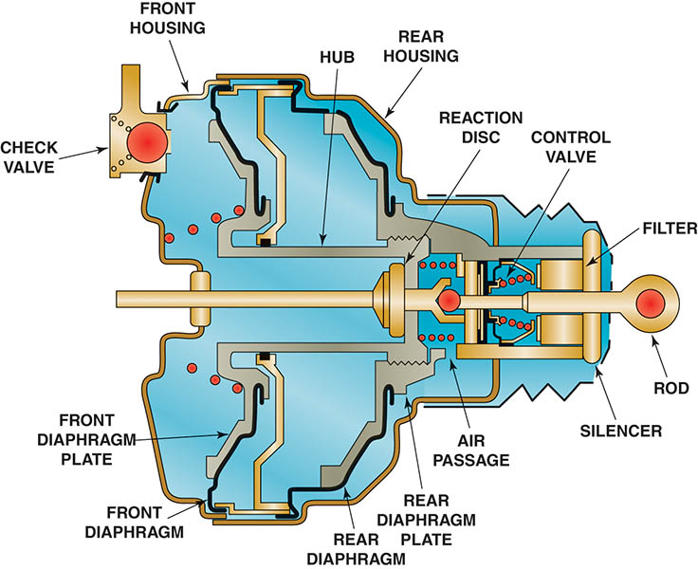
Figure 109.12 Cutaway showing a dual-diaphragm (tandem) vacuum brake booster

Slide 25
BRAKE ASSIST SYSTEM
Purpose and Function
  Applies the brakes with maximum force if the system detects that the driver is making a panic stop.
Operation
  The brake assist system uses a solenoid to open an air valve on the rear part of the vacuum booster assembly.
  Allows more air at atmospheric pressure into the chamber and increase the stopping pressure.
  Brake switch input is required for operation.

Slide 26
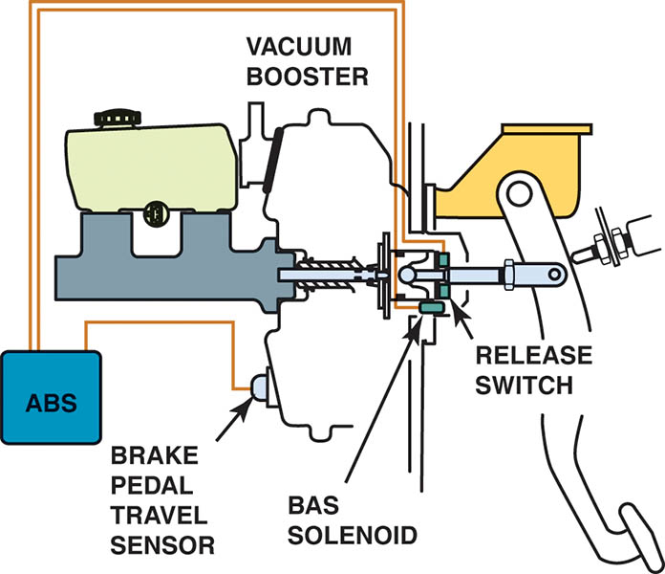
Figure 109.13 A typical brake assist system uses a brake pedal travel sensor and a BAS solenoid to apply the brakes during a panic condition

Slide 27
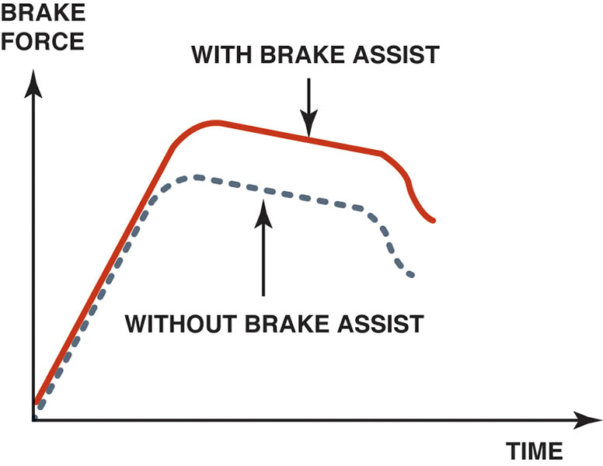
Figure 109.14 When the brake assist function operates, the brake force is much higher than normal

Slide 28
QUESTION 2: ?
What is the purpose of the brake assist system?

Slide 29
ANSWER 2:
To provide additional stopping force in a panic stop situation.

Slide 30
VACUUM BOOSTER OPERATION TEST
With the engine “off,” apply the brakes several times to deplete the vacuum.
With your foot on the brake pedal, start the engine.
The brake pedal should drop.
If the brake pedal does not drop, check for proper vacuum source to the booster.
If there is proper vacuum, repair or replacement of the power booster is required.

Slide 31
VACUUM BOOSTER LEAK TEST
To test if the vacuum booster can hold a vacuum, perform the following steps:
  Operate the engine to build up a vacuum in the booster, then turn the engine off.
  Wait one minute.
  Depress the brake pedal several times. There should be two or more power-assisted brake applications.

Slide 32
HYDRAULIC SYSTEM LEAK TEST
After depleting the power-assist unit, depress and then hold the brake pedal depressed with medium force (20 to 35 lb or 88 to 154 N).
The brake pedal should not fall away.
If the pedal falls, the hydraulic brake system is leaking.

Slide 33
PUSHROD CLEARANCE ADJUSTMENT
Whenever the vacuum brake booster or the master cylinder is replaced, the pushrod length should be checked.
An incorrect pushrod length can cause a low pedal or a brake system that does not fully release.
A gauge is often used to measure the position of the master cylinder piston, and then the other end of the gauge is used to determine the proper pushrod clearance.

Slide 34
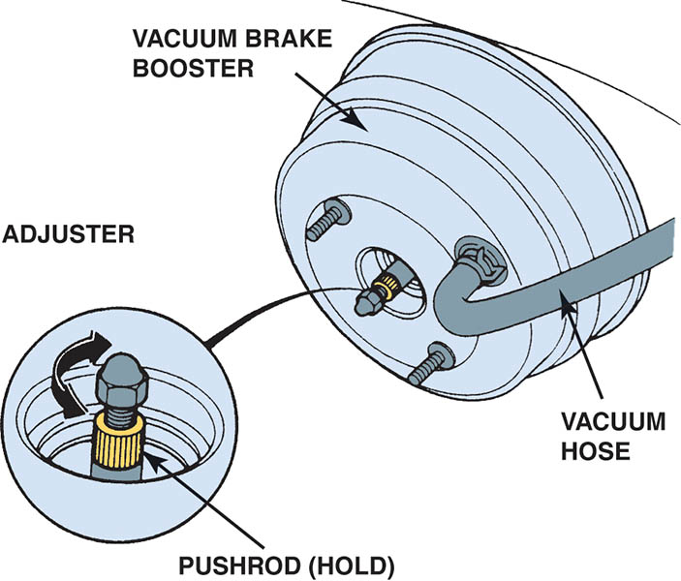
Figure 109.15 Typical adjustable pushrod. This adjustment is critical for the proper operation of the braking system. If the pushrod is too long, the brakes may be partially applied during driving. If the rod is too short, the brake pedal may have to be depressed farther down before the brakes start to work

Slide 35
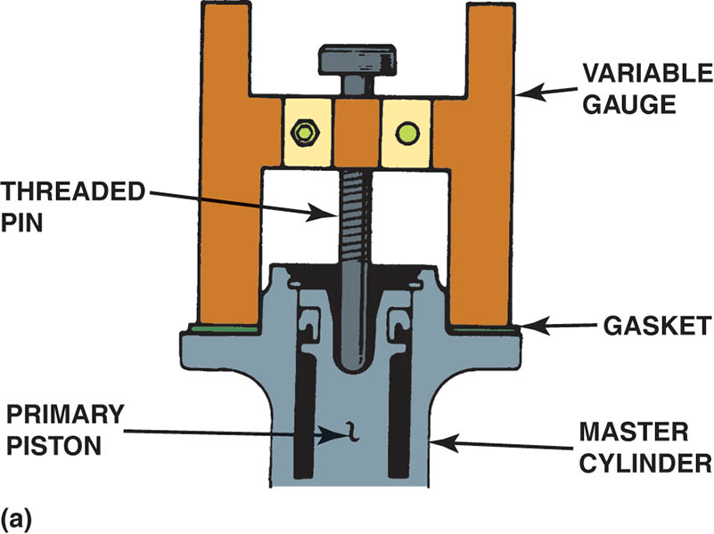
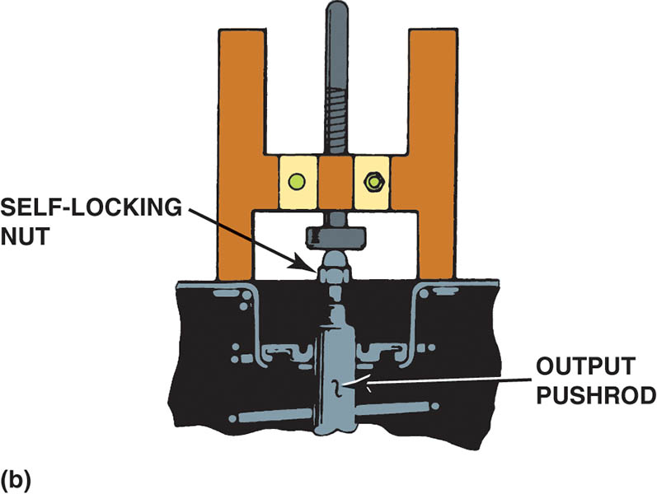
Figure 109.16 Typical vacuum brake booster pushrod gauging tool. (a) The tool is first placed against the mounting flange of the master cylinder and the depth of the piston determined. (b) The gauge is then turned upside down and used to gauge the pushrod length.

Slide 36
VACUUM BOOSTER DISASSEMBLY AND SERVICE
Some vehicle manufacturers recommend that the vacuum brake booster be disassembled and overhauled if defective.
A special holding fixture should be used before rotating (unlocking) the front and rear housing because the return spring is strong.
A rebuilding kit is available that includes all necessary parts and the proper silicone grease.

Slide 37
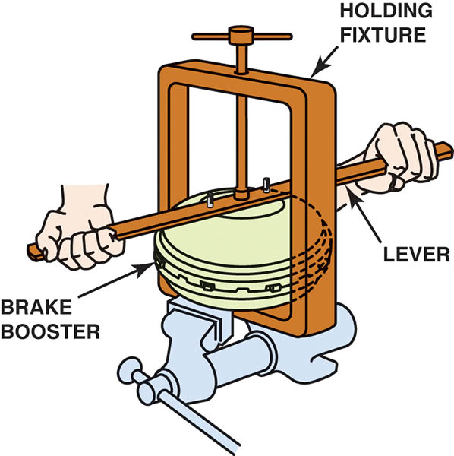
Figure 109.17 A holding fixture and a long tool being used to rotate the two halves of a typical vacuum brake booster

Slide 38
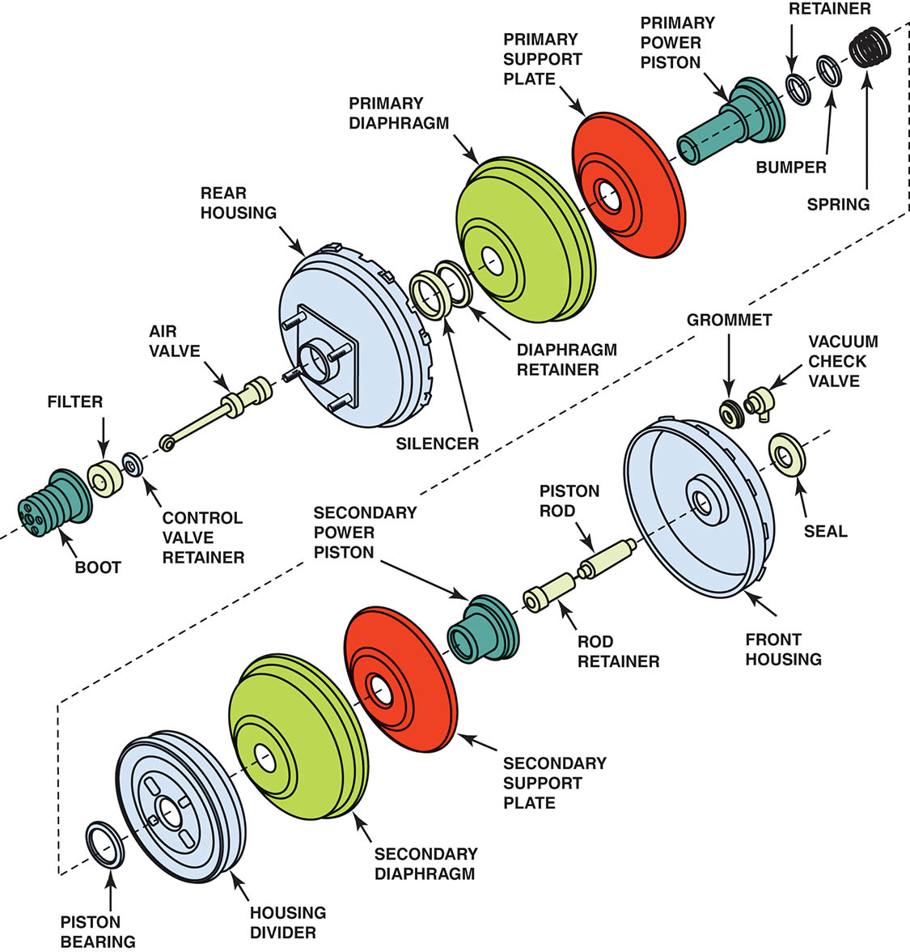
Figure 109.18 Exploded view of a typical dual-diaphragm vacuum brake booster assembly

Slide 39
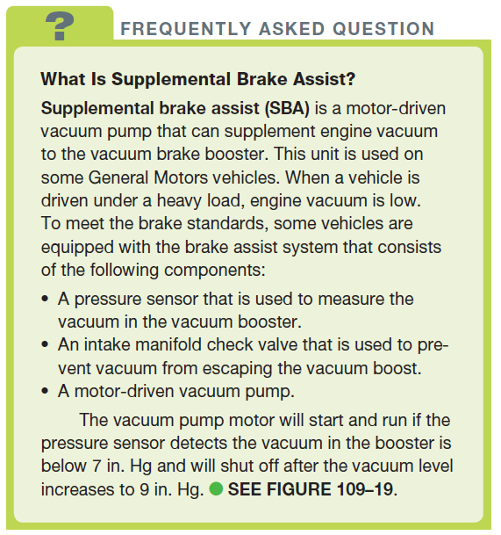
FREQUENTLY ASKED QUESTION

Slide 40
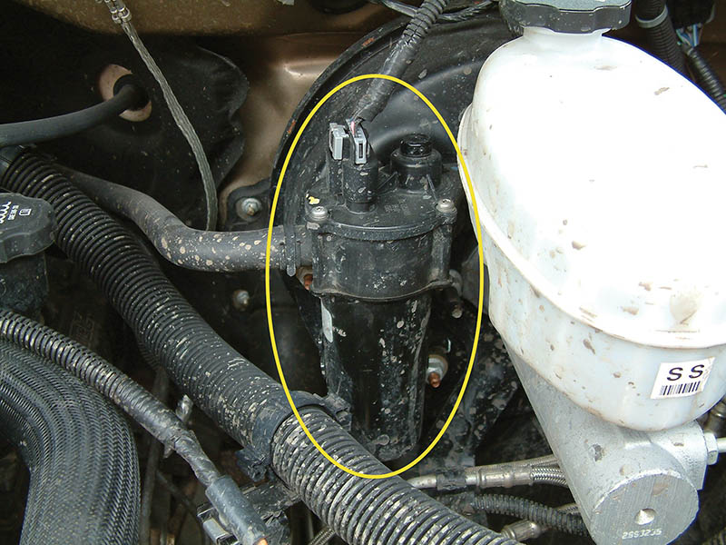
Figure 109.19 The supplemental brake assist (BAS) pump mounts on the brake booster housing

Slide 41
HYDRO-BOOST HYDRAULIC BRAKE BOOSTER (1 OF 2)
Purpose
  The system uses the pressurized hydraulic fluid from the vehicle’s power steering pump as a power source rather than using engine vacuum as is used with vacuum boosters.
Operation
  When the brake pedal is depressed, the spool valve closes off the return port, causing pressure to build in the boost pressure chamber.

Slide 42
HYDRO-BOOST HYDRAULIC BRAKE BOOSTER (2 OF 2)
Diagnosis
  Checking for proper power steering fluid level.
  Checking for leaks from the unit or power steering pump.
  Checking the condition and tightness of the power steering drive belt.
After checking all of the visual components, check for proper pressure and volume from the power steering pump using a power steering pump tester.

Slide 43
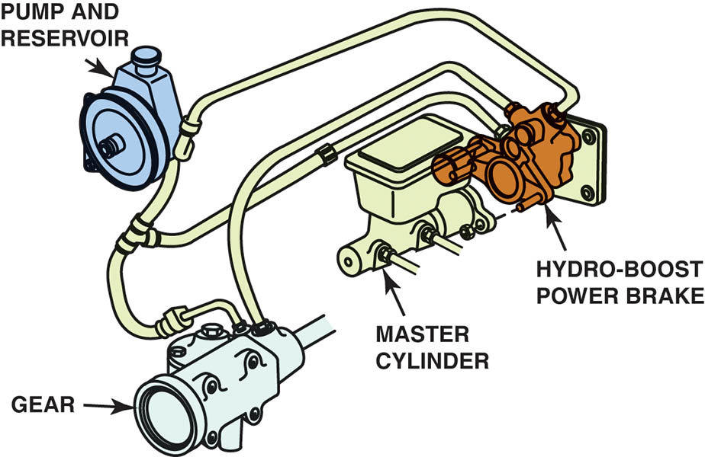
Figure 109.20 Hydro-Boost unit attaches between the bulkhead and the master cylinder and is powered by the power steering pump

Slide 44
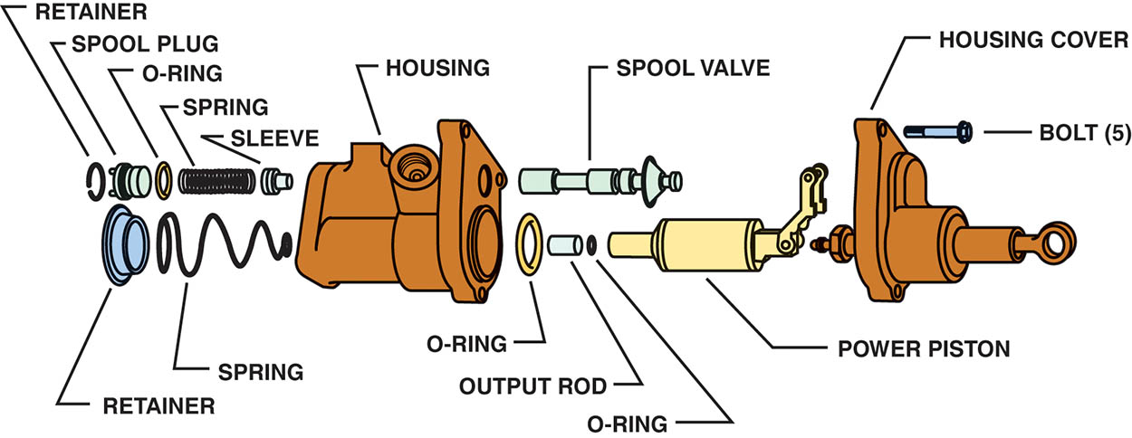
Figure 109.21 Exploded view of the Hydro-Boost unit

Slide 45
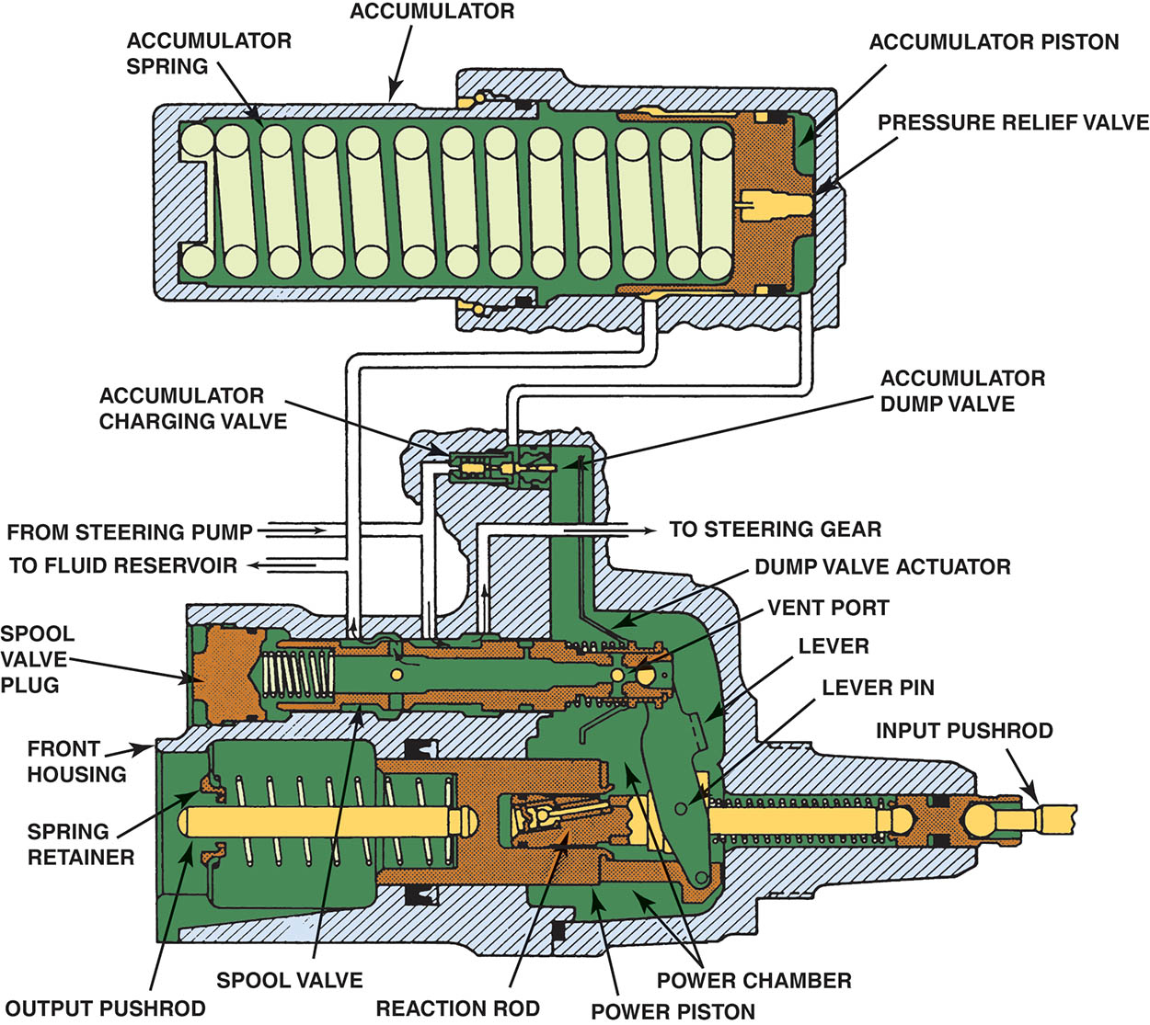
Figure 109.22 A Hydro-Boost hydraulic booster in the unapplied position

Slide 46
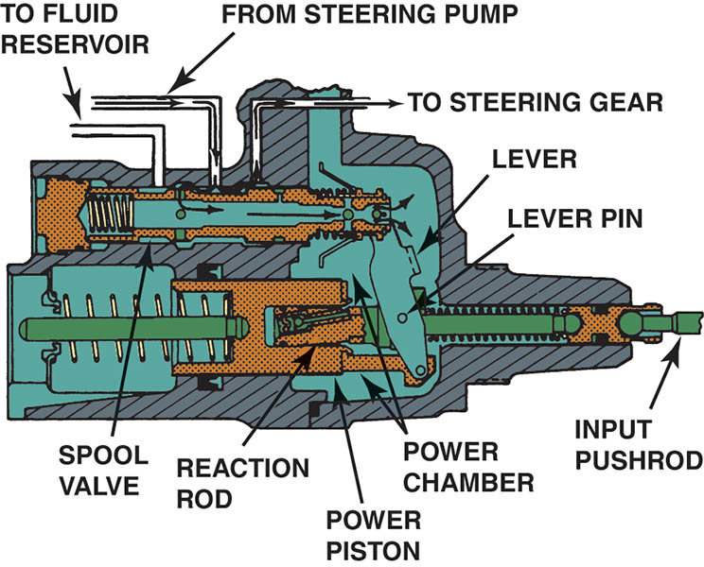
Figure 109.23 A Hydro-Boost hydraulic booster as the brakes are applied

Slide 47
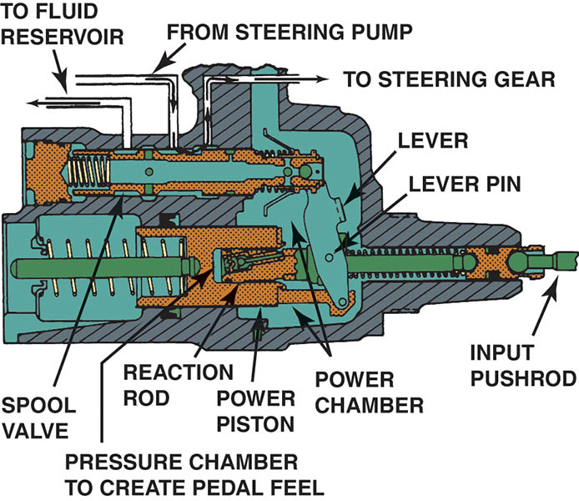
Figure 109.24 A Hydro-Boost hydraulic booster in the holding position

Slide 48
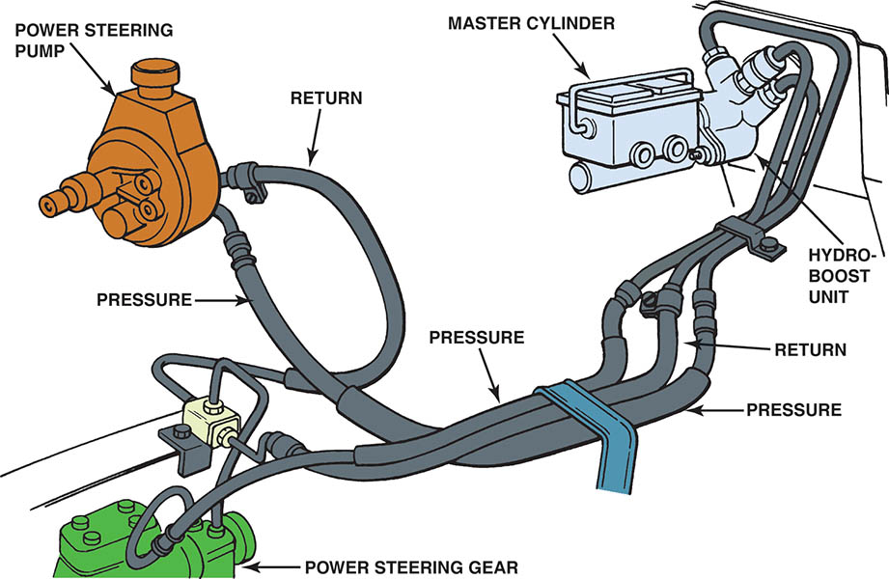
Figure 109.25 A typical Hydro-Boost hydraulic line arrangement showing the pump, steering gear, and brake booster assembly

Slide 49
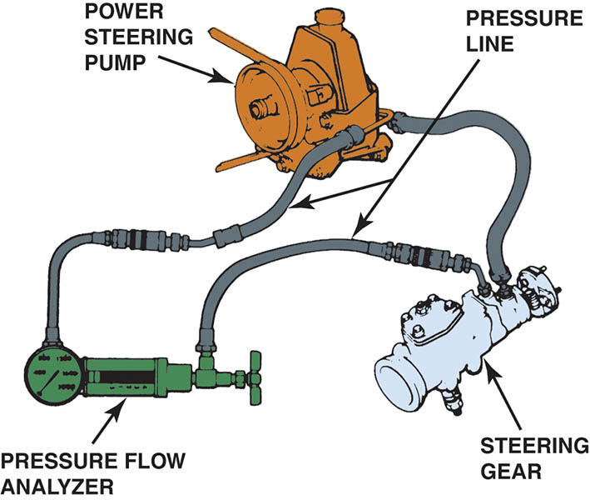
Figure 109.26 Pressure and flow analyzer installation to check the power steering pump output

Slide 50
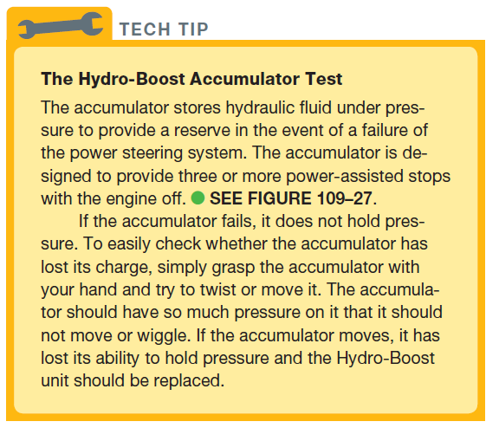
Tech Tip

Slide 51
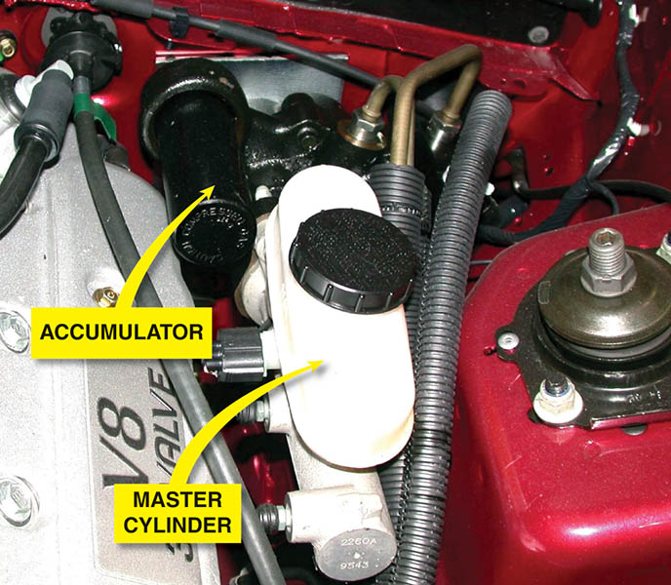
Figure 109.27 The accumulator should be able to hold pressure and feel tight when hand force is used to try to move it

Slide 52
HYDRO-BOOST SYMPTOM BASED GUIDE
Excessive brake pedal effort
Slow brake pedal return
Grabby brakes
Boost chatters – pedal vibrates

Slide 53
QUESTION 3: ?
How does a hydro-boost system provide assist?

Slide 54
ANSWER 3:
  When the brake pedal is depressed, the spool valve closes off the return port, causing pressure to build in the boost pressure chamber.

Slide 55

Copyright

