Slide 1
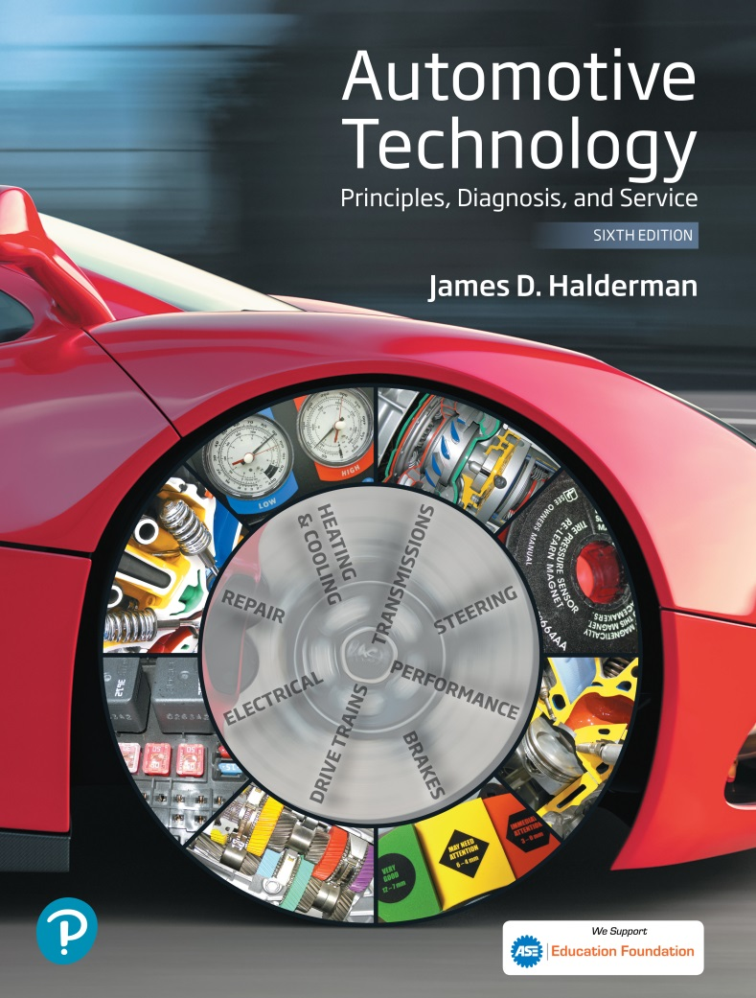
Automotive Technology Principles, Diagnosis, and Service
Sixth Edition
Chapter 108
Machining Brake Drums and Rotors
Copyright © 2018, 2015, 2011 Pearson Education, Inc. All Rights Reserved

Slide 2
LEARNING OBJECTIVES (1 of 2)
108.1 Describe the types of brake drums.
108.2 Explain the factors that cause rotor damage.
108.3 Discuss brake drum distortion and removal.
108.4 Explain how to machine a brake drum and when a brake drum should be discarded.
108.5 Explain the procedure for machining disc brake rotor.

Slide 3
LEARNING OBJECTIVES (2 of 2)
108.6 Discuss disc brake rotors and causes of rotor distortion.
108.7 Explain when to machine a disk brake rotor, and discuss rotor thickness and finish.
108.8 Explain the procedure for qualifying a brake lathe.
108.9 This chapter will help prepare for the Brakes (A5) ASE certification test content area “C” (Drum Brake Diagnosis and Repair) and “D” (Disc Brake Diagnosis and Repair).

Slide 4
BRAKE DRUMS
Cast-Iron Drums
  Cast iron contains approximately 3% carbon, which makes the drum hard, yet brittle.
  The 3% carbon content of the cast iron also acts as a lubricant, which prevents noise during braking.
Aluminum Drums
  Aluminum brake save weight, and transfer heat to the surrounding air faster than cast iron or steel.
  Aluminum brake drums use cast iron for the friction surface area.

Slide 5
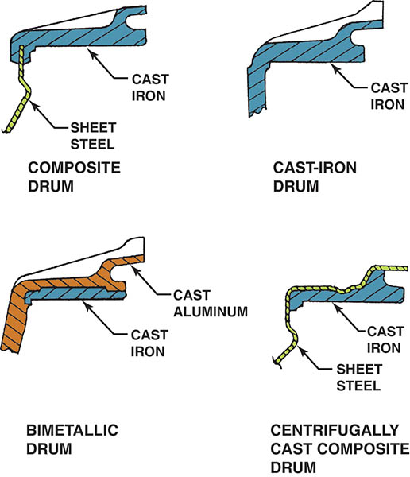
Figure 108.1 Types of brake drums. Regardless of the design, all types use cast iron as a friction surface

Slide 6
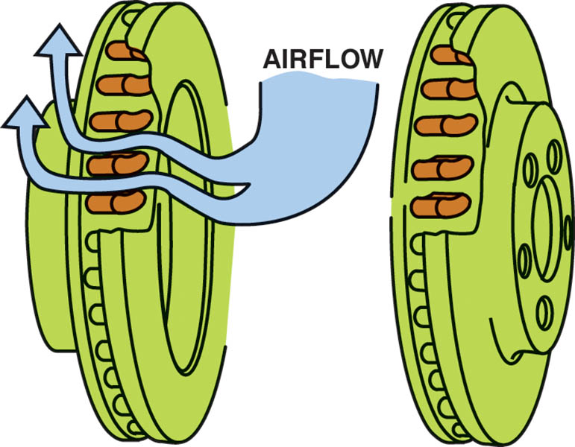
Figure 108.2 The airflow through cooling vents helps brakes from overheating

Slide 7
BRAKE DRUM AND ROTOR DAMAGE (1 OF 2)
Scoring
  Scoring is an extreme form of drum and rotor wear consisting of scratches, deep grooves, and a generally rough finish on the friction surface.
Cracking
  Cracks in a brake drum or rotor are caused by the stress of severe braking or an impact during an accident.

Slide 8
BRAKE DRUM AND ROTOR DAMAGE (2 OF 2)
Heat Checking
  Heat checking consists of many small, interlaced cracks on the friction surface.
Hard or Chill Spots
  Hard or chill spots are an altering the structure of the metal caused by heat.

Slide 9
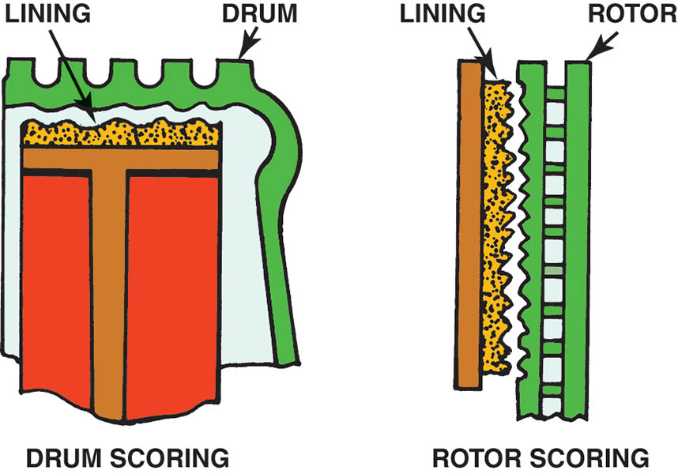
Figure 108.3 Scored drums and rotors often result in metal-to-metal contact

Slide 10
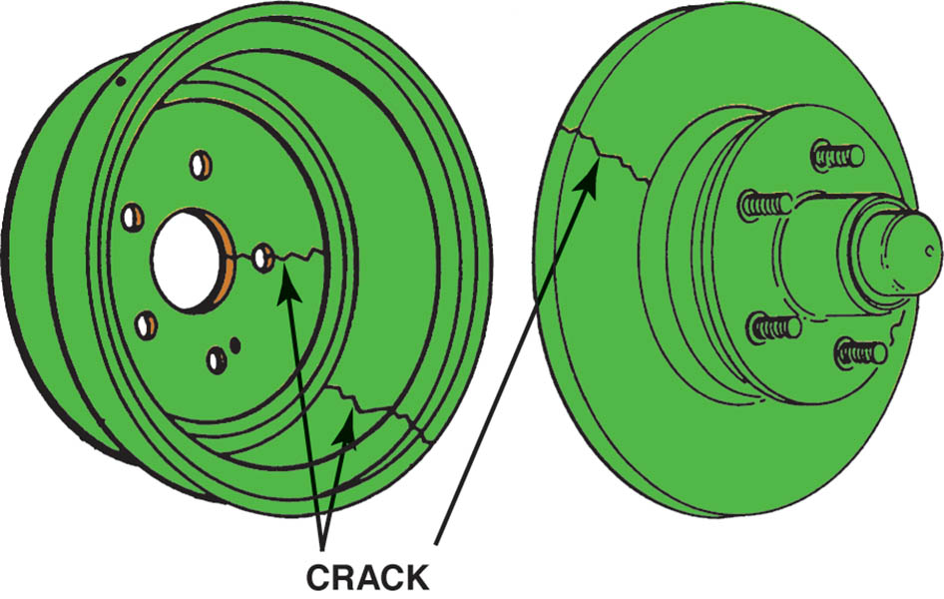
Figure 108.4 Cracked drums or rotors must be replaced

Slide 11
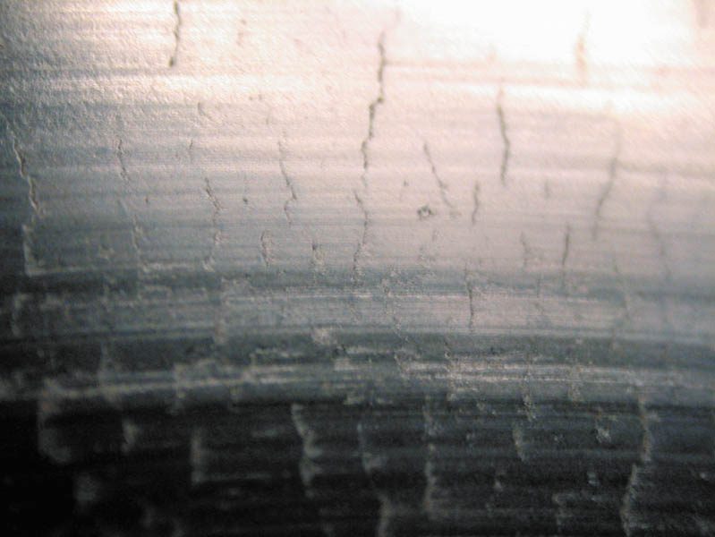
Figure 108.5 A heat-checked surface of a disc brake rotor

Slide 12
QUESTION 1: ?
What are the four types of rotor damage?

Slide 13
ANSWER 1:
Scoring, cracking, heat checking and hard spots.

Slide 14
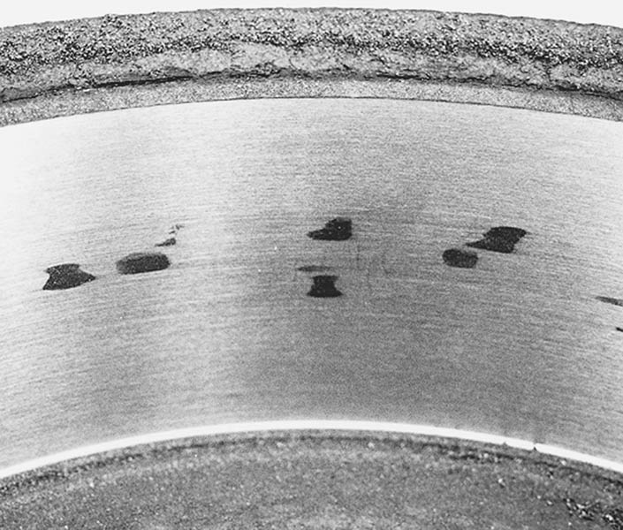
Figure 108.6 These dark hard spots are created by heat that actually changes the metallurgy of the cast-iron drum. Most experts recommend replacement of any brake drum that has these hard spots

Slide 15
BRAKE DRUM DISTORTION (1 OF 2)
Drum Distortion
  Drum distortion occurs when the friction surface does not return to its proper shape, is no longer parallel to the axle
Bellmouth Drums
  Occurs when an open edge of a brake drum friction surface has a larger diameter than the closed edge.

Slide 16
BRAKE DRUM DISTORTION (2 OF 2)
Out-Of-Round Drums
  A distortion in which the drum radius varies when measured at different points around its circumference.
Eccentric Drums
  Eccentric distortion exists when the geometric center of the circle described by the brake drum friction surface is other than the center of the axle or the bolt circle of the drum web.

Slide 17
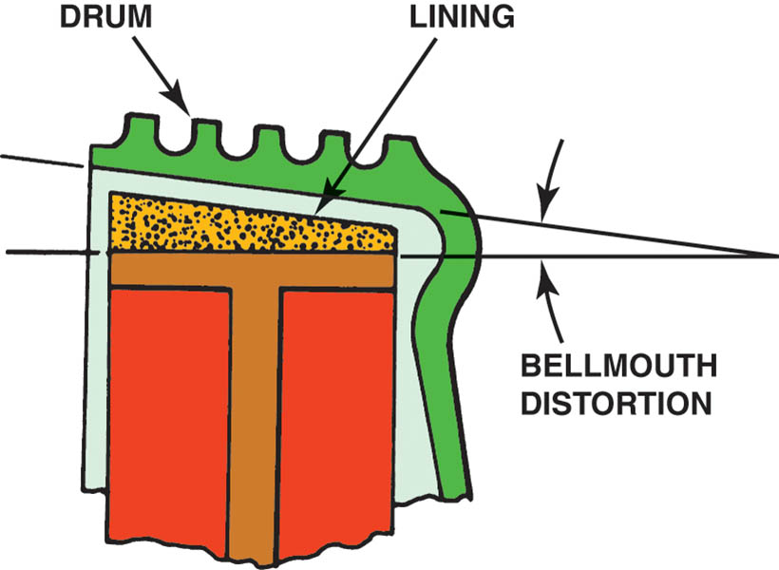
Figure 108.7 Bellmouth brake drum distortion

Slide 18
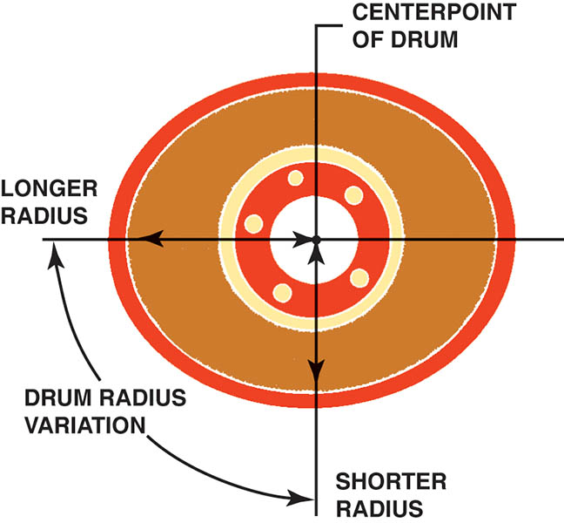
Figure 108.8 Out-of-round brake drum distortion

Slide 19
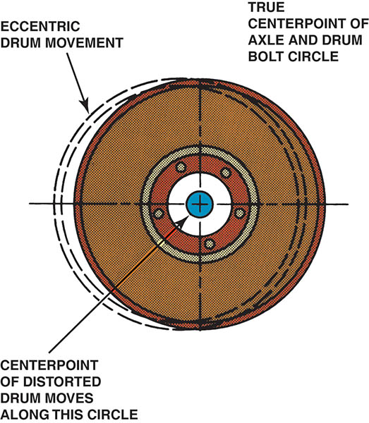
Figure 108.9 Eccentric brake drum distortion

Slide 20
REMOVING DRUMS
The first inspection step after removing a brake drum is to check it for warpage using a straightedge.
A warped drum is often a source of vibration.
A brake drum that is out-of-round can cause a brake pedal pulsation during braking.

Slide 21
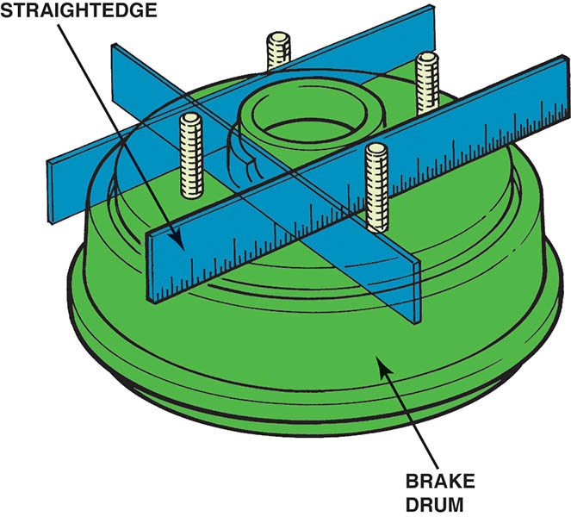
Figure 108.10 A straightedge can be used to check for brake drum warpage

Slide 22
“MACHINE TO” VERSUS “DISCARD”
Brake drums can usually be machined a maximum of 0.060 inch (1.5 mm) oversize unless otherwise stamped on the drum.
Most brake experts recommend that both drums on the same axle be within 0.010 inch (0.25 mm) of each other.
Always leave at least 0.015 inch (0.4 mm) after machining (resurfacing) for wear. Many manufacturers recommend that 0.030 inch (0.8 mm) be left for wear.

Slide 23
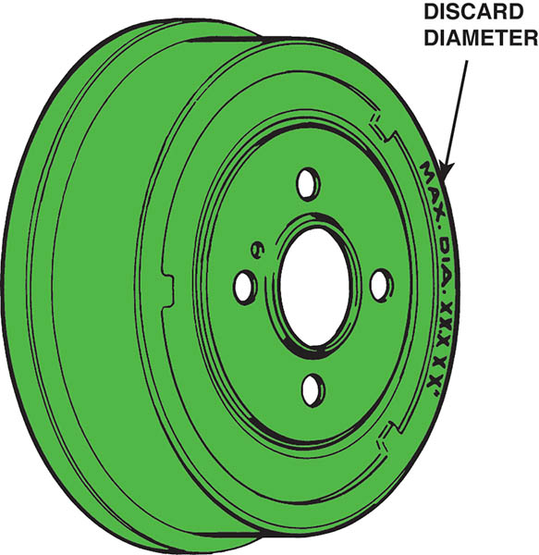
Figure 108.11 Discard diameter and maximum diameter are brake drum machining and wear limits

Slide 24
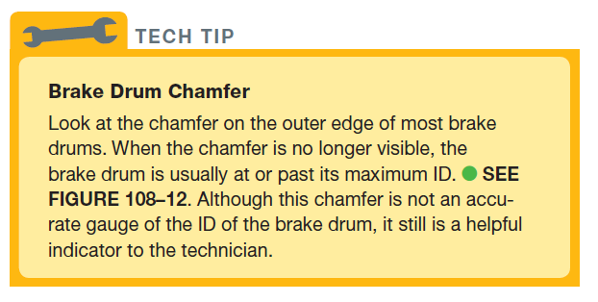
Tech Tip

Slide 25
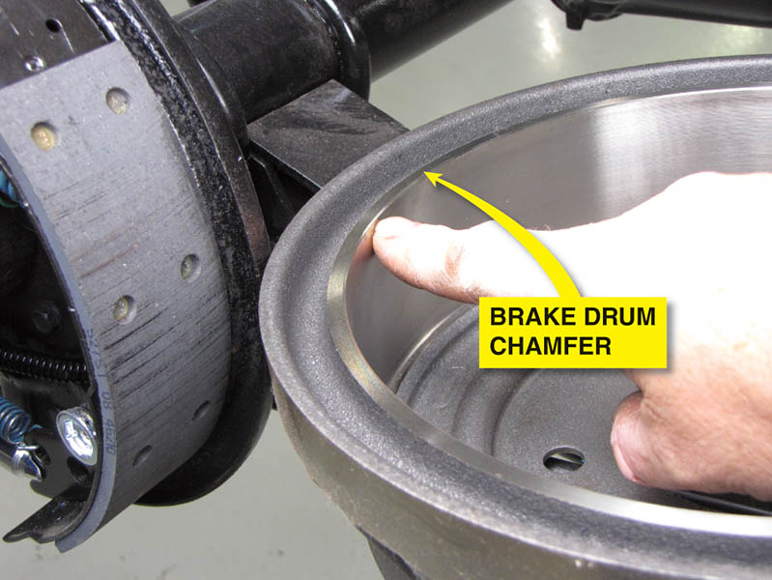
Figure 108.12 Most brake drums have a chamfer around the edge. If the chamfer is no longer visible, the drum is usually worn (or machined) to its maximum allowable ID

Slide 26
MACHINING BRAKE DRUMS
Measuring a Drum
  Brake drums are usually measured using a micrometer especially designed for brake drums.
  Compare the micrometer reading to the discard diameter.
Machining a Drum Procedure
  Follow the machine specific procedures to ensure the drum is properly mounted with a silencer band.
  Perform a scratch cut to confirm the mounting position.
  Start the lathe and set the depth of cut.

Slide 27
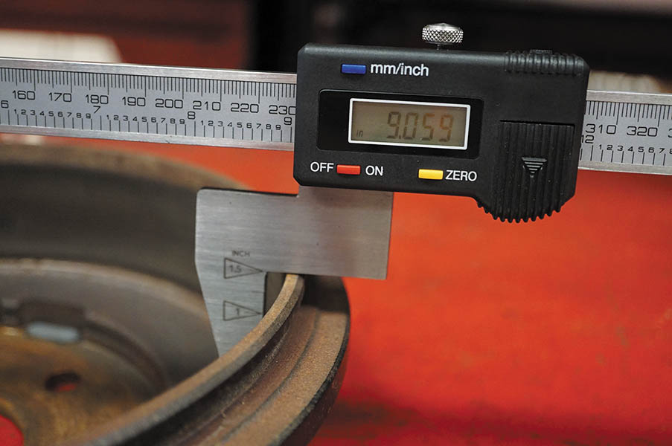
Figure 108.13 A digital drum micrometer makes measuring brake drums easily and accurately

Slide 28
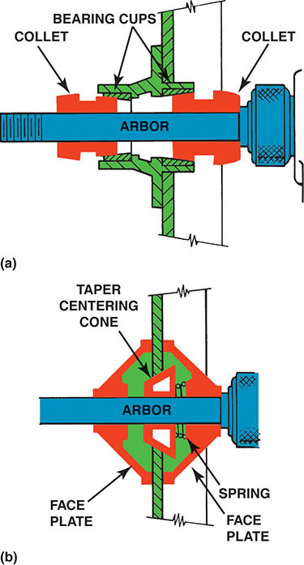
Figure 108.14 (a) A rotor or brake drum with a bearing hub should be installed on a brake lathe using the appropriate size collet that fits the bearing cups (races)

Slide 29
Figure 108.14 (b) A hubless rotor or brake drum requires a spring and a tapered centering cone. A faceplate should be used on both sides of the rotor or drum to provide support

Slide 30
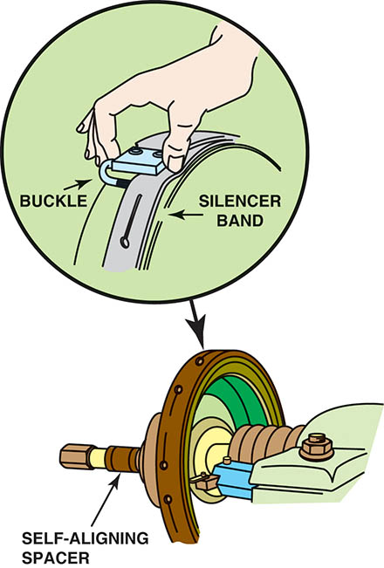
Figure 108.15 A self-aligning spacer (SAS) should always be used between the drum or rotor and the spindle retaining nut to help ensure an even clamping force and to prevent the adapters and cone from getting into a bind. A silence band should always be installed to prevent turning-tool chatter and to ensure a smooth surface finish

Slide 31
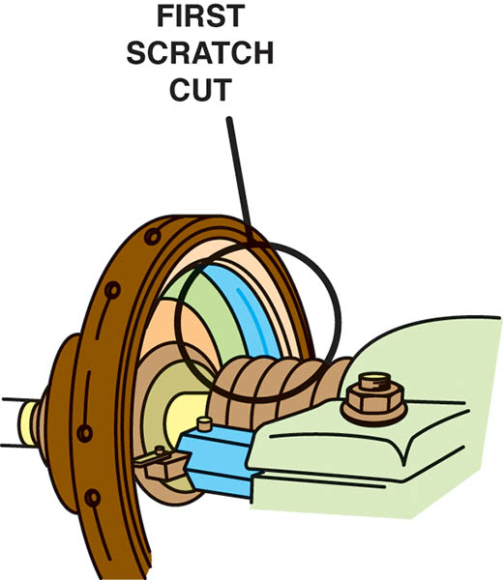
Figure 108.16 After installing a brake drum on the lathe, turn the cutting tool outward until the tool just touches the drum. This is called a scratch cut

Slide 32
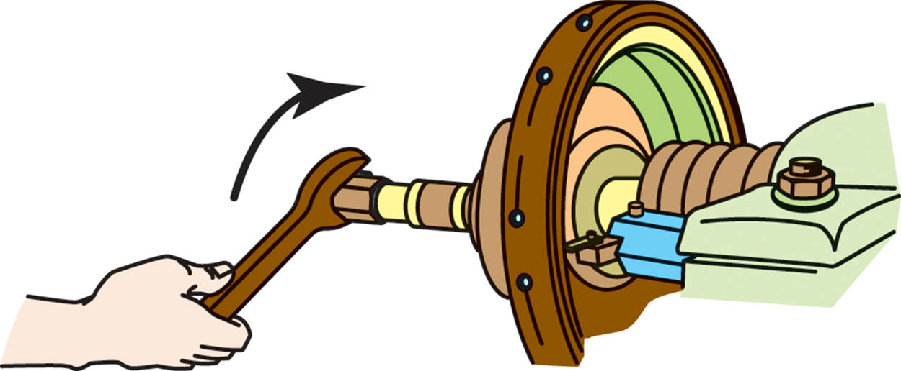
Figure 108.17 After making a scratch cut, loosen the retaining nut, rotate the drum on the lathe, and make another scratch cut. If both cuts are in the same location, the drum is installed correctly on the lathe and drum machining can begin

Slide 33
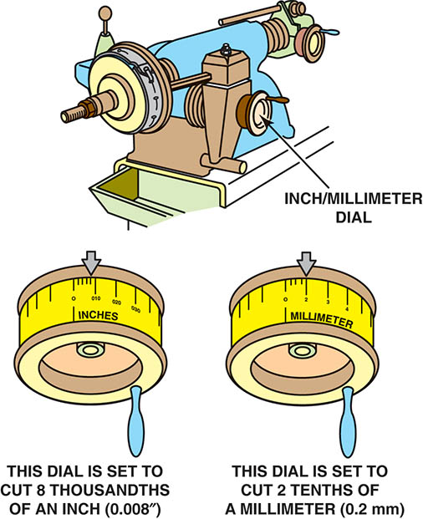
Figure 108.18 Set the depth of the cut indicator to zero just as the turning tool touches the drum

Slide 34
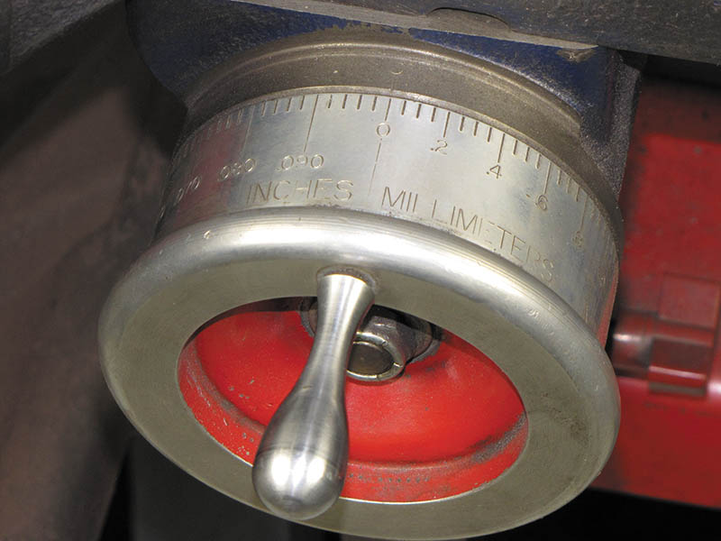
Figure 108.19 This lathe has a dial that is “diameter graduated.” This means that a reading of 0.030 inch indicates a 0.015 inch cut that increases the inside diameter of the brake drum by 0.030 inch

Slide 35
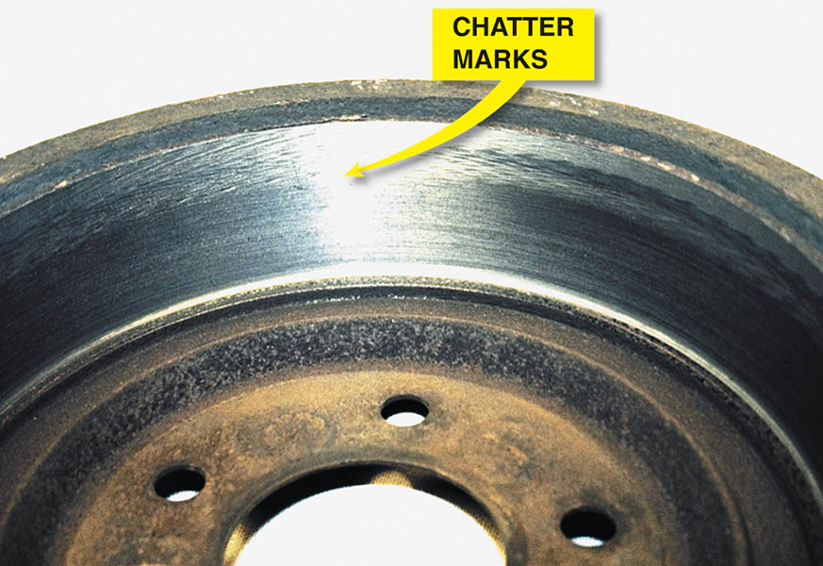
Figure 108.20 Notice the chatter marks at the edge of the friction-area surface of the brake drum. These marks were caused by vibration of the drum because the technician failed to wrap the dampening strap (silencer band) over the friction-surface portion of the brake drum

Slide 36
DISC BRAKE ROTORS
Disc brake rotors use cast gray iron at the area that contacts the friction pad.
Styles of Rotors
  Solid
  Vented
Composite Rotors
  Composite rotors use a steel center section with a cast-iron wear surface.
Aluminum Metal Matrix Composite Rotors
  Manufactured from an aluminum metal matrix composite alloy reinforced with 20% silicon carbide particulate.

Slide 37
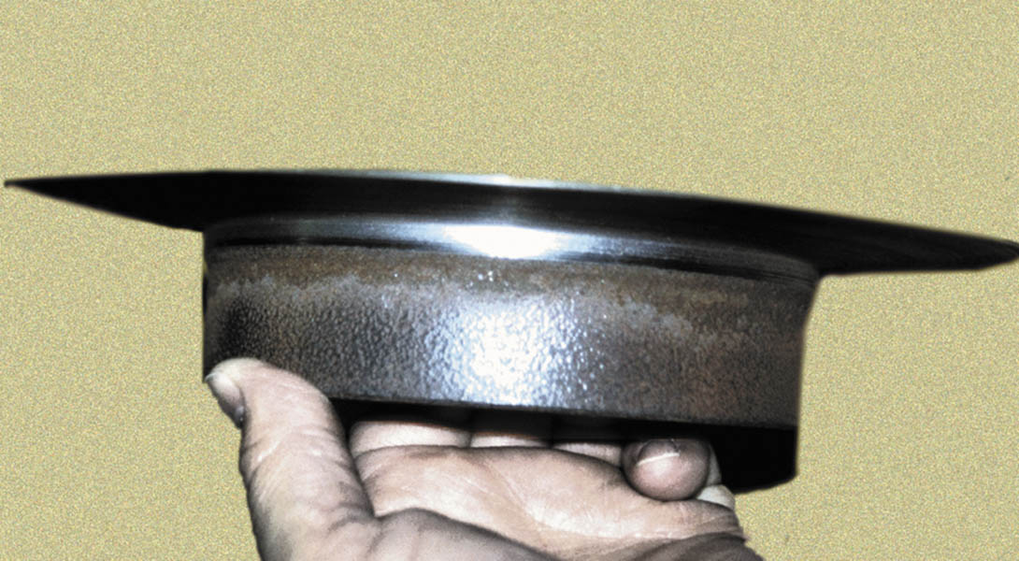
Figure 108.21 This excessively worn (thin) rotor was removed from the vehicle in this condition. It is amazing that the vehicle was able to stop with such a thin rotor.

Slide 38
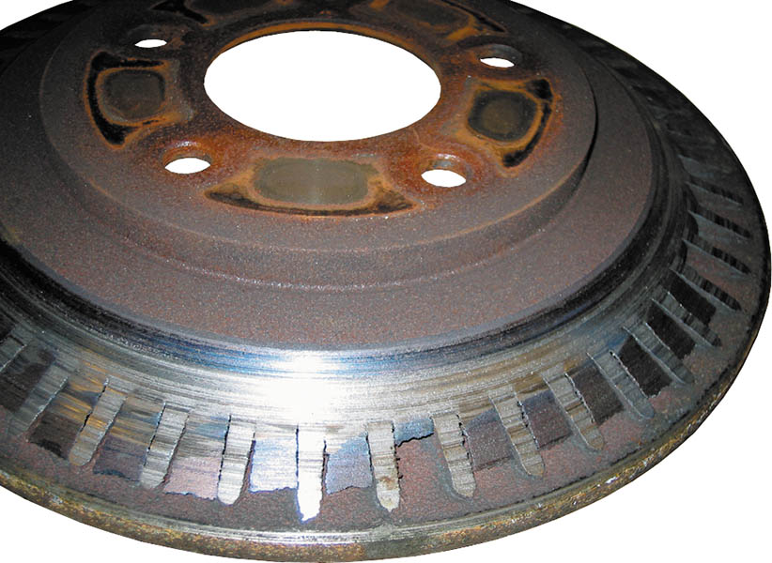
Figure 108.22 Severely worn vented disc brake rotor. The braking surface has been entirely worn away exposing the cooling fins. The owner brought the vehicle to a repair shop because of a “little noise in the front.”

Slide 39
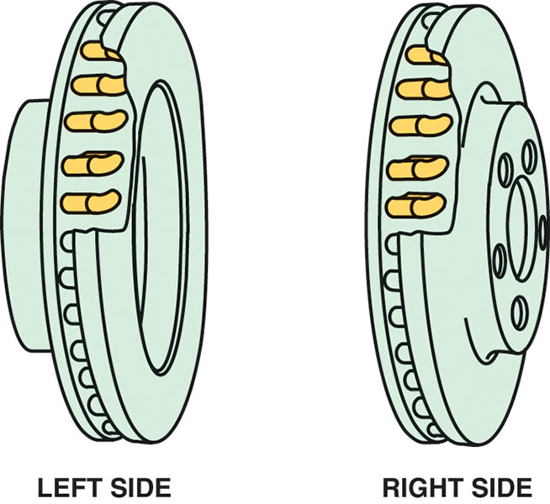
Figure 108.23 Directional vane vented disc brake rotors. Note that the fins angle toward the rear of the vehicle. It is important that this type of rotor be reinstalled on the correct side of the vehicle.

Slide 40
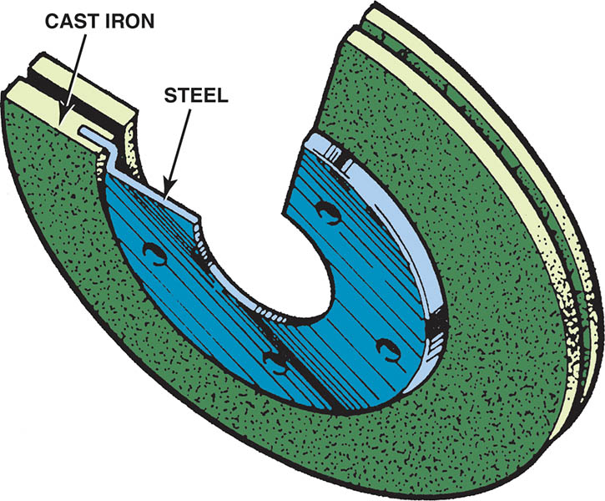
Figure 108.24 Typical composite rotor that uses cast-iron friction surfaces and a steel center section.

Slide 41
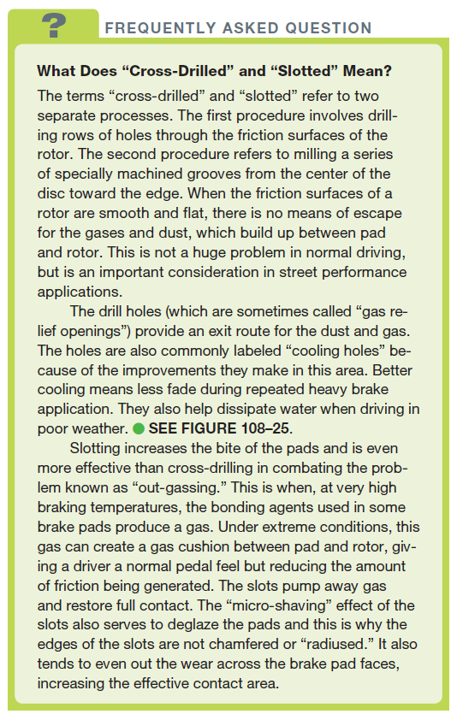
FREQUENTLY ASKED QUESTION

Slide 42
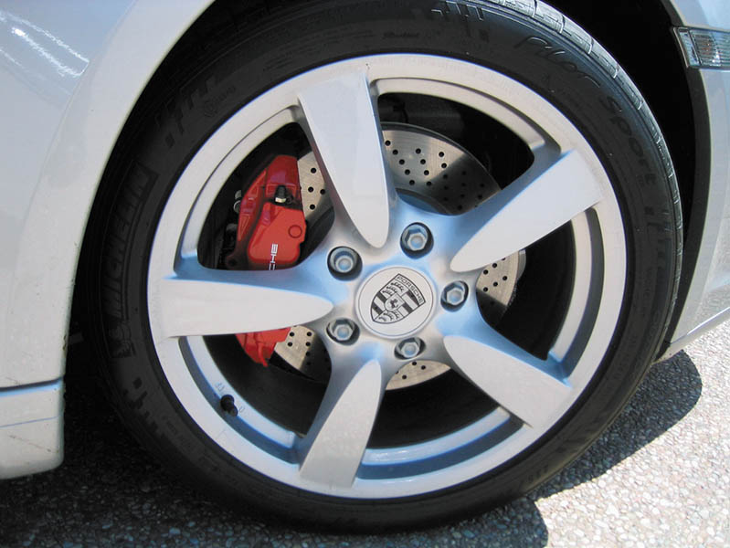
Figure 108.25 This Porsche is equipped with high performance brakes including cross-drilled brake rotors

Slide 43
DISC BRAKE ROTOR DISTORTION
Causes of Rotor Distribution
  The most common cause of distortion is when there is a problem with the friction assembly, such as a frozen caliper piston that creates unequal application force on the two sides of the rotor.
Rotor Lateral Runout
  A side-to-side wobble of the rotor as it rotates on the spindle.
Rotor Lack of Parallelism
  A variation in the thickness of the rotor

Slide 44
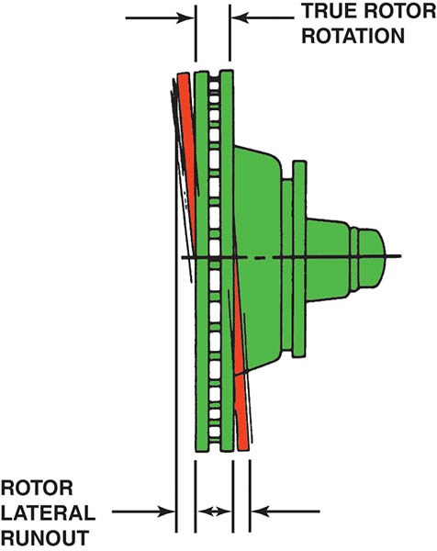
Figure 108.26 Brake rotor lateral runout distortion

Slide 45
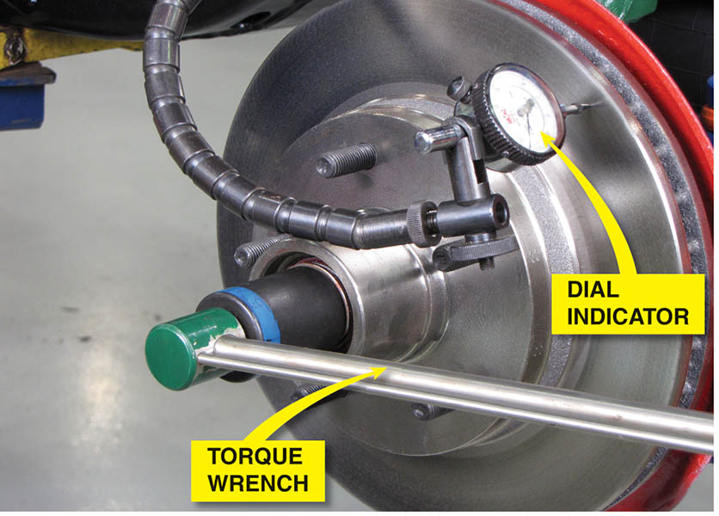
Figure 108.27 Before measuring lateral runout with a dial indicator (gauge), remove any wheel bearing end play by tightening the spindle nut to 10 to 20 ft lb with a torque wrench. This step helps prevent an inaccurate reading.

Slide 46
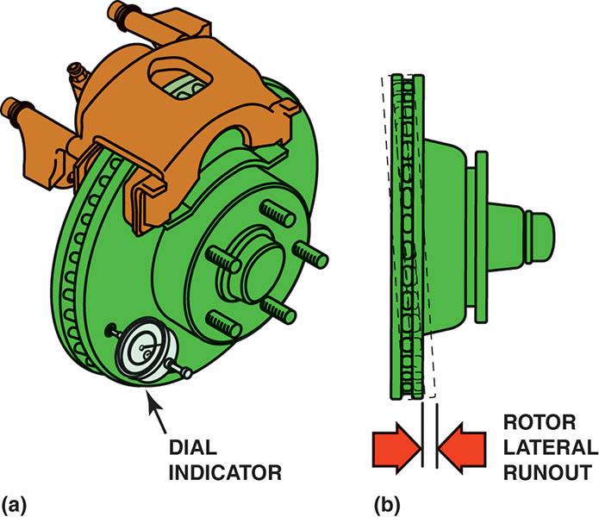
Figure 108.28 (a) Rotate the disc brake rotor one complete revolution while observing the dial indicator (gauge)

Slide 47
Figure 108.28 (b) Most vehicle manufacturers specify a maximum runout of about 0.003 inch (0.08 mm)

Slide 48
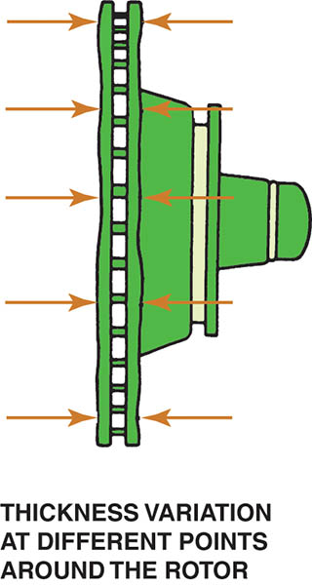
Figure 108.29 Brake rotor lack-of-parallelism distortion

Slide 49
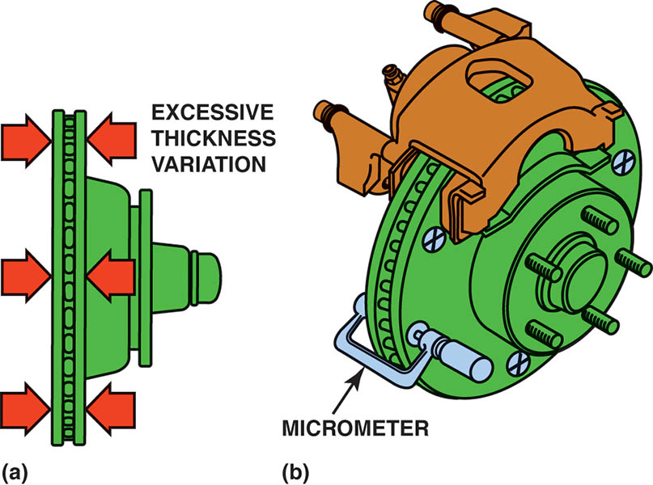
Figure 108.30 (a) Disc brake rotor thickness variation (parallelism)

Slide 50
Figure 108.30 (b) The rotor should be measured with a micrometer at four or more equally spaced locations around the rotor

Slide 51
QUESTION 2: ?
What is the most common cause of rotor distortion?

Slide 52
ANSWER 2:
A frozen caliper piston that creates unequal application force to each side of the rotor.

Slide 53
CARBON-CERAMIC ROTORS
Description
  Carbon-ceramic brake (CCB) rotors are used on some high-performance vehicles and are very expensive.
Construction
  Carbon-ceramic brake rotors are made of a carbon-fiber-reinforced ceramic silicon carbide material.
Advantages
  Low weight and corrosion and weather resistant.
Service Procedures
  Cannot be serviced or machined, it must be replaced.

Slide 54
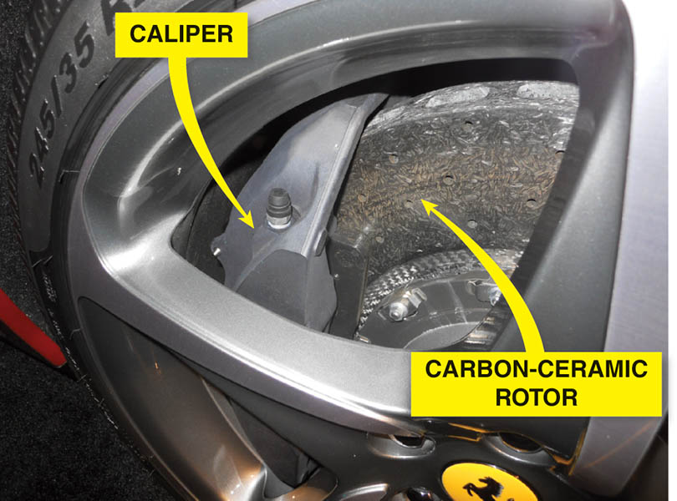
Figure 108.31 A carbon-ceramic brake (CCB) rotor on a Ferrari

Slide 55
DISC BRAKE ROTOR THICKNESS
Most rotors have a minimum thickness cast or stamped into the rotor.
At least 0.015 inch (0.4 mm) to 0.030 inch (0.8 mm) must remain after machining to allow for wear.
Whenever machining (resurfacing) a rotor, an equal amount of material must be removed from each side.

Slide 56
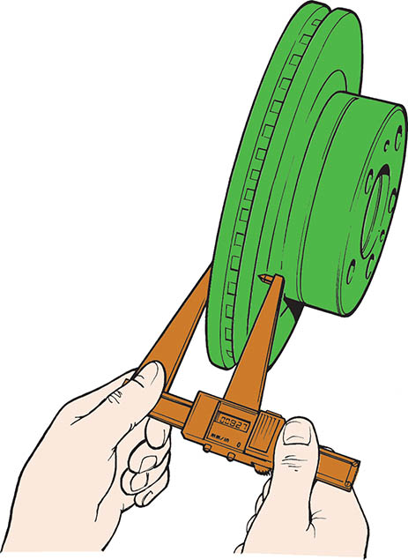
Figure 108.32 A digital readout rotor micrometer is an accurate tool to use when measuring a rotor. Both fractional inches and metric millimeters are generally available

Slide 57
WHEN THE ROTORS SHOULD BE MACHINED
Grooves deeper than 0.060 inch (1.5 mm). This is the approximate thickness of a nickel.
Thickness variation exceeding specifications and a brake pedal pulsation complaint.
Heavy rust that has corroded the friction surface of the rotor.

Slide 58
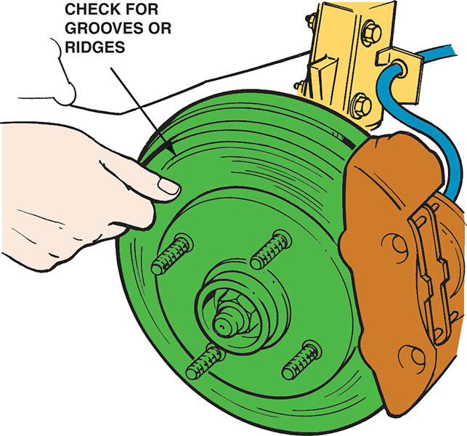
Figure 108.33 If a fingernail catches on a groove in the rotor, the rotor should be machined

Slide 59
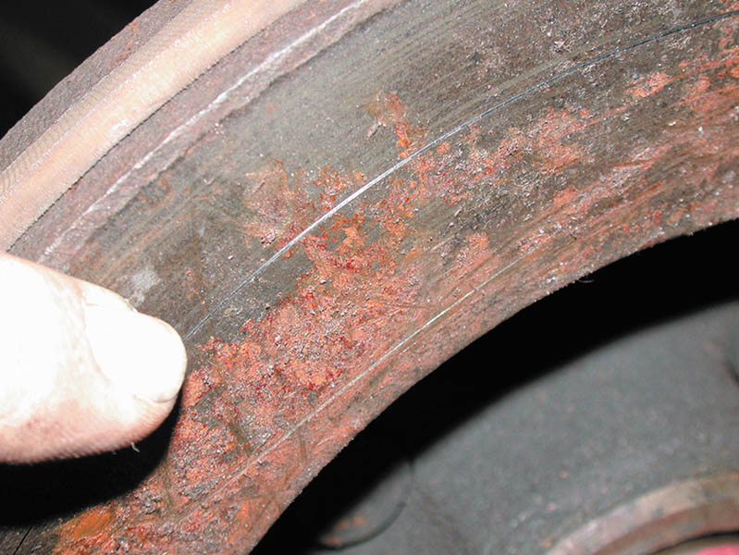
Figure 108.34 This rusted rotor should be machined

Slide 60
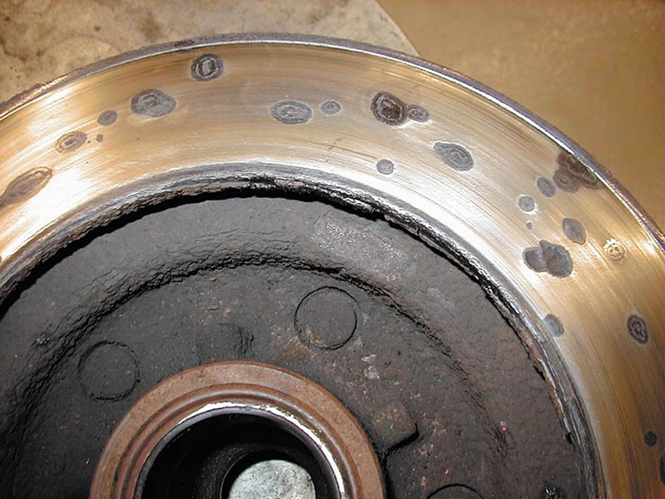
Figure 108.35 Rotors that have deep rust pockets usually cannot be machined

Slide 61
QUESTION 3: ?
When should a rotor be machined?

Slide 62
ANSWER 3:
When deep grooves, excessive thickness variation or heavy rust exist on the friction surface.

Slide 63
ROTOR FINISH
Surface finish is measured in units called microinches, abbreviated μin..
The usual method of expressing surface finish is the arithmetic average roughness height, abbreviated Ra, which is the average of all peaks and valleys from the mean (average) line.
Most new rotors have a surface finish of 45 to 60 μin. Ra.

Slide 64
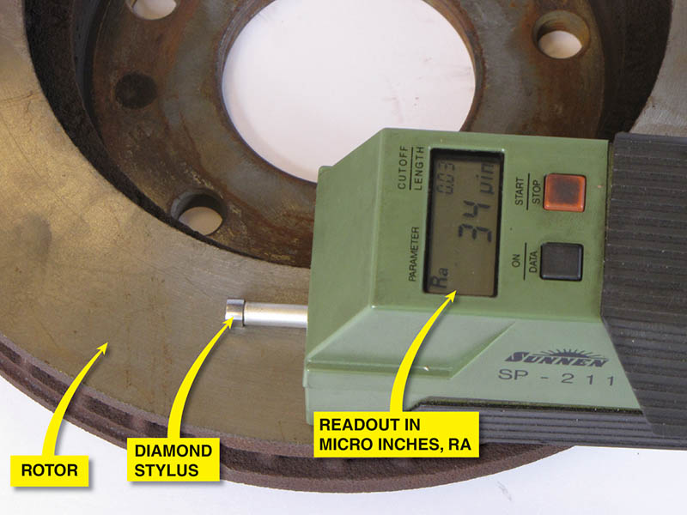
Figure 108.36 Electronic surface finish machine. The reading shows about 34 μin. This is a very smooth rotor and is suitable for use with any brake pad

Slide 65
QUALIFYING A BRAKE LATHE
Purpose of Qualifying a Brake Lathe
  To make sure the lathe is in good condition and are capable of machining brake drums and rotors accurately.
Qualifying Procedure
  Ensure the machine is clean and fully operational.
  Check all adapters and mounting surface for nicks and contamination.
  Follow the manufactures specific operating and machining instructions.

Slide 66
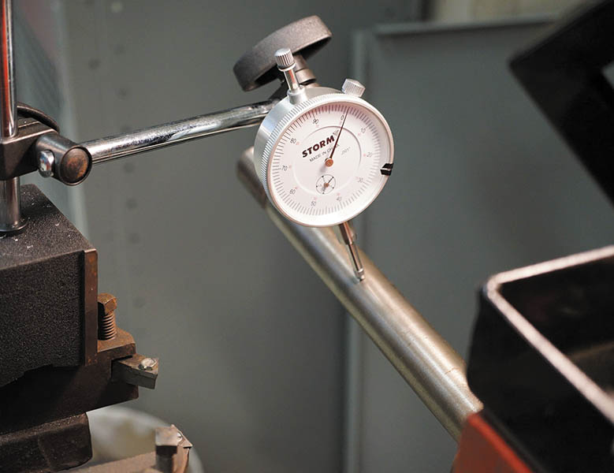
Figure 108.37 A dial indicator being used to check the arbor for total indicator runout (TIR). brake lathe

Slide 67
MACHINING A DISC BRAKE ROTOR (1 OF 2)
Mount the disc brake rotor
Install a rotor damper
Make a scratch cut on the rotor face
Turn the rotor one-half turn (180°), and retighten the nut. Make another scratch cut.
Verify rotor mounting
Machine the rotor following the manufacturer's guidelines.

Slide 68
MACHINING A DISC BRAKE ROTOR (2 OF 2)
Rough Cut
  A rough cut on a lathe involves cutting 0.005 inch per side with a feed of 0.008 inch per revolution.
Finish Cut
  A finish cut means removing 0.002 inch per side with a feed of 0.002 inch per revolution.
Non-directional Finish
  A non-directional finish is used to help prevent the grooves machined into the rotor from acting like record grooves that can force the pads to move outward while the rotor rotates.

Slide 69
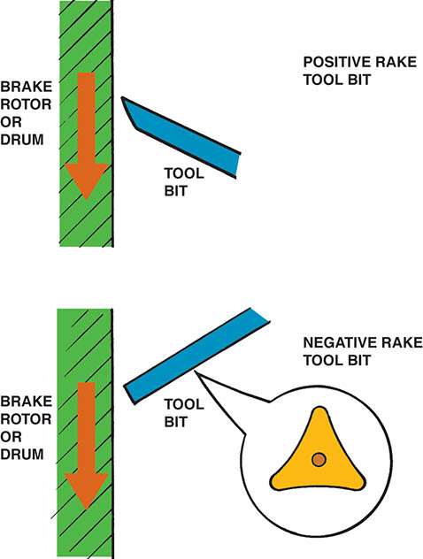
Figure 108.38 Most positive rake brake lathes can cut any depth in one pass, thereby saving time. A typical negative rake lathe uses a three-sided turning tool that can be flipped over, thereby giving six cutting edges

Slide 70
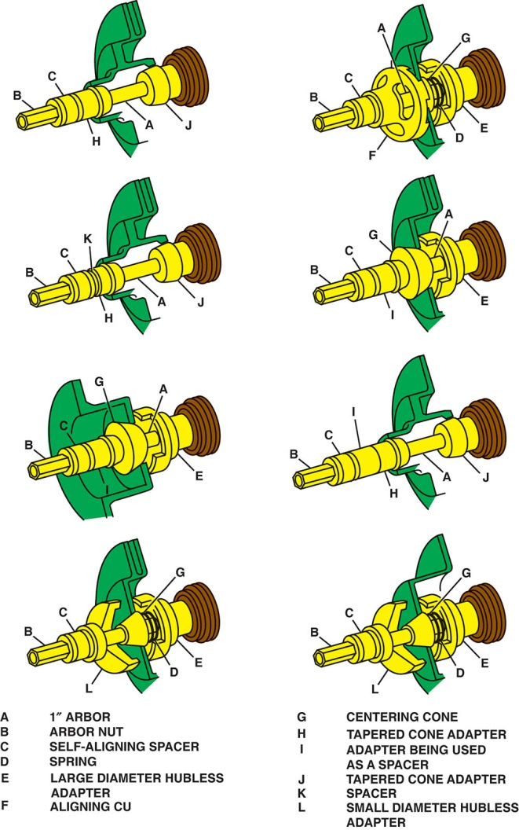
Figure 108.39 Recommended adapters and location for machining hubbed and hubless rotors

Slide 71
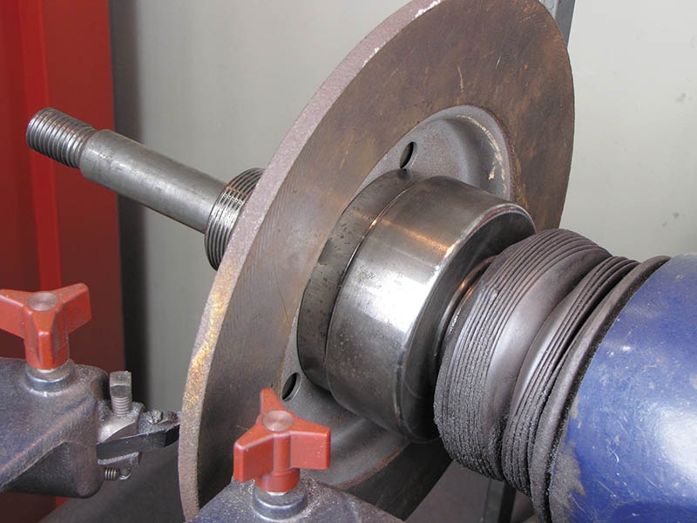
Figure 108.40 A composite rotor properly mounted on a brake lathe

Slide 72
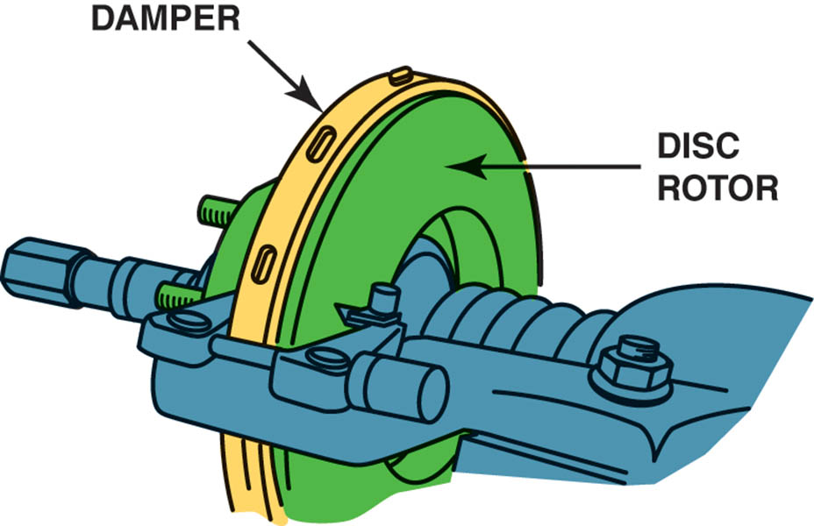
Figure 108.41 A damper is necessary to reduce cutting-tool vibrations that can cause a rough surface finish

Slide 73
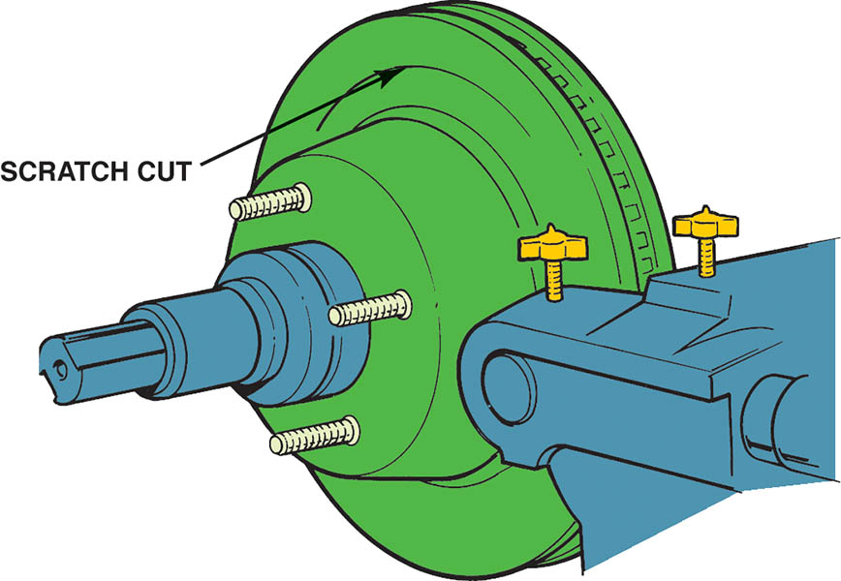
Figure 108.42 After installing the rotor on the brake lathe, turn the cutting tool in just enough to make a scratch cut

Slide 74
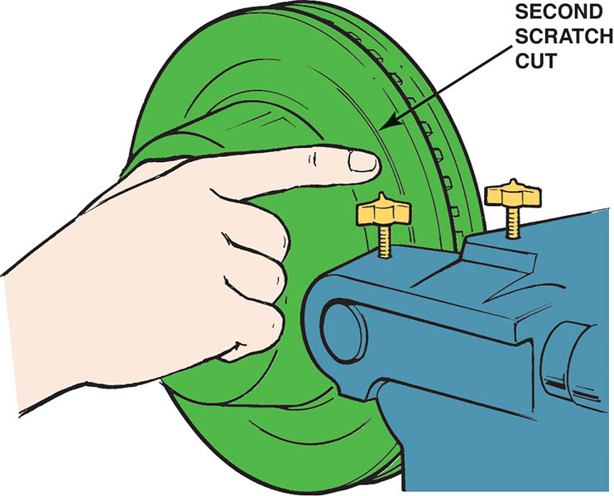
Figure 108.43 After making a scratch cut, loosen the retaining nut and rotate the rotor on the spindle of the lathe one-half turn. Tighten the nut and make a second scratch cut. The second scratch cut should be side-by-side with the first scratch if the rotor is installed correctly on the brake lathe

Slide 75
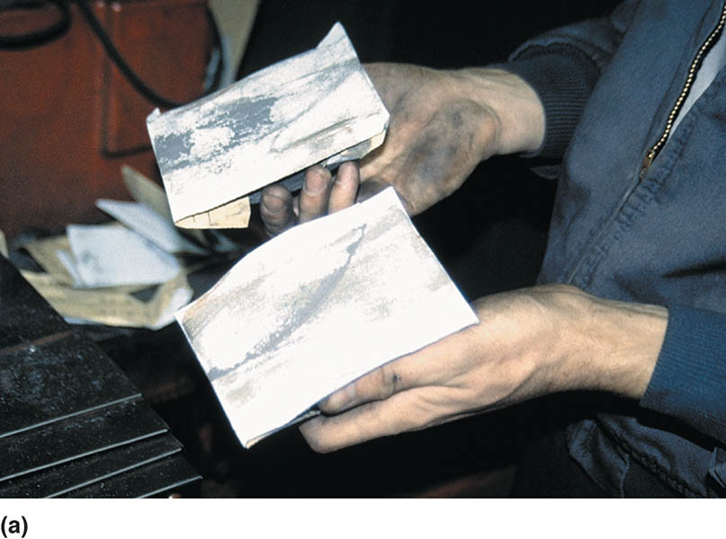
Figure 108.44 (a) This technician uses two sanding blocks each equipped with 150-grit aluminum-oxide sandpaper

Slide 76
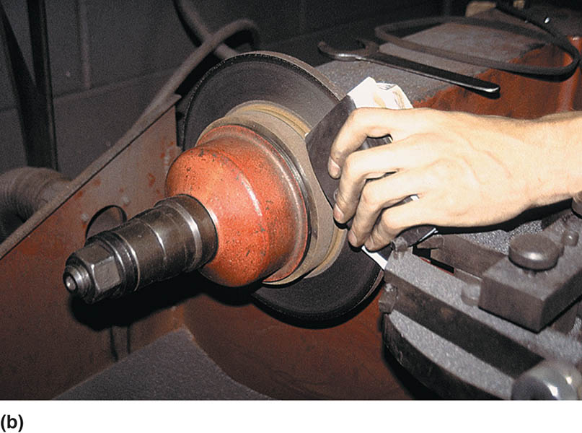
Figure 108.44 (b) With the lathe turned on, the technician presses the two sanding blocks against the surface of the rotor after the rotor has been machined to achieve a smooth microinch surface finish.

Slide 77
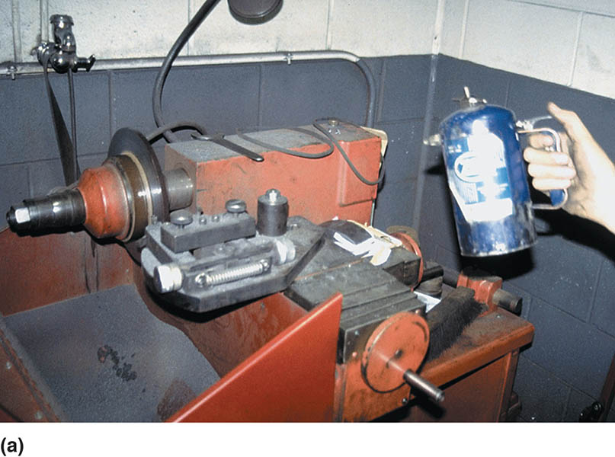
Figure 108.45 (a) After machining and sanding the rotor, it should be cleaned. In this case, brake cleaner from an air pressurized spray can is used

Slide 78
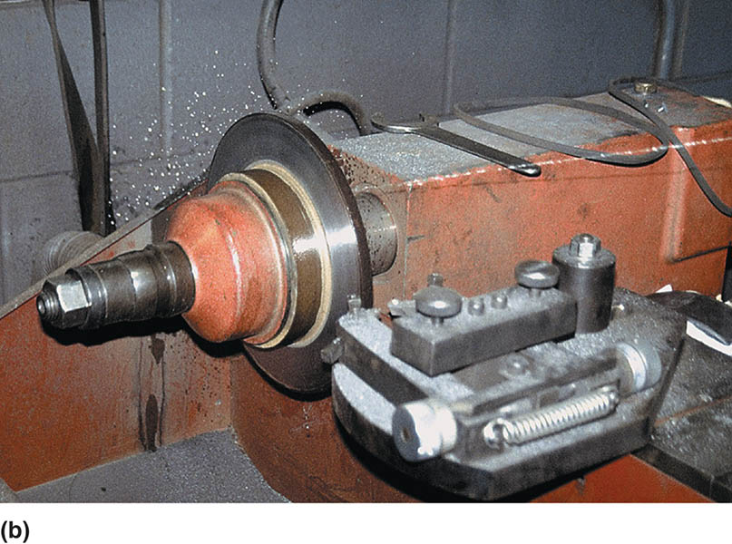
Figure 108.45 (b) With the lathe turning, the technician stands back away from the rotor and sprays both sides of the rotor to clean it of any remaining grit from the sanding process. This last step ensures a clean, smooth surface for the disc brake pads and a quality brake repair.

Slide 79

Figure 108.46 A grinder with sandpaper can be used to give a smooth nondirectional surface finish to the disc brake rotor

Slide 80

Figure 108.47 The correct final surface finish should be smooth and non-directional

Slide 81

Figure 108.48 Rust should always be cleaned from both the rotor and the hub whenever the rotors are machined or replaced. An air-powered die grinder with a sanding disc makes quick work of cleaning this hub

Slide 82
ON-THE-VEHICLE ROTOR MACHINING
Many vehicle manufacturers recommend on-the-vehicle machining for rotors if the disc brake rotor must be machined.
Follow the manufacturer specific instructions for the on-car lathe that is being used.

Slide 83

Figure 108.49 A typical hub-mount on-the-vehicle lathe. This particular lathe oscillates while machining the rotor, thereby providing a smooth and non-directional finish at the same time

Slide 84

TECH TIP

Slide 85

Figure 108.50 A wheel stud was replaced on the rotor hub assembly when it was discovered to be stripped

Slide 86
DRUM MACHINING

Slide 87

1. Before starting to machine a brake drum, check the drum for any obvious damage such as heat cracks or hard spots.

Slide 88

2. Lightly tap the drum. It should ring like a bell. If a dull thud is heard, the drum may be cracked and should be discarded.

Slide 89

3. Use a drum micrometer to measure the inside diameter of the drum and compare this measurement to specifications to be sure that the drum can be safely machined.

Slide 90

4. Most brake drums have the maximum inside diameter cast into the drum as shown.

Slide 91

5. Thoroughly clean the outside and inside of the drum.

Slide 92

6. Be sure the center hole in the drum is clean and free from any burrs that could prevent the drum from being properly centered on the shaft of the brake lathe.

Slide 93

7. A typical brake lathe used to machine drums.

Slide 94

8. Locate a tapered, centering cone that best fits inside the hole of the brake drum.

Slide 95

9. Slide the large face plate over the shaft of the brake lathe.

Slide 96

10. Slide the tapered centering cone onto the shaft with the spring between the face plate and the centering cone.

Slide 97

11. Slide the other face plate onto the shaft.

Slide 98

12. Install the self-aligning spacer (SAS) and left hand- thread spindle nut.

Slide 99

13. Tighten the spindle nut.

Slide 100

14. Loosen the turning bar retainer.

Slide 101

15. Carefully check the cutting bits and either rotate the bit to a new cutting point or replace it with a new part as necessary.

Slide 102

16. Turn the spindle control knob until the spindle is as short as possible (i.e., the drum as close to the machine as possible) to help reduce vibration as much as possible.

Slide 103

17. Position the cutting bar so that the cutting bit is located at the back surface of the drum.

Slide 104

18. Install the silencer band (vibration dampener strap).

Slide 105

19. Be sure the tool bit and clothing are away from the drum and turn the brake lathe on.

Slide 106

20. Center the bit in the center of the brake surface of the drum and rotate the control knob that moves the bit into contact with the drum friction surface. This should produce a light scratch cut.

Slide 107

21. Turn the lathe off.

Slide 108

22. Observe the scratch cut.

Slide 109

23. Loosen the spindle nut.

Slide 110

24. Rotate the drum 180° (one-half turn) on the spindle.

Slide 111

25. Tighten the spindle nut.

Slide 112

26. Turn the lathe on, rotate the control knob, and run the cutter into the drum for another scratch cut.

Slide 113

27. Observe the scratch cut. If the second scratch cut is in the same place as the first scratch cut or extends all the way around the drum, the drum is correctly mounted on the lathe.

Slide 114

28. Adjust the depth gauge to zero when the cutter just touches the drum.

Slide 115

29. Run the cutter all the way to the back surface of the drum.

Slide 116

30. Adjust the depth of the cut and lock it in position by turning the lock knob. Most vehicle manufacturers recommend a rough cut depth should be 0.005–0.010 inch and a finish cut of 0.002 inch.

Slide 117

31. Select a fast-feed rate if performing a rough cut (0.006–0.016 inch per revolution) or 0.002 inch per revolution for a finish cut.

Slide 118

32. Turn the lock knob to keep the feed adjustment from changing.

Slide 119

33. Engage the automatic feed.

Slide 120

34. The drum will automatically move as the tool remains stationary to make the cut.

Slide 121

35. Turn the lathe off.

Slide 122

36. If additional material must be removed, proceed with the finish cut. Clean thoroughly before installing on a vehicle.

Slide 123
ROTOR MACHINING

Slide 124

1. Before machining any rotor, use a micrometer and measure the thickness of the rotor.

Slide 125

2. Check the specifications for the minimum allowable thickness.

Slide 126

3. Visually check the rotor for evidence of heat cracks or hard spots that would require replacement (rather than machining) of the rotor.

Slide 127

4. After removing the grease seal and bearings, remove the grease from the bearing races.

Slide 128

5. Clean and inspect the brake lathe spindle for damage or burrs that could affect its accuracy.

Slide 129

6. Select a tapered cone adapter that fits the inner bearing race.

Slide 130

7. Slide the cone adapter onto the brake lathe spindle.

Slide 131

8. Select the proper size cone adapter for the smaller outer wheel bearing race.

Slide 132

9. Place the rotor onto the large cone adapter and then slide the small cone adapter into the outer wheel bearing race.

Slide 133

10. Install the self-aligning spacer (SAS) and spindle nut.

Slide 134

11. Tighten the spindle nut (usually left-hand threads).

Slide 135

12. If a hubless rotor is being machined, be sure to thoroughly clean the inside surface.

Slide 136

13. Also remove all rust from the other side of the hubless rotor.

Slide 137

14. Select the proper centering cone for the hole in the center of the hub.

Slide 138

15. Select the proper size cone-shaped hubless adapter and the tapered centering cone with a spring in between.

Slide 139

16. After sliding the rotor over the centering cone, install the matching hubless adapter.

Slide 140

17. Install the self-aligning spacer (SAS) and spindle nut.

Slide 141

18. After the rotor has been secured to the brake lathe spindle, install the noise silencer band (dampener).

Slide 142

19. Carefully inspect the cutting bits and replace, if necessary.

Slide 143

20. Loosen the tool holder arm.

Slide 144

21. Adjust the twin cutter arm until the rotor is centered between the two cutting bits.

Slide 145

22. Turn the lathe on.

Slide 146

23. Move the cutter arm toward the center of the rotor, placing the cutting bits in about the center of the friction surface.

Slide 147

24. Turn one cutting bit into the surface of the rotor to make a scratch cut. This step checks the lathe setup for accuracy.

Slide 148

25. Turn the lathe off.

Slide 149

26. Observe the first scratch cut.

Slide 150

27. Loosen the spindle retaining nut.

Slide 151

28. Rotate the rotor 180° (one-half turn) on the spindle of the brake lathe.

Slide 152

29. Tighten the spindle nut.

Slide 153

30. Turn the lathe back on and turn the cutting bit slightly into the rotor until a second scratch cut is made.

Slide 154

31. If the second scratch cut is in the same location as the first scratch cut or extends all around the surface of the rotor, then the rotor is properly installed on the lathe.

Slide 155

32. Start the machining process by moving the twin cutters to about the center of the rotor friction surface.

Slide 156

33. Turn the cutting bits inward until they touch the rotor and zero the depth adjustment.

Slide 157

34. Adjust the twin cutters, then dial in the amount of depth (0.005–0.010 inch per side for a rough cut or 0.002 inch for a finish cut) and lock the adjustment so that vibration will not change the setting.

Slide 158

35. Turn the feed control knob until the desired feed rate is achieved for the first or rough cut (0.006– 0.010 inch per revolution) or finish cut (0.002 inch per revolution).

Slide 159

36. Engage the automatic feed.

Slide 160

37. Observe the machining operation.

Slide 161

38. After the cutting bits have cleared the edge of the rotor, turn the lathe off and measure the thickness of the rotor.

Slide 162

39. Readjust the feed control to a slow rate (0.002 inch per revolution or less) for the finish cut.

Slide 163

40. Reposition the cutting bits for the finish cut.

Slide 164

41. Loosen the adjustment locks.

Slide 165

42. Turn the depth of the cut for the finish cut (0.002 inch maximum).

Slide 166

43. Lock the adjustment.

Slide 167

44. Engage the automatic feed.

Slide 168

45. Use 150-grit aluminum-oxide sandpaper on a block of wood for 60 seconds per side on a grinder to give a non-directional and smooth surface to both sides of the rotor.

Slide 169

46. After the sanding or grinding operation, thoroughly clean the machined surface of the rotor to remove any and all particles of grit that could affect the operation and life of the disc brake pads.

Slide 170

47. Remove the silencer band.

Slide 171

48. Loosen the spindle retaining nut and remove the rotor.

Slide 172
ON-THE-VEHICLE LATHE

Slide 173

1. Prepare to machine a disc brake rotor using an on-the-vehicle lathe by properly positioning the vehicle in the stall and hoisting the vehicle to a good working height.

Slide 174

2. Remove the wheels and place them out of the way.

Slide 175

3. Remove the disc brake caliper and use a wire to support the caliper out of the way of the rotor.

Slide 176

4. Measure the rotor thickness and compare it with factory specifications before machining. If a discard thickness is specified, be sure to allow an additional 0.015 inch for wear.

Slide 177

5. Install the hub adapter onto the hub and secure it using the wheel lug nuts.

Slide 178

6. Engage the drive unit by aligning the hole in the drive plate with the raised button on the adapter.

Slide 179

7. Use the thumb wheel to tighten the drive unit to the adapter.

Slide 180

8. Attach a dial indicator to a secure part on the vehicle and position the dial indicator on a flat portion of the lathe to measure the lathe runout.

Slide 181

9. Rotate the wheel or turn the lathe motor on and measure the amount of runout.

Slide 182

10. Use a wrench to adjust the runout using the four numbers stamped on the edge of the drive flange as a guide.

Slide 183

11. After the hub runout is adjusted to 0.005 inch or less, remove the dial indicator from the vehicle.

Slide 184

12. Using a T-handle Allen wrench, adjust the cutter arms until they are centered on the disc brake rotor.

Slide 185

13. Move the cutters to the center of the rotor.

Slide 186

14. Adjust the cutter depth until each cutter barely touches the rotor.

Slide 187

15. Position the cutters to the inside edge of the rotor surface and adjust the cutters to the desired depth of cut.

Slide 188

16. Adjust the automatic shut-off so the lathe will turn itself off at the end of the cut.

Slide 189

17. Turn the lathe on by depressing the start button.

Slide 190

18. Monitor the machining operations as the lathe automatically moves the cutters from the center toward the outside edge of the rotor.

Slide 191

19. After the lathe reaches the outside edge of the rotor, the drive motor should stop.

Slide 192

20. Measure the thickness of the rotor after machining to be certain that the rotor thickness is within service limits.

Slide 193

21. The technician is using 150-grit aluminum-oxide sandpaper and a wood block for 60 seconds on each side of the rotor to provide a smooth surface finish.

Slide 194

22. After completing the machining and resurfacing of the rotor, unclamp the drive unit from the hub adapter and clean the rotor.

Slide 195

23. After the drive unit has been removed, remove the lug nuts holding the adapter to the rotor hub.

Slide 196

24. After removing the hub adapter, the caliper can be reinstalled.

Slide 197

25. Be sure to torque the caliper retaining bolts to factory specifications.

Slide 198

26. Install the wheel and wheel cover. On this vehicle, the wheel cover must be installed before the lug nuts because the lug nuts hold the wheel cover on the wheel.

Slide 199

27. Always use a torque wrench or a torque-limiting adapter with an air impact wrench as shown here when tightening lug nuts.

Slide 200

28. Pump the brake pedal several times to restore proper brake pedal height. Check and add brake fluid as necessary before moving the vehicle.

Slide 201

Copyright

