Slide 1
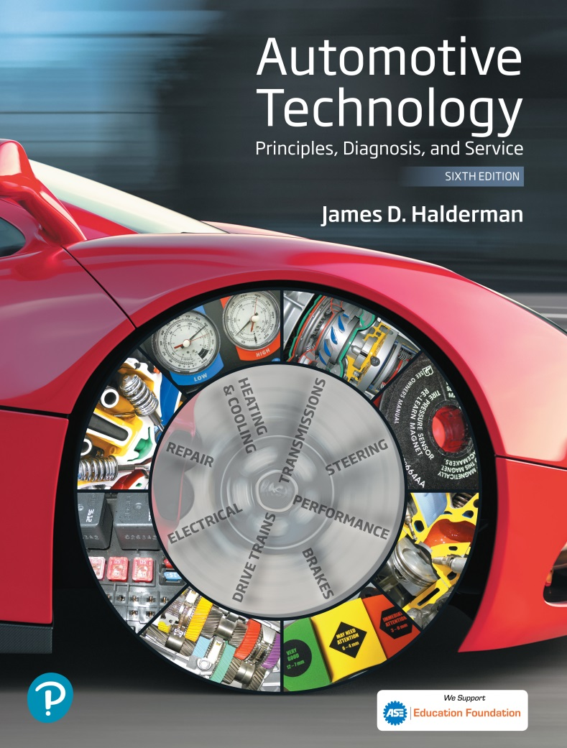
Automotive Technology Principles, Diagnosis, and Service
Sixth Edition
Chapter 107
Parking Brake Operation, Diagnosis and Service
Copyright © 2018, 2015, 2011 Pearson Education, Inc. All Rights Reserved

Slide 2
LEARNING OBJECTIVES (1 of 2)
107.1 Discuss parking brake standards, components, warning lamp and automatic parking brake release.
107.2 Explain parking brake linkages.
107.3 Describe drum parking brakes.
107.4 Describe caliper-actuated disc parking brakes.

Slide 3
LEARNING OBJECTIVES (2 of 2)
107.5 Explain how to adjust a parking brake properly.
107.6 Discuss electric parking brakes.
107.7 This chapter will help prepare for the Brakes (A5) ASE certification test content area "A" (Hydraulic, Power Assist, and Parking Brake Systems Diagnosis and Repair).

Slide 4
PARKING BRAKE STANDARDS
Background
The term parking brake has replaced the term emergency brake since the change to dual master cylinder design.
FMVSS 135
The parking brake must hold a fully loaded (laden) vehicle stationary on a slope of 20% up or down grade.
The hand force required cannot exceed 80 lb (18 N) or a foot force greater than 100 lb (22 N).

Slide 5
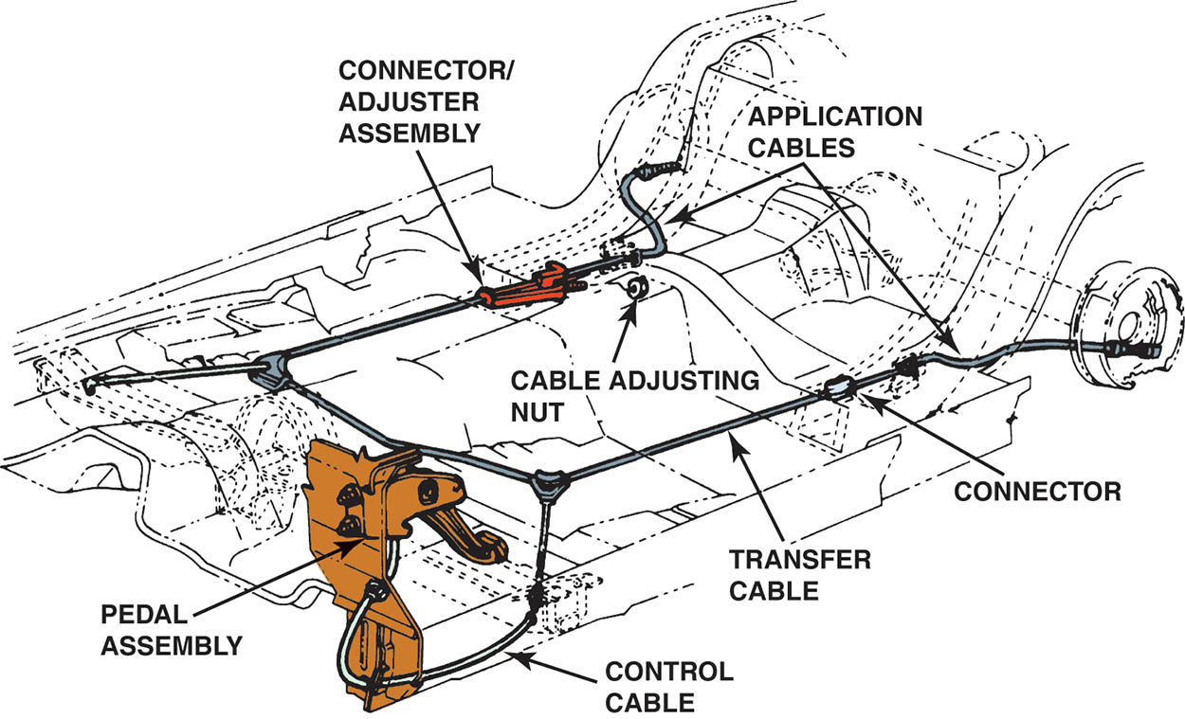
Figure 107.1 Typical parking brake cable system showing the foot operated parking brake lever and cable routing

Slide 6
PEDALS, LEVERS, AND HANDLES (1 OF 2)
Parking brakes are applied by a pedal, a lever, or a handle from inside the vehicle.
Parking Brake Pedals
The ratchet engages automatically and the pedal remains in the depressed position.
The pedal is released by a pull or a small T-handle or lever under the dash.

Slide 7
PEDALS, LEVERS, AND HANDLES (2 OF 2)
Automatic Parking Brake Release
Some vehicles with pedal-operated parking brakes have an automatic release mechanism that disengages the parking brake using a vacuum servo controlled by an electrical solenoid.

Slide 8
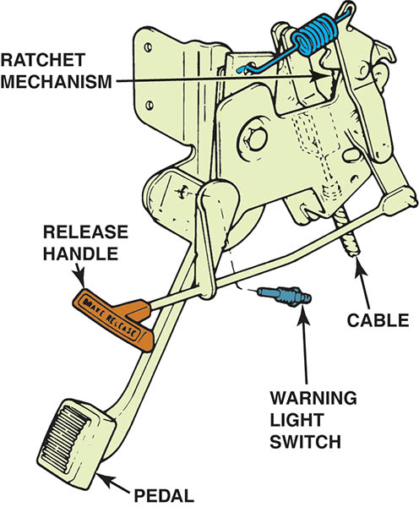
Figure 107.2 A typical parking brake pedal assembly

Slide 9
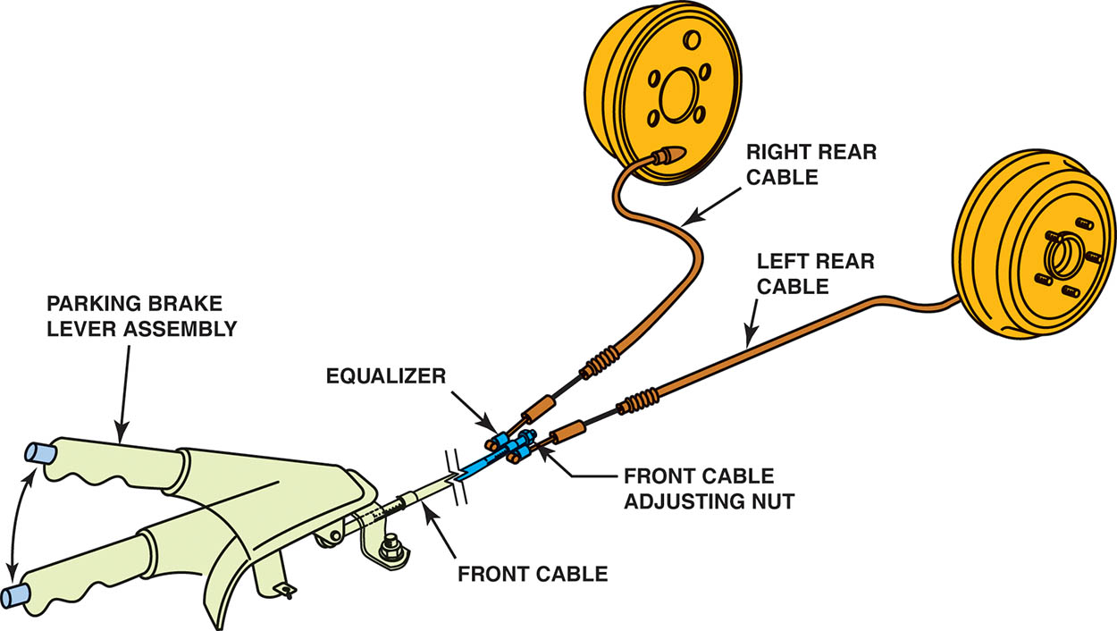
Figure 107.3 Typical hand-operated parking brake. Note that the adjustment for the cable is underneath the vehicle at the equalizer

Slide 10
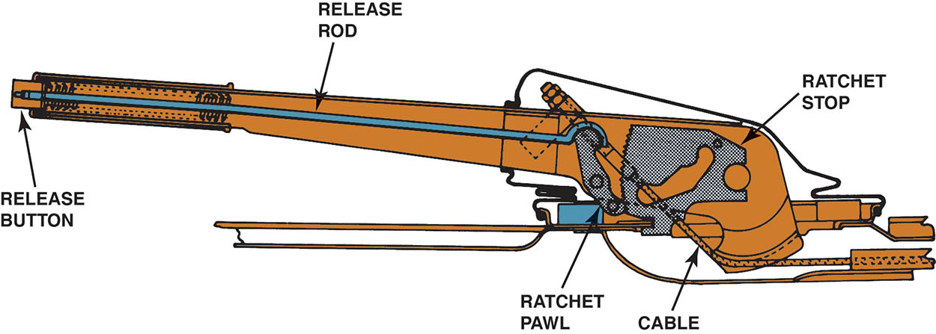
Figure 107.4 A ratchet mechanism is used to lock parking brakes in the applied position

Slide 11
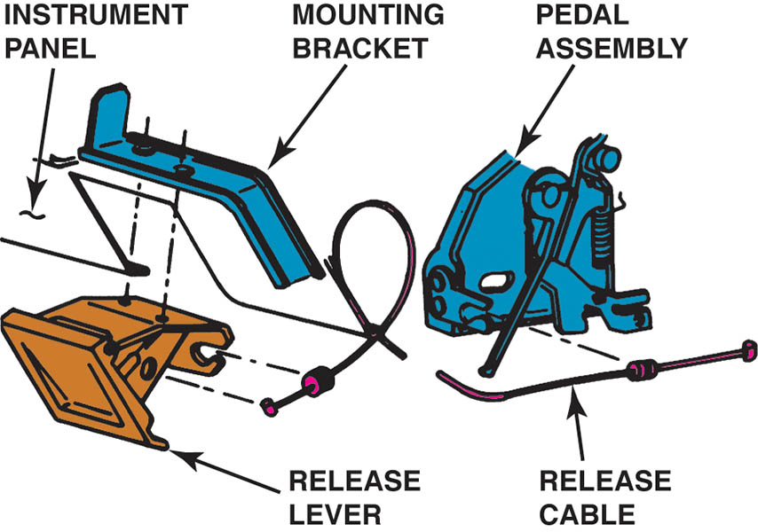
Figure 107.5 A remote-mounted parking brake release lever

Slide 12
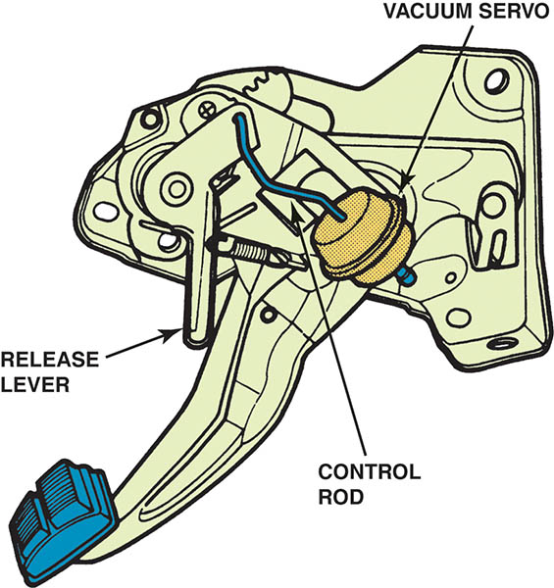
Figure 107.6 Automatic parking brake release mechanisms usually use a vacuum servo to operate the release lever

Slide 13
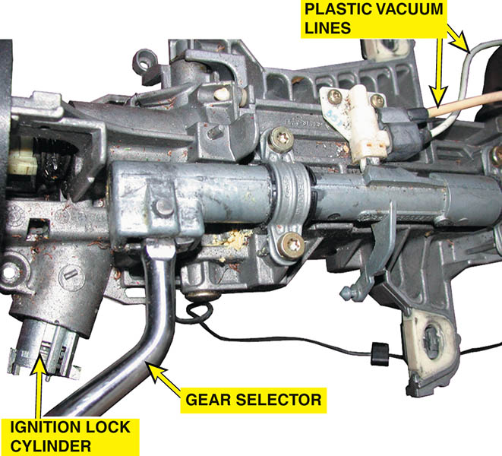
Figure 107.7 The two plastic vacuum tubes on the steering column are used to release the parking brake when the gear selector is moved from park into a drive gear

Slide 14
PARKING BRAKE WARNING LAMP
A red brake warning lamp lights on the dash if any of the following events occur:
A hydraulic or brake fluid level problem.
The parking brake is applied or partially applied.
If the red BRAKE warning lamp is on, check the parking brake to see if it is fully released.

Slide 15
PARKING BRAKE LINKAGES (1 OF 2)
Linkage Rods
Used with floor-mounted actuating levers to span the short distance to an intermediate lever or an equalizer.
Linkage Cables
Control cables attach to the parking brake pedal, lever, or handle inside the vehicle.
A transfer cable transmits force to an intermediate lever or equalizer to the application cables.
The application cables use the force passed through the linkage to apply the rear-wheel brake assembly.

Slide 16
PARKING BRAKE LINKAGES (2 OF 2)
Linkage Equalizers
Parking brake linkages use an equalizer to balance the force from the parking brake control and transmit an equal amount to each friction assembly.
Linkage Design
Most linkages combine intermediate levers and equalizers in various ways and use from one to four cables to actuate the friction assemblies.

Slide 17
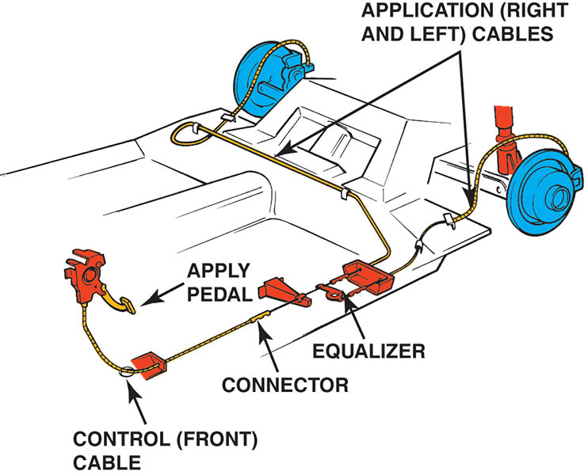
Figure 107.8 The cable from the activating lever to the equalizer is commonly called the control cable. From the equalizer, the individual brake cables are often called application cables.

Slide 18
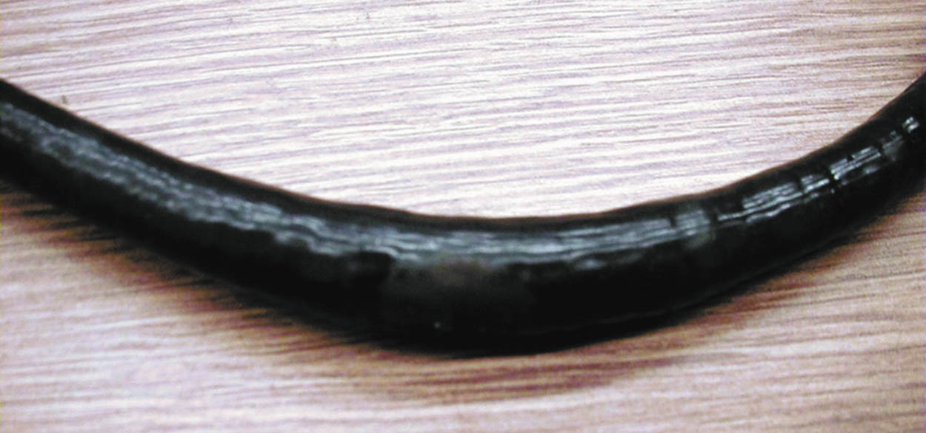
Figure 107.9 Notice how rust inside the covering of this parking brake cable has caused the cable to swell

Slide 19
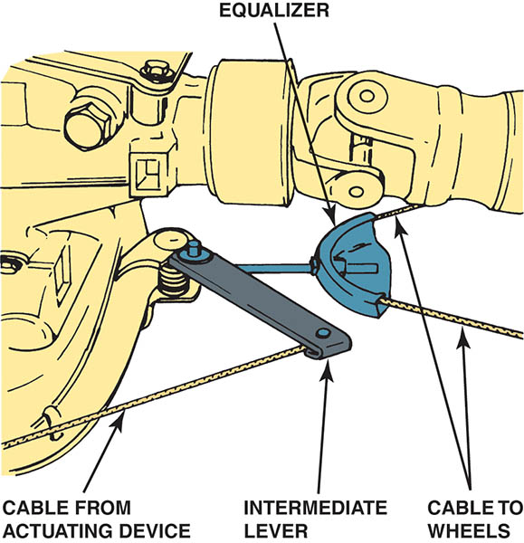
Figure 107.10 Intermediate levers in the parking brake linkage increase the application force

Slide 20
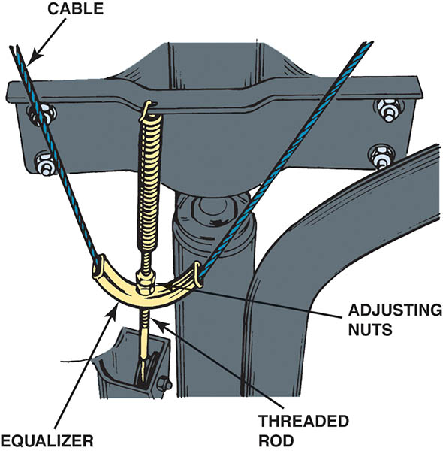
Figure 107.11 A cable guide is a common type of parking brake linkage equalizer

Slide 21
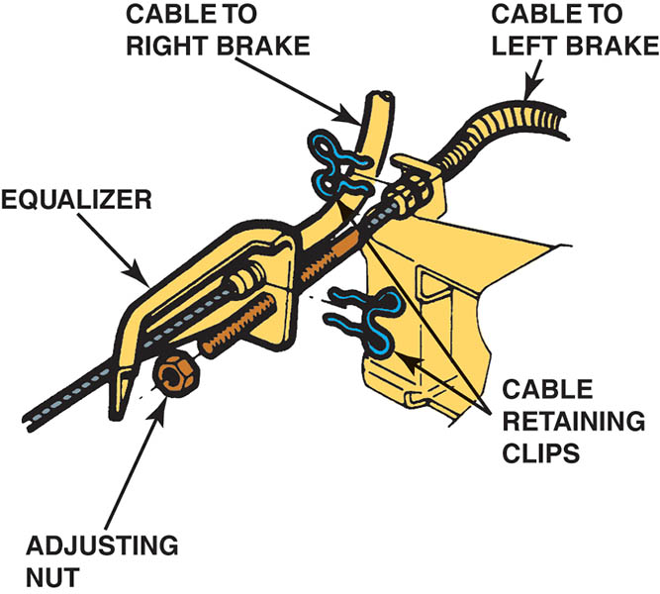
Figure 107.12 Some parking brake equalizers are installed in the brake cable

Slide 22
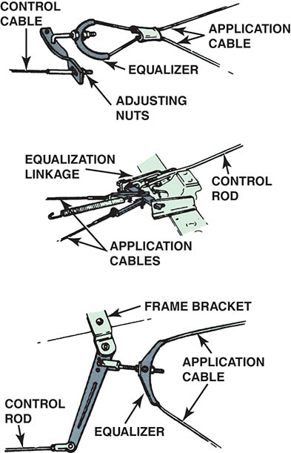
Figure 107.13 Many parking brake linkages use both an intermediate lever and an equalizer

Slide 23
QUESTION 1: ?
What components typically make up a parking brake assembly?

Slide 24
ANSWER 1:
Lever or pedal, rods, cables, and equalizers.

Slide 25
FRONT AND REAR ENTRY PARKING BRAKE CABLES
Front Entry
The parking brake systems attach the parking brake lever on the secondary (rearward) shoe and pushes the primary (forward facing) brake shoe against the drum.
Rear Entry
The parking brake has the parking brake lever installed on the primary shoe.

Slide 26
DRUM PARKING BRAKES
Integral Drum Parking Brakes
Apply the rear drum service brakes to serve as the parking brakes.
Rear Disc Auxiliary Drum Parking Brakes
Rear disc service brakes with fixed calipers commonly have a parking brake drum formed into the hub of the brake rotor.
A small dual-servo drum brake friction assembly that serves as the parking brake.

Slide 27
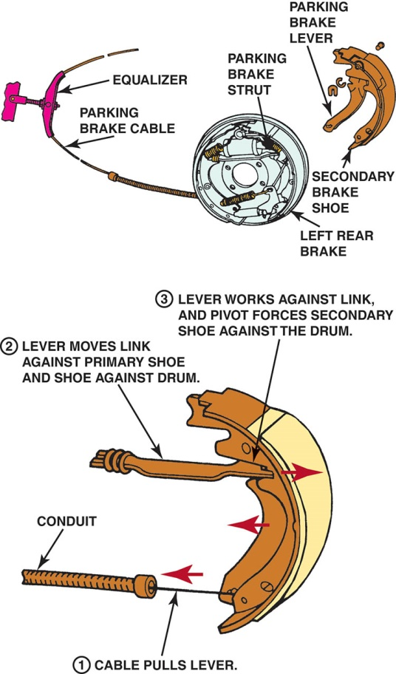
Figure 107.14 Notice the spring at the end of the parking brake strut. This antirattle spring keeps tension on the strut. The parking brake lever is usually attached with a pin and spring (wavy) washer and retained by a horseshoe clip

Slide 28
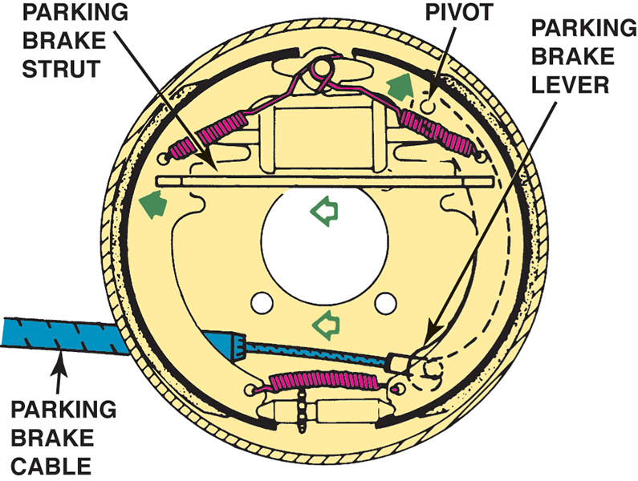
Figure 107.15 The parking brake cable pulls on the parking brake lever, which in turn forces the brake shoe against the drum

Slide 29
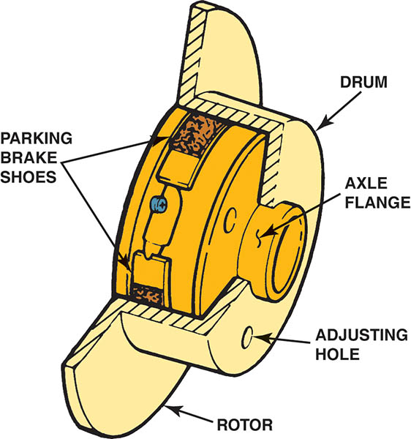
Figure 107.16 The inside “hat” of the disc brake rotor is the friction surface for the parking brake shoes

Slide 30
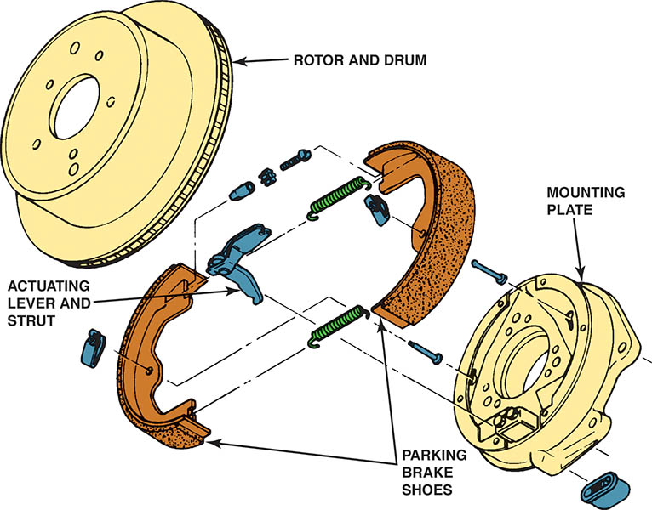
Figure 107.17 A typical rear disc brake auxiliary drum brake friction assembly

Slide 31
QUESTION 2: ?
What are the two types of drum parking brakes?

Slide 32
ANSWER 2:
Integral drum and rear disc auxiliary drum.

Slide 33
CALIPER-ACTUATED DISC PARKING BRAKE
Ball and Ramp Actuation
As the parking brake cable moves the lever and rotates the operating shaft, the balls ride up the ramps and force the two plates apart.
Adjustment is automatic with service brake application.
Screw, Nut and Cone Actuation
When the parking brake is applied, the cable moves the lever and rotates the actuator screw.
The nut then unthreads along the screw, and jams the cone against the clutch surface of the caliper piston.

Slide 34
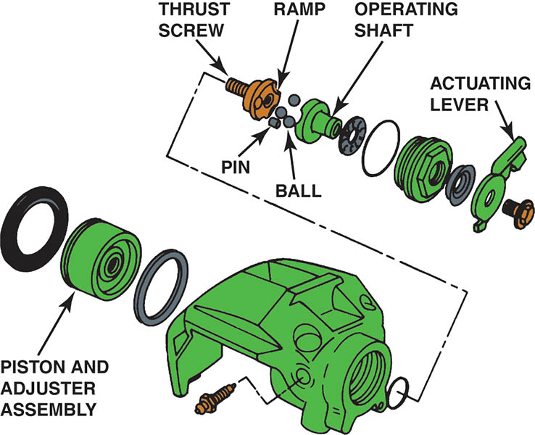
Figure 107.18 A Ford rear brake caliper ball and ramp-type apply mechanism

Slide 35
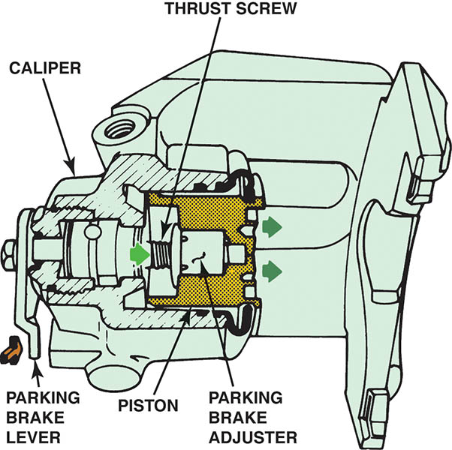
Figure 107.19 Operation of a ball and ramp-type rear disc brake caliper parking brake

Slide 36
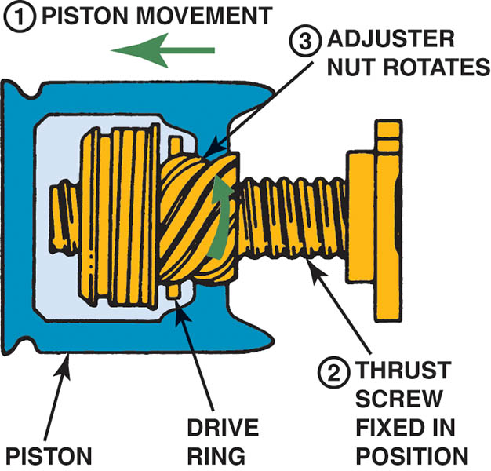
Figure 107.20 Automatic adjustment of a ball and ramp-type rear disc brake parking brake occurs when the service brakes are applied

Slide 37
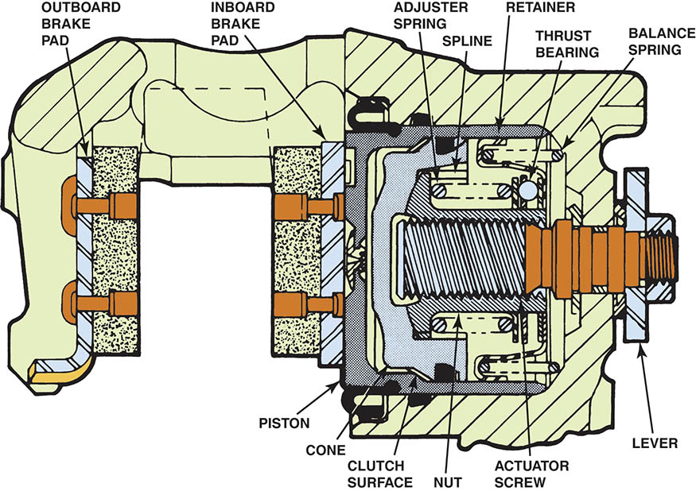
Figure 107.21 A typical General Motors rear disc brake with an integral parking brake. This type uses a screw, nut, and cone mechanism to apply the caliper piston

Slide 38
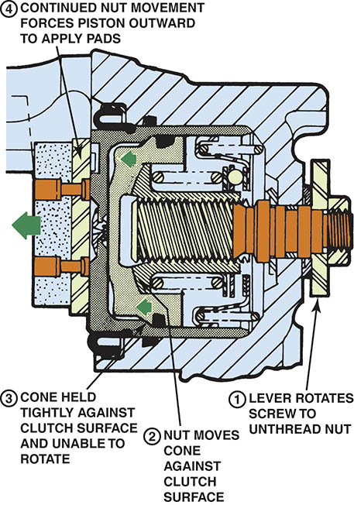
Figure 107.22 Parking brake application of a General Motors rear drive brake caliper

Slide 39
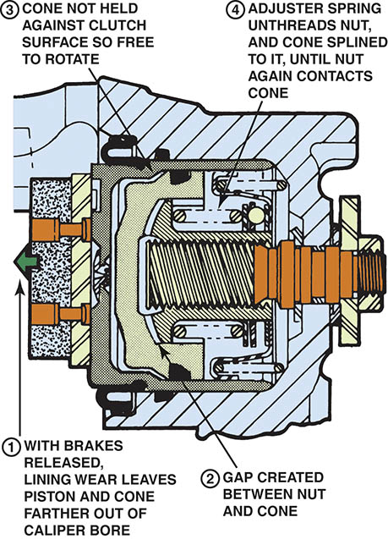
Figure 107.23 Automatic adjustment of a General Motors rear disc brake caliper

Slide 40
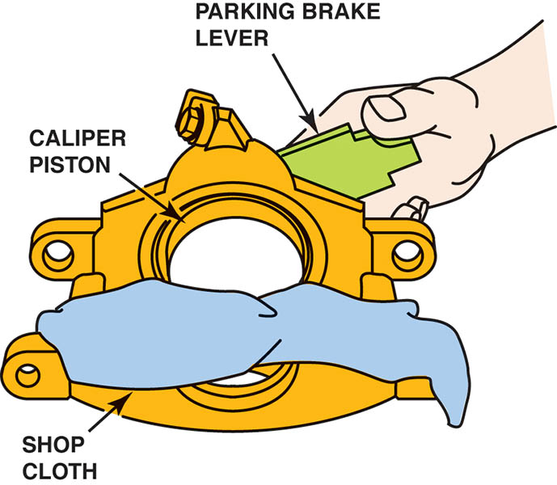
Figure 107.24 Removing the piston from a typical General Motors rear disc brake caliper

Slide 41
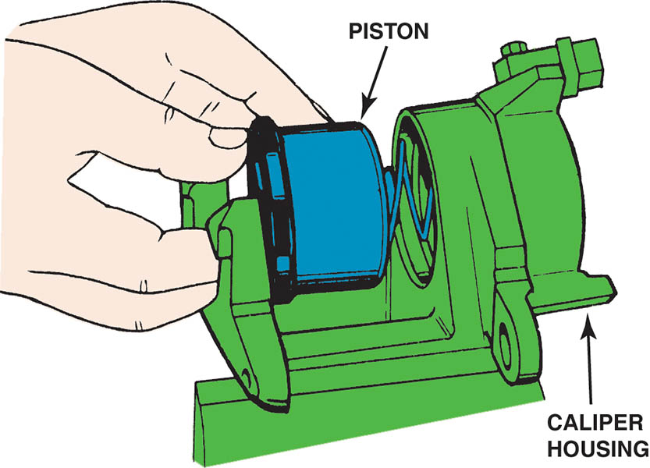
Figure 107.25 Installing the piston into a General Motors rear disc brake caliper

Slide 42
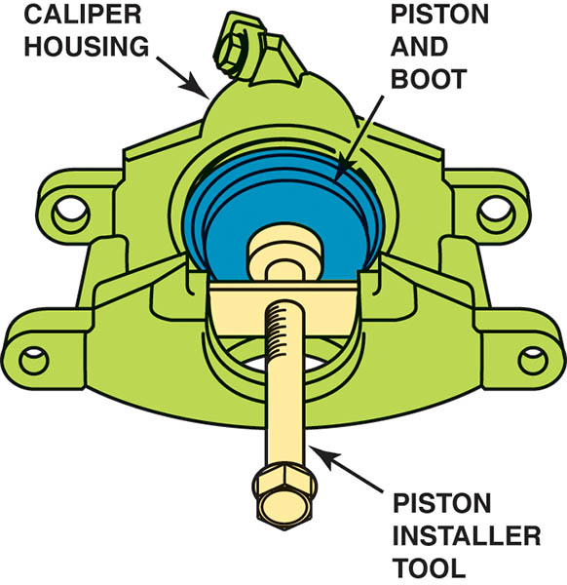
Figure 107.26 A piston installation tool is often needed to complete the installation of the piston in a General Motors rear disc brake

Slide 43
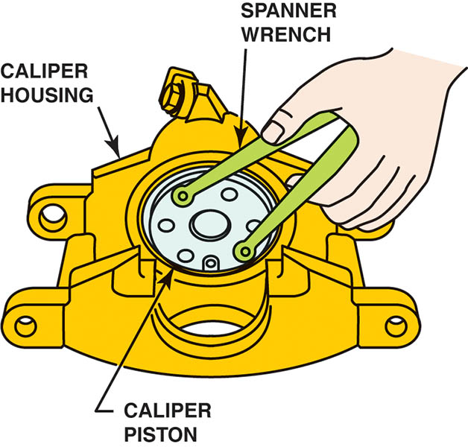
Figure 107.27 A spanner wrench (or needle-nose pliers) can be used to rotate the caliper piston prior to installing the disc brake pads. A notch on the piston must line up with a tab on the back of the brake pad to keep the piston from rotating when the parking brake is applied

Slide 44
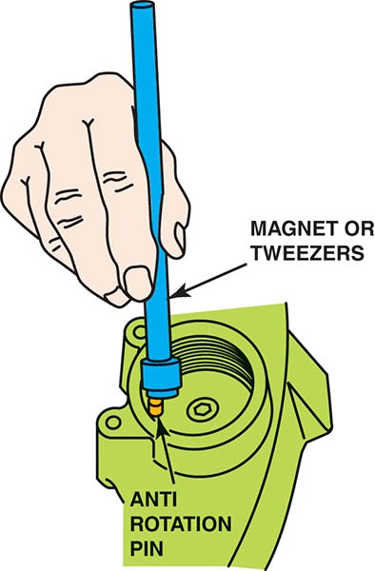
Figure 107.28 After removing the parking brake lever and thrust bearing, remove the anti-rotation pin

Slide 45
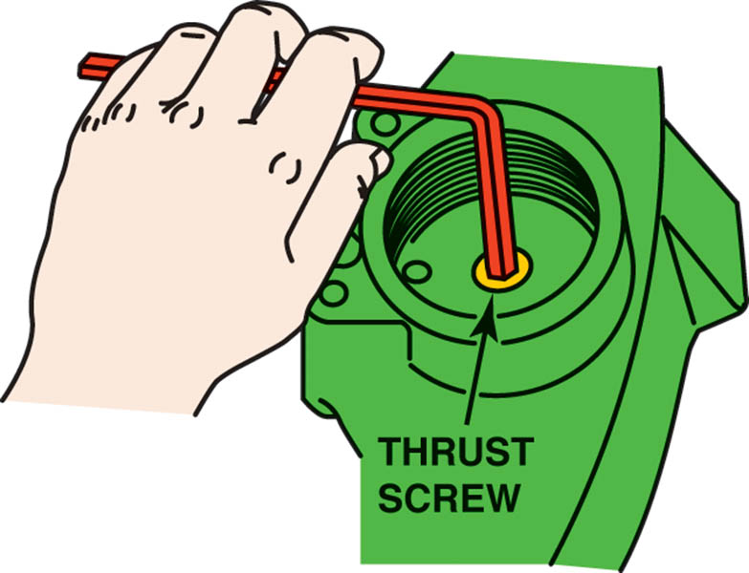
Figure 107.29 Unscrew the thrust screw from the piston with an Allen (hex) wrench. After removing the thrust screw, push the piston out of the caliper bore

Slide 46
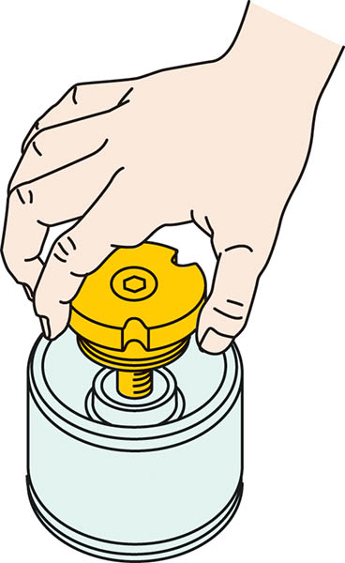
Figure 107.30 To test the piston adjuster, thread the thrust screw into the piston. Hold the piston and pull the thrust screw outward 1/4 inch (6 mm). The adjuster nut should not turn when the thrust screw retracts. Replace the piston assembly if not functioning correctly

Slide 47
PARKING BRAKE CABLE ADJUSTMENT
Most manufacturers specify a minimum of three or four and a maximum of eight to ten clicks when applying the parking brake.
Below is a general procedure for parking brake adjustment:
Ensure service brakes are in good condition and properly adjusted.
Apply the parking brake three to four clicks.
Adjust the parking brake mechanism to specifications.
Release the parking brake. Wheel should roll freely.

Slide 48
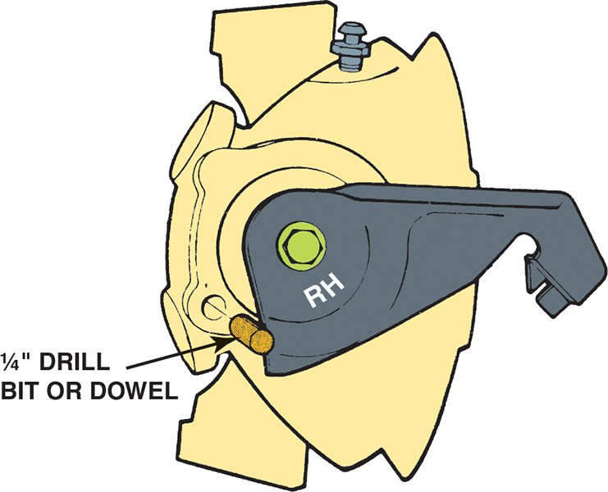
Figure 107.31 To adjust the parking brake cable on a Ford vehicle equipped with rear disc brakes, start by loosening the cable adjustment until the cables to the calipers are slack. Tighten until the caliper lever moves. Position a 1/4 inch drill bit or dowel into the caliper alignment hole.

Slide 49
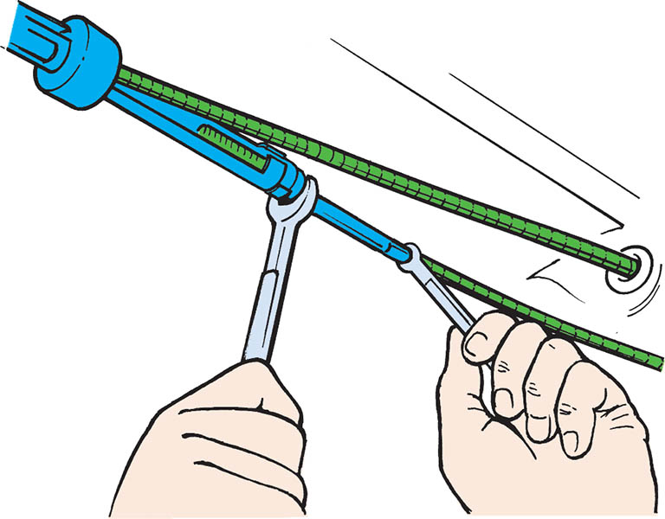
Figure 107.32 After checking that the rear brakes are okay and properly adjusted, the parking brake cable can be adjusted. Always follow the manufacturer’s recommended procedure

Slide 50
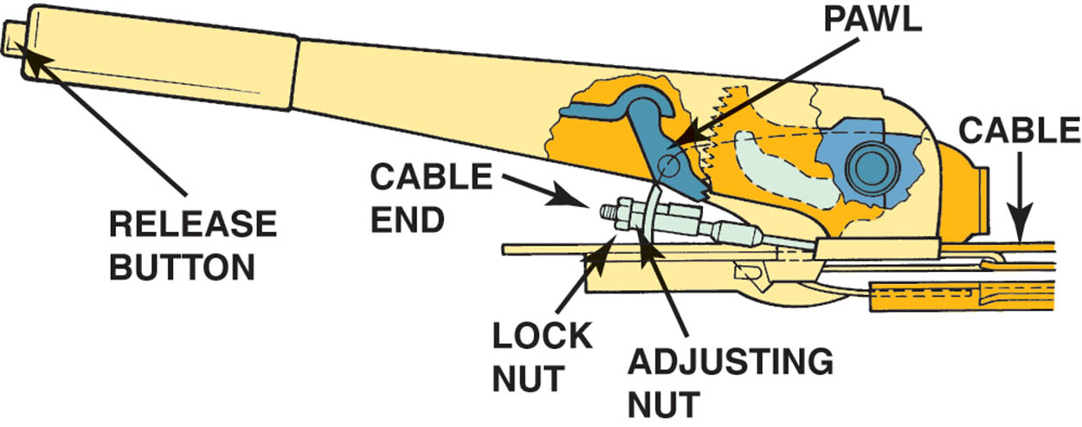
Figure 107.33 Many hand-operated parking brakes are adjusted inside the vehicle

Slide 51
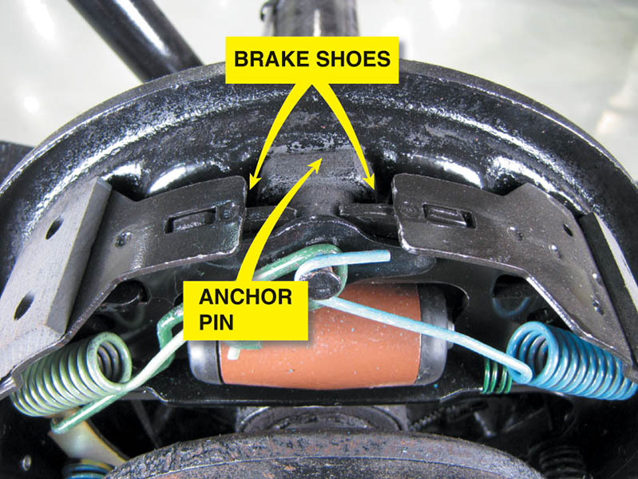
Figure 107.34 Always check that the brake shoes contact the anchor pin

Slide 52
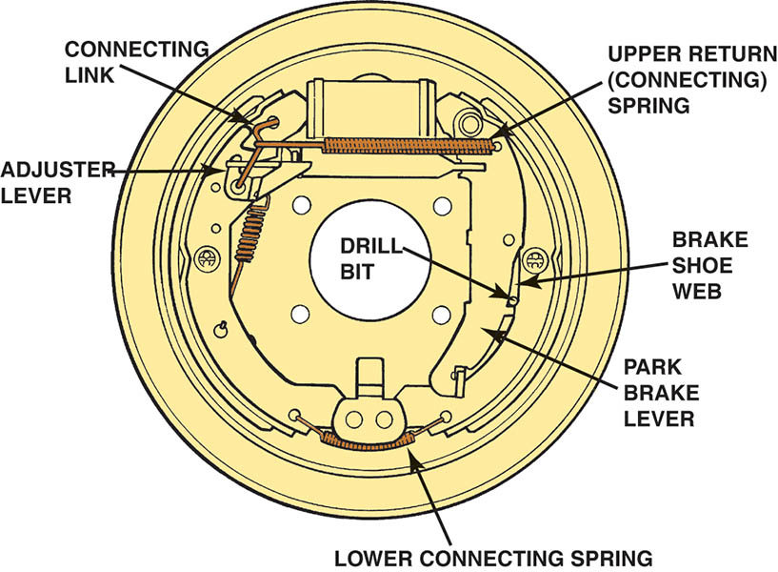
Figure 107.35 A 1/8 inch (3 mm) drill bit is placed through an access hole in the backing plate to adjust this General Motors leading-trailing rear parking brake. Adjust the parking brake cable until the drill can just fit between the shoe web and the parking brake lever

Slide 53
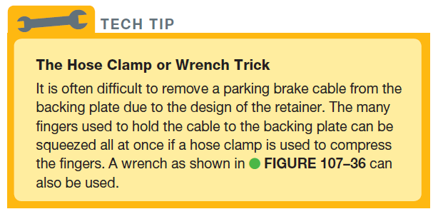
Tech Tip

Slide 54
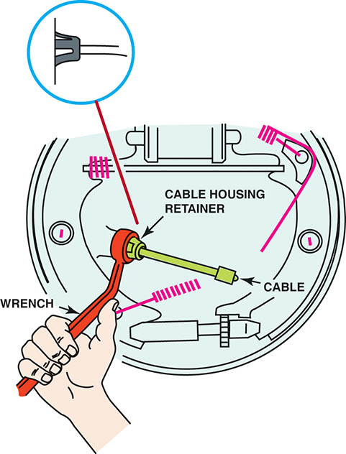
Figure 107.36 Many parking brake cables can be removed easily from the backing plate using a 1/2 inch (13 mm) box-end wrench. The wrench fits over the retainer finger on the end of the parking brake cable

Slide 55
ELECTRIC PARKING BRAKE
Electric parking brake (EPB) systems are available using two different designs including the following:
A cable-pulling type that uses an electric motor to pull the parking brake cable.
A more advanced unit uses a computer-controlled motor attached to the brake caliper to activate it.
EPB Service
Use a scan tool and follow the on-screen instructions to service the electric parking brake.

Slide 56
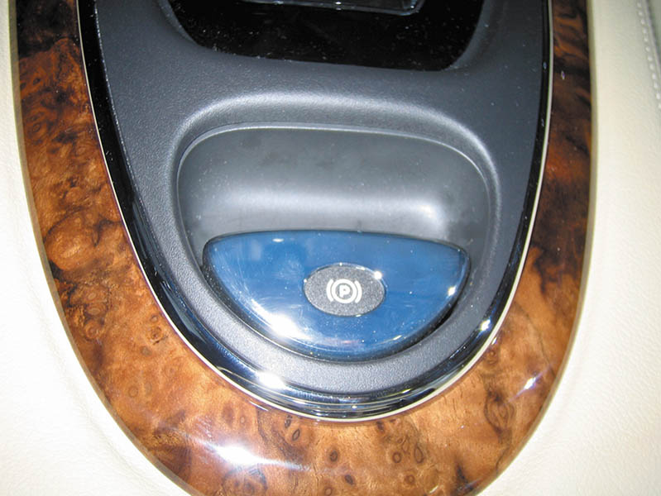
Figure 107.37 An electric parking brake button on the center console of a Jaguar

Slide 57
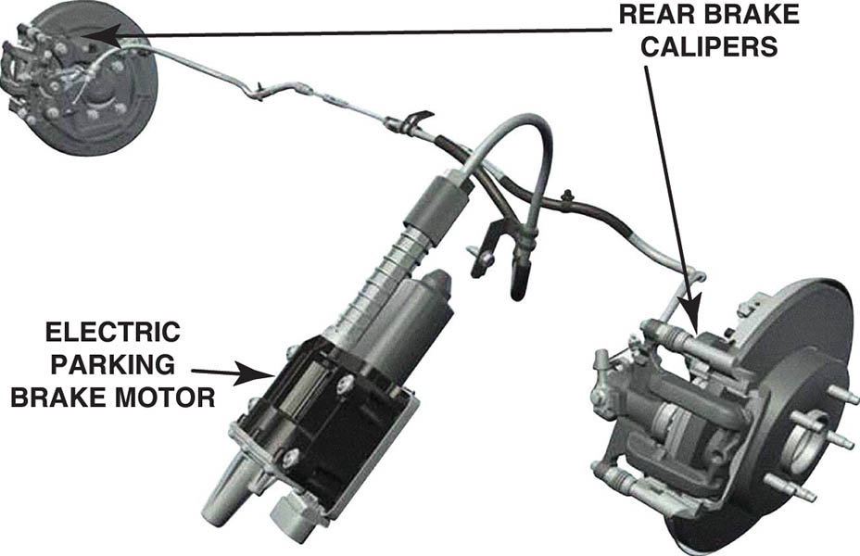
Figure 107.38 A type of electric parking brake that uses an electric motor to pull on the parking brake cable to each rear wheel

Slide 58
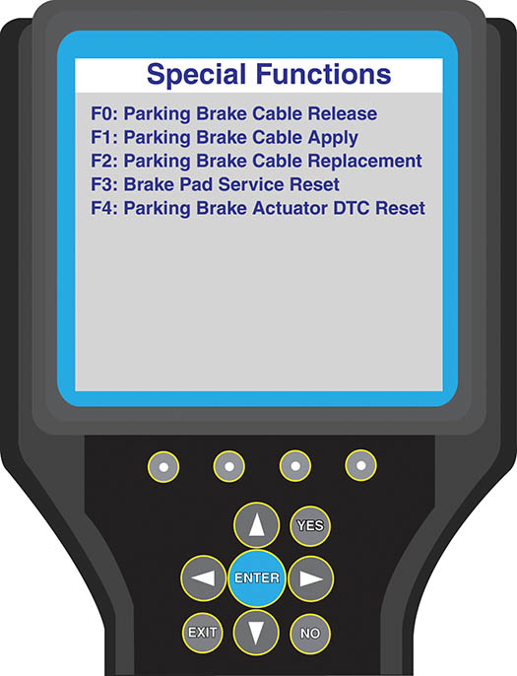
Figure 107.39 A scan tool can be used when servicing the rear brakes on a vehicle equipped with an electric parking brake

Slide 59
QUESTION 3: ?
What are the two types of electronic parking brake systems?

Slide 60
ANSWER 3:
Cable pulling type, and computer controlled caliper motor.

Slide 61

Copyright

