Slide 1

Automotive Technology Principles, Diagnosis, and Service
Sixth Edition
Chapter 106
Disc Brake Diagnosis and Service
Copyright © 2018, 2015, 2011 Pearson Education, Inc. All Rights Reserved

Slide 2
LEARNING OBJECTIVES
106.1 Discuss how to diagnose problems with disc brakes.
106.2 Describe how to inspect, disassemble, and service disc brake calipers.
106.3 Explain disc brake squeal correction.
106.4 State the symptoms of a faulty disc brake.
106.5 This chapter will help prepare for the Brakes (A5) ASE certification test content area “C” (Disc Brake Diagnosis and Repair).

Slide 3
DISC BRAKE DIAGNOSTIC PROCEDURES
The first step is to verify the customer complaint.
Check the brake pedal height and verify proper operation.
Safely hoist the vehicle and remove the wheels and visually inspect the system.
Remove disc brake calipers and check the disc brake pads for proper lining thickness and check for cracks or other damage.
Replace all components that do not meet factory specifications.
Verify the repair.

Slide 4
VISUAL INSPECTION
Even with operating wear-indicating sensors, a thorough visual inspection is very important.
A thorough visual inspection can only be accomplished by removing the friction pads.
Uneven pad wear may be an indication the caliper is not applying even pressure.

Slide 5
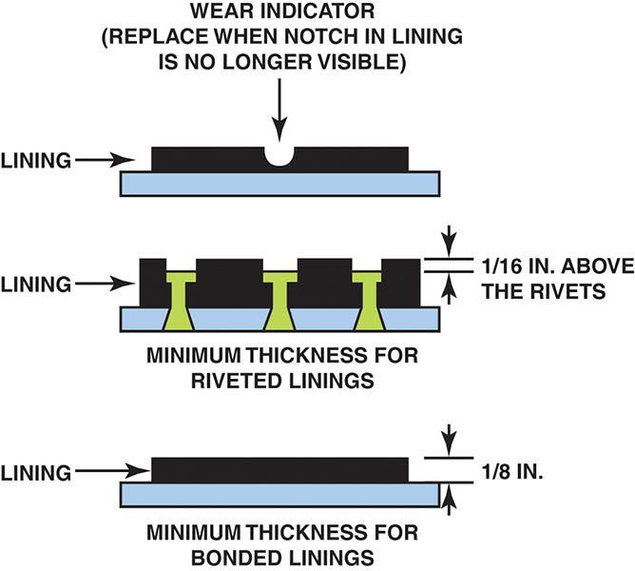
Figure 106.1 Minimum thickness for various types of disc brake pads. Pad wear sensors often make a “chirping” sound when the vehicle is moving if the pads are worn.

Slide 6
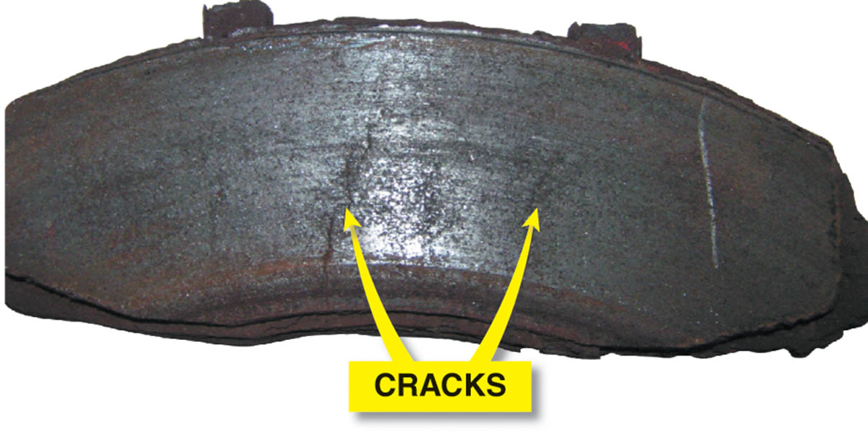
Figure 106.2 This cracked disc brake pad must be replaced even though it is thicker than the minimum allowed by the vehicle manufacturer

Slide 7
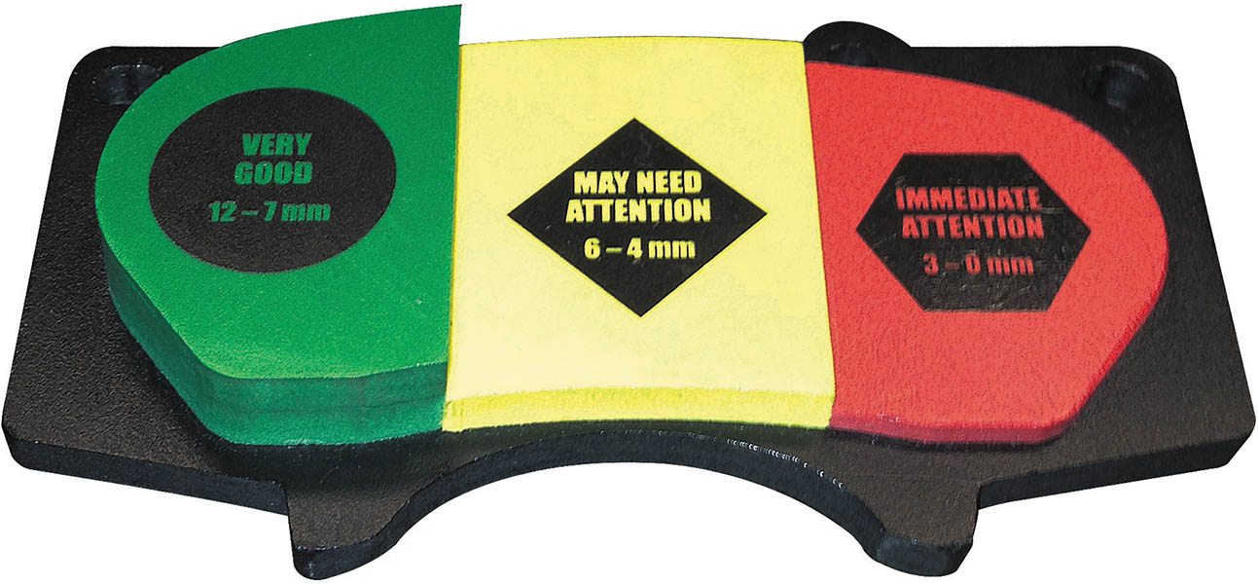
Figure 106.3 A brake pad display used by shops to help customers visualize the measurements taken when their brakes were inspected.

Slide 8
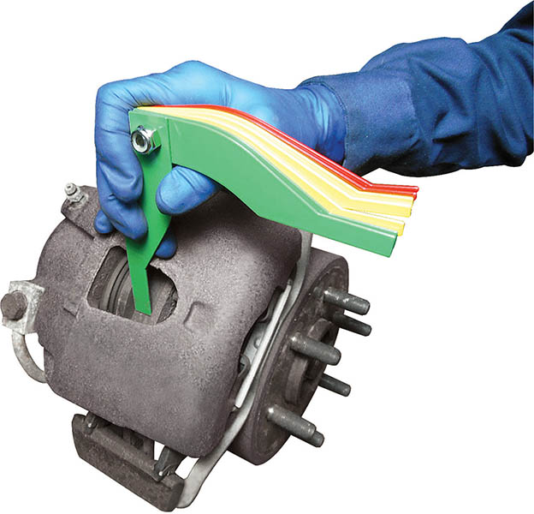
Figure 106.4 Most disc brake calipers have a brake inspection opening. This inspection opening does allow the use of a brake pad thickness gauge so that the pad thickness can be documented on the work order.

Slide 9
DISC BRAKE CALIPER SERVICE (1 OF 2)
Removal
  Note the caliper mount position before removing the caliper.
Inspection and Disassembly
  Check for brake fluid in and around the piston boot area.
  If the boot is damaged or a fluid leak is visible, then a caliper assembly repair or replacement is required.

Slide 10
DISC BRAKE CALIPER SERVICE (2 OF 2)
Phenolic Caliper Pistons
  Phenolic caliper pistons are made from a phenol-formaldehyde resin combined with various reinforcing fibers.
Steel Caliper Pistons
  The stamped steel pistons are plated first with nickel, then chrome to achieve the desired surface finish.

Slide 11
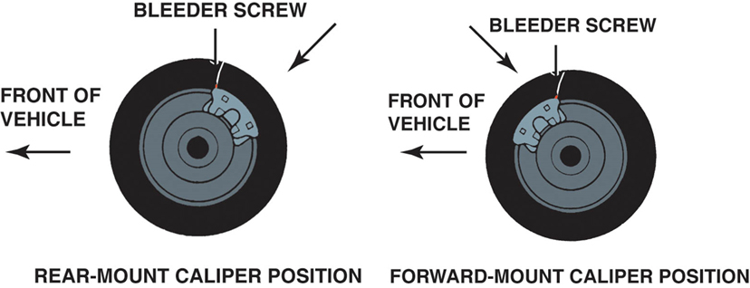
Figure 106.5 Both rear- and forward-mounted calipers have the bleeder valve at the top. Some calipers will fit on the wrong side of the vehicle, yet not be able to be bled correctly because the bleeder valve would point down.

Slide 12
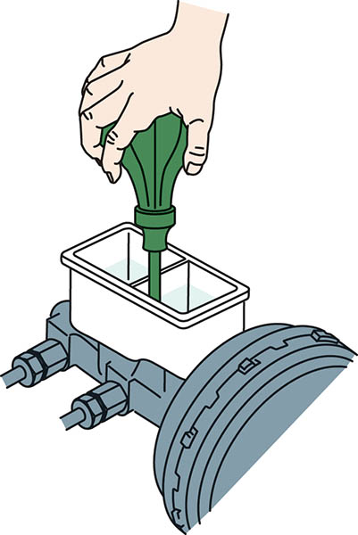
Figure 106.6 Many manufacturers recommend removing one-half of the brake fluid from the master cylinder before servicing disc brakes.

Slide 13
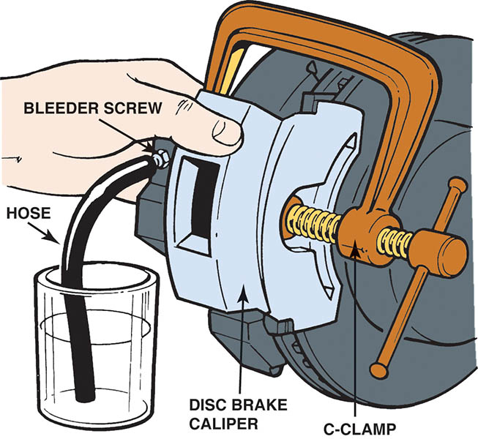
Figure 106.7 Most manufacturers recommend that the bleeder valve be opened and the brake fluid forced into a container rather than back into the master cylinder reservoir.

Slide 14
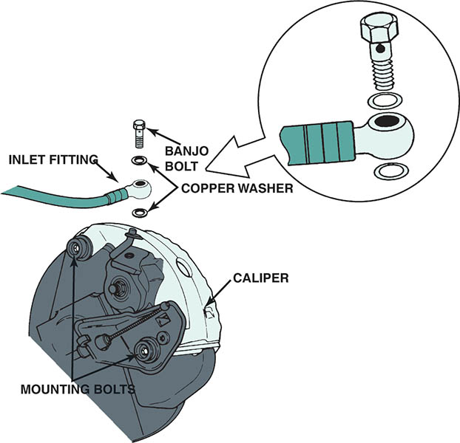
Figure 106.8 Many calipers use a hollow “banjo bolt” to retain the flexible brake line to the caliper housing. The fitting is usually round like a banjo. The copper washers should always be replaced and not reused.

Slide 15
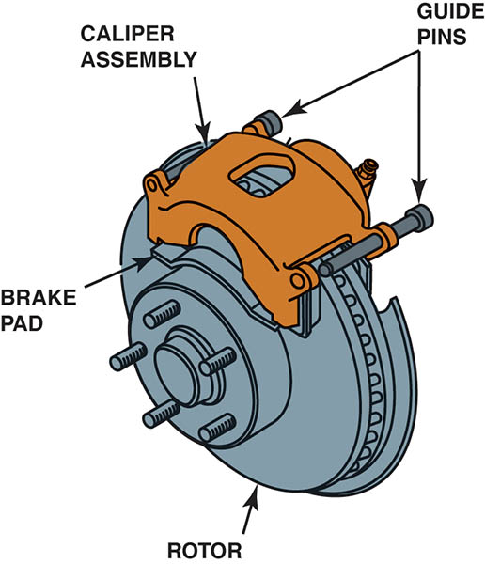
Figure 106.9 Caliper retaining bolts are often called guide pins. These guide pins are used to retain the caliper to the steering knuckle. These pins also slide through metal bushings and rubber O-rings.

Slide 16
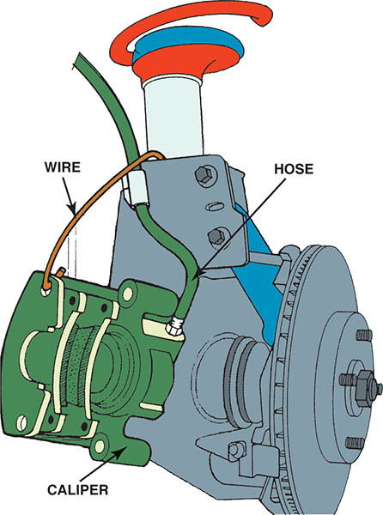
Figure 106.10 If the caliper is not being removed, it must be supported properly so that the weight of the caliper is not pulling on the flexible rubber brake line.

Slide 17
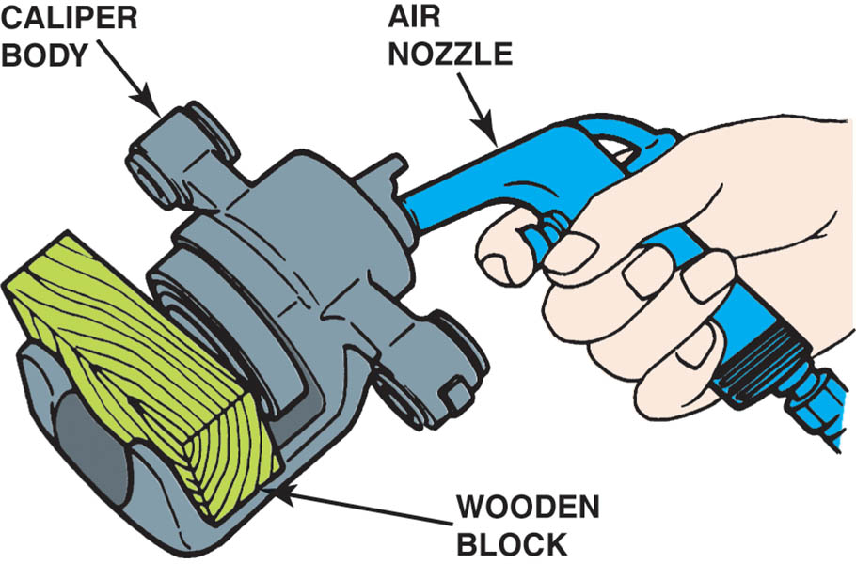
Figure 106.11 A wooden block or a folded shop cloth helps prevent damage when caliper pistons are removed

Slide 18
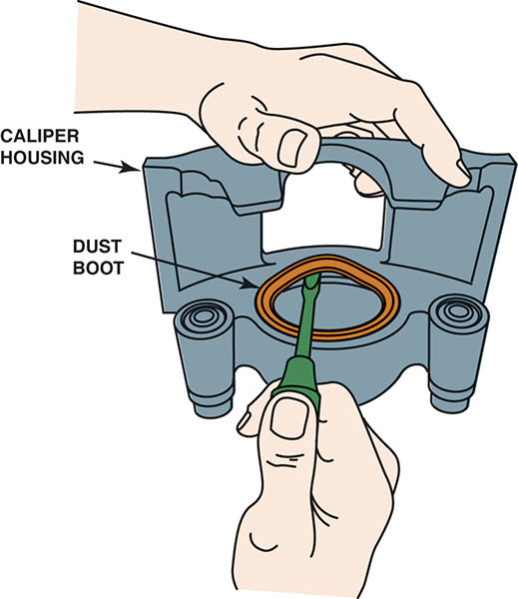
Figure 106.12 After the piston is removed from the caliper housing, the dust boot can often be removed using a straight-blade screwdriver

Slide 19
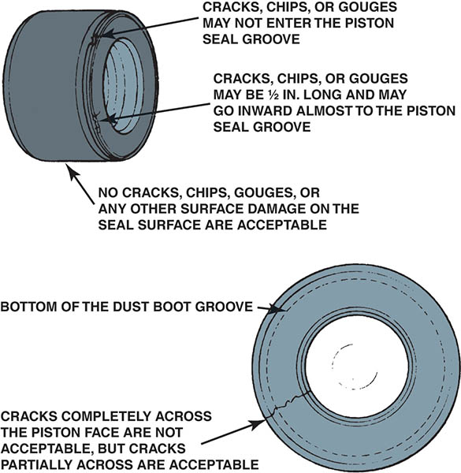
Figure 106.13 Phenolic (plastic) pistons should be carefully inspected

Slide 20
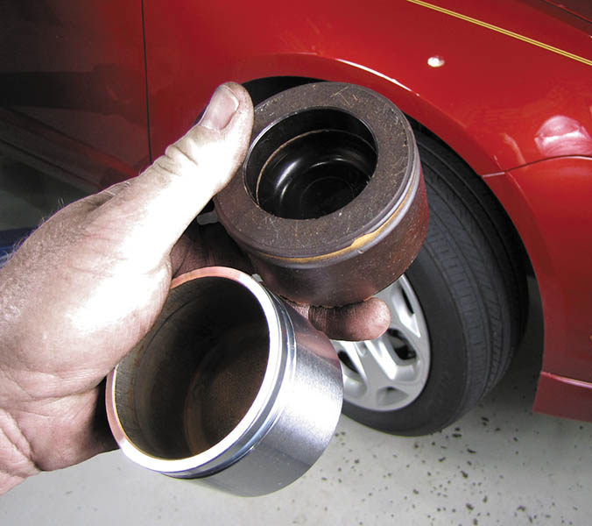
Figure 106.14 All caliper pistons should be inspected for damage and replaced if there are any faults found

Slide 21
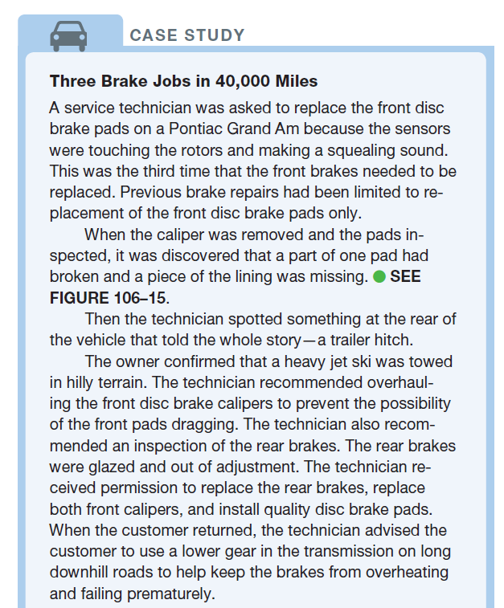
CASE STUDY

Slide 22
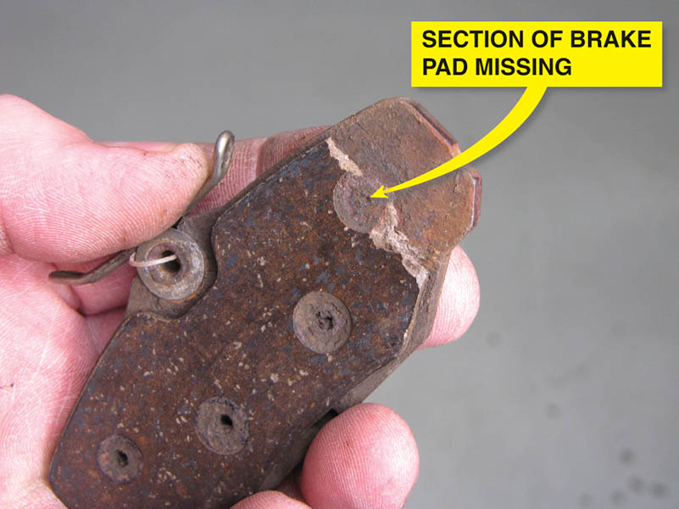
Figure 106.15 These pads were found to be cracked and a section was missing from a part of one pad

Slide 23
QUESTION 1: ?
What are the two most common types of caliper pistons?

Slide 24
ANSWER 1:
Stamped steel and phenolic.

Slide 25
SERVING DISC BRAKE CALIPERS (1 OF 3)
Inspection
  After removing the caliper piston then remove the square-cut O-ring.
  The caliper should be thoroughly cleaned in denatured alcohol and closely examined.
Caliper Assembly
  Carefully clean the caliper bore with clean brake fluid from a sealed container.
  Lubricate the piston seal and install in the bore.
  Install the boot and the piston in the caliper
  Clean and lubricate hardware and install pads

Slide 26
SERVING DISC BRAKE CALIPERS (2 OF 3)
Caliper Mount Service
  The sliding surfaces of the caliper support should be cleaned with a wire brush and coated with a synthetic grease or antiseize compound according to manufacturer’s recommendations.
  As the vehicle ages and the brakes are used thousands of times, these abutments (pads) can wear, causing too much clearance between the caliper and the mounting.
  This may require replacement of the entire steering knuckle or caliper mount.

Slide 27
SERVING DISC BRAKE CALIPERS (3 OF 3)
Rotating Pistons Back into the Caliper
  A special tool is used to rotate the piston back into the brake calipers.
  Follow manufactures instructions for proper clearance and piston location.
Test Drive After Brake Replacement
  After installing replacement disc brake pads or any other brake work, depress the brake pedal several times before driving the vehicle.
Bedding-in Replacement Brake Pads
  This break-in procedure helps the replacement pads to conform to the rotor and helps cure the resins used in the manufacture of the pads.

Slide 28
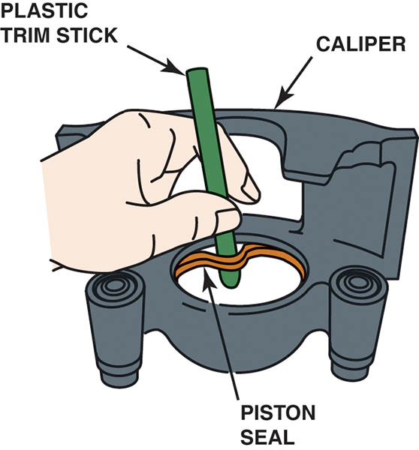
Figure 106.16 Removing the square-cut O-ring seal from the caliper bore. Use a wooden or plastic tool to prevent damage to the seal groove

Slide 29
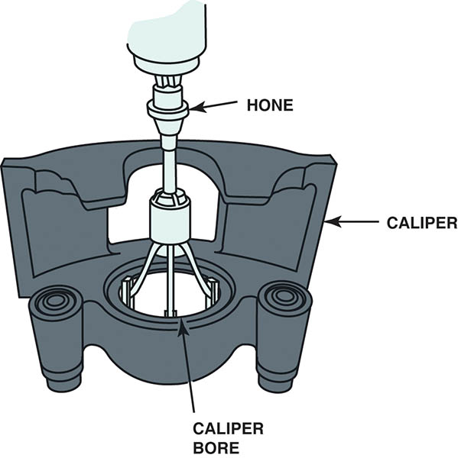
Figure 106.17 Some manufacturers recommend cleaning the inside of the caliper bore using a honing tool as shown.

Slide 30
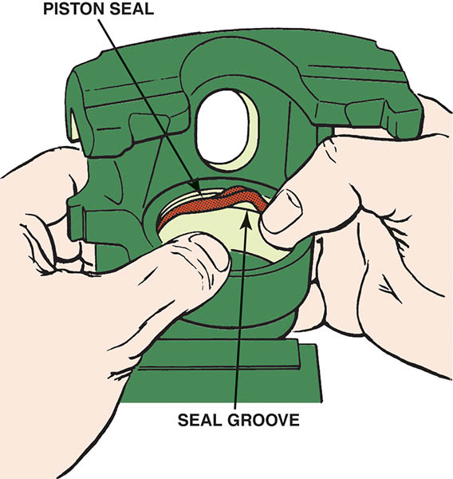
Figure 106.18 Installing a new piston seal. Never reuse old rubber parts. A caliper overhaul kit includes just two items: the square-cut piston seal O-ring and dust boot

Slide 31
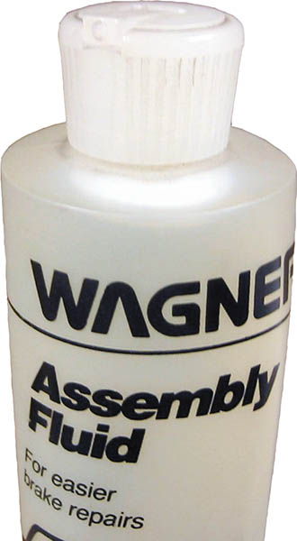
Figure 106.19 Brake assembly fluid or clean brake fluid from a sealed container can be used to lubricate the caliper seal and caliper pistons before assembly

Slide 32
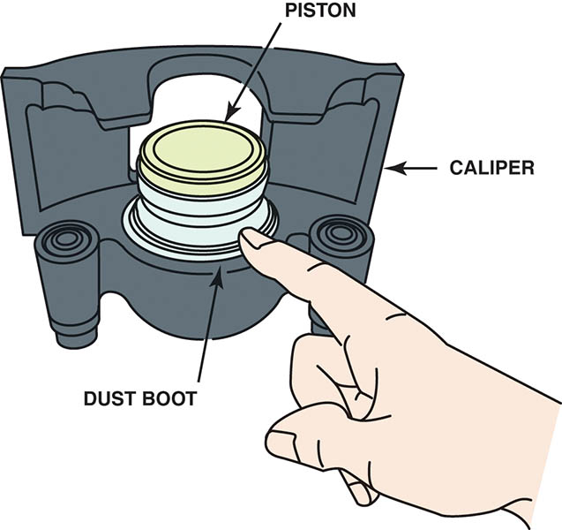
Figure 106.20 Installing the caliper piston. Many calipers require that the dust boot be installed in the groove of the piston and/or caliper before installing the piston

Slide 33
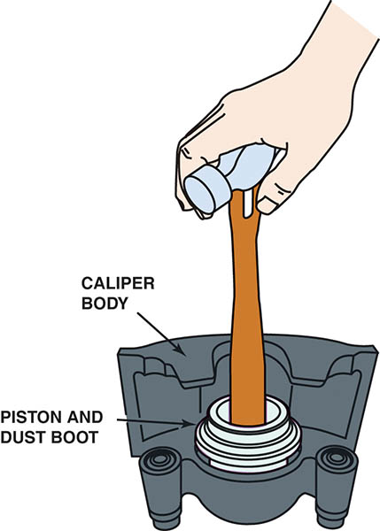
Figure 106.21 Installing a piston into a caliper. Sometimes a C-clamp is needed to install the piston. Both the piston and the piston seal should be coated in clean brake fluid before assembly

Slide 34
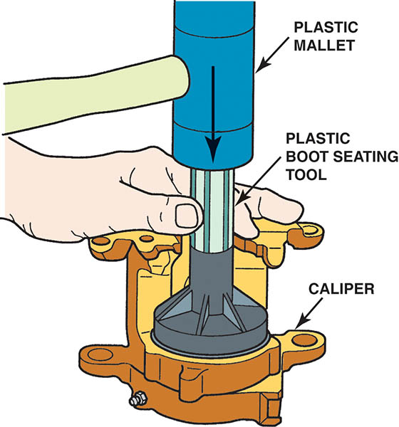
Figure 106.22 Seating the dust boot into the caliper housing using a special plastic seating tool

Slide 35
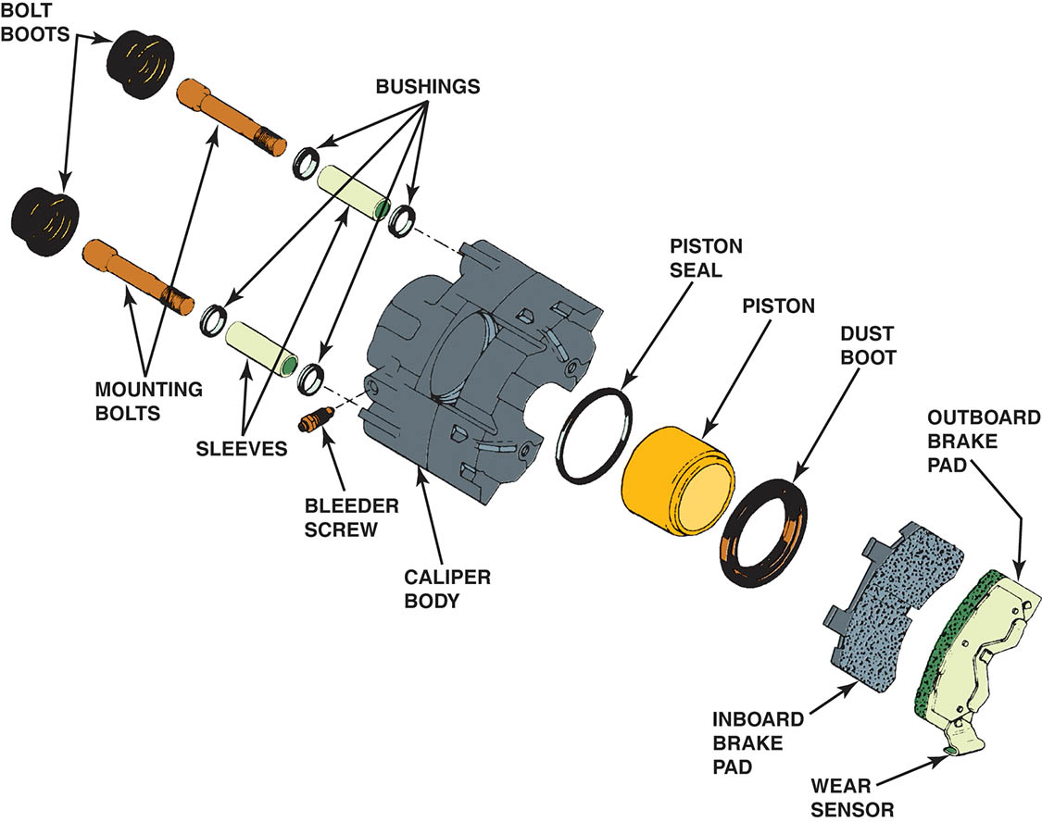
Figure 106.23 All rubber bushings should be lubricated with silicone brake grease for proper operation

Slide 36
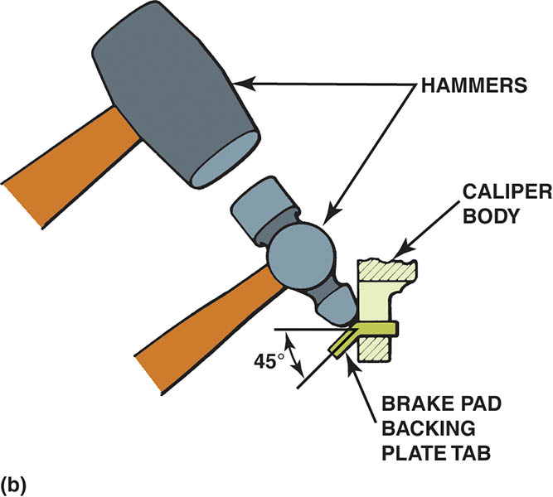
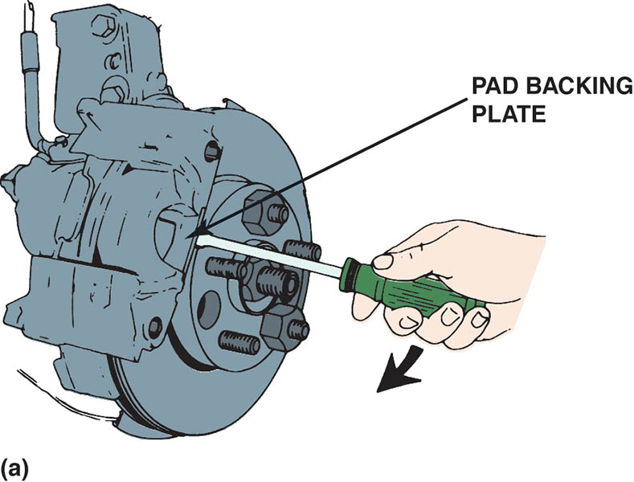
Figure 106.24 (a) Using a screwdriver to force the outboard pad into proper position before bending the retaining tabs. (b) Use two hammers to bend the tab where it extends through the hole in the caliper body

Slide 37
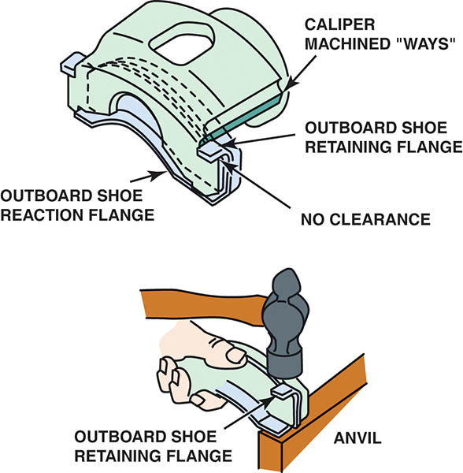
Figure 106.25 Often, a hammer is necessary to bend the retainer flange to make certain that the pads fit tightly to the caliper. If the pads are loose, a “click” may be heard every time the brakes are depressed.

Slide 38
QUESTION 2: ?
What parts come in a typical one-piston caliper overhaul kit?

Slide 39
ANSWER 2:
A square-cut O-ring and a dust boot.

Slide 40
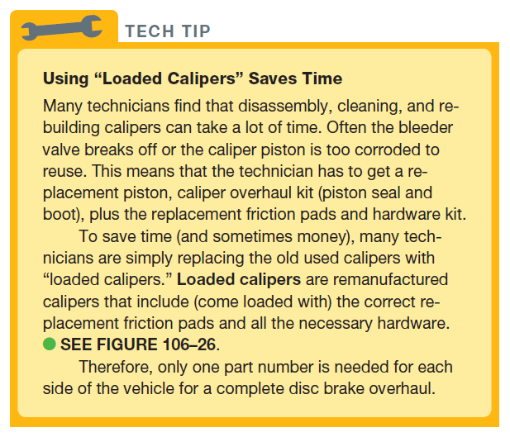
Tech Tip

Slide 41
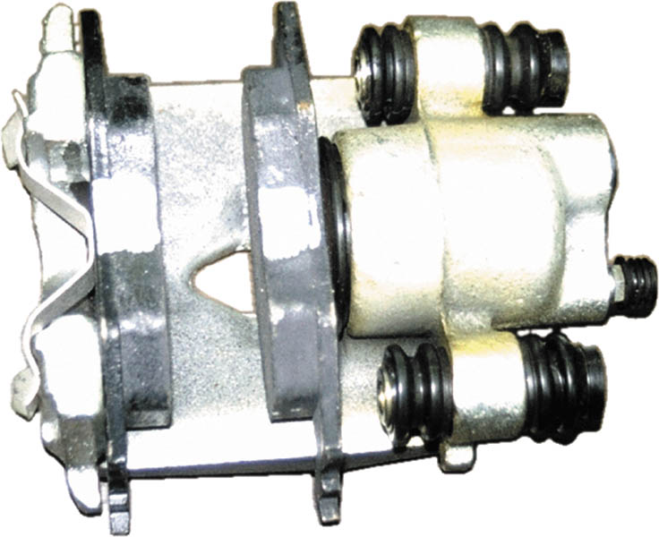
Figure 106.26 A loaded caliper includes all hardware and shims with the correct pads all in one convenient package, ready to install on the vehicle

Slide 42
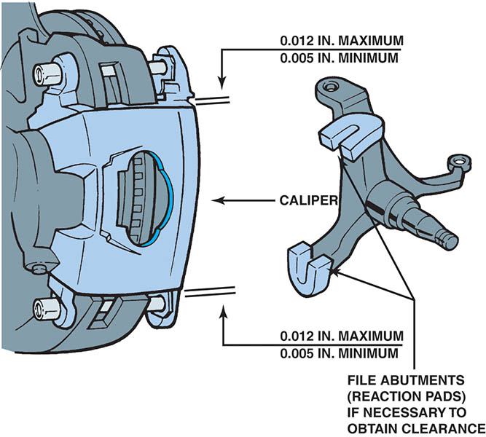
Figure 106.27 Floating calipers must be able to slide during normal operation. Therefore, there must be clearance between the caliper and the caliper mounting pads (abutments).

Slide 43
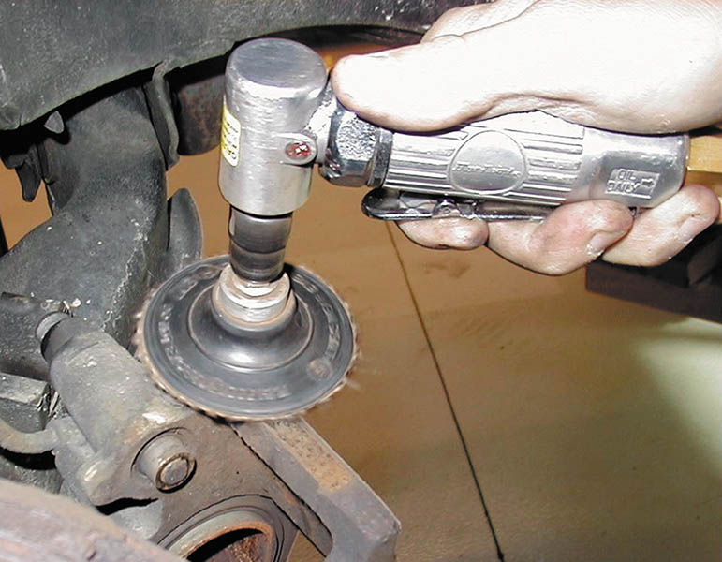
Figure 106.28 Using an air-powered sanding disc to clean the caliper mount pads

Slide 44
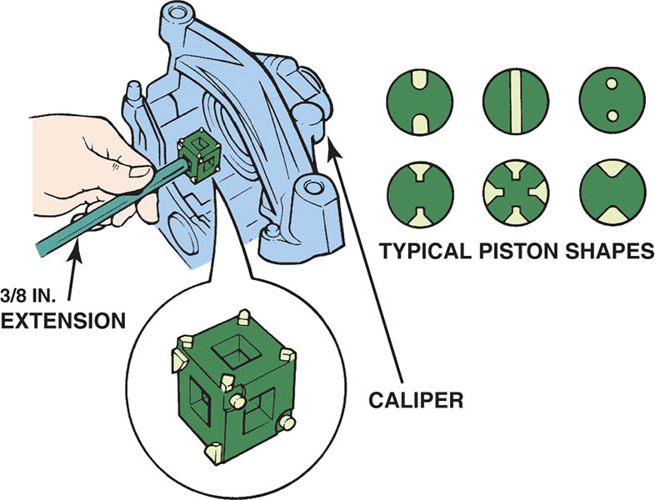
Figure 106.29 Determine which face of the special tool best fits the holes or slots in the piston. Sometimes needle-nose pliers can be used to rotate the piston back into the caliper bore

Slide 45
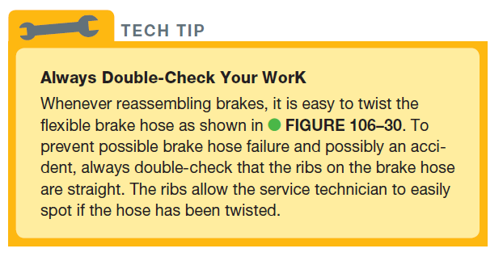
TECH TIP

Slide 46
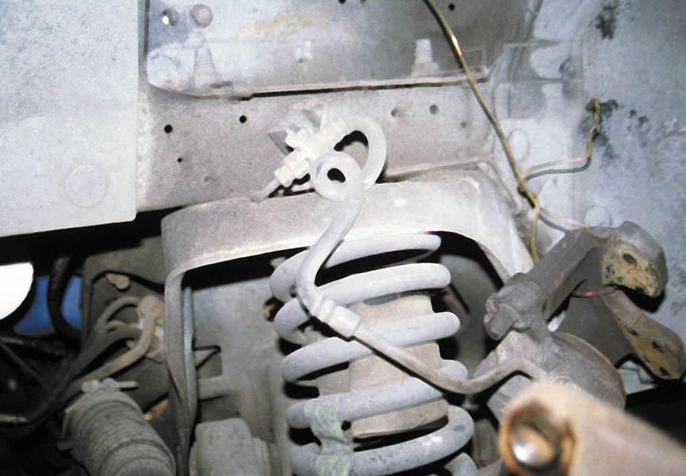
Figure 106.30 Note the twisted flexible brake line. This was caught by an automotive instructor before the brake work on the vehicle was completed.

Slide 47
DISC BRAKE SQUEAL CORRECTION
Causes of Brake Squeal
  Disc brake squeal is caused by the movement (vibration) of brake components. The noise is transmitted through the air.
Correcting Disc Brake Squeal
  Keep the disc brake pads clean.
  Use factory-type clips and anti-squeal shims.
  Lubricate all caliper slide points as per manufacturer’s recommendation.
  Machine the brake rotor as little as possible and with the correct surface finish.

Slide 48
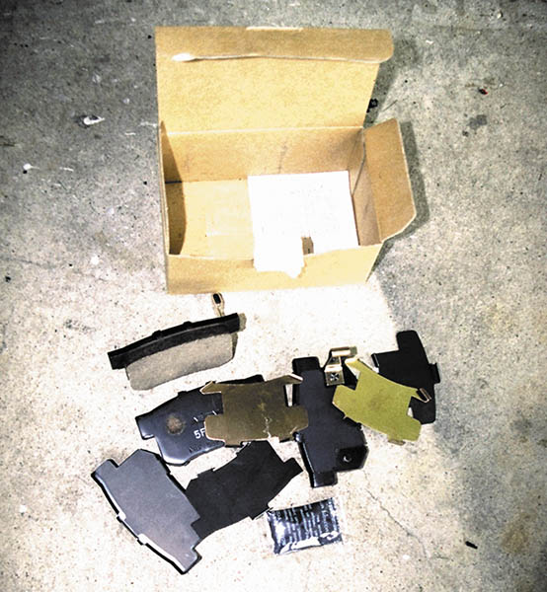
Figure 106.31 For best braking performance, purchase replacement disc brake pads that include all clips and shims specified by the vehicle manufacturer.

Slide 49
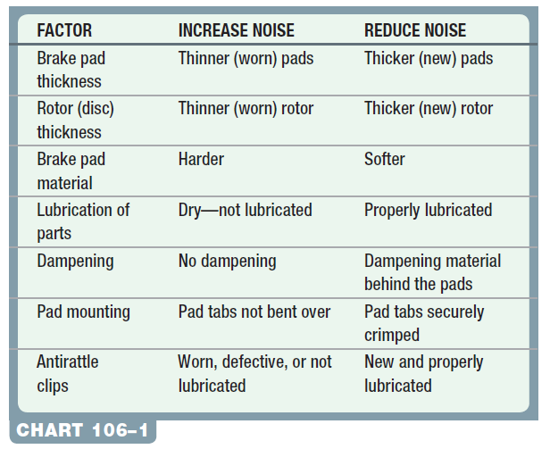
Chart 106-1The causes of brake noise can have many reasons and corrections.

Slide 50
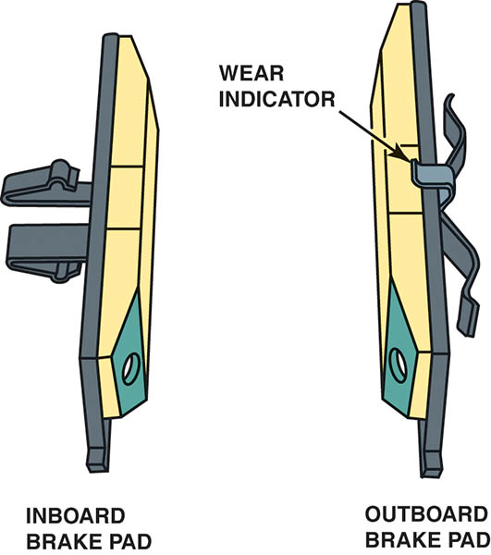
Figure 106.32 Notice the beveled pads. The shape of the pad helps reduce brake noise

Slide 51
QUESTION 3: ?
What is the purpose of the brake pad shims and clips?

Slide 52
ANSWER 3:
To prevent unwanted brake noise and squeal

Slide 53
DISC BRAKE SYMPTOM GUIDE
Pulls to one side during breaking.
Brake roughness or chatter (pedal pulsates)
Excessive pedal effort
Excessive Pedal travel
Dragging brakes
Front disc brakes very sensitive to light application
Rear drum brakes skidding under heavy application

Slide 54
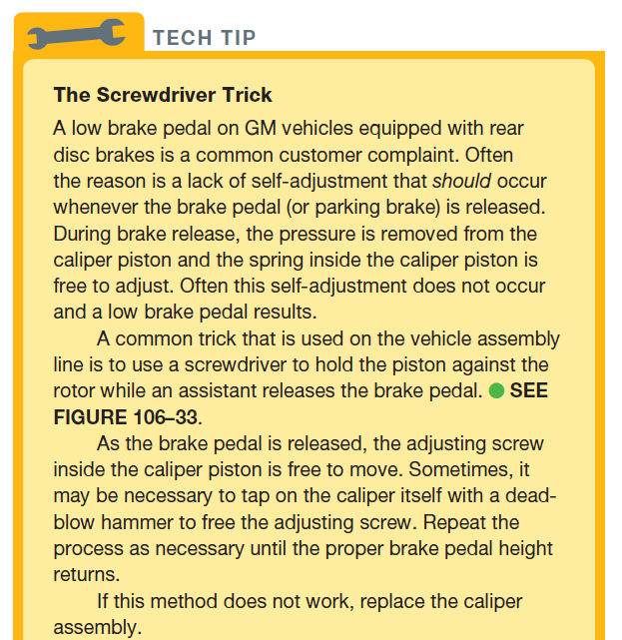
TECH TIP

Slide 55
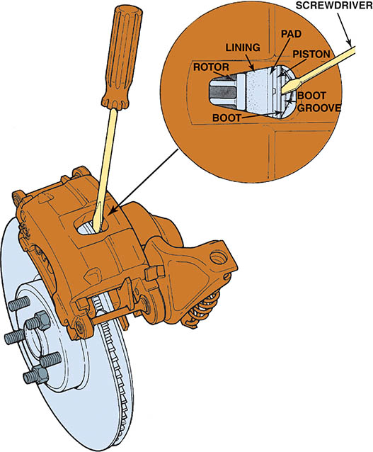
Figure 106.33 The screwdriver blade is used to keep the piston applied to allow self-adjustment to occur when the brake pedal is released

Slide 56
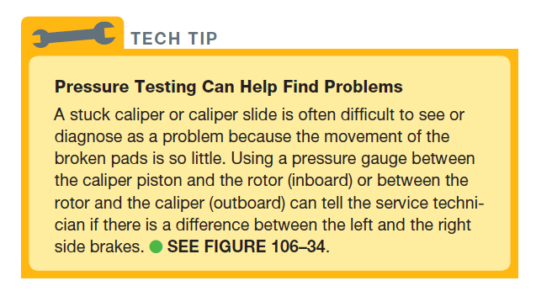
TECH TIP

Slide 57
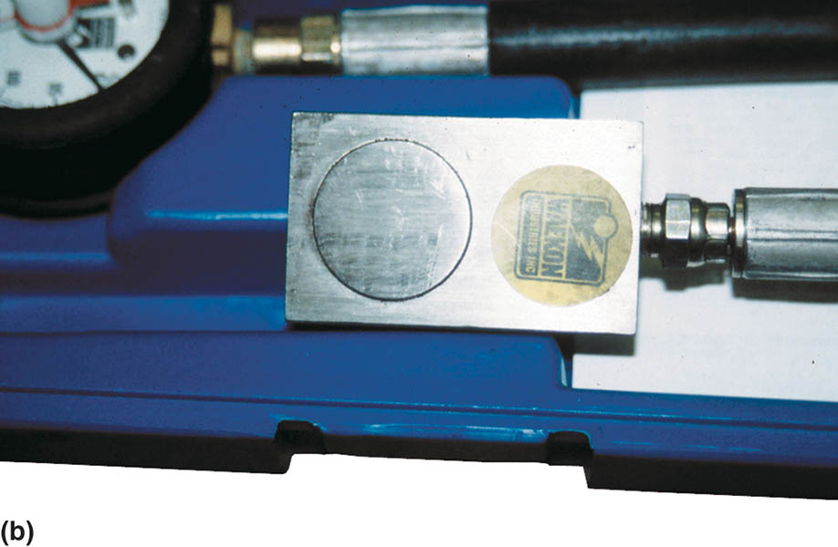
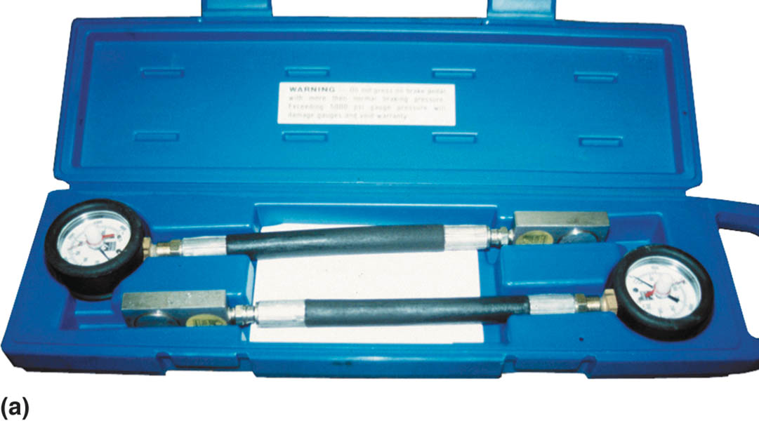
Figure 106.34 (a) A brake pressure tester. (b) The small “pads” can be placed between the caliper piston and the rotor to check for applied pressure and inserted between the caliper and the rotor on the outside of the rotor to test the pressure—the pressure should be the same if the caliper is able to slide on its pins or slides

Slide 58
DISC BRAKE SERVICE

Slide 59
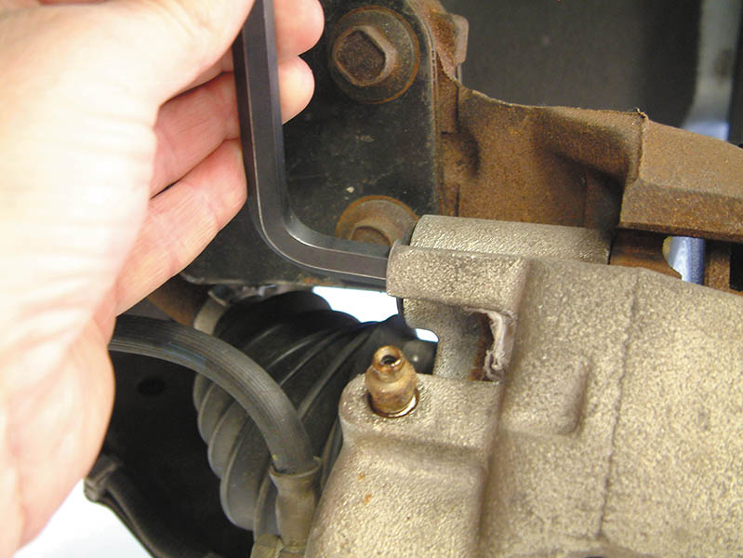
1. Use a hex wrench to remove the caliper mounting bolts.

Slide 60
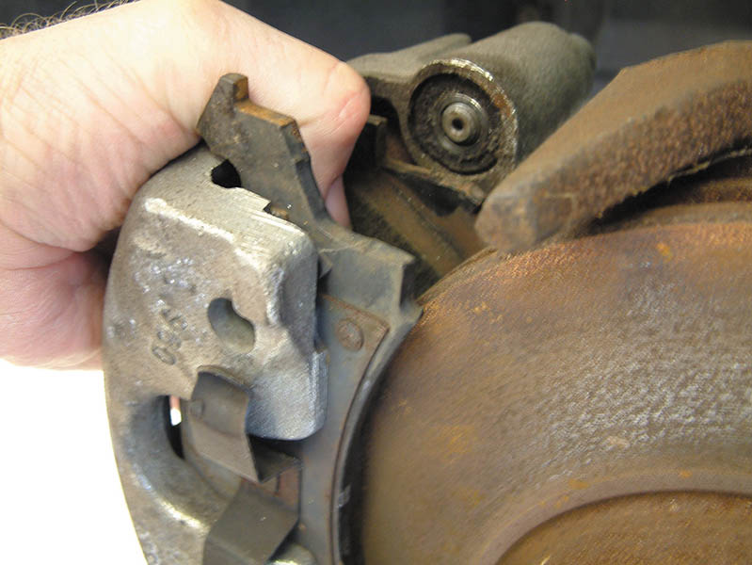
2. Remove the caliper and pads from the brake rotor.

Slide 61
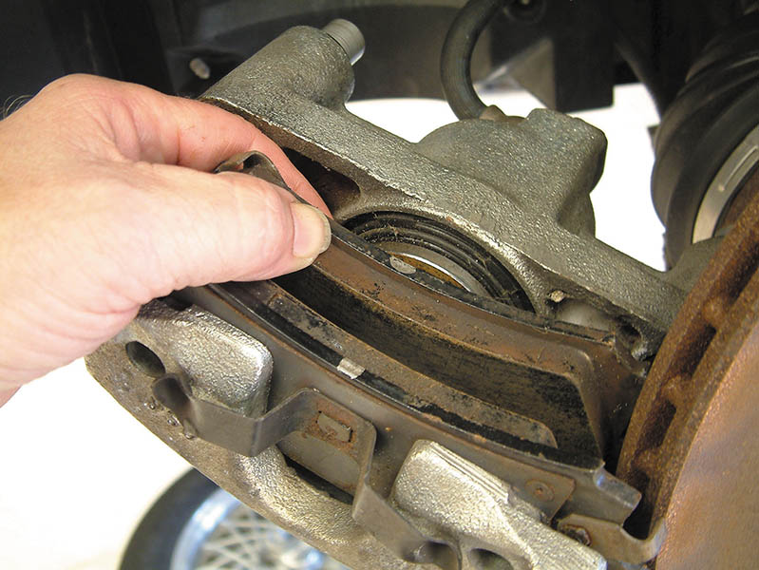
3. Remove the brake pads from the caliper

Slide 62
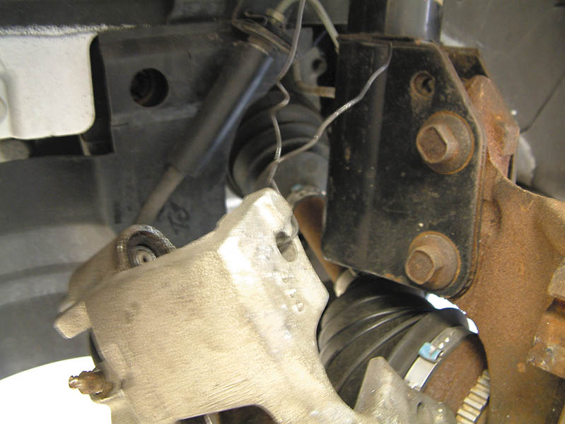
4. Hang the caliper with wire or a hook. Do not let the caliper hang from the brake hose.

Slide 63
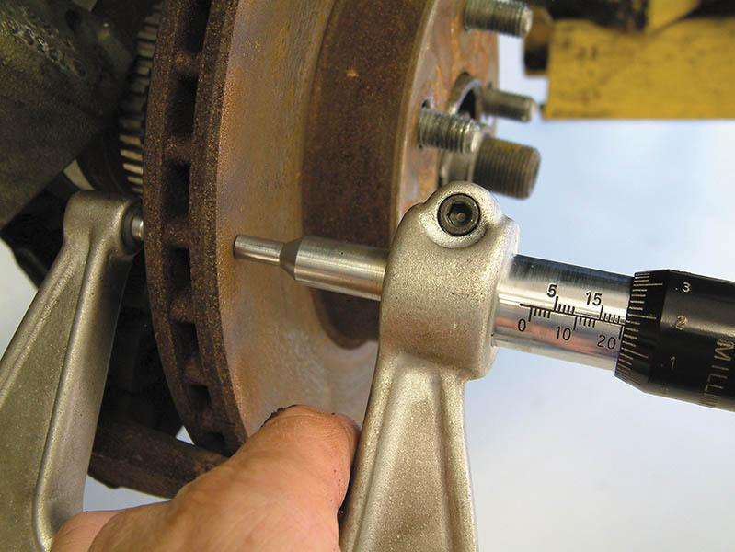
5. Measure the rotor thickness and machine or replace, if necessary.

Slide 64
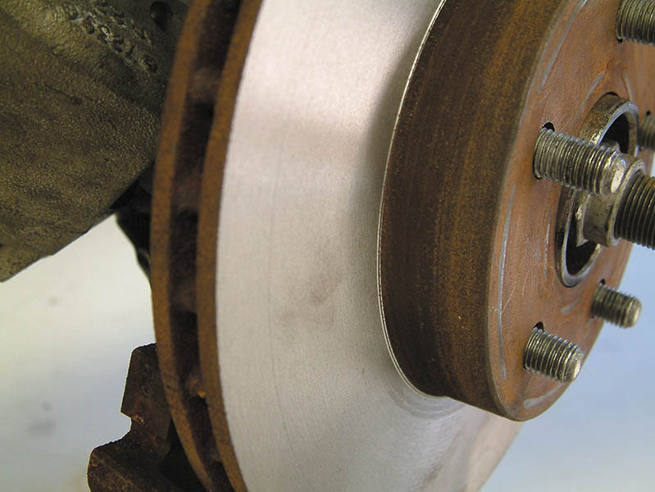
6. Clean the rotor and install it on the hub.

Slide 65
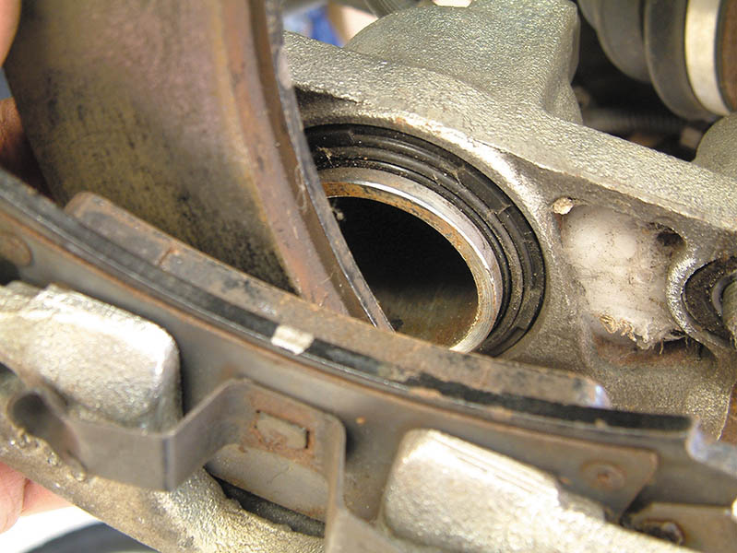
7. Bottom the piston and install the new brake pads.

Slide 66
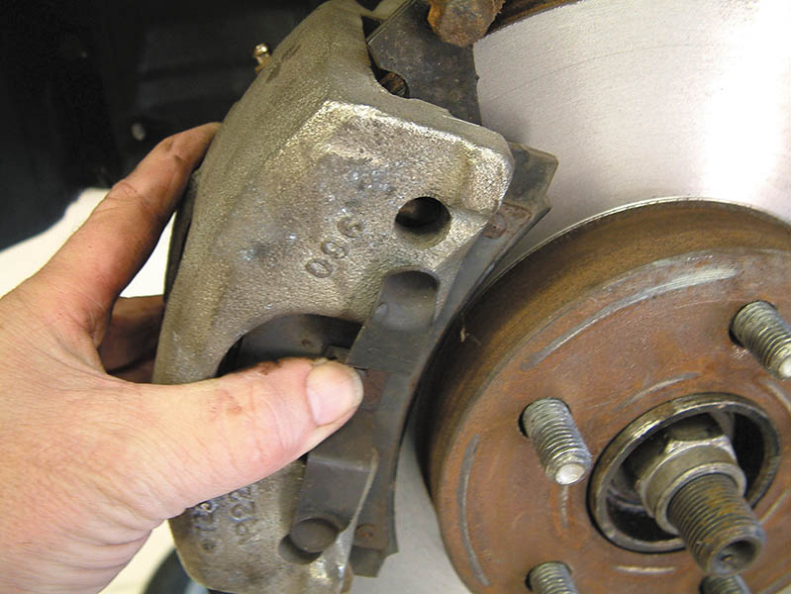
8. Slide the caliper and new pads into position on the rotor and steering knuckle.

Slide 67

9. Install and torque the caliper mounting bolts to factory specifications.

Slide 68

Copyright

