Slide 1
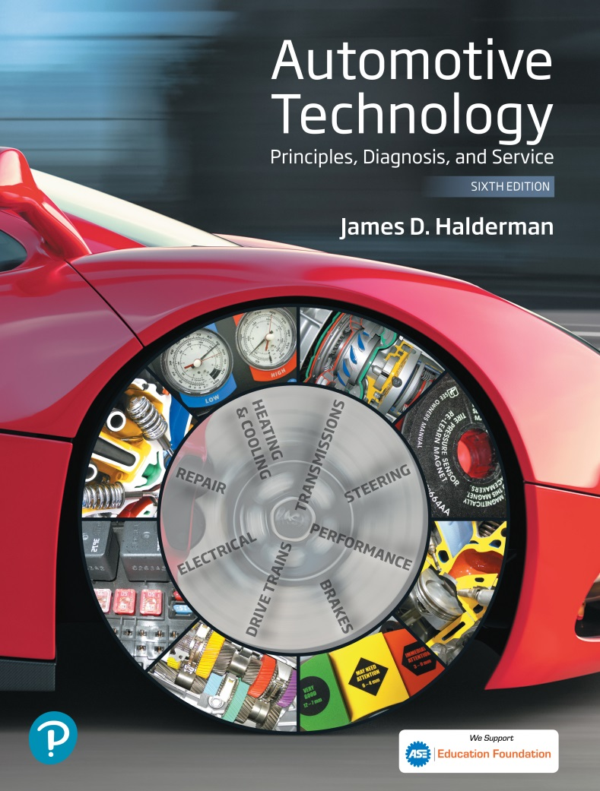
Automotive Technology Principles, Diagnosis, and Service
Sixth Edition
Chapter 105
Disc Brakes
Copyright © 2018, 2015, 2011 Pearson Education, Inc. All Rights Reserved

Slide 2
LEARNING OBJECTIVES (1 of 2)
105.1 Describe the parts and operation of disc brakes.
105.2 Describe the construction of disc brake pads.
105.3 Discuss the brake pad assembly methods and brake lining composition.

Slide 3
LEARNING OBJECTIVES (2 of 2)
105.4 Describe the difference between fixed caliper and floating or sliding caliper.
105.5 Discuss brake rotors, disc brake designs, and rear disc brakes.
105.6 This chapter will help prepare for the Brakes (A5) ASE certification test content area “C” (Disc Brake Diagnosis and Repair).

Slide 4
DISC BRAKES
Parts and Operation
Disc brakes use a piston(s) to squeeze friction material (pads) on both sides of a rotating disc (rotor).
Disc Brake Advantages
Fade resistant
Self-adjusting ability
Freedom from Pull
Disc Brake Disadvantages
No servo action, brake noise, brake dust, poor parking brake performance.

Slide 5
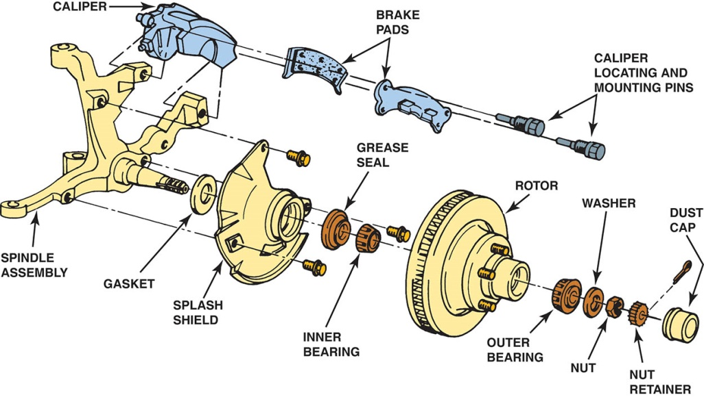
Figure 105.1 An exploded view of a typical disc brake assembly

Slide 6
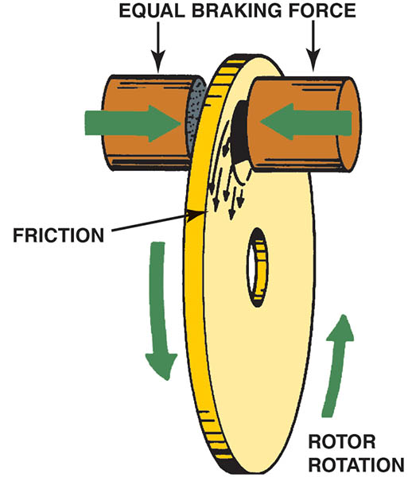
Figure 105.2 Braking force is applied equally to both sides of the brake rotor

Slide 7
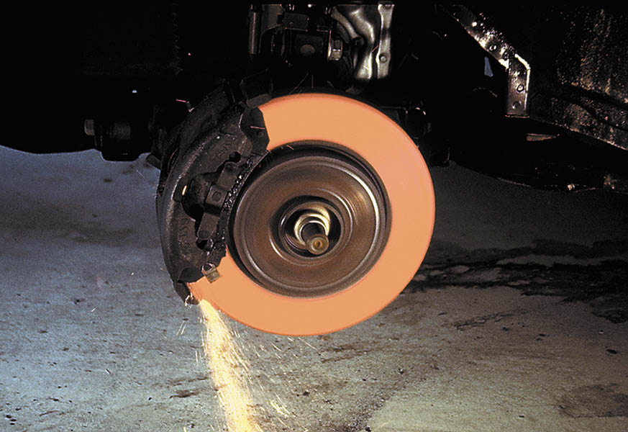
Figure 105.3 Disc brakes can absorb and dissipate a great deal of heat. During this demonstration, the brakes were gently applied as the engine drove the front wheels until the rotor became cherry red. During normal braking, the rotor temperature can exceed 350°F (180°c), and about 1,500°F (800°c) on a race vehicle

Slide 8
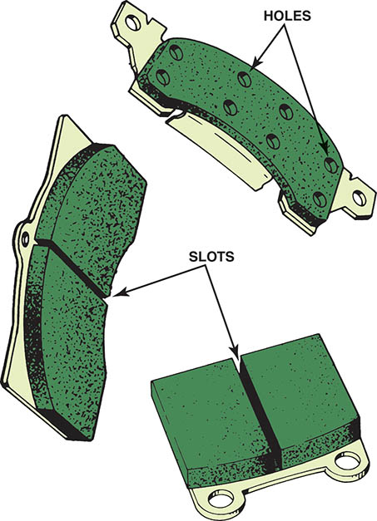
Figure 105.4 Slots and holes in the brake linings help prevent gas and water fade

Slide 9
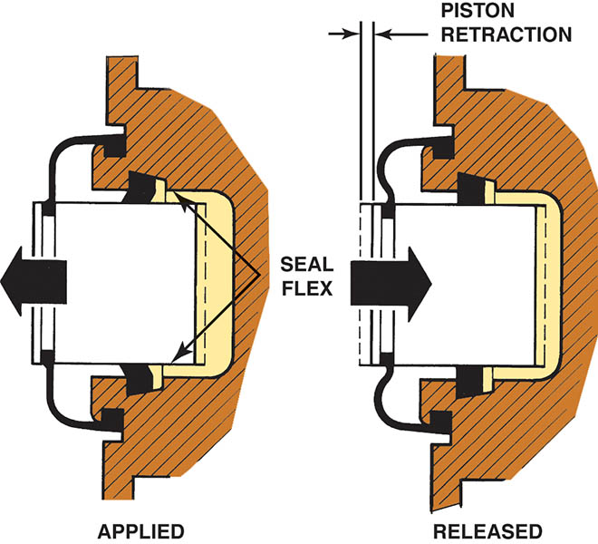
Figure 105.5 The square-cut O-ring not only seals hydraulic brake fluid but also retracts the caliper piston when the brake pedal is released

Slide 10
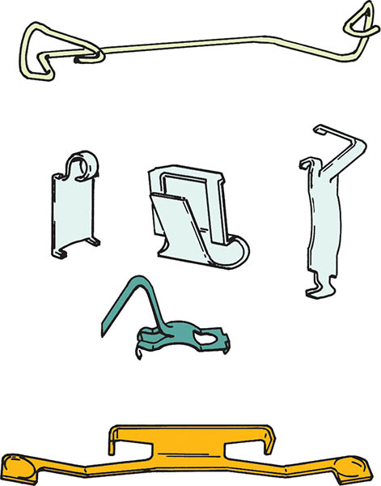
Figure 105.6 Antirattle clips reduce brake pad movement and vibration

Slide 11
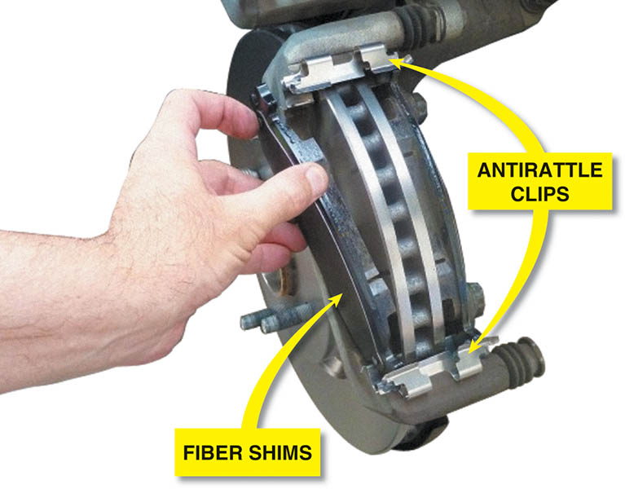
Figure 105.7 Antivibration shims are used behind the pads on many disc brake caliper designs

Slide 12
QUESTION 1: ?
What are the advantages of disc brakes?

Slide 13
ANSWER 1:
Fade resistant, self-adjusting ability, and freedom from pull.

Slide 14
DISC BRAKE CONSTRUCTION
Caliper
The brake caliper uses hydraulic pressure to create the mechanical force required to move the brake pads into contact with the brake rotor.
Splash Shield
The job of the splash shield is to protect the inner side of the brake rotor from water and other contaminants, whereas the outer side of the rotor is protected by the wheel.

Slide 15
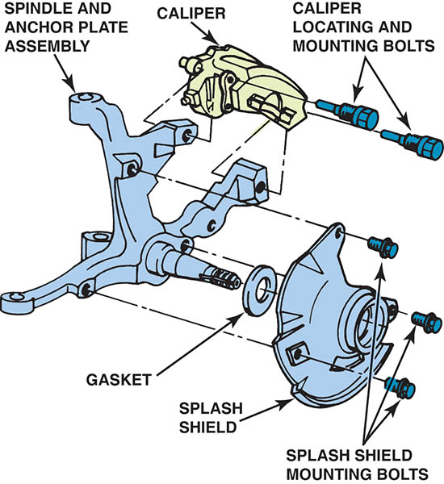
Figure 105.8 This brake caliper attaches to the front spindle

Slide 16
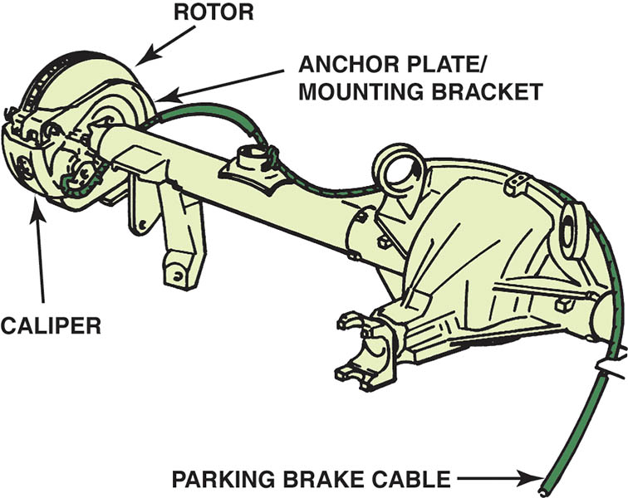
Figure 105.9 A rear disc brake caliper often attaches to a mounting bracket on the rear axle housing

Slide 17
DISC BRAKE PADS (1 OF 2)
The lining of a disc brake is part of an assembly called the brake pad.
Some pad backing plates have tabs that bend over the caliper to hold the pad tightly in place and help prevent brake noise.
Other pad backing plates have tabs with holes in them that pins slide through.
Other pad backing plates have a retainer spring attached that locates the pad in the caliper by locking it to the caliper piston.

Slide 18
DISC BRAKE PADS (2 OF 2)
Pad Wear Indicators
Pad wear indicators are either mechanical or electrical and signal the driver when the lining material has worn to the point where pad replacement is necessary.
Pad Assembly Methods
Riveted linings
Bonded linings
Mold-bond linings

Slide 19
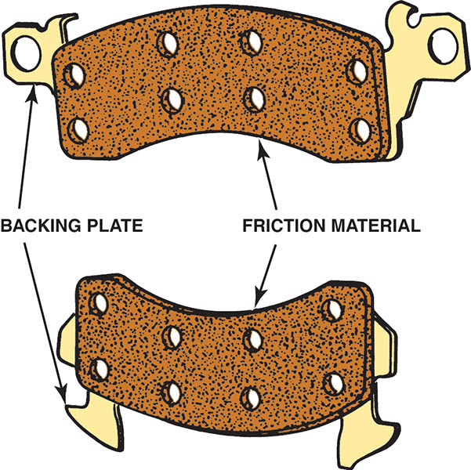
Figure 105.10 A typical disc brake pad

Slide 20
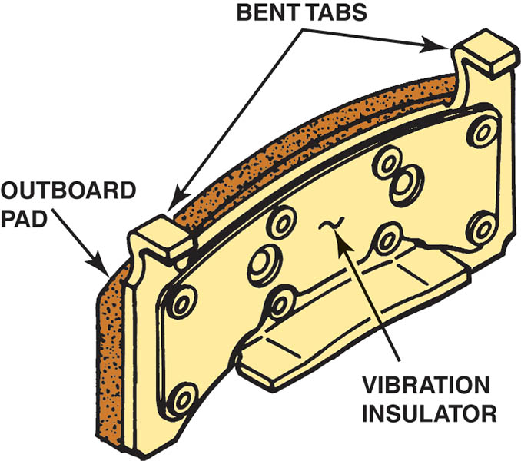
Figure 105.11 To prevent noise, bent tabs on the backing plate hold some brake pads to the caliper housing

Slide 21
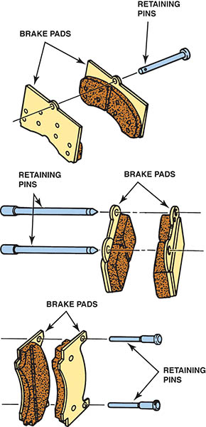
Figure 105.12 Holes in the backing plate are a method of locating a pad in the caliper

Slide 22
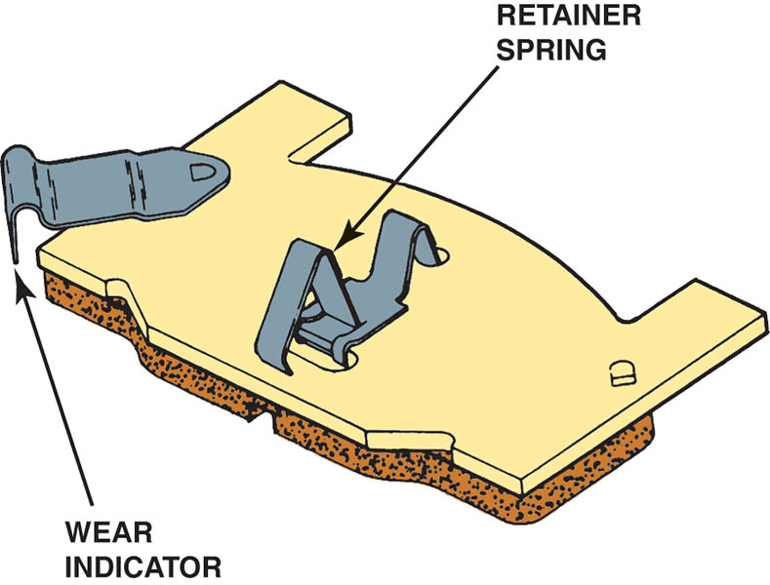
Figure 105.13 Retainer springs lock the pad to the caliper piston to prevent brake noise

Slide 23
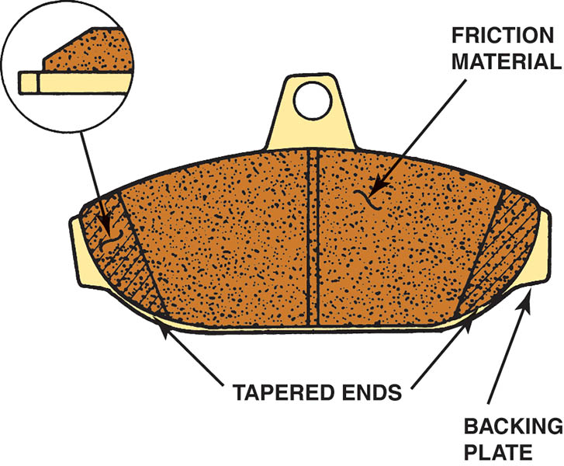
Figure 105.14 The lining edges of some brake pads are tapered to help prevent vibration

Slide 24
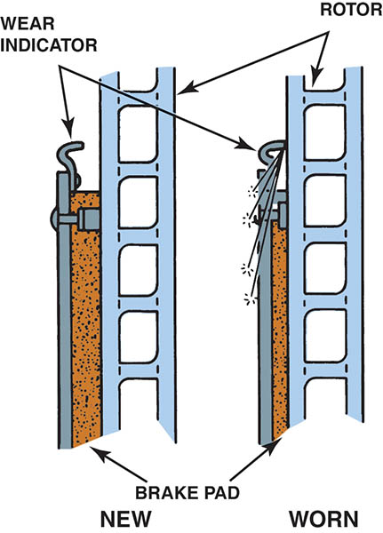
Figure 105.15 Typical pad wear sensor operation. It is very important that the disc brake pads are installed on the correct side of the vehicle to be assured that the wear sensor will make a noise when the pads are worn.

Slide 25
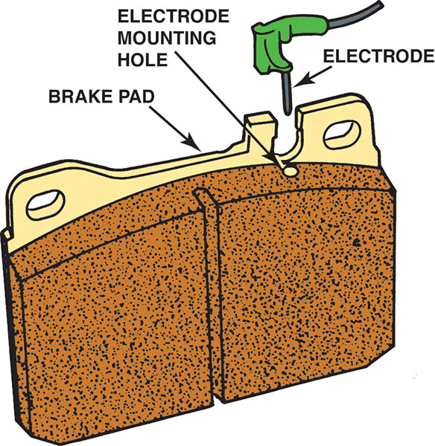
Figure 105.16 Electrical wear indicators ground a warning light circuit when the pads need replacement

Slide 26
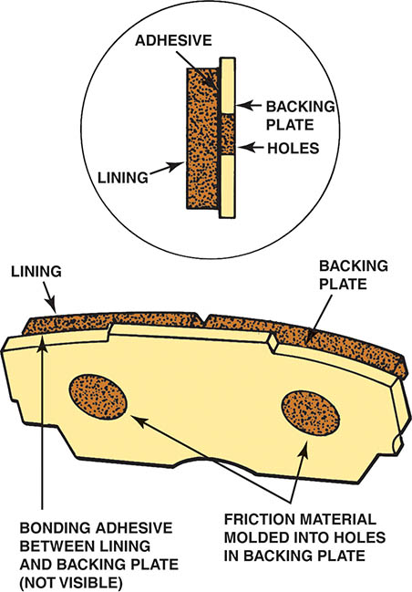
Figure 105.17 Mold-bonded linings are commonly used in many applications

Slide 27
QUESTION 2: ?
What are the three methods that brake pads are assembled?

Slide 28
ANSWER 2:
Riveted, bonded, and mold-bonding.

Slide 29
BRAKE ROTORS
The brake rotor provides the friction surfaces for the brake pads to rub against.
There are two basic types of rotors:
Solid
Vented

Slide 30
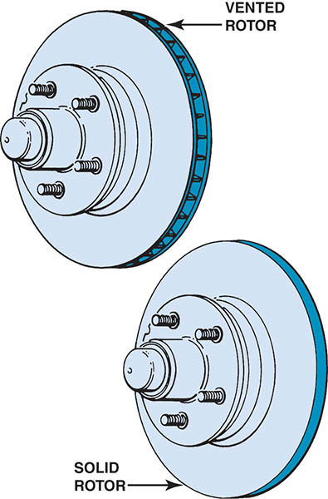
Figure 105.18 Disc brake rotors can be either solid or vented

Slide 31
DISC BRAKE DESIGNS (1 OF 4)
Fixed Caliper Design
The fixed caliper gets its name from the fact that the caliper is rigidly mounted to the suspension.
When the brakes are applied, the pistons extend from the caliper bores and apply the brake pads with equal force from both sides of the rotor.
Fixed calipers are relatively large and heavy, which enables them to absorb and dissipate great amounts of heat.
Fixed calipers add un-sprung weight to the vehicle.

Slide 32
DISC BRAKE DESIGNS (2 OF 4)
Floating and Sliding Caliper Design
The caliper is free to move within a limited range on an anchor plate that is solidly mounted to the vehicle suspension.
When the brakes are applied, the caliper piston moves out of its bore and applies the inner brake pad.
At the same time, the caliper body moves in the opposite direction on the anchor plate and applies the outer brake pad.
Floating and sliding calipers are lower cost, simple construction, and compact size.

Slide 33
DISC BRAKE DESIGNS (3 OF 4)
Floating Caliper Operation
The body of a floating caliper does not make direct metal-to-metal contact with the anchor plate.
Instead, the caliper body is supported by bushings and/or O-rings that allow it to “float” or slide on metal guide pins or locating sleeves attached to the anchor plate.
Floating calipers depend on proper lubrication of their pins, sleeves, bushings, and O-rings for smooth operation.

Slide 34
DISC BRAKE DESIGNS (4 OF 4)
Sliding Calipers
Unlike a floating caliper, the body of a sliding caliper mounts in direct metal-to-metal contact with the anchor plate.
Instead of pins and bushings, sliding calipers move on ways cast and machined into the caliper body and anchor plate.
Like floating calipers, sliding calipers depend on good lubrication of their ways for proper operation.

Slide 35
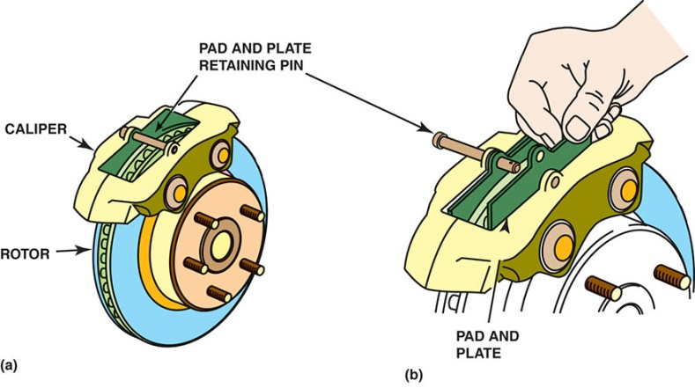

Figure 105.19 (a) Many fixed caliper disc brakes use a simple retaining pin to hold the disc brake pads. (b) Removing the retainer pin allows the brake pads to be removed. (c) Notice the cross-over hydraulic passage that connects both sides of the caliper.

Slide 36
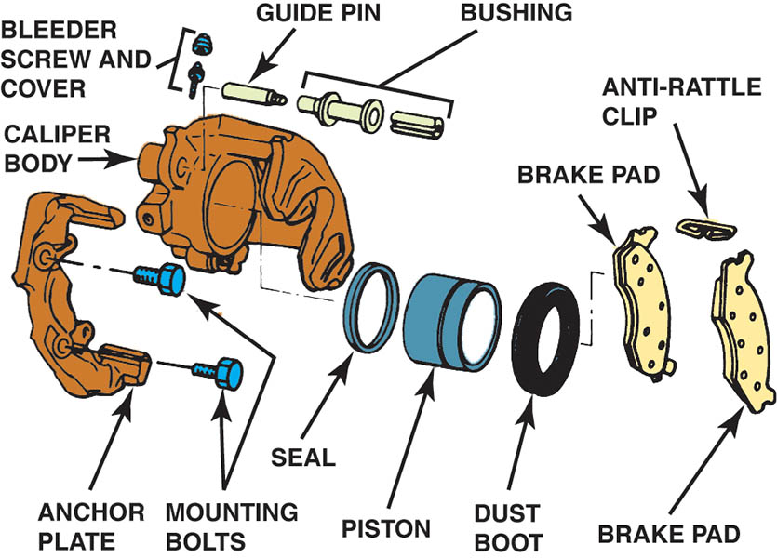
Figure 105.20 This floating caliper mounts on a separate anchor plate that bolts to the vehicle suspension

Slide 37
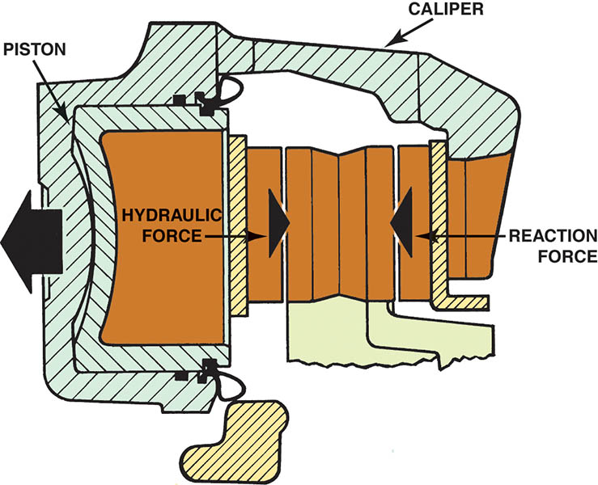
Figure 105.21 Hydraulic force on the piston (left) is applied to the inboard pad and the caliper housing itself. The reaction of the piston pushing against the rotor causes the entire caliper to move toward the inside of the vehicle (large arrow).

Slide 38
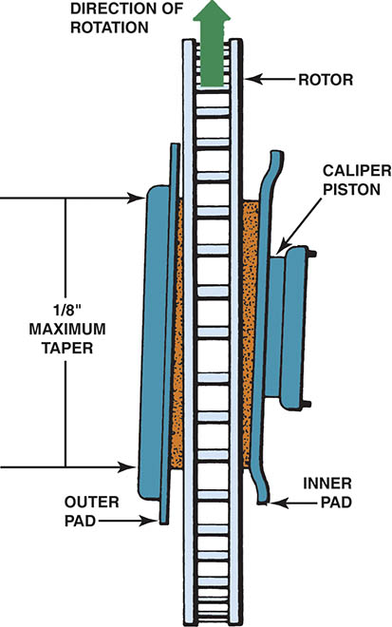
Figure 105.22 Caliper flex can cause tapered wear of the brake lining

Slide 39
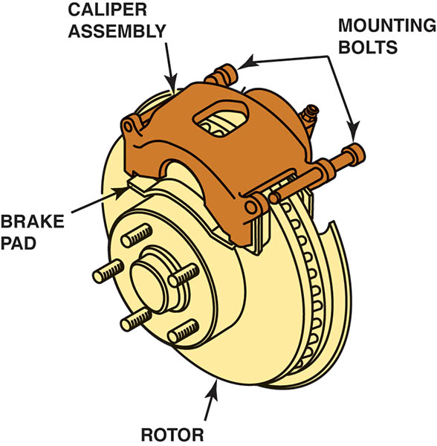
Figure 105.23 A typical single-piston floating caliper. In this type of design, the entire caliper moves when the single piston is pushed out of the caliper during a brake application.

Slide 40
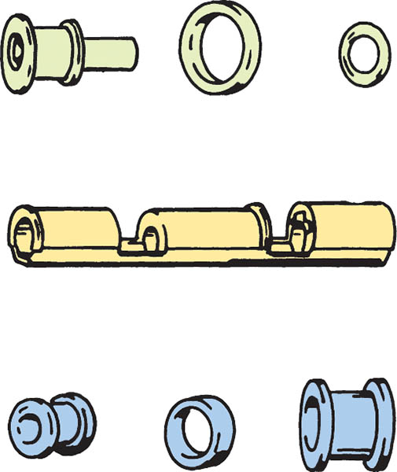
Figure 105.24 Floating calipers are supported by rubber O-rings or plastic bushings

Slide 41
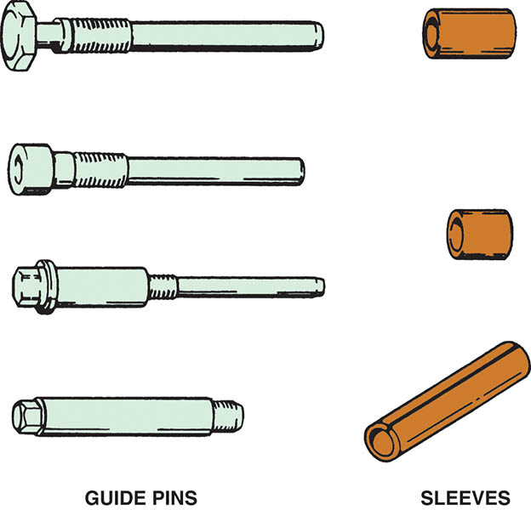
Figure 105.25 Metal guide pins and sleeves are used to retain and locate floating calipers

Slide 42
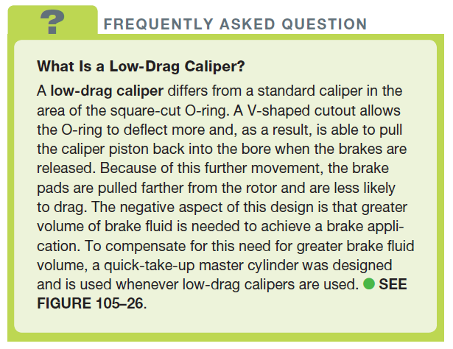
FREQUENTLY ASKED QUESTION

Slide 43
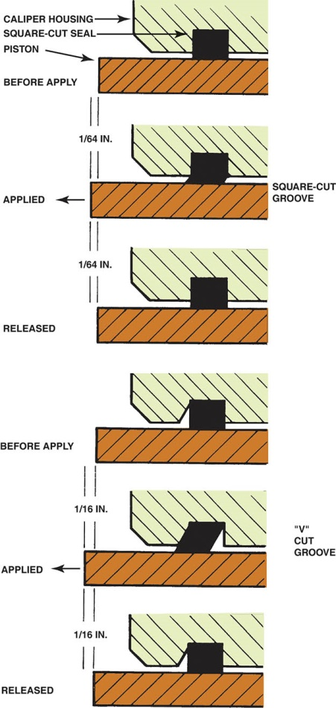
Figure 105.26 In a standard disc brake caliper, the square-cut O-ring deforms when the brakes are applied and returns the piston to its original (released) position due to the elastic properties of the rubber seal.

Slide 44
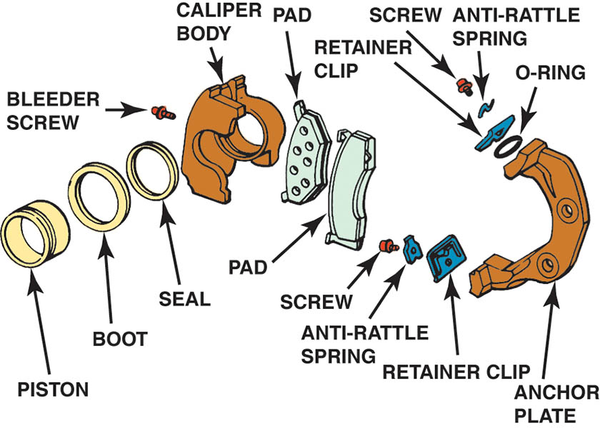
Figure 105.27 Exploded view of a typical sliding brake caliper

Slide 45
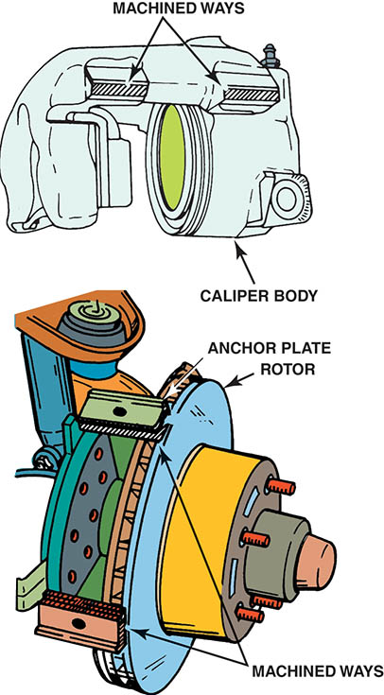
Figure 105.28 Sliding calipers move on machined ways

Slide 46
REAR DISC BRAKES
In recent years, four-wheel disc brake systems have become more common.
No brake fade
Self-adjusted
Rear Disc Parking Brake
Two methods of providing parking brakes:
Single piston caliper
Drum brakes in the rear rotors

Slide 47
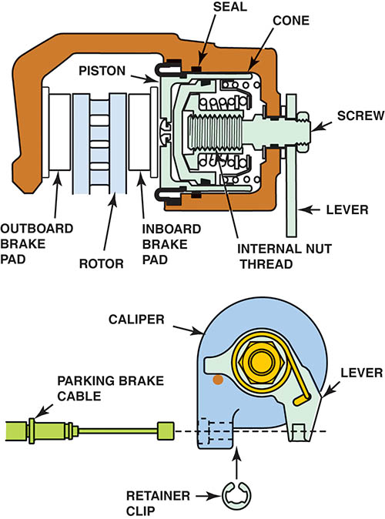
Figure 105.29 Exploded view of a typical rear disc brake with an integral parking brake. The parking brake lever mechanically pushes the caliper piston against the rotor.

Slide 48
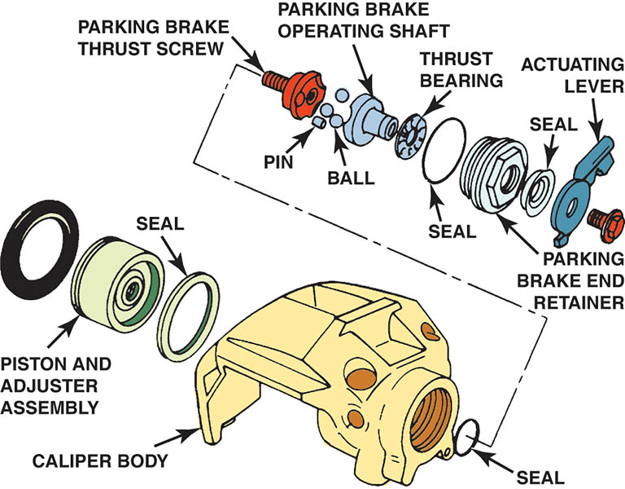
Figure 105.30 This single-piston brake caliper is mechanically actuated to serve as a parking brake

Slide 49
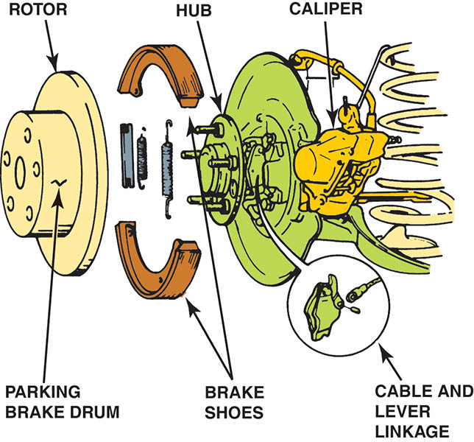
Figure 105.31 Drum parking brakes are fitted inside the rotors on this vehicle equipped with rear disc brakes

Slide 50
QUESTION 3: ?
What are the two methods of appling the parking brake with a rear disc brake system?

Slide 51
ANSWER 3:
The caliper and a drum-in-hat rotor design.

Slide 52
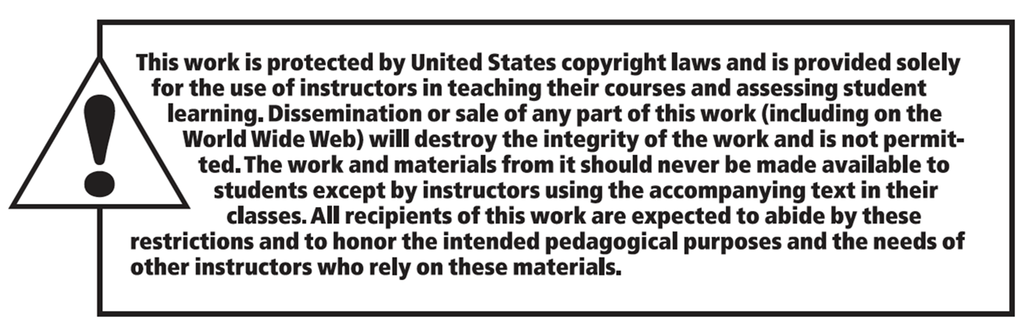
Copyright

