Slide 1

Automotive Technology Principles, Diagnosis, and Service
Sixth Edition
Chapter 104
Drum Brake Diagnosis and Service
Copyright © 2018, 2015, 2011 Pearson Education, Inc. All Rights Reserved

Slide 2
LEARNING OBJECTIVES (1 of 2)
104.1 Discuss the procedures recommended for brake drum diagnosis, removal, and disassembly.
104.2 Discuss the procedure for inspecting drum brake parts.
104.3 Describe how to clean, lubricate, reassemble, and adjust drum brake parts.

Slide 3
LEARNING OBJECTIVES (2 of 2)
104.4 Describe the symptoms of a faulty drum brake.
104.5 This chapter will help prepare for the Brakes (A5) ASE certification test content area “B” (Drum Brake Diagnosis and Repair).

Slide 4
DRUM BRAKE DIAGNOSIS
Diagnostic Steps
  Verify the customer complaint (concern).
  Perform a visual inspection
  Determine the root cause
  Restore the brake system to like-new operation
  Test-drive the vehicle to verify that the service has corrected the customer’s complaint

Slide 5
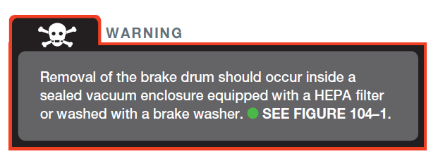
WARNING

Slide 6
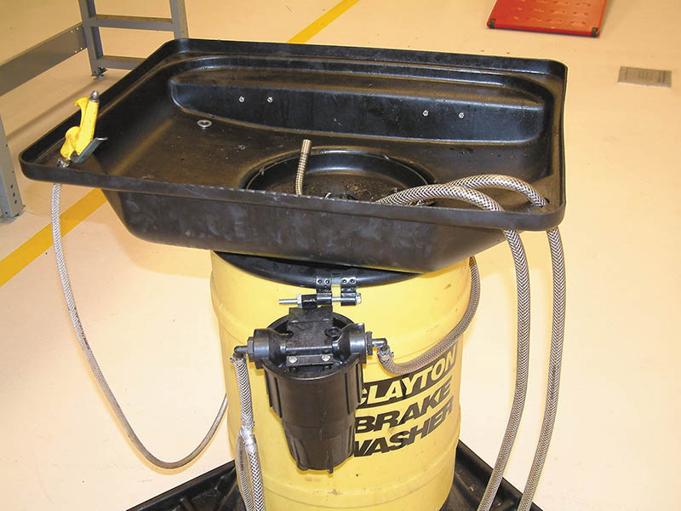
Figure 104.1 An aqueous-based (water-based) brake washer can be used to wet down the outside of the brake assembly before removing the drum. after the drum is removed, wash down the shoes and other parts to capture the dust into the washer

Slide 7
QUESTION 1: ?
What is the purpose of the aqueous brake parts washer?

Slide 8
ANSWER 1:
To make sure asbestos does not become airborne.

Slide 9
BRAKE DRUM REMOVAL (1 OF 2)
Mark Drums
  Mark the drums so they can be replaced at the same location.
Hub or Fixed Drums
  A fixed or hub-mounted drum is often used on the rear of front-wheel-drive vehicles.
  Remove the spindle nut and washer and then the brake drum can be carefully pulled off the spindle.

Slide 10
BRAKE DRUM REMOVAL (2 OF 2)
Hubless of Floating Drums
  Floating or hubless drums are usually used on the rear of a rear-wheel-drive vehicle.
  New vehicles have tinnerman nuts (clips) on the stud when the vehicle is being assembled.
  The drum may be rusted to the hub.
  The brake shoes may be worn into the drum.
  To prevent damage, back-off the shoes before removing the drum.

Slide 11
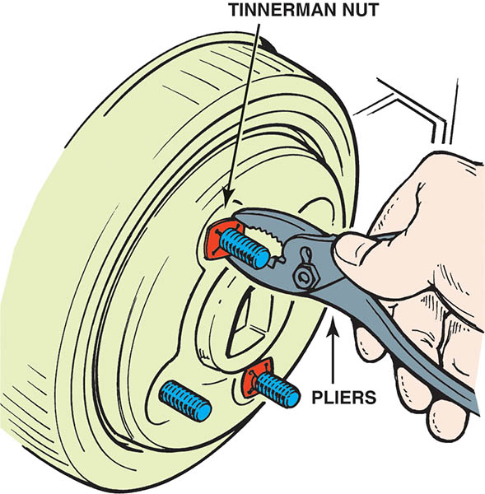
Figure 104.2 Tinnerman nuts are used at the assembly plant to prevent the brake drum from falling off until the wheels are installed

Slide 12
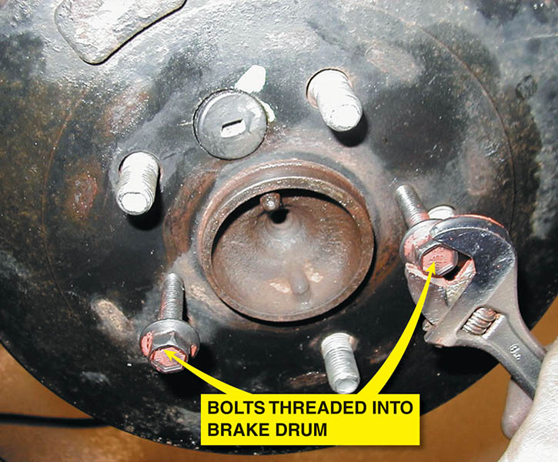
Figure 104.3 Turning the bolts that are threaded into the brake drum forces the drum off of the hub

Slide 13
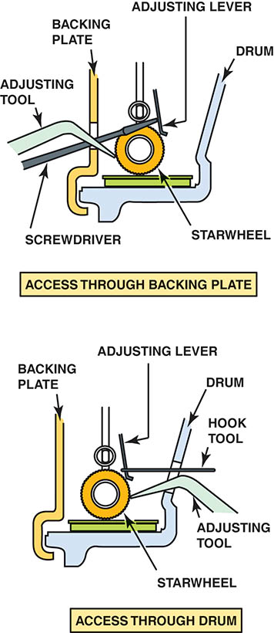
Figure 104.4 If the brake shoes have worn into the drum, the adjuster can be backed in after removing the access plug. After removing the plug, use a wire or a screwdriver to move the adjusting lever away from the starwheel, then turn the starwheel with a brake adjusting tool, often called a “brake spoon”

Slide 14
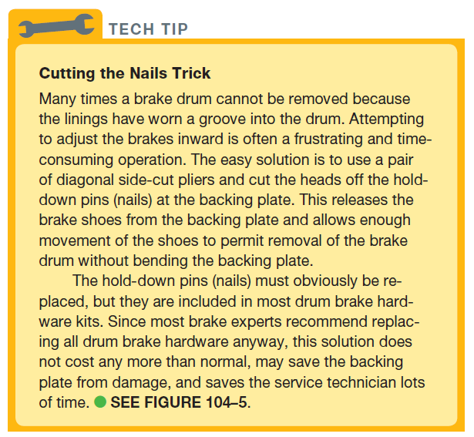
Tech Tip

Slide 15
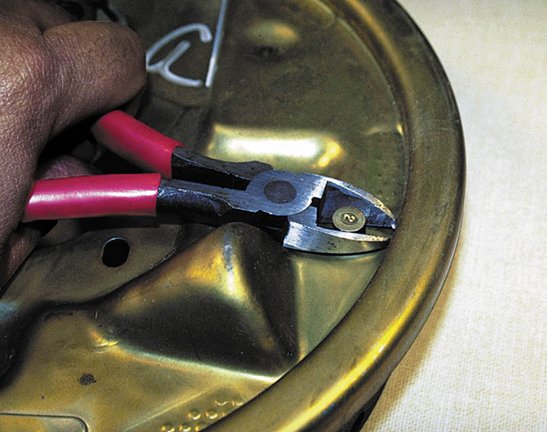
Figure 104.5 Using side-cut pliers to cut the heads off of the hold-down pins (nails) from the backing plate to release the drum from the shoes

Slide 16
QUESTION 2: ?
What is the purpose of the tinnerman nuts?

Slide 17
ANSWER 2:
To hold the brake drums on the axle at the assembly plant.

Slide 18
DRUM BRAKE DISASSEMBLY
After removal of the brake drum, the brake shoes and other brake hardware should be wetted down with a solvent or enclosed in an approved evacuation system to prevent possible asbestos release into the air.
Usually, the first step in the disassembly of a drum brake system is removal of the return (retracting) springs.
After the return springs have been removed, the hold-down springs and other brake hardware can be removed.

Slide 19
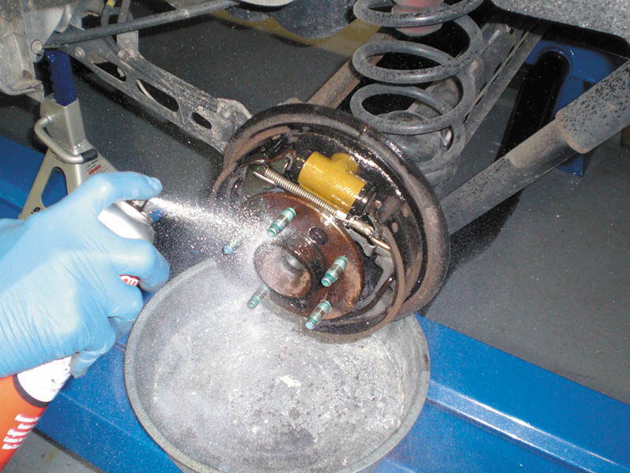
Figure 104.6 A liquid soaking solvent, such as brake cleaner, should be used to wet the linings. The purpose of wetting the lining material while the drum is still on the vehicle is to prevent the possibility of asbestos from the lining becoming airborne. asbestos is only hazardous when asbestos dust is airborne and is breathed in during brake system service

Slide 20
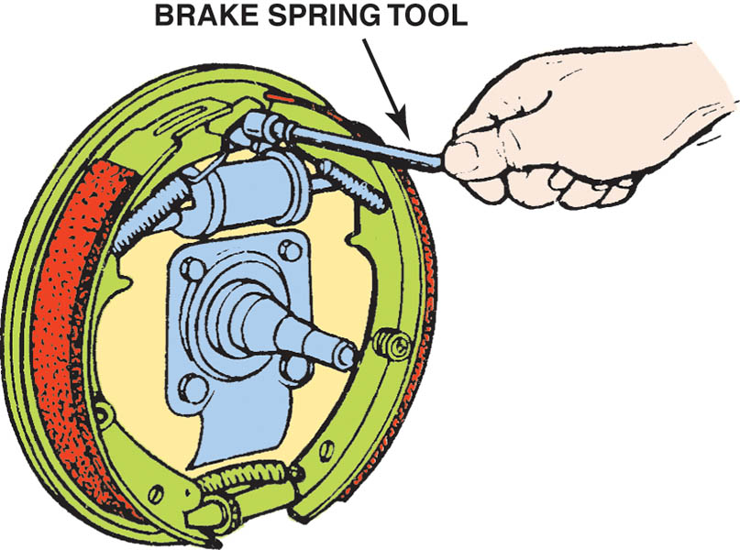
Figure 104.7 Using a brake spring tool to release a return (retracting) spring from the anchor pin

Slide 21
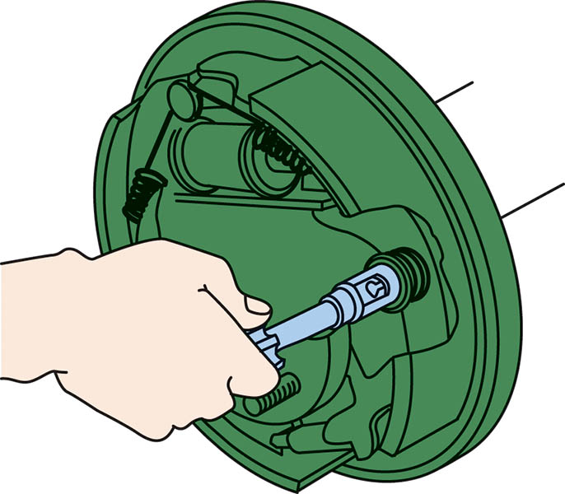
Figure 104.8 A special tool, called a hold-down spring tool, being used to depress and rotate the retainer

Slide 22
INSPECTING THE BACKING PLATE
To inspect the backing plate, follow these steps:
  The six raised contact surfaces, called pads, ledges, or shoe contact areas, of the backing plate should be inspected because they rub against the sides of the shoes.
  Check for looseness and bending
  Ensure that they are parallel with the axle flange.
  The raised pads should be cleaned and lubricated.

Slide 23
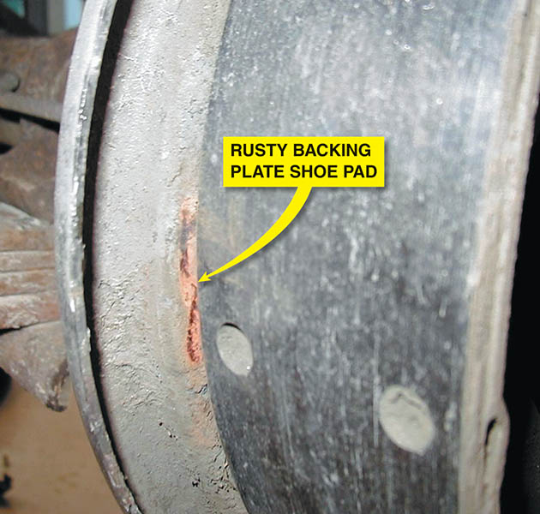
Figure 104.9 A typical rusting backing plate shoe pad. This can cause the brakes to squeak when the shoes move outward during a brake application and again when the brake pedal is released

Slide 24
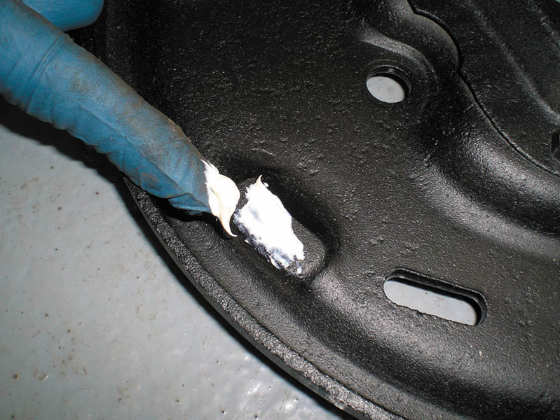
Figure 104.10 Applying lithium grease to the raised pads on the backing plate

Slide 25
DRUM BRAKE LINING INSPECTION
To inspect the drum brake lining, follow these steps:
  Some vehicles are equipped with holes in the backing plate that allow for a visual inspection of the thickness of the lining.
  Most experts agree that the best possible inspection involves removing the brake drum and making a thorough visual inspection of the entire brake instead of just looking at the thickness of the remaining lining.

Slide 26
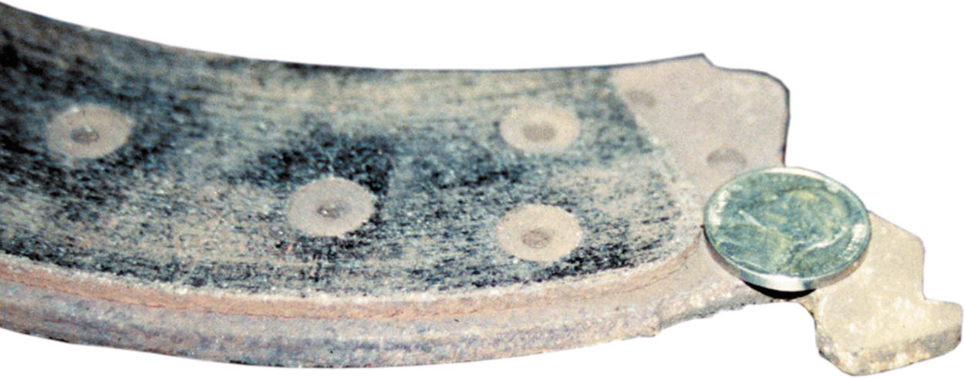
Figure 104.11 A rule of thumb is that the lining should be at least the thickness of a nickel

Slide 27
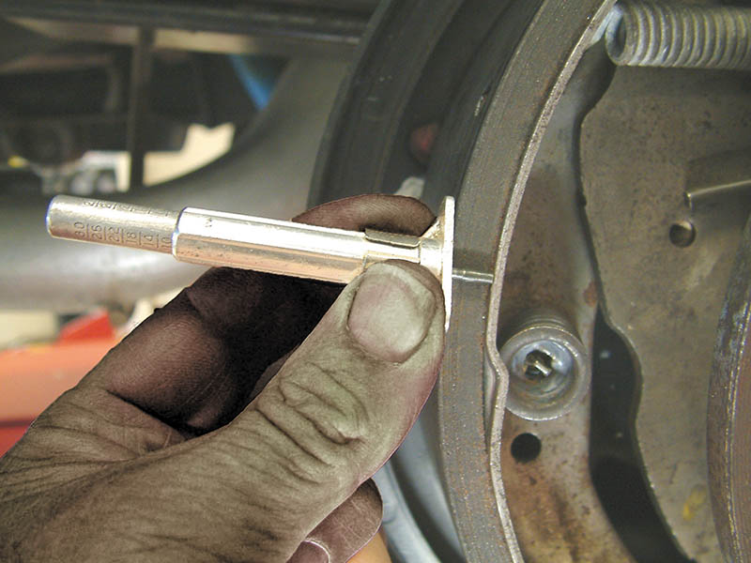
Figure 104.12 A tire tread depth gauge can be used to measure lining thickness. When measuring riveted linings, measure to the head of the rivets

Slide 28
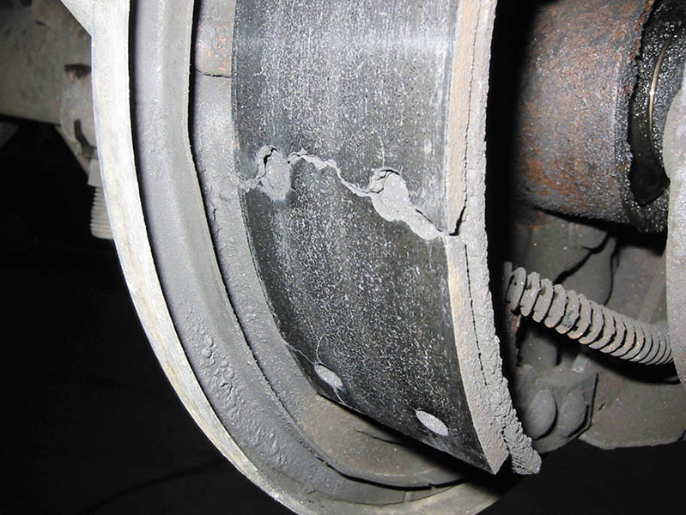
Figure 104.13 Cracked brake lining must be replaced

Slide 29
BRAKE SPRING INSPECTION
Return Springs
  The springs should be tested prior to a brake overhaul, especially when uneven lining wear is discovered.
  Return springs can get weak due to heat and time and can cause the linings to stay in contact with the drum when the brakes are released.
Hold-Down Springs
  Hold the linings tightly to the backing plate.
Connecting Springs
  Check or replace at every brake lining replacement.

Slide 30
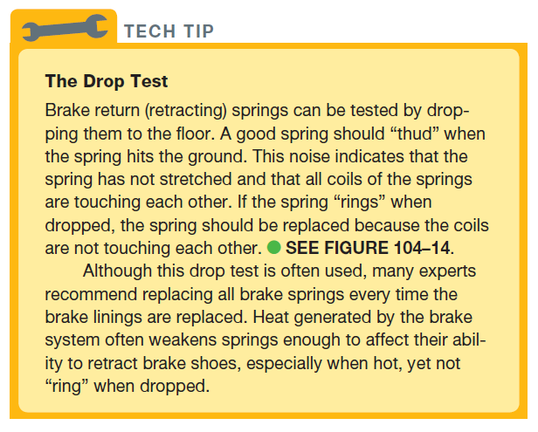
TECH TIP

Slide 31
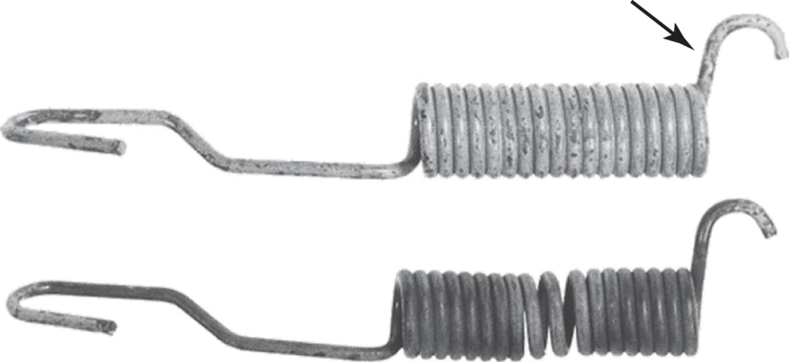
Figure 104.14 The top spring is a good-looking spring because all coils of the spring are touching each other. The bottom spring is stretched and should be discarded.

Slide 32
WHEEL CYLINDER INSPECTION (1 OF 2)
The surface inside the wheel cylinder is bearingized.
The surface can not be honed or damage will occur.
Dust boots keep the dirt out of the cylinder bore.
Each wheel cylinder has a threaded port for the line and a bleeder valve to allow air to escape.

Slide 33
WHEEL CYLINDER INSPECTION (2 OF 2)
Overhaul of the Wheel Cylinders (If allowed by the Manufacturer)
  Loosen the bleeder valve.
  Remove the wheel cylinder.
  Remove all internal parts of the wheel cylinder.
  Clean the wheel cylinder as specified by the manufacturer to remove any rust and corrosion.
  Install the pistons (usually not included in a wheel cylinder overhaul kit), seals, spring, and dust boots.
  Install on the vehicle and bleed the system.

Slide 34
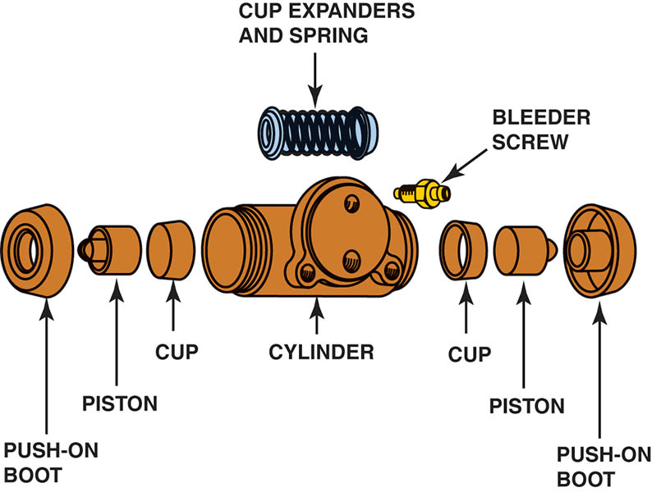
Figure 104.15 Exploded view of a typical wheel cylinder. Note how the flat part of the cups touches the flat part of the piston. The cup expander and spring go between the cups

Slide 35
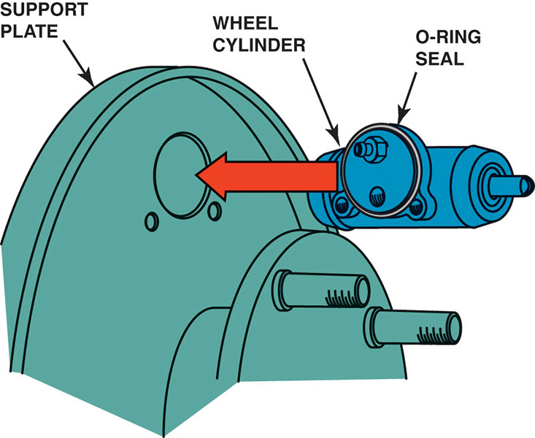
Figure 104.16 Many wheel cylinders are bolted to the support plate (backing plate). The O-ring seal helps keep water and dirt out of the drum brake

Slide 36
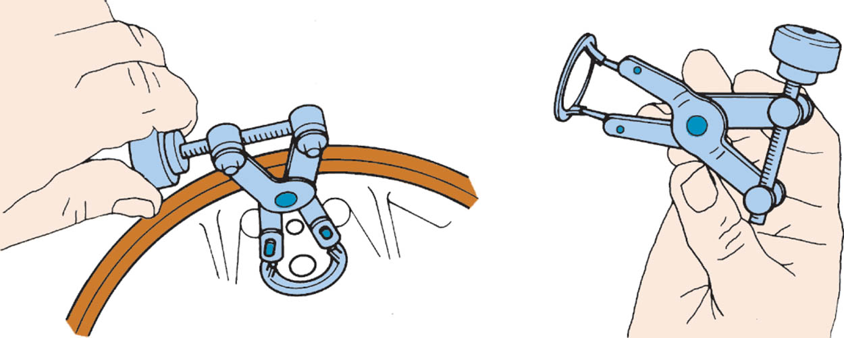
Figure 104.17 This special tool makes it a lot easier to remove the wheel cylinder clip. a socket (1 1/8 inch, 12 point) can be used to push the clip back onto the wheel cylinder

Slide 37
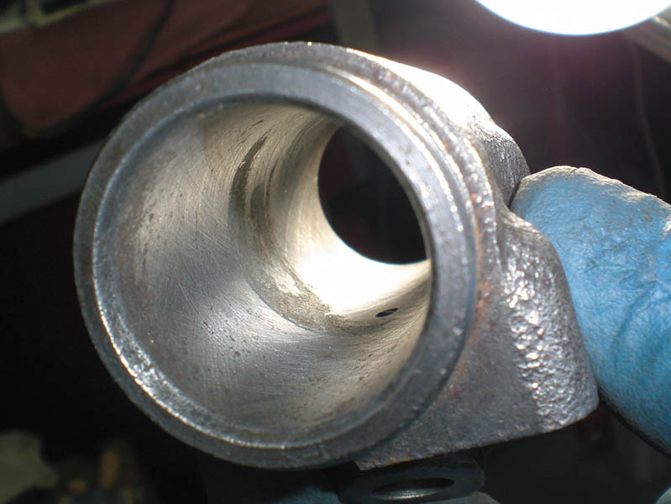
Figure 104.18 The rust inside this wheel cylinder will not affect the operation as it is located inside the working area of the sealing cups

Slide 38
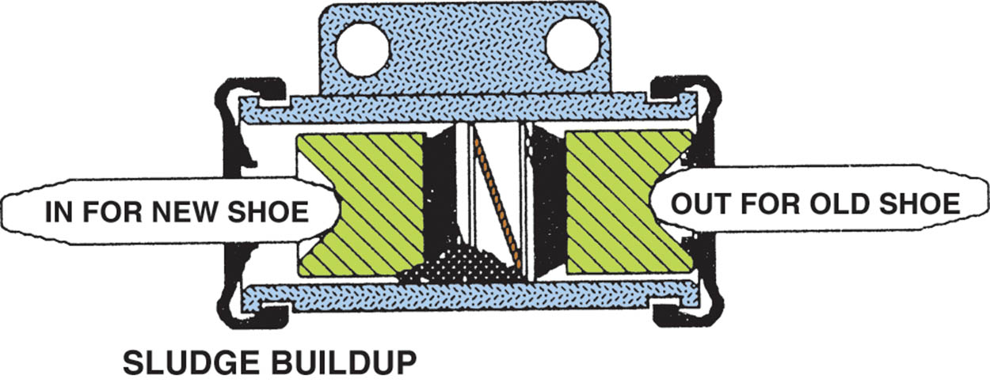
Figure 104.19 When new, thicker brake linings are installed, the pistons and cups are forced back into the wheel cylinder and pushed through the sludge that is present in every cylinder

Slide 39
BRAKE DRUM HARDWARE KIT
If any spring is found to be defective, it is possible to purchase most parts individually or in pairs.
However, for best results, many brake suppliers sell drum brake hardware kits. These kits usually include all the items for two drum brakes (axle set).

Slide 40
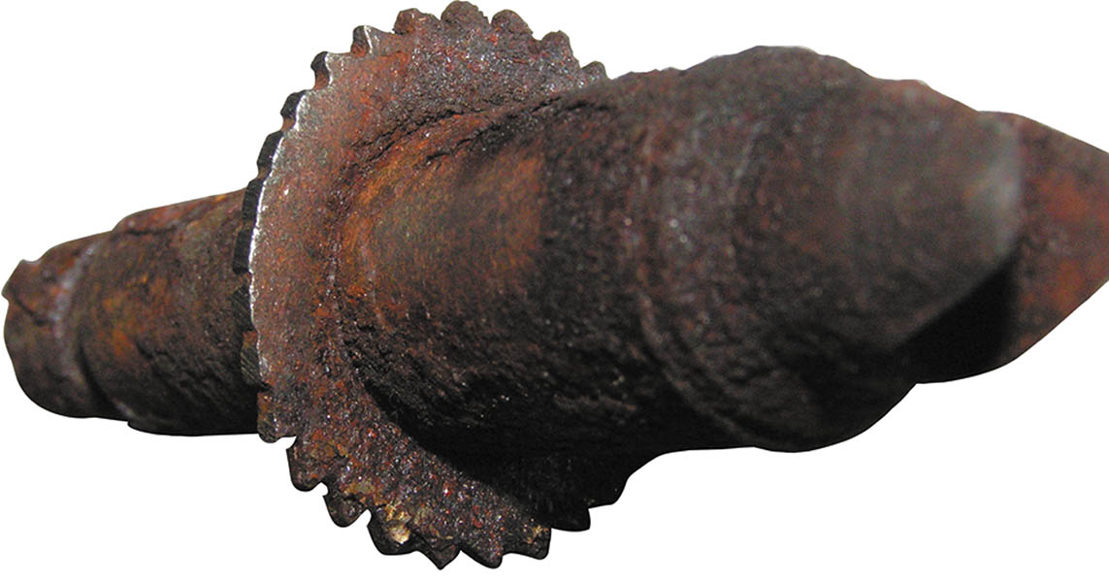
Figure 104.20 This starwheel adjuster is damaged and must be replaced. a lack of proper lubrication can cause the starwheel to become frozen in one place and not adjust properly

Slide 41
INSPECTING THE DRUM BRAKE SHOES
Carefully inspect the replacement brake shoes. Check all of the following:
  Check that the replacements are exactly the same size (width and diameter) as the original.
  Check for sound rivets (if rivet type). The friction material should also be snug against the metal brake shoe backing.

Slide 42
BRAKE PARTS CLEANING
Whenever cleaning brake parts or components, always use the following guidelines:
  Denatured alcohol or “brake clean” should only be used to clean brake parts that are disassembled.
  When individual parts are cleaned, they should be allowed to dry before being assembled.

Slide 43
LUBRICATION CHECKLIST
For proper operation, the following points should be lubricated with approved brake lubricant:
  The starwheel adjuster threads and under end caps
  The backing plate contact areas (pads or ledges)
  Anchor pins
  Check and lubricate the parking brake cable, if necessary.

Slide 44
REASSEMBLING THE DRUM BRAKE
Reassembling the drum brake includes the following steps:
  Carefully clean the backing plate.
  Check the anchor pin for looseness.
  Lubricate the shoe contact surfaces (shoe pads) with antiseize, brake grease, or synthetic grease.
  Reassemble the primary and secondary shoes and brake strut, along with all springs.
  Finish assembling the drum brake, being careful to note the correct location of all springs and parts.

Slide 45
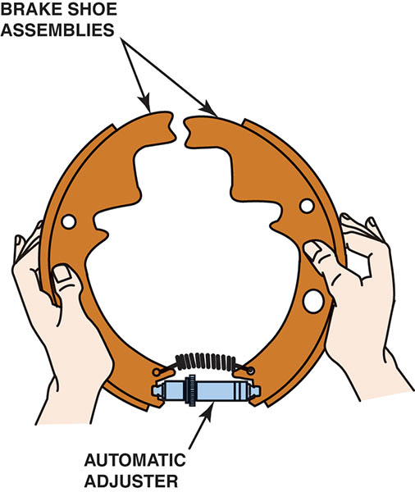
Figure 104.21 Pre-assembly of the starwheel adjuster with its connecting spring often helps when reassembling a drum brake.

Slide 46
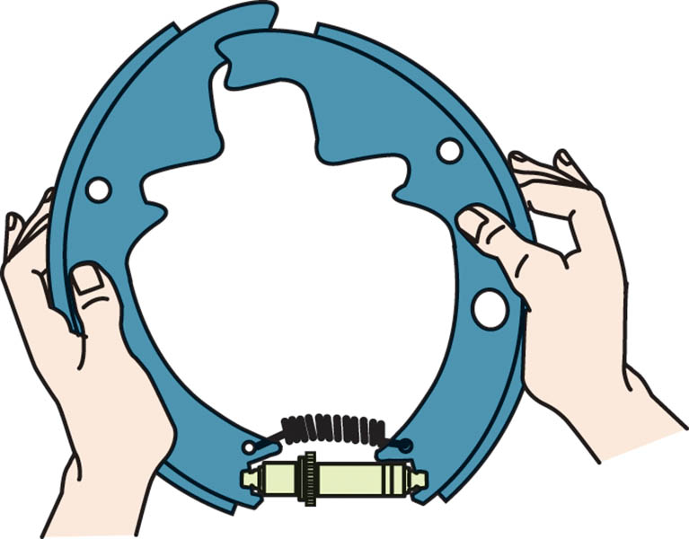
Figure 104.22 Sometimes it is necessary to cross the shoes when pre-assembling the starwheel adjuster and connecting spring

Slide 47
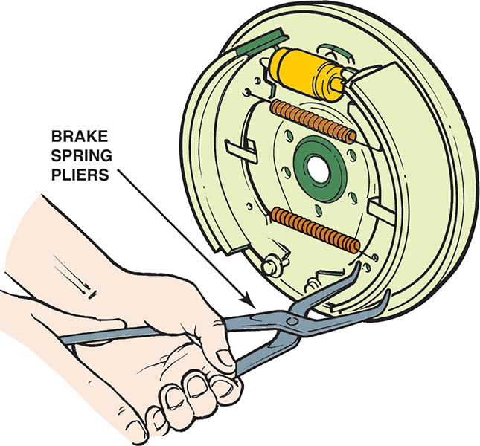
Figure 104.23 Brake spring pliers being used to install the connecting spring

Slide 48
QUESTION 3: ?
What areas need to be lubricated prior to reassembly?

Slide 49
ANSWER 3:
  The starwheel adjuster threads and under end caps, the backing plate contact areas (pads or ledges), the anchor pins, and the parking brake cable.

Slide 50
ADJUSTING DRUM BRAKES
Most drum brakes are adjusted by rotating a starwheel or rotary adjuster. As the adjuster is moved, the brake shoes move toward the drum.
If the clearance between the brake shoes and the brake drum is excessive, a low brake pedal results.
Many technicians use a brake shoe clearance gauge to adjust the brake shoes before installing the drum.

Slide 51
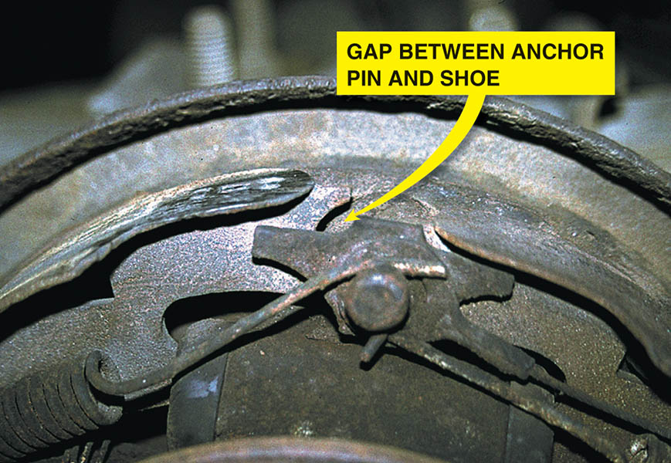
Figure 104.24 Notice that the brake shoe is not contacting the anchor pin. This often occurs when the parking brake cable is stuck or not adjusted properly

Slide 52
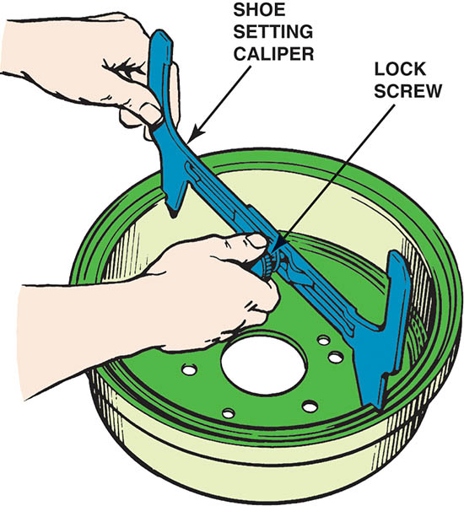
Figure 104.25 The first step in using a brake shoe clearance gauge is to adjust it to the drum inside diameter and tighten the lock screw

Slide 53
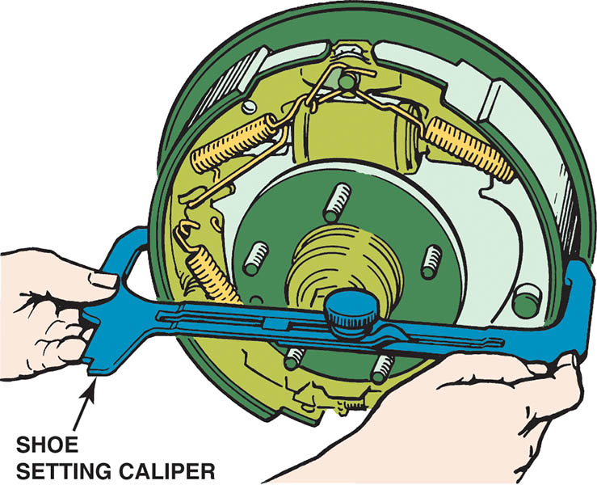
Figure 104.26 Place the gauge over the shoes and adjust the brakes until they contact the inside of the gauge

Slide 54
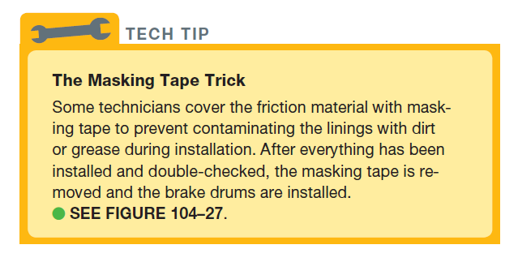
TECH TIP

Slide 55
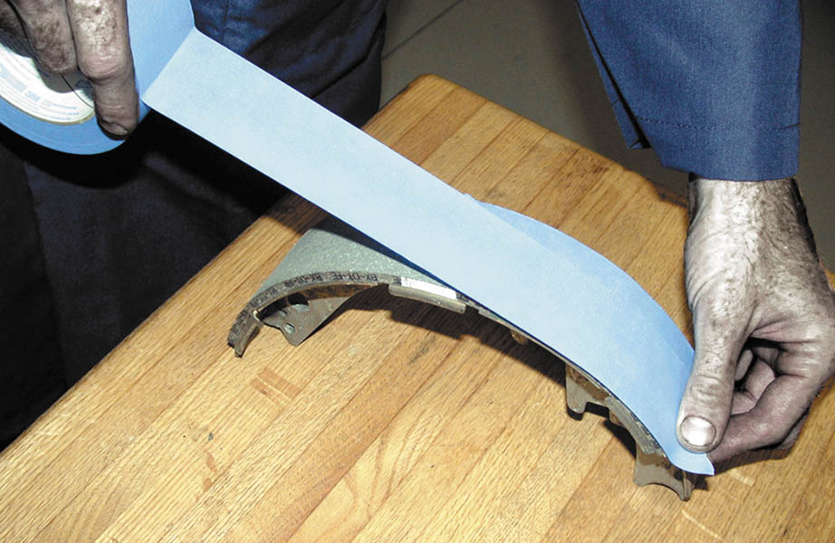
Figure 104.27 To prevent getting grease on the lining, the wise service technician covers the friction material with masking tape. The tape is removed after the brake shoes have been installed

Slide 56
DRUM BRAKE FAULT SYMPTOM GUIDE (1 OF 2)
Low pedal or pedal goes to the floor.
Springy, spongy pedal.
Excessive pedal pressure required to stop the vehicle.
Light pedal pressure – Brake too sensitive.
Brake pedal travel decreasing.
Pulsating brake pedal.
Brake fade.
Shoe click noise.

Slide 57
DRUM BRAKE FAULT SYMPTOM GUIDE (2 OF 2)
Thumping noise when brakes are applied.
Grinding noise.
One wheel drags.
Vehicle pulls to one side.
Wet weather: Brake grab or won’t hold.
Breaks Squeak.
Brake Chatter.

Slide 58
DRUM BRAKE SERVICE

Slide 59
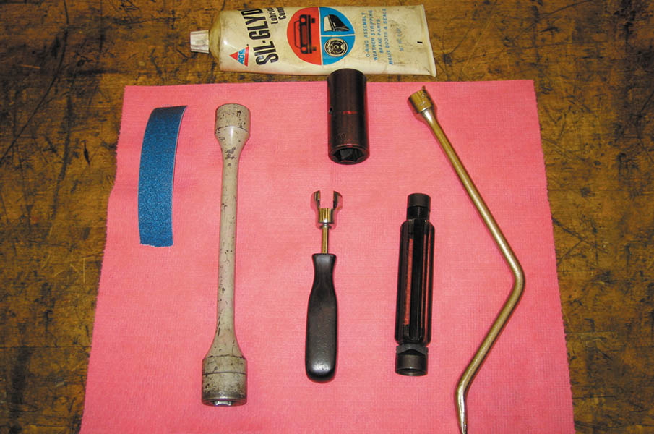
1. Tools needed to service a drum brake assembly include brake tools, silicone grease, wheel lug nut sockets, and torque-limiting adapters or a torque wrench.

Slide 60
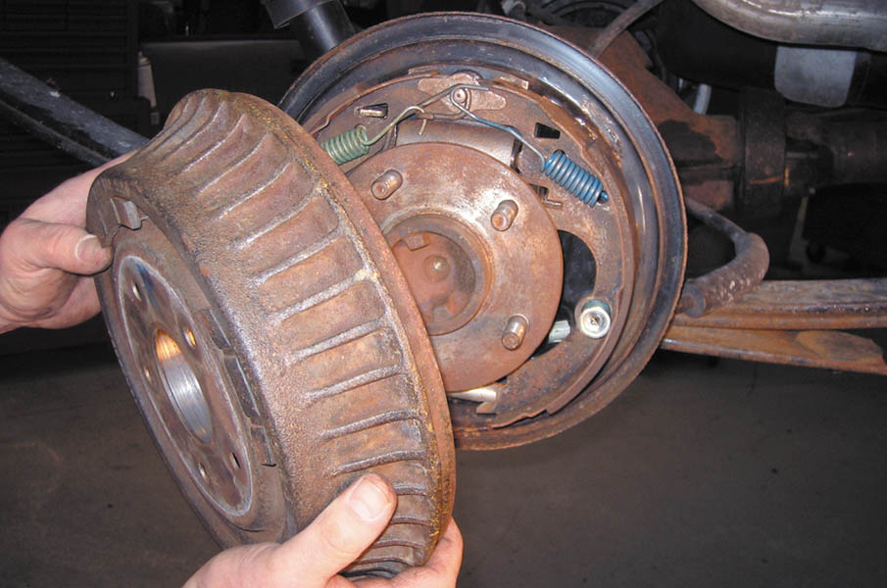
2. After safely hoisting the vehicle to chest height, remove the brake drum.

Slide 61
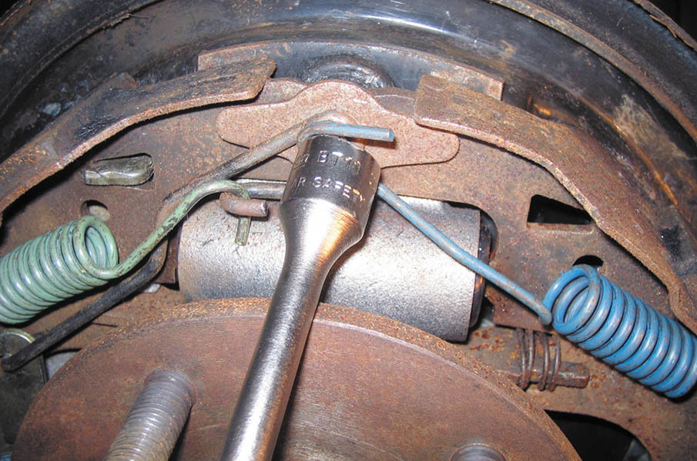
3. Remove the primary (forward facing) shoe return spring, using a brake tool. Then, remove the secondary return spring.

Slide 62
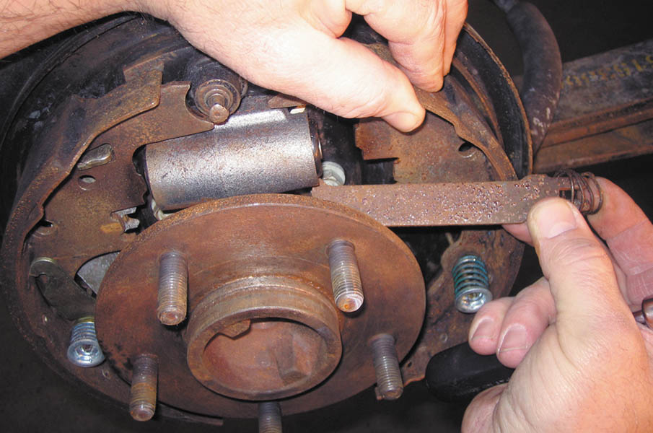
4. Remove the parking brake strut along with the antirattle spring.

Slide 63
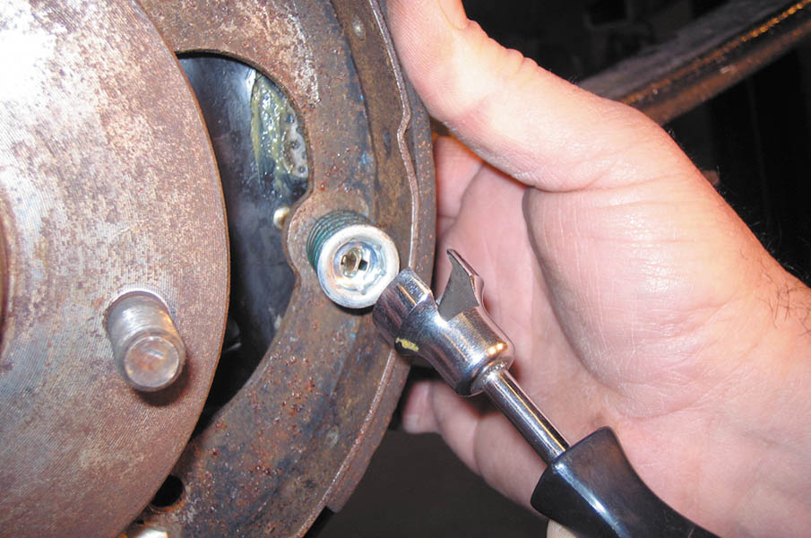
5. Use a brake tool to depress the hold-down spring, and then rotate it until the slot in the retainer lines up with the flattened part of the hold-down pin.

Slide 64
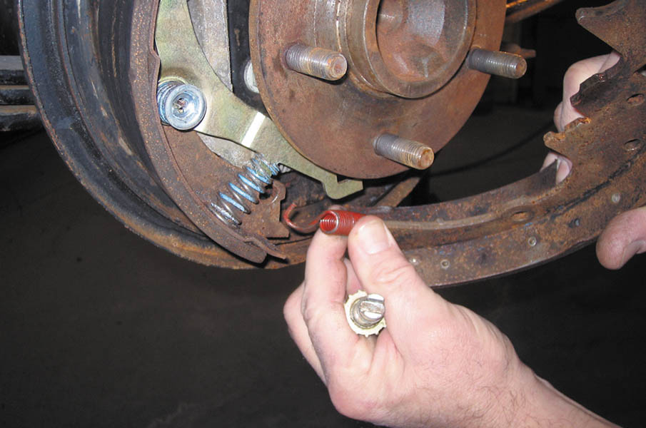
6. Removing the primary brake shoe plus the starwheel adjuster and connecting spring.

Slide 65
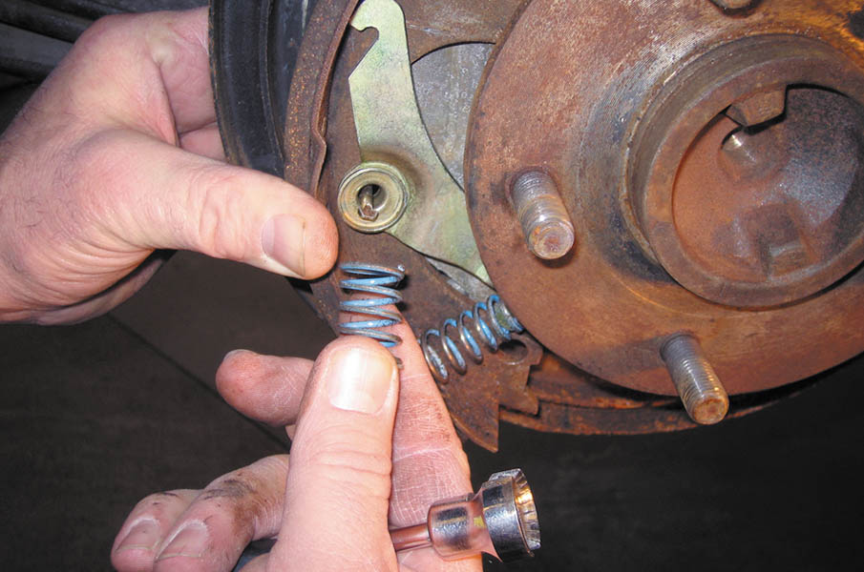
7. When the secondary lining hold-down spring is removed, the adjusting lever and pawl return spring can be removed.

Slide 66
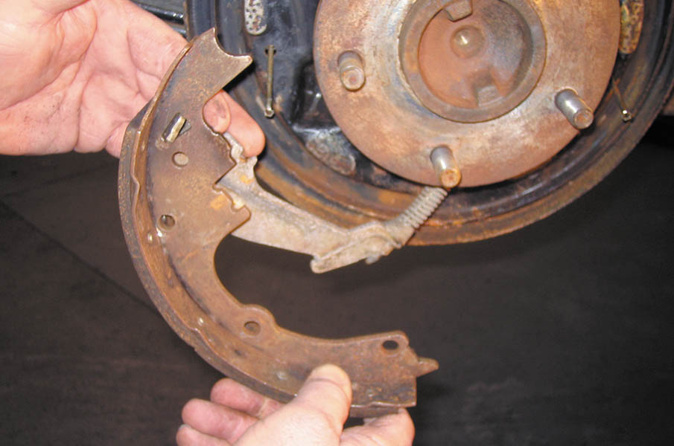
8. The parking brake lever can now be disconnected from the secondary brake shoe.

Slide 67
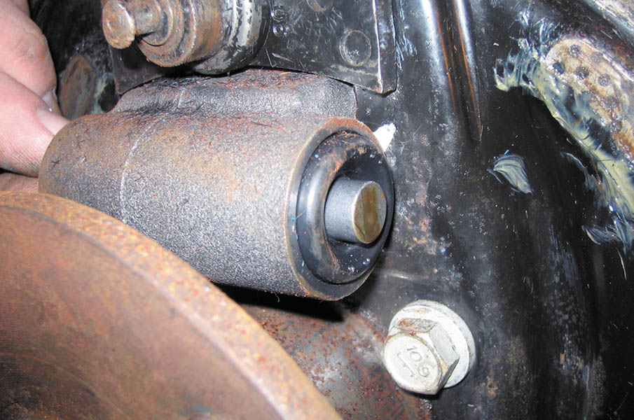
9. Check the wheel cylinder for leakage. This wheel cylinder is relatively new and not leaking.

Slide 68
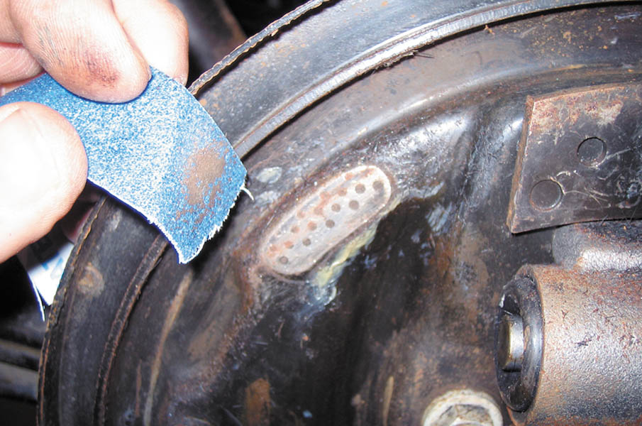
10. Clean all six brake shoe ledges. Lubricate the ledges with silicone brake grease.

Slide 69
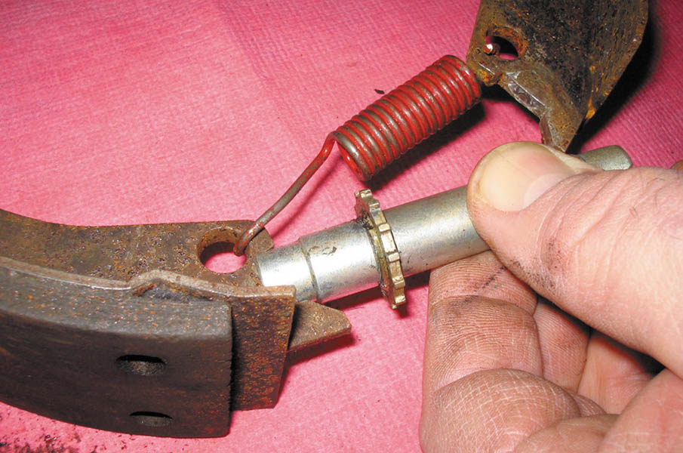
11. Many technicians prefer to assemble the connecting spring and starwheel adjuster to both shoes to help in the reinstallation.

Slide 70
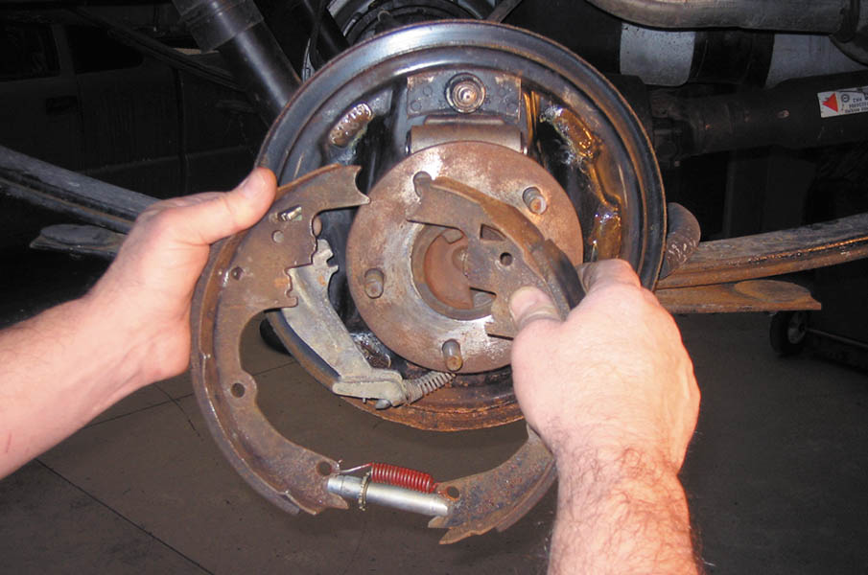
12. Attaching the parking brake lines to the secondary shoe. The assembled parts at the bottom help keep everything together.

Slide 71
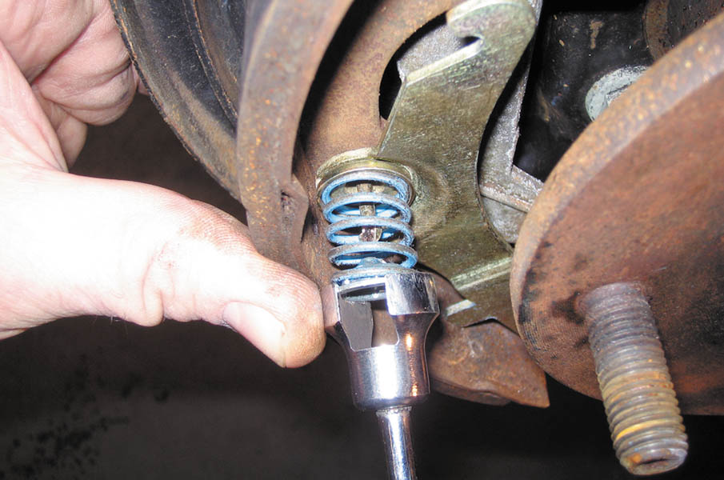
13. Installing the secondary shoe hold-down spring.

Slide 72
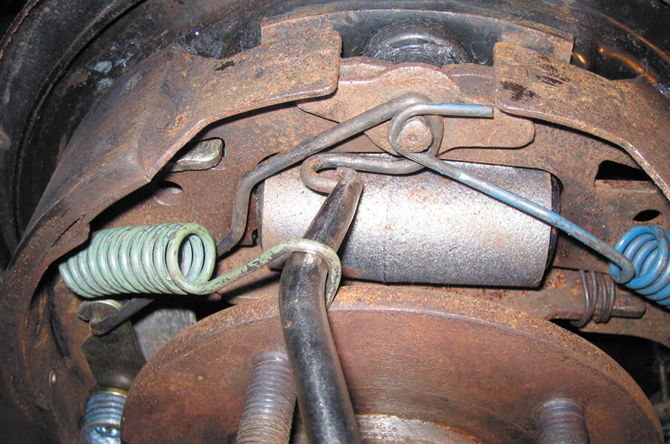
14. Installing the secondary shoe return spring. Note that the primary return spring has already been installed.

Slide 73
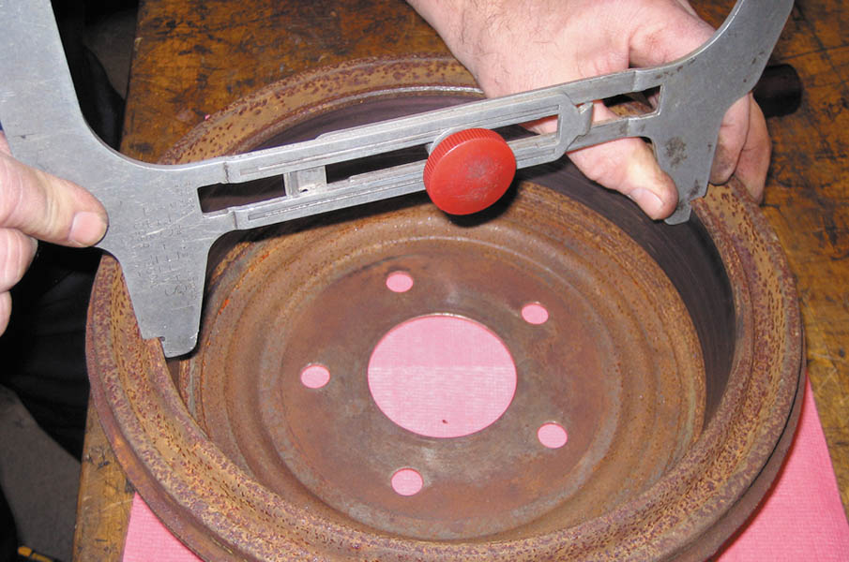
15. After installing the brake shoes and springs, use a drum/shoe clearance gauge and set it to the inside diameter of the drum.

Slide 74
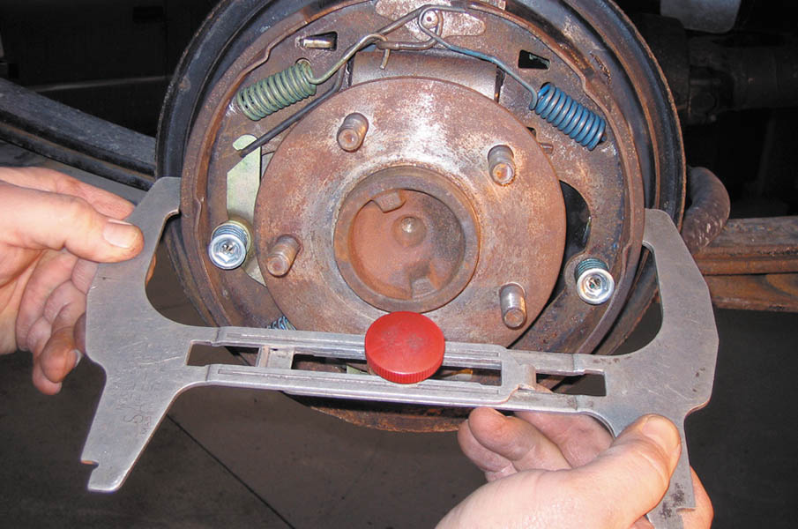
16. Adjust the starwheel adjuster until the linings contact the drum brake shoe clearance gauge.

Slide 75
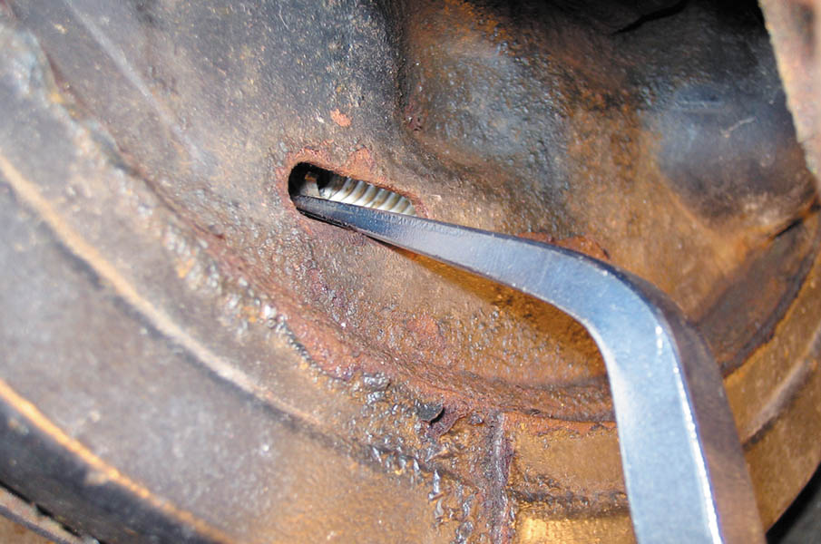
17. After installing the drum, it may be necessary to make the final adjustment using a brake adjusting tool (spoon).

Slide 76
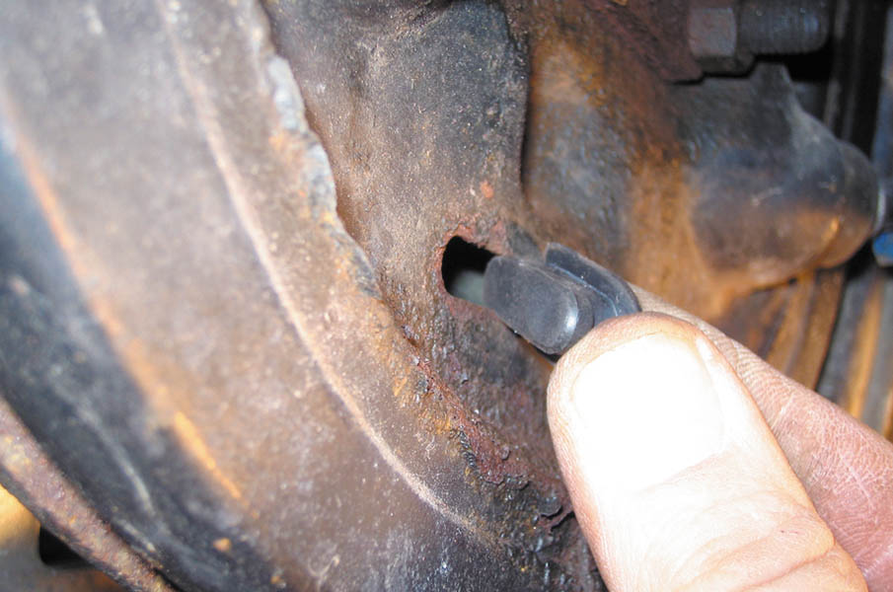
18. After completing the brake service, be sure to cover the brake adjustment opening to prevent water from getting into the brake.

Slide 77
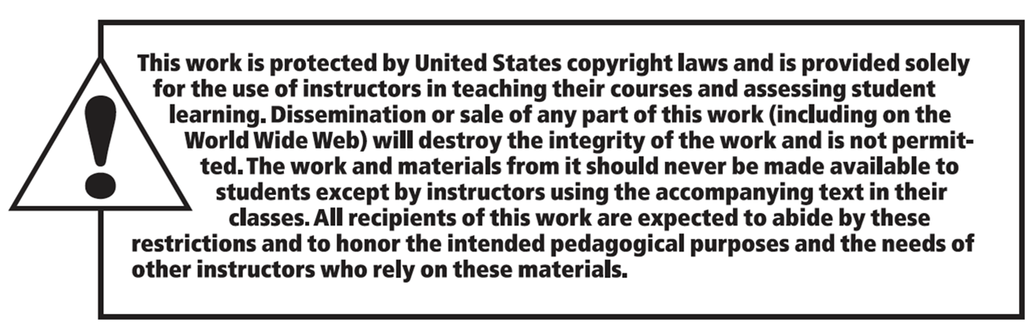
Copyright

