Slide 1

Automotive Technology Principles, Diagnosis, and Service
Sixth Edition
Chapter 103
Drum Brakes
Copyright © 2018, 2015, 2011 Pearson Education, Inc. All Rights Reserved

Slide 2
LEARNING OBJECTIVES (1 of 2)
103.1 Identify drum brake component parts.
103.2 Discuss the advantages and disadvantages of drum brakes.
103.3 Explain the function of the backing plate, wheel cylinders, and drum brake shoes.
103.4 Describe the operation of non-servo brakes.

Slide 3
LEARNING OBJECTIVES (2 of 2)
103.5 Explain the operation of dual-servo brakes.
103.6 Discuss automatic brake adjusters.
103.7 This chapter will help prepare for the Brakes (A5) ASE certification test content area “B” (Drum Brake Diagnosis and Repair).

Slide 4
DRUM BRAKES
Background
Drum brakes were the first type of brakes used on motor vehicles.
The drum brake continues to have a widespread use on the rear axle of many automobiles.

Slide 5
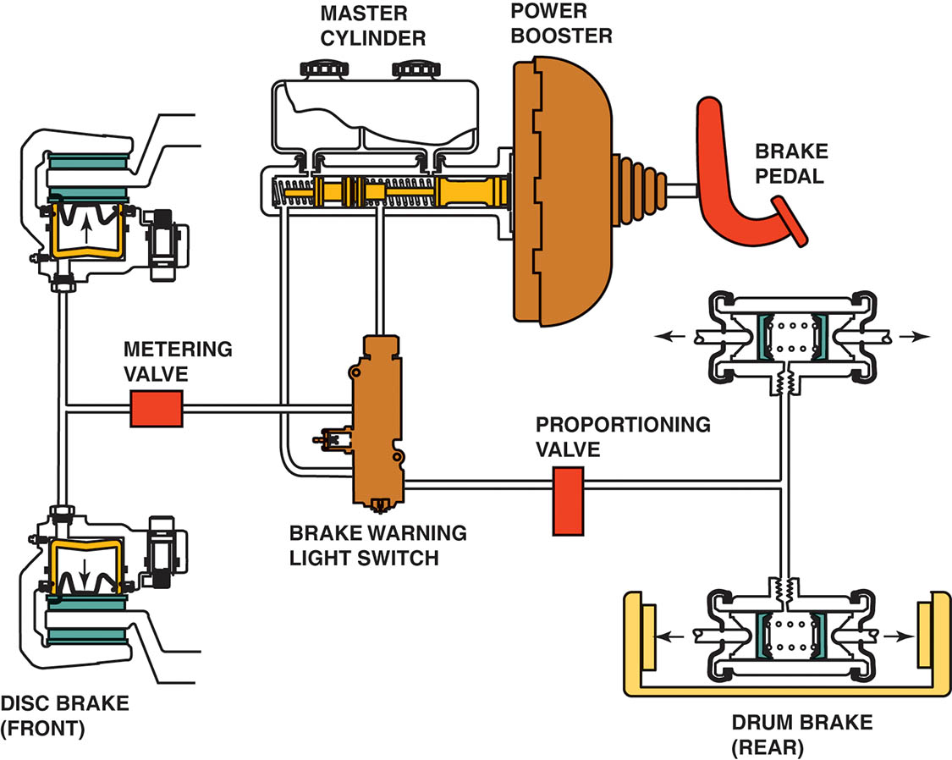
Figure 103.1 Typical brake system components showing disc brakes on the front and drum brakes on the rear

Slide 6
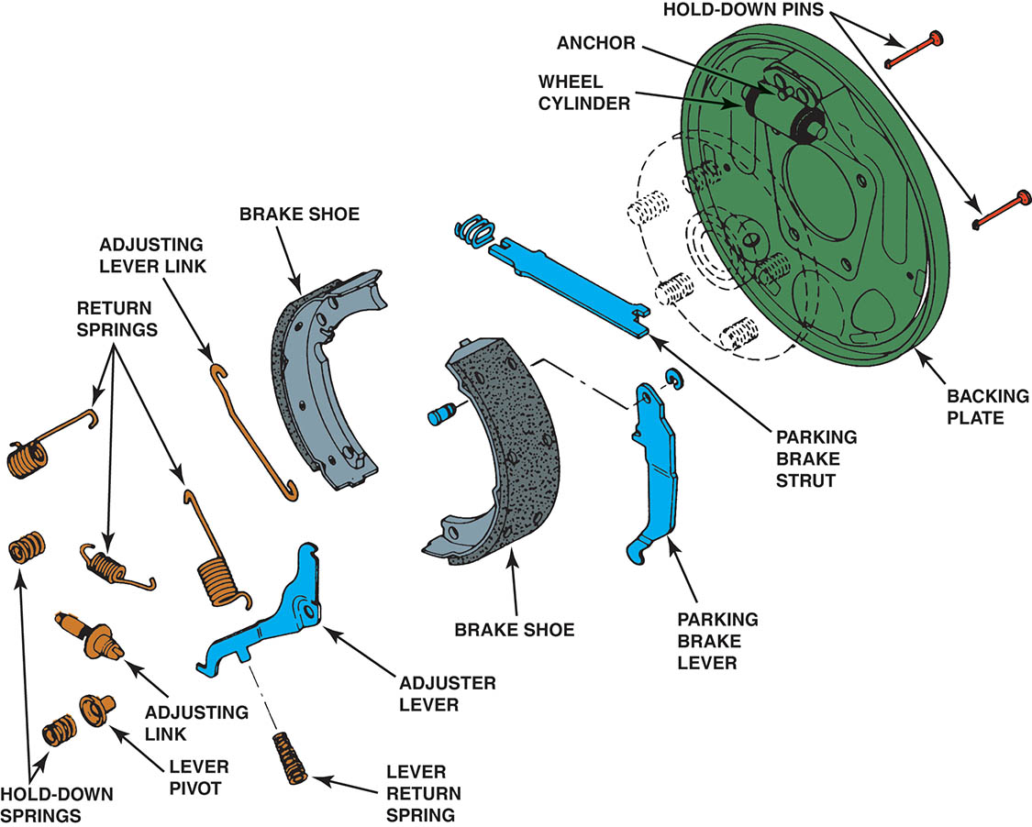
Figure 103.2 An exploded view of a typical drum brake assembly

Slide 7
DRUM BRAKE ADVANTAGES
Self-Energizing and Servo Action
The primary advantage of drum brakes is that they can apply more stopping power for a given amount of force applied to the brake pedal than can disc brakes.
The drum brake design offers a self-energizing action that helps force the brake linings tightly against the drum.
Parking Brake Service
One advantage of drum brakes is that they make excellent parking brakes.

Slide 8
DRUM BRAKE DISADVANTAGES (1 OF 2)
Brake Fade
Brake fade is the loss of stopping power that occurs when excessive heat reduces the friction between the brake shoe linings and the drum.
Mechanical fade
Lining fade
Gas fade
Water fade

Slide 9
DRUM BRAKE DISADVANTAGES (2 OF 2)
Brake Adjustment
Another disadvantage of the drum brake design is its need for an adjusting mechanism.
As the brake shoe lining material wears, adjustments must be made to maintain the proper drum to lining clearance.
Brake Pull
Brake pull occurs when the friction assemblies on opposite sides of the vehicle have different amounts of stopping power.

Slide 10
BACKING PLATE AND WHEEL CYLINDERS (1 OF 2)
Backing Plate
The backing plate serves as the mounting surface for all the other friction assembly parts.
Shoe Anchors
Shoe anchors prevent the brake shoes from rotating with the drum when the brakes are applied.
Piston Stops
Piston stops prevent the wheel cylinder pistons from coming out of their bores when the friction assembly is disassembled for servicing.

Slide 11
BACKING PLATE AND WHEEL CYLINDERS (2 OF 2)
Shoe Support Pads
The shoe support pads are stamped into the backing plate and contact the edges of the brake shoes to keep the linings properly aligned with the center of the friction surface inside the brake drum.
Wheel Cylinders
The mechanism at each wheel that hydraulic pressure is transferred from the master cylinder to each wheel brake through brake fluid.

Slide 12
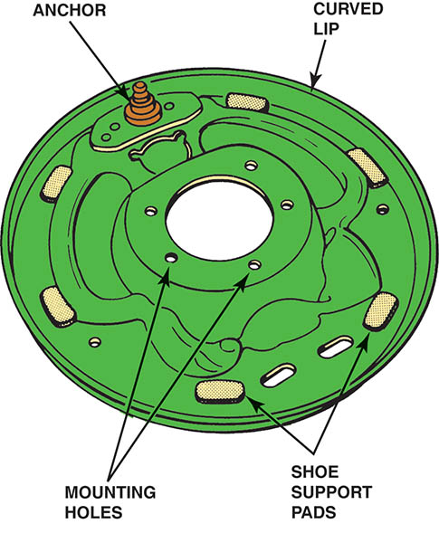
Figure 103.3 The backing plate is the foundation of every drum brake. There are normally six pads where the brake shoes contact the backing plate

Slide 13
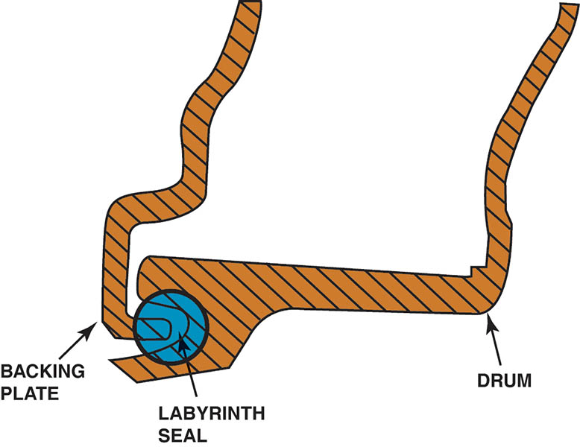
Figure 103.4 A labyrinth seal is created between the lip of the backing plate and the groove in the brake drum

Slide 14
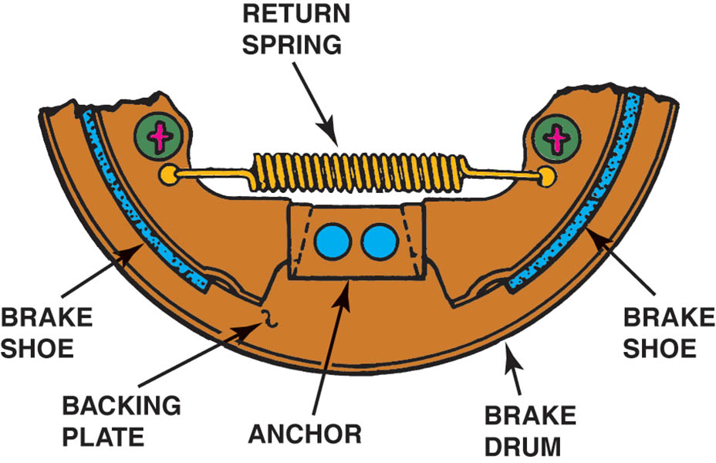
Figure 103.5 A keystone anchor allows the brake shoes to self-center in the drum

Slide 15
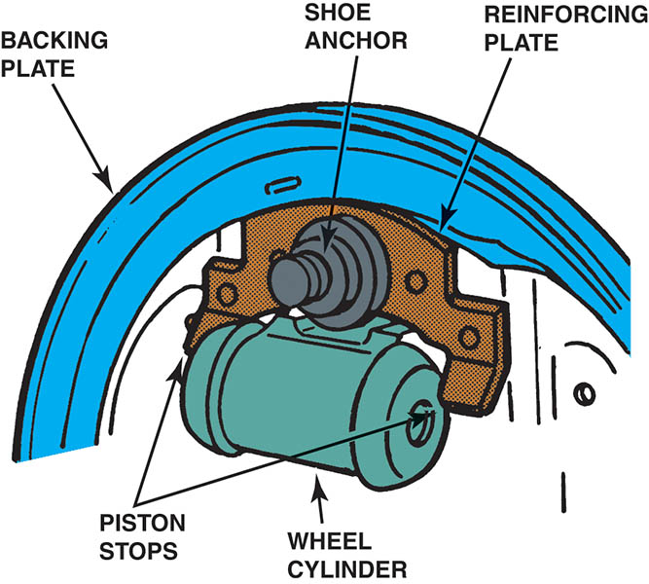
Figure 103.6 Piston stops prevent the wheel cylinder from coming apart

Slide 16
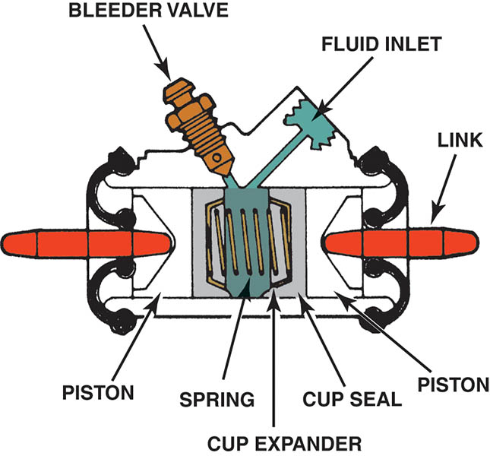
Figure 103.7 Cross-section of a wheel cylinder that shows all of its internal parts. The brake line attaches to the fluid inlet. The cup expander prevents the cup seal lip from collapsing when the brakes are released

Slide 17
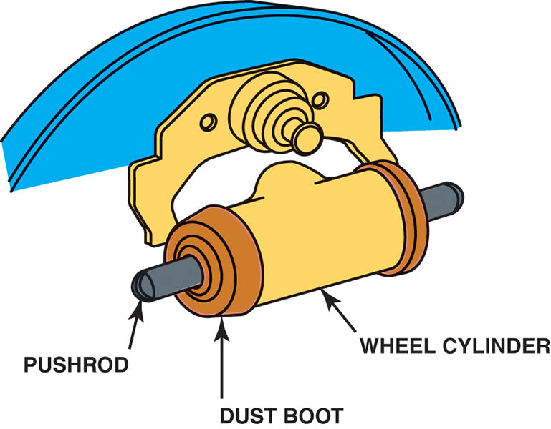
Figure 103.8 The pushrods are held in place by the rubber dust boots. As the wheel cylinder pistons move outward, the pushrods transfer the movement to the brake shoes

Slide 18
QUESTION 1: ?
What is the purpose of the backing plate?

Slide 19
ANSWER 1:
The backing plate serves as the mounting surface for all the other friction assembly parts.

Slide 20
DRUM BRAKE SHOES (1 OF 3)
Terminology
The linings of drum brakes are attached to curved metal assemblies called brake shoes.
The ends of the linings on most brake shoes are tapered to prevent vibration and brake noise.
The curved metal piece on the outer portion of the shoe is called the lining table, the shoe rim, or platform.
The metal piece of the shoe positioned under the lining table and welded to it is called the shoe web.
The upper ends of the webs on dual-servo brake shoes have semicircular cutouts called anchor eyes.

Slide 21
DRUM BRAKE SHOES (2 OF 3)
Primary and Secondary Brake Shoes
In a dual-servo drum brake system, the shoes in a dual-servo brake perform different jobs.
The primary shoe (forward-facing shoe) is self-energized by drum rotation to create a servo action that forces the secondary shoe more firmly against the drum.
Lining Assembly Methods
Riveting
Bonding

Slide 22
DRUM BRAKE SHOES (3 OF 3)
Return Springs
The brake shoe return springs retract the shoes to their unapplied positions when the brake pedal is released.
Brake Shoe Hold-Downs
The brake shoe hold-downs keep the shoes securely against the support pads on the backing plate.
Parking Brake Linkage
Most rear drum brake friction assemblies include a parking brake linkage.

Slide 23
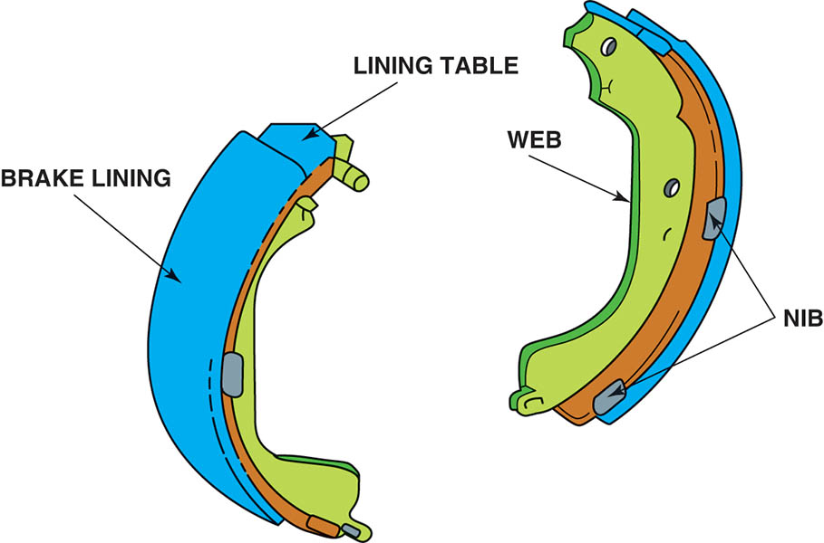
Figure 103.9 Steel brake shoes are made from two stampings welded together—the web and the lining table

Slide 24
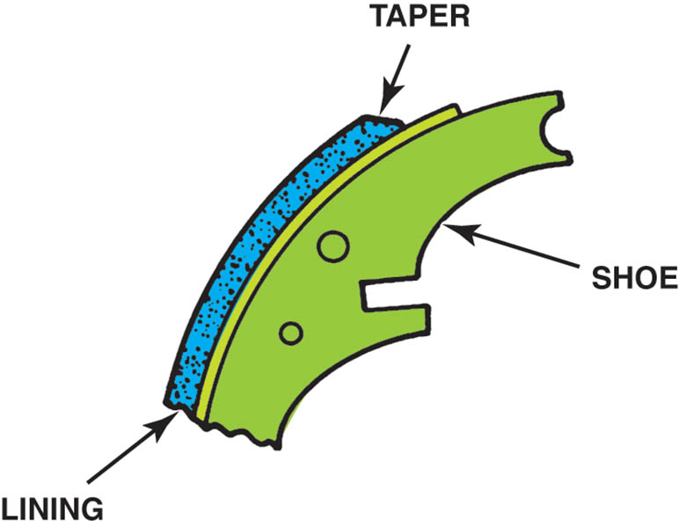
Figure 103.10 Tapered ends on the linings help to reduce brake noise

Slide 25
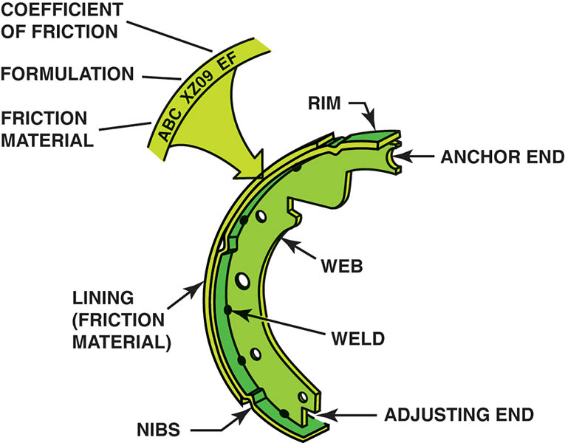
Figure 103.11 Typical drum brake shoe and the names of the parts

Slide 26
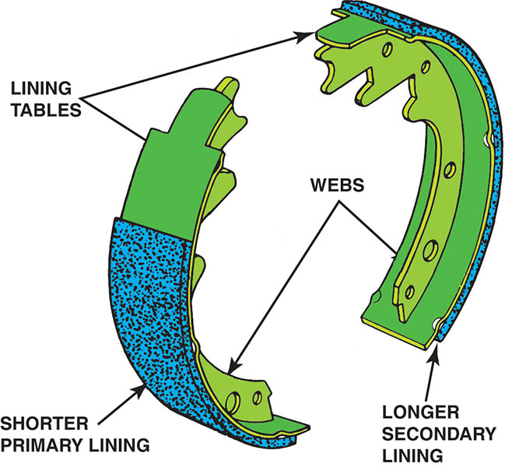
Figure 103.12 The primary (forward facing) brake shoe often has a shorter lining than the secondary shoe (rearward facing)

Slide 27
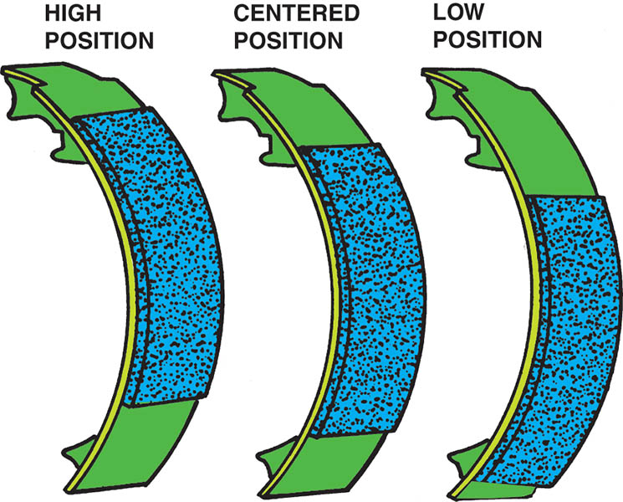
Figure 103.13 Primary shoe lining may vary depending on the application

Slide 28
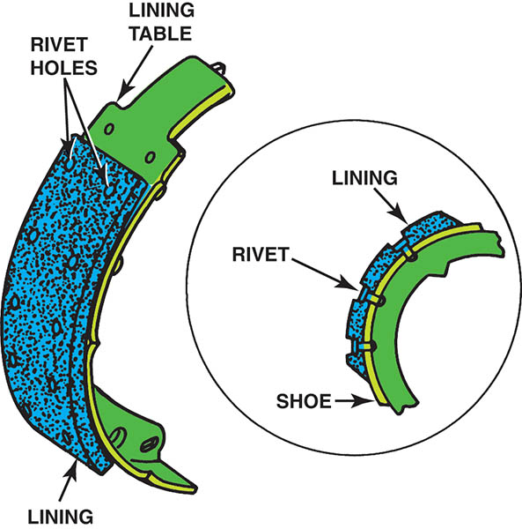
Figure 103.14 Riveted brake linings are quiet and reliable at high temperatures

Slide 29
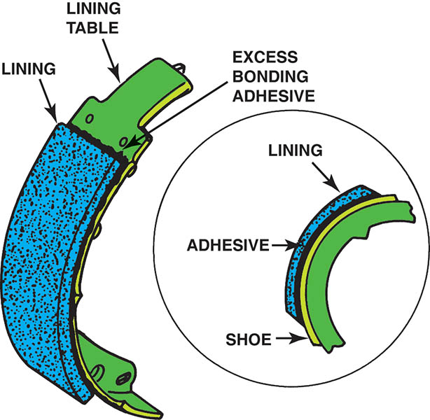
Figure 103.15 Many brake linings are bonded

Slide 30
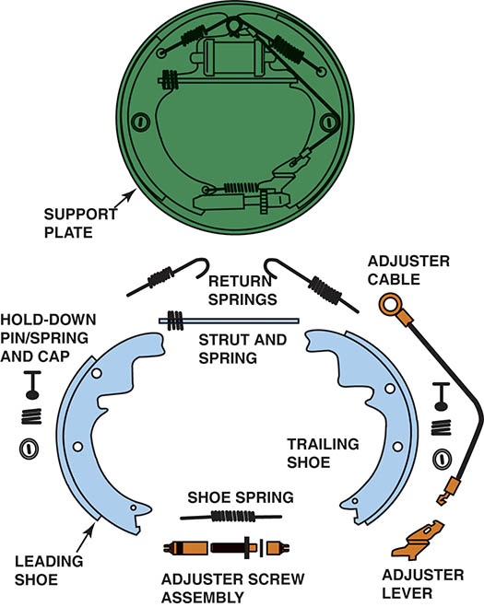
Figure 103.16 A typical drum brake assembly showing the support plate (backing plate), anchor pin, and springs

Slide 31
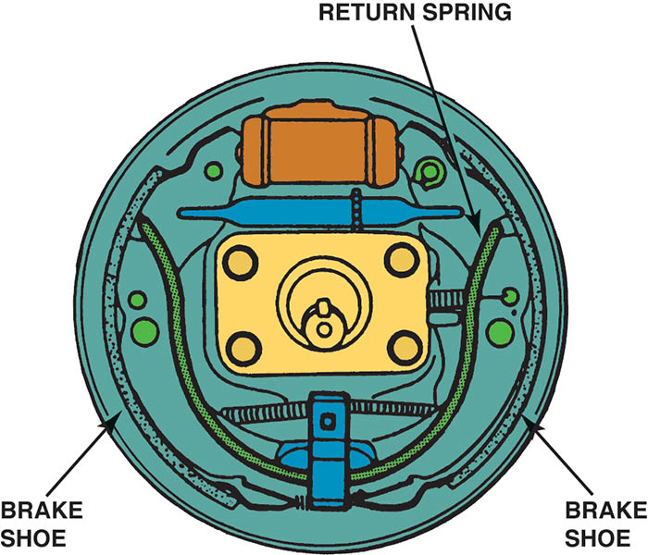
Figure 103.17 A single spring-steel spring is used on some drum brakes. The spring also takes the place of the shoe hold-down springs

Slide 32
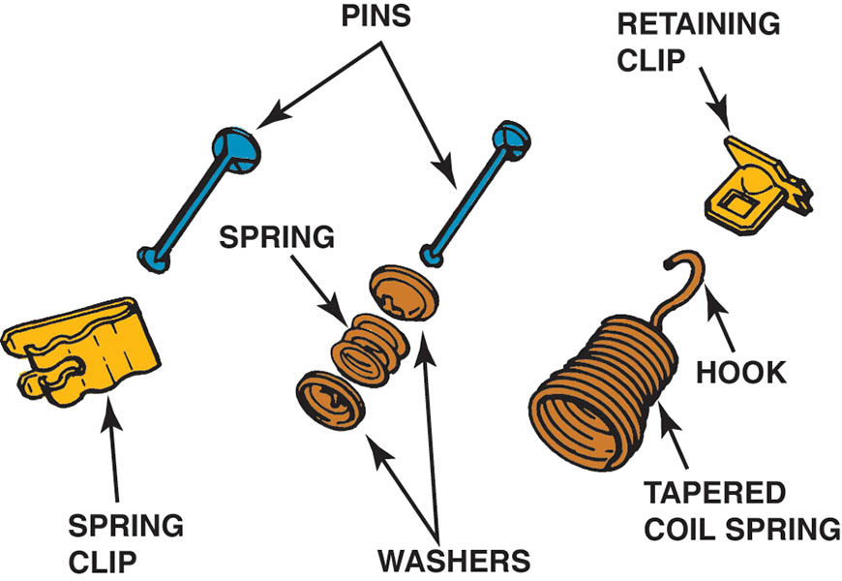
Figure 103.18 Various types and styles of hold-down springs

Slide 33
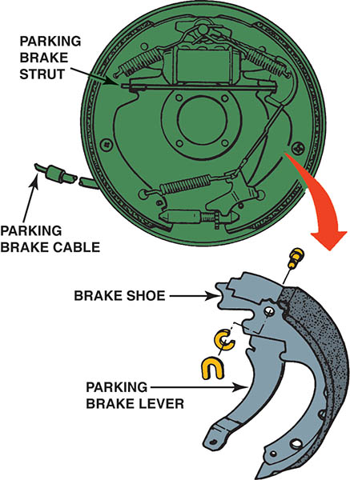
Figure 103.19 A mechanical brake linkage is part of most drum brake assemblies

Slide 34
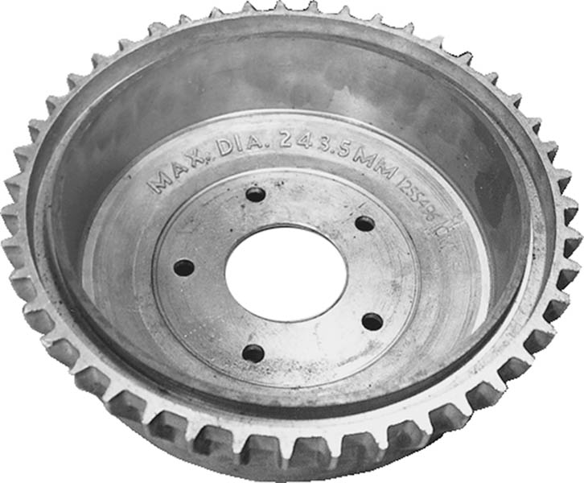
Figure 103.20 An aluminum brake drum with a cast-iron friction surface. The cooling fins around the outside help dissipate the heat from the friction surface to the outside air

Slide 35
QUESTION 2: ?
What is the purpose of the return springs?

Slide 36
ANSWER 2:
To return the brake shoes to the unapplied position.

Slide 37
NON-SERVO BRAKE DESIGN (1 OF 2)
Purpose and Function
A non-servo brake feature is that each brake shoe is applied individually.
Parts and Operation
Self-energizing action occurs when the forward or leading shoe contacts the drum and the drum attempts to rotate the shoe along with it.
When this type of brake is applied with the vehicle backing up, the roles of the forward and reverse shoes are switched.

Slide 38
NON-SERVO BRAKE DESIGN (2 OF 2)
Double-Trailing Brake
This design has two trailing shoes and does not use any self-energization.
Leading-Trailing Brake Design
The non-servo leading-trailing brake has one leading shoe and one trailing shoe.
The brake design has one energized and one de-energized shoe regardless of whether it is applied while the vehicle is traveling forward or in reverse.

Slide 39
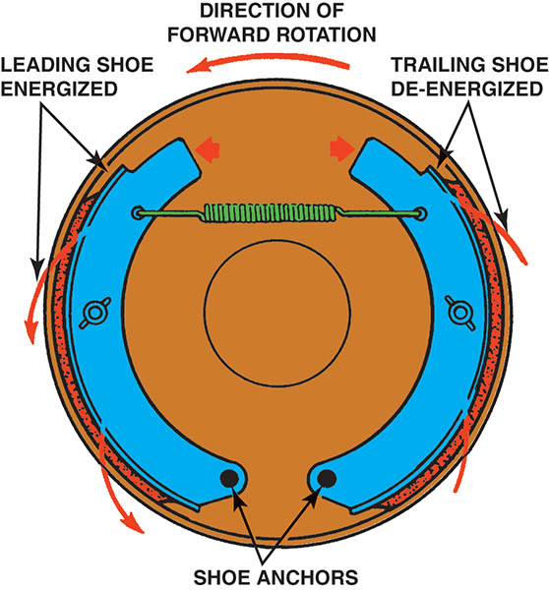
Figure 103.21 Self-energizing action can increase or decrease the stopping power of a brake shoe

Slide 40
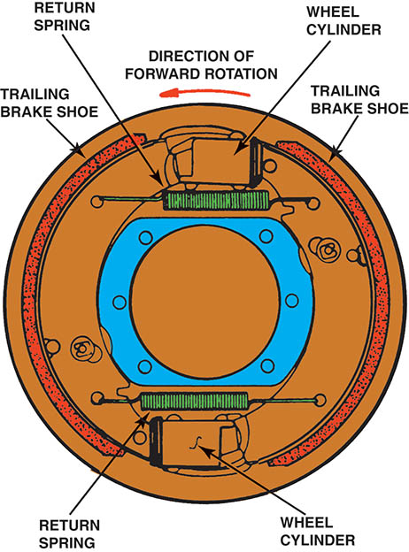
Figure 103.22 A double-trailing non-servo drum brake

Slide 41
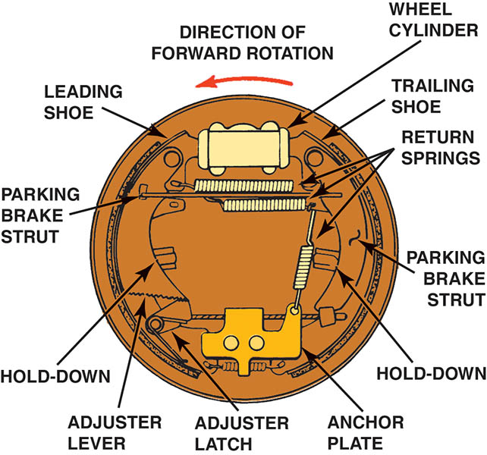
Figure 103.23 A leading-trailing non-servo brake

Slide 42
DUAL-SERVO BRAKE DESIGN (1 OF 2)
Purpose and Function
One shoe “serves” the other to increase application force.
All servo brakes used on automobiles are of the dual-servo design that works with equal force in both directions.
Dual-Servo Brake Construction
The basic dual-servo brake uses one anchor and a single two-piston wheel cylinder.
The adjusting link consists of a starwheel that is part of an adjusting screw.

Slide 43
DUAL-SERVO BRAKE DESIGN (2 OF 2)
Dual-Servo Brake Operation
When a dual-servo brake is applied, the wheel cylinder attempts to force the tops of both brake shoes outward against the drum.
Servo Action
The anchor pin prevents the secondary shoe from rotating, and the adjusting link serves as the anchor for the primary shoe.
Servo action then occurs as a part of the braking force generated by the primary shoe is transferred through the adjusting link to help apply the secondary shoe.

Slide 44
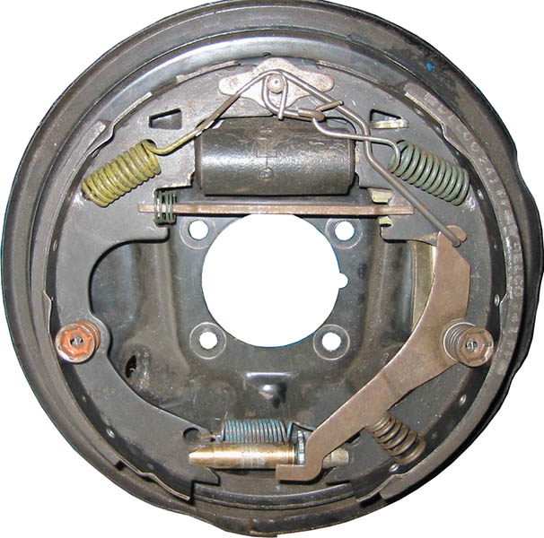
Figure 103.24 A typical dual-servo drum brake

Slide 45
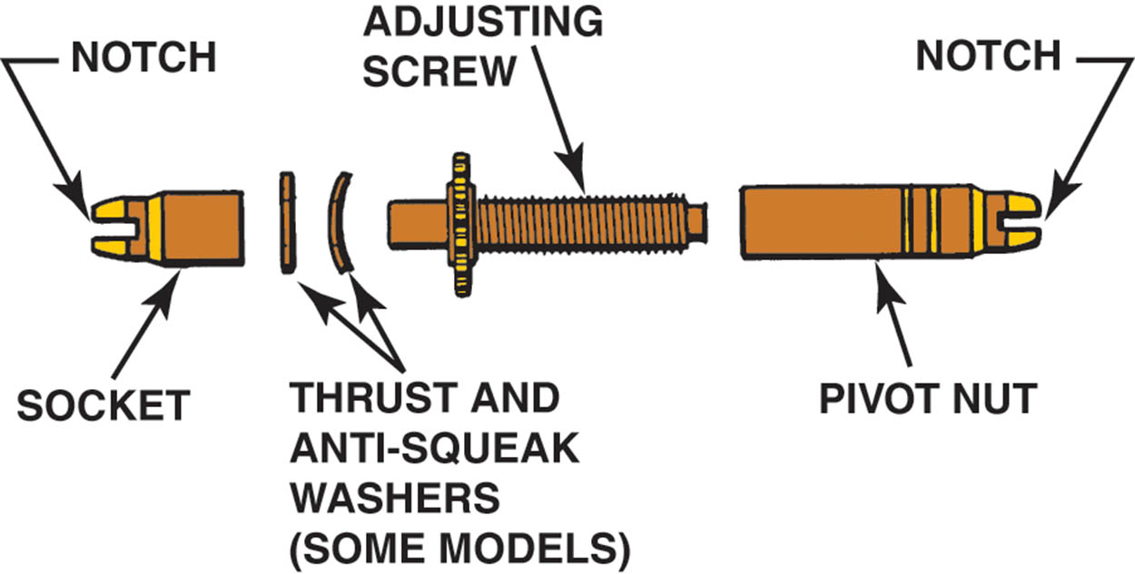
Figure 103.25 A typical dual-servo brake adjusting link assembly

Slide 46
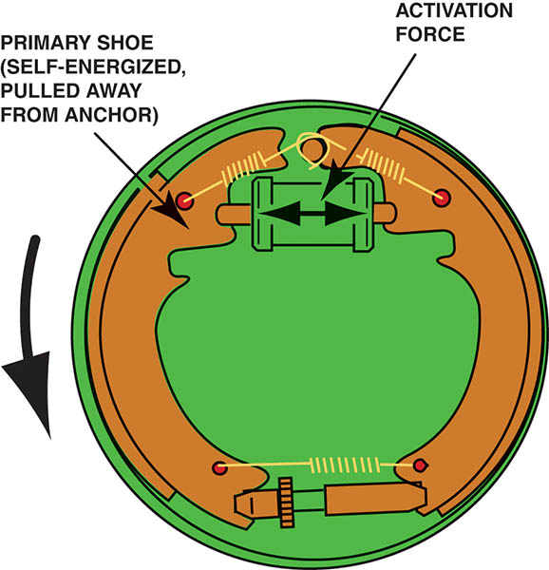
Figure 103.26 Dual-servo brake operation. The primary shoe on the left exerts a force on the secondary shoe on the right

Slide 47
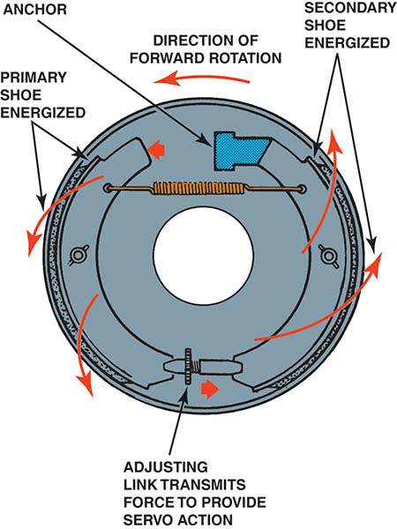
Figure 103.27 Dual-servo action greatly increases the application force on the secondary shoe

Slide 48
AUTOMATIC BRAKE ADJUSTERS (1 OF 2)
Servo Brake Automatic Starwheel Adjusters
Cable
Lever
Link
All three adjusters mount on the secondary brake shoe and adjust only when the brakes are applied while the vehicle is moving in reverse.

Slide 49
AUTOMATIC BRAKE ADJUSTERS (2 OF 2)
Non-Servo Starwheel Automatic Adjusters
The starwheel automatic adjusters used on non-servo brakes may be mounted on either the leading or trailing shoe.
These types of adjusters work whenever the brakes are applied—in either the forward or reverse direction.
Ratchet Type Adjusters
Most ratchet automatic adjusters use movement of the brake shoes to adjust the lining-to-drum clearance.

Slide 50
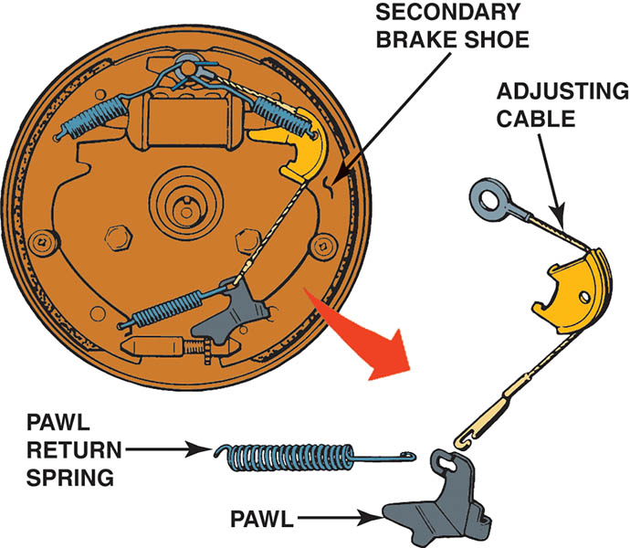
Figure 103.28 A cable-actuated starwheel adjuster. This type of adjuster makes the adjustment as the brakes are released

Slide 51
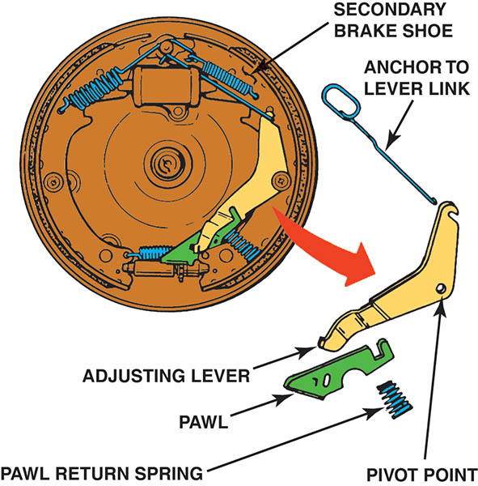
Figure 103.29 A lever-actuated starwheel automatic adjuster. This type of adjuster makes the adjustment when the brakes are applied

Slide 52
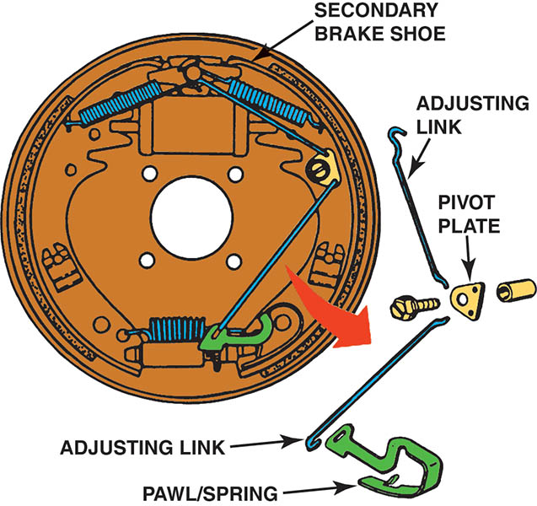
Figure 103.30 A link-actuated starwheel adjuster. This type of adjuster makes the adjustment when the brakes are released

Slide 53
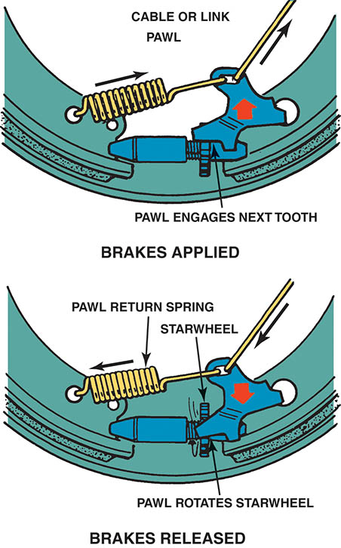
Figure 103.31 The operation of a typical self-adjuster. Notice that the adjuster actually moves the starwheel. The starwheel adjuster use left-hand and right-hand threads and must be installed on the correct side of the vehicle to function as designed

Slide 54
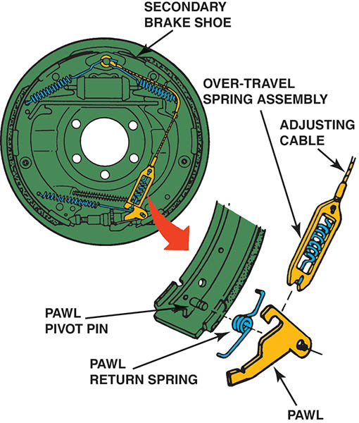
Figure 103.32 A cable-actuated starwheel adjuster with an over-travel spring

Slide 55
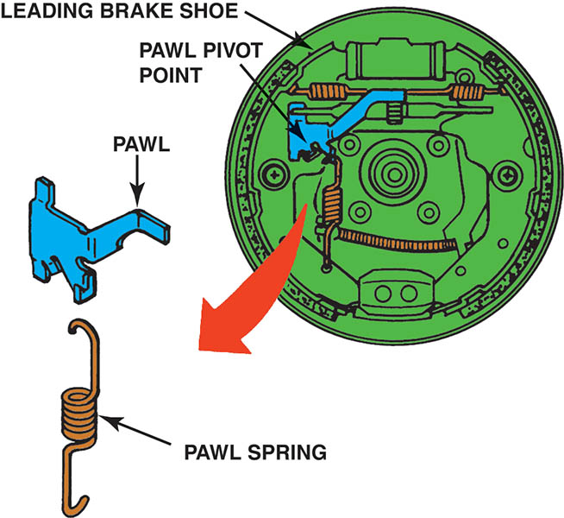
Figure 103.33 A non-servo brake with a lever-actuated starwheel automatic adjuster on a leading shoe. This type of adjuster makes an adjustment as the brakes are applied

Slide 56
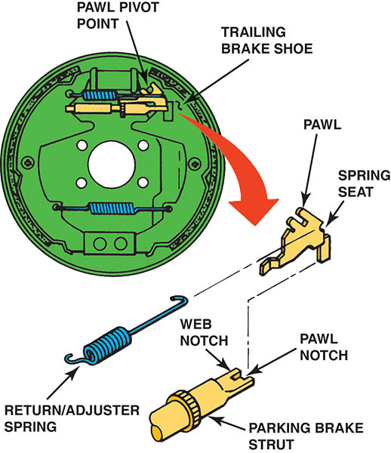
Figure 103.34 A non-servo brake with a lever-actuated starwheel automatic adjuster on the trailing shoe. This type of adjuster makes the adjustment as the brakes are released

Slide 57
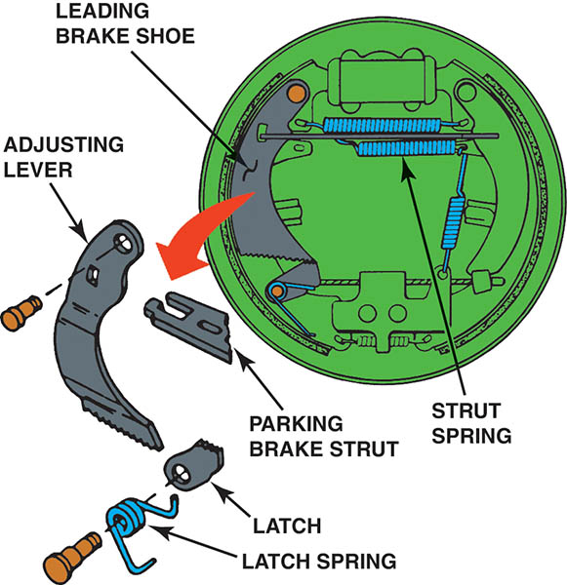
Figure 103.35 A lever-latch ratchet automatic adjuster

Slide 58
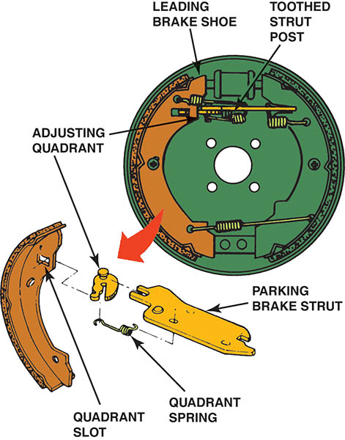
Figure 103.36 A strut-quadrant ratchet automatic adjuster

Slide 59
QUESTION 3: ?
What is the purpose of the automatic adjuster?

Slide 60
ANSWER 3:
To maintain the desired clearance between the lining and drum.

Slide 61

Copyright

