Slide 1
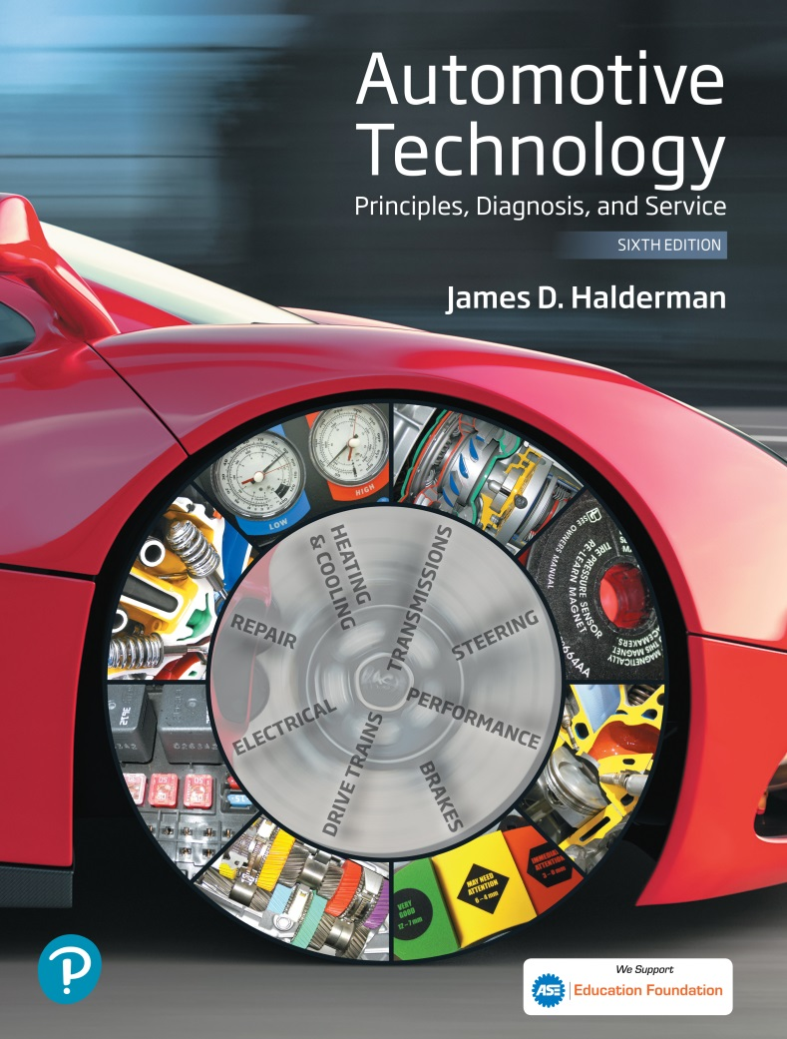
Automotive Technology Principles, Diagnosis, and Service
Sixth Edition
Chapter 102
Wheel Bearings and Service
Copyright © 2018, 2015, 2011 Pearson Education, Inc. All Rights Reserved

Slide 2
LEARNING OBJECTIVES (1 of 2)
102.1 Describe the types of antifriction bearings, bearing greases, and seals.
102.2 Explain the diagnosis of defective wheel bearings.
102.3 Describe wheel bearing service and sealed bearing replacement.
102.4 Discuss rear drive axle classifications.

Slide 3
LEARNING OBJECTIVES (2 of 2)
102.5 Describe rear axle bearing and seal replacement.
102.6 State the reasons for bearing failure.
102.7 This chapter will help prepare for Suspension and Steering (A4) ASE certification test content area “C” (Related Suspension and Steering Service).

Slide 4
ANTIFRICTION BEARINGS (1 OF 3)
Purpose and Function
Bearings allow the wheels of a vehicle to rotate and still support the weight of the entire vehicle.
Ball Bearings
Ball bearings use hardened steel balls between the inner and outer race to reduce friction.
While ball bearings cannot support the same weight as roller bearings, there is less friction in ball bearings and they generally operate at higher speeds.

Slide 5
ANTIFRICTION BEARINGS (2 OF 3)
Roller Bearings
Roller bearings use rollers between the inner and outer race to reduce friction.
A roller bearing having a greater (longer) contact area can support heavier loads than a ball bearing.
Tapered Roller Bearing
By design, this type of bearing can withstand radial loads (up and down) as well as axial loads (thrust) in one direction.

Slide 6
ANTIFRICTION BEARINGS (3 OF 3)
Inner and Outer Wheel Bearings
Many vehicles use an inner and outer wheel bearing.
The inner wheel bearing is always the larger bearing because it is designed to carry most of the vehicle weight and transmit the weight to the suspension through to the spindle.
Standard Bearing Sizes
The standardization of bearing sizes helps interchangeability.
Sealed Front Wheel Drive Bearings
A most common non-adjustable bearing.

Slide 7
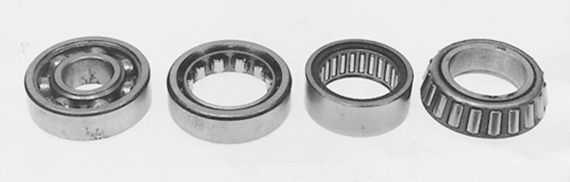
Figure 102.1 Rolling contact bearings include (left to right) ball, roller, needle, and tapered roller.

Slide 8
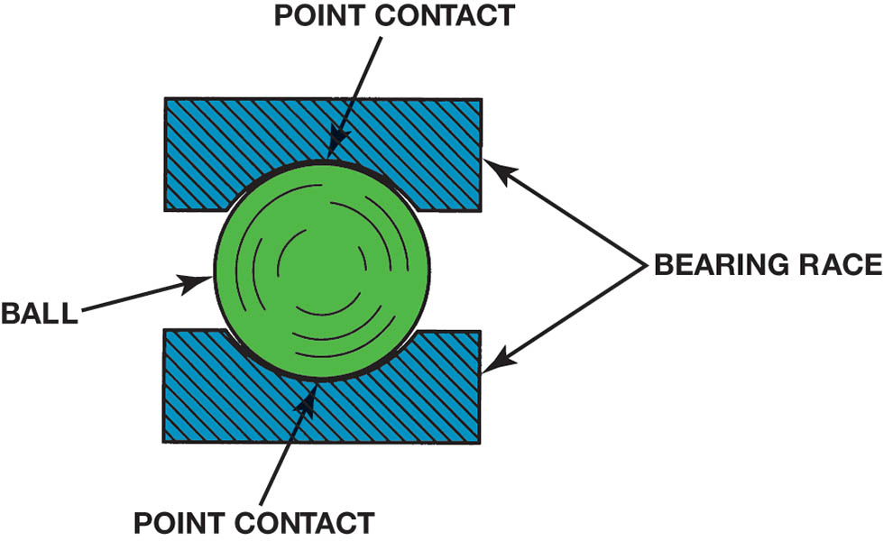
Figure 102.2 Ball bearing point contact

Slide 9
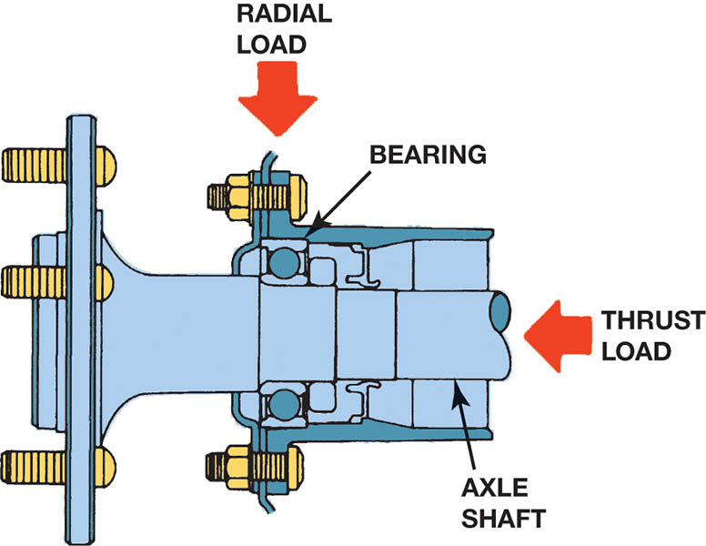
Figure 102.3 Radial load is the vehicle weight pressing on the wheels. The thrust load occurs as the chassis components exert a side force during cornering.

Slide 10
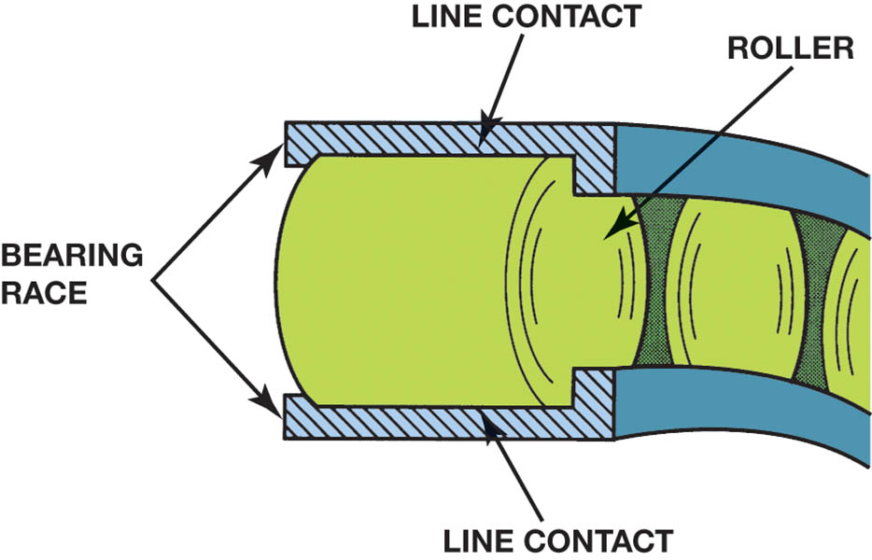
Figure 102.4 Roller bearing line contact

Slide 11
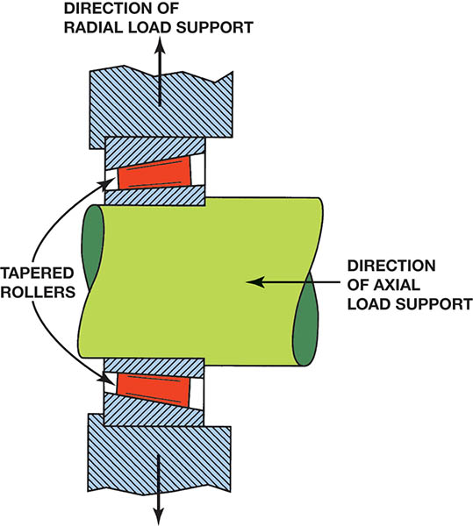
Figure 102.5 A tapered roller bearing will support a radial load and an axial load in only one direction.

Slide 12
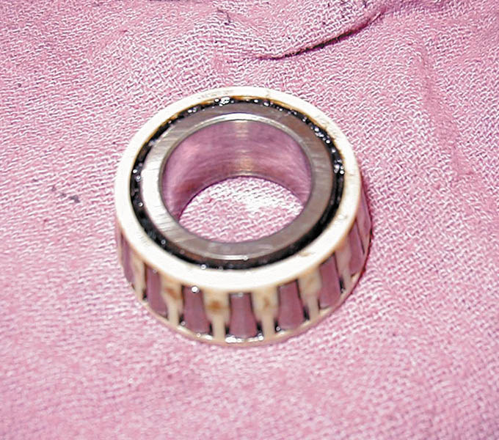
Figure 102.6 Many tapered roller bearings use a plastic cage to retain the rollers.

Slide 13
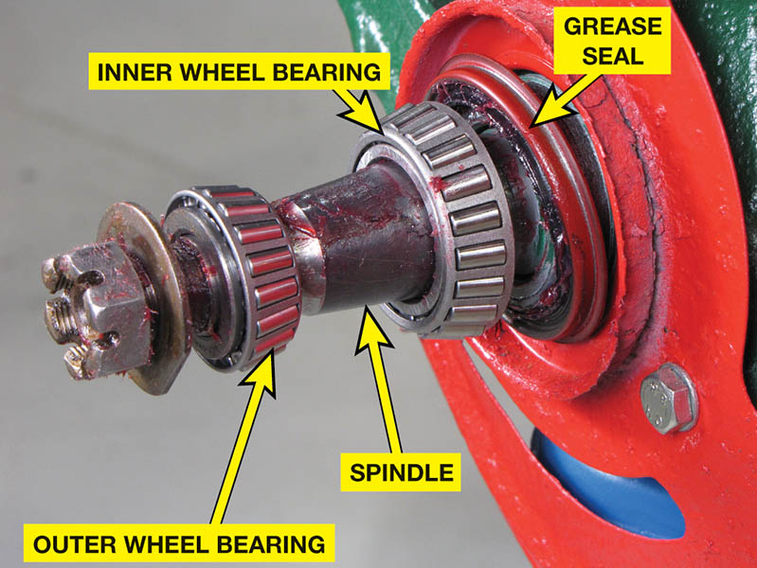
Figure 102.7 Non-drive-wheel hub with inner and outer tapered roller bearings. By angling the inner and outer in opposite directions, axial (thrust) loads are supported in both directions.

Slide 14
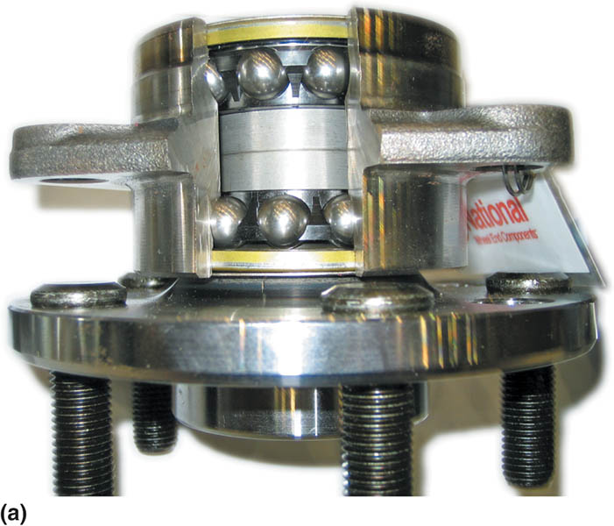
Figure 102.8 Sealed bearing and hub assemblies are used on the front and rear wheels of many vehicles. (a) A type using a double row of ball bearings.

Slide 15
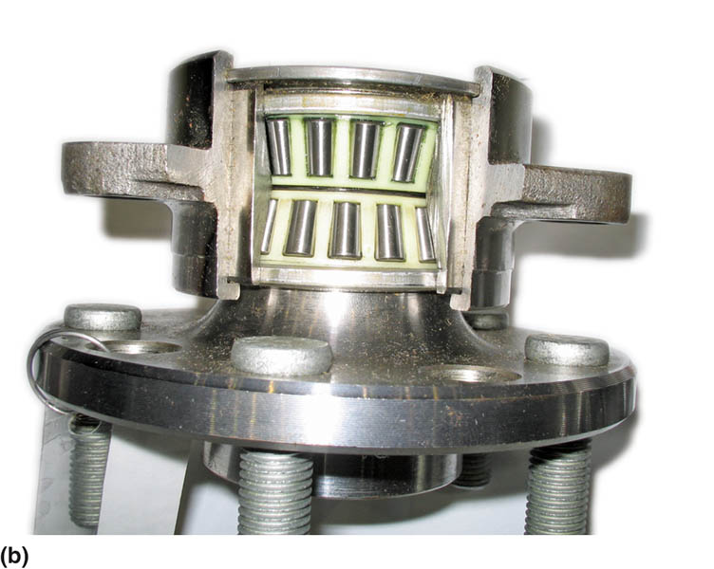
Figure 102.8 (b) A type using tapered roller bearings

Slide 16
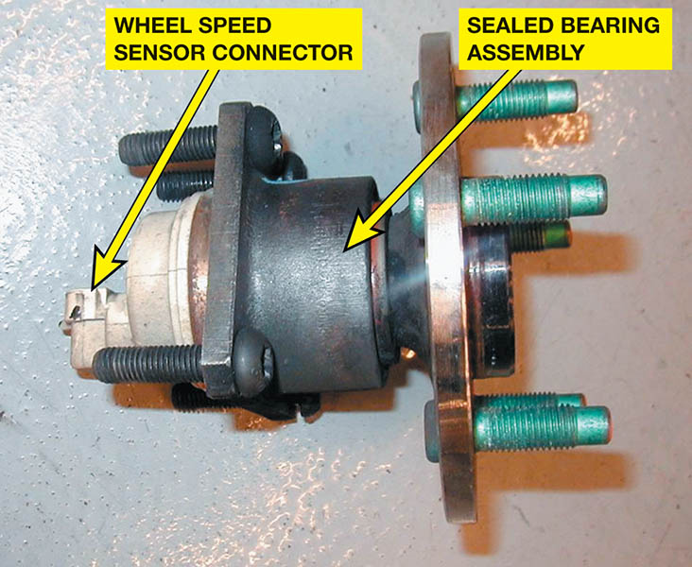
Figure 102.9 Sealed bearing and hub assemblies are serviced as a complete unit as shown. This hub assembly includes the wheel speed sensor.

Slide 17
QUESTION 1: ?
What are the three most common types of anti-friction bearings?

Slide 18
ANSWER 1:
Ball, roller, and tapered-roller.

Slide 19
BEARING GREASES (1 OF 4)
Definition of Grease
Grease is oil with a thickening agent to allow it to be installed in places where a liquid lubricant would not stay.
Grease Additives
Antioxidants
Anti-wear agents
Rust inhibitors
Extreme pressure (EP) additives such as sulfurized fatty oil or chlorine

Slide 20
BEARING GREASES (2 OF 4)
NLGI Classification
The National Lubricating Grease Institute (NLGI) uses the penetration test as a guide to assign the grease a number.
Low numbers are very fluid and higher numbers are more firm or hard.
Number 2 grease is the most commonly used.

Slide 21
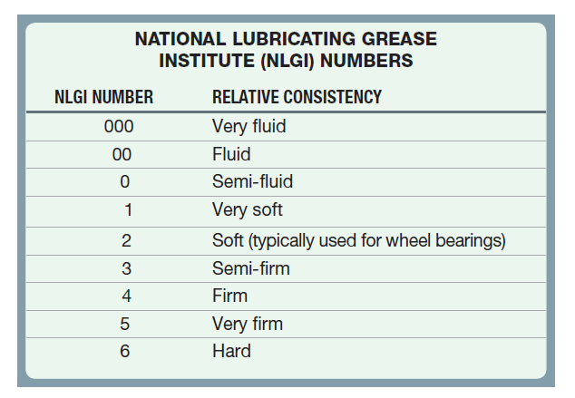
BEARING GREASES (3 OF 4)

Slide 22
BEARING GREASES (4 OF 4)
Grease is also classified according to quality.
GA—mild duty
GB—moderate duty
GC—severe duty, high temperature
Chassis grease, such as is used to lubricate steering and suspension components, includes the following classifications:
LA—mild duty (frequent re-lubrication)
LB—high loads (infrequent re-lubrication)

Slide 23
QUESTION 2: ?
What are the two ways wheel bearing grease is classified?

Slide 24
ANSWER 2:
Hardness and quality.

Slide 25
SEALS
Purpose and Function
Seals are used in all vehicles to keep lubricant, such as grease, from leaking out and to prevent dirt, dust, or water from getting into the bearing or lubricant.
Types of Seals
Static seals are used between two surfaces that do not move.
Dynamic seals are used to seal between two surfaces that move.

Slide 26
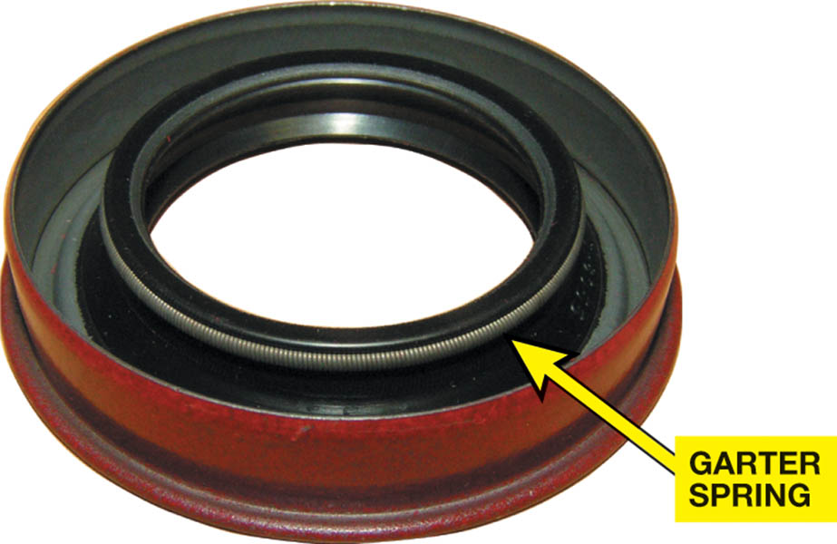
Figure 102.10 Typical lip seal with a garter spring

Slide 27
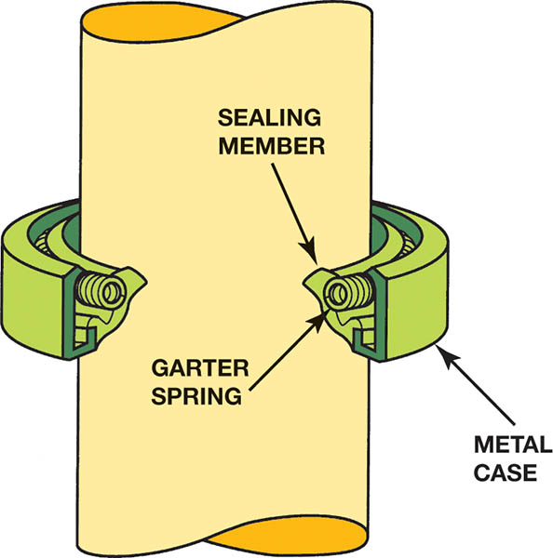
Figure 102.11 A garter spring helps hold the sharp lip edge of the seal tight against the shaft.

Slide 28
QUESTION 3: ?
What are the two types of seals?

Slide 29
ANSWER 3:
Static and dynamic.

Slide 30
BEARING DIAGNOSIS (1 OF 2)
Symptoms of a Defective Bearing
A hum, rumbling, or growling noise that increases with vehicle speed
Roughness felt in the steering wheel that changes with the vehicle speed or cornering
Looseness or excessive play in the steering wheel, especially while driving over rough road surfaces
A loud grinding noise in severe cases, indicating a defective front wheel bearing
Pulling during braking

Slide 31
BEARING DIAGNOSIS (2 OF 2)
Determining Bearing Noise from Tire Noise
Drive the vehicle over a variety of road surfaces
If the noise remains the same, then the cause is a defective wheel bearing
Try temporarily overinflating the tires. If the noise changes, then the tires are the cause.
Testing a Wheel Bearing
With the vehicle off the ground, rotate the wheel by hand, listening and feeling carefully for bearing roughness.
Grasp the tire top and bottom, wiggle and check for looseness.

Slide 32
WHEEL BEARING SERVICE (1 OF 2)
The steps in a non-drive-wheel bearing inspection include the following:
Hoist the vehicle safely and remove the wheel.
Remove the brake caliper assembly and remove the bearing dust cap.
Remove and discard the cotter key.
Remove the spindle nut, washer, and outside bearing.
Remove the bearing hub, and remove the inside bearing.
Clean both bearings and inspect for damage.

Slide 33
WHEEL BEARING SERVICE (2 OF 2)
Non-drive-wheel bearing inspection continued…
Pack the cleaned or new bearing thoroughly with clean, new, approved wheel bearing grease.
Place a thin layer of grease on the outer race.
Apply a thin layer of grease to the spindle
Install a new grease seal
Install the hub, the outer bearing, washer and nut
Torque the bearings to specifications and install new cotter key.
Install dust cap and brake caliper.

Slide 34
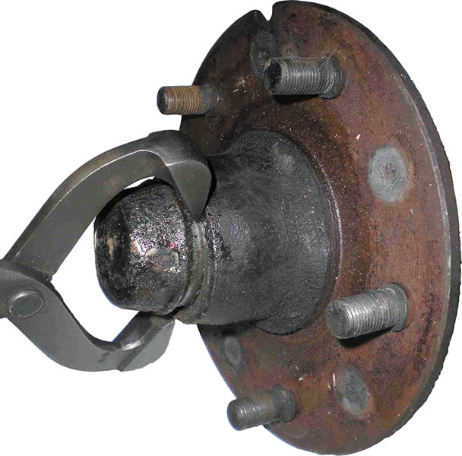
Figure 102.12 Removing the grease cap with grease cap pliers

Slide 35
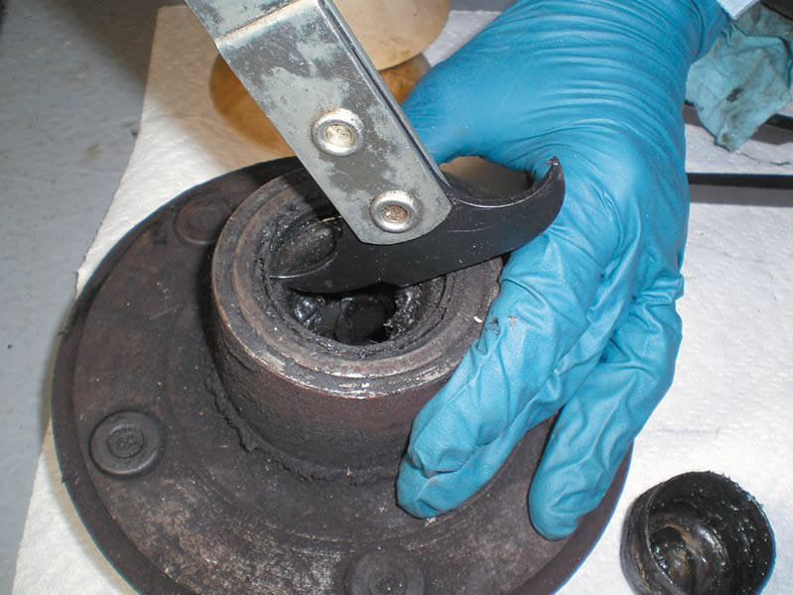
Figure 102.13 Using a seal puller to remove the grease seal

Slide 36
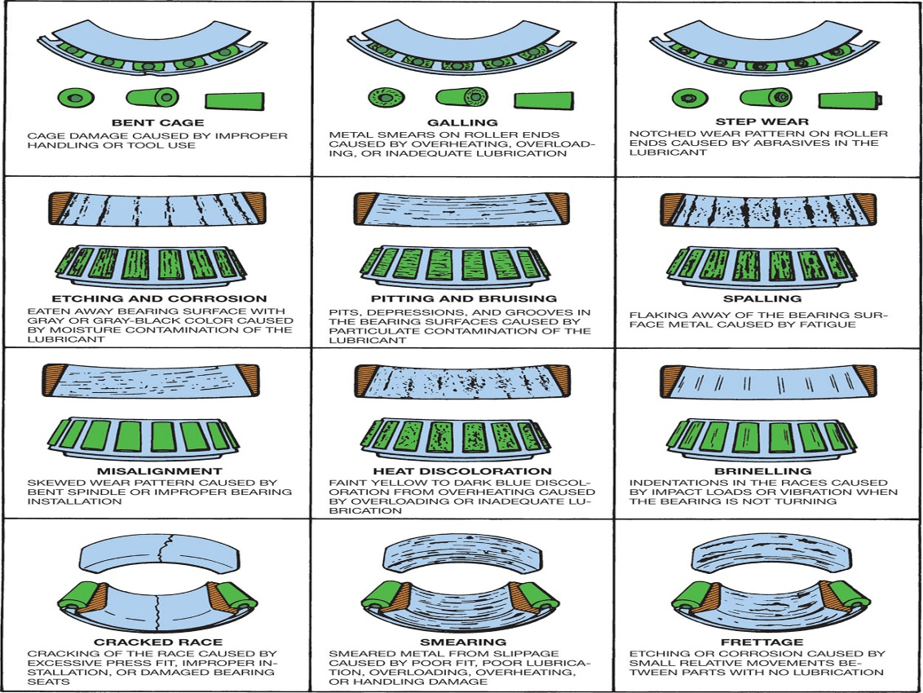
Chart 102.1 Wheel bearing inspection chart. Replace the bearing if it has any of the faults shown.

Slide 37
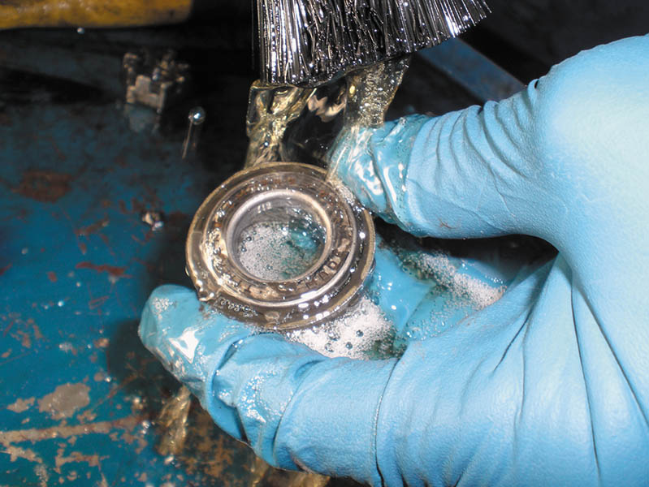
Figure 102.14 Cleaning a wheel bearing with a parts brush and solvent

Slide 38
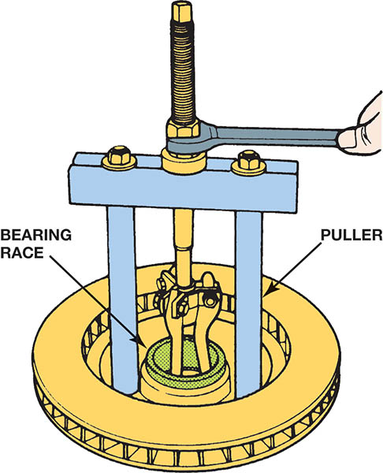
Figure 102.15 A wheel bearing race puller

Slide 39
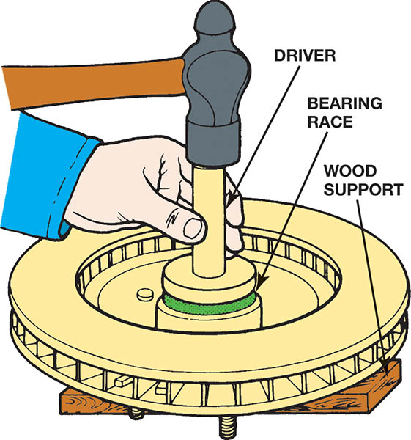
Figure 102.16 Installing a bearing race with a driver

Slide 40
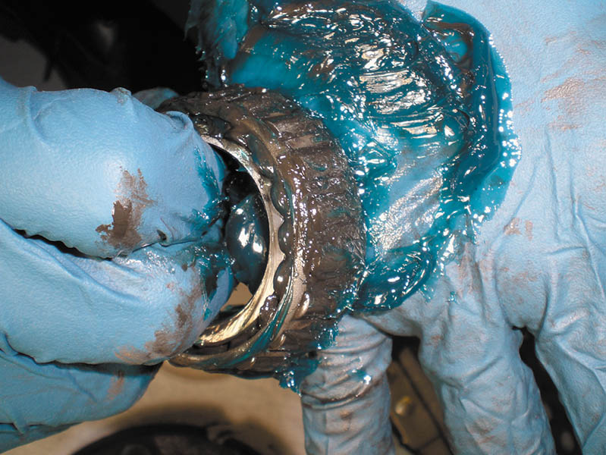
Figure 102.17 Notice the new blue grease has been forced through the bearing

Slide 41
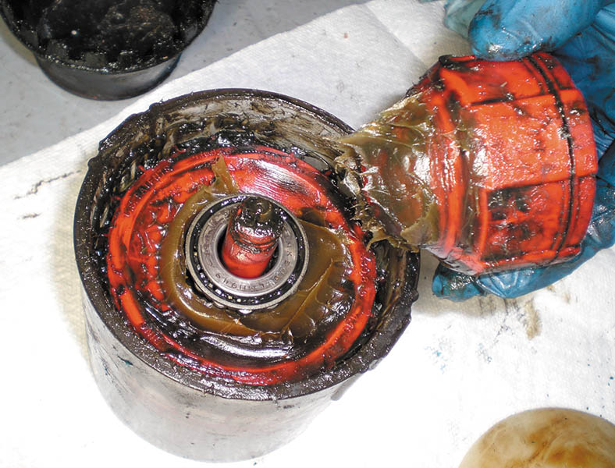
Figure 102.18 A commonly used hand-operated bearing packer

Slide 42
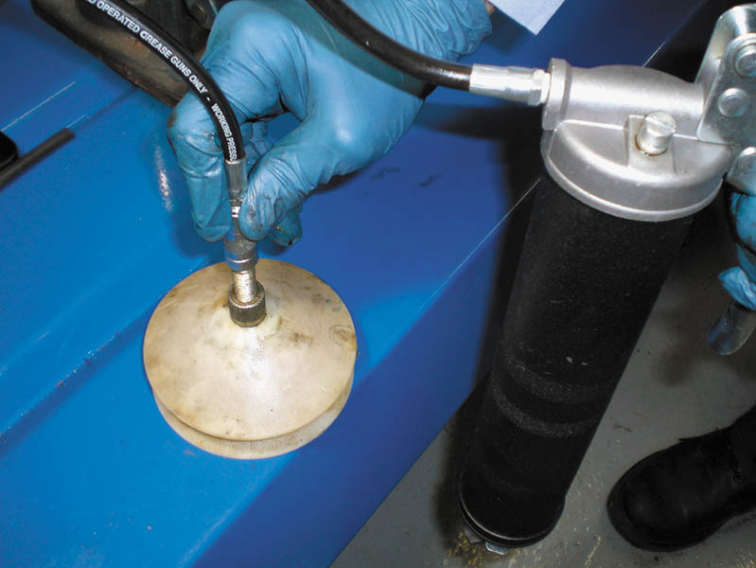
Figure 102.19 The wheel bearing is placed between two nylon cones and then a grease gun is used to inject grease into the center of the bearing

Slide 43
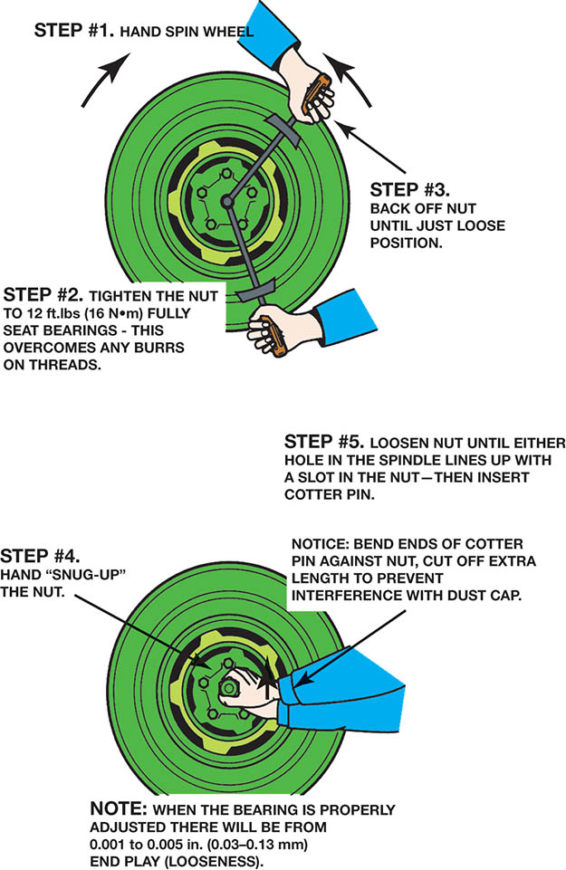
Figure 102.20 The wheel bearing adjustment procedure as specified for rear-wheel-drive vehicles. Always check service information for the specified procedure to follow

Slide 44
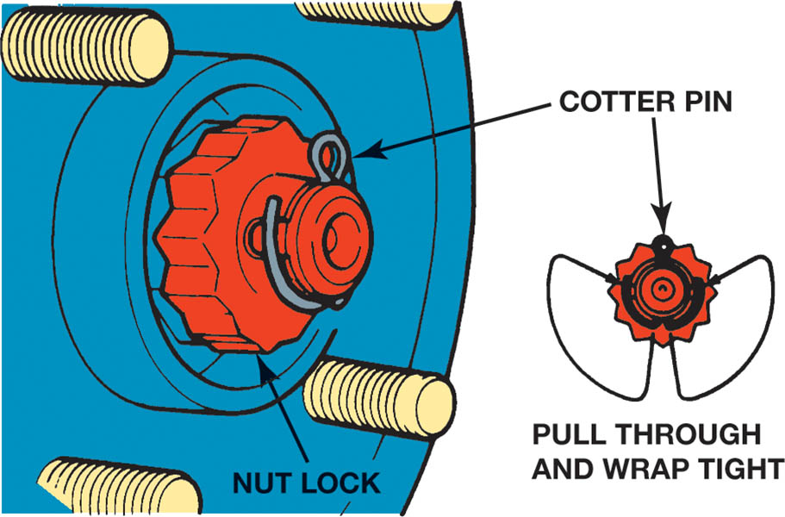
Figure 102.21 A properly secured wheel bearing adjust nut

Slide 45
SEALED BEARING REPLACEMENT
Some front-wheel-drive vehicles use a sealed bearing assembly that is bolted to the steering knuckle and supports the drive axle.
Many front-wheel-drive vehicles use a bearing that must be pressed off the steering knuckle.
Special aftermarket tools are also available to remove many of the bearings without removing the knuckle from the vehicle.

Slide 46
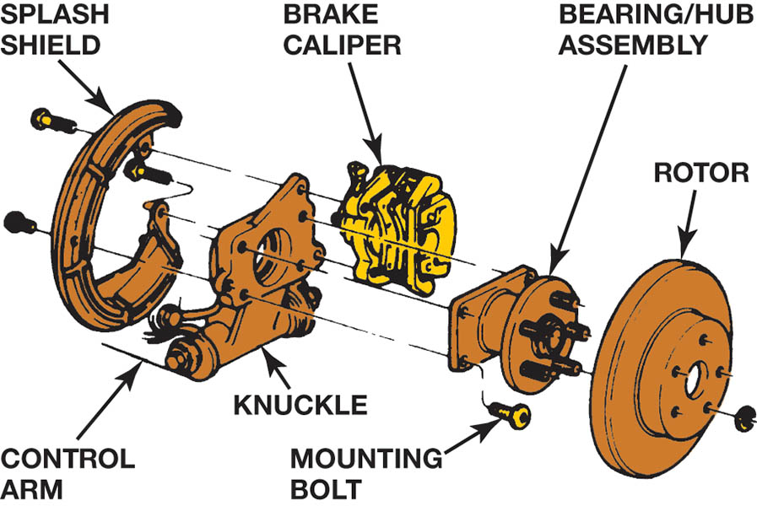
Figure 102.22 A rear wheel sealed bearing hub assembly

Slide 47
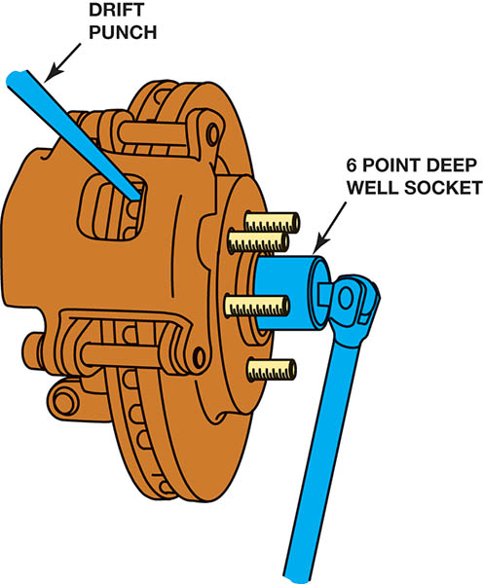
Figure 102.23 Removing the drive axle shaft hub nut. This nut is usually very tight and the drift (tapered) punch wedged into the cooling fins of the brake rotor keeps the hub from revolving when the nut is loosened. Never use an air impact wrench to loosen or tighten the drive axle shaft nut because the hammering action will damage the bearings

Slide 48
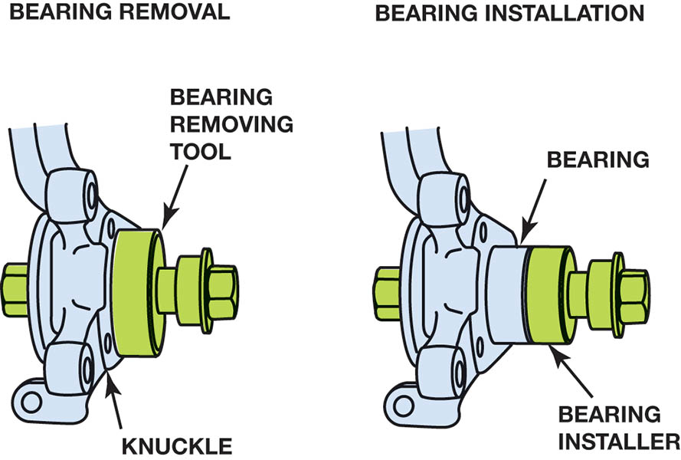
Figure 102.24 A special puller makes the job of removing the hub bearing from the knuckle easy without damaging any component

Slide 49
REAR DRIVE AXLE CLASSIFICATIONS (1 OF 2)
Full-Floating Axle
The wheel mounts onto the hub, and lug bolts or nuts retain it. In this design, the axle shafts “float” in the axle housing and drive the wheels without supporting their weight.
Three-Quarter-Floating Axle
The bearings in a three-quarter-floating axle are mounted and retained in the brake drum or rotor hub, which mounts onto the axle housing.

Slide 50
REAR DRIVE AXLE CLASSIFICATIONS (2 OF 2)
Semi-Floating Axle
The wheel bearings in a semi-floating axle either press onto the axle shaft or are installed in the outer end of the axle housing.
The outboard end of the shaft retains the wheel and transmits the weight of the wheel to the housing.

Slide 51
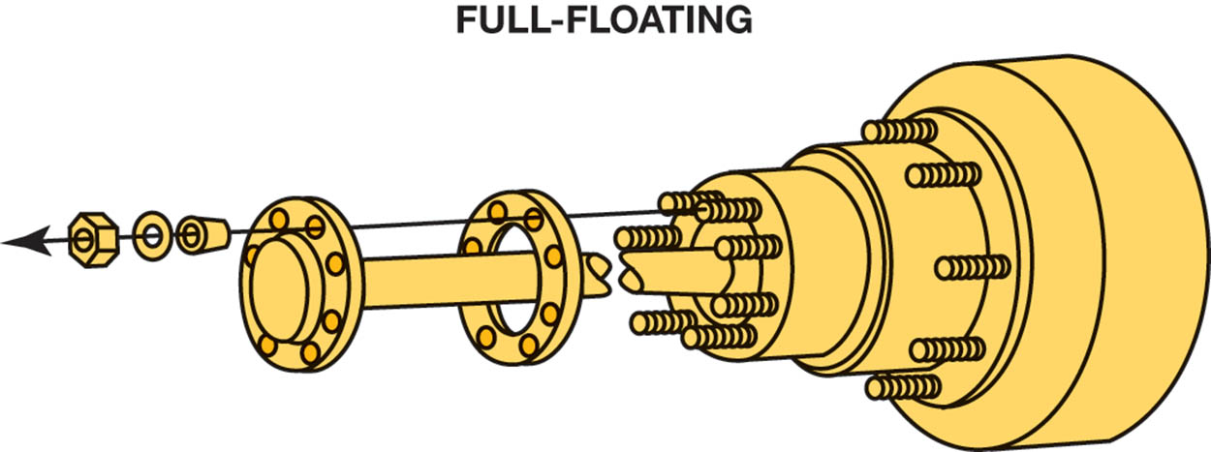
Figure 102.25 A typical full-floating rear axle assembly

Slide 52
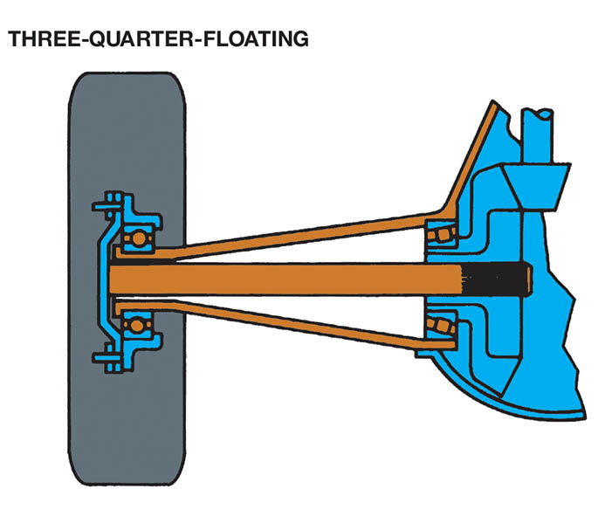
Figure 102.26 A three-quarter-floating rear axle

Slide 53
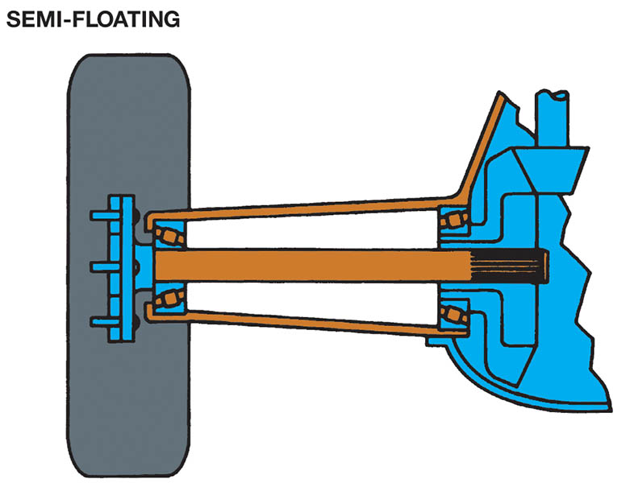
Figure 102.27 A semi-floating rear axle housing is the most commonly used in light rear-wheel-drive vehicles

Slide 54
REAR AXLE BEARING AND SEAL REPLACEMENT (1 OF 2)
The rear axle must be removed from the vehicle to replace the rear axle bearing.
There are two basic types of axle retaining methods:
Retainer plate-type
C-lock

Slide 55
REAR AXLE BEARING AND SEAL REPLACEMENT (2 OF 2)
Retainer-Plate Type Rear Axles
The retainer plate type rear axle uses four fasteners that retain the axle in the axle housing. To remove the axle shaft and the rear axle bearing and seal, the retainer bolts or nuts must be removed.
C-Lock Type Axles
The C-lock-type rear axle retaining method requires that the differential cover plate be removed. After removal of the cover, the differential pinion shaft has to be removed before the C-lock that retains the axle can be removed.

Slide 56
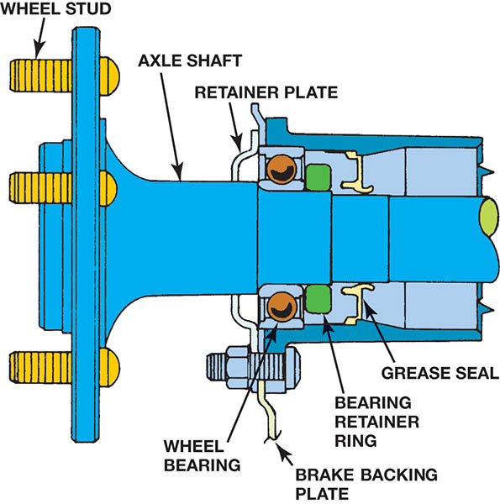
Figure 102.28 A retainer plate-type rear axle bearing. Access to the fasteners is through a hole in the axle flange

Slide 57
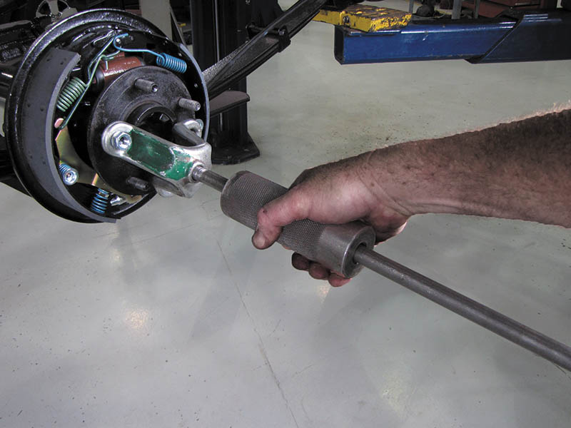
Figure 102.29 A slide-hammer-type axle puller can be used to remove an axle

Slide 58
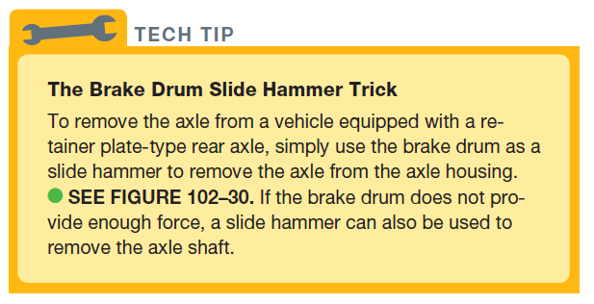
TECH TIP

Slide 59
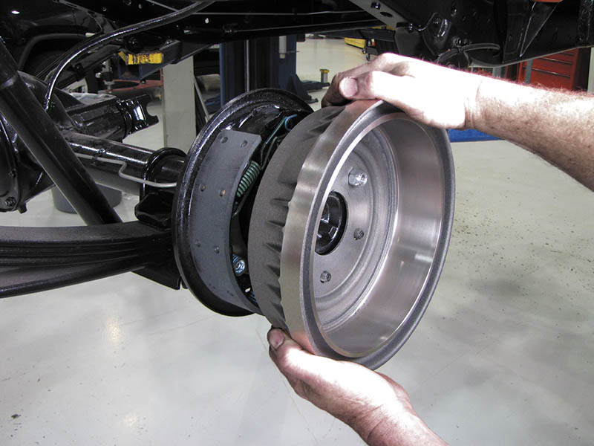
Figure 102.30 To remove the axle from this vehicle equipped with a retainer-plate rear axle, the brake drum was placed back onto the axle studs backward so that the drum itself can be used as a slide hammer to pull the axle out of the axle housing. A couple of pulls and the rear axle is pulled out of the axle housing

Slide 60
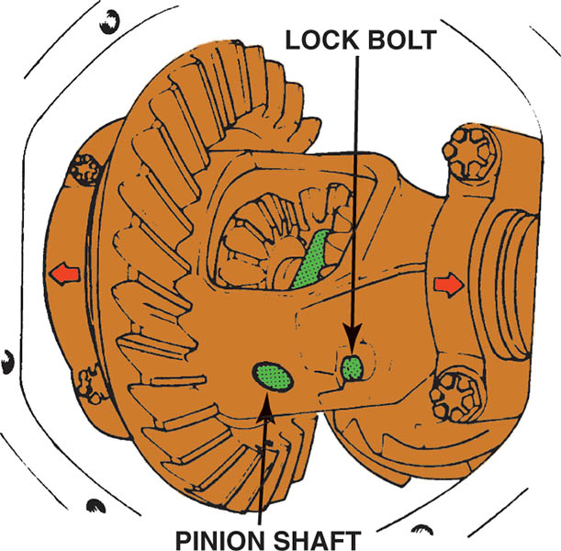
Figure 102.31 To remove the C-lock (clip), the lock bolt must be removed before the pinion shaft is taken out

Slide 61
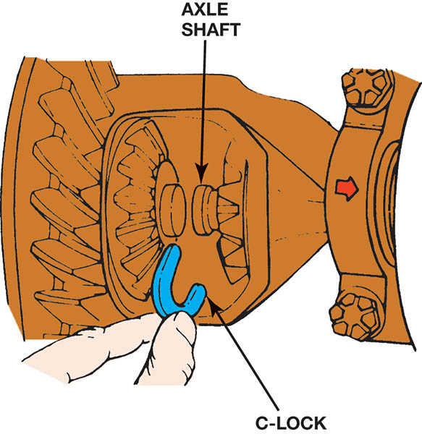
Figure 102.32 The axle must be pushed inward slightly to allow the C-lock to be removed. After the C-lock has been removed, the axle can be easily pulled out of the axle housing

Slide 62
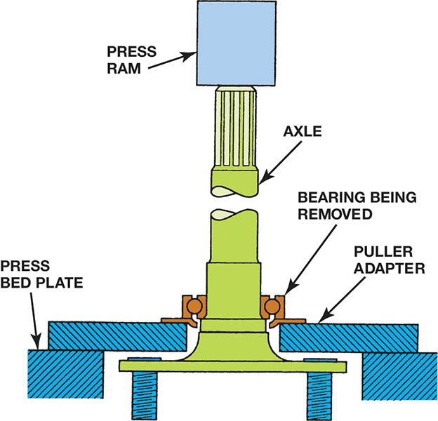
Figure 102.33 Using a hydraulic press to press an axle bearing from the axle. When pressing a new bearing back onto the axle, pressure should only be on the inner bearing race to prevent damaging the bearing

Slide 63
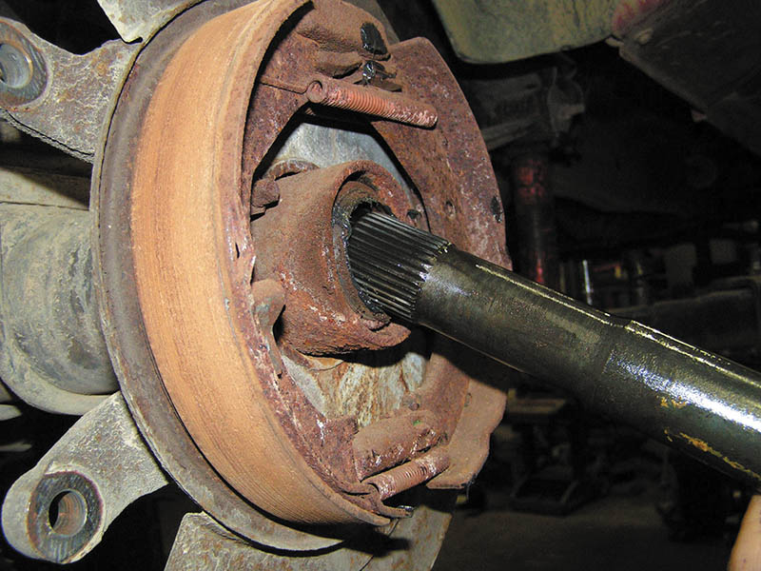
Figure 102.34 Removing an axle seal using the axle shaft as the tool. While this procedure is done in some shops, the preferred and specified procedure is to use a seal puller

Slide 64
BEARING FAILURE ANALYSIS
A wheel bearing may also fail for reasons that include the following:
Metal Fatigue
Electrical Arcing
Shock Loading

Slide 65
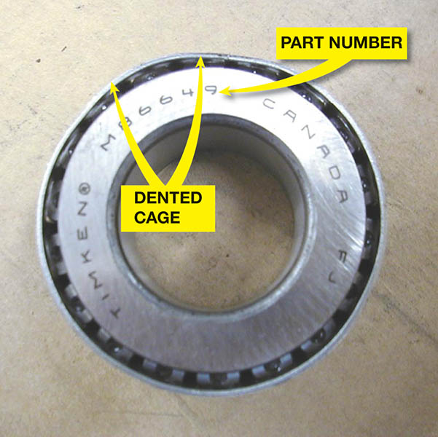
Figure 102.35 This bearing has a bent cage and must be replaced

Slide 66
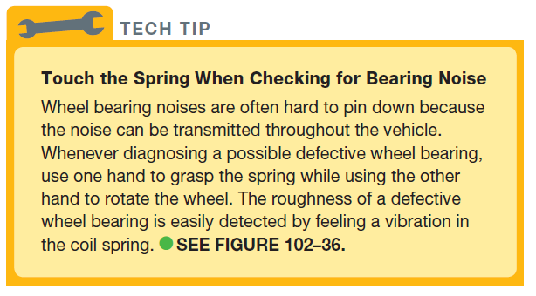
TECH TIP

Slide 67
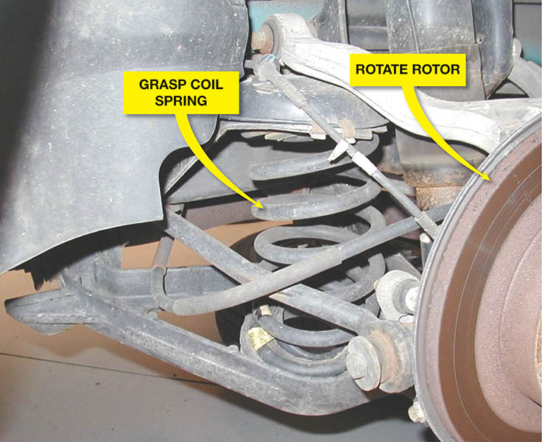
Figure 102.36 To detect a possible defective wheel bearing, grasp the coil spring and then rotate the wheel. If there is roughness in the bearing, a vibration will be felt in the spring

Slide 68
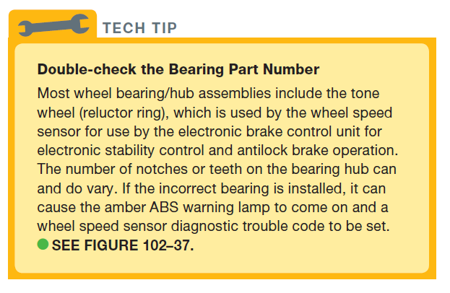
Tech Tip

Slide 69
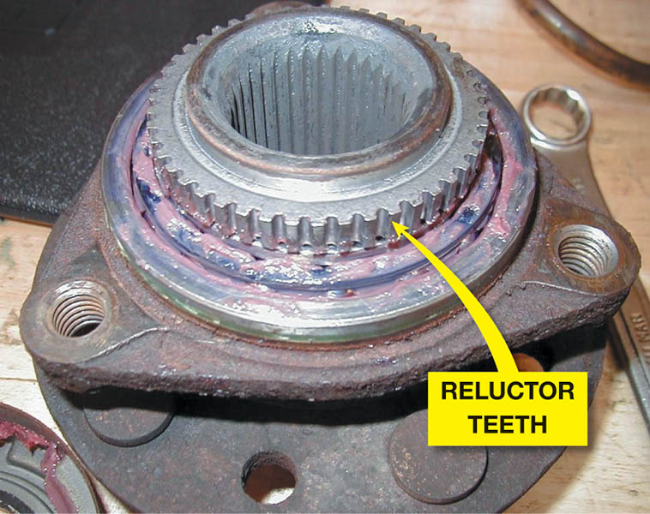
Figure 102.37 A bearing/hub assembly that shows the reluctor (tone wheel) teeth used by the wheel speed sensor

Slide 70
REAR AXLE BEARING SERVICE

Slide 71
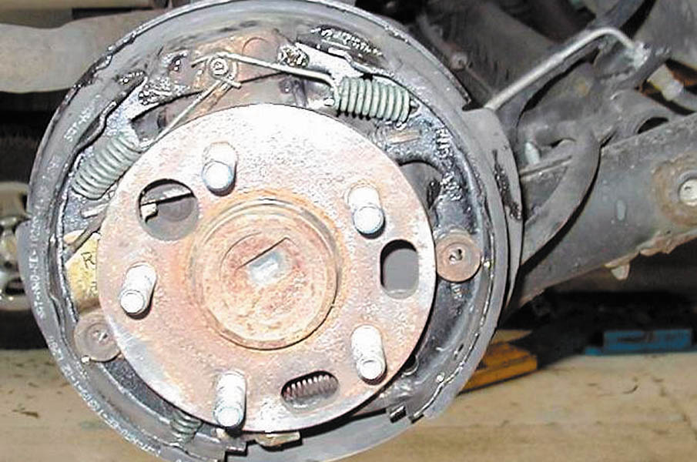
1. After safely hoisting the vehicle, remove the rear wheels and brake drums.

Slide 72
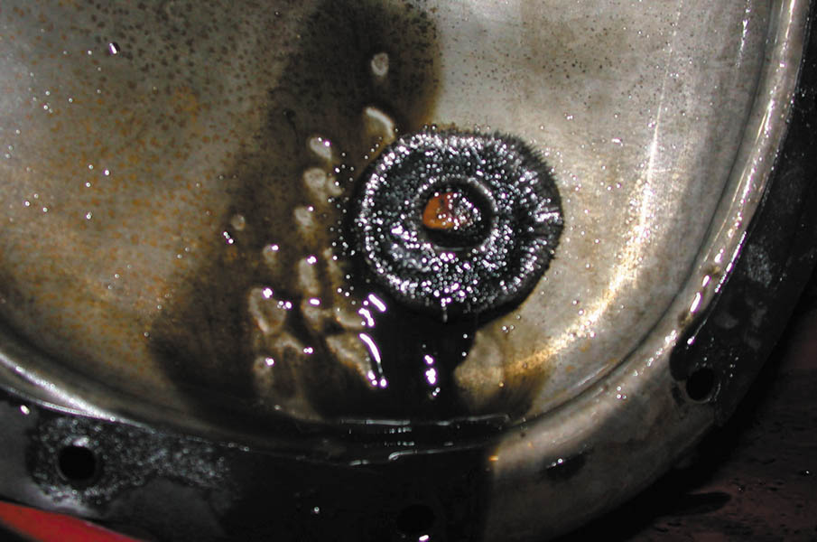
2. Remove the rear differential cover and inspect the magnet for metal particles that would indicate serious wear or damage.

Slide 73
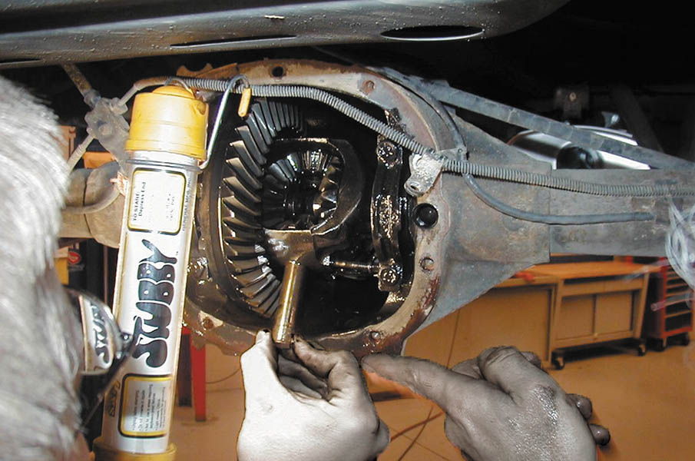
3. Remove the retaining bolt and allow the pinion shaft to be removed.

Slide 74
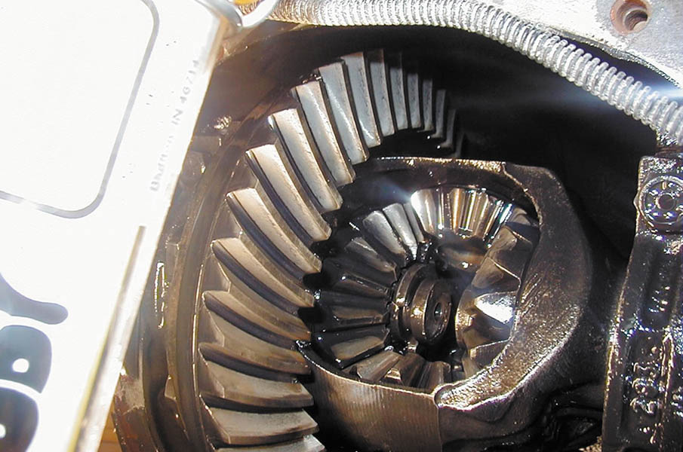
4. Push the axle inward toward the center of the vehicle to free the axle clip.

Slide 75
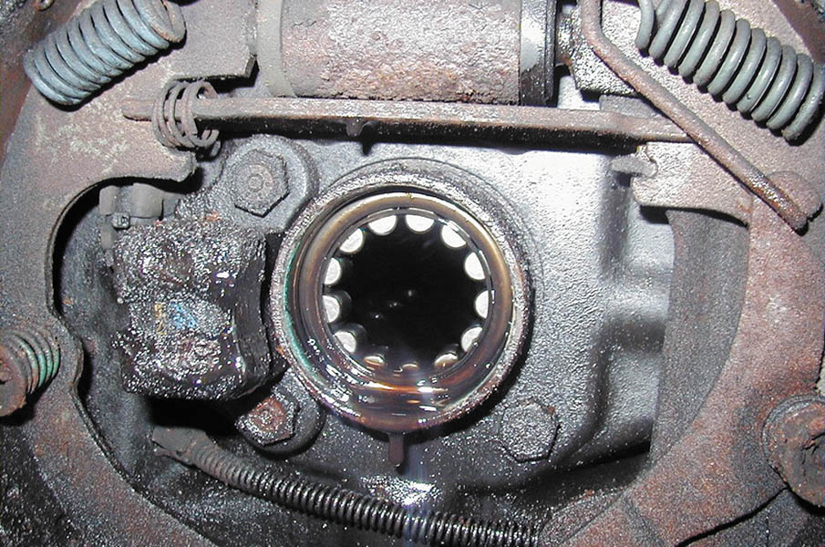
5. After removing the clip, the axle can then be removed. Note that the backing plate is wet, indicating that the axle seal has been leaking.

Slide 76
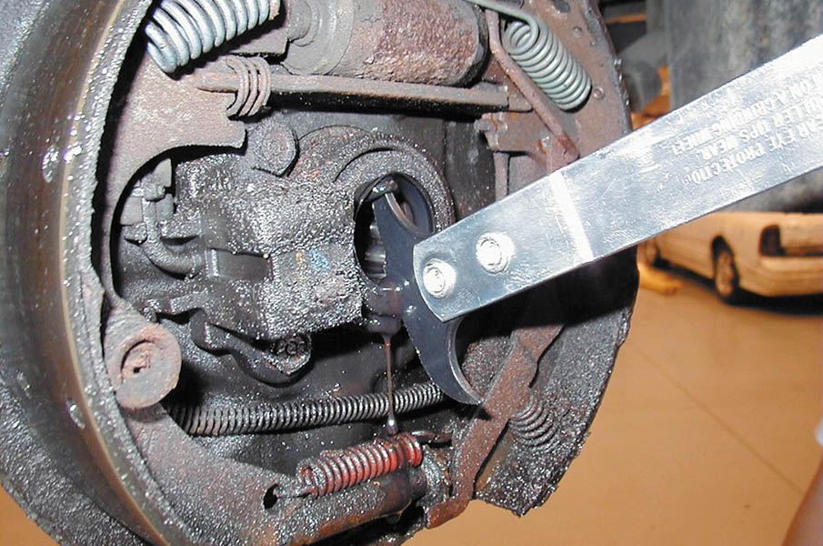
6. A seal removal tool being used to remove the axle seal.

Slide 77

7. If a retainer-type axle is being serviced, the bearing and seal need to be pressed off of the axle.

Slide 78

8. After installing a new bearing and seal, insert the axle and install the clip, then the pinion shaft.

Slide 79

9. Clean the differential housing before installing the cover gasket and cover. Refill the differential with the specified fluid.

Slide 80

Copyright

