Slide 1

Automotive Technology Principles, Diagnosis, and Service
Sixth Edition
Chapter 101
Brake Bleeding Methods and Procedures
Copyright © 2018, 2015, 2011 Pearson Education, Inc. All Rights Reserved

Slide 2
LEARNING OBJECTIVES (1 of 2)
101.1 Discuss the need for brake bleeding.
101.2 Discuss the various methods of loosening the brake bleeder valve.
101.3 Describe the bleeding sequence for most vehicles.
101.4 Describe the manual bleeding procedure.
101.5 Discuss how to vacuum bleed and gravity bleed the hydraulic brake system.

Slide 3
LEARNING OBJECTIVES (2 of 2)
101.6 Discuss how to pressure bleed the hydraulic brake system.
101.7 Describe how to service the hydraulic ABS and flush brake fluid.
101.8 This chapter will help prepare for the Brakes (A5) ASE certification test content area “A” (Hydraulic, Power Assist, and Parking Brake Systems Diagnosis and Repair).

Slide 4
BRAKE BLEEDING
The Need for Brake Bleeding
Brake bleeding is removing any trapped air from the hydraulic system.
Bleeding the Master Cylinder
Bench bleed the master cylinder.
Fill the master cylinder with clean brake fluid.
slowly depress the brake pedal as you “crack open” the master cylinder bleed screw.
Repeat the procedure several times until a solid flow of brake fluid is observed leaving the bleeder valve.
If the master cylinder is not equipped with bleeder valves, the outlet tube nuts can be loosened instead.

Slide 5
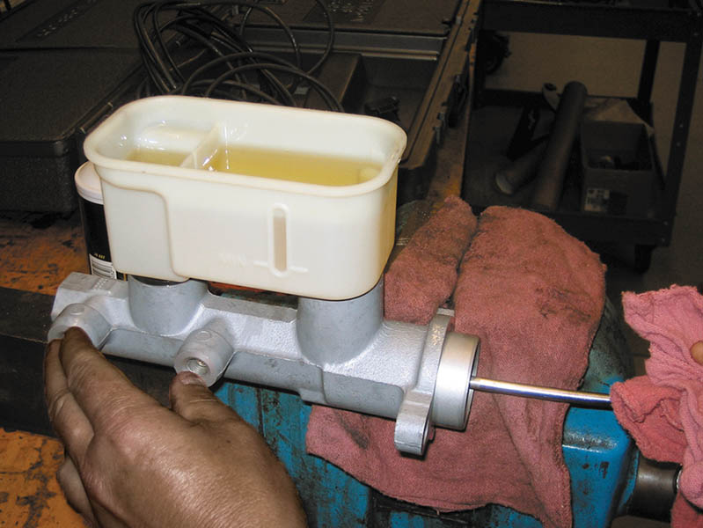
Figure 101.1 Bench bleeding a master cylinder. Always clamp a master cylinder in a vise by the mounting flange to prevent distortion of the cylinder bore. Bench bleeding tubes can also be used that route the fluid back into the reservoir

Slide 6
BRAKE BLEEDER VALVE LOSENING METHODS
Attempting to loosen a seized bleeder valve often results in breaking (shearing off) the bleeder valve.
Procedures that can help prevent breaking the valve:
Hit and tap method
Air punch method
Heat and tap method
Wax method

Slide 7
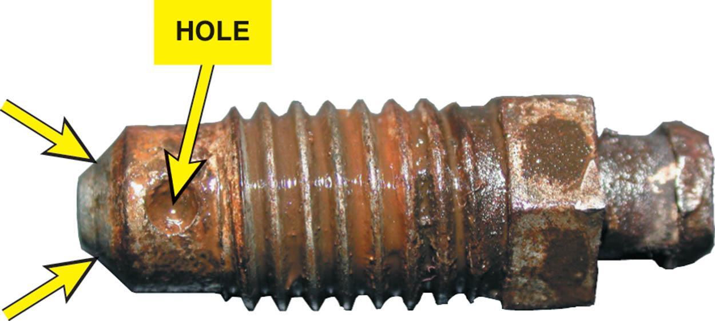
Figure 101.2 Typical bleeder valve from a disc brake caliper. The arrows point to the taper section that does the actual sealing. Once loosened, brake fluid flows around the taper and out through the hole in the side of the bleeder valve. The hole is clogged in this example and needs to be cleaned out

Slide 8
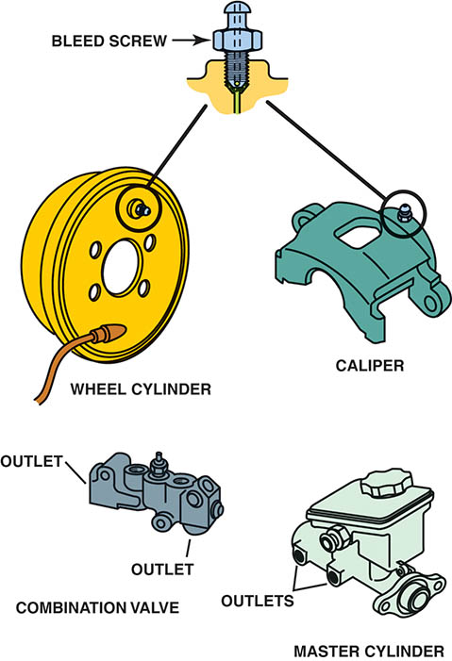
Figure 101.3 Typical bleeder locations. Note that the combination valve and master cylinder shown do not have bleeder valves; therefore, bleeding is accomplished by loosening the brake line at the outlet ports

Slide 9
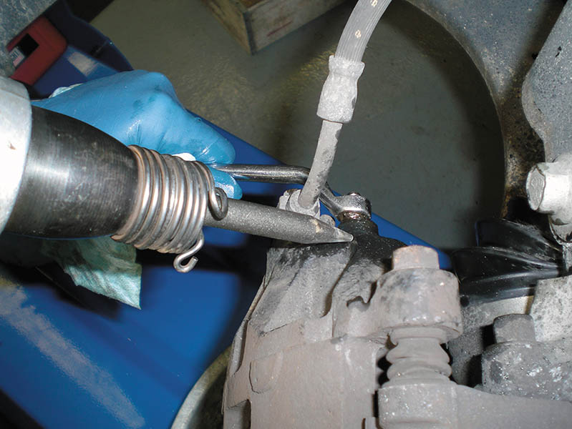
Figure 101.4 Using an air punch next to the bleeder valve to help “break the taper” on the bleeder valve

Slide 10
QUESTION 1: ?
What are methods for turning a frozen bleeder screw?

Slide 11
ANSWER 1:
Hit and tap method, Air punch method, Heat and tap method, and Wax method.

Slide 12
BLEEDING SEQUENCE
For most rear-wheel-drive vehicles equipped with a front/rear split system, start the bleeding with the wheel farthest from the master cylinder and work toward the closest.
For vehicles equipped with a diagonal split section or equipped with ABS, follow the brake bleeding procedure recommended in the service information for the vehicle.

Slide 13
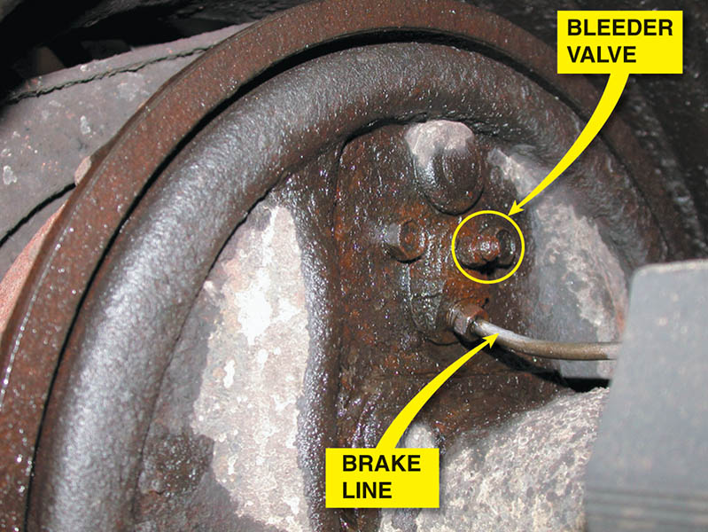
Figure 101.5 Most vehicle manufacturers recommend starting the brake bleeding process at the rear wheel farthest from the master cylinder

Slide 14
MANUAL BLEEDING
Manual bleeding is the most commonly used method and uses hydraulic pressure created by the master cylinder to pump fresh fluid through the brake system.
Manual Bleeding Procedure
Discharge the vacuum or hydraulic power booster
Fill the master cylinder reservoir
Attach the plastic hose over the bleeder screw
Loosen the bleeder screw and depress the pedal
Tighten the bleeder screw and release the pedal.

Slide 15
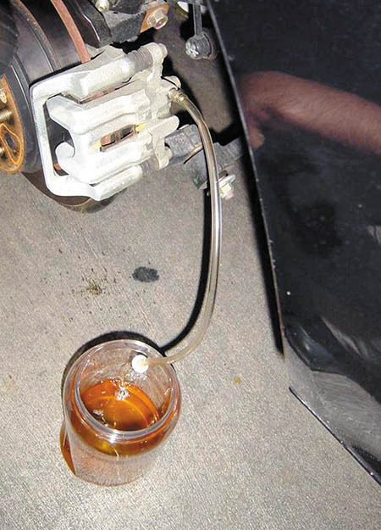
Figure 101.6 Bleeding brakes using clear plastic tubing makes it easy to see air bubbles. Submerging the hose in a container of clean brake fluid helps ensure that all of the air will be purged by the system

Slide 16
VACUUM BLEEDING
The vacuum pump creates a low-pressure area at the bleeder screw, which allows atmospheric pressure to force brake fluid through the system when the bleeder screw is opened.
Advantages of Vacuum Bleeding
Requires only one technician and it is easy and the equipment needed is inexpensive.
Disadvantages of Vacuum Bleeding
Often air can be drawn into the line between the bleeder valve and the hose that can be interpreted by the technician as air in the system.

Slide 17
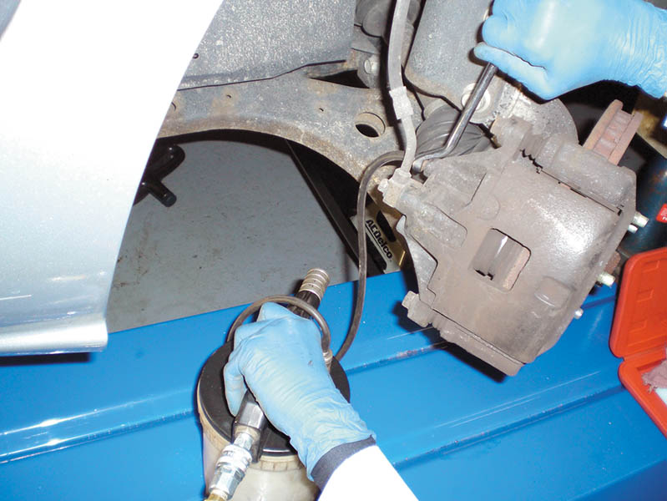
Figure 101.7 Using a compressed air-powered vacuum bleeder

Slide 18
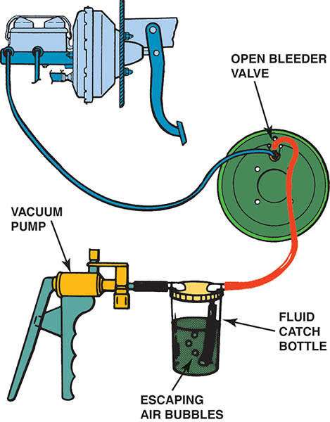
Figure 101.8 Vacuum bleeding uses atmospheric pressure to force brake fluid through the hydraulic system

Slide 19
GRAVITY BLEEDING
Gravity bleeding is a slow, but effective, method that will work on many vehicles to rid the hydraulic system of air.
Advantages of Gravity Bleeding
All four-wheel brakes can be bled at one time.
Disadvantages of Gravity Bleeding
Gravity bleeding is a slow process that can take an hour or more.

Slide 20
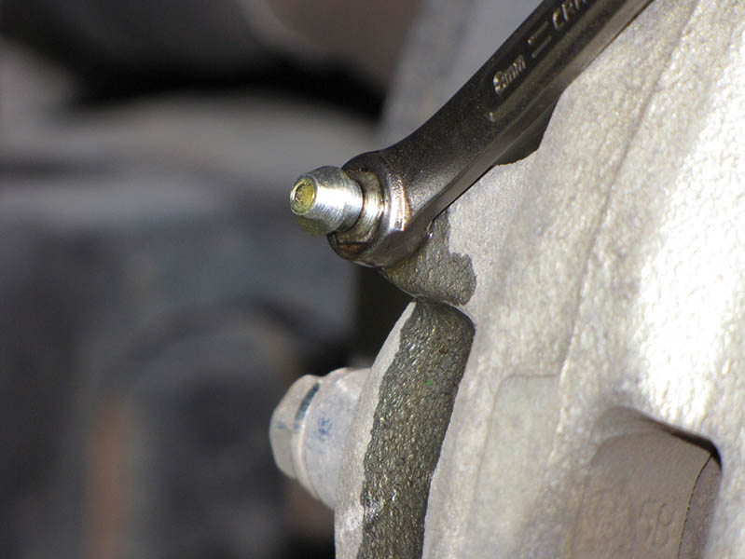
Figure 101.9 Gravity bleeding is simply opening the bleeder valve and allowing gravity to force the brake fluid out of the bleeder valve. Because air is lighter than brake fluid, all of the air escapes before the brake fluid runs out

Slide 21
QUESTION 2: ?
What is the advantage of gravity bleeding?

Slide 22
ANSWER 2:
All four wheels can be done at the same time.

Slide 23
PRESSURE BLEEDING
A pressure bleeder attached to the master cylinder forces brake fluid through the system under pressure to purge any trapped air.
Adapters are attached to the master cylinder to create pressure and the system is bled one corner at a time.
A metering valve override tool may be needed depending on the system design.

Slide 24
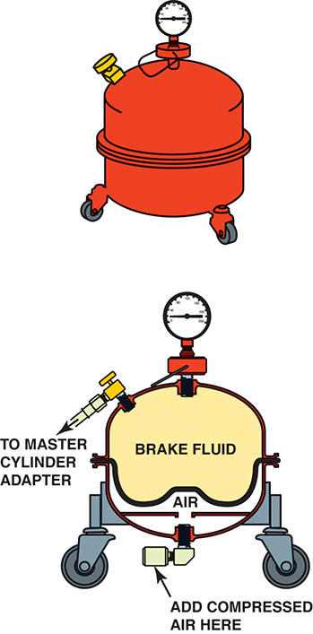
Figure 101.10 A typical pressure bleeder. The brake fluid inside is pressurized with air pressure in the air chamber. This air pressure is applied to the brake fluid in the upper section. A rubber diaphragm separates the air from the brake fluid

Slide 25
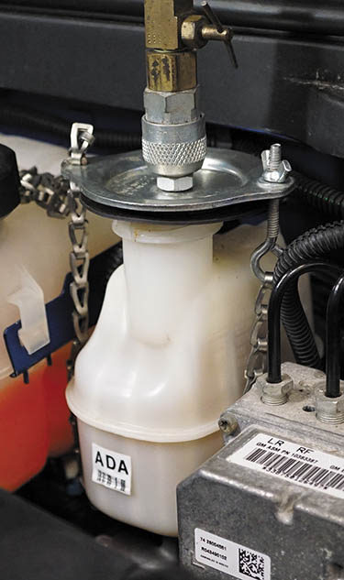
Figure 101.11 Brake fluid under pressure from the power bleeder is applied to the top of the master cylinder. It is very important that the proper adapter be used for the master cylinder. Failure to use the correct adapter or failure to release the pressure on the brake fluid before removing the adapter can cause fluid to escape under pressure

Slide 26
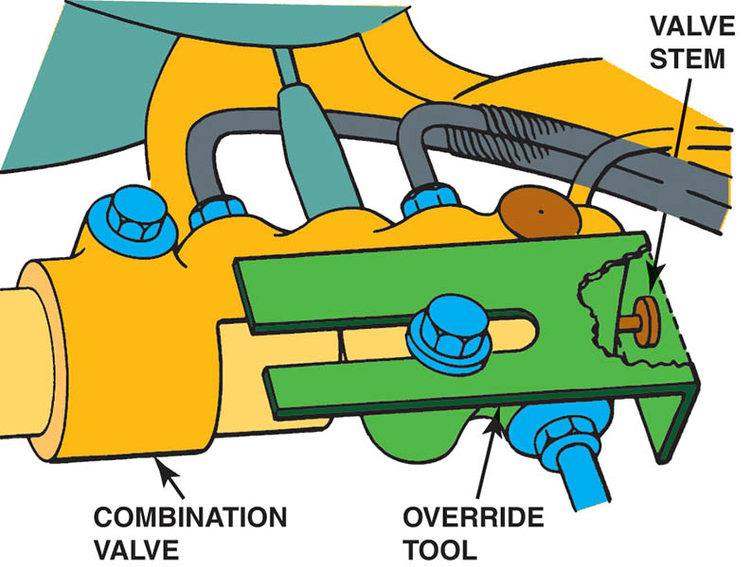
Figure 101.12 Metering valve override tool on a General Motors vehicle

Slide 27
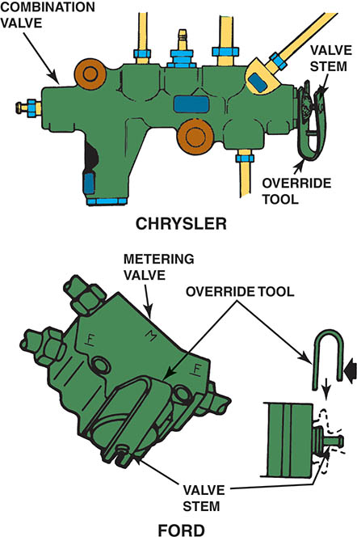
Figure 101.13 Pull-out-type metering valves being held out using a special override tool

Slide 28
HYDRAULIC ABS SERVICE
Check Service Information
Before doing any brake work on a vehicle equipped with antilock brakes, always consult the appropriate service information for the exact vehicle being serviced.
Bleeding the Electronic-Hydraulic (E-H) Assembly
Some E-H units can be bled through the use of a scan tool where the valves are pulsed in sequence by the electronic brake controller (computer).
Some units are equipped with bleeder valves while others must be bled by loosening the brake lines.

Slide 29

Figure 101.14 Special bleed valve tools are often required when bleeding some ABS units such as the Kelsey-Hayes 4WAl system

Slide 30
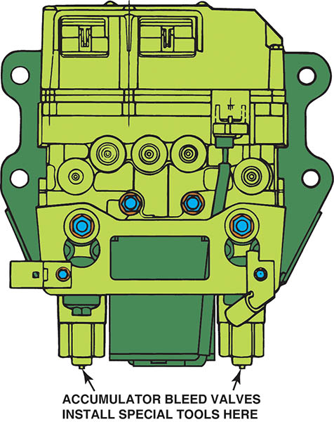
Figure 101.15 Two bleed valve tools are needed to bleed the Kelsey-Hayes 4WAl system, which attaches to the bleeder valves on the accumulator

Slide 31
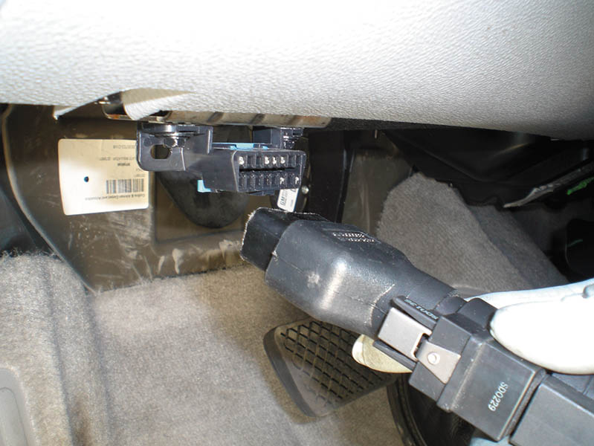
Figure 101.16 To perform an automated brake bleed procedure on an antilock brake system, first connect a factory or enhanced scan tool to the data link connector (DLC) located under the dash on this vehicle

Slide 32
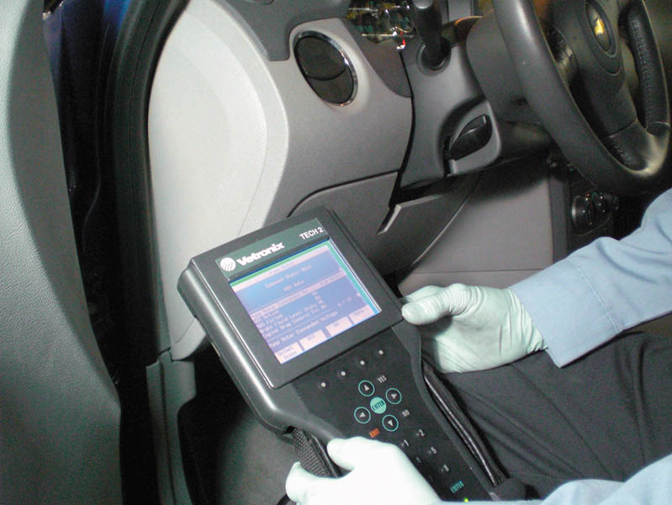
Figure 101.17 Access the menu that includes antilock brake system (ABS) functions

Slide 33
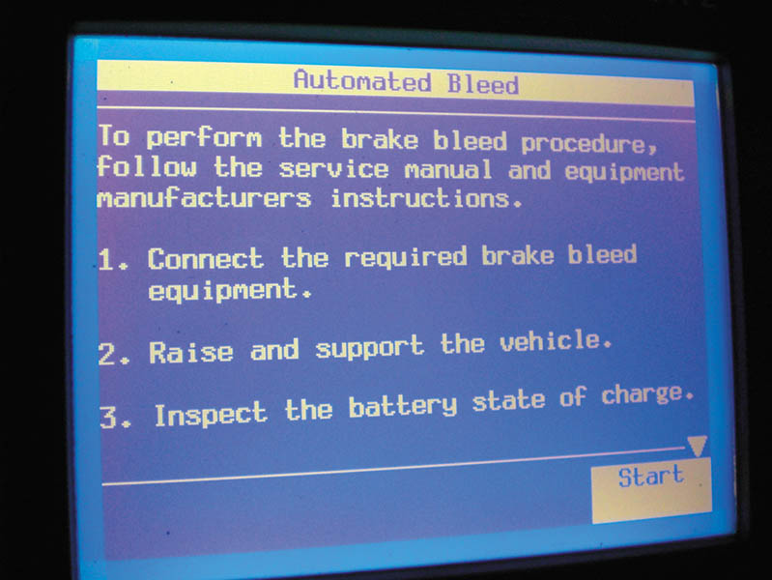
Figure 101.18 Scroll through the menus and select automated bleed procedure and follow the on-screen instructions

Slide 34
QUESTION 3: ?
What are the two methods of bleeding a electronic-hydraulic unit?

Slide 35
ANSWER 3:
With a scan tool or by opening bleeder valves.

Slide 36
BRAKE FLUID REPLACEMENT/FLUSHING
Brake fluid flushing is a procedure where the old brake fluid is removed and new brake fluid is added to the hydraulic system.
Remove the old brake fluid from the master cylinder reservoir.
Fill the master cylinder reservoir with new brake fluid.
Slip the plastic hose over the bleeder screw of the wheel cylinder or caliper.
Open the bleeder screw and depress the pedal.
Close the bleeder screw and release the pedal.
Repeat until new fluid emerges from the bleeder screw.

Slide 37
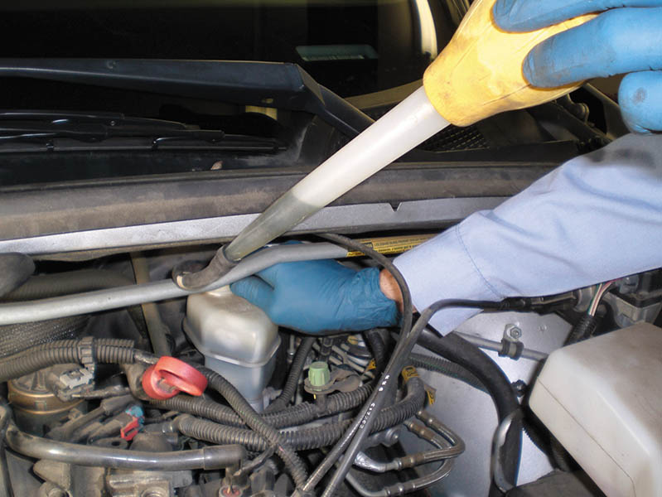
Figure 101.19 A turkey baster can be used to remove the old brake fluid from the master cylinder reservoir. A rubber hose was attached to the end of the turkey baster to get access to the brake fluid

Slide 38
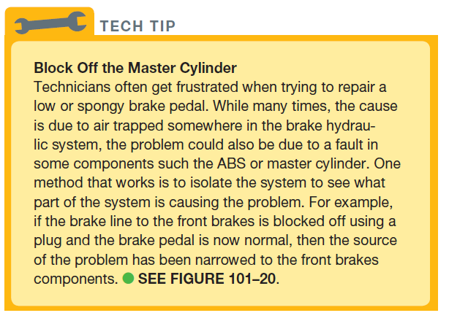
Tech Tip

Slide 39
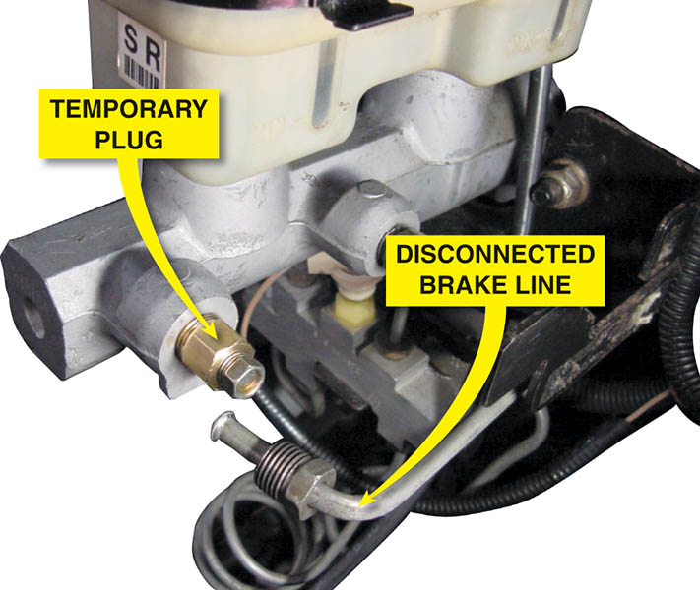
Figure 101.20 Using a plug at the outlet of the master cylinder is a common method when diagnosing a low brake pedal complaint

Slide 40

Copyright

