Slide 1

Automotive Technology Principles, Diagnosis, and Service
Sixth Edition
Chapter 100
Brake Fluid and Lines
Copyright © 2018, 2015, 2011 Pearson Education, Inc. All Rights Reserved

Slide 2
LEARNING OBJECTIVES (1 of 2)
100.1 Discuss the purpose, function, and specifications of brake fluids.
100.2 Describe brake service procedures and precautions.
100.3 Discuss the types of rubber that are used in brake system components.

Slide 3
LEARNING OBJECTIVES (2 of 2)
100.4 Discuss the use of brake lines.
100.5 This chapter will help prepare for the Brakes (A5) ASE certification test content area “A” (Hydraulic, Power Assist, and Parking Brake Systems Diagnosis and Repair).

Slide 4
BRAKE FLUID
Purpose and Function
  Brake fluid is designed to function in the hydraulic brake system under all operating conditions.
Physical Properties
  Brake fluid is a polyalkylene-glycol-ether mixture called polyglycol for short.
  All polyglycol brake fluid is clear to amber in color.
  A high boiling point
  A low freezing point
  No ability to damage rubber parts in the system

Slide 5
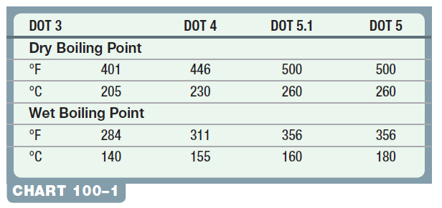
BRAKE FLUID SPECIFICATIONS (1 OF 2)
FMVSS 116: All automotive brake fluid must meet Federal Motor Vehicle Safety Standard (FMVSS) 116.

Slide 6
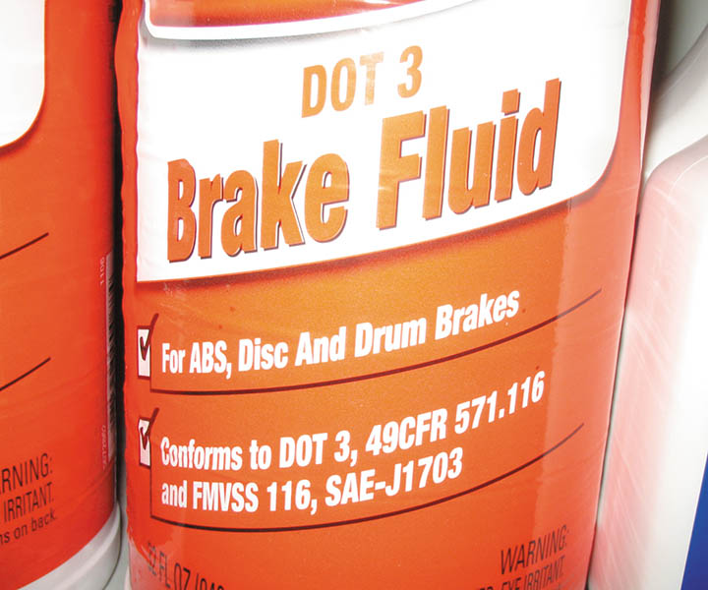
Figure 100.1 Brake fluid can absorb moisture from the air even through plastic, so many experts recommend that brake fluid be purchased in metal containers, if possible

Slide 7
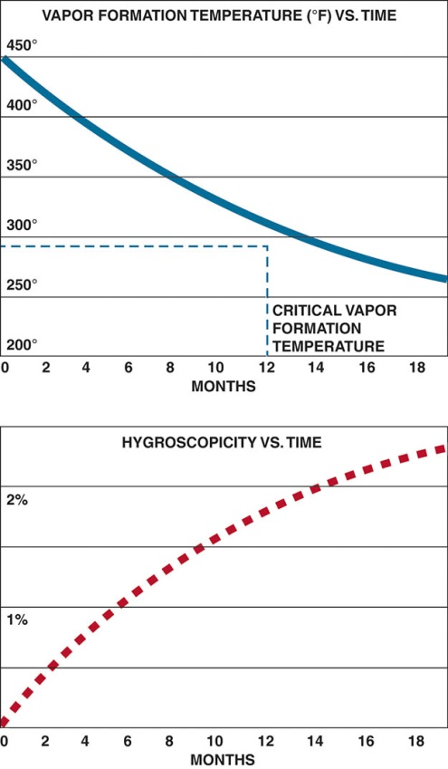
Figure 100.2 Brake fluid absorbs moisture from the air at the rate of about 2% per year. As the brake fluid absorbs water, its boiling temperature decreases

Slide 8
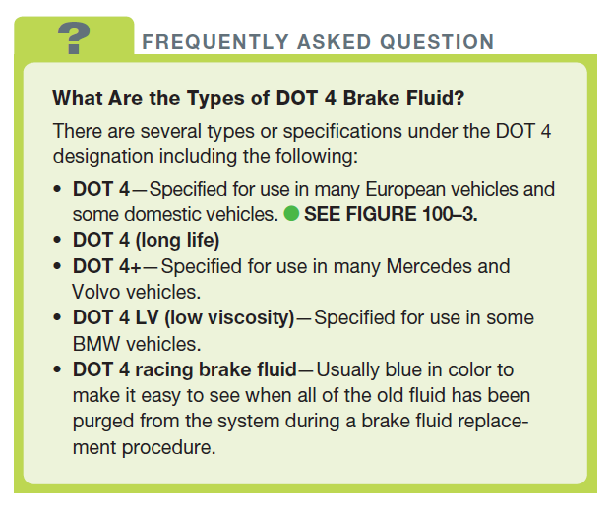
FREQUENTLY ASKED QUESTION

Slide 9
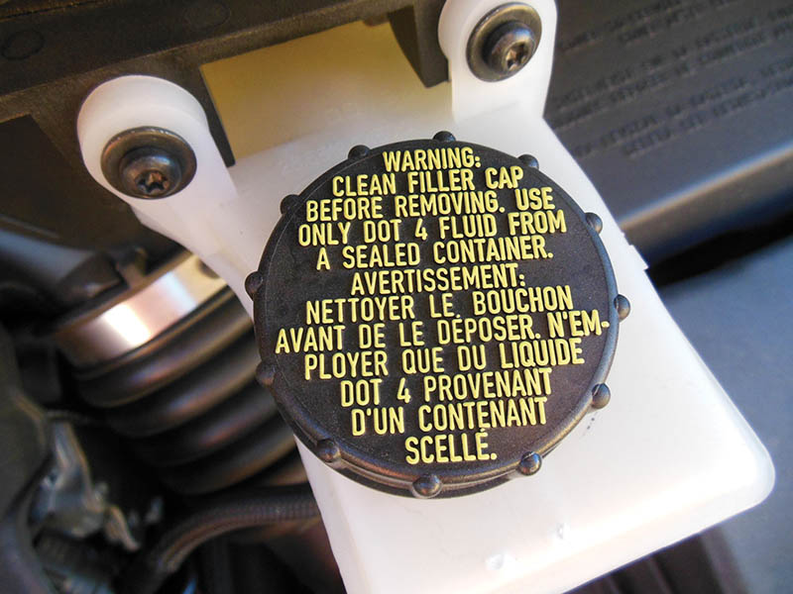
Figure 100.3 This Ford Escape requires DOT 4 as stated on the cap of the master cylinder

Slide 10
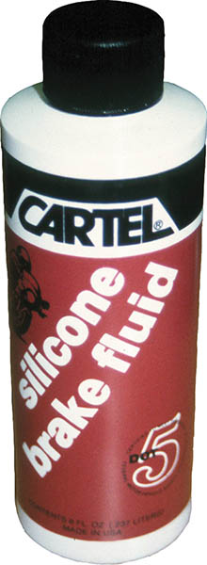
Figure 100.4 DOT 5 brake fluid is used mostly in motorcycles because if spilled, it will not hurt painted surfaces

Slide 11
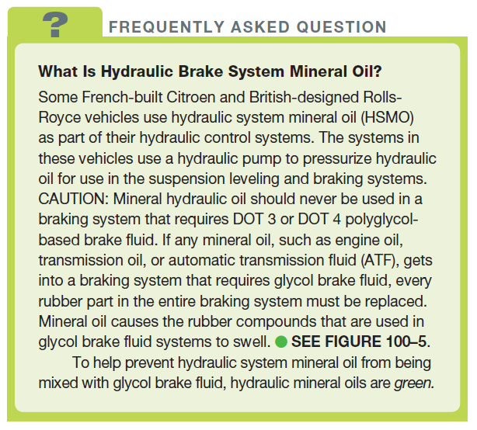
FREQUENTLY ASKED QUESTION

Slide 12
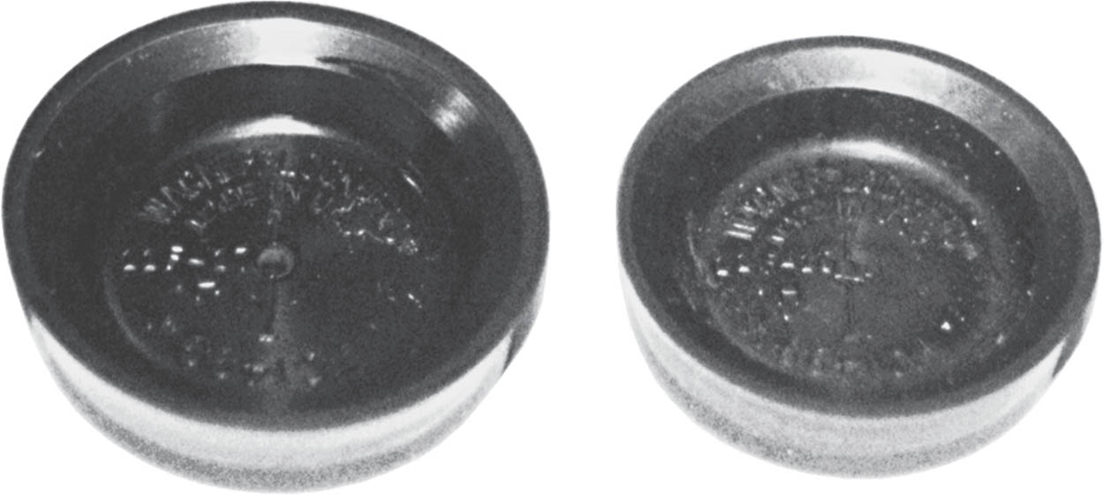
Figure 100.5 Both rubber sealing cups were exactly the same size. The cup on the left was exposed to mineral oil. Notice how the seal greatly expanded

Slide 13
QUESTION 1: ?
What is the difference between DOT 3, DOT 4, DOT 5.1, and DOT 5 brake fluid?

Slide 14
ANSWER 1:
The boiling point.

Slide 15
BRAKE FLUID SPECIFICATIONS (2 OF 2)
Brake Fluid Inspection and Testing
  Proper level.
  Color/condition.
  Tested using a tester or test strips.
  Boiling point tester.
  Brake fluid contamination test.

Slide 16
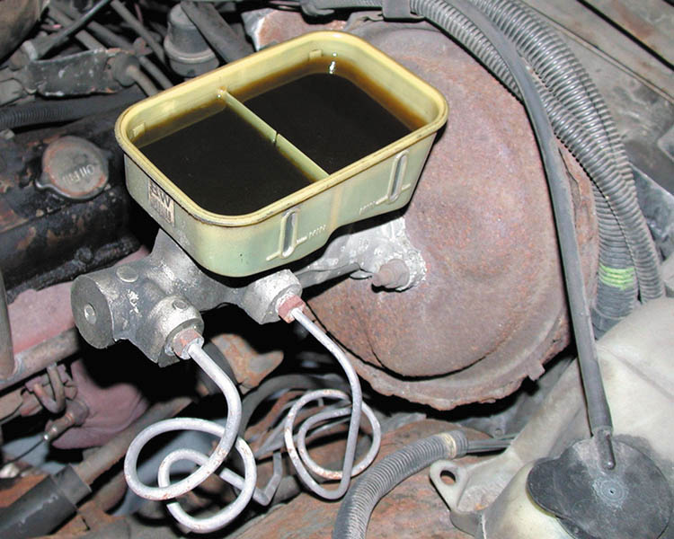
Figure 100.6 If the brake fluid is black in color, it should be replaced

Slide 17
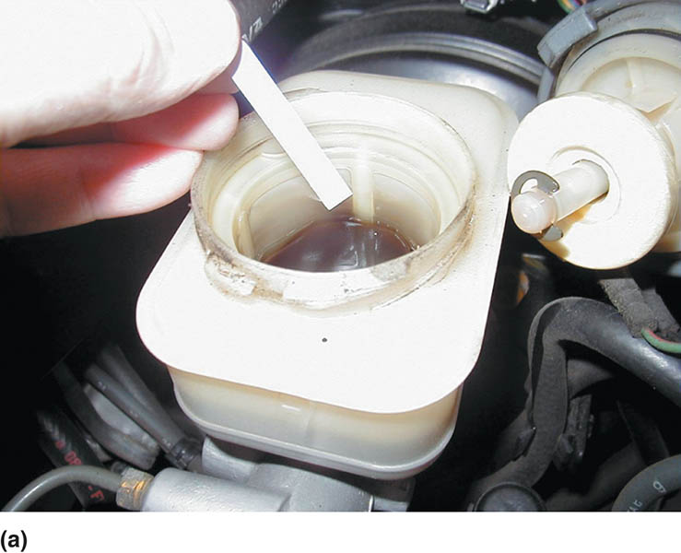
Figure 100.7 (a) A brake fluid test strip is being used to test the condition of the brake fluid

Slide 18
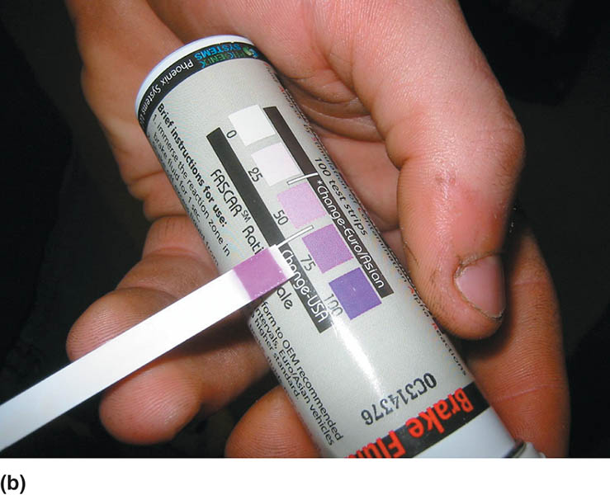
Figure 100.7 (b) The color of the test strip is then compared with a chart on the package, which indicates the condition and if the fluid should be replaced

Slide 19
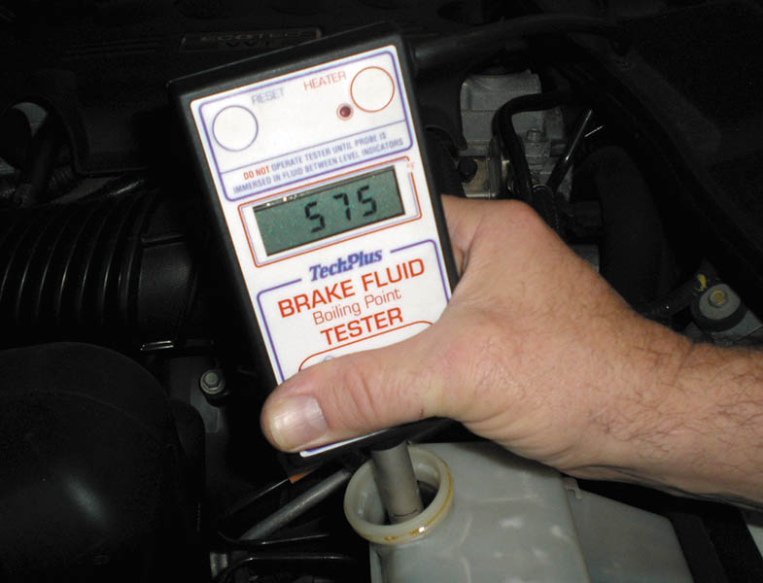
Figure 100.8 An electronic tester that measures the boiling temperature of the brake fluid is useful to help determine if the brake fluid needs to be replaced

Slide 20
BRAKE FLUID SERVICE PROCEDURES
Storage of Brake Fluid
  Store brake fluid only in its original container.
  Before opening a brake fluid container clean the top and outside of the container.
  Do not reuse brake fluid that has been siphoned from another vehicle or drawn out during a brake bleeding operation.
  Use only fresh, new brake fluid for flushing the hydraulic brake system.
Brake Fluid Handling and Disposal
  Dispose per regulations in your area.

Slide 21
QUESTION 2: ?
What are the methods for testing and inspecting brake fluid?

Slide 22
ANSWER 2:
  Proper level.
  Color/condition.
  Tested using a tester or test strips.
  Boiling point tester.
  Brake fluid contamination test.

Slide 23
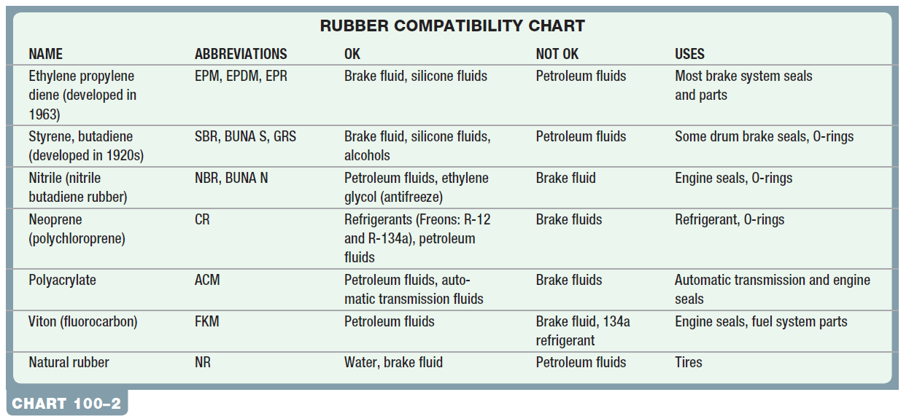
RUBBER TYPES
Terminology
  Rubber products are called elastomers

Slide 24
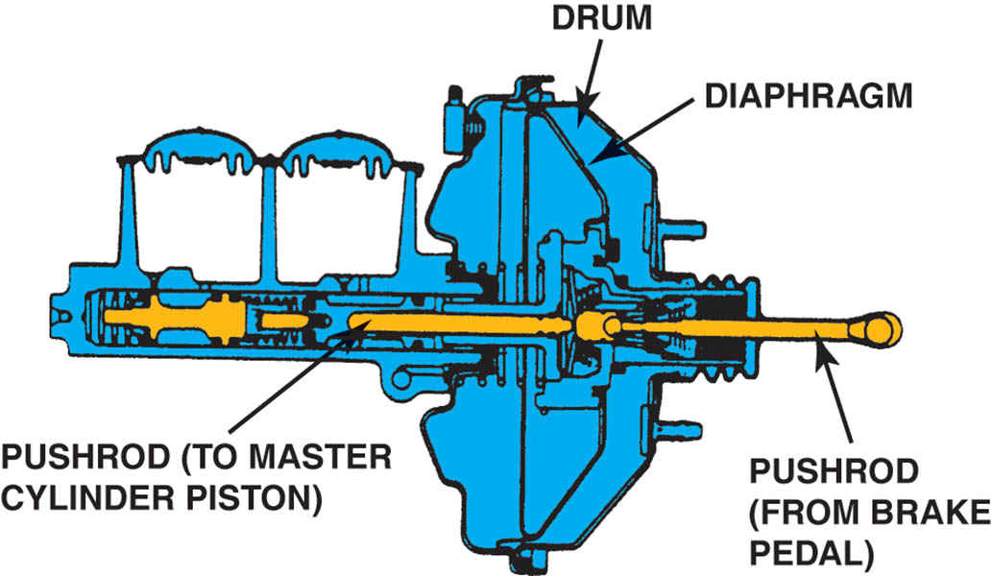
Figure 100.9 The master cylinder piston seals are usually constructed from EPDM rubber, and the diaphragm of the vacuum power brake booster is usually made from SBR

Slide 25
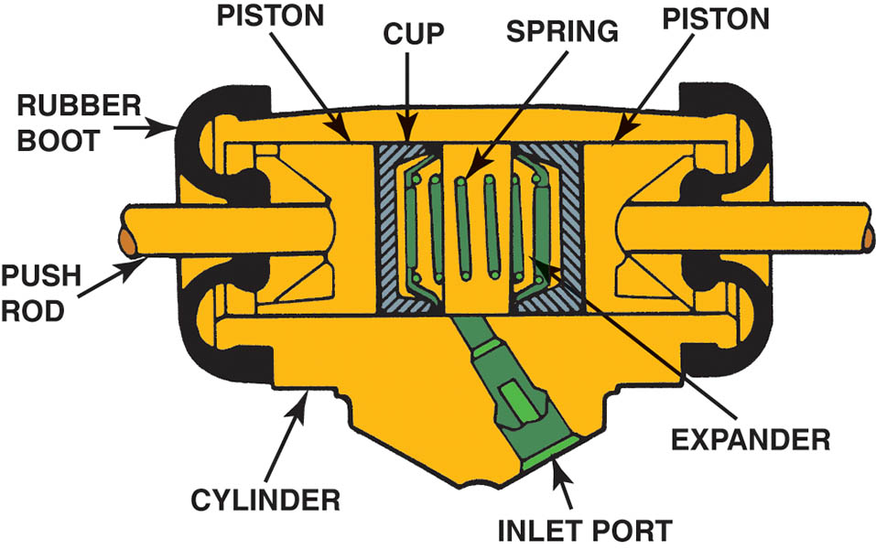
Figure 100.10 Cross-sectional view of a typical drum brake wheel cylinder. Most wheel cylinder boots and cups are either SBR or EPDM rubber

Slide 26
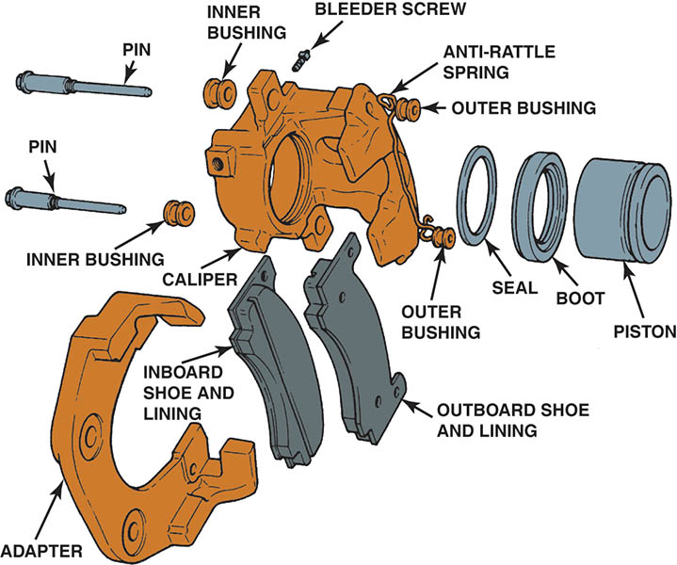
Figure 100.11 Exploded view of a typical disc brake caliper. Both the caliper seal and dust boot are constructed of EPDM rubber

Slide 27
BRAKE LINES (1 OF 4)
Construction
  High-pressure double-walled steel brake lines or high-strength flexible lines are used to connect the master cylinder to each wheel.
Steel Brake Line Coatings
  Aluminum-rich paint (called AlGal)
  Nylon-coated (called NyGal)
  Zinc
  Terne plate (lead and tin alloy)
  Epoxy
  PVF (Polyvinylfluoride)—olive green color

Slide 28
BRAKE LINES (2 OF 4)
Cooper-Nickel Brake Lines
  Nickel-copper brake line is commonly referred to as “90-10 copper” because it contains about 90% copper and 10% nickel.
Types of Flares
  Double flare
  ISO or bubble flare
Brake Line Replacement
  Pre-made lines
  Cut and flare lines to match what is needed.

Slide 29
BRAKE LINES (3 OF 4)
Coiled Brake Line
  Steel brake line is often coiled to allow movement between the brake components without stress that could lead to metal fatigue and brake line breakage.
Armored Brake Line
  The steel brake line is covered with a wire coil wrap.
  This armor is designed to prevent damage from stones and other debris that could dent or damage the brake line.

Slide 30
BRAKE LINES (4 OF 4)
Flexible Brake Hose
  Flexible brake hoses are used on each front wheel to allow for steering and suspension movement and at the rear to allow for rear suspension travel.
  Flexible brake hose is made from synthetic yarn (poly vinyl alcohol, abbreviated PVA) that is braided into position from multi-end yarn spindles.
  Are able to withstand braking system pressure over 1,000 PSI (6,900 kPa).

Slide 31
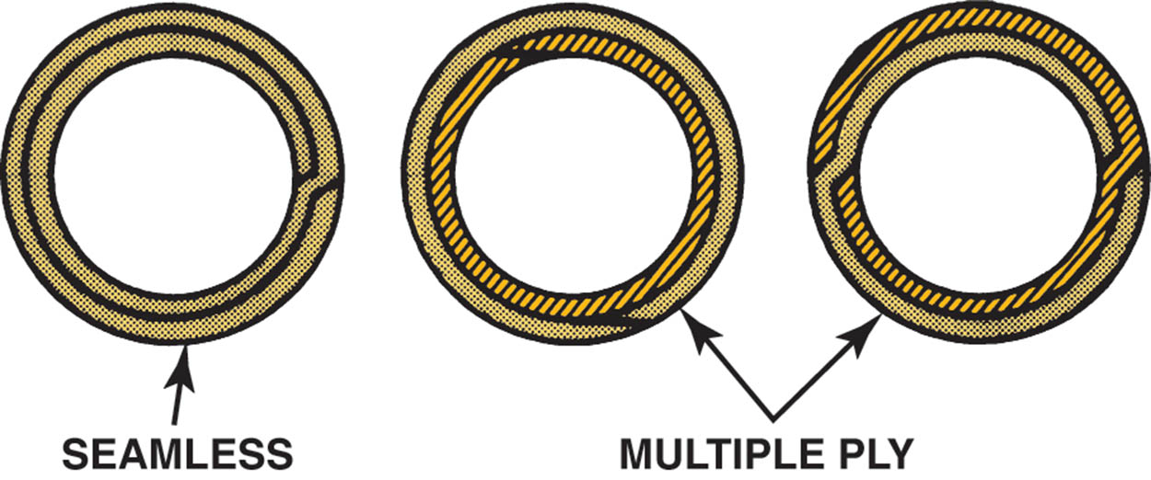
Figure 100.12 Steel brake tubing is double walled for strength and plated for corrosion resistance

Slide 32
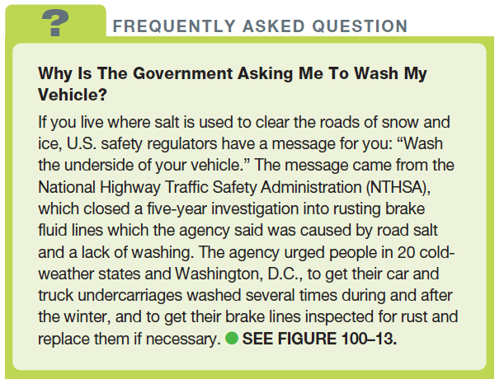
FREQUENTLY ASKED QUESTION

Slide 33
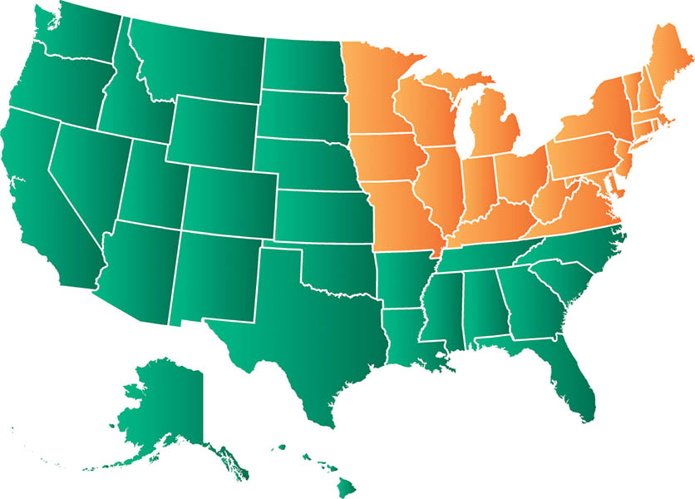
Figure 100.13 The rust prone states are areas where snow and the use of salt contribute to the brake line rust. Vehicles that operate outside this area also rust, but not to the extent that they do in the states known for rust problems

Slide 34
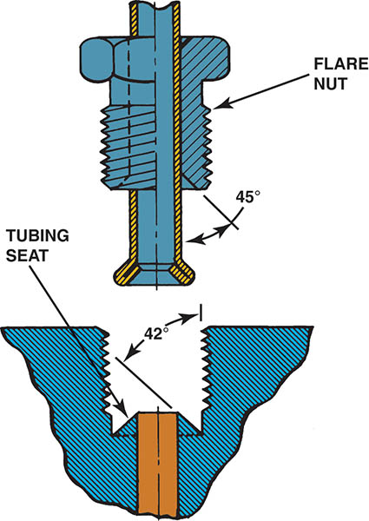
Figure 100.14 Because of the slight difference in flare angle, double-flare fitting seals cause a wedging action

Slide 35
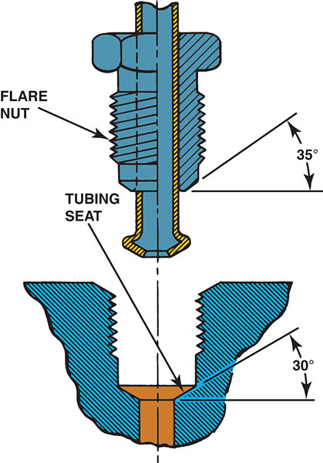
Figure 100.15 An ISO fitting, also called a ball or bubble flare

Slide 36
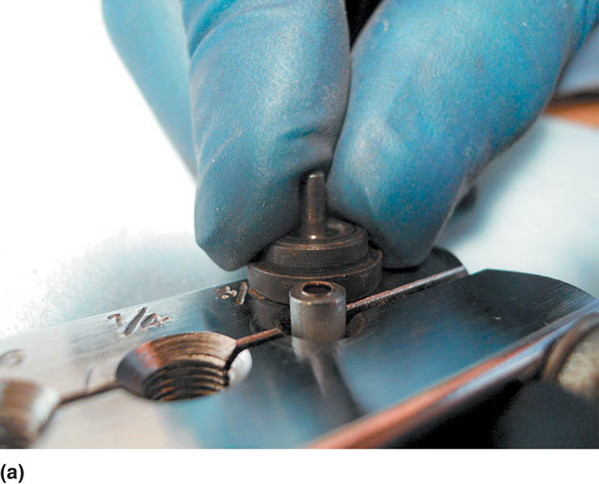
Figure 100.16 Double flaring the end of a brake line. (a) Clamp the line at the correct height above the surface of the clamping tool using the shoulder of the insert as a gauge

Slide 37
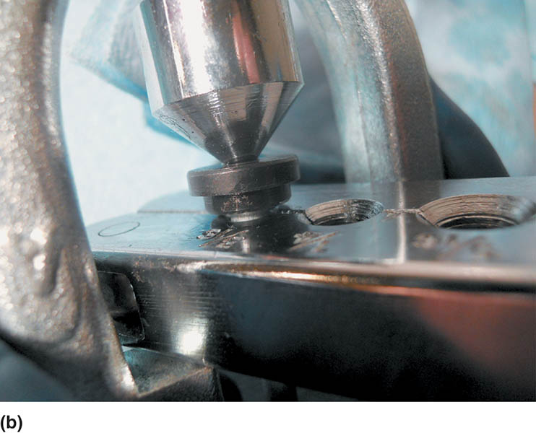
Figure 100.16 Double flaring the end of a brake line. (b) The insert is pressed into the end of the tubing. This creates the first bend

Slide 38
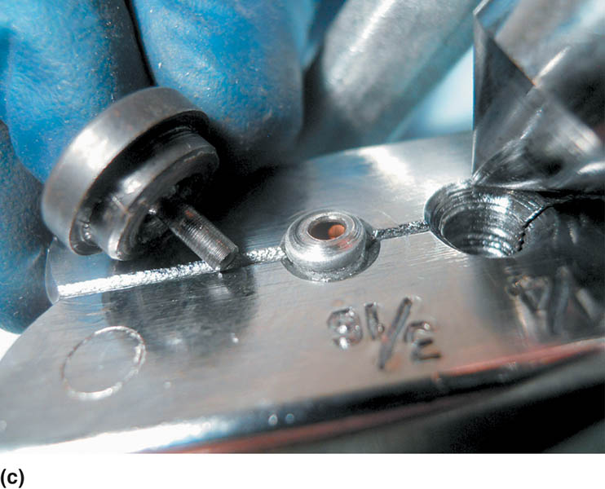
Figure 100.16 Double flaring the end of a brake line. (c) Remove the insert and use the pointed tool to complete the overlap double flare

Slide 39
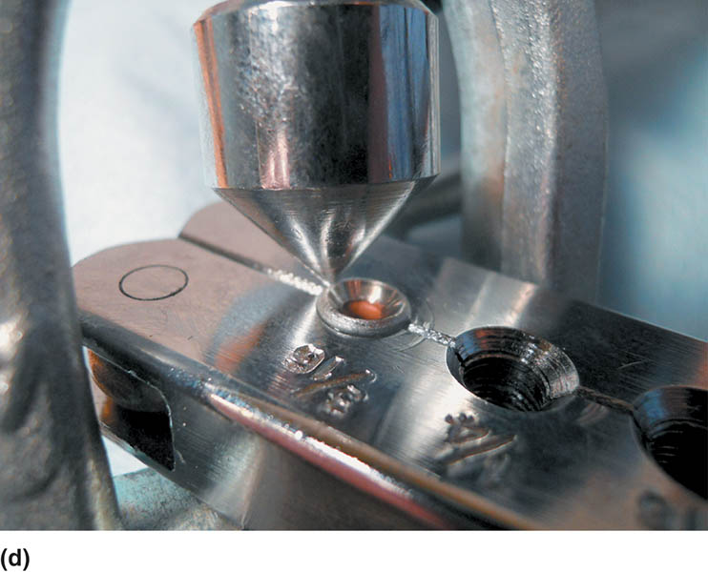
Figure 100.16 Double flaring the end of a brake line. (d) The completed operation as it appears while still in the clamp

Slide 40
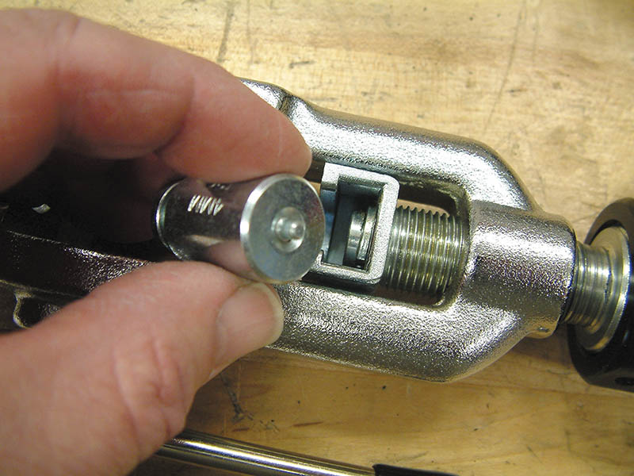
Figure 100.17 Making an ISO flare requires a special tool. (a) Select the proper size forming mandrel

Slide 41
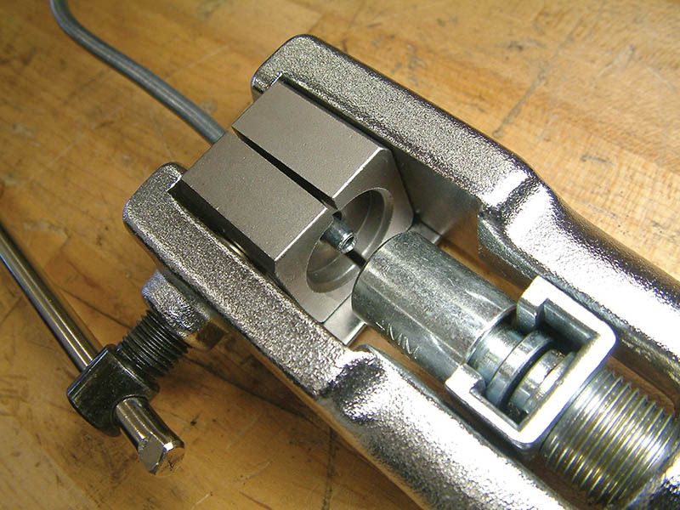
Figure 100.17 Making an ISO flare requires a special tool. (b) Clamp the tubing flush with the split die and place the mandrel into the tool

Slide 42
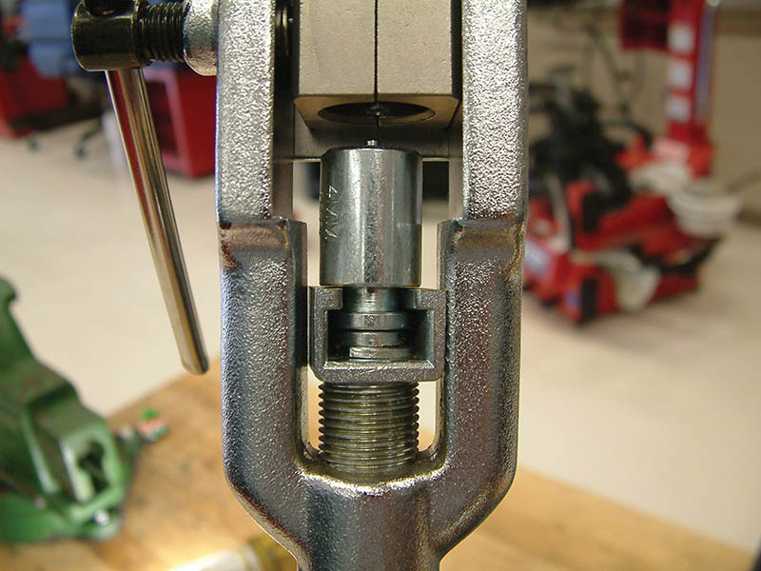
Figure 100.17 Making an ISO flare requires a special tool. (c) Thread the tool handle in until the mandrel pilot seats into the tubing

Slide 43
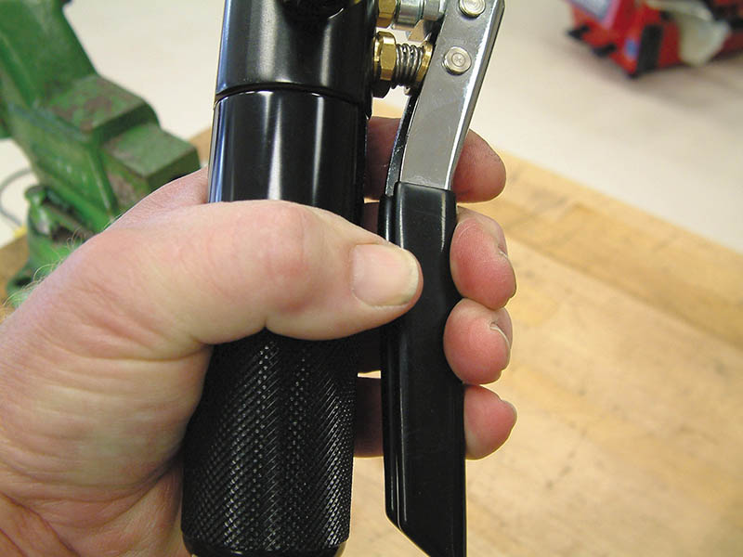
Figure 100.17 Making an ISO flare requires a special tool. (d) Close the tool valve and pump the handle until the mandrel seats in the die

Slide 44
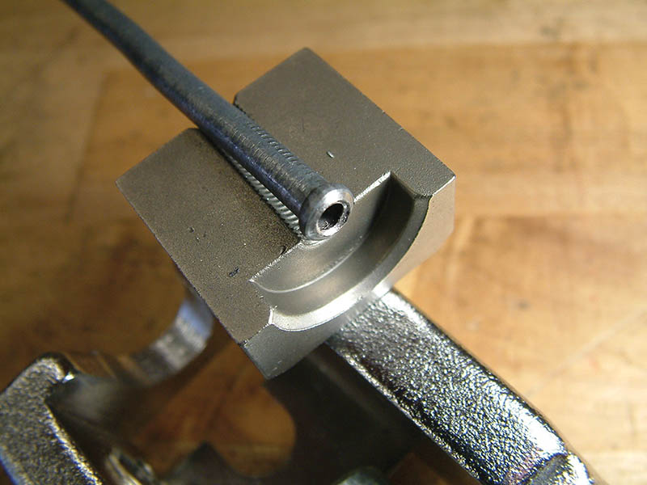
Figure 100.17 Making an ISO flare requires a special tool. (e) The strong hydraulic pressure forms the ISO flare

Slide 45
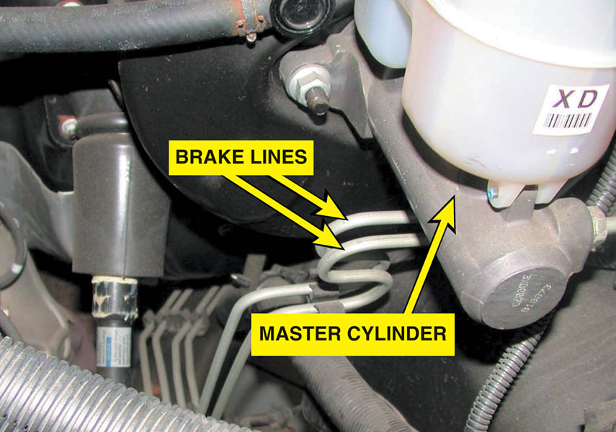
Figure 100.18 The coils in the brake line help prevent cracks caused by vibration

Slide 46
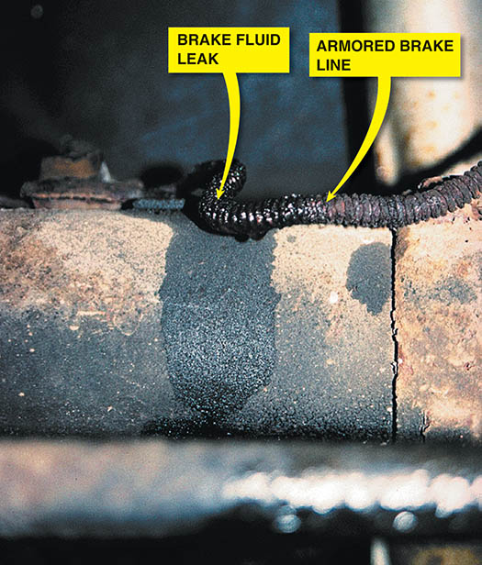
Figure 100.19 Armored brake line is usually used in the location where the line may be exposed to rock or road debris damage. Even armored brake line can leak and a visual inspection is an important part of any brake service

Slide 47
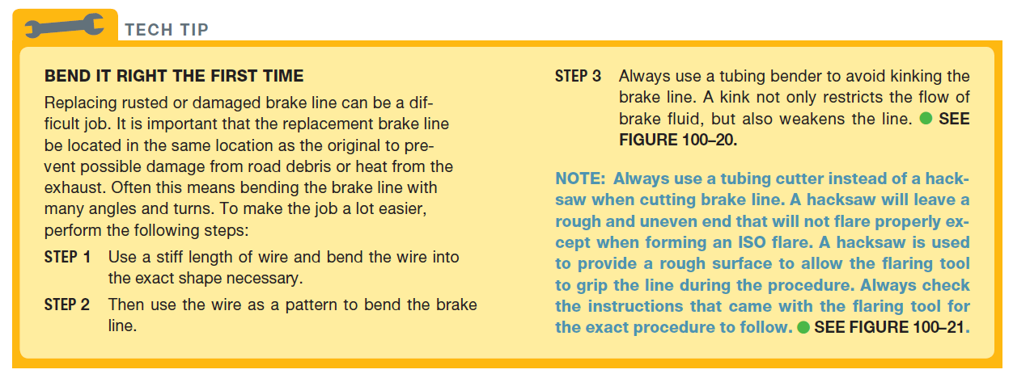
TECH TIP

Slide 48
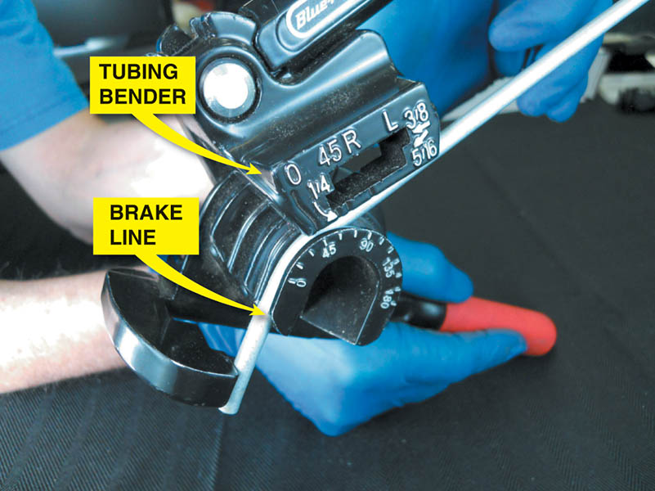
Figure 100.20 A tube bender being used to bend a brake line

Slide 49
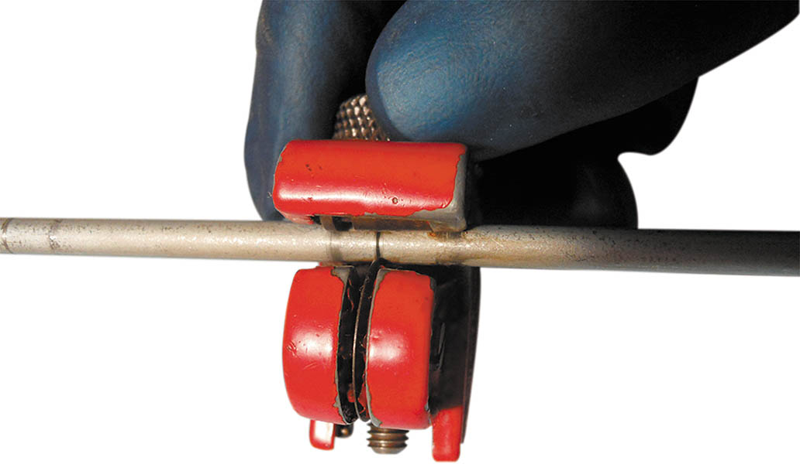
Figure 100.21 A tubing cutter is the preferred tool to use to cut brake line because it leaves a clean edge

Slide 50
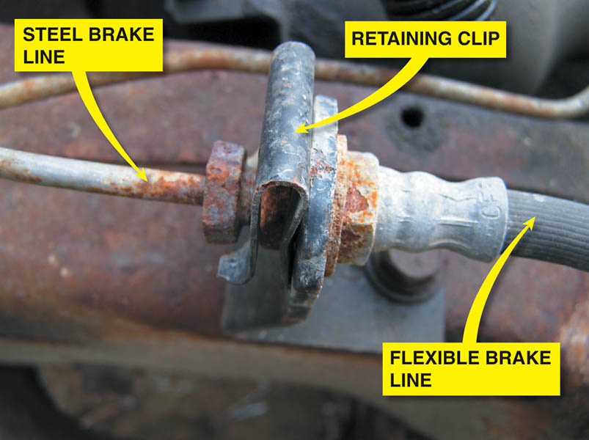
Figure 100.22 Flexible brake hoses are used between the frame or body of the vehicle and the wheel brakes. Because of suspension and/or steering movement, these flexible brake lines must be strong enough to handle high brake fluid pressures, yet remain flexible

Slide 51
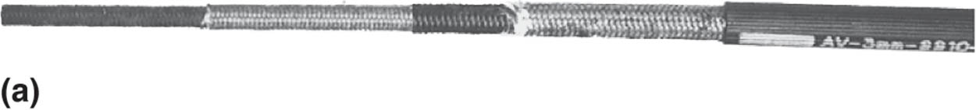
Figure 100.23 (a) Typical flexible brake hose showing the multiple layers of rubber and fabric

Slide 52
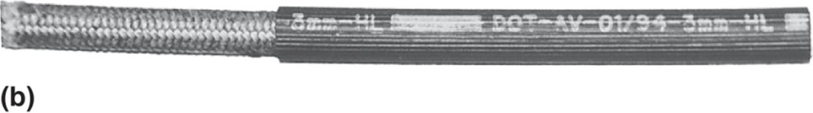
Figure 100.23 (b) The inside diameter (ID) is printed on the hose (3 mm)

Slide 53
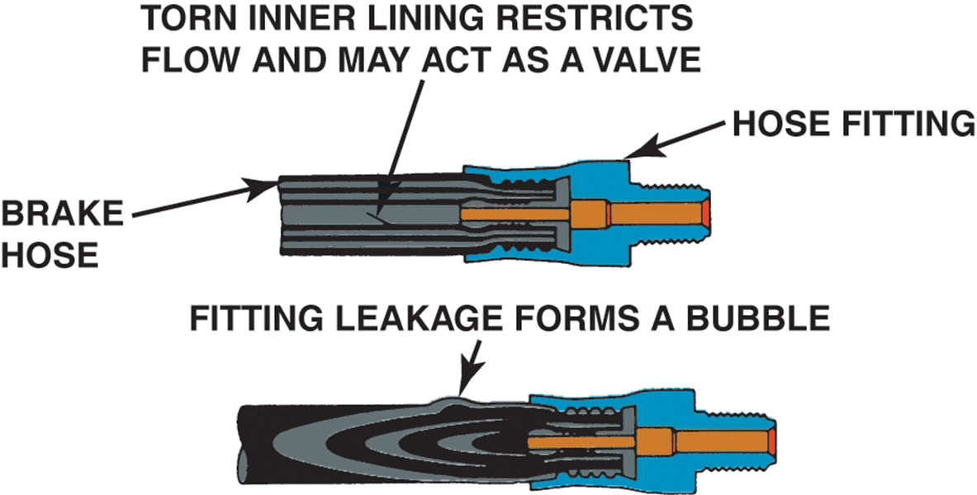
Figure 100.24 Typical flexible brake hose faults. Many faults cannot be seen, yet can cause the brakes to remain applied after the brake pedal is released

Slide 54
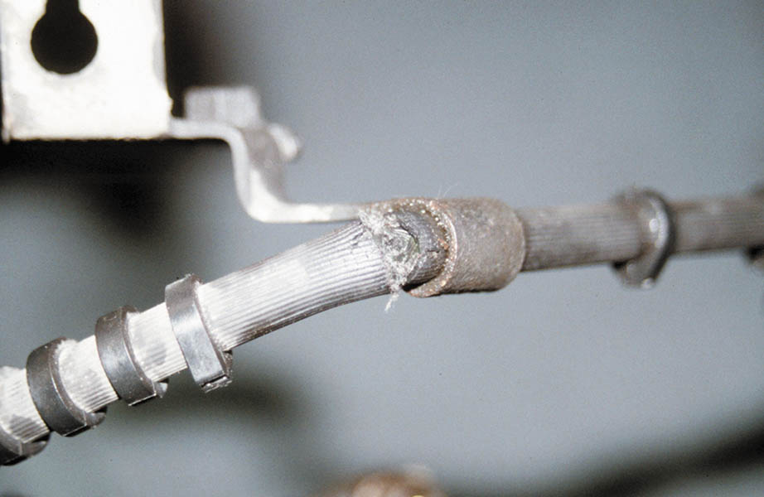
Figure 100.25 Flexible brake hose should be carefully inspected for cuts or other damage, especially near sections where the brake hose is attached to the vehicle. Notice the crack and cut hose next to the mounting bracket

Slide 55
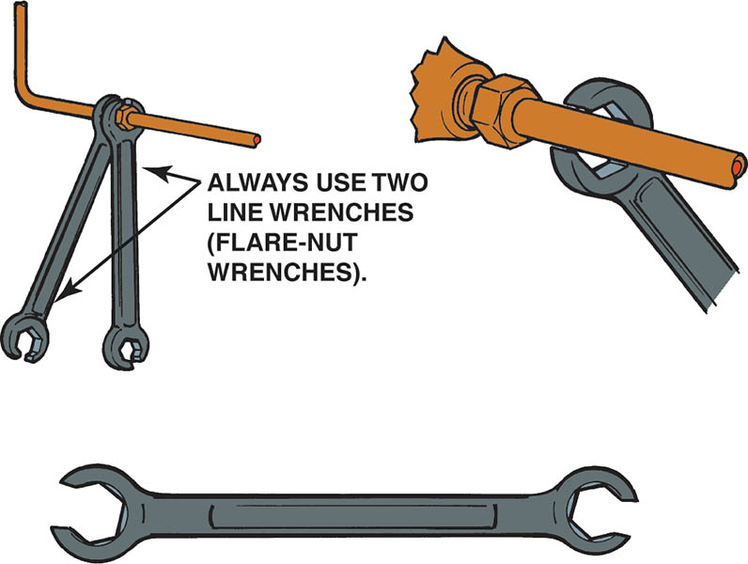
Figure 100.26 Whenever disconnecting or tightening a brake line, always use the correct size flare-nut wrench. A flare-nut wrench is also called a tube-nut wrench or a line wrench

Slide 56
QUESTION 3: ?
What are the two types of flares used on brake lines?

Slide 57
ANSWER 3:
Bubble and ISO.

Slide 58
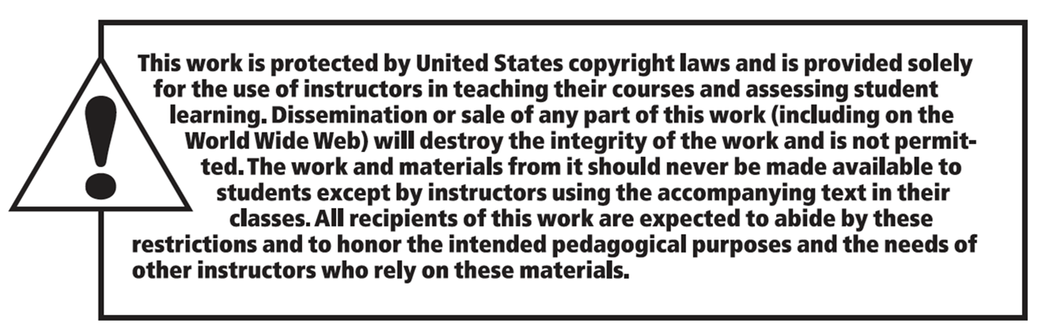
Copyright

