Slide 1

Automotive Technology Principles, Diagnosis, and Service
Sixth Edition
Chapter 10
Power Tools and Shop Equipment
Copyright © 2018, 2015, 2011 Pearson Education, Inc. All Rights Reserved

Slide 2
LEARNING OBJECTIVES (1 of 2)
10.1 Describe the purpose of the air compressor, and other air and electrically operated tools.
10.2 Compare the different types of trouble lights.
10.3 Describe the purpose of the bench/pedestal grinder and the bench vise.

Slide 3
LEARNING OBJECTIVES (2 of 2)
10.4 Discuss the purpose of hydraulic presses, portable crane and chain hoist, and engine stands.
10.5 Describe proper care and maintenance of shop equipment.

Slide 4
AIR COMPRESSOR
Typically located in a separate room.
Powered by a 220-volt AC electric motor.
Includes the storage tank and the compressor.
Maintains a minimum air pressure.

Slide 5
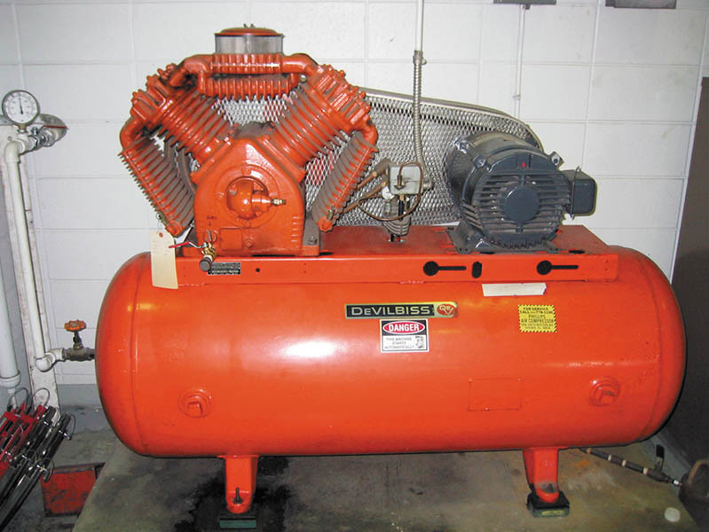
Figure 10.1 A typical shop compressor. It is usually placed out of the way, yet accessible to provide for maintenance to the unit

Slide 6
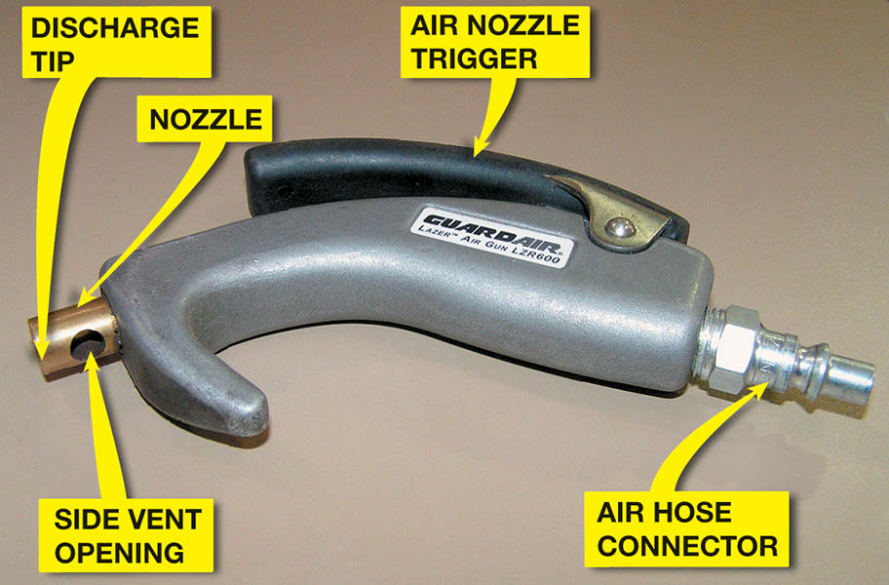
Figure 10.2 Always use an air nozzle that is OSHA approved. The openings in the side are used to allow air to escape if the nozzle tip were to become clogged

Slide 7
QUESTION 1: ?
When using a blow gun, what precautions need to be taken?

Slide 8
ANSWER 1:
Automotive air-blow guns should meet OSHA requirements.

Slide 9
AIR AND ELECTRICALLY OPERATED TOOLS
These tools include:
Impact wrench
Air ratchet
Die grinder
Air drill
Air-blow gun
Air operated grease gun
Battery powered grease gun

Slide 10
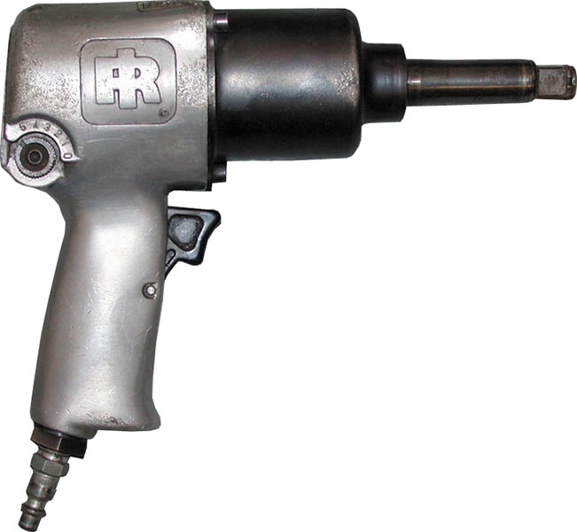
Figure 10.3 A typical 1/2 inch drive impact wrench

Slide 11
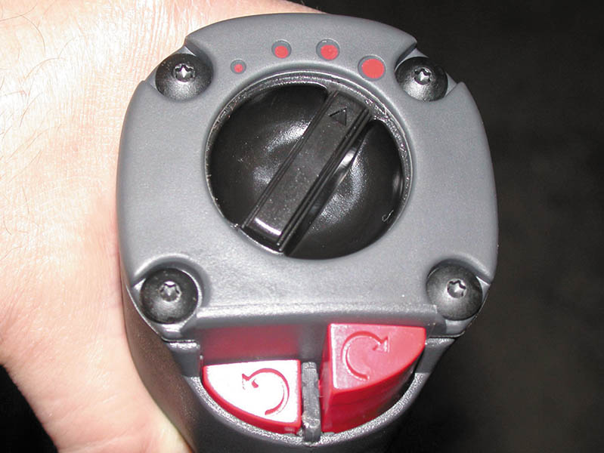
Figure 10.4 This impact wrench features a variable torque setting using a rotary knob. The direction of rotation can be changed by pressing the buttons at the bottom

Slide 12
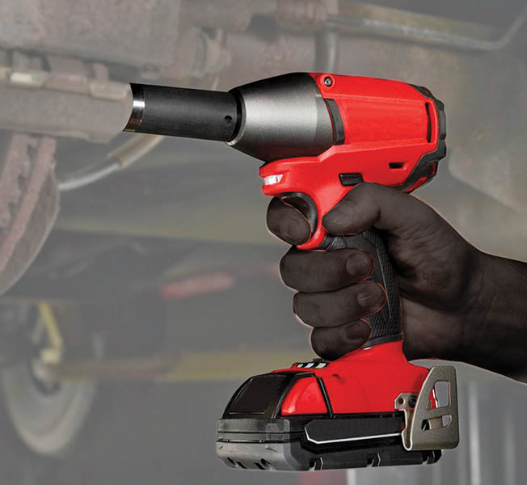
Figure 10.5 A typical battery-powered 1/2 inch drive impact wrench

Slide 13
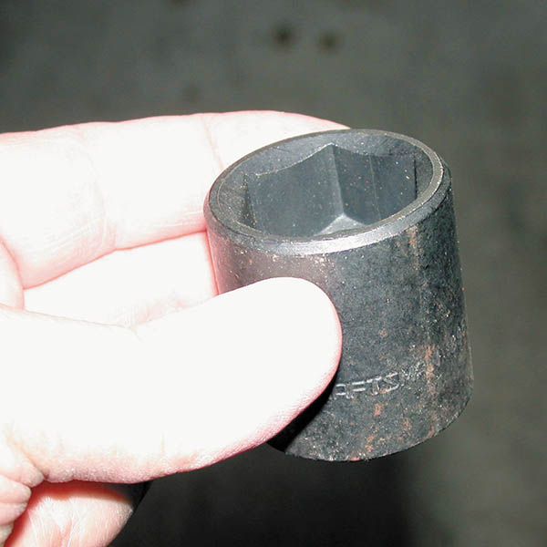
Figure 10.6 A black impact socket. Always use impact-type sockets whenever using an impact wrench to avoid the possibility of shattering the socket, which can cause personal injury

Slide 14
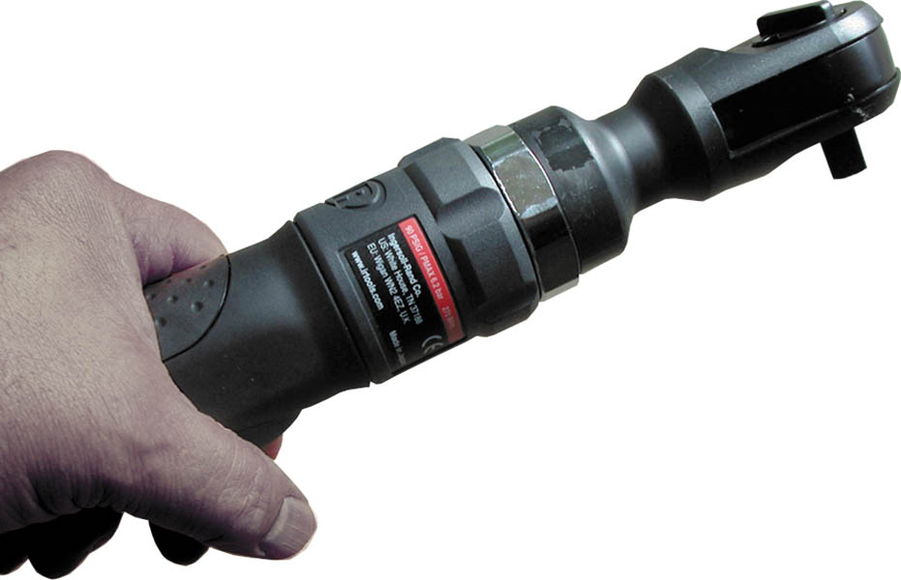
Figure 10.7 An air ratchet is a very useful tool that allows fast removal and installation of fasteners, especially in areas that are difficult to reach or do not have room enough to move a hand ratchet wrench

Slide 15
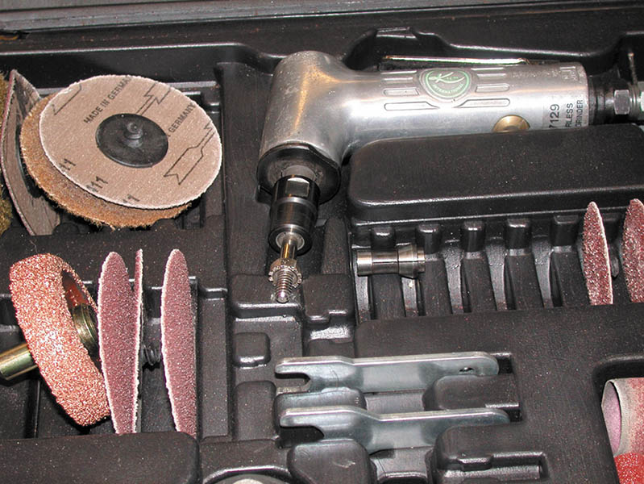
Figure 10.8 This typical die grinder surface preparation kit includes the air-operated die grinder, as well as a variety of sanding discs for smoothing surfaces or removing rust

Slide 16
TROUBLE LIGHTS
Incandescent: Uses a filament that produces light when electric current flows through the bulb.
Fluorescent: Light tubes are protected with plastic sleeves and are less likely to break.
LED: Light-emitting diode trouble lights are brighter, longer lasting, and do not represent a fire hazard.

Slide 17
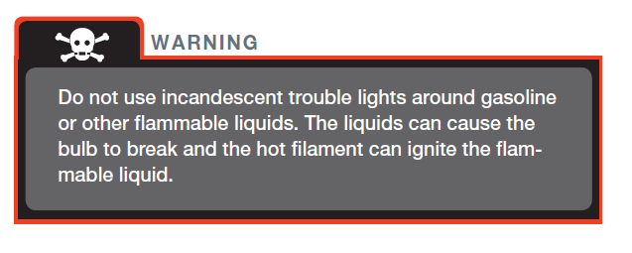
WARNING

Slide 18
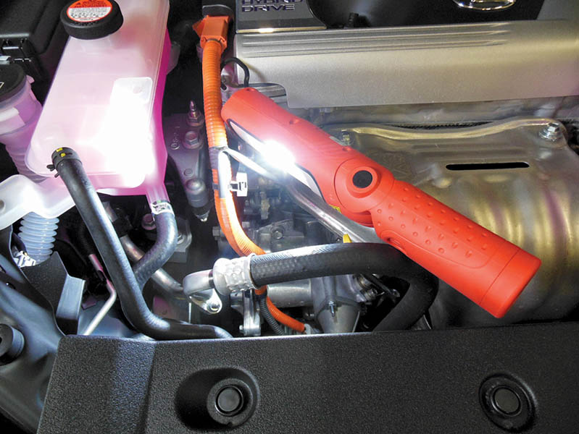
Figure 10.9 A battery-powered LED trouble light

Slide 19
QUESTION 2: ?
Which trouble light design(s) is (are) the recommended type for
maximum safety?

Slide 20
ANSWER 2:
LED trouble lights do not represent a fire hazard.

Slide 21
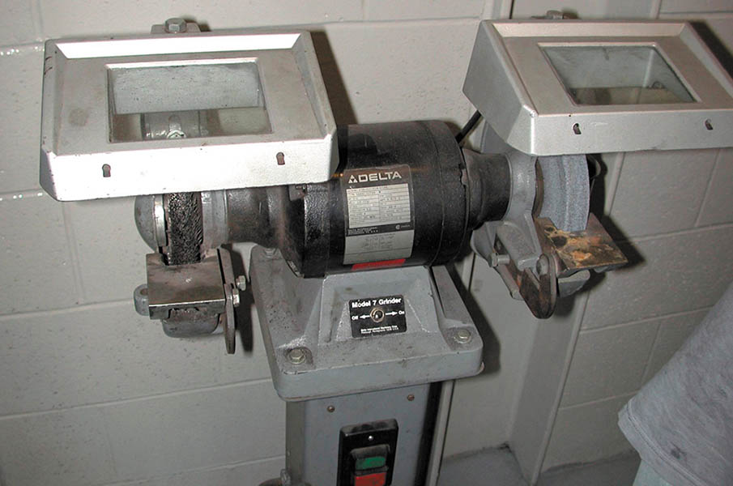
Figure 10.10 A typical pedestal grinder with a wire wheel on the left side and a stone wheel on the right side. Even though this machine is equipped with guards, safety glasses or a face shield should always be worn when using a grinder or wire wheel

Slide 22
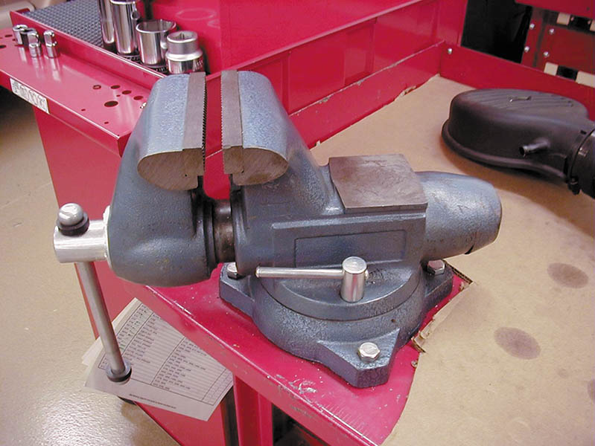
Figure 10.11 A typical vise mounted to a workbench

Slide 23
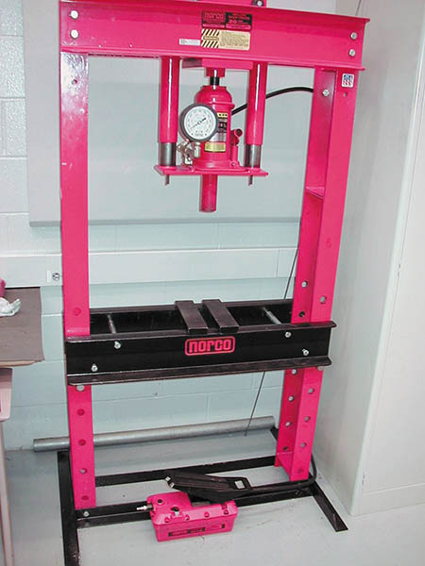
Figure 10.12 A hydraulic press is usually used to press bearings on and off of rear axles and transmissions

Slide 24
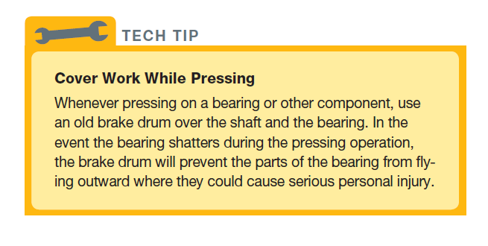
Tech Tip

Slide 25
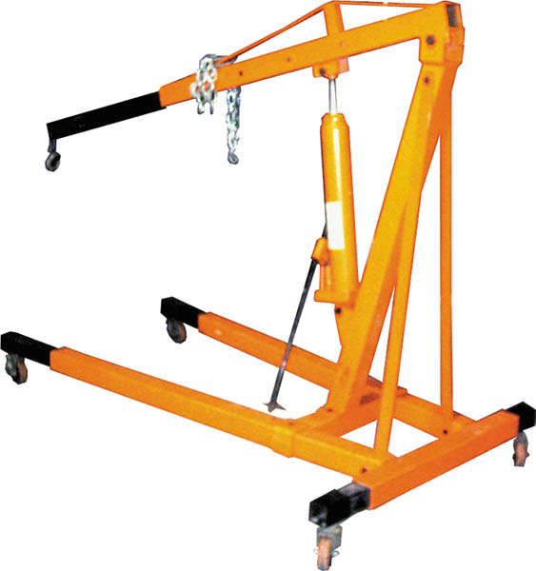
Figure 10.13 A typical portable crane used to lift and move heavy assemblies, such as engines and transmissions

Slide 26
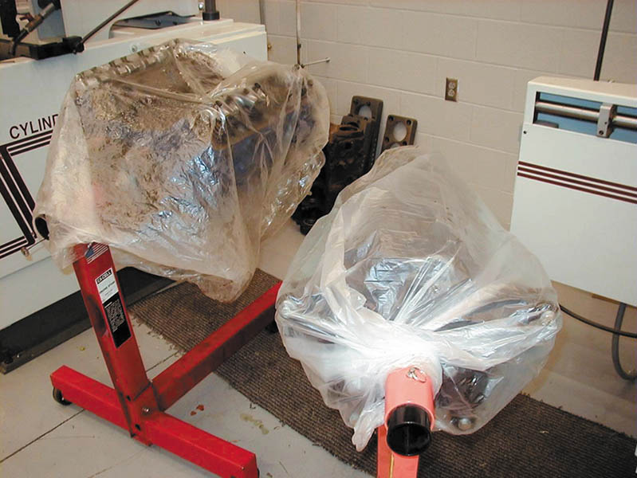
Figure 10.14 Two engines on engine stands. The plastic bags over the engines help keep dirt from getting onto these engines and engine parts

Slide 27
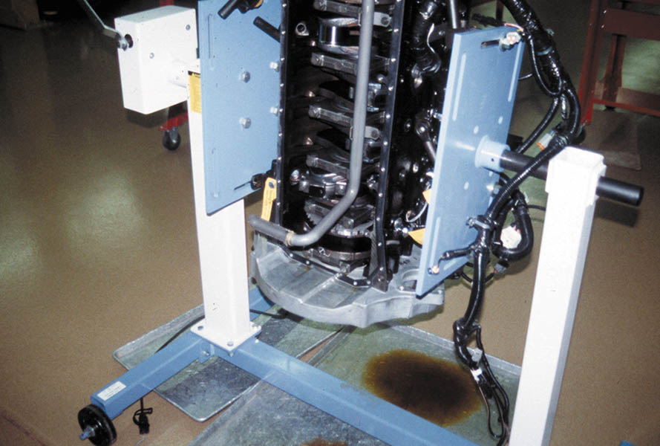
Figure 10.15 An engine stand that grasps the engine from the sides rather than the end

Slide 28
SETUP AND USE OF A TORCH

Slide 29
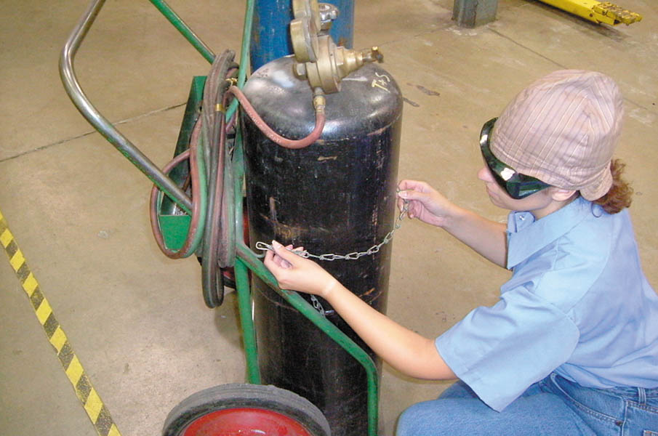
Inspect the cart and make sure the tanks are chained properly before moving it to the work location.

Slide 30
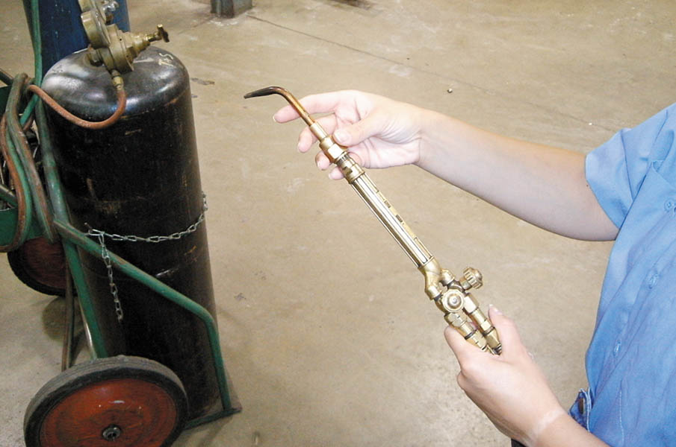
Start by attaching the appropriate work tip to the torch handle. The fitting should only be tightened hand tight. Make sure the valves on the torch handle are closed at this time.

Slide 31
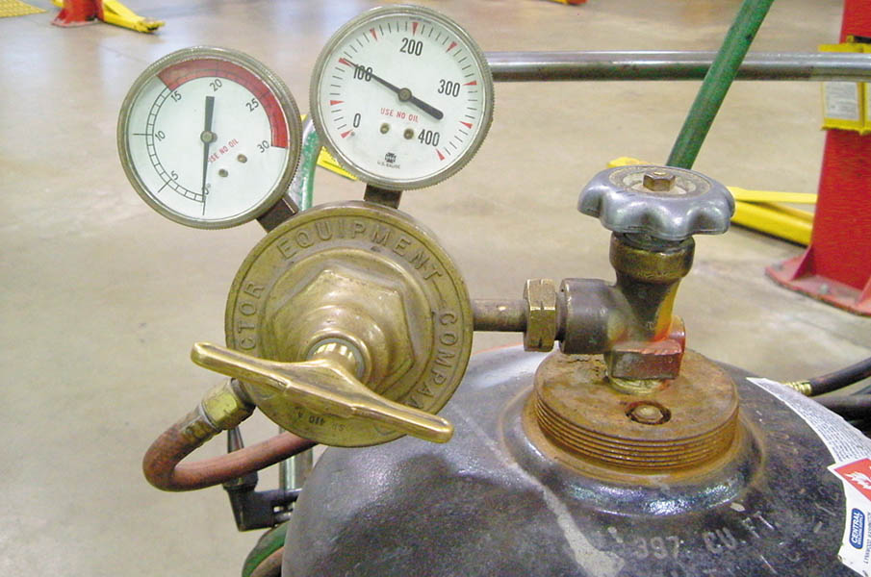
Each tank has a regulator assembly with two gauges. The high-pressure gauge shows tank pressure, and the low-pressure gauge indicates working pressure.

Slide 32
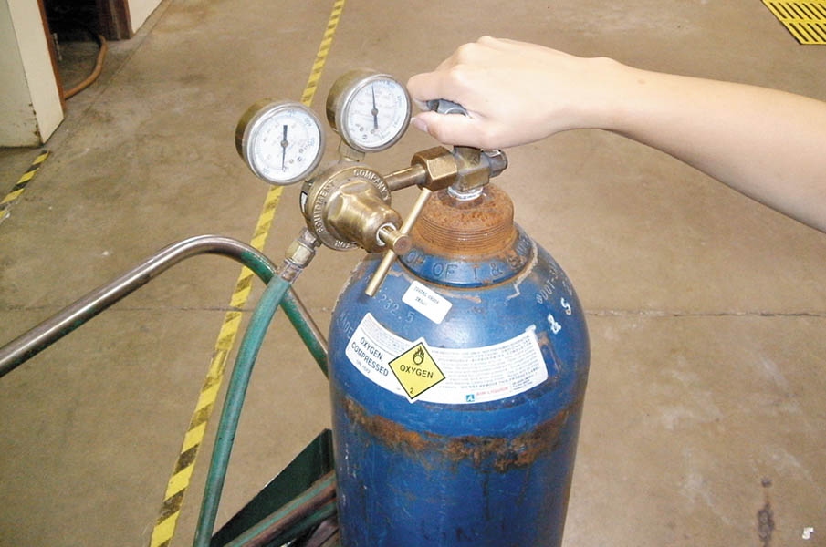
Open the oxygen tank valve fully open, and open the acetylene tank valve 1/2 turn.

Slide 33
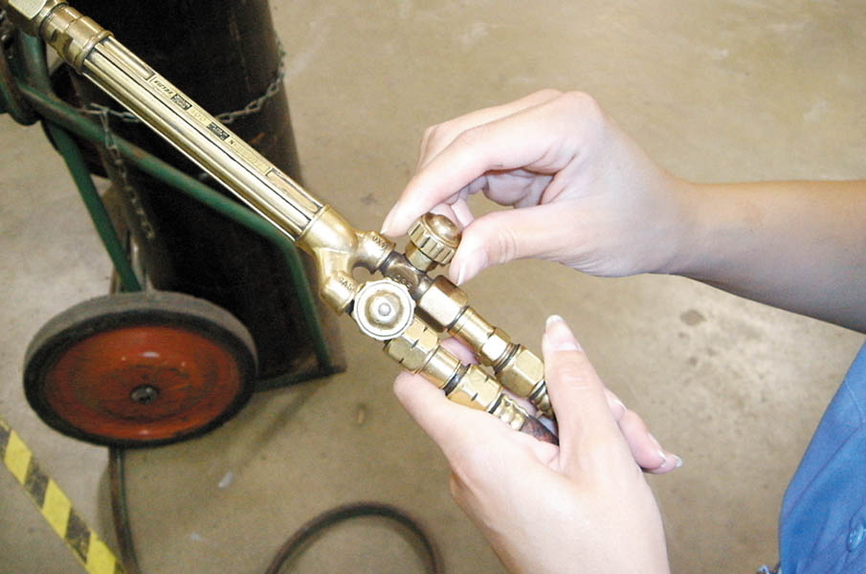
Open the oxygen valve on the torch handle 1/4 turn in preparation for adjusting oxygen gas pressure.

Slide 34
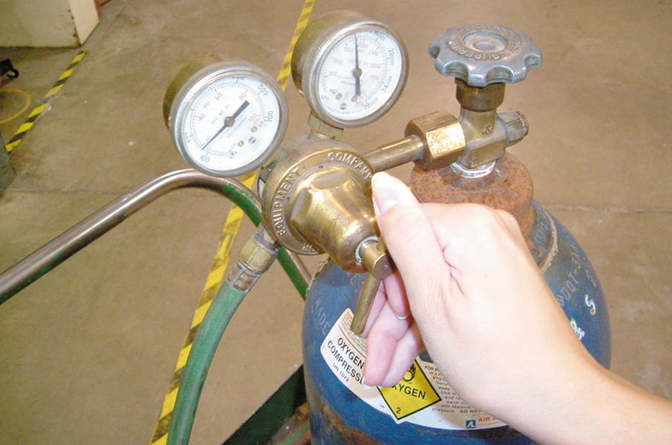
Turn the oxygen regulator valve clockwise and adjust oxygen gas pressure to 20 PSI. Close the oxygen valve on the torch handle.

Slide 35
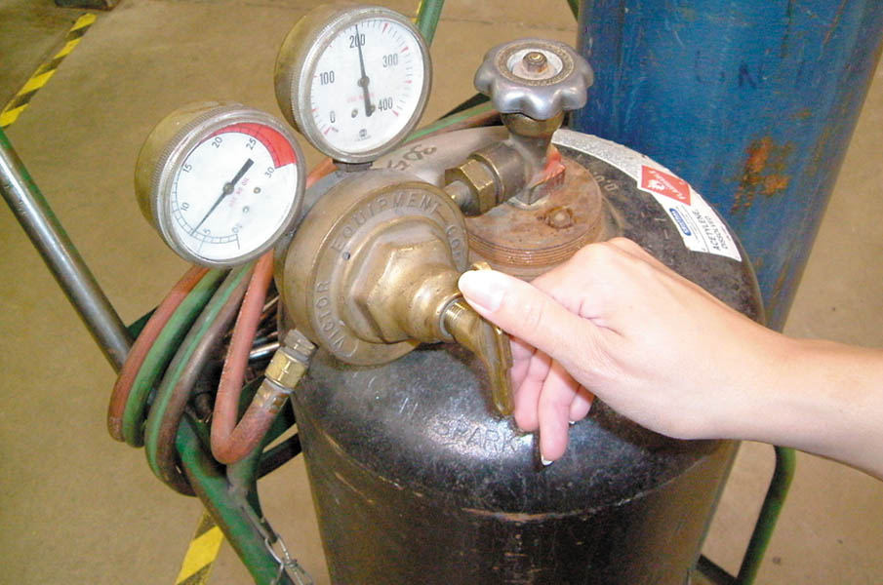
Open the acetylene valve on the torch handle 1/4 turn and adjust acetylene gas pressure to 7 PSI. Close the acetylene valve on the torch handle.

Slide 36
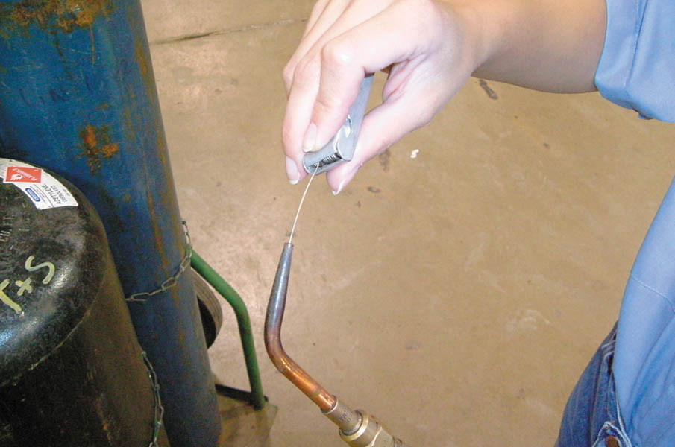
Open the oxygen valve on the torch handle 1/4 turn and use an appropriate size tip cleaner to clean the tip orifice. Finish by closing the oxygen valve.

Slide 37
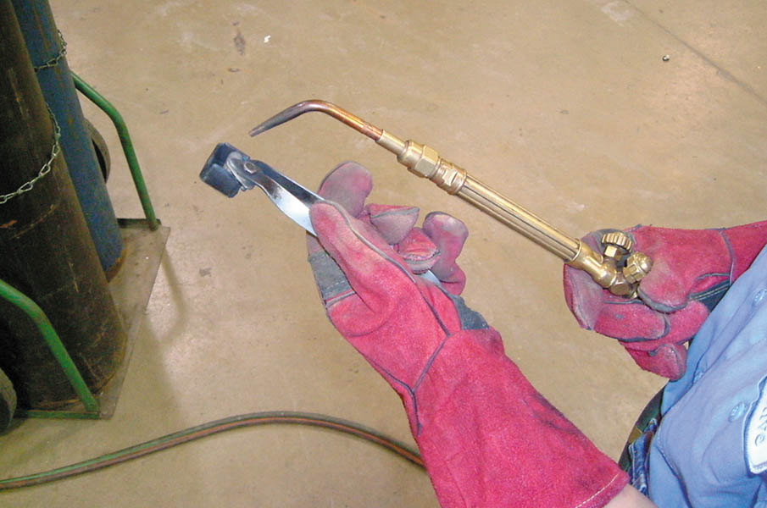
Put on leather gloves and open the acetylene valve on the torch handle 1/4 turn. Use a flint striker to ignite the acetylene gas exiting the torch tip.

Slide 38
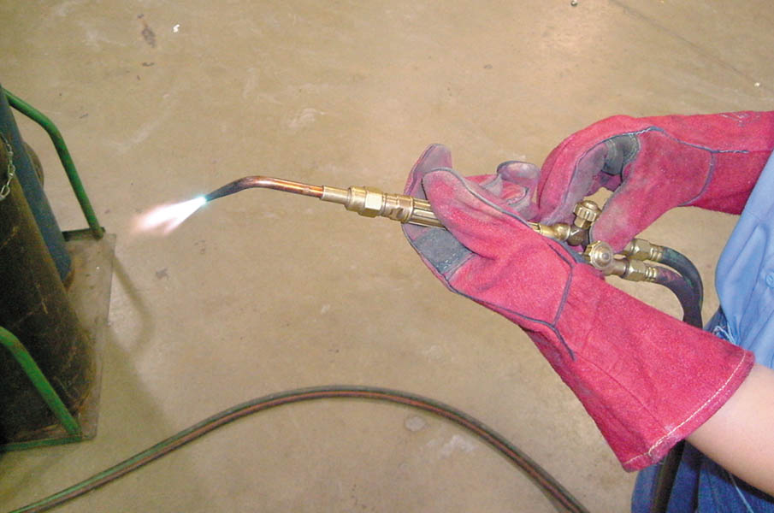
Adjust the acetylene valve until the base of the flame just touches the torch tip. Slowly open the oxygen valve on the torch handle and adjust for a neutral flame (blue cone is well-defined).

Slide 39
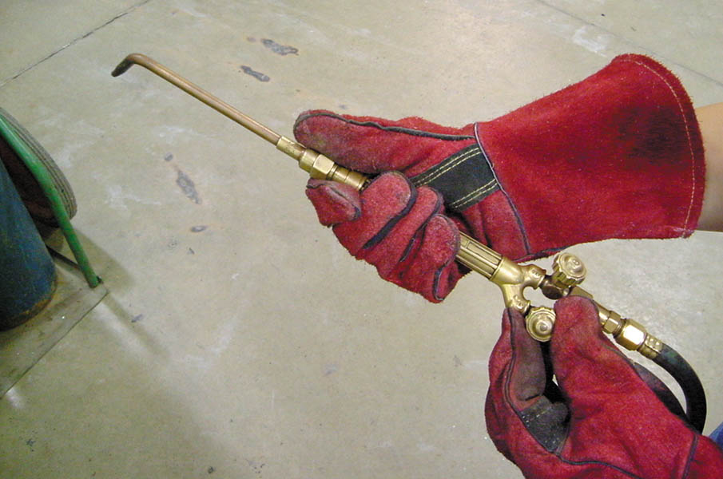
Once work is complete, extinguish the flame by quickly closing the acetylene valve on the torch handle. Be prepared to hear a loud “pop” when the flame goes out. Close the oxygen valve on the torch handle.

Slide 40
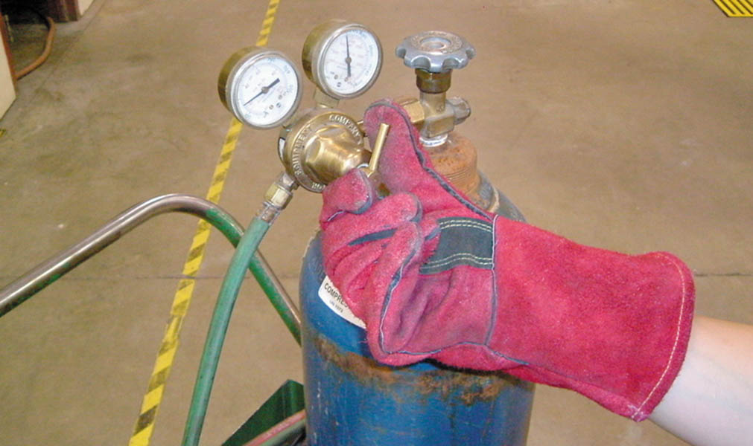
Close the valves on both tanks and turn the regulator handles counterclockwise until they no longer contact the internal springs. Open the gas valves briefly on the torch handle to release gas pressure from the hoses. Close the gas valves on the torch handle and put away the torch assembly.

Slide 41
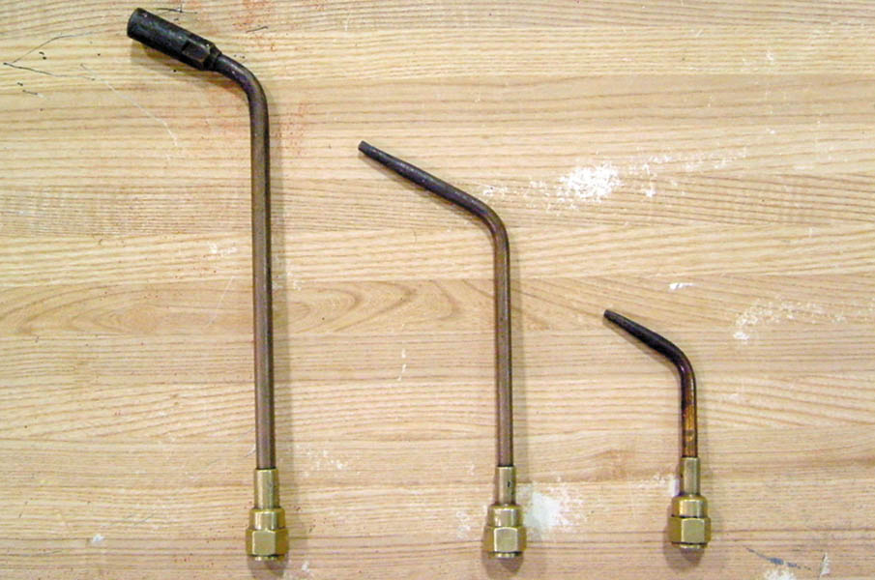
Heating attachments include ordinary heating tips, middle and right and a “rosebud” (left). Ordinary heating tips work fine for most purposes, but occasionally the rosebud is utilized when a great deal of heat is needed.

Slide 42
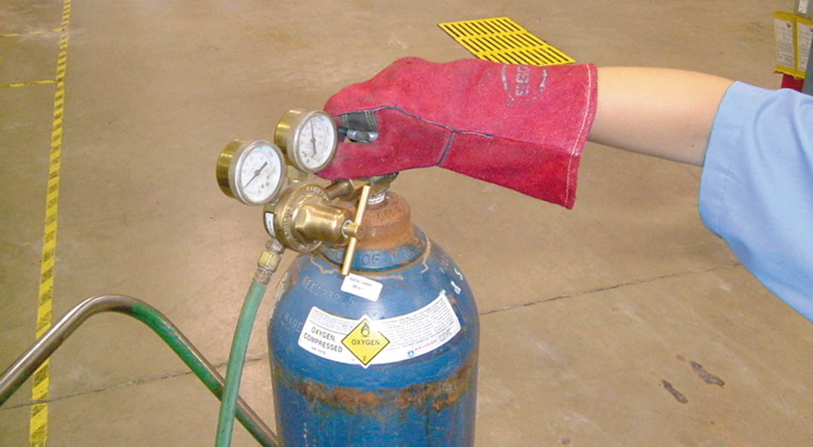
Note that while acetylene tank pressures are relatively low, the oxygen tank can be filled to over 2,000 PSI. This can represent a serious hazard if precautions are not taken. Be absolutely certain that the tanks are chained properly to the cart before attempting to move them!

Slide 43
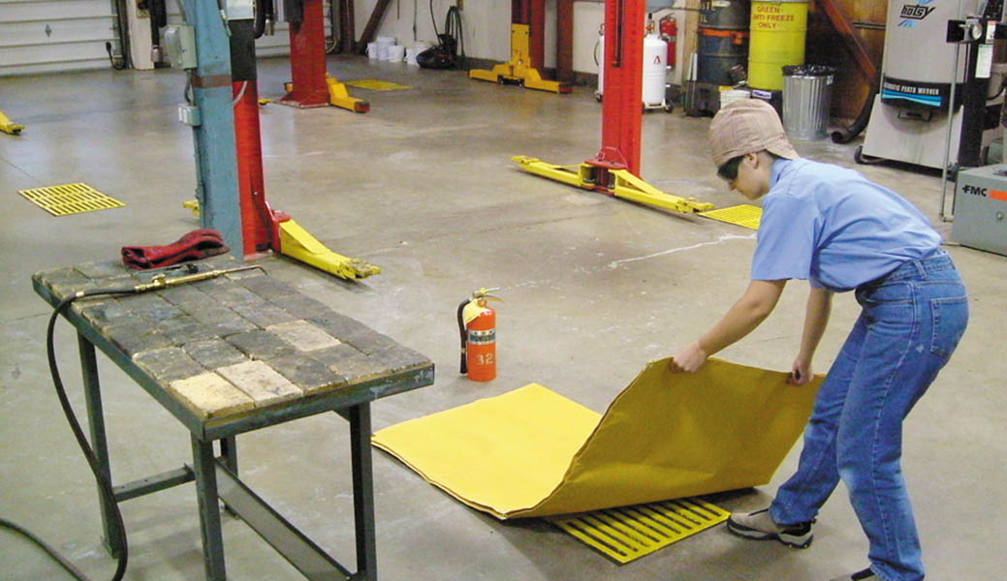
Any time heating or cutting operations are being performed, be sure that any flammables have been removed from the immediate area. A fire blanket may be placed over floor drains or other objects to prevent fires. A fire extinguisher should be on hand in case of an emergency.

Slide 44
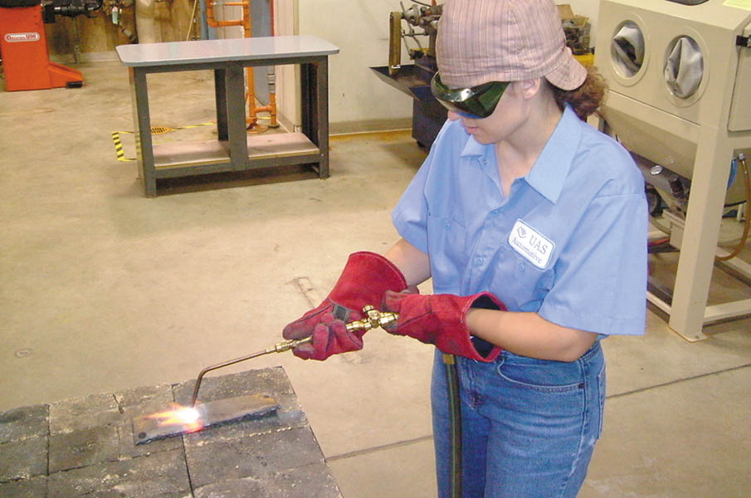
Be sure to wear appropriate personal protective equipment during heating and cutting operations.

Slide 45
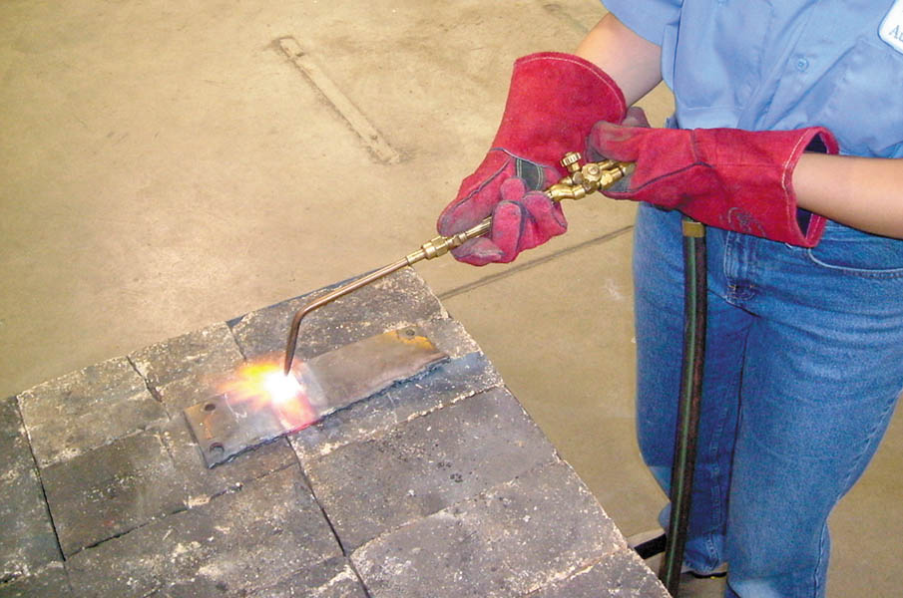
Note that heating operations should be performed over steel or firebrick. Never heat or cut steel close to concrete, as it could cause the concrete to explode.

Slide 46
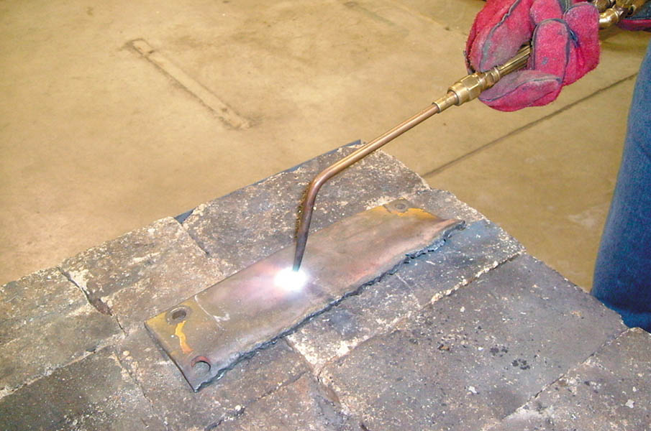
When heating steel, move the torch in a circular pattern to prevent melting of the metal. Don’t hold the torch too close to the work as this will cause a “snapping” or “backfire” that can extinguish the flame.

Slide 47
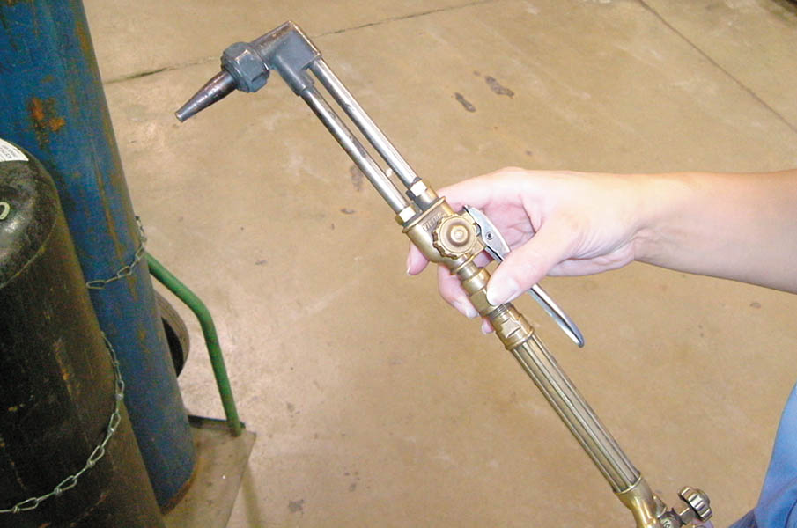
Affix the cutting attachment to the torch handle. Note that the cutting attachment has a cutting handle and a separate oxygen valve.

Slide 48
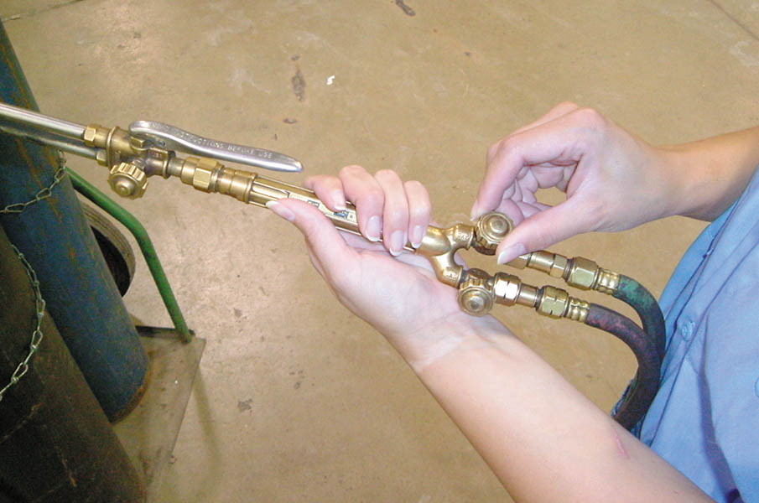
Fully open the oxygen valve on the torch handle. Oxygen flow will now be controlled with the valve on the cutting attachment.

Slide 49
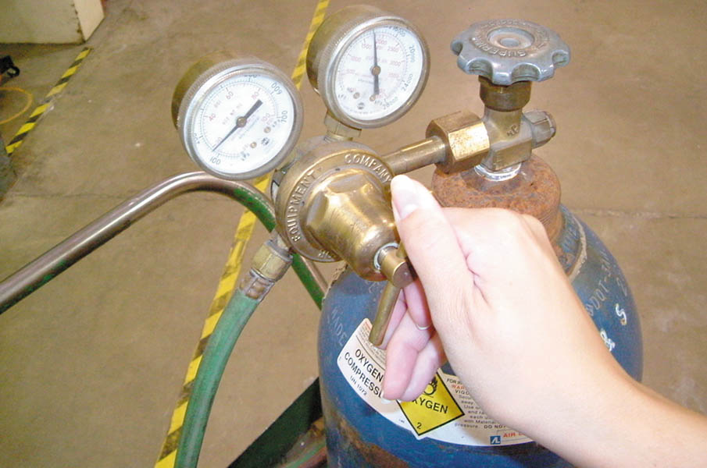
Oxygen gas pressure should be adjusted to 30 PSI whenever using the cutting attachment. Acetylene pressure is kept at 7 PSI.

Slide 50
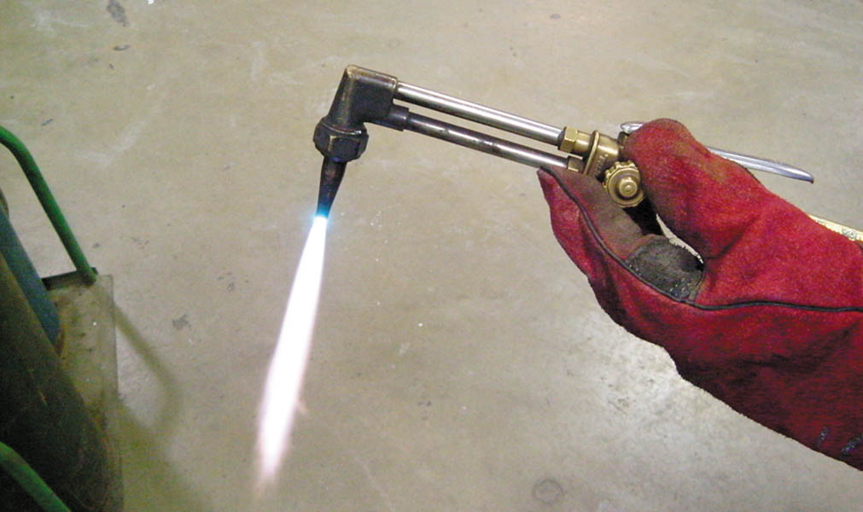
Open the acetylene valve on the torch handle ¼ turn and light the torch. Adjust the flame until its base just touches the cutting tip. Slowly open the oxygen valve on the cutting attachment and adjust the flame until the blue cone is well-defined.

Slide 51
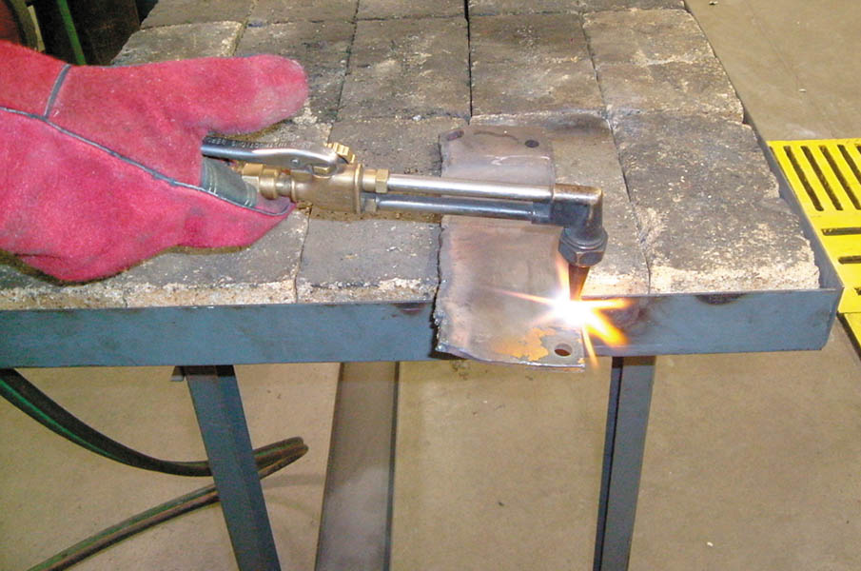
Direct the flame onto a thin spot or sharp edge of the metal to be cut. This will build the heat quicker in order to get the cut started.

Slide 52
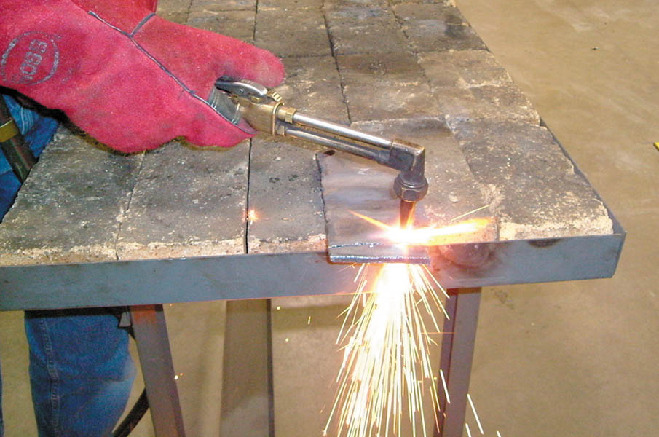
When the metal glows red, depress the cutting handle and move the torch to advance the cut. You will need to move the torch faster when cutting thinner pieces of steel. On thicker pieces, point the cutting tip into the direction of the cut.

Slide 53
QUESTION 3: ?
What safety precautions must be taken when using a torch?

Slide 54
ANSWER 3:
Use personal protective equipment.

Slide 55

Copyright

