Slide 1
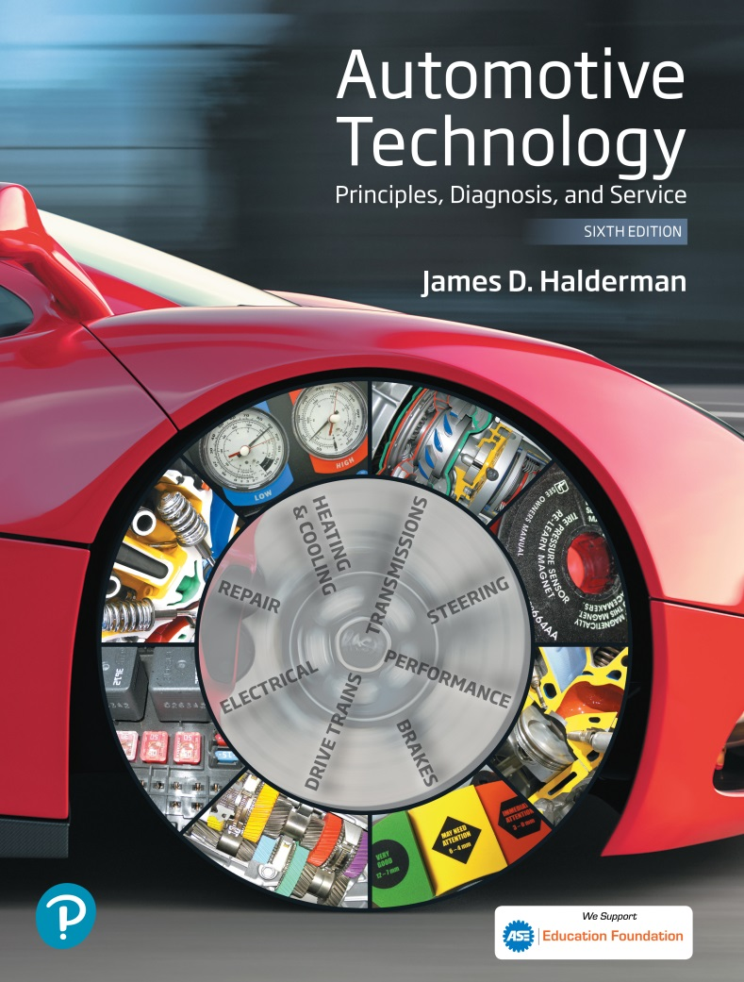
Automotive Technology Principles, Diagnosis, and Service
Sixth Edition
Chapter 1
Automotive Background and Overview
Copyright © 2018, 2015, 2011 Pearson Education, Inc. All Rights Reserved

Slide 2
LEARNING OBJECTIVES (1 of 2)
1.1 Explain the evolution of the automobile.
1.2. Discuss the components of the body and chassis.
1.3. Describe the evolution of engines.

Slide 3
LEARNING OBJECTIVES (2 of 2)
1.4 List the major systems common to most vehicles.
1.5 List the eight areas of automotive service according to ASE/NATEF

Slide 4
HISTORICAL BACKGROUND
Self-propelled vehicles- vehicles that move under their own power
  Developed after the invention of electric, steam, and gasoline propulsion systems
  Replace walking and animal use

Slide 5
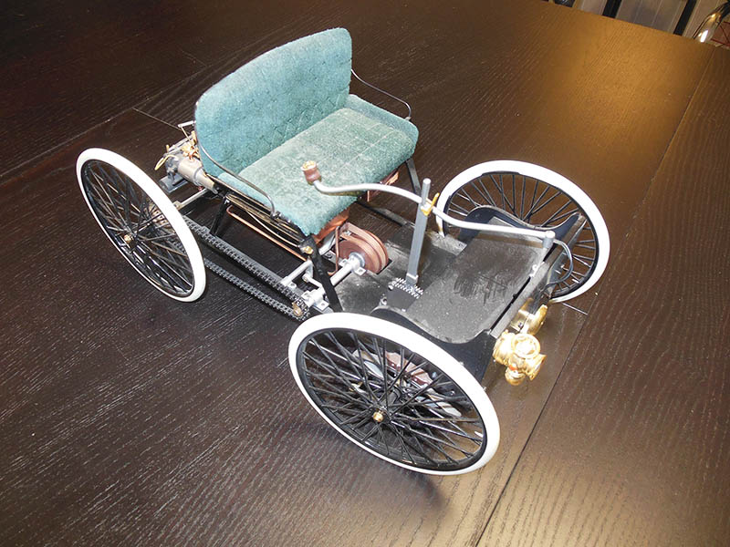
Figure 1.1 A model of the Quadricycle, a car built by Henry Ford in 1896

Slide 6
BODIES
Early motor vehicles evolved from horse-drawn carriages.
Most vehicle bodies were constructed with a wood framework until the 1920s

Slide 7
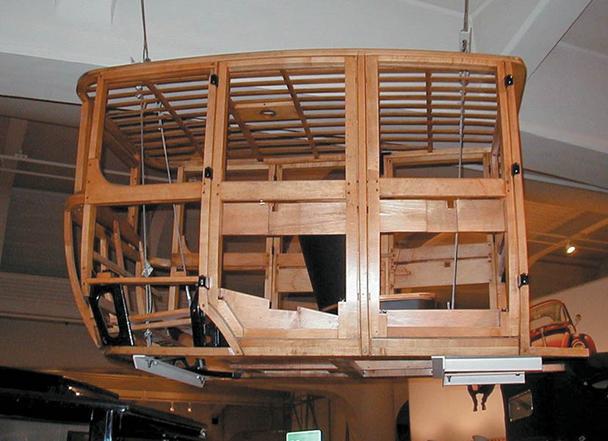
Figure 1.2 Most vehicle bodies were constructed with a wood framework until the 1920s

Slide 8
QUESTION 1: ?
Early Vehicles were constructed mostly of what material?

Slide 9
ANSWER 1:
Wood.

Slide 10
CHASSIS SYSTEMS OVERVIEW
The chassis system of the vehicle includes the following components:
  The frame or body.
  The suspension system.
  The braking system.
  The wheels and tires.

Slide 11
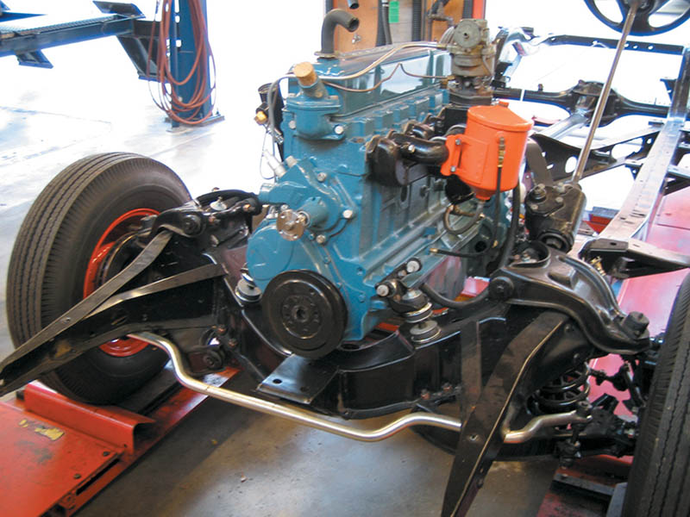
Figure 1.3 A chassis of a 1950s era vehicle showing the engine, drivetrain, frame, and suspension

Slide 12
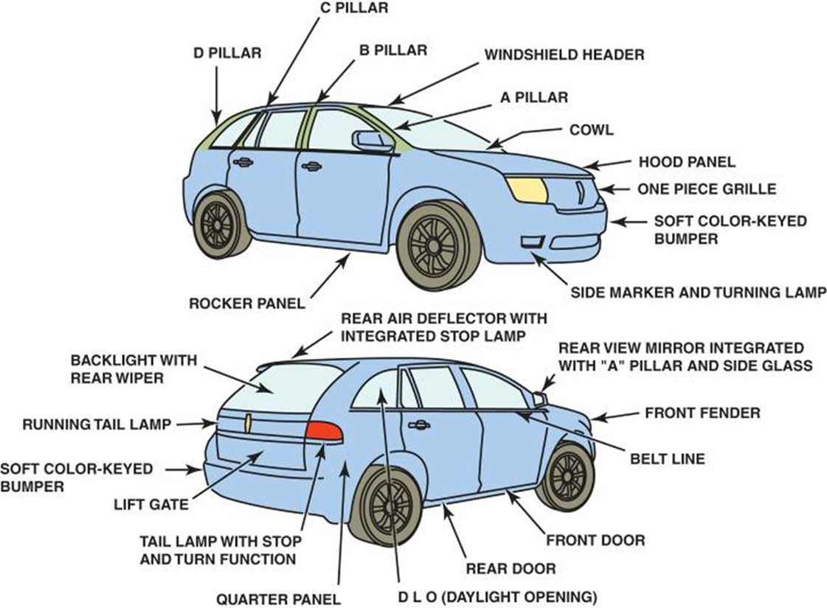
FIGURE 1.4 Body and Terms.

Slide 13
FRAMES (1 of 3)
Frame Construction
  Vehicles with a separate frame and body are usually called body-on-frame (BOF) vehicles.

Slide 14
FRAMES (2 of 3)
UNIT–BODY CONSTRUCTION
  Combines the body with the structure of the frame.
  Composed of many individual stamped-steel panels welded together.

Slide 15
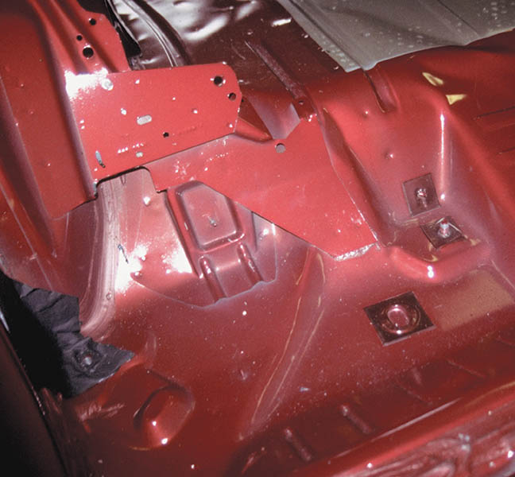
Figure 1.5 Note the ribbing and the many different pieces of sheet metal used in the construction of this body

Slide 16
FRAMES (3 of 3)
SPACE-FRAME CONSTRUCTION
  Consists of formed sheet steel used to construct a framework of the entire vehicle.
  The vehicle is drivable without the body.
  Plastic or steel panels cover the framework.
.

Slide 17
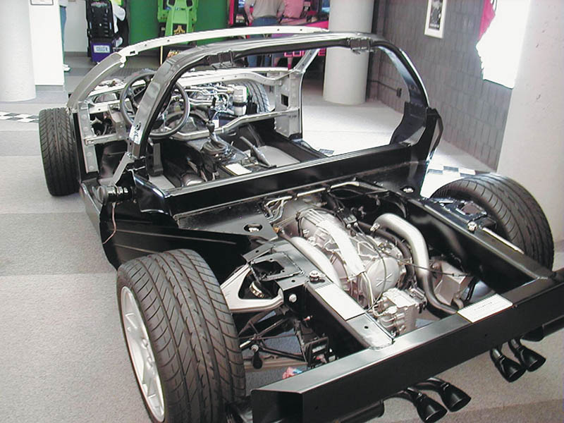
Figure 1.6 A Corvette without the body. Notice that the vehicle is complete enough to be driven. This photo was taken at the Corvette Museum in Bowling Green, Kentucky

Slide 18
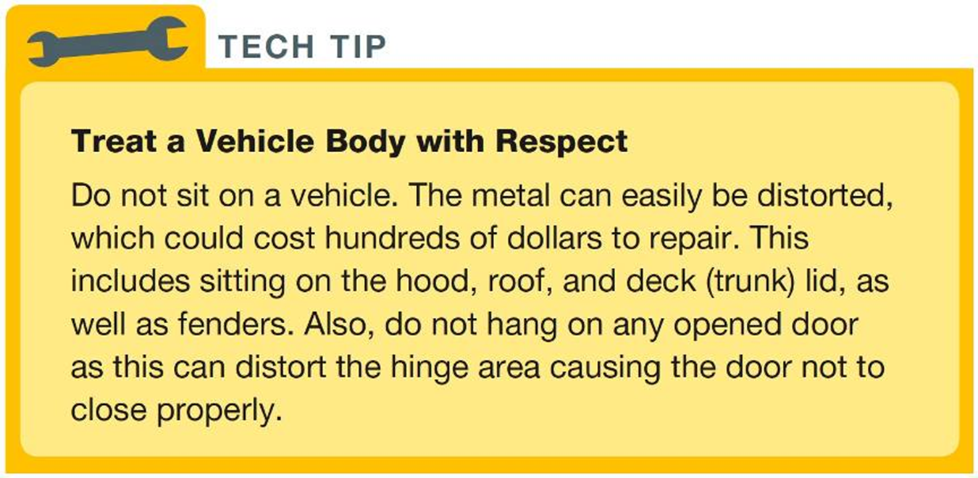
Tech Tip

Slide 19
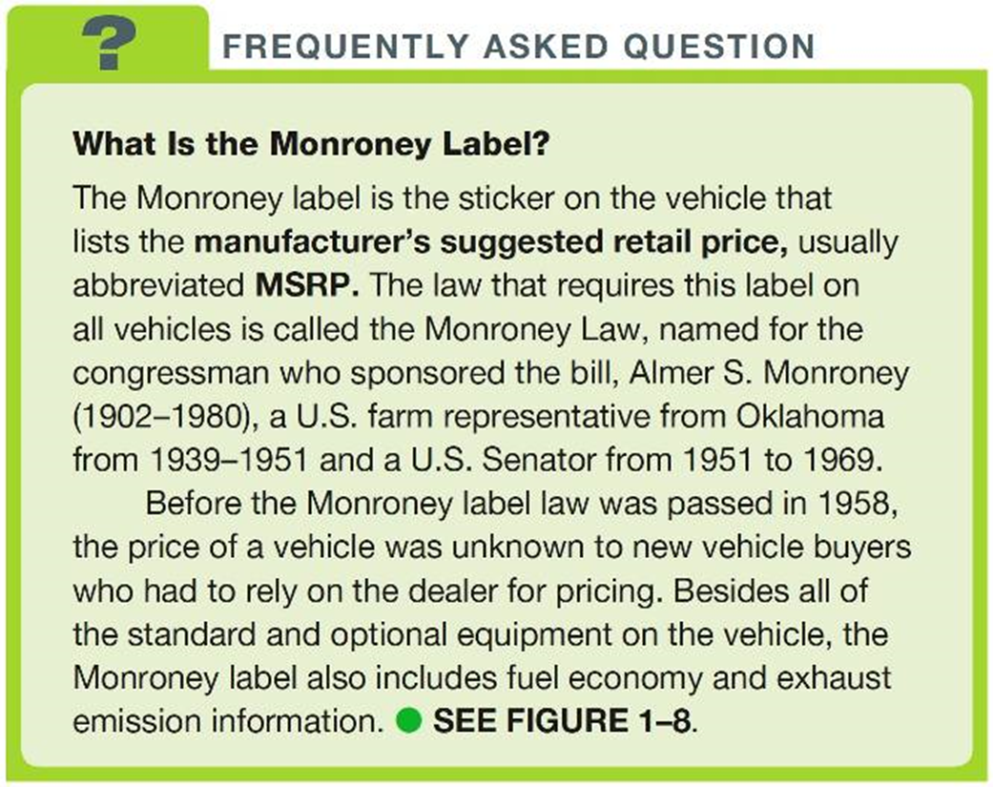
FREQUENTLY ASKED QUESTION

Slide 20
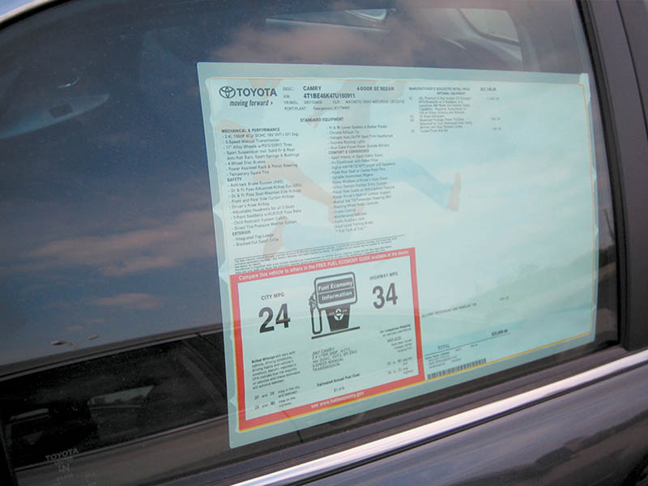
Figure 1.8 A Monroney label as shown on the side window of a new vehicle

Slide 21
ENGINE DESIGN EVOLUTION (1 of 2)
Internal Combustion Engine
  All gasoline and diesel engines.
  Designed to compress an ignitable mixture.
Inline Versus V-Type Design
  Inline: four or six cylinders arranged inline.
  V-Type: 4,6,8, 10, 12, or 16 cylinders arranged with half the cylinders on each side of the “V” and connected to a common crankshaft.

Slide 22
ENGINE DESIGN EVOLUTION (2 of 2)
Valve Location Design
  Flathead: Valves located in the engine block
  Overhead valve (OHV): Valves located in the cylinder head
  Single Overhead Cam (SOHC): Camshaft and valves located in the cylinder head
  Double Overhead Cam (DOHC) Two camshafts and valves located in the cylinder head

Slide 23
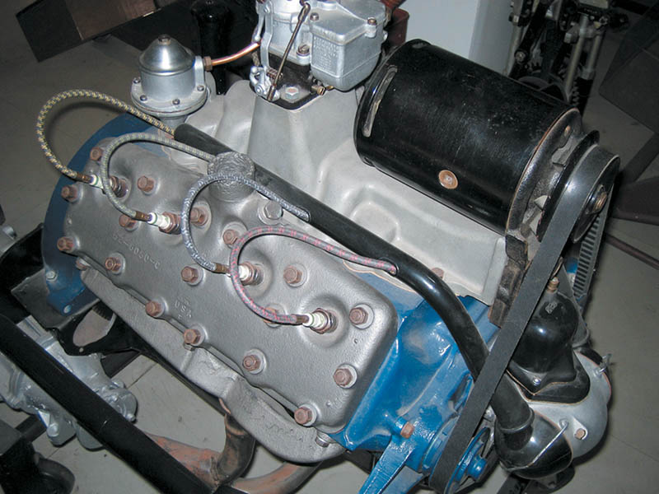
Figure 1.7 A Ford flathead V-8 engine. This engine design was used by Ford Motor Company from 1932 through 1953. In a flathead design, the valves are located next to (beside) the cylinders

Slide 24
QUESTION 2: ?
Why were early engines referred to as flat head design?

Slide 25
ANSWER 2:
The cylinder head did not contain the valves.

Slide 26
ENGINE SYSTEMS OVERVIEW (1 of 7)
Cooling System
  Coolant is circulated by a water pump through passages in the cylinder block called water jackets.
  Coolant is a mixture of antifreeze and water to provide corrosion and freeze protection.
  Engine heat is removed from the coolant when it flows through a radiator.
  The temperature of the coolant is maintained by using a thermostat.

Slide 27
ENGINE SYSTEM OVERVIEW (2 of 7)
Lubrication System
  Forces the oil under pressure through the engine to reduce friction and heat.
  The oil pan or oil sump holds the oil.
  The oil pump forces the oil under pressure through the oil filter and the oil galleries in the block and cylinder head.

Slide 28
ENGINE SYSTEM OVERVIEW (3 of 7)
Air Intake System
  All engines draw air from the atmosphere.
  Approximately 9000 gallons of air is needed for every gallon of fuel.
  The air must be drawn into the engine from a place water cannot enter.
  The air is filtered by a replaceable air filter.
  The filtered air passes through the throttle valve and into the intake manifold.

Slide 29
ENGINE SYSTEM OVERVIEW (4 of 7)
Fuel System
  The fuel system includes the following components and systems:
    Fuel tank
    Fuel lines and filter(s)
    Fuel Injectors
    Electronic control of the fuel pump and fuel injection

Slide 30
ENGINE SYSTEM OVERVIEW (5 of 7)
Starting and Charging System
  Includes the following components:
    Battery
    Starter
    Alternator
    Associated circuits

Slide 31
ENGINE STSTEM OVERVIEW (6 of 7)
Ignition System
  Ignition Coils
    Create a high voltage spark.
  Ignition Control Module
    Controls the timing of the spark.

Slide 32
ENGINE SYSTEMS OVERVIEW (7 of 7)
Emission Control System
  The control of tailpipe and evaporative emissions using the following systems:
    Positive Crankcase Ventilation (PCV)
    Exhaust Gas Recirculation (EGR)
    Catalytic Converter
    On board diagnostics

Slide 33
POWERTRAIN OVERVIEW (1 of 3)
Rear-Wheel-Drive Powertrain
  Transmission: An automatic or manual method of providing the correct torque for the desired speed.
  Driveshaft (also called a propeller shaft): Used to connect the transmission to the differential.
  Differential: Allows for different axle speeds for cornering and to increase torque to the drive wheels.

Slide 34
POWERTRAIN OVERVIEW (2 of 3)
Front-Wheel-Drive Powertrain
  Uses a transaxle
    A combination of transmission and differential in one assembly.
    Drive axle shafts transfer power to front drive wheels.

Slide 35
POWERTRAIN OVERVIEW (3 of 3)
Four-Wheel-Drive System
  Powers all four wheels
  Many systems
    A transfer case splits engine torque to both front and rear wheels.

Slide 36
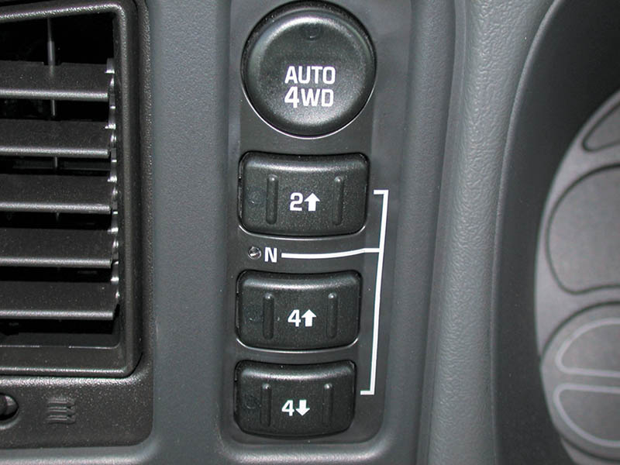
Figure 1.9 A dash control panel used by the driver to control the four-wheel-drive system

Slide 37
ELECTRICAL/ELECTRONIC SYSTEMS OVERVIEW
Systems Include:
  Tire pressure monitoring
  Heated and cooled seats
  Automatic climate control
  Power windows
  Security systems
  Electric power steering
  Electronic suspension

Slide 38
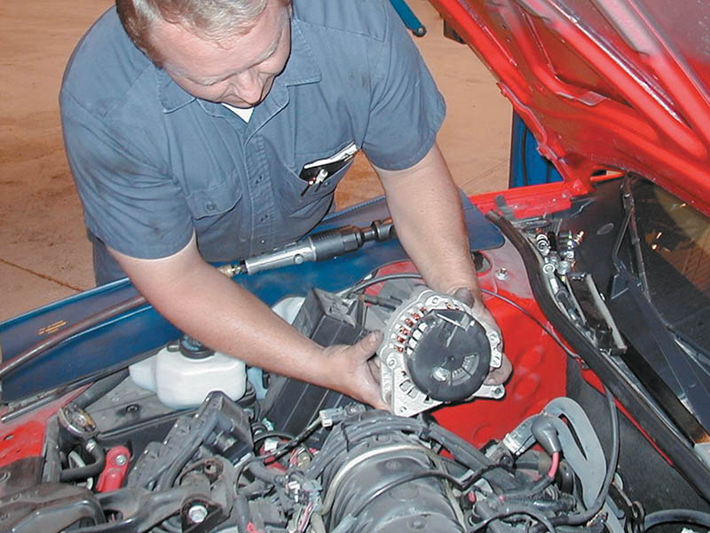
Figure 1.10 The alternator is responsible for supplying the electrical needs of the vehicle and to keep the battery charged

Slide 39
EIGHT AREAS OF AUTOMOTIVE SERVICE
Eight Automotive Test Areas
  Engine Repair (A1)
  Automatic Transmission (A2)
  Manual Drive Train and Axles (A3)
  Suspension and Steering (A4)
  Brakes (A5)
  Electrical/Electronic Systems (A6)
  Heating and Air Conditioning (A7)
  Engine Performance (A8)

Slide 40
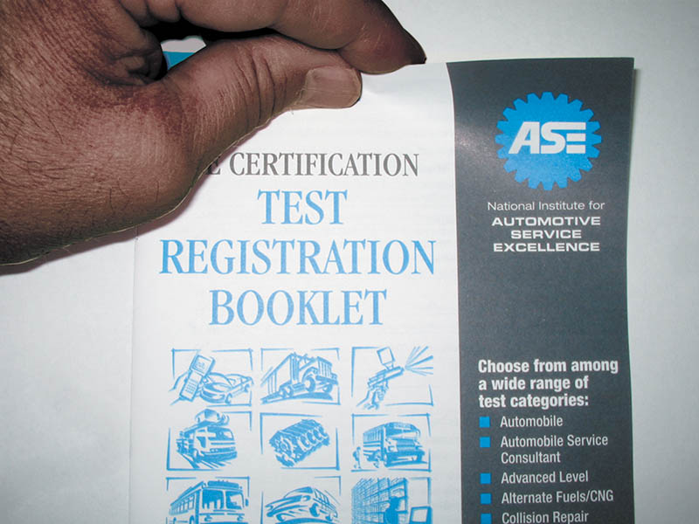
Figure 1.11 Test registration booklet that includes details on all vehicle-related certification tests given by ASE. All testing is now done electronically at proctored locations

Slide 41
QUESTION 3: ?
Automotive service systems are generally separated into how many content areas?

Slide 42
ANSWER 3:
Eight.

Slide 43
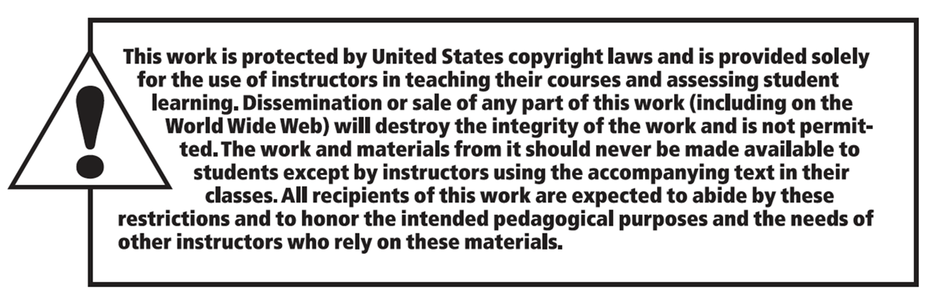
Copyright

