Slide 1
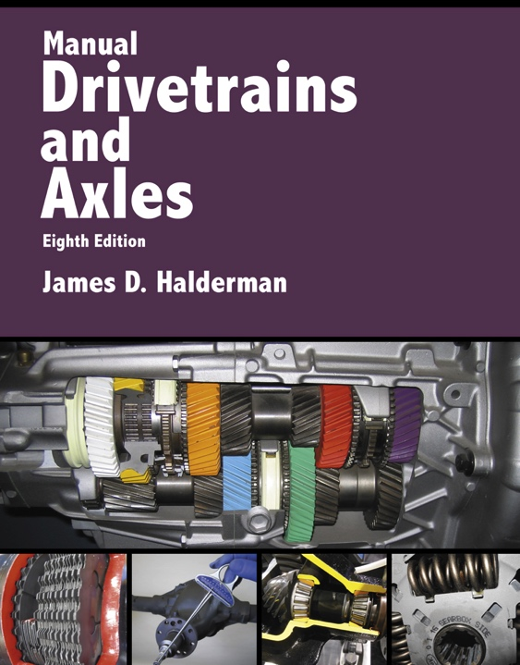
Manual Drivetrains and Axles
8th Edition
Chapter 9
Drive Shafts and CV Joints

Slide 2
Learning Objectives
1.1 Describe driveshaft design and balance.
1.2 Describe the function and operation of U-joints.
1.3 Describe how CV joints work.
1.4 Discuss the two types of CV joints.

Slide 3
Driveshafts
What is the purpose and function of drive shafts?
Driveshaft Design
  One- or two-piece driveshaft
  Aluminum driveshafts

Slide 4
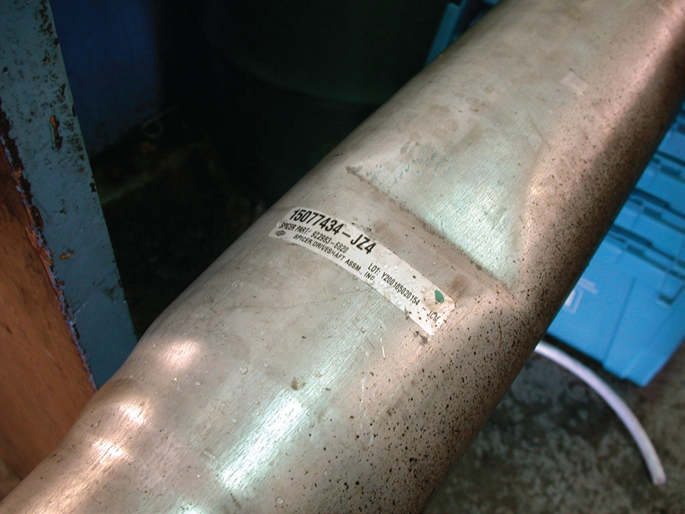
Figure 9–4 This driveshaft was found to be dented during a visual inspection and has to be replaced.

Slide 5
Figure 9–5 A center support bearing is used on many vehicles with long two-part driveshafts.

Slide 6
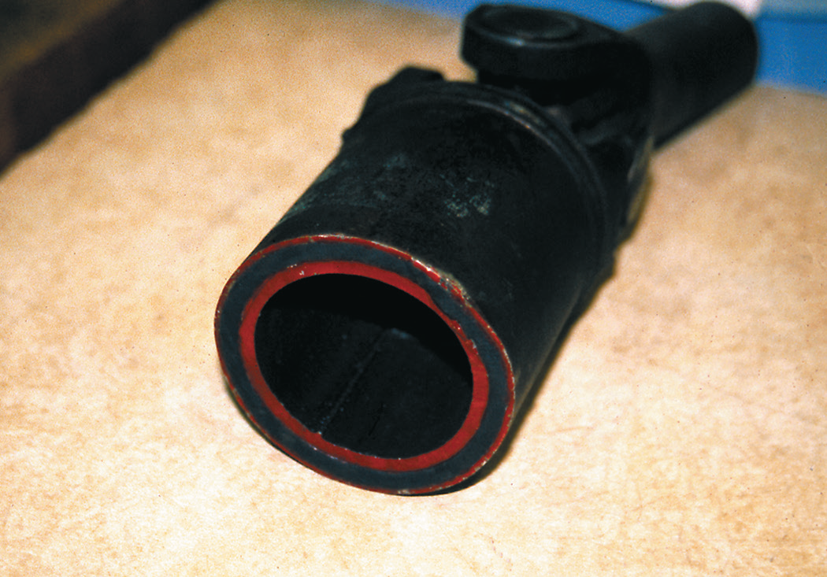
FIGURE 9–6 Some driveshafts use rubber between an inner and outer housing to absorb vibrations and shocks to the driveline.

Slide 7
Driveshaft Balance
Any driveshaft whose rotational speed is greater than 1000 RPM must be balanced.
Driveshaft balance should be within 0.5% of the driveshaft weight.

Slide 8
U-Joint Design and Operation
U-joints allow the wheels and the rear axle to move up and down, remain flexible, and still transfer torque to the drive wheels.
Working angle of 1/2 to 3 degrees
  If the angles differ by more than a 1/2 degree between the front and the rear joint, a vibration is usually produced that is torque sensitive.

Slide 9
Figure 9–9 The joint angle is the difference between the angles of the joint.

Slide 10
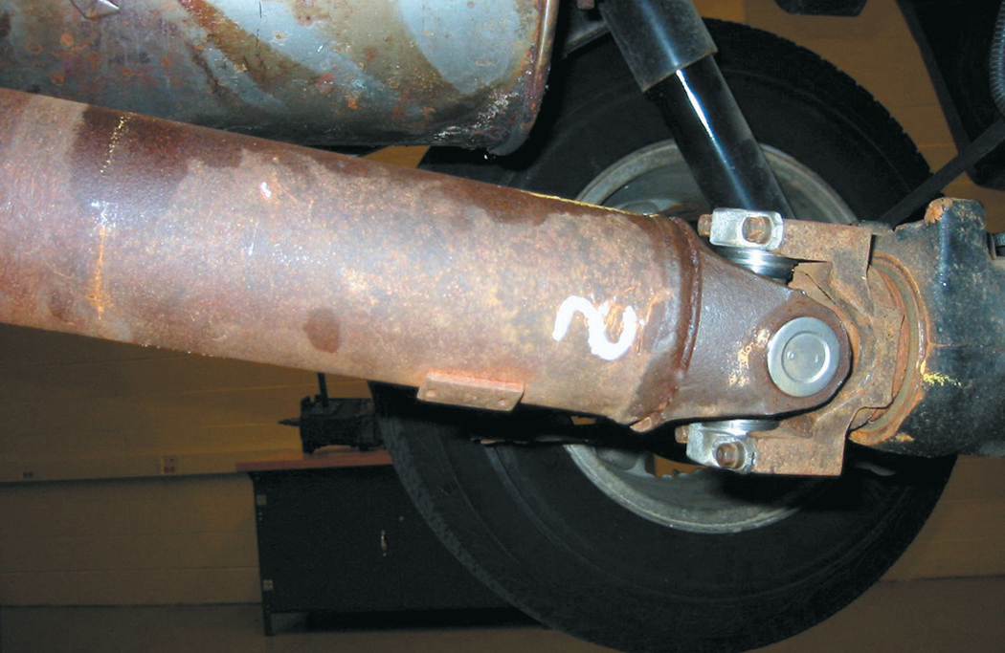
Figure 9–10 The angle of this rear Cardan U-joint is noticeable.

Slide 11
Double-Cardan Joints
Regular U-joints are usually designed to work up to 12 degrees of angularity.
If two Cardan-style U-joints are joined together, the angle at which this double-Cardan joint can function is about 18 to 20 degrees.

Slide 12
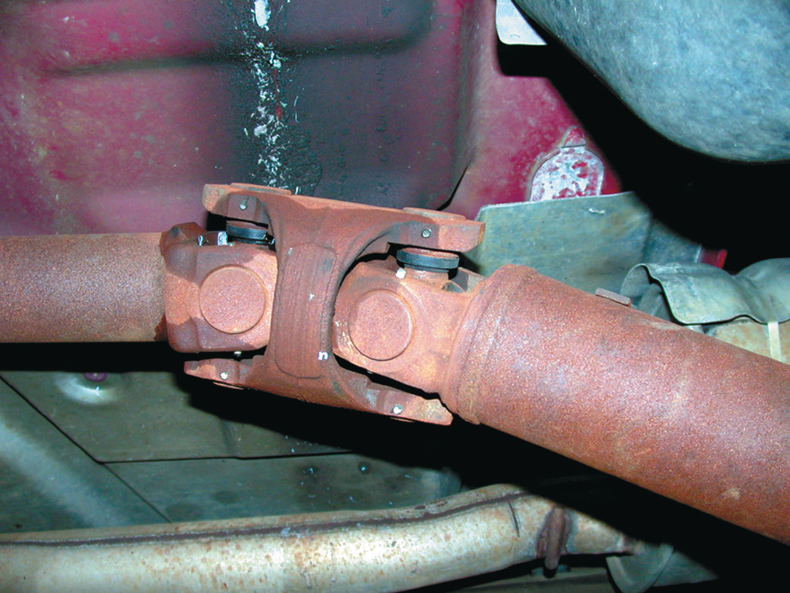
FIGURE 9–11 A double-Cardan U-joint.

Slide 13
Constant Velocity Joints (1 of 2)
Designed to rotate without changing speed
Regular U-joints are usually designed to work up to 12 degrees of angularity
Double-Cardan U-joints were first used on large rear-wheel drive vehicles to help reduce drive line-induced vibrations

Slide 14
Figure 9–12 A constant velocity (CV) joint can operate at high angles without a change in velocity (speed) because the joint design results in equal angles between input and output.

Slide 15
Constant Velocity Joints (2 of 2)
Outer CV Joints
  Rzeppa Joints: Most commonly used joint as an outer joints.
  Transfers torque through six round balls that are held in position midway between the two shafts.
Inner CV Joints
  Attach the output of the transaxle to the drive axle shaft.

Slide 16
Figure 9–13 A Rzeppa fixed joint.

Slide 17
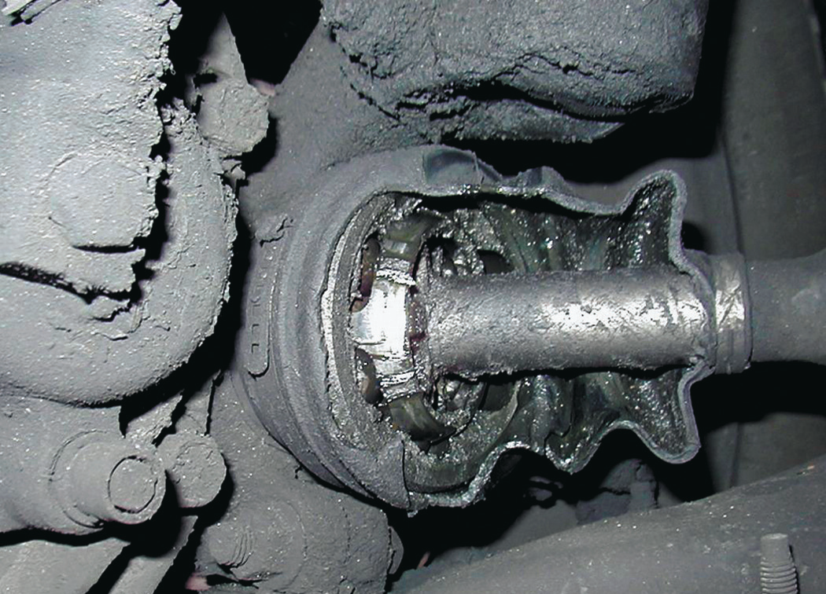
Figure 9–14 The protective CV joint boot has been torn away on this vehicle and all of the grease has been thrown outward onto the brake and suspension parts.

Slide 18
Figure 9–15 A tripod fixed joint.

Slide 19
Figure 9–16 The fixed outer joint is required to move in all directions because the wheels must turn for steering as well as move up and down during suspension movement.

Slide 20
Summary (1 of 2)
The driveshaft of a rear-wheel-drive vehicle transmits engine torque from the transmission to the differential.
U-joints allow the driveshaft to transmit engine torque while the suspension and the rear axle assembly are moving up and down during normal driving conditions.

Slide 21
Summary (2 of 2)
CV joints provide a smooth transmission of torque to the drive wheels regardless of angularity of the wheel or joint.
Outer or fixed CV joints commonly use a Rzeppa design, while inner CV joints are the plunging or tripod type.

