Slide 1
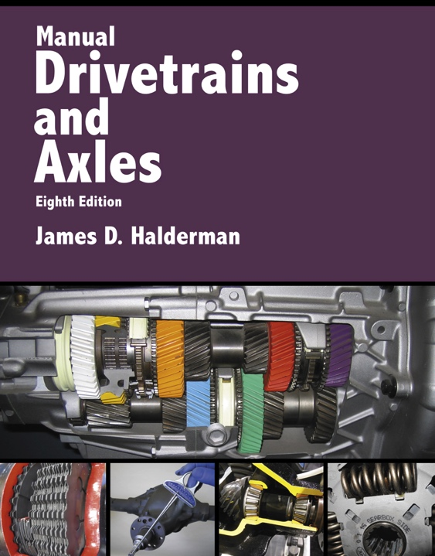
Manual Drivetrains and Axles
8th Edition
Chapter 8
Manual Transmission/Transaxle Diagnosis and Service

Slide 2
Learning Objectives (1 of 2)
1.1 Prepare for the Manual Drivelines and Axles (A2) ASE certification test content area “C” (Transmission/Transaxle Diagnosis and Repair).
1.2 Explain how to perform transaxle/transmission maintenance operations.
1.3 Explain manual transaxle/transmission diagnosis.

Slide 3
Learning Objectives (2 of 2)
1.4 Discuss the procedure for transaxle/transmission removal and replacement.
1.5 Discuss the procedure for transaxle/transmission overhaul.

Slide 4
Preventive Maintenance (1 of 2)
Normal maintenance operation includes:
  Periodic check of the lubricant level
  Linkage/shifter adjustment
  Mount inspection or replacement as needed
  Visual inspection for leaks and other abnormal conditions
Lubricant check
  What are some things to check for?

Slide 5
Preventive Maintenance (2 of 2)
Transmission Lubricant replacement steps
How should the transaxle linkage get adjusted?
How can an alignment check get accomplished?

Slide 6
Figure 8–1 (a) Transaxles and transmissions use either a dipstick or level plug to check the oil level. (b) To determine the fluid level, insert a finger into the opening and feel for the fluid level.

Slide 7
Figure 8–2 (a) Operate the shift levers through all of the gears with the engine off and again with it running. (b) If necessary, adjust the shift linkage following the vehicle manufacturer’s specified procedure.

Slide 8
Figure 8–3 The enlarged views of the inner CV joints show that the engine and transaxle are misaligned; they should be moved toward the right.

Slide 9
Manual Transmission/Transaxle Diagnosis
Verify the customer concern by performing a road test.
Perform a visual inspection.
Follow service information and follow pinpoint tests to determine the root cause.
Perform the needed repair.
Verify the repair.

Slide 10
Typical manual transmission/transaxles faults and some possible causes.

Slide 11
Figure 8–5 When performing a visual inspection, check for “rust dust,” which is evidence of a worn components such as universal joints.

Slide 12
Typical noises, their causes and possible items to look for to solve the noise concerns

Slide 13
Transaxle/Transmission Removal (1 of 3)
Transaxle Removal
  Disconnect the negative (–) battery cable.
  Disconnect the shift cables or rods, clutch linkage, backup light switch or wires speedometer cable or speed sensor connections, and any hose or cable brackets.
  Installation of an engine support tool.
  Remove the upper clutch housing bolts and install a guide pin into one or two of the bolt holes.

Slide 14
Transaxle/Transmission Removal (2 of 3)
  Raise and securely support the vehicle on a hoist or on jack stands.
  Drain the transaxle oil
  Install the second guide pin.
How does the transaxle get installed?
Transmission Removal/Replacement
  Disconnect the negative (–) battery cable.
  Raise and securely support the vehicle.
  Drain the fluid.

Slide 15
Transaxle/Transmission Removal (3 of 3)
  Remove the backup light wires, speedometer cable or speed sensor connections, any hose or cable brackets attached to the vehicle, and the shift linkage.
  Remove transmission bolts.
  Remove transmission-to-clutch housing or transmission-to-engine bolts.
  Lower the unit out of the vehicle.
Transmission installation

Slide 16
Figure 8–7 A transaxle being removed from underneath a vehicle and being supported by a transmission jack.

Slide 17
Figure 8–8 A tail shaft housing plug is being used to help keep the transmission fluid from leaking as the transmission is being removed from the vehicle.

Slide 18
Transaxle/Transmission Overhaul (1 of 3)
Typical Procedure
  Disassembly of the unit
  Clean and identify the unit
  Gear inspection
  Bearing inspection
  Reconditioning of the subassemblies
  Checking gear end float and adjusting bearing clearances as the unit is reassembled
What wear items should be checked?

Slide 19
Transaxle/Transmission Overhaul (2 of 3)
What is included in a typical transmission/transaxle kit?
Transaxle Disassembly
  Install holding fixture
  Remove drain plug and check fluid
  On some transaxles, the differential bearing retainer, extension housing, and differential are removed first. On some transaxles, the disassembly begins with the removal of the left side case cover, fifth-gear synchronizer assembly, and the fifth counter gear.

Slide 20
Transaxle/Transmission Overhaul (3 of 3)
    Sometimes service information specifies that the disassembly begin with the removal of the backup light switch, reverse idler shaft retaining bolt, detent plunger retaining screw, interlock sleeve retaining pin, and fill plug.
  Remove case-to-clutch housing or end-cover-to-case attachment bolts.
  Remove shift mechanism, reverse idler gear, and shaft
  Remove input and main shaft
  Remove ring gear and differential assembly

Slide 21
Figure 8–9 A service parts kit for a Borg-Warner T5 manual transmission which includes bearings, seals, and snap rings.

Slide 22
Figure 8–10 Using a holding fixture is a great way to support the transaxle during disassembly and reassembly.

Slide 23
Figure 8–11 Most transaxles use formed-in-place gaskets that tend to glue the case and covers together.

Slide 24
Figure 8–12 Removing the side cover allows access to the shift forks and differential assembly.

Slide 25
Transmission Disassembly (1 of 3)
What is the procedure to disassemble a typical transmission?
Parts cleaning
  Check the debris attached to the magnet
  Cleanup
Gear inspection
  Sometimes damage is easy to locate; a close inspection is necessary

Slide 26
Transmission Disassembly (2 of 3)
Bearing inspection
  Normally done by sight, feel, and sound
  Brinelling; Contamination; Electric arcing; Fretting; Misalignment; Peeling; Seizing; Spalling
Bearing Removal and installation
  The inner races of bearing are often pressed onto the shaft and the pressing force should be transmitted only to the inner race.
Main shaft disassembly
  What are the steps to disassemble a main shaft?

Slide 27
Transmission Disassembly (3 of 3)
Synchronizer disassembly, inspection, and reassembly
  What are the steps for reassembling a synchronizer?
Blocker ring inspection
  Cone surface should be smooth and polished
Main shaft reassembly
  What are the steps to reassemble a main shaft?

Slide 28
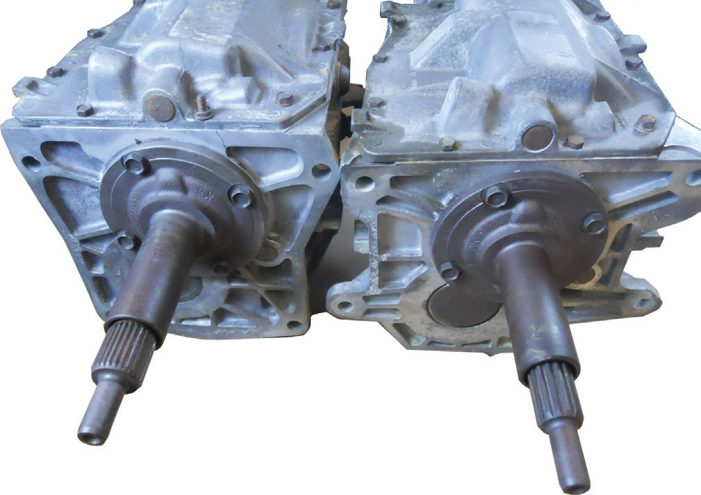
FIGURE 8–13 The Borg-Warner T5 five-speed manual transmission is used in many makes and models of vehicles and they vary with the number of splines for either the input shaft or output shaft or both.

Slide 29
Shift Mechanism
Check the following during visual inspection:
  Shift forks
  Shift rails
  Detent springs
  Detent cam
  Interlock plates
  Selector plates
  Reverse lockout mechanism/solenoid

Slide 30
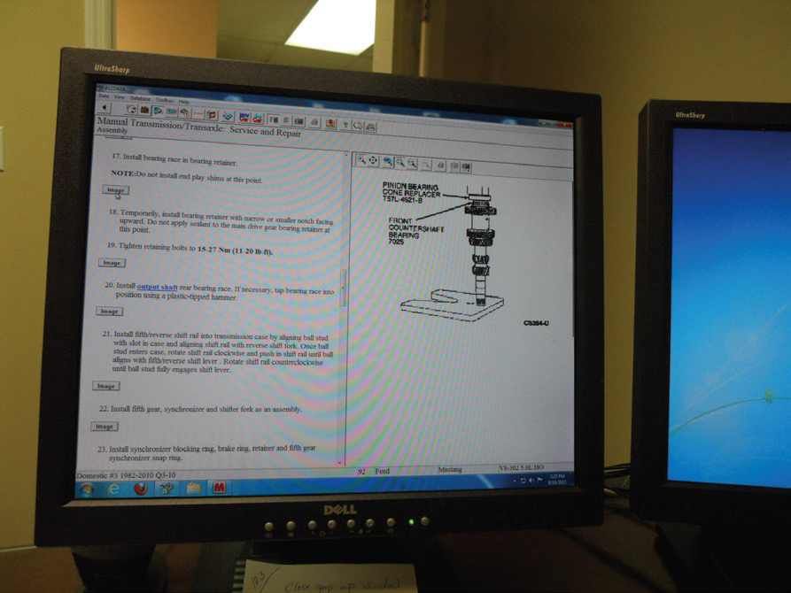
FIGURE 8–25 Having service information readily available is important so that each step can be checked as the unit is being reassembled.

Slide 31
Case and Covers (1 of 2)
Cleaning and inspection
  Should be thoroughly cleaned and carefully checked
Seal installation
  Each shift shaft that passes through the case
  One or two output shaft seals
  Sometimes an input shaft seal
End play/preload checks
  What are the steps used to check and adjust bearing clearance/preload on a transaxle?

Slide 32
Case and Covers (2 of 2)
Case sealants
  Room-temperature vulcanizing (RTV)
  Anaerobic sealants
Final checks

Slide 33
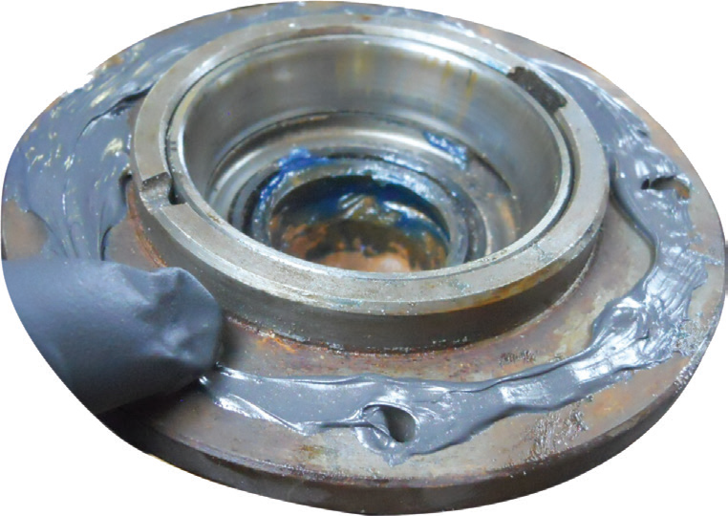
FIGURE 8–28 When using RTV to seal a transmission/ transaxle case, be sure to surround each bolt hole to help prevent leakage.

Slide 34
Summary (1 of 2)
Transmissions must have clean gear oil at the proper level and of the proper type.
The cause of improper transmission operation is determined using several diagnostic steps.
Internal transmission problems require that the transmission be removed from the vehicle.

Slide 35
Summary (2 of 2)
Transmission and transaxle disassembly and reassembly varies between different makes and models.
Gears, bearings, synchronizer assemblies, shift forks, and transaxle differentials are the major wear components.

