Slide 1

Manual Drivetrains and Axles
8th Edition
Chapter 2
Environmental and Hazardous Materials

Slide 2
Learning Objectives (1 of 2)
1.1 Identify hazardous waste materials in accordance with state and federal regulations and follow proper safety precautions while handling hazardous materials.
1.2 Define the Occupational Safety and Health Act (OSHA).

Slide 3
Learning Objectives (2 of 2)
1.3 Explain the term material safety data sheets (MSDS).
1.4 Define the steps required to safely handle and store automotive chemicals and waste.

Slide 4
Hazardous Waste
When handling hazardous waste material, one must always wear the proper protective clothing and equipment detailed in the right-to-know laws.

Slide 5
Federal and State Laws (1 of 3)
Occupational Safety And Health Act
  This legislation was designed to assist and encourage the citizens of the United States in their efforts to ensure the following:
    Safe and healthful working conditions, by providing research, information, education & training in the field of occupational safety and health
    Safe and healthful working conditions for working men and women, by authorizing enforcement of the standards developed under the act

Slide 6
Federal and State Laws (2 of 3)
EPA
  Reactive
  Corrosive
  Toxic
  Ignitable
  Radioactive

Slide 7
Federal and State Laws (3 of 3)
Right-to-know Laws
Resource Conservation And Recovery Act
Lockout/Tagout
Clean Air Act

Slide 8
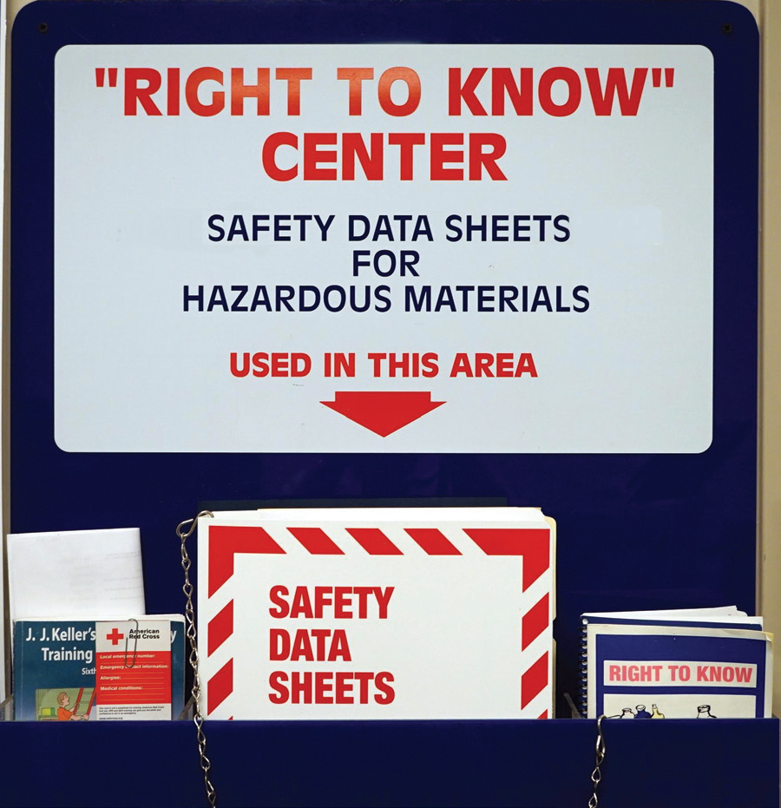
Figure 2–1 Safety data sheets (SDS), formerly known as material safety data sheets (MSDS) should be readily available for use by anyone in the area who may come into contact with hazardous materials.

Slide 9
Asbestos Hazards
Asbestos OSHA Standards
  Less than .2 fibers per cub centimeter
Asbestos EPA Regulations
  Only when asbestos becomes airborne is it considered to be hazardous
Asbestos Handling Guidelines
  HEPA vacuum
  Solvent spray
  Disposal of brake dust and brake shoes

Slide 10
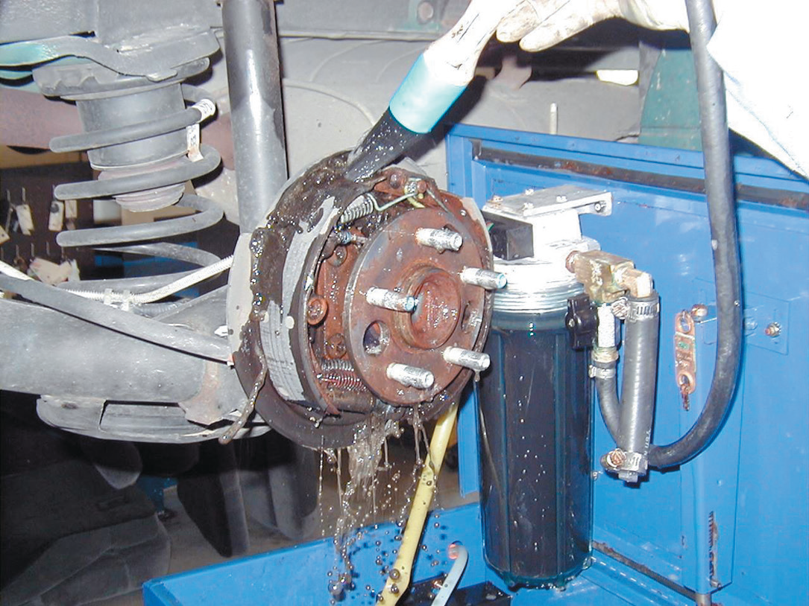
FIGURE 2–3 All brakes should be moistened with water or solvent to help prevent brake dust from becoming airborne.

Slide 11
Used Brake Fluid (1 of 2)
Storage and Disposal of Brake Fluid
  Collect brake fluid in a container clearly marked to indicate that it is designated for that purpose.
  If the waste brake fluid is hazardous, be sure to manage it appropriately and use only an authorized waste receiver for its disposal.

Slide 12
Used Brake Fluid (2 of 2)
  If the waste brake fluid is nonhazardous (such as old, but unused), determine from your local solid waste collection provider what should be done for its proper disposal.
  Do not mix brake fluid with used engine oil.
  Do not pour brake fluid down drains or onto the ground.
  Recycle brake fluid through a registered recycler.

Slide 13
Used Oil
Storage and Disposal of Used Oil
  Keep used oil storage drums in good condition.
  Never store used oil in anything other than tanks and storage containers.
  Follow used oil filter disposal regulations.

Slide 14
Figure 2–4 A typical aboveground oil storage tank.

Slide 15
Figure 2–5 Washing hands and removing jewelry are two important safety habits all service technicians should practice.

Slide 16
Solvents (1 of 2)
Used Solvents
  Containers should be clearly labeled “Hazardous Waste” and the date the material was first placed into the storage receptacle should be noted.
  Labeling is not required for solvents being used in a parts washer.
  Used solvents will not be counted toward a facility’s monthly output of hazardous waste if the vendor under contract removes the material.

Slide 17
Solvents (2 of 2)
  Used solvents may be disposed of by recycling with a local vendor, like SafetyKleen®, to have the used solvent removed according to specific terms in the vendor agreement.
  Use aqueous-based (nonsolvent) cleaning systems to help avoid the problems associated with chemical solvents.

Slide 18
Figure 2–6 Typical fireproof flammable storage cabinet.

Slide 19
Coolant Disposal
Coolant Disposal
  Coolant should be recycled either onsite or offsite.
  Used coolant should be stored in a sealed and labeled container.
  Used coolant can often be disposed of into municipal sewers with a permit.
    Check with local authorities and obtain a permit before discharging used coolant into sanitary sewers.

Slide 20
Figure 2–8 Used antifreeze coolant should be kept separate and stored in a leak-proof container until it can be recycled or disposed of according to federal, state, and local laws. Note that the storage barrel is placed inside another container to catch any coolant that may spill out of the inside barrel.

Slide 21
Lead-acid Battery Waste
Battery Disposal
  Used lead-acid batteries must be reclaimed or recycled in order to be exempt from hazardous waste regulations.

Slide 22
Fuel Safety and Storage
Gasoline is a very explosive liquid.
The expanding vapors that come from gasoline are extremely dangerous.
These vapors are present even in cold temperatures.

Slide 23
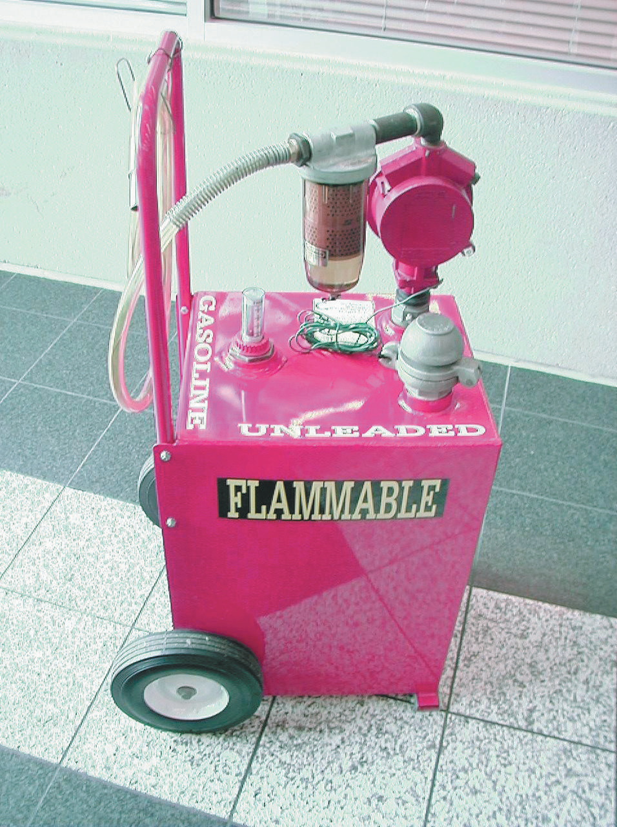
FIGURE 2–9 This red gasoline container holds about 30 gallons of gasoline and is used to fill vehicles used for training.

Slide 24
Airbag Handling
Airbag modules are pyrotechnic devices that can be ignited if exposed to an electrical charge or if the body of the vehicle is subjected to a shock.

Slide 25
Other Disposals
Used Tire Disposal
  Reuse
  Retraded
  Recycled
  Landfill
  Burned
Air-conditioning Refrigerant Oil Disposal
  Waste Chart

Slide 26
Figure 2–10 Air-conditioning refrigerant oil must be kept separated from other oils because it contains traces of refrigerant and must be treated as hazardous waste.

Slide 27
Summary (1 of 2)
Hazardous materials include common automotive chemicals, liquids, and lubricants, especially those whose ingredients contain chlor or fluor in their name.
Right-to-know laws require that all workers have access to material safety data sheets.
Asbestos fibers should be avoided and removed according to current laws and regulations.

Slide 28
Summary (2 of 2)
Used engine oil contains metals worn from parts and should be handled and disposed of properly.
Solvents represent a serious health risk and should be avoided as much as possible.
Coolant should be disposed of properly or recycled.
Batteries are considered to be hazardous waste and should be discarded to a recycling facility.

