Slide 1
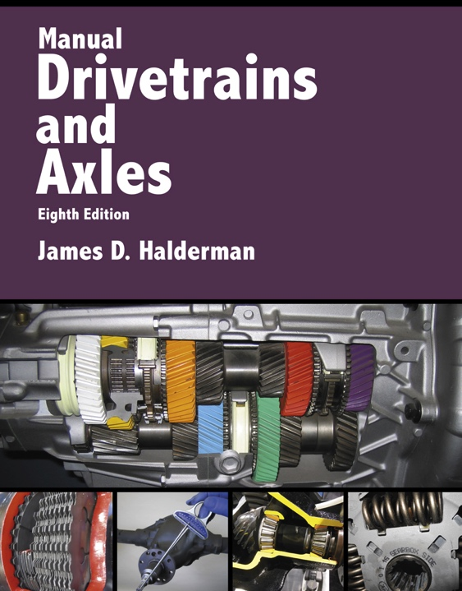
Manual Drivetrains and Axles
8th Edition
Chapter 17
Vibration and Noise Diagnosis and Correction

Slide 2
Learning Objectives (1 of 2)
1.1 Prepare for Suspension and Steering (A4) ASE certification test content area “C” (Related Suspension and Steering Service).
1.2 List the possible vehicle components that can cause a vibration or noise.
1.3 Explain the vibration speed ranges and the method to determine the frequency of the vibration.

Slide 3
Learning Objectives (2 of 2)
1.4 Discuss the methods for measuring driveshaft U-joint phasing and balancing the driveshaft.
1.5 Diagnose and correct noise problems.

Slide 4
Causes of Vibration and Noise
Vehicles are designed and built to prevent most vibrations and to dampen out any vibrations that cannot be eliminated.
If a new vehicle has a vibration or noise problem, then the most likely cause is an assembly or parts problem.

Slide 5
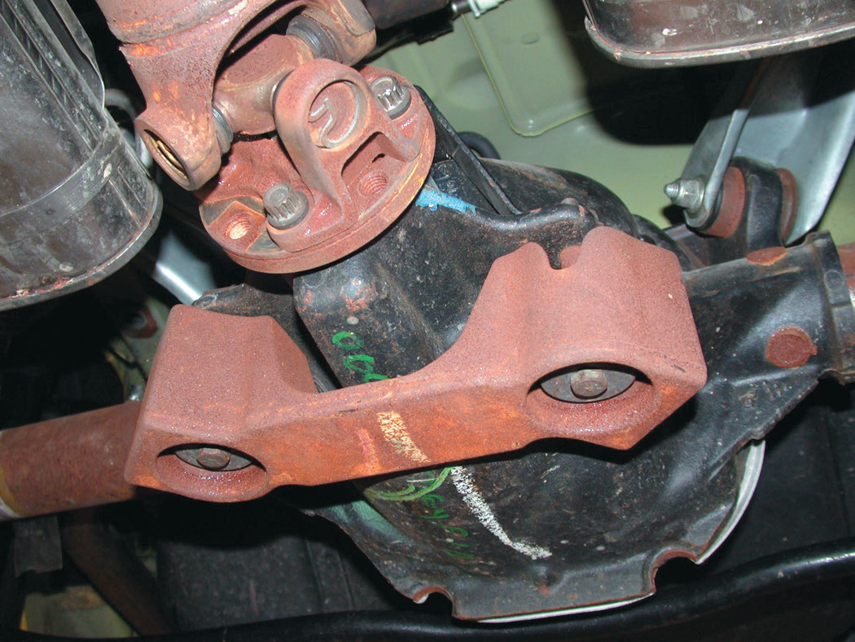
FIGURE 17–1 Many vehicles, especially those equipped with four-cylinder engines, use a dampener weight attached to the exhaust system or drive axle as shown to dampen out certain frequency vibrations.

Slide 6
Test-Drive
The first thing a technician should do when given a vibration or noise problem to solve is to duplicate the condition.
What are some simple observations that may help locate the problem?
  Gather information about the vibration or noise complaint.

Slide 7
FIGURE 17–4 Vibration created at one point is easily transferred to the passenger compartment. MacPherson strut suspensions are more sensitive to tire imbalance than SLA-type suspensions.

Slide 8
Neutral Run-Up Test
The neutral run-up test is used to determine if the source of the vibration is engine-related.
With the transmission in neutral or park, slowly increase the engine RPM and with a tachometer observe the RPM at which the vibration occurs.

Slide 9
Vibration During Braking
A vibration during braking usually indicates out-of-round brake drums, warped disc brake rotors, or other braking system problems.
Note: Wheels should never be installed using an air impact wrench.

Slide 10
Vibration Speed Ranges
The number of times a complete motion cycle takes place during a period of one second is called frequency and is measured in hertz (Hz).
Vibration order is the number of vibrations created in one revolution of a component.
Tire and wheel vibrations
  What are the steps used to determine the rolling circumference?
  Low (5-20 Hz), Medium (20-50 Hz), and High (50-100 Hz)

Slide 11
Figure 17–5 Hertz means cycles per second. If six cycles occur in one second, then the frequency is 6 Hz. The amplitude refers to the total movement of the vibrating component.

Slide 12
Figure 17–6 Every time the end of a clamped yardstick moves up and down, it is one cycle. The number of cycles divided by the time equals the frequency. If the yardstick moves up and down 10 times (10 cycles) in two seconds, the frequency is 5 Hertz (10 ÷ 2 = 5)

Slide 13
Figure 17–7 Determining the rolling circumference of a tire.

Slide 14
Frequency
Measure frequency with a reed tachometer.
Correcting low-frequency vibrations
  What low-frequency vibration problems may be included?
Correcting medium-frequency vibrations
  What medium-frequency vibration problems may be included?
Correcting high-frequency vibrations
  What high-frequency vibration problems may be included?

Slide 15
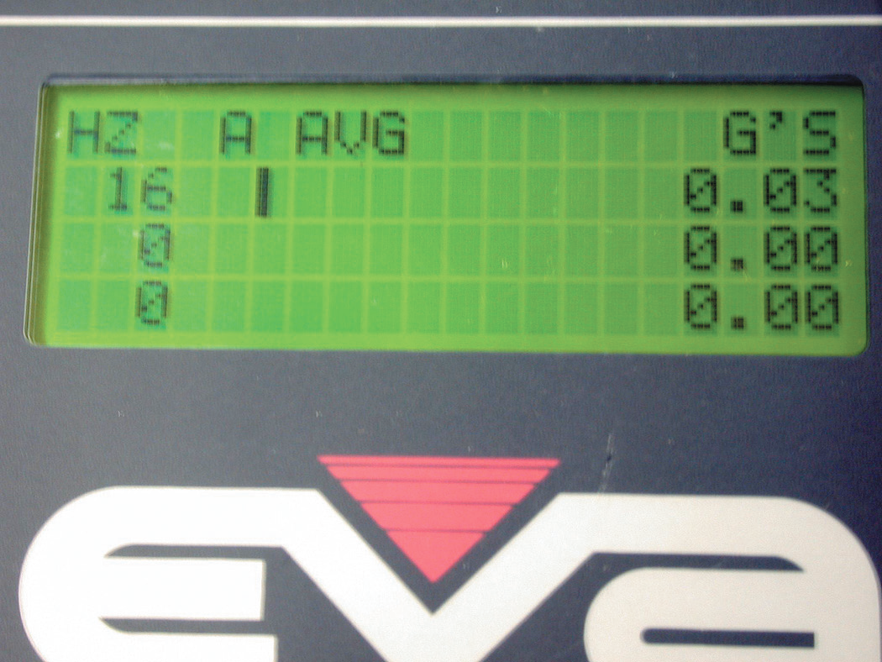
Figure 17–8 An electronic vibration analyzer

Slide 16
Correcting Driveline Angles
Incorrect driveline angles are usually caused by one or more of the following:
  1. Worn, damaged, or improperly installed U-joints.
  2. Worn, collapsed, or defective engine or transmission mount(s).
  3. Incorrect vehicle ride height. (As weight is added to the rear of a rear-wheel-drive vehicle, the front of the differential rises and changes the working angle of the rear U-joint.)
  4. Bent or distorted driveshaft.

Slide 17
Checking Driveshaft Runout
Check to see that the driveshaft is not bent by performing a driveshaft runout test using a dial indicator.
Runout should be measured at three places along the length of the driveshaft.

Slide 18
Measuring Driveshaft U-Joint Phasing
Measuring driveshaft U-joint phasing
  Checking to see if the front and rear U-joints are directly in line or parallel with each other
  Place an inclinometer on the front U-joint bearing cup and rotate the driveshaft until horizontal
  Move the inclinometer to the rear U-joint. The angles should match

Slide 19
Companion Flange Runout
The companion flange is splined to the rear axle pinion shaft and provides the mounting for the rear U-joint of the driveshaft.
What things should be checked on the companion flange while diagnosing a vibration?

Slide 20
Balancing the Driveshaft (1 of 2)
Checking for driveshaft balance is usually done with a strobe balancer
  Mark the driveshaft with four equally spaced marks around its circumference
  Attach the strobe balancer sensor to the bottom of the differential housing
  Start the engine and put the transmission into gear to allow the drive wheels to rotate

Slide 21
Balancing the Driveshaft (2 of 2)
  Check using the strobe light close to the driveshaft for balance
  Apply hose clamps so that the screw portion of the clamp(s) is opposite the number seen with the strobe light

Slide 22
Figure 17–12 When checking the balance of a driveshaft, make reference marks around the shaft so that the location of the unbalance may be viewed when using a strobe light

Slide 23
Figure 17–13 Using a strobe balancer to check for driveline vibration requires that an extension be used on the magnetic sensor. Tall safety stands are used to support the rear axle to keep the driveshaft angles the same as when the vehicle is on the road

Slide 24
Figure 17–14 Typical procedure to balance a driveshaft using hose clamps

Slide 25
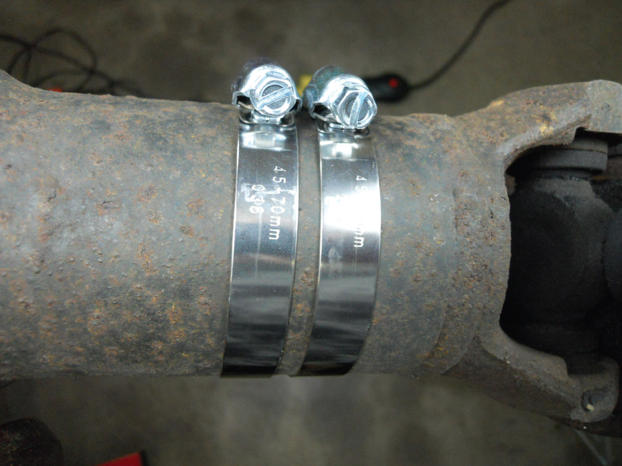
Figure 17–15 Two clamps were required to balance this front driveshaft of a four-wheel-drive vehicle. Be careful when using hose clamps that the ends of the clamps do not interfere with the body or other parts of the vehicle

Slide 26
Noise Diagnosis (1 of 2)
Tire noise
Engine/exhaust noise
Wheel bearing noise
Differential side bearing noise
Differential pinion bearing noise
U-joint noise
Clutch noise

Slide 27
Noise Diagnosis (2 of 2)
Noises usually become louder and easier to find as time and mileage increase.
An occasional noise usually becomes a constant noise.

Slide 28
Figure 17–16 Tire wear caused by improper alignment or driving habits, such as high-speed cornering, can create tire noise. Notice the feather edged outer tread blocks.

Slide 29
Noise Correction
Check all power steering high-pressure lines.
Carefully check, tighten, and lubricate the flexible couplings in the exhaust system.
Lubricate all rubber bushings with rubber lube and replace any engine or transmission mounts that are collapsed.
Replace and/or tighten all engine drive belts and check that all accessory mounting brackets are tight.

Slide 30
Summary (1 of 2)
Vibration and noise are two of the most frequently heard complaints from vehicle owners.
A vibration felt in the steering wheel, dash, or hood is usually due to out-of-balance or defective front tires.
Defective engine or transmission mounts, warped rotors, and out-of-round brake drums can all cause a vibration.

Slide 31
Summary (2 of 2)
Vibration is measured by an electronic vibration analyzer or a reed tachometer and measured in Hertz.
Driveshafts should be inspected for proper U-joint working angles and balance.

