Slide 1
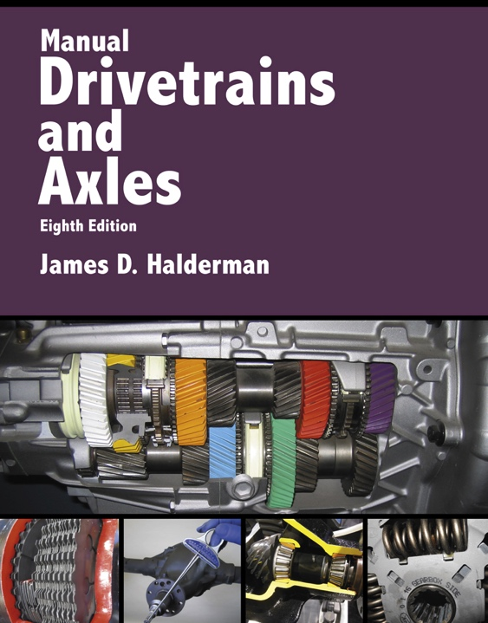
Manual Drivetrains and Axles
8th Edition
Chapter 15
Four-Wheel and All-Wheel Drive

Slide 2
Learning Objectives (1 of 3)
1.1 Prepare for the ASE Manual Drive Train and Axles (A3) certification test content area “F” (Four-Wheel-Drive/All-Wheel-Drive Component Diagnosis and Service).
1.2 Explain the characteristics of four-wheel-drive (4WD) vehicles.
1.3 Differentiate between part-time and full-time four-wheel-drive vehicles.

Slide 3
Learning Objectives (2 of 3)
1.4 Explain the purpose and function of the central differential and transfer case in a four-wheel drive vehicle.
1.5 Explain the purpose and function of electronic transfer cases and the power transfer unit of a four-wheel-drive vehicle.
1.6 Explain the purpose and function of couplers and torque bias devices.

Slide 4
Learning Objectives (3 of 3)
1.7 Discuss the operation of front drive axles and drive axle/wheel disconnect systems.

Slide 5
Four-wheel Drive (1 of 2)
Four-wheel drive (4WD) for cars, pickups, and light trucks has steadily evolved from the somewhat crude but rugged Jeep of World War II to sport cars and sport-utility vehicles.
What are the issues of powering all four wheels?

Slide 6
Four-wheel Drive (2 of 2)
4WD can be based on any drivetrain configuration including:
  Front engine–RWD—Most truck-based four-wheel systems use this arrangement.
  Front engine–FWD—Many passenger vehicles and sport utility vehicles (SUV) use this arrangement.
  Mid-engine–RWD—Some sport cars use this arrangement such as some Porsches.
  Rear engine–RWD—Some sport cars use this arrangement such as some Porsches.

Slide 7
Figure 15–3 Four-wheel-drive vehicles can be achieved by using an existing rear-wheel-drive arrangement and adding a transfer case, or a front wheel-drive arrangement with the addition of rear axle output shaft and center differential assembly

Slide 8
Terminology
Two-wheel drive
Four-wheel drive
Part-time four-wheel drive
Full-time four-wheel drive
On-demand four-wheel drive

Slide 9
Transfer cases
Purpose and function
Types of shifts
  Mode
  Range

Slide 10
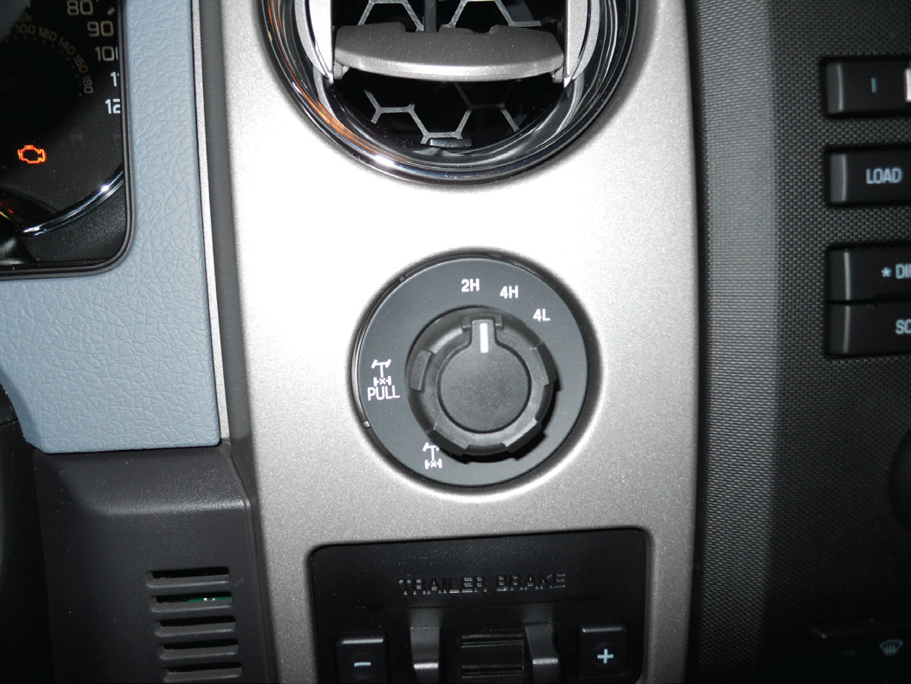
Figure 15–5 A typical electronic transfer case control that is used to shift between two-wheel drive and four wheel drive (mode shift) or from four wheel high to four-wheel low (range shift)

Slide 11
Part-time Four-wheel drive
Both front and rear axles are mechanically connected and locked together.
Dry pavement can cause the drivetrain to bind unless the front wheels are disconnected usually using locking hubs.
  If so, the vehicle should only be driven on dirt, mud, or snow to avoid damage caused by driveline windup.

Slide 12
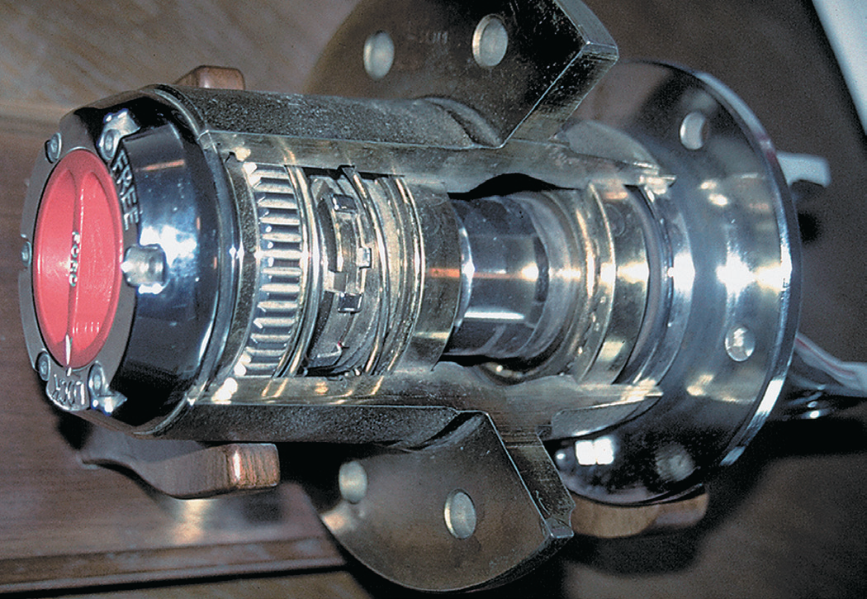
Figure 15–6 Cutaway of a manually operated locking hub

Slide 13
Figure 15–7 Manual locking hubs require that the hubs be rotated to the locked position by hand to allow torque to be applied to the front wheels.

Slide 14
Full-time Four-wheel Drive
Uses a center (interaxle) differential, which allows for both the front and rear axles to rotate at different speeds.
Can be safely driven in four-wheel drive on dry pavement and under all driving conditions.

Slide 15
Figure 15–8 A typical planetary gear set used in a transfer case

Slide 16
Central Differentials
Purpose and Function
  Center differential, also called interaxle differential, prevent driveline harshness and vibration, commonly referred to as “driveline windup.”
Types
  Standard bevel gear
  Planetary gear
  Viscous coupling

Slide 17
Figure 15–4 A typical transfer case is attached to the output of the transmission and directs engine torque to the rear or to the front and rear differentials

Slide 18
Transfer Cases (1 of 2)
The purpose and function of the transfer case is to control the power flow to both the front and rear axles.
The gear ranges can be engaged in a number of ways, such as:
  Manual lever (older vehicles)
  Electrical motor (most commonly used)
  Vacuum actuators (Usually used to connect and disconnect the front-drive axle when two-wheel drive is selected).

Slide 19
Transfer Cases (2 of 2)
Two-wheel drive operation
Four-wheel drive operation
Oil pump
Manual shift on-the-fly systems

Slide 20
FIGURE 15–19 The oil pump is driven by the rear output shaft and is removed with the rear part of the case.

Slide 21
Electronic Transfer Cases
Purpose and Function
  The transfer case motor/ encoder assembly is an electric motor used to shift the transfer case from two-wheel high to four-wheel high
    Can also make a range change between four-wheel high and four-wheel low.
Motor/Encoder assembly
Torque split

Slide 22
Figure 15–20 Four-wheel-drive/low range torque flow in a NV231 transfer case

Slide 23
Power Transfer Unit
4WD/AWD vehicles that are based on FWD vehicles integrate a power transfer unit (PTU) into the transaxle. In its simplest form, a PTU is just a right angle gear set.
Parts and operation

Slide 24
FIGURE 15–24 A PTU has an interaxle differential that drives the front axle differential and the transfer of torque to the rear driveshaft.

Slide 25
Couplers and Torque Bias Devices
Purpose and Function
  Couplers are connected in series with other drivetrain members and are used to transfer torque, much like a clutch. They are applied only when needed.
Electromagnetic clutch coupler
  Torque Management
  Interactive Torque Management System
  Intelligent AWD System
  Active Torque Dynamics
Electro-hydraulic coupler

Slide 26
FIGURE 15–30 The Haldex system uses hydraulic pressure to apply the clutch, which can be created as soon as there is a speed differential between the input and output shafts. Hydraulic pressure and speed at which the clutch will be applied are controlled by the ECU.

Slide 27
Front Drive
Front Drive Axles
  Some of the 4WD vehicles use a RWD drive axle that is rotated so the drive pinion points toward the rear.
  Axles using reverse-cut gears can be identified by a high-mounted pinion shaft.

Slide 28
FIGURE 15–32 Constant velocity (CV) joints are used on the front axles of many four-wheel-drive vehicles like this Chevrolet Blazer.

Slide 29
Drive Axles/Wheel Disconnect Systems
Purpose and function
Drive Axles/Wheel Disconnect Systems
  The engine intake manifold provides the vacuum, which is controlled by the vacuum control valve.
    The control valve is controlled by the mode switch.
Continuous vacuum locking hubs
Pulse vacuum locking hubs

Slide 30
FIGURE 15–34 A General Motors sport utility vehicle front axle showing the electric axle disconnect actuator.

Slide 31
Summary (1 of 2)
Many of today’s 4WD/AWD vehicles are based on front engine FWD vehicles.
A transfer case or power transfer unit drives the second axle.
AWD transfer cases/PTUs can include a differential, viscous coupler, or electromechanical clutch to control torque to the front and rear drive axles.

Slide 32
Summary (2 of 2)
A front drive axle has outboard U-joints or CV joints to allow steering.
Front wheel hubs can be disconnected using a mechanical, automatic, or vacuum operation.

