Slide 1
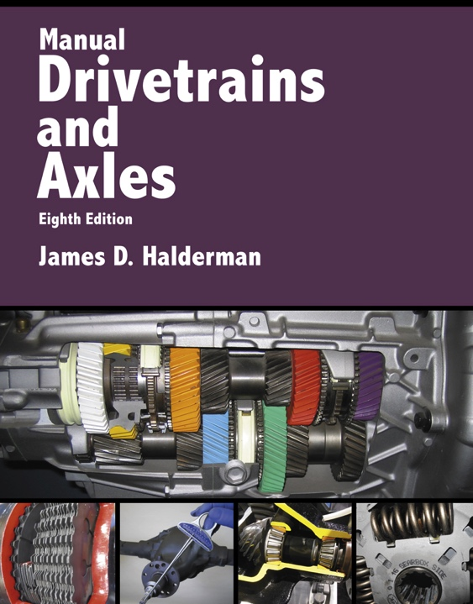
Manual Drivetrains and Axles
8th Edition
Chapter 12
Drive Axles and Differentials

Slide 2
Learning Objectives (1 of 2)
1.1 Prepare for the Manual Drivelines and Axles (A2) ASE certification test content area “C” (Transmission/Transaxle Diagnosis and Repair)
1.2 Discuss the different drive axle designs.
1.3 Explain the features of ring and pinion gears.

Slide 3
Learning Objectives (2 of 2)
1.4 Discuss the types of differential carriers.
1.5 State the purpose of differentials and identify the parts of a differential assembly.
1.6 Identify the different types of limited slip differentials.

Slide 4
Drive Axle Terminology
The major parts of a drive axle include:
  The ring and pinion gears
  Differential
  Axle shafts

Slide 5
Drive Axle Assembly
Purpose and function
  Changing the direction of engine torque
  Allowing the drive wheels to rotate at different speeds
  Support the weight of the vehicle
  Drive the wheels through axles

Slide 6
FIGURE 12–1 The differential assembly changes the direction of engine torque and increases the torque to the drive wheels.

Slide 7
Axle Designs (1 of 2)
Axe Shafts
  Transfer the torque from the differential side gears to the drive wheels and support the weight of the vehicle
Semi-Floating Axles
  Used by all rear-wheel-drive passenger vehicles
    Retainer-plate type
    C-lock

Slide 8
Axle Designs (2 of 2)
Full-floating Axles
  Used by all heavy trucks
Three-Quarter Axles
  Used by some older vehicles

Slide 9
Figure 12–3 A typical retainer-plate type axle, which uses a ball bearing and uses a bearing retainer ring which is a press fit into the axle shaft

Slide 10
Figure 12–4 A C-lock type axle uses a straight roller bearing which is lubricated by the drive axle lube

Slide 11
Figure 12–5 In a full-floating axle the axle itself slides through the center of the wheel hub assembly and does not support the weight of the vehicle

Slide 12
Ring and Pinion Gears (1 of 3)
The ring and pinion gears are the final drive reduction gears.
The ring and pinion gear set is a hypoid type.
After the gears have been cut, hardened, and ground to shape,…
  The ring and pinion are run against each other in a machine with abrasive compound on their teeth.
Final gear ratio

Slide 13
Ring and Pinion Gears (2 of 3)
How are hypoid gear sets manufactured?
Hypoid gear tooth terms
  Pitch line
  Face
  Flank
  Drive side
  Backlash
  Coast side
  Float

Slide 14
Ring and Pinion Gears (3 of 3)
Hunting, non-hunting, and partially non-hunting gear sets
Reverse-cut ring and pinion gears
ABS reluctor wheel
Gear and pinion mounting

Slide 15
Figure 12–6 A hypoid gear set uses a drive pinion that meshes with the ring gear below the center line of the ring gear

Slide 16
Figure 12–8 The drive side is the convex side of the ring gear except for some front axles used in four-wheel vehicles, and they often use the concave side on the drive side.

Slide 17
Figure 12–9 (a) During a drive condition, the pinion gear is driving the ring gear and there is backlash at the coast side of the ring gear tooth. (b) During a coast condition, this action is reversed. (c) During a float condition, lash is split between both sides of the tooth.

Slide 18
Figure 12–10 A reverse-cut gear set is a mirror image of the normal hypoid gear set.

Slide 19
Figure 12–11 Two front drive axles. The left one has a standard-cut ring and pinion, whereas the one at the right has high-pinion, reverse-cut ring and pinion gears.

Slide 20
Differential Carriers
What are the purpose and function of differential carriers?
Removable Carriers
  In most early trucks
Integral carriers
  Used by most rear-wheel-drive passenger vehicles and light trucks
Pinion shafts
  Overhung; straddle mounting

Slide 21
Figure 12–14 A removal carrier such as this Ford 9 inch unit. This older design uses an axle housing that is often called a “banjo” because of the shape, which is similar to the musical instrument.

Slide 22
Figure 12–15 An integral carrier axle assembly is the most commonly used design of drive axle

Slide 23
Differentials
A differential…
  Splits torque equally to the drive wheels
  Allows engine torque to be applied to both drive axles
Parts must include a differential, which includes two or more differential pinion gears and two side or axle gears.
Types
  Open, limited slip, and locked

Slide 24
Figure 12–16 When the vehicle turns a corner, the inner wheel slows and the outer wheel increases in speed to compensate. This difference in rotational speed causes the pinion gears to “walk” around the slower side gear

Slide 25
Figure 12–17 A close-up view of the side gears and spider (pinion) gear.
Notes:
Note the ridges on the gear teeth. These ridges are manufactured into the gear teeth to help retain lubricant so that no metal-to-metal contact occurs

Slide 26
Limited Slip Differentials (1 of 2)
An open differential has a torque bias ratio (TBR) of 1:1.
Types
  Preloaded clutches
  Self-applying clutches
  Viscous couplings
  Eaton locker differential
  Hydraulic applied clutches
  Cone type

Slide 27
Limited Slip Differentials (2 of 2)
What is a Torsen differential?
Electric locking differentials
  When the axle shaft or side gear is connected to the differential case, the differential becomes locked.
Electronic torque management
Independent rear suspension drive axles

Slide 28
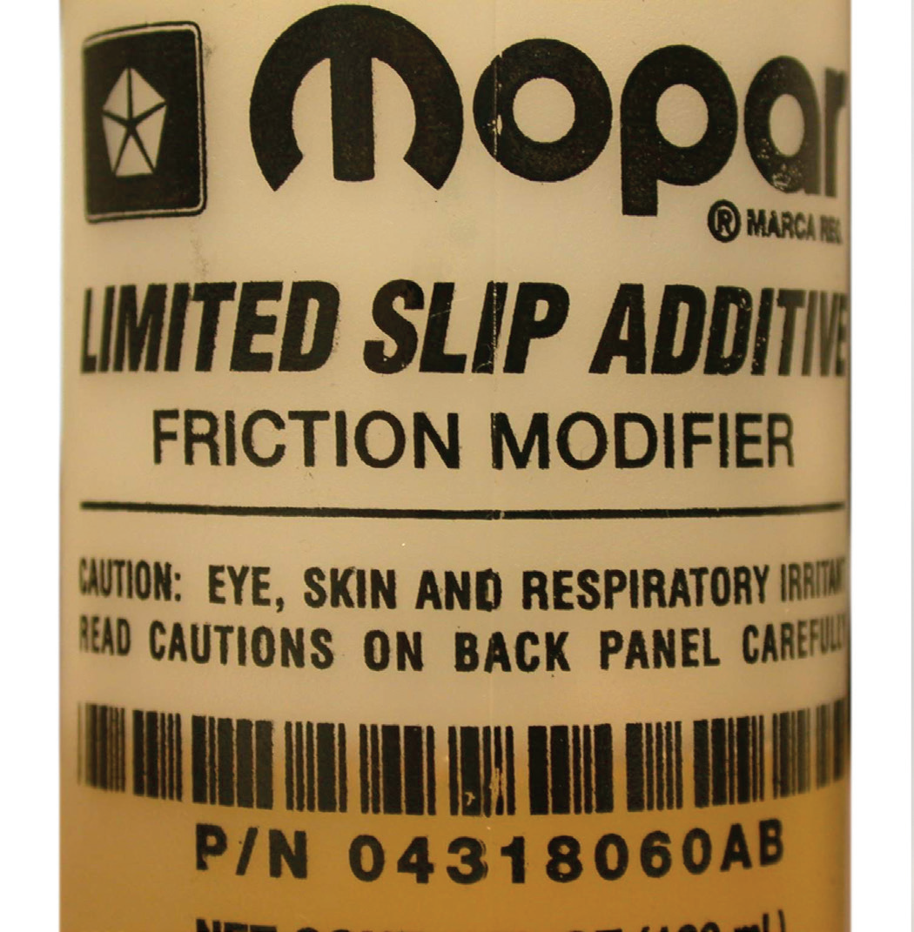
FIGURE 12–23 A friction additive needs to be added to the gear lube if using a preloaded clutch-type differential.

Slide 29
Summary (1 of 2)
A drive axle combines the hypoid final drive gears with the differential and two axle shafts.
Hypoid ring and pinion gears must be adjusted correctly for long life and quiet operation.

Slide 30
Summary (2 of 2)
The pinion gear and shaft are supported by two pinion bearings, and the ring gear and differential case are supported by two carrier bearings.
Differentials allow two wheels to be driven at different speeds.
Limited slip differentials increase torque bias to send more torque to the tire with good traction.

