Slide 1
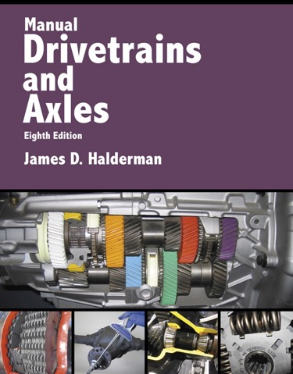
Manual Drivetrains and Axles
8th Edition
Chapter 10
Drive Shaft and CV Joint Service

Slide 2
Learning Objectives
1.1 Explain how to perform a U-joint inspection.
1.2 List the steps necessary to replace a U-joint.
1.3 Explain how to perform a measurement of the working angles of a U-joint.
1.4 Diagnose problems with CV joints and describe the service procedures for replacing CV joints.

Slide 3
U-Joint Diagnosis
What is some background on the driveshaft of a rear-wheel-drive vehicle?
Symptoms of defective U-Joints
  1. Vibration or harshness at highway speed
  2. A clicking sound whenever the vehicle is moving either forward or in reverse
  3. A clunking sound whenever changing gears, such as moving from drive to reverse

Slide 4
Driveshaft and U-Joint Inspection
The U-joints should be inspected every time the vehicle chassis is lubricated, or four times a year.
  The driveshaft must be removed to do this.
Check driveshaft for movement of U-joints; movement means the U-joint must be replaced.

Slide 5
Figure 10–2 All U-joints and spline collars equipped with a grease fitting should be greased four times a year as part of a regular lubrication service.

Slide 6
Figure 10–3 Many U-joints require a special grease gun tool to reach the grease fittings.

Slide 7
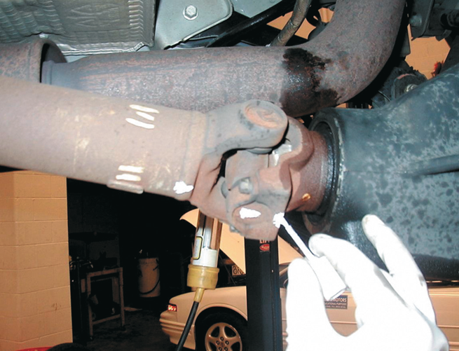
Figure 10–4 Always mark the original location of U-joints before disassembly.

Slide 8
Figure 10–5 Two types of retaining methods that are commonly used at the rear U-joint at the differential.

Slide 9
Figure 10–6 The best way to check any U-joint is to remove the driveshaft from the vehicle and move each joint in all directions.

Slide 10
U-Joint Replacement
Remove the retainers; use a press or a vise to separate the U-joint from the yoke.
Replacement U-joints use spring clips instead of injected plastic.
  Should be forged and use up to 32 needle bearings.
After removing any dirt or burrs from the yoke, press in a new U-joint.

Slide 11
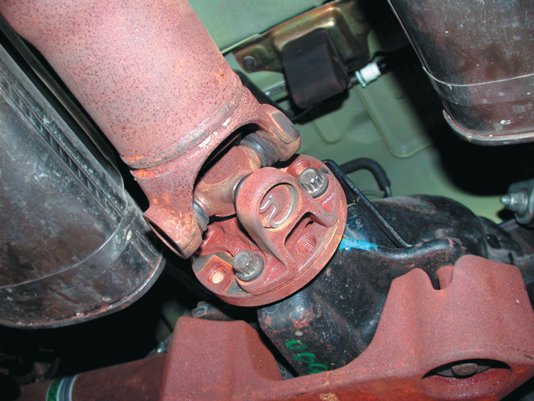
Figure 10–7 Typical U-joint that uses an outside snap ring.

Slide 12
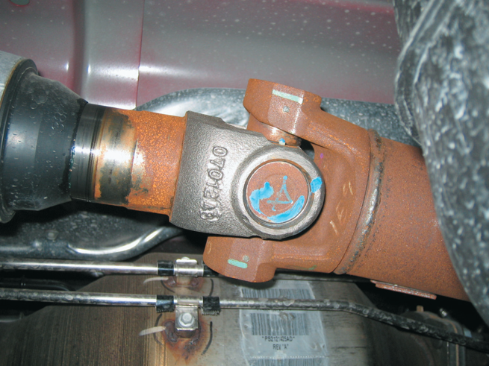
Figure 10–8 A U-joint that is held together by nylon and usually requires that heat be applied to remove from the yoke.

Slide 13
Figure 10–9 Use a vise and two sockets to replace a U-joint.

Slide 14
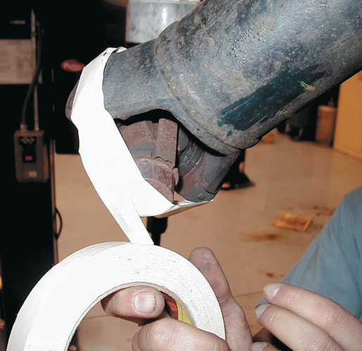
Figure 10–10 Taping the U-joint to prevent the caps from coming off.

Slide 15
Figure 10–11 A special tool being used to press apart a U-joint that is retained by injected plastic.

Slide 16
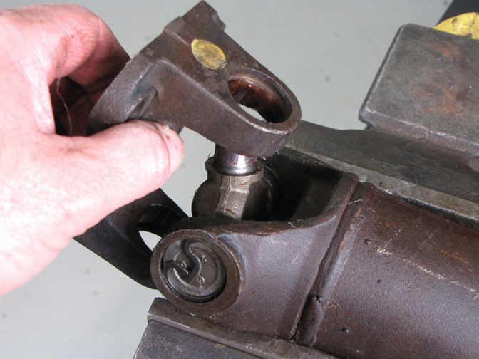
Figure 10–12 Removing the worn cross from the yoke.

Slide 17
Figure 10–13 When installing a new U joint, position the grease fitting on the inboard side (toward the driveshaft tube) and in alignment with the grease fitting of the U-joint at the other end.

Slide 18
U-Joint Working Angles
Place an inclinometer on the rear U-joint bearing cap. Level the bubble and read the angle.
Rotate the driveshaft 90 degrees and read the angle of the rear yoke.
Subtract the smaller reading from the larger reading to obtain the working angle of the joint.

Slide 19
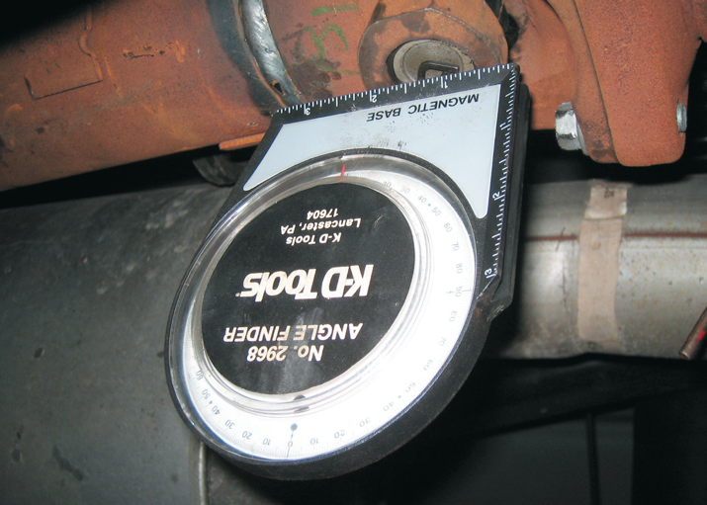
Figure 10–15 An inclinometer with a magnetic base is being used to measure the angle of the driveshaft at the rear U-joint.

Slide 20
Figure 10–16 Placing a tapered metal wedge between the rear leaf spring and the rear axle pedestal to correct rear U-joint working angles.

Slide 21
Figure 10–17 A transmission oil pan gasket leak allowed automatic trans-mission fluid to saturate the rear trans-mission mount rubber, causing it to collapse.

Slide 22
CV Joint Diagnosis
Noise while driving could signal that a CV joint is worn or has failed.
  Try driving the vehicle in reverse while turning and accelerating.

Slide 23
Replacement Shaft Assemblies
Front-wheel-drive vehicles were widely used in Europe and Japan long before they became popular in North America.
Standard repair procedure is to replace the entire drive assembly if there is a CV joint failure.

Slide 24
CV Joint Service
The hub nut must be removed whenever servicing a CV joint or shaft assembly on a front-wheel-drive vehicle.
What are the steps to follow after the hub nut is loosened?

Slide 25
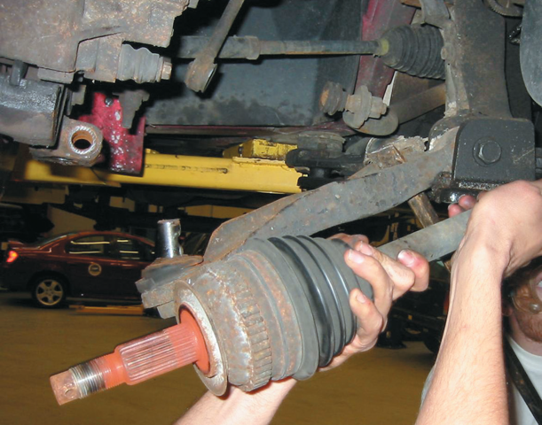
FIGURE 10–24 When removing a drive axle shaft assembly, use care to avoid pulling the plunge joint apart.

Slide 26
Summary
A defective U-joint often makes a clicking sound when the vehicle is in reverse.
Driveline clunk noise can often be corrected by applying high-temperature chassis grease to the splines of the front yoke on the driveshaft.
CV joints require careful cleaning, inspection, and lubrication with specific CV joint grease.

