Slide 1
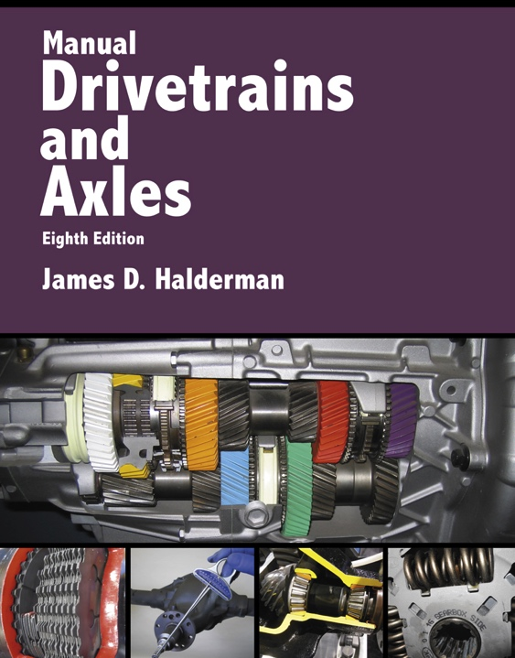
Manual Drivetrains and Axles
8th Edition
Chapter 1
Service Information, Tools, and Safety

Slide 2
Learning Objectives (1 of 2)
1.1 Locate and interpret vehicle and major component identification numbers.
1.2 Identify the strength ratings of threaded fasteners.
1.3 Explain the difference between the brand name (trade name) and the proper name for tools.
1.4 Describe what tool is the best to use for each job.
Notes:
Slide 2 is list of textbook LO numbers and statements

Slide 3
Learning Objectives (2 of 2)
1.5 Explain how to maintain hand tools.
1.6 Identify the personal protective equipment
(PPE) that all service technicians should wear.
1.7 Discuss how to safely use hand tools.
1.8 Describe how to safely hoist a vehicle.

Slide 4
Vehicle Identification
Make, Model, And Year
Vehicle Identification Number
  Vin
Vehicle Safety Certification Label
VECI Label
Calibration Codes
Casting Numbers

Slide 5
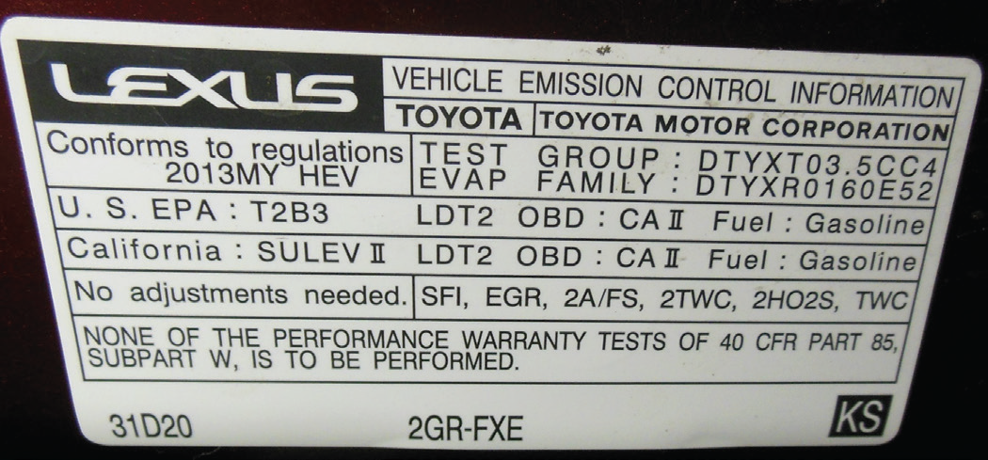
FIGURE 1–2 The vehicle emissions control information (VECI) sticker is placed under the hood.

Slide 6
Service Information
Service information is used by the service technician to determine specifications and service procedures, and any needed special tools.
Electronic service information is available mostly by subscription and provides access to an Internet site where service manual–type information is available.
What important information is available through technical service bulletins? The Internet?

Slide 7
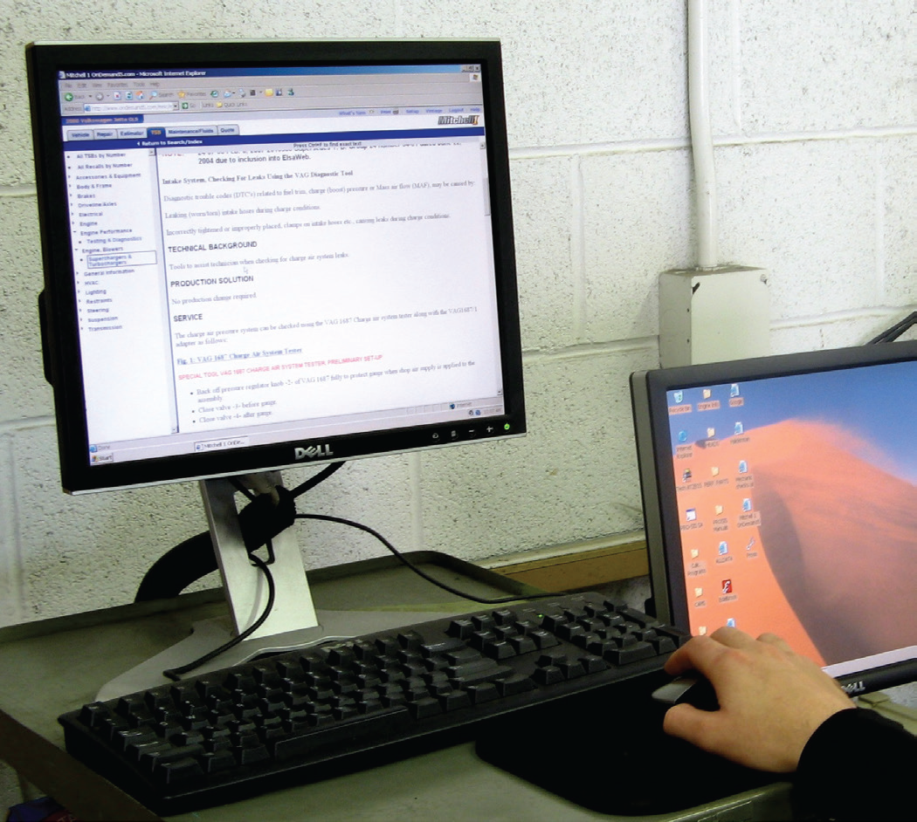
FIGURE 1–5 Electronic service information is available from aftermarket sources such as ALLDATA and Mitchell On Demand, as well as on websites hosted by vehicle manufacturers.

Slide 8
Threaded Fasteners (1 of 2)
Bolts and Threads
  Bolts are called cap screws when they are threaded into a casting.
Fractional threads are either coarse or fine.
How do you identify a metric bolt?
The strength or classification of a bolt is called the grade. The bolt heads are marked to indicate their grade strength.

Slide 9
Threaded Fasteners (2 of 2)
Tensile Strength Of Fasteners
  The maximum stress used under tension without causing failure of the fastener.
  Tensile strength is specified in pounds per square inch (psi).
Nuts are the female part of a threaded fastener.
Washers are often used under cap screw heads and under nuts.

Slide 10
FIGURE 1–14 Washers come in a variety of styles, including flat and serrated used to help prevent a fastener from loosening.

Slide 11
Hand Tools (1 of 2)
Wrenches are used to grasp and rotate threaded fasteners.
  Wrenches should be inspected before use to be sure they are not cracked, bent, or damaged.
  How do you safely use wrenches?
A socket fits over the fastener and grips the points and/or flats of the bolt or nut.

Slide 12
Hand Tools (2 of 2)
  A ratchet turns the socket in only one direction and allows the rotating of the ratchet handle back and forth in a narrow space.
    Always use the proper size socket that correctly fits the bolt or nut.
Torque wrenches are socket turning handles that apply a known amount of force to the fastener.
  Clicker type
  Beam-type
  How do you safely use sockets and ratchets?

Slide 13
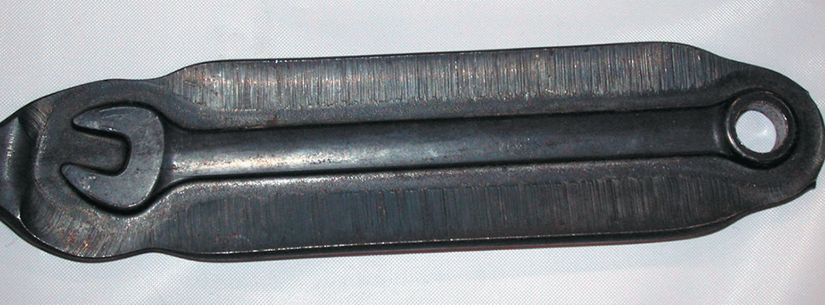
FIGURE 1–15 A wrench after it has been forged but before the flashing, extra material around the wrench, has been removed.

Slide 14
Screwdrivers
What is the difference between a straight-blade screwdriver, a Phillips screwdriver, a offset screwdriver, and a impact screwdriver?
Always use the proper type and size screwdriver that matches the fastener.
Hammers and Mallets: used to force objects together or apart.
  All mallets and hammers should be cleaned after use and not exposed to extreme temperatures.

Slide 15
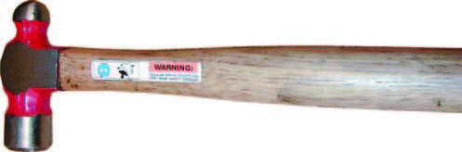
Figure 1–33 A typical ball-peen hammer

Slide 16
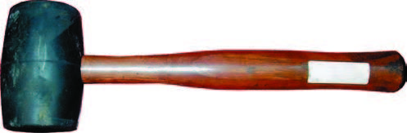
Figure 1–34 A rubber mallet used to deliver a force to an object without harming the surface.

Slide 17
Torx
A Torx is a six-pointed star shaped tip that was developed by Camcar (formerly Textron) to offer higher loosening and tightening torque than is possible with a straight (flat tip) or Phillips.

Slide 18
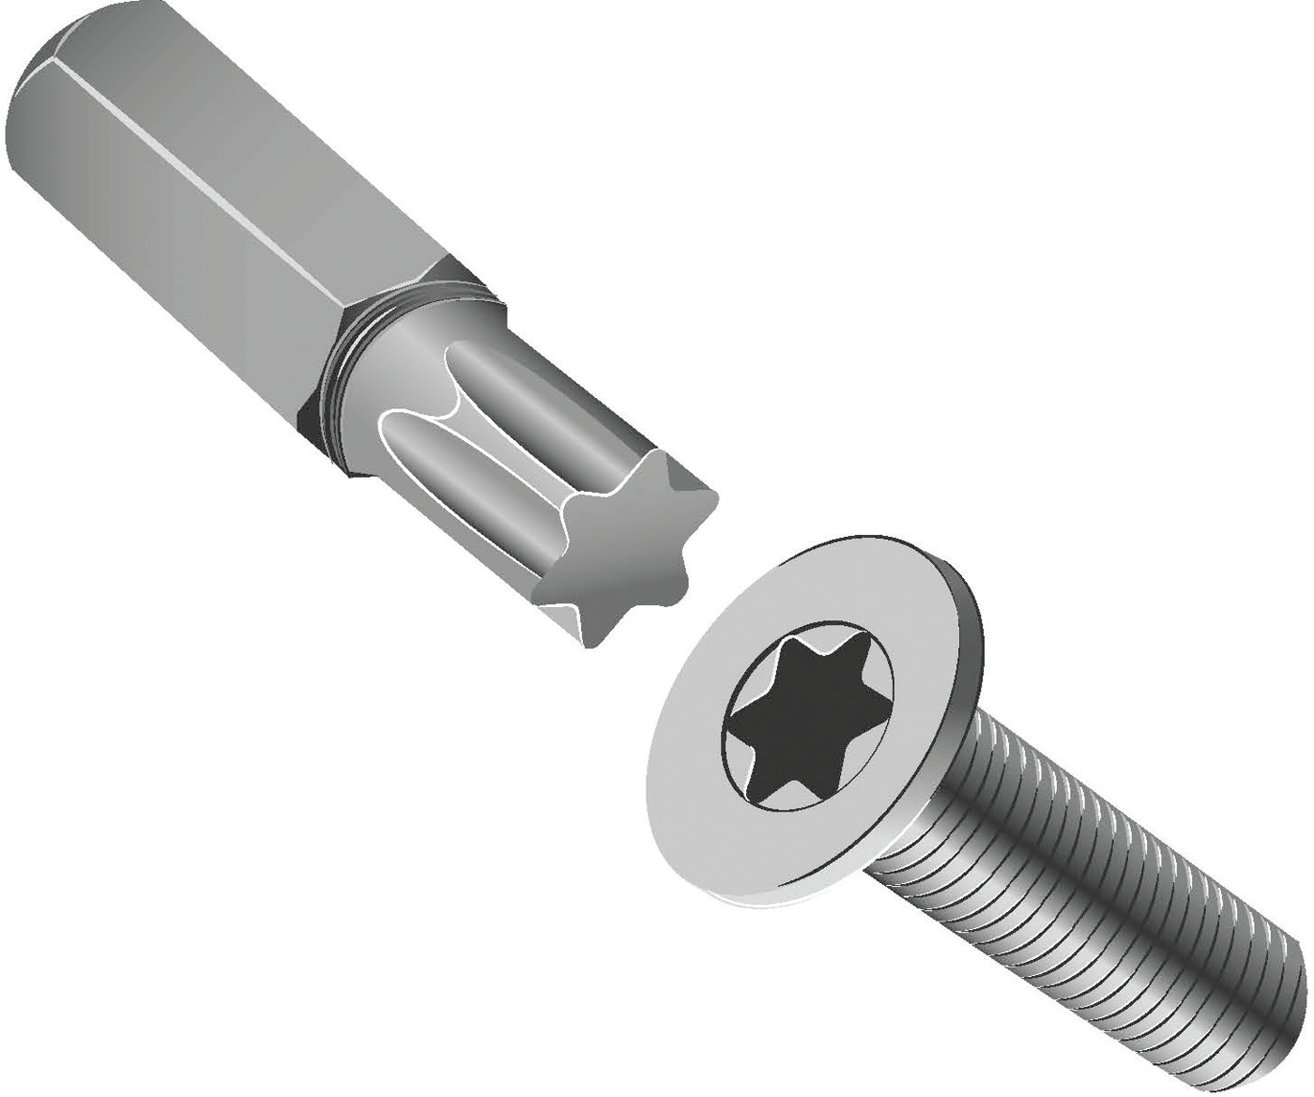
FIGURE 1–31 A Torx bit and fastener.

Slide 19
Pliers (1 of 4)
A pliers is capable of holding, twisting, bending, and cutting objects and is an extremely useful classification of tools.
  Pliers should only be used when specified for use by the vehicle manufacturer.
What are the differences between these types of pliers?: Slip joint, multigroove adjustable, linesman’s, diagonal, needle-nose, locking, snap-ring.

Slide 20
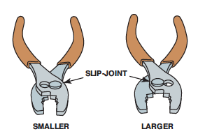
Figure 1–36 Typical slip-joint pliers are common household pliers. The slip joint allows the jaws to be opened to two different settings.

Slide 21
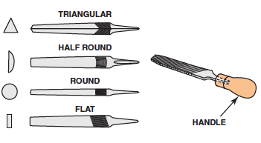
Figure 1–43 Files come in many different shapes and sizes. Never use a file without a handle.

Slide 22
Pliers (2 of 4)
Files are used to smooth metal and are constructed of hardened steel with diagonal rows of teeth.
  Always use a file with a handle.
Snips: cutters used for a variety of material to fabricate sheet metal brackets or heat shields.
Utility Knife: used to cut a variety of materials such as carpet, plastic, wood, and paper products, such as cardboard.

Slide 23
Pliers (3 of 4)
Punches: used to drive a pin out that is used to retain two components.
Chisels: used for cutting off rivets or to separate two pieces of an assembly.
  Always wear eye protection because the hardened steel is brittle and parts of the punch could fly off and cause serious personal injury.

Slide 24
Pliers (4 of 4)
Hacksaws: used to cut metals, such as steel, aluminum, brass, or copper.
  Move the hacksaw slowly away from you, then lift slightly and return for another cut.

Slide 25
Basic Hand Tool List
What is included in a typical list of hand tools that every automotive technician should possess?

Slide 26
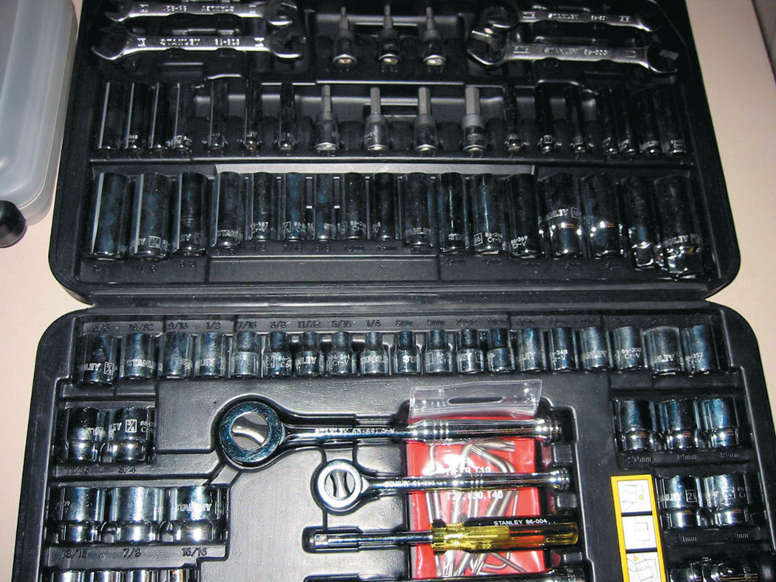
Tool Sets and Accessories
A beginning service technician may wish to start with a small set of tools before purchasing an expensive tool set.
Notes:
FIGURE 1–50 A typical beginning technician tool set that
includes the basic tools to get started.

Slide 27
Electrical Hand Tools
A test light is used to test for electricity.
What are the types of soldering guns?
What are the types of electrical work hand tools?
Digital meter: DC volts, AC volts, Ohms, Amperes

Slide 28
FIGURE 1–53 Electric and butane-powered soldering guns used to make electrical repairs. Soldering guns are sold by the wattage rating. The higher the wattage, the greater amount of heat created. Most solder guns used for automotive electrical work usually fall within the 60 to 160 watt range.

Slide 29
Hand Tool Maintenance (1 of 2)
Clean each tool before placing it back into the tool box.
Keep tools separated.
  Moisture on metal tools will start to rust more readily if the tools are in contact with another metal tool.

Slide 30
Hand Tool Maintenance (2 of 2)
Line the drawers of the tool box with a material that will prevent the tools from moving as the drawers are opened and closed.
  This helps to quickly locate the proper tool and size.
Release the tension on all “clicker-type” torque wrenches.
Keep the tool box secure.

Slide 31
Trouble Lights
Incandescent lights use a filament that produces light when electric current flows through the bulb. This was the standard trouble light, also called a work light for many years until safety issues caused most shops to switch to safer fluorescent or LED lights.

Slide 32
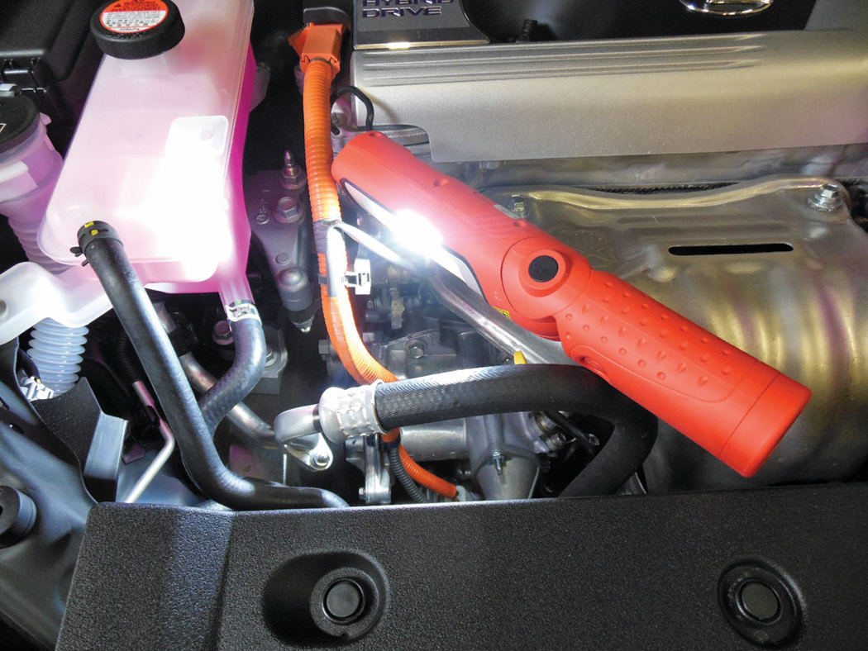
FIGURE 1–54 A battery-powered LED trouble light.

Slide 33
Air and Electrically Operated Tools
An impact wrench, either air or electrically powered, is a tool that is used to remove and install fasteners.
What is a: Air ratchet? Die grinder? Bench or pedestal-mounted grinder?

Slide 34
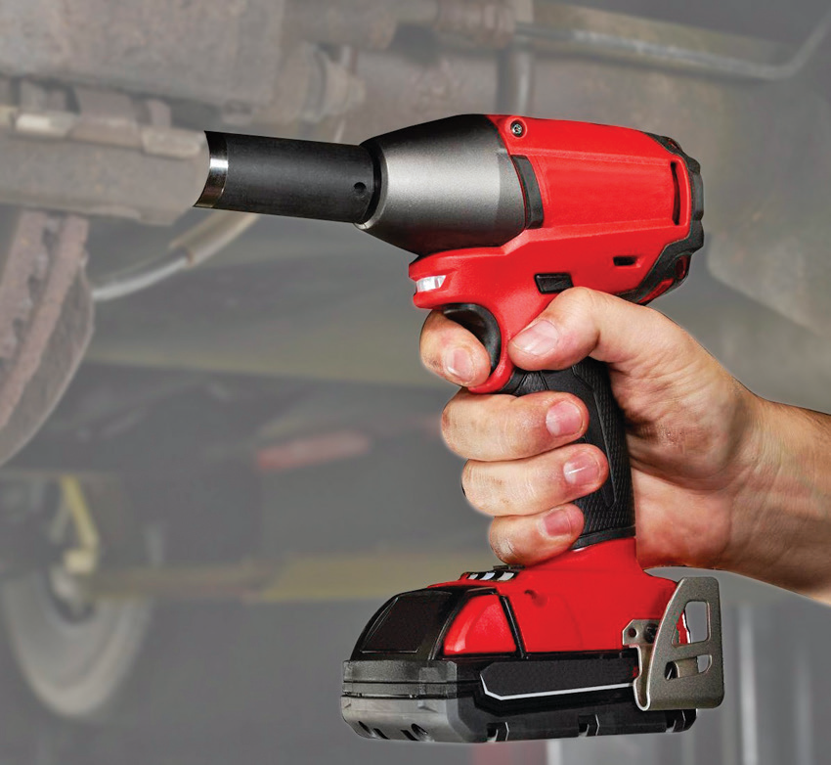
FIGURE 1–56 A typical battery-powered 1/2 inch drive impact wrench.

Slide 35
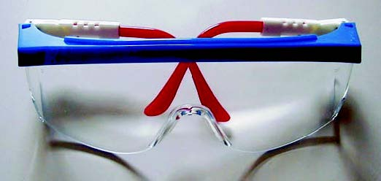
Personal Protective Equipment
Safety Glasses
Steel-toed Safety Shoes
Bump Cap
Hearing Protection
Gloves
FIGURE 1–61 Safety glasses should be worn at all times when working on or around any vehicle or servicing any components.

Slide 36
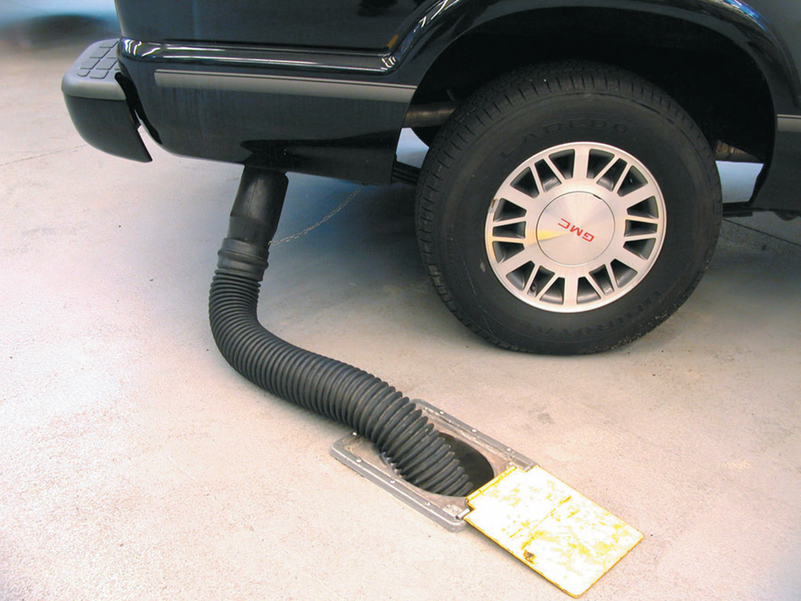
Safety Precautions
What are the safety precautions you should perform to keep safe in the shop?
Notes:
FIGURE 1–66 Always connect an exhaust hose to the tailpipe
of a vehicle to be run inside a building.

Slide 37
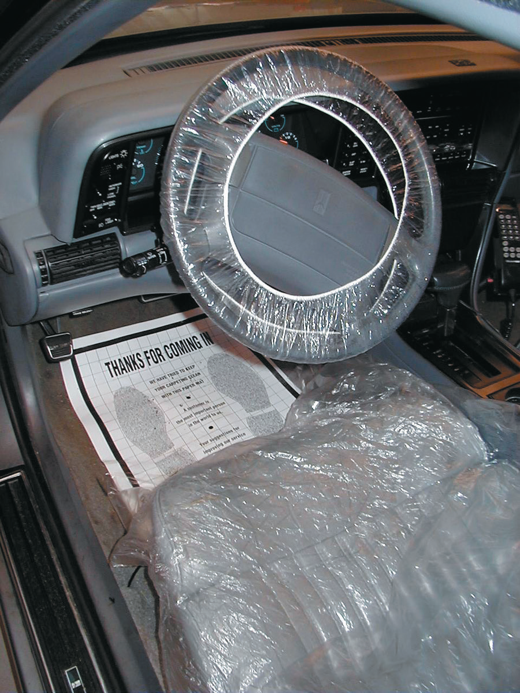
Vehicle Protection
How do fender covers help protect a vehicle?
Why use interior protection?
Notes:
FIGURE 1–68 Covering the interior as soon as the vehicle
comes in for service helps improve customer satisfaction.

Slide 38
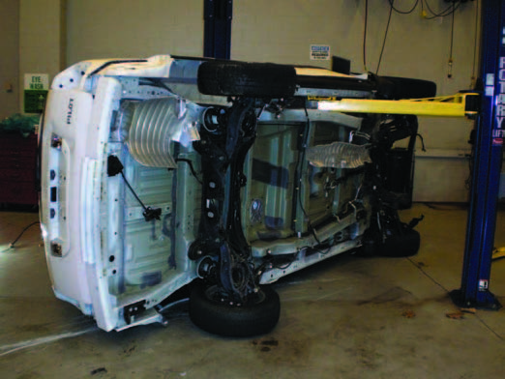
Hoisting a Vehicle (1 of 2)
The vehicle should be centered on the lift or hoist so as not to overload one side or put too much force either forward or rearward.
The pads of the lift should be spread as far apart as possible to provide a stable platform.
FIGURE 1–72 This training vehicle fell from the hoist because the pads were not set correctly. No one was hurt, but the vehicle was damaged.

Slide 39
Hoisting a Vehicle (2 of 2)
Each pad should be placed under a portion of the vehicle that is strong and capable of supporting the weight of the vehicle.

Slide 40
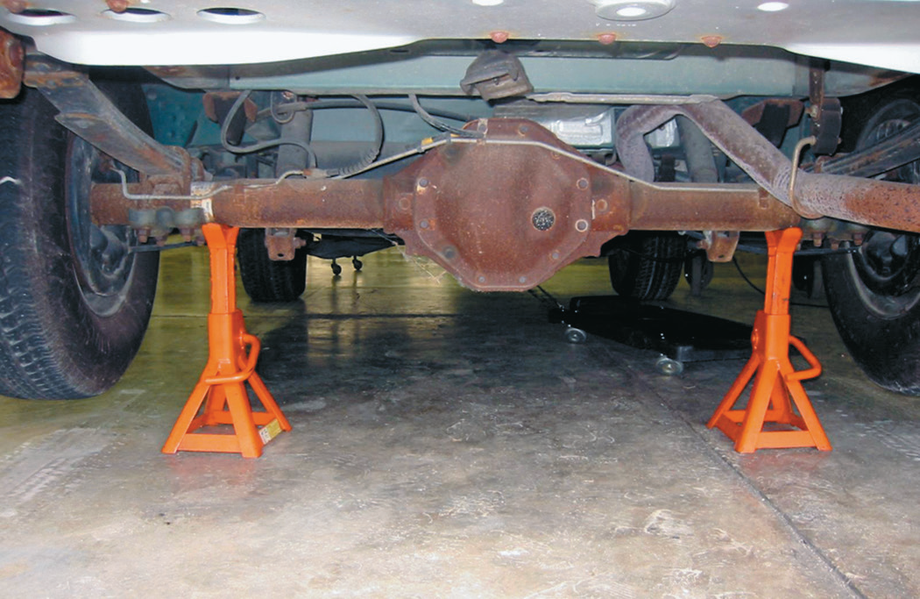
Jacks and Safety Stands
Floor jacks are used to lift one side or end of a vehicle. They are portable and relatively inexpensive and must be used with safety (jack) stands.
Notes:
FIGURE 1–75 (b) Whenever a vehicle is raised off the ground, a safety stand should be placed under the frame, axle, or body to support the weight of the vehicle.

Slide 41
Drive-on Ramps
Ramps are an inexpensive way to raise the front or rear of a vehicle.
Notes:
FIGURE 1–76 Drive-on-type ramps are dangerous to use.
The wheels on the ground level must be chocked (blocked) to
prevent accidental movement down the ramp.

Slide 42
Electrical Cord Safety
Use correctly grounded three-prong sockets and extension cords to operate power tools. Some tools use only two-prong plugs.
What are some other safety procedures you should follow when dealing with electrical cords?

Slide 43
Jump Starting and Battery Safety
To jump start another vehicle with a dead battery, connect good-quality copper jumper cables.
Batteries contain acid and should be handled with care to avoid tipping them greater than a 45-degree angle.
Notes:
FIGURE 1–77 Jumper cable usage guide. Follow the same connections if using a portable jump box.

Slide 44
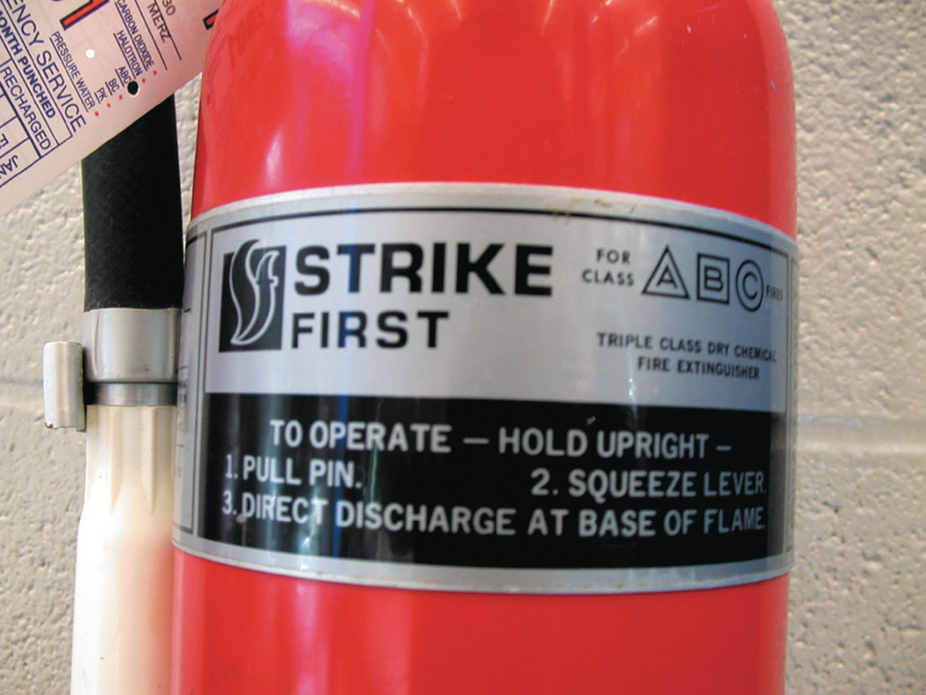
Fire Extinguishers
What are the four fire extinguisher classes?
Types of fire extinguishers: Water, Carbon dioxide (CO₂).
Notes:
FIGURE 1–79 A typical fire extinguisher designed to be used
on type A, B, or C fires.

Slide 45
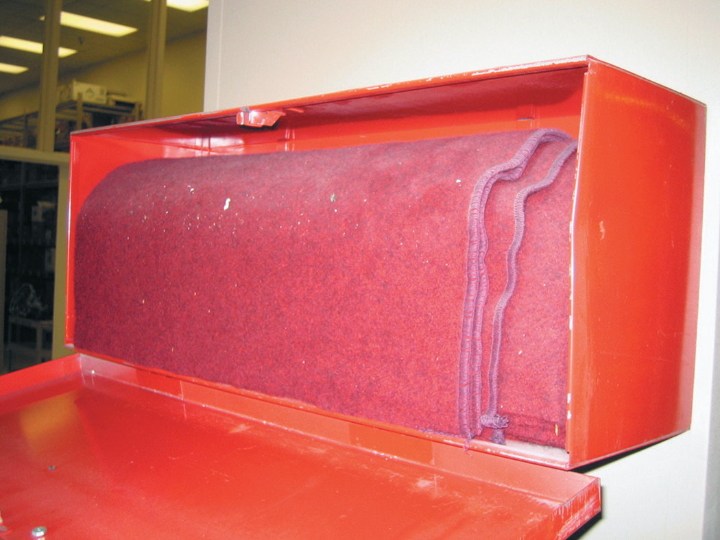
Fire Blankets
Fire blankets are required to be available in the shop areas.
Notes:
FIGURE 1–81 A treated wool blanket is kept in an easy to-
open wall-mounted holder and should be placed in a
central location in the shop.

Slide 46
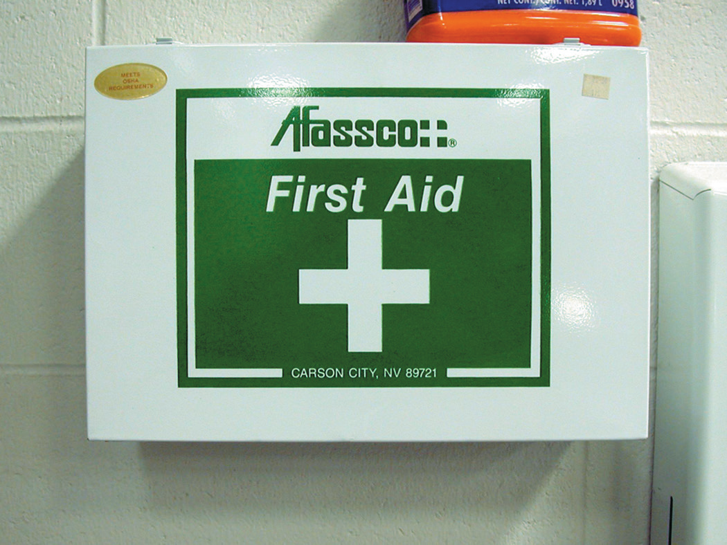
First Aid and Eye Wash Stations
All shop areas must be equipped with a first aid kit and an eye wash station centrally located and kept stocked with emergency supplies.
Notes:
FIGURE 1–82 A first aid box should be centrally located
in the shop and kept stocked with the recommended
supplies.

Slide 47
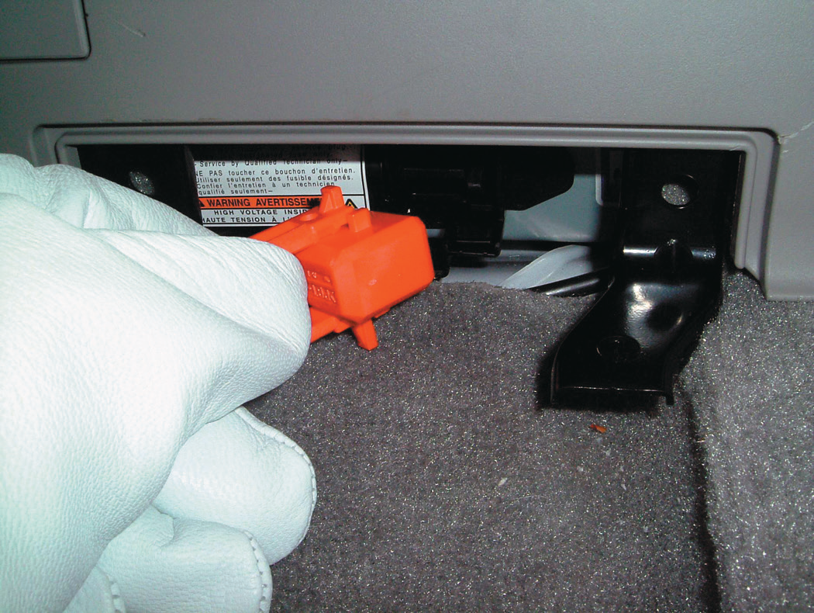
Hybrid Electric Vehicle Safety Issues
Toyota Prius
Ford Escape and Mercury Mariner
Honda Civic
Chevrolet Silverado and GMC Sierra Pickup Truck

Slide 48
Summary (1 of 3)
Whenever a vehicle is raised above the ground, it must be supported at a substantial section of the body or frame.
Wrenches: open end, box end, and combination open and box end; adjustable; line; torque
Sockets are rotated by a ratchet or breaker bar, also called a flex handle.

Slide 49
Summary (2 of 3)
Hybrid electric vehicles should be de-powered if any of the high-voltage components are going to be serviced.
Screwdriver types include straight blade and Phillips.
Hammers and mallets come in a variety of sizes and weights.

Slide 50
Summary (3 of 3)
Pliers are a useful tool and are available in many different types.
Other common hand tools include snap-ring pliers, files, cutters, punches, chisels, and hacksaws.

