Slide 1
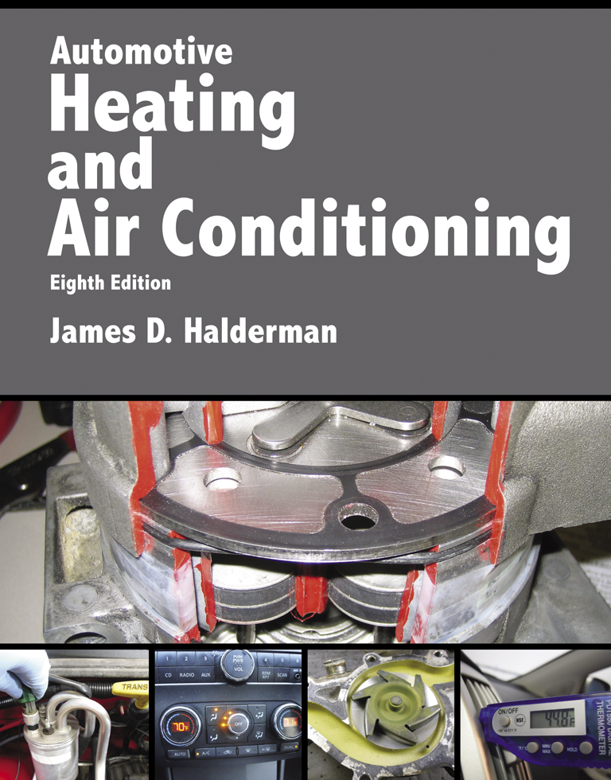
Automotive Heating And Air Conditioning
Eighth Edition
Chapter 8
Cooling System Operation and Diagnosis

Slide 2
Learning Objectives (1 of 2)
8.1 Explain the purpose and function of the cooling system and cooling system operation.
8.2 Explain the purpose of thermostats, radiators, pressure caps, and water pumps.
8.3 Explain coolant flow in the engine and coolant recovery systems.

Slide 3
Learning Objectives (2 of 2)
8.4 Explain the purpose of cooling fans and heater cores.
8.5 Describe cooling system testing and explain the purpose of the coolant temperature warning light.
8.6 Explain cooling system inspection and cooling system service.

Slide 4
Cooling System
Coolant flows through the engine, where it picks up heat.
It then flows to the radiator, where the heat is given up to the outside air.
The coolant continually recirculates through the cooling system.

Slide 5
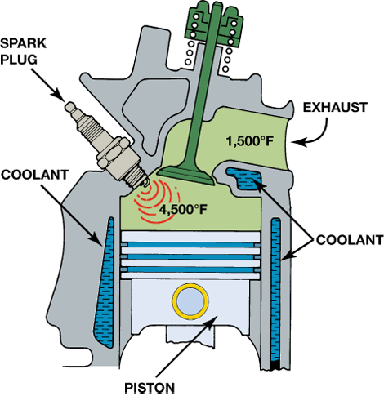
FIGURE 8–1 Typical combustion and exhaust temperatures.

Slide 6
Cooling System Operation (1 of 2)
Its temperature rises as much as 15°F (8°C) as it goes through the engine; then it recools as it goes through the radiator.
The coolant flow rate may be as high as 1 gallon (4 liters) per minute for each horsepower the engine produces.

Slide 7
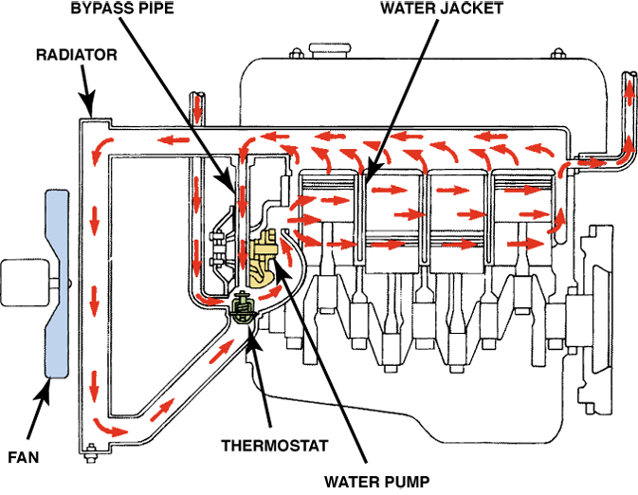
FIGURE 8–3 Coolant flow through a typical engine cooling system.

Slide 8
Cooling System Operation (2 of 2)
Hot coolant comes out of the thermostat housing on the top of the engine.
The engine coolant outlet is connected to the top of the radiator by the upper hose and clamps.
The coolant in the radiator is cooled by air flowing through the radiator.

Slide 9
Thermostats (1 of 2)
There is a normal operating temperature range between low-temperature and high-temperature extremes.
The thermostat controls the minimum normal temperature.
The thermostat is a temperature-controlled valve placed at the engine coolant outlet.

Slide 10
Thermostats (2 of 2)
An encapsulated, wax-based, plastic-pellet heat sensor is located on the engine side of the thermostatic valve.
As the engine warms, heat swells the heat sensor.

Slide 11
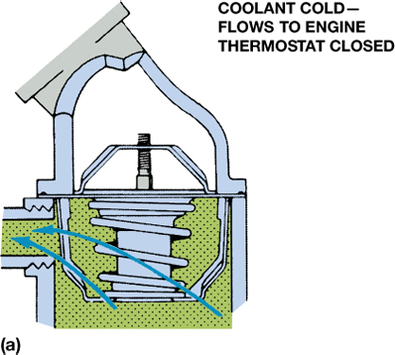
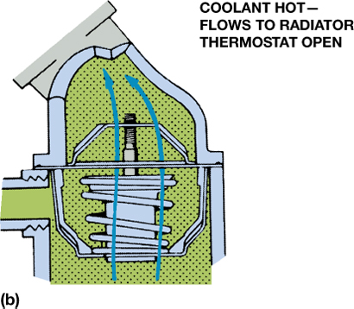
FIGURE 8–5 (a) When the engine is cold, the coolant flows through the bypass. (b) When the thermostat opens, the coolant can flow to the radiator.

Slide 12
Radiators
What are the types of radiators?
What are the two basic designs of radiators?
How radiators work

Slide 13
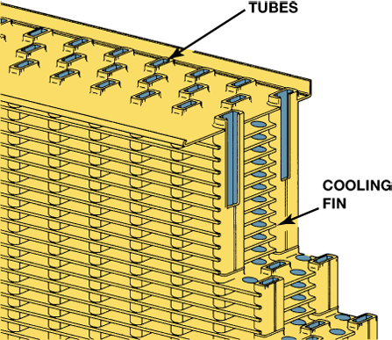
FIGURE 8–11 The tubes and fins of the radiator core.

Slide 14
Pressure Cap
The filler neck is fitted with a pressure cap.
The cap has a spring-loaded valve that closes the cooling system vent.
This causes cooling pressure to build up to the pressure setting of the cap.
At this point, the valve will release the excess pressure to prevent system damage.

Slide 15
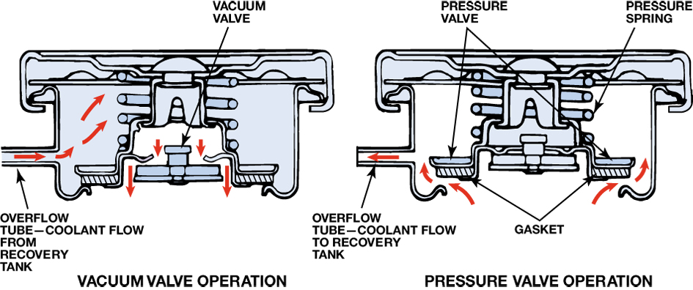
FIGURE 8–14 The pressure valve maintains the system pressure and allows excess pressure to vent. The vacuum valve allows coolant to return to the system from the recovery tank.

Slide 16
Coolant Recovery Systems
What is the purpose and function of coolant recover systems?
Most cooling systems connect the overflow to a plastic reservoir to hold excess coolant while the system is hot.
Surge tank
Some vehicles use a surge tank, which is located at the highest level of the cooling system and holds about 1 quart (1 liter) of coolant.

Slide 17
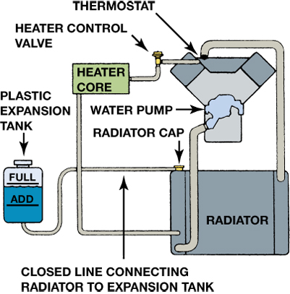
FIGURE 8–15 The level in the coolant recovery system raises and lowers with engine temperature.

Slide 18
Water Pumps
Water pumps are not positive displacement pumps.
The water pump is a centrifugal pump that can move a large volume of coolant without increasing the pressure of the coolant.
Coolant leaving the pump impeller is fed through a scroll.

Slide 19
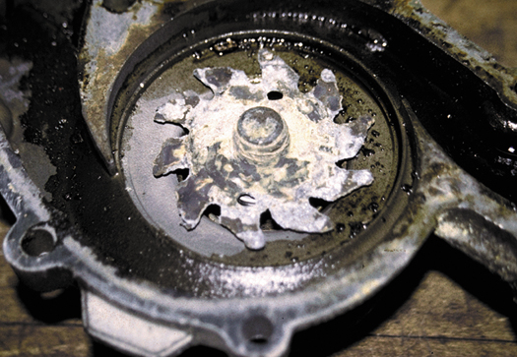
FIGURE 8–19 This severely corroded water pump could not circulate enough coolant to keep the engine cool. As a result, the engine overheated and blew a head gasket.

Slide 20
Coolant Flow in the Engine
Coolant flows through the engine in one of the following ways:
Parallel flow system
Series flow system
Series–parallel flow system
Excess pressure usually forces some coolant from the system through an overflow.

Slide 21
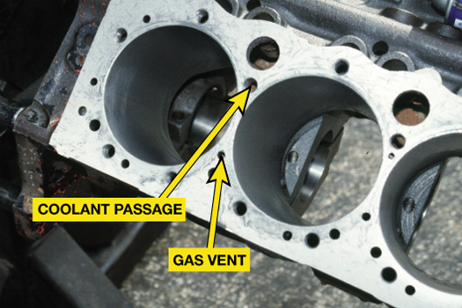
FIGURE 8–22 A Chevrolet V-8 block that shows the large coolant holes and the smaller gas vent or bleed holes that must match the head gasket when the engine is assembled.

Slide 22
Cooling Fans (1 of 2)
The thermostatic spring operates a valve that allows the fan to freewheel when the radiator is cold.
As the radiator warms to about 150°F (65°C), the air hitting the thermostatic spring will cause the spring to change its shape.

Slide 23
Cooling Fans (2 of 2)
The thermal fan is designed so that it uses little power at high engine speeds and minimizes noise.
A second type of thermal fan has a thermostatic spring added to the silicone coupling fan drive.
The thermal fan has a silicone coupling fan drive mounted between the drive pulley and the fan.

Slide 24
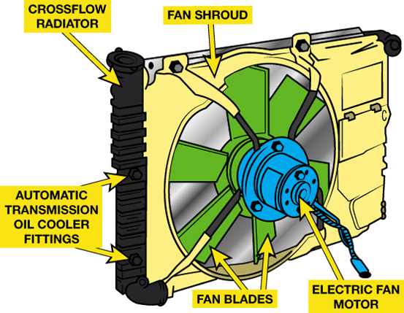
FIGURE 8–23 A typical electric cooling fan assembly showing the radiator and related components.

Slide 25
Heater Cores
Most of the heat absorbed from the engine by the cooling system is wasted.
Some of this heat, however, is recovered by the vehicle heater.
The heater and air conditioning work in series to maintain vehicle compartment temperature.

Slide 26
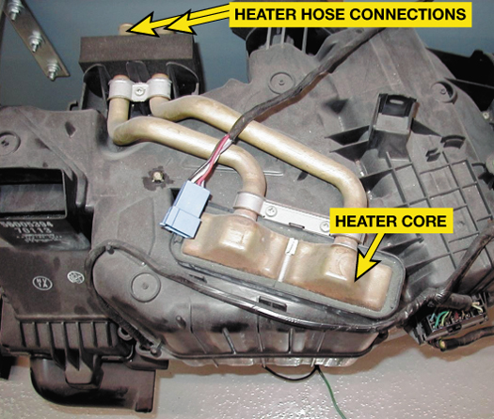
FIGURE 8–25 A typical heater core installed in a heating, ventilation, and air-conditioning (HVAC) housing assembly.

Slide 27
Cooling System Testing and Warning Light (1 of 2)
Many cooling system faults can be found by performing a thorough visual inspection.
Pressure testing using a hand operated pressure tester is a quick and easy cooling system test.
Check for fluorescent dye in the coolant to check for a leak, one that is specifically designed for coolant.

Slide 28
Cooling System Testing and Warning Light (2 of 2)
Most vehicles are equipped with a heat sensor for the engine operating temperature indicator light.
If the warning light comes on during driving (or the temperature gauge goes into the red danger zone), then the coolant temperature is about 250°F to 258°F (120°C to 126°C), which is still below the boiling point of the coolant

Slide 29

FIGURE 8–29 Use dye specifically made for coolant when checking for leaks using a black light.

Slide 30
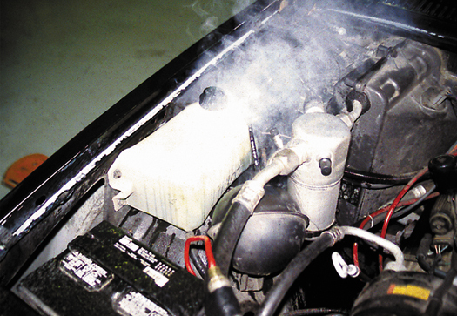
FIGURE 8–30 When an engine overheats, often the coolant overflow container boils.

Slide 31
Cooling System Inspection and Cooling System Service (1 of 2)
Normal maintenance involves an occasional check on the coolant level.
Testing if belt tension is within factory specifications:
Belt tension gauge; marks on the tensioner; torque wrench reading; deflection

Slide 32
Cooling System Inspection and Cooling System Service (2 of 2)
Flushing coolant
Coolant exchange machine
Hose inspection
Disposing of used coolant
Cleaning the radiator exterior

Slide 33
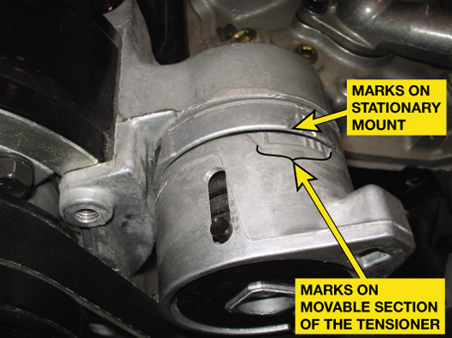
FIGURE 8–31 Typical marks on an accessory drive belt tensioner.

Slide 34
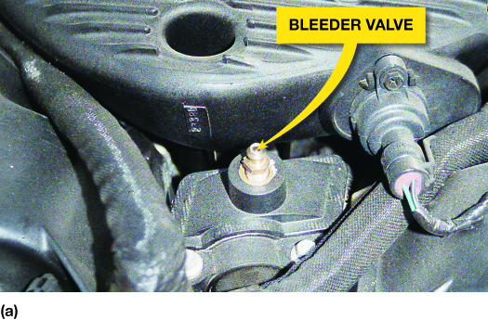
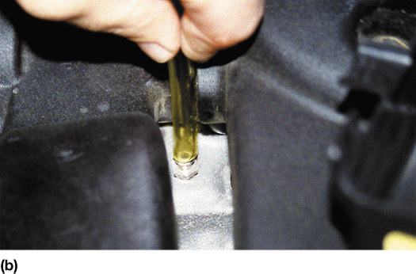
FIGURE 8–32 (a) Many vehicle manufacturers recommend that the bleeder valve be opened whenever refilling the cooling system. (b) Chrysler recommends that a clear plastic hose (1/4 inch ID) be attached to the bleeder valve and directed into a suitable container to keep from spilling coolant onto the ground and on the engine and to allow the technician to observe the flow of coolant for any remaining air bubbles.

Slide 35
Summary (1 of 3)
The purpose and function of the cooling system is to maintain proper engine operating temperature.
The thermostat controls engine coolant temperature by opening at its rated opening temperature to allow coolant to flow through the radiator.

Slide 36
Summary (2 of 3)
Coolant fans are designed to draw air through the radiator to aid in the heat transfer process, drawing the heat from the coolant and transferring it to the outside air through the radiator.
The cooling system should be tested for leaks using a hand-operated pressure pump.

Slide 37
Summary (3 of 3)
Water pumps are usually engine driven and circulate coolant through the engine and the radiator when the thermostat opens.
Coolant flows through the radiator hoses to and from the engine and through heater hoses to send heated coolant to the heater core in the passenger compartment.

