Slide 1
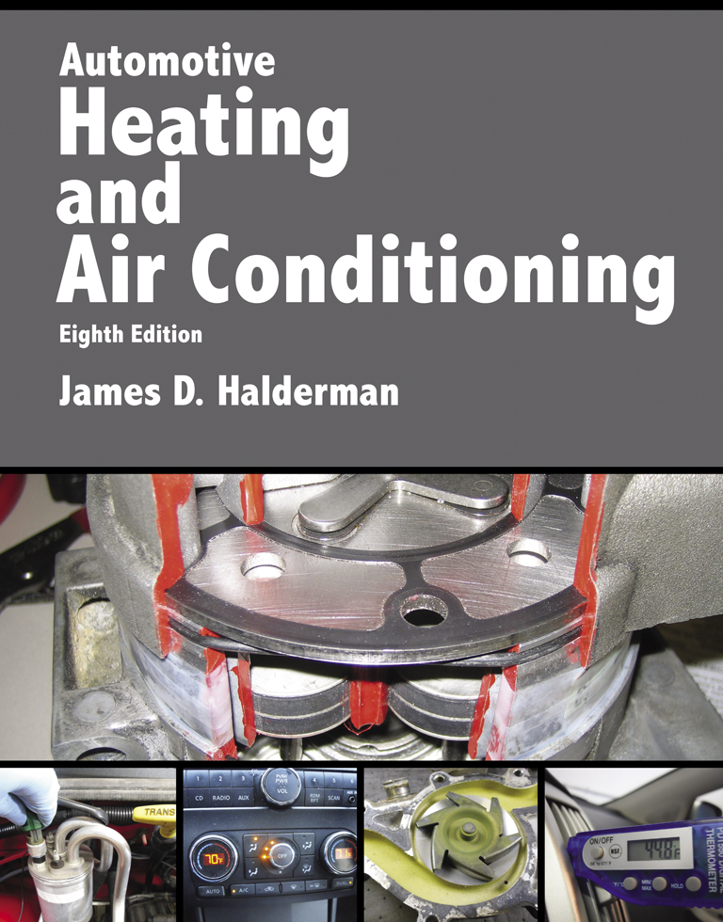
Automotive Heating And Air Conditioning
Eighth Edition
Chapter 1
Heating and Air-Conditioning Principles

Slide 2
Learning Objectives (1 of 2)
1.1 Prepare for the ASE Heating and Air Conditioning (A7) certification test content area “A” (A/C System Service, Diagnosis and Repair).
1.2 Discuss the changes of states of matter.
1.3 Discuss the effect of heat and temperature on matter.

Slide 3
Learning Objectives (2 of 2)
1.4 Discuss the two types of humidity.
1.5 Explain heating and cooling load.
1.6 Explain the three ways in which heat flows.
1.7 Describe the air-conditioning process.
1.8 Explain the purpose of an HVAC system.

Slide 4
Introduction (1 of 4)
A solid is a substance that cannot be compressed and has strong resistance to flow.
The molecules of a solid attract each other strongly, and resist changes in volume and shape.

Slide 5
Introduction (2 of 4)
A substance is solid at any temperature below its melting point.
A liquid is a substance that cannot be compressed.
The boiling point is the temperature at which a liquid substance turns to vapor.

Slide 6
Introduction (3 of 4)
Temperature is the measure of the level of energy.
Temperature is measured in degrees.
Heat is measured in the metric unit called calorie and expresses the amount of heat needed to raise the temperature of one gram of water one degree Celsius.

Slide 7
Introduction (4 of 4)
Absolute humidity is the mass of water vapor in a given volume of air.
Relative humidity (RH) is the percentage of how much moisture is present in the air compared to how much moisture the air is capable of holding at that temperature.

Slide 8
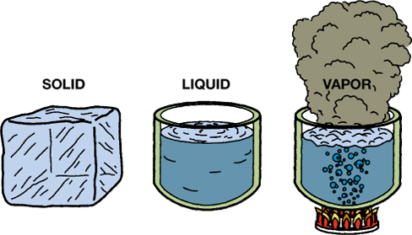
FIGURE 1–1 Water is a substance that can be found naturally in solid, liquid, and vapor states.

Slide 9
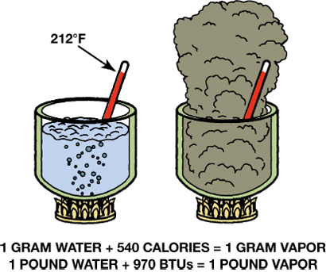
FIGURE 1–2 The extra heat required to change a standard amount of water at its boiling point to vapor is called latent heat of vaporization.

Slide 10
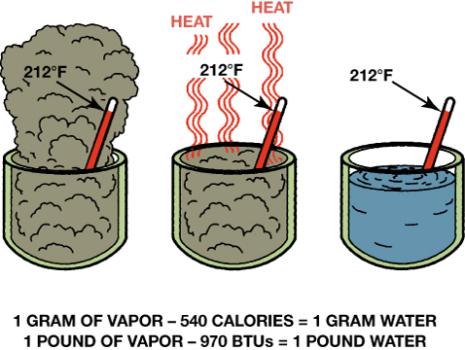
FIGURE 1–3 The latent heat of vaporization that water vapor stores is released when the vapor condenses to a liquid. The temperature stays the same.

Slide 11
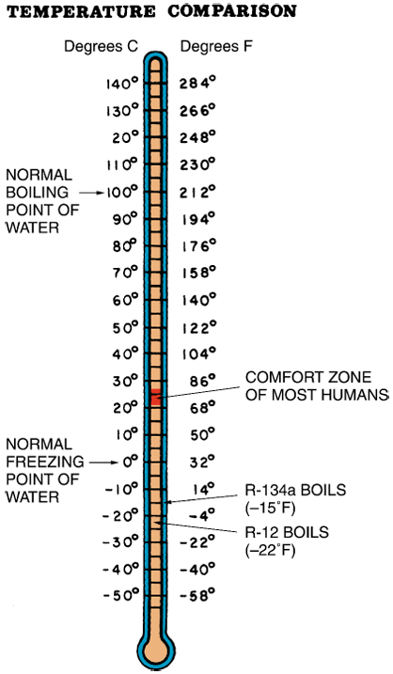
FIGURE 1–4 Heat intensity is measured using a thermometer. The two common measuring scales, Celsius and Fahrenheit, are shown here. This thermometer is also marked with water freezing and boiling and refrigerant boiling temperatures.

Slide 12
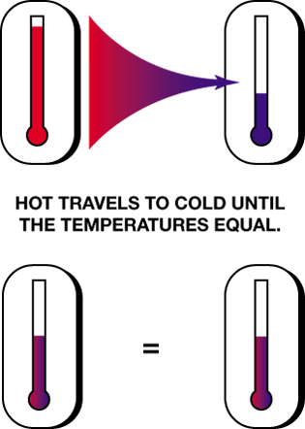
FIGURE 1–5 Heat travels from higher temperature (higher energy level), to lower temperature (lower energy level).

Slide 13
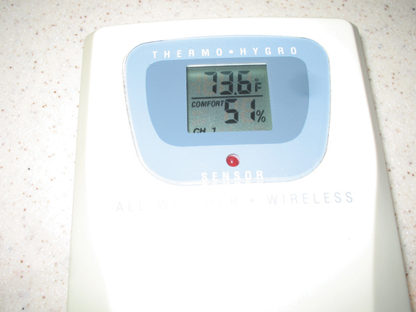
FIGURE 1–6 A combination meter that measures and displays both the temperature and the humidity is useful to use when working on air-conditioning systems.

Slide 14
Heating and Cooling Load (1 of 2)
Heating load is the term used when additional heat is needed. The actual load is the number of BTUs or calories of heat energy that must be added.
In most vehicles, heated coolant is circulated through a heat exchanger, called a heater core.

Slide 15
Heating and Cooling Load (2 of 2)
One way to move heat, called cooling load, is with a block of ice.
A substantial amount of latent heat is required to change the state of the solid ice into a liquid.

Slide 16
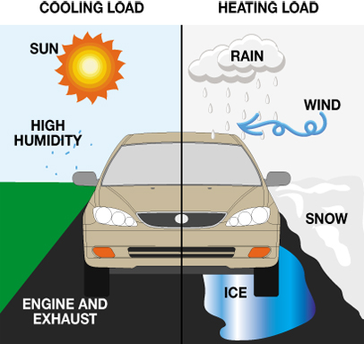
FIGURE 1–8 Winter presents a heat load where heat must be added for comfort (right). Summer presents a cooling load.

Slide 17

FIGURE 1–9 Ice has a cooling effect because of latent heat of fusion which means that it absorbs heat as it melts.

Slide 18
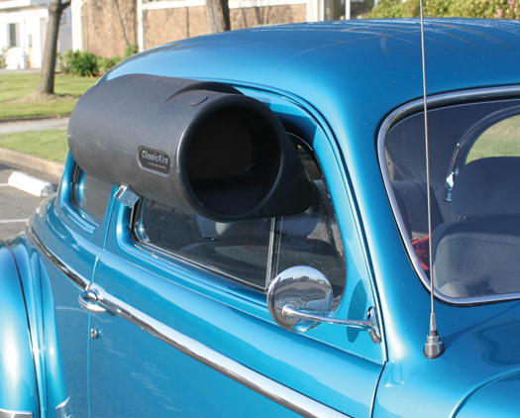
FIGURE 1–10 At one time, evaporative coolers were used to cool car interiors. Air forced through a water-wetted mesh produces evaporation and a cooling effect.

Slide 19
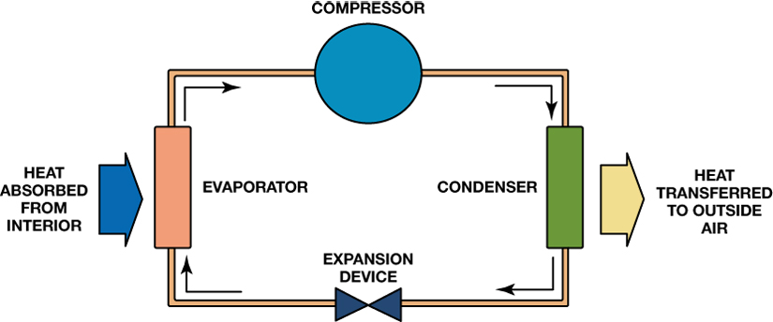
FIGURE 1–11 Heat, from in-vehicle cabin air, causes the refrigerant to boil in the evaporator (left). The compressor increases the pressure and moves refrigerant vapor to the condenser, where the heat is transferred to ambient air. This also causes the vapor to return to liquid form.

Slide 20
Heat Movement (1 of 2)
The simplest heat movement method is conduction, by which heat travels through a medium such as a solid or liquid, moving from one molecule of the material to the next.
Convection is a process of transferring heat by moving the heated medium, usually air or a liquid.

Slide 21
Heat Movement (2 of 2)
Heat can travel through heat rays and pass from one location to another without warming the air through which it passes.

Slide 22
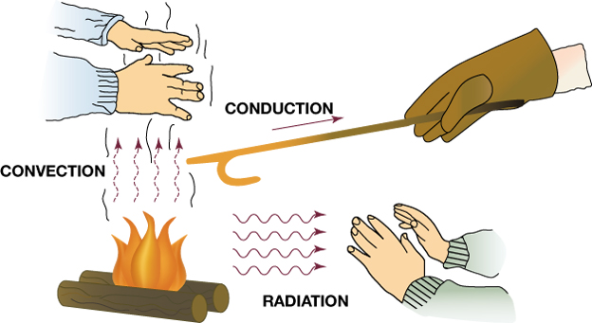
FIGURE 1–12 Heat can be moved from the source by convection, conduction, or radiation.

Slide 23
Air-conditioning Process (1 of 2)
The air-conditioning process works using a fluid, called refrigerant, which continuously changes state from liquid to gas and back to liquid.
Most states of matter can be changed from one state to another by adding or removing heat.

Slide 24
Air-conditioning Process (2 of 2)
The three states of water are well known and include:
1. Solid ice
2. Liquid water
3. Vapor (gaseous)

Slide 25
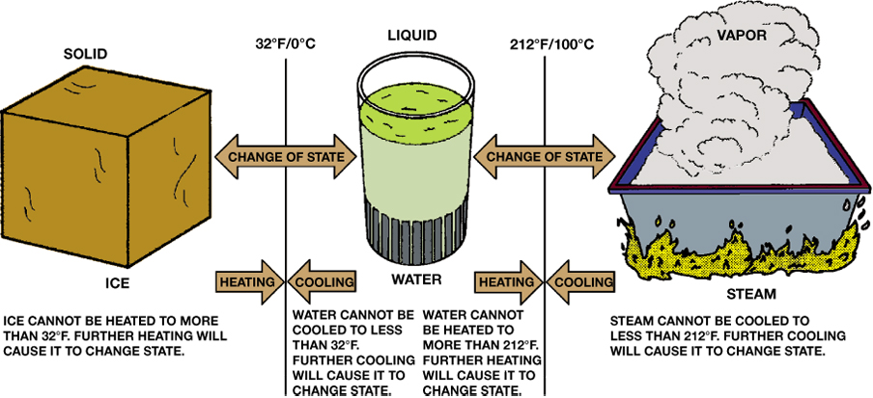
FIGURE 1–13 Matter can change state by adding or removing heat.

Slide 26
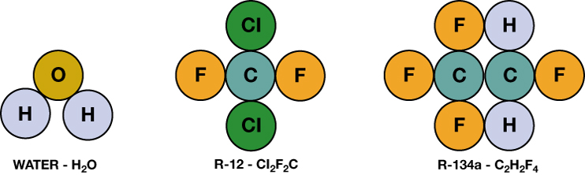
FIGURE 1–14 A water molecule contains two oxygen atoms and one hydrogen atom. R-12 is a combination of one carbon, two chlorine, and two fluorine atoms. R-134a is a combination of two carbon, four fluorine, and two hydrogen atoms.

Slide 27
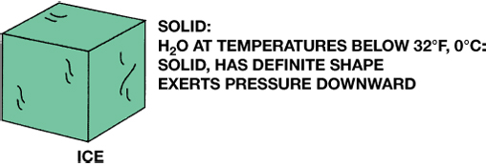
FIGURE 1–15 Ice is a solid form of water with a low temperature and slow molecular action.

Slide 28
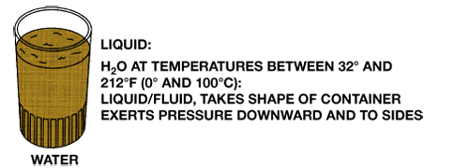
FIGURE 1–16 Water is warmer than ice and can flow to take the shape of any container.

Slide 29
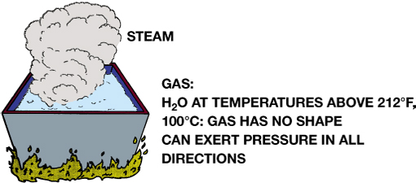
FIGURE 1–17 Adding heat to water produces steam, the gas state, with a much freer molecular action.

Slide 30
Purpose of an HVAC System
The goal in heating and air conditioning is to maintain a comfortable in-vehicle temperature and humidity.
Humid cold air feels much colder than dry air at the same temperature.
The act of cooling and dehumidifying air at the A/C evaporator causes water droplets to form on the evaporator fins.

Slide 31
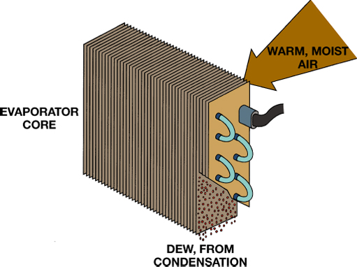
FIGURE 1–18 When air comes into contact with the cold evaporator, excess moisture forms dew. This condensed moisture leaves the car through the evaporator drain.

Slide 32
Summary (1 of 2)
Heat is moved into or out of the passenger compartment to obtain a good comfort level.
Heat intensity is measured using the Fahrenheit or Celsius scales, and heat quantity is measured using calories and BTU.

Slide 33
Summary (2 of 2)
The comfort zone of most humans is between 68°F and 78°F (20°C and 26°C) and 45% to 50% humidity.
A/C systems reduce humidity by removing moisture (water) from the air.
HVAC systems clean air because particles are caught by moisture on the evaporator and by filters.

