Slide 1

Light Vehicle Diesel Engines
First Edition
Chapter 21
OBD-II DIESEL DIAGNOSIS
Copyright © 2018, 2015, 2011 Pearson Education, Inc. All Rights Reserved

Slide 2
LEARNING OBJECTIVES (1 of 2)
21.1 Prepare for the ASE Diesel engine controls diagnosis (A9) certification test content area “A”(General Diagnosis).
21.2 List the steps of the diagnostic process.
21.3 Describe the simple preliminary tests that should be performed at the start of the diagnostic process.
21.4 List six items to check as part of a thorough visual inspection.
.

Slide 3
LEARNING OBJECTIVES (2 of 2)
21.5 Explain the troubleshooting procedures to follow if no diagnostic trouble code has been set.
21.6 Explain the troubleshooting procedures to follow if a diagnostic trouble code has been set.
21.7 Discuss the type of scan tools that are used to assess vehicle components.
21.8 Describe the methods that can be used to reprogram (reflash) a vehicle computer.
.

Slide 4
DIESEL ENGINE DIAGNOSTIC PROCESS (1 of 5)
8 steps to narrow possibilities to one
  STEP 1: Verify Concern
  STEP 2: Visual inspection &basic tests
  STEP 3: Retrieve DTCs
  STEP 4: Check for TSBs
  STEP 5: Look carefully at scan tool data
  STEP 6: Narrow problem to system/cylinder
  STEP 7: Repair problem, determine root cause
  STEP 8: Verify repair clear any stored DTCs

Slide 5
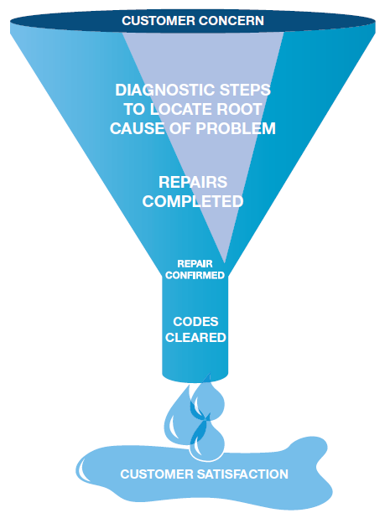
FIGURE 21–1 funnel is one way to visualize diagnostic process. The purpose is to narrow possible causes of a concern until root cause is determined and corrected.

Slide 6
VERIFY THE CUSTOMER
CONCERN
Before Diagnosis, Ask Questions:
  Are there any warning lights on?
  What was the temperature outside?
  Was the engine warm or cold?
  Was the problem during starting, acceleration, cruise?
  How far had the vehicle been driven?
  Has there been service or repair work done lately?

Slide 7
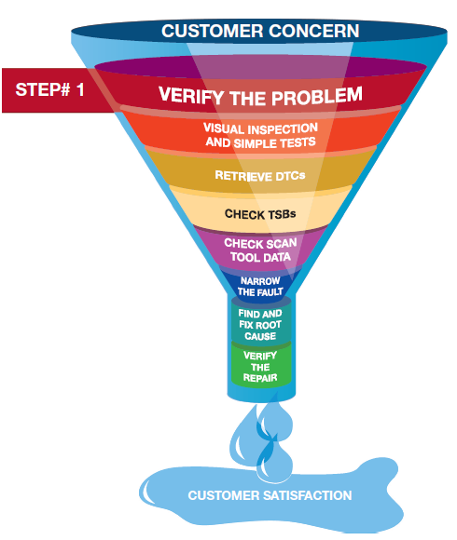
FIGURE 21–2 Step #1 is to verify customer concern or problem. If problem cannot be verified, then repair cannot be verified.

Slide 8
VISUAL INSPECTION (1 of 2)
Inspection Should Include:
  Check the oil level, color of the oil, and smell
    Determine if there may be diesel fuel in oil
  Unusual noises, smoke, or smell
  Check the air cleaner and air duct
  Check for oil or fuel leaks

Slide 9

Why Check the Oil First?
Oil condition & level issues include:
If engine oil level low
  Engine oil consumption
  Incorrect service or repair
  Engine oil leaks
If engine oil level high
  Fuel in the oil (fuel dilution)
  Incorrect service or repair
  If engine oil is contaminated with diesel fuel
  HP fuel injection pump leaking
  Fuel injector(s) leaking
If engine oil is contaminated with coolant
  Defective head gasket
  Leaking engine oil cooler

Slide 10
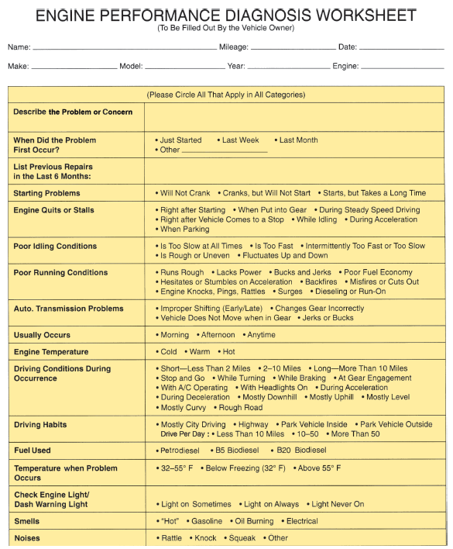
FIGURE 21–3 form that customer should fill out if there is a drivablilty concern to help service technician more quickly find root cause.

Slide 11
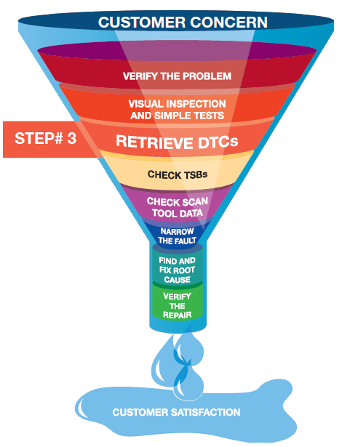
FIGURE 21–4 Step 3 in diagnostic process is to retrieve any stored diagnostic trouble codes.

Slide 12
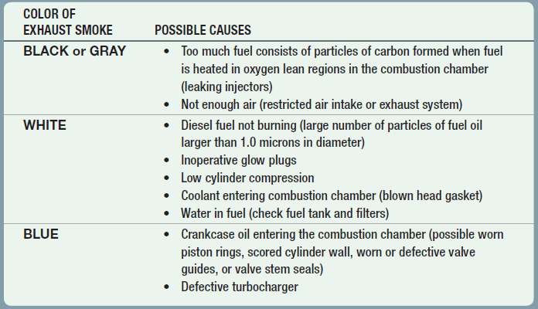
CHART 21-1 Excessive Exhaust Smoke Colors & Possible Causes

Slide 13
VISUAL INSPECTION (2 of 2)
Exhaust Color
  SEE CHART 21–1.
General Tests
  Determine General Condition:
    Low-pressure Fuel System
    High-pressure Fuel System
    Intake Air System
    Engine Mechanical Condition

Slide 14
CHECK FOR ANY STORED DTCs (1 of 2)
Current & Pending
  DTC present signaled by MIL
    Use service information procedures for stored DTC
      FIGURE 21–4.
  DTC on scan tool, MIL not on
  Called pending code
  Fault has not reoccurred, causing
  PCM to not turn on MIL

Slide 15
CHECK FOR ANY STORED DTCs (2 of 2)
Pinning Down Causes of Problem
  Done by trying to set opposite code
    If opposite code sets, indicates
    wiring and connector for sensor is okay
    Sensor defective

Slide 16
CHECK TSBs
After checking for stored diagnostic trouble codes (DTCs), check service information for any technical service bulletins that may relate to vehicle being serviced

Slide 17
STEP 5 Looking carefully at the scan tool data is very helpful in locating the source of a problem.

Slide 18
SCAN TOOL DATA (1 of 4)
Two Basic Groups
  Factory scan tools
    General Motors—Tech 2
    Ford—New Generation Star (NGS) and IDS (Integrated Diagnostic Software)
    Chrysler—DRB-III or Star Scan (CAN-equipped vehicles)
    Honda—HDS or Master Tech
    Toyota—Master Tech

Slide 19
SCAN TOOL DATA (2 of 4)
  All factory scan tools are bidirectional
    Technician can operate components using the scan tool to confirm component will work when commanded
  All factory scan tools can display all factory parameters
  Aftermarket scan tools
    Designed to function on more than one brand

Slide 20
SCAN TOOL DATA (3 of 4)
    Examples:
      Snap-on
      OTC
      AutoEnginuity
  Many aftermarket scan tools can display most if not all parameters of factory scan tool
  Aftermarket scan tools may not troubleshoot some faults

Slide 21
Why Check DTCs before Checking TSBs?
DTCs must be known before searching for service bulletins because bulletins often include information on solving problems that involve a stored diagnostic trouble code (DTC).

Slide 22
FIGURE 21–5 TECH 2 scan tool is factory scan tool used on General Motors vehicles.

Slide 23
FIGURE 21–6 Bluetooth adapter that plugs into DLC and transmits global OBD-II information to a smart phone that has a scan tool app installed.

Slide 24
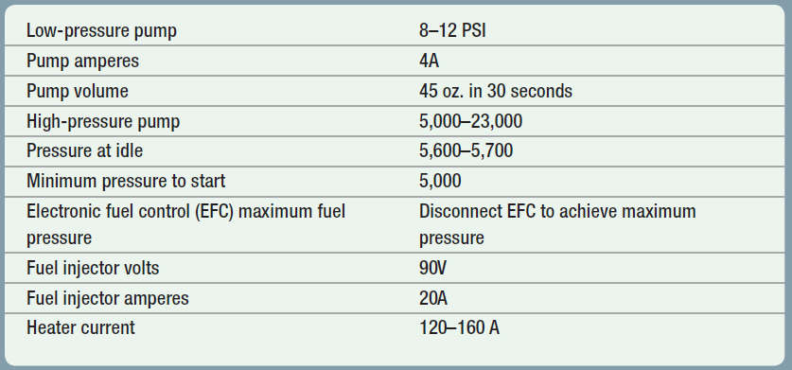
CHART 21-2 Cummins 5.9 & 6.7 liter. Values obtained by using a scan tool and basic test equipment. Always follow OEM recommended procedures.

Slide 25
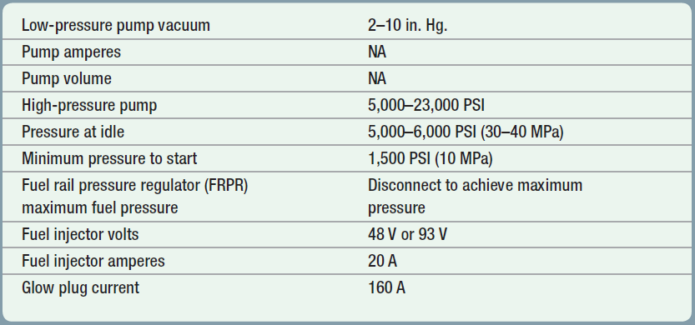
CHART 21-3 GM Duramax. Values obtained by using scan tool and basic test equipment. Always follow OEM recommended procedures.

Slide 26
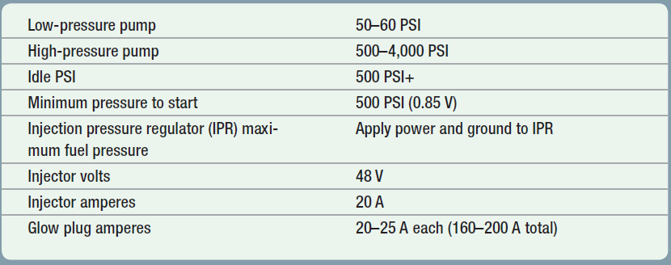
CHART 21-4 Ford Power Stroke. Values can be obtained by using scan tool and basic test equipment. Always follow OEM recommended procedures.

Slide 27
SCAN TOOL DATA (4 of 4)
GLOBAL OBD II: Page 245 of text
USING GLOBAL MODE$06: Page 245 of text
SELECT MONITOR: Page 245 of text
MODE $06 EXAMPLE: CHART 21-5

Slide 28
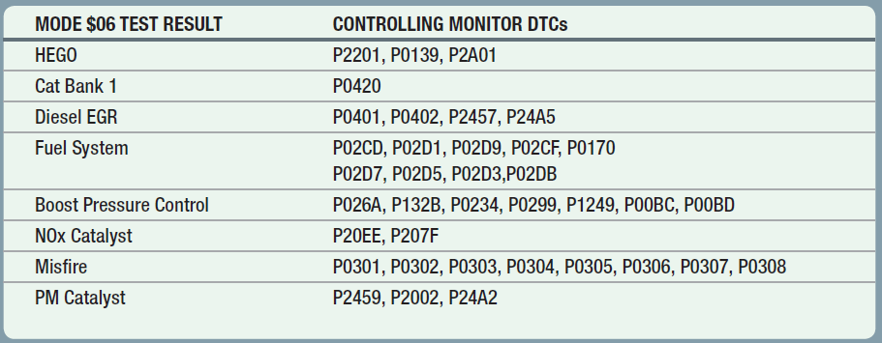
CHART 21-5 Check Mode $06 data if any of the DTCs are displayed to see limits and why the DTC was set.

Slide 29
PINPOINT TESTS
Pinpoint Test Is Diagnostic Procedure
  Designed to narrow root cause to a system or cylinder:
    Compression test
    Cylinder leakage test
    Cylinder contribution (power balance) test
    Exhaust backpressure test
  See Chapter 6 for details

Slide 30
DETERMINE THE ROOT CAUSE
Perform Same Conditions
  Vehicle operated under
  Repair or part replacement must be performed
  Following OEM recommendations
  Certain that the root cause found
Final Actions
  Test drive to verify that original concern fixed

Slide 31
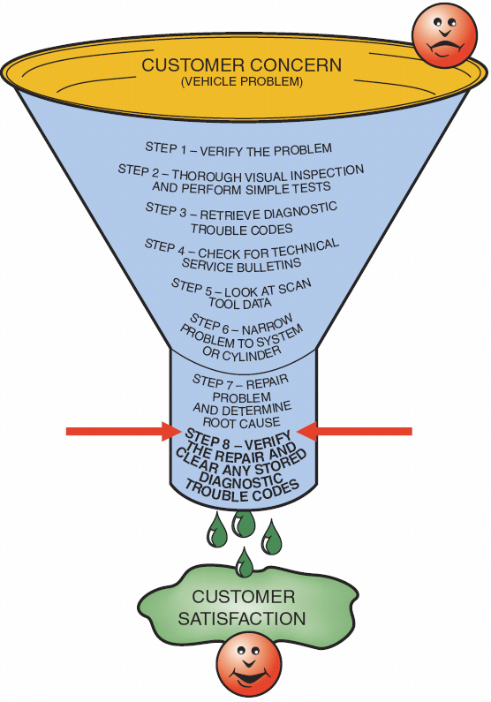
STEP 8 is very important. Be sure that customer’s concern has been corrected.

Slide 32
FLASH PROGRAMMING (1 of 8)
Periodic revisions to OBD-II software occurs
Reprogramming
  Downloading new calibration files
  From scan tool, PC, or modem
  into PCM’s EEPROM
Can be done on or off vehicle

Slide 33
FLASH PROGRAMMING (2 of 8)
Reprogramming not OBD-II requirement
  3 methods for reprogramming EEPROM
    Remote programming
    Direct programming
    Off-board programming

Slide 34
FIGURE 21–7 first step in reprogramming procedure is to determine current software installed, using a scan tool. Not all scan tools can be used. In most cases using factory scan tool is needed for reprogramming unless scan tool is equipped to handle reprogramming

Slide 35
FIGURE 21–8 Follow on-screen instructions.

Slide 36
FLASH PROGRAMMING (3 of 8)
Remote Programming
  Uses scan tool to transfer data
  From shop PC to vehicle’s PCMF
  Connect scan tool to vehicle’s DLC
  Enter vehicle information into scan tool
  Through programming application software
  Download VIN and current EEPROM calibration

Slide 37
FLASH PROGRAMMING (4 of 8)
Remote Programming
  Disconnect scan tool from DLC
  Connect to shop PC
  Download new calibration from PC to scan tool
  Reconnect scan tool to vehicle’s DLC
  Download new calibration
Direct Programming
  Uses connection between PC & vehicle DLC

Slide 38
FIGURE 21–9 Internet connection is usually needed to perform updates although some vehicle manufacturers use CDs, which are updated regularly at a cost to the shop.

Slide 39
FLASH PROGRAMMING (5 of 8)
Off-Board Programming
  Used if PCM programmed away from vehicle
  Uses off-board programming adapter
  J2534 compliant pass-through system
  Standardized programming & diagnostic system
  Uses PC plus standard interface
  To software device driver

Slide 40
FIGURE 21–10 battery charger that does not introduce any alternating current (AC) when charging battery is extremely important when programming a PCM.

Slide 41
FIGURE 21–11 Connecting cables and a computer to perform off-board programming.

Slide 42
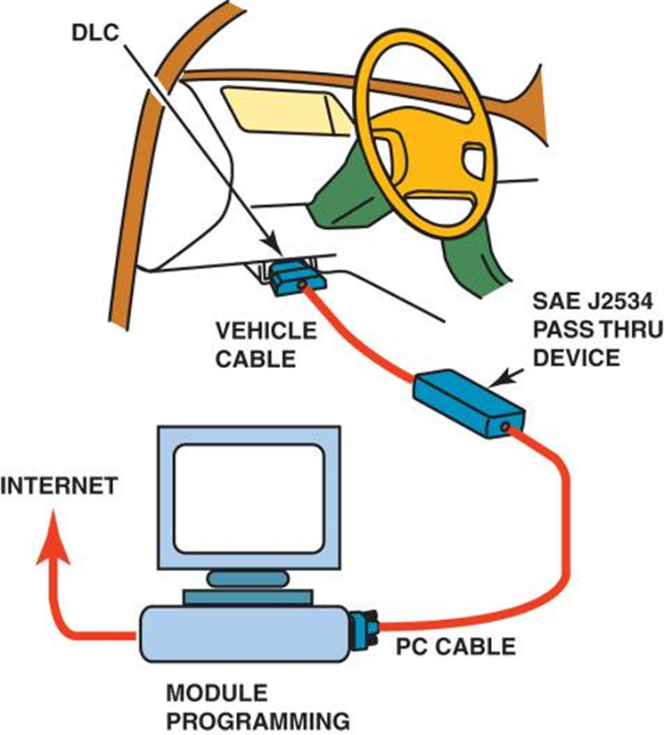
FIGURE 21–12 J2534 pass-through reprogramming system does not need a scan tool to reflash the PCM on most
2004 and newer vehicles.

Slide 43
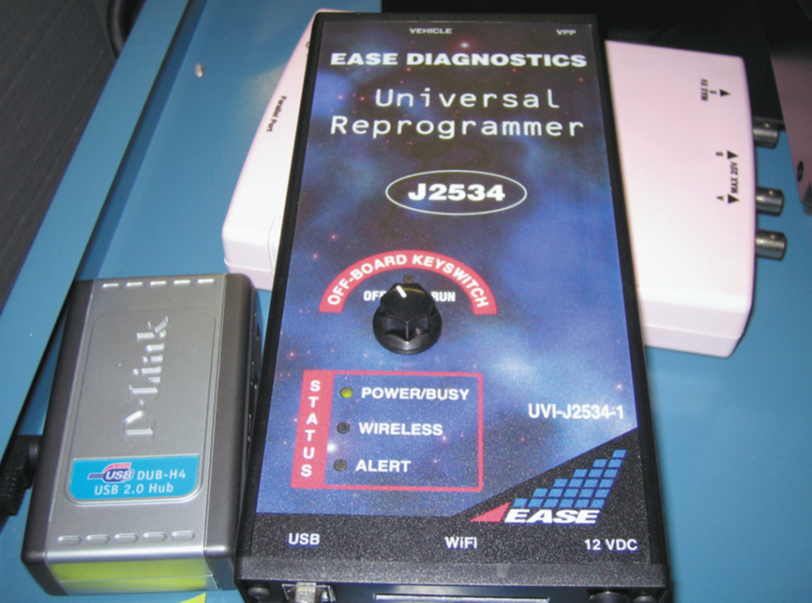
FIGURE 21–13 A typical J2534 universal reprogrammer that uses the J2534 standards.

Slide 44
FLASH PROGRAMMING (6 of 8)
  Interface connects to PC and programmable
  ECM on vehicle through J1962 DLC
  Allows programming of all computers
  Using single set of programming hardware
  Programming software from OEM
  Must be functional with J2534 System

Slide 45
FLASH PROGRAMMING (7 of 8)
  Software for typical pass-through application
  2 major components
    First part delivered by CO. furnishes hardware for J2534
    Second part of pass-through enabling software
    Usually subset of software with OEM tools
  Internet browser and connection
  needed to access pass-through application

Slide 46
FLASH PROGRAMMING (8 of 8)
PCM reset/cleared of previously set DTCs
  Drive vehicle under circumstances similar
  To those when problem occurred
  If 3 passes cannot be achieved
  Problem fixed and MIL will go out after a few days
  Clear DTCs using scan tool
  Battery disconnect

Slide 47
Summary (1 of 2)
Diagnostic procedure includes following 8 steps:
  STEP 1 Verify customer’s problem (concern).
  STEP 2 Perform thorough visual inspection and general
  tests.
  STEP 3 Retrieve diagnostic trouble codes (DTCs).
  STEP 4 Check for technical service bulletins (TSBs).
  STEP 5 Look carefully at scan tool data.
  STEP 6 Narrow problem to a system or cylinder.
  STEP 7 Repair problem & determine root cause.
  STEP 8 Verify the repair and check for any stored DTCs.

Slide 48
Summary (2 of 2)
Global OBD II can be used by a service technician to do the following:
  a. Check PCM regarding what it has detected as a fault.
  b. Verify repair.
  c. Check if test results are close to failure, which could trigger MIL.
Mode $06 is most commonly used mode of global
OBD II because it includes data on the non-continuous monitored system.
Most aftermarket scan tools and some original equipment
scan tools can access global OBD-II data.

