Slide 1

Light Vehicle Diesel Engines
First Edition
Chapter 11
DIESEL & BIODIESEL FUELS
Copyright © 2018, 2015, 2011 Pearson Education, Inc. All Rights Reserved

Slide 2
LEARNING OBJECTIVES (1 of 1)
11.1 Explain diesel fuel specifications.
11.2 List the advantages and disadvantages of biodiesel.
11.3 Discuss API gravity.
11.4 Explain E-diesel specifications.

Slide 3
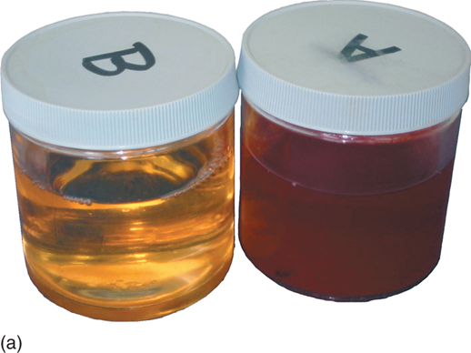
Diesel Fuel (1 of 14)
Features of Diesel Fuel
  Contains 12% more heat energy
  Than same amount of gasoline
  Fuel in a diesel engine not ignited with spark
  Heat generated by high compression

Slide 4
Diesel Fuel (2 of 14)
Diesel Fuel Requirements
  Cleanliness: fuel must be clean & free from water
  Low-temperature fluidity
  Flow freely at all expected ambient temperatures
  Cloud point:
    low-temperature point when waxes in most diesel fuels tend to form crystals that clog fuel filter

Slide 5
Diesel Fuel (3 of 14)
Cetane Number
  Opposite of octane number for gasoline
  Measure of ease with which fuel can be ignited
  Determines fuel’s ability to start engine
    At low temperatures
    Determines ability to provide
    Smooth warm-up and combustion

Slide 6
Diesel Fuel (4 of 14)
Cetane Number
  Should be between 45 and 50
  Higher Cetane rating
  More easily fuel is ignited

Slide 7
Diesel Fuel (5 of 14)
Sulfur Content
  Very important to life of engine
  Sulfur creates sulfuric acid during combustion
  Can damage engine components
  Federal regulations limit sulfur content
    < 15 ppm
    High-sulfur fuel contributes to acid rain

Slide 8
Diesel Fuel (6 of 14)
Diesel Fuel Color
  Clear or GREEN
  Intended for use on streets and highways
  RED: to be used on farms and off-road use

Slide 9

Diesel Fuel (7 of 14)
Grades of Diesel Fuel
  ASTM classifies diesel fuel by volatility
    (boiling range)
  Grade #1
    Lowest boiling point, lowest cloud & pour points
  GRADE #2
    Higher boiling point, cloud point, & pour point
    Constant speed and high loads
    Most diesel is grade #2

Slide 10

Figure 11-1(a) Regular diesel fuel on the left has a clear or greenish tint, whereas fuel for off-road use is tinted red for identification.
Notes:
Figure 68-1(a) Regular diesel fuel on the left has a clear or greenish tint, whereas fuel for off-road use is tinted red for identification.

Slide 11
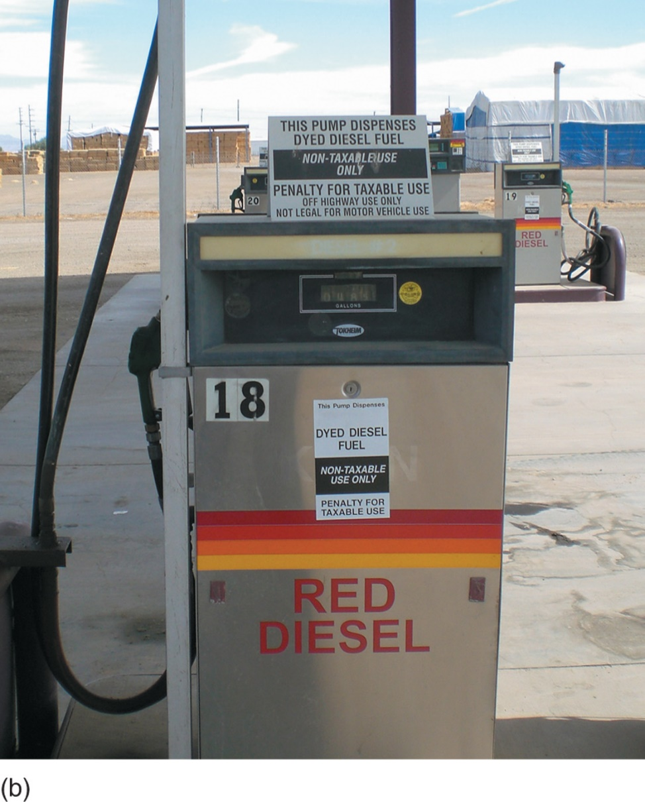
Figure 11-1(b) A fuel pump in a farming area that clearly states the red diesel fuel is for off-road use only.
Notes:
Figure 68-1(b) A fuel pump in a farming area that clearly states the red diesel fuel is for off-road use only.

Slide 12

Diesel Fuel (8 of 14)
Grade #1
  Lower BTU content—
  Less heat per pound of fuel
  Use during low-temperature (winter) operation
  Produces less heat per pound of fuel
    Compared to Grade #2
  May be specified for use in engines
  With frequent changes in load and speed

Slide 13
Diesel Fuel (9 of 14)
Grade #2
  Higher boiling point, cloud point, pour point
  Usually specified with constant speed and high loads
    Long-haul trucking and automotive diesel applications

Slide 14
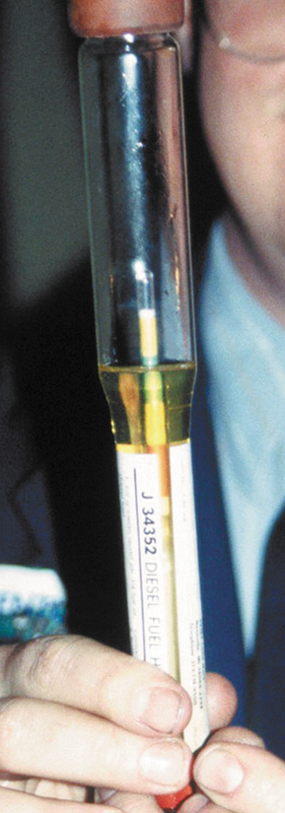
Diesel Fuel (10 of 14)
Diesel Fuel Specific Gravity Testing
  Density should be tested whenever a driveability concern
    Measured in units of API gravity
    Arbitrary scale expressing gravity or density of liquid petroleum products
    Scale calibrated in terms of degrees API

Slide 15
Diesel Fuel (11 of 14)
Diesel Fuel Specific Gravity Testing
  Fuel with least specific gravity has highest API gravity
  Normal API gravity for #1 diesel fuel 39 to 44 (typically 40)
  Normal API gravity for #2 diesel fuel 30 to 39 (typically 35)
  Hydrometer calibrated in API gravity units used to test diesel fuel

Slide 16

Figure 11-2 Testing the API viscosity of a diesel fuel sample using a hydrometer.
Notes:
Figure 68-2 Testing the API viscosity of a diesel fuel sample using a hydrometer.

Slide 17
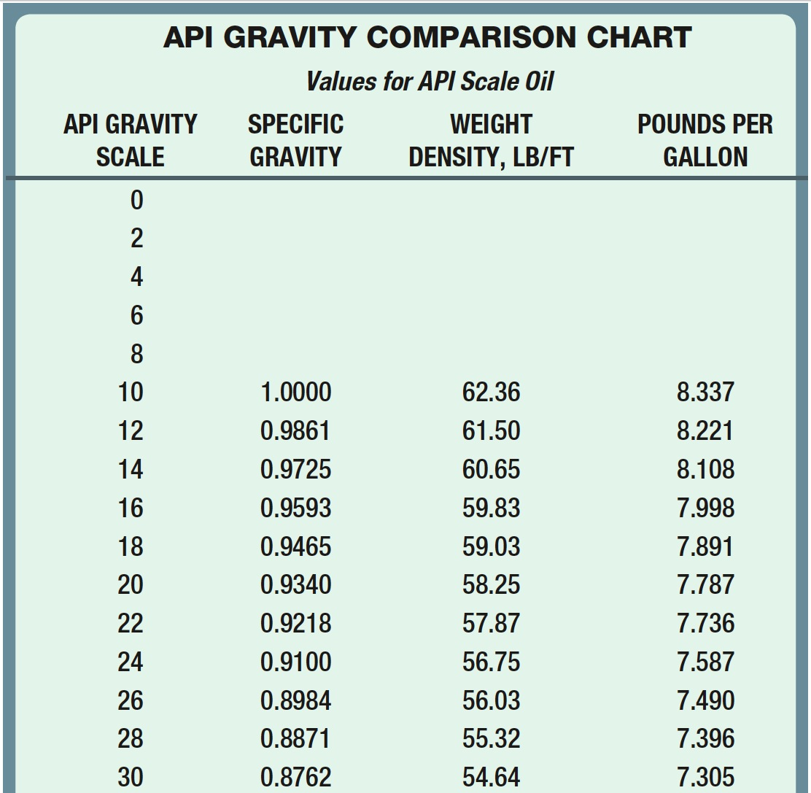
Chart 11-1 API gravity scale is based on specific gravity of fuel.
Notes:
Chart 68-1 The API gravity scale is based on the specific gravity of the fuel.

Slide 18
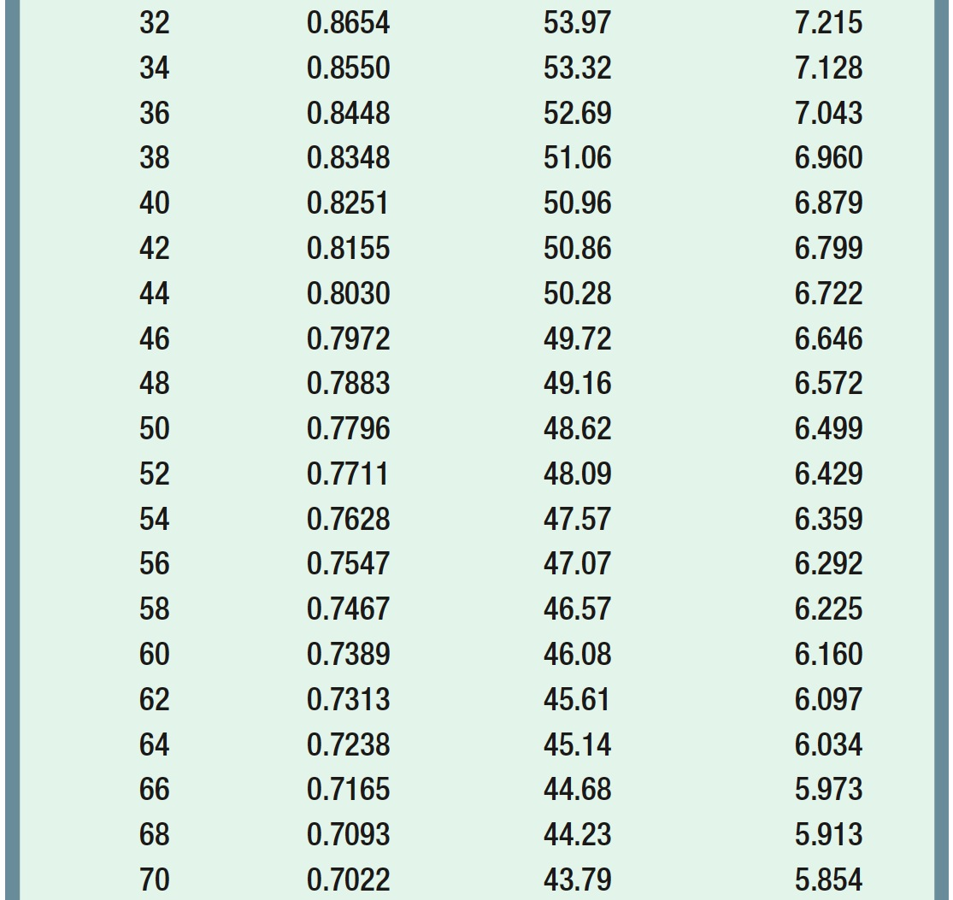
Chart 11-1 (continued) API gravity scale is based on specific gravity of fuel. (1 of 2)
Notes:
Chart 68-1 (continued) The API gravity scale is based on the specific gravity of the fuel.

Slide 19
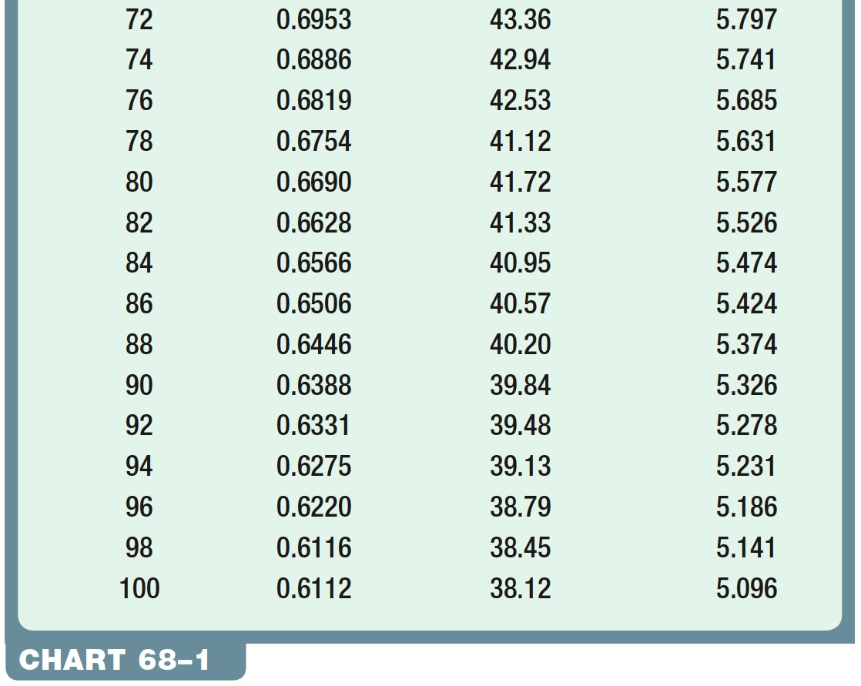
Chart 11-1 (continued) API gravity scale is based on specific gravity of fuel. (2 of 2)
Notes:
Chart 68-1 (continued) The API gravity scale is based on the specific gravity of the fuel.

Slide 20
Diesel Fuel (12 of 14)
Diesel Fuel Heaters
  Help prevent power loss and stalling in cold weather
  Placed in fuel line between tank and primary filter
  Some heaters thermostatically controlled
    Fuel can bypass heater once operating temperature reached

Slide 21
Diesel Fuel (13 of 14)
Ultra-Low-Sulfur Diesel Fuel
  Diesel engines manufactured to 2007 or newer standards must use ultra-low-sulfur diesel fuel
  Contains less than 15 ppm of sulfur
    Older, low-sulfur specification was 500 ppm

Slide 22
Diesel Fuel (14 of 14)
Ultra-Low-Sulfur Diesel Fuel
  Purpose to reduce emissions of sulfur oxides and particulate matter
  Emission controls on newer engines require ultra-low-sulfur diesel (ULSD) for reliable operation
  ULSD will eventually replace all low-sulfur diesel fuel

Slide 23

How Can You Tell If Gasoline Has Been Added to Diesel Fuel by Mistake?
If gasoline has been accidentally added to diesel fuel and is burned in diesel engine, result can be very damaging to engine. Gasoline can ignite faster than diesel fuel, which would tend to increase temperature of combustion. High temperature can harm injectors and glow plugs, as well as pistons, head gaskets, &other major components. If contaminated fuel is suspected, first smell fuel at filler neck. If fuel smells like gasoline, then tank should be drained and refilled with diesel fuel. If smell test does not indicate a gasoline smell (or any rancid smell), then test a sample for proper API gravity.

Slide 24
How Can You Tell If Gasoline Has Been Added to Diesel Fuel by Mistake? NOTE:
NOTE: Diesel fuel designed for on-road use should be GREEN in color. RED diesel fuel (high sulfur) should only be found in off-road or farm equipment.

Slide 25
What Are Diesel Fuel Additives?
Several types and many brands of additives that are designed to be added to diesel fuel. These types of additives include:
Winter Conditioners—Winter conditioners designed to reduce Cold Filter Plugging Point (CFPP). CFPP is the lowest temperature at which a specified volume of diesel type of fuel can pass through a standardized filtration device
Multi-functional Conditioners—Many multifunctional additives increase Cetane rating helps keep injectors clean. Raising Cetane rating power & economy Improved.
Microbicide—Microbes can grow in diesel fuel at the junction between the water and the diesel. Water heavier near bottom of the tank. Microbicide kills microorganisms including bacteria and fungi.
Always follow OEM recommended service procedures and for best results

Slide 26
FIGURE 11–3 Many diesel fuel additives increase the cetane rating which results in improved fuel economy.

Slide 27
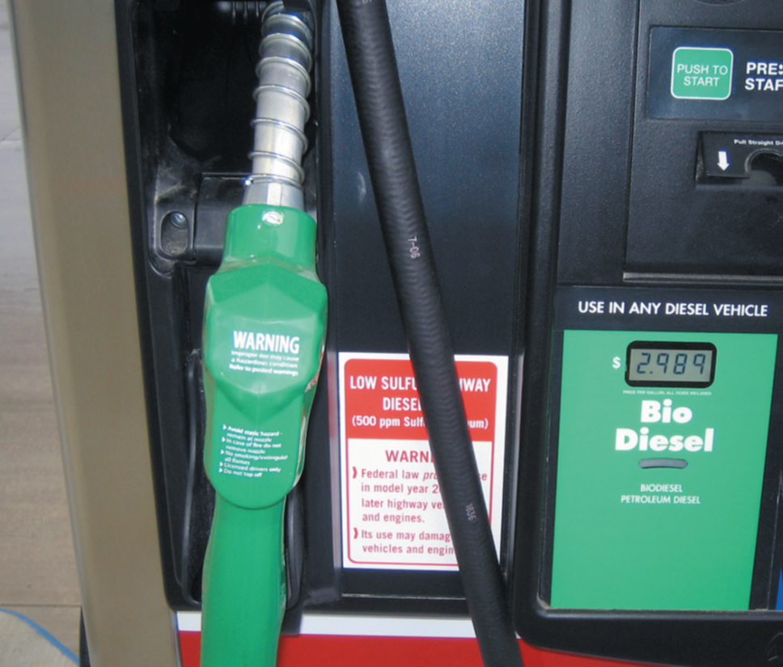
Biodiesel (1 of 2)
Features of Biodiesel
  Purchasing in bulk quantities decreases cost of fuel
  Maintains similar horsepower, torque, fuel economy
  Has higher Cetane number than conventional diesel, increasing engine performance

Slide 28
FIGURE 11–4 A pump decal indicating that the biodiesel fuel is ultra-low-sulfur diesel (ULSD) and must be used in 2007 and newer diesel vehicles.

Slide 29

Biodiesel
Features of Biodiesel
  Nontoxic; safe to handle, transport, and store
  Maintenance requirements for B20 and petrodiesel vehicles are same
  Acts as a lubricant; can add to life of fuel system components

Slide 30
I Thought Biodiesel Was Vegetable Oil? 1
Biodiesel is vegetable oil with glycerin component removed by means of reacting vegetable oil with a catalyst. The resulting hydrocarbon esters are 16 to 18 carbon atoms in length, almost identical to petroleum diesel fuel atoms. This allows the use of biodiesel fuel in a diesel engine with no modifications needed. Biodiesel-powered vehicles do not need a 2nd fuel tank, whereas vegetable-oil-powered vehicles do.

Slide 31
I Thought Biodiesel Was Vegetable Oil? 2
3 main types of fuel used in diesel engines: • Petroleum diesel, fossil hydrocarbon 16 carbon atoms. Biodiesel, a hydrocarbon with a carbon chain length 16 to 18 carbon atoms. Vegetable oil is a triglyceride with a glycerin component joining 3 hydrocarbon chains of 16 to 18 carbon atoms each, called straight vegetable oil (SVO). Pure plant oil (PPO)—most often used in Europe to describe SVO. Waste vegetable oil (WVO)—this oil could include animal or fish oils from cooking. Used cooking oil (UCO)—used when oil may or may not be pure vegetable oil

Slide 32
I Thought Biodiesel Was Vegetable Oil? 3
Vegetable oil is not liquid enough at common ambient temperatures for use in diesel fuel delivery system designed for lower-viscosity petroleum diesel fuel. Vegetable oil needs to be heated to obtain a similar viscosity to biodiesel/petroleum diesel. This means that a heat source needs to be provided before fuel can be used in a diesel. This is achieved by starting on petroleum diesel or biodiesel fuel until engine heat can be used to sufficiently warm a tank containing vegetable oil. It also requires purging fuel system of vegetable oil with petroleum diesel or biodiesel fuel prior to stopping engine to avoid vegetable oil thickening and solidifying in fuel system away from heated tank. Use of vegetable oil in its natural state does, however, eliminate need to remove glycerin component. Many vehicle and diesel engine fuel system suppliers permit use of biodiesel fuel that is certified as meeting testing standards. None permit use of vegetable oil in its natural state.

Slide 33
E-Diesel Fuel (1 of 3)
Definition of E-Diesel
  Also called diesohol outside of U.S.
  No. 2 diesel fuel containing up to 15% ethanol
  Typical blend levels have from 8% to 10% ethanol

Slide 34
E-Diesel Fuel (2 of 3)
Cetane Rating of E-Diesel
  Higher Cetane number
  Shorter the delay between injection and ignition
  Normal diesel fuel has Cetane number about 50
  Adding 15% ethanol lowers Cetane number

Slide 35
E-Diesel Fuel (3 of 3)
Cetane Rating of E-Diesel
  To raise Cetane number, Cetane-enhancing
    Additive added to E-diesel
  E-diesel has better cold-flow properties
  Than conventional diesel
  Heat content about 6% < conventional diesel

Slide 36
E-Diesel Fuel (4 of 4)
Cetane Rating of E-Diesel
  Emissions of PM, carbon monoxide
  NOX significantly reduced
  Considered to be experimental
  Can be used legally in off-road applications
  or in mass-transit buses with EPA approval

Slide 37
Summary (1 of 2)
Diesel fuel produces 12% more heat energy than the same amount of gasoline.
Diesel fuel requirements include cleanliness, low-temperature fluidity, and proper Cetane rating.
Emission control devices used on 2007 and newer engines require the use of ultra-low-sulfur diesel (ULSD) that has less than 15 parts per million (PPM) of sulfur.
The density of diesel fuel is measured in a unit called API gravity.

Slide 38
Summary (2 of 2)
The Cetane rating of diesel fuel is a measure of the ease with which the fuel can be ignited.
Biodiesel is the blend of vegetable-based liquid with regular diesel fuel. Most diesel engine manufacturers allow the use of a 5% blend, called B20, without any changes to the fuel system or engine.
E-diesel is a blend of ethanol with diesel fuel up to 15% ethanol by volume.

