Slide 1
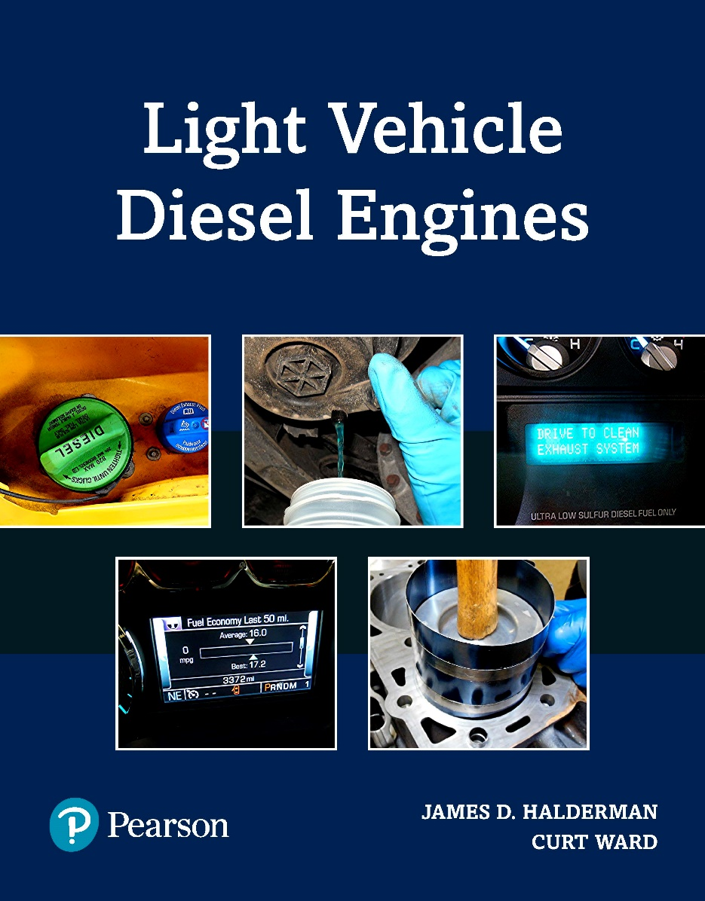
Light Vehicle Diesel Engines
First Edition
Chapter 1
Diesel Engine Operation
Copyright © 2018, 2015, 2011 Pearson Education, Inc. All Rights Reserved

Slide 2
LEARNING OBJECTIVES (1 of 2)
1.1 Prepare for the light Vehicle Diesel engine (A9) ASE certification test content area “A” (general Diagnosis).
1.2. Explain how a four-stroke cycle engine operates.
1.3. List the various characteristics by which vehicle engines are classified.

Slide 3
LEARNING OBJECTIVES (2 of 2)
1.4 Discuss how a compression ratio is calculated.
1.5 Explain how engine size is determined.
1.6 Describe how displacement is affected by the bore and stroke of the engine.

Slide 4
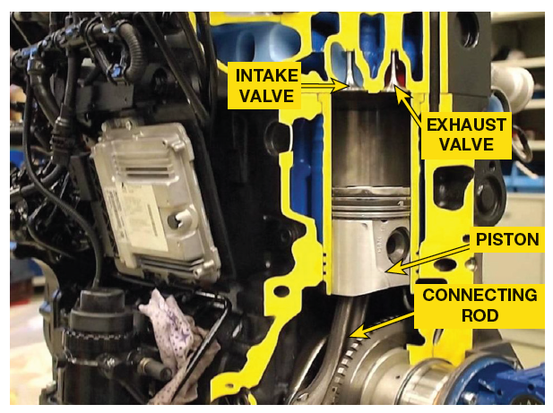
ENGINES (1 of 2)
Purpose/Function of Engine
  Convert heat energy into mechanical energy
    Mechanical energy
      Propel vehicle
      Power air-conditioning & power steering
      Produce electrical power
    Chemical energy in fuel is converted to heat energy
    By burning fuel at controlled rate

Slide 5
ENGINES (2 of 2)
Combustion
  Chemical energy converted to heat energy
  By burning diesel fuel at a controlled rate
    Convert diesel fuel energy into heat
    Within a combustion chamber
    Combustion occurs above piston
    Called internal combustion engine

Slide 6
FOUR-STROKE CYCLE OPERATION (1 of 1)
4-Stroke Cycle
  Developed by Nikolaus Otto
Stroke
  Movement of piston from TDC to BDC
  Piston moves up and down, or
    Reciprocates (moves up and down) in a cylinder
    Piston is attached to crankshaft with connecting rod

Slide 7
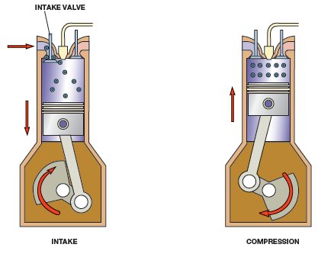
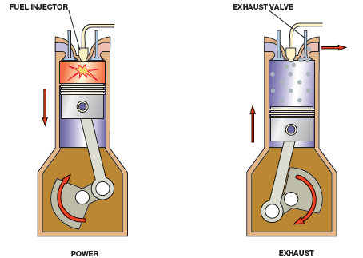
FIGURE 1–1 In diesel engine downward movement of piston draws air into cylinder through intake valve on intake stroke. On compression stroke, air is compressed by upward movement of piston with both valves closed. Fuel is injected and ignition occurs at beginning of power stroke, and combustion drives the piston downward to produce power. On exhaust stroke, upward-moving piston forces burned gases out open exhaust valve.

Slide 8
QUESTION 1: ?
Which engine stroke brings in air?

Slide 9
ANSWER 1:
Intake.

Slide 10
ENGINE CONSTRUCTION OVERVIEW (1of 3)
BLOCK
  Solid frame, called an engine block
  Constructed of cast iron or aluminum
  Provides foundation for engine components & systems.

Slide 11
FIGURE 1–2 Cutaway of a diesel engine showing the cylinder, piston, connecting rod, and crankshaft.

Slide 12
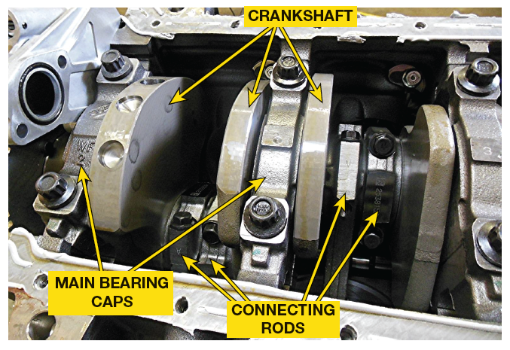
ENGINE CONSTRUCTION
OVERVIEW (2 of 3)
ROTATING ASSEMBLY
  Pistons are installed in block
  Move up and down during engine operation
  Connected to connecting rods
  Connect pistons to crankshaft
  Crankshaft converts up/down piston motion
  To rotary motion, transmitted to drive wheels

Slide 13
FIGURE 1–3 Rotating assembly for a V-8 engine that has 8 pistons and connecting rods, and one crankshaft.

Slide 14
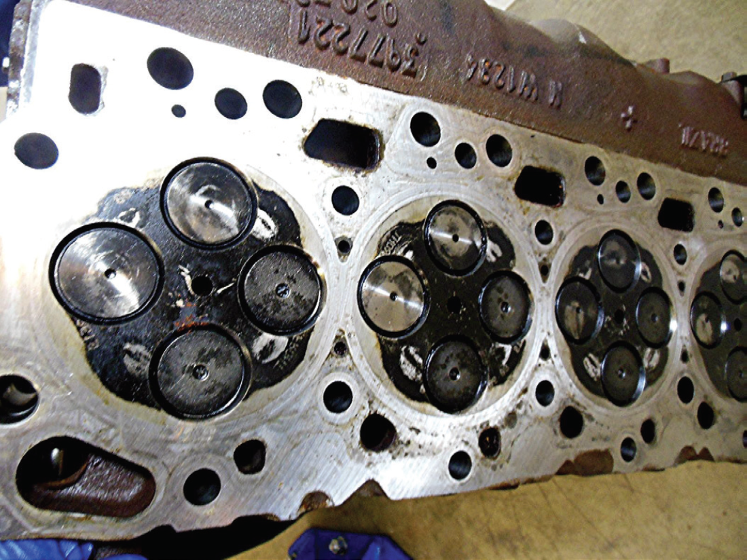
ENGINE CONSTRUCTION
OVERVIEW (3 of 3)
CYLINDER HEAD
  Seals top of cylinders in engine block
  Contains both intake valve that allow air & and fuel in
  Exhaust valves, which allow spent gases out
  Constructed of cast iron or aluminum
  Machined for valves

Slide 15
FIGURE 1–4 A cylinder head with four valves per cylinder, two intake valves (larger) and two exhaust valves (smaller).

Slide 16
DIESEL ENGINES (1 of 10)
Compression Ignition Engine
  Invented by Rudolf Diesel (1858–1913)
  Uses heat created by compression to ignite fuel
  Requires compression ratios of 16:1 & higher
  Incoming air is compressed until the temperature
    reaches about 1,000°F (540°C) heat of compression
  Piston reaches TDC, fuel is injected into cylinder
  Ignited by hot air
  As fuel burns, it expands and produces power

Slide 17
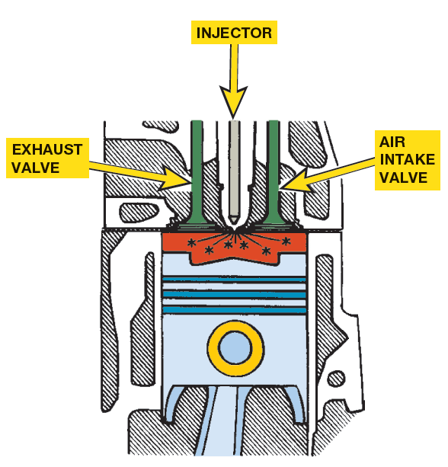
FIGURE 1–5 Diesel combustion occurs when fuel is injected into the hot, highly compressed air in the cylinder.

Slide 18
DIESEL ENGINES (2 of 10)
Diesel Engine Advantages
  Compared to a similar size gasoline engine:
    1. More torque output
    2. Greater fuel economy
    3. Long service life

Slide 19
DIESEL ENGINES (3 of 10)
Diesel Engine Disadvantages
  Compared to a similar size gasoline-powered engine:
    1. Engine noise, especially when cold and/or idling
    2. Exhaust smell
    3. Hard starting in cold weather
    4. Overall weight, heavier than a gasoline engine
    5. Fuel availability
    6. Extra cost compared to a gasoline engine

Slide 20
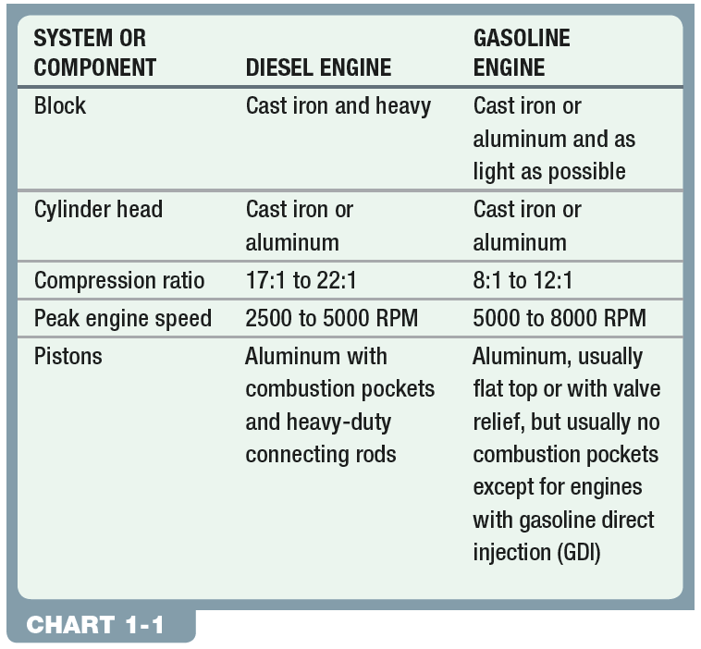
CHART 1-1 Comparison between a typical gasoline and a diesel engine.

Slide 21
DIESEL ENGINES (4 of 10)
Indirect Diesel Injection (IDI)
  Fuel injected into small pre-chamber
  Connected to cylinder by narrow opening
  Initial combustion takes place in pre-chamber
  Slowing rate of combustion, reduces noise
  Requires use of a glow plug for cold starts

Slide 22
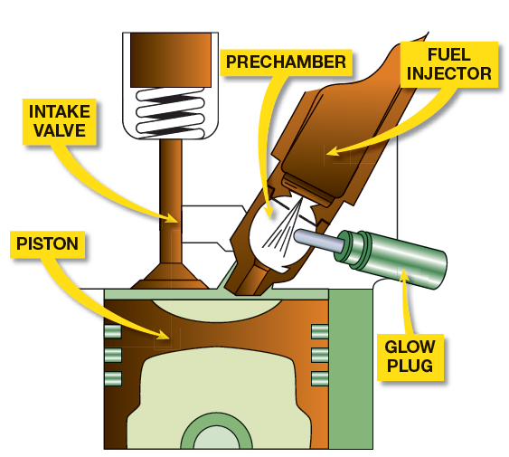
FIGURE 1–6 indirect injection IDI diesel engine uses a prechamber and a glow plug.

Slide 23
DIESEL ENGINES (5 of 10)
Diesel Injection (DI)
  Fuel injected directly into cylinder
  Piston has depression where initial combustion takes place
  Generally more efficient than IDI engines
  Tendency to produce greater amounts of noise

Slide 24
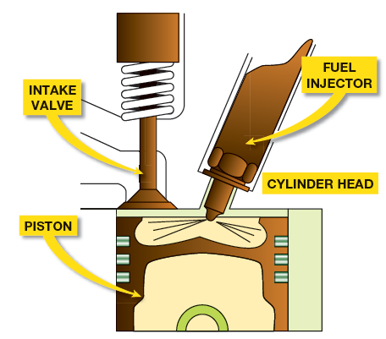
FIGURE 1–7 A direct injection diesel engine injects the fuel directly into the combustion chamber. Many designs do not use a glow plug.

Slide 25
DIESEL ENGINES (6 of 10)
Fuel Injection
  Ignition occurs by injecting fuel into air charge
  Heated by compression to about 1,000°F (538°C)
  Chemical reaction of burning fuel creates heat
  Causes gases to expand & piston to rotate crankshaft

Slide 26
DIESEL ENGINES (7 of 10)
Three Phases of Combustion
  Ignition Delay
    Near end of compression stroke, fuel injection begins, but ignition does not begin immediately, delayed
  Rapid Combustion
    Fuel first starts to burn, creating sudden rise in pressure
    Sudden & rapid rise in combustion chamber pressure
    Causes characteristic diesel engine knock
  Controlled Combustion
    Rest of fuel in combustion chamber begins to burn & injection continues
    Process occurs near injector that contains fuel surrounded by air
    Fuel burns as it mixes with air

Slide 27
QUESTION 2: ?
Which phase of combustion casues a sudden and rapid rise in combustion chamber pressure, which causes the characteristic diesel engine knock?

Slide 28
ANSWER 2:
Rapid Combustion

Slide 29
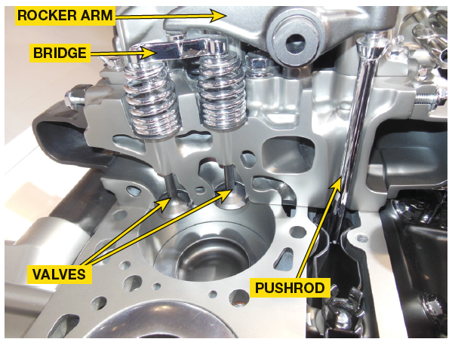
DIESEL ENGINES (8 of 10)
Valve & Camshaft Arrangements
  intake & exhaust valves controlled by camshaft
  Used to open valves
  Older diesels uses 1 intake valve & 1 exhaust valve
  Many newer engines use 2 intake & 2 exhaust valves

Slide 30
DIESEL ENGINES (9 of 10)
Overhead Valve (OHV) Engines
  Camshaft is located in block
    Valves are operated by lifters, pushrods, &rocker arms.
  Pushrod engine
    Use pushrods to transfer motion of camshaft lobes to valves
  Cam-in-block design
    Another term used to describe overhead valve or pushrod design
  Overhead valve (OHV)
    Overhead valve engine has camshaft in block and the valves are located in cylinder head

Slide 31
FIGURE 1–8 Cutaway of an overhead valve (OHV) V-8 engine showing the lifters, pushrods, roller rocker arms, and valves.

Slide 32
DIESEL ENGINES (10 of 10)
Overhead Camshaft
  Camshaft in cylinder head
  Called overhead camshaft-type
  Single Overhead Camshaft (SOHC)
    One overhead camshaft used
  Double Overhead Camshaft (DOHC)
    Two overhead camshafts are used,
    One cam operating intake valve & other operating exhaust valves

Slide 33
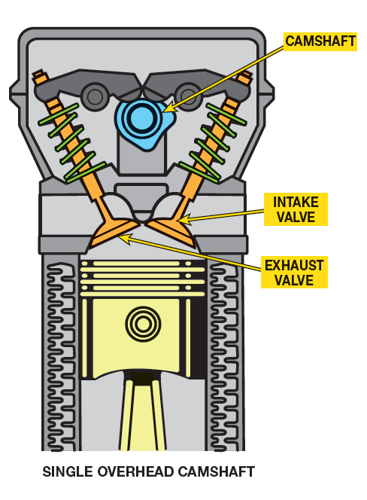
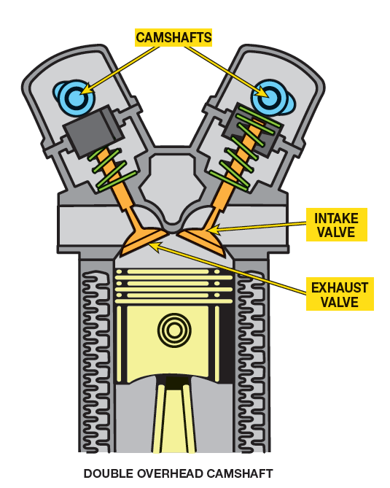
FIGURE 1–9 SOHC engines usually require additional components, such as a rocker arm, to operate all of the valves. DOHC engines often operate the valves directly.

Slide 34
ENGINE SIZE (1 of 4)
BORE
  Diameter of cylinder
  Measured in inches or millimeters (mm)
  Larger the bore greater the piston head area
  Pressure is measured in units, such as PSI
  Greater area of piston head (square inches)
  Higher force exerted by pistons to rotate crankshaft

Slide 35
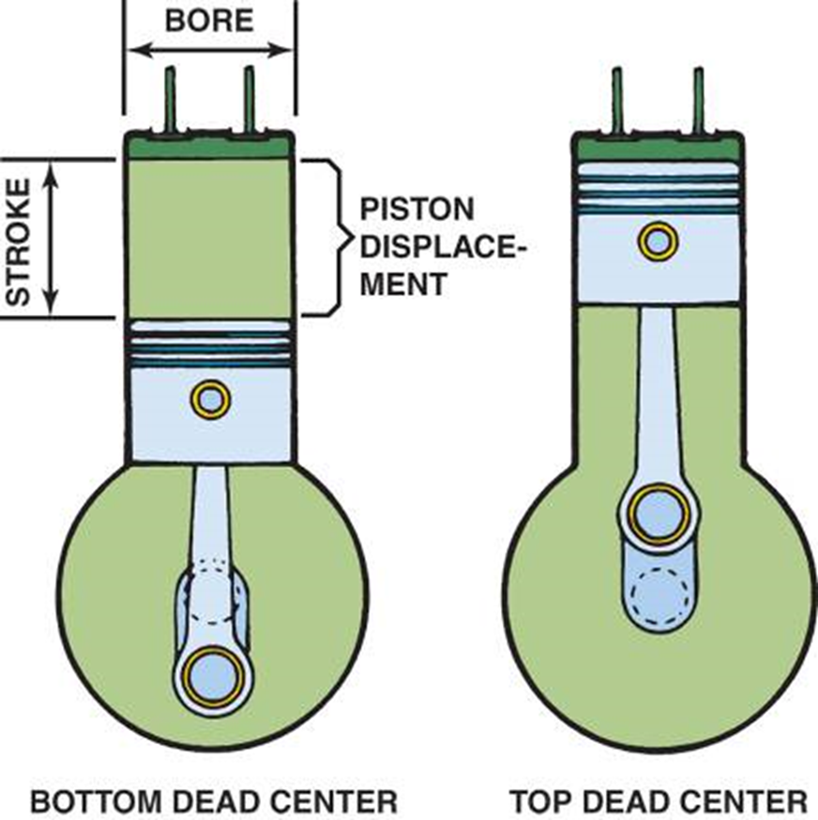
FIGURE 1–10 bore and stroke of pistons are used to calculate engine displacement.

Slide 36
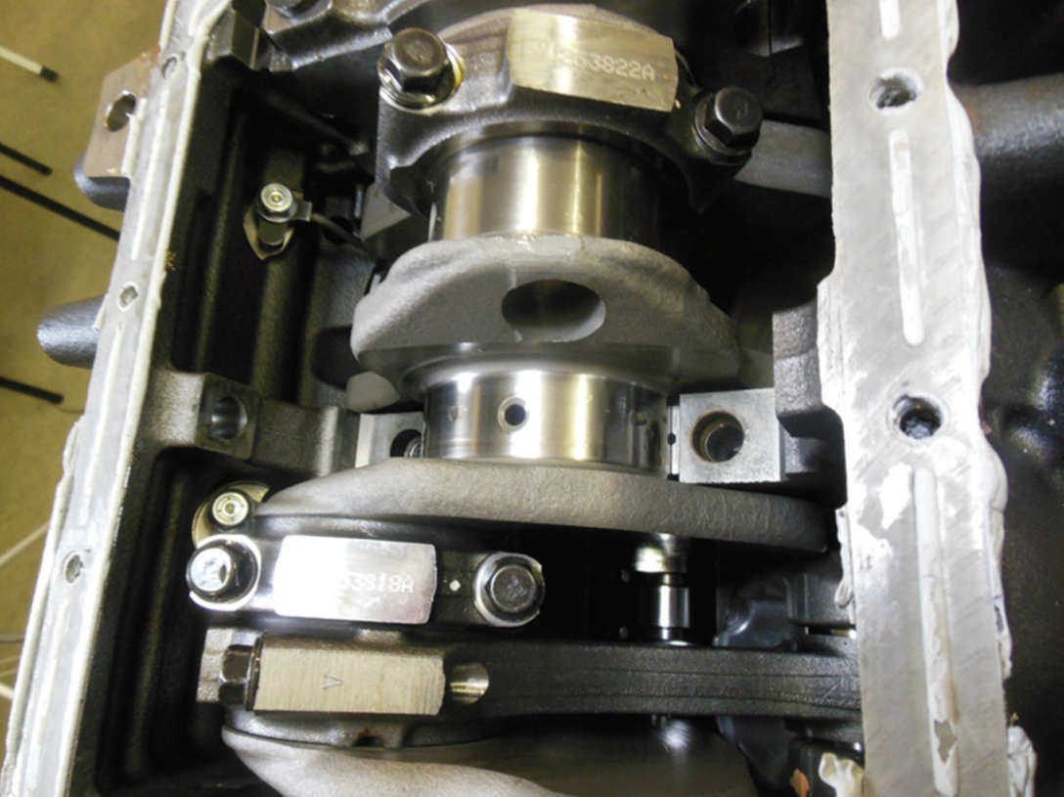
ENGINE SIZE (2 of 4)
STROKE
  Distance piston travels from TDC to BDC
  Distance determined by throw of crankshaft
    Throw is distance from centerline of crankshaft
    To centerline of crankshaft rod journal
    ½ the stroke

Slide 37
FIGURE 1–11 crankshaft determines the stroke of the engine, which is the difference between the centerline of the crankshaft journal and the centerline of the connecting rod journal. .

Slide 38
ENGINE SIZE (3 of 4)
NOTE: Changing connecting rod length does not change stroke of an engine. Changing connecting rod only changes position of piston in the cylinder. Only crankshaft determines stroke of an engine

Slide 39
QUESTION 3: ?
Which is the definition of engine stroke?

Slide 40
ANSWER 3:
The distance the piston travels.

Slide 41
ENGINE SIZE (4 of 4)
Displacement
  Cubic inch (cu. in.) cubic centimeter (cc) volume displaced
  How much air is moved by all of pistons
  A liter (L) is equal to 1,000 cubic centimeters
  Engines identified by their displacement in liters
Cubic inch displacement $=π$R² X Stroke X Number of cylinders

Slide 42
COMPRESSION RATIO (1of 4)
Compression Ratio
  Ratio of difference in cylinder volume
    When piston is at bottom of stroke to
    Volume in cylinder above piston when piston is at TDC
Compression Ratio $=\frac{Volume BDC }{Volume TDC}$

Slide 43
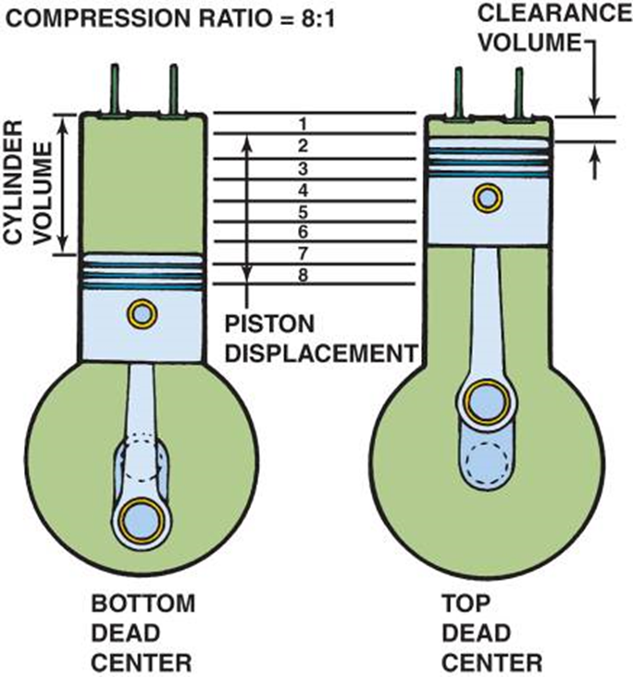
FIGURE 1–12 compression of an engine is expressed as a ratio of the volume, with the piston at the bottom of the cylinder, to that volume when the piston is at the top of cylinder.

Slide 44

Think of a 2-Liter Bottle
A two-liter bottle contains two liters of liquid. This is the volume of all four cylinders combined in a two-liter four-cylinder engine. A six-liter engine would therefore have the piston displacement of three two-liter bottles.

Slide 45
TORQUE (1of 4)
Torque
  Rotating force that may or may not result in motion
    Amount of force multiplied by length of lever
    Through which it acts
    Force of 10 pounds applied to end of 1 foot long wrench
    To turn a bolt, a torque of 10 pound-feet (lb-ft) is achieved
    Form of Work

Slide 46
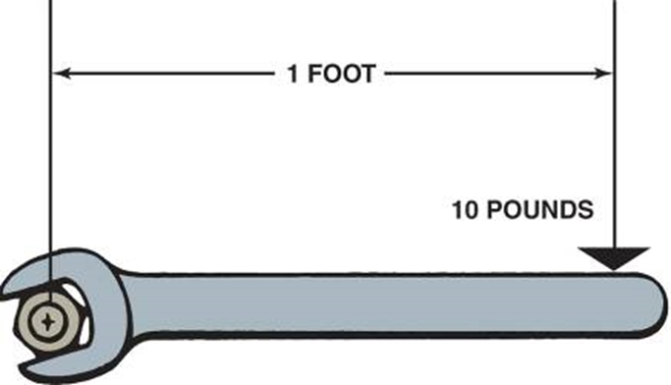
FIGURE 1–13 Torque is a twisting force equal to distance from pivot point times force applied, expressed in units called pound-feet (lb-ft) or newton-meters (N-m).

Slide 47

Is torque ft-lb or lb-ft?
Definition of torque is a force (lb) applied to an object times the distance from that object (ft). Therefore, based on the definition of the term, torque should be:
lb-ft (a force times a distance)
Newton-meter (N-m) (force times distance)
However, torque is commonly labeled, even on some torque wrenches, as ft-lb.

Slide 48
POWER (1of 4)
Definition of Power
  Rate of doing work or torque
  Horsepower & Altitude
    Air density lower at high altitude
    Power reduced at high altitude
    One Horsepower =
      Power to move 550 pounds one foot in one second,
      Or 33,000 pounds one foot in one minute
      (550 lb * 60 sec = 33,000 lb)
.

Slide 49
POWER (1 of 2)
Definition of Power
  Rate of doing work or torque
  Horsepower & Altitude
    Air density lower at high altitude
    Power reduced at high altitude
    One Horsepower =
      Power to move 550 pounds one foot in one second,
      Or 33,000 pounds one foot in one minute
      (550 lb * 60 sec = 33,000 lb)
.

Slide 50
POWER (2 of 2)
Horsepower Formula
  Horsepower is torque times RPM divided by 5252
  Horsepower = Torque * RPM/ 5252.

Slide 51
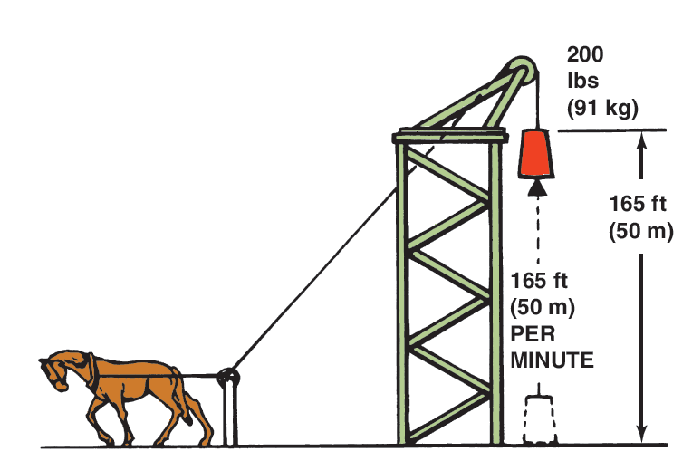
FIGURE 1–14 One horsepower is equal to 33,000 foot pounds (200 lbs X 165 feet) of work per minute.

Slide 52
How to Explain the Difference between
Horsepower and Torque
As Carroll Shelby, well-known race car driver and business owner said, “Horsepower sells cars, but torque wins races.” Torque determines how fast the vehicle will accelerate, and horsepower determines how fast the vehicle will go..

Slide 53
Summary (1 of 2)
The four strokes of the four-stroke cycle are intake, compression, power, and exhaust.
Gasoline engines draw an air-fuel mixture into the combustion chamber, but only air enters a diesel engine on the intake stroke.
Engine size is called displacement and represents the volume displaced by all of the pistons.

Slide 54
Summary (2 of 2)
There are three distinct phases or parts to the combustion in a diesel engine:
  Ignition delay
  Rapid combustion
  Controlled combustion
The term power means the rate of doing work. Power equals work divided by time. Work is achieved when a certain amount of mass (weight) is moved a certain distance by a force.

