Slide 1
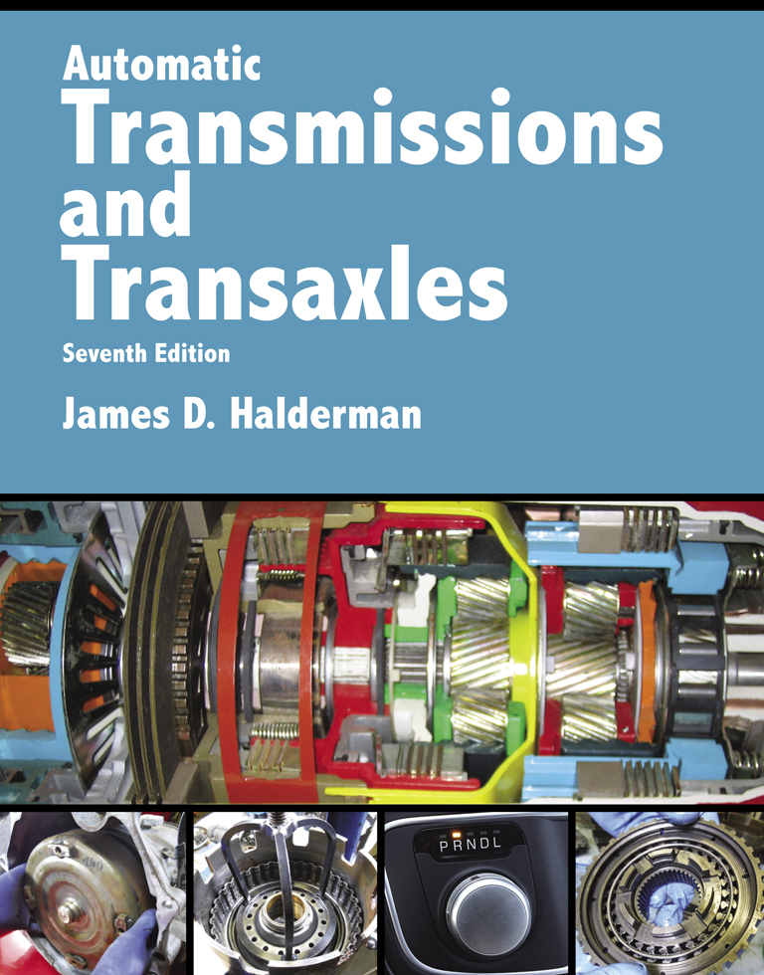
Automatic Transmissions and Transaxles
Seventh Edition
Chapter 9
Electronic Transmission Controls

Slide 2
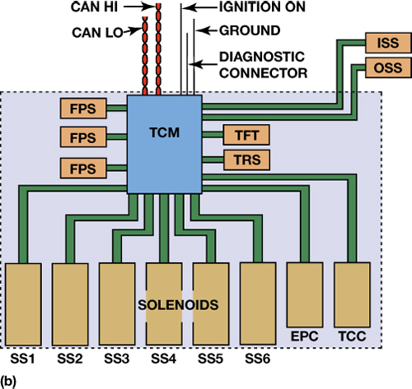
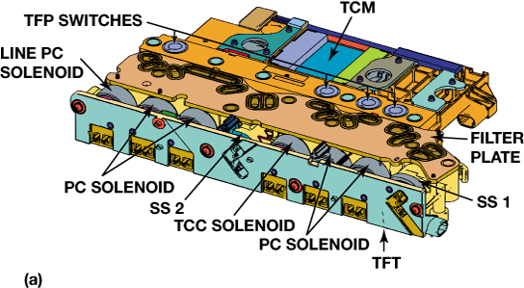
FIGURE 9–1 (a) This control solenoid assembly contains four transmission fluid pressure (TFP) switches, a line pressure control (PC) solenoid, four pressure control (PC) solenoids, two shift solenoids (SS), a torque converter clutch (TCC) solenoid, a transmission fluid temperature (TFT) sensor, and the transmission control module (TCM). It also has a vehicle harness connector with connections to the shift position switch and the input and output speed sensors. (b) A simplified view is also shown.

Slide 3
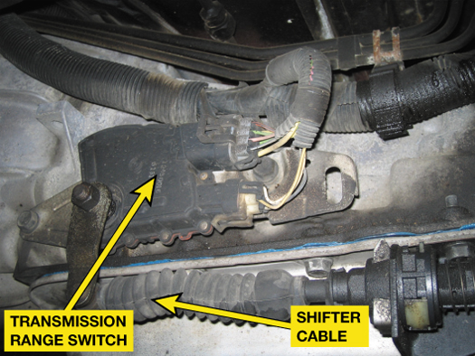
FIGURE 9–2 The transmission range switch is usually located on the case where the shifter cable attaches to the manual valve lever. The switch also includes the switch for the backup lights and the park/neutral switch, which is used to prevent the start being engaged unless the shifter is in park or neutral.

Slide 4
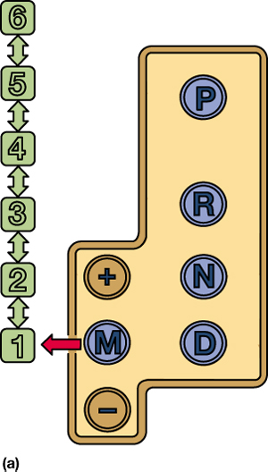
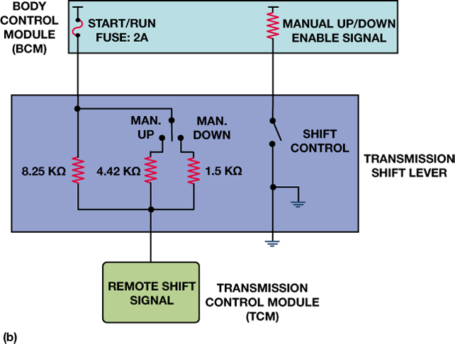
FIGURE 9–3 Moving the shift lever to the M (manual) position (a) activates the up/down, +/- switches that will cause an upshift or downshift.

Slide 5
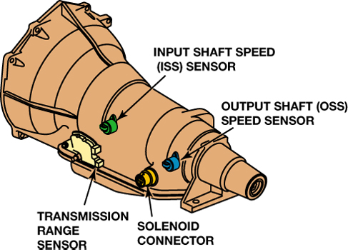
FIGURE 9–4 Speed sensors are used by the powertrain control module (PCM) or the transmission control module (TCM) to control shifts and detect faults such as slippage when the two speeds do not match the predetermined ratio for each gear commanded.

Slide 6
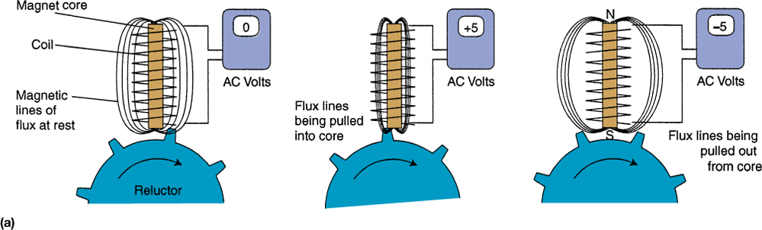
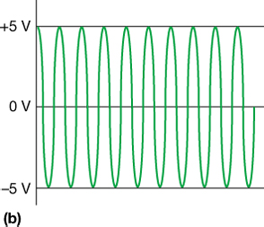
FIGURE 9–5 (a) The speed sensor switch will close as the magnet moves past it. (b) It will generate a sine wave signal, which is converted inside the PCM/TCM to a digital signal. The frequency of the signal is used to measure the speed.

Slide 7
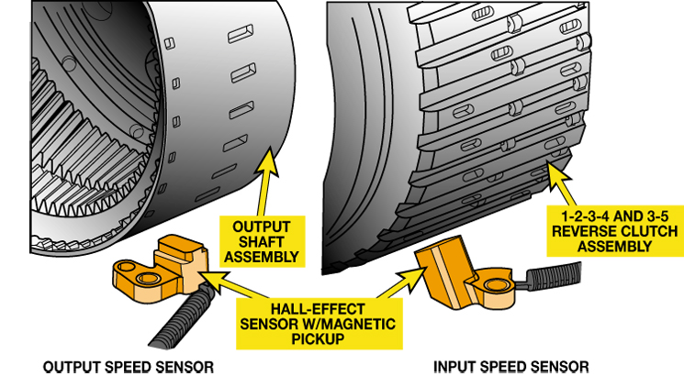
FIGURE 9–6 Input and output speed sensors are often mounted so that the notches in the rotating assembly are used to measure speed (RPM), which is used by the PCM/TCM for shift control and diagnostic information.

Slide 8
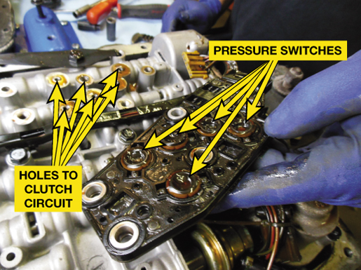
FIGURE 9–7 The pressure switch manifold (PSM) used in a GM 4L60-E consists of diaphragm switches with seals around each one that are bolted to the valve body over holes for each clutch circuit.

Slide 9
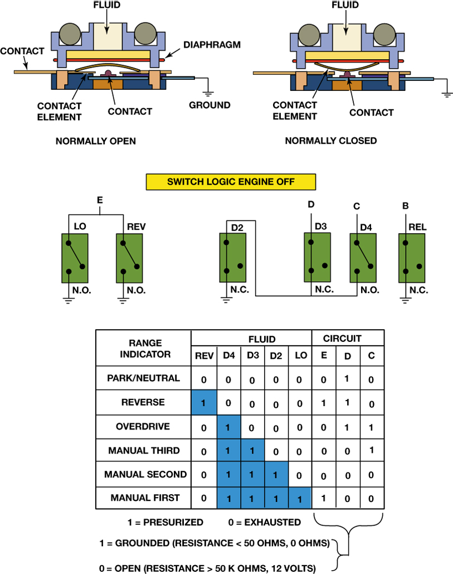
FIGURE 9–8 Some switches are electrically normally open (N.O.) and others are normally closed (N.C.) and are used to provide gear selection information to the PCM/TCM.

Slide 10
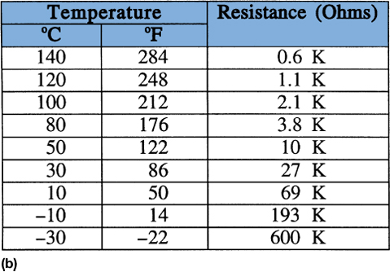
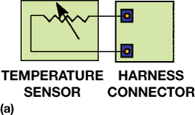
FIGURE 9–9 (a) A transmission fluid temperature sensor can be checked by connecting an ohmmeter to the harness connector terminals. (b) The resistance should change as the temperature changes.

Slide 11
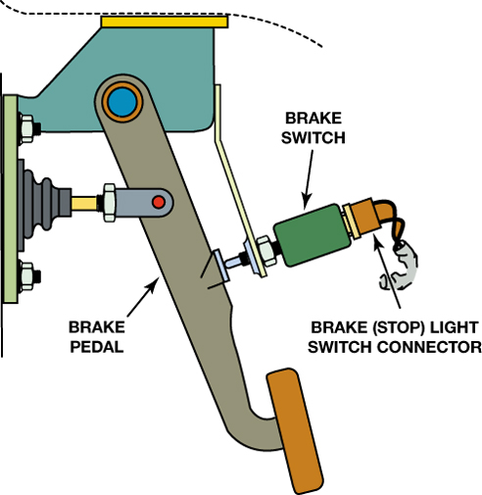
FIGURE 9–10 The brake (stop light) switch is mounted at the brake pedal. It provides a brake-apply signal to the TCM.

Slide 12
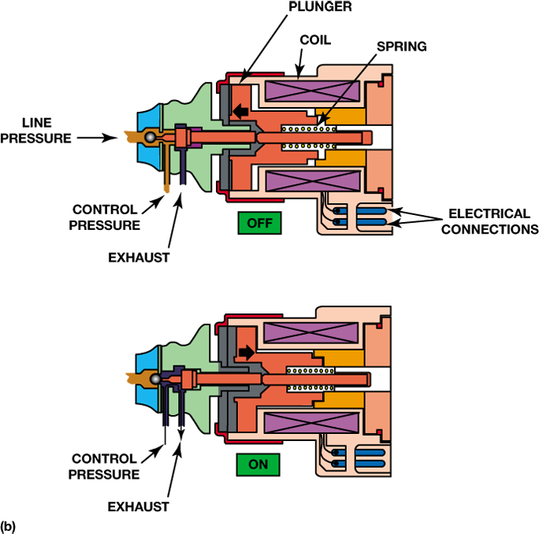
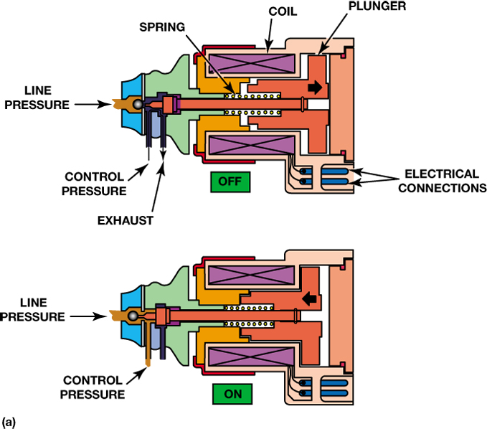
FIGURE 9–11 (a) The normally closed solenoid blocks fluid flow when it is off while opening the exhaust; and when it is on, it opens the valve. (b) The normally open solenoid allows fluid flow when it is off; and when it is on, it closes the valve while opening the exhaust.

Slide 13
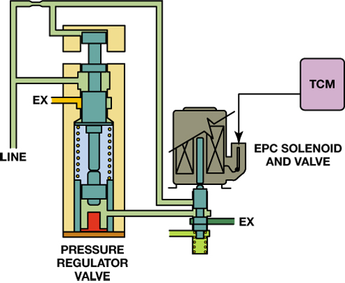
FIGURE 9–12 The signal from the TCM can cause the EPC solenoid to change the pressure regulator valve to adjust line pressure.

Slide 14
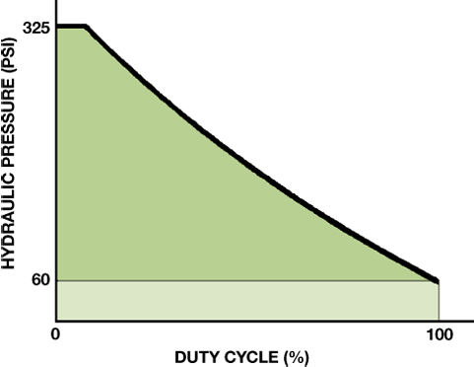
FIGURE 9–13 Line pressure increases as the duty cycle of the EPC solenoid decreases.

Slide 15
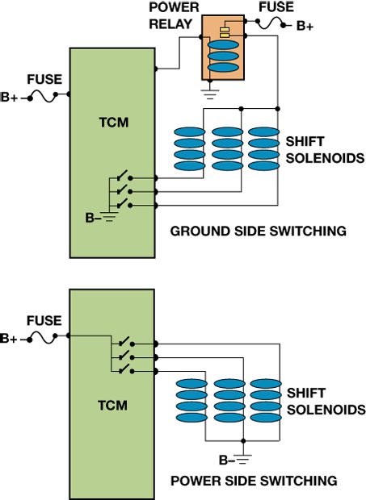
FIGURE 9–14 Solenoid control occurs when the PCM/TCM completes the circuit to ground (top) or switches on B+ (bottom). The ground connection is also B-.

Slide 16
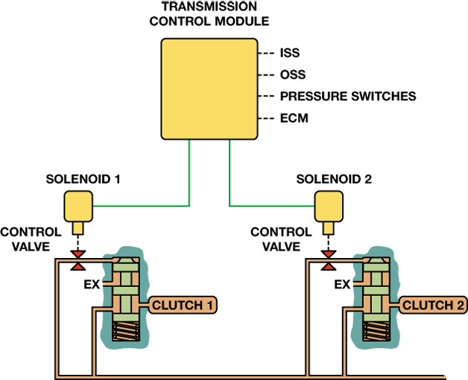
FIGURE 9–15 Using data from the various sensors, the TCM can apply or release the clutches. During an upshift, solenoid 1 can control how fast clutch 1 releases as solenoid 2 controls how fast clutch 2 applies to keep the shift time at the proper speed.

Slide 17
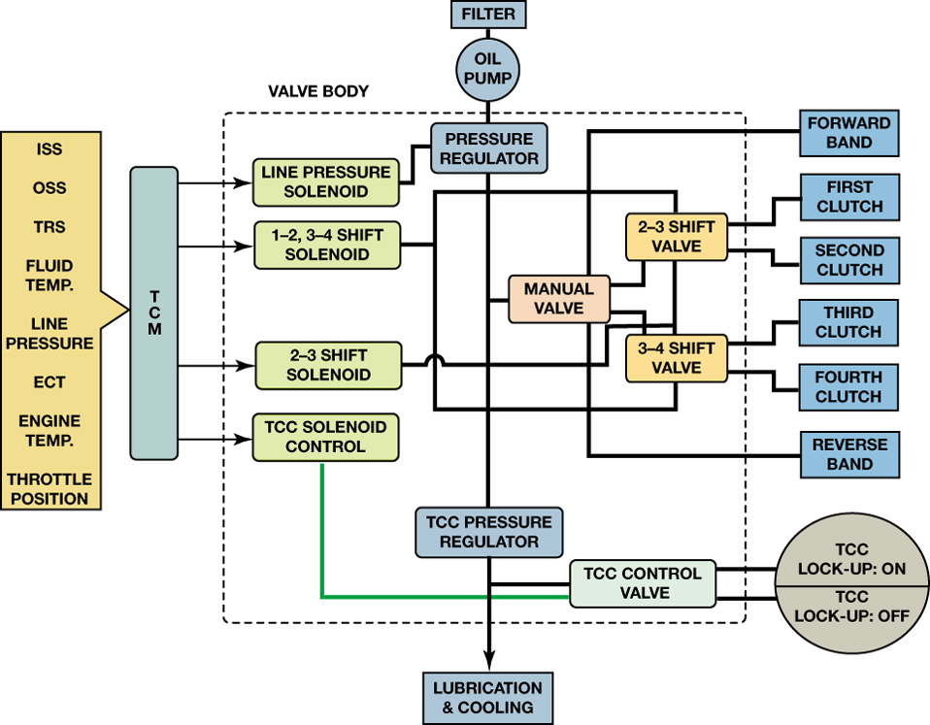
FIGURE 9–16 A diagram showing the relationship between the electronic and hydraulic controls.

Slide 18
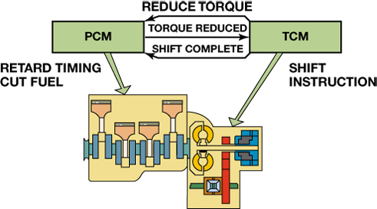
FIGURE 9–17 When the transmission control module (TCM) is ready to begin an upshift, it signals the powertrain control module (PCM) to reduce engine torque. This produces a smoother shift with less wear in the transmission.

Slide 19
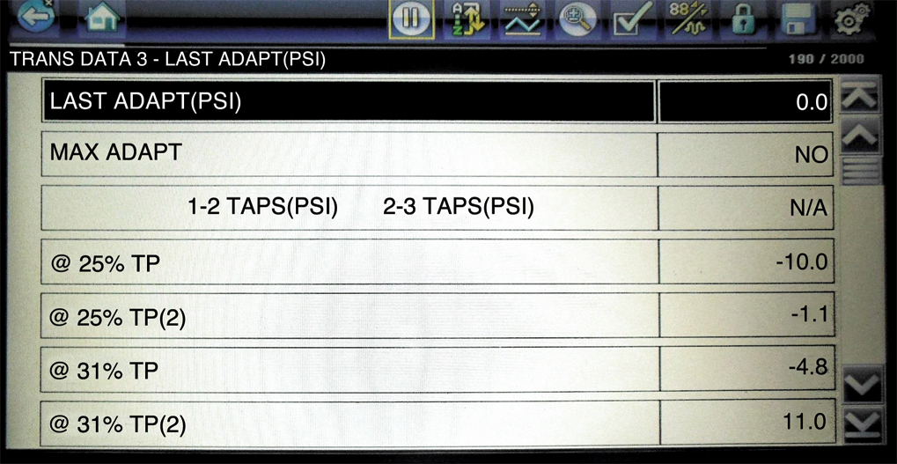
FIGURE 9–18 A scan tool display showing the adaptive (TAP) pressure changes at various throttle positions.

Slide 20
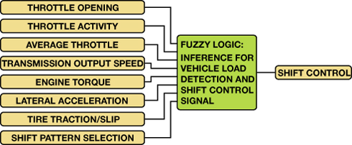
FIGURE 9–19 The fuzzy logic part of the TMC receives input signals, compares what the driver is doing with the throttle and what the vehicle is doing with normal operation, and adapts shift timing.

