Slide 1
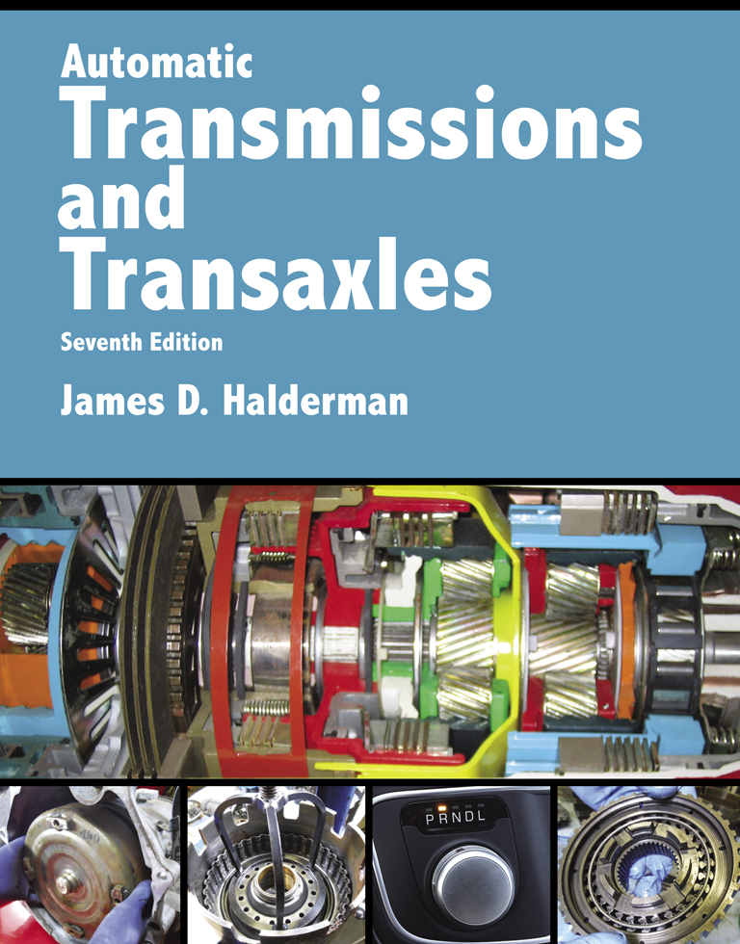
Automatic Transmissions and Transaxles
Seventh Edition
Chapter 8
Drivetrain Electricity and Electronics

Slide 2
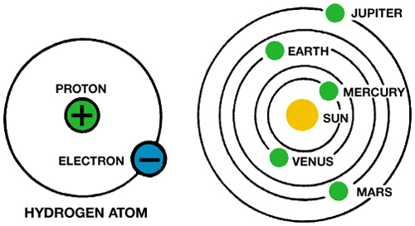
FIGURE 8–1 In an atom (left), electrons orbit protons in the nucleus just as planets orbit the sun in our solar system (right).

Slide 3
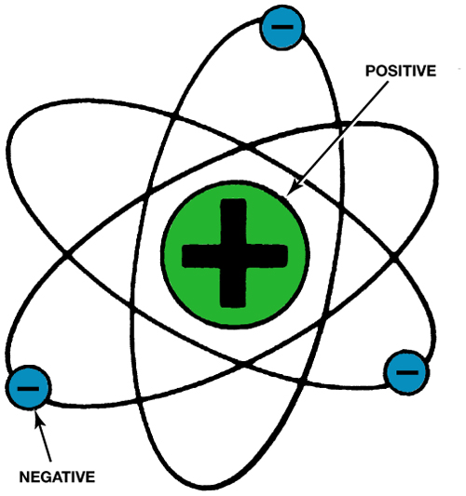
FIGURE 8–2 The nucleus of an atom has a positive (+) charge and the surrounding electrons have a negative (-) charge.

Slide 4
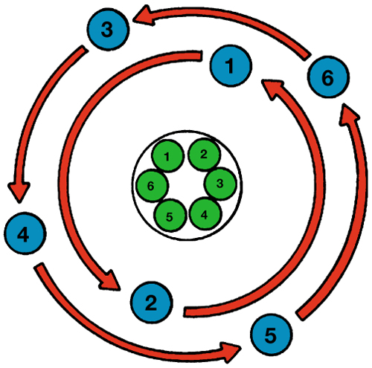
FIGURE 8–3 This FIGURE shows a balanced atom. The number of electrons is the same as the number of protons in the nucleus.

Slide 5

FIGURE 8–4 Unlike charges attract and like charges repel.

Slide 6
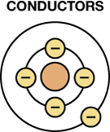
FIGURE 8–5 A conductor is any element that has one to three electrons in its outer orbit.

Slide 7
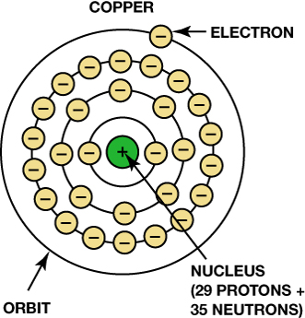
FIGURE 8–6 Copper is an excellent conductor of electricity because it has just one electron in its outer orbit, making it easy to be knocked out of its orbit and flow to other nearby atoms. This causes electron flow, which is the definition of electricity.

Slide 8
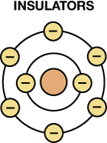
FIGURE 8–7 Insulators are elements with five to eight electrons in the outer orbit.

Slide 9
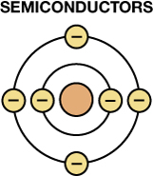
FIGURE 8–8 Semiconductor elements contain exactly four electrons in the outer orbit.

Slide 10

FIGURE 8–9 Current electricity is the movement of electrons through a conductor.

Slide 11
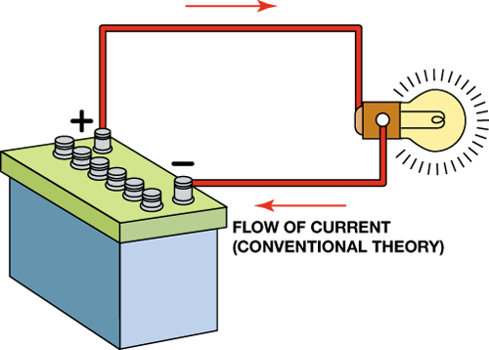
FIGURE 8–10 Conventional theory states that current flows through a circuit from positive (+) to negative (–). Automotive electricity uses the conventional theory in all electrical diagrams and schematics.

Slide 12
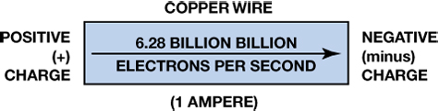
FIGURE 8–11 One ampere is the movement of 1 coulomb (6.28 billion billion electrons) past a point in 1 second.

Slide 13
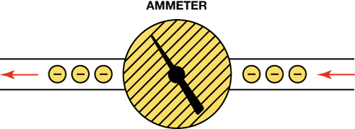
FIGURE 8–12 An ammeter is installed in the path of the electrons similar to a water meter used to measure the flow of water in gallons per minute. The ammeter displays current flow in amperes.

Slide 14
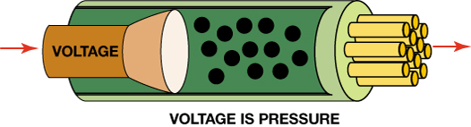
FIGURE 8–13 Voltage is the electrical pressure that causes the electrons to flow through a conductor.

Slide 15
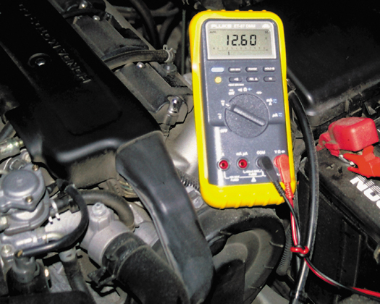
FIGURE 8–14 This digital multimeter set to read DC volts is being used to test the voltage of a vehicle battery. Most multimeters can also measure resistance (ohms) and current flow (amperes).

Slide 16
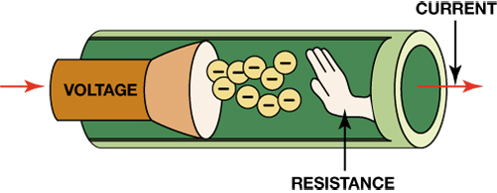
FIGURE 8–15 Resistance to the flow of electrons through a conductor is measured in ohms.

Slide 17
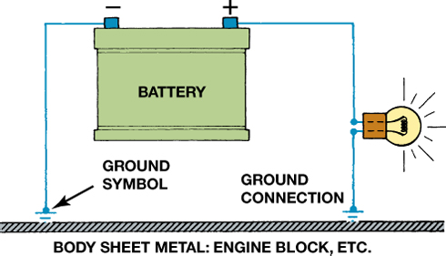
FIGURE 8–16 The return path back to the battery can be any electrical conductor, such as a copper wire or the metal frame or body of the vehicle.

Slide 18
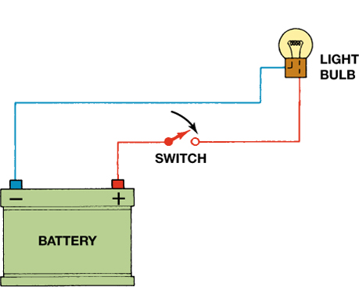
FIGURE 8–17 An electrical switch opens the circuit and no current flows. The switch could also be on the return (ground) path wire.

Slide 19
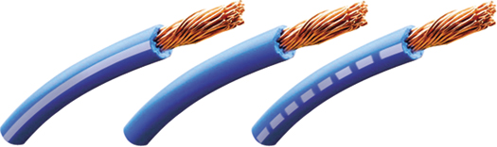
FIGURE 8–18 The center wire is a solid color wire, meaning that the wire has no other identifying tracer or stripe color. The two end wires could be labeled “BLU/WHT,” indicating a blue wire with a white tracer or stripe.

Slide 20
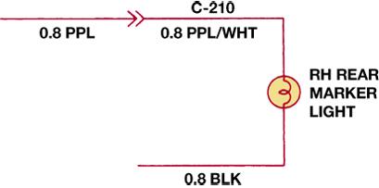
FIGURE 8–19 Typical section of a wiring diagram. Notice that the wire color changes at connection C210. The “0.8” represents the metric wire size in square millimeters.

Slide 21
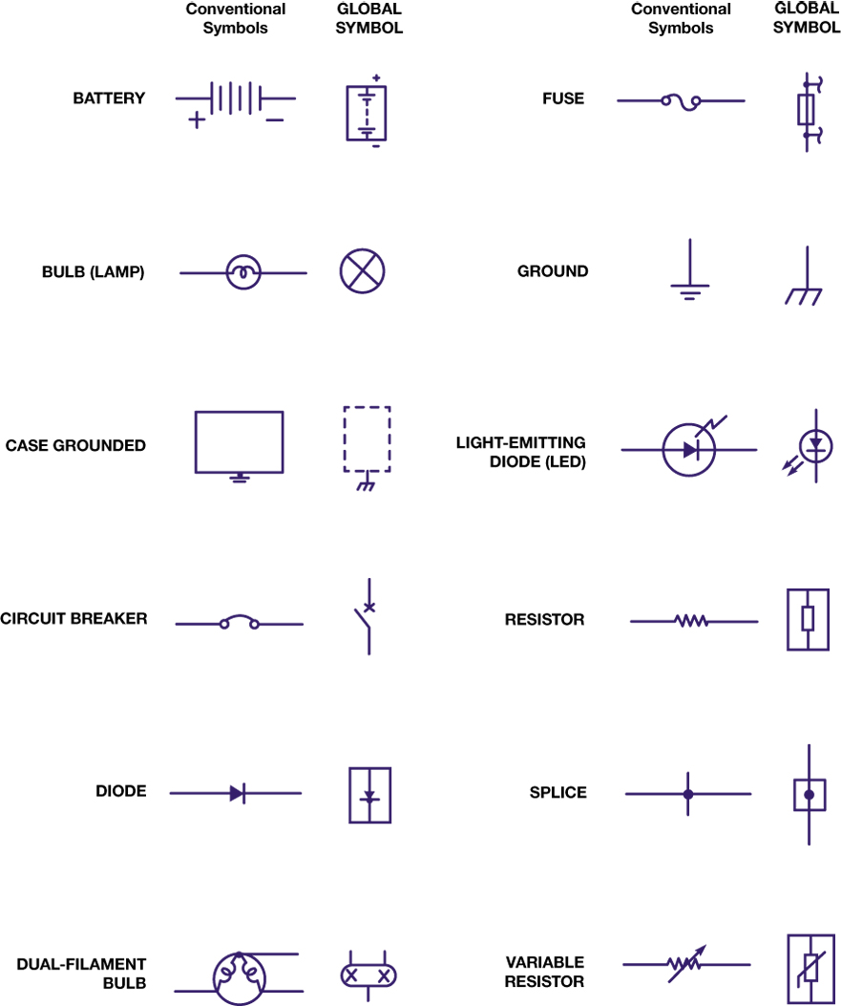
FIGURE 8–20 Typical electrical and electronic symbols used in automotive wiring and circuit diagrams. Both the conventional and the global symbols are shown side-by-side to make reading schematics easier. The global symbols are used by many vehicle manufacturers.

Slide 22
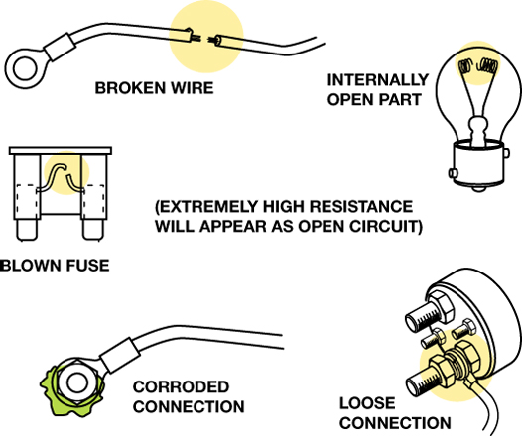
FIGURE 8–21 Examples of common causes of open circuits. Some of these causes are often difficult to find.

Slide 23
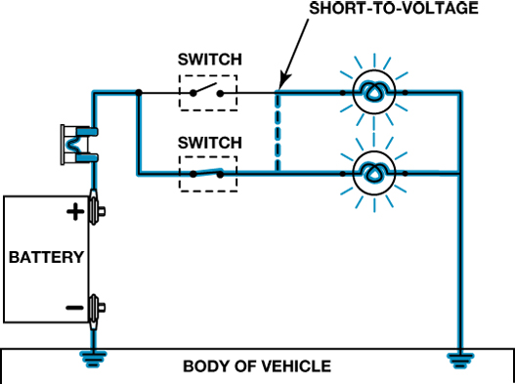
FIGURE 8–22 A short circuit permits electrical current to bypass some or all of the resistance in the circuit.

Slide 24
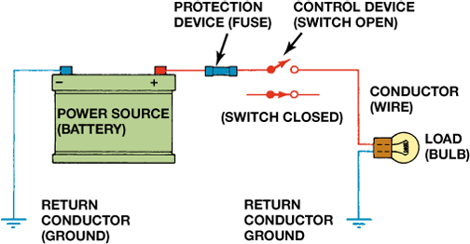
FIGURE 8–23 A fuse or circuit breaker opens the circuit to prevent possible overheating damage in the event of a short circuit.

Slide 25
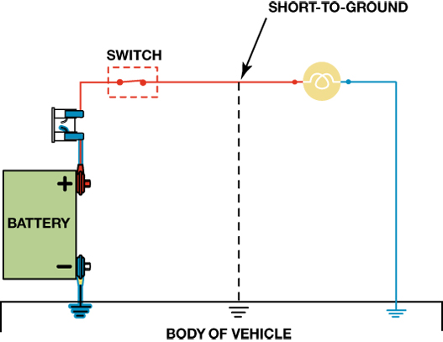
FIGURE 8–24 A short-to-ground affects the power side of the circuit. Current flows directly to the ground return, bypassing some or all of the electrical loads in the circuit. There is no current in the circuit past the short. A short-to-ground will also cause the fuse to blow.

Slide 26
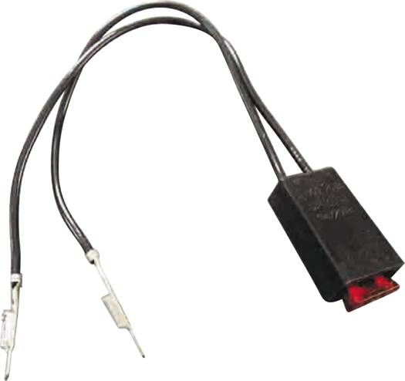
FIGURE 8–25 A technician-made fused jumper lead, which is equipped with a red 10-ampere fuse. This fused jumper wire uses terminals for testing circuits at a connector instead of alligator clips.

Slide 27
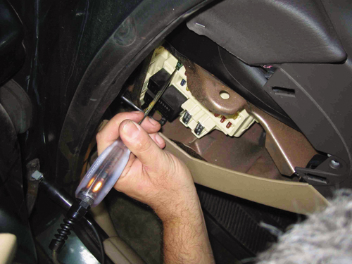
FIGURE 8–26 Testing a fuse with a test light. If the fuse is good, the test light should light on both sides (power side and load side) of the fuse.

Slide 28
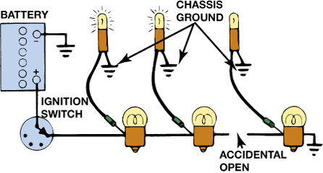
FIGURE 8–27 A test light can be used to locate an open in a circuit. Note that the test light is grounded at a different location than the circuit itself.

Slide 29
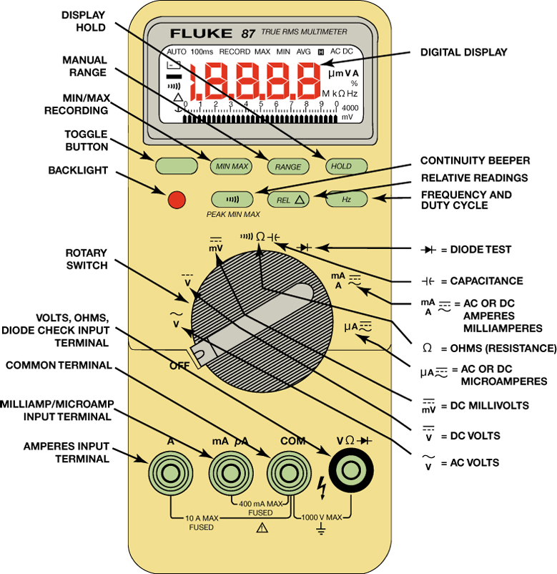
FIGURE 8–28 Typical digital multimeter. The black meter lead always is placed in the COM terminal. The red meter test lead should be in the volt-ohm terminal except when measuring current in amperes.

Slide 30
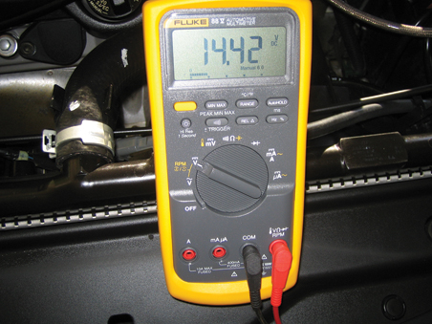
FIGURE 8–29 Typical digital multimeter (DMM) set to read DC volts.

Slide 31
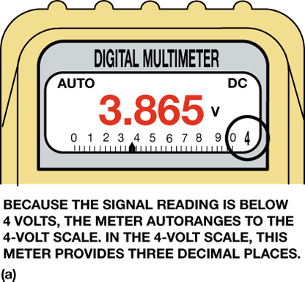
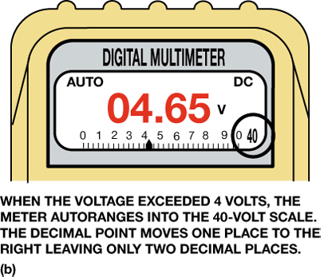
FIGURE 8–30 A typical autoranging digital multimeter automatically selects the proper scale to read the voltage being tested. The scale selected is usually displayed on the meter face. (a) Note that the display indicates “4,” meaning that this range can read up to 4 volts. (b) The range is now set to the 40-volt scale, meaning that the meter can read up to 40 volts on the scale. Any reading above this level will cause the meter to reset to a higher scale. If not set on autoranging, the meter display would indicate OL if a reading exceeds the limit of the scale selected.

Slide 32
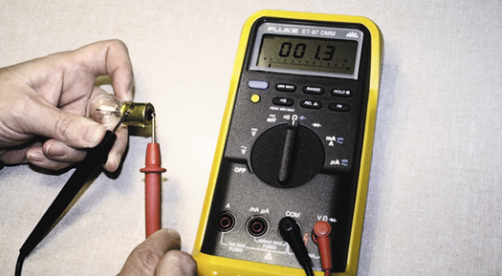
FIGURE 8–31 Using a digital multimeter set to read ohms (Ω) to test this light bulb. The meter reads the resistance of the filament.

Slide 33
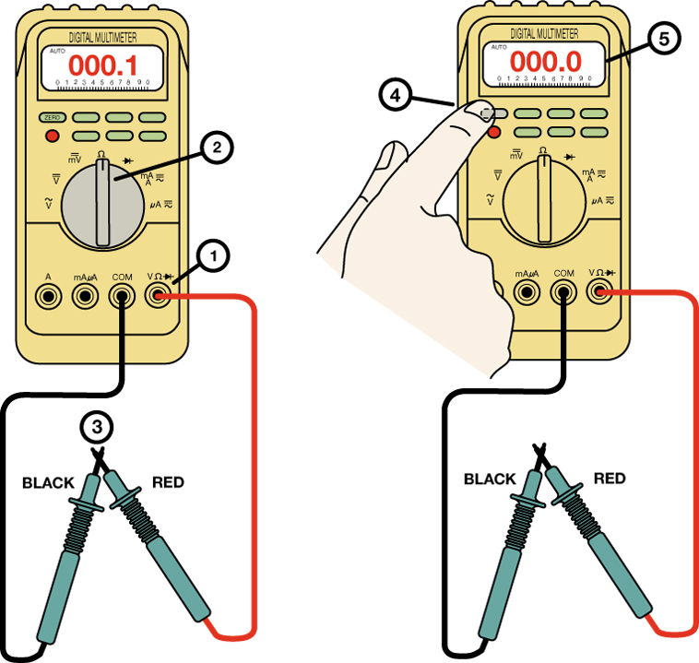
FIGURE 8–32 Many digital multimeters can have the display indicate zero to compensate for test lead resistance. (1) Connect leads in the V Ω and COM meter terminals. (2) Select the Ω scale. (3) Touch the two meter leads together. (4) Push the “zero” or “relative” button on the meter. (5) The meter display will now indicate zero ohms of resistance.

Slide 34
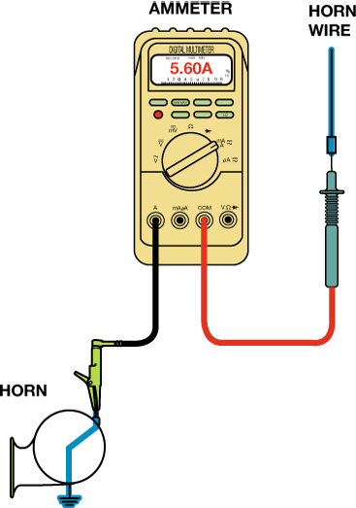
FIGURE 8–33 Measuring the current flow required by a horn requires that the ammeter be connected to the circuit in series and the horn button be depressed by an assistant.

Slide 35
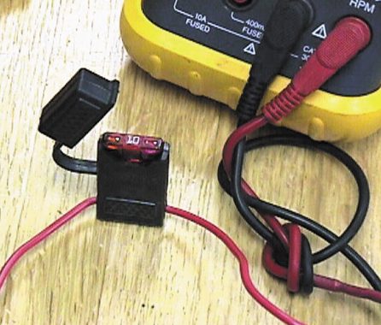
FIGURE 8–34 Note the blade-type fuse holder soldered in series with one of the meter leads. A 10-ampere fuse helps protect the internal meter fuse (if equipped) and the meter itself from damage that may result from excessive current flow if accidentally used incorrectly.

Slide 36
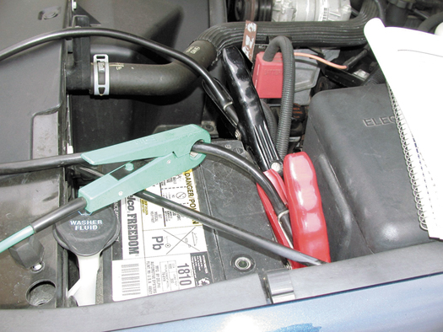
FIGURE 8–35 An inductive ammeter clamp is used with all starting and charging testers to measure the current flow through the battery cables.

Slide 37
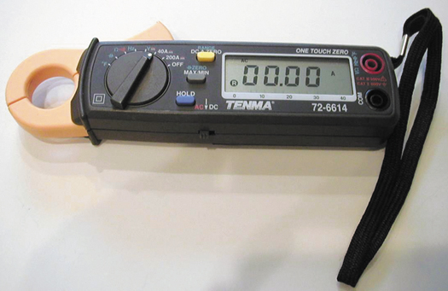
FIGURE 8–36 A typical mini clamp-on-type digital multimeter. This meter is capable of measuring alternating current (AC) and direct current (DC) without requiring that the circuit be disconnected to install the meter in series. The jaws are simply placed over the wire and current flow through the circuit is displayed.

Slide 38
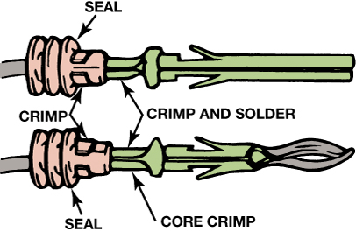
FIGURE 8–37 Some terminals have seals attached to help seal the electrical connections.

Slide 39
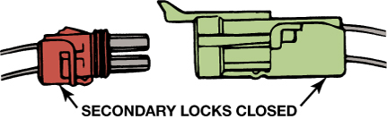
FIGURE 8–38 Separate a connector by opening the lock and pulling the two apart.

Slide 40
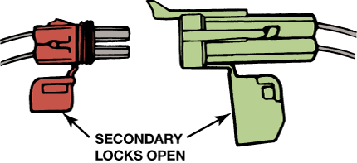
FIGURE 8–39 The secondary locks help retain the terminals in the connector.

Slide 41
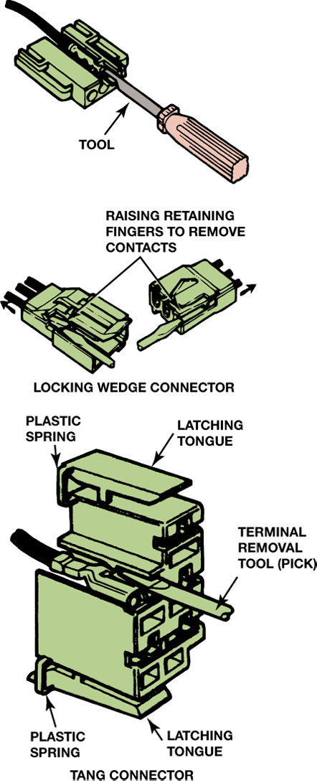
FIGURE 8–40 Use a small removal tool, sometimes called a pick, to release terminals from the connector.

Slide 42
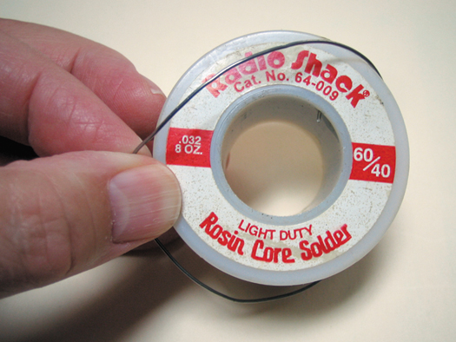
FIGURE 8–41 Always use rosin-core solder for electrical or electronic soldering. Also, use small-diameter solder for small soldering irons. Use large-diameter solder only for large-diameter (large-gauge) wire and higher-wattage soldering irons (guns).

Slide 43
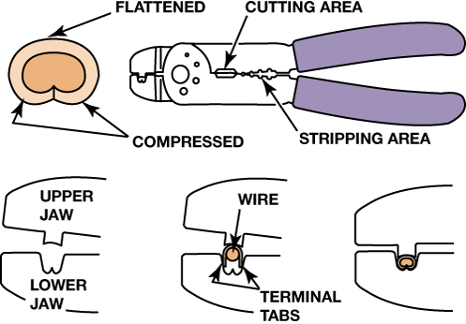
FIGURE 8–42 Notice that to create a good crimp, the open part of the terminal is placed in the jaws of the crimping tool toward the anvil or the W-shape part.

Slide 44
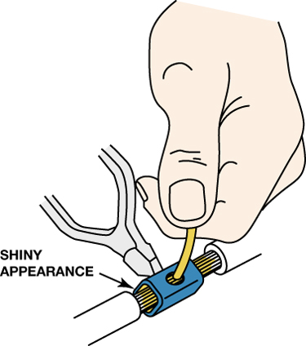
FIGURE 8–43 All hand-crimped splices or terminals should be soldered to be assured of a good electrical connection.

Slide 45
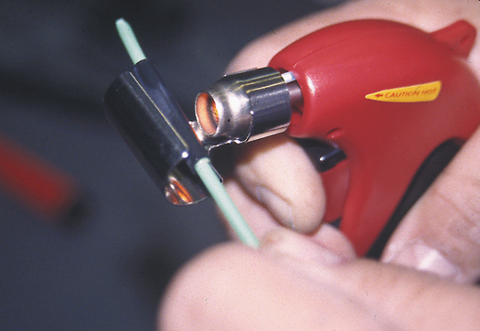
FIGURE 8–44 A butane torch especially designed for use on heat shrink applies heat without an open flame, which could cause damage.

Slide 46
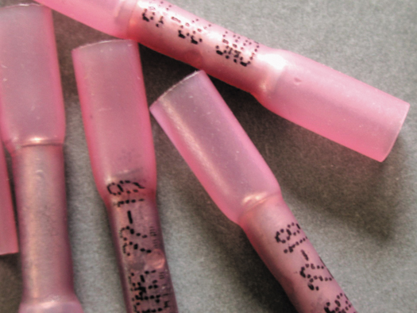
FIGURE 8–45 A typical crimp-and-seal connector. This type of connector is first lightly crimped to retain the ends of the wires and then it is heated. The tubing shrinks around the wire splice, and thermoplastic glue melts on the inside to provide an effective weather-resistant seal.

Slide 47
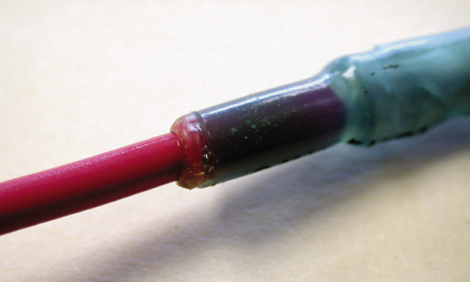
FIGURE 8–46 Heating the crimp-and-seal connector melts the glue and forms an effective seal against moisture.

Slide 48
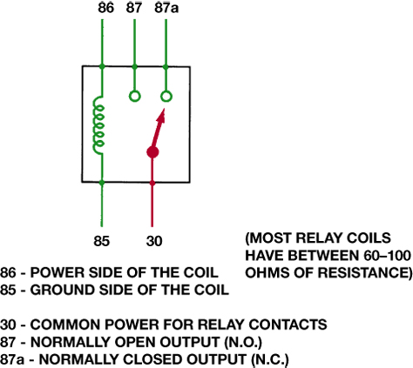
FIGURE 8–47 A relay uses a movable arm to complete a circuit whenever there is a power at terminal 86 and a ground at terminal 85. A typical relay only requires about 1/10 ampere through the relay coil. The movable arm then closes the contacts (#30 to #87) and can often handle 30 amperes or more.

Slide 49
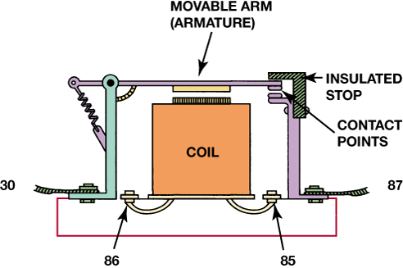
FIGURE 8–48 A cross-sectional view of a typical four-terminal relay. Current flowing through the coil (terminals 86 and 85) causes the movable arm (called the armature) to be drawn toward the coil magnet. The contact points complete the electrical circuit connected to terminals 30 and 87.

Slide 50
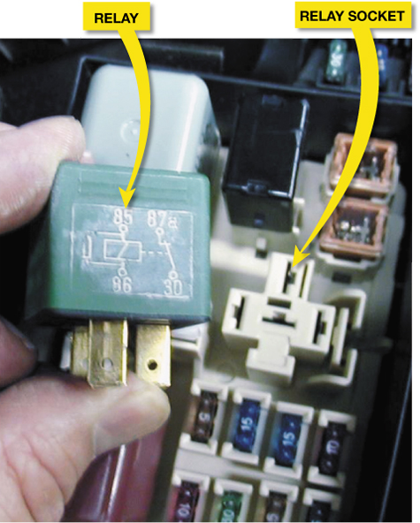
FIGURE 8–49 A typical relay showing the schematic of the wiring in the relay.

Slide 51
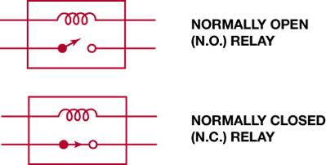
FIGURE 8–50 All schematics are shown in their normal, non-energized position.

Slide 52

FIGURE 8–51 A typical horn circuit. Note that the relay contacts supply the heavy current to operate the horn when the horn switch simply completes a low-current circuit to ground, causing the relay contacts to close.

Slide 53

FIGURE 8–52 A typical transmission range switch is also similar to the circuit used for electronic transfer case switches. In this example, power, usually 12 volts, is applied at pin 30 and pin 46 is an input to the PCM. The change in voltage at pin 46 indicates how much resistance the circuit has, which is used to detect the gear selected.

Slide 54

FIGURE 8–53 A magnetic sensor uses a permanent magnet surrounded by a coil of wire. The notches on the rotating shaft create a variable magnetic field strength around the coil. When a metallic section is close to the sensor, the magnetic field is stronger because metal is a better conductor of magnetic lines of force than air.

Slide 55

FIGURE 8–54 A Hall-Effect sensor produces an on-off voltage signal whether it is used with a blade or a notched wheel.

Slide 56

FIGURE 8–55 The signal voltage from a throttle position increases as the throttle is opened because the wiper arm is closer to the 5-volt reference. At idle, the resistance of the sensor winding effectively reduces the signal voltage output to the powertrain control module (PCM).

Slide 57

FIGURE 8–56 Module communications makes controlling multiple electrical devices and accessories easier by using simple low-current switches to signal another electronic control module (ECM), which does the actual switching of the current to the device.

Slide 58

FIGURE 8–57 A network allows all modules to communicate with other modules.

Slide 59

FIGURE 8–58 A typical (generic) system showing how the CAN BUS is connected to various electrical accessories and systems in the vehicle.

Slide 60

FIGURE 8–59 A schematic of a Chevrolet Equinox shows that the vehicle uses a GMLAN BUS (DLC pins 6 and 14), plus a Class 2 (pin 2). A scan tool can therefore communicate to the transmission control module (TCM) through the high-speed network. Pin 1 connects to the low-speed GMLAN network.

