Slide 1
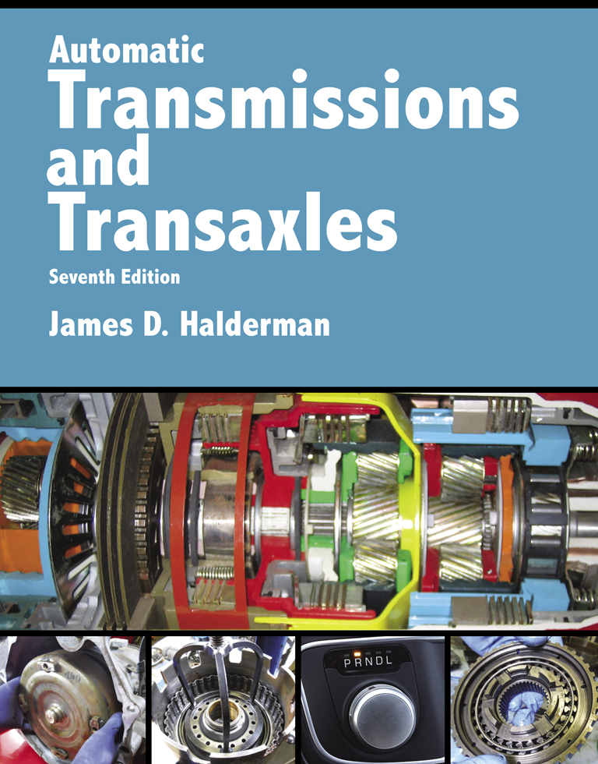
Automatic Transmissions and Transaxles
Seventh Edition
Chapter 7
Clutches and Bands

Slide 2
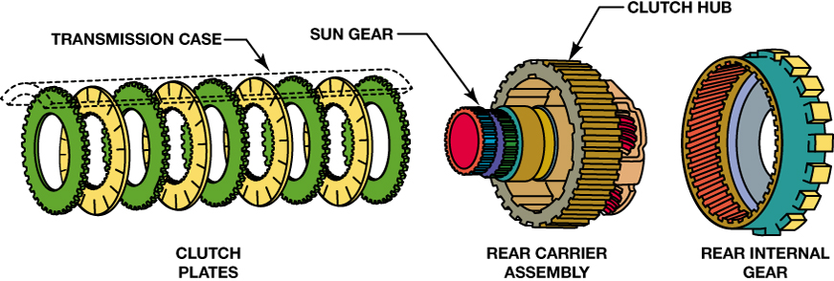
FIGURE 7–1 A multiple-disc clutch can hold, or drive a member of a gear set.

Slide 3
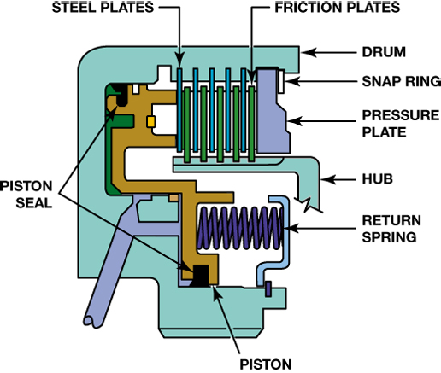
FIGURE 7–2 A sectioned view of a multiple-disc clutch. Note the piston to apply the clutch and the spring(s) to release it.

Slide 4
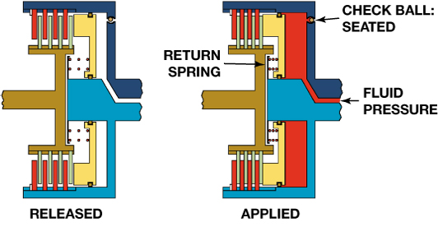
FIGURE 7–3 The apply piston is released (left) by the coil springs. Fluid pressure moves the piston to apply the clutch (right).

Slide 5
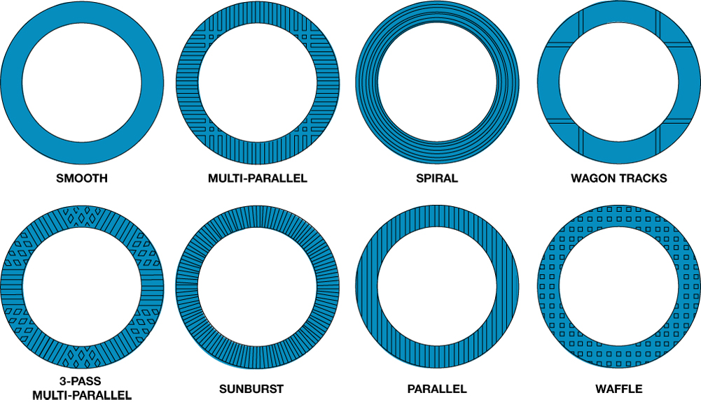
FIGURE 7–4 Friction plates often have a groove pattern to help wipe fluid away, dissipate heat, eliminate clutch noise, and change friction qualities during apply and release. A smooth plate is the coolest and slowest to apply and the waffle plate will apply the fastest.

Slide 6
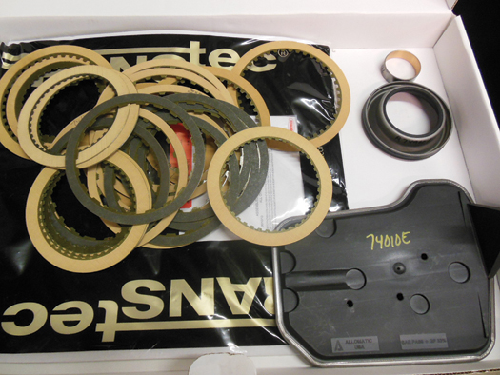
FIGURE 7–5 Most clutches included in overhaul kits use paper as the basis for the lining material.

Slide 7
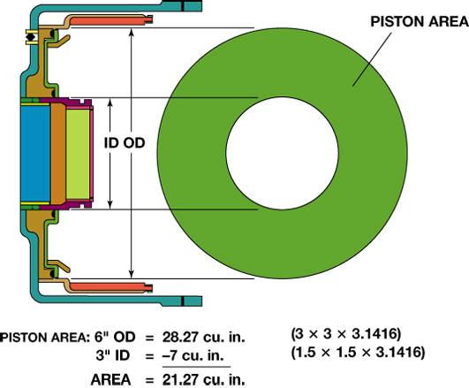
FIGURE 7–6 A typical clutch piston area is determined by subtracting the area of the inner diameter from the area of the outer-circle diameter.

Slide 8
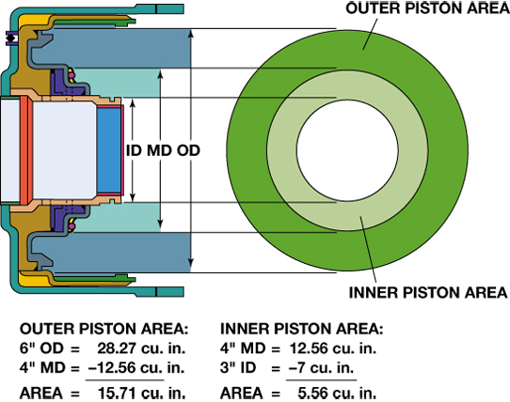
FIGURE 7–7 Some clutch pistons use a middle seal so the piston will have two working areas.

Slide 9
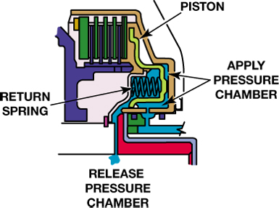
FIGURE 7–8 The baffle that supports the return springs also forms a chamber for release pressure. The clutch is released when fluid pressure enters this chamber as pressure is released from the apply side of the piston.

Slide 10
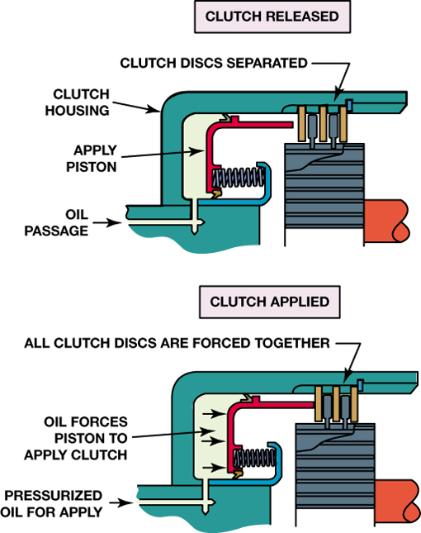
FIGURE 7–9 Pressurized oil is sent to the apply side of the piston to force the clutch discs together.

Slide 11
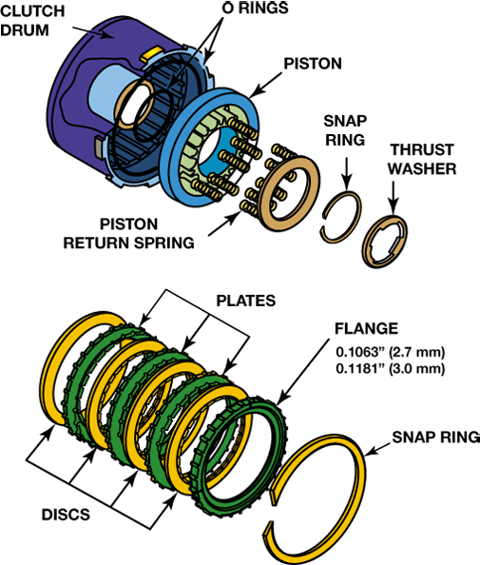
FIGURE 7–10 Clutch stack clearance is adjusted using either the large or the small flange (backing plate). Other clutches may use a selective snap ring.

Slide 12
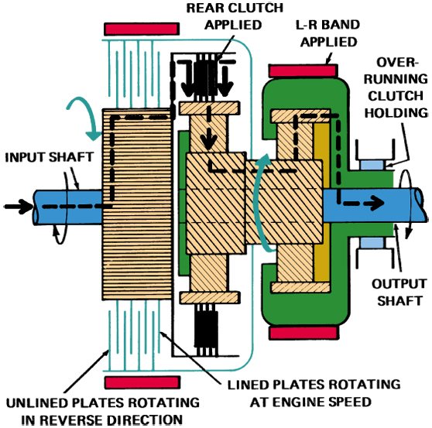
FIGURE 7–11 When this transmission is in first gear, the sun gear and unlined plates of the front clutch rotate counterclockwise while the hub and lined plates of this clutch rotate clockwise. Any drag will produce heat that can cause clutch burnout.

Slide 13
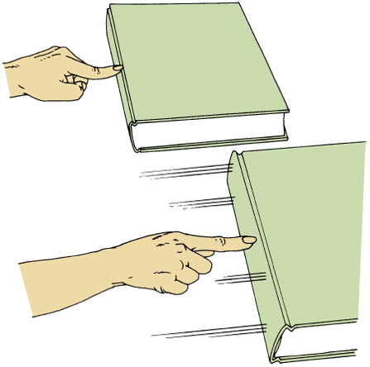
FIGURE 7–12 When pushing against a stationary book, the static friction resists motion. Pushing against the same book while it is sliding is easier because the dynamic friction is less.

Slide 14
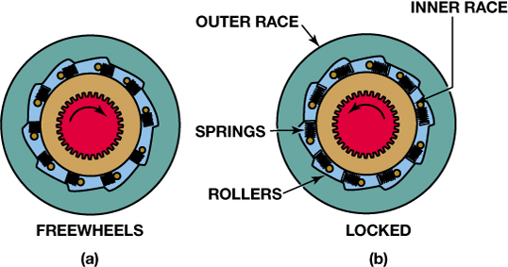
FIGURE 7–13 (a) Roller one-way clutch in released (free) position. When the inner roller clutch race rotates faster than the outer support, the rollers move out of the wedge and are free to rotate, thereby unlocking the one-way clutch. (b) Roller one-way clutch in the locked (held) position. Note how the rollers are wedged into the ramp that is machined into the outer support.

Slide 15
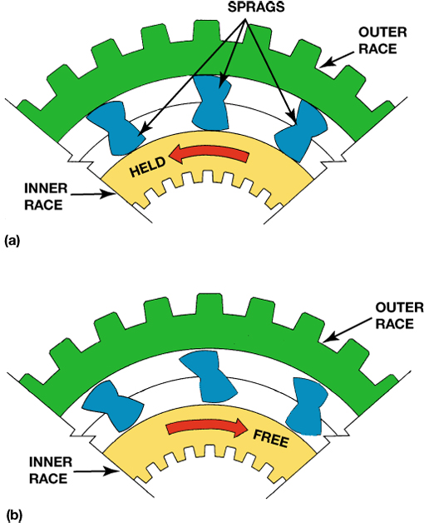
FIGURE 7–14 (a) The sprag in the holding (locked) position. Note how the long portion of the sprag is wedged between the inner and outer race. (b) The sprag in the released position. The inner race is free to rotate faster than the outer race.

Slide 16
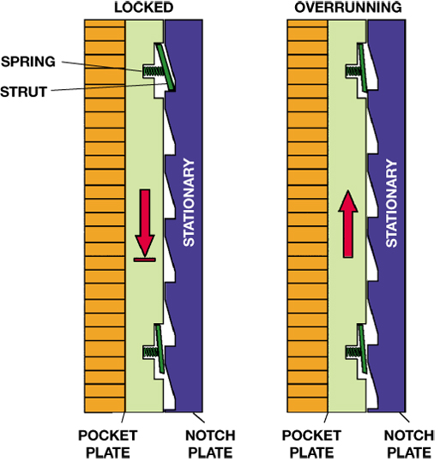
FIGURE 7–15 A mechanical diode. The struts can move out of the pocket plate to engage the notch plate, and this will lock the pocket plate. The pocket plate can overrun in the opposite direction.

Slide 17
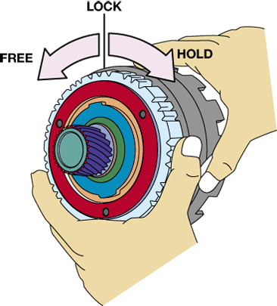
FIGURE 7–16 This clutch hub and sprag clutch should rotate freely in a counterclockwise direction but should lock up in the opposite direction.

Slide 18
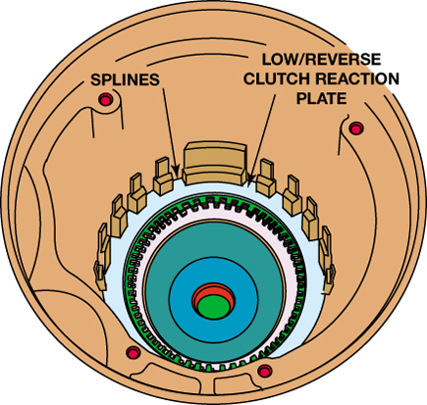
FIGURE 7–17 The 41TE transaxle low/reverse clutch is a holding clutch. Note the splines in the case for the clutch plates.

Slide 19
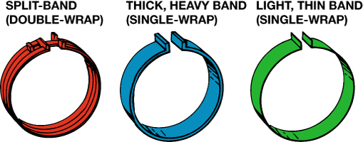
FIGURE 7–18 Transmission bands come in several designs and thicknesses.

Slide 20
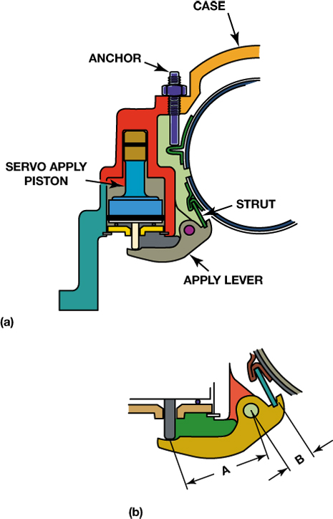
FIGURE 7–19 (a) This band uses an adjustable anchor that allows the clearance to be easily adjusted. (b) Note that the apply lever will increase apply force.

Slide 21
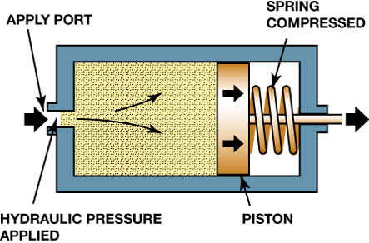
FIGURE 7–20 A servo uses hydraulic pressure to move a piston, which applies a band.

Slide 22
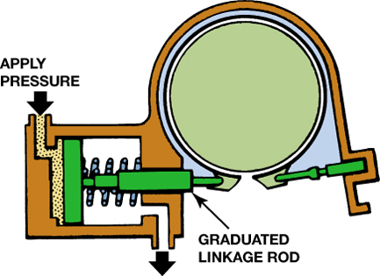
FIGURE 7–21 One end of a band is held stationary and the other end is attached to the servo.

Slide 23
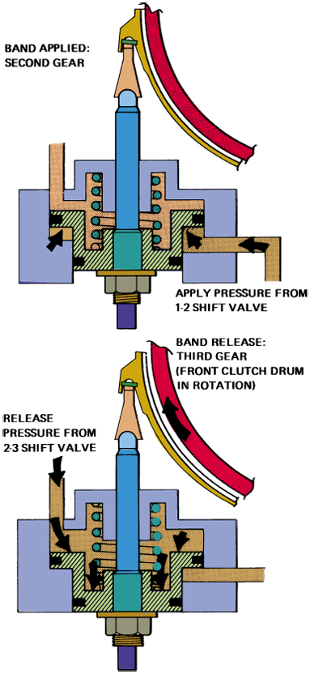
FIGURE 7–22 In this example, the band is applied when 1–2 shift valve pressure pushes upward on the servo piston (top). It will release when 2–3 shift valve pressure pushes the piston downward (bottom). Note the larger area above the piston.

Slide 24
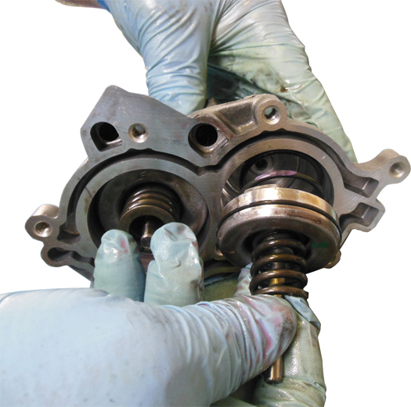
FIGURE 7–23 A band accumulator piston and spring being removed from a GM 4T65-E.

Slide 25
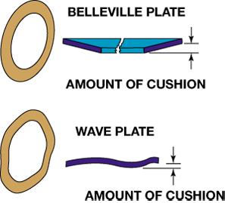
FIGURE 7–24 Two cushion plates: The Belleville plate has a coned shape; the wave plate has a wavy shape. Both of them will flatten slightly as the clutch is applied.

